Slide 1
An Accurate Model of Beam Ion instability & its application to ILC DR and SPEAR3*
Lanfa Wang, M. Pivi, T. O. Raubenheimer and J. Safranek
LCWS2012
Arlington, Texas, USA
October 22-26.
*Submitted to Phys. Rev. ST Accel. Beams

Slide 2
Contents
Brief Review of observations
Brief Review of FII theory
Our model
Application to ILC Damping ring and SPEAR3
Summary

Slide 3
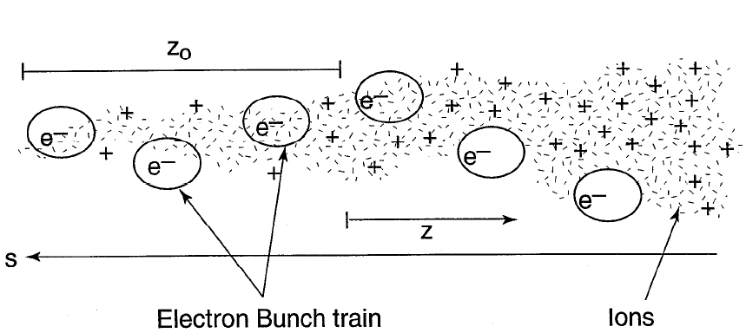
Introduction
Ions generated by beam-gas ionization
Ions are trapped along the electron-bunch train;
The ions created by the head of the bunch train perturb the bunches that follow.
Occur in rings, linacs or beam transport lines;
Broad-band spectrum
Normally only in vertical direction due to the small vertical beam size

Slide 4
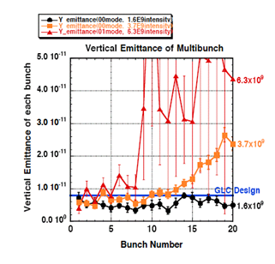
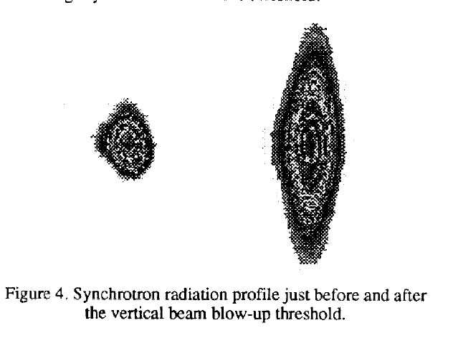
Observations-Beam Size Blow-up
The instability has been observed at many laboratories when vacuum is not good
    Artificially increasing the vacuum pressure (ALS, PLS, ATF)
    At commissioing times or restart after a long shutdown (ESRF, DIAMOND,…)
    After installation of new (insertion device) chambers (SPring-8, ESRF, …)
ELETTRA
C. J. Bocchetta, et. al. 1994
KEK ATF
Notes:
- Mostly when the vacuum was temporarily not good:

Slide 5
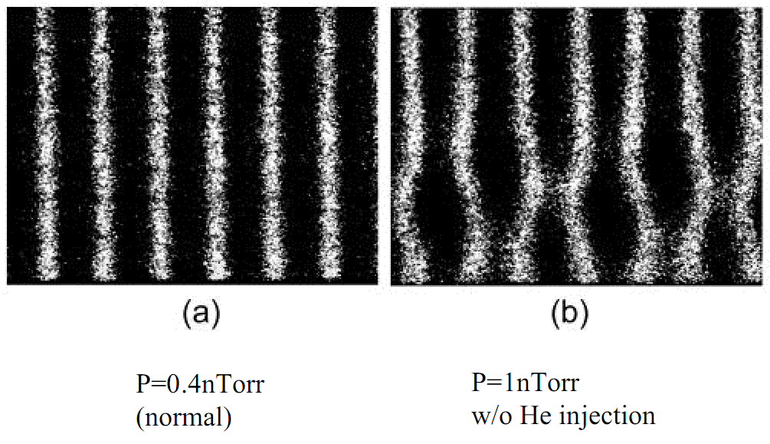
Observations---Coupled bunch instability
ALS σ_{y}~30μm
Dual sweep streak camera image of a bunch train
ALS
Beam spectrum at different beam current
(M. Kwon et al., Phys. Rev. E57 (1998) 6016)
(J. Byrd et al., PRL, 79 (1997) 79)

Slide 6
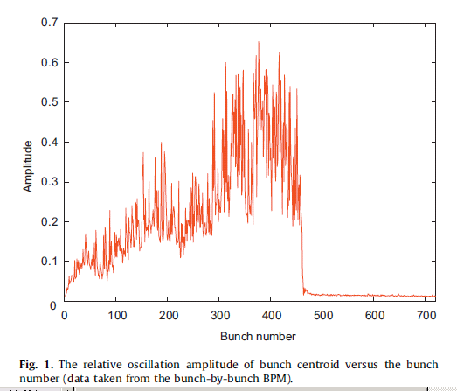
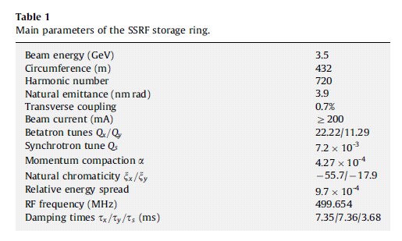
FII at SSRF with nominal vacuum (Bocheng Jiang, et. al. NIMA 614, 2010)
Single bunch train with bunch Number 450, 37.5% gap (0.54μs)
Beam current: 200mA
Vertical emiittance: 27.3pm
Horizontal emittance 3.9nm

Slide 7
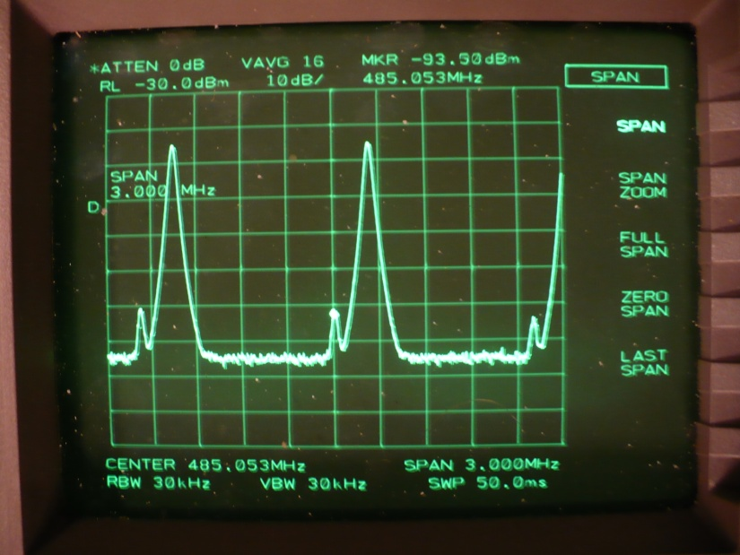
FII@SPEAR3
Small vertical oscillation (~10 µm) has been observed when a single bunch train beam filling pattern is used
Beam spectrum at 200 mA with a single bunch train filling pattern
Measured vertical amplitude along
the bunch train (200mA)

Slide 8
Main Parameters of SPEAR3 and the ILC DTC02 damping Ring
Physics | Symbol/Unit | SPEAR3 | ILC DTC damping ring
Beam Energy | E₀ [GeV] | 3 | 5
Circumference | C [m] | 234 | 3238.76
Horizontal Emittance | ε_{x} [nm] | 10 | 0.637
Vertical Emittance | ε_{y} [pm] | 14 | 2
Beam Current | I [mA] | 200-500 | 389/779
Bunch Number | M | 280 | 1312/2625
Harmonic Number | h | 372 | 7022
Bunch Spacing | ns | 2.1 | 6.2/3.1
RF Frequency | f_{RF} [MHz] | 476.315 | 650
Revolution Frequency | f₀ [MHz] | 1.280 | 0.09
Tune | n_{x} / n_{y} / n_{s} | 14.1/6.18/0.01 | 48.36/27.22/ 0.03
Momentum Compaction Factor | α | 1.6×10⁻³ | 3.36×10⁻⁴
Energy Spread | σ_{e} | 9.8×10⁻⁴ | 1.0×10⁻³
Bunch Length | σ_{l} [mm] | 6 | 6
Radiation Damping Time | τ_{x} /τ_{y} /τ_{z} [ms] | 4.0/5.3/3.2 | 22/22/11
Total Vacuum Pressure | P [nTorr] | 0.1~0.5 | 0.5

Slide 9
Beam filing patterns of ILC DTC02 damping ring
Parameter | KCS | DRFS | FP upgrade
Energy[GeV] | 5.0 | 5.0 | 5.0
Circumference[m] | 3238.76 | 3238.76 | 3238.76
Emittance ε_{x}/ε_{y} [pm] | 637/2 | 637/2 | 637/2
Harmonic number | 7022 | 7022 | 7022
Number of bunches | 1312 | 1312 | 2625
Beam current[mA] | 389 | 389 | 779
Bunch spacing [λ_{RF}] | 4 | 4 | 2
Beam Filling period | 19 | 14 | 29
Fill pattern (1period)
Train [bunch number] | 34 | 22 | 44
Gap [in λ_{RF}] | 45 | 33 | 31
Train [bunch number] | 34 | 22 | 45
Gap [in λ_{RF}] | 49 | 33 | 31
Train [bunch number] |  | 22
Gap [in λ_{RF}] |  | 33
 |  | 23
 |  | 33
Bunch length[mm] | 6 | 6 | 6
Energy spread, σ_{δ} | 1 x 10⁻³ | 1 x 10⁻³ | 1 x 10⁻³
Mom. compaction, α | 3.36 x 10⁻⁴ | 3.36 x 10⁻⁴ | 3.36 x 10⁻⁴
Tunes, ν_{x} / ν_{y} / ν_{s} | 48.36 /27.22 /0.03 | 48.36/27.22/ 0.03 | 48.36/27.22 /0.03
Damp times τ_{x} /τ_{y} /τ_{s} [ms] | 22 / 22 / 11 | 22 / 22 / 11 | 22 / 22 / 11
E loss/turn, U₀ [MeV] | 4.87 | 4.87 | 4.87
RF voltage, V_{RF} [MV] | 12.83 | 12.83 | 12.83

Slide 10
Summary of beam-ion instability Theory
FII (single bunch train with long gap)
(I)
Quasi-exponential growth (linear force)
(T. O. Raubenheimer and Frank Zimmermann, PRE,51,5487,1995)
Can we include all effects together?
Nonlinear space charge;
Arbitrary Beam optics;
Arbitrary Multiple gas species vacuum
(II)
Exponential growth (includes nonlinear space charge force)
(E. Kim and K. Ohmi, Japanese Journal of Applied Physics 48 (2009) 086501)
(only when time is small?)
(III)
Exponential growth (Linear space charge + Optics with large frequency spread)
(Gennady Stupakov, KEK Proceedings 96-6)
(IV)
Nonlinear regime (nonlinear space charge regime)
(S. Heifets, PEP-II AP note, 95-20)
Uniform/Multi-bunch-train filling (Includes both nonlinear space charge and optics)
(L. Wang, et. al. PRSTAB 14, 084401, 2011)
Growth rate is proportional to the ion density and Q of the wake!!

Slide 11
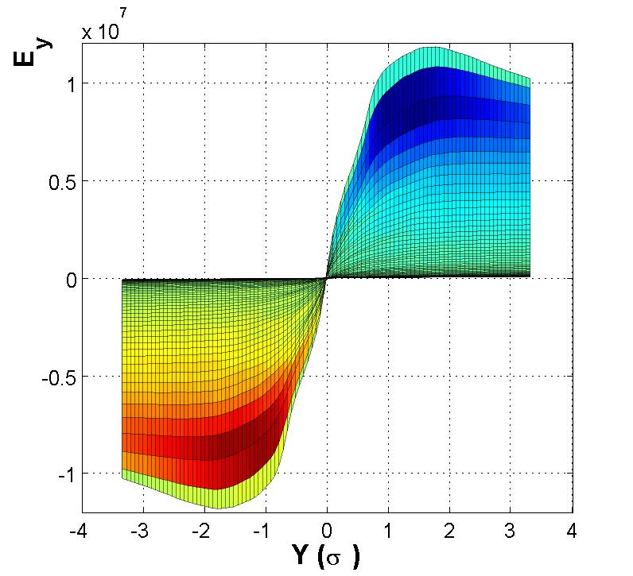
Our method: Wake function
The nonlinear space charge force is included. The Q of the wake represents the nonlinearity of the E-force. Typically, it is below 10.
The wake has good linearity when the bunch offset is smaller than the beam size where the fastest instability occurs
(L. Wang, et. al. PRSTAB 14, 084401, 2011)
Comparison with analysis
E-field of ion cloud

Slide 12
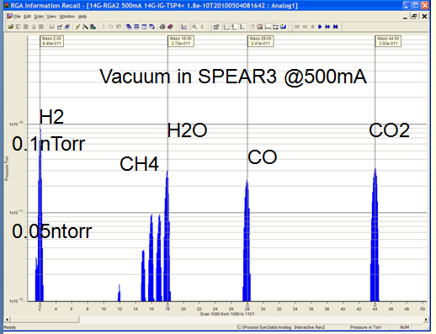
Effects of Optics & multiple gas species
Beam size varies along the ring, this frequency spread due to optics provide damping to the instability. How to accurately model it?
There are multiple gas species in the real vacuum. Does the superposition rule apply?
Ion frequency along the ILC damping ring with the KCS beam

Slide 13
Wake and impedance with arbitrary Optics and Vacuum
The total wake function of ions along the whole ring
Ion Frequency:
A is the mass number of ion; so the wake is ion species dependent.
SPEA3R
ILC DR

Slide 14
Impedance of ion cloud
Impedance provides a rich source of information:
Easy to know the contributions from individual gas species and also from ions at different location along the accelerator.
Instability growth rate is directly related to impedance(next page)
C
B
B
A
A
A
B
C
Impedance of ion cloud in ILC DR with KCS configuration. The total pressure is 0.5nTorr.
The partial pressure is 48%, 5%, 16%,14% and 17% for H2, CH4, H2O, CO and CO2 gas,
respectively.

Slide 15
Analysis Beam ion instability in ILC DR
When the beam is evenly filled along the ring, the coherent frequency shift for mode number µ is
Damping effect of H2 ion on the most unstable modes
KCS
FP upgrade
The unstable modes driven by various types of ions for the ILC KCS (Left) and FP upgrade (right) configuration. The total vacuum pressure is 0.5 nTorr

Slide 16
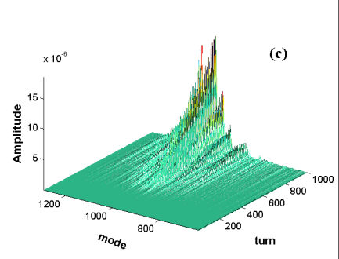
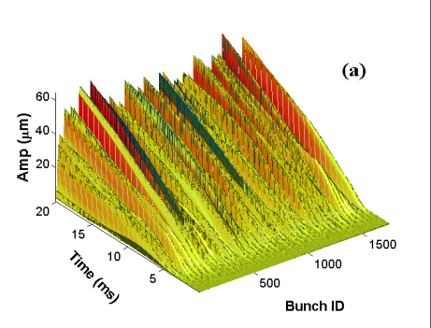
Simulation of FII in ILC DR
Simulation is done with PIC code (L. Wang, et. al. PRSTAB 14, 084401, 2011)
The simulation is expensive , >100 CPU hrs
The fastest exponential growth times for the three configurations shown in Table are 0.61 ms, 0.91 ms and 0.40 ms, respectively. Again the simulations agree with our analyses (0.89ms, 1.2ms, 0.7ms)
Simulated vertical beam ion instability in the ILC damping ring with KCS configuration: 3D plot (a) and 2D plot (b) of the growth of vertical amplitude; growth of unstable modes(c) Total pressure 0.5nTorr

Slide 17
FII at ILC DR with DCT04
The optics of DCT is recently updated. There is a smaller vertical emittance of 1.2pm in DCT04 design compared with 2pm as in DCT02. Therefore the growth time becomes shorter: they are 0.59ms, 0.80ms and 0.29 ms for KCS, DRFS and FP upgrade beam, respectively (SLAC-PUB-15268)
Simulated vertical beam ion instability with DCT04 lattice for various beam configurations

Slide 18
Beam filling patter effect@SPEAR3
Multiple bunch train can mitigate the beam ion instability with high intensity beam by reducing the ion density (Theory and simulation, see L. Wang, et. al. PRSTAB 14, 084401, 2011)
Observation

Slide 19
Mitigation with Chromaticity
Observed oscillation amplitude of beam’s vertical lower sidebands with varying vertical chromaticity in SPEAR3.
Calculated growth rate of the beam ion instability in SPEAR3 at different chromaticity, P=0.37nTorr. 1tr

Slide 20
Chromaticity effect
Chromaticity is more effective for machines with low momentum compaction factor, small ring and long bunch length
damping effect of chromaticity to the beam ion instability in SPEAR3 and the ILC damping ring. The vertical axis is the normalized growth rate

Slide 21
Comparison of the damping effect of nonlinear space charge force and beam optics
In SPEAR3, the two damping effects are similar
In ILC, beam optics provides stronger damping
The real part of the impedance (a) and growth rate of beam ion instability (b) in ILC damping ring with KCS configuration for various effects

Slide 22
Summary
We analyze the multi-bunch train beam ion instabilities with arbitrary beam optics, multi-gas species vacuum, nonlinear space charge force and realistic beam filling pattern together. All these factors provide damping to the instability.
Our analyses agree well with expensive simulation, and the observations in SPEAR3.
It is critical to use multiple gas species….
Both beam optics and nonlinear space charge provide strong damping effect to the instability;
A large chromaticity can mitigate the instability at the expense of reduced lifetime

Slide 23
Acknowledge
Thanks the SPEAR3 team for its great help on the SPEAR3 observations
Thanks the organizers of the working group on Damping Rings :
David Rubin
Yannis Papaphilippou
Junji Urakawa
etc..
Thank You!

