Slide 1




Vibration Stabilization Experimental Results
CLIC Main Beam and Final Focus Magnet Stabilization
A.Jeremie
LAPP: A.Jeremie, S.Vilalte, J.Allibe, G.Balik, L.Brunetti, G.Deleglise, J.P.Baud
CERN: K.Artoos, M.Esposito, P.Fernando Carmona, M.Guichard, C.Hauviller, A.Kuzmin, R.Leuxe, R.Moron Ballester
SYMME: B.Caron, A.Badel, R.LeBreton
ULB: C.Collette
Nikhef: S.Jansens

Slide 2
Outline
Introduction
Final Focus quadrupole stabilization
Main Beam Linac quadrupole stabilization
Global performance
Conclusion and identification of limiting factors

Slide 3
Introduction
Although the two systems shown have different demonstration objectives, the final MDI stabilisation system will probably take the best of both…
Or something completely different…

Slide 4
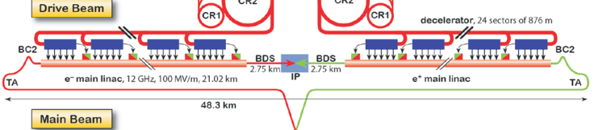
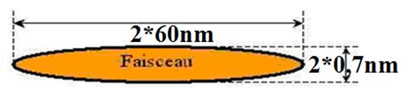
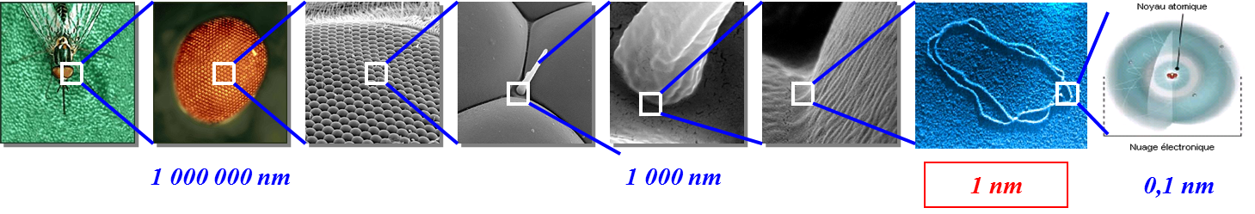
Why do we need stabilization?
Beam
DNA
But Vibration Sources can amount to 100s of nm:
Ground motion, Traffic, Lifts, cooling water, ventilation, pumps, machinery, acoustic pressure
Transmitted:
from the ground through the magnet support,
directly to the magnet via beam pipe, cooling pipes, cables...
We cannot rely only on the quietness of the site
Stabilization techniques have to be developed

Slide 5
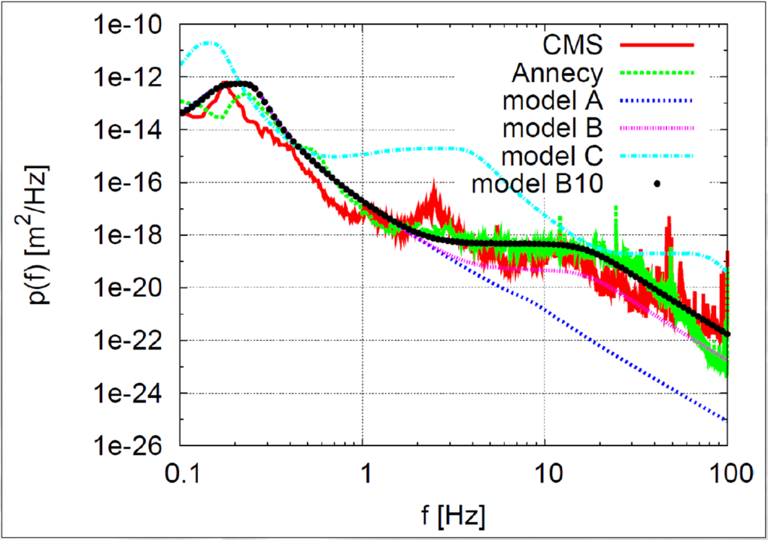
What we are aiming at
Ground motion has an impact on luminosity
=> especially when beam guiding quadrupole magnets vibrate
Micro-seismic peak
 | FF | MBQ
Vert. | 0.2 nm > 4Hz | 1.5 nm > 1 Hz
Lat. | 5 nm > 4 Hz | 5 nm >1 Hz
Technical noise
<1Hz | 1Hz<f<100Hz | 100Hz<f
Beam-based feedback | Mechanical stabilisation | Low Ground motion
At the IP (mechanical + beam feedback), we aim at 0,1nm at 0,1Hz
Active Stabilization techniques have been chosen

Slide 6
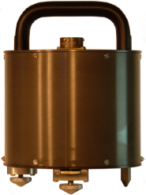
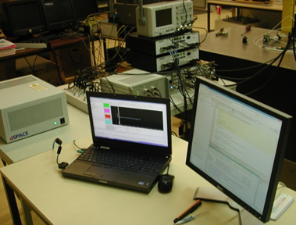
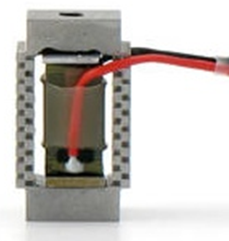
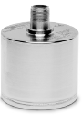
What is needed?
Active Stabilisation means :
measure => decide action => act
sensor feedback/-forward actuator
-measure sub-nanometre
-low frequency
-Large band width (0.5-100Hz)
-Low noise
-Smalest delay for real-time
-Small and light
=> Seismic sensors
-real-time feedback
-Mutli-channel
-simulation possibilities
-Fast electronics
-Large dynamics( >16bits)
-Nanometre displacement
-Displace heavy weight
-Compact
-Real-time response
=> Piezoelectric actuator
Accelerator environment
=> Magnetic field resistant and radiation hard

Slide 7
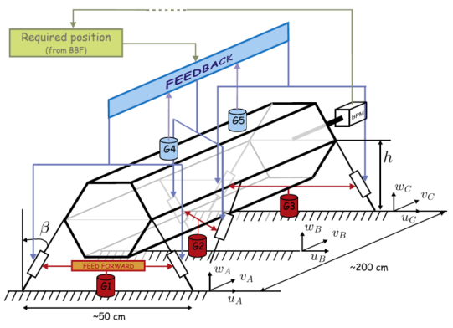
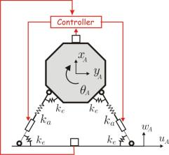
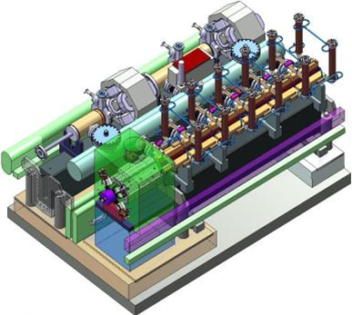
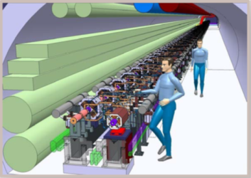
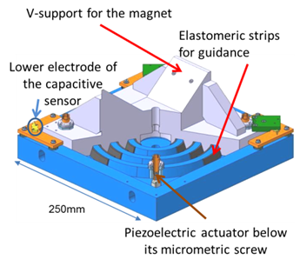
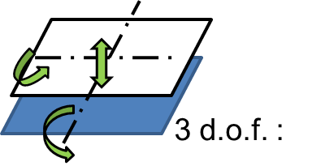
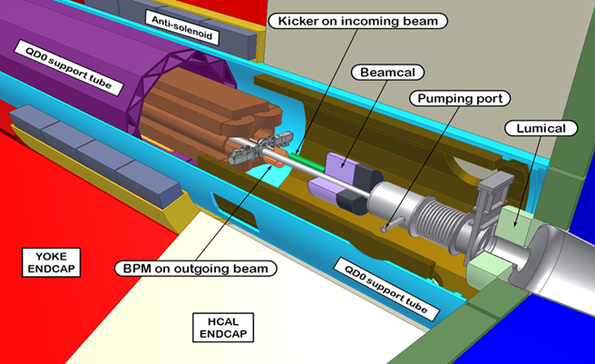
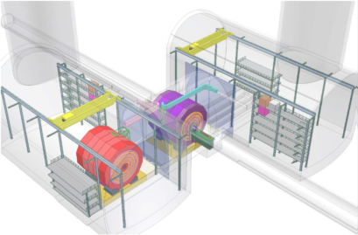
2 « similar » active solutions
Main Beam Linac quadrupole demonstration (« CERN »)
4 d.o.f.
Final Focus quadrupole demonstration (« Annecy »)

Slide 8
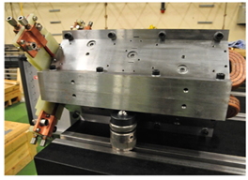
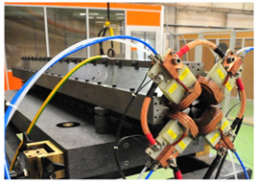
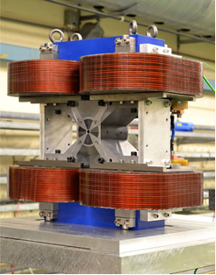
Magnets to be stabilised
Main Beam quadrupoles
Type 1
500mm
100kg
Type 4
2000mm
450kg
Final focus quadrupole prototype
Permanent magnet (Nd2Fe14B) + coils

Slide 9
Final Focus Stabilization
Mechanics
Instrumentation
Electronics and acquisition
Results

Slide 10
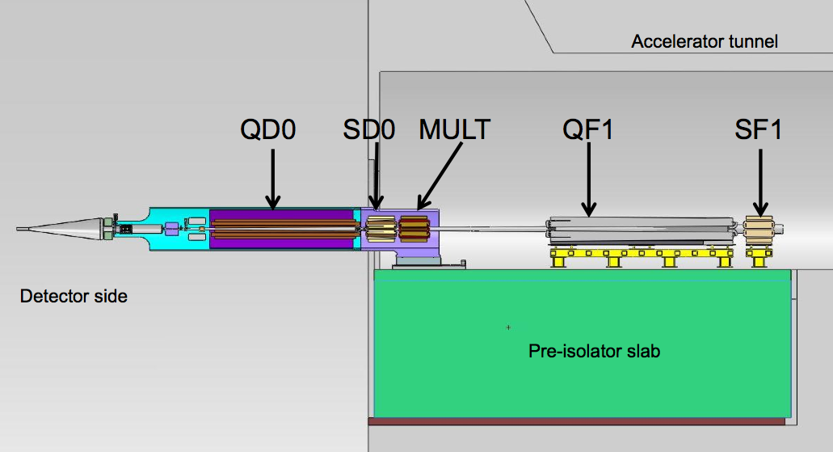
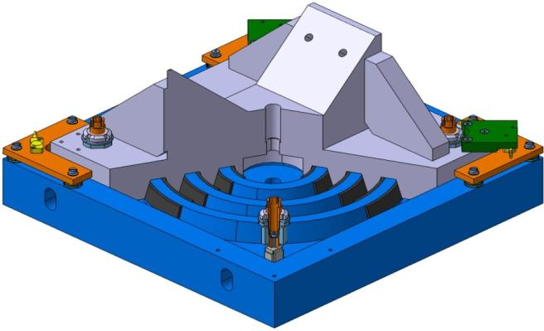

Final Focus quadrupole:
Passive and active solution
A. Gaddi et al.
Add coherence between QD0 and QF1 and reduce band-width on which active stabilisation has to act
V-support for the magnet
Elastomeric strips for guidance
Lower electrode of the capacitive sensor
250mm
Piezoelectric actuator below its micrometric screw
Additional passive stage directly under active system is also envisaged
H.Gerwig + N.Siegrist

Slide 11
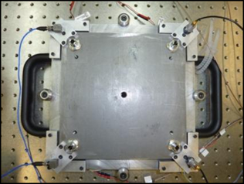
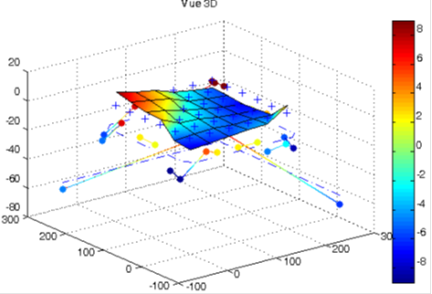
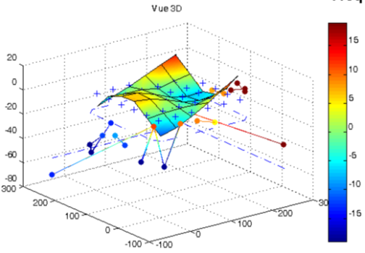
Mechanical characteristics
50
Gain dB
40
30
20
10
0
-10
0
1
2
3
4
Intrinsic resonances if change of phase by 90°: other peaks just from boundary conditions
=> 2 resonance peaks just below 2kHz and near 4kHz.
10
10
10
10
10
Phase
0
-500
-1000
-1500
0
1
2
3
4
First intrinsic resonance frequency near 2kHz : experimental and theoretical values agree.
10
10
10
10
10

Slide 12
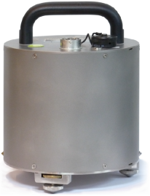
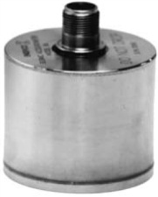
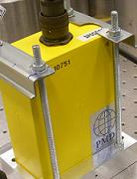

Sensors and actuators
Sensor type | Electromagnetic Geophone |  | Piezoelectric Accelerometer |  | Electrochemical Geophone | Capacitive
Model | GURALP CMG-40T | GURALP CMG-6T | ENDEVCO 86 | WILCOXON 731A | SP500 | D-015.00
Company | Geosig | Geosig | Brüel & Kjaer | Meggitt | EENTEC | Physik Instrumente
Output signal | Velocity (X,Y,Z) |  | Z acceleration |  | Velocity | Distance
Sensitivity | 1600 V/m/s | 2400 V/m/s | 10 V/g | 10 V/g | 2000 V/m/s | 0.67 V/µm
Bandwidth [Hz] | [0.033-50] | [0.033-100] | [0.01-100] | [0.05-500] | [0.0167-75] | [0-3000]
Mass [g] | 7500 | 2600 | 771 | 555 | 750 | <10
Zeros | [999, 0, 0, 0] | [0, 0, 0] |  | Real part < 0
PPA10M piezoelectric actuators
Resolution | Resonnance | Response time | Max Force | Max displacement
0.08nm | 65kHZ | 0.01ms | 400N | 8µm

Slide 13
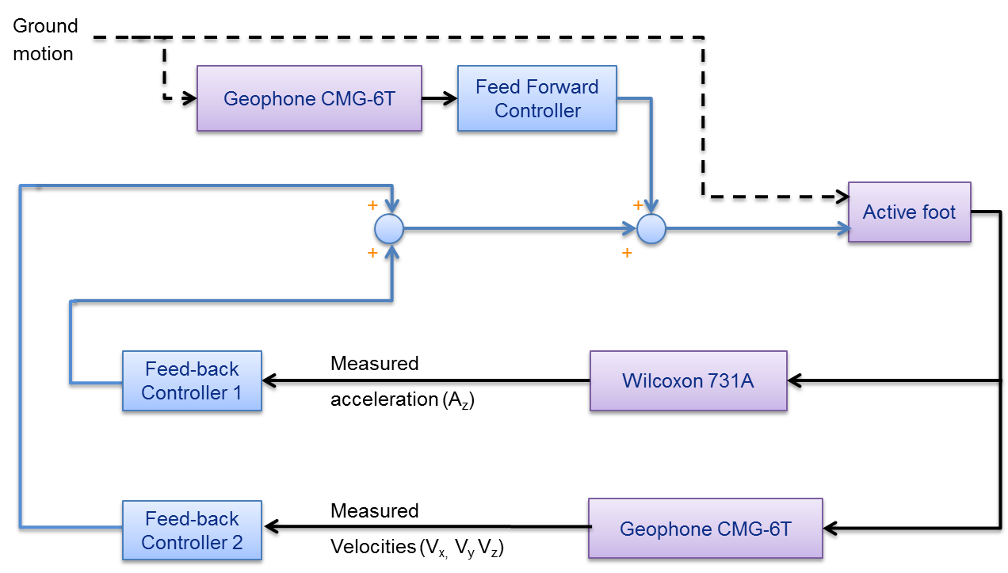
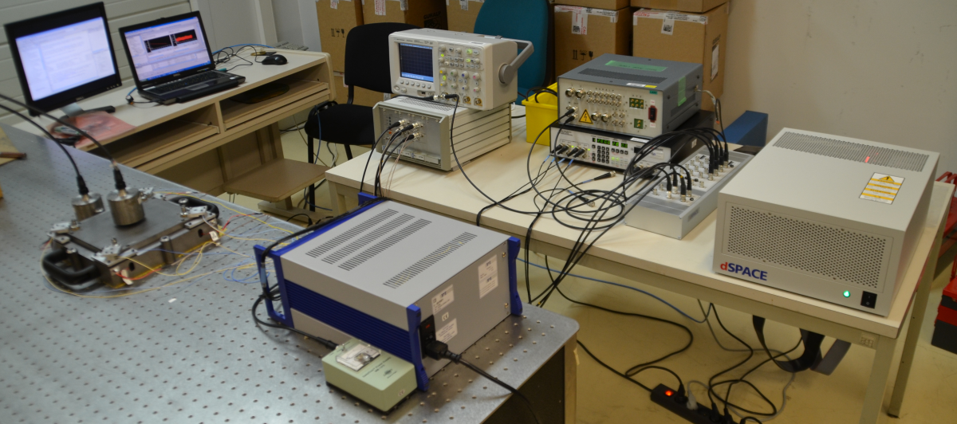
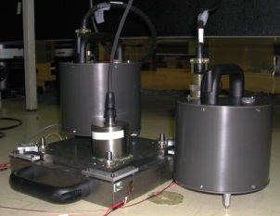
Experimental set-up
Amplifiers, filtres, inputs/outputs, signal conditionning
Matlab and dSPACE ControlDesk
Active system with sensors
dSPACE real-time system dedicated to rapid prototyping and simulation with 16bits ADC

Slide 14
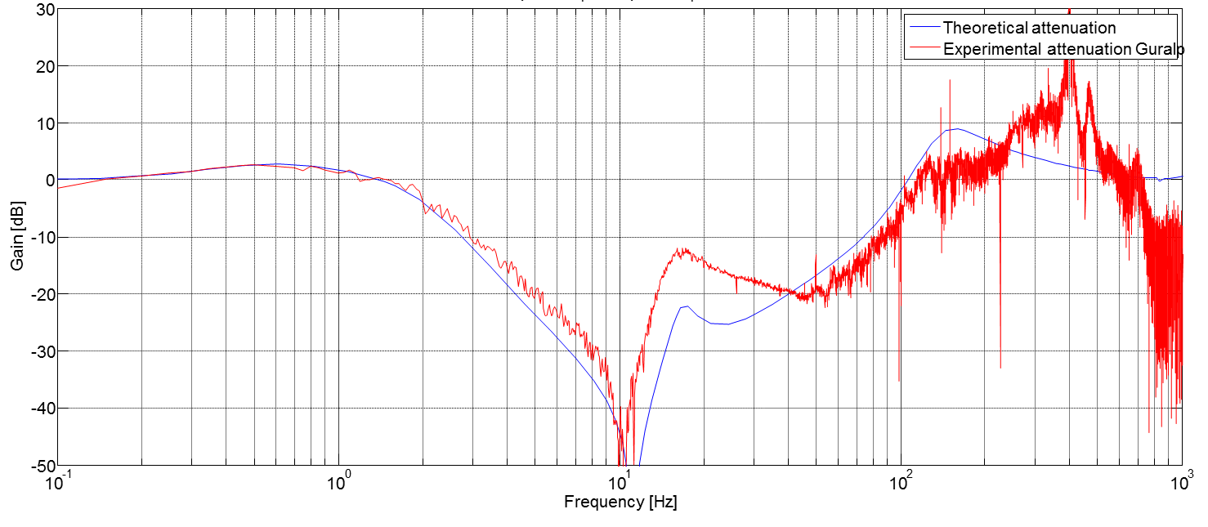

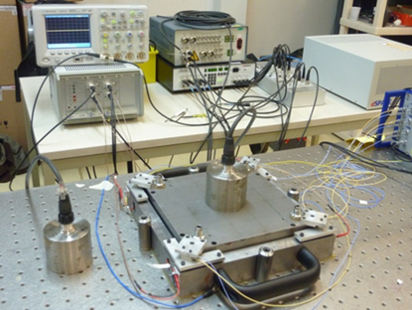
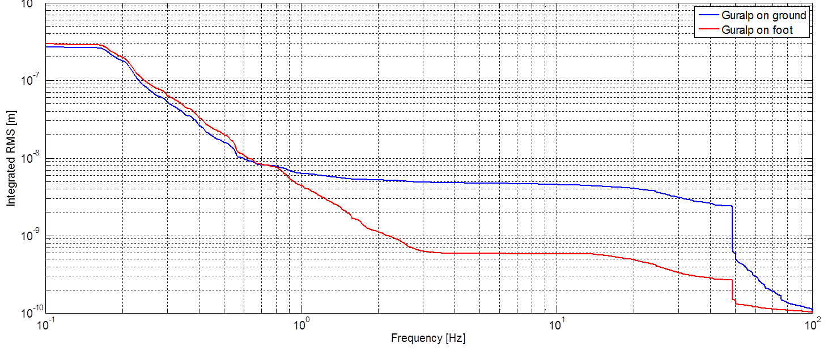
FF stabilization results
Attenuation up to 50dB between 1,5-100Hz
1,5Hz-100Hz
5 nm
RMS ground at 4 Hz: 5 nm
RMS on foot at 4Hz: 0,6nm
RMS ratio: 8,3
0,6 nm

Slide 15

Main Beam Linac Stabilization
Mechanics
Electronics and acquisition
Results

Slide 16
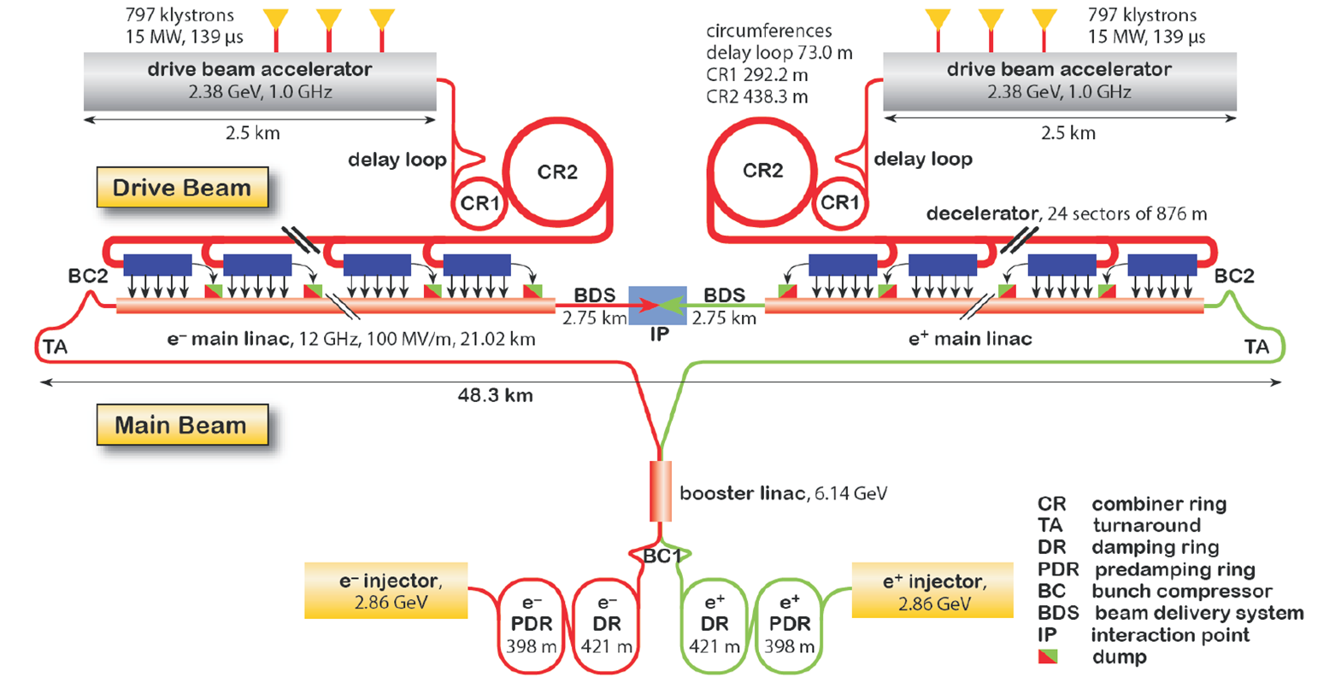
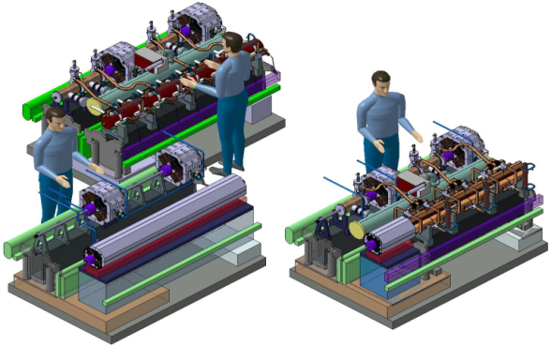
CLIC and CLIC modules
Type 0: No Main Beam Quad
20.926 “Modules” of which there are 3992 with CLIC Main Beam Quadrupoles
Type 4: 2m, 400 kg
Type 1: 0.5 m, 100 kg

Slide 17
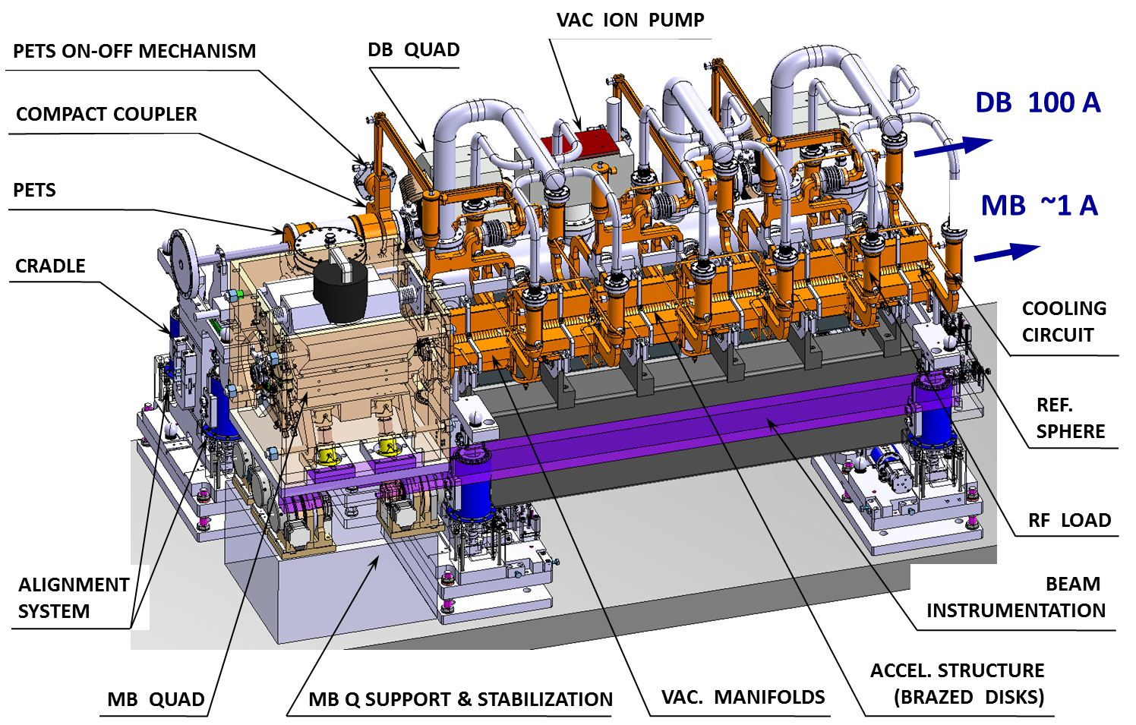
Main Linac Module with Type 1 quadrupole

Slide 18
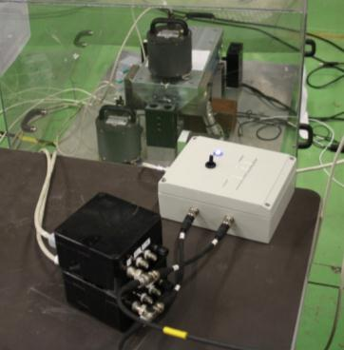
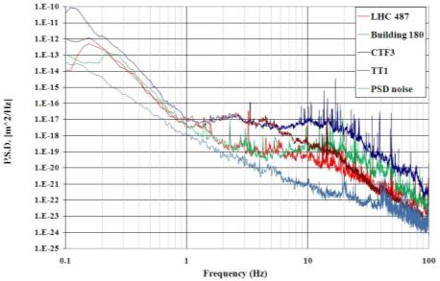
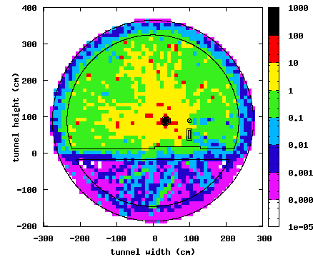
Design constraints
Inputs:
  Resolution 2 µV
  Dynamic range 60 dB
  Bandwidth 0.1-100 Hz
Output:
  Dynamic range 140 dB
Resistance to radiation
  Shielding, location, design
Cost (~4000 magnets to be stabilized)
Power restrictions (cooling)
MB 9 GeV
Courtesy S. Mallows

Slide 21
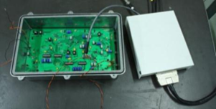
Control
Component | Delay
ADC | 8 µs
Electro-optic transducer | 100 ns
Optic fiber transmission | 5 µs/Km
Opto-electric transducer | 120 ns
DAC | 3 µs
Actuator (20nm single step) | 1 µs
Typical catalog delay values for the components
The farther away the control hardware, the less effective the
stabilisation system
=> Need for a local controller
Control loop delay | Stabilization performance
43μs | 100%
80 μs | 90%
90 μs | 80%
100 μs | 60%
130 μs | 30%
Local controller
Digital and analog hybrid controller :
Digital: flexibility
Analog: less latency and higher radiation hardness

Slide 22
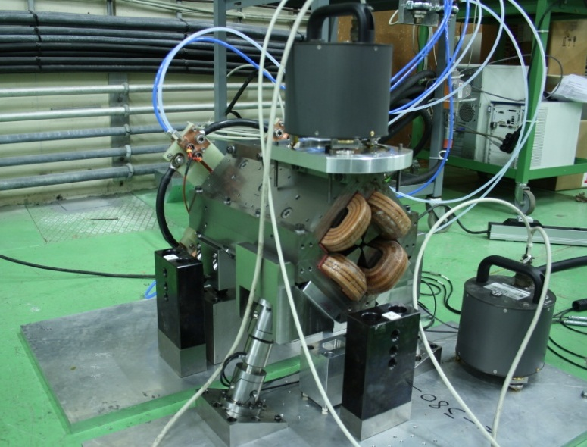

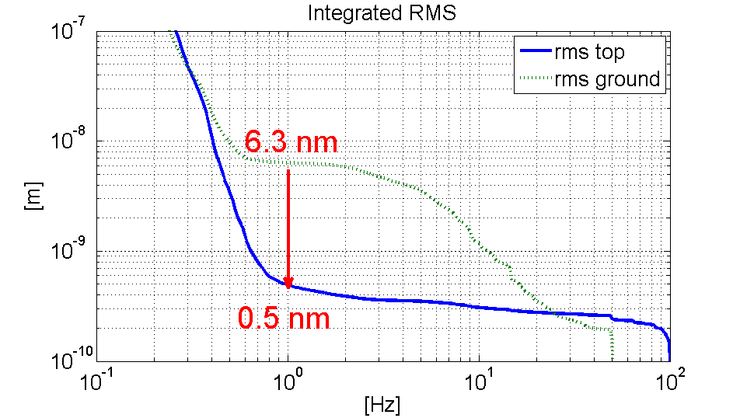
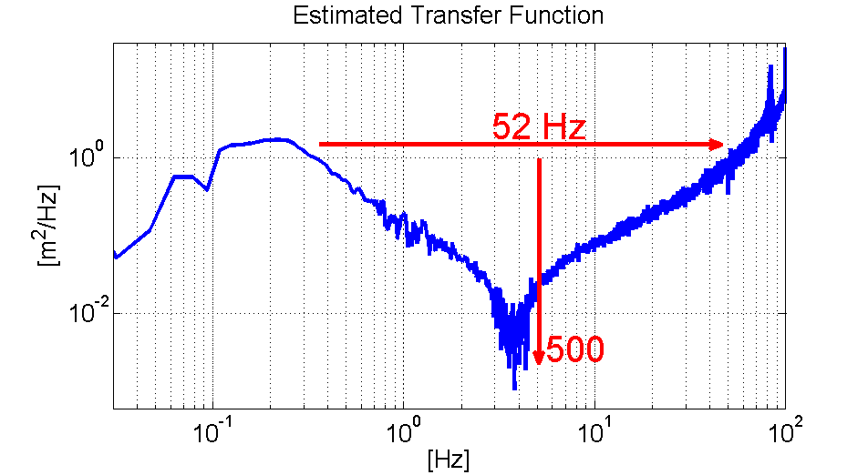
Stabilization on Type 1 MBQ
    Water cooling 4 l/min
    With magnetic field on
    With hybrid circuit
Figure | Value
R.m.s @ 1Hz magnet | 0.5 nm
R.m.s @ 1Hz ground | 6.3 nm
R.m.s. attenuation ratio | ~13
R.m.s @ 1Hz objective | 1.5 nm

Slide 23
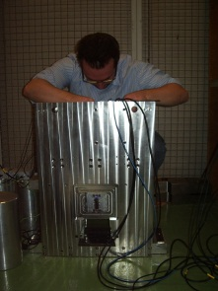
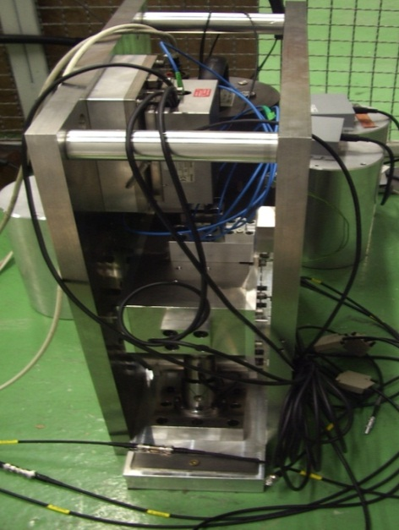
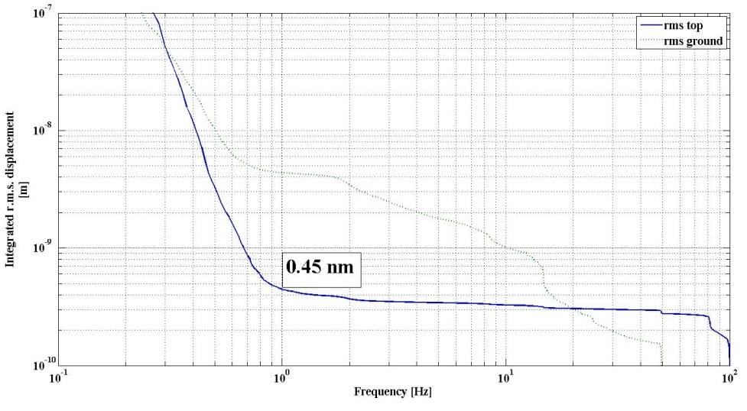
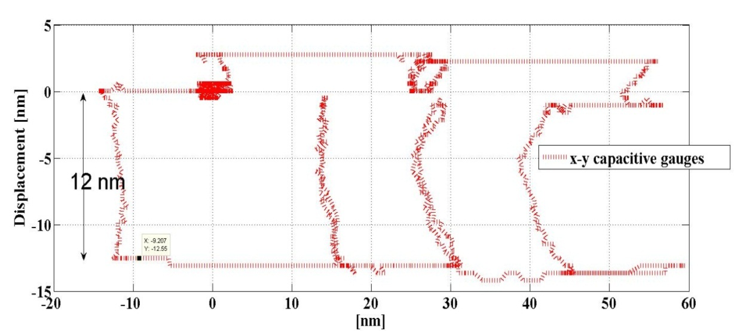
Improved mechanics prototype x-y guide
X-y guide « blocks » roll + longitudinal direction
Increases lateral stiffness by factor 500, increases band width without resonances to ~100 Hz
Introduces a stiff support for nano metrology
cross check with interferometer

Slide 24
Conclusion for Stabilization
Different domains needed:
  Mechanics (supports, guides, mechanical resonators, …)
  Instrumentation (sensors, compatibility with active control, …)
  Electronics (acquisition & control, band-width, resolution,…)
  Automatics (control, real time simulation …)
  Accelerator physics (beam simulations, luminosity at Interaction Point…).
Sub-nanometre stabilisation peformed validating CLIC stabilisation feasibility: limiting factor are the « noisy » sensors (especially limiting in the 0.8-6Hz range)
Integrated luminosity simulations show sub-nanometre beam size at IP and less than 6% luminosity loss (see LCWS 2011 Jeremie and Collette)
Next step: tests in accelerator environment

