Slide 1

Summary of Calorimetry/Muon Sessions
Burak Bilki
University of Iowa
Argonne National Laboratory

Slide 2
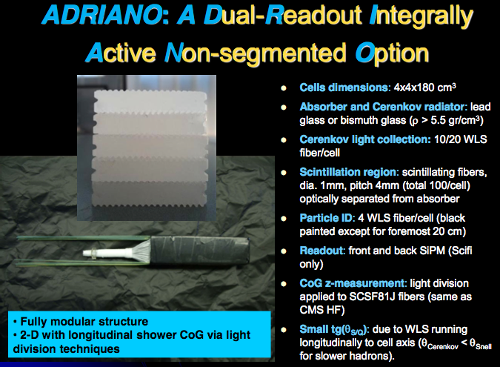
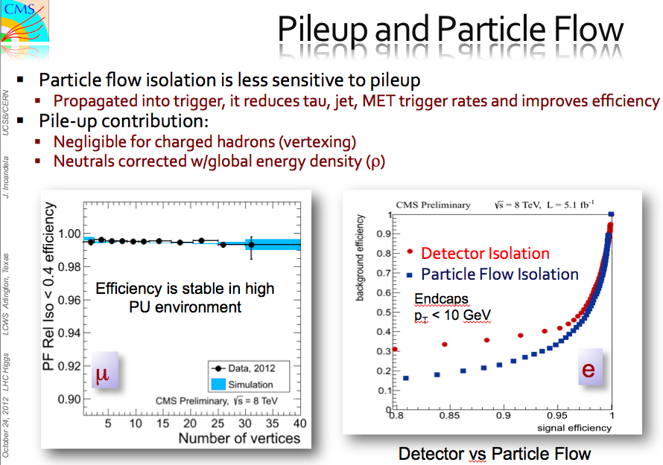
Calorimetry Requirements
Jet energy resolution ( ) ≤ 3.5 – 5 % for jet energies ~ 1 TeV – 50 GeV
Excellent e/γ ID
Low noise, fit inside the coil, radiation hard (for forward calorimeters)
Precision timing (~1 ns) needed for CLIC
Conventional → Novel
Two major methods
Dual Readout Calorimetry: Imaging/PFA Calorimetry:
Different hardware concepts under beam test Has large scale prototypes with ~ established principles
J. Incandela
C. Gatto

Slide 3
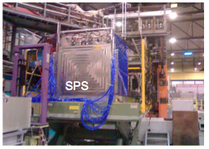
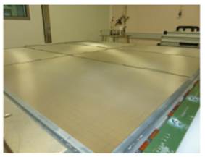
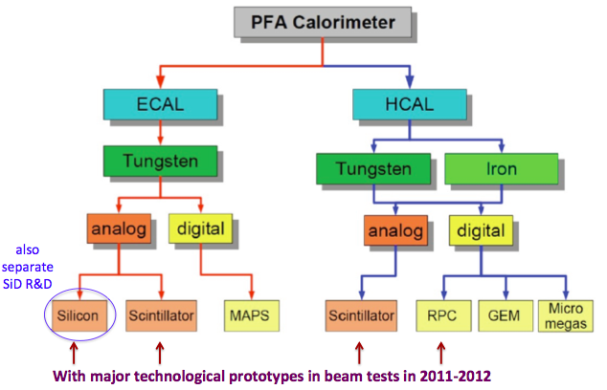
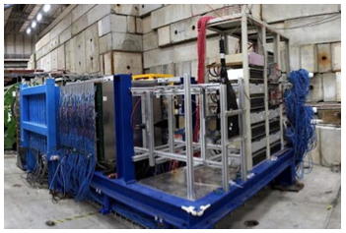
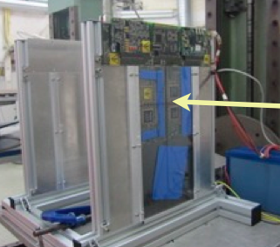
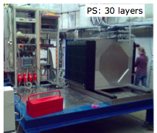

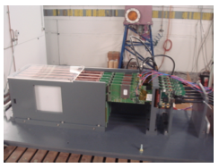
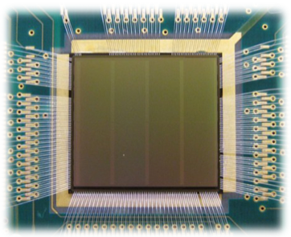
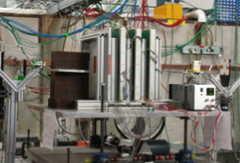
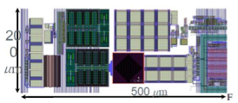
CALICE RPC SDHCal
Micromegas
Experiments:
CALICE RPC DHCal
CALICE W-Scintillator HCAL
CALICE SciW-ECal
CALICE SiW-ECal
SPiDeR DECAL w/MAPS
GEM
Common Features:
Fine granularity
Embedded front-end electronics
SiD SciW-ECal

Slide 4
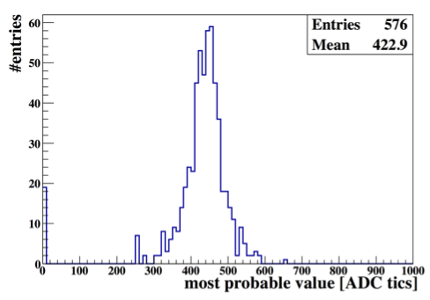
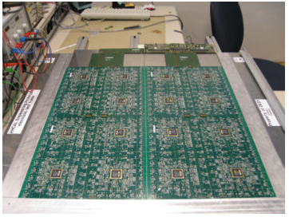
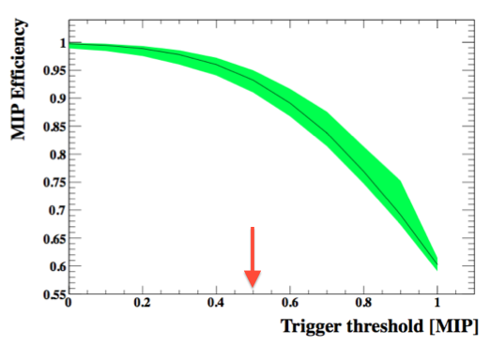
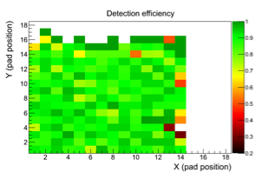
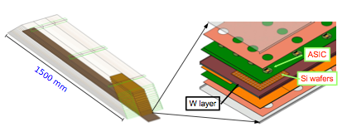
2nd Generation Prototypes:
~ Realistic dimensions (partly equipped)
Technological solutions for the final detector
Calice AHCAL
K. Kruger
T. Frisson
Calice SiW ECAL

Slide 5
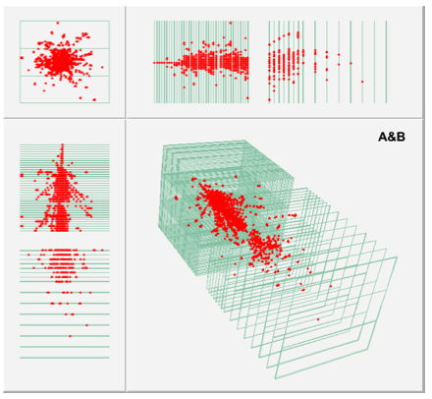
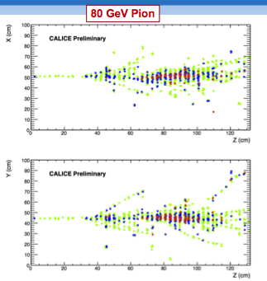
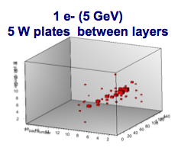
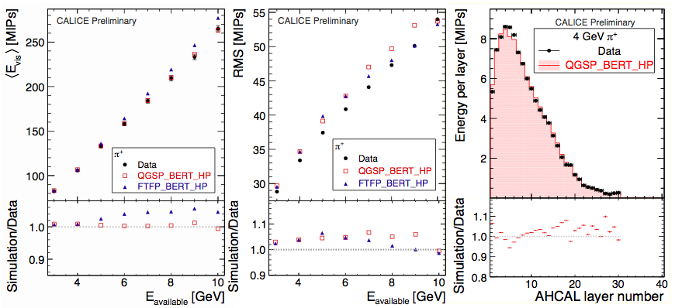
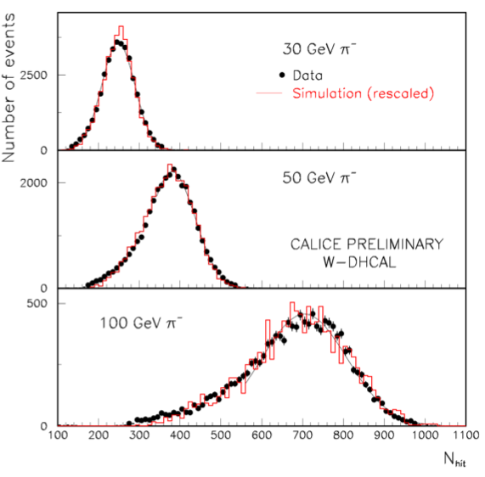
Overall Achievements
A lot of data – Successful test beams at FNAL, CERN and DESY; 100Ms of events
Very beautiful images.
SDHCAL
SiW-ECAL
300 GeV π in W-DHCAL
J. Repond
V. Boudry
T. Frisson
Comparison with MC and testing the reliability of detector simulations.
Immediately accessible after/during test beam → Excellent understanding of the calorimeters!
W-AHCAL
W-DHCAL
F. Sefkow
J. Repond

Slide 6
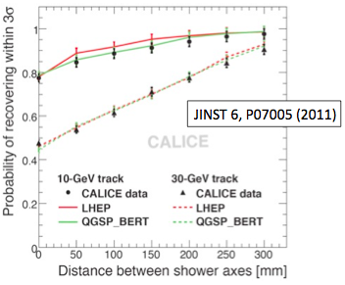
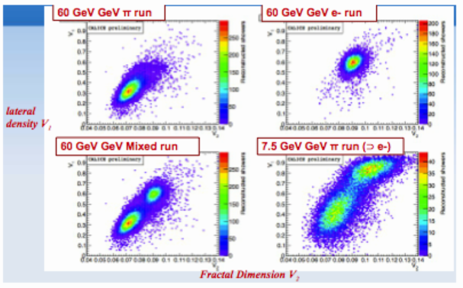
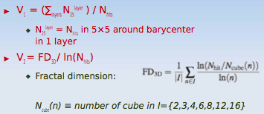
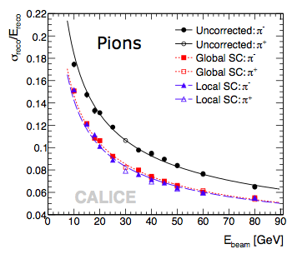
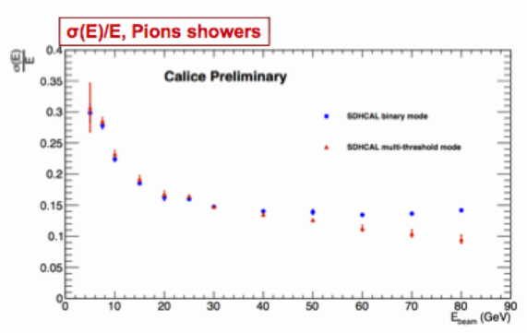
Particle ID and separation
SiW ECAL + Fe - AHCAL
SDHCAL
In addition to PFA, software compensation is also possible
Utilization of multiple thresholds (very preliminary)
V. Boudry
Fe - AHCAL
F. Sefkow
SDHCAL
Local compensation: re-weighting based on single cell energy density
Global compensation: correction factor calculated on event-by-event basis

Slide 7
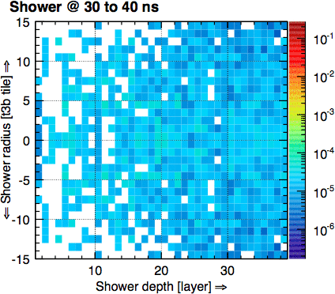
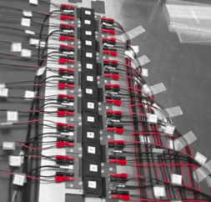

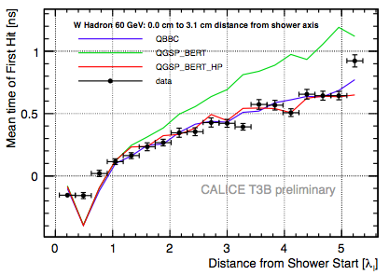
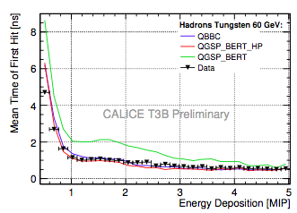
Precision Timing for CLIC
Measure the time structure of the signal within hadron showers
CALICE T3B
w/ W - AHCAL
F. Simon
w/ W - AHCAL
w/ W - AHCAL

Slide 8
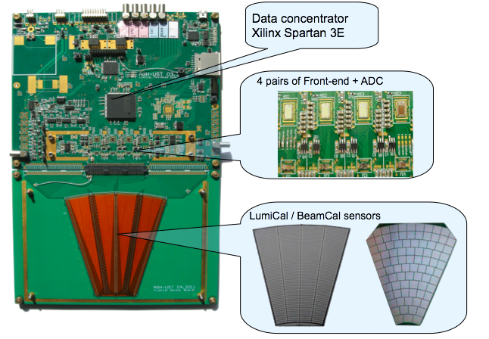
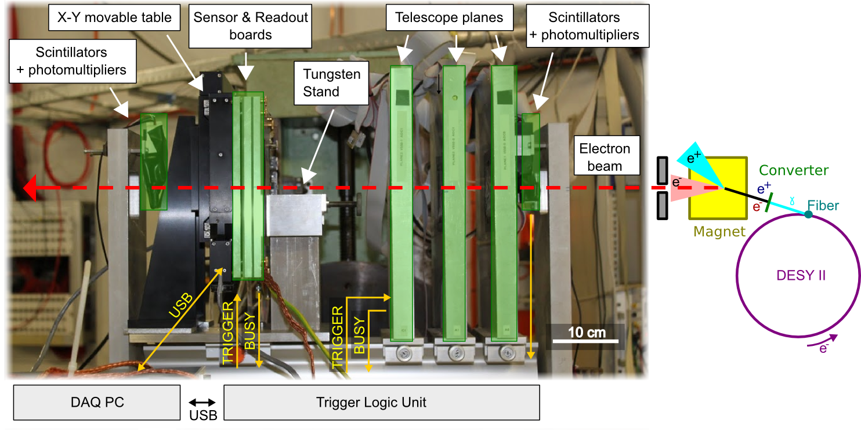
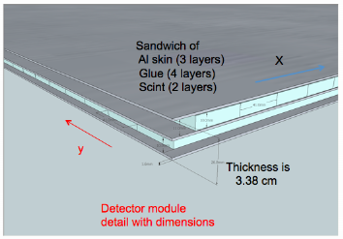
Forward Calorimetry SiD Muon Detector
SiD Muon Detector Baseline Design
Large planar modules ~ 5.54m X 3.8m ~ 21m².
Si avalanche photo-diodes-pixelated photon det.
Common electronics: KPiX.
E. Fisk
W. Lohmann
Radiation damage studies underway.

Slide 9
Conclusions and Outlook
Several projects at different stages of prototyping.
Full scale beam test series completed for all major technologies.
First test beam results from 2nd generation prototypes addressing integration issues available.
Viability of PFAs and imaging calorimetry not questioned anymore.
No expectation of breakthrough in basic principles and technology in the near future.
BUT, the calorimeters already started to produce unprecedented physics results well before collider detector integration.

