Slide 1
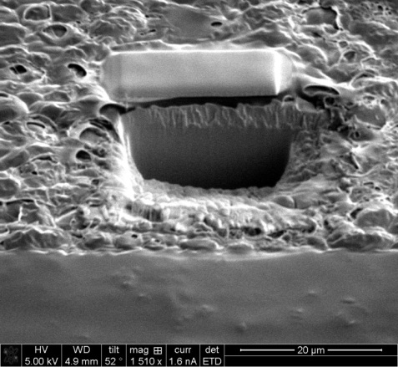
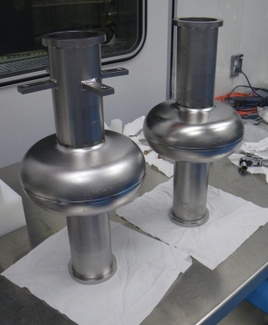
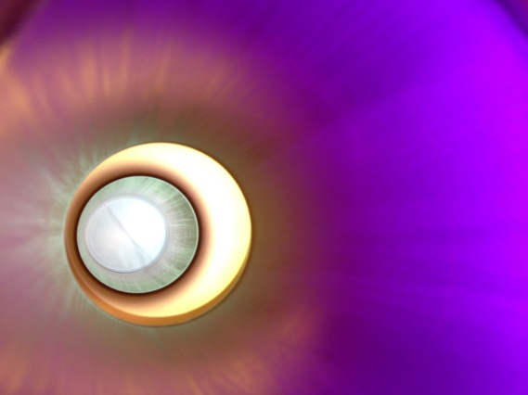
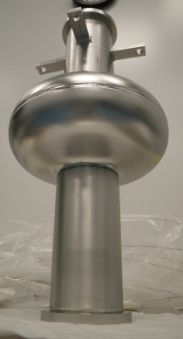
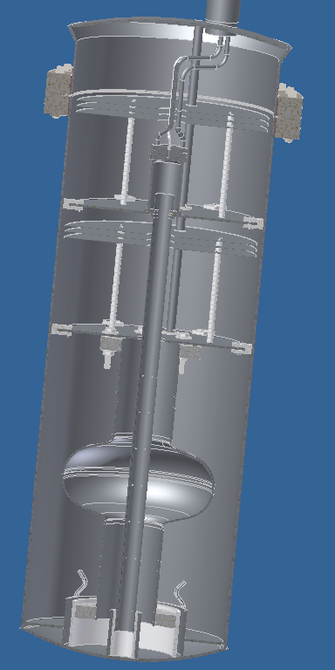
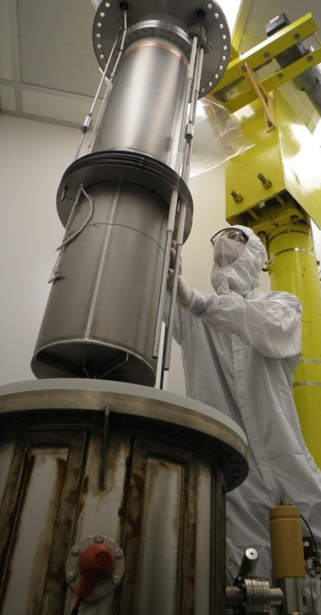
Update on the Development of Coated Cavities
New Results from 1-cell
Cavities at Cornell and JLab
Sam Posen, Cornell University
May 28, 2013
Linear Collider 2013
This work is supported by NSF PHY-0841213 and DOE DE-SC0002329. This work made use of the Cornell Center for Materials Research Shared Facilities which are supported through the NSF MRSEC program (DMR-1120296).

Slide 2
Nb₃Sn For SRF Cavities
Nb₃Sn is an attractive potential alternative material to Nb for SRF cavities, having:
  A T_{c} of ~18 K, compared to ~9 K for Nb, giving it a much lower BCS R_{s}, ideal for CW linacs – huge reduction in cost of cryo plant and grid power
  A predicted H_{sh} of ~400 mT, nearly twice that of Nb, ideal for high energy linacs – higher accelerating gradient: fewer cavities required
Cornell has been pioneering new R&D on Nb₃Sn after 10 years of inactivity. Other labs are now starting Nb₃Sn programs as well.

Slide 3
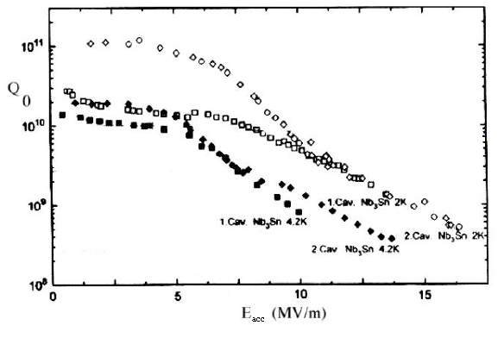
Previous SRF Research with Nb₃Sn
Siemens AG
U Wuppertal
KfK
JLab
Cornell
And others
Nb, 2 K
Nb, 4.2 K
“Determining the origin of these non-linearities and eliminating the possibility that this behavior is not a fundamental property of the films are the next important steps.”
–Peter Kneisel, 2012

Slide 4
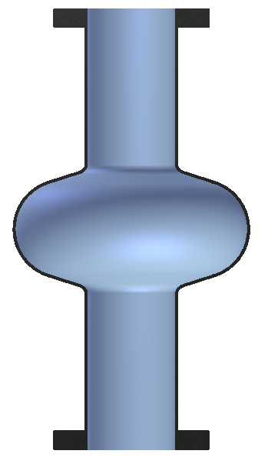
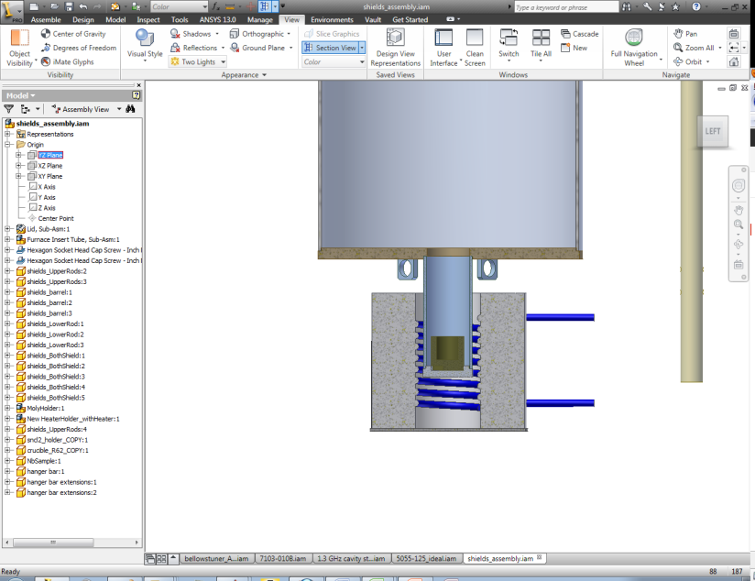
Coating Mechanism
Vapor Diffusion
Coating chamber in UHV furnace
Nb cavity substrate
Sn vapor arrives at surface
Nb
Nb-Sn interdiffusion
Sn Vapor
Sn
Nb₃Sn
By independently controlling Sn vapor abundance, it can balanced with Nb-Sn interdiffusion rate to achieve desired stoichiometry
T_{f} = furnace temperature
=~1100 C
T_{s} = Sn source temperature
=~1200 C
Heater
4

Slide 5
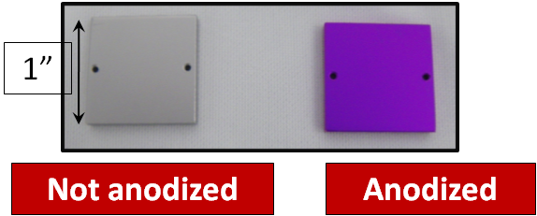
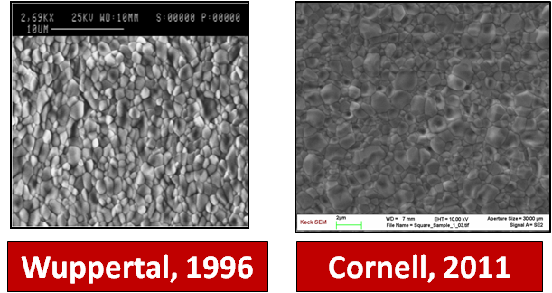
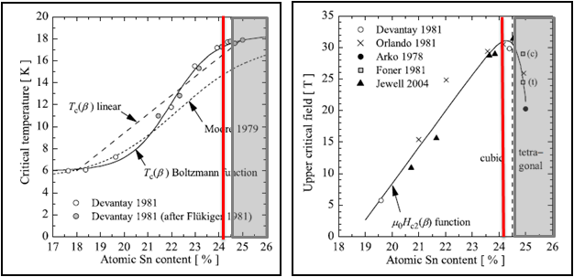
Cornell Sample Results
Successfully fabricated Nb₃Sn samples with near-ideal stoichiometry
Uniformity of stoichiometry determined by anodization and EDX
Appropriate grain size and texture confirmed using SEM

Slide 6
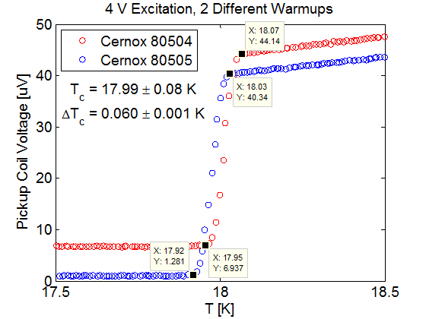
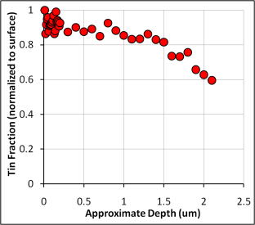
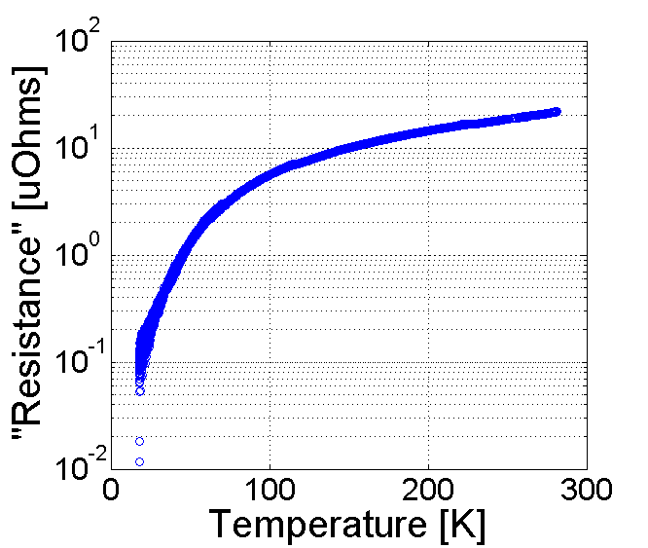
Cornell Sample Results
Appropriate thickness determined through XPS
T_{c} = 18.0 ± 0.1 K measured inductively is close to highest literature value
RRR measured through cryogenic 4-wire probe shows minimal degradation

Slide 7

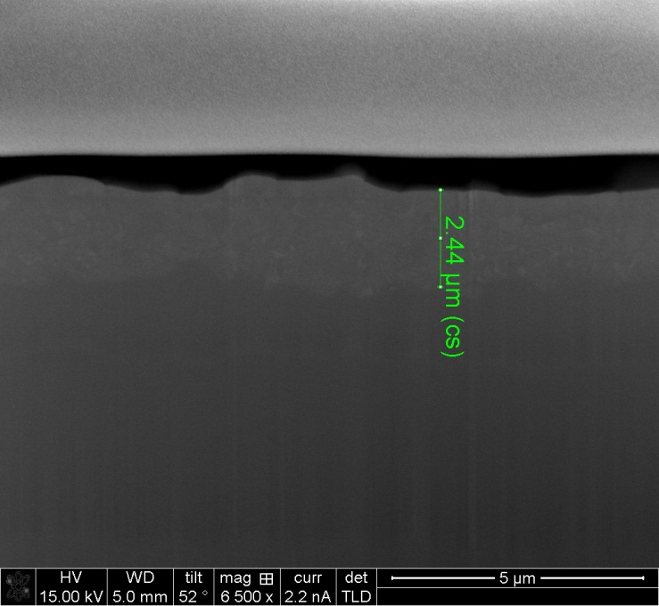
New FIB Results
Recently used focused ion beam milling to see cross section of coated sample
Layer thickness measurement agrees with XPS
TEM to come…
20 µm

Slide 8


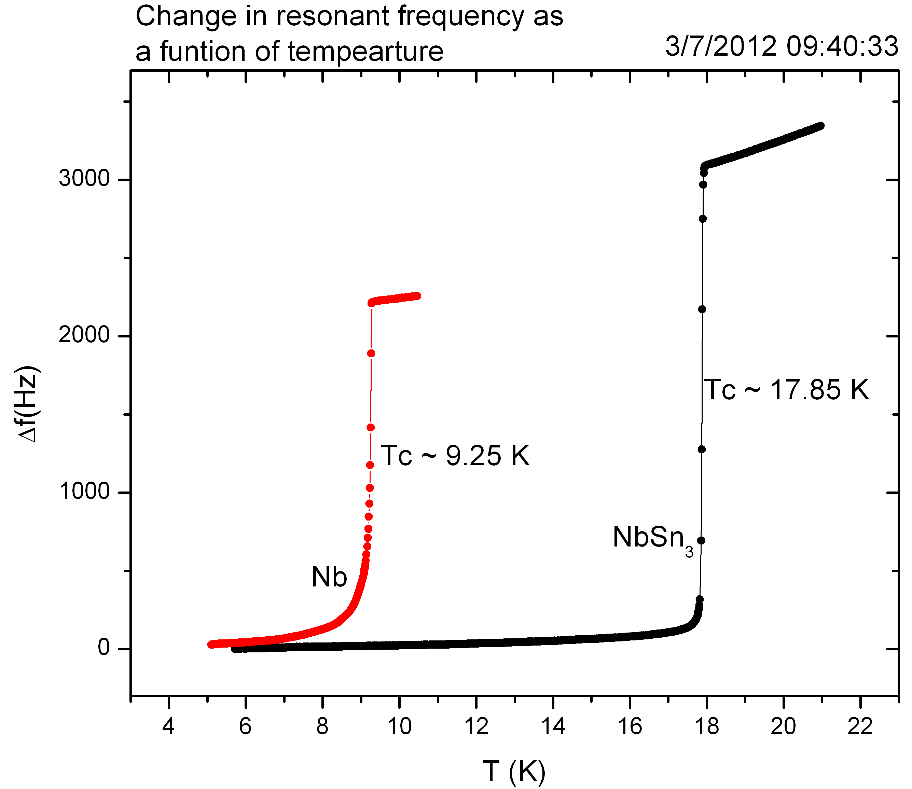
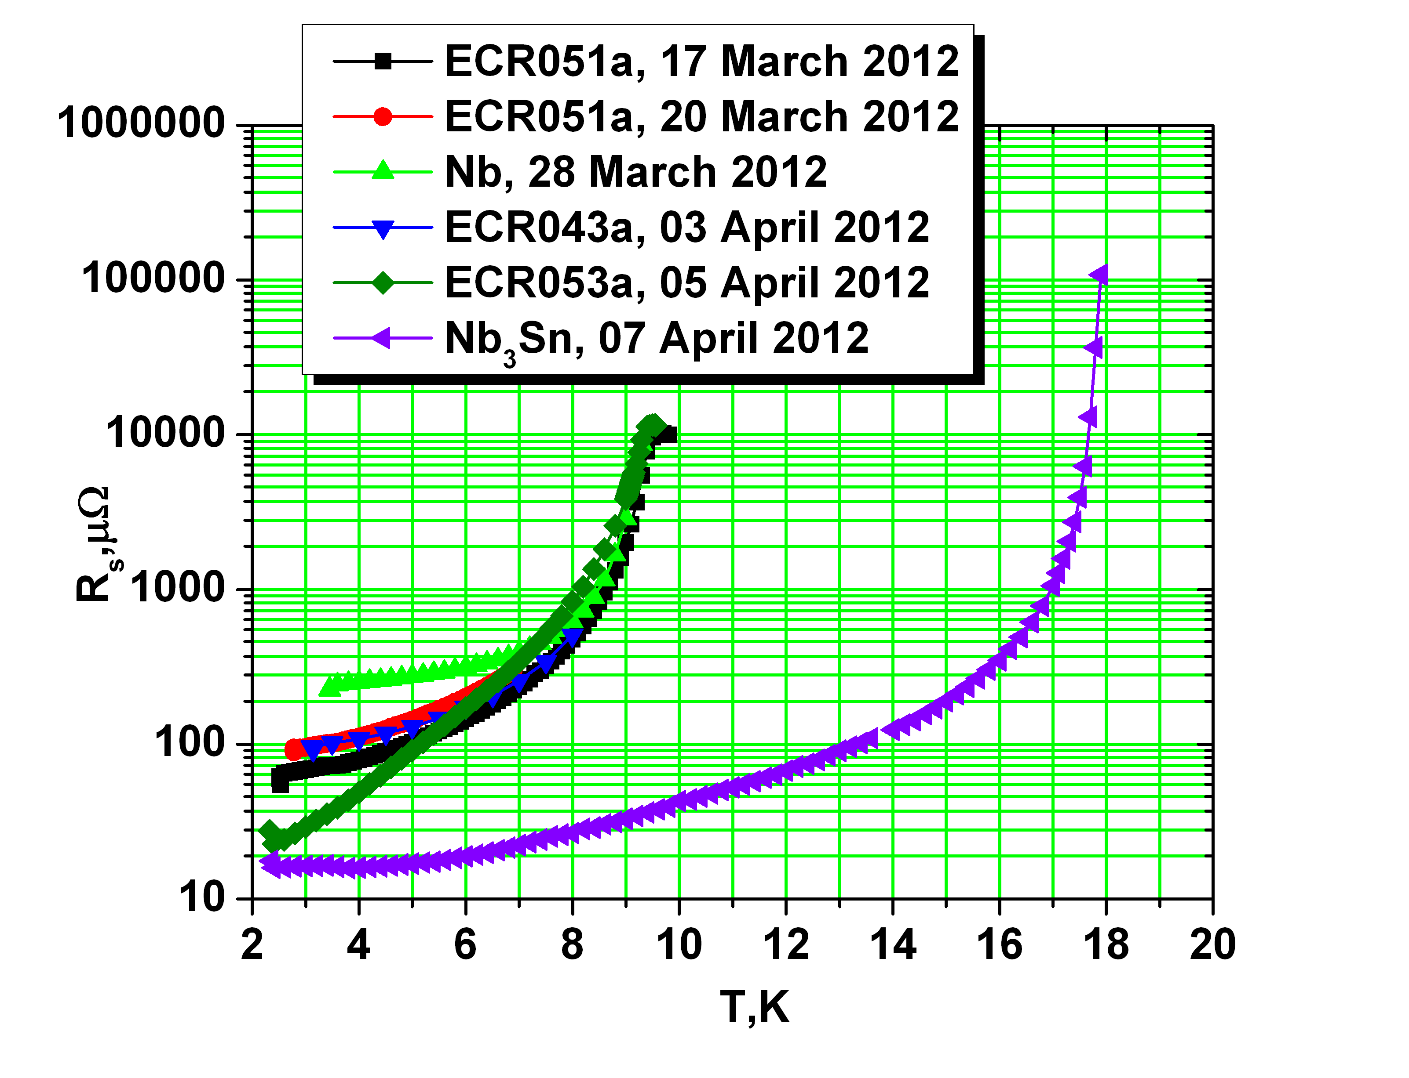
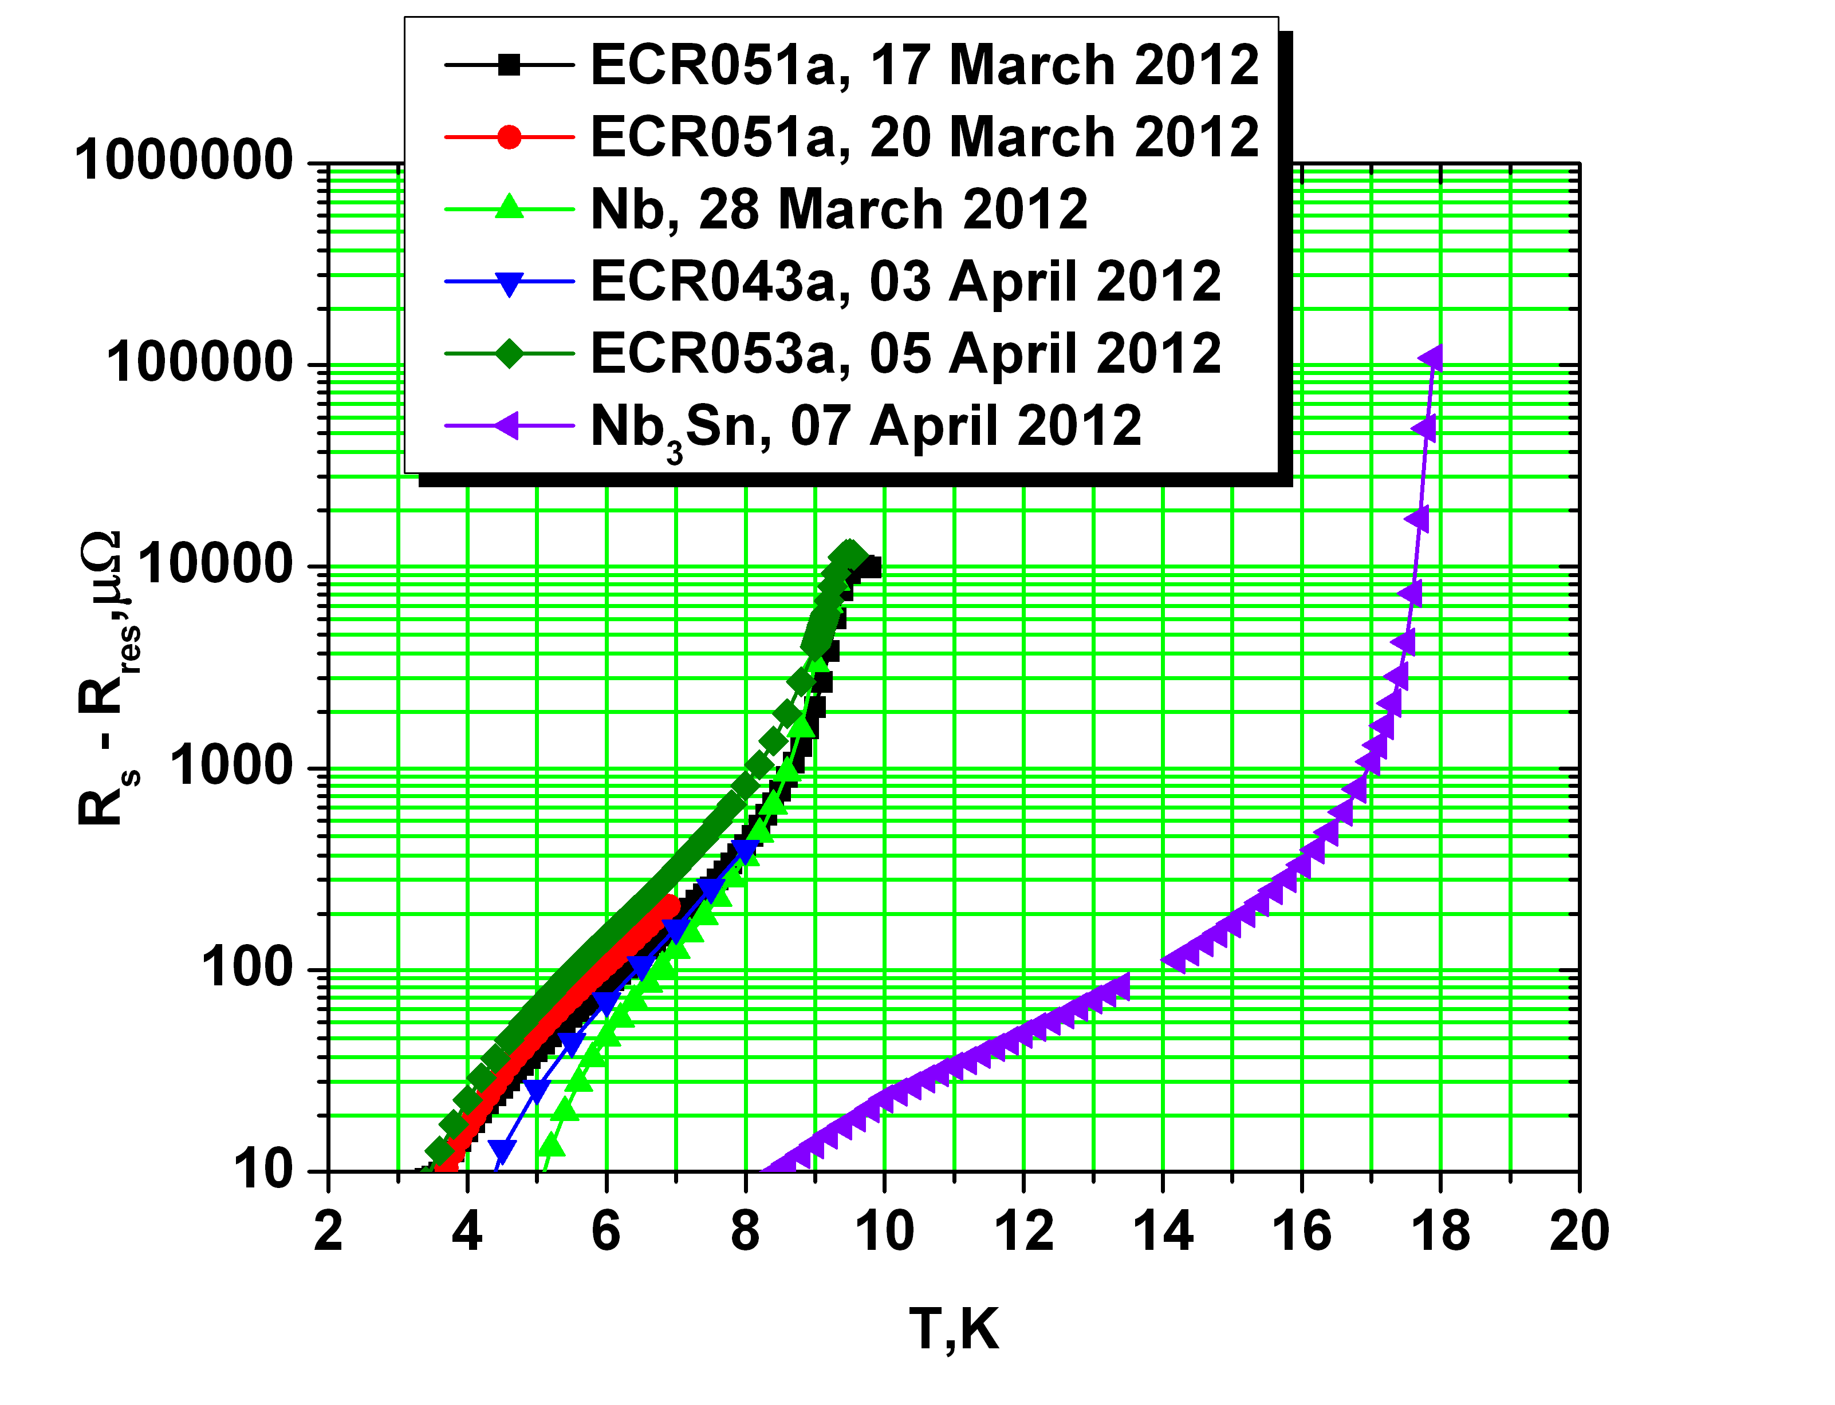
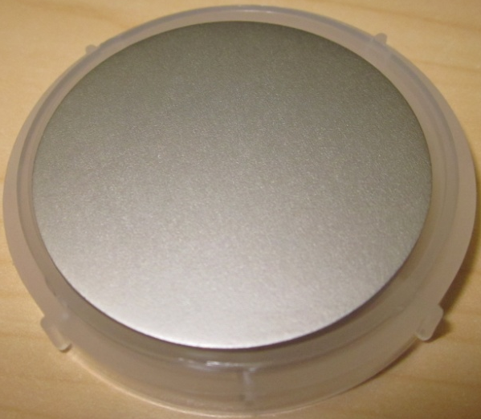

Sample Measurement at JLab
Recent measurements of surface resistance of several ECR films, bulk Nb sample, and Nb₃Sn sample as a function of temperature at 7.4 GHz. The samples exhibit high residual resistance at low temperature, which we believe is related to the measurement system and is extrinsic to the films.
Data from P. Dhakal
Transition temperature is ~ 17.85 K. The best of three samples shows very smooth surface with no residual tin contamination
Surface resistance of the films as a function of temperature at 7.4 GHz with the residual resistance subtracted.

Slide 9
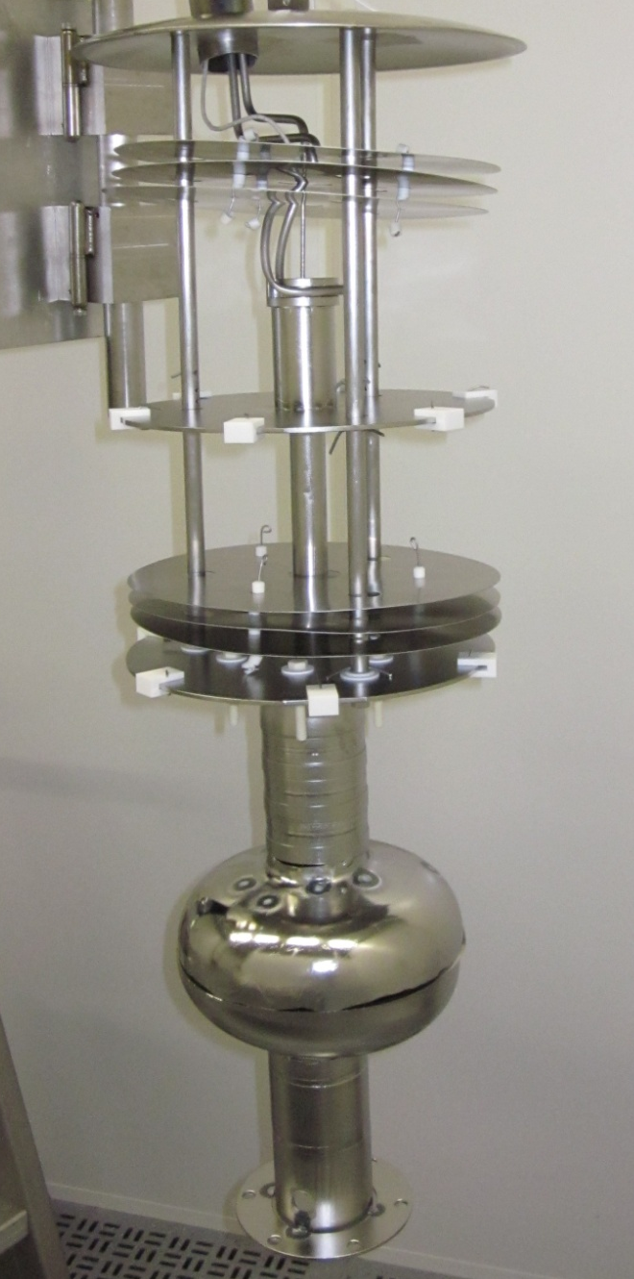
Jlab Nb₃Sn Vertical Chamber
Pump-out line
He gas cooling line for crucible
14’’ conflat mating flanges
Crucible thermocouple
Sn and SnCl₂ crucible
Nb heat shields
Nb cavity support plate
Sn vaporguide
Cavity flange support cylinder
Vapor guide support cylinder

Slide 10
Current Status at JLab
Preliminary studies with samples have been done.
The horizontal insert has been built and inserted in the furnace. The first furnace run is being done.
R&D furnace for Nb₃Sn development has been ordered in October 2012. It is expected to be delivered in August 2013.

Slide 11

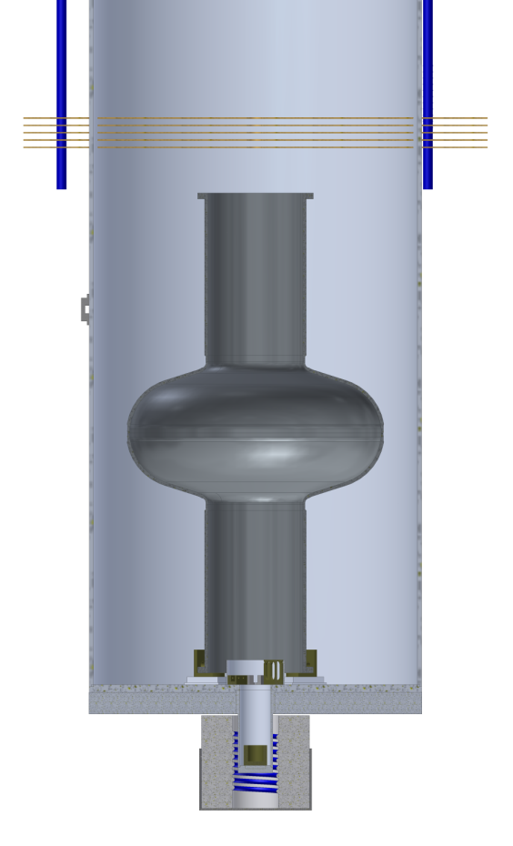
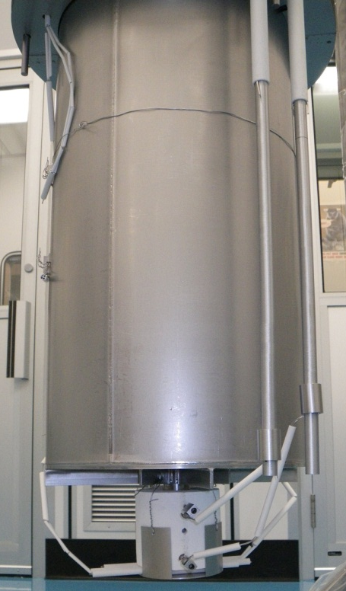
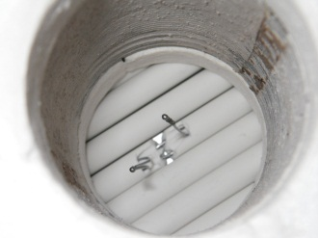
Cornell Cavity Coating Chamber
Flange to UHV furnace
Degas: 1 day
Nucleation: 5 hours
Coating: 3 hours
Surface diffusion: 0.5 hours
Copper transition weld from stainless to Nb
Cavity Temp Thermo-couples
Tungsten Supports
Heat Shields
Heater Temp Thermo-couples
Heater Power
UHV Furnace
Tin Heater
Tin Container

Slide 12
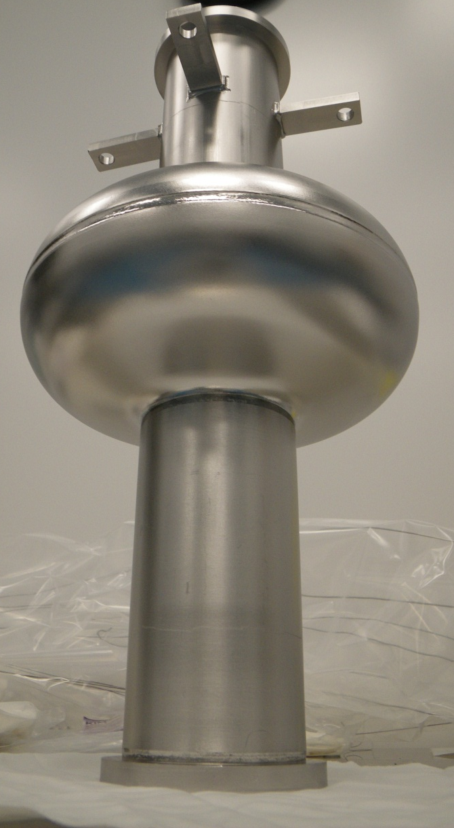
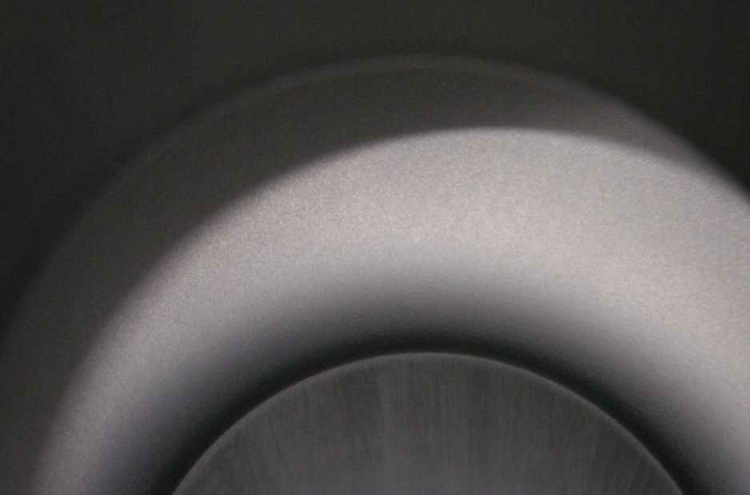
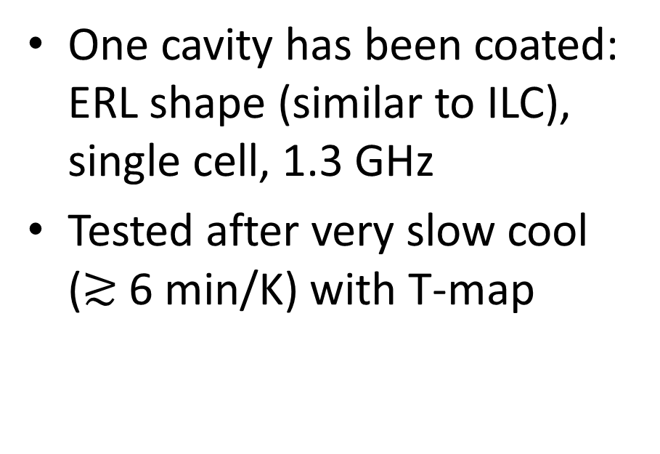
Cornell Cavity Testing
One cavity has been coated: ERL shape (similar to ILC), single cell, 1.3 GHz
Tested after very slow cool ($≳$6 min/K) with T-map
Looking down into cavity from above

Slide 13

Cornell Cavity Testing
Some very positive results:
  Very high T_{c}
  Reaches mid-field range without quenching
  4.2 K Q₀ is much higher than a similar Nb cavity
  Most of cavity shows little heating in T-map
Some problems to work on:
  Residual resistance higher than Wuppertal cavities
  Some bad spots on T-map
Standard Nb cavity
Nb₃Sn-coated

Slide 14
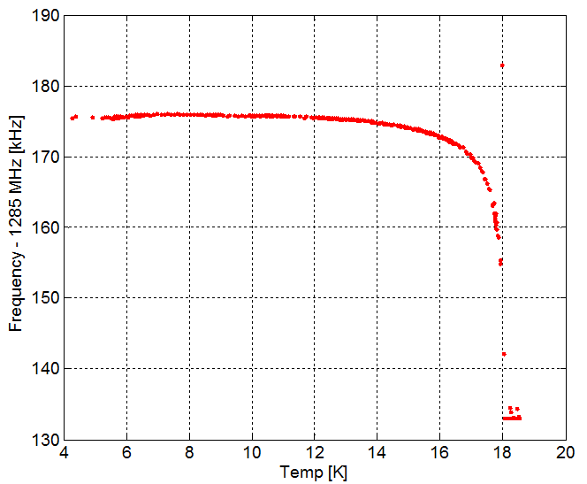
f vs T
Network analyzer used to follow resonance during cooldown
Temperature given by 3 cernox sensors over cavity surface (close agreement between sensors)
No observed freq shift near Nb T_{c}! (shielding is good)
Very high T_{C}, close to 18.0 K!

Slide 15
Q vs E
Indication of residual resistance: T-maps on next slide show heating pattern
Similar Q-slope is observed, so we can begin to investigate its origin!
Strong improvement compared to Nb in 4.2 K Q₀ (Nb ~3-5x10⁸)

Slide 16
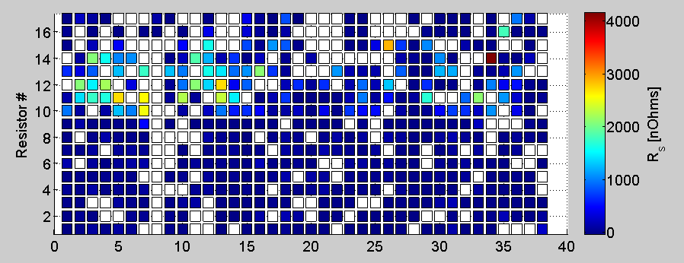
T-maps
Q -> 1x10⁸
Q -> 3x10⁸
Q -> 1x10⁹
Cavity at 2.0 K, 9 MV/m, Q = 1.4x10⁹
White indicates bad channel or R_{s} very close to 0
Tmap indicates bad spots with very large R_{s}

Slide 17
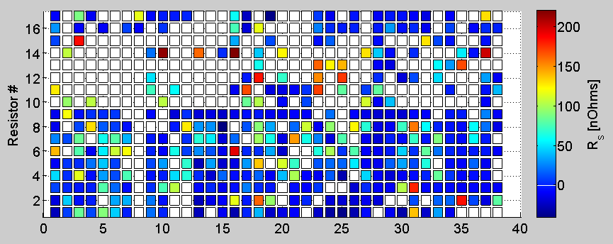
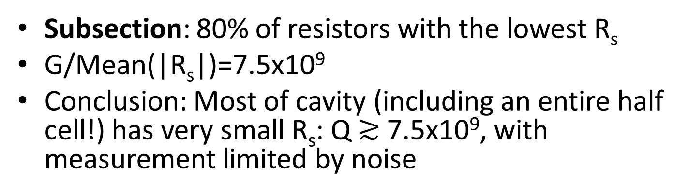
T-maps
Ignored sensors with R_{s} above ~220 nΩ (20% of sensors)
Q -> 3x10⁹
Q -> 7.5x10⁹
Q -> 1x10¹⁰
Subsection: 80% of resistors with the lowest R_{s}
G/Mean(|R_{s}|)=7.5x10⁹
Conclusion: Most of cavity (including an entire half cell!) has very small R_{s}: Q $≳$7.5x10⁹, with measurement limited by noise

Slide 18
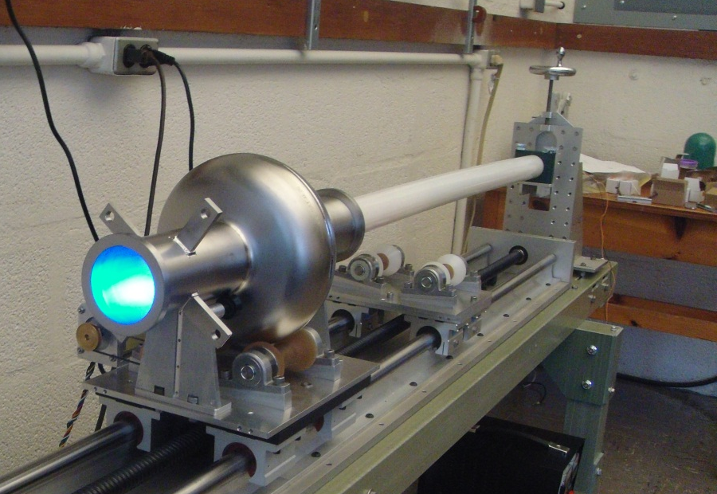
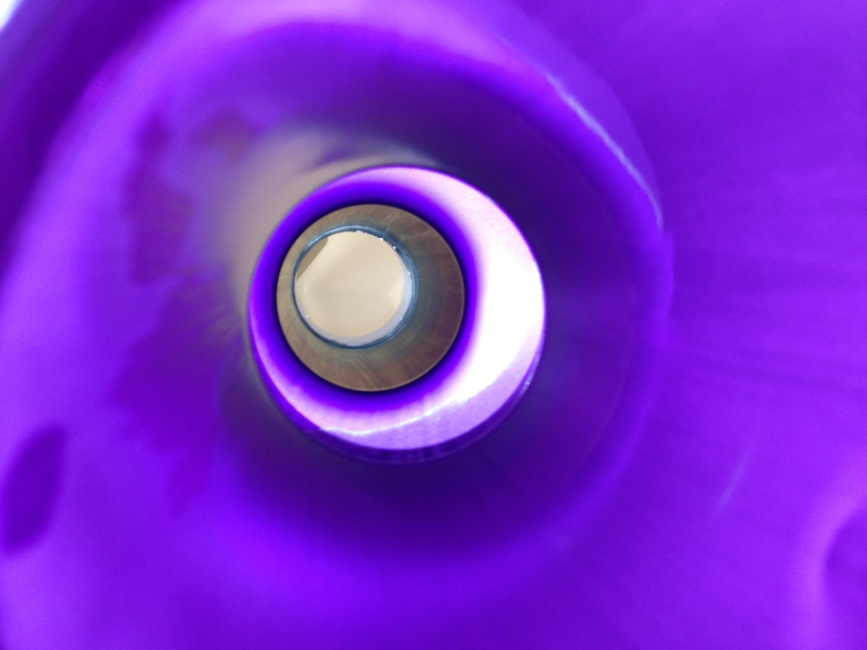
Bad Spots
Performed a series of vertical tests:
  Orientation during cooling does not seem to affect location of bad spots
  2x HF rinse does not affect Q significantly, 2x oxipolishing reduces Q significantly, bad area remains bad

Slide 19
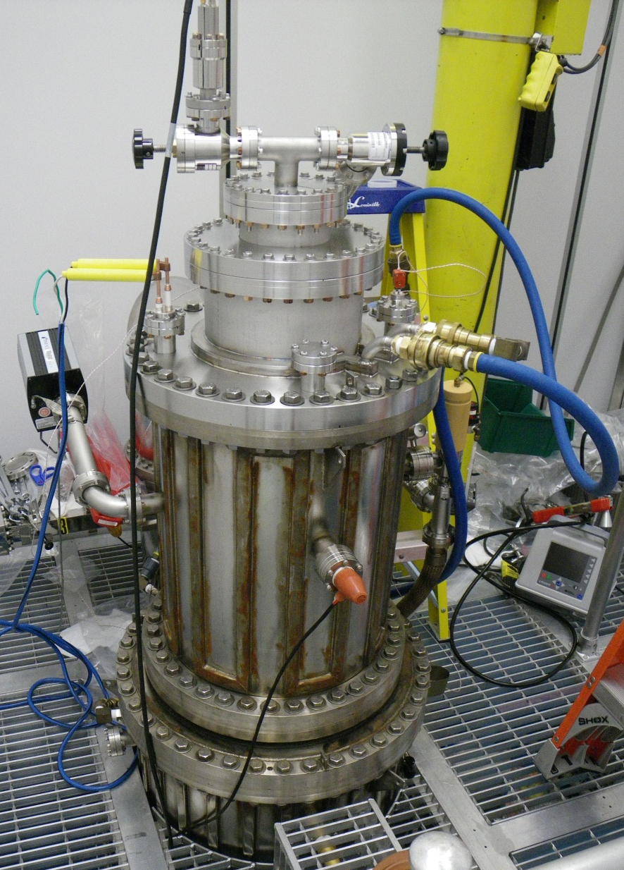
Bad Spots
Performed a second coating cycle (following BCP to reset surface):
  Orientation during coating does not seem to affect the half cell in which bad spots appear
Overall indication: problem with Nb substrate surface?

Slide 20
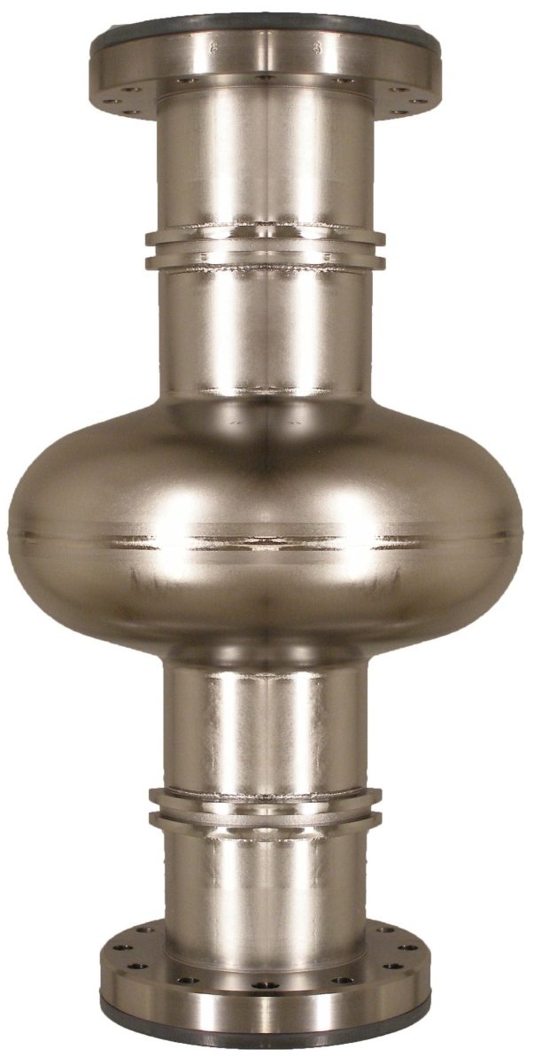
Summary and Outlook
Coating cavities with Nb₃Sn may allow for higher gradients, and therefore shorter linacs
Cornell has developed repeatable fabrication of high quality Nb₃Sn surfaces on samples
Great promise in results of first coated cavity
Already with our first cavity we have an opportunity to study the origin of the Q-slope associated with Nb₃Sn cavities!
High residual resistance in bad spots may be result of problems with Nb cavity substrate
Next: Study Q-slope in first cavity, coat a second cavity

Slide 21
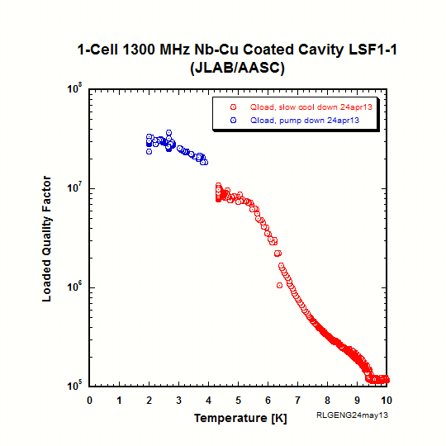
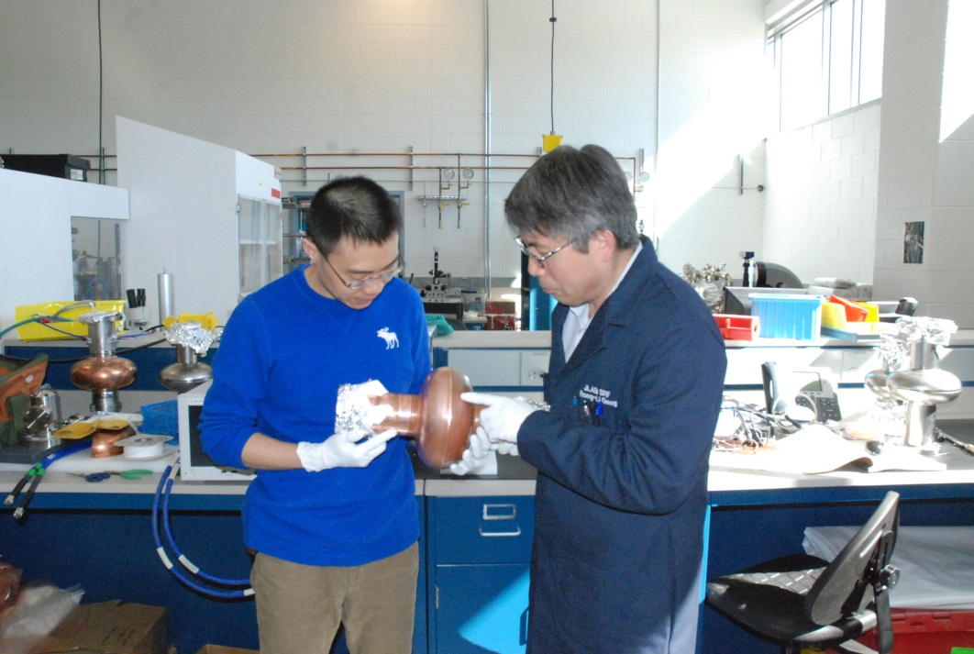
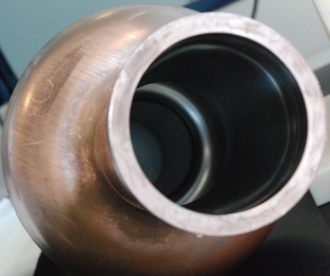
Coated Nb-Cu Cavity
Development at JLab
Motivation: Ultimately coated cavity. Near term applications to end groups for cost saving
Cu cavity fabrication at Jlab
  LSF shape
  Mirror-finish surface
Coating at AASC
  Energetic condensation via CED
Processing and cryogenic RF testing at Jlab
  1st result excellent SC transition
  But high R_{res} – source being studied

Slide 22
Acknowledgements
Special thanks to:
  Grigory Eremeev and Rongli Geng, for slides on JLab progress
  Mick Thomas, for SEM and FIB
  Dan Gonnella, for T-map development and assistance with cavity preparation
  Nick Valles, for Matlab development and development of Q vs T technique
  The organizing committee, for inviting me
Thanks for listening!

