Slide 1
ILD Optimization
Why – when – what
Ties Behnke, DESY
Henri Videau, LLR

Slide 2
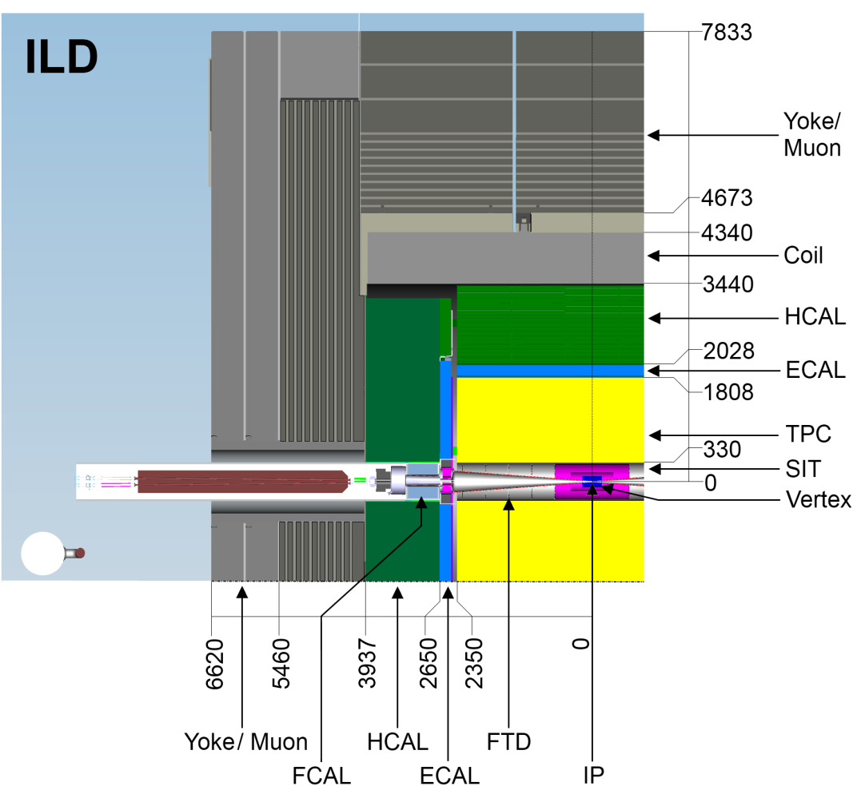
The current ILD concept
Started as a combination of
GLD and LDC in 2007
(LCWS 2007 at DESY)
Some detailed optimization work
done, but main parameter
choices were “ad hoc” (politics)
as much as physics driven
Now is the time to re-open
the box and look at all
choices:
There are no forbidden areas
There are no prejudices

Slide 3
The forbidden thoughts?
ILD fundamental design philosophy:
granular imaging detector, optimized for particle flow
large volume TPC in the center, supplemented by Silicon
ultimate performance ECAL and HCAL all inside the coil
I believe the concept is still sound, but we need to be prepared to answer:
All Silicon tracking?
Other technologies but TPC or Silicon in the central region?
How should particle flow calorimetry for a Higgs factory look like?
We need to be open: have good answers or study alternatives seriously

Slide 4
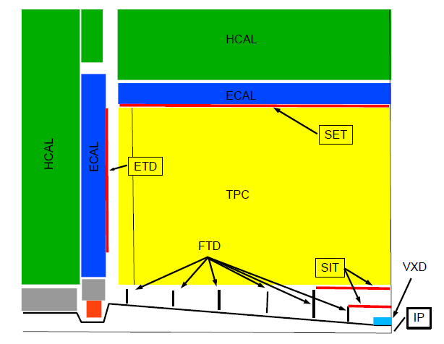
The inner system
Do we understand our performance requirements?
VTX detector
Silicon tracking?
Readout speed might be an important
variable to control background and
complexity:
Are the ambitious enough in ILD in this
respect?
Do we understand / do we have a proper
design of the beamtube etc?
We propose a big Silicon system for ILD:
are we sure of its parameters?
What about the outer Silicon system?
How much of this is baseline?
Design of the VTX detector
Role and merrit of double layer
Alternative geometries?

Slide 5
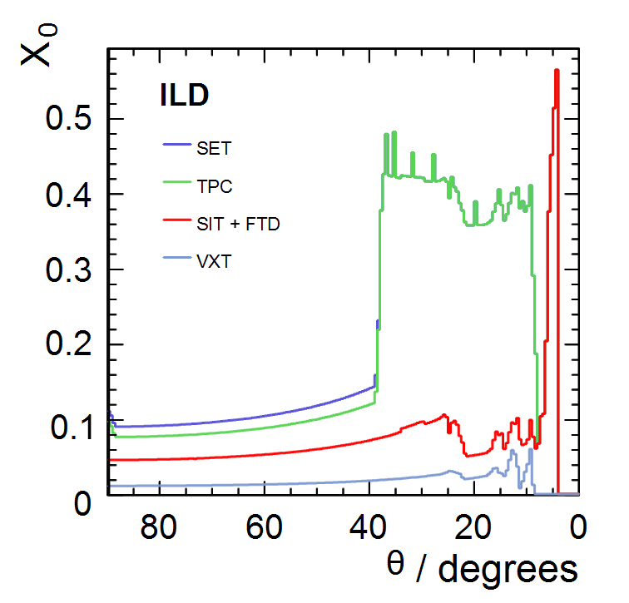
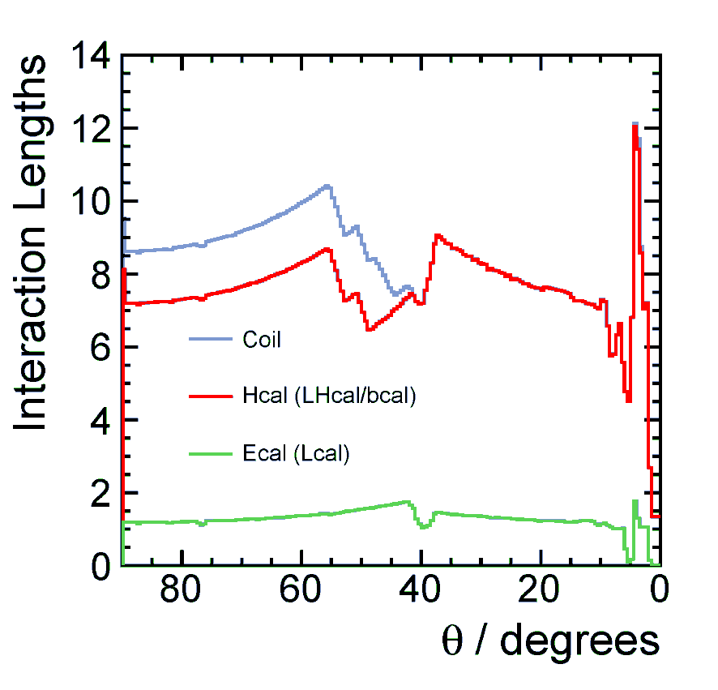
Material
Material issues System thickness
Silicon tracker - ECAL/ HCAL thickness
TPC tracker - choice of material?

Slide 6
Tracking System
Overall system optimization:
Aspect ratio
Outer radius
Role of Silicon
Role of material e.g. in the
TPC system
We should ask fundamental questions
But we should also not forget
about the constraints from real
life: engineering needs to be
factored in at the right level.

Slide 7
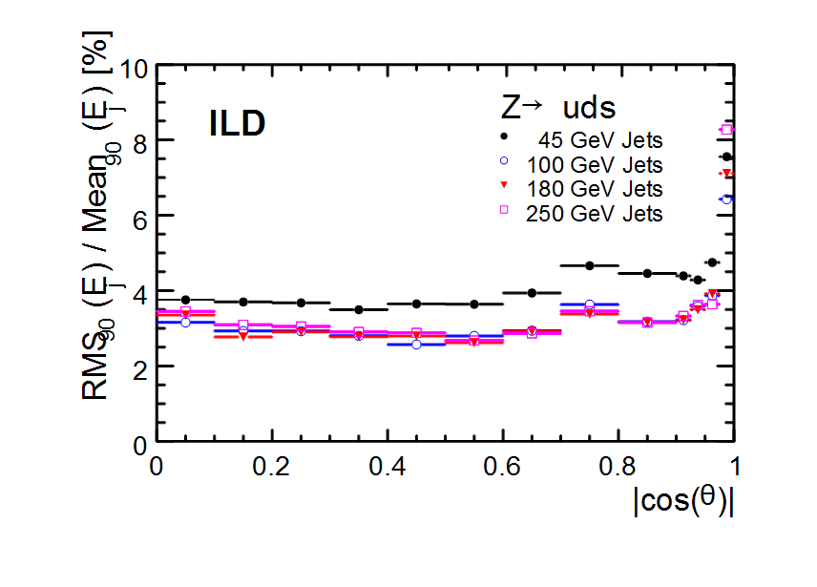
Pflow as a driving force
Pflow has been at the
core of the definition of
ILD
Size
Calorimeter performance
Tracking performance

Slide 8
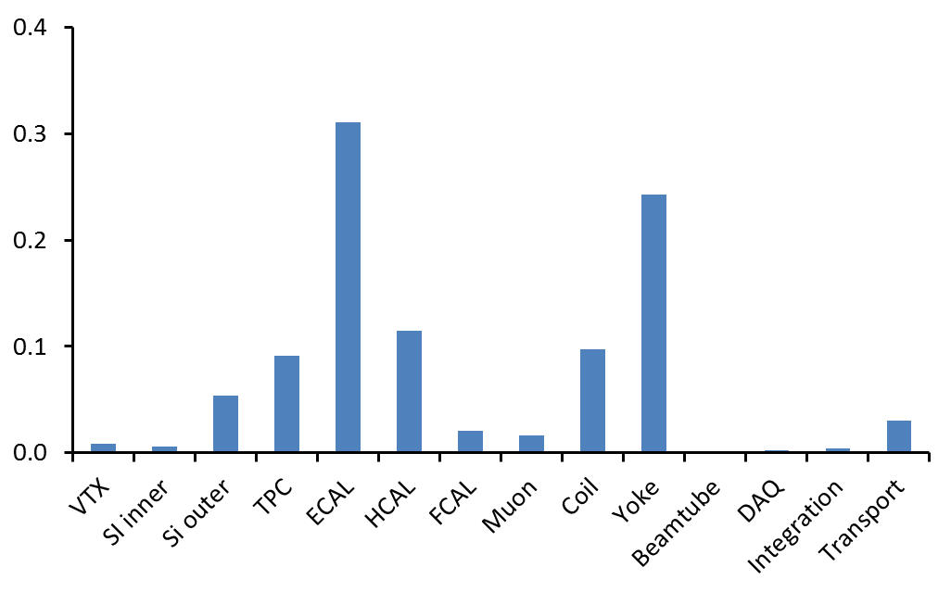
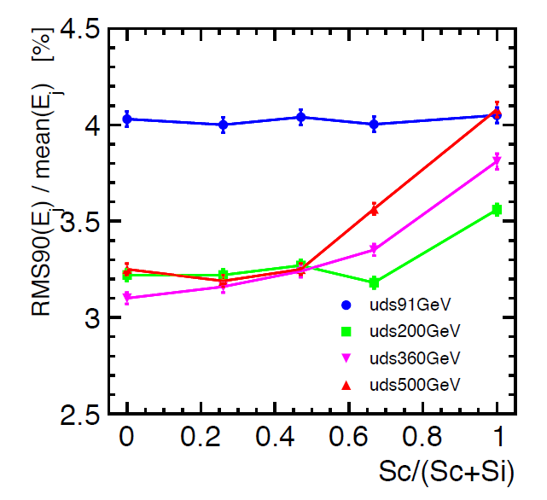
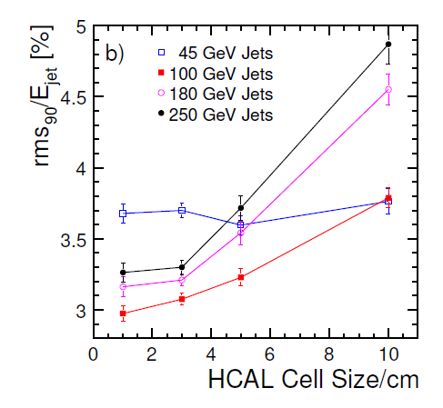
Imaging Calorimeter
Calorimetry is clearly a main part of ILD
Can we make our calorimeter cheaper?
Can we make the step from ECAL to HCAL less severe?
Can we find an intelligent way to stage the system?
Si for the ECAL is a very attractive, but also
very expensive option

Slide 9
Overall Detector size
Outer radius of Yoke:
Defined from push-pull
condition on field < 50 mG
Is this the correct requirement
Changing this will have a hige impact
on size (and cotst)

Slide 10
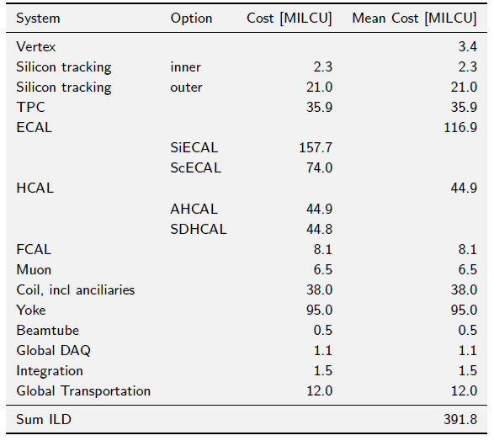
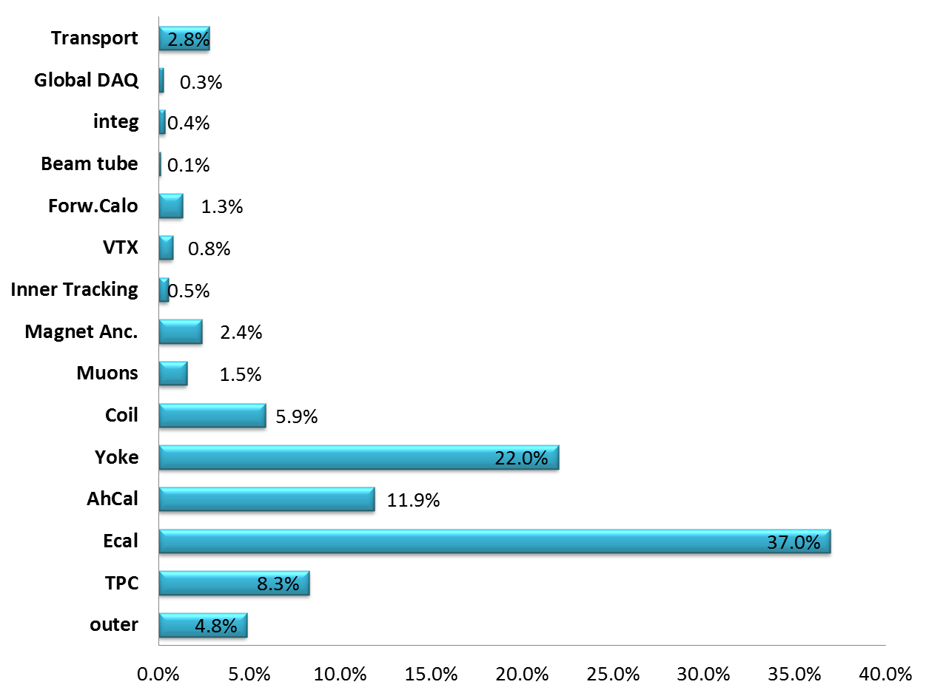
Costs
Costing exercise as part of DBD
Needs significant more work
and checking, but main
messages are clear.

Slide 11
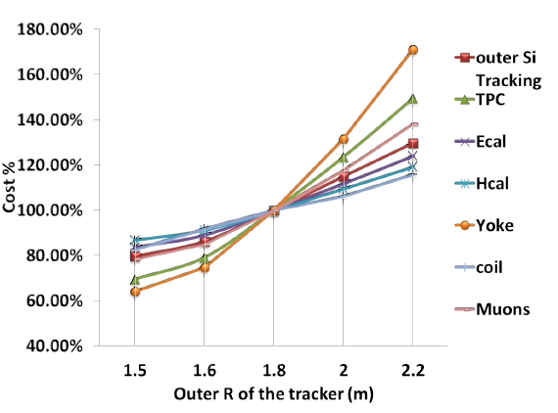
ILD size? Cost?
Cost scaling law with
different systems radius
Potentially large impact
on the cost
Careful optimization
of cost –performance
benefit is needed

Slide 12
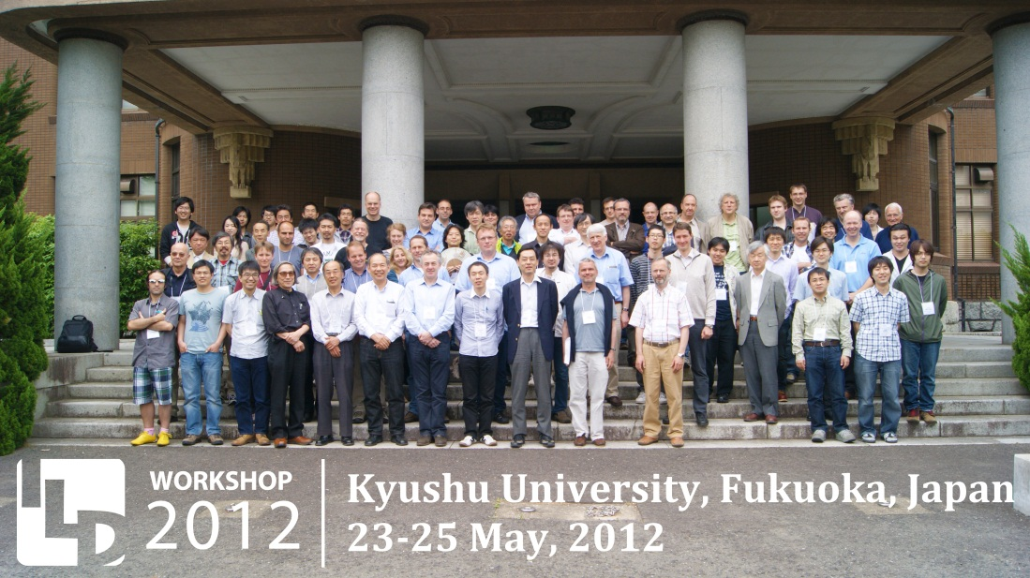
Procedure
We should approach a re-optimization in an open way, without excluding
anything
We need to do this in a structured way, systematically
We need to make sure that this does not interfere with our drive to
prepare a construction ready project
We probably should include some “review” mechanism to get external
input into this question.
  See also the discussion session after coffee break as an opportunity
  to discuss structures and organizational issues.

