Slide 1
Electron Cloud Instabilities at CESRTA
Michael Billing
for the CESRTA Collaboration
LCWS13
May 28, 2013

Slide 2
Overview
EC Dynamics Instrumentation
Two Sets of Experiments
Effects Visible with Trains Having Different Spacings for the Bunches
Investigation of the Vertical Enlargement of the First Bunch in the Train

Slide 3
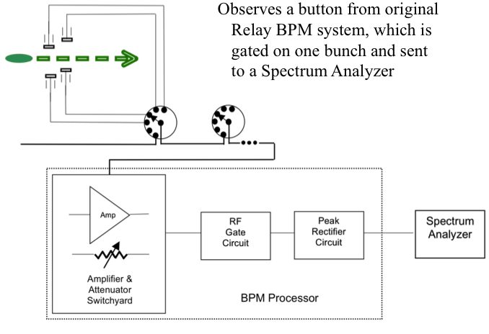
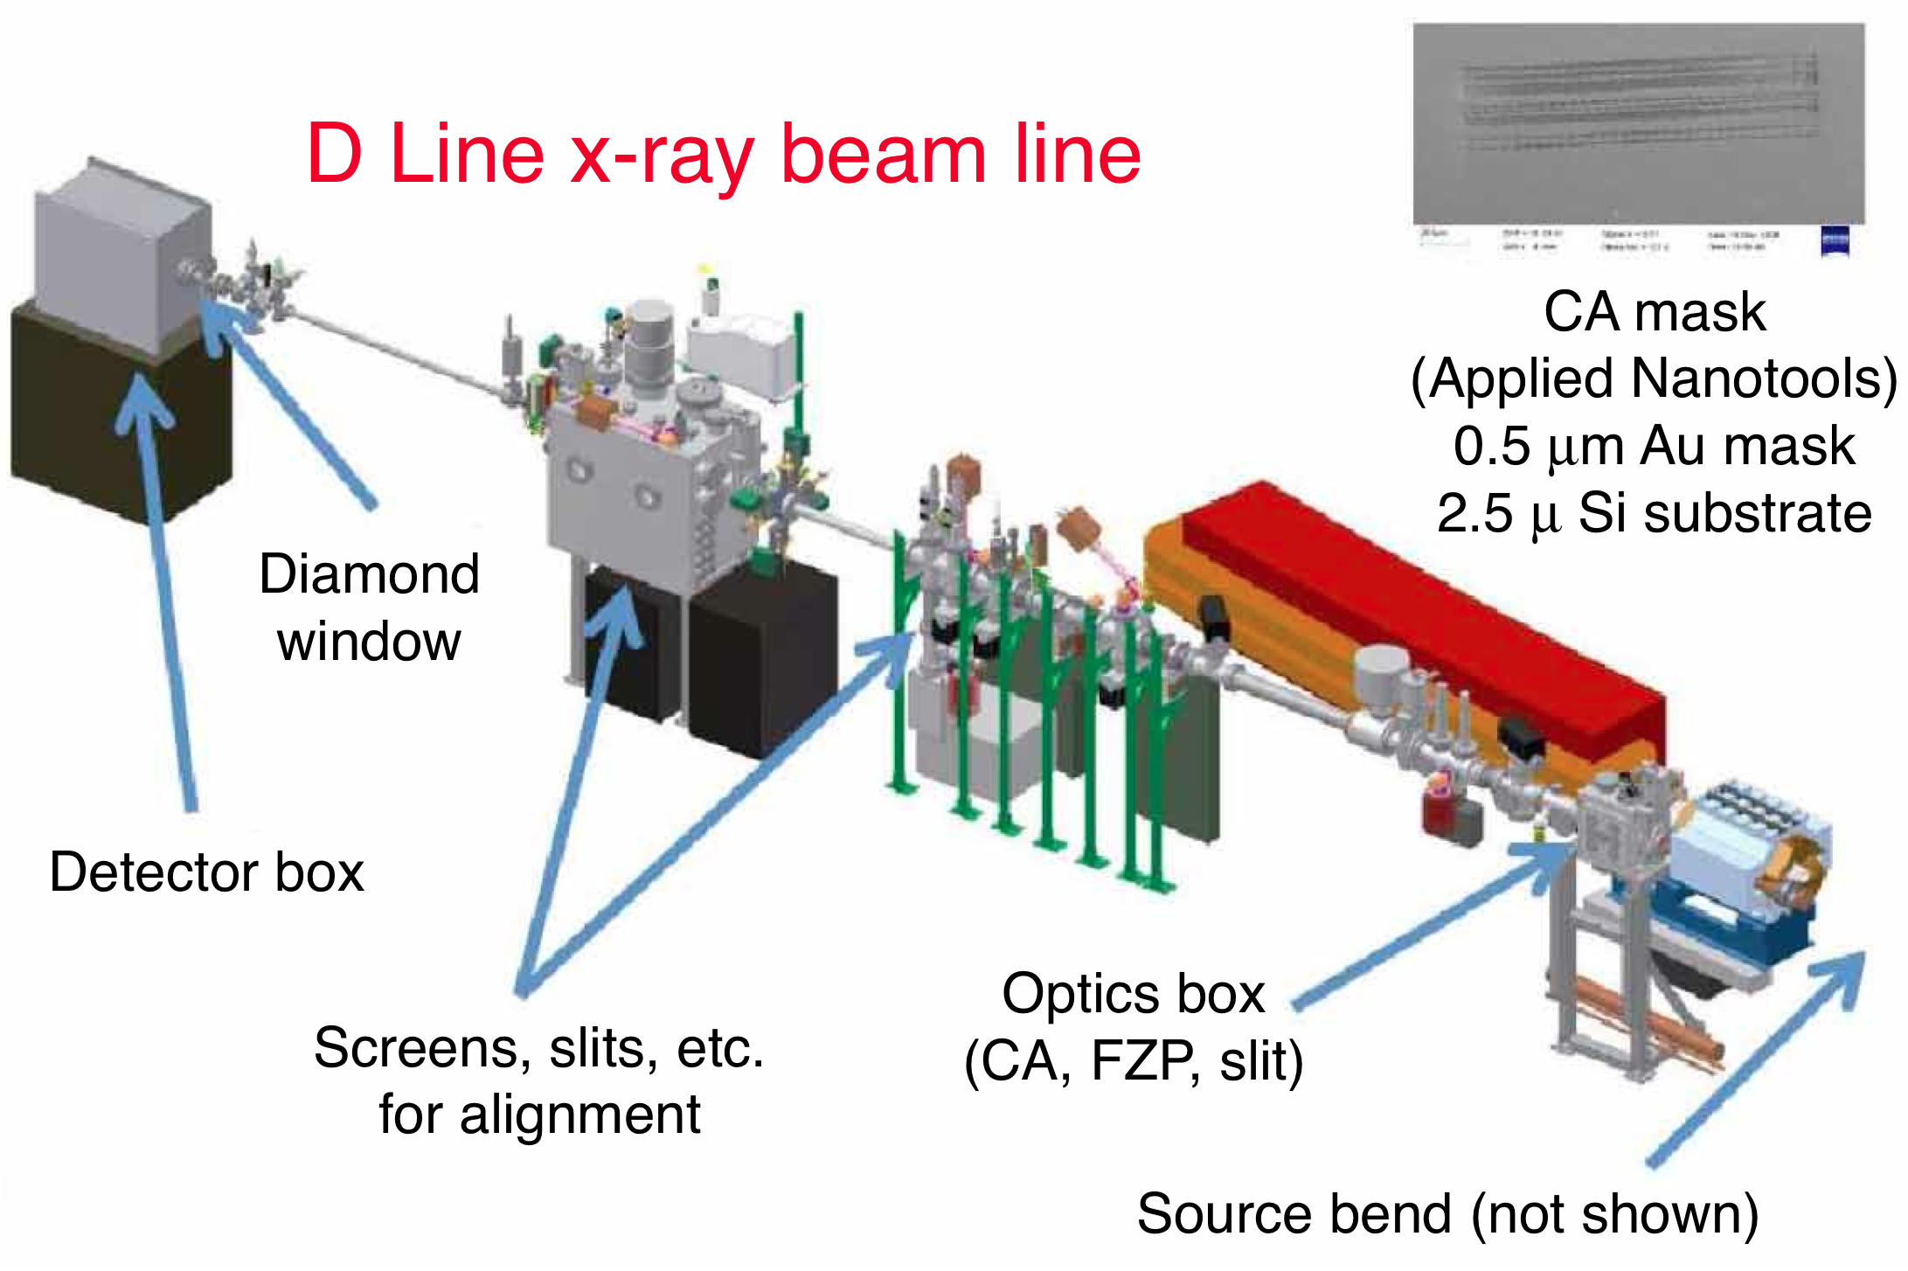
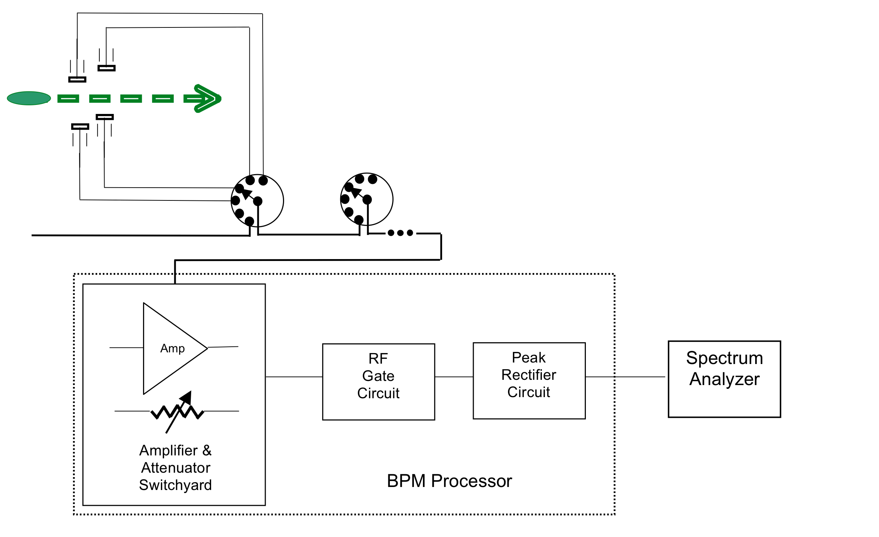
Instrumentation at CESRTA
  Position spectrum of individual
  bunches within train
    Single button of a BPM
    Gate the signal to accept
    only 1 bunch
    Send to spectrum analyzer & detect:
      H & V dipole (m=0) betatron
      modes at frequencies F_{h} and F_{v}
      Vert head-tail (m=±1) lines at F_{v}±F_{s} (F_{s} is the synchrotron tune)
      Horz head-tail modes (m=±1) lines
      at F_{h}±F_{s}
  X-ray beam size monitors
  (xBSMs) for e+/e- beams
    Linear, Vert 32-pixel arrays:
    bunch-by-bunch & turn-by-turn
    Removes dipole motion before fitting
    vertical beam size σ_{V} of each bunch.
BPM Hardware for Coherent Mode Measurements for Bunches Within the Train
Observes a button from original
Relay BPM system, which is
gated on one bunch and sent
to a Spectrum Analyzer

Slide 4
A. Trains with Different Bunch Spacings
Experimental Goals
  Measure the coherent mode growth rates for the most unstable bunches in the train
    For vertical Dipole modes
    For vertical Head-tail modes
    Measured by comparing the peak coherent oscillation amplitudes vs. Vertical Chromaticity
  Measure with different bunch spacings
  Calibrate coherent damping rates vs. Vertical Chromaticity

Slide 5
Conditions & Analysis of e+ Stability Data
Conditions
  30 Bunch Positron Trains
  Bunch Spacings: 4, 8, 12, 14, 16, 20, 24, 28, 36, 42 and 56 nsec
  Bunch current (nominal) I_{b} = 0.75 mA (1.2x10¹⁰)
Analysis utilizes
  Xquneing-to-Chromaticity calibration data (MGB)
  Drive-damp measurements for Vert m=0, ±1 modes for a single bunch ==> fitted damping rate:
  where α_{SR} = SR damping rate,
  & Q’ = chromaticity
  Spectral amplitudes for Vert m=0, ±1 modes for each bunch (RLH)

Slide 6
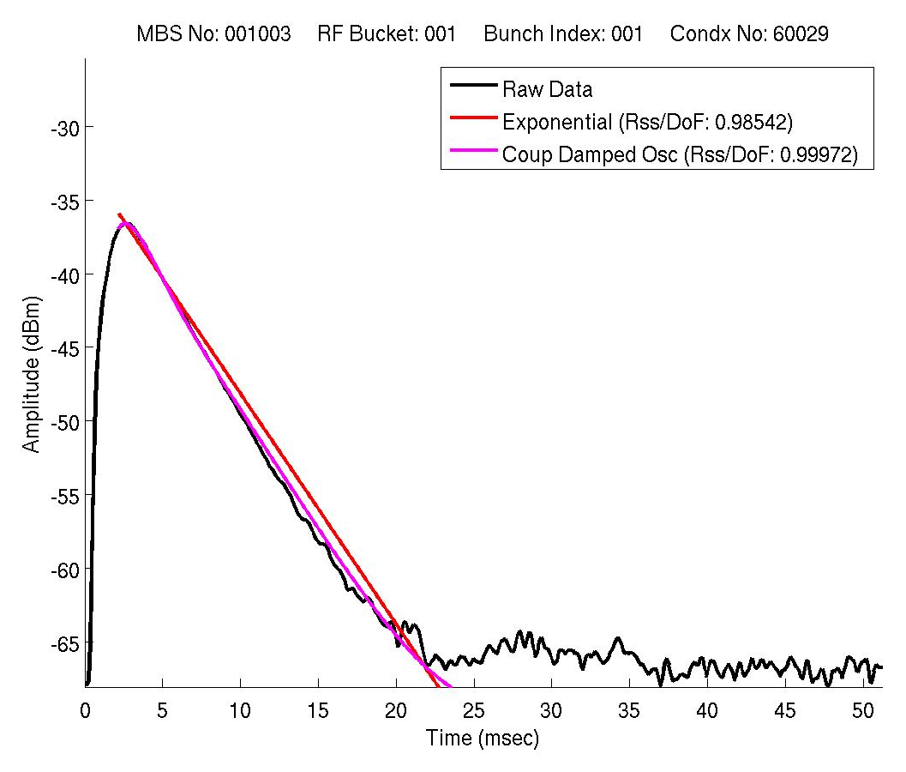
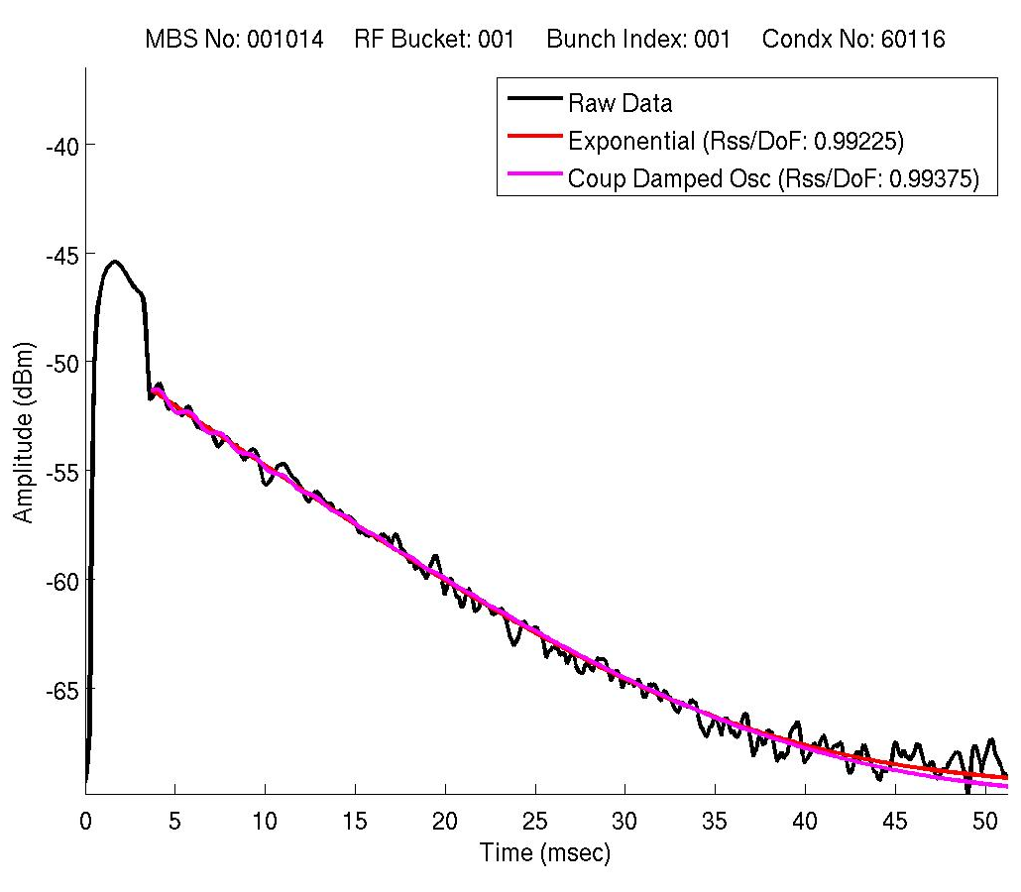
Items 1) & 2)
Xquneing-to-Chromaticity calibration data
from control settings vs. chromaticity measurements
Drive-damp measurements for
Vert m=0, ±1 modes for 1 bunch
m = 0
m = +1

Slide 7
Experimental Plan
Instrumentation & Results
  Gated BPM signal routed to spectrum analyzer
  Spectrum contains
    Horizontal and vertical dipole (D) (m=0) betatron modes at frequencies Fh and Fv
    Vertical head-tail (HT) (m=±1) lines at Fv±Fs
    (Fs is the synchrotron tune)
    Horizontal HT lines (ocassionally.)
  Over some range of vertical chromaticity settings
    Amplitudes of the D and HT lines will decrease as the chromaticity increases.
    By interpolating within sets of measurements at different chromaticities we arrive at the same spectral D and HT mode amplitudes for the most unstable bunches.

Slide 8
Experimental Procedures
Select a spacing of bunches
  Fill 30 bunches to 0.75 mA (1.2x10¹⁰ particles.)
  Vary chromaticity while observing amplitude of at least one of the HT modes for bunch 25 to determine a reasonable range for the chromaticity settings.
For each chromaticity & bunch spacing
  Set the chromaticity within this range.
  Top-off beam and take
    Spectra for five of the bunches (one at a time)
    Turn-by-turn vertical beam size data for each bunch
  Iterate last step until all bunches are measured

Slide 9
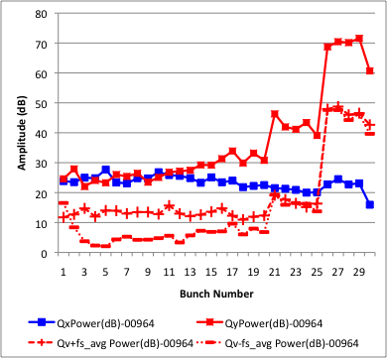
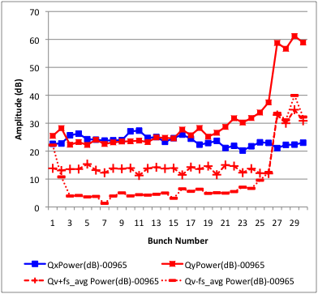
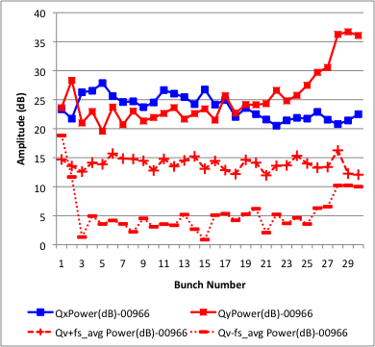
3) Analysis of Bunch-by-bunch Spectra
Fit spectral peaks in dB to gaussians for each Q_{v}’
Plots of spectral
amplitudes vs. bunch
number for 8 nsec spacing
(N.b. bunch 1 blow up)
Medium Q_{v}’
Topped off
High Q_{v}’
Low Q_{v}’

Slide 10
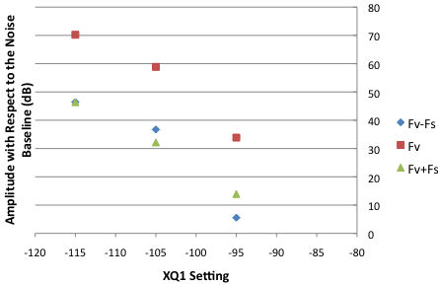
Analysis of Bunch-by-bunch Spectra
Determine “Typical” Max Coherent Oscillation Amplitude (m=0, ±1) for each XQ1 & Spacing:
Average amplitude
for all bunches with amplitudes within
NN dB of max
amplitude (e.g.
5 dB).
Fit the 3 points
(dB, XQ1) to line
(for quadratic fit of
the data – can give
unreasonable fits)
Select a Reference Amplitude for each mode (m=0,±1)
Interpolate (usually) to find XQ1 value to match
8 nsec-spaced bunches

Slide 11
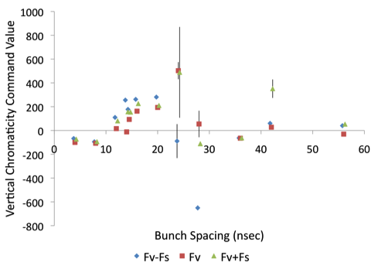
Analysis of Bunch-by-bunch Spectra
5. Vary the range of amplitudes used for finding the Average Unstable Amplitude – Don’t assume we know correct value for NN dB
  Step the value of ΔA = NN dB in 0.5 dB steps
  Span the range of 2 dB ≤ NN ≤ 6 dB
  Fit Amplitude (dB) vs Chromaticity command for each step
  Find Chromaticity command for Reference Level in each step
6. Compute from each set:
Chromaticity Command
  For each Coherent Mode
  and each Bunch Spacing
  Average Chromaticity
  Command & Standard
  Deviation

Slide 12
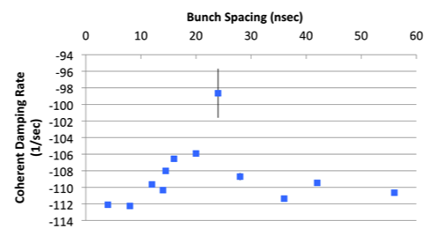
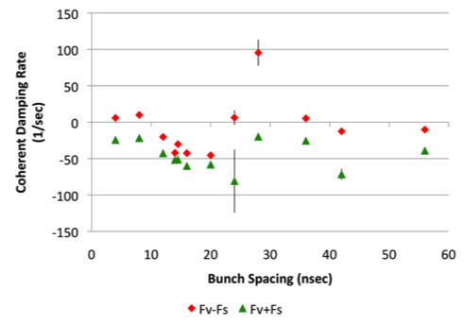
Plots of α vs. Bunch Spacing
Transform XQ1 to Damping Rate, α, & plot results
Dipole Mode Head-Tail Modes
Radiation damping for Vertical Dipole Mode (m=0) is -17.7 sec⁻¹
Conclusions: Trend for Coherent motion with Increase in Bunch Spacing:
1) Dipole mode essentially constant
2) HT modes less stable (40-50 sec⁻¹) centered around 16-20 nsec-spacing

Slide 13
Conclusions from Bunch Spacing Studies
Dipole Mode Damping Rates
  Deviation is small (approximately 6 sec⁻¹ or less than 50% of the radiation damping rate) & in the direction to slightly increase the damping of the dipole coherent motion for bunch spacings between 8 and 28 ns
  H-T Modes Damping Rates
  For bunch spacings between 8 and 28 ns
    Deviation from constant damping rate is much more pronounced yielding between 40 and 50 sec⁻¹ of growth rate between 8 and 28 ns bunch spacings.
    Since the larger amplitudes typically occur for the later bunches, this implies that the HT modes are less stable for the later bunches within trains at these spacings

Slide 14
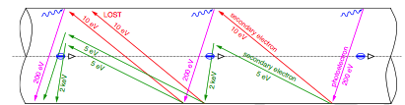
Possible Mechanism
Multipacting Resonance in the Dipoles
  EC accelerated by bunch: Δt₁ is quite short
  SEY gives low energy e-, which drift back to beam:
  Δt₂ is approx. 60 nsec
    If bunches are spaced at approx. 30 nsec, then every second bunch could resonantly enhance the EC produced
Δt₂
Δt₁
Resonance Process

Slide 15
B. Enlargement of Lead Bunch in Trains
Experimental Goals
  Explore Conditions when Vertical Size of the lead bunch is increased – Three sets of experiments:
    Vary spacing between Bunches
    Bunch Trailing the train
    Precursor bunch in front of the train
    Different train Lengths at fixed train Current

Slide 16
Recap of Early Observations
CESR Conditions
  2.1 GeV
  Trains containing 30 or 45 bunches
  3.6x10¹¹ positrons or electrons in the train
  Bunch-spacings: 4 or 14 ns

Slide 17
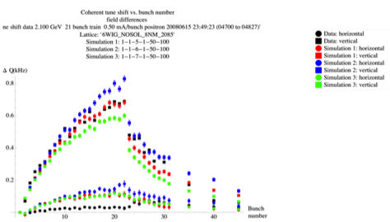
Earlier Observations
  EC in positron trains causes
    Growth of coherent oscillations along the train
    Enlargement of vertical beam size in later bunches in trains
    Tune shift from the EC grows in magnitude along the train and then falls ~200 ns after the end of the train
    Tune shift indicates EC similarly grows and then dissipates as the train passed
    EC buildup in Al
    vacuum chamber
    in dipoles
    – agrees with
    POSINST
    simulations
Vertical Tune Shift
Horizontal Tune Shift
Train
Witness
Bunches
June 2008 positron data,
21 bunch train, 14 ns spacing,
0.8x10¹⁰/bunch
Peak SEY scan

Slide 18
Earlier Observations
Observations
  Surprising Phenomenon
    Observed for positrons and not for electrons
    For the First Bunch & possibly the Second Bunch in the Train: Enlargement of its vertical beam size and presence of the (m=-1) coherent head-tail mode.
    2 μs gap between the last bunch in the train & first bunch
      Unlikely dipoles or drifts are trapping the EC for 2 μs in CESR.
      RFA measurements and POSINST simulations hint at 2 possibilities: Trapped EC in quadrupole and wiggler magnets
    A “precursor” bunch of same charge as other bunches within train and placed 162 ns before train will completely counteract vertical blowup of first bunch(es).

Slide 19
Earlier Observations
Observations
  Summarizing: These observations caused us to consider the source of the first bunch blowup
  for Positrons and NOT Electrons
    Long-lived EC effect
    Rather than effects such as
      Impedance/wake-fields
      Beam loading
      Malfunction of the bunch-by-bunch beam-stabilizing feedback systems

Slide 20
Beam Configuration for Present Observations
Typical CESR parameters
  2.1 GeV
  30 bunches each of 1.2x10¹⁰ particles
  Vary following parameters
    V chromaticity
    Spacing between bunches

Slide 21
Measurement Plans
For these experiments
  Focus on σ_{v} of first bunch
  Performed different sets of measurements:
    Different spacing of bunches
      4, 8, 12, 14, 16, 20, 24, 28, 36, 42 and 56 nsec
    Add precursor or trailing bunch: only took BPM spectra for the first 5 bunches in the train & added bunch
      4 nsec-spaced bunches
      8 nsec-spaced bunches
      12 nsec-spaced bunches
    Increased the number of bunches within the train, while holding the total beam current constant.

Slide 22
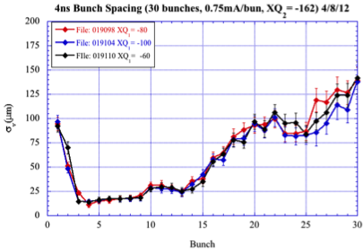
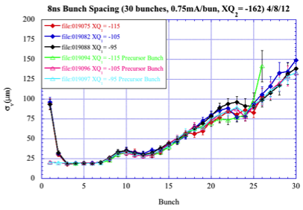
Observations 1
Vary Spacing Between Bunches in the Train
  Spacing between bunches: Vertical Chromaticity
  4, 8, 12, 14, 16, 20, 24 & 28 ns Low / Medium / High
  Bunch in train: 1.2x10¹⁰
  General Conclusions
    Enlargement of σ_{V} of first bunch only occurs for spacings of 4, 8, 12 and under some circumstance 14 ns.
4 nsec
8 nsec
Precursor Bunch at 162 nsec

Slide 23
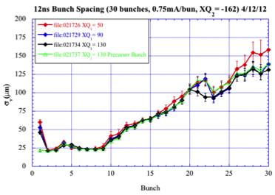
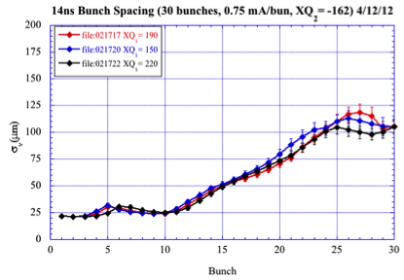
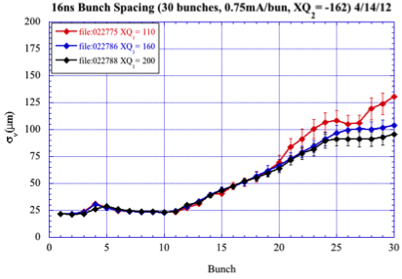
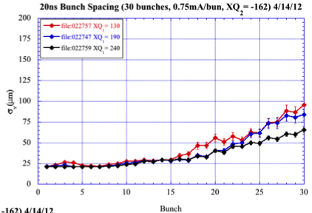
Observations 1
Vary Spacing Between Bunches in the Train
12 nsec
14 nsec
Precursor Bunch at 162 nsec
16 nsec
20 nsec

Slide 24
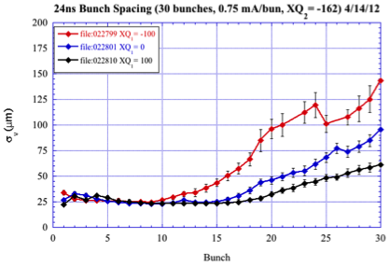
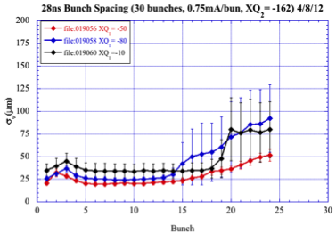
Observations 1
Vary Spacing Between Bunches in the Train
(All above plots are shown for three different value of Vertical Chromaticity)
24 nsec
28 nsec

Slide 25
Observations 2
Studies with Trailing Bunches
  30 bunch-long, 4 ns-spacing of bunches (1.2x10¹⁰)
  Add single trailing bunch delayed from end of train
Delay from End of Train (in nsec) | Number of Particles in Added Bunch | Relative Magnitude of σ_{V} for First Bunch | Relative Amplitude of Fv-Fs HT Mode for First Bunch | Relative Magnitude of σ_{V} for Added Bunch
16-28 nsec | 1.2x10¹⁰ | Large | Large | Large
36-240 nsec | 1.2x10¹⁰ | Not Enlarged | Not Enlarged | Less Large to Not Enlarged
Approx. 32 nsec | 1.2x10¹⁰ | Sometimes Large | Sometimes Large | Large
24 nsec | Between 1.6x10¹⁰ and 2.4x10¹⁰ | Becomes Not Enlarged | Becomes Not Enlarged | Large
40 nsec | Between 8.0x10⁹ and 4.0x10⁹ | Becomes Large | Becomes Large | Large

Slide 26
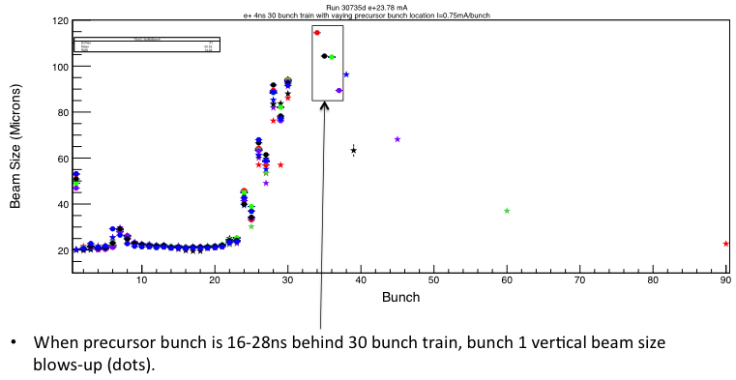
Observation of σ_{V}
Studies with Trailing Bunches
  4 ns-spaced bunches in train
  σ_{V} for each condition is plotted below with different color
  – easy to tell by color of the Trailing Bunch
Trailing Bunch

Slide 27
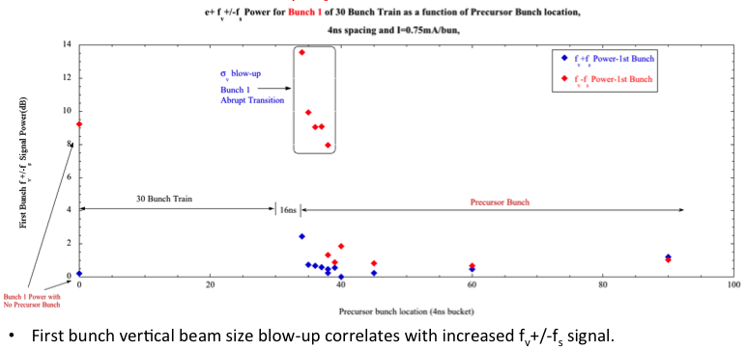
Observations of Amplitude of Head-Tail Modes
Studies with Trailing Bunches
  4 ns-spaced bunches in train
  aabs
  First Bunch has Fv-Fs Head-Tail Coherent Oscillations, which decrease as the delay of Trailing Bunch increases
  This correlates with enlargement of σ_{V} for First Bunch
Relative Amplitudes of Head-Tail Modes (Fv – Fs) & (Fv + Fs) for First Bunch in Train, Plotted at the Location of the Trailing Bunch
Trailing Bunch
Bunch 1 with No Trailing Bunch

Slide 28
Observations 2
Studies with Precursor Bunch
  8 ns- or 12 ns-spaced bunches (1.2x10¹⁰)
  Add single trailing bunch of 1.2x10¹⁰ .
  Trailing bunch: transition for affecting lead bunch is around 20-24 nsec
Delay from End of Train (in nsec) | Number of Particles in Added Bunch | Relative Magnitude of σ_{V} for First Bunch | Relative Amplitude of Fv-Fs HT Mode for First Bunch | Relative Magnitude of σ_{V} for Added Bunch
8 nsec Spaced Bunches
12-20 nsec | 1.2x10¹⁰ | Large | Less Large | Large
24-36 nsec | 1.2x10¹⁰ | Not Enlarged | Not Enlarged | Less Large
12 nsec Spaced Bunches
12-20 nsec | 1.2x10¹⁰ | Less Large | Barely Enlarged | Large
24-28 nsec | 1.2x10¹⁰ | Not Enlarged | Not Enlarged | Less Large

Slide 29
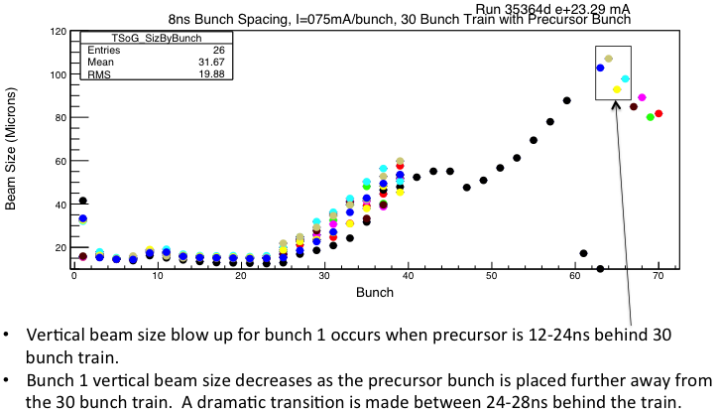
Observation of σ_{V}
Studies with Trailing Bunches
  8 ns-spaced bunches in train
  σ_{V} for each condition is plotted below with different color
  – easy to tell by color of the Trailing Bunch
Trailing Bunch
Trailing Bunch
Trailing Bunch

Slide 30
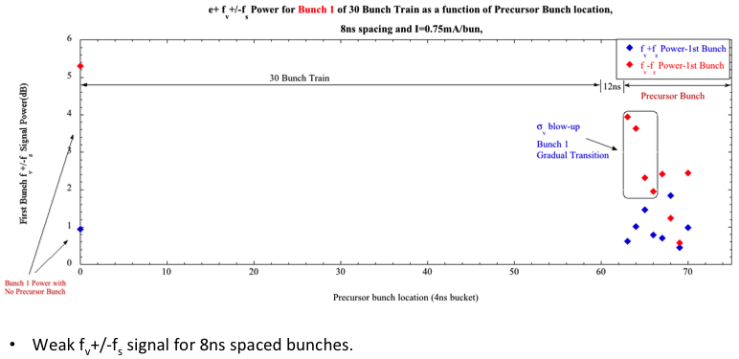
Observations of Amplitude of Head-Tail Modes
Studies with Trailing Bunches
  8 ns-spaced bunches in train
  First Bunch has a Weak Fv-Fs Head-Tail Coherent Oscillations, which approximately decrease as the delay of Trailing Bunch increases
Relative Amplitudes of Head-Tail Modes (Fv – Fs) & (Fv + Fs) for First Bunch in Train, Plotted at the Location of the Trailing Bunch
Trailing Bunch
Bunch 1 with No Trailing Bunch

Slide 31
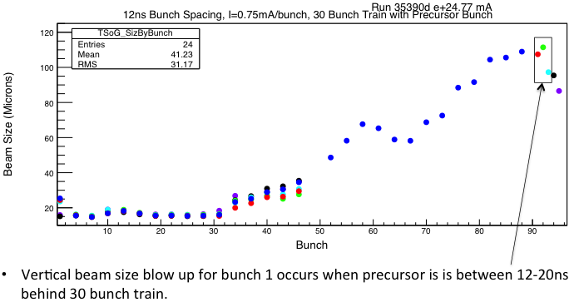
Observation of σ_{V}
Studies with Trailing Bunches
  12 ns-spaced bunches in train
  σ_{V} for each condition is plotted below with different color
  – easy to tell by color of the Trailing Bunch
Trailing Bunch

Slide 32
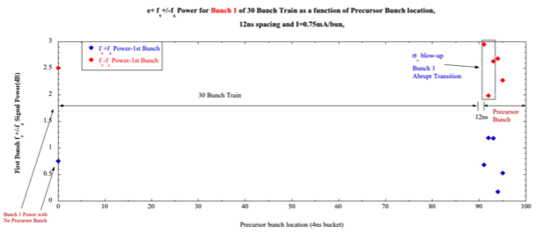
Observations of Amplitude of Head-Tail Modes
Studies with Trailing Bunches
  12 ns-spaced bunches in train
  First Bunch has a Quite Weak Fv-Fs Head-Tail Coherent Oscillations, which approximately decrease as the delay of Trailing Bunch increases
Relative Amplitudes of Head-Tail Modes (Fv – Fs) & (Fv + Fs) for First Bunch in Train, Plotted at the Location of the Trailing Bunch
Trailing
Bunch
Bunch 1 with No Trailing Bunch

Slide 33
Observations 3
Precursor Bunch Studies
  4 ns-spaced bunches in train
  Add single Precursor bunch at one of three intensities:
  4.0x10⁹, 8.0x10⁹ and 1.2x10¹⁰
  Precursor bunch: precedes the train
    Train begins at 4 ns bucket number 41 and continues through 70
    Precursor is placed in buckets from 1 to 40; the values for σ_{V} are overlaid in different colors depending on the location of the precursor bunch

Slide 34
Conclusions from Observations 3
Precursor Bunch Studies
  4 ns-spaced bunches in train
  Precursor bunch: precedes the train
    Results for σ_{V} for 8.0x10⁹ & 1.2x10¹⁰ yielded essentially the same results
    Precursor bunches ≥ 8.0x10⁹ & placed in any preceding 4 ns bucket always reduces blow up of σ_{V} for first bunch.
    However, Precursor bunches = 4.0x10⁹ particles as moved earlier in 4 ns steps from the front of train, σ_{V} of first bunch is reduced in magnitude monotonically over first 16 ns.
    Enlargement of precursor bunch is reduced as it moves further ahead of train!!
    ➔ Difficult to argue that the effect we observe is caused by a remnant EC, which enlarges σ_{V} of the first bunch that passes through it while the EC is dispersed by this bunch’s passage.

Slide 35
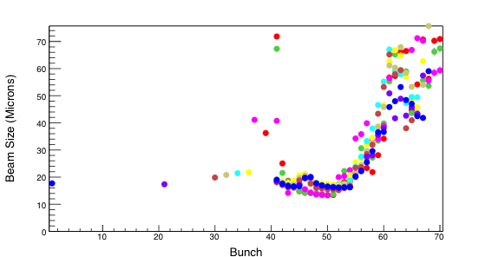
Observations 3
Studies with Precursor Bunch
  4 ns-spaced bunches in train
  Add Precursor bunch: 4.0x10⁹
  σ_{V} for each condition is plotted below with different color
  – easy to tell by color of the Trailing Bunch

Slide 36
Observations 4
Vary Number of Bunches Within the Train
  Total number of particles in the train constant at 30 x (1.2x10¹⁰)
  Vary number of 4 ns-spaced bunches in the train between 30 and 60.
  Results for σ_{V}: trains between 30 and 60 bunches
    Large error bars are indicative of large dipole oscillations for those bunches
    Enlargement of σ_{V} for the first bunch decreases monotonically & disappears for trains longer than 40 bunches.

Slide 37
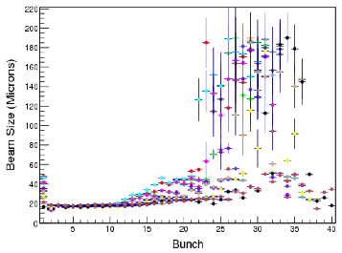
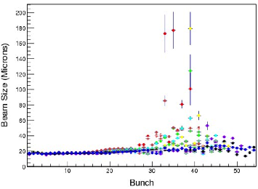
Observations 4
Vary Number of Bunches Within the Train
  Total Charge in the Train: 30 x (1.2x10¹⁰)
  σ_{V} for each condition is plotted below with different color
  – easy to tell by color of the Trailing Bunch
  Enlargement of first bunch decreases; it is gone for 40 bunch-long trains
  Enlargement of later bunches in train decreases as train lengthens

Slide 38
Conclusions
These experiments were expected to clarify the observations of the enlargement of the lead bunch in a 30 bunch e+ trains.
Real effect since it is observed with 2 different instruments, BPM & xBSM
Effect visible for e+ and not e-, it is not likely that this is an impedance/wake-field or beam-loading effect.
Our measurements have mostly studied e+ trains, perhaps it may be visible with e- also, but in a difference range of parameters.
Regardless of possible mechanisms, we must conclude that further observations of electron trains under a wider range of parameters should be part of future experimental studies.
As this is an un-anticpated effect, it may be important to understand its source.

Slide 39
Backup Slides
Backup Slides

Slide 40
Other Observations
Additional Experimental Tests
  Tested other potential mechanisms, which might enlarge σ_{V} of first bunch in 30 bunch trains of 1.2x10¹⁰ positrons having 4 ns-spacing per bunch.
    Turn on/off EC solenoids wound around beam pipes for most the drift length of CESR.
    Change V & L 4 ns-feedback system gains including off
    Raise H 4 ns-feedback system gain, but never was off
    Disconnect 14 ns modulators from amp for the feedback system’s stripline kickers
    Disconnect & terminate drive cable to stripline kickers
    Disconnect drive to shaker used for F_{h}/F_{v} measurements
    Vary V chromaticity
    In all cases: No effect on σ_{V} of first bunch in train

Slide 41
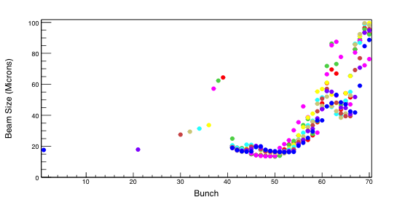
Observations
Studies with Precursor Bunch
  4 ns-spaced bunches in train
  Add Precursor bunch: 8.0x10⁹
  σ_{V} for each condition is plotted below with different color
  – easy to tell by color of the Trailing Bunch

Slide 42
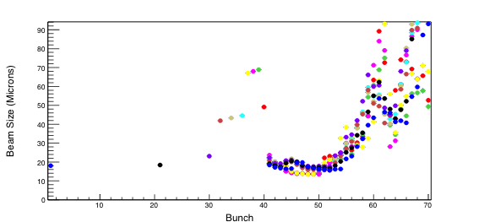
Observations
Studies with Precursor Bunch
  4 ns-spaced bunches in train
  Add Precursor bunch: 1.2x10¹⁰
  σ_{V} for each condition is plotted below with different color
  – easy to tell by color of the Trailing Bunch

Slide 43
Experimental Methodology
Instrumentation at CESRTA
  Position spectrum of individual bunches within train
    Single button of a BPM
    Gate the signal to accept only 1 bunch
    Send to a spectrum analyzer & gives
      H & V dipole (m=0) betatron modes at frequencies F_{h} and F_{v}
      V head-tail (HT) (m=±1) lines at F_{v}±F_{s} (F_{s} is the synchrotron tune)
      H HT modes (m=±1) lines at F_{h}±F_{s}
  X-ray beam size monitors (xBSMs) for e+/e- beams
    Linear, Vert 32 pixel arrays bunch-by-bunch & turn-by-turn
    Removes dipole motion before the fitting the vertical beam size σ_{V} of each bunch.

Slide 44
X-ray Vertical Beam Size Monitor
xBSM diode array
X-ray Beam Size Monitor (xBSM)
  Images X-rays from bending magnet
  Uses 1D 32-chan vertical diode array
  Has 3 choices for Optics Element
    Adjustable Slit (“Pinhole” optics)
    Fresnel Zone Plate (FZP)
    Coded Aperture (CA)
Functions
  Capable of measuring TBT bunch
  size for ≥ 4ns-spaced bunches
  40 dB gain adjustment
  Primary tool for confirming vertical
  emittance corrections
50 μm pitch
E_{c} = 0.6 keV
at 2 GeV
FZP
Geometric
Magnification ~2.5
CA

Slide 45
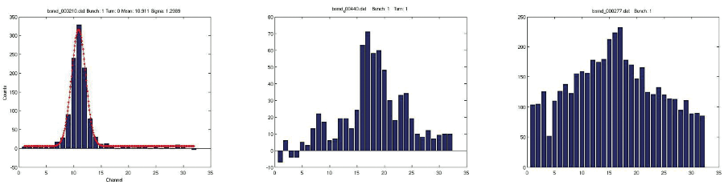
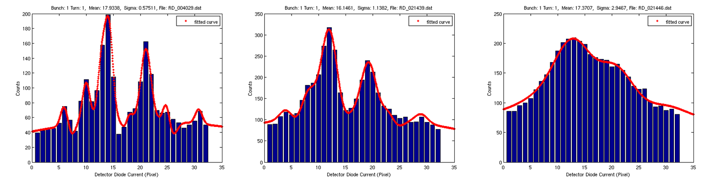
xBSM Measurements
Observe signal with single bunches
with different x-ray optics
  Slit Coded Aperture Fresnel ZP
Single Pass-Single Bunch Distributions
with Fitting Function
Coded Aperture Fits for Different Beam Sizes
Sample Point Bunch 1
Sample Point Bunch 2

Slide 46
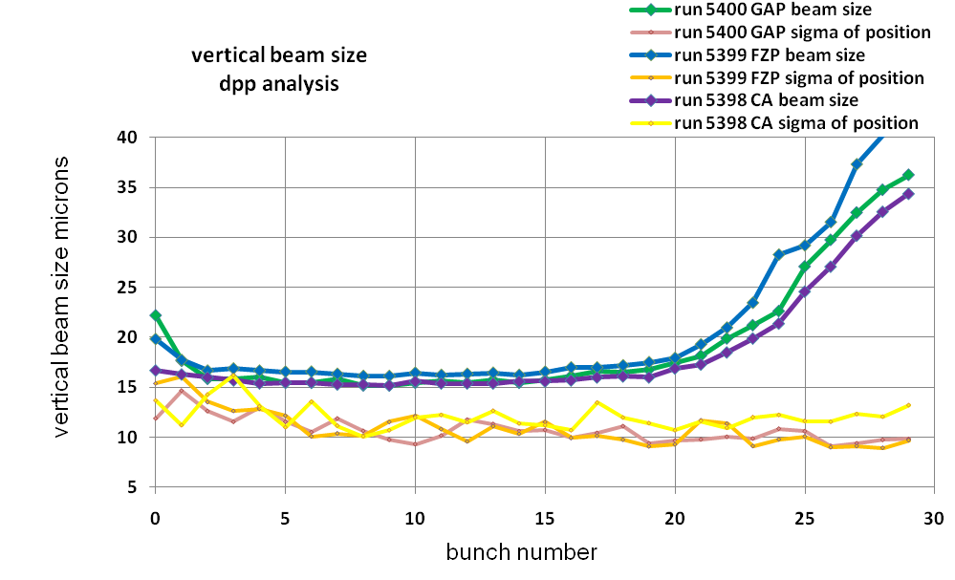
xBSM Measurements
Systematic studies of multi-bunch performance
with different x-ray optics (30 bunch train)
  Slit (Gap) size & position
  Fresnel ZP size & position
  Coded Aperture size & position
  Data for each
  optic taken
  simultaneously
Effect of Electron Cloud
ε_{v}=6-7 pm

