Slide 1
Helical Undulator Based Positron Source for LC
Wanming Liu
05/29/2013

Slide 2
Outline
Undulator based positron source for ILC
Photon beam from helical undulator
  Effects from undulator
  Effects from drive beam
Polarization of positron beam under different conditions
Practical issues

Slide 3
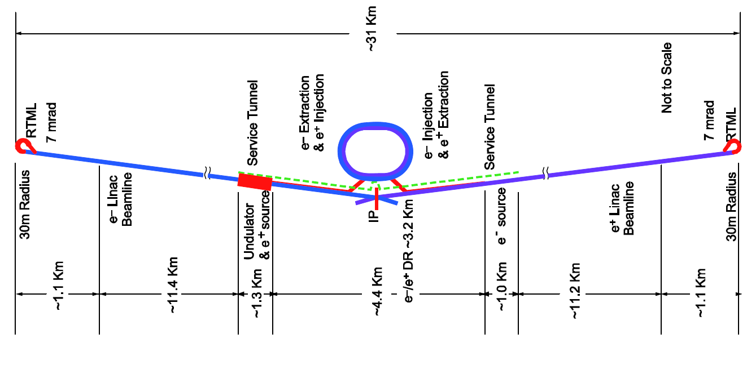
ILC TDR positron source location
Target for e+ production
147 m helical undulator for photon production
Optical Matching Device for e+ capture
PPA
(125-400MeV)
PBSTR 400MeV-5GeV
Photon collimator for pol. upgrade
PCAP
Damping ring
γ
Main e- beam from electron main linac
PTAPA
(~125MeV)
γ dump
PLTR: Energy compression and spin rotation
e- dump
Main e- beam to IP
150 GeV beam to dump
3

Slide 4
ILC Positron source schematic with key components
147 m helical undulator for photon production
Target for e+ production
Optical Matching Device for e+ capture enhancement
Positron Energy Booster (PBSTR): Cryo-modules to boost e+ energy from 400MeV up to 5GeV
Photon collimator for pol. upgrade
Damping ring
γ
Main e- beam from electron main linac
γ dump
e- dump
Positron Linac to damping Ring (PLTR): Energy compression and spin rotation
Main e- beam to IP
Used e+ production beam to dump
Positron Target Area Pre-Accelerator (PTAPA ): L-band normal conducting RF accelerator to accelerate e+ beam up to ~125MeV
Positron Pre-Accelerator (PPA): Normal conducting L-band RF accelerator to accelerate e+ beam from 125MeV up to 400MeV
Positron separation and capture section:
To separate e+ from e- and γ
To clean up e+ which will not be accepted by damping
When Ecm is bellow 300GeV, the machine will be working in 10Hz mode where a dedicated 5Hz 150GeV positron production beam will be interlaced with 5Hz luminosity production beam

Slide 5
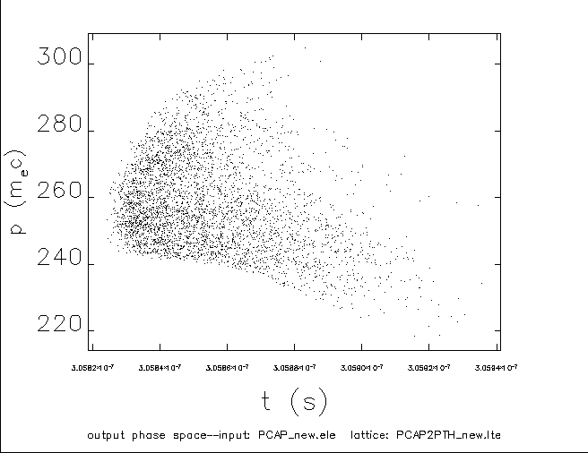
Positron separation
Target for e+ production
147 m helical undulator for photon production
Optical Matching Device for e+ capture
PPA
(125-400MeV)
PBSTR 400MeV-5GeV
Photon collimator for pol. upgrade
PCAP
Damping ring
γ
Main e- beam from electron main linac
PTAPA
(~125MeV)
γ dump
PLTR: Energy compression and spin rotation
e- dump
Main e- beam to IP
150 GeV beam to dump
Positron separation beamline
Positron separation beamline (PCAP section) is used to separate positrons beam from electrons and γ beam.
The electron beam and γ beam will be dumped into the e- dump and γ dump.
The positrons with energy too low and too high will be cleaned up in this chicane using collimators.
The length of this section is 74m
Typical longitudinal distribution after PCAP

Slide 6
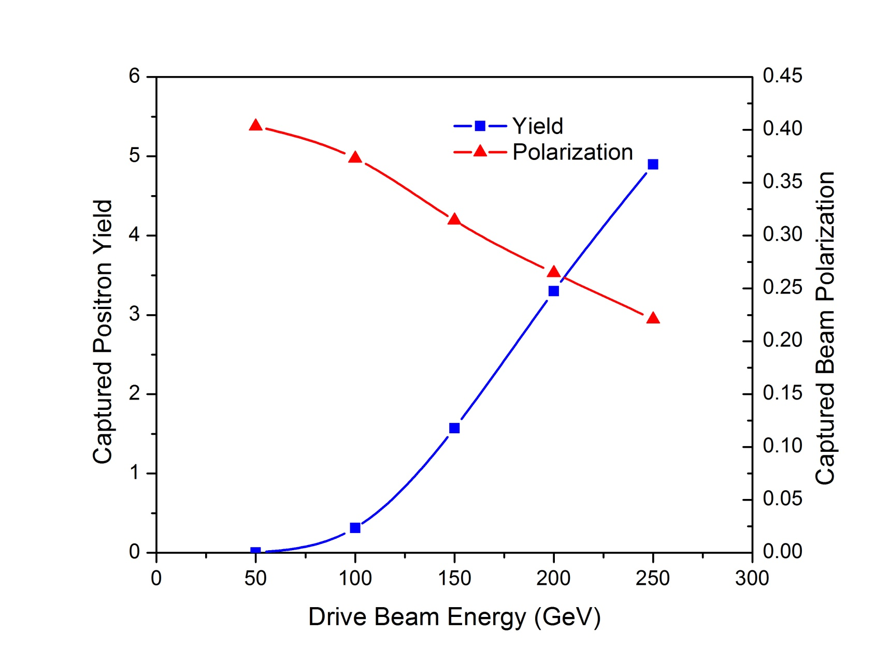
Drive beam energy dependence study (no collimation)

Slide 7
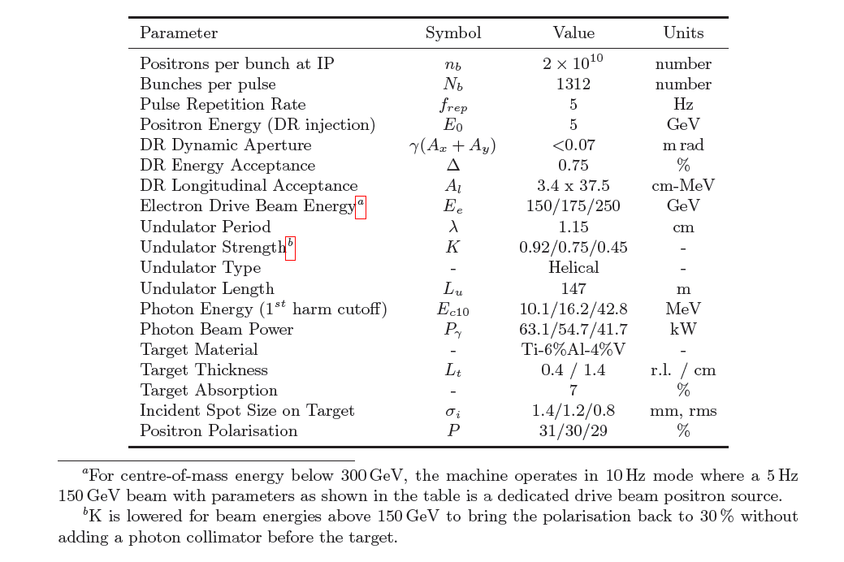
Nominal parameters of ILC positron source

Slide 8
TeV upgrade
  High drive beam energy, 500GeV which doubles the 250GeV TDR maximum
    photon beam energy increases by factor of 4 results in a larger energy spread and more positrons with unwanted polarization
    Smaller radiation angle results in smaller beam spot on target and thus higher energy deposition density
  Solution
    New undulator, challenges exist in finding the parameter set with photon number spectrum similar to RDR undulator with 150GeV drive beam

Slide 9
With Fixed K=1 and different undulator period length
Based on the above plot, λu=4.3 is used for a more detail simulation to evaluate the energy deposition and impact on drive beam

Slide 10
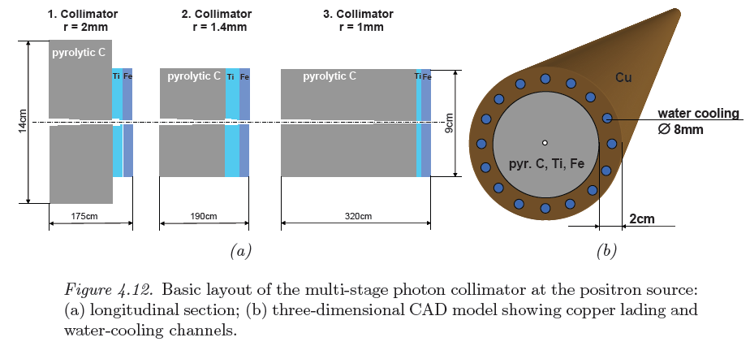
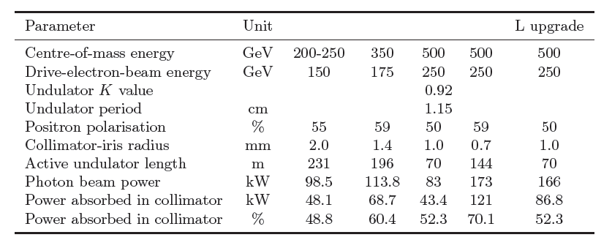
Photon collimator for Polarization upgrade
A photon collimator is not required for the TDR baseline
As part of positron source upgrade study, DESY team developed a photon collimator design. With the designed photon collimator, positron source polarization can be increased from ~30% up to 50-60% depending on the colliding beam energy

Slide 11
Photon Number and Polarization of Radiation from Undulator

Slide 12
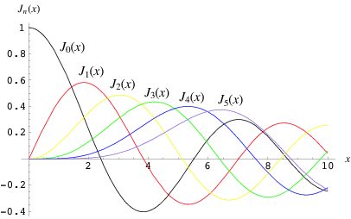
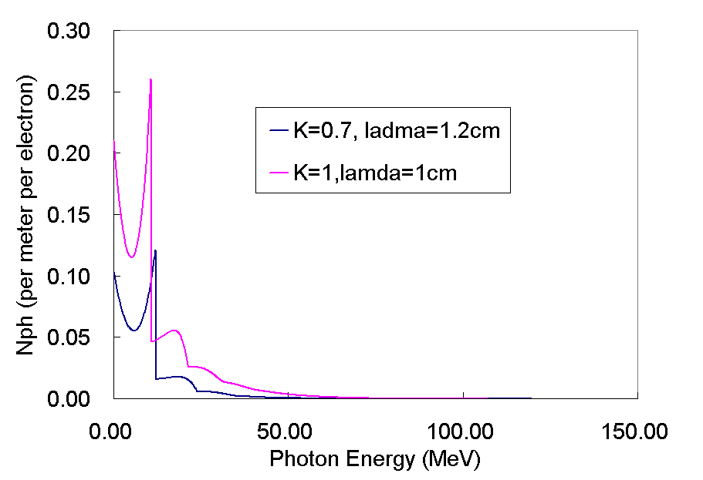
Helical undulator:
Can produce circularly polarized photon, good for polarized e+ source.
Higher k, more high order harmonics contents.
Smaller k, fewer high order harmonics, less photon flux, higher photon energy

Slide 13
Formulas about the polarization characteristics of helical undulator radiation*
The amplitude of radiation from helical undulator can be obtained as
(1)
Where,
From which the Stokes parameters is obtained as:
(2)
* Klaus Flottmann, Investigation toward the development of polarized and unpolarized high intensity positron sources for linear colliders, DESY 93-161

Slide 14
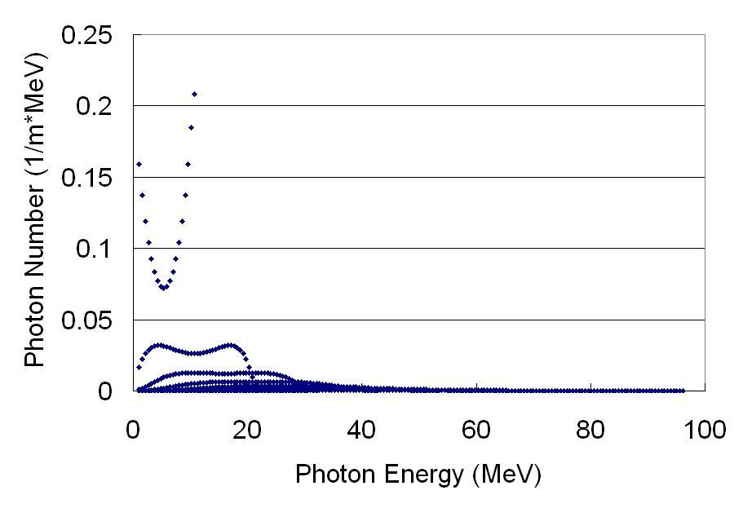
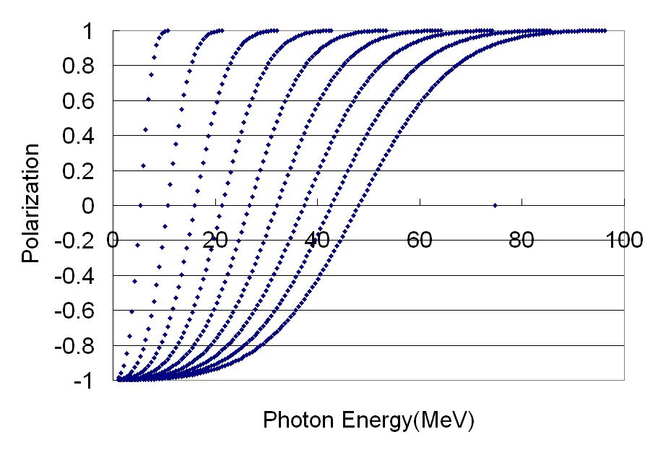
Results ---Photon number spectrum and polarization characteristics
Results of photon number spectrum and polarization characteristic of ILC undulator are given here as examples. The parameter of ILC undulator is K=1, λu=1cm and the energy of electron beam is 150GeV.
Photon Number spectrum and polarization characteristics of ILC undulator up to the 9th harmonic

Slide 15
Results, photon number vs polarization before and after collimator
the relation between photon number and their polarization before and after collimator with acceptance angle of 2.1e-6 rad. After the collimator, only photons with polarization greater than 0.95 will survive.

Slide 16
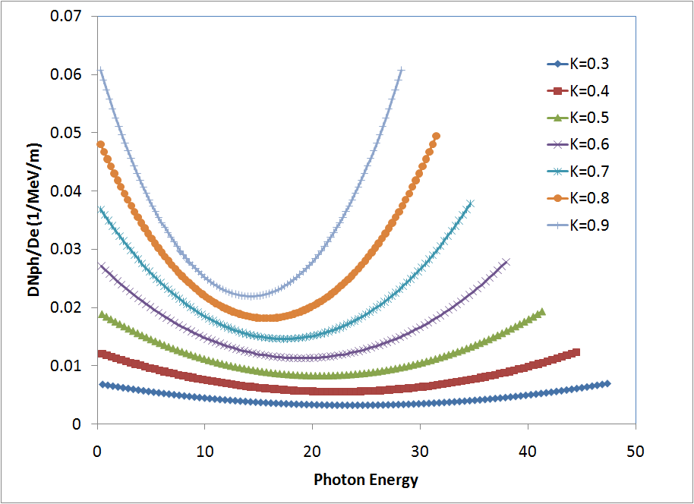
Effect of K
Disadvantage of Low K: increase the critical energy of photon of helical undlator radiations and lower the number of photon produced for a given length of undulator.
Advantage of low K: lower high order harmonic radiation

Slide 17
photon number spectrum for different drive beam energy

Slide 18
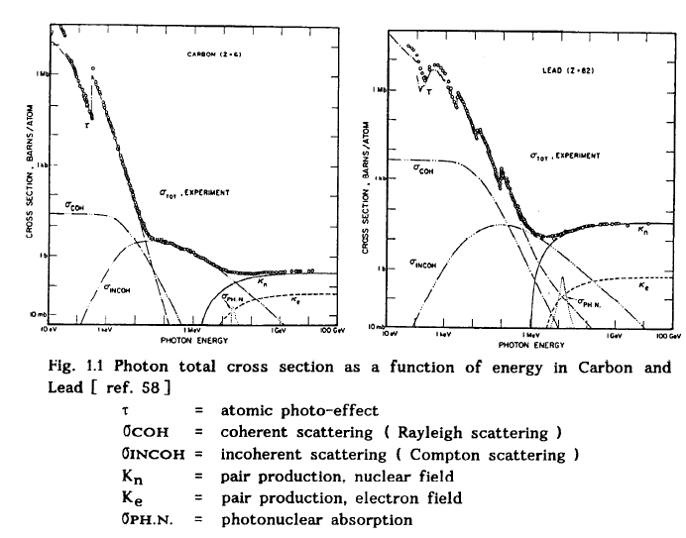
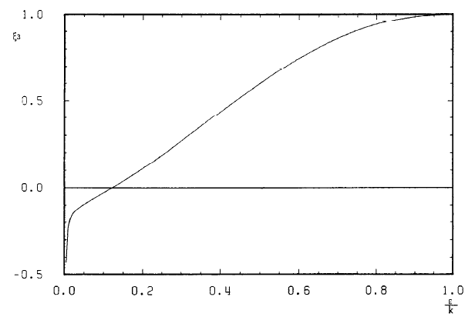
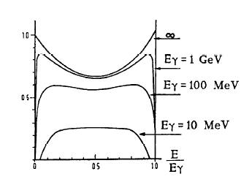
Some facts about pair production
Photon energy
Only high energy e+ carries the polarization from incoming photon
Longitudinal polarization of e+ or e- as function of its fractional energy
Cross section of pair production is near constant for high energy photons; high Z material tends to have a sharper leading edge for pair production cross section and higher cross section.
Particles are roughly equally distributed except for very high and very low photon energy
Energy distribution of e+/e- pairs as function of fractional energy

Slide 19
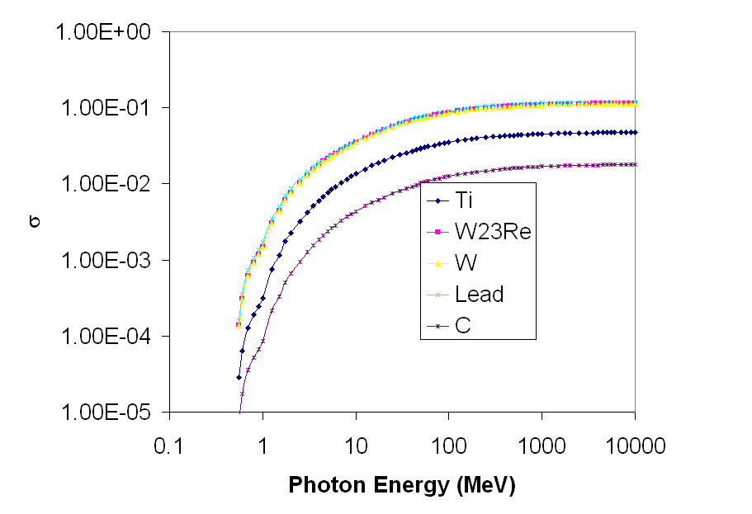
The cross section of Pair production extracted from PEGS4 (we do not use table directly)

Slide 20
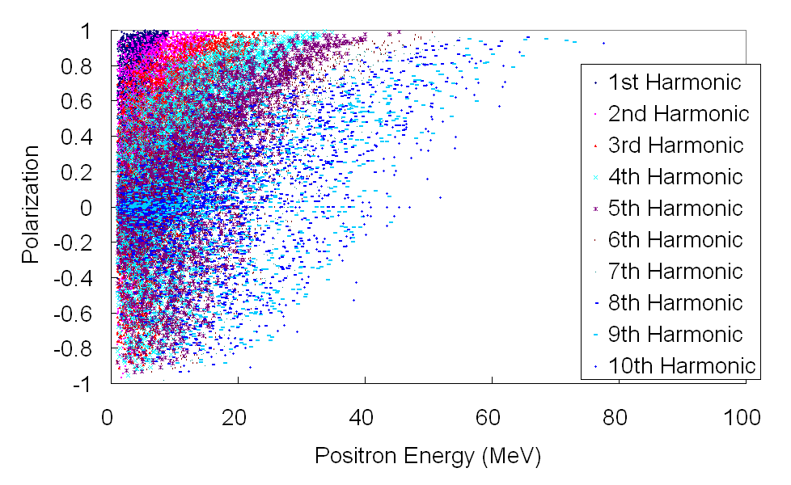
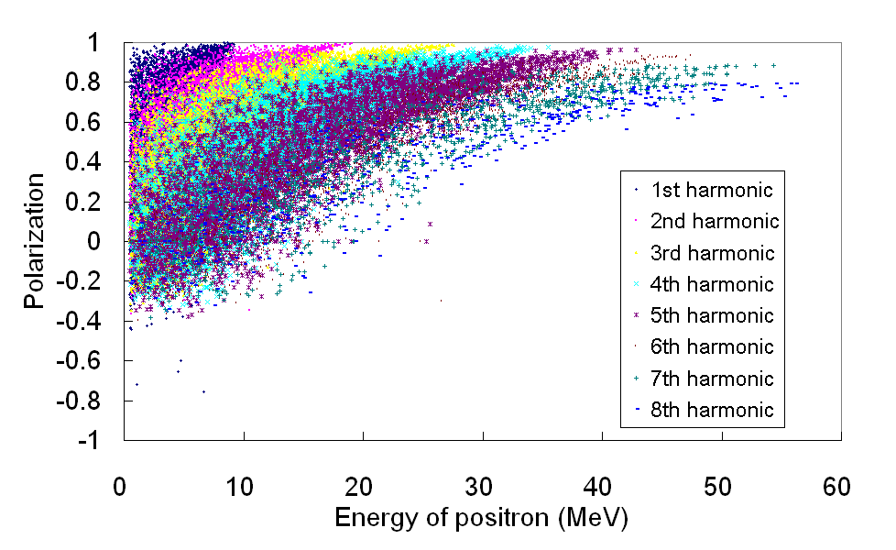
polarization vs energy of positron generated with photon from different undulator harmonics
without collimator
with collimator
The collimator is 2.5mm in radius and is 700m away from the end of an 100m long undulator. Photons are radiated uniformly along the undulator. For the case without collimator, the photon source is treated as a point source. The collimator screened out those photon with lower polarization and thus improved the positron polarization.

Slide 21
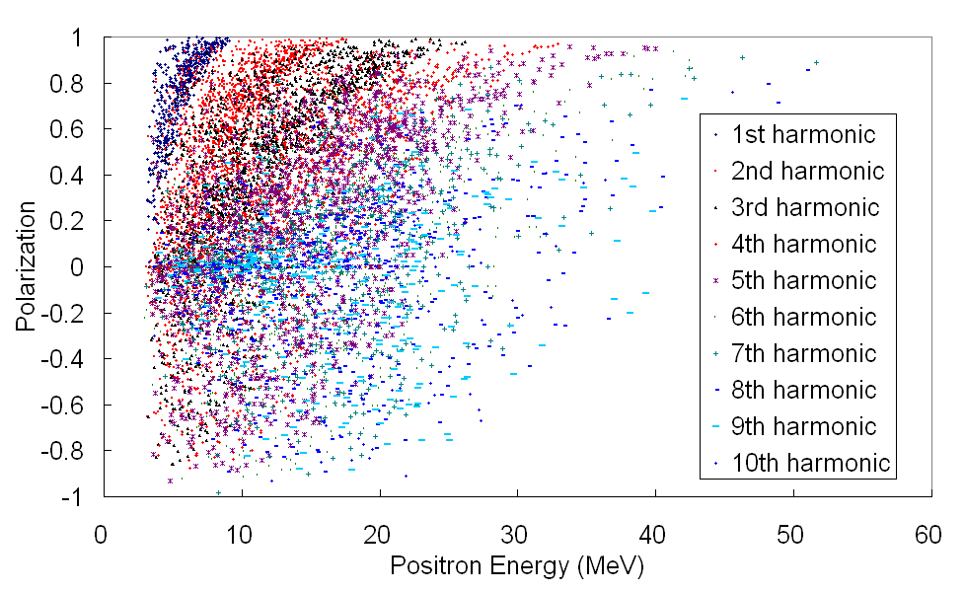
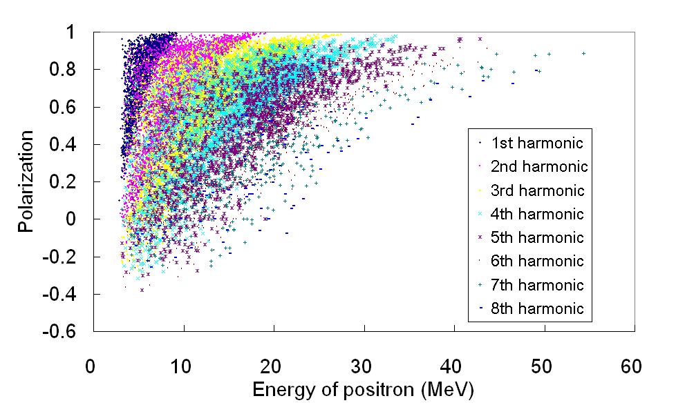
Initial Polarization vs energy of those captured positrons
Without collimator
With collimator
The capturing optics are the same for both with and without collimator. The collimator screened out those photons with lower polarization and thus improved the polarization resulting positron beam. The polarization of captured positron beam is about 30% without collimator and 63% with the collimator setting used here.

Slide 22
What will impact on positron polarization
22
The impact on polarization of Undulator parameters
Drive beam energy
Photon collimator
The capturing optics

Slide 23
Assumptions and conditions
OMD: flux concentrator : 0.5T at target (z=0), 3.5T at z=2cm decrease adiabatically down to 0.5T at z=14cm.
Target: 0.4X0 Ti
Undulator:
  RDR undulator and high K short period undulators
    Length is fixed at 231m
    Drive beam energy varies from 100GeV to 250GeV
  RDR undulator with lower B field (Lower K)
    K varies from 0.3 to 0.9
    Length is fixed to 231m
    Drive beam energy is 250GeV
Drift between undulator end and the target: 400m long
Photon collimator: A numerical mask with an iris at target

Slide 24
Undulator parameters
Photon spectrum
1st harmonic critical energy
Only photons with energy near critical energy of each harmonics carries high polarization
1st harmonic
2nd harmonic
3rd harmonic
In order to have higher polarization in e+ beam, one would want to have fewer photons from higher order harmonics. 150 GeV and RDR undulator

Slide 25
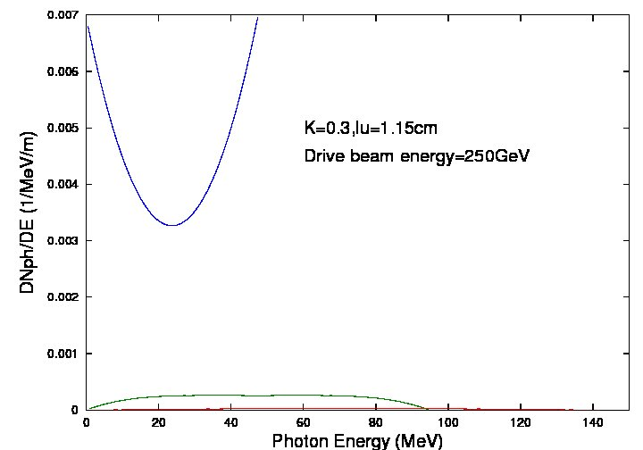
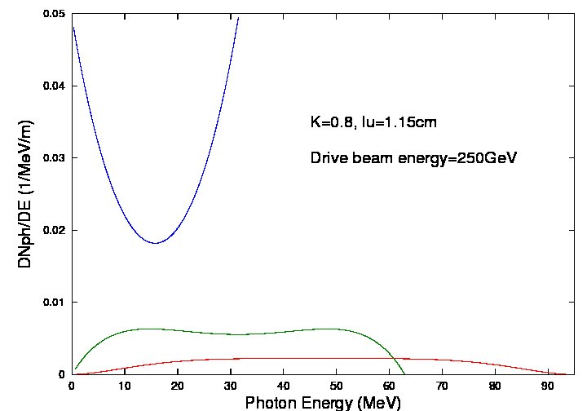
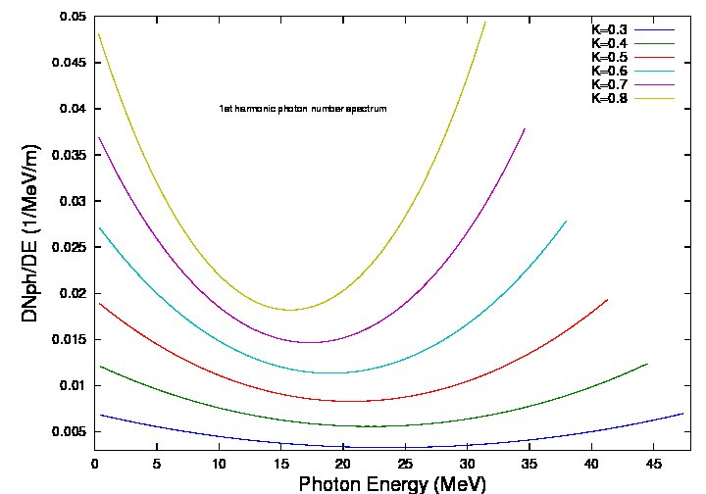
Undulator parameters
Lower K gives higher 1st harmonic radiation contents in spectrum and also higher critical energies
Lower K radiates less photons for a given length and drive beam
Lowering K can improve the polarization with a price on the e+ beam intensity

Slide 26
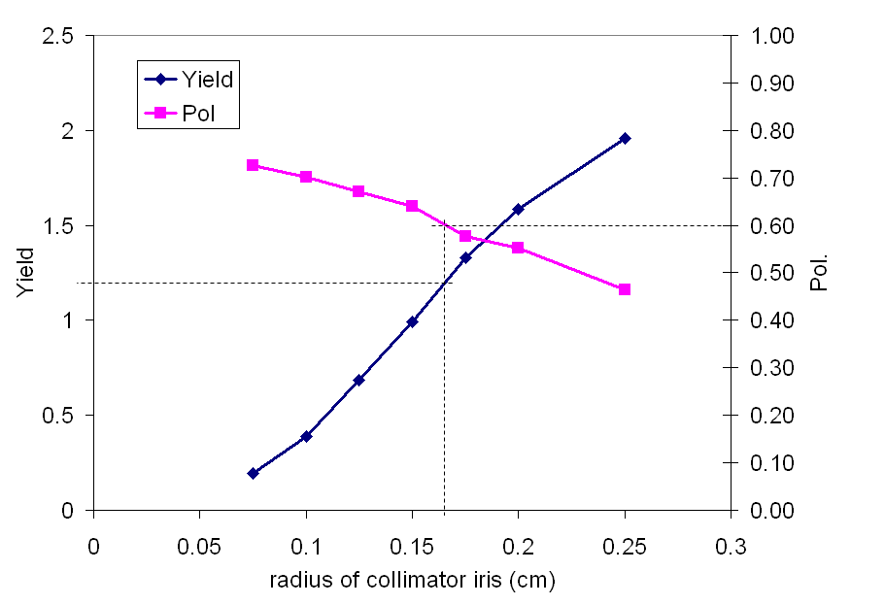
150GeV drive beam, RDR undulator (reference)
For 150GeV drive beam, 60% polarization required a photon collimator with an iris of ~1.6mm in radius. The corresponding yield is ~1.2 for 231m long RDR undulator

Slide 27
Examples
Varying E (100 -250 GeV),
K (0.3 – 0.9)
Lambda (0.9 and 1.15 cm)
Collimator radius as a variable.

Slide 28
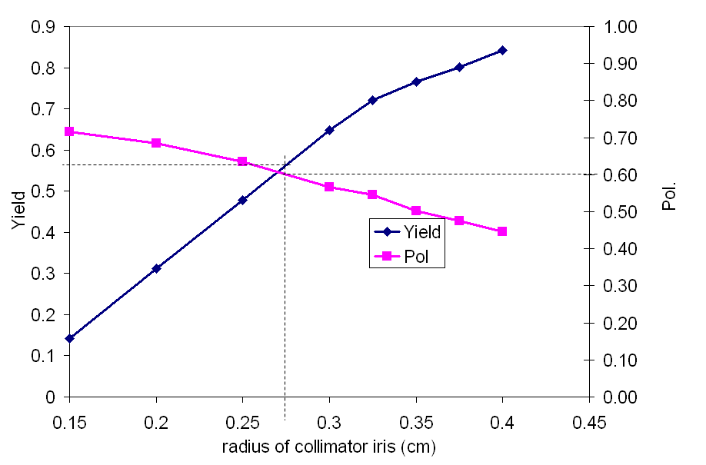
Drive beam energy 100GeV, K=0.9,lu=0.9
For 60% polarization, an photon collimator with iris of 2.75mm in radius is required and the corresponding yield is only ~0.57 for 231m long undulator.

Slide 29
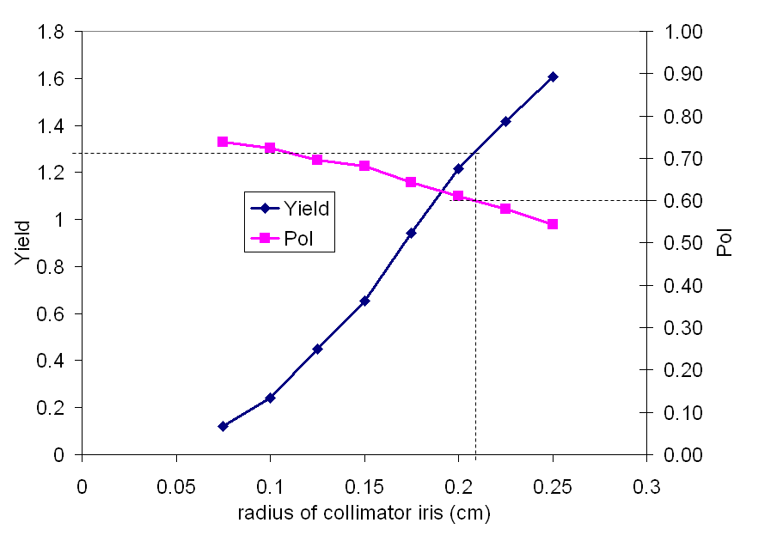
Drive beam energy 125GeV, K=0.9,lu=0.9
For 125GeV drive beam, the 60% polarization required a photon collimator with an iris of ~2.1mm in radius and the corresponding yield is ~1.28 for 231m long undulator

Slide 30
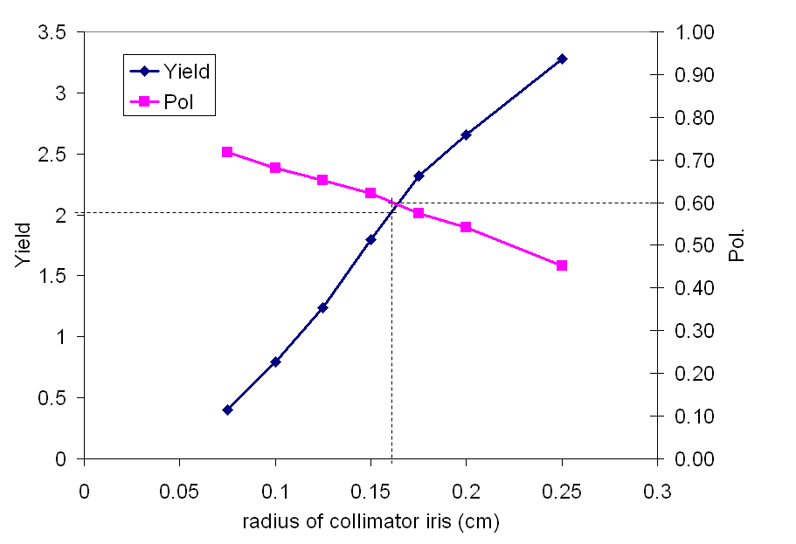
Drive beam energy 150GeV, K=0.9,lu=0.9
For 150GeV drive beam, 60% polarization required a photon collimator with an iris of ~1.6mm in radius. The corresponding yield is ~2 for 231m long undulator

Slide 31
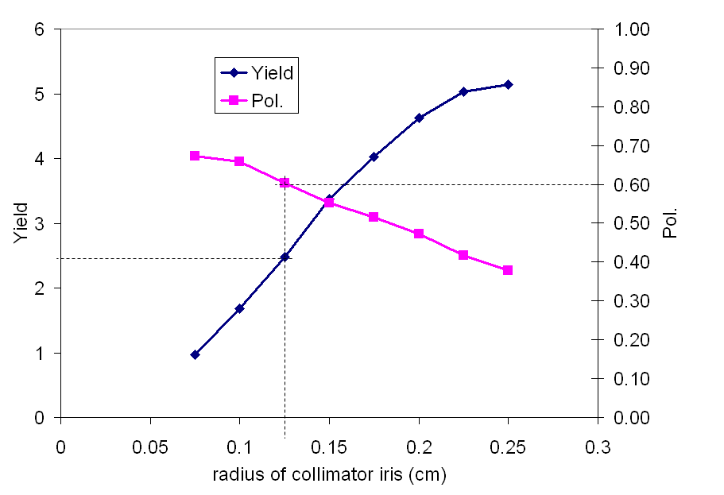
Drive beam energy 175GeV, K=0.9,lu=0.9
For 175GeV drive beam, 60% polarization required a photon collimator with an iris of ~1.25mm in radius. The corresponding yield is ~2.4 for 231m long undulator

Slide 32
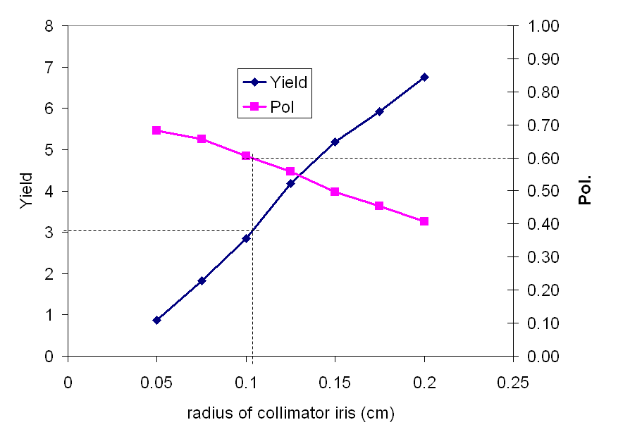
Drive beam energy 200GeV, K=0.9,lu=0.9
For 200GeV drive beam, 60% polarization required a photon collimator with an iris of ~1.1mm in radius. The corresponding yield is ~3 for 231m long undulator

Slide 33
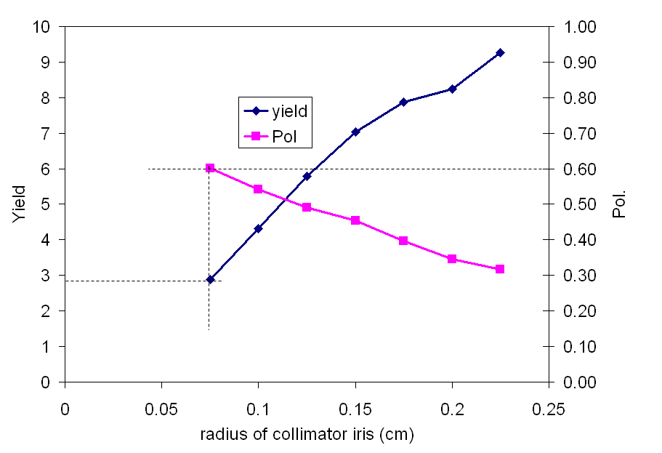
Drive beam energy 225GeV, K=0.9,lu=0.9
For 200GeV drive beam, 60% polarization required a photon collimator with an iris of ~0.75mm in radius. The corresponding yield is ~2.8 for 231m long undulator

Slide 34
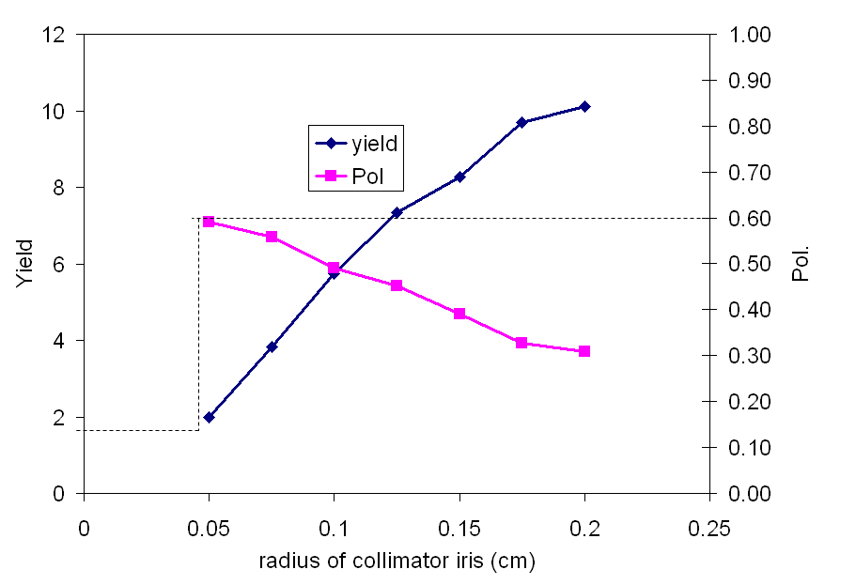
Drive beam energy 250GeV, K=0.9,lu=0.9
For 250GeV drive beam, 60% polarization required a photon collimator with an iris of ~0.45mm in radius. The corresponding yield is ~1.75 for 231m long undulator

Slide 35
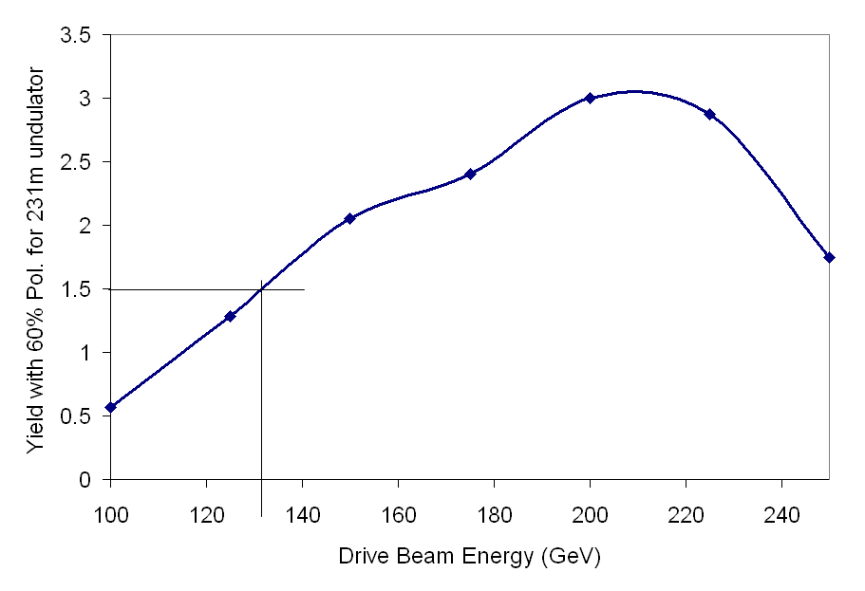
Yield with 60% Pol. As function of drive beam energy
With 231m long undulator with K=0.9, λu=0.9, 1.5 yield with 60% polarization can be achieved with drive beam energy of about 132GeV

Slide 36
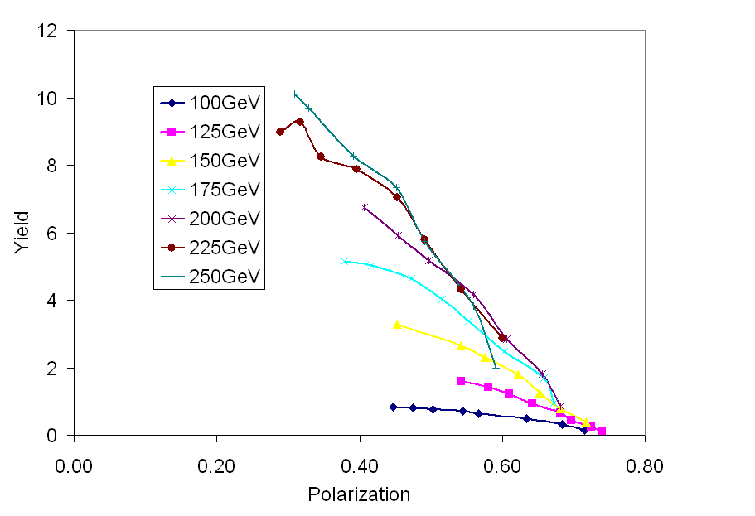
Yield vs Pol for different drive beam Energy
K=0.9,lu=0.9
For a given required polarization, the yield increase with drive beam energy with the penalty of more challenge to the photon collimator design
Higher drive beam energy will have a lower achievable polarization.

Slide 37
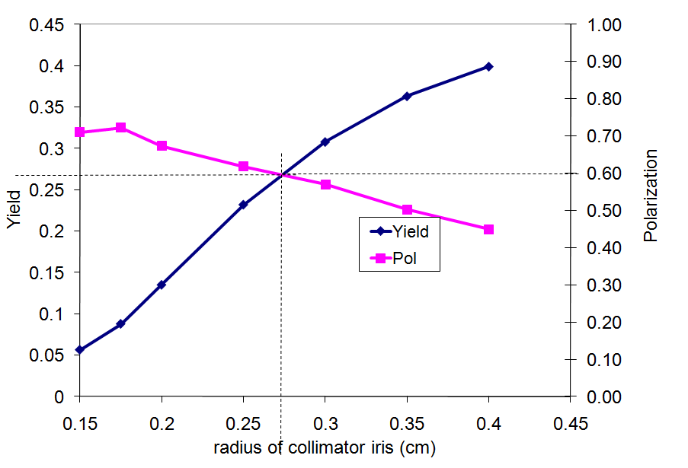
100GeV drive beam, RDR undulator
For 100GeV drive beam, 60% polarization required a photon collimator with an iris of ~2.6mm in radius. The corresponding yield is ~0.27 for 231m long RDR undulator

Slide 38
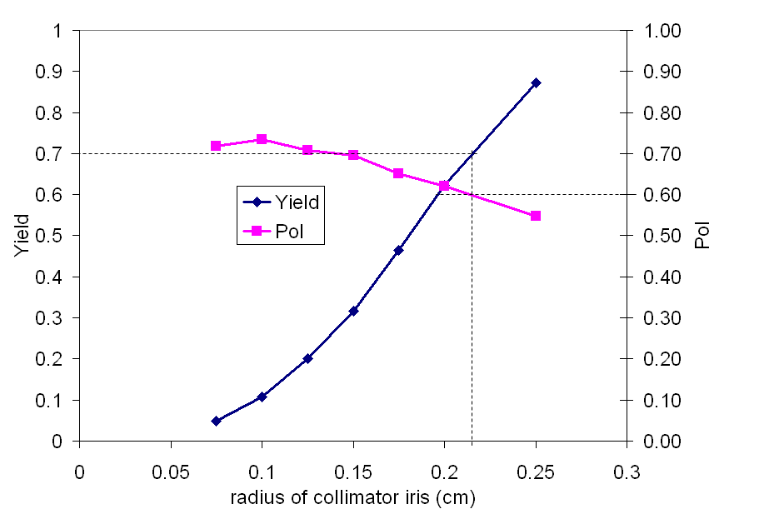
125GeV drive beam, RDR undulator
For 125GeV drive beam, 60% polarization required a photon collimator with an iris of ~2.2mm in radius. The corresponding yield is ~0.7 for 231m long RDR undulator

Slide 39
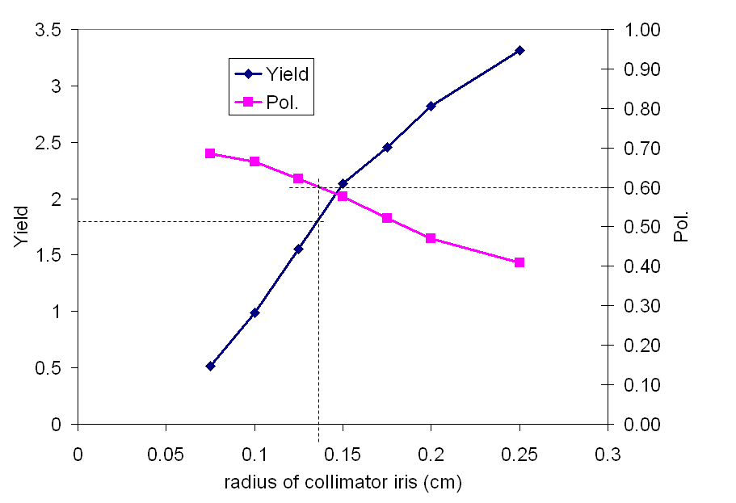
175GeV drive beam, RDR undulator
For 175GeV drive beam, 60% polarization required a photon collimator with an iris of ~1.4mm in radius. The corresponding yield is ~1.8 for 231m long RDR undulator

Slide 40
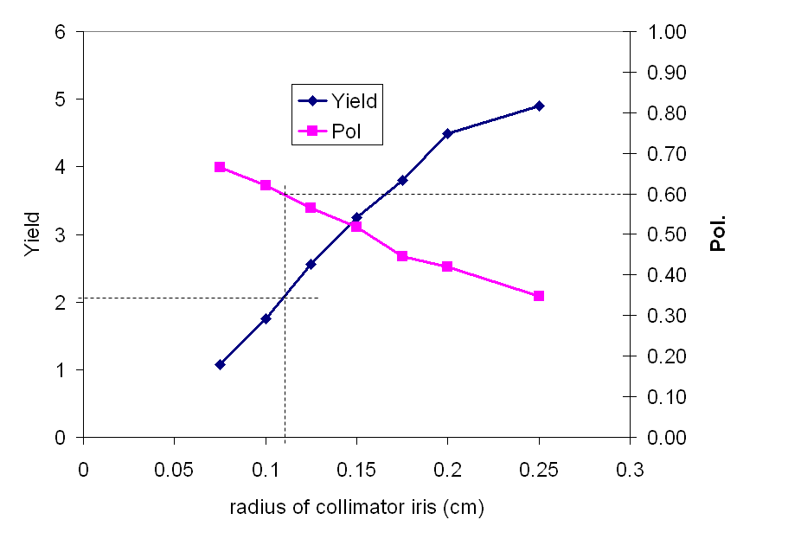
200GeV drive beam, RDR undulator
For 200GeV drive beam, 60% polarization required a photon collimator with an iris of ~1.15mm in radius. The corresponding yield is ~2.05 for 231m long RDR undulator

Slide 41
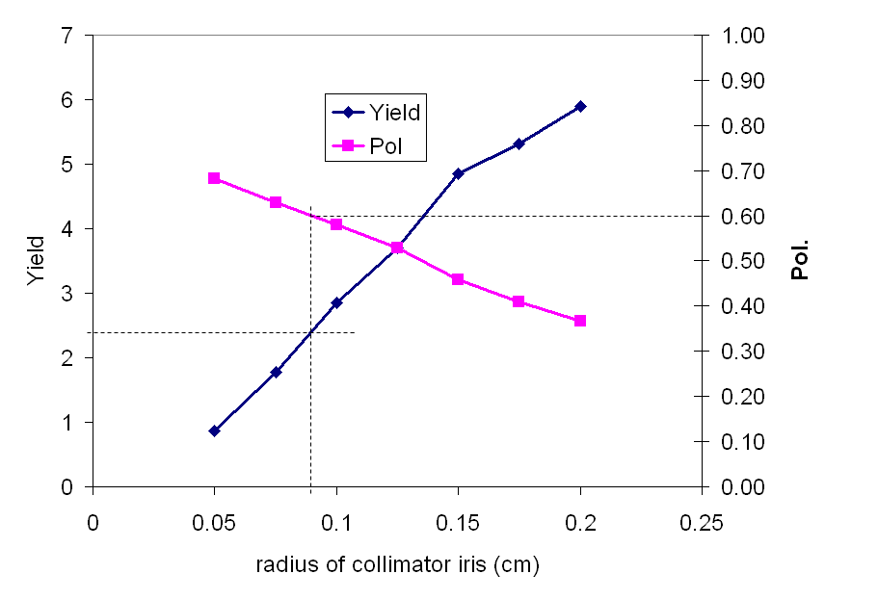
225GeV drive beam, RDR undulator
For 225GeV drive beam, 60% polarization required a photon collimator with an iris of ~0.85mm in radius. The corresponding yield is ~2.4 for 231m long RDR undulator

Slide 42
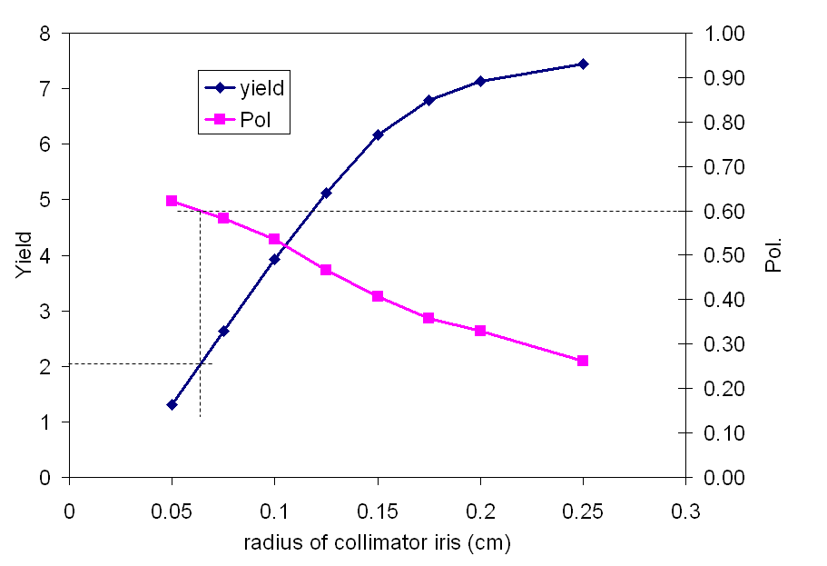
250GeV drive beam, RDR undulator
For 250GeV drive beam, 60% polarization required a photon collimator with an iris of ~0.6mm in radius. The corresponding yield is ~2.0 for 231m long RDR undulator

Slide 43
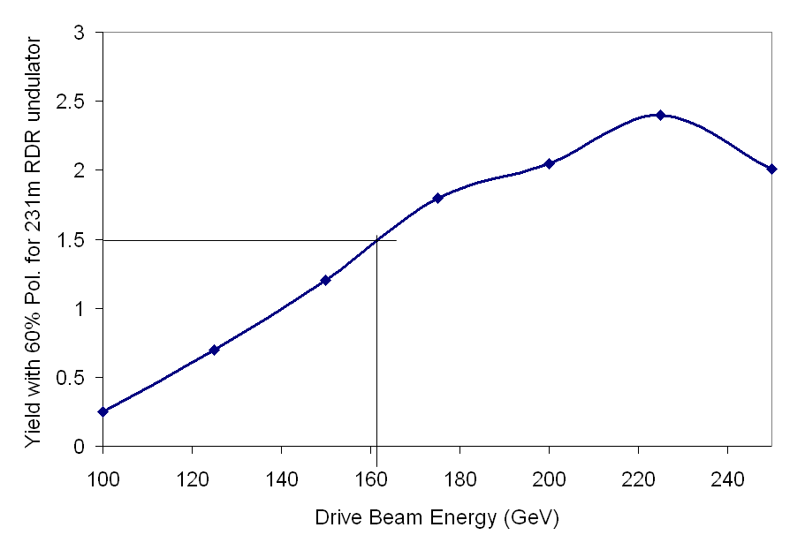
Yield with 60% Pol. As function of drive beam energy. 231m long RDR undulator
Yield of 1.5 with 60% yield can be reached with drive beam energy of ~162GeV

Slide 44
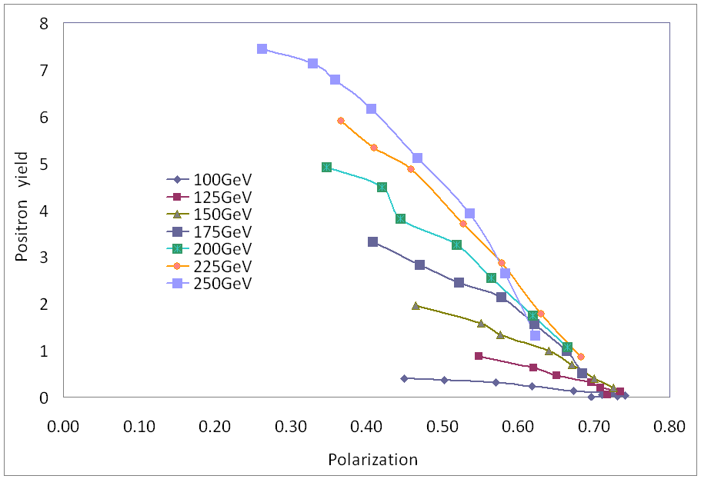
Yield vs pol for different drive beam energy
ILC RDR undulator
For a given required polarization, the yield increase with drive beam energy with the penalty of more challenge to design photon collimator
Higher drive beam energy will have a lower achievable polarization.

Slide 45
Varying K for RDR undulator at the end of linac.
45
Undulator: λu=1.15cm, K=0.3 – 0.9
OMD:
  FC, 0.5T ramp up to over B in 2cm and then adiabatically fall back to 0.5T at z=14cm, where B varied from 3T to 6T.
Length of undulator 231m
Target: 0.4X0 Ti target
Drift from Undulator end to target: 400m
Varying photon collimator iris.

Slide 46
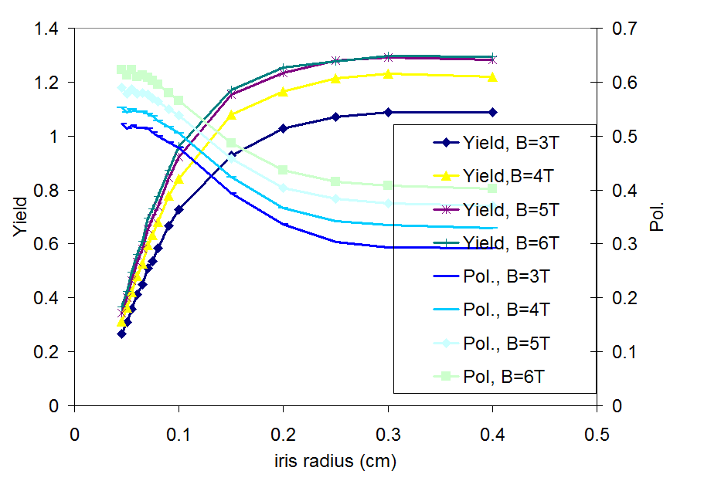
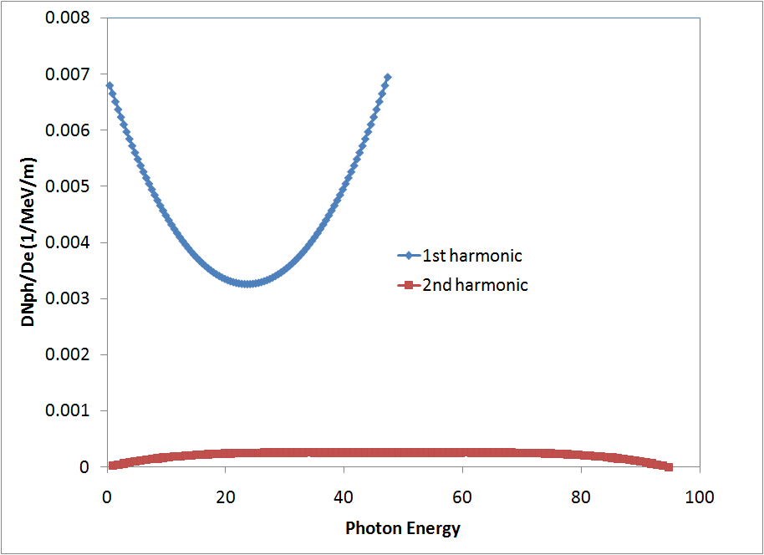
K=0.3, Drive beam energy 250GeV
With FC
Photon spectrum
When K is 0.3, the total number of photon is small and also the photon from 2nd harmonic is very small comparing with 1st harmonic radiation.
For 60% polarization, the positron yield is about 0.8.

Slide 47
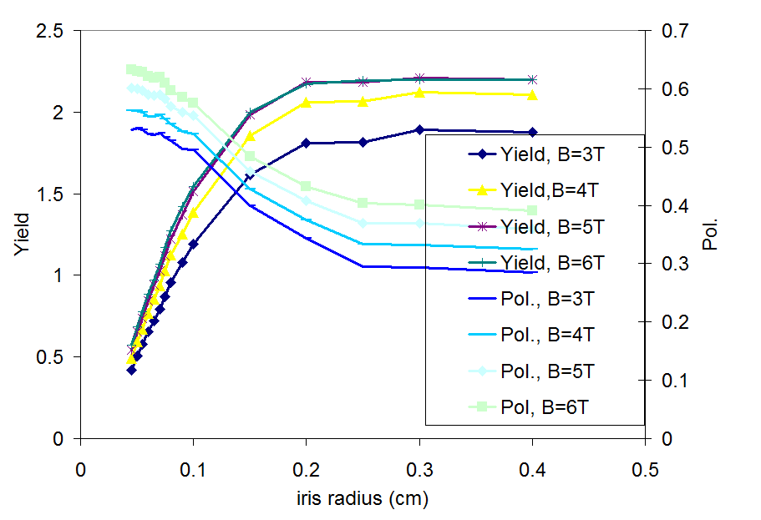
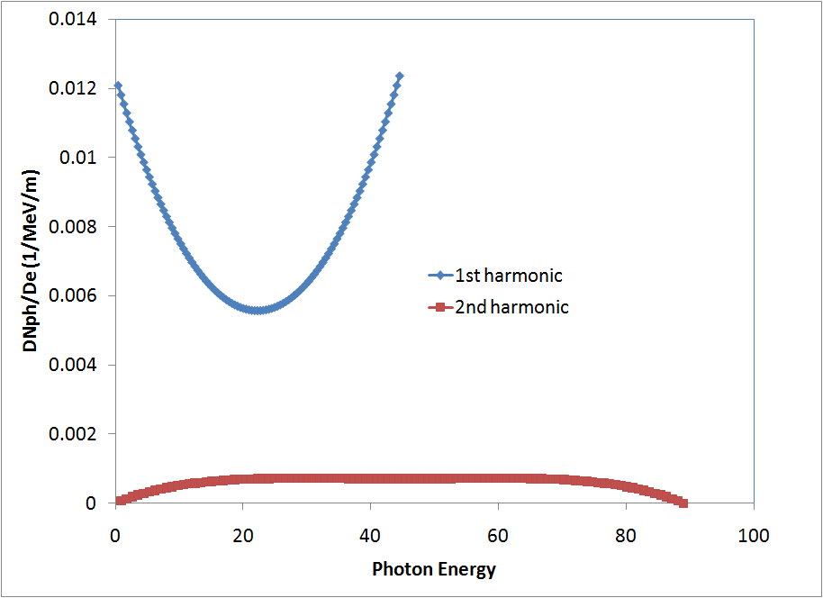
K=0.4, Drive beam energy 250GeV
With FC
Photon spectrum
For 60% polarization, the positron yield is about 1.3

Slide 48
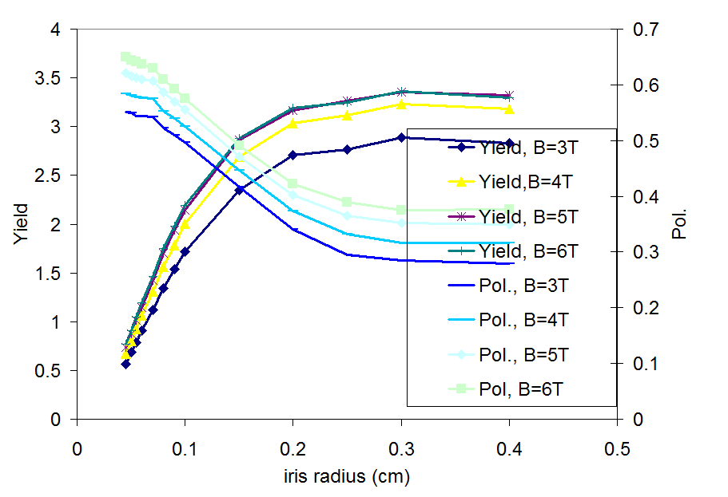
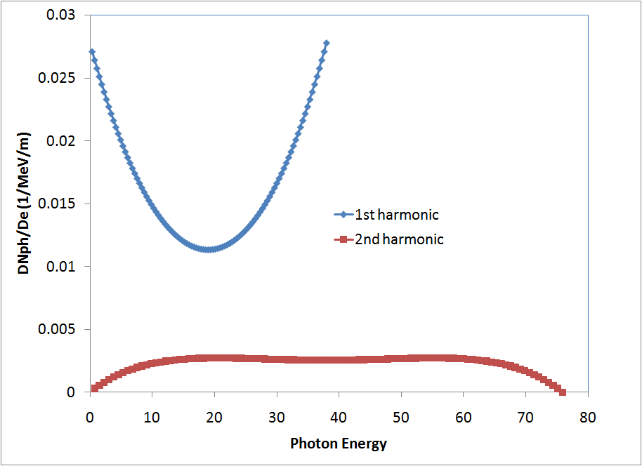
K=0.5, Drive beam energy 250GeV
With FC
Photon spectrum
For 60% polarization, the positron yield is about 2.0

Slide 49
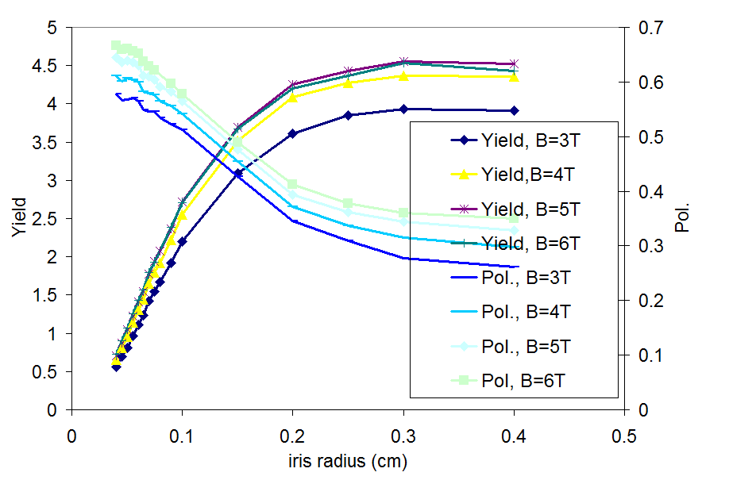
K=0.6, Drive beam energy 250GeV
With FC
Photon spectrum
For 60% polarization, the positron yield is about 2.4

Slide 50
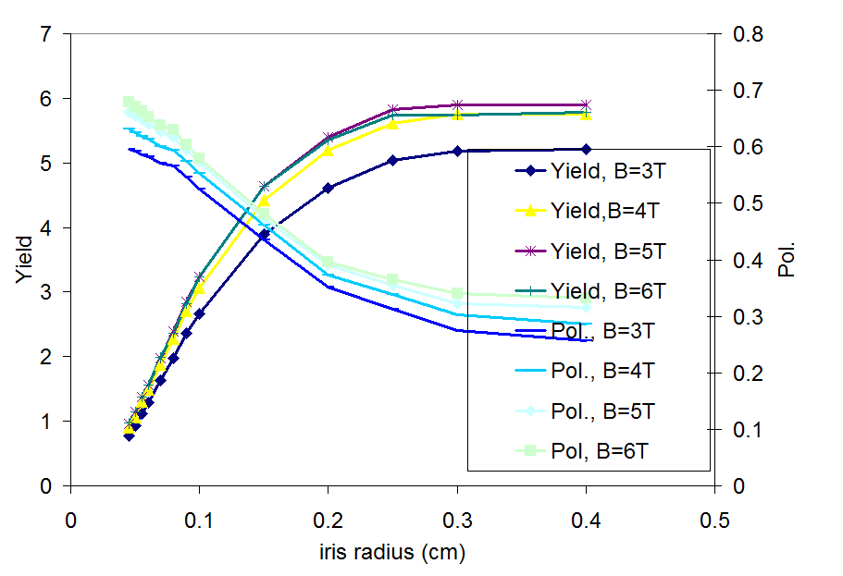
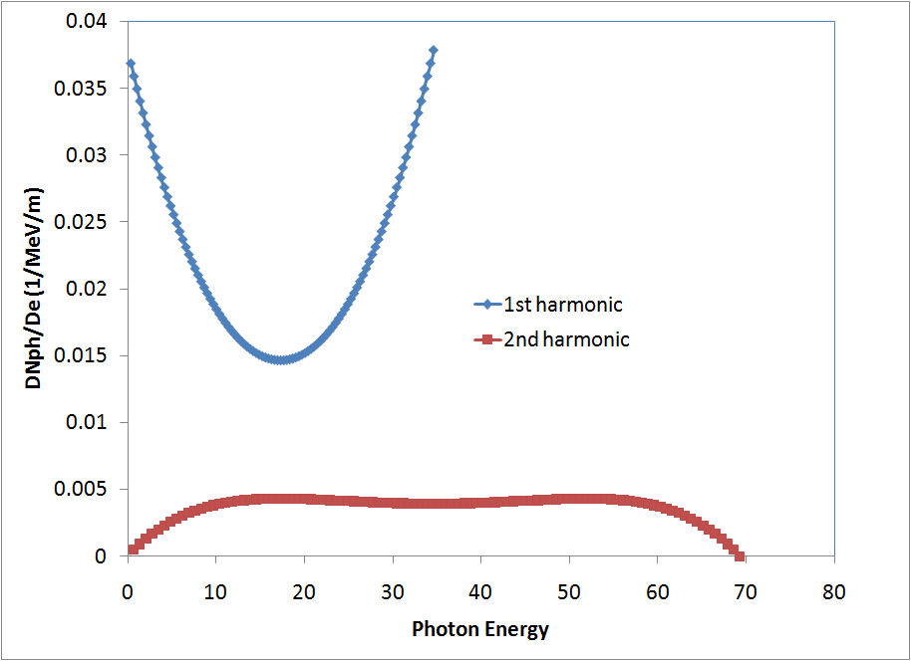
K=0.7, Drive beam energy 250GeV
With FC
Photon number spectrum
For 60% polarization, the positron yield is about 3.0 when strong FC is applied

Slide 51
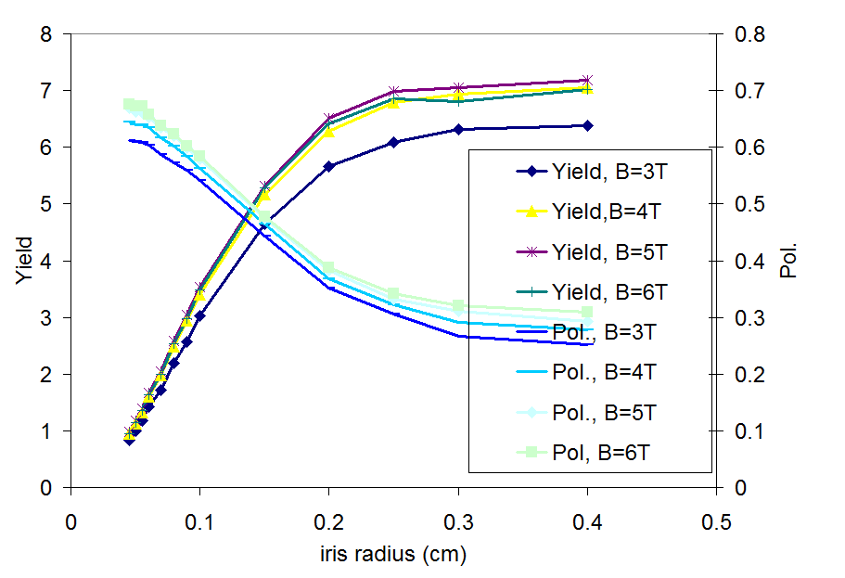

K=0.8, Drive beam energy 250GeV
With FC
Photon number spectrum
For 60% polarization, the positron yield is about 3.2 when strong FC is applied

Slide 52


K=0.9, Drive beam energy 250GeV
With FC
Photon number spectrum
For 60% polarization, the positron yield is about 3 when a strong FC ( peak over 6T) is applied. When a softer FC (peak about 3T) is applied, the 60% polarization has corresponding yield of about 2.0

Slide 53

Summary on varying K
231m undulaotr with λu=1.15cm
Disadvantage of Low K: increase the critical energy of photon of helical undlator radiations and lower the number of photon produced for a given length of undulator.
Advantage of low K: lower high order harmonic radiation
1.5 yield with 60% polarization can be achieved by lowering K down to ~0.42 with strong FC
53

Slide 54

Yield vs Pol for fixed 250GeV drive beam
K varies, lu=1.15cm
For a fixed drive beam energy, and given requirement on polarization, higher K gives higher yield. Higher K also gives a higher achievable polarization.

Slide 55
Practical issues
Alignment
Drive beam Zigzagging

Slide 56


Example of drive beam zigzagging effect
With photon collimator
Without photon collimator
seta
Alignment tolerance as specified in TDR: 0.1mm over 150m =>~0.7 micro radian

Slide 57
Summary
ILC TDR baseline positron source design is done but upgrade options still need to be studied in detail
High polarization is desired. It is very challenging but still possible.

