Slide 1

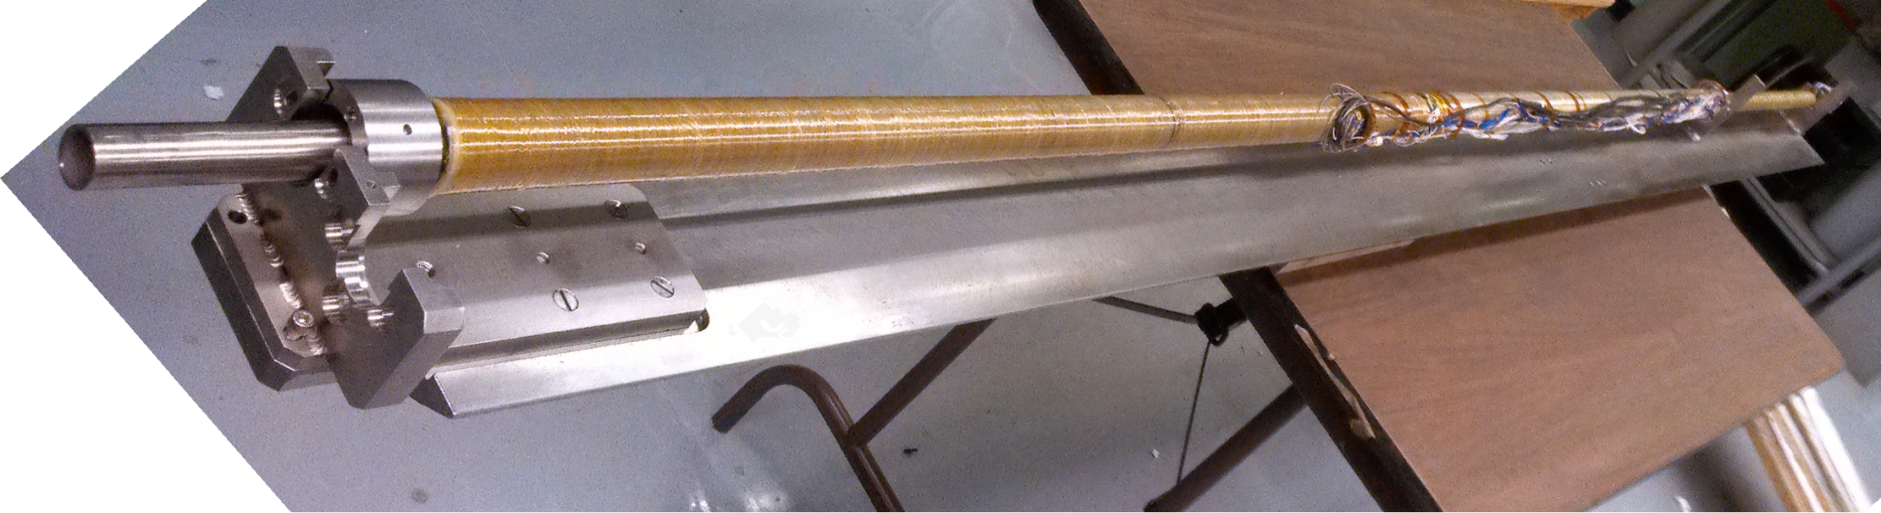
QD0 R&D Update
presented by Brett Parker, BNL-SMD

Slide 2
QD0 R&D Update
All major parts and subassemblies needed for the QD0 R&D prototype and its Service Cryostat are now in hand.
Assembly of the magnet & service cryostat will be completed before end of FY’13 (Sept’).
We do not anticipate having sufficient funds remaining for full cold and vibration testing but we hope at least to test the Service Cryostat low temperature operation.

Slide 3
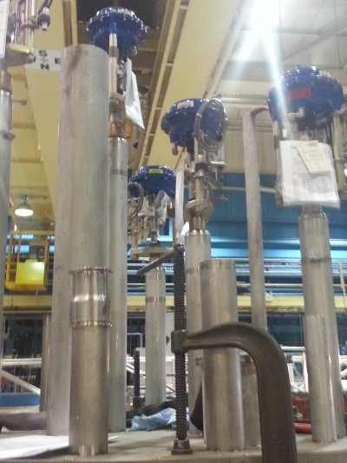
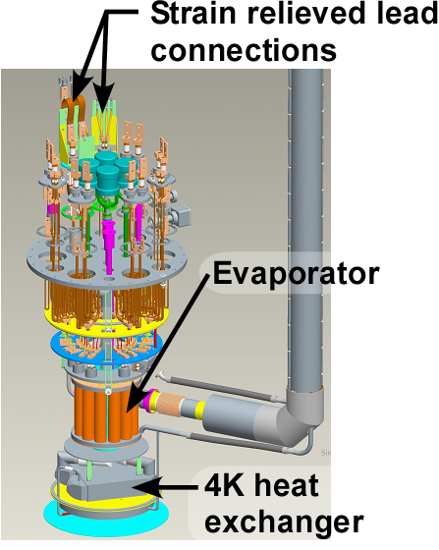
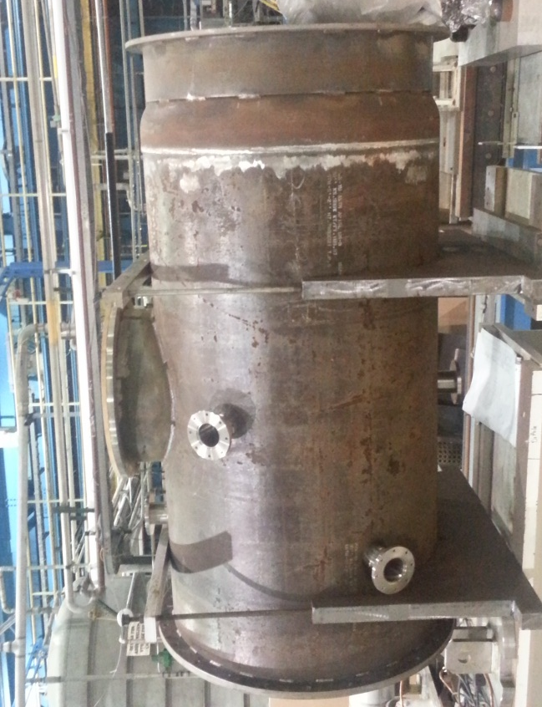
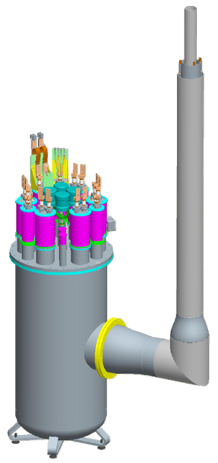
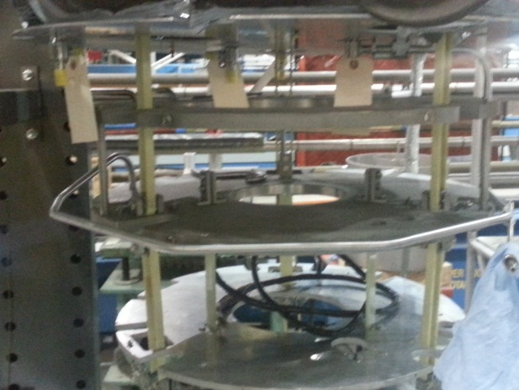
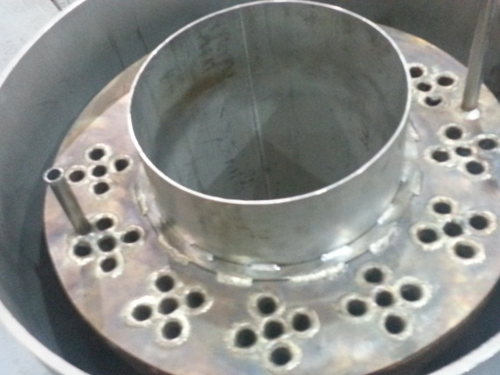
Service Cryostat Assembly

Slide 4
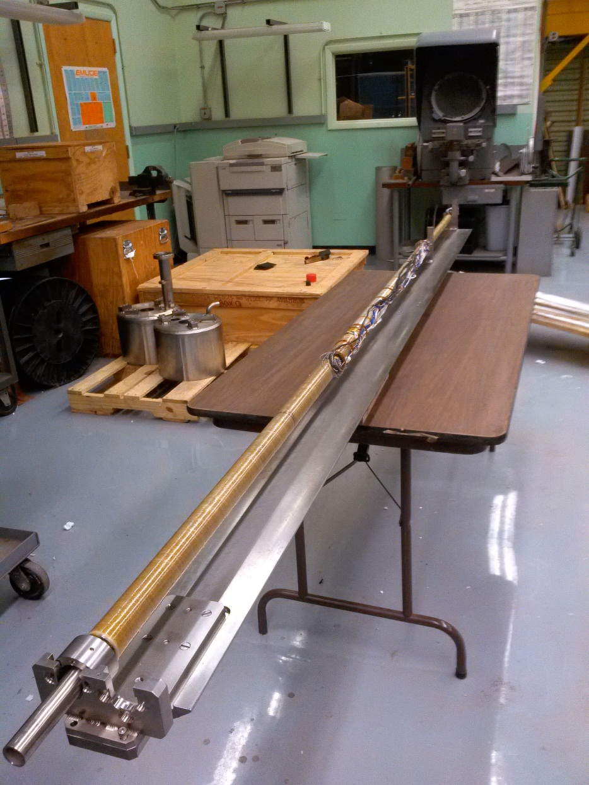
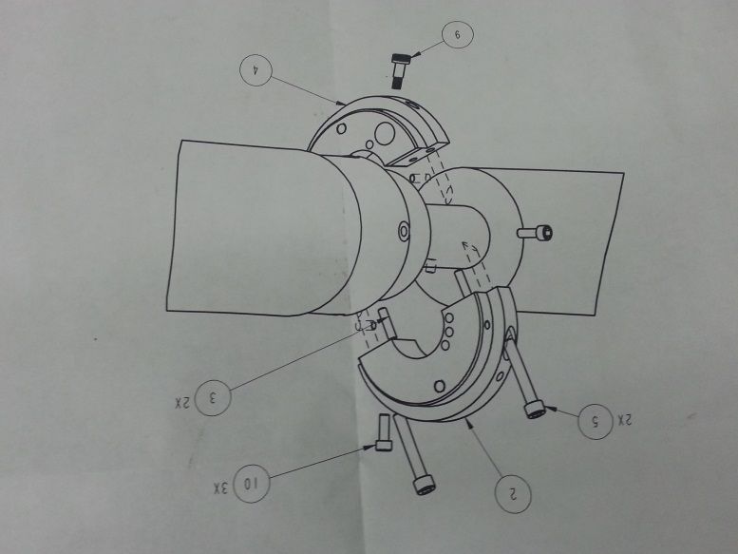
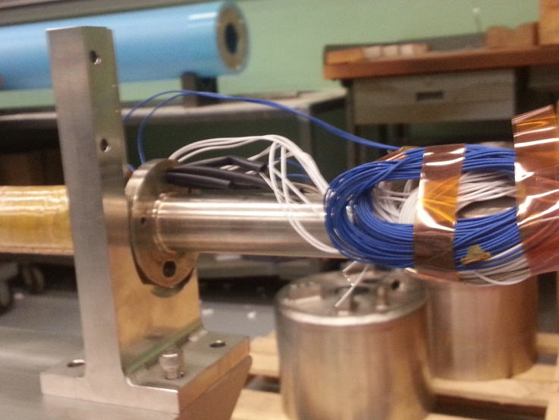
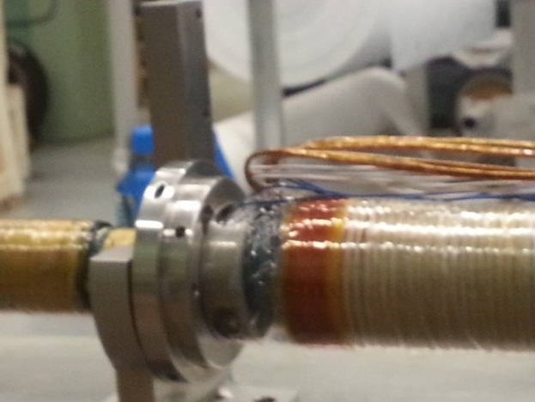
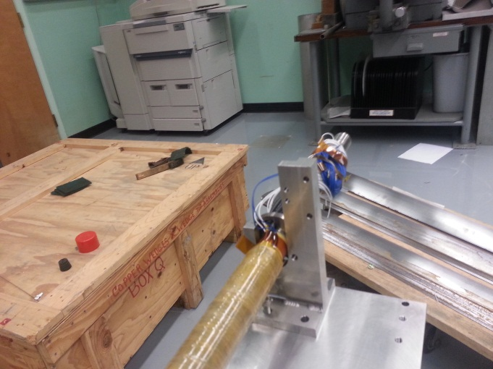
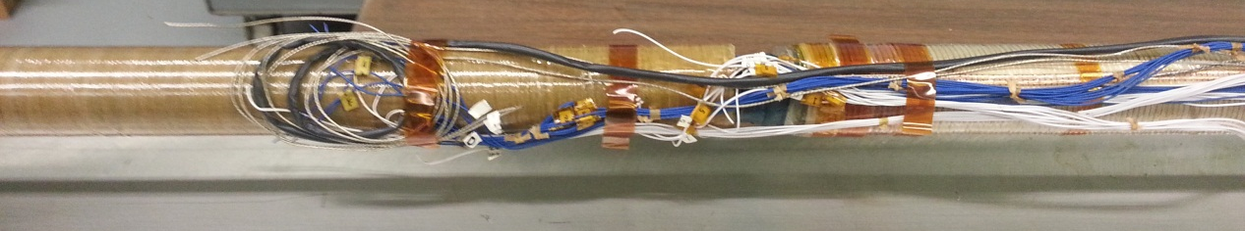
QD0 Coil & Alignment Sled Assembly

Slide 5
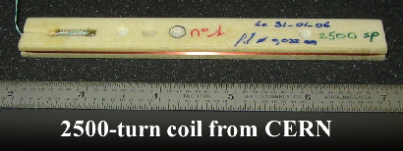
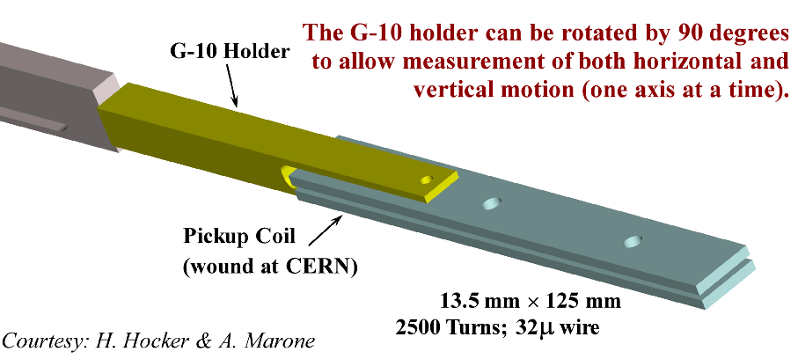
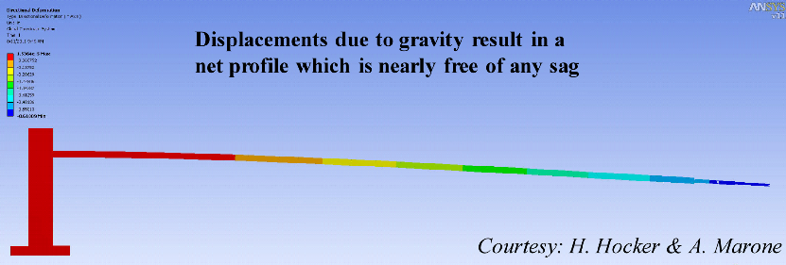
Magnetic Stability Measurements
R&D proceeds developing system with a 2500 turn pickup coil that is cantilevered into the magnet bore from a vibration isolation table.
Our ultimate goal is to directly measure small magnetic field shifts due to magnet vibration.
This technology will also be applied to the measurement of the SuperKEKG IR magnets.
The above will be discussed at magnetic measurements workshop next week at BNL, IMMW 18.

Slide 6
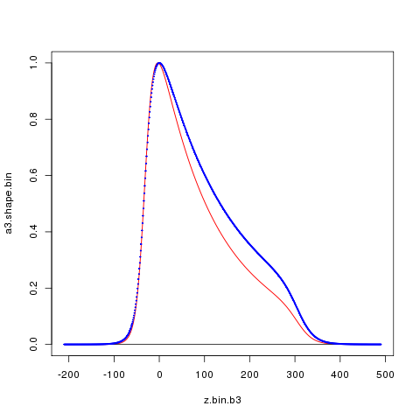
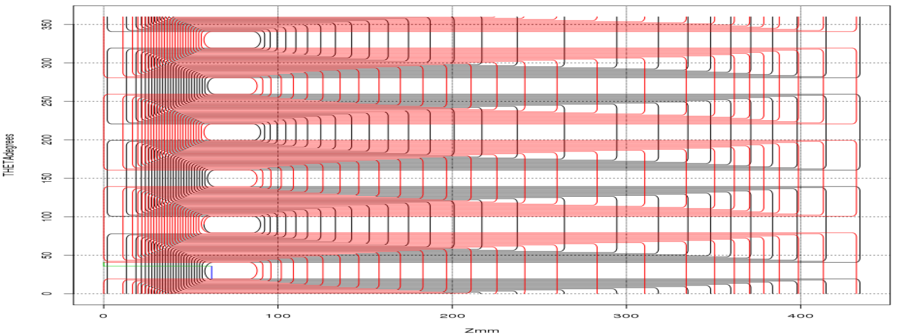
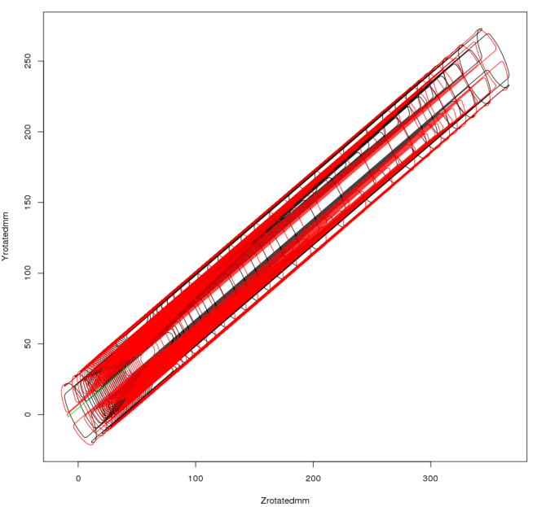

Consider Some New MDI Possibilities
SuperKEKB Cancel Coil
SuperKEKB Cancel Coil: Two Layer Sextupole Winding Pattern
b₃
a₃
Normalized Shape Distribution
Angle on Tube (Degrees)
Z (mm)
Z (mm)
First Layer Wound
Now have experience winding quite sophisticated superconducting coils (see SuperKEKB example).
There are also new ideas for QD0 anti-solenoid.
Can try to decrease cryostat transvers size while improving optics flexibility at low energy.
There are also some new concepts to explore to improve anti-DID manufacture and integration.
Projected-Y (mm)
3D View
“Twisted Coil”
generates a3 from b3
Projected-Z (mm)

