Slide 1
CLIC studies in the LCC
Context of the CLIC studies
    Option for a post LHC energy frontier machine
CDR finalization
    Including input to strategy processes
Some recent news
    CLIC workshop in January and Detector & Physics studies
    LCC and CLIC
Plans towards 2017-18
    Some key challenges

Slide 2
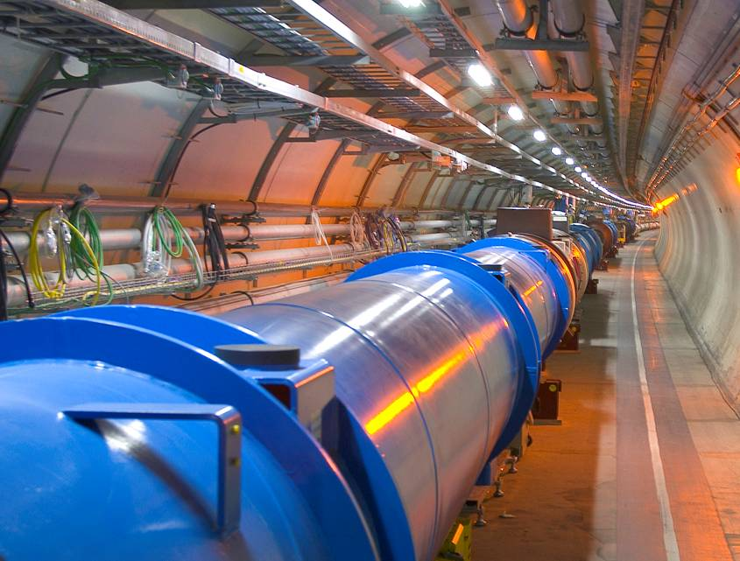
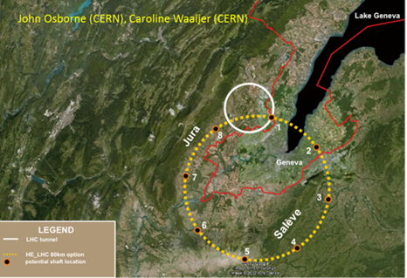
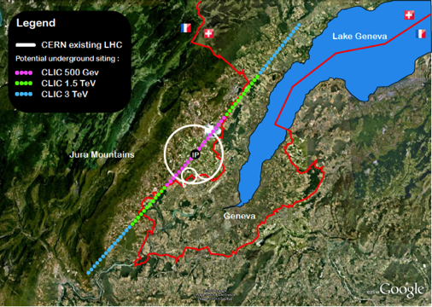
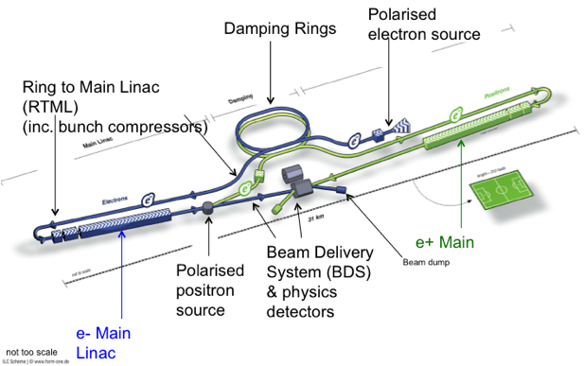
The context of the LC studies at CERN
European Strategy priorities related to the Energy Frontier:
LHC and LHC luminosity upgrades (until ~2030)
  Higgs and Beyond the Standard Model physics in long term programme
BSM – does it show up at LHC at 14 TeV, 2015 onwards ?
  What are the best machines to access such physics directly post-LHC …. we don’t know but we can prepare main options the next years towards next strategy update (~2018)
  Two alternatives considered; higher energy hadrons (HE LHC or VHE LHC), or highest possible energy e+e- with CLIC
ILC in Japan, a possibility for exploring the Higgs in detail, starting at 250 GeV
  If implemented a comprehensive programme that can map out the Higgs sector in particular
In accordance with this, pursue three connected activities in the period towards 2017-18 (when LHC results at nominal energy are becoming mature):
CLIC as option for the energy frontier
ILC project development contributions using common activities wherever possible
Detector and Physics studies for future LCs

Slide 3
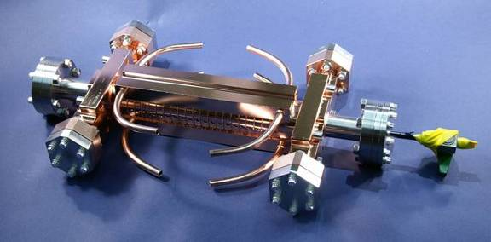
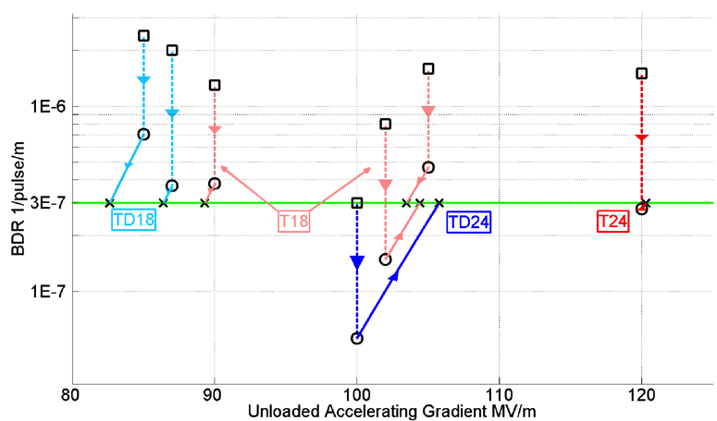
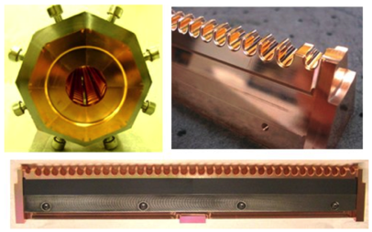
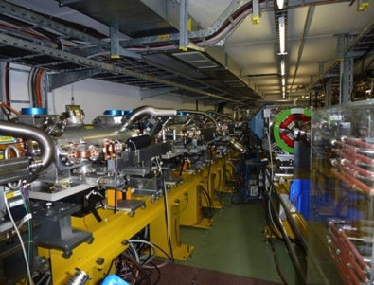
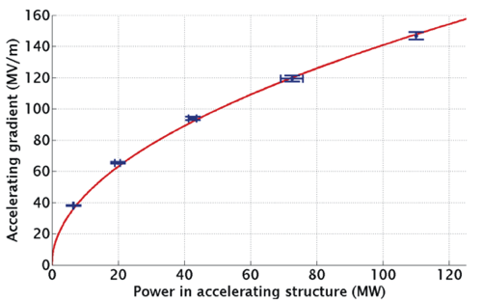
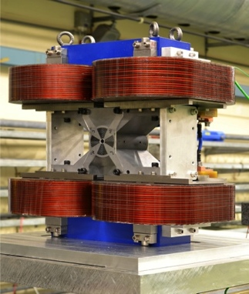
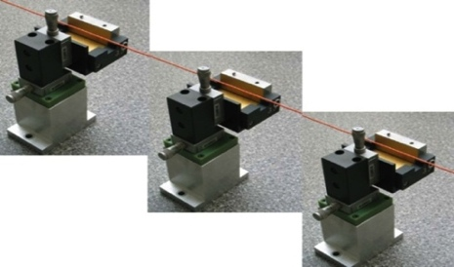
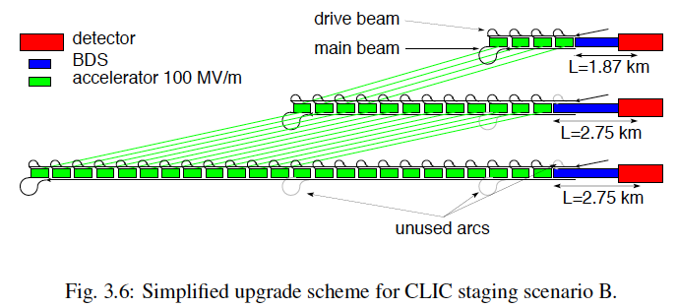
Conclusion of the accelerator CDR studies
Main linac gradient
Ongoing test close to or on target
Uncertainty from beam loading being tested
Drive beam scheme
Generation tested, used to accelerate test beam above specifications, deceleration as expected
Improvements on operation, reliability, losses, more deceleration studies underway
TD24 baseline: Unloaded 106 MV/m
Expected with beam loading 0-16% less
CLIC Nominal, unloaded
CLIC Nominal, loaded
Luminosity
Damping ring like an ambitious light source, no show stopper
Alignment system principle demonstrated
Stabilisation system developed, benchmarked, better system in pipeline
Simulations on or close to the target
Operation &
Machine Protection
Start-up sequence and low energy operation defined
Most critical failure studied and first reliability studies
Implementation
Consistent three stage implementation scenario defined
Schedules, cost and power developed and presented
Site and CE studies documented

Slide 4
The CLIC CDR documents
Vol 1: The CLIC accelerator and site facilities
- CLIC concept with exploration over multi-TeV energy range up to 3 TeV
- Feasibility study of CLIC parameters optimized at 3 TeV (most demanding)
- Consider also 500 GeV, and intermediate energy range
- https://edms.cern.ch/document/1234244/
Vol 2: Physics and detectors at CLIC
- Physics at a multi-TeV CLIC machine can be measured with high precision, despite challenging background conditions
- External review procedure in October 2011
- http://arxiv.org/pdf/1202.5940v1
Vol 3: “CLIC study summary”
- Summary and available for the European Strategy process, including possible implementation stages for a CLIC machine as well as costing and cost-drives
- Proposing objectives and work plan of post CDR phase (2012-16)
- http://arxiv.org/pdf/1209.2543v1
In addition a shorter overview document was submitted as input to the European Strategy update, available at:
http://arxiv.org/pdf/1208.1402v1
An input document to Snowmass 2013 has also been submitted:
http://arxiv.org/abs/1305.5766

Slide 5
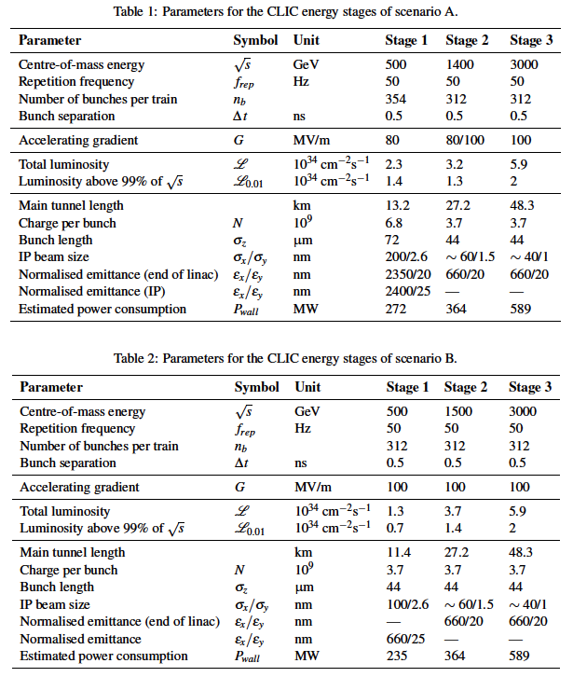
Possible CLIC stages studied
Key features:
High gradient (energy/length)
Small beams (luminosity)
Repetition rates and bunch spacing (experimental conditions)

Slide 6
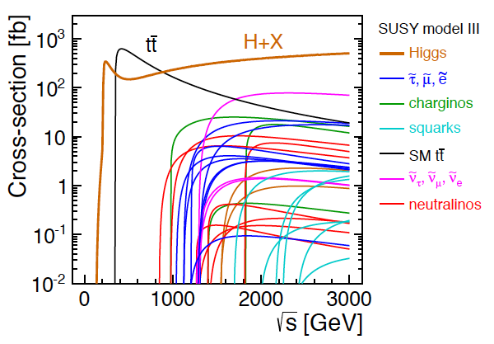
CLIC physics potential
LHC complementarity at the energy frontier:
How do we build the optimal machine given a physics scenario (partly seen at LHC ?)
Examples highlighted in the CDR:
Higgs physics (SM and non-SM)
Top
SUSY
Higgs strong interactions
New Z’ sector
Contact interactions
Extra dimensions
Detailed studies at 350 (500), 1400 and 3000 GeV for these processes
Operation at lower than nominal energy
Stage 1: ~350-375 GeV => Higgs and top physics
Stage 2: ~1.5 TeV => ttH, ννHH + New Physics (lower mass scale)
Stage 3: ~3 TeV => New Physics (higher mass scale)

Slide 7
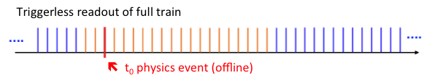
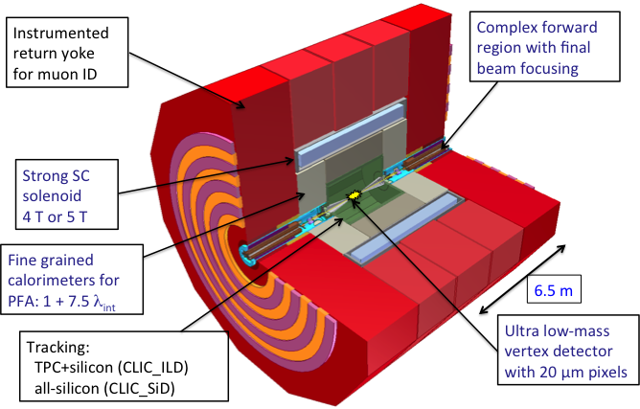
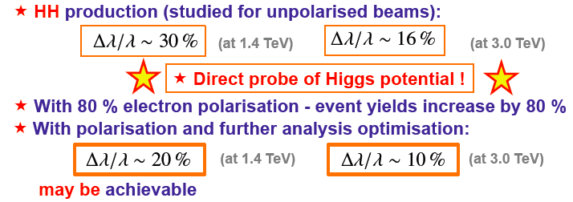
CLIC Physics and Detector studies
tCluster
Detailed GEANT 4 simulation
  Consider in particular pair background and γγ-processes
Studied using full reconstruction with background
  Make full use of timing and fine granularity to reconstruct the physics objects with very high precision
Have verified that the CLIC bunch and timing structures are fully compatible with high precision e+e- physics
Studies at a range of CM energies from 350 to 3000 GeV (SM, Higgs, BSM), see: https://indico.cern.ch/getFile.py/access?contribId=18&sessionId=0&resId=0&materialId=slides&confId=204269
Further work on completing picture of Higgs prospects at ~350 GeV, ~1.4 TeV, ~3 TeV, example:

Slide 8
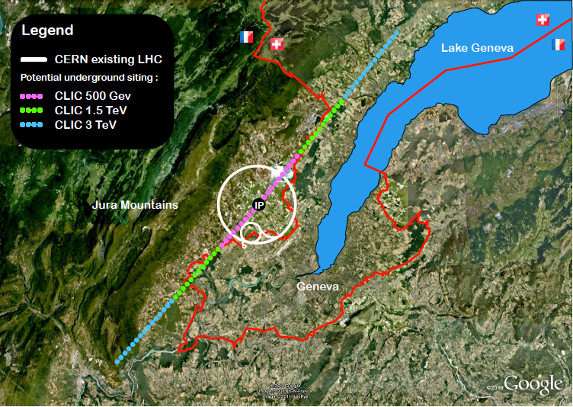
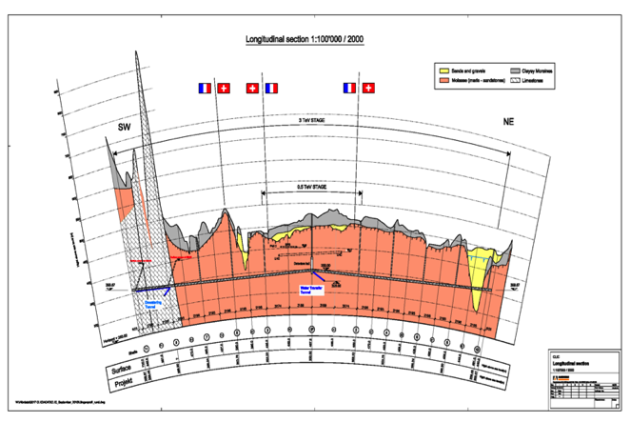
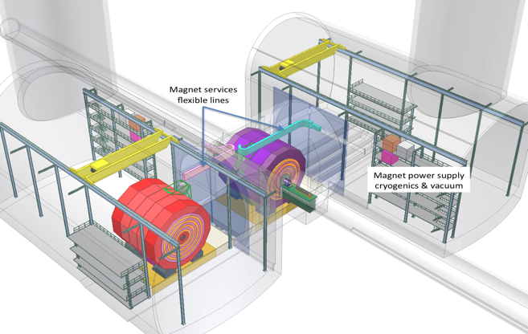
CLIC near CERN
Tunnel implementations (laser straight)
Central MDI & Interaction Region

Slide 9
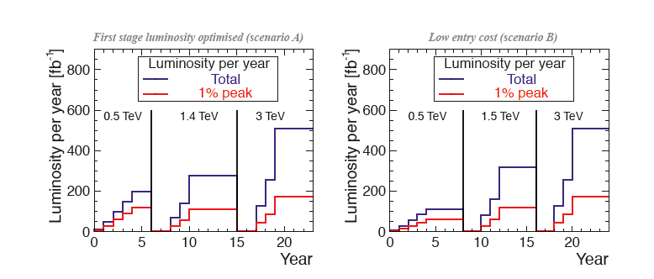
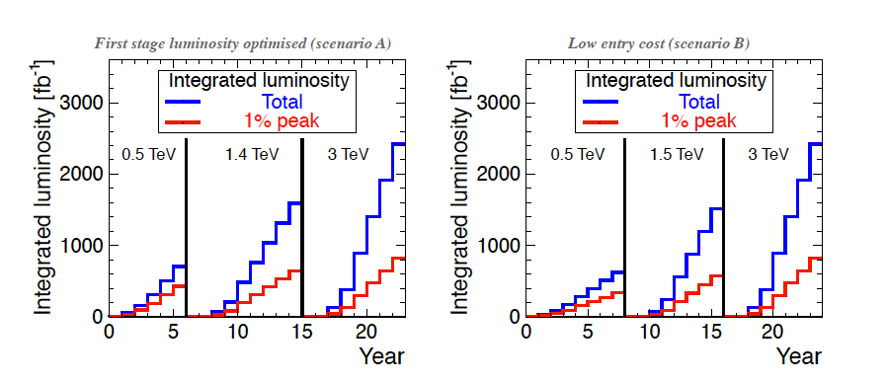
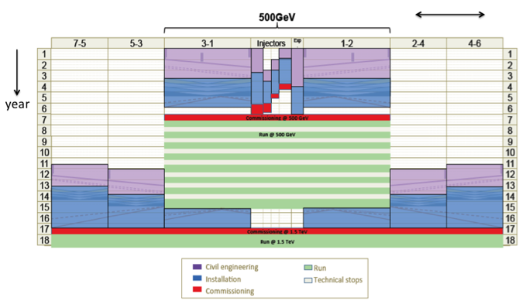
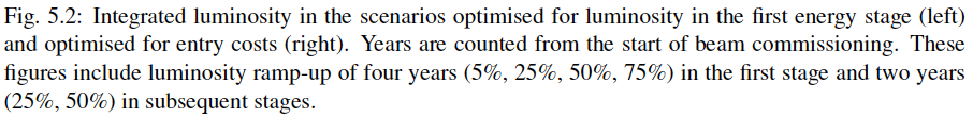
Possible luminosity examples
Based on 200 days/year at 50% efficiency (accelerator + data taking combined)
Target figures: >600 fb⁻¹ at first stage, 1.5 ab⁻¹ at second stage, 2 ab⁻¹ at third stage

Slide 10
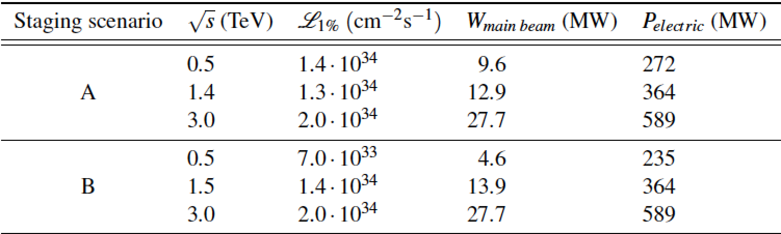
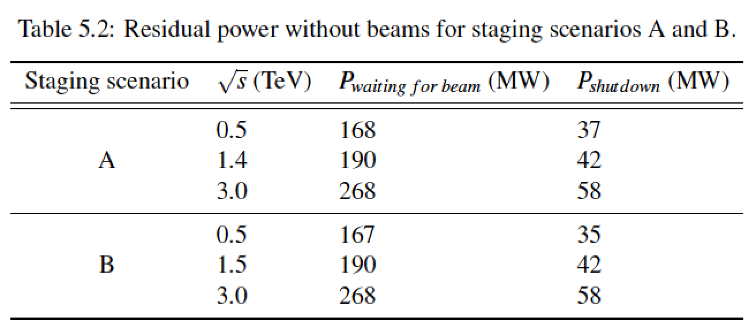
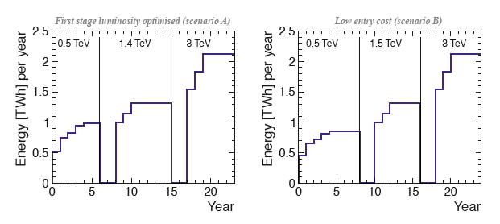
Power/energy consumption
Considering 150 days per year of normal operation at nominal power and a luminosity ramp-up in the early years at each stage of collision energy, the development of yearly energy consumption can be sketched.
Re-optimize parts
  Reduced current density in normal-conducting magnets
  Reduction of heat loads to HVAC
  Re-optimization of accelerating gradient with different objective function
Efficiency
  Grid-to-RF power conversion
  Permanent or super-ferric superconducting magnets
Energy management
  Low-power configurations in case of beam interruption
  Modulation of scheduled operation to match electricity demand: Seasonal and Daily
  Power quality specifications
Waste heat recovery
  Possibilities of heat rejection at higher temperature
  Waste heat valorization by concomitant needs, e.g. residential heating, absorption cooling
Beyond:
Scale with inst. luminosity – i.e. running at the very end of the project lifetime might be power limited and require more time.
CERN energy consumption 2012: 1.35 TWh

Slide 11
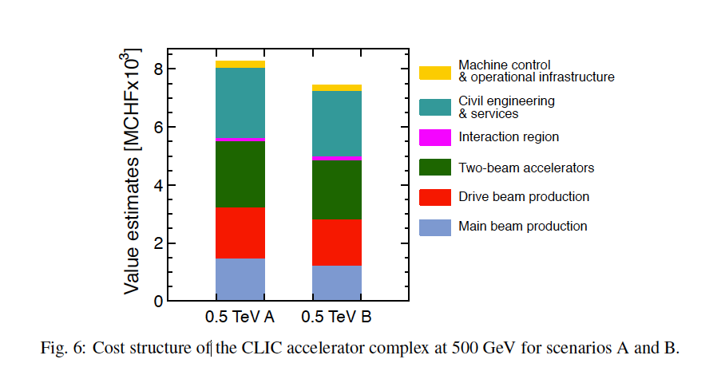
Costs
First to second stage: 4 MCHF/GeV (i.e. initial costs are very significant)
Caveats:
  Uncertainties 20-25%
  Possible savings around 10%
  However – first stage not optimised (work for next phase), parameters largely defined for 3 TeV final stage

Slide 12


























Current CLIC Collaboration
CLIC multi-lateral collaboration - 48 Institutes from 25 countries
Over the last months increased to 48 institutes from 25 countries adding Jerusalem, Belgrade, Alba and Tartu to the list – linked to 2012-2017 work-programme
On-going discussions with 5 more groups … large interest for participation in development of this technology
Detector and Physics Studies for CLIC being organized in a similar manner, but with less formal agreements – yet allowing a collaboration like structure to organize the work, elections and making decisions about priorities and policies
ACAS (Australia)
Aarhus University (Denmark)
Ankara University (Turkey)
Argonne National Laboratory (USA)
Athens University (Greece)
BINP (Russia)
CERN
CIEMAT (Spain)
Cockcroft Institute (UK)
ETH Zurich (Switzerland)
FNAL (USA)
Gazi Universities (Turkey)
Helsinki Institute of Physics (Finland)
IAP (Russia)
IAP NASU (Ukraine)
IHEP (China)
INFN / LNF (Italy)
Instituto de Fisica Corpuscular (Spain)
IRFU / Saclay (France)
Jefferson Lab (USA)
John Adams Institute/Oxford (UK)
Joint Institute for Power and Nuclear Research SOSNY /Minsk (Belarus)
John Adams Institute/RHUL (UK)
JINR
Karlsruhe University (Germany)
KEK (Japan)
LAL / Orsay (France)
LAPP / ESIA (France)
NIKHEF/Amsterdam (Netherland)
NCP (Pakistan)
North-West. Univ. Illinois (USA)
Patras University (Greece)
Polytech. Univ. of Catalonia (Spain)
PSI (Switzerland)
RAL (UK)
RRCAT / Indore (India)
SLAC (USA)
Sincrotrone Trieste/ELETTRA (Italy)
Thrace University (Greece)
Tsinghua University (China)
University of Oslo (Norway)
University of Vigo (Spain)
Uppsala University (Sweden)
UCSC SCIPP (USA)

Slide 13

Organisation of CLIC detector and physics study
Collaboration-like structure, based on a “Memorandum on Cooperation”
Partners join on a “best-effort” basis
http://lcd.web.cern.ch/LCD/Home/MoC.html
17 partners have signed (of which 4 since the CLIC workshop)

Slide 14
MoC partners
Partners who have already joined (17):
Australia: ACAS;
Belarus: NC PHEP Minsk;
Czech Republic: Academy of Sciences Prague;
Denmark: Aarhus Univ.;
Germany: MPI Munich;
Israel: Tel Aviv Univ.;
Norway: Bergen Univ.;
Poland: Cracow AGH + Cracow Niewodniczanski Inst.
Romania: Inst. of Space Science;
Serbia: Vinca Inst. Belgrade;
Spain: Spanish LC network;
UK: Cambridge Univ. + Oxford Univ. + Birmingham Univ.;
USA: Argonne lab;
CERN
Discussions ongoing with ~6 additional partners:

Slide 15
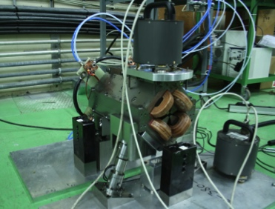
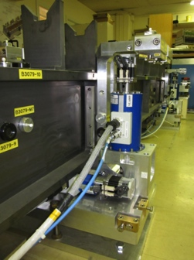
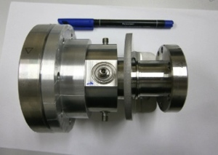
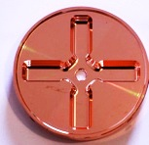
CLIC Accelerator Activities 2012-18
An optimised machine:
Higgs mass scale known and much improved cost and power models allow significant optimization
Re-baselining studies ongoing (~375 GeV, ~1.5 TeV, 3 TeV) – including more work on a klystron based initial phase
Overall design and system optimisation, technical parameters for all systems
Cost, power/energy optimisation, scheduling, site including specific developments/studies
Energy reach:
Increase test-capacity (several sites)
Detailed studies and optimisation of all the critical RF elements (main structures the most central) as well as further industrialisation
Luminosity performance:
Final focus optimisation and studies
Overall performance, reliability, robustness and risk studies
Linked to X-band technology development and industrialisation
Overall performance simulation and optimisation of each system – in some case linked to experimental benchmarking and/or tests (some examples below)
Damping ring designs including experimental development and studies
Main linac alignment and stability, wakefield studies, BBA alignment
CTF3+ programme
ATF, FACET for luminosity performance and various other smaller programmes for specific technology developments
System tests:
Studies of drive-beam stability and RF units, beam-loading experiments, deceleration, RF power generation and two beam acceleration with complete modules, as well as beam based alignment/beam delivery system/final focus studies
Continuing/increasing links to light source community related to low emittance rings and X-band based FELs design studies
Technical developments:
Critical elements, for performance, costs or power consumption, industrial developments or as needed for systemtest (some examples below)
Module development including complete modules (RF, alignment/stability, magnets, instrumentation, vacuum, cooling, controls) for lab and CTF3
RF power systems development (1 GHz)
Alignment and stability methods and hardware
Notes:
Key words for 2013:
rebaseling
power reduction studies
systemtests
structure testing capacity
drive beam power unit
common work with light source community

Slide 16
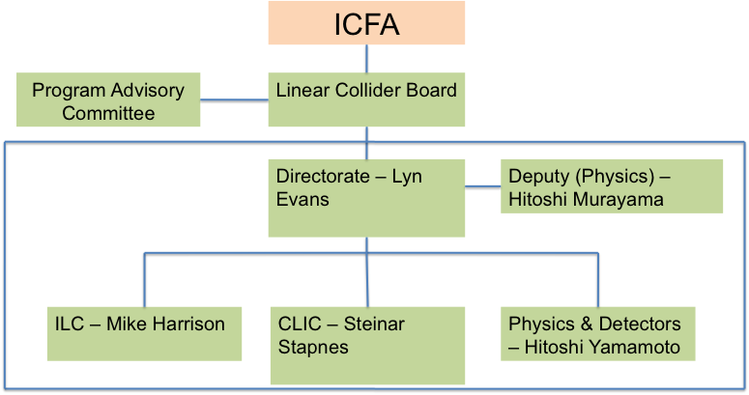
The LCC Organisation and CLIC
Issues for CLIC:
Improve common work with ILC (optimize resources) – see below
Keep strong CLIC physics and detector activities (we have a common CLIC steering group and very direct weekly contacts)
Understand machine committee organization
Sources (common working group on positron generation)
Machine Detector Interfaces
Damping rings
Beam dynamics (covers along entire machine)
Beam delivery systems
Physics and detectors
  Major potential for common activities related to all luminosity performance studies including corresponding experimental programmes
  Some technical developments also very much of common interest: alignment/stability, L-band power sources, beam-instrumentation ….

Slide 17

The CLIC Workshop 2013
(295 people signed up, 250 contributions - Open Session Monday morning)
ENERGY FRONTIER PROJECTS AT CERN AFTER LHC – THE CONTEXT OF THE CLIC ACTIVITIES
Monday afternoon:
Common session with main other alternatives for energy frontier projects at CERN after LHC (LHC energy upgrades), including presentations of what we can expect from LHC and a potential Higgs-factory
Status and very first focus on potential common or co-ordinated activities in the coming years (2013-2017)
CLIC PROJECT CORE ACTVITIES
Tuesday and Wednesday:
Parallel working groups for accelerator topics (3) and detector-physics (2)
Review of technical studies related to accelerator and detector and physics studies – with focus on ongoing and planned activities 2012-2017
Focus on the collaboration involvement and responsibilities
Define goals and milestones for end 2013 across project
Tuesday evening: Detector and Physics Institute Board
Friday AM: Accelerator plenary
Friday PM: CLIC Accelerator Collaboration Board
Many common developments between CLIC and ILC, related to accelerators and detector&physics
HIGH GRADIENT DAY
Thursday:
Presentation by labs/projects with core technology normal conducting high gradient structures and high efficiency power sources (11 project and 18 industry presentations)
Increase exchange of information between these activities, consider more common technical activities, and work towards increasing the industrial technology base for these projects

Slide 18
Summary
Technical progress within the CLIC accelerator and detector studies very significant and the results of feasibility studies have now been documented in the CDR volumes:
  Substantial work on a staged implementation also documented
  CDR process finished and focus is now on next phase(s)
Context and strategy for CLIC studies well established and integrated work within the LCC can strengthen the CLIC project (as well as any other part)
Plans for 2012-18 well defined for CLIC – with key challenges related to system specifications and performance, system tests to verify performances, technical developments of key elements, implementation studies including power and costs
  A rebaselining of the machine stages with particular emphasis on the lower energy stages in progress, including an option of an initial klystron based stage
  The programme combines the resources of collaborators inside the current collaboration, plus several new ones now joining. Wherever possible common work with ILC is being implemented
  The work needed also in the area of Physics and Detectors being defined, many studies made in common with ILC
Thanks to the CLIC collaboration for the slides and work presented – for and from the CDR and also recent presentations

Slide 20
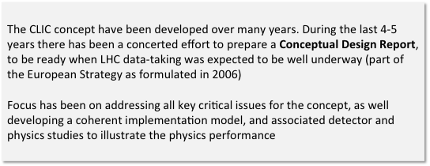
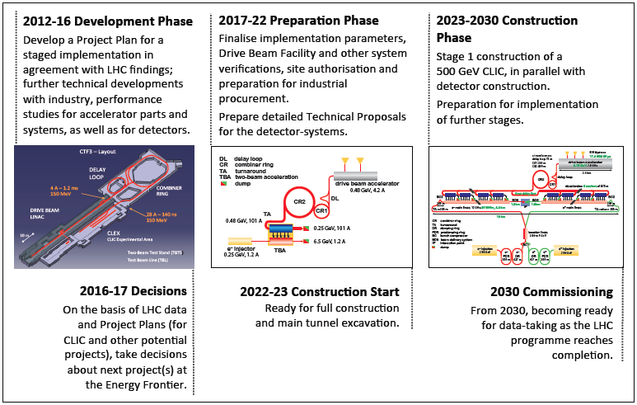
CLIC project time-line
(input to European Strategy)
The CLIC concept have been developed over many years. During the last 4-5 years there has been a concerted effort to prepare a Conceptual Design Report, to be ready when LHC data-taking was expected to be well underway (part of the European Strategy as formulated in 2006)
Focus has been on addressing all key critical issues for the concept, as well developing a coherent implementation model, and associated detector and physics studies to illustrate the physics performance

Slide 21
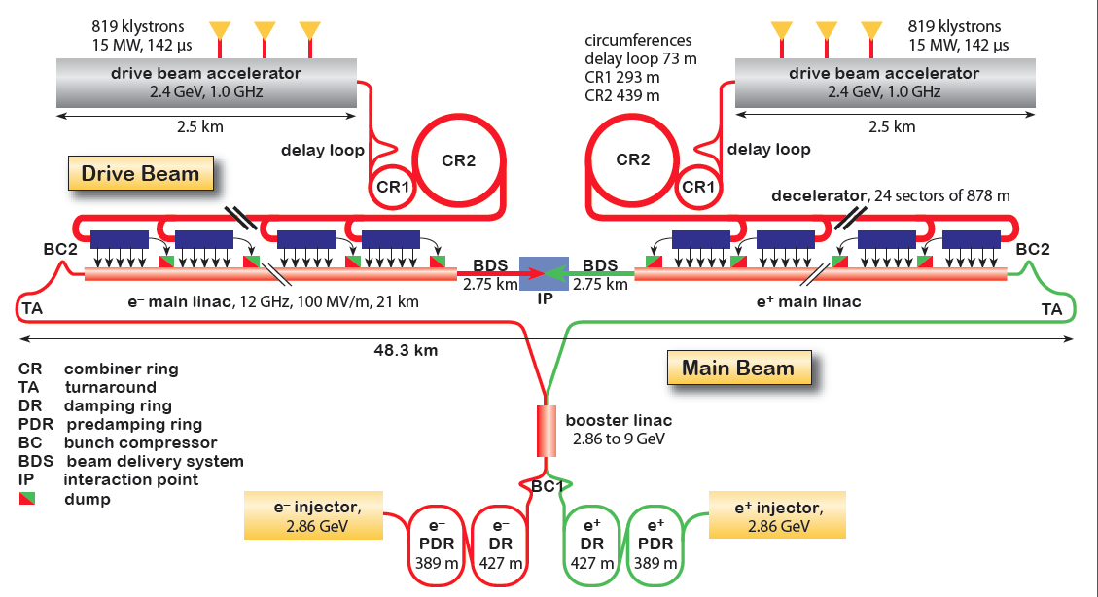
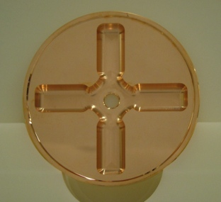
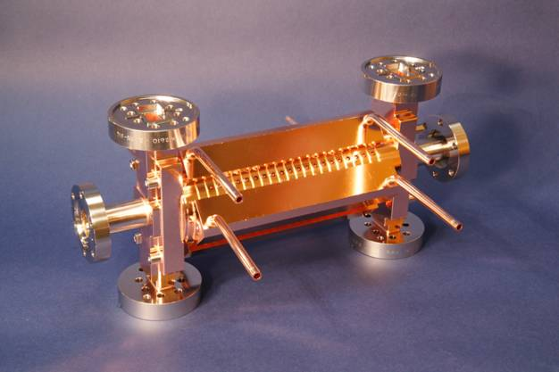
CLIC Layout at 3 TeV
Drive Beam Generation Complex
Drive beam time structure - initial
Drive beam time structure - final
240 ns
240 ns
5.8 μs
140 μs train length - 24 × 24 sub-pulses
4.2 A - 2.4 GeV – 60 cm between bunches
24 pulses – 101 A – 2.5 cm between bunches
Main Beam Generation Complex

Slide 22
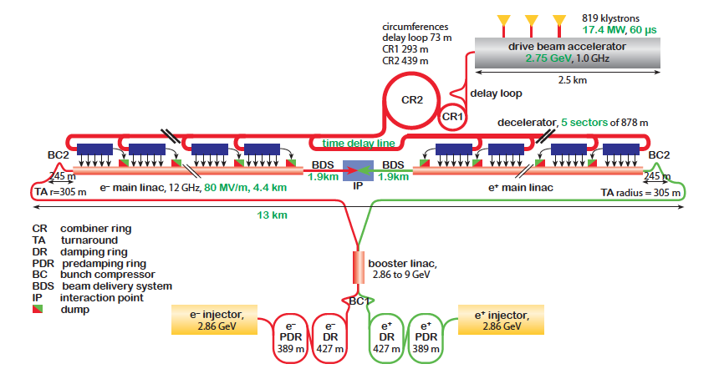
CLIC Implementation – in stages?
Need to operate at
lower than nominal energy
CLIC two-beam scheme compatible with energy staging to provide the optimal machine for a large energy range
Lower energy machine can run most of the time during the construction of the next stage.
Physics results will determine the energies of the stages
Linac 1
I.P.
Linac 2
0.5 TeV Stage
Injector
Complex
4 km
4 km
~14 km
Linac 1
I.P.
Linac 2
1-2 TeV Stage
Injector
Complex
7.0-14 km
7.0-14 km
~20-34 km
Linac 1
3 TeV Stage
I.P.
Linac 2
Injector
Complex
20.8 km
3 km
3 km
20.8 km
48.2 km

Slide 23
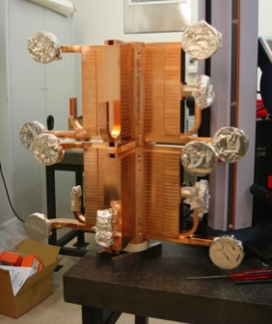
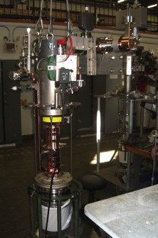
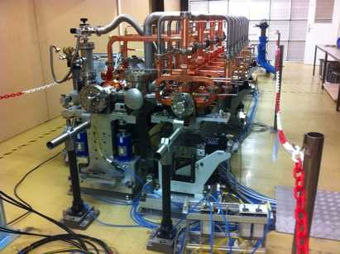
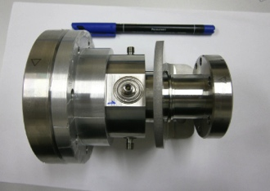
Project Implementation Plan 2012-18
Define the scope, strategy and cost of the project implementation
LHC data crucial – also at nominal energy, rebaseling studies ongoing (375 GeV, ~1.5 TeV, 3 TeV) – including more work on a klystron based initial phase
Costs, power, scheduling, site, etc
Define and keep an up-to-date optimized overall baseline design that can achieve the scope within a reasonable schedule, budget and risk.
Overall design and system optimisation, activities across all parts of the machine from sources to beam-dump, links to technical developments and system verification activities
Develop the technical design basis. i.e. move toward a technical design for crucial items of the machine – X-band as well as all other parts.
Priorities are the modulators/klystrons, module/structure development including significantly more testing facilities, and alignment/stability studies.
A number of specific instrumentation and technical system studies.
Identify and carry out system tests and programs to address the key performance and operation goals and mitigate risks associated to the project implementation.
Priorities are the measurements in: CTF3+, ATF, FACET and related to the CLIC Drive Beam Injector studies, addressing the issues of drive-beam stability, beam-loading experiments, RF power generation and two beam acceleration with complete modules, as well as beam based alignment/beam delivery system/final focus studies.
Key words for 2013:
rebaseling
power reduction studies
systemtests
structure testing capacity
drive beam power unit
common work with light source community

