Slide 1
Plan for the summer
Nobuhiro Terunuma, KEK

Slide 2
Major works in summer
For the stable beam injection
  Stabilize the LINAC
    Klystron Modulators
    Refrigerator for the RF cooling water system
  Stabilize the DR
    Checkout of power supplies, Air, Cooling water, …
For Goal-2
  ATF2 IP
For low emittance (2pm)
  Laser Wire Monitor in DR

Slide 3

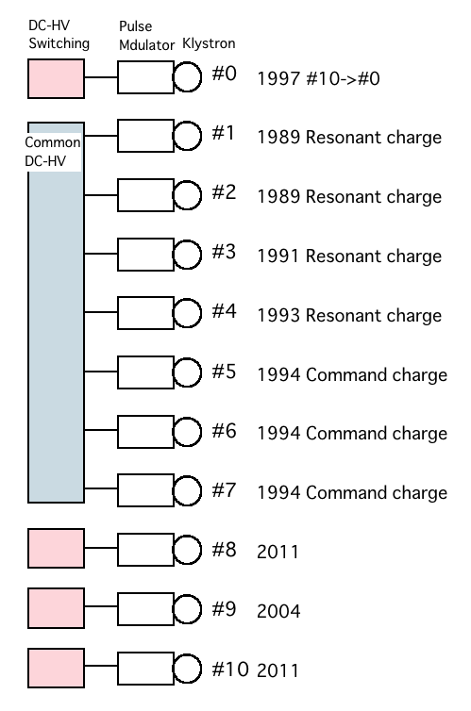
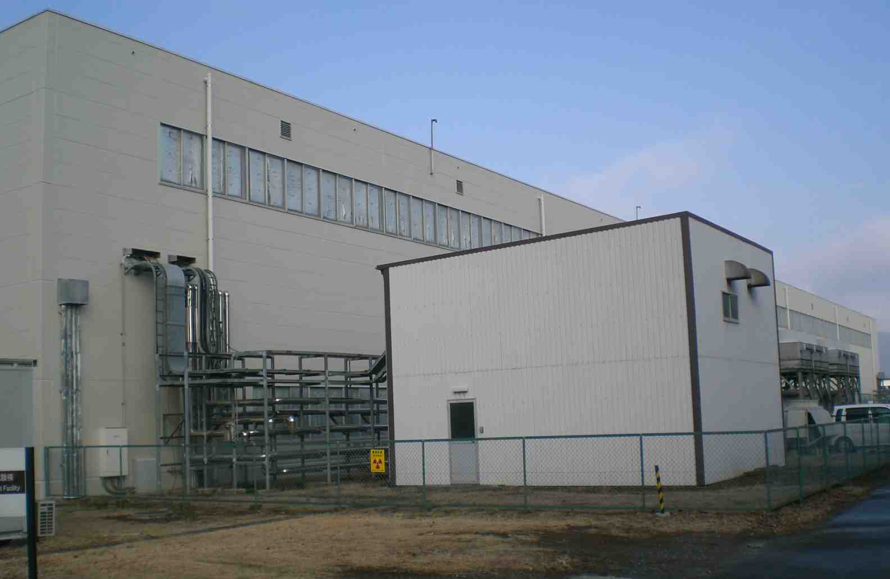
Renewal of the klystron PS(1)
Stabilization of the klystron power supply is key issue for the stable beam.
Each klystron power supply has different history and different hardware.
Especially, the common DC High Voltage power supply(common DC HV PS) is located outside of the building, which made many troubles.
The replacement of the power supplies from the common DC HV PS to the switching HV PS is now in progress.
ATF Building
DC HV PS

Slide 4
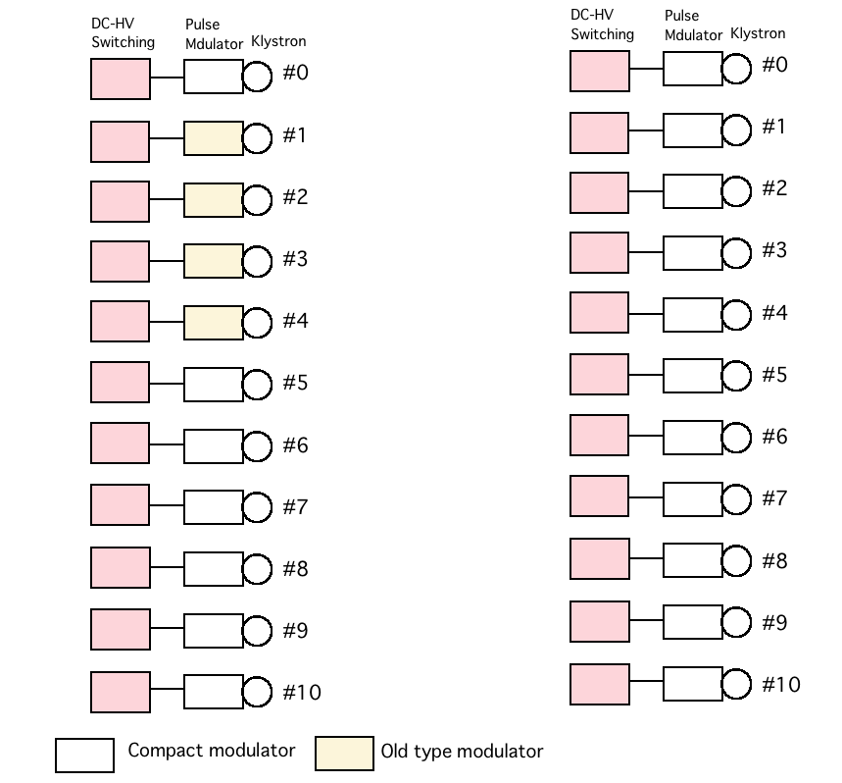
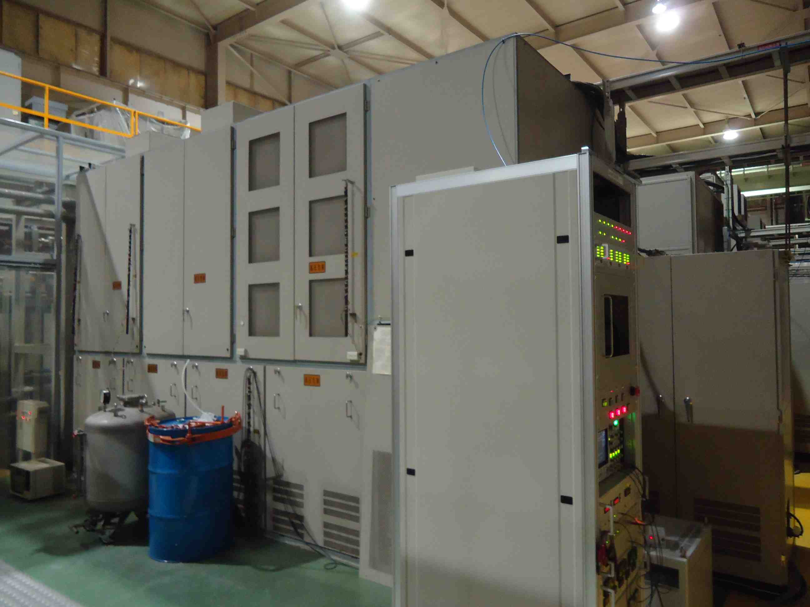
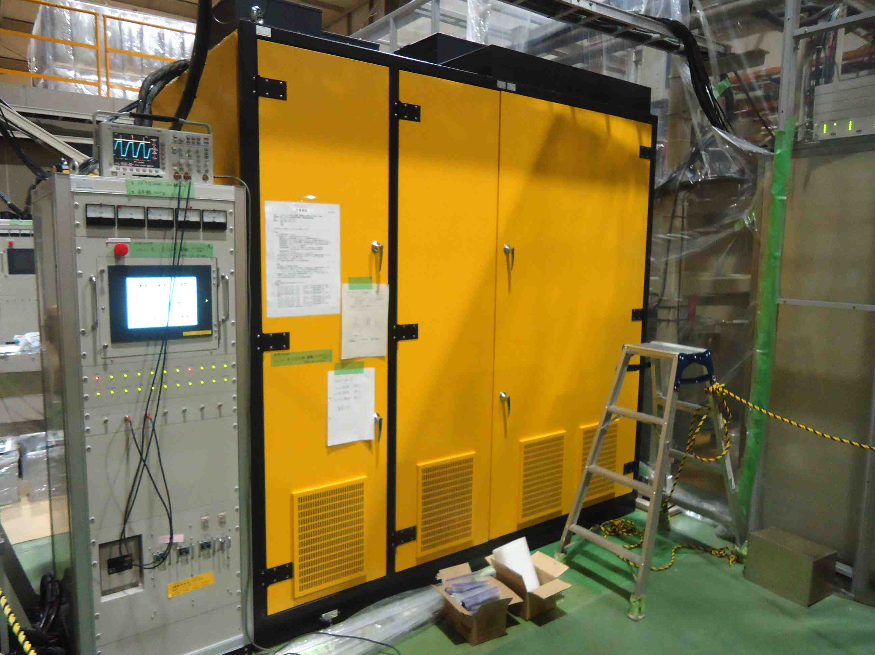
Renewal of the klystron PS(2)
Apr/2013
All switching PS
Oct/2013
All compact modulator
Old type modulator
Compact modulator

Slide 5
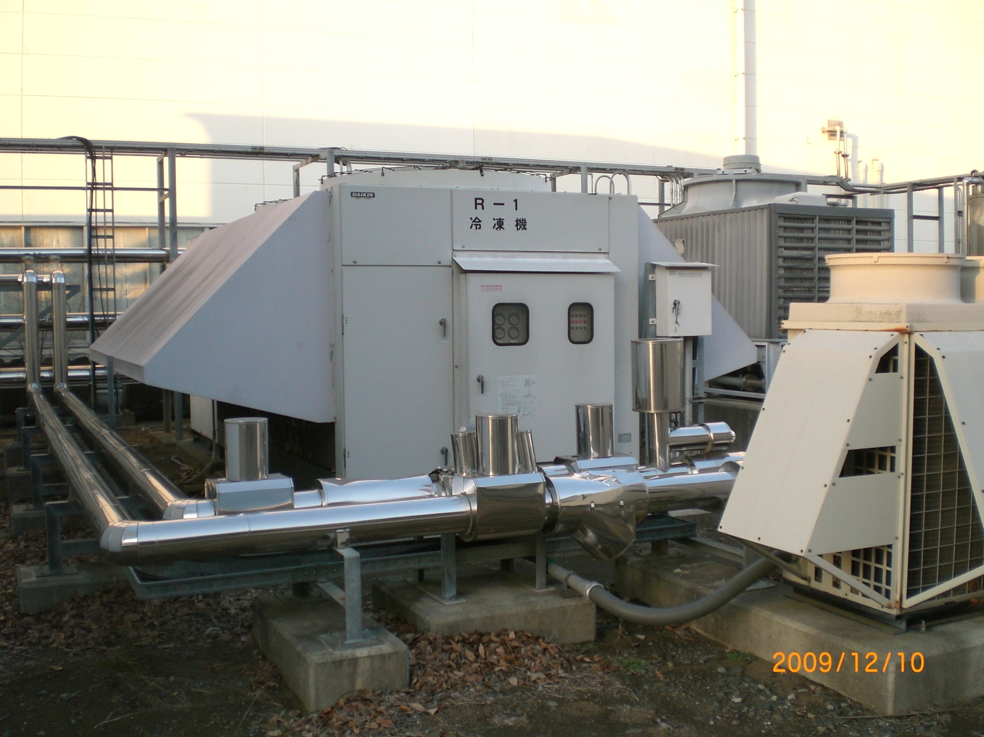
Renewal of the LINAC cooling water system
Present refrigerator
decreased performance
  Assembled in 1990
  broken fins for heat exchange
No intelligent power control
  (ON/OFF only)
  sudden change of a temperature
  → unstable RF
New refrigerator in this summer
brand-new
linear power control (automatic)
  stable temperature
  stable RF → stable beam injection

Slide 6
Schedule in 2012-2013
JFY
2012
2013
4
7
10
1
4
7
10
1
Decrease the beam size
Continuous studies for technique establishment and for goal-2
Goal-1
(37nm)
Goal-2
(2nm stabilization)
Development of components at EXT and IP
IP installation
Electronics development (FONT, IPBPM readout)
Emittance 1pm
10pm→1pm study in DR
Cavity Compton
4-mirror Cavity R&D; KEK, Hiroshima, LAL

Slide 8
P.Bambade, IPAC2013

Slide 9
P.Bambade, IPAC2013

Slide 10
P.Bambade, IPAC2013

Slide 11
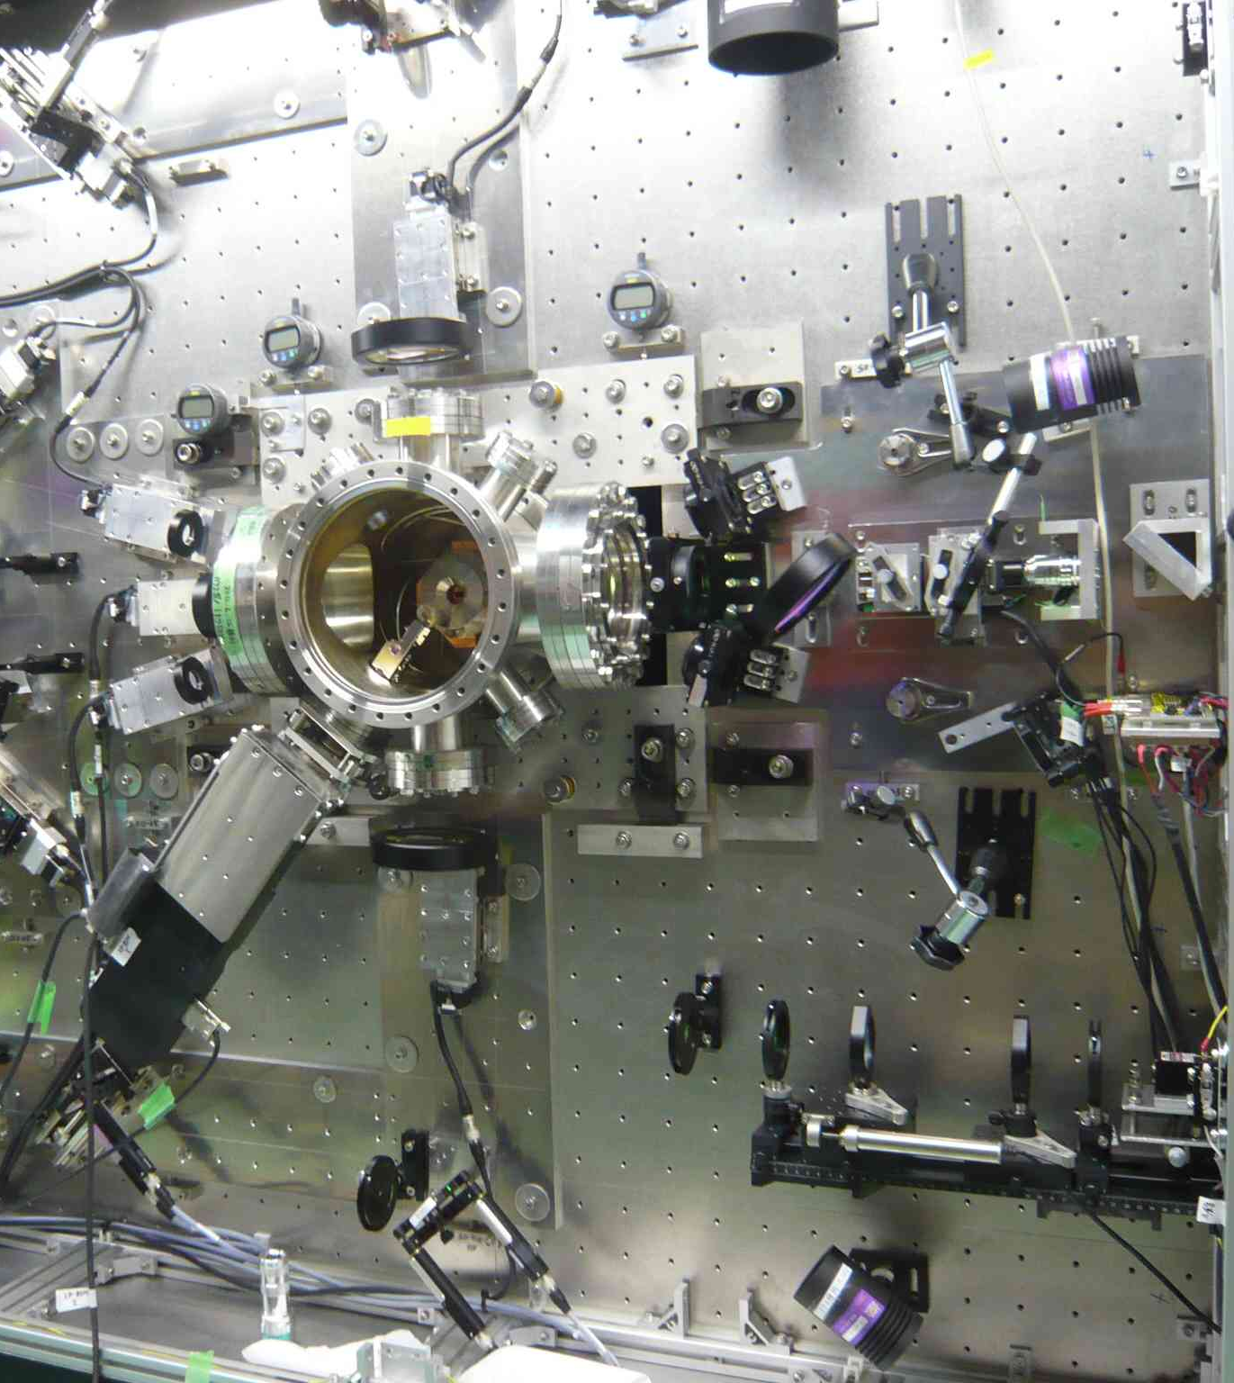
Remove uncertainty of laser path at IP
Put new base plate at right side with reference lines. →8, 30 degrees
It makes Left-Right constraint on the laser path to minimize the uncertainty of fringe tilt, roll and pitch.
Connect all base plate with relative-position constraints.→174 degree

Slide 12
IP screen and Carbon wires
Can not maintain the carbon wire by opening the end plate anymore. BPM is there.
Need extension box to replace wires by moving a rod to there.
Space for this box is available only at the upper right of a table.
Connect all base plate with relative-position constraints.→174 degree

Slide 13
Candidate location for new IP mover
Reference of laser path
Carbon
wire
replacement
Base plate with reference lines
Present IP mover

Slide 14
Summary
Improvement of the LINAC will be done for the stable beam injection.
  Four LINAC Klystron Modulators will be renewed.
  Refrigerator for the LINAC RF will be renewed.
ATF2 IP will be reconfigured for Goal-2.
  chamber with 3 IP-BPMs on movers
  well defined laser alignment scheme for IPBSM
New Laser Wire Monitor in DR will be available for the low emittance study.

