Slide 1




Overview of enhancement cavity work at LAL/Orsay
INTRO:
  Optical cavity developments at LAL
Results on optical cavity in picosecond regime
Polarised positron source R&D effort
Developments for compact Compton X-ray source (ThomX)
ECFA Linear Collider Workshop, Hambourg, may 2013

Slide 2
Introduction
Instrumentation developments around laser-electron beam interaction at LAL since ~2000 (accelerator physics applications)
  2000: cw 30000 cavity finesse for the 30GeV electron beam at HERA/DESY (Coll. DESY, CEA)
  ~2005 we started an R&D on Optical cavities in picosecond regime for a polarised positron source
    2006: start collaboration with ATF group of KEK
    2008: optical cavity for gamma-ray production on ATF/KEK
      Coll. CELIA/KEK/LMA
  2011: optical cavity for X-ray production for the equipex ThomX/LAL

Slide 3
High Finesse Fabry-Perot cavity in 2ps & 200fs regime
Experiments at LAL
with E. Cormier & K. Osvay

Slide 4
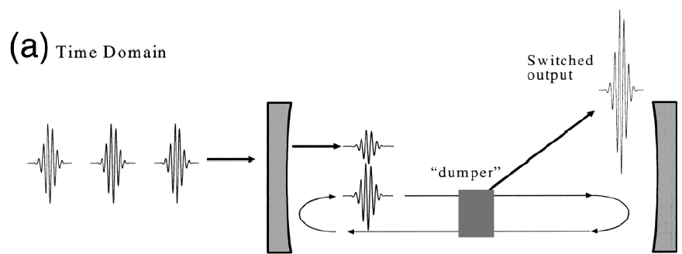
Fabry-Perot cavity in pulsed regime
Electron beam
1ps
Pulsed laser
Fabry-Perot cavity
with Super mirrors
Difference between continuous and pulsed regime

Slide 5
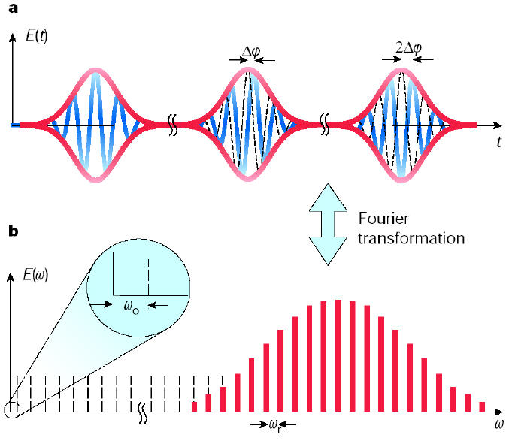
Pulsed_laser/cavity feedback technique
T=2π/ω_{r}
ΔϕCEP phase
Specificity ➔ properties of passive
mode locked laser beams
Frequency comb ➔ all the comb
must be locked to the cavity
➔ Feedback with
2 degrees of freedom :
control of the
Dilatation (frep) & translation (CEP phase)
ω_{n}= nω_{r}+ω₀
_{n~10}⁶
T. Udem et al. Nature 416 (2002) 233
State of the art (Garching MPI) : ~70kW, 2ps pulses @78MHz, stored in a 6000 finesse cavity
(O.L.35(2010)2052) ~20kW, 200fs pulses @78MHz

Slide 6
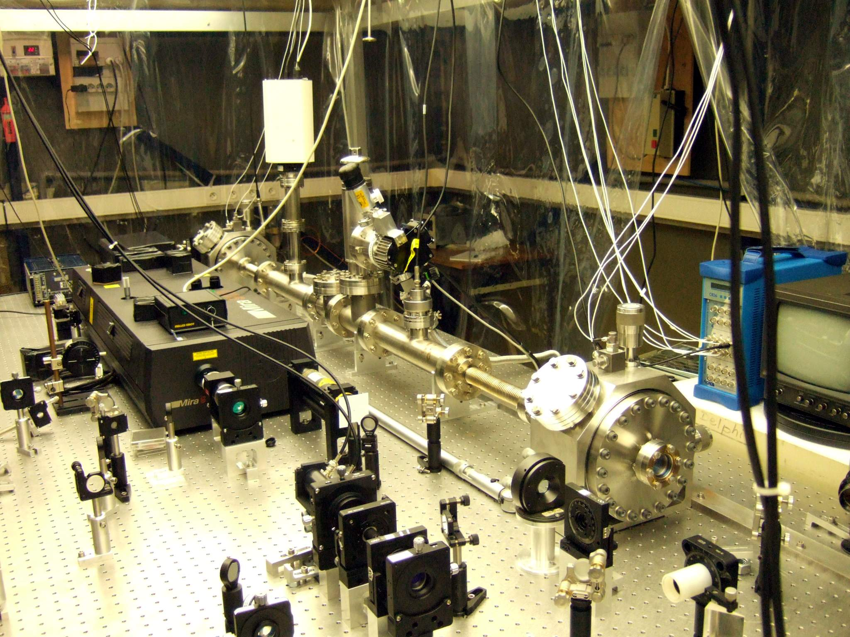
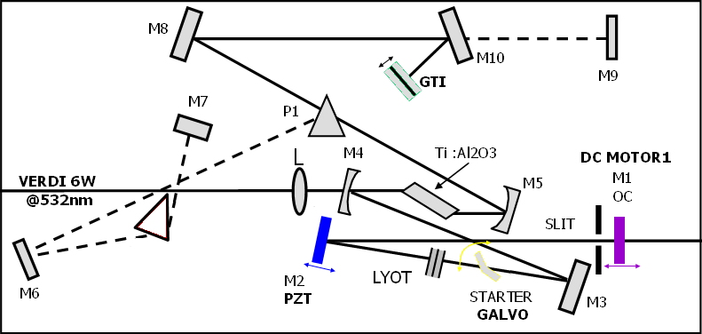
n
Orsay setup: Picosecond/High Finesse
Ti:sapph oscillator (~0.4nm spectrum)
MIRA
2-Mirror Fabry-Perot cavity
Finesse ~ 30000
Driver
VERDI 6W
AOM
M1
MOTOR
532nm
EOM
AOM
M2
PZT
+/-
Driver
Amplifier
Driver
Driver
grating
SLITS
PDH #1
Front end
PDH #2
Front end
TRANS
Front-end
Pound-Drever-Hall Scheme
Serial
RS232
Transmission Signal
+/-
Laser Length Control
Laser Δφce Control
DAQ
Feedback

Slide 7
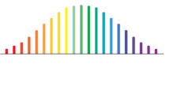

CEP effects measurement in picosecond/high finesse regime
CELIA, LAL, SZEGED Univ.
2-Mirror Fabry-Perot cavity
PDT
2ps Ti:Sapph (75MHz) Locked to a
~30000 finesse cavity
No control of the CEP drift in the
feedback loop
Ti:sapph
oscillator
Chiller
Water cooling
GTI
Ti:Sapph
SM
Pump laser
FI
PZT
Lyot
filter
IDW
Slit
EOM
Starter
AOM
PDF1
PDR
Slit
Numerical feedback loop
BW=100-200kHz
BW ~1MHz under development
PDH
PZT filter
PDF2
AOM filter
Digital Feedback
Multiple Beam Interferometer
CCD
Stabilized He-Ne
CEP measured with Karoly’s
interferometer
Imaging
Spectrograph
Feedback loop to piezo
Frequency
Counter

Slide 8
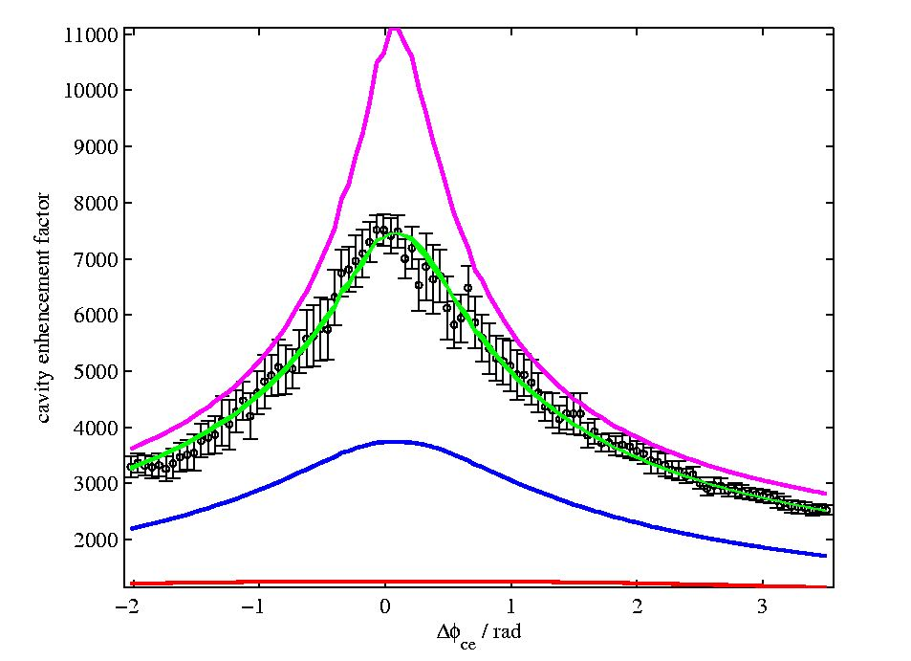
Variation of the pump power
➔laser/cavity coupling measurement➔effective enhancement factor
➔CEP measurement
F=45000
Measured
enhancement
factor
Freq. Comb fit
With F~30000
F=15000
F=3000
➔60% enhancement factor variation if CEP phase [0,2π] for 2ps & ~30000 Finesse
  CEP phase must be also controled in high Finesse/picosecond regime
Feedback loop BW must be>200kHz (on Frep at least)

Slide 9
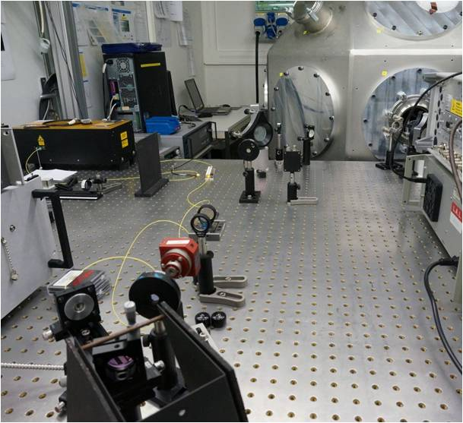
Same experiment with Yb fiber laser at Orsay
(8nm spectrum)
4 mirror non planar cavity
Cavity mirrors: T~20ppm
➔Finesse~25000
Fiber laser
➔frequency noise issues
➔feedback bandwidth>1MHz
Very stable laser/cavity Locking
‘Secondhand’ vacuum vessel
➔We had dust issued
➔laser/cavity coupling ~50%
(→Net power gain ~7500*50%)
Next week:
➔new mirrors T~8ppm (➔F~43000)
➔fiber amplifier (CELIA) : 50W
Summer 2013
➔installation of ATF at KEK
Fiber yb laser

Slide 10
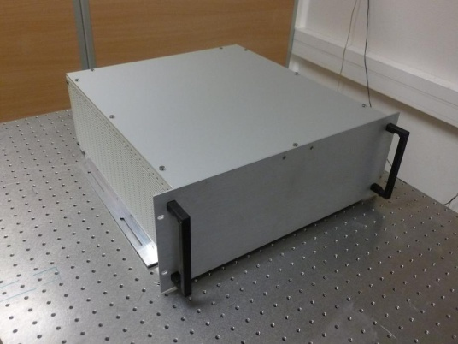
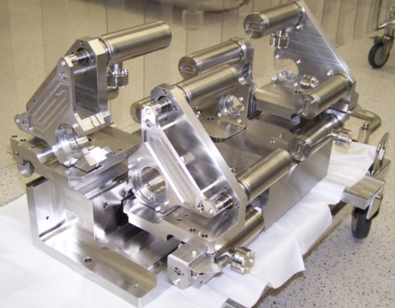
Towards 1 MW average power
G = 10000
150 W fiber laser
CELIA
F = 30 000
FP cavity
LAL
Stored average power of 100 kW to 1 MW
Notes:
1 min 15 sec

Slide 11
Polarised positron source
Experiment at KEK
Collaboration with ATF/KEK and CELIA
to provide Yb fibre amplifier
(10W→60W average power)

Slide 12
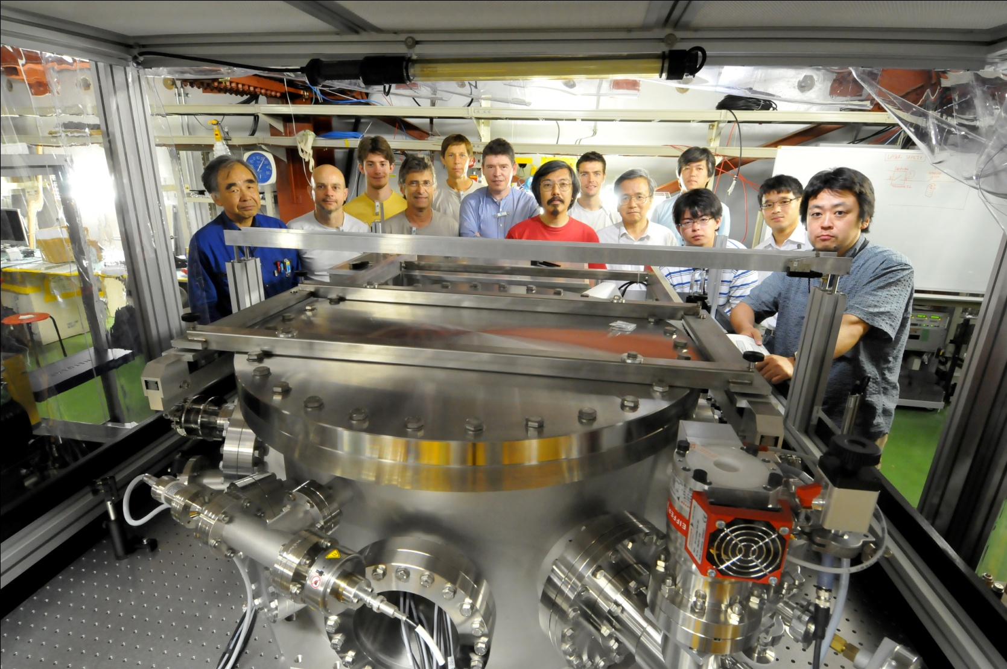
KEK cavity
French Japanese Collaboration
+I. Chaikovska, N. Delerue, R. Marie LAL
+ J. Lhermite from CELIA
Araki-san
12

Slide 13
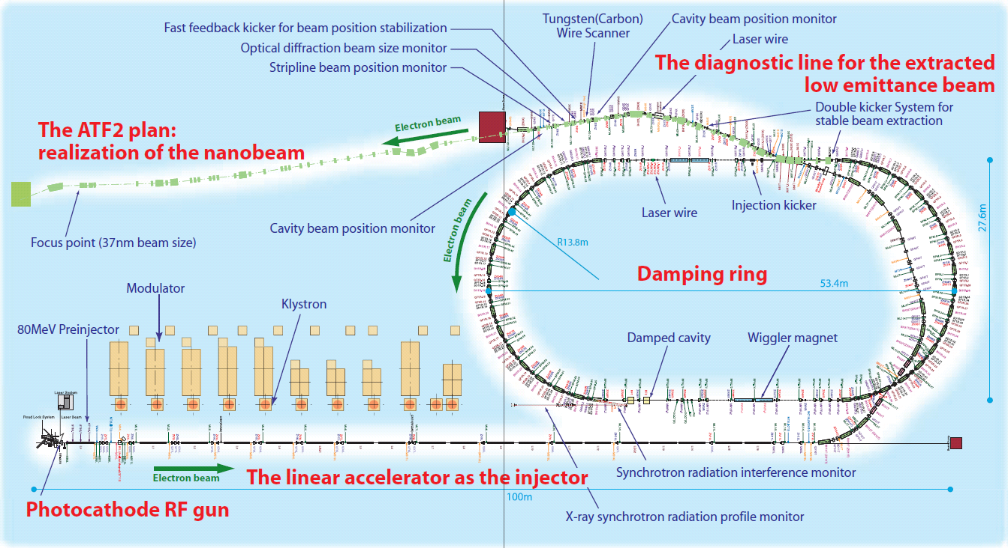
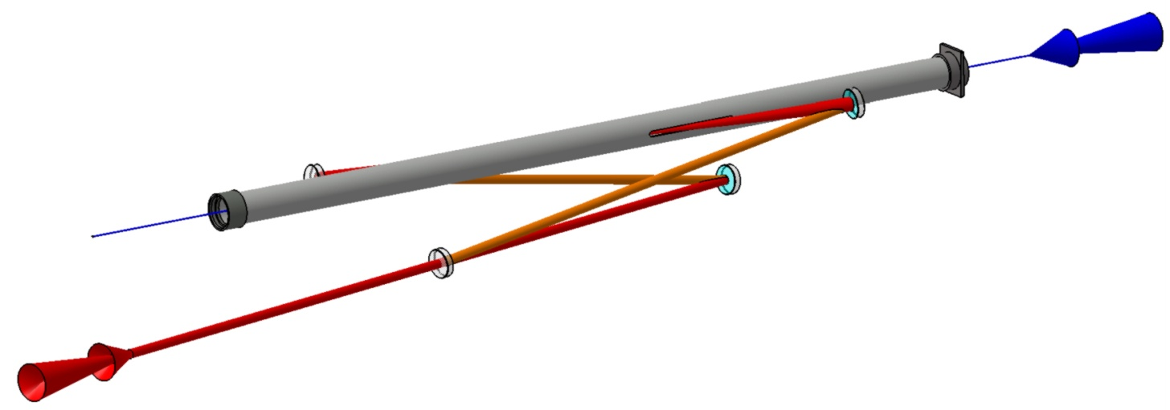
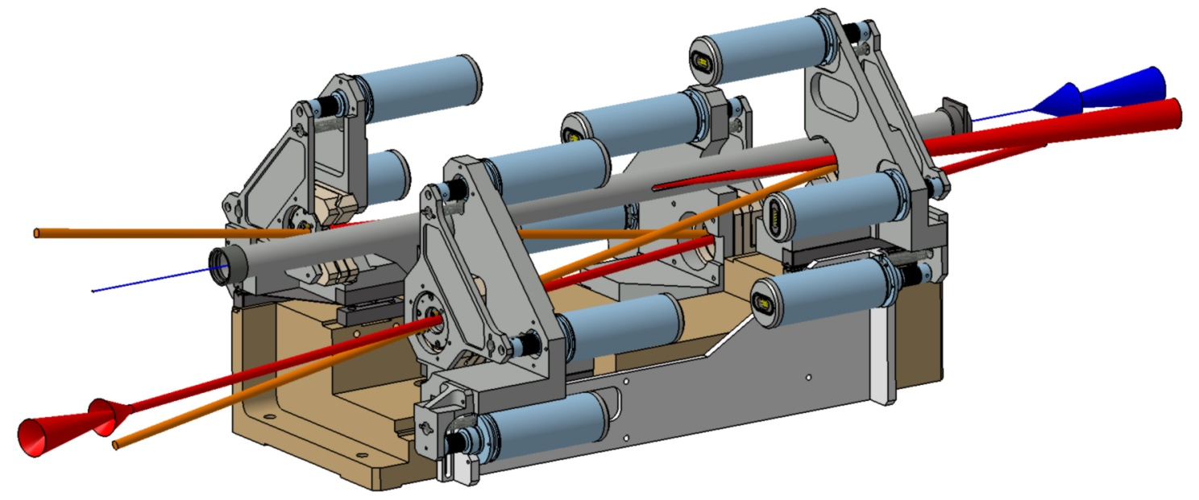
Results at KEK
Non planar 4-mirror
cavity
12 encapsulated Motors
2 spherical mirrors
e⁻
mechanical stability
➔ 4-mirror cavity
circularely polarised
eigenmodes
➔Non-planar geometry
laser
2 flat mirrors

Slide 14
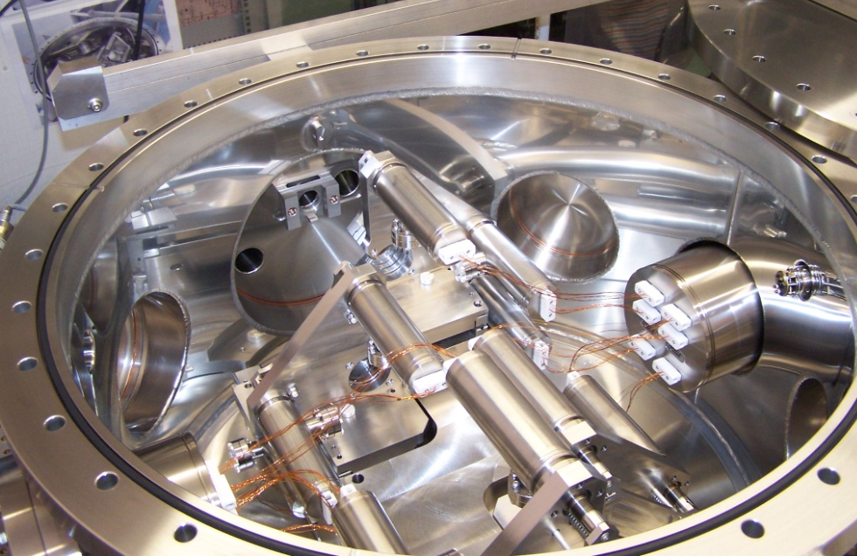
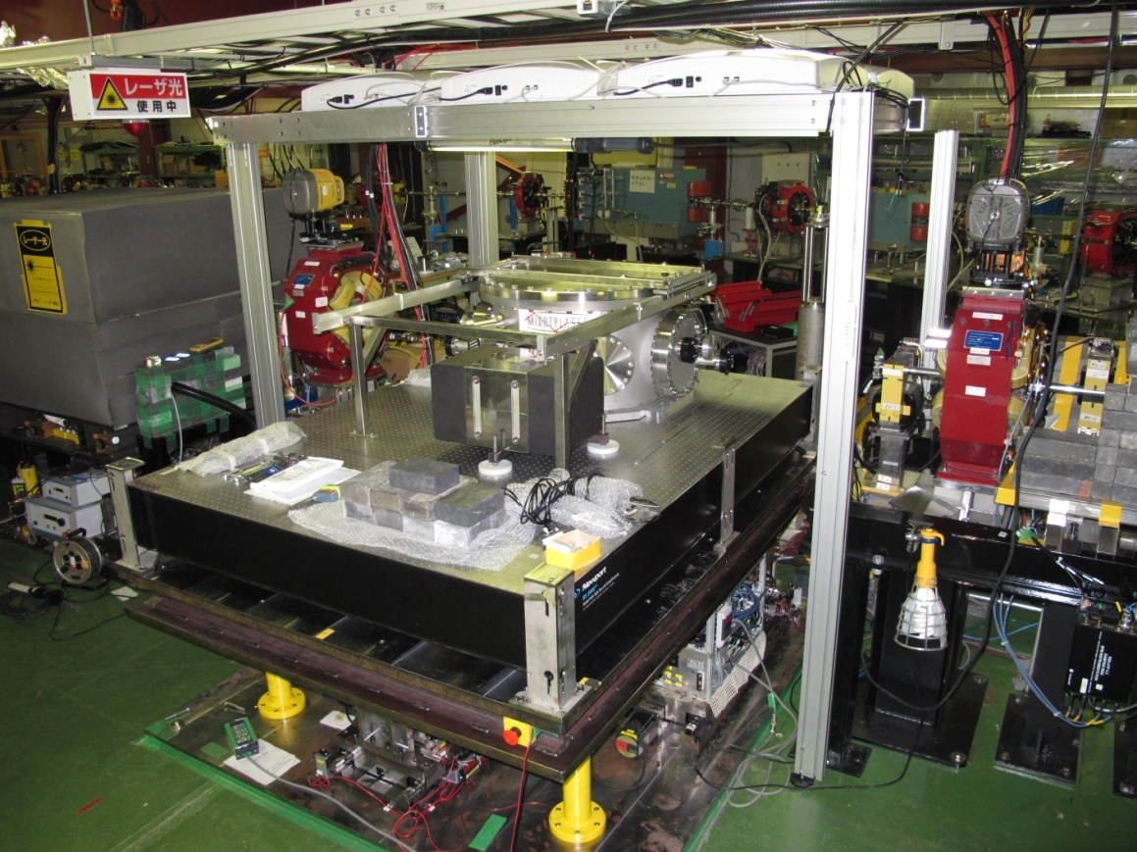
Four mirror non-planar
cavity
Results before the earthquake
Finesse 3000 & 10W incident
laser power
Detection of ~30MeV gamma-rays
Re installation during summer 2013
New fiber Laser
Cavity Finesse 25000→45000
Laser power 50W→100W

Slide 15
Monochromatic X-ray source
ThomX
Experiment at Orsay
CELIA in charge of high average power amplifier

Slide 16

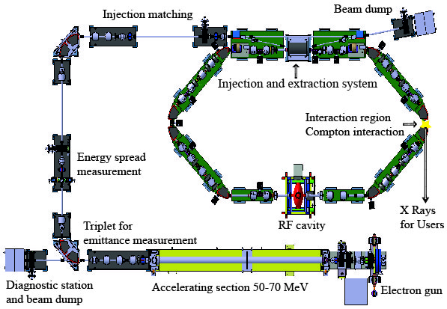







ThomX
IN2P3
Les deux infinis
~10m
~7m
Résonateur
optique

Slide 17
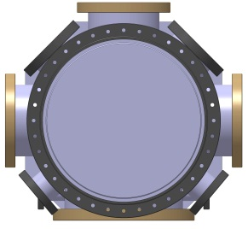
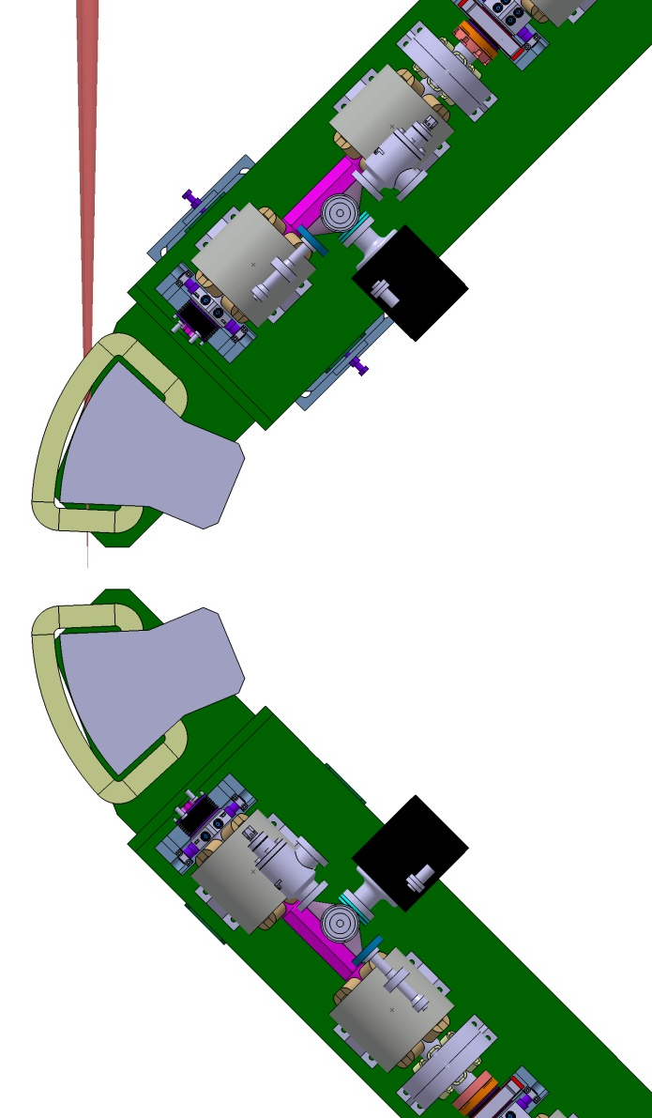
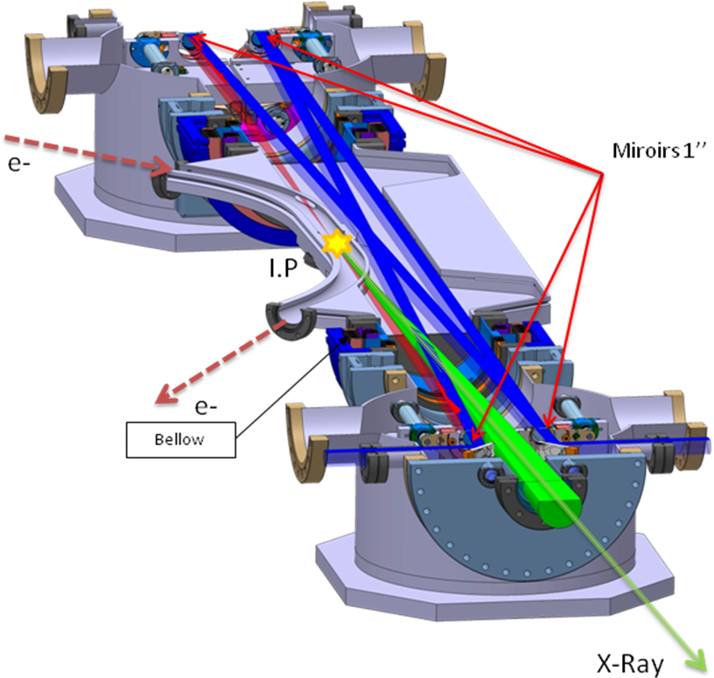
Geometry for ThomX
  Mechanical stability
  ➔4-mirror cavity
  Linear polarised modes
  ➔Planar geometry
Point d’interaction

Slide 18
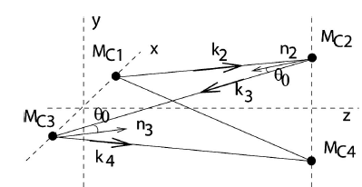
Summary
ORSAY
KEK cavity
ThomX
Yb
180 MHz
0.2ps
1.6m
Ti:sapph
76 MHz
1ps
Yb
35.7MHz
~15ps
4m
8m
Achieved
  Gain~10000
  Laser coupling ~80%
  Low laser power <1W
Achieved at ATF in 2011-2012
  Gain~1000
  Laser coupling ~60%
  laser 10W-50W
  Laser amplification stability
Achieved at Orsay with new laser
Finesse 25000
Coupling ~50%
Laser power<100mW
Immediate improvement
Finesse 43000
Coupling >50%
Laser power>50W
➔ Expected stored power>300kW
Foreseen end 2013-2014
  Gain ~10000
  Laser coupling ~80%
  Laser power 50-100W
  ➔400kW

Slide 19
results
Measurement
F=45000
F=30000
F=15000
F=3000
Only 3 free parameters in the fit:
a normalisation factor, an offset and the Finesse

Slide 20
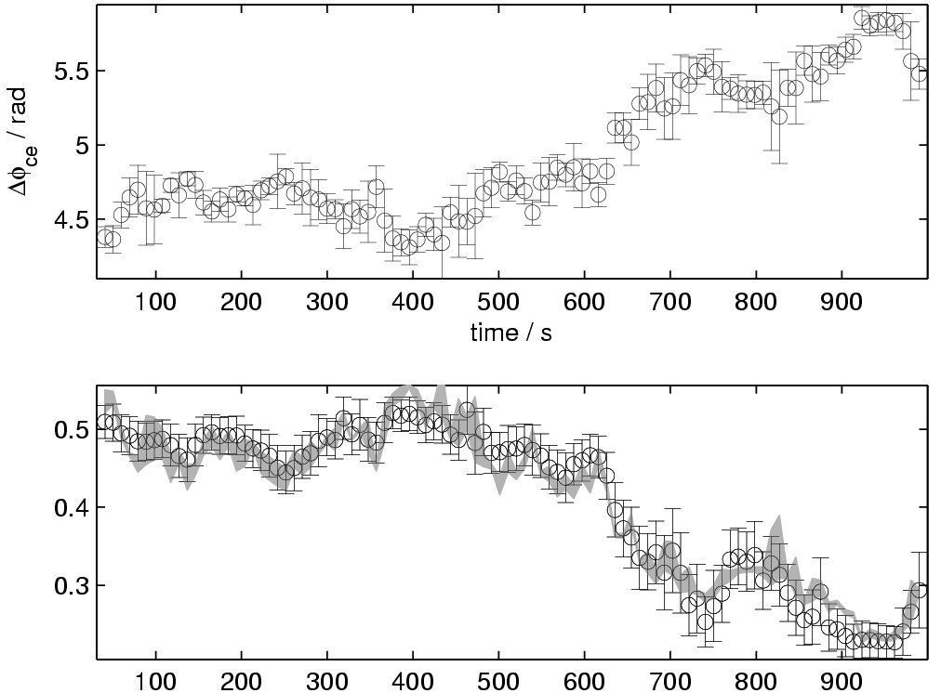
We observed strong free running laser/cavity coupling variations
(Finesse~30000)
CEP measurement
Laser/cavity
coupling
Fit:
Frequency comb
+Δφ_{ce} variations
Only 3 free
parameters in
the fit:
a normalisation,
an offset
the Finesse
25% coupling variation
over ~15min

Slide 21
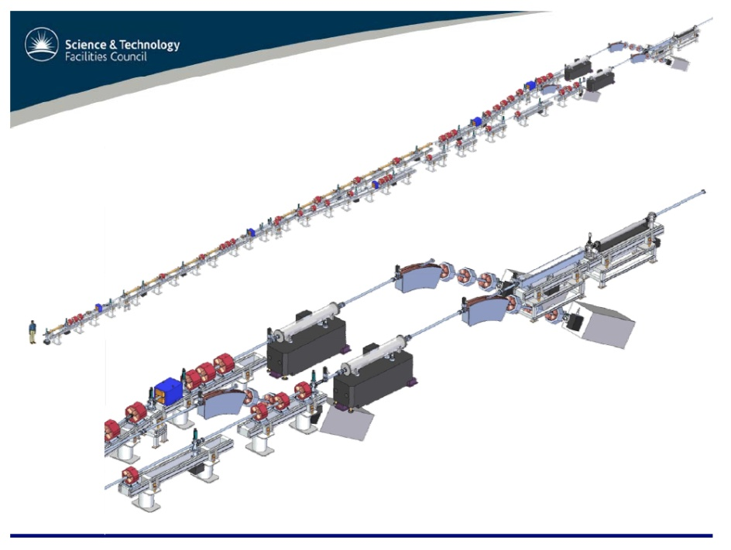
A technological issue: huge requested laser power
Priority : High X/g ray Flux
(spectral purity ~few %)
➔ Electron ring (ThomX)
Priority : High X/g ray spectral purity <1% (ϕν applications)
➔LINAC (ELI-NP)
~20MHz e-beam/laser collision frequency
Optical resonator to increase the laser
power
High cavity gain & High laser average power
~100Hz e-beam/laser collision frequency
Optical recirculator of a high peak power
laser pulse
High laser peak power & high nb of passes

