Slide 1
Localization of field emitter in a 9-cell cavity
Yongming Li^{1,2}, Ari Palczewski¹, Rongli Geng¹
¹ Jefferson Lab
² Peking University

Slide 2
Content
      1. Motivation
      2. Localization of field emitter in a 9-cell cavity
      3. Summary

Slide 3
1. Motivation
Field emission/dark current issue of concern for SRF cavity performance and SRF linac operation
  ILC, pulsed, pushing high gradient, driven by Epk
  CEBAF and other future CW SRF linacs, driven by DF
Complete understanding and reliable control of the issue is still needed in particular in multicell practical cavities
  Dark current in multicell cavity
    Where are the emitters
    Origin of emitters
    Impact to cryogenic load and machine operation

Slide 4
Goal
Locate field emitter in multicell cavity
  Develop a generic producer
  Benchmark with vertically multicell cavity test
  Close loop by optical inspection of predict emitter site
  Provide feedback for cavity string assembly
Ultimate goal– to reduce & elemate filed emission in multicell cavity

Slide 5
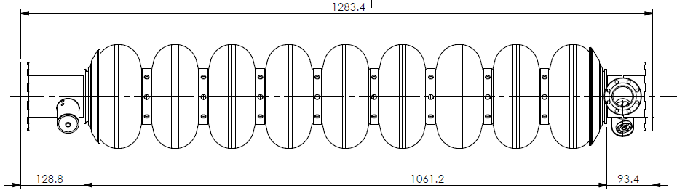
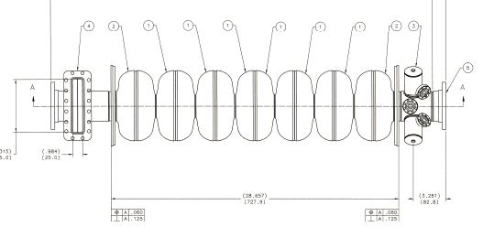
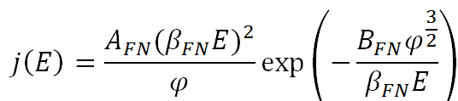
2. Full Scale multicell cavities and FN Law
ILC 9cell cavity
TTF shape
CEBAF Upgrade 7cell cavity
LLC shape
QM tunneling theory predicts exponential Fowler-Nordheim emission current density

Slide 6
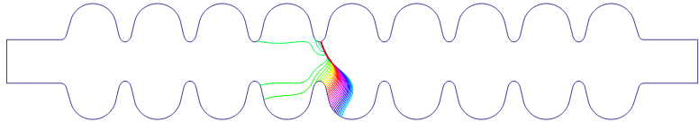
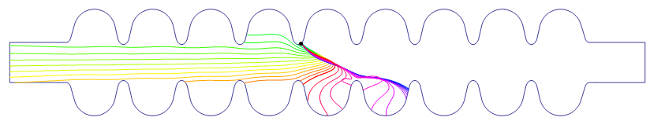
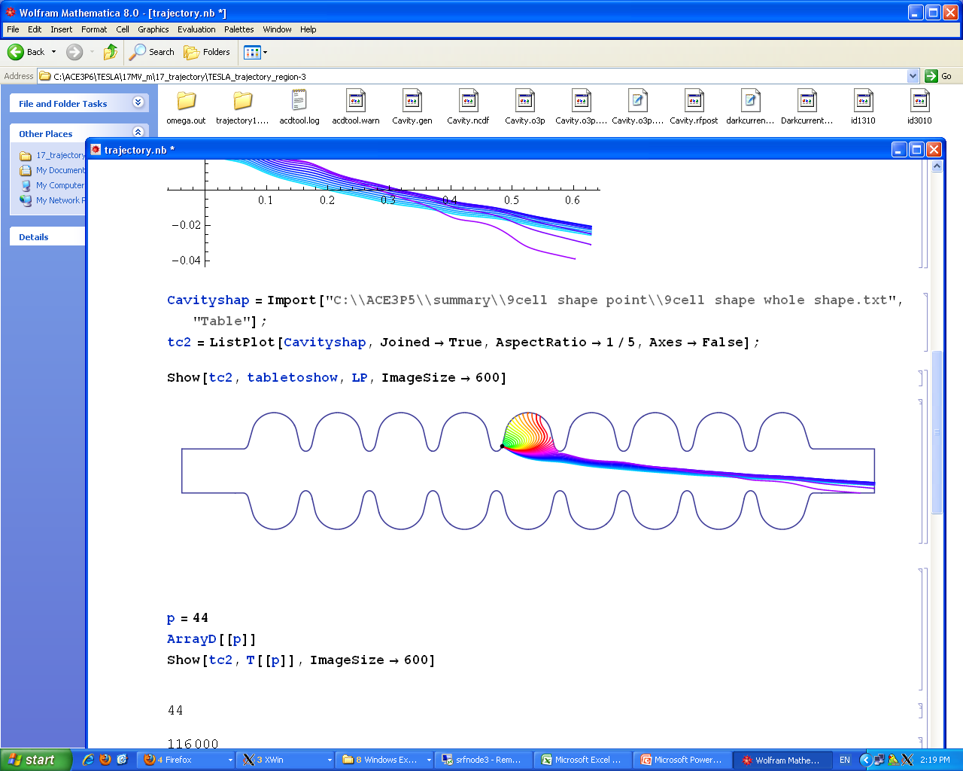
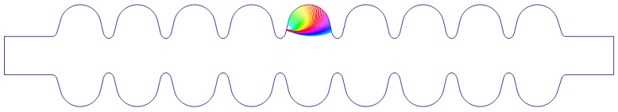
Trajectories of different Emitters

Slide 7
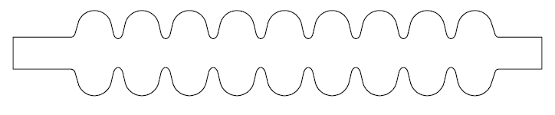
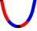
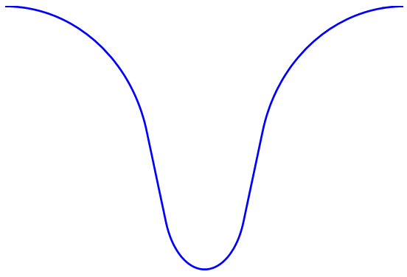
9-cell Model and Definition of Coordinate
iris4
iris5
R
iris2
iris3
iris6
iris7
iris8
iris9
iris1
iris10
(0,0)
Z
Left flange
Right flange
(Iris-5 left)
R/m
(Iris5- right)
I5 region, 15MV/m
β=150, Φ=4.4eV
I5-L
I5-R
-S
S
Z/m

Slide 8
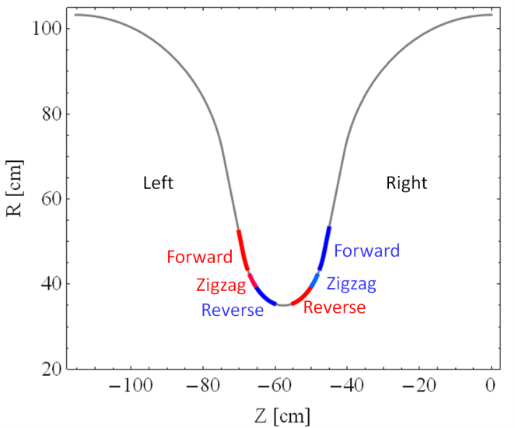
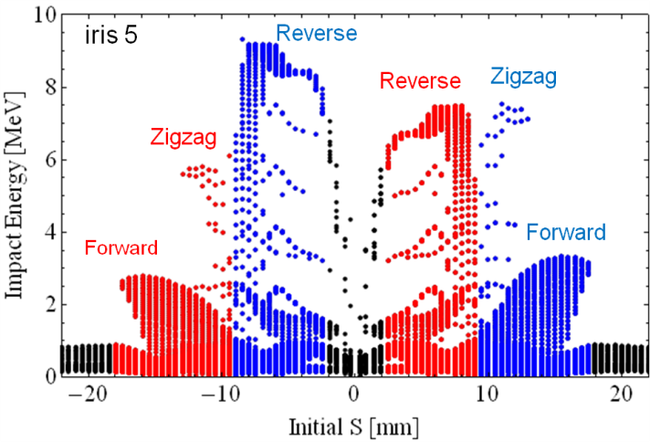
3 Types of “Long Range” Trajectories
Emission in region
>>> “Reverse type”
Emission in region >>> “Zigzag type”
Emission in region >>> “Forward type”
IR5
Impact position VS impact energy distribution

Slide 9
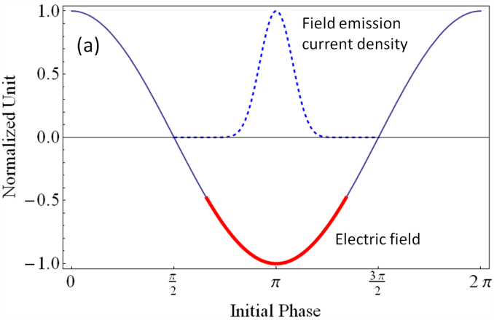
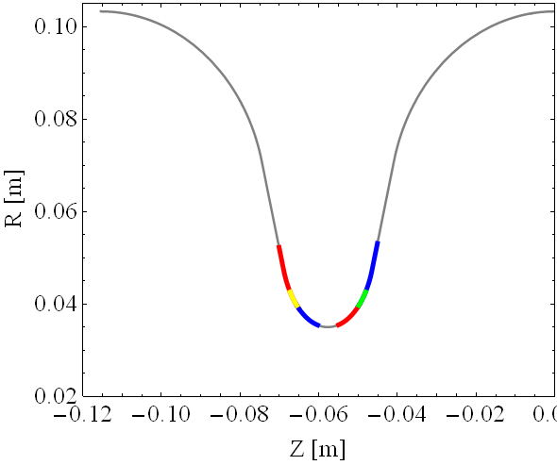
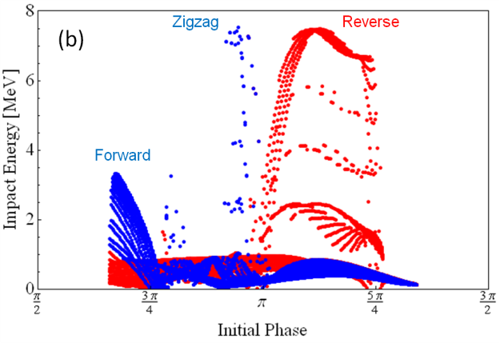
Position and phase distribution
I5-R
Forward (S): 12.2mm ~decided by field
Zigzag area: (S)
9.9mm~12.2mm
Reverse area: (S) 2.2mm~9.9mm
Position distribution
Phase distribution

Slide 10
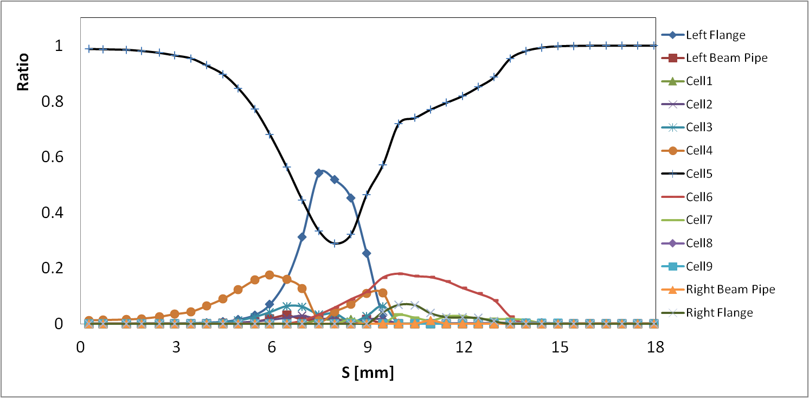
Ratio of Electrons Escaping Cavity
R_{esp}=N_{esp} /N_{total}
R_{hc}=N_{hc} /N_{total}
R2 electron escaping rate is very high (0.5 at s=0.008m)
Most of electrons at hitting at cell 5 ( emitter: IR5_RT)
R1 escaping is low compare with R2 (less than 8%)
Cell-5
Reverse
Left Flange
Escape
Cell-6
Right Flange
Escape
Cell-4
Forward
Zigzag

Slide 11
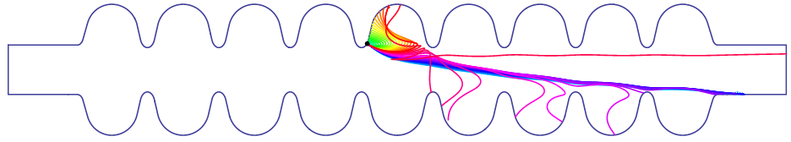
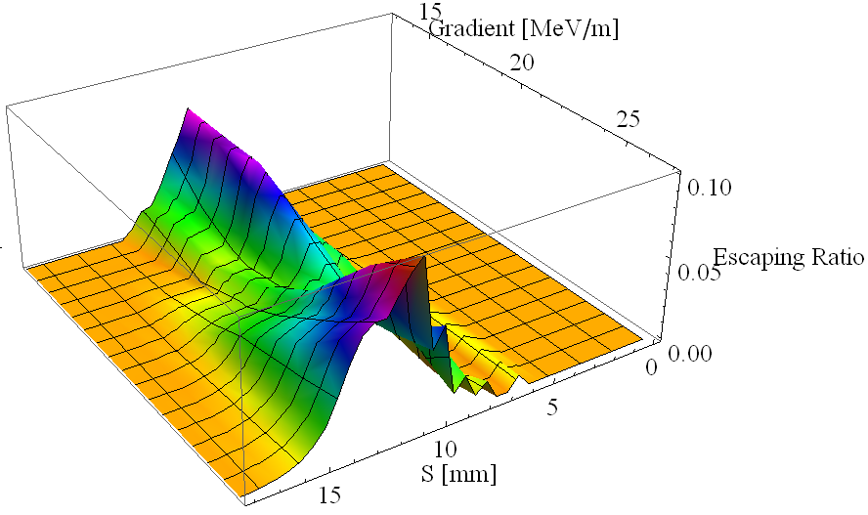
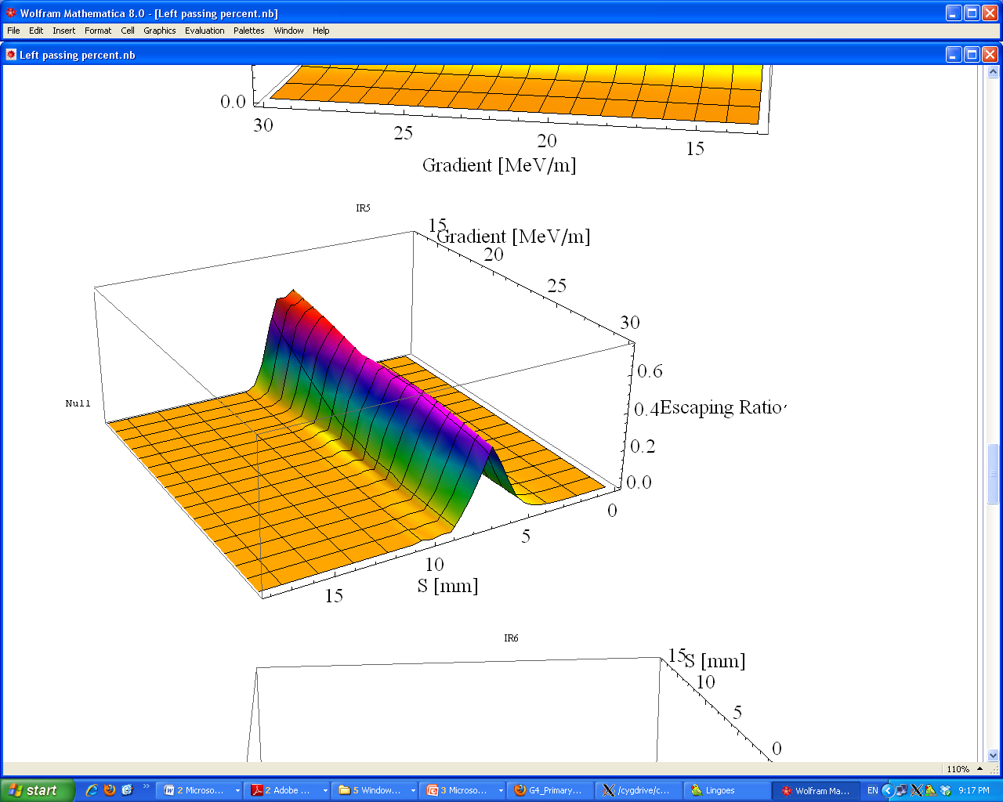
Escaping Ratio
Escaping from Left Flange
“Reverse type” trajectory
Escaping from Right Flange
“Zigzag type” & “forward type” trajectory

Slide 12
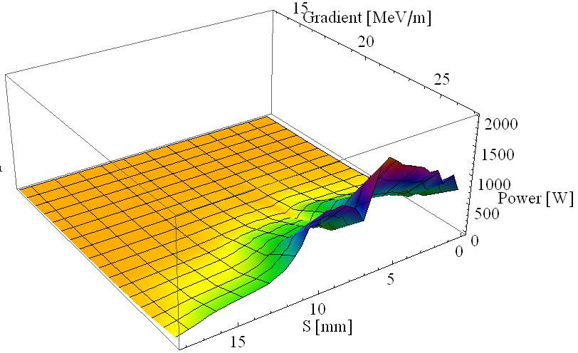
Energy Deposit in Cavity
Emitter bellow10mm [s] is very important considering the energy deposit in the cavity and escaping ratio of the electron.

Slide 13
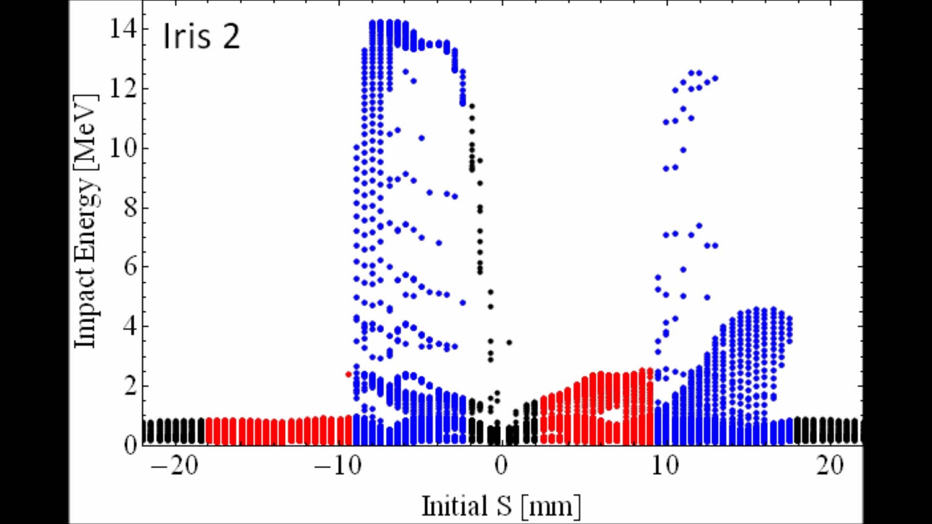
Impact Energy with Iris

Slide 14
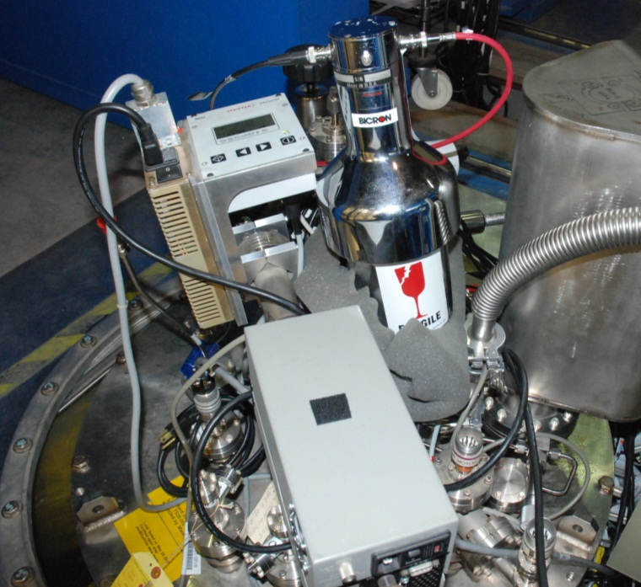
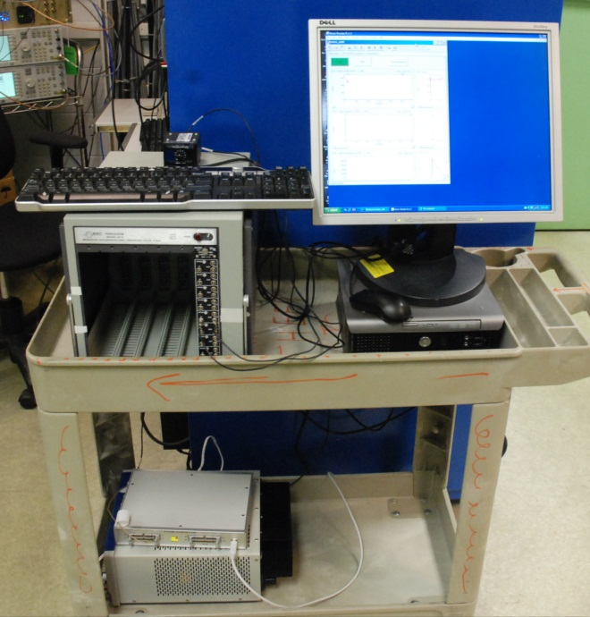
Experiment: 9-cell cavity RI23
γ energy spectrum measurement system
High Voltage
② Detector
③ Amplifier
④ Attenuation
⑤ DAQ
⑥ computer
② Detector
④ Attenuation
③ Amplifier
⑥ computer
① Dewar
⑤ DAQ
① Dewar

Slide 15
Energy Spectrum from NaI(Tl) Crystal
End Point Energy Fitting
counts
counts
Photon Energy/ MeV
Photon Energy/ MeV
Pi mode 10MV/m Ep=4.3MeV
Pi mode 11MV/m Ep=6.8MeV
counts
counts
Photon Energy/ MeV
Photon Energy/ MeV
Pi mode 12MV/m Ep=9.4MeV
Pi mode 13.1MV/m Ep=11.14MeV

Slide 16
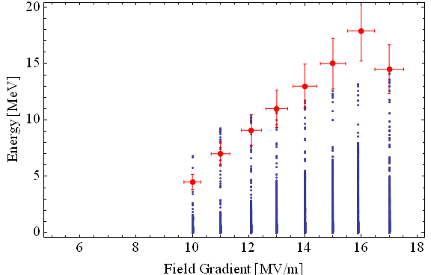
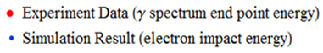
Correlation between Simulation and Measurements
Calculated impact energy of field emission electrons and measured end point energy in γ spectrum π mode
Identification
Field emission onset
π mode 9MV/m
6/9 π mode 30MV/m
1/9 π mode 5.7MV/m
5/9 π mode 28MV/m
7/9 π 13.5MV/m
Radiation at bottom is much higher than that at top
detector saturated

Slide 17
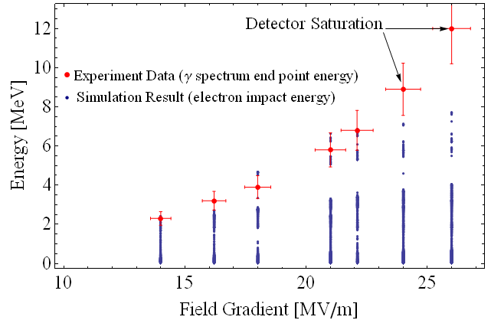
Correlation at another Pass-Band Mode
Calculated impact energy of field emission electrons and measured end point energy in γ spectrum 7/9π mode

Slide 18
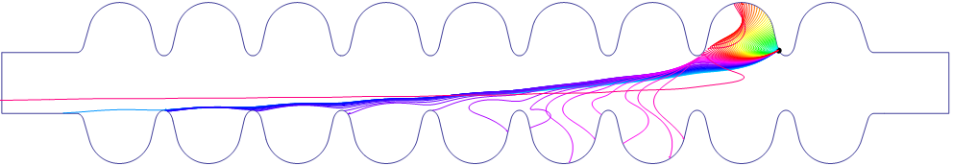
Final Answer: Emitter in Cell8/Iris9
bottom
top
Field emitter area
Field emission region is: [S] -9.9mm~-12.2mm
@ I9-L-Zigzag region

Slide 19
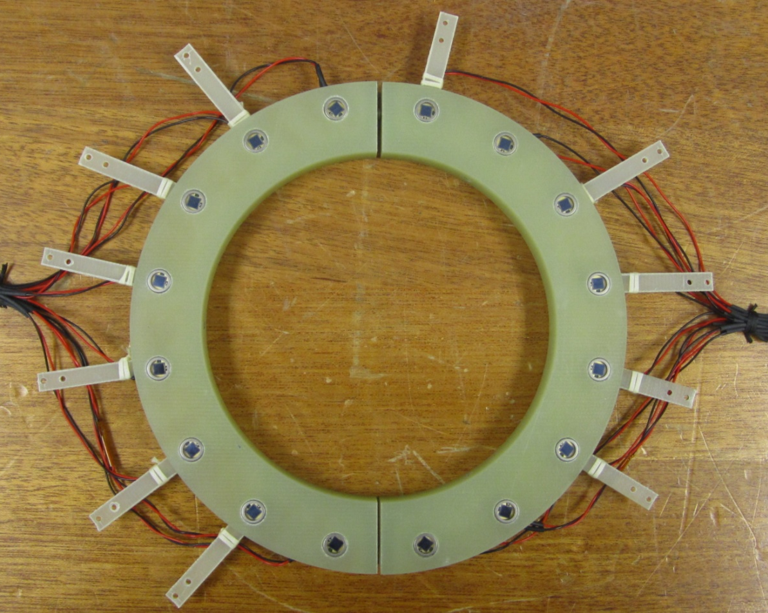
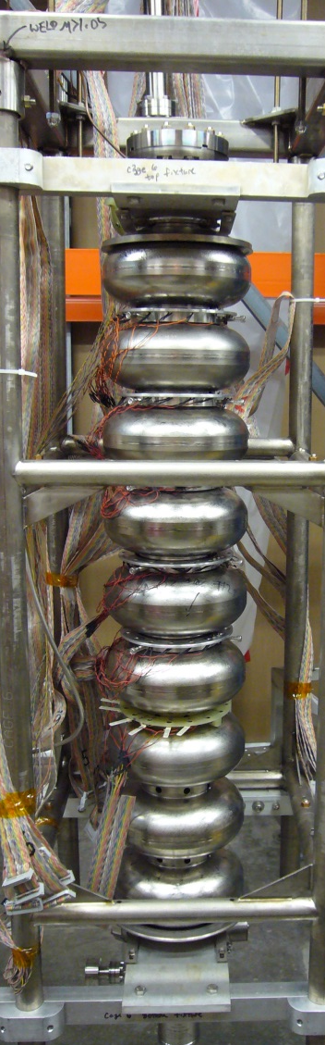
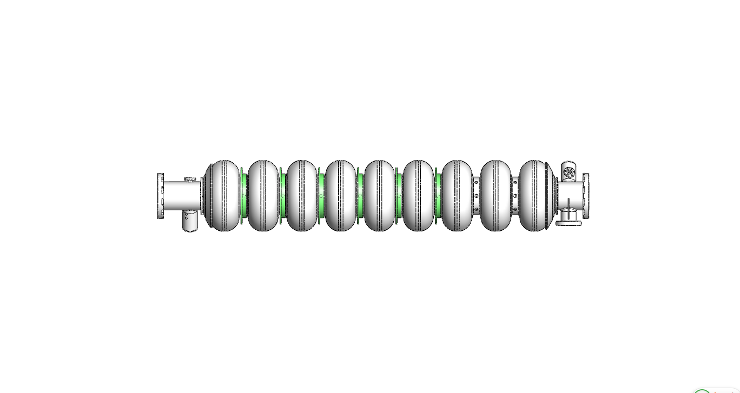
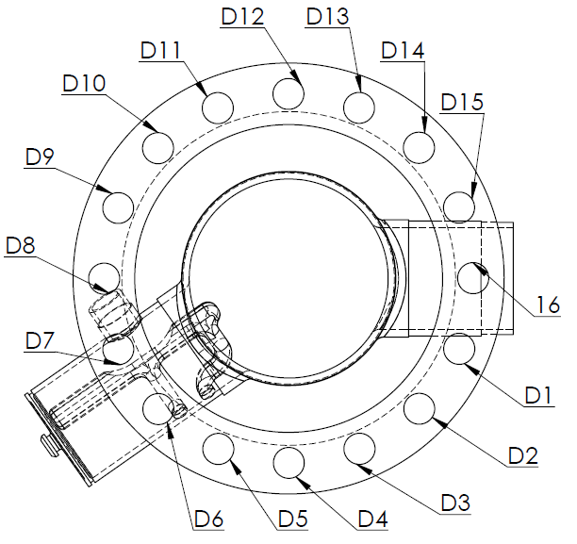
Radiation angular location measurement system
top
Emitter
Ring 1
Ring 2
Ring 3
Ring 4
Ring 5
Ring 6
Diode ring
bottom

Slide 20
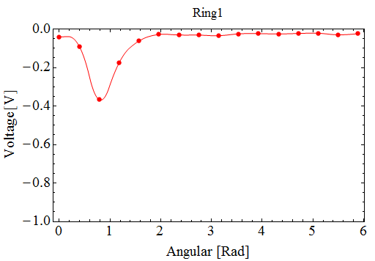
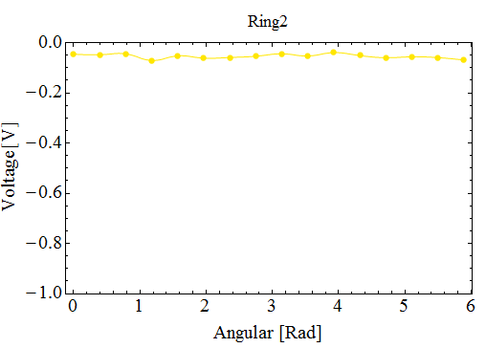
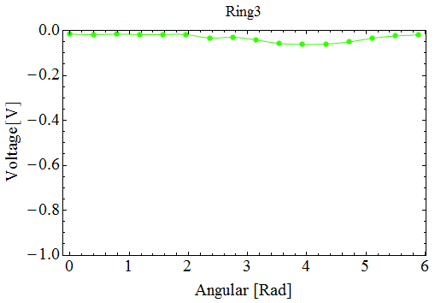
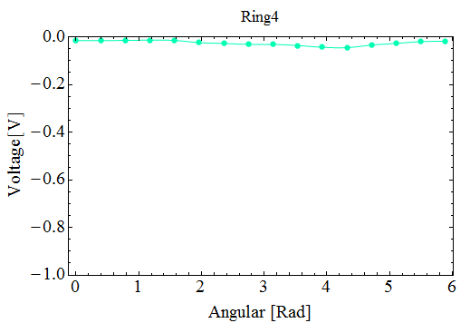
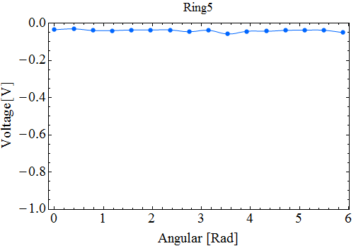
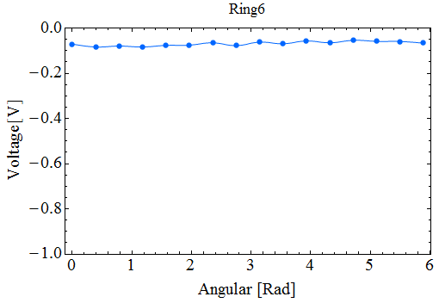
X-ray Angular Distribution
Eacc=14.9 MV/m

Slide 21
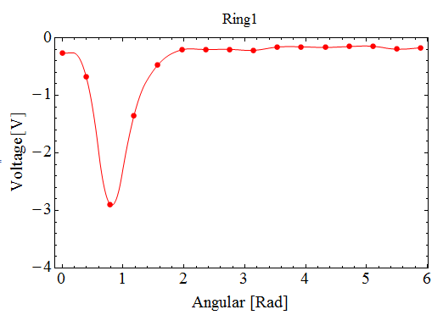
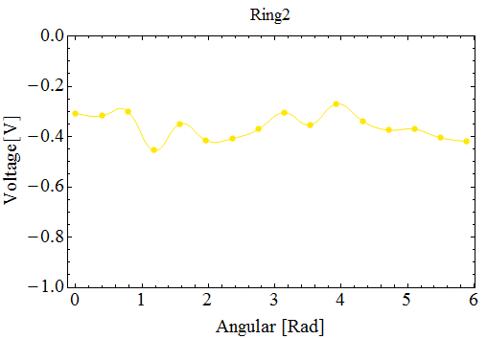

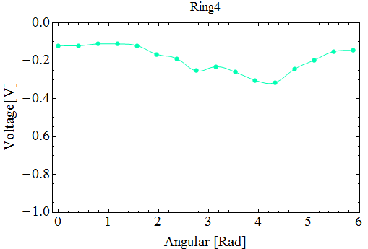
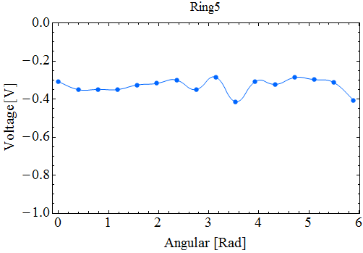
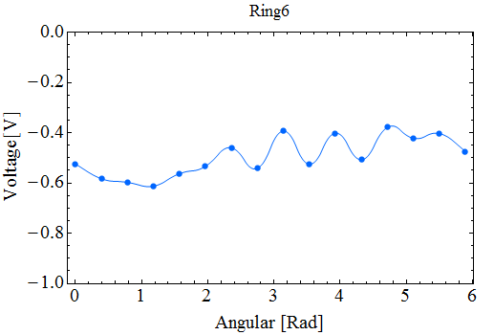
X-ray Angular Distribution
Eacc=17.5 MV/m

Slide 22
X Ray Data Analysis
0.038
0.001
0.004
0.011
0.04
0.119
0.788
Ratio of e hitting on each cell
Geant 4 to simulate the radiation is still going on.

Slide 23
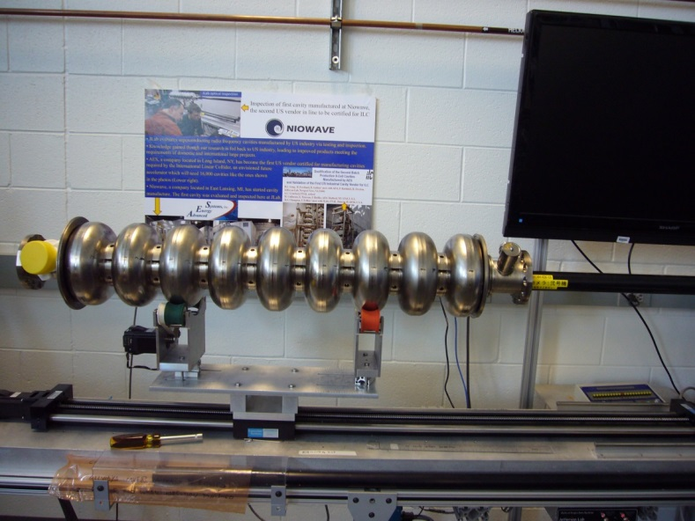

Optical Inspection
7mm
Resolution: 7.4um/pixel
In standard mode of Kyoto camera, no feature was observed within resolution limitation. This rules out “gross field emitter”. Next inspection using CYCLOPS.

Slide 24
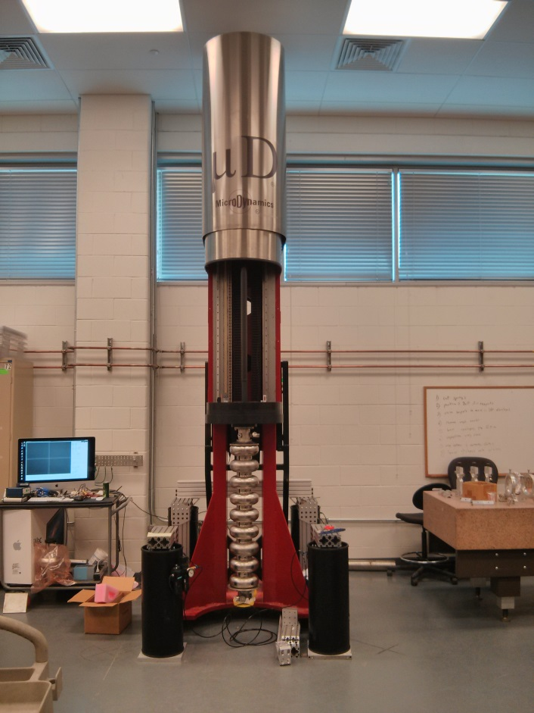
Optical inspection for next step
Resolution: 2um

Slide 25
Summary
First demonstration of field emitter localization achieved in a full-scale 9-cell cavity
  End-point gamma ray energy measure + simulation for longitudinal location
  Multiple diode rings for angular location
The method can be generalized for routine use in cavity vertical test or horizontal test
Work also extended to calculate CEBAF 12 GeV upgrade cavities

