Slide 1
CLIC RTML collimation systems and beam stabilisation
R. Apsimon
CERN, TE-ABT-BTP
ECFA LC2013 at DESY, Hamburg
27th-31st May 2013

Slide 2
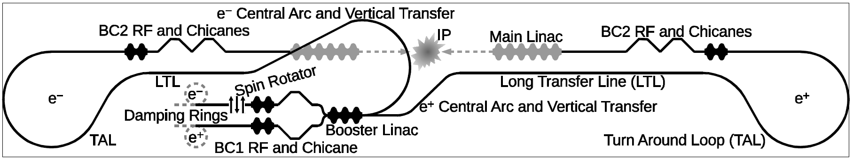
RTML layout
eFF2
EC2
BC
eFF1
BC
EC2
EC1
pFF1
pFF2
EC1 + EC2: Energy collimators
BC: Betatron collimators
FF1 + FF2: Feed-forward jitter correction

Slide 3
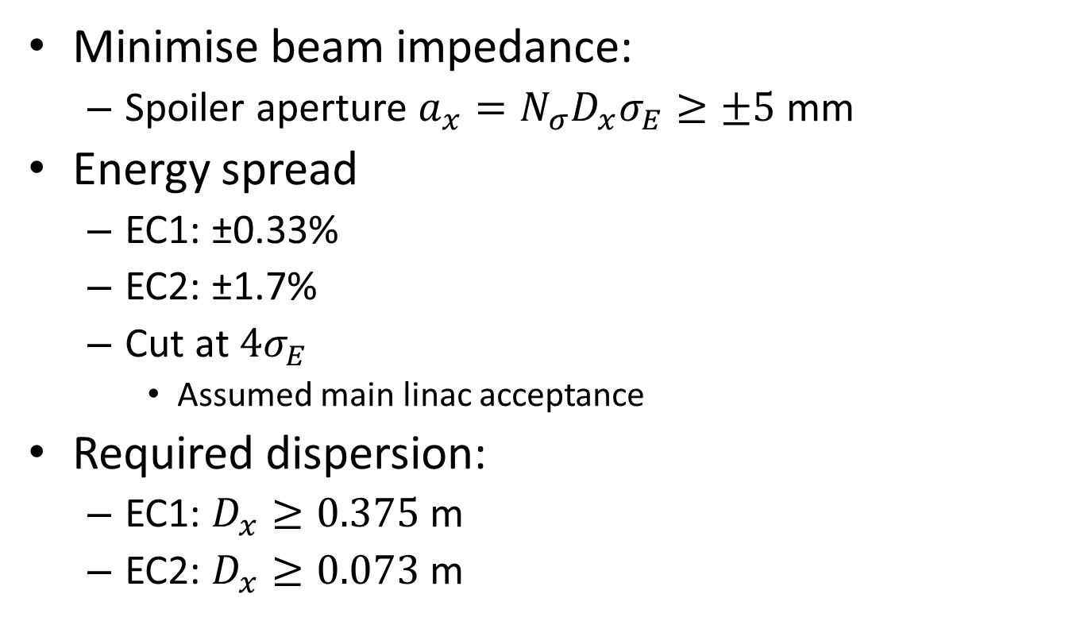
Energy collimator assumptions
Minimise beam impedance:
  Spoiler aperture $a_{x}={N_{σ}D}_{x}σ_{E}≥±5$ mm
Energy spread
  EC1: ±0.33%
  EC2: ±1.7%
  Cut at $4σ_{E}$
    Assumed main linac acceptance
Required dispersion:
  EC1: $D_{x}≥0.375$m
  EC2: $D_{x}≥0.073$ m

Slide 4
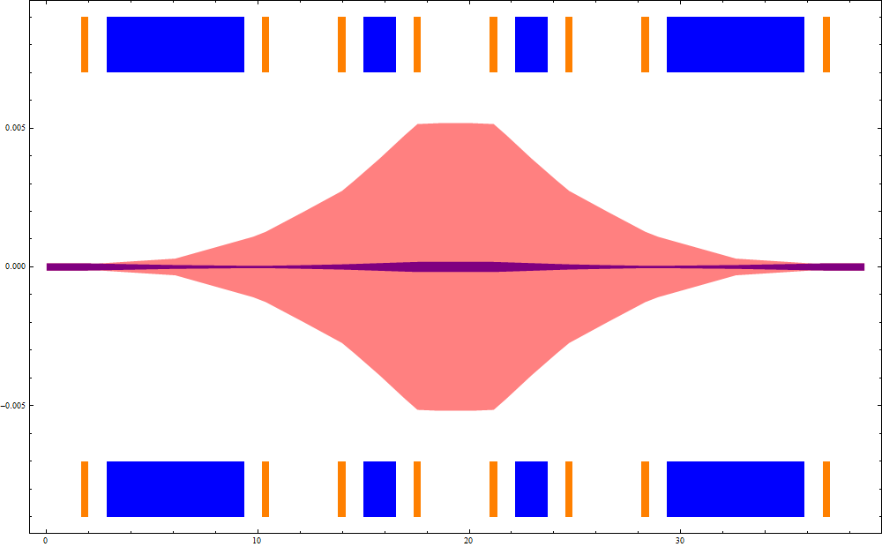

EC1 design
Design matched to existing optics
L_{gap}
Blue: dipole magnet
Orange: quadrupole
Purple: $4\sqrt{ε_{x}β_{x}}$
Pink:$4\left(\sqrt{ε_{x}β_{x}}+η\frac{∆p}{p}\right)$
Spoiler
Absorber

Slide 5
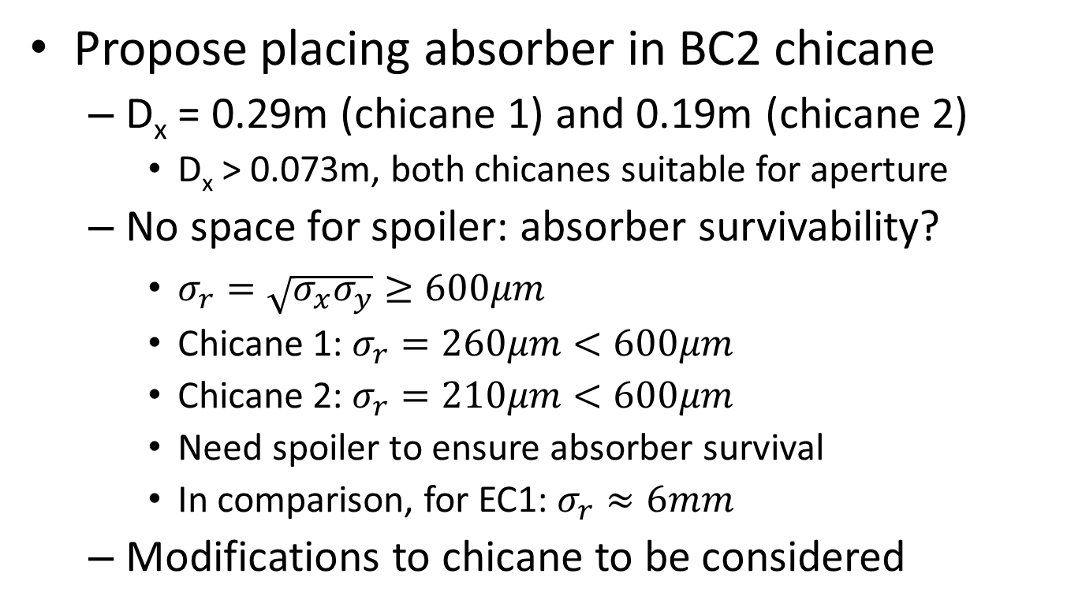
EC2 design
Propose placing absorber in BC2 chicane
  D_{x} = 0.29m (chicane 1) and 0.19m (chicane 2)
    D_{x} > 0.073m, both chicanes suitable for aperture
  No space for spoiler: absorber survivability?
    $σ_{r}=\sqrt{σ_{x}σ_{y}}≥600μm$
    Chicane 1: $σ_{r}=260μm<600μm$
    Chicane 2: $σ_{r}=210μm<600μm$
    Need spoiler to ensure absorber survival
    In comparison, for EC1: $σ_{r}≈6mm$
  Modifications to chicane to be considered

Slide 6
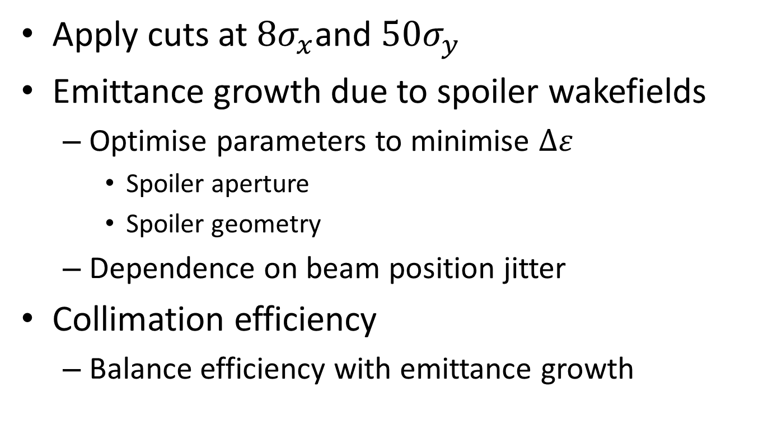
Betatron collimation design
Apply cuts at $8σ_{x}$and $50σ_{y}$
Emittance growth due to spoiler wakefields
  Optimise parameters to minimise $∆ε$
    Spoiler aperture
    Spoiler geometry
  Dependence on beam position jitter
Collimation efficiency
  Balance efficiency with emittance growth

Slide 7
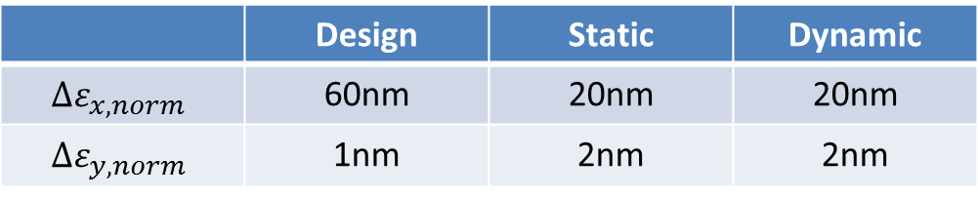
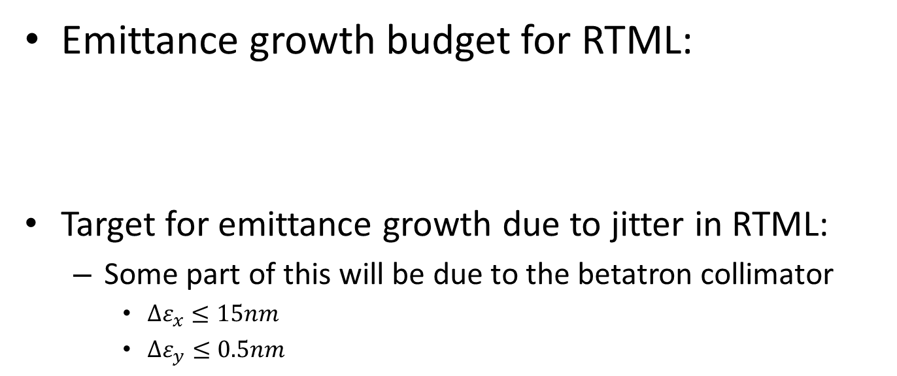
Emittance growth (1)
Emittance growth budget for RTML:
Target for emittance growth due to jitter in RTML:
  Some part of this will be due to the betatron collimator
    $∆ε_{x}≤15nm$
    $∆ε_{y}≤0.5nm$
 | Design | Static | Dynamic
$${∆ε}_{x,norm}$$ | 60nm | 20nm | 20nm
$${∆ε}_{y,norm}$$ | 1nm | 2nm | 2nm
Induced wakefields in spoilers are the main source of emittance growth:
They consists of a geometric and a resistive component.
Geometric wakefields depend on the design of the spoiler
Resistive wakefields depend on the electrical properties of the spoiler.

Slide 8
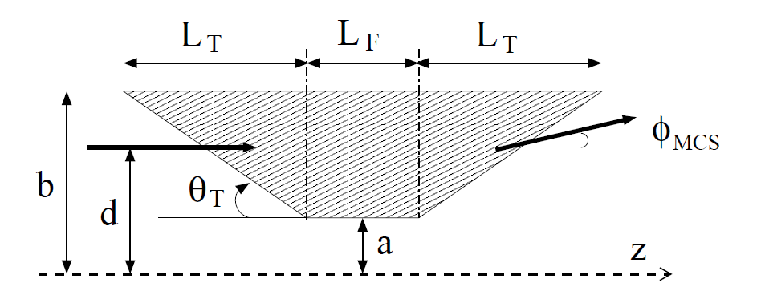
Mathematical description

Slide 9
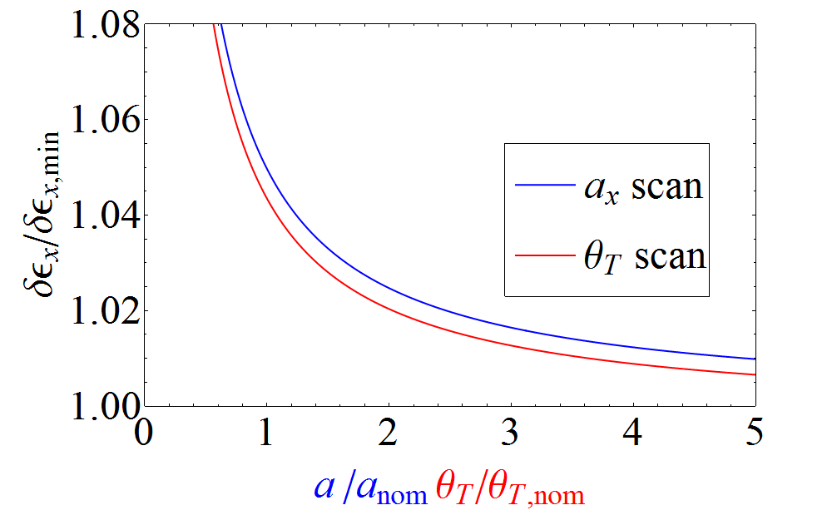
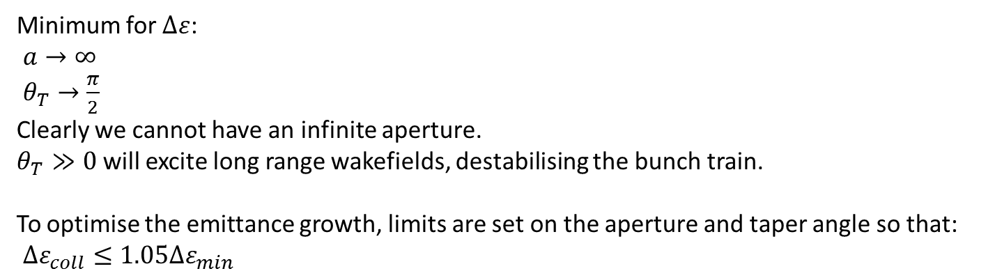
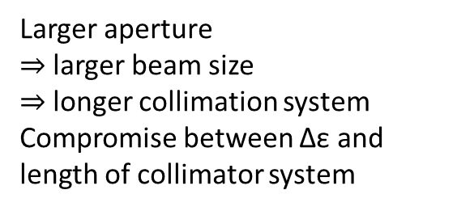
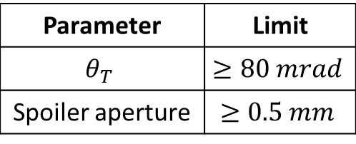
Emittance growth (2)
Minimum for $∆ε$:
$a→∞$
$θ_{T}→\frac{π}{2}$
Clearly we cannot have an infinite aperture.
$θ_{T}≫0$ will excite long range wakefields, destabilising the bunch train.
To optimise the emittance growth, limits are set on the aperture and taper angle so that:
$∆ε_{coll}≤1.05∆ε_{min}$
Parameter | Limit
$$θ_{T}$$ | $$≥80 mrad$$
Spoiler aperture | $$≥0.5 mm$$
Larger aperture
$⇒$larger beam size
$⇒$longer collimation system
Compromise between Δε and length of collimator system

Slide 10
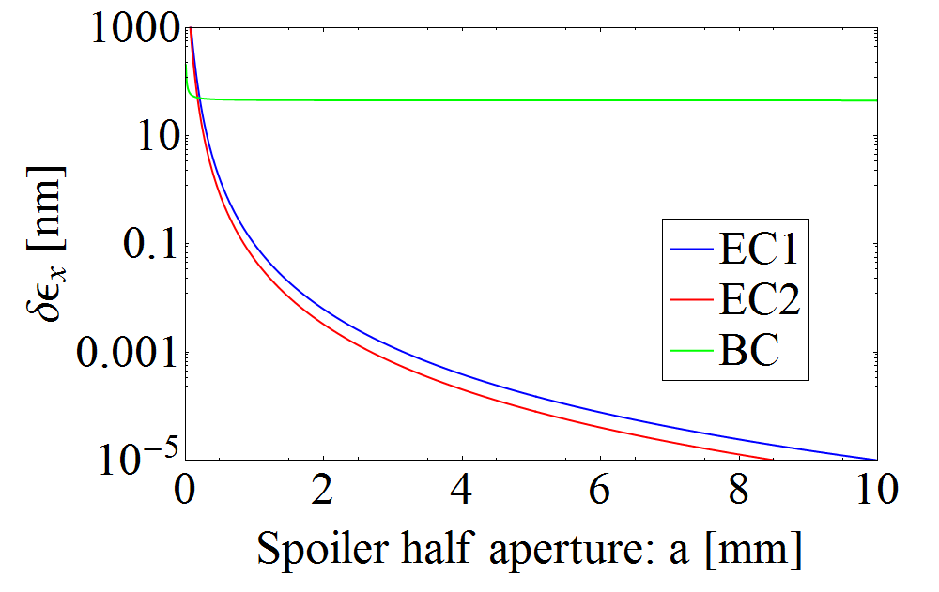

Beam jitter
Optimisation of the collimator design is not enough to limit emittance growth in the betatron collimator.
The emittance growth is strongly dependent on the beam jitter in the spoilers.
 | #σ cut | Δε_{x} 1σ offset | Δε_{x} 0.25σ offset
x | 8 | 62.6 nm | 4.0 nm
y | 50 | 2.5 nm | 0.16 nm
It is vital that the beam jitter is controlled in the betatron collimator.
N.B. beam jitter is dependent on the betatronic beam size; therefore emittance growth in the energy collimators is negligible.
The results in this table assumes 4 collimator cells
This plot shows emittance growth for a $1σ_{β}$ offset.

Slide 11

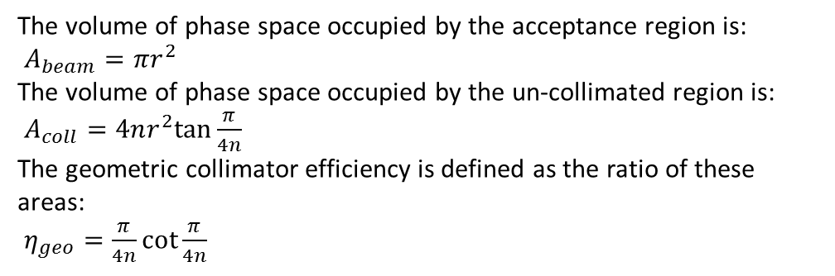




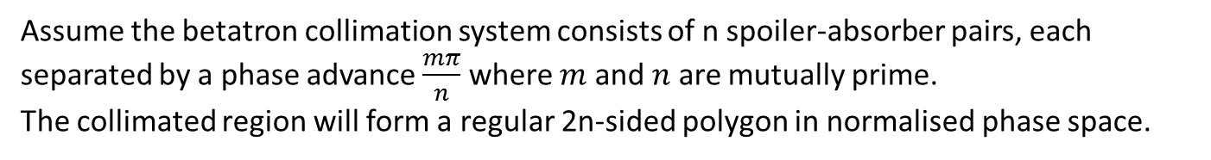
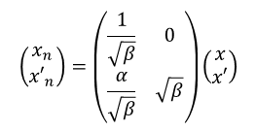
Collimation efficiency (1)
In normalised phase space, the acceptance of the beam forms a circle:
$$\left(\begin{matrix}x_{n} \\ {x′}_{n}\end{matrix}\right)=\left(\begin{matrix}\frac{1}{\sqrt{β}} & 0 \\ \frac{α}{\sqrt{β}} & \sqrt{β}\end{matrix}\right)\left(\begin{matrix}x \\ x′\end{matrix}\right)$$
x'
$${x′}_{n}$$
x
$$x_{n}$$
Assume the betatron collimation system consists of n spoiler-absorber pairs, each separated by a phase advance $\frac{mπ}{n}$ where $m$ and $n$ are mutually prime.
The collimated region will form a regular 2n-sided polygon in normalised phase space.
Collimated region
The volume of phase space occupied by the acceptance region is:
$A_{beam}=πr^{2}$
The volume of phase space occupied by the un-collimated region is:
$A_{coll}=4nr^{2}tan{\frac{π}{4n}}$
The geometric collimator efficiency is defined as the ratio of these areas:
$η_{geo}=\frac{π}{4n}\cot{\frac{π}{4n}}$
Acceptance region
$$r$$
$$\frac{π}{4n}$$

Slide 12
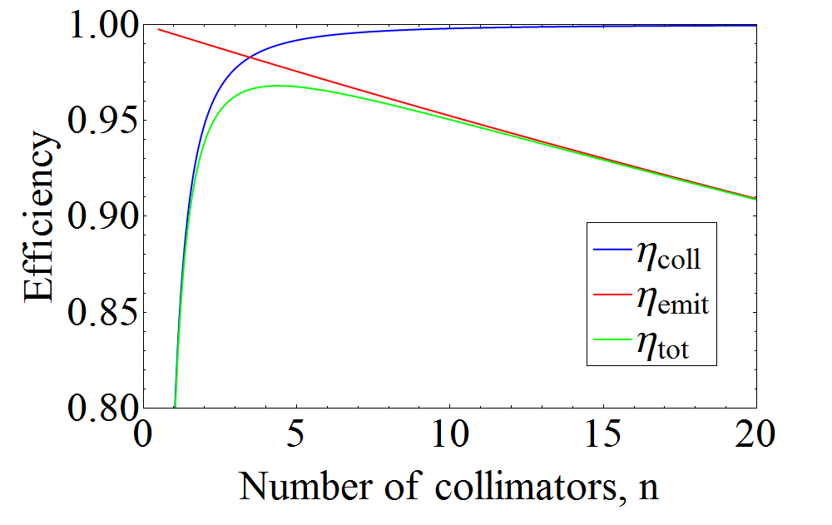
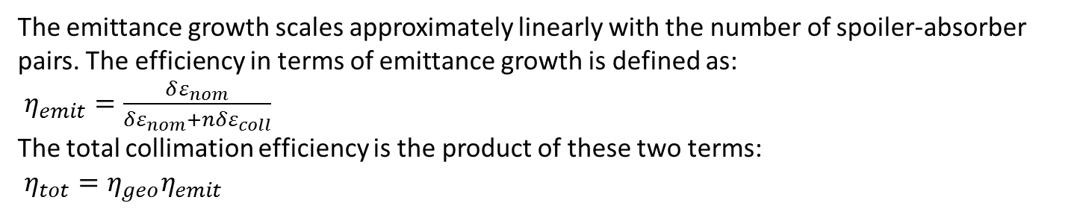
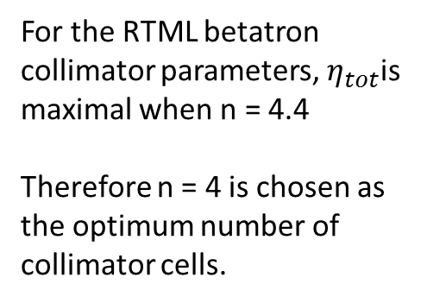
Collimation efficiency (2)
The emittance growth scales approximately linearly with the number of spoiler-absorber pairs. The efficiency in terms of emittance growth is defined as:
$η_{emit}=\frac{δε_{nom}}{δε_{nom}+nδε_{coll}}$
The total collimation efficiency is the product of these two terms:
$η_{tot}=η_{geo}η_{emit}$
For the RTML betatron collimator parameters, $η_{tot}$is maximal when n = 4.4
Therefore n = 4 is chosen as the optimum number of collimator cells.

Slide 13
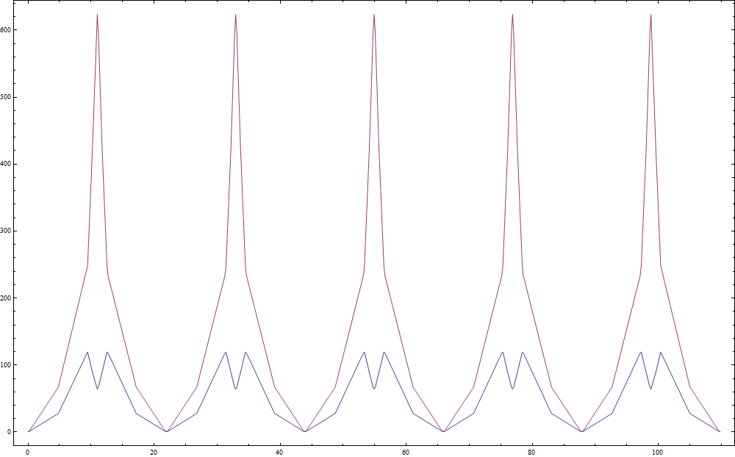
Betatron collimation optics

Slide 14
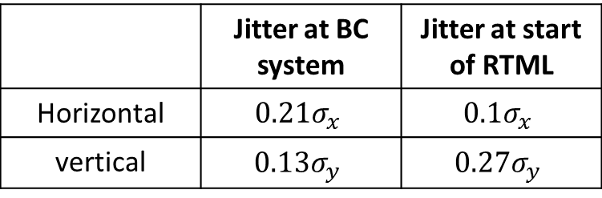
Jitter amplification in the RTML
Tracking simulations in PLACET have been used to determine the maximum jitter at the start of the RTML in order to meet the jitter requirements for the betatron collimation.
 | Jitter at BC system | Jitter at start of RTML
Horizontal | $$0.21σ_{x}$$ | $$0.1σ_{x}$$
vertical | $$0.13σ_{y}$$ | $$0.27σ_{y}$$
The jitter tolerances at the start of the RTML put very tight requirements on the stability of the extraction kicker and septum magnets#.
Indications are that the kicker and septa cannot be designed and built with the required stability.
Feed forward systems in the RTML have been considered as a solution to relax the stability requirements of the damping ring extraction system and to meet the jitter requirements of the betatron collimation system.
# “Optics and protection of the injection and extraction regions of the CLIC damping rings”, R. Apsimon et al. IPAC13 proceedings

Slide 15
Proposed locations
EC2
BColl
BColl
EC2
eFF2
eFF1
pFF2
EC1
pFF1
The e⁺ RTML has a chicane rather than a loop for the central arc; pFF1 will be different to the other FF systems.
BColl: betatron collimation system
EC1 + EC2: energy collimator systems
FF1:
Correct DR extraction jitter
Limits emittance growth along RTML
FF2:
Correct jitter at entrance of betatron collimator system (BC)
Prevents significant emittance growth in BC system
kickers
To main linac
Feed forward electronics
BPMs
e⁻
Notes:
Fix names

Slide 16
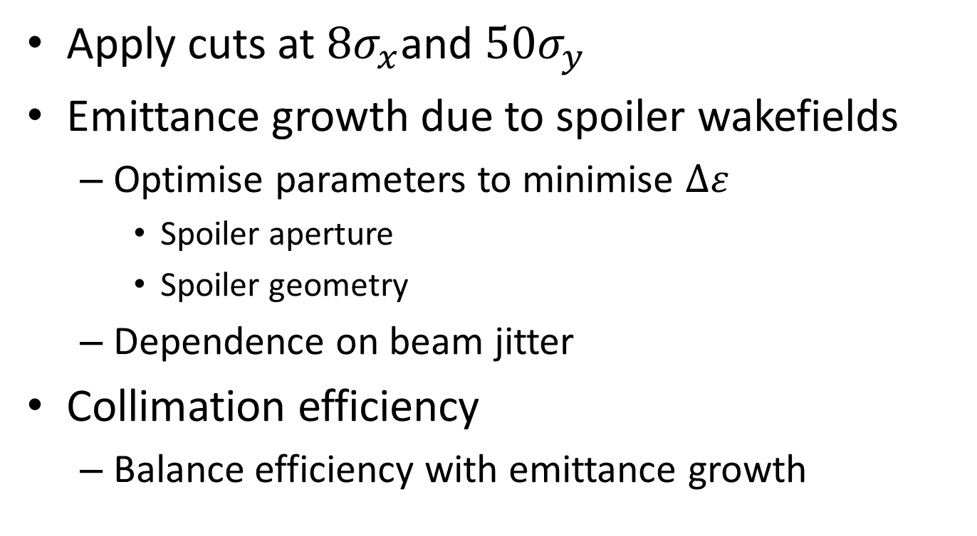
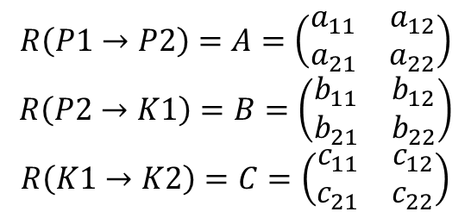
Feed forward corrections
P1
P2
K1
K2
Transfer matrices
Kicker corrections
$$R\left(P1→P2\right)=A=\left(\begin{matrix}a_{11} & a_{12} \\ a_{21} & a_{22}\end{matrix}\right)$$
$$R\left(P2→K1\right)=B=\left(\begin{matrix}b_{11} & b_{12} \\ b_{21} & b_{22}\end{matrix}\right)$$
$$R\left(K1→K2\right)=C=\left(\begin{matrix}c_{11} & c_{12} \\ c_{21} & c_{22}\end{matrix}\right)$$
$$θ_{K1}=\frac{{\left[CB\right]}_{12}}{a_{12}c_{12}}x_{1}−\frac{{\left[CBA\right]}_{12}}{a_{12}c_{12}}x_{2}$$
$$θ_{K2}=−\frac{b_{12}}{a_{12}c_{12}}x_{1}+\frac{{\left[BA\right]}_{12}}{a_{12}c_{12}}x_{2}$$

Slide 17
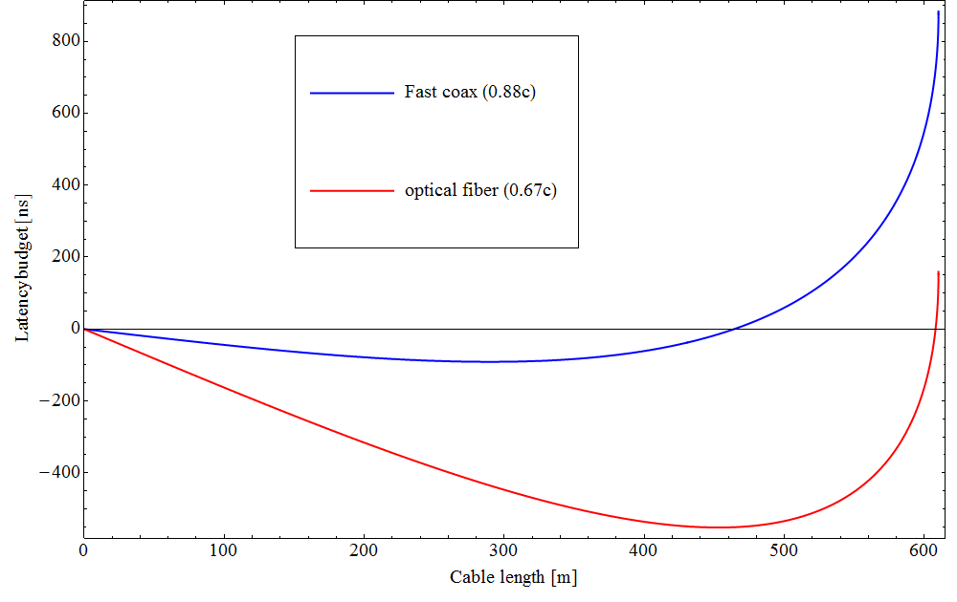
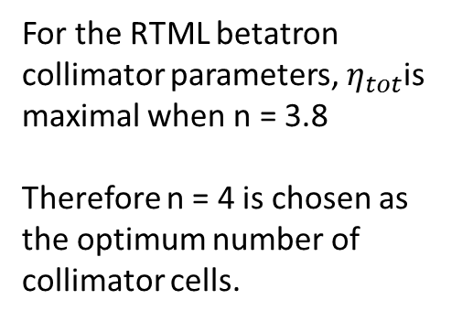
System latency
Latency budget = $t_{lat}=t_{signal}−t_{beam}=\frac{ρθ}{βc}−\frac{2ρ\sin{\frac{θ}{2}}}{v_{cable}}$
$ρ$ is the radius of curvature of the arc
$v_{cable}$is the transmission velocity of the FF signal cables
ρ
θ
L
ρ
Coaxial cables are fast, but for low attenuation, very thick cables (~20 mm diameter) would be needed; this would be difficult to install and repair.
Optical cables are low loss, compact, but very slow; the latency budget might not be enough.

Slide 18
System latency
Experience from the FONT feedback system at ATF2 suggests that the minimum latency requirement would be ~150 ns ^{[2]}.
Additional latency allows for improvements:
Digitise BPM signals: less susceptible to noise
Use of high resolution ADCs and DACs
Use of high-bit processing for the digital feed-forward electronics
Systematic correction of the bunch-to-bunch profile within the train
  Analogue electronics to add “compensation ripple” to kicker pulse
In summary, the large latency budget provided by coaxial cables would allow for a very high resolution digital feed forward system. The limiting factor would be the resolution of the BPMs.

Slide 19
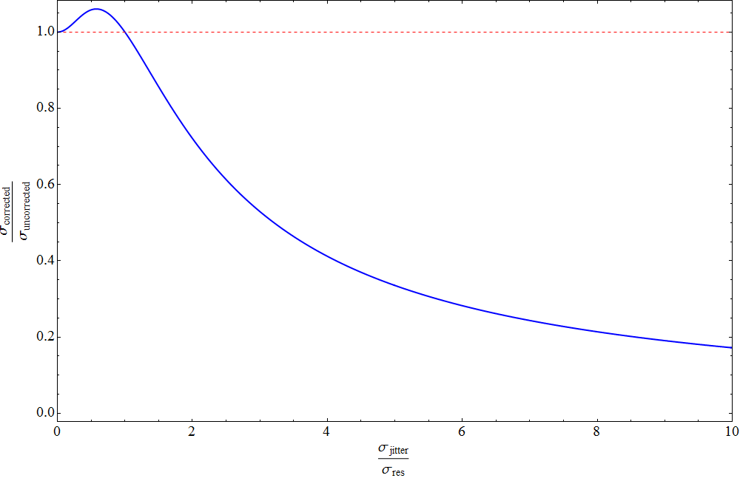
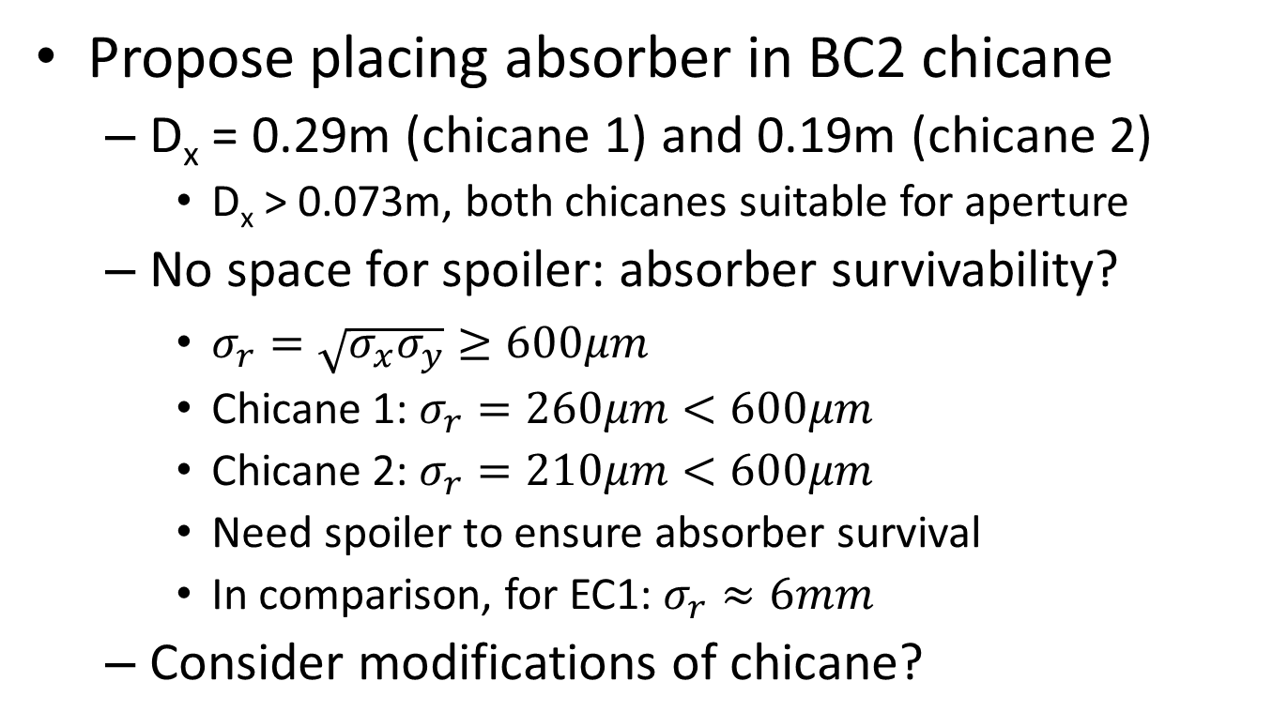
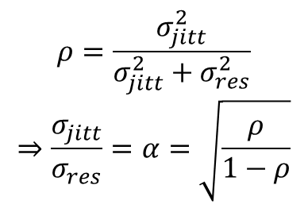
BPM resolution
To achieve good jitter correction, the BPM resolution must be much smaller than the expected beam jitter.
The expected beam jitter in the FF regions is ~10μm horizontally, but the required BPM resolution is ~140nm; probably not possible with 12 cm aperture…
Currently looking at dependence of required BPM resolution on value of β in BPMs.
$$ρ=\frac{σ_{jitt}^{2}}{σ_{jitt}^{2}+σ_{res}^{2}}$$
$$⇒\frac{σ_{jitt}}{σ_{res}}=α=\sqrt{\frac{ρ}{1−ρ}}$$
$$\frac{σ_{corrected}}{σ_{uncorrected}}=\sqrt{1+ρ−2ρ^{2}}=\frac{\sqrt{3α^{2}+1}}{α^{2}+1}$$
Notes:
Look at the resolution and dynamic range

Slide 20
FF kicker specifications
Parameter | Value
Length | 1 m
Kicker type | Electrostatic
Reproducibility | > 1 %
Field homogeneity | > 1 %
Rise / fall time | > 10 ns
Flat top duration | ~160 ns
Deflection angle | ~ 0.8 μrad
For a kicker stability of 2%, the resulting jitter at the entrance of the BC system will be ~20nm; smaller than the resolution of any existing BPM system.
Therefore we can assume the kickers are perfect for simulation purposes.

Slide 21
Tracking simulations
Tracking in PLACET
    No FF correction
    Only FF1
    Only FF2
    FF1 + FF2
  Jitter amplification + emittance growth
    Vs. initial jitter
    Vs. BPM resolution
Following slides only show horizontal beam as this is the more critical.

Slide 22
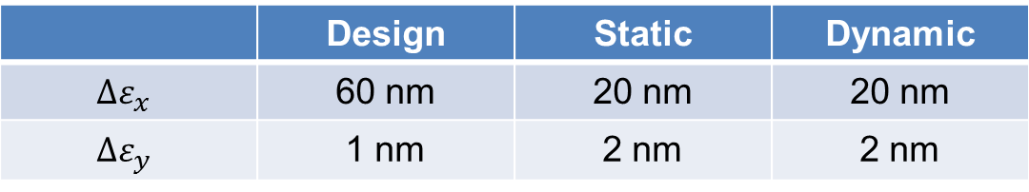
RTML emittance growth budget
 | Design | Static | Dynamic
$$∆ε_{x}$$ | 60 nm | 20 nm | 20 nm
$$∆ε_{y}$$ | 1 nm | 2 nm | 2 nm
The aim is to allocate 25% of the dynamic budget to emittance growth due to beam jitter.
Tracking simulations show that only 50 nm of the horizontal budget is used, therefore the remaining 10 nm will be allocated to the beam jitter budget.

Slide 23
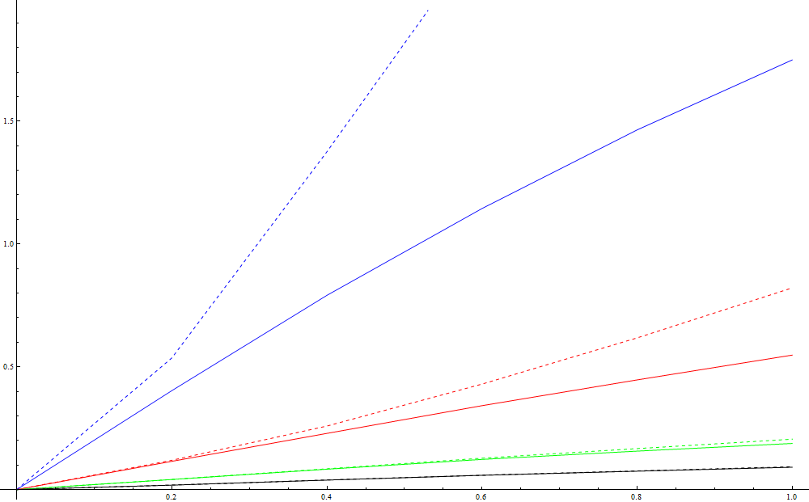
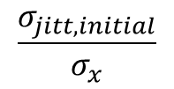
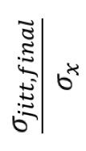
Final jitter vs. initial jitter
No FF
Only FF1
Only FF2
Both FF1 + FF2
Solid line:
no collimation
Dashed line:
with collimation
$$\frac{σ_{jitt,final}}{σ_{x}}$$
$$\frac{σ_{jitt, initial}}{σ_{x}}$$

Slide 24
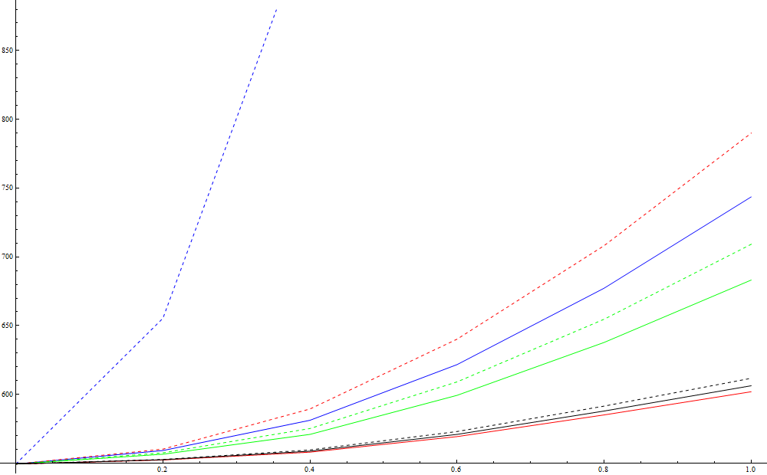
Δε_{x} vs. initial jitter
No FF
Only FF1
Only FF2
Both FF1 + FF2
Solid line:
no collimation
Dashed line:
with collimation
$$ε_{x,final}$$
$$\frac{σ_{jitt, initial}}{σ_{x}}$$

Slide 25
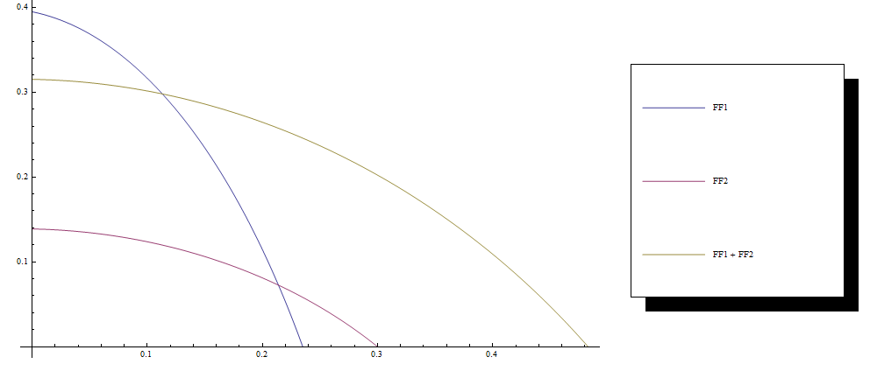
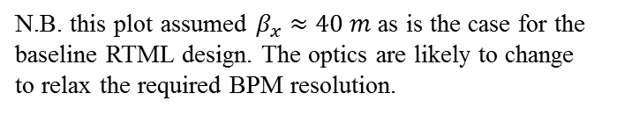
Required BPM resolution vs. initial jitter
This plot shows how the BPM resolution varies with initial jitter to produce 15 nm of emittance growth due to beam jitter
BPM resolution [μm]
$$\frac{σ_{jitt, initial}}{σ_{x}}$$
N.B. this plot assumed $β_{x}≈40 m$ as is the case for the baseline RTML design. The optics are likely to change to relax the required BPM resolution.
Notes:
Put in emittance budgets and explain and say its horizontal

Slide 26
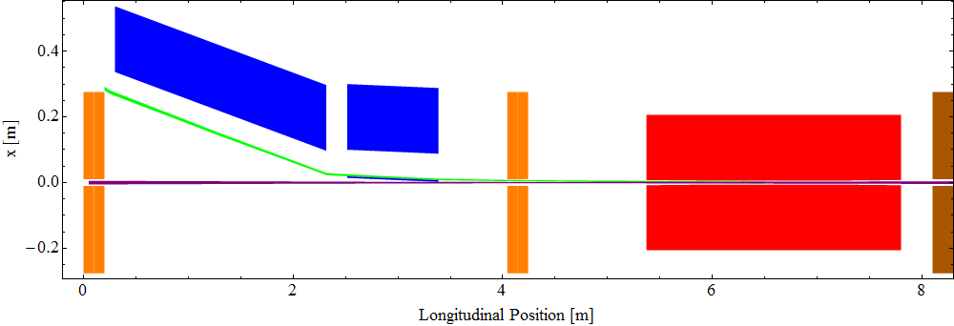
Extraction system layout
Thick septum
Thin septum
Kicker

Slide 27
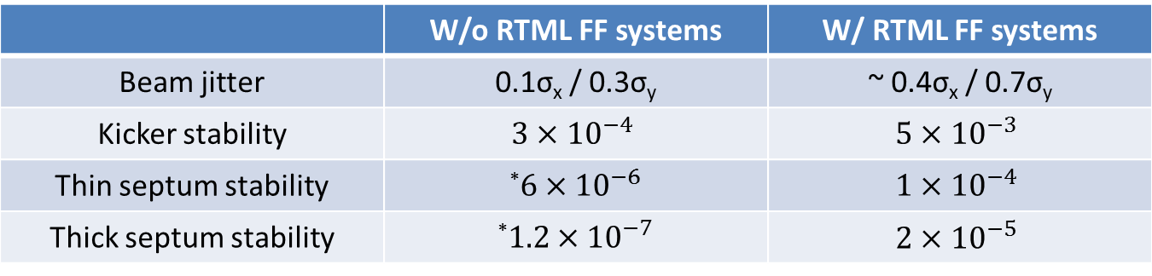
Tolerances for damping ring extraction
 | W/o RTML FF systems | W/ RTML FF systems
Beam jitter | 0.1σ_{x} / 0.3σ_{y} | ~ 0.4σ_{x} / 0.7σ_{y}
Kicker stability | $$3×{10}^{−4}$$ | $$5×{10}^{−3}$$
Thin septum stability | *$6×{10}^{−6}$ | $$1×{10}^{−4}$$
Thick septum stability | *$1.2×{10}^{−7}$ | $$2×{10}^{−5}$$
The kicker good field region has been reduced from a radius of 1mm to 0.5mm.
This combined with the proposed FF systems relaxes the stability requirements for the extraction system by a factor of ~16.
The stability requirements for the extraction elements have been optimised to maximise the combined extraction stability.
* These values differ from the CLIC CDR because the CDR values were optimised for a previous design of the DR extraction system
Notes:
Add extraction system plot

Slide 28
kickers
To main linac
Dump kicker
Feed forward electronics
BPMs
e⁻
Feed forward firmware
BPM
signals
Calculate FF kicks
To
FF kickers
Safe beam?
No
Fire
dump kicker

Slide 29
Possible machine protection
Due to the large available latency, the feed forward electronics could double as a fast emergency dump system. This would reduce the risk of damage to the collimation systems in the event of total beam loss; especially for EC2, which would not survive a total beam loss in the current design.
Off-trajectory
The FF kickers will only be able to correct orbit deviations of ~0.5σ. If the beam is dangerously off-trajectory, the digital feed forward electronics can be used to trigger a dump kicker downstream of the FF kickers.
Off-energy
BPMs situated in a dispersion region at the start of the turn-around loop can be used to trigger the dump kicker for large beam energy deviations. These measurements would also allow the FF kicks to be normalised for energy deviations.

Slide 30
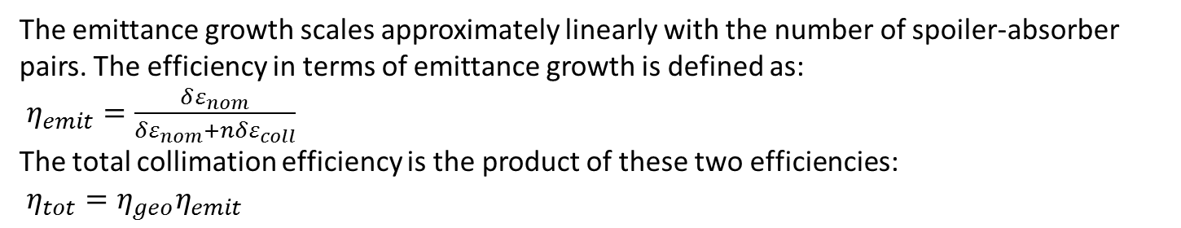

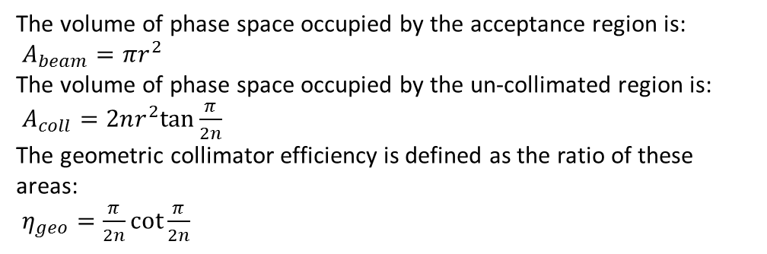
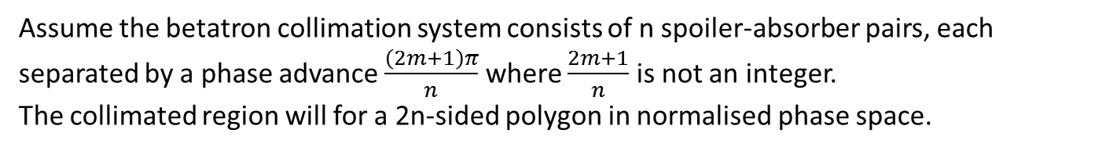


Determination of an “unsafe beam”
BPM: P2
BPM: P1
$\left(\begin{matrix}x_{P1} \\ {x′}_{P1}\end{matrix}\right)=\left(\begin{matrix}x_{P1} \\ \frac{x_{P2}−R_{11}x_{P1}}{R_{12}}\end{matrix}\right)$
Transform into normalised phase space:
$\left(\begin{matrix}x_{n} \\ {x′}_{n}\end{matrix}\right)=\left(\begin{matrix}\frac{1}{\sqrt{β_{P1}}} & 0 \\ \frac{α_{P1}}{\sqrt{β_{P1}}} & \sqrt{β_{P1}}\end{matrix}\right)\left(\begin{matrix}x_{P1} \\ \frac{x_{P2}−R_{11}x_{P1}}{R_{12}}\end{matrix}\right)$
$$\left(\begin{matrix}R_{11} & R_{12} \\ R_{21} & R_{22}\end{matrix}\right)$$
e⁻ / e⁺
$$\left(\begin{matrix}x_{P2} \\ {x′}_{P2}\end{matrix}\right)$$
$$\left(\begin{matrix}x_{P1} \\ {x′}_{P1}\end{matrix}\right)$$
x'
$${x′}_{n}$$
x
$$x_{n}$$
$$δr$$
$δr^{2}=\frac{x_{n}^{2}+{x′}_{n}^{2}}{ε}$
$=\frac{1}{εβ_{P1}\sin^{2}{μ}}x_{P1}^{2}−\frac{2\cos{μ}}{ε\sqrt{β_{P1}β_{P2}}\sin^{2}{μ}}x_{P1}x_{P2}+\frac{1}{εβ_{P2}\sin^{2}{μ}}x_{P2}^{2}≥n_{thresh}$
To maximise the sensitivity of the feed forward system:
$μ=\frac{π}{2}$ and $β_{P1}=β_{P2}=β$
So the “unsafe beam” condition becomes: $\frac{x_{P1}^{2}+x_{P2}^{2}}{σ^{2}}≥n_{thresh}$
This can be calculated digitally in 3-4 clock cycles (5-10 ns for a clock frequency of ~500MHz)

Slide 31
e⁺ FF1 Considerations
Without FF1, extremely low BPM resolution is required for the e⁺ RTML to relax requirement for the DR extraction system: probably not achievable.
150 ns latency can be achieved if the signal velocity > 0.945c:
Use free-space optical links ( > 0.999c)
  The signals are transmitted by a laser through a narrow tunnel
  ~300 ns of latency
Due to the smaller latency budget for the e⁺ FF1 system, some high-latency features may need to be disabled, but hopefully not. Some changes to feature may be:
Lower resolution digitisation and processing
No energy normalisation for the kick corrections
The emergency dump feature should remain without any problem.
Notes:
E+ FF1

Slide 32
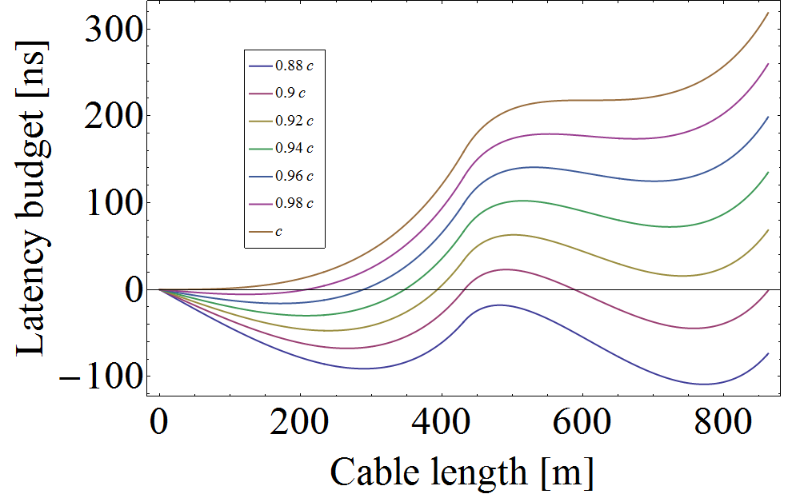
e⁺ FF1 latency curves
Minimum latency
Notes:
Say it can work!

Slide 33
Summary
RTML collimation systems have been designed:
Need to modify optics for EC2 to allow space for a spoiler
RTML FF systems are essential to:
Minimise beam jitter at the entrance of the main linacs
Respect the emittance growth budget of the RTML
  Jitter through betatron collimator is critical
Relax stability requirements of damping ring extraction system
The main requirements of the FF system have been outlined
Latency requirement
Cable type
BPM resolution
Kicker requirements
e⁺ FF1 system is possible, but will have a smaller latency budget
Vertical beam is less critical since the vertical motion damps along the RTML
Tracking simulations investigated:
Emittance growth and jitter amplification
BPM resolution
Limits on initial jitter
FF system requirements seem achievable given FONT and cavity BPM studies at ATF2
Notes:
Talk about vertical case

Slide 34
References
[1] “Optics and protection of the injection and extraction regions of the CLIC damping rings”, R. Apsimon et. al., IPAC 2013, Shanghai, MOPWO025
[2] “Latest performance results from the FONT 5 intra train beam position feedback system at ATF”, M. Davis et al., IPAC 2013, Shanghai, WEPME053

