Slide 1
ITER Integration
Akira Yamamoto (KEK)
presented at
ECFA-LC2013, DESY, May 28, 2012

Slide 2
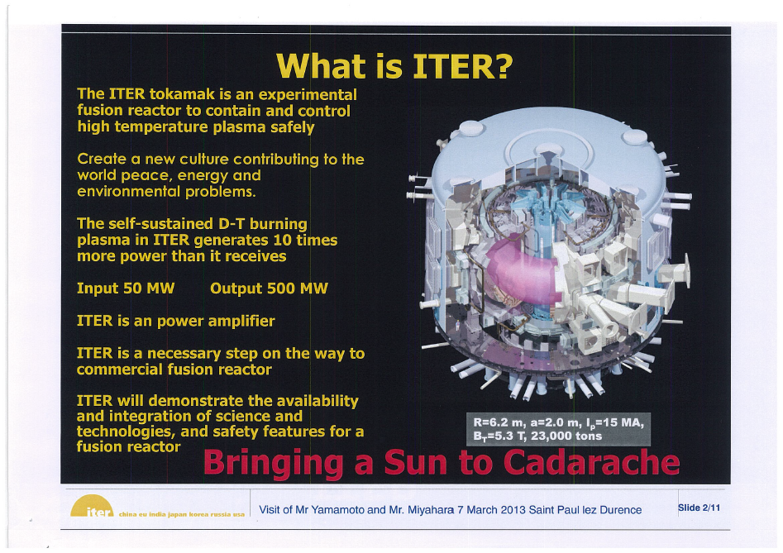
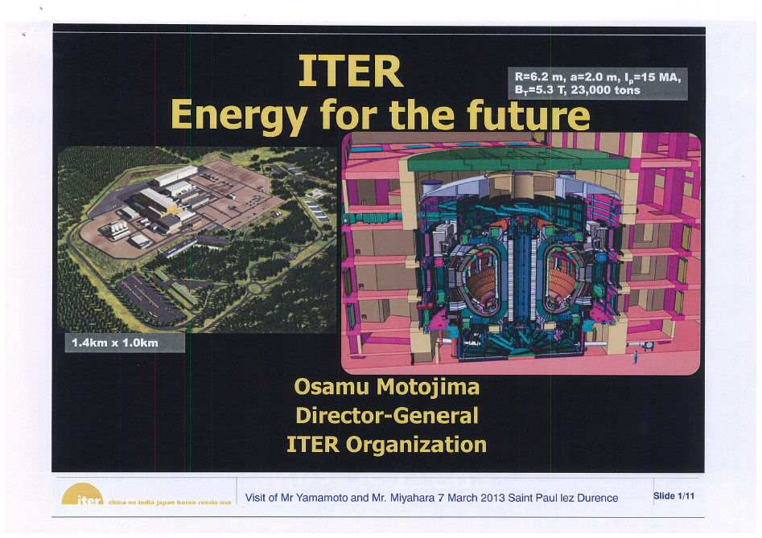

Slide 3
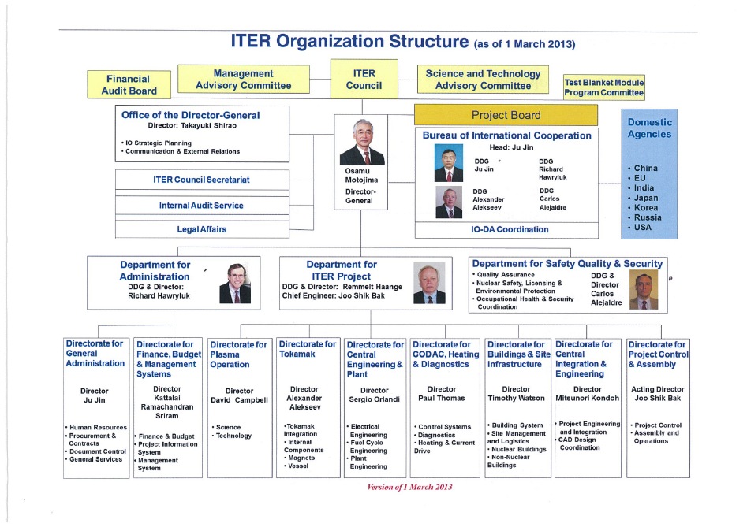

Slide 4
1

Slide 5
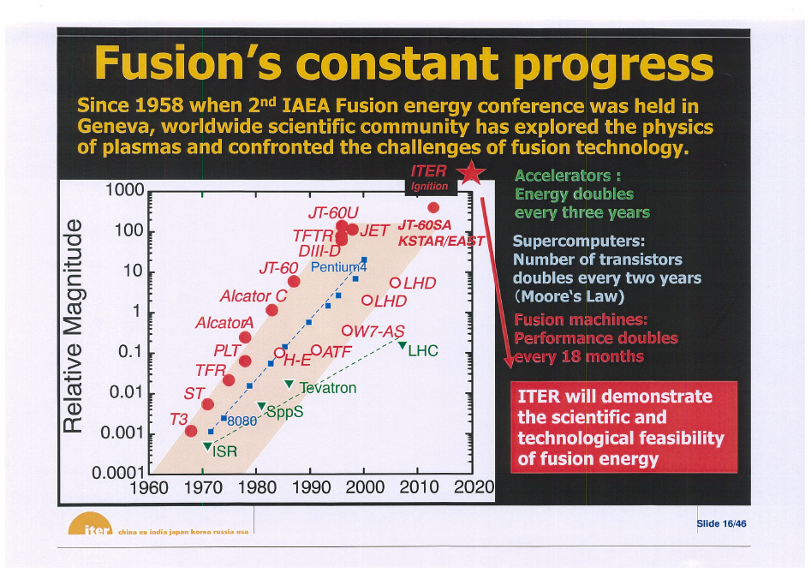

Slide 6
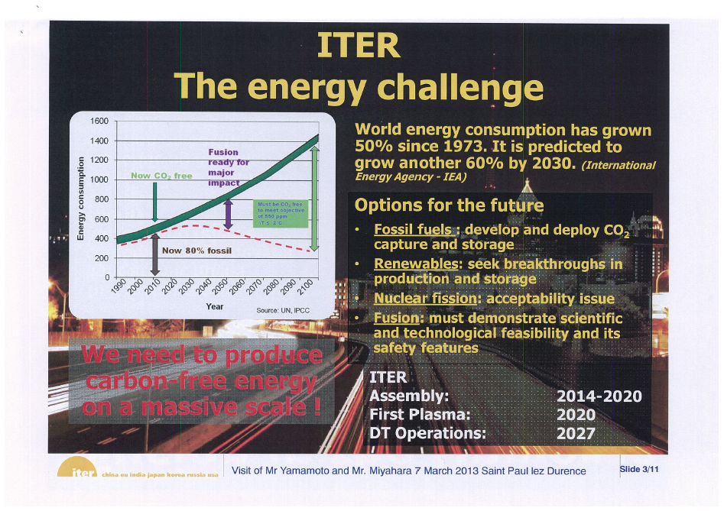

Slide 7
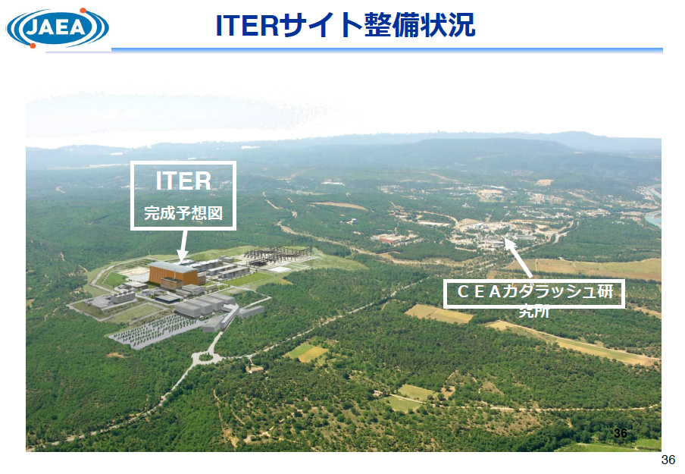

Slide 8
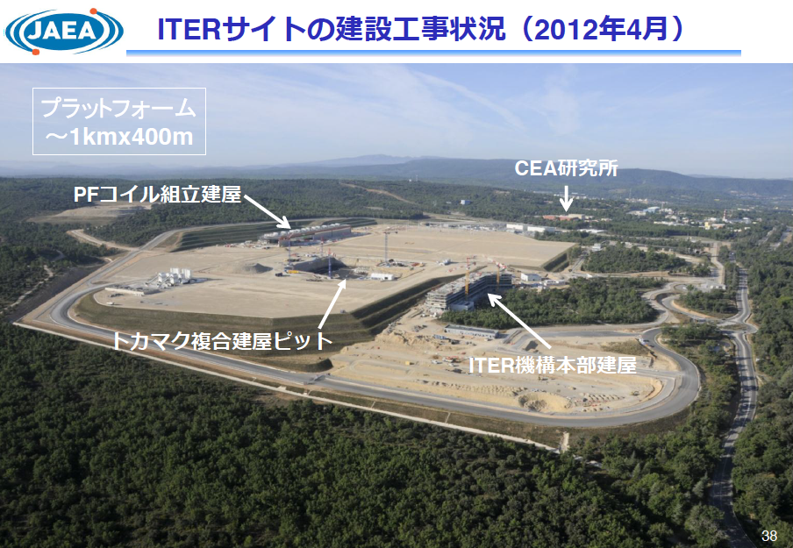

Slide 9
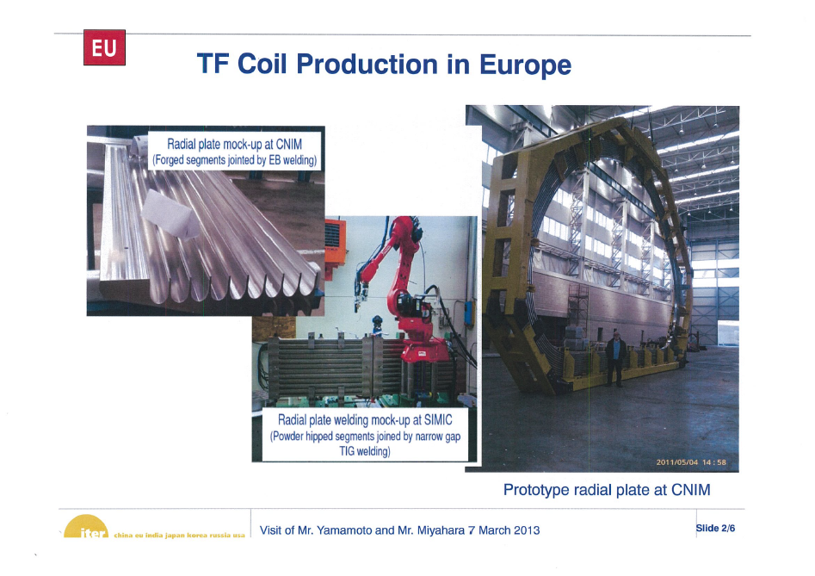

Slide 10
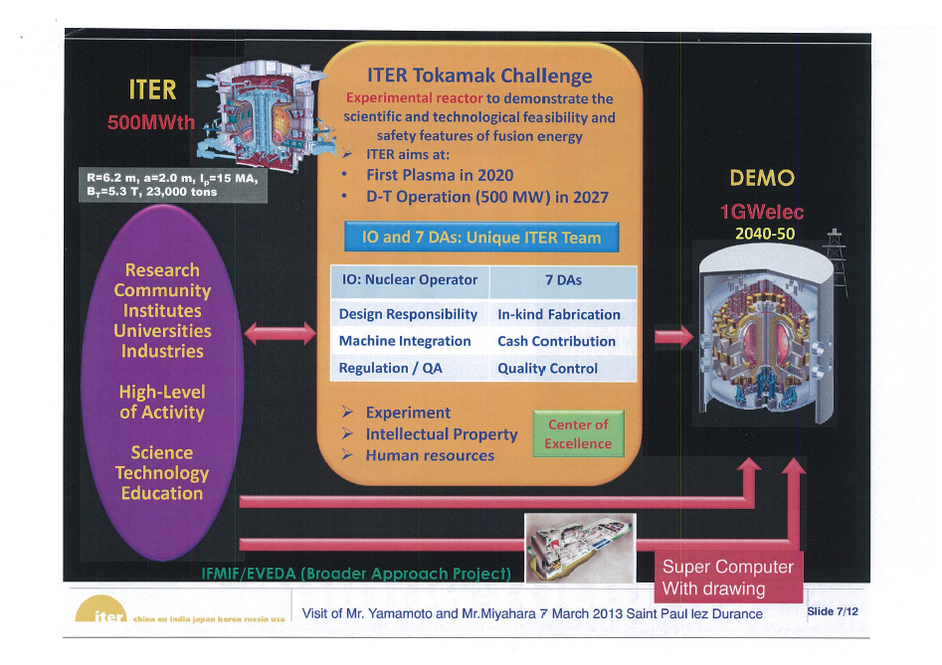

Slide 11
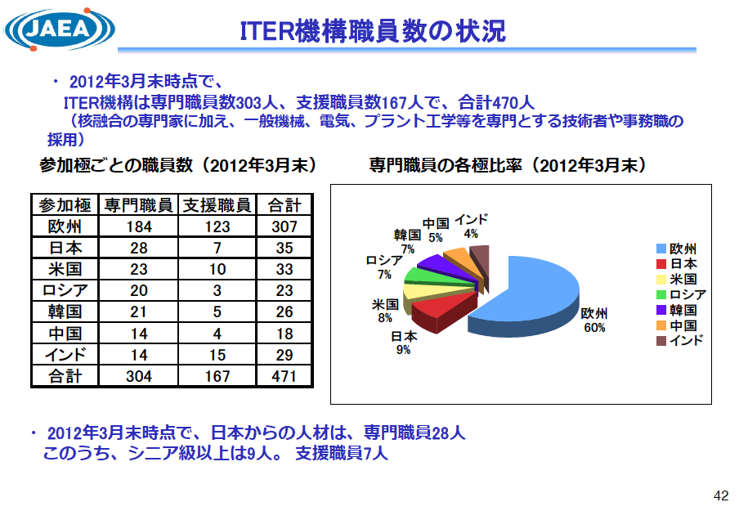

Slide 12
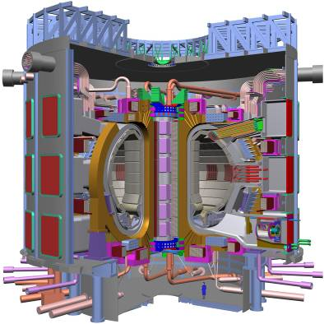
ITER Construction
- Plant System Integration -
Provided by Eisuke Tada
JAEA Naka Institute
and
ITER: Japanese Domestic Agency

Slide 13

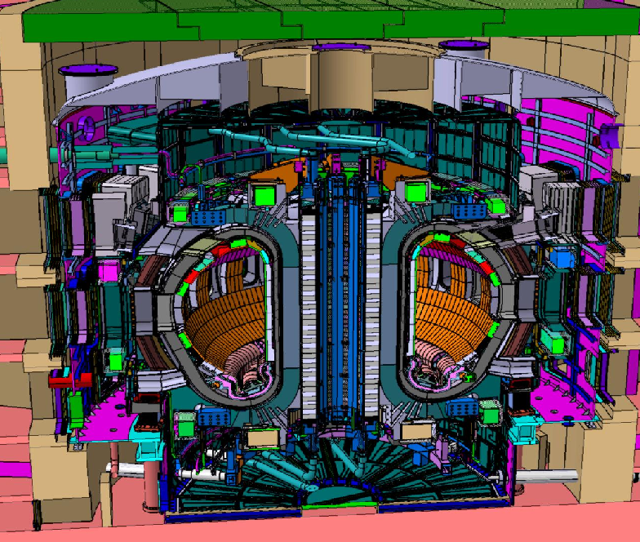
ITER Tokamak Structure
PF coils
Nb-Ti
TF coils
Nb₃Sn
Cryostat
24 m high x 28 m dia.
Center solenoid
Nb₃Sn, 6 modules
Vacuum vessel
9 sectors
Shielding blankets
440 modules
Divertor
54 cassettes
Major radius: 6.2 m
Plasma volume: 840 m³
Plasma current: 15 MA
Fusion power: 500 MW
Total weight: ~ 23400 t

Slide 14
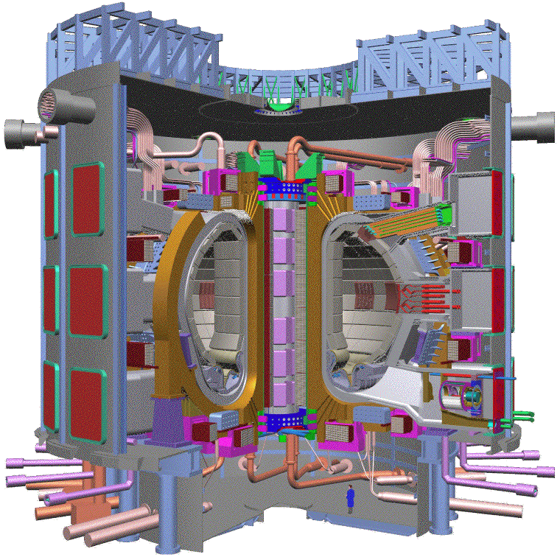
Key Technology Development
in the EDA Phase
TOROIDAL FIELD MODEL COIL
CENTRAL SOLENOID MODEL COIL
Height 4 m
Width 3 m
B_{max}=7.8 T
Radius 3.5 m
Height 2.8m
B_{max}=13 T
0.6 T/sec
BLANKET MODULE
VACUUM VESSEL SECTOR
HIP Joining Tech
Double-Wall,
± 5 mm
REMOTE MAINTENANCE OF BLANKET
REMOTE MAINTENANCE OF DIVERTOR CASSETTE
Attachment Tolerance ± 2 mm
DIVERTOR CASSETTE AND PFCs
4 t blanket sector ±0.25 mm
20 MW/m²
Notes:
A lot of R&D has also been done on the manufacturing of these components…during the EDA

Slide 15
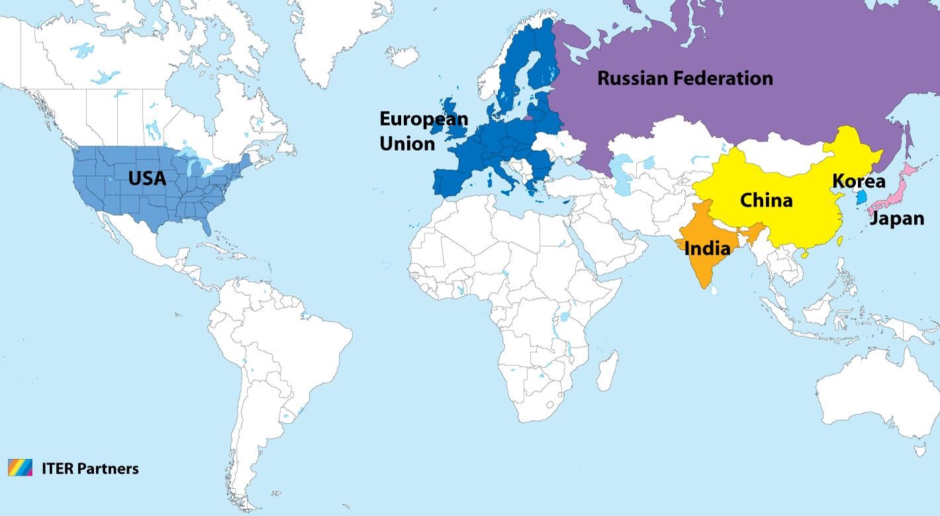

ITER - International Cooperation
Construction & operation by the ITER Organization (IO) with support of the Domestic Agencies (DAs) of the seven parties
IO: Management & integration (Nuclear operator)
DAs: In kind contribution & procurement
Notes:
Seven participants - the ITER parties - are involved in the construction of the world´s largest fusion device. This international joint venture is coordinated by the International ITER Organization based in Cadarache, in the south of France, app. 70 km north of Marseille.

Slide 16
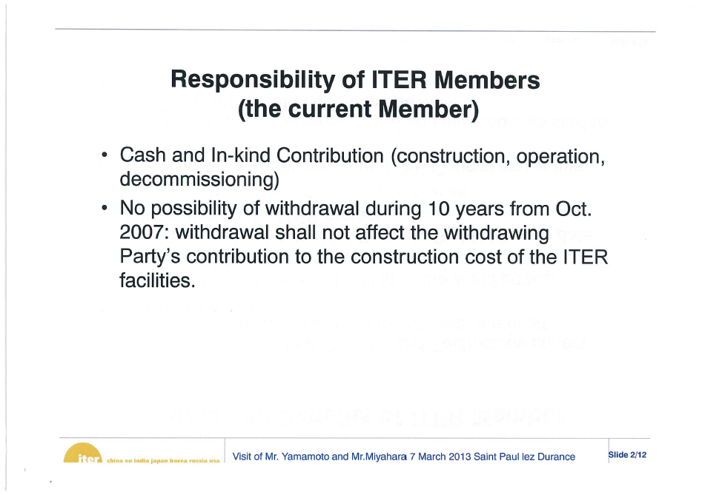

Slide 17
Construction Sharing
Complex plant system with advanced technology
Sharing: EU 5/11, other six parties 1/11 each
90 % in kind procurement
Buildings
13.4 %
Blanket &
Divertor 8.4 %
Magnet
System 26.6 %
Power supplies &
Distribution 7.2 %
ITER Plant System
Vacuum
Vessel 7.9 %
Fuel Cycle
4.1 %
Heating System 7.7 %
Cryoplant &
Distribution 3.2 %
Diagnostic &
CODAC 6.2 %
Cryostat & Thermal
Shield 3.5 %
Cooling Water
System 4.9 %
Assembly & Remote
Handling 6.8 %

Slide 18
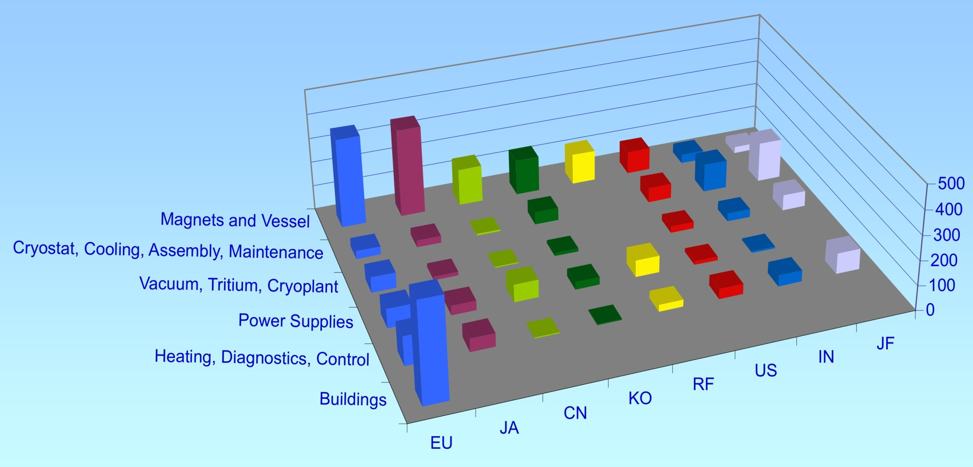
Procurement In Kind
  Involvement of the parties in key fusion technology areas
  A fair sharing of the cost of the device by ‘value’ and not by currency
  Interfaces management and integration by IO

Slide 19
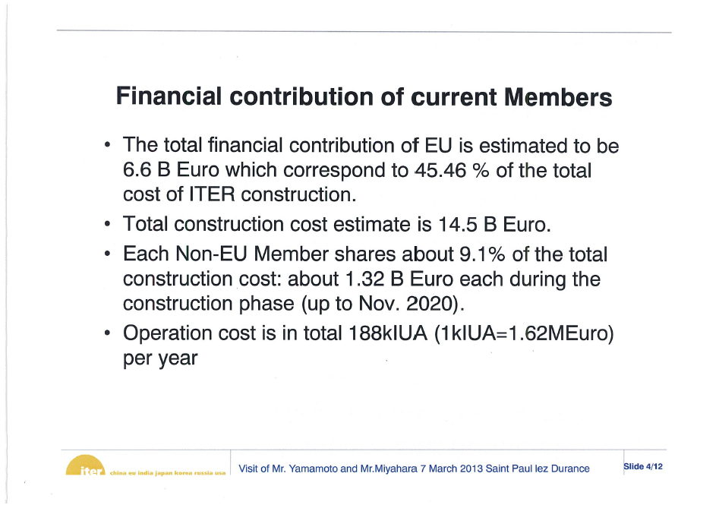

Slide 20
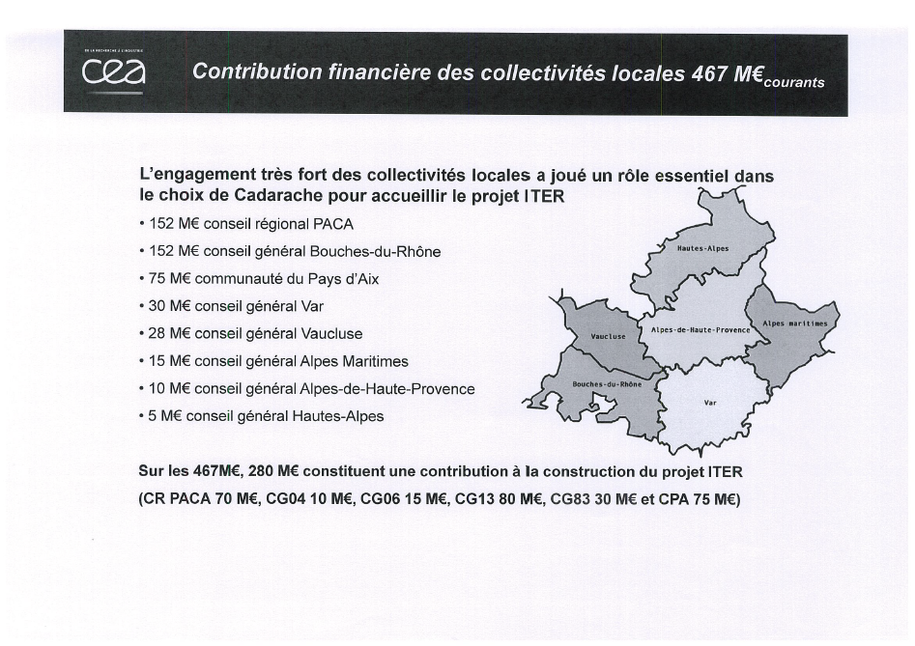

Slide 21
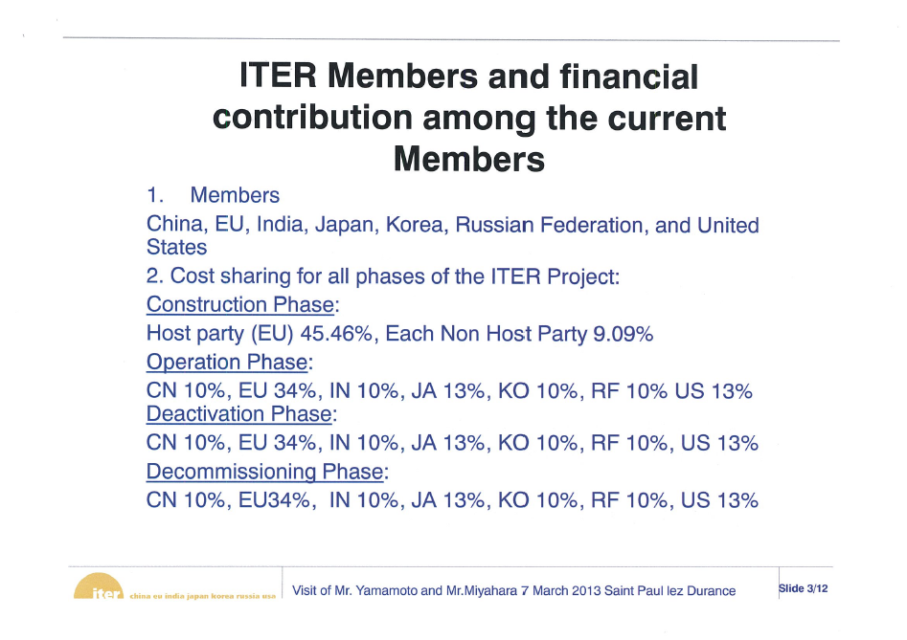

Slide 22
General Roles & Responsibilities for Construction
ITER Organization (IO)
  Planning/Design
  Integration / QA / Safety / Licensing / Schedule
  Global transportation & Installation
  Testing + Commissioning
  Operation
Parties - Domestic Agencies (DAs)
  Detailing / Designing
  Procuring
  Delivering
  Support installation
IO and DAs plus Fusion Community work together on exploitation of ITER. ITER IO coordinates and participates in the program (e.g. Test Blanket Module program for power generation).

Slide 23
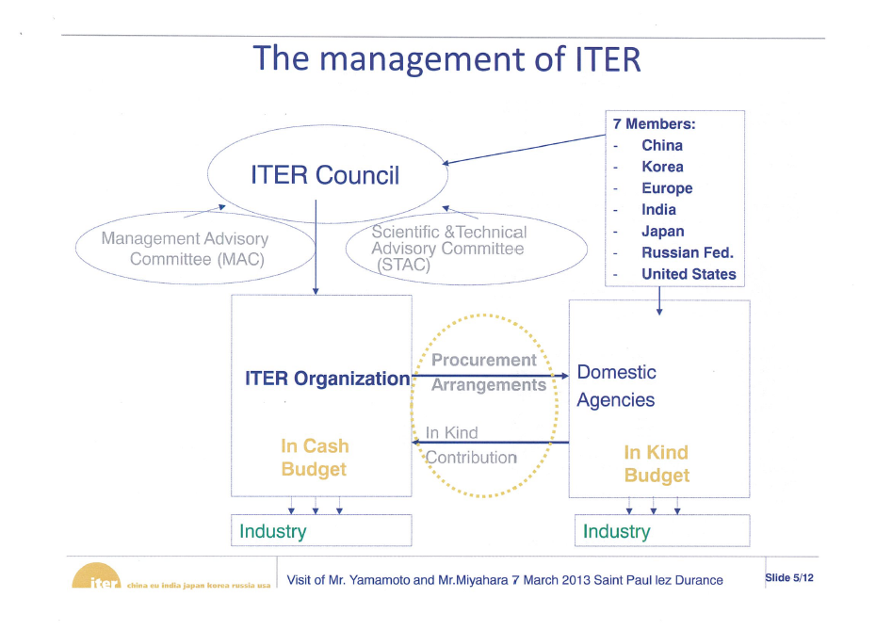

Slide 24
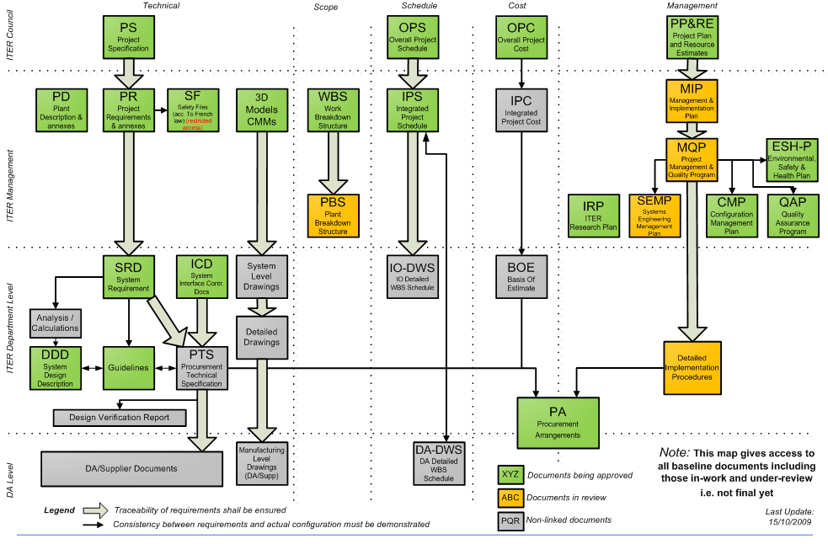
ITER Baseline Structure
Technical scope
Schedule
Cost
Management
Council
ITER
DG
Division
Group

Slide 25
Integral Management
Project Plan and Resource Estimate (Council level doc.)
Overall project schedule & construction schedule
Management systems for the project execution
Work plan and resources for construction
MQP (Management level doc.)
Cost & Schedule Management (Earned Value Management)
Configuration Management – change control
Procurement management – in-kind procurement by DAs
Risk Management – avoidance, reduction and mitigation
Quality Assurance – graded approach based on importance
Detailed Procedures & PA (Department level doc.)

Slide 26
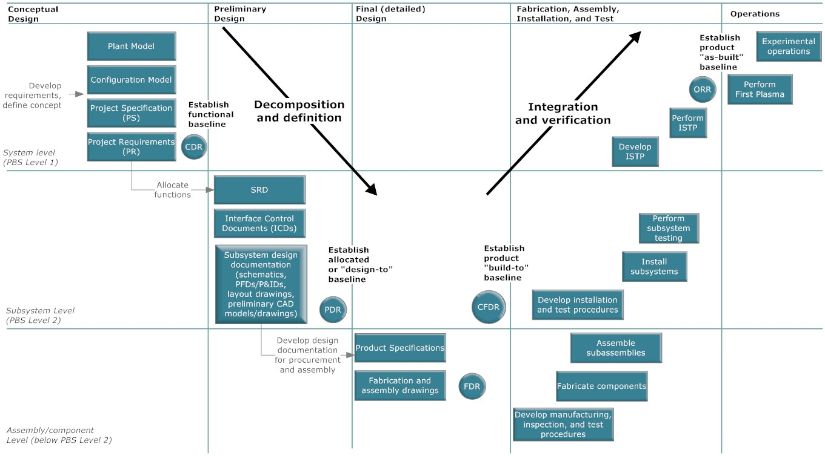
Systems Integration
ITER System Engineering plan to define engineering processes and clarify roles & responsibilities for integration. It focuses on needs and functionality in the early stage and then integration and verification.
System
Components
Parts

Slide 27
Sharing of Work between IO and DA
Work sharing defined by frame chart
・ Construction：IO/DAs depending on the type of specifications
・ Transportation：IO to coordinate a global transportation
・ On-site installation/testing：IO in support of DAs
・ Project management & integration: IO
Type or specifications
- Functional: DA for preliminary design based on conceptual design by IO
- Detailed: DA for final design based on preliminary design by IO
- Build-to-print: DA for manufacturing design based on final design by IO

Slide 28
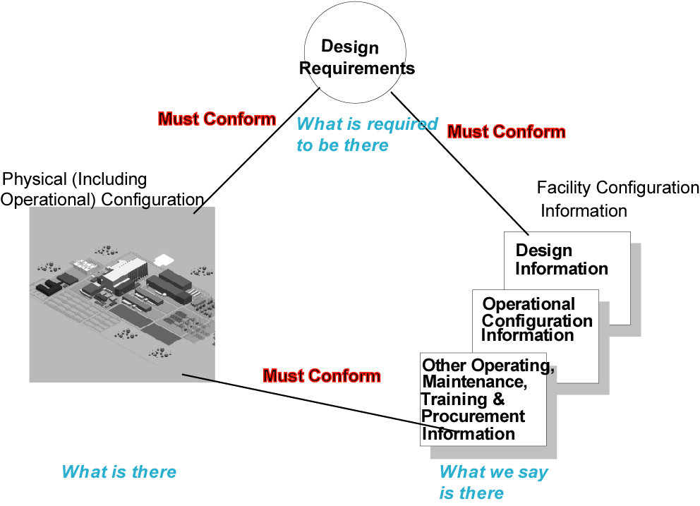
Configuration Management
Configuration Management is the process for establishing and maintaining consistency of a product’s performance, functional and physical attributes with its requirements, design and operational information throughout its life.
Main process:
Identification
Implementation
Monitoring
Review & audits
Procedures:
Requirements
Changes
Documents
Assessments
Interfaces
Database
PA
Notes:
28

Slide 29
Management of Design Requirements
The PS defines the operational features and performance required to fulfil the ITER mission.
The PR translates the top level mission requirements into engineering terms.
The SRDs define the requirements for the systems.
DOORS
PS
Project RQs
(P-RQ)
PR
System RQs
(S-RQ)
SRD
Compliance
Design Documents
PS : Project Specification
PR : Project Requirement
SRD: System Requirement Document

Slide 30
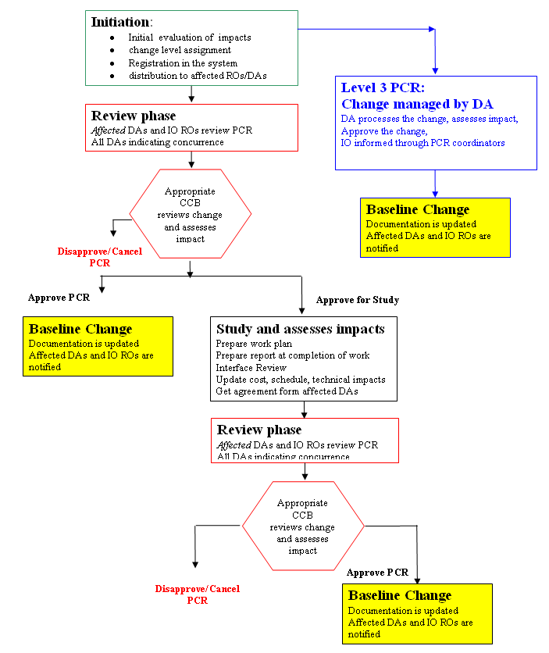
Design Change Management
Level 3
Changes categorize and approved depending on the level of impact:
Level 0: ITER Council
Level 1: ITER DG
Level 2: ITER DDGs
Level 3: TROs
Level
0, 1 & 2
Change request (PCR) to be generated and reviewed in terms of impact on scope, schedule and cost
Changes to be managed by Configuration Control Board (CCB)

Slide 31
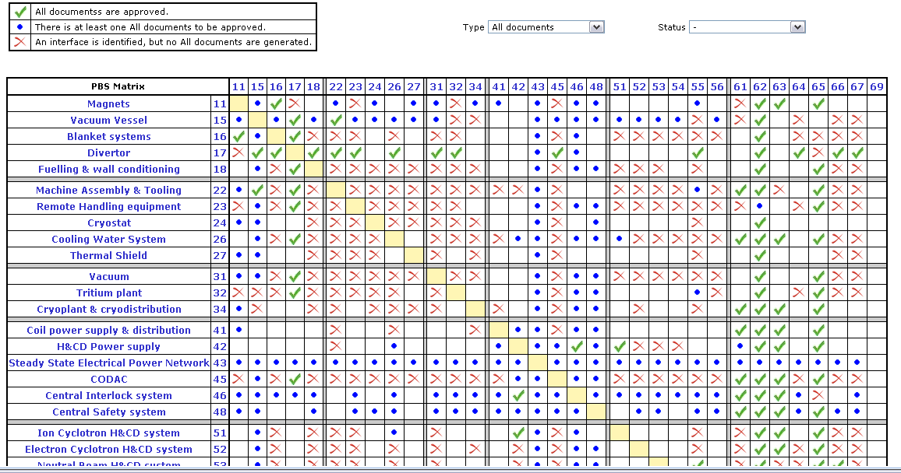
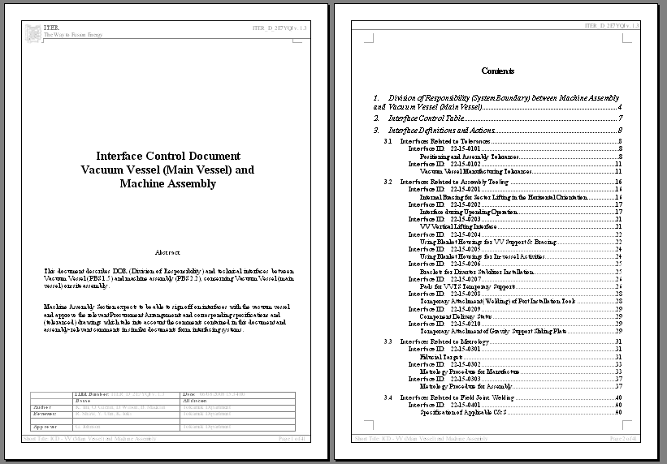
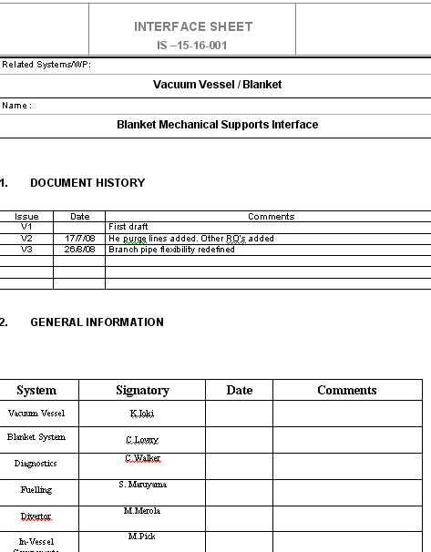
Interface Management
Management
per each PBS
SRD
ICT
ICD
IS
Linked with a cell of ICT
ICDs
SRD：System Requirement Documents
ICT：Interface Control Table
ICD：Interface Control Document
IS：Interface Sheet
ISs stored in subfolder of ICD

Slide 32
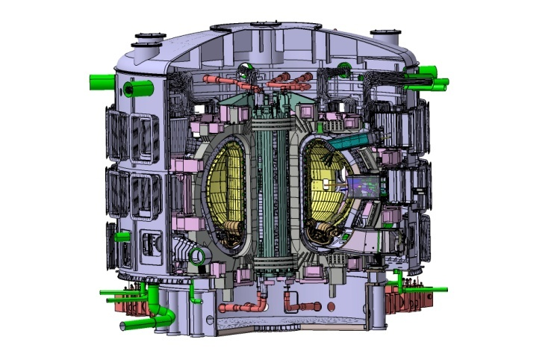
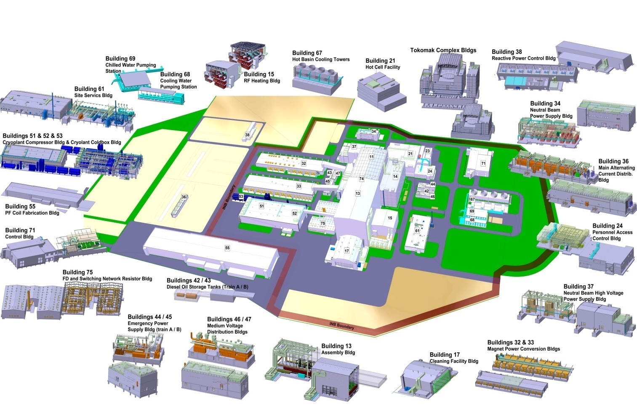
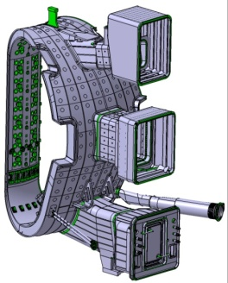
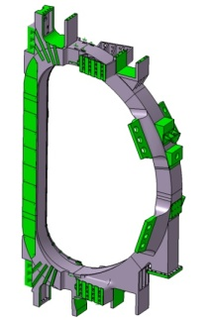
Interface Management: CMM
Simplified 3D Model based on baseline, representing space, geometry and interfaces
Layout and interface management
Tolerance analysis for different operating temperatures
Examples of CMM

Slide 33
Risk Management
Primary Objective of the ITER Risk Management is to provide a sustainable and consistent process for the management of cost, schedule, technical, and operational uncertainty on the project.
Execution
Components
Project Integration
Magnets
Managing Risk
Vessel
Internal Components
1.
Identify
Risks
2.
Assess & Measure Risks
3.
Determine
Handling
Strategy
4.
Develop
Response & Mitigation Plans
5. Monitor, Report & Dispose
Diagnostics & HC
Plant & Fuel Cycle
Electrical Power Supply
CODAC and IT
Civil Construction
Procurement
Technology
Schedule
Operational
Hazard
People
Process
Compliance
Financial
Possible Risk Areas

Slide 34
RAMI: Reliability, Availability,
Maintainability & Inspectability
RAMI: Technical Risk Control program for the success and availability of ITER. The ITER RAMI program is declined in 4 stages:
  A classical Functional Analysis to identify the main functions and their possible Failures.
  An analysis of the failure modes, their cause & effects and the establishment of a Critical List according to their importance with respect to the machine operation availability (FMEA).
  Evaluation of Severity, Occurrence and Detectability levels of main failure mode causes: Criticality = S.O.D (FMECA).
  As a function of this criticality level, the risk of a failure can be considered as acceptable or not. When the risk level is too high, measures are to be taken for improvement of Design, Fabrication and Testing to reduce the risk level, and/or for an optimized Preventive Maintenance Plan and an adapted Spare Part Strategy.
Notes:
It begins with a classical Functional Breakdown to identify the main functions and their possible Failures.
The second stage concerns the analysis of the failure modes, their effects for the system and the establishment of a List according to their importance with respect to the machine and pulse operation availability (FMEA).
By evaluating their severity, occurrence and detectability levels, it is then possible to allot a criticality value for each failure mode (FMECA).
As a function of this criticality, the risk of a failure can be considered as acceptable or not. The Risk level of Critical Failure Modes could be progressively reduced by providing recommendations for Design, Fabrication, Testing, and more especially, by preparing an efficient machine operation with an optimized Preventive Maintenance Plan and an adapted Spare Part Strategy.

Slide 35
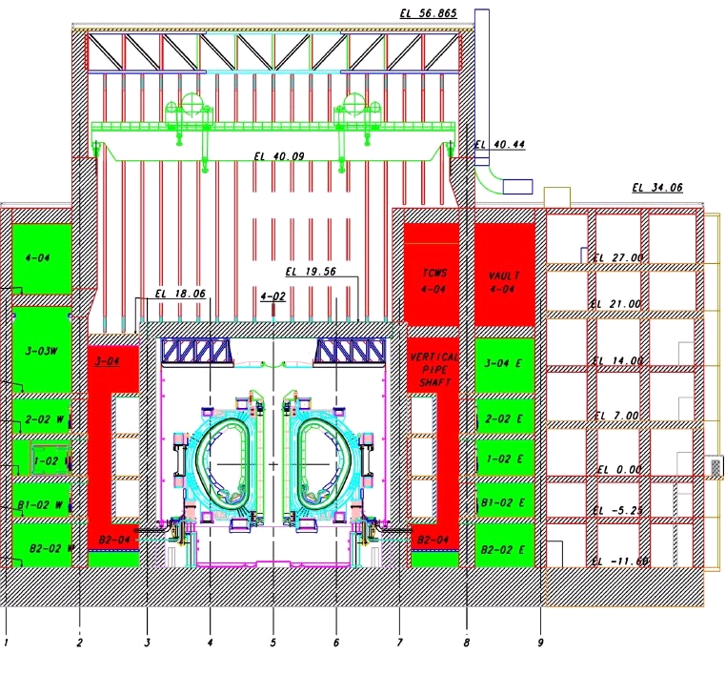
Basic Safety Approach
- Confinement of Radioactive Material -
Based on the unique safety features, the safety goal will be achieved by a combination of enclosure containing radioactive material and vent/clean-up system for mitigating the consequence in case of failure of enclosure.
Port cell &vault
1st Confinement System
Vacuum vessel
VV extensions
etc
2nd Confinement System
Port cells
Vaults
etc
Dynamic Systems
Vent & cleanup system
etc
Vacuum vessel

Slide 36
Codes and Standards Application
Internationally recognized codes & standards can be applied for construction but the compliance with nuclear regulation should be justified for the safety important components.
Governmental Acts:
  Pressure equipment
  Nuclear pressure equipment
  Nuclear quality
1
2. Codes:
  RCC-MR (vacuum vessel)
  ASME (Sec VIII, B31.1, etc.)
  EN13445
  EUROCODE (building)
2
3. Standards:
  ASTM
  EN
  ISO
  ANSI, EJIMA
3
4
4. Technical specifications:
defined in Procurement
Arrangement

Slide 38
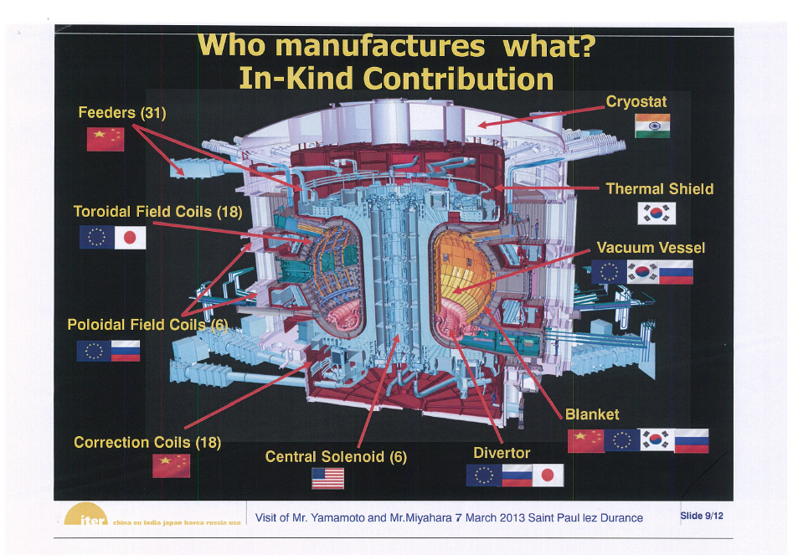

Slide 39
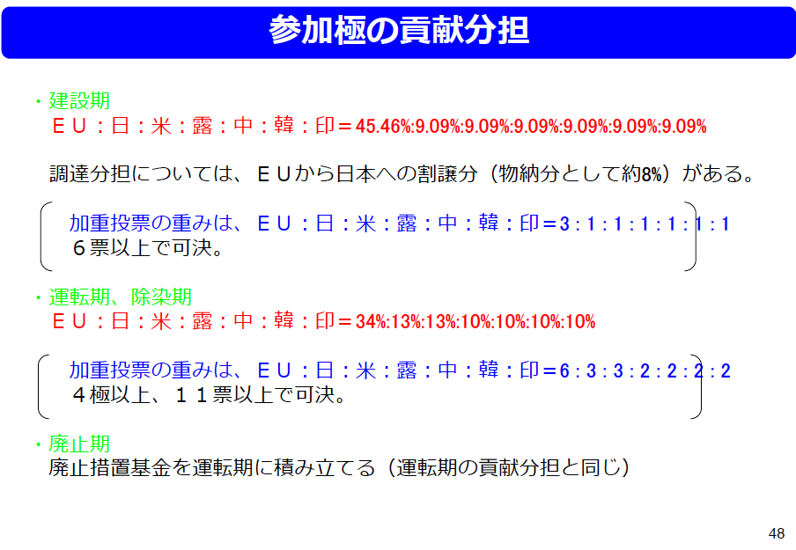

Slide 40
