Slide 1


Novel sensor technologies for tracking and vertexing:
A 2D position sensitive microstrip sensor with charge division.
A segmented p-type sensor with low-gain charge amplification.
Esteban Currás
Instituto de Física de Cantabria(CSIC-UC)

Slide 2
Outline
Motivations for the R&D.
A 2D position sensitive microstrip sensor.
  Laser characterization
  Electrical equivalent circuit simulations
  Test beam results
Segmented p-type sensors with low-gain charge amplification
  TCAD simulations of the device.
  Laser characterization of diodes with amplification.
Conclusions

Slide 3
R&D Motivation
Charge division in microstrips:
  Long microstrips ladders (several tens of centimeters) proposed for the ILC tracking detectors.
  Getting the particle hit coordinate along the strip using the charge division method.
  Avoid the complexity of double sided sensors and the additional material of a second layer of sensors.
Low gain segmented p-type pixels (strips)
  Implementing a small gain in the segmented diode so we can reduce the thickness of the sensors without reducing the signal amplitude
  Smaller contribution to the material budget.

Slide 4
Charge Division in uStrips
S₁
S₁
Simple single-side AC-coupled microstrip detectors
with resistive coupling electrodes.
X-coordinate: cluster-finding algorithms for strip detectors.
Y-coordinate: Resistive charge division method.
Resistive material
Aluminium
y
Aluminium
x
x
L
** Electrode resistance >> preamplifier impedance.
L
S₁=f(y)
S₂=f(L-y)
y A₂
L A₁+A₂
=
Resistive material: high doped polysilicon
S₂
** V. Radeka, IEEE Transaction on Nuclear Science NS-21 (1974) 51

Slide 5
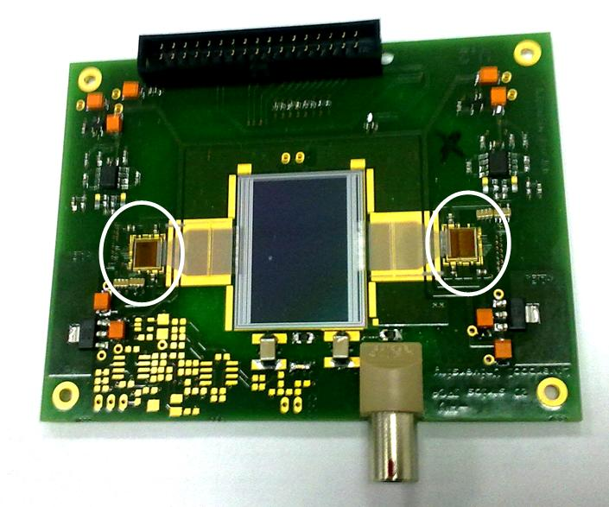
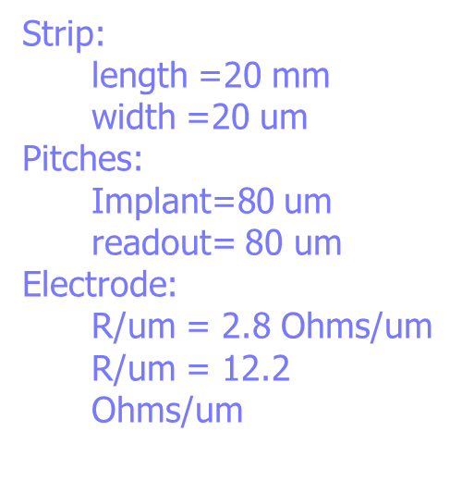
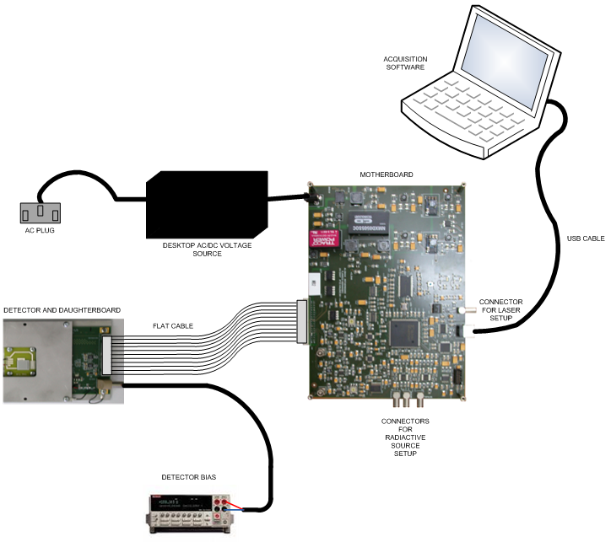
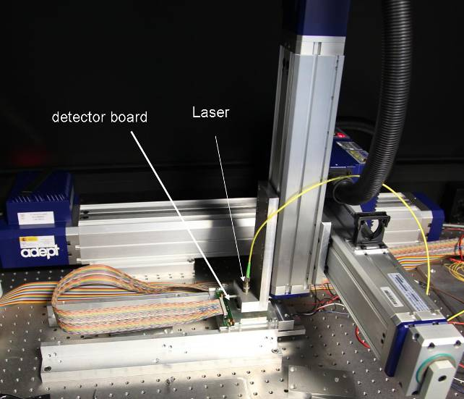
Proof-of-Concept Prototype
2 Beetle chips
ALIBAVA DAQ system for microstrip detectors, based on the Beetle analogue
readout ASIC
3D axis stage with displacement accuracy ≈ 10 μm
Pulsed DFB laser λ=1060nm
Gaussian beam spot width ≈ 15 μm
pulse duration 2ns
256 channels
peaking time = 25ns
S/N≈20 for standard no irradiated detectors
Clean room laboratory at IFCA, Santander

Slide 6
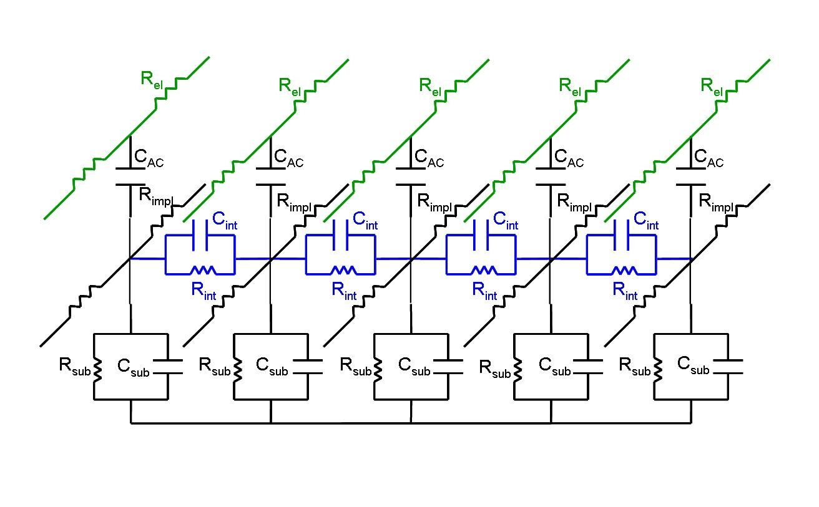
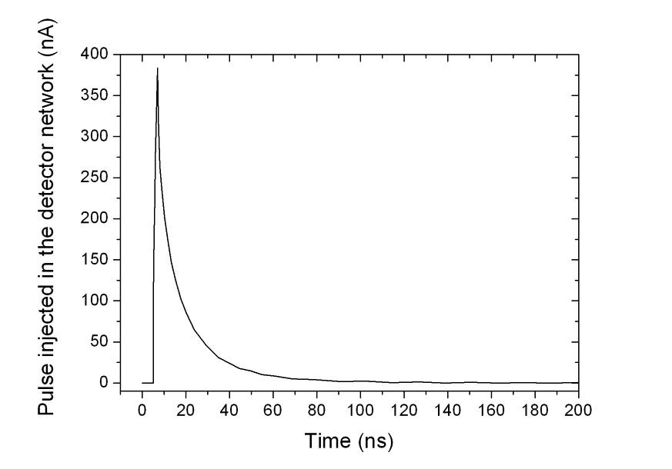
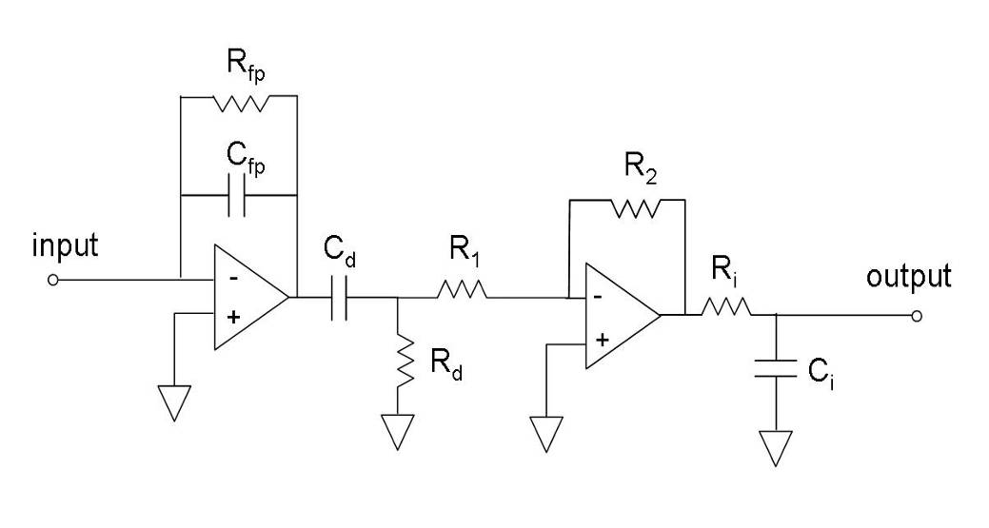
Equivalent Electrical Circuit
Detector (p⁺-on-n) model ***
80 cells 250 μm long
p
e⁻
h⁺
V_{bias}
Peaking time 25ns (Beetle chip ALIBAVA DAQ system).
rise time 2ns
Q~4fC

Slide 7
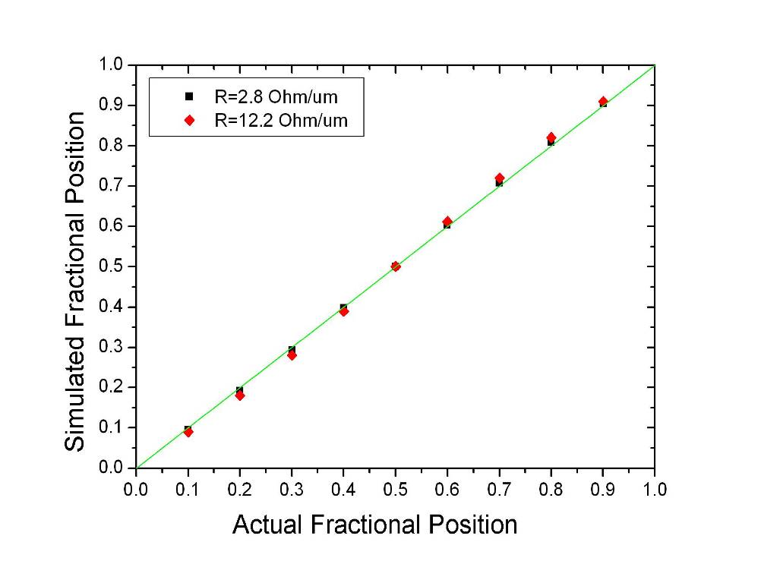
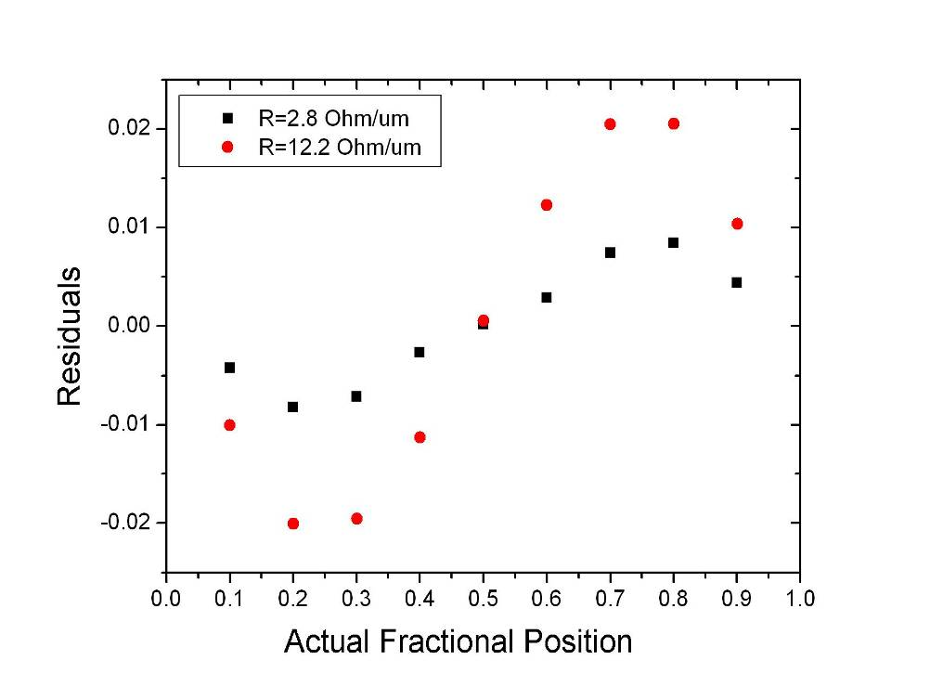
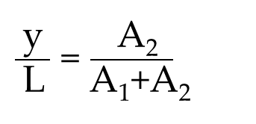
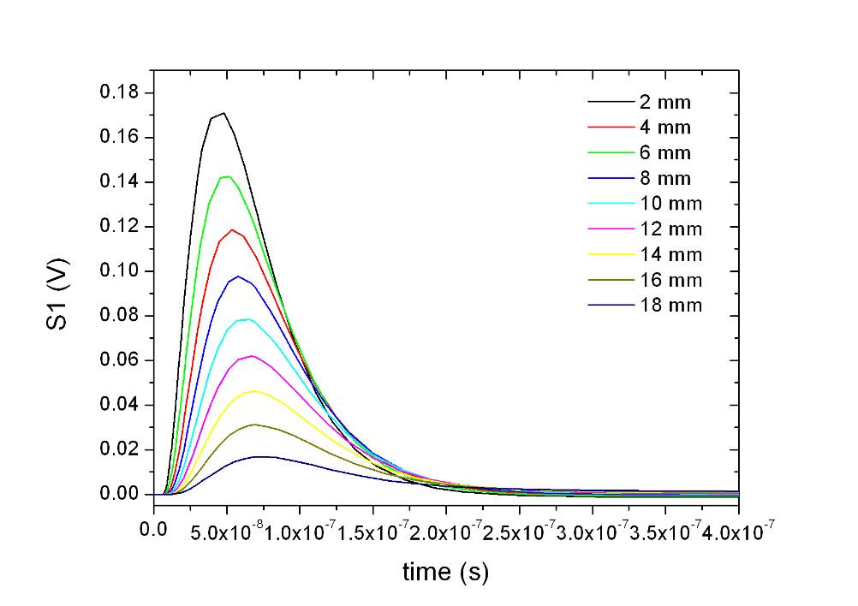
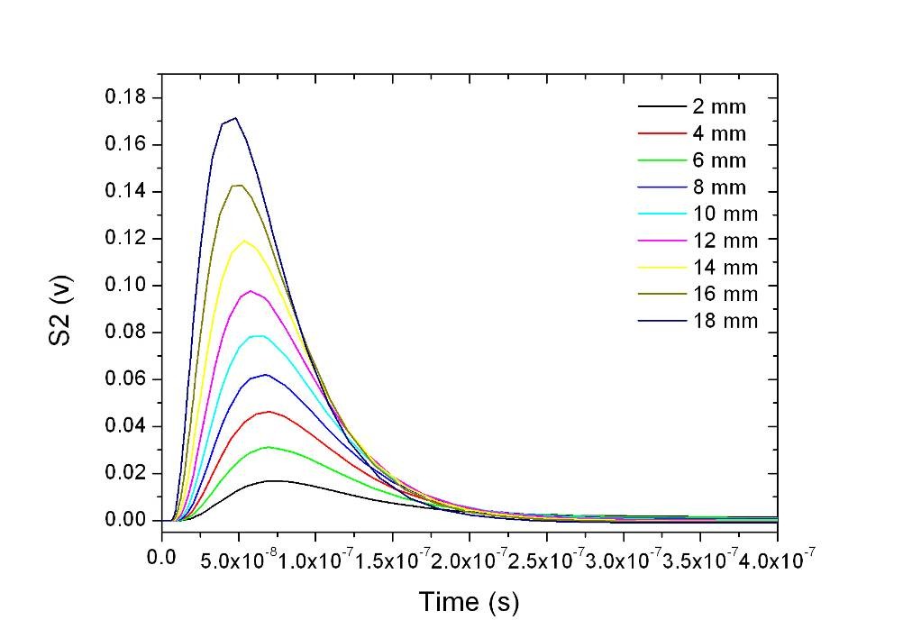
Signal Propagation – Linearity (Simulation)
S₁
S₁
Particle
S₂
t
2 mm
t₁
t
t₂
y
V
S₂
18 mm

Slide 8
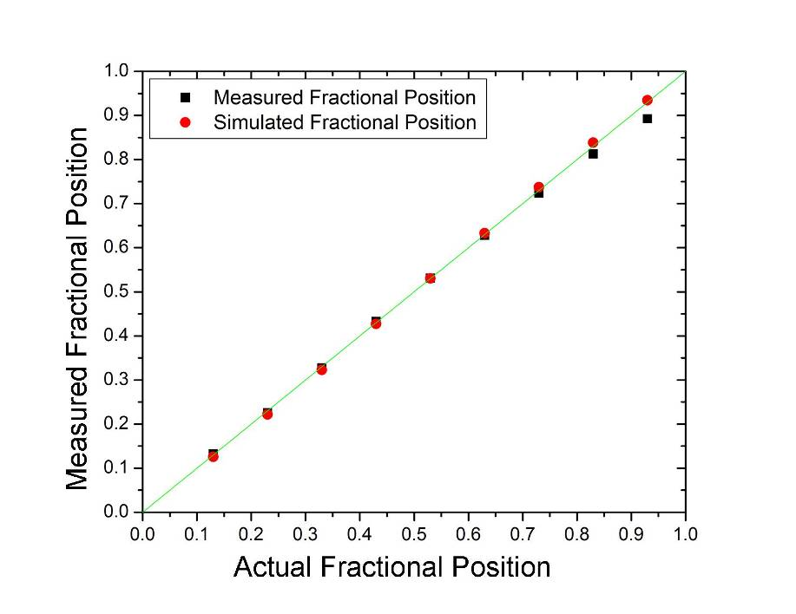
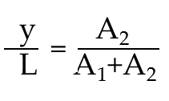
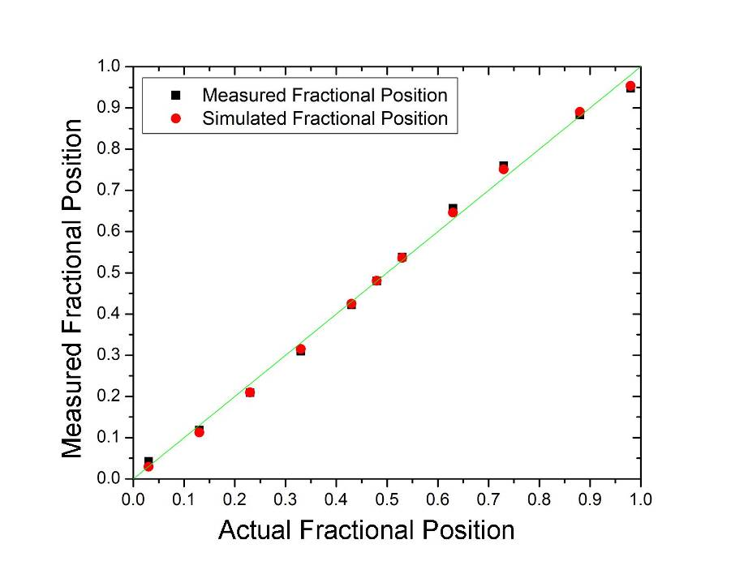
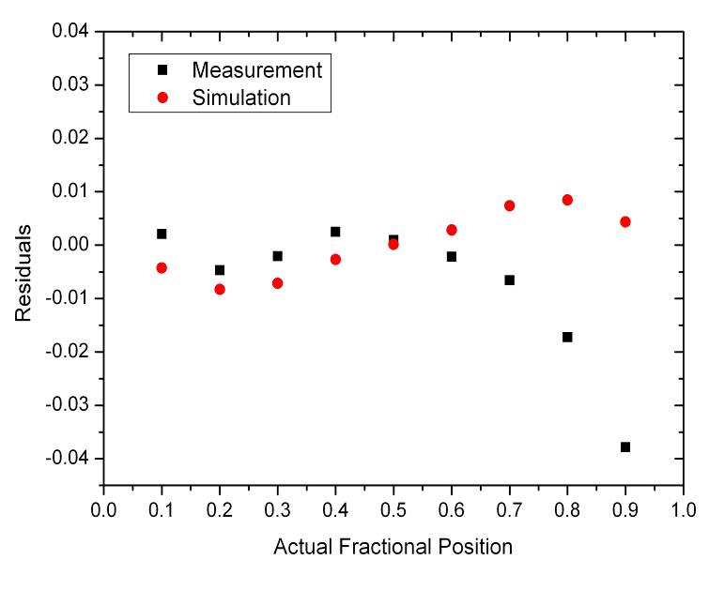
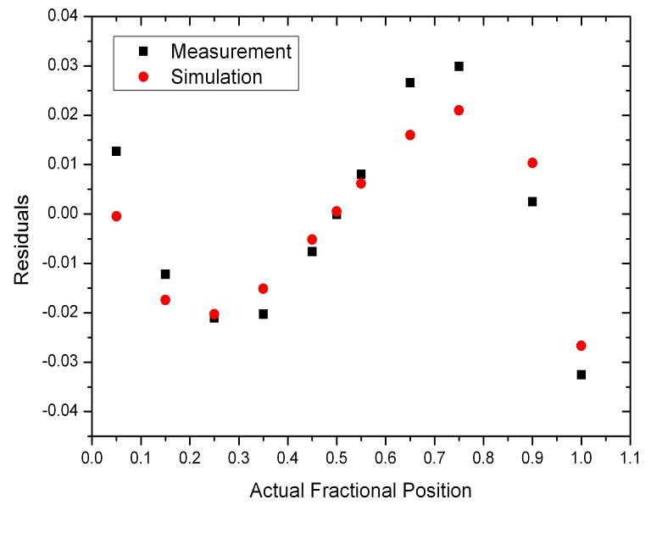
R/l=2.8 Ω/μm
R/l=12.2 Ω/μm
20000 events ∀ measurement
Systematic error
=>
Ballistic deficit

Slide 9
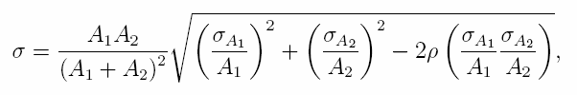
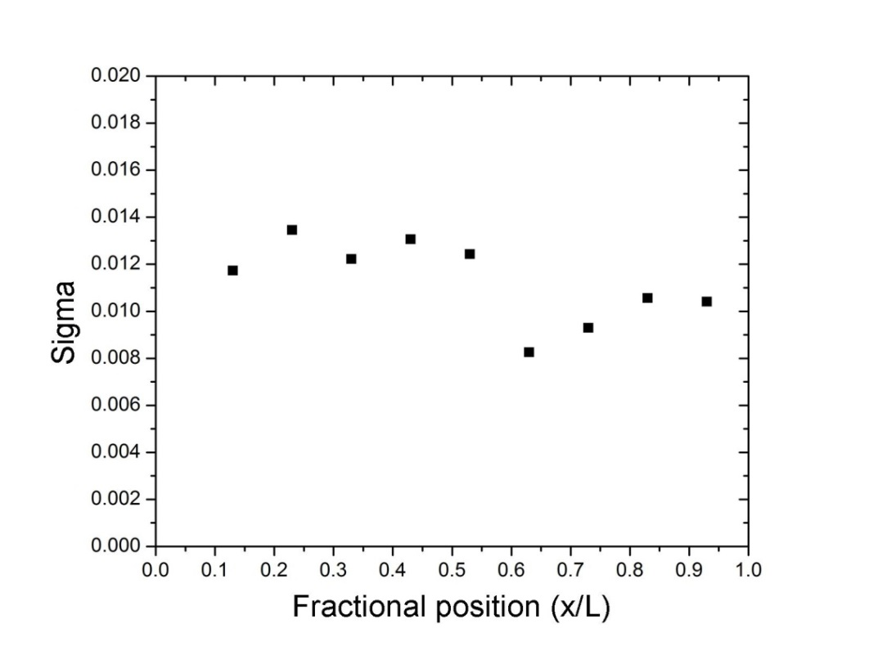
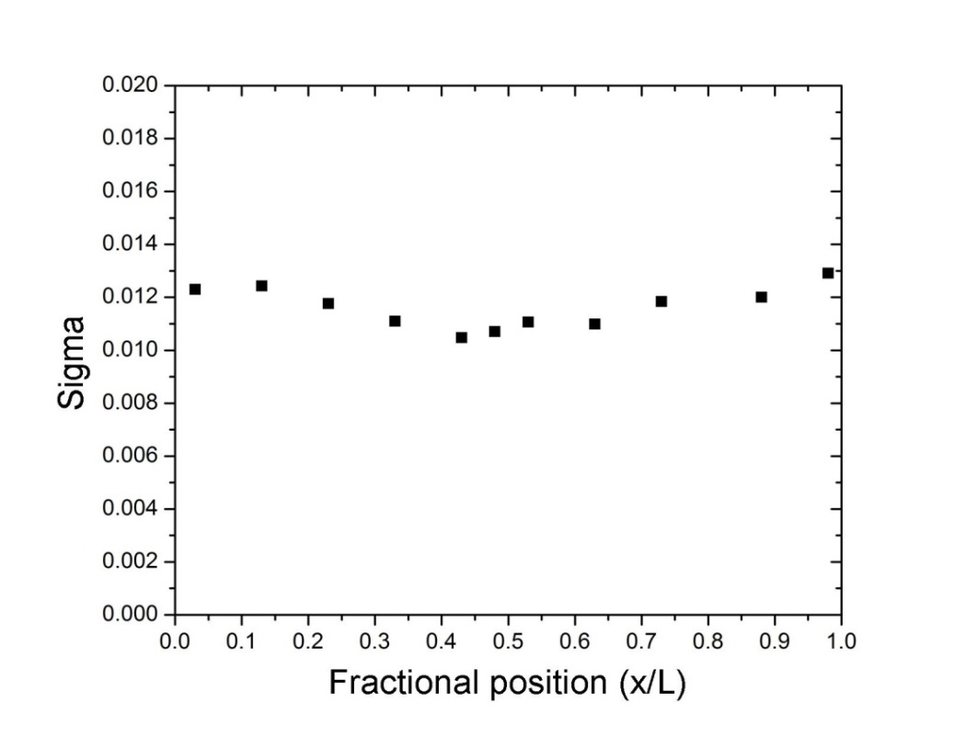
Longitudinal spatial resolution for 6 MIPs signal
A₂
A₁+A₂
1.1% L => 220 μm
1.2% L => 240 μm
R/l=2.8 Ω/μm
R/l=12.2 Ω/μm
σ_{A1}=1.83 ADU
σ_{A2}=1.80 ADU

Slide 10
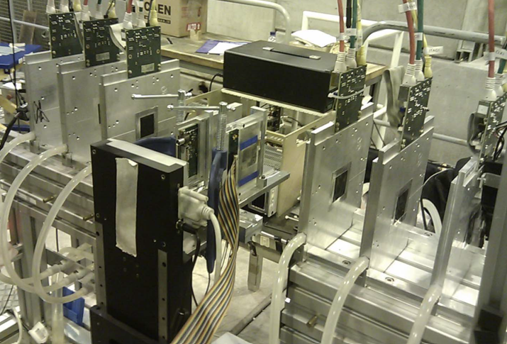
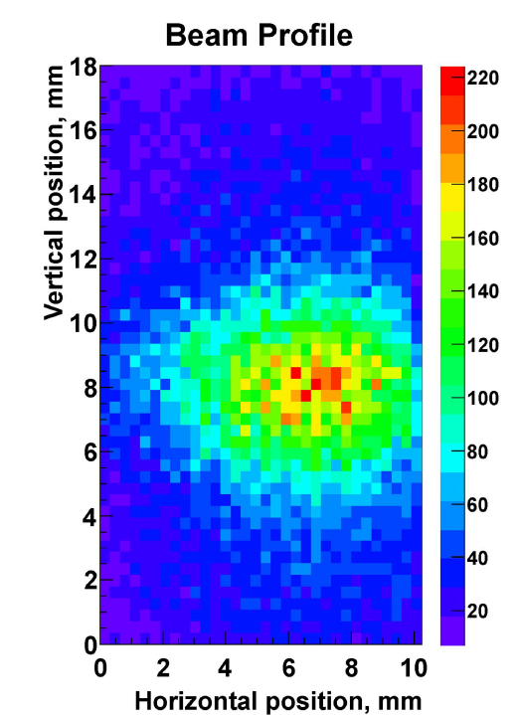
Test Beam Characterization
Test beam at CERN SPS Pion Beam, Nov 2012
First successful integration and synchronization with AIDA MIMOSA pixel telescope
Prelimirary results:
  Monitoring of beam profile.
Currently in progress:
  Efficiency and resolution using tracking information.

Slide 11
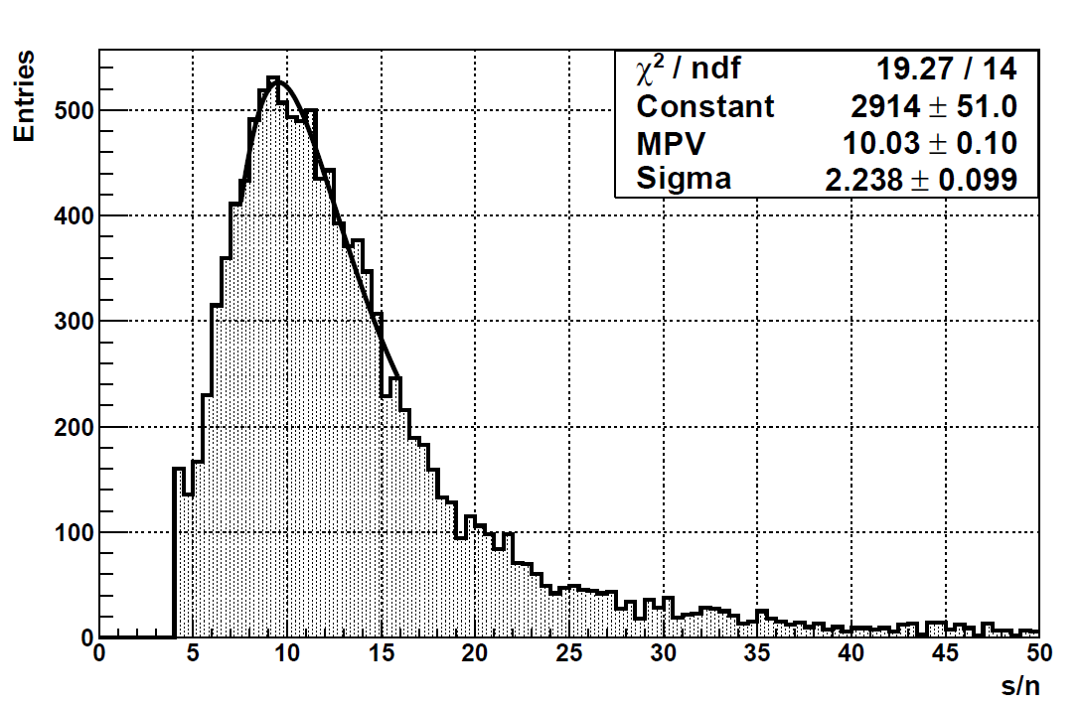
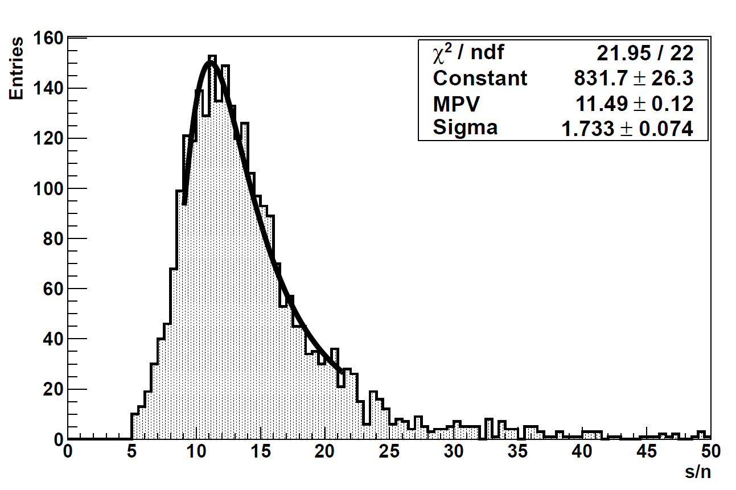
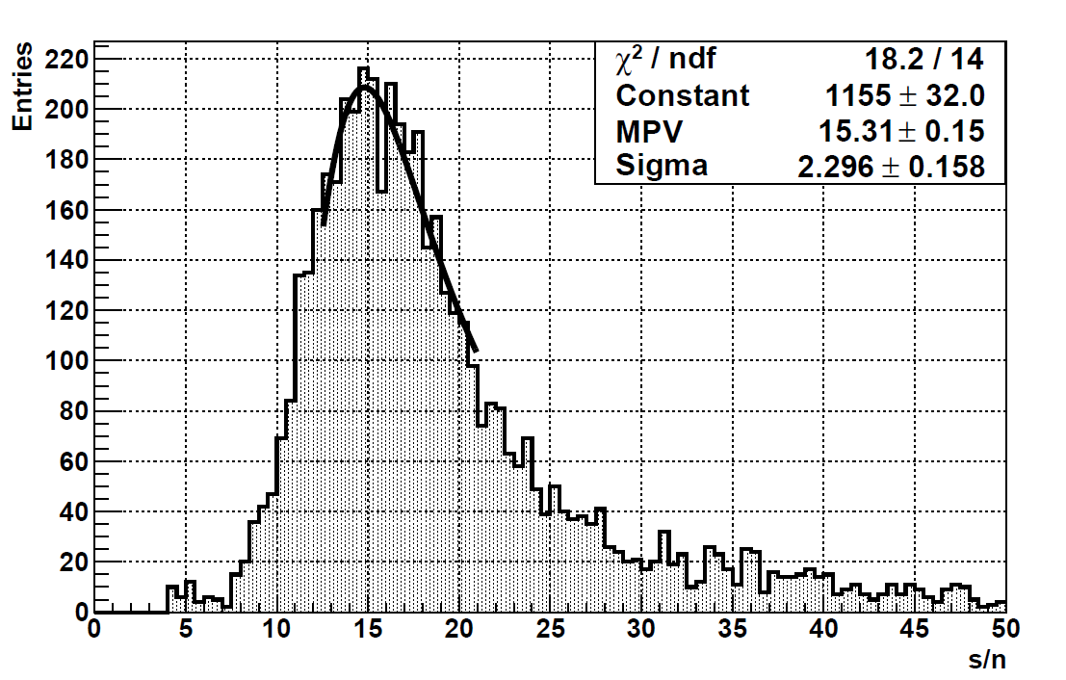
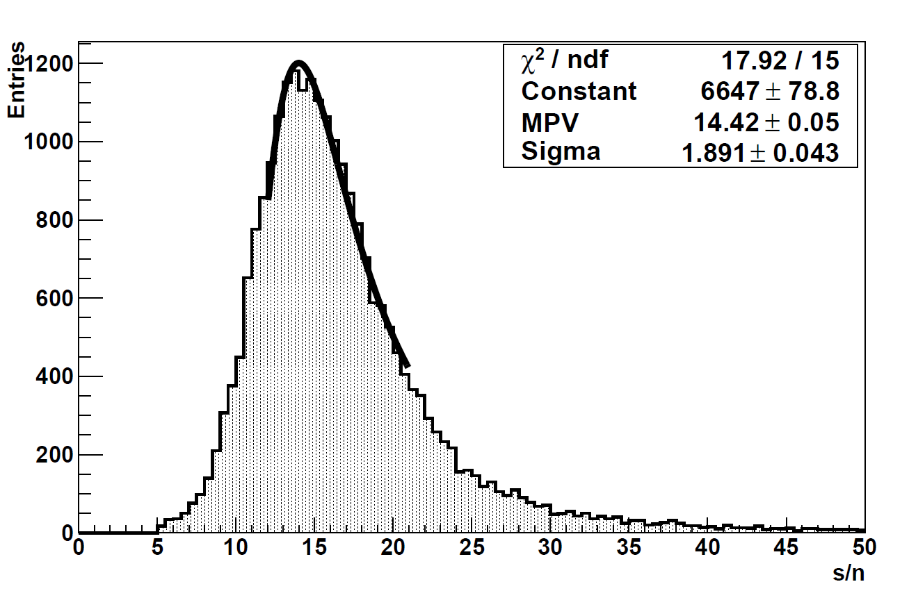
s/n test beam vs s/n radioctive source
Resistive strips detector
Conventional strips detector

Slide 12
SEGMENTED P-TYPE SENSORS WITH CHARGE AMPLIFICATION

Slide 13
Charge Multiplication- pixel detectors
We are starting the fabrication of new p-type pixel detectors with enhanced multiplication effect in the n-type electrodes, very low collection times and with no cross-talk.
Three different approaches:
Thin p-type epitaxyal substrates
Low gain avalanche detectors
3D with enhanced electric field.
Two projects funded by CERN RD50 collaboration to work on these technologies.
http://rd50.web.cern.ch/rd50/

Slide 14
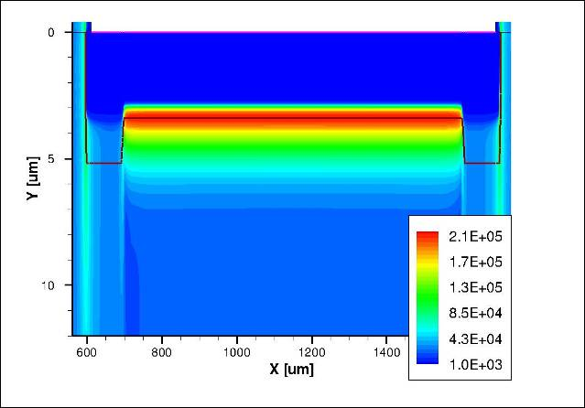
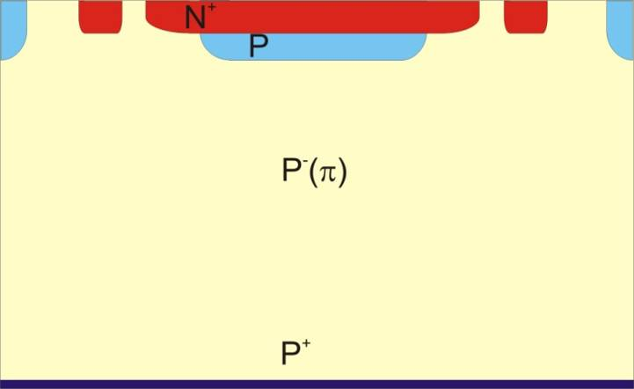
Low gain avalanche detectors (LGAD)
Implating an n++/p+/p- junction along the centre of the electrodes. Under reverse bias conditions, a high electric field region is created at this localised region, which can lead to a multiplication mechanism (impact Ionization).
Advantages = Thinning while keeping same S/N as standard detectors.
High Electric Field region leading to multiplication
N⁺
285 um
P
P. Fernandez et al, “Simulation of new p-type strip detectors with trench to enhance the charge multiplication effect in the n-type electrodes” , Nuclear InstrumentsandMethodsinPhysicsResearchA658(2011) 98–102.

Slide 15
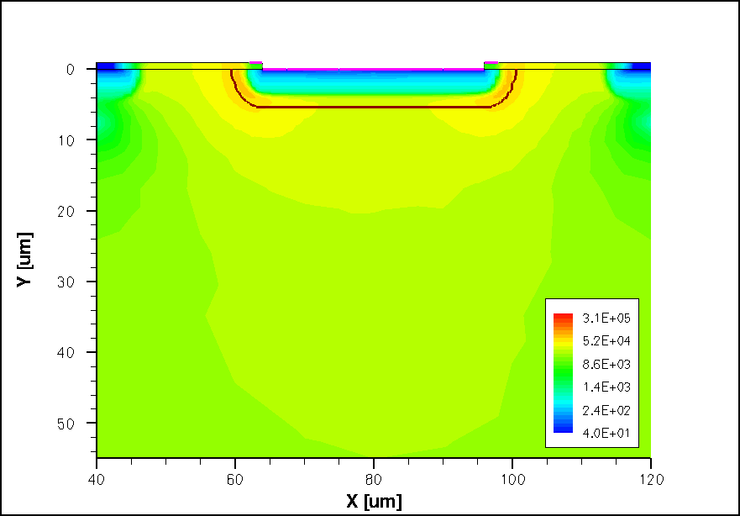
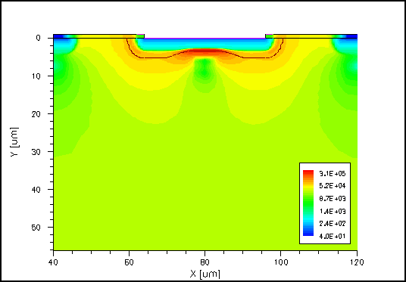
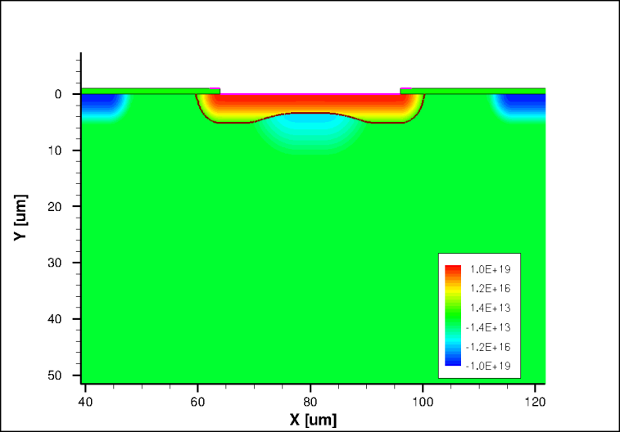
Simulation of the Electric Field
- To obtain the manufacture parameters (doping profiles)
Standard Strip
Strip with P-type diffusion
Strip with P-type diffusion: 2D and 1D doping profiles

Slide 16
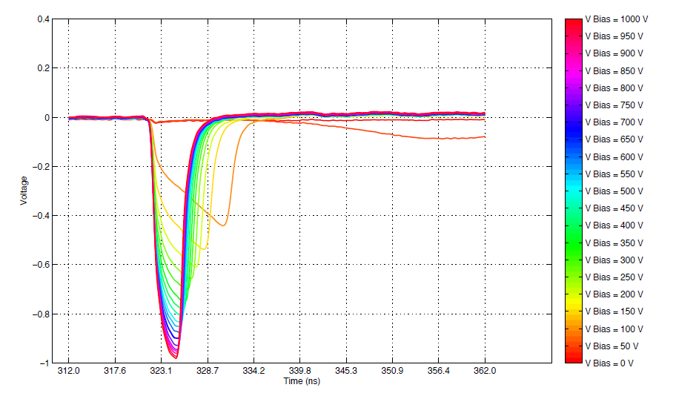
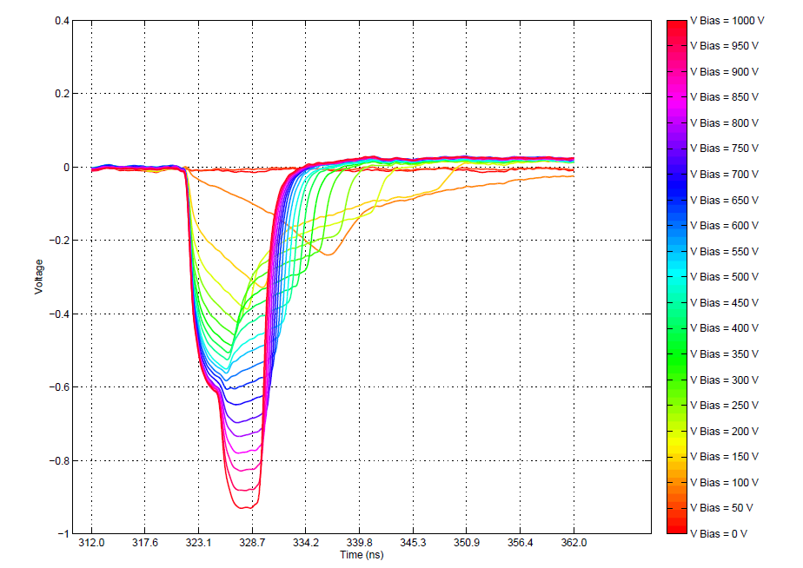
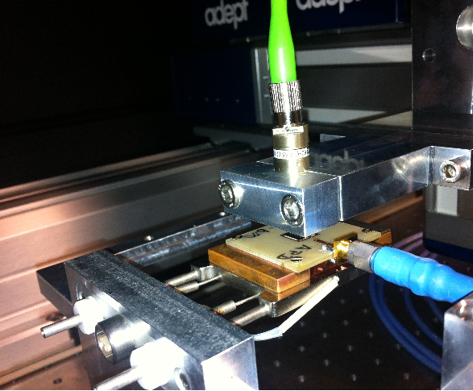

Red laser TCT characterization
Bottom injection
Standard diode n on p
P-type diffusion diode
5ns
h+
e-
285 um
Red laser (1060 nm)

Slide 17
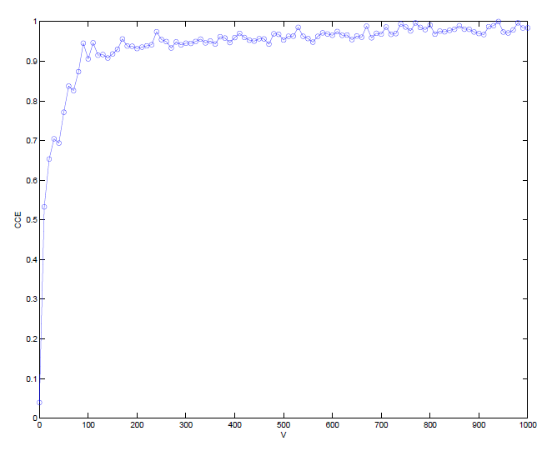
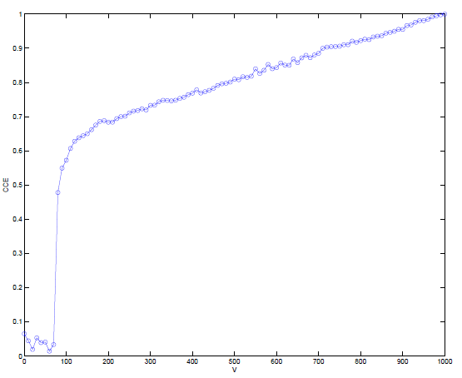
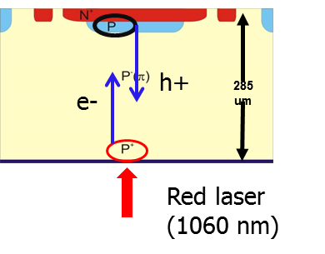
Red laser TCT characterization
Charge collection efficiency
Standard diode
P-type diffusion diode

Slide 18
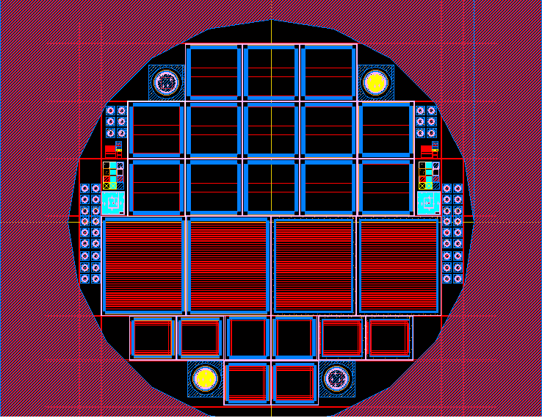
Mask set (planar)
AC 1
Strip = 24
Metal = 20
AC 2
Strip = 24
Metal = 24
AC 3
Strip = 24
Metal = 28
DC
Strip = 32
Metal = 40
AC 4
Strip = 48
Metal = 44
AC 5
Strip = 48
Metal = 48
AC 6
Strip = 48
Metal = 52
AC
Strip = 32
Metal = 40
DC
Strip = 32
Metal = 40
AC 7
Strip = 62
Metal = 58
AC 8
Strip = 62
Metal = 62
AC 9
Strip = 62
Metal = 66
AC
Strip = 32
Metal = 40
FEI4
With Guard rings
FEI4
With Guard rings
FEI4
With one Guard ring
FEI4
With one Guard ring
FEI3
With Guard rings
CMS pixel detectors
FEI3
With one Guard ring
FEI3
With Guard rings

Slide 19
Summary
A novel 2D position-sensitive semiconductor detector concept based on the resistive charge-division readout method has been introduced.
The initial results demonstrates the feasibility of the charge division method in a fully fledged microstrip sensor.
Test-beam studies on detection of minimum ionizing particles are in progress
The effect of charge multiplication has been observed within RD50 and it was started to be investigated systematically.
New detector designs aim to fabricate detectors with moderate gain and fast collection times.

Slide 21
