Slide 1



FIBER BRAGG GRATING SENSORS FOR SMART-TRACKERS
Application to Belle II Vertex Detector
LC2013 ,Tracking Vertex session, Desy May 30th 2012
D. Moya, I. Vila, A. L. Virto, E. Curras , A.Ruiz
Instituto de Física de Cantabria
M. Frovel, J.G. Carrión
Instituto Nacional de Técnica Aeroespacial
A.Oyanguren, C.Lacasta, P.Ruiz
Instituto de Física corpuscular
David Moya Martín, IFCA (CSIC-UC)

Slide 2
Outline
Introduction to Fiber Bragg Grating (FBG) optical sensors
The Belle II vertex detector (VXD):
A FBG-based real time monitoring for VXD.
  Displacement transducers (omega and L-shape)
    Manufacturing
    Thermal and displacement calibration
    Humidity, Nitrogen sensitivity
  Environmental measurements on PXD-SVD thermal closure.
Summary

Slide 3
OFS & FBG advantages
FBG sensors are strain and temperature sensors inscribed in the core of an optical fiber (length ≈ 10 mm, diameter ≈ 200um). Attributes:
  Immunity against:
    High electromagnetic fields, high voltages.
    High and low temperatures. ((4 K to 1200 K).
  Characterized up to high radiation dose (1.5 Grads)
  Small footprint, Light-weight, flexible, low thermal conductivity.
  Low-loss, long-range signal transmission(“Remote sensing”)
  Wavelength encoded ( multiplexing capability)
  Embedding in composite materials.
  Mass producible at reasonable costs.

Slide 4
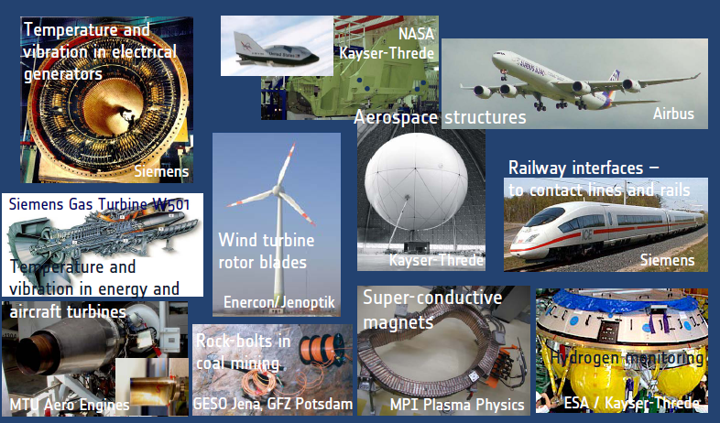
FOS for environmental and structural monitoring industry driven technology

Slide 5
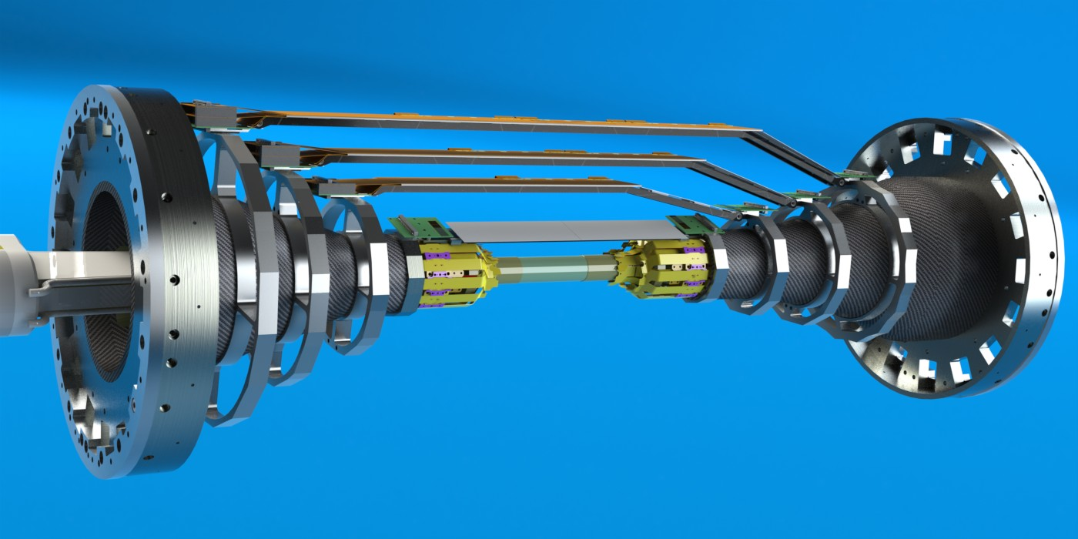
A FBG-BASED REAL TIME ESTRUCTURAL AND ENVIROMENTAL MONITOR FOR BELLE-II VXD.
,
Strip Vertex detector
(microstrips)
≈300mm
DEPFET PIXELS
≈900mm
Notes:
Overall geometry and technology
Independent support
Central drift chamber
Thermal envelope

Slide 6
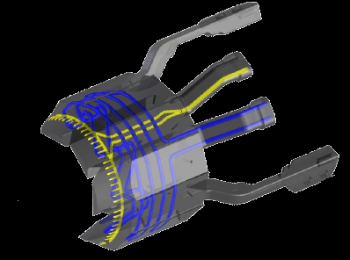
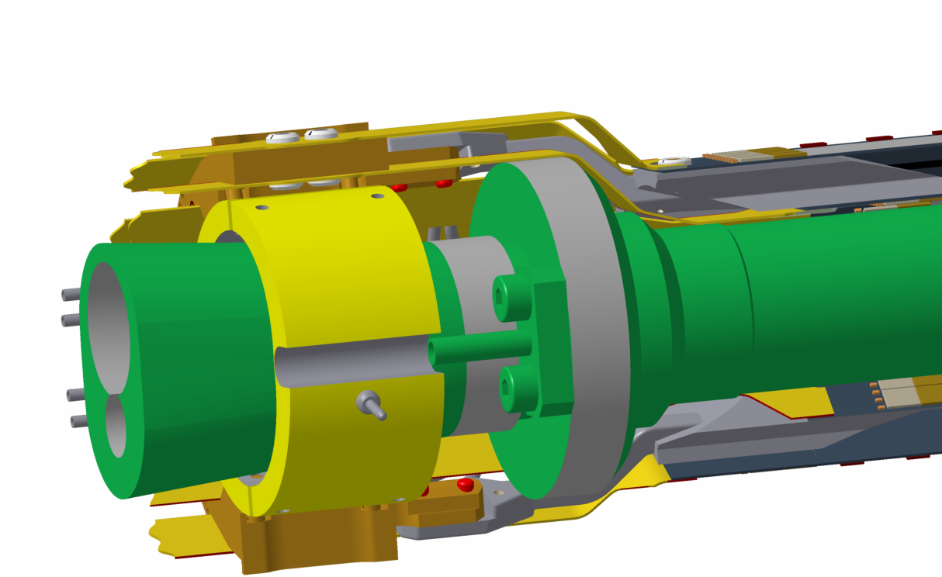
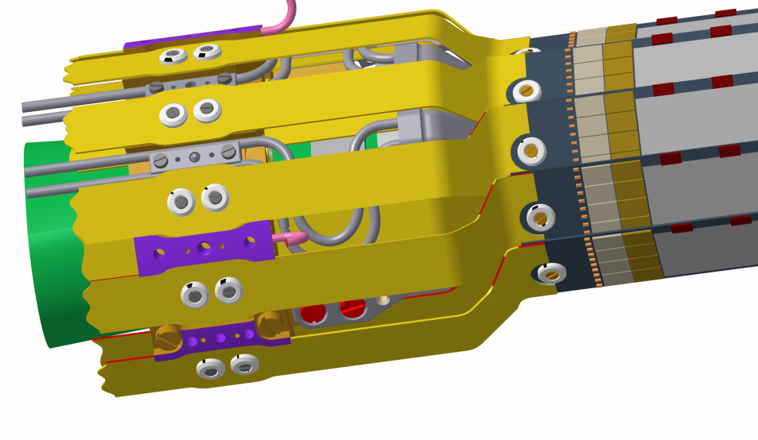
A FBG BASED REAL TIME ESTRUCTURAL AND ENVIROMENTAL MONITOR FOR BELLE-II VXD.
,
Cooling block screwed to ring, attached to the beam pipe
CO2 inlet
Air inlet
Cooling block
DEPFET PIXEL
Notes:
Foto PXD especifica
Cooling PXD (Co2 cooling, beampipe, blowing air)
Support on beampipe
Air cooling
Para el SVd lo mismo.
In consequience thermal gradients, vibrations…..

Slide 7
FBG Real time monitor for VXD
,
Relative PXD-SVD radial positioning.
  Using displacement FOS-based custom made transducers ( Omega and L-shape)
  Radial compressions and expansions (PXD and SVD are mechanically independent) are a mode to which track-based alignment has a poor sensitivity.
Environmental measurement inside the PXD-SVD thermal envelope
  PXD & SVD cooled with CO2 and forced air; inside the thermal envelop we will have a dry atmosphere ( Dry air or Nitrogen).
  Distributed FBG network for temperature and humidity monitoring.
Notes:
L shape, combinable con la anterior. Solo L-shape
Relative PXD-SVD radial positioning. Using displacement – strain transducers ( Omega and L-shape) we will be able to measure online, radial relative displacements between PXD and SVD. This is a degree of freedom of the detector (PXD and SVD are mechanically independent) to which software alignment is blind
Environmental measurement inside PXD-SVD volume. The PXD-SVD will be inside a thermal envelop. PXD will be cooled with CO2, and forced air convection ,and SVD will also need forced air convection. In the thermal envelop we will have a dry atmosphere ( Dry air or Nitrogen). Having a distributed FBG system for temperature and humidity monitoring, will allow us to know what is happening inside the thermal envelop at every moment, and fast detection of possible cooling problems or leakage of the cooling system.

Slide 8
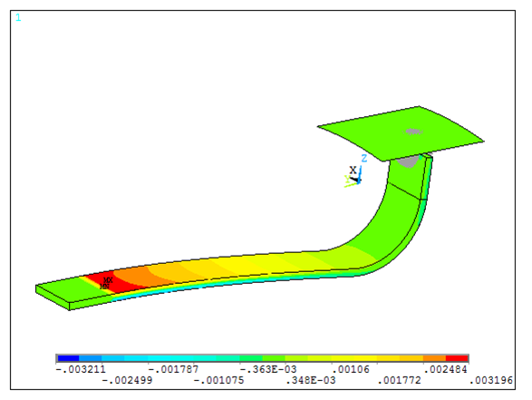
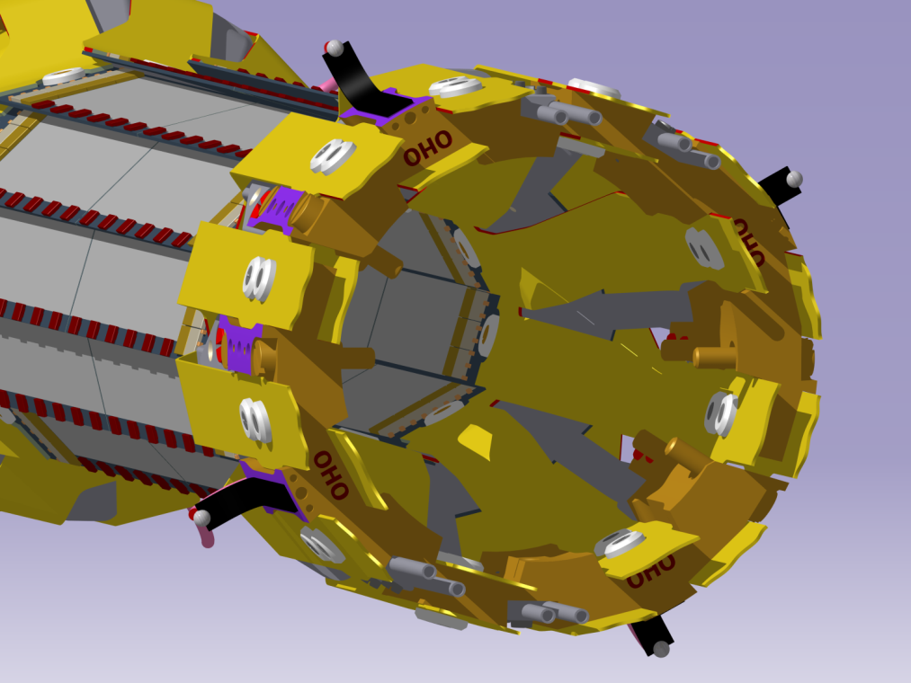
_Displacement-Strain transducers
,
The idea is to monitor online PXD-SVD relative displacement using a tiny CFRP structure with FBG sensors embedded.
Four Omega Shapes(Ω1, Ω2, Ω3 and Ω6) and three L shapes (L-1,L-2,L-3) have been manufactured and calibrated with temperature and displacement
L-shapes attached to Belle II PXD
Contact surface
Locked part
FBG sensors
L-shapes
Contact ball

Slide 9
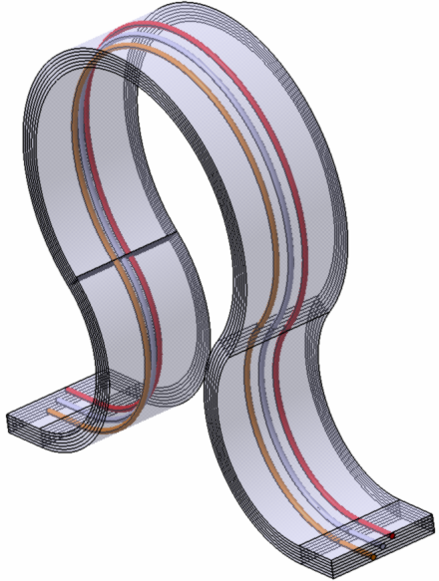
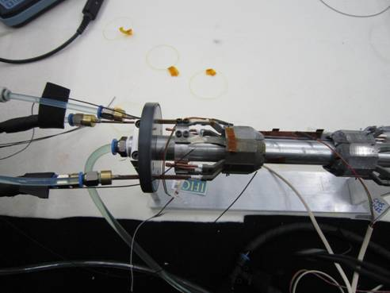
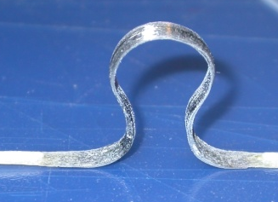
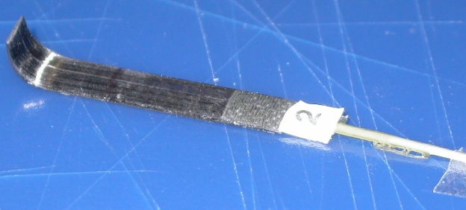
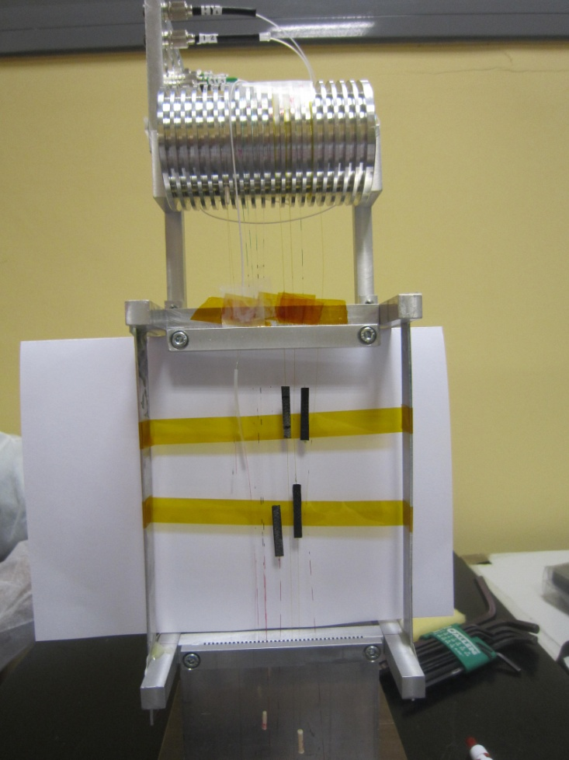
VXD FOS Monitor Timeline
,
2009 Oct FOS Monitor proposal
2010 Jan Omega-shape proposal
2010 Oct. FOS radiation hardness study (1.5 GRads ,3.3 10¹⁵ p/cm2)
2011 January First omega mechanical dummies
2011 March Test in depfet mock-up at IFIC
2011 Sept. FOS radiation hardness study ( 10 Mrads )
2011 Dec Proof-of-comcept-prototype omega
2012 Feb Omega calibration.
2012 March New transducer design L-shape
2012 May Test in depfet mock-up at IFIC
2012 October L –shape calibration
(resolution less 1 um ,accuracy≈10 um )
2013 May Test in deftet mock-up at IFIC (N₂ atmosphere)
2013 June-July Omegas and L-s irradiation ELSA
2014 January commissioning at PXD-SVD common test beam
Notes:
Poner primero el año
Poner omega-shape
Test in first Depfet mock-up
Poner punto de la calibración

Slide 10
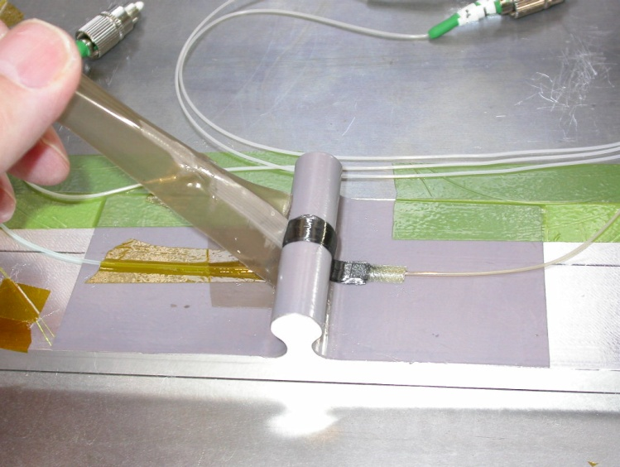
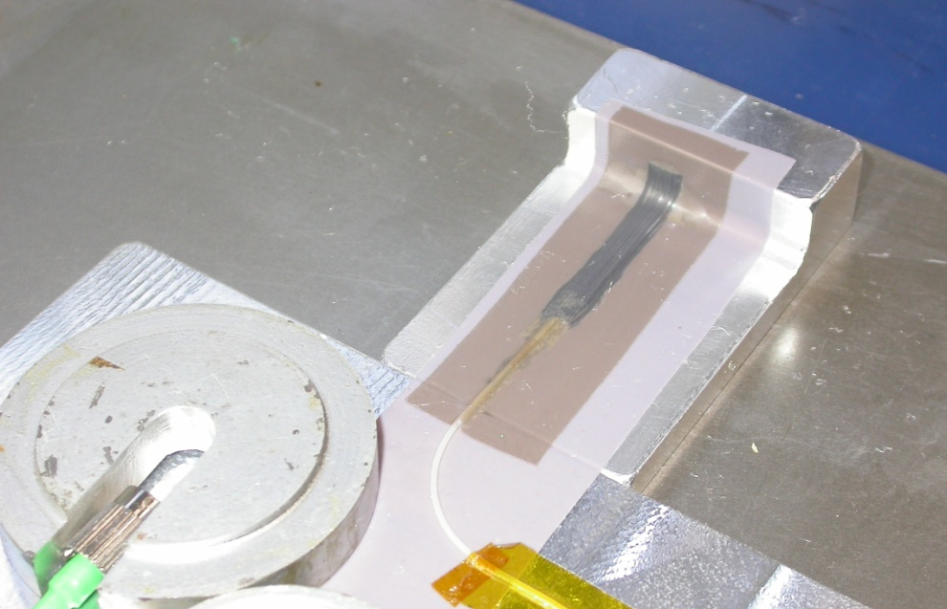
Omega Shapes & L-shapes Manufacturing
Omega Shape
Omega CFRP layout
FO output
Aluminum Cask
L-Shape
Kapton Film
FO output
Aluminum Cask
Aluminum support base
Steel cask for connectors protection
Kapton Film

Slide 11
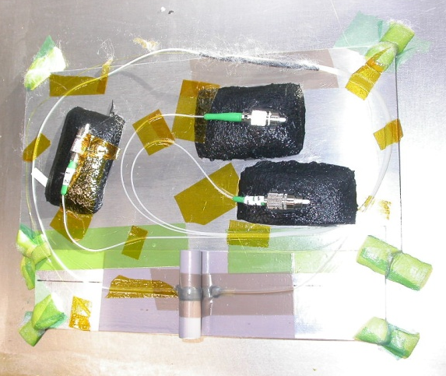
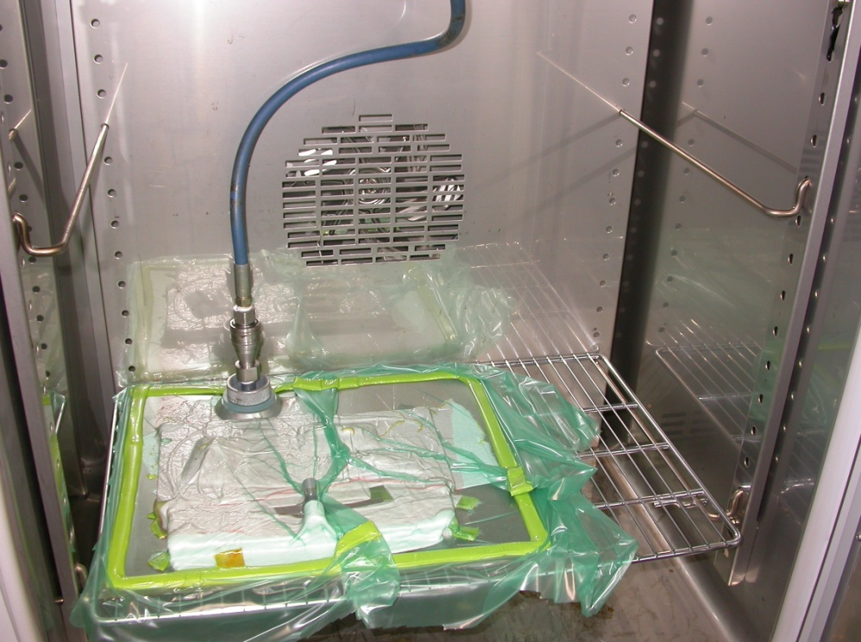
Omega Shapes an L-shapes Manufacture Process
Connectors protection
Vacuum Pump connection
Omega Shape
Protection output cable from the omega
Omega Shape
Vacuum bag
All inside an oven

Slide 12
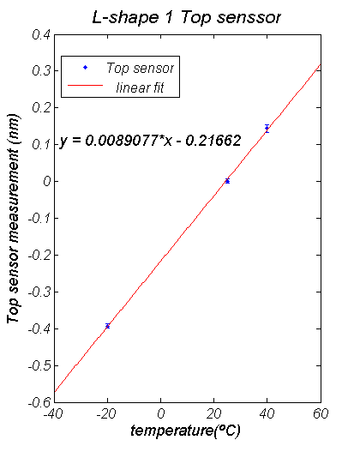
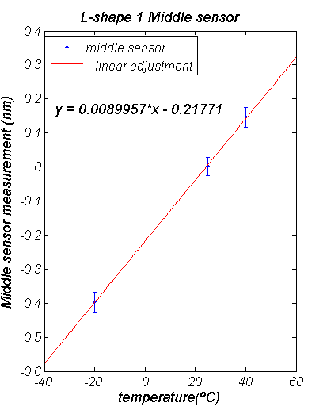
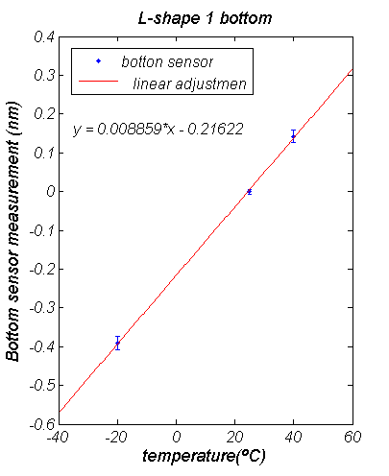
Thermal calibrations and temperature compensation
Omega and L-shapes were calibrated using a thermocouples calibrator. They were calibrated to three different temperatures, and the calibration was repeated three times.
The sensitivity of three sensors was constant and near the same (difference<0.6%)
Maximum error < 3 pm (0.3 ºC)
Error X 10
Error X 10
Error X 10
Trivial approach to temperature compensation with subtraction of top and bottom sensor readout ( Destimator)

Slide 13
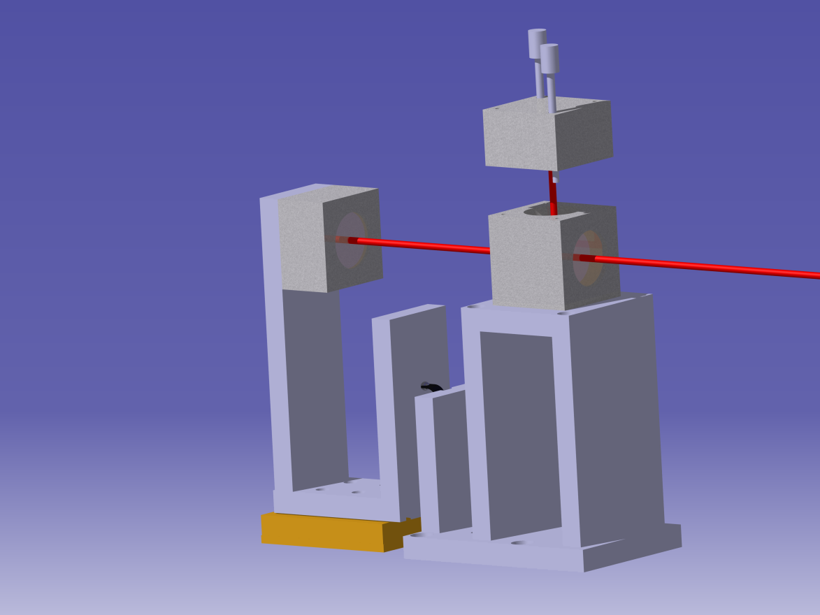
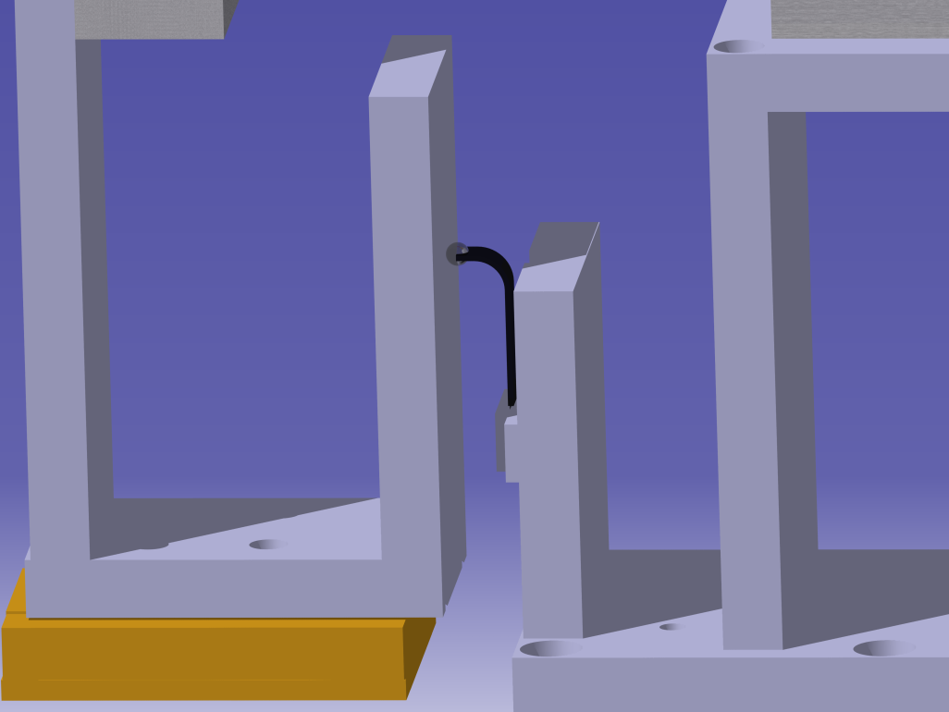
Interferometric calibration set-up
We have setup a Michelson interferometer for the L-shape calibration
The use of the Interferometer allow us to measure the displacement with a resolution and an stability below the micron.
Retro reflector
Contact ball
Beam spliter
Laser beam
Micrometric stage
Beam spliter
Contact
surface
L-shape
L-shape
Notes:
Mejor el dibujo que tenemos.

Slide 14
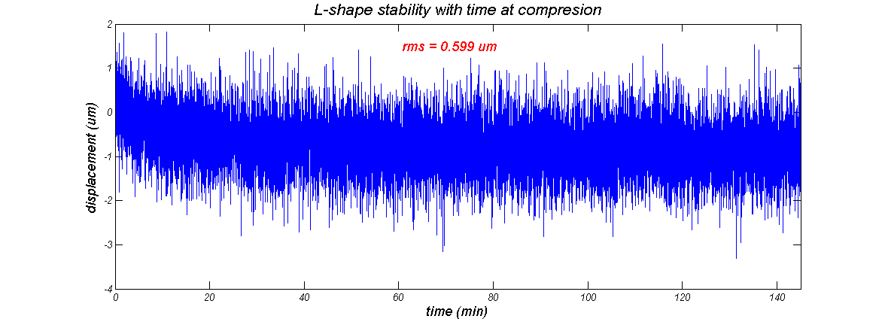
L-shape stability study
The stability of the L shape was measured during near two and a half hours at a compression of near 0.2 mm.
.RMS ≈ 0.6 um

Slide 15
L-shape repeatability study
Repeatability measurements done with the interferometer
The L-shape was compressed between 0.3 mm and 1.1 mm and this process was repeated seven times with a repositioning better than 1 um according to the interferometer readout.
Tables show the deviation with respect to the initial position
0.3 mm displacment
Nº of measure | Destimator desviation (um)
1 | 1.77
2 | 5.08
3 | 6.85
4 | 6.61
5 | 7.02
6 | 8.39
7 | 9.35
rms(um) | 2.46 um
1.1 mm displacment
Nº of measure | Destimator desviation (um)
1 | -16.94
2 | -9.11
3 | 11.21
4 | 11.45
5 | 5.65
6 | -12.34
rms | 12.60 um

Slide 16
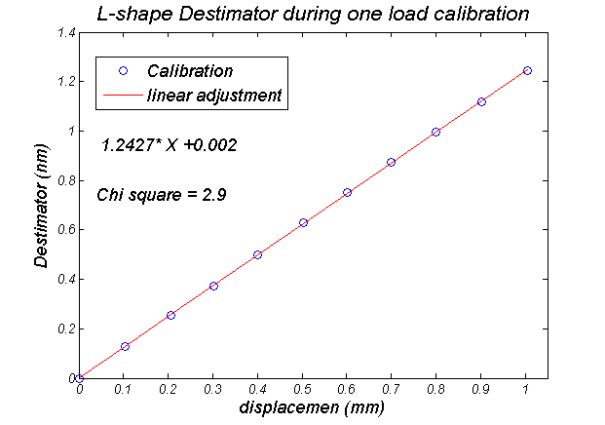
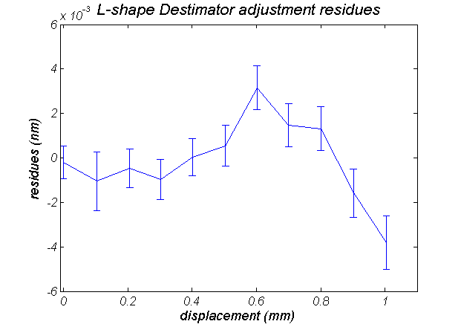
L-shape Calibration: Response vs. displacement
The L-shapes have been compressed in steps of 0.1 mm up to a total compression of 1 mm
The L-shape has a resolution below one micron.
Reconstructed Displacement (mm)
Linear fit Residuals (mm)

Slide 17
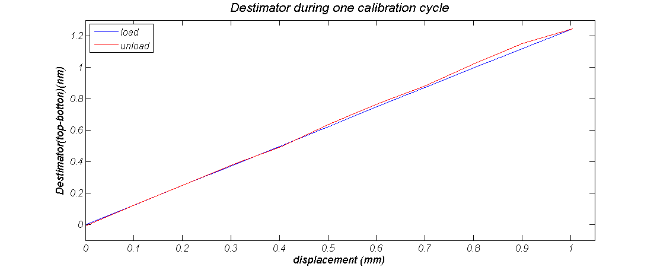
L-shape Calibration problem
Some problems due to contact roughness surface on the uncompressing displacement.

Slide 18
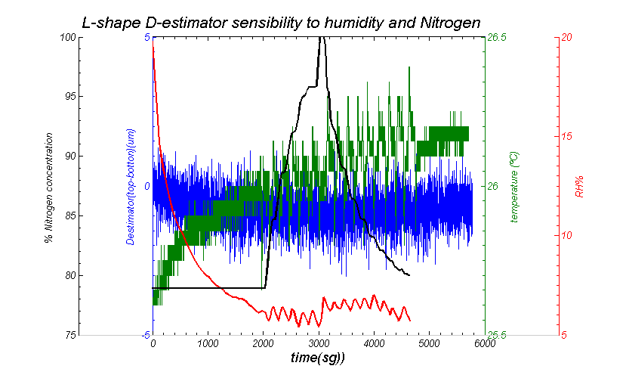
L-shape humidity and Nitrogen sensitivity
The L-shape was introduced in IFIC PXD mockup and some humidity and Nitrogen cycles where done
We concluded that the L-shape is not sensitive to humidity changes or Nitrogen concentration.

Slide 19
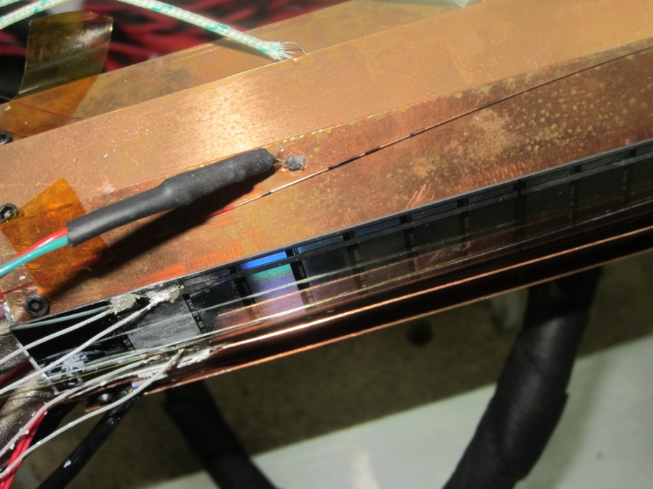
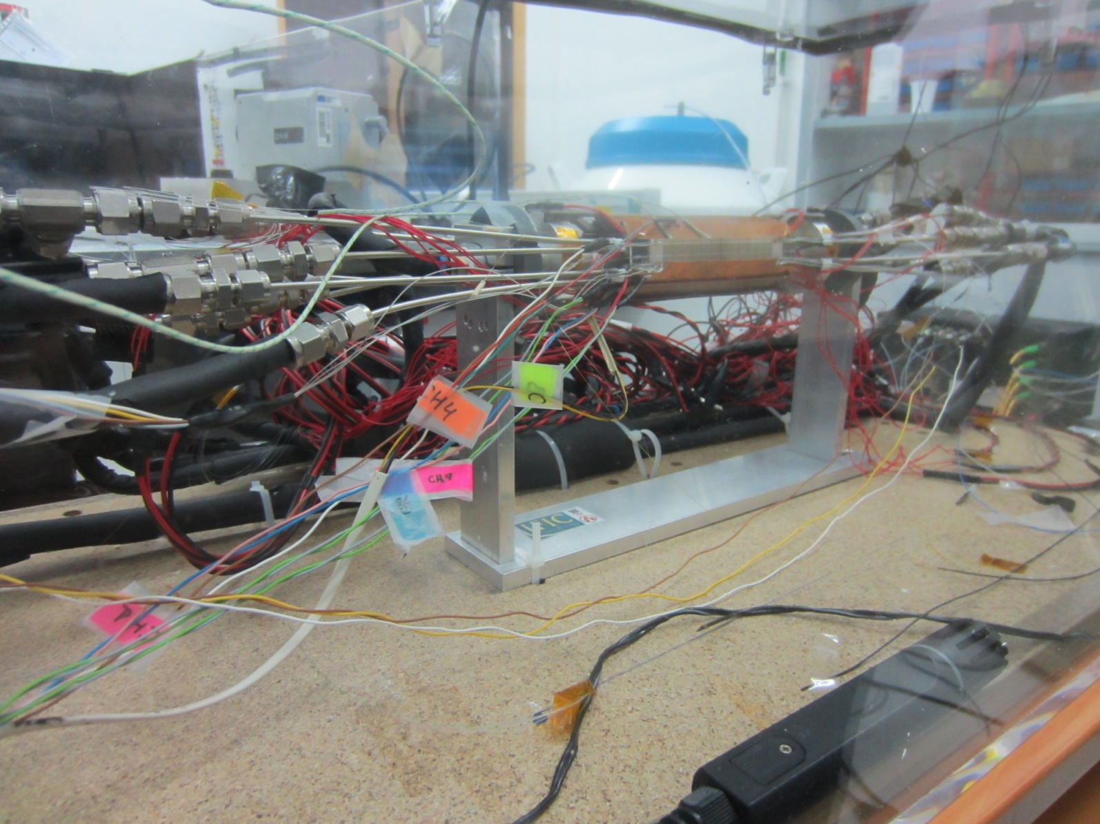
Environmental monitoring at IFIC Defpet Set-up
,
FBG on Cu ladder
Omega Shape
L Shape
FBG on sensor
Reference FBG sensors
Humidity sensor

Slide 20
Summary …
,
A displacement and environmental monitor for the Belle II vertex detector based on Fiber Bragg Grating optical sensors was introduced.
A miniaturized, application specific, displacement transducer (L-shape) was designed, developed and (almost) fully characterized with a displacement resolution of about 1 um.
L-shape experimentally proven not sensible to the environmental conditions of Belle-II thermal envelope: changes in HR%, temperature and N₂ concentration.

Slide 21
… and work in progress
Roughness of the contact surface with the sensor tip limits sensor precision (repeatability) and accuracy (few tens of microns). Optimize the L-shape tip and contact surface
2013 June-July, new Irradiation at Elsa with electrons up to 10 Mrads
2014 January, partial of the system commissioning at PXD-SVD common test beam @ DESY.

Slide 22
BACK - UP

Slide 23
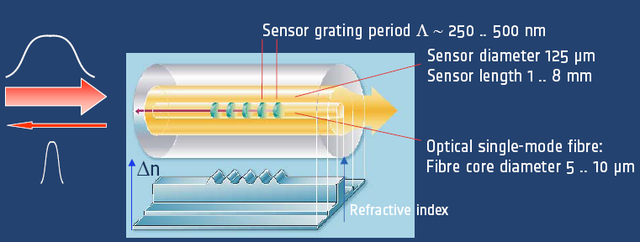


_Bragg grating sensor basics
,
FOS monitoring is an standard technique in aeronautic and civil engineer
Kkkk
Mechanical sensitivity
Thermal sensitivity

Slide 24
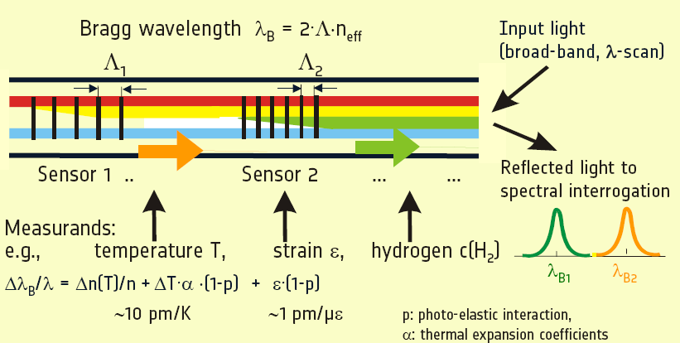
_Bragg grating Multiplexing

Slide 25
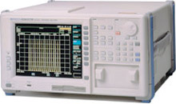
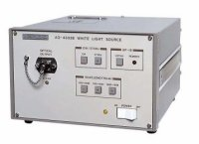
_Basic Interrogating Unit
The number of different Braggs is more than 100; moreover by using an optical switching we can use tens of sensing fiber
Optical Spectrum Analyzer
Large Bandwidth
Light source
1x2 coupler
λ_{B1}
λ_{Bn}
λ_{B2}
λ_{B3}

