Slide 1
Progress towards an ultra compact LumiCal
Yan Benhammou
Tel Aviv University
On behalf of the FCAL collaboration

Slide 2
Outline
Introduction
Thin module design
  Mechanical support
  Fan out
Assembly of thin LumiCal module
Test beam
Summary and plans

Slide 3
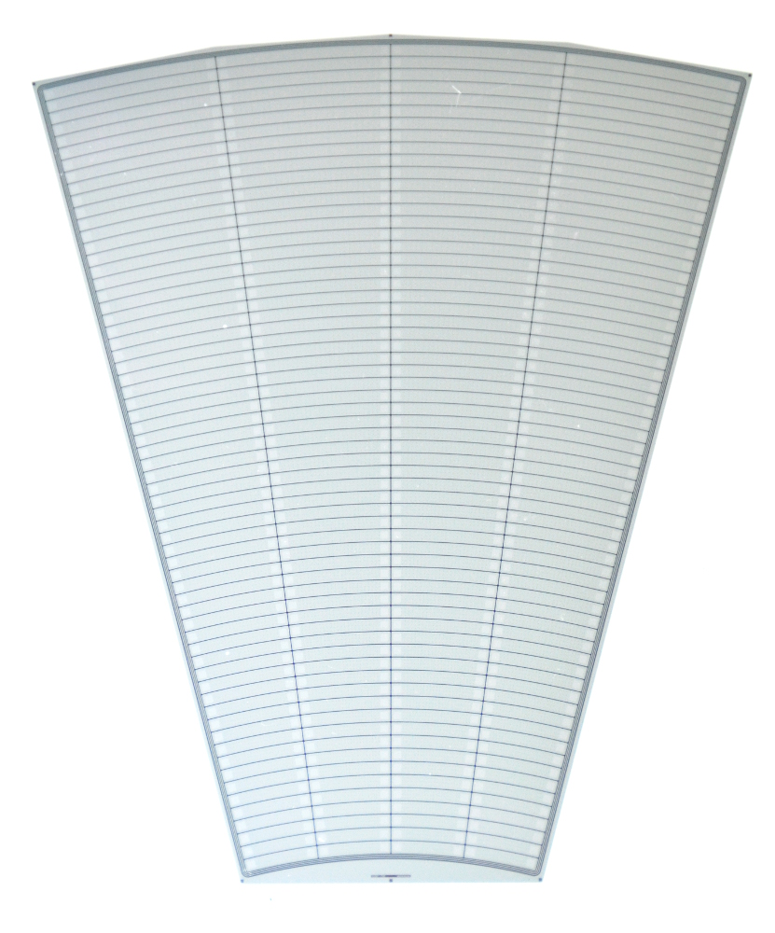
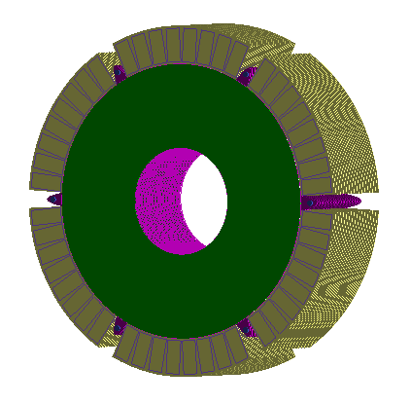
LumiCal and Sensor Design
4 sectors:
Silicon sensor
thickness 320 μm
DC coupled with read-out electronics
p+ implants in n-type bulk
64 radial pads, pitch 1.8 mm
4 azimuthal sectors in one tile, each 7.5°
12 tiles makes full azimuthal coverage
L2
L1
R1
R2
Outer active radius R = 195.2 mm
channels: 1 - 64
3 x 100 μm guard rings
Inner active radius R = 80.0 mm

Slide 4
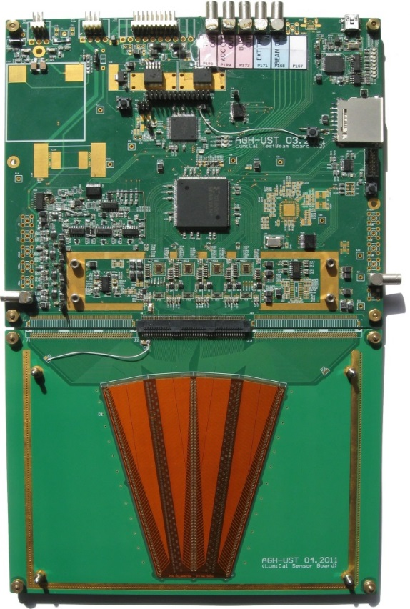
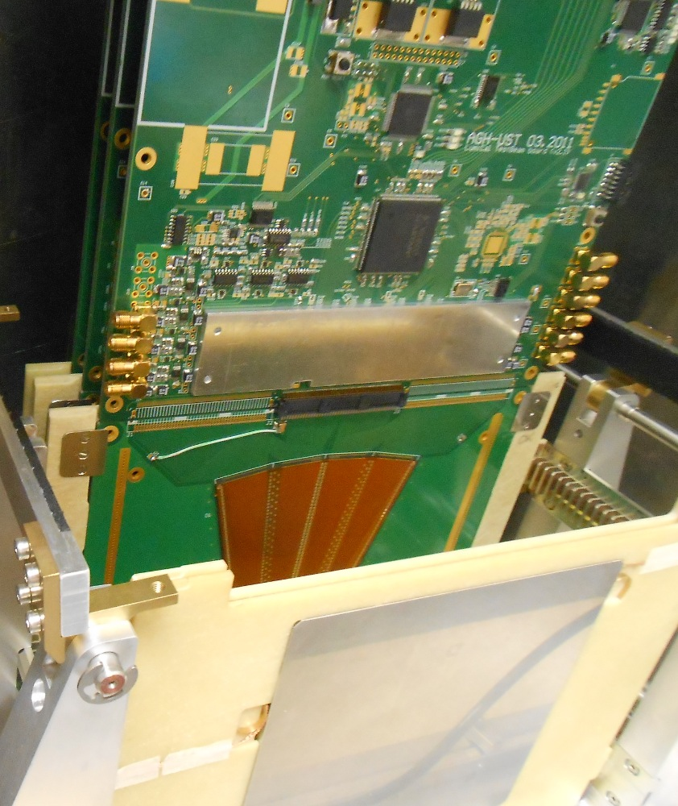
2014 developments
Sensor glued on a 3.5mm PCB (HV)
Short PCB fan out
Electronic read out : 32 channels (4x8channels)
Test beam @ CERN with electron beam
4 sensor layers in between tungsten planes
Tungsten
Silicon
Tungsten
Silicon
Tungsten
(cf Previous talk)
3.5 mm
3.5 mm
3.5 mm
3.5 mm
3.5 mm

Slide 5
2015 goals
Primary aim was to build LumiCal prototype for beam tests and demonstrate the principle of compact electromagnetic calorimeter;
Make the geometry of the detector module closer to the designed for LumiCal at LC experiments;
Reduce the thickness of the sensor layer below 1 mm;
Provide mechanical rigidity for the module to simplify its handling during the assembly of calorimeter prototype;
Try to read-out all pads (256) of the LumiCal sensor.

Slide 6
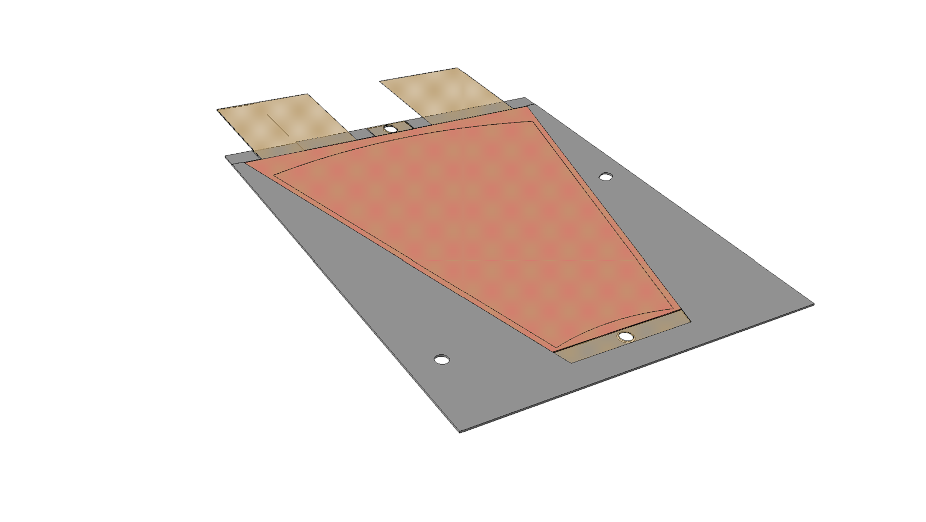
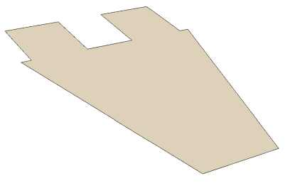
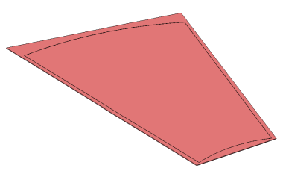
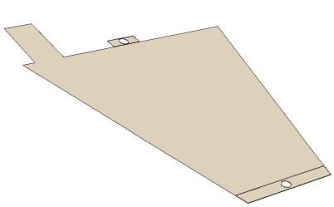
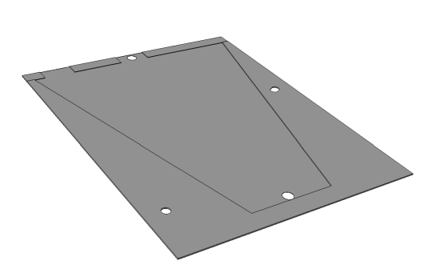
Thin LumiCal module design
Current LumiCal modules are based on 3.5 mm thick PCB : compactness is an essential requirement to provide small Molière radius/accurate shower position reconstruction.
In current LumiCal conceptual design the space between absorbers is 1 mm!
Easy to mount on tungsten planes
100 μm
320 μm
50 μm
150 μm
Kapton Fan out
Kapton fan out (connectors)
Sensor
envelope
Kapton HV
Sensor
Kapton HV
Envelope
650 μm

Slide 7
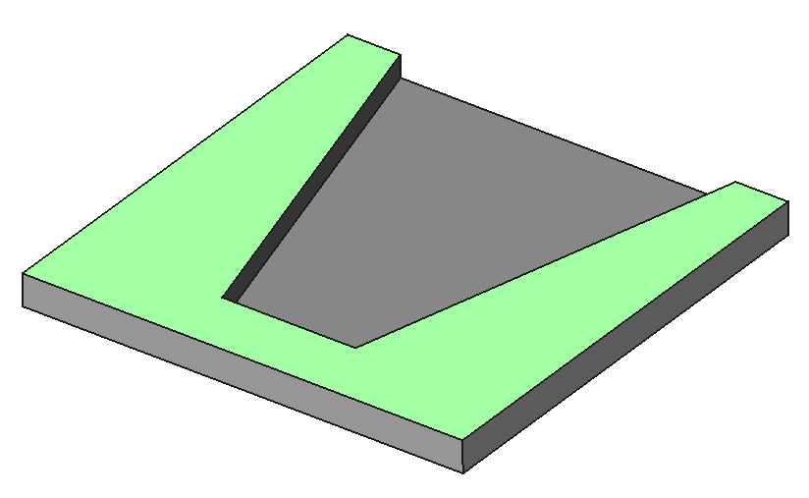
Mechanical support : the envelope
In collaboration with the CERN mechanics group, we considered two options to produce the envelop :
    3D printing
    carbon fiber
The 3D printing was not rigid and flat enough so we opted for the carbon fiber solution

Slide 8
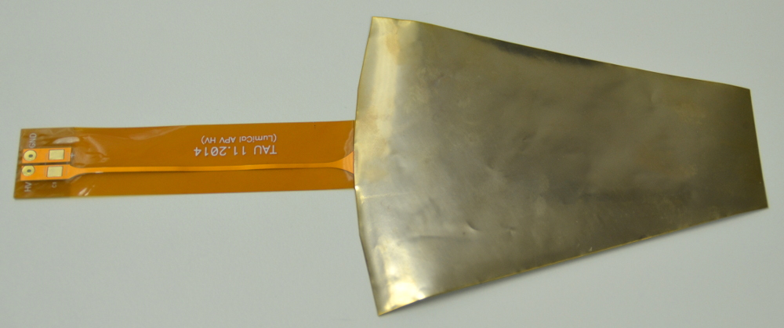
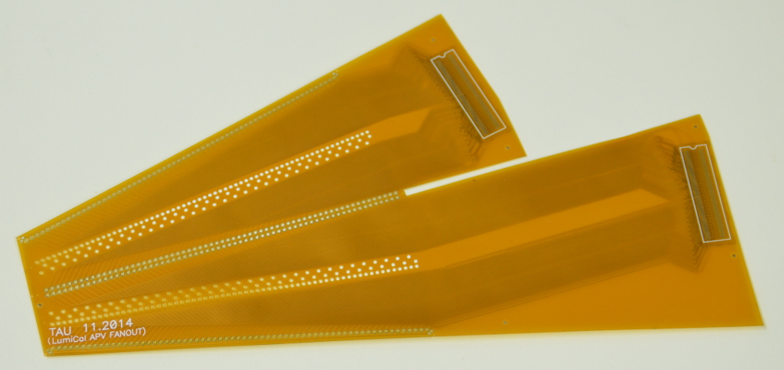
HV and Fan-out kapton
The thickness of the HV kapton is 90 μm.
90
Thickness of fan-out varies in different areas from
129 μm to 158 μm
Thickness, μm
connectors
141
138
139
136
129
158
144

Slide 9
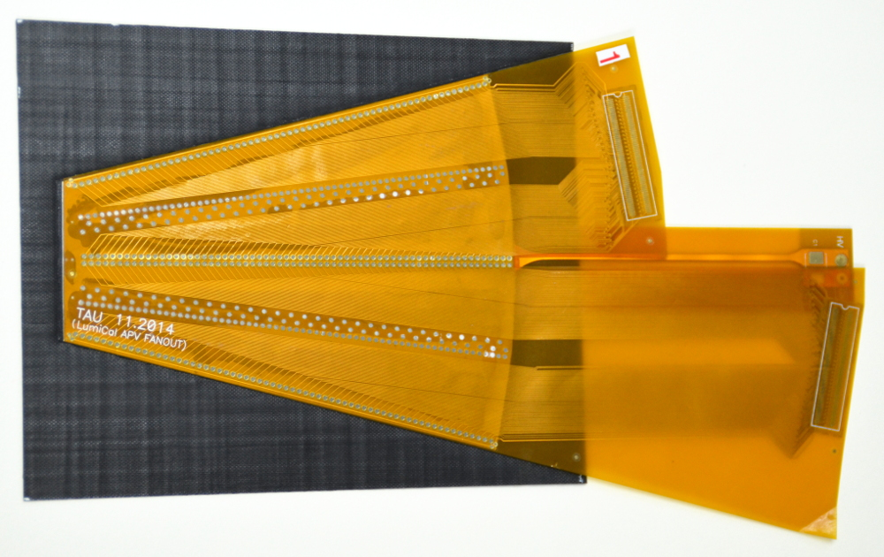
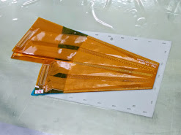
Fake thin LumiCal Prototypes
Gluing of the fake sensor inside the envelope
Total assembly thickness:
less then 900 μm for carbon fiber
less then 800 μm for 3d printing
Procedure was destructive for wire bonding connections.

Slide 10
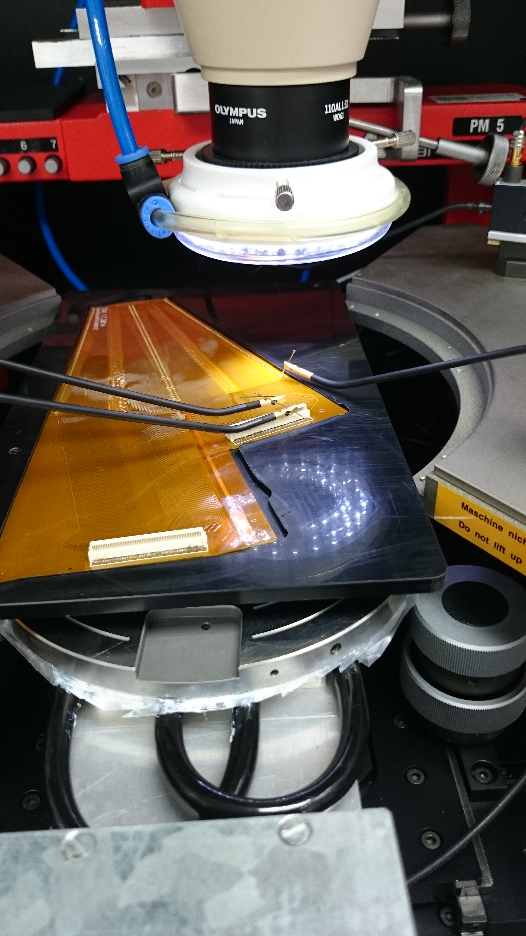
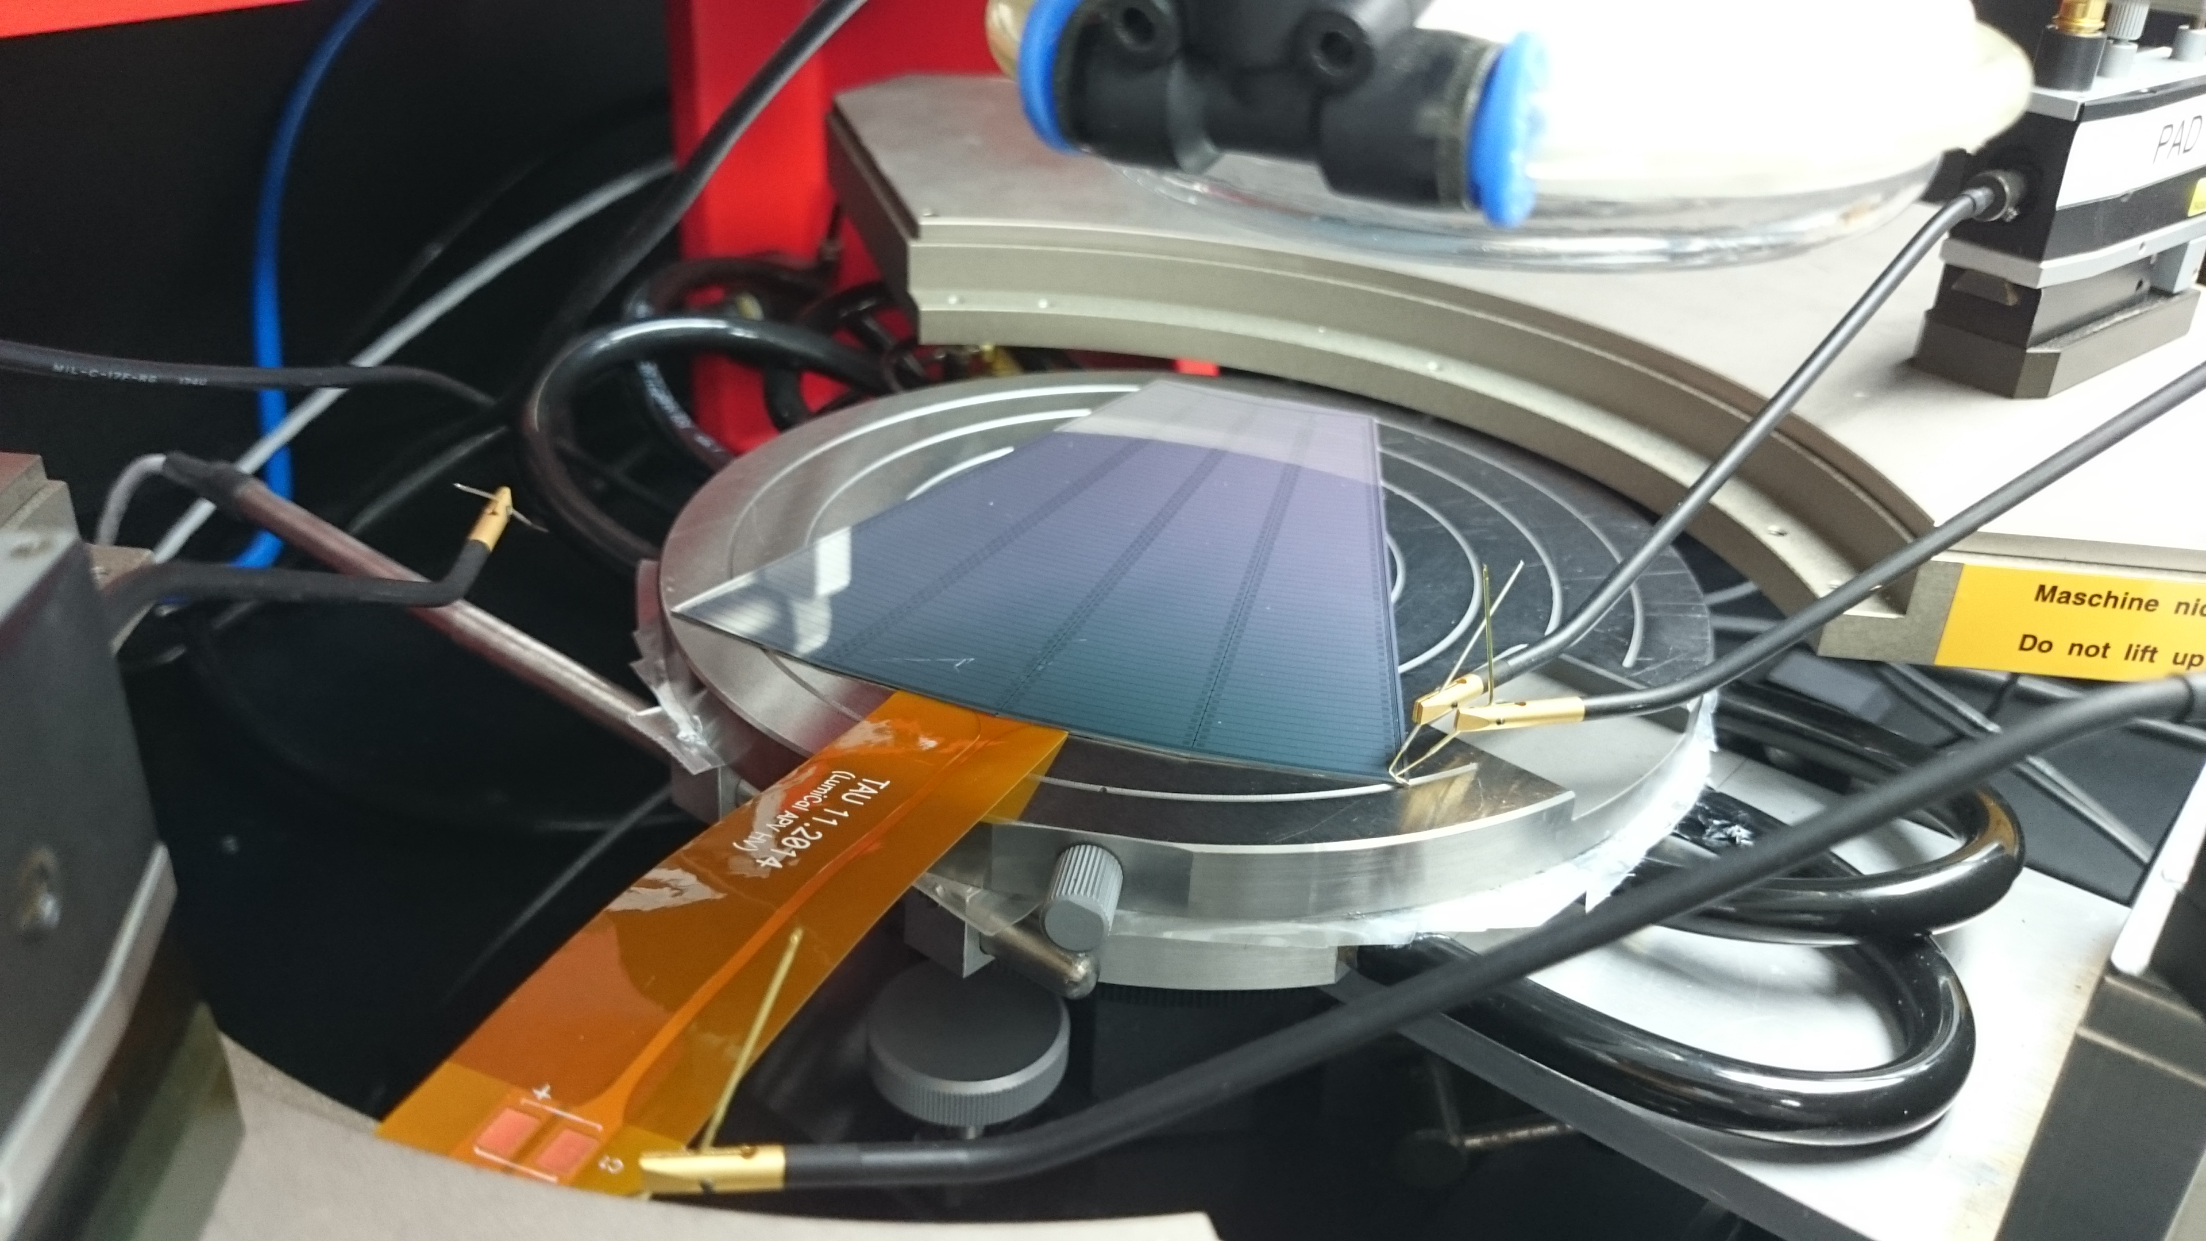
Module assembly and Tests
HV kapton is glued to the n-side of the sensor using conductive glue;
Fanout with Panasonic connector soldered was glued to the p-side of the sensor;
Traditional ultrasonic wire bonding was used to connect sensor pads to fanout traces;

Slide 11
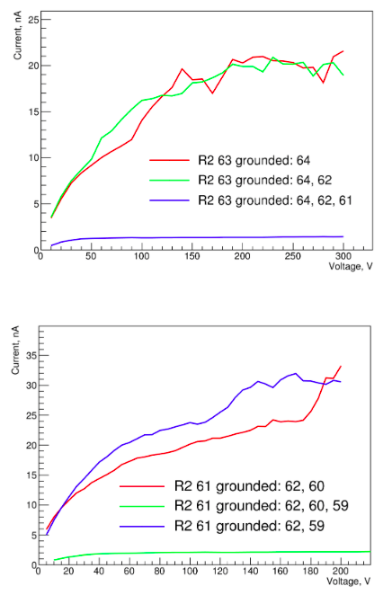
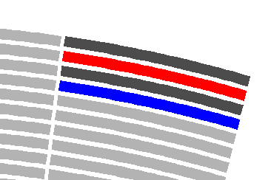
Module 17, current measurements
61
63
...
...
64
62
Sector R2
Grounding the adjacent pin in Panasonic connector reduces the measured dark current from the pad.
There is some essential conductivity between Panasonic connector pins.
Further tests confirmed that the problem was created by soldering flux.

Slide 12


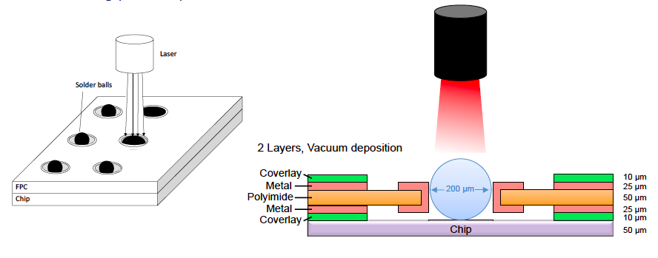


low-height contact between sensor and readout electronics
Approaches :
  wirebonding
  conventional, currently used, minimum height ~100μm
  Flat loop wire bonding
  staggered pcb required
  Conductive glue
  tested at DESY, Krakow,TAU : not satisfying …
  Laser bonding
  tested by TAU : not possible because aluminum pads
  tape automated bonding (TAB)
  first enquiries by TAU
  bonding wedge & dedicated fanout sample received
  Spring loaded contact
    technology tests by ZEUTHEN

Slide 13
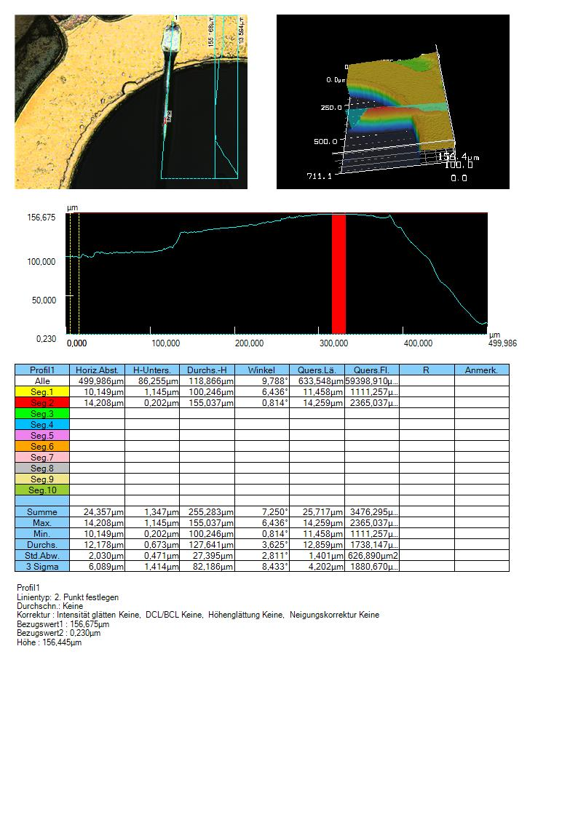
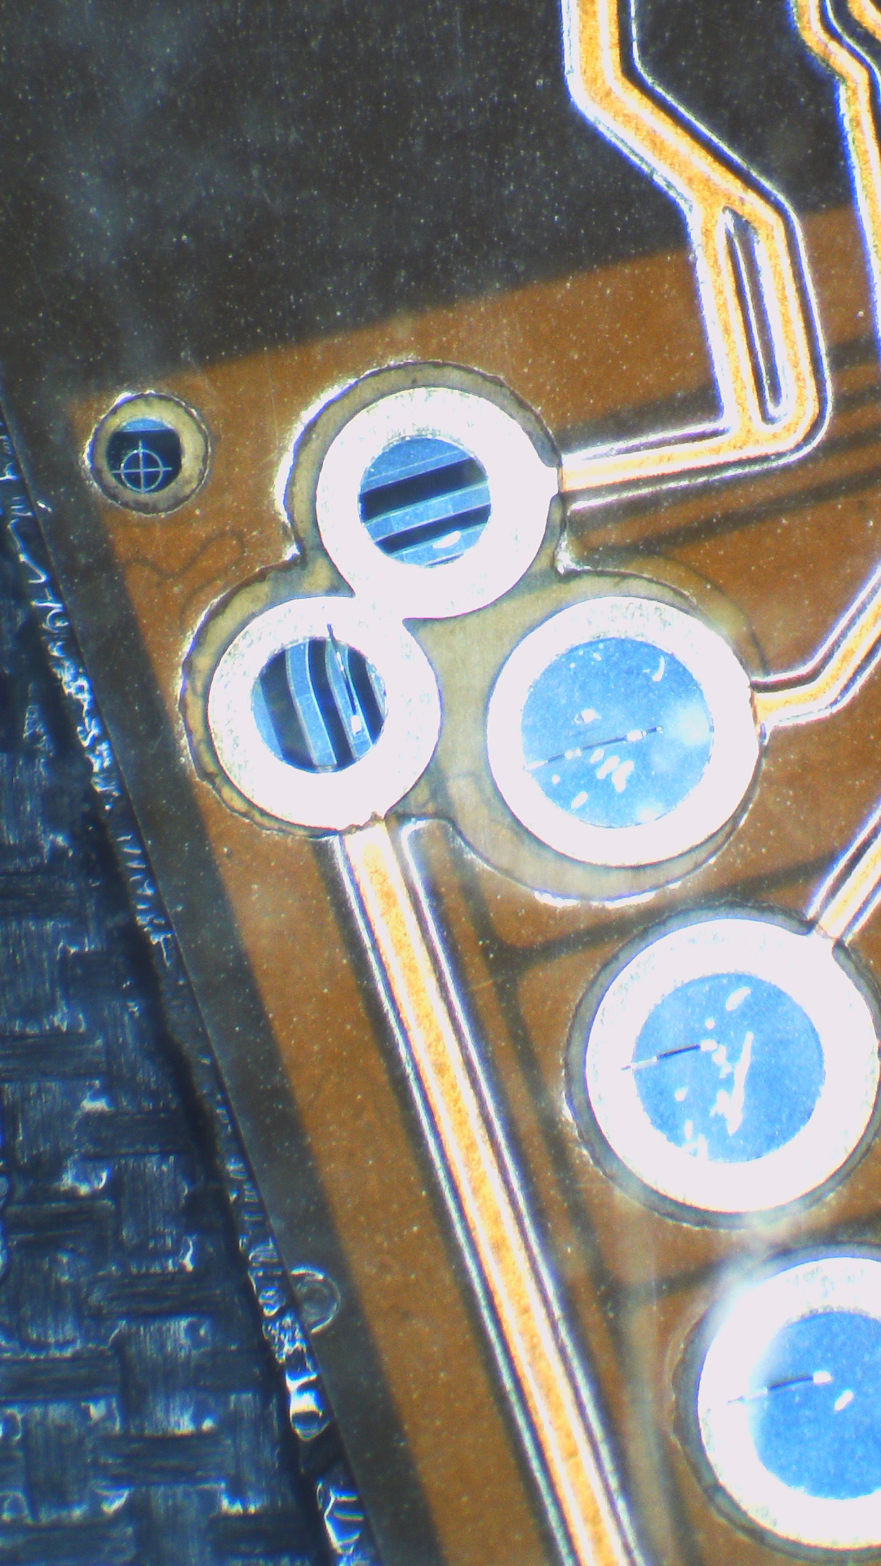
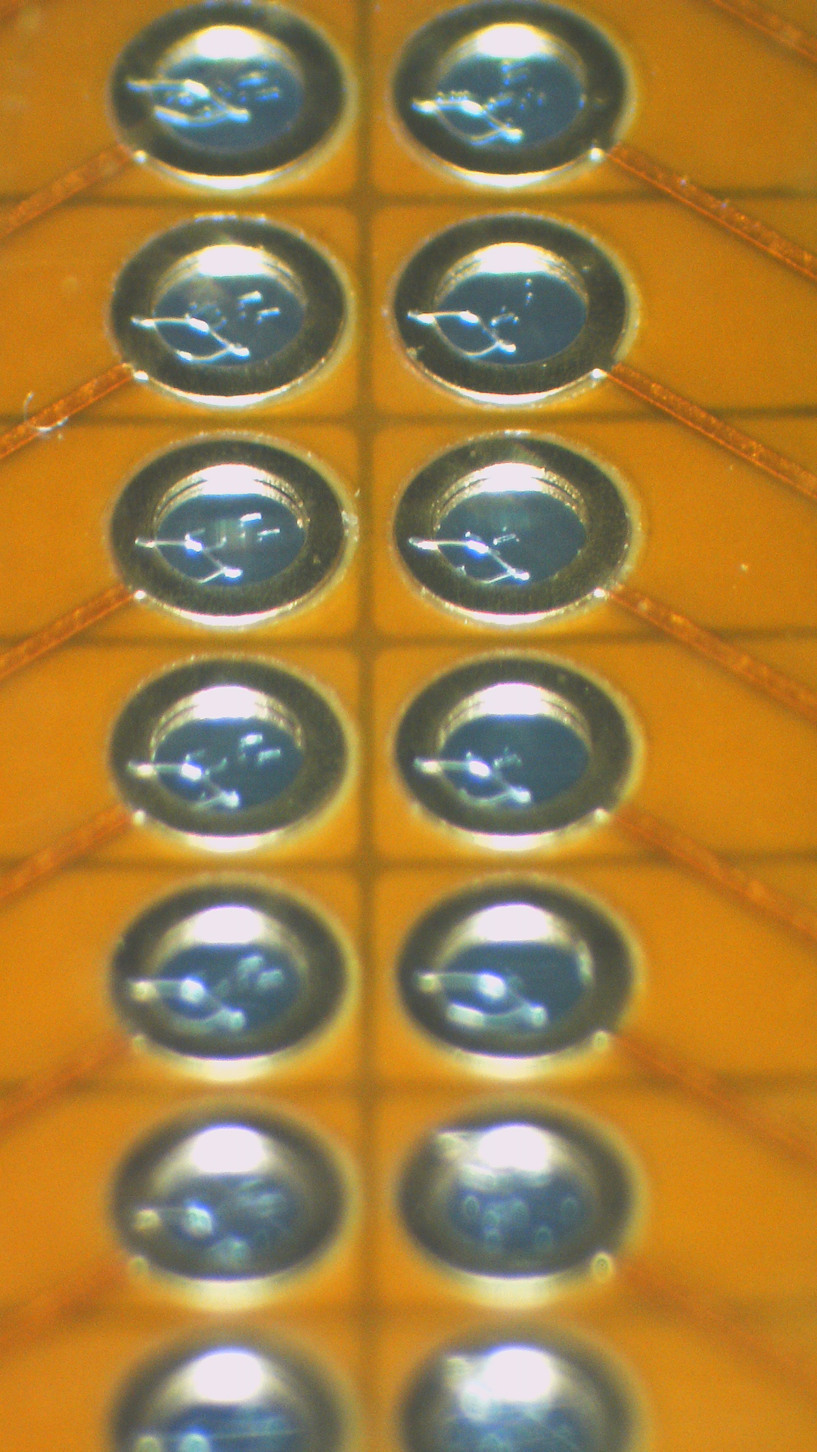
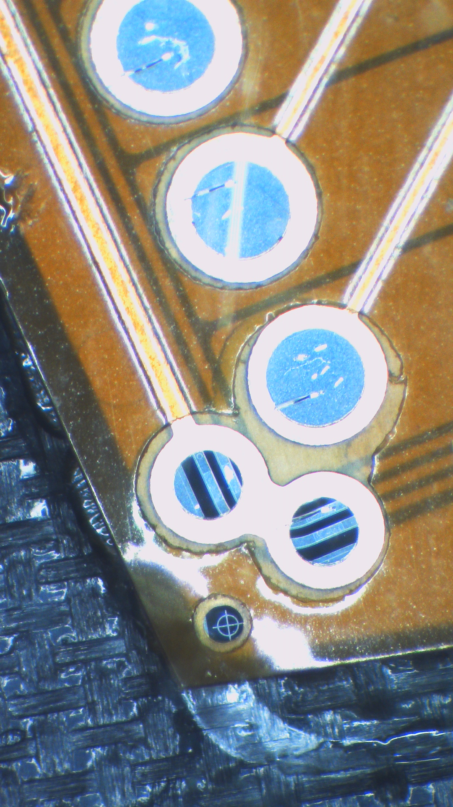
Wire bonding : loop size

Slide 14
Sensor gluing to the Envelope
Wire bonding loops does not allow to apply uniformly distributed pressure on top of the module using simple weight;
Applying the pressure with simple weight increase the risk of sensor damage;
Possible solutions:
  Support which eliminates contact with sensitive areas of the module (wire loops, soldering balls);
  Support which creates vacuum below.
Module
adhesive
Envelope
support
This method was successfully realized to glue the envelope

Slide 15
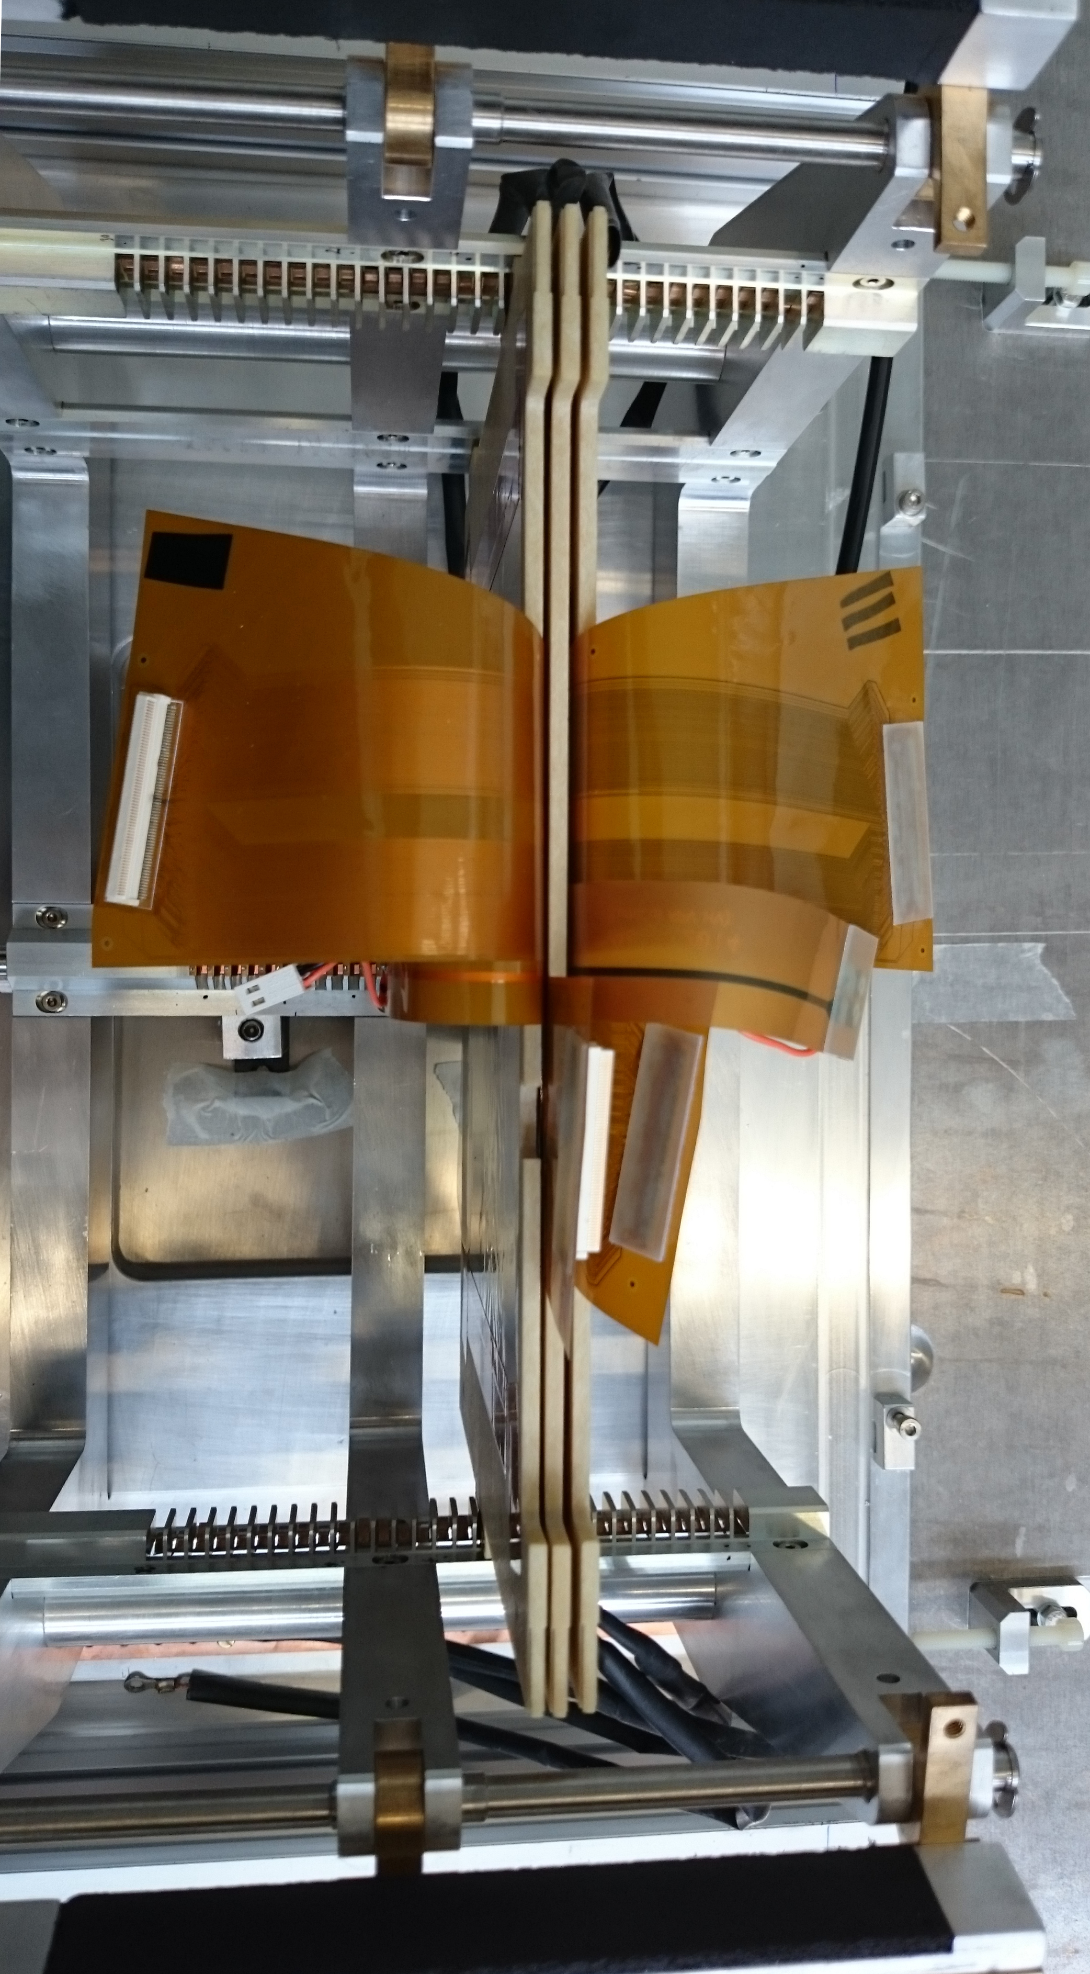
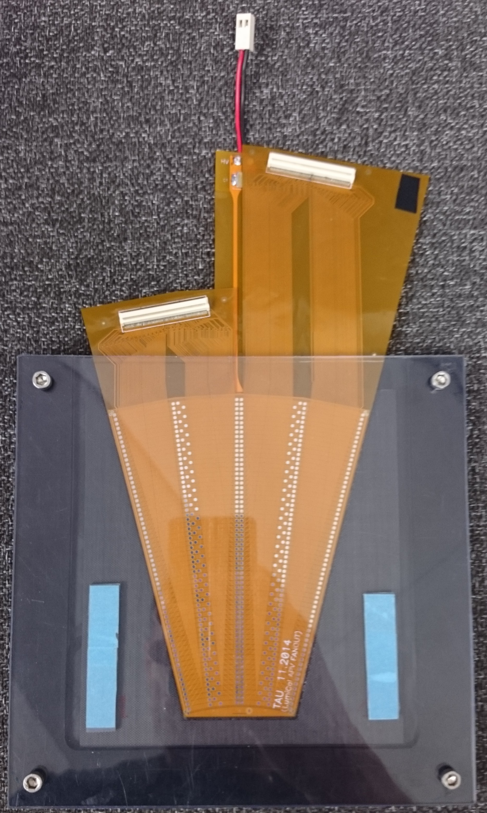
Module 18 tests @ CERN

Slide 16
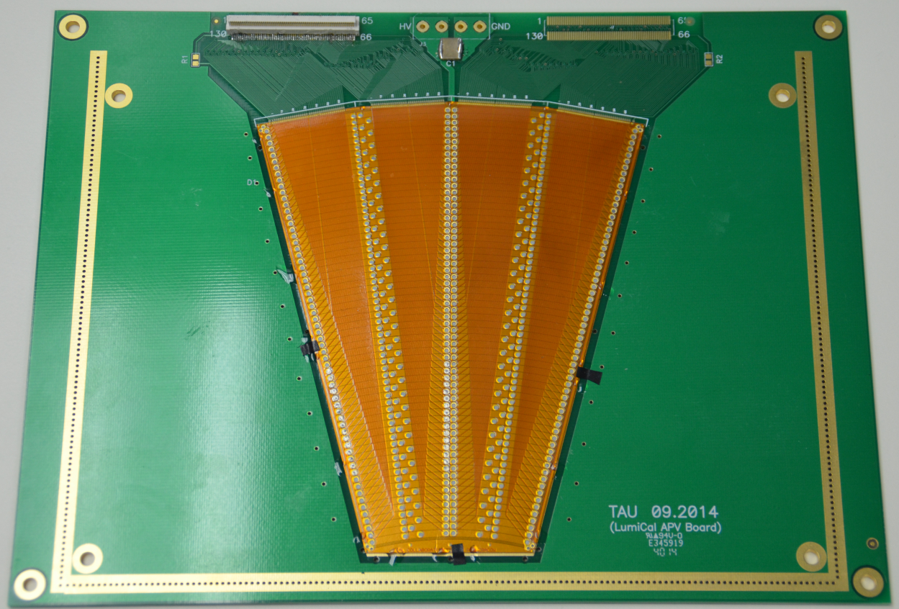
Readout
The aim was to read the whole sensor (256 pads)
Different candidates were tested : APV, VMM1 and VMM2
APV is a good candidate :
  Pre amplifier shaper, 192-cell analog pipeline and an analog pulse shape processor per channel, 128 channels
  Easy to find
  Intensively used by different collaborations
  Problem : gain is not adjustable and not a important dynamic range; good for MIP, saturated for electromagnetic shower

Slide 17
DESY test beam (12-19/10)
4 planes with thin sensor scotched on tungsten
FEB : APV chip based
DAQ : SRS system, designed by RD51 collaboration.
Silicon telescope : 6 planes with MIMOSA chip
Synchronization using TLU and fake SRS busy signal (generated by dual timer)
Online and “light” offline

Slide 18
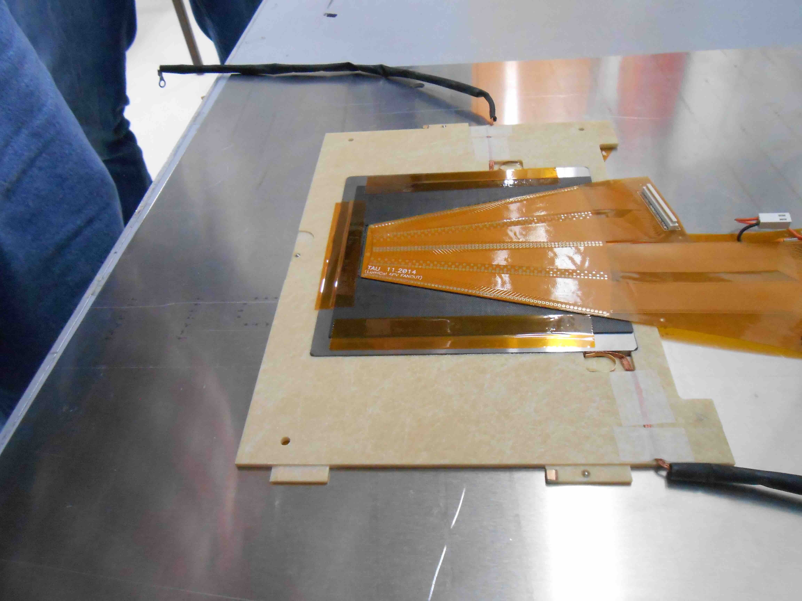
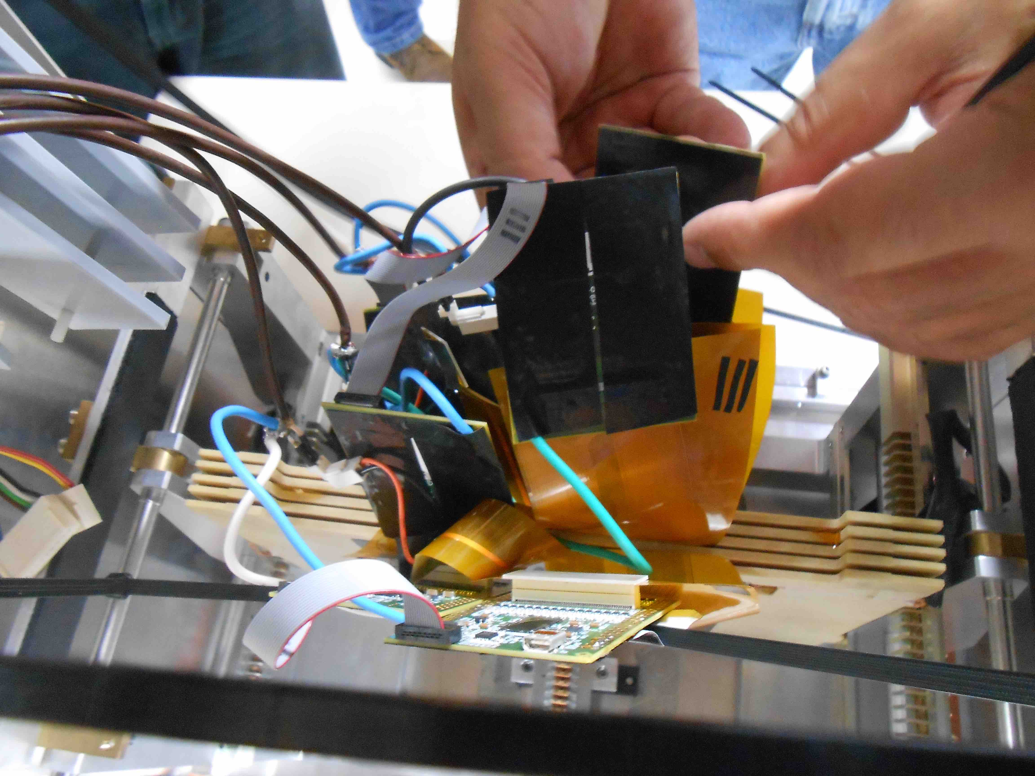
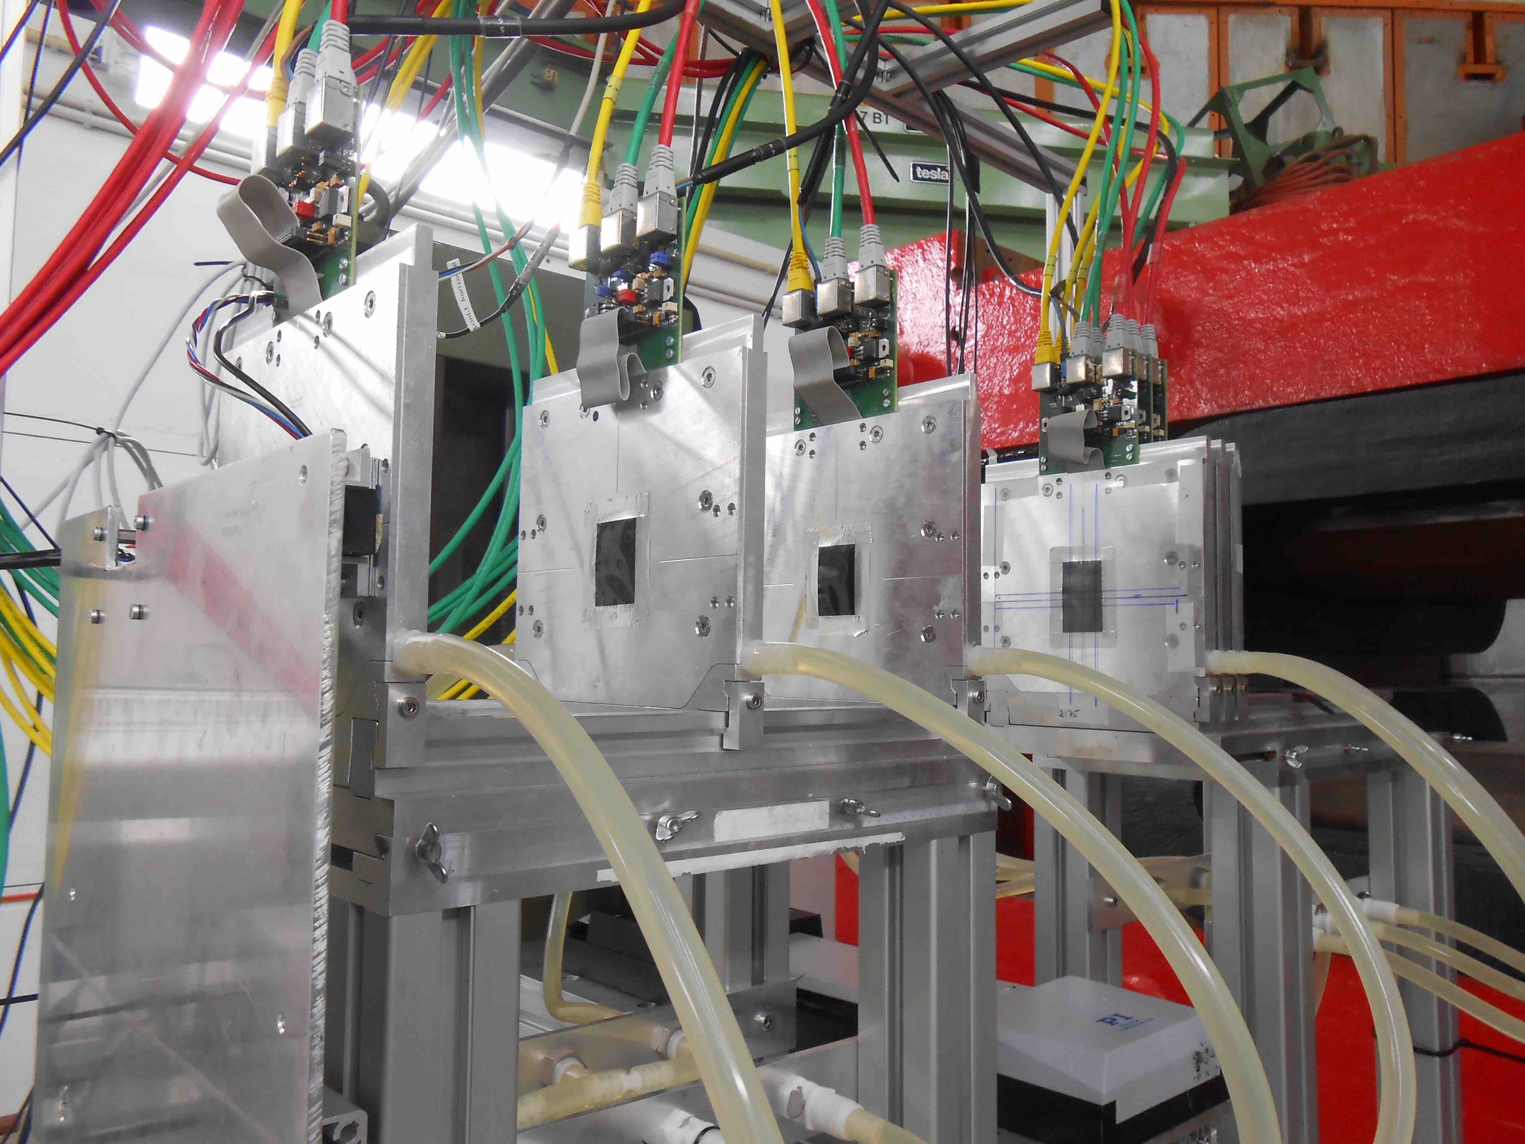
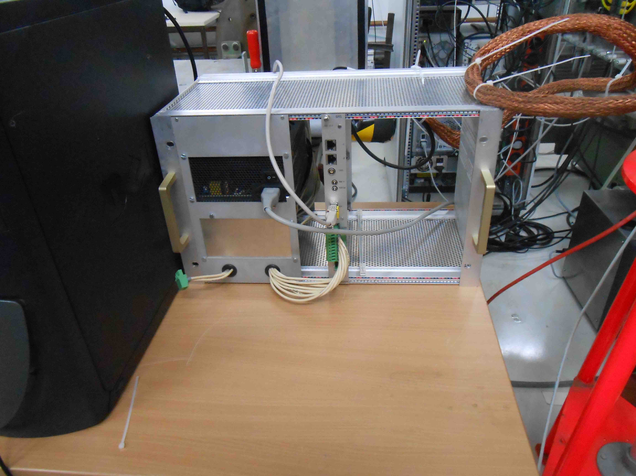

Slide 19
DAQ NUMBERING
APV 1 (slave)
APV 0 (master)
129
256
1
128
130
255
2
127
131
254
3
126
132
133
134
135
136
189
196
61
68
190
195
62
67
191
194
63
66
192
193
64
65

Slide 20
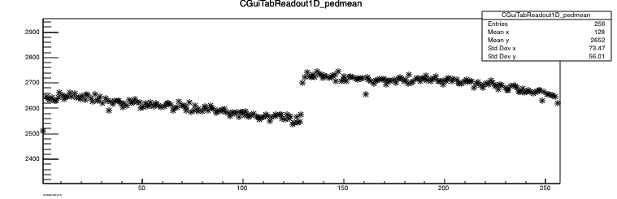
Pedestals
129
256
1
128
130
255
2
127
131
254
3
126
132
133
134
135
136
189
196
61
68
190
195
62
67
191
194
63
66
192
193
64
65

Slide 21
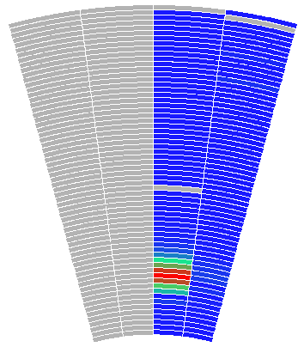
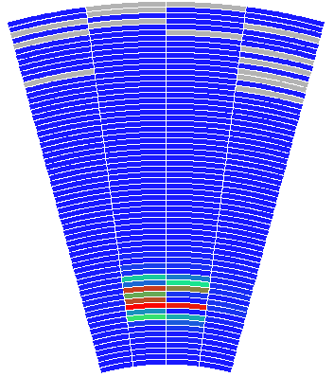
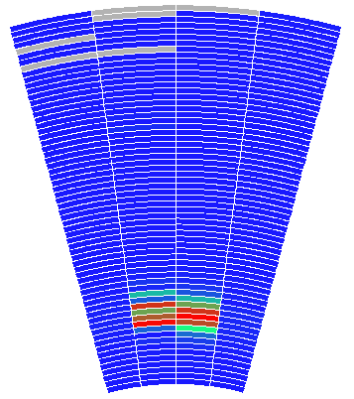
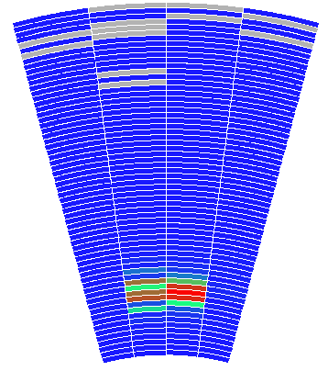
XY Scan
occupancy, run 110
Plane 2,
Module 20
Plane 1,
Module 18
Plane 4,
Module 21
Plane 3,
Module 17

Slide 22
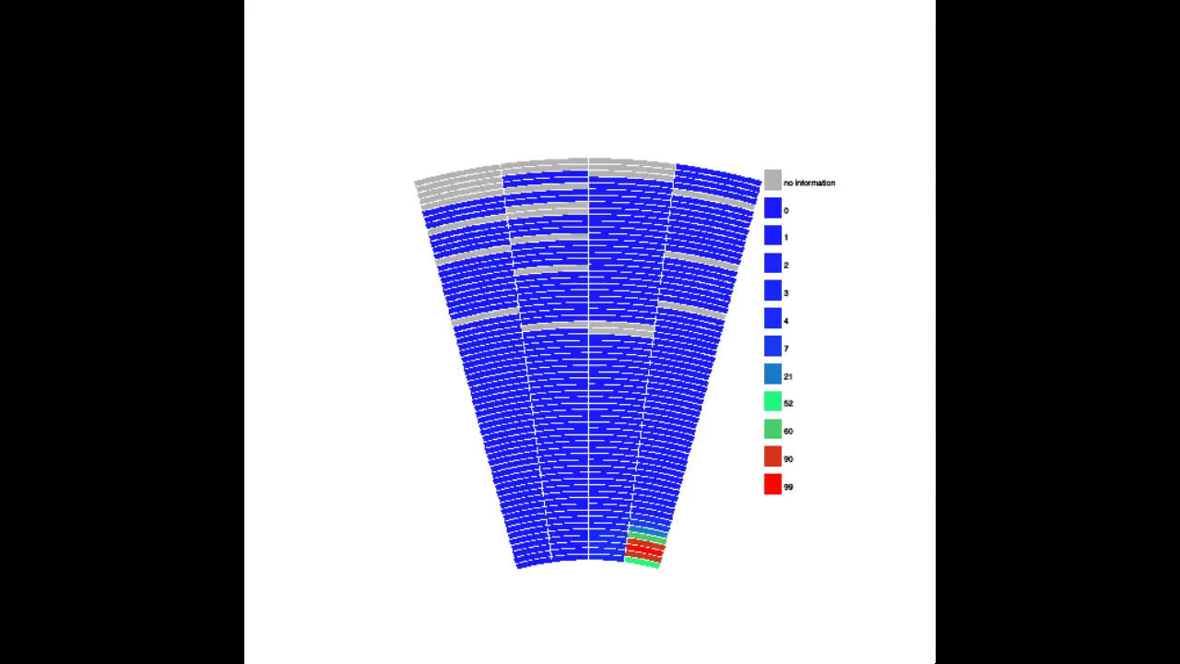
XY scan

Slide 23
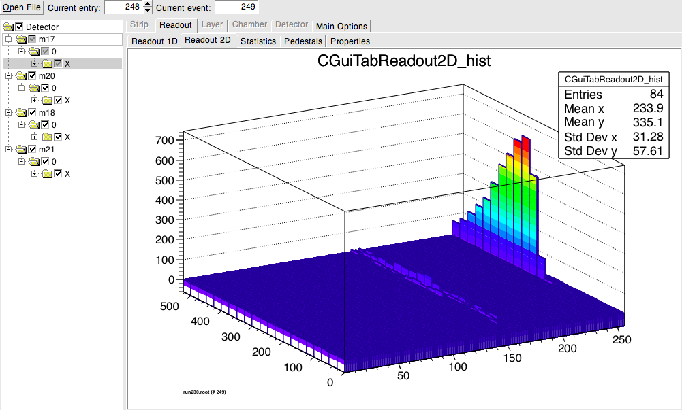
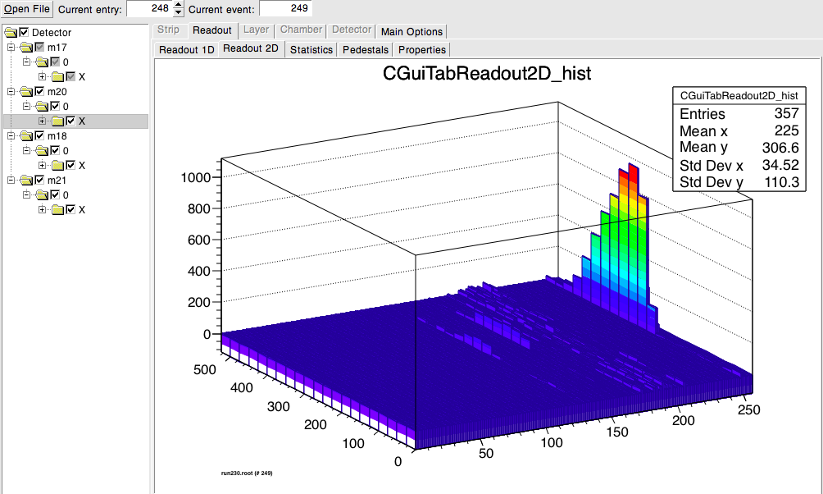
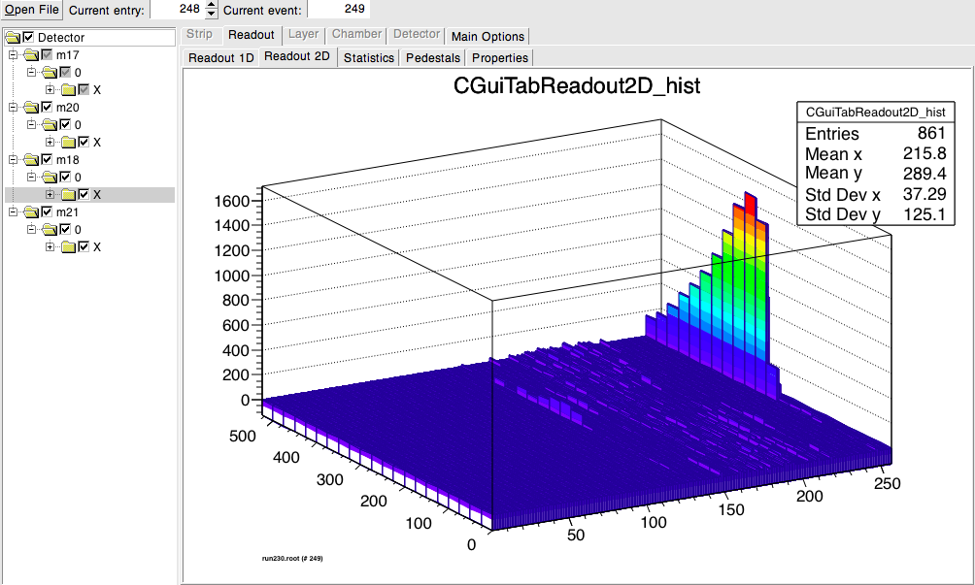
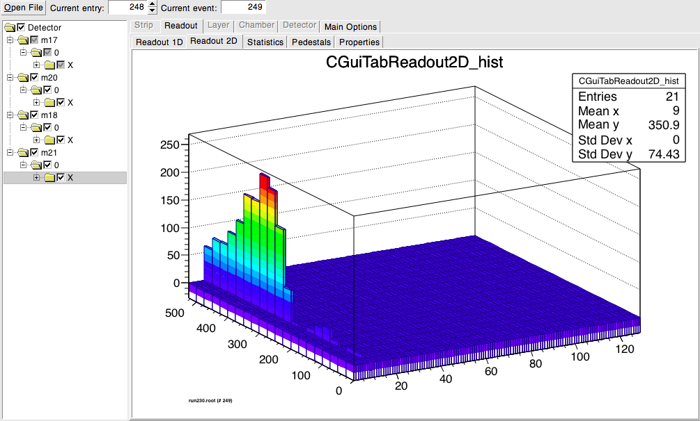
1st plane
2nd plane
Channel 247 (700)
Channel 247(1100),248(400)
Shower development
Alignment ? Channel 10 ?
3rd plane
4th plane
Channel 247(1500),248(1000)
Channel 9 (250)

Slide 24
Summary and plans
Thin LumiCal detector modules (~800 μm) have been developed, produced and tested in test beam
Assembly procedure was constantly optimized during the production of 3.5 modules to improve its reliability.
Further developments are ongoing to decrease the thickness of the silicon layer
Test beam analysis just started (charge and shower study, cross talk, …)

Slide 25
Thank you !

Slide 26

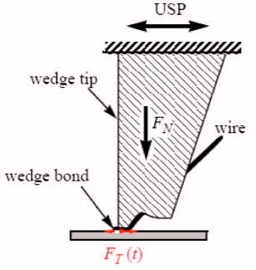
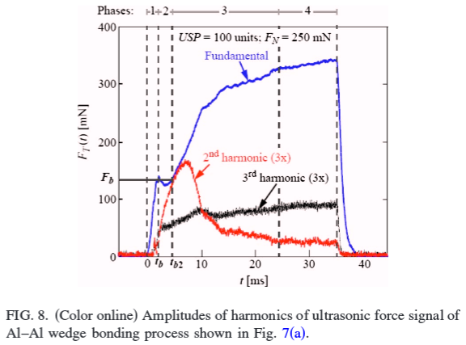
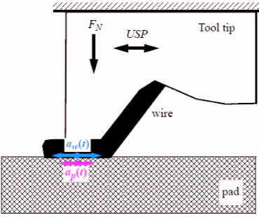
Wedge Bonding
Relative motion of wire and substrate in combination with friction on their interface facilitates the relative sliding of the wire on the pad causing bond area cleaning from the native oxide layers at the interface and bond formation.
To provide relative motion between the wire and bonding pad the last one in our case must be fixed well by the glue.

Slide 27
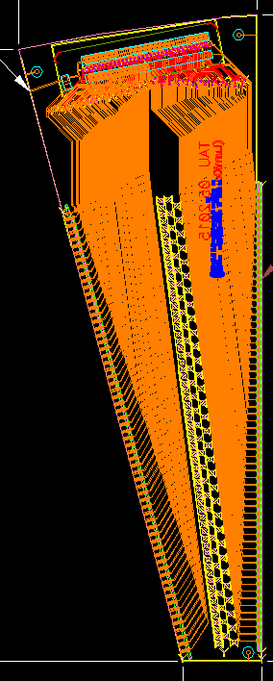
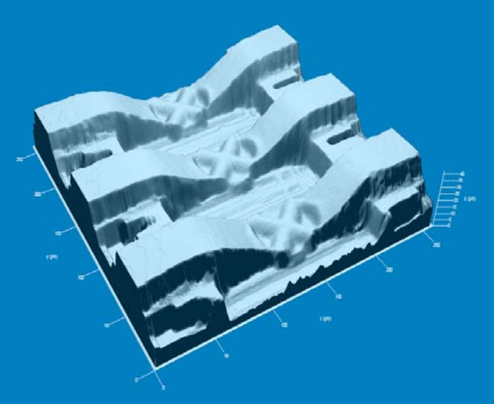
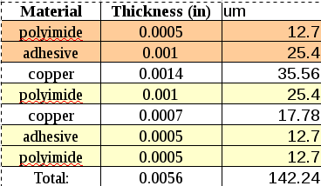
TAB Technology
Stable contact between sensor and readout electronics which meets LumiCal geometrical (compactness) requirement
Bond
Al / Cu
kapton
sensor / chip
Single point Tape Automated Bonding (TAB):
No wire loop;
The bond can be covered by the glue for better protection;
It is difficult to repair bonding defects;
Fanout was shipped by manufacture.

Slide 28
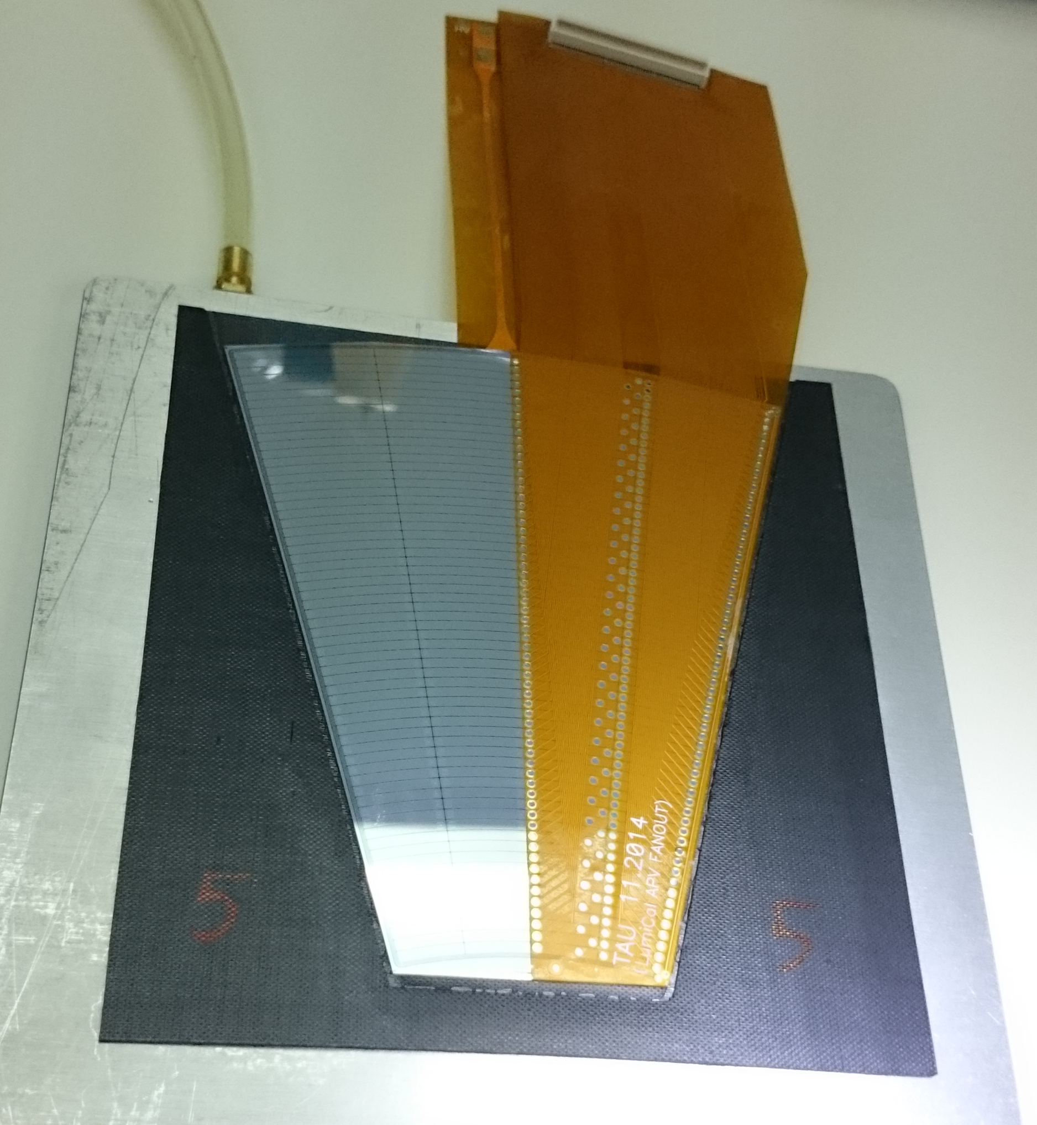
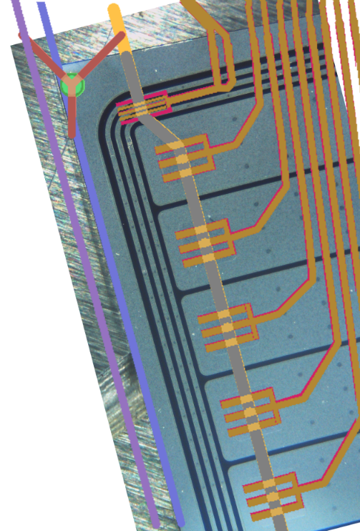
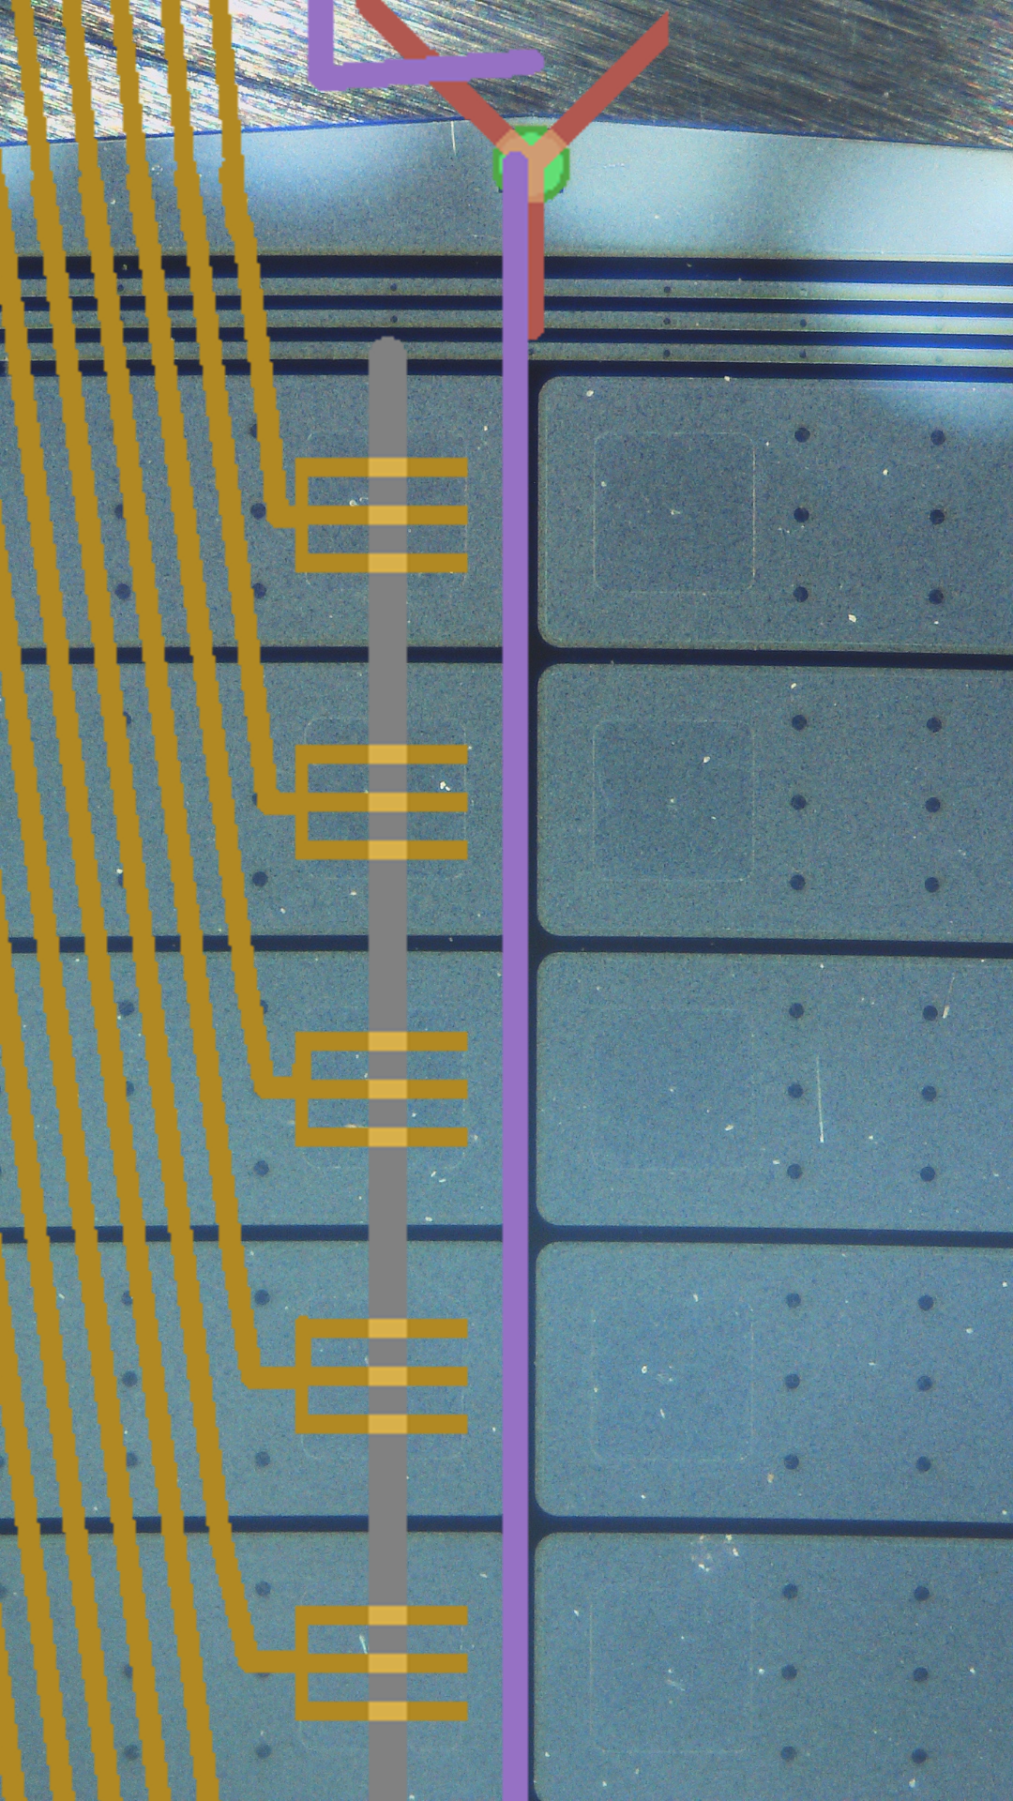
TAB Fanout Geometry
Photo overlapped by two versions of drawings:
The last version:
Yellow - traces,
Grey – window in kapton,
Blue - fanout edge position.

Slide 29
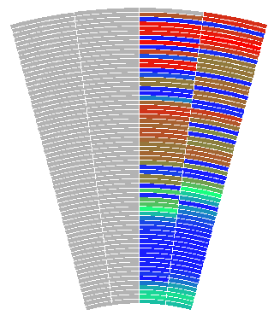



Combined occupancy
Plane 2,
Module 20
Plane 1,
Module 18
Plane 4,
Module 21
Plane 3,
Module 17

Slide 30


RUN 221

Slide 31
 | 1 | 2 | 3 | 4 | 5 | 6 | 7 | 8 | 9 | 10 | 11 | 12 | 13 | 14 | 15
env 1 | 720 | 142 | 708 |  | 698 | 123 | 676 | 129 | 700 |  | 712 | 134 | 101 | 660 | 687
env 2 | 720 | 118 | 701 |  | 729 | 129 | 689 | 133 | 699 |  | 691 | 107 | 100 | 700 | 692
env 3 | 700 | 125 | 703 |  | 742 | 130 | 697 | 127 | 705 |  | 703 | 126 | 110 | 713 | 704
env 4 | 717 | 136 | 677 |  | 679 | 132 | 727 | 131 | 706 |  | 693 | 134 | 104 | 693 | 692
env 5 | 716 | 155 | 753 |  | 758 | 126 | 705 | 160 | 717 |  | 739 | 123 | 100 | 699 | 708
1
2
13
12
11
3
4
10
9
14
5
6
8
7
15

Slide 32

Luminosity at e⁺e⁻ collider
Bhabha scattering at low polar angles is used
e⁺e⁻ e⁺e⁻ (γ)
L = N / σ
Count Bhabha events
From theory

Slide 33


Luminosity at e⁺e⁻ collider
Precise measurement of the luminosity
Low angle physics
Lumical composed of silicon and tungsten planes.

