Slide 1
tth study
Lepton ID with BDT
2015/02/27
Yuji Sudo
Kyushu University

Slide 2
Motivation
cut based lepton ID is useful to find isolated lepton with small systematic uncertainty
but
it is important to increase signal acceptance for tth study.
MVA lepton identification will be improve lepton ID efficiency and miss ID fraction.
→ signal acceptance will be improved.
-- issues related to MVA lepton ID method are
- specified lepton ID method to tth study
- more complicate lepton ID method than cut-based lepton selection

Slide 3
training and test sample
signal : e, mu, tau(e), tau(mu), tau(1-prong), tau(3-prong)
training and test samples: tth→2l2nbbbb
background: mu, tau(e), tau(mu), tau(1-prong), tau(3-prong), b jet, lf jet
training and test samples: ttZ for light flavor jet
: tth→2l2nbbbb for the other background
PFOs which can be traced to MC information are used to make samples.
BDTs:
Backgrounds
 | e | mu | tau(e) | tau(mu) | tau 1-prong | tau 3-prong | bjet | lf jet
e | - | x | x | x | x | x | x | x
mu |  | - | x | x | x | x | x | x
tau(e) |  |  | - | x | x | x | x | x
tau(mu) |  |  |  | - | x | x | x | x
tau(1-prong) |  |  |  |  | - | x | x | x
tau(3-prong) |  |  |  |  |  | - | x | x
Signals

Slide 4
Input variables
Input variables are chosen from the following parameters
hadOvEM: E_{hcal}/E_{ecal}
calEovE: (E_{hcal}+E_{ecal})/Epfo
coneE2woSeed: E_{cone2} without seed E_{PFO}
isoCutOld: 6(E_{PFO}-15)² – (coneE2woSeed)²
pfoR0 : sqrt(trkD0²+trkZ0²)
coneE1OvConeE2: E_{cone1}/E_{cone2}
coneMass1: reconstructed mass with PFOs in cone1
coneMass3: reconstructed mass with PFOs in cone3
clusterShape0: χ2 of fit
clusterShape1: maximum deposited energy (GeV)
clusterShape2: shower Max (mm)
clusterShape3: transverse absorption length(mm)
clusterShape5: shower Max/ Expected shower Max
clusterShape16: xl20 (mm)
yokuE: deposited energy in the yoku
pfoe: PFO energy
pt: Pt of PFO
cone1E
maxTrkEInCone13: Maximum energy of a PFO with track
between cone1 and cone2
nNeutralCone1: Number of PFOs with no track in cone1
eNeutralCone1: Energy sum of PFOs with no track in cone1
(*1) cone1: cosθ>0.99
cone2: cosθ>0.98
cone3: cosθ>0.93
(*2)cluster shape variables
- choose the highest energy cluster
- electron shower shaped is used to fit
(*3) transverse absorption length :
distance btw shower center
and location where cluster energy
goes down to 1/e
(*4) xl20:length to the positon where the deposited energy reaches 80 % of total energy on shower axis
(*4)
80%
deposited
energy
shower axis (mm)

Slide 5
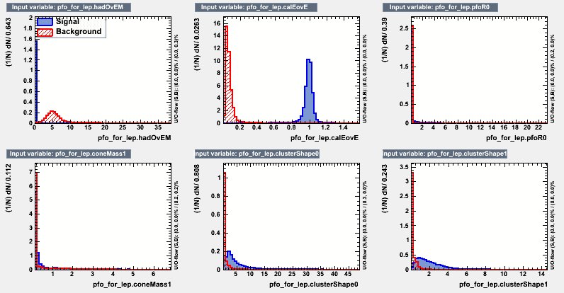
input variables e-mu 1 signal:e, background:mu
Calorimeter energy/ PFO energy
distance of
reconstructed vertex
(mm)
HCAL energy/ ECAL energy
Cone Mass 1
(GeV)
χ2 of fit
maximum deposited
energy (GeV)
cone1: cosθ>0.99
cone2: cosθ>0.98
cone3: cosθ>0.93
cluster shape variables
- choose the highest energy cluster
- electron shower shape is used to fit

Slide 6
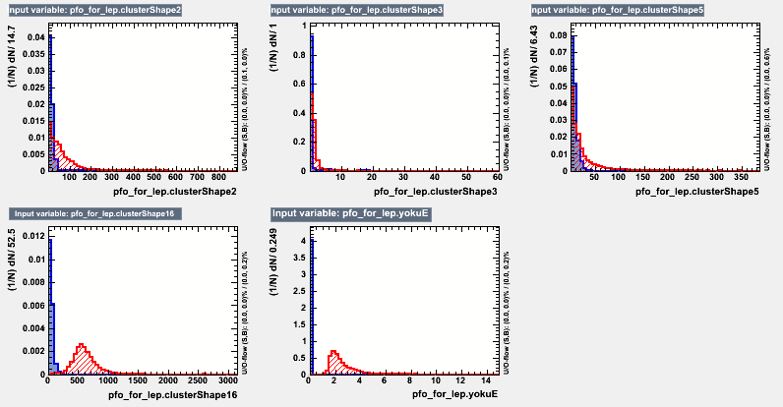
input variables e-mu 2 signal : e, background : mu
transverse absorption
length(mm)
shower Max/ Exp. shower Max
shower Max (mm)
xl20 (mm)
energy deposit
in yoku (GeV)
transverse absorption length :
distance btw shower center
and location where cluster energy
goes down to 1/e
cone1: cosθ>0.99
cone2: cosθ>0.98
cone3: cosθ>0.93
cluster shape variables
choose the highest energy cluster

Slide 7
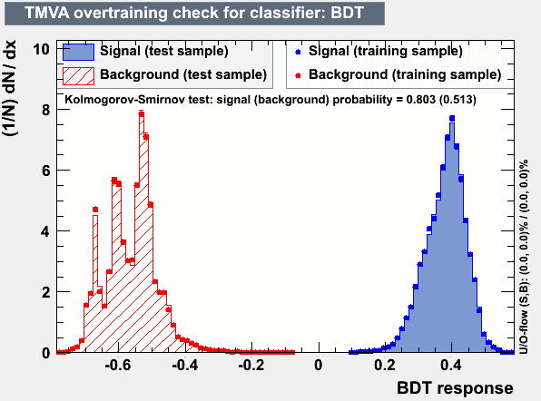
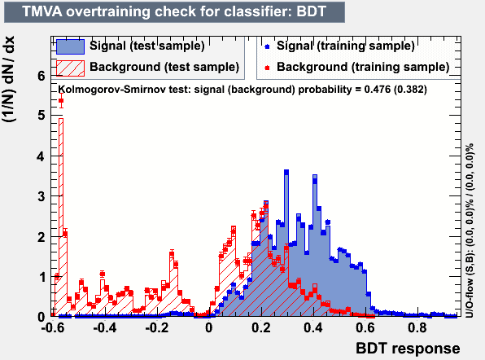
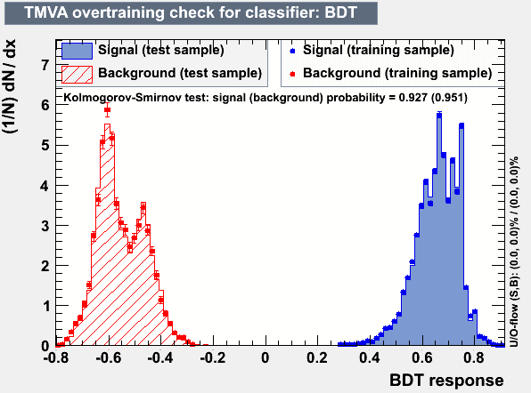
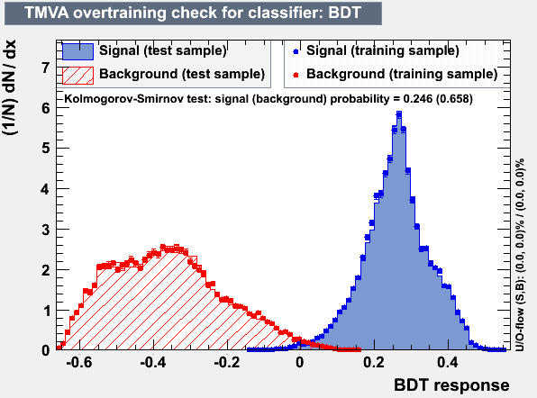
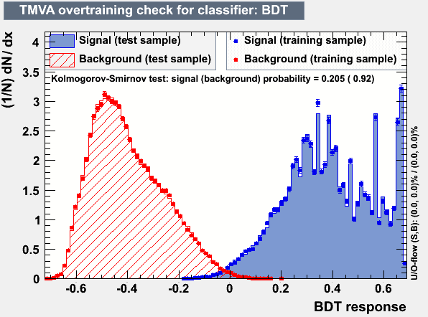
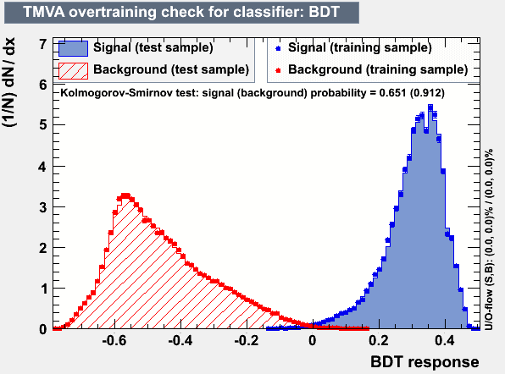
BDT Output, signal: electron
pre-cut : PFO energy > 2 GeV, PFO with track
additional pre-cut for electron or muon: PFO energy > 5 GeV
background: muon
background: tau(e)
background: tau (μ)
background: tau(h)
background: b jet
background: lf jet

Slide 8
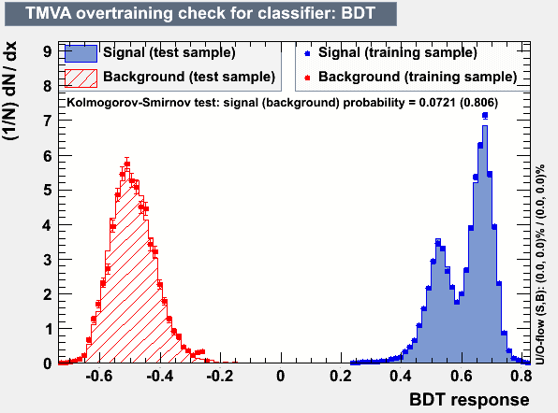
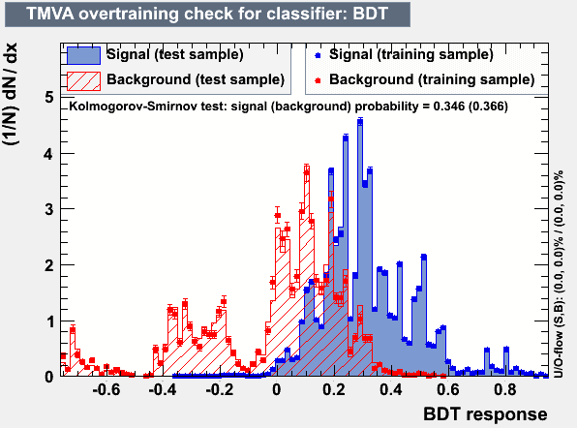
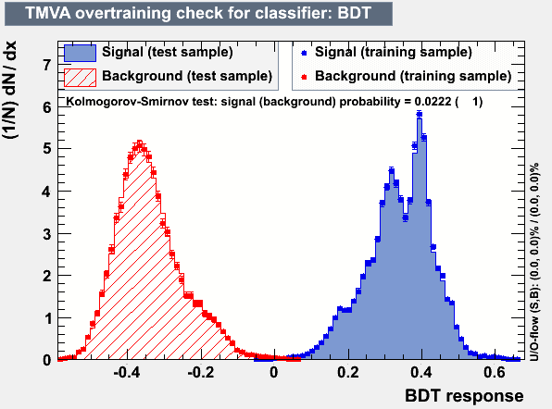
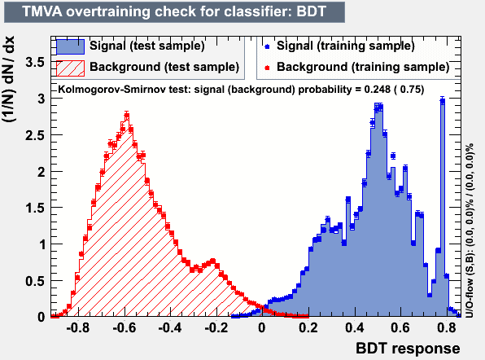
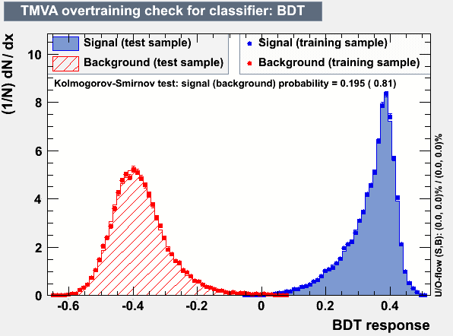
BDT Output, signal: muon
pre-cut : PFO energy > 2 GeV, PFO with track
additional pre-cut for electron or muon: PFO energy > 10 GeV
background: muon
background: tau(e)
background: tau (μ)
background: tau(h)
background: b jet
background: lf jet

Slide 9
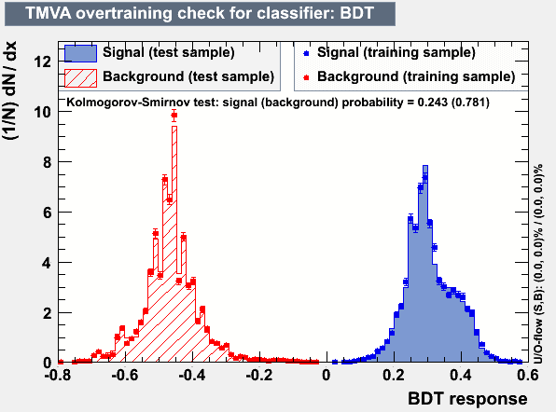
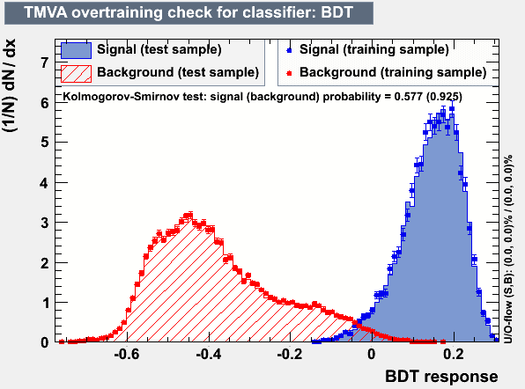
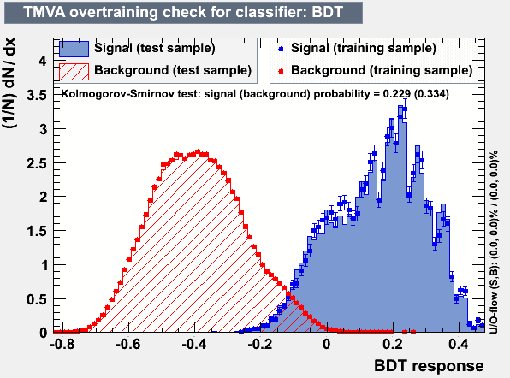
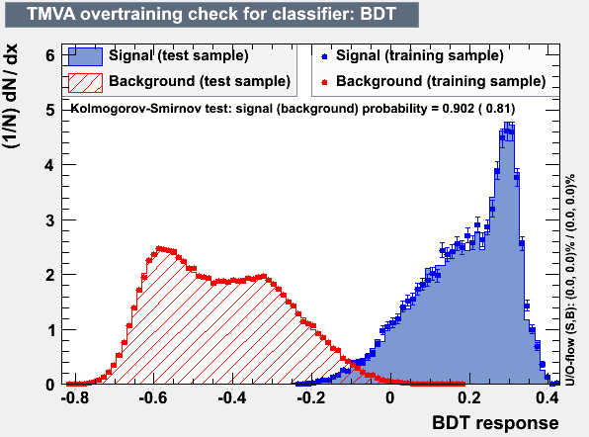
BDT Output, signal: tau(e)
pre-cut : PFO energy > 2 GeV, PFO with track
background: muon
background: tau(e)
background: tau (μ)
background: tau(h)
background: b jet
background: lf jet

Slide 10
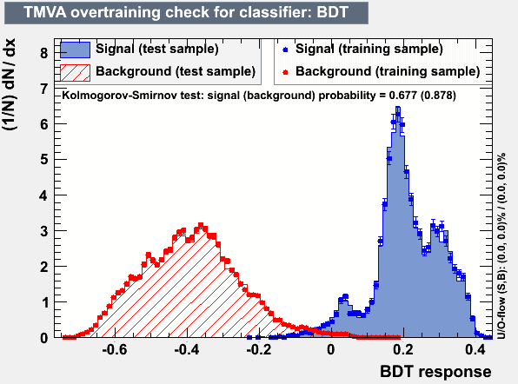
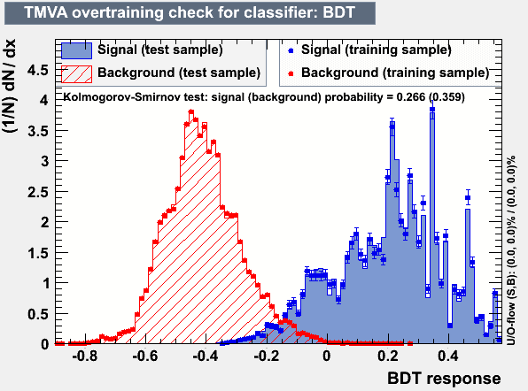
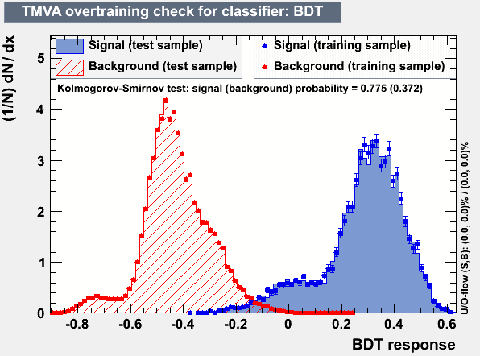
BDT Output, signal: tau(m)
pre-cut : PFO energy > 2 GeV, PFO with track
background: muon
background: tau(e)
background: tau (μ)
background: tau(h)
background: b jet
background: lf jet

Slide 11
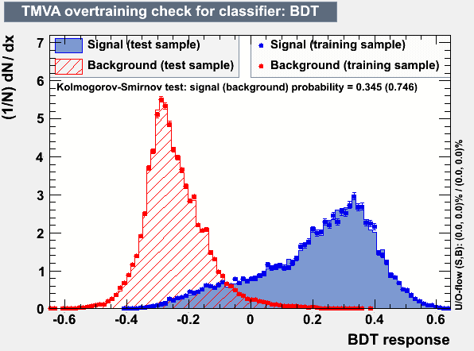
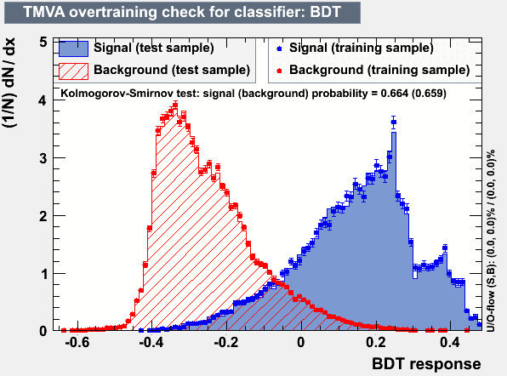
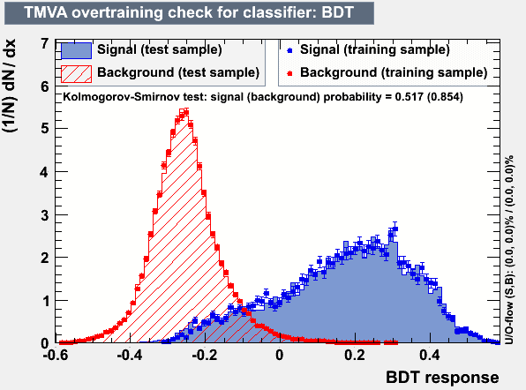
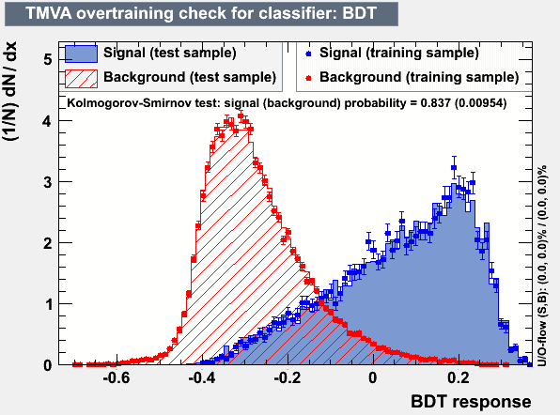
BDT Output, signal: tau 1-prong (top), tau 3-prong (bottom)
pre-cut : PFO energy > 2 GeV, PFO with track
background: b jet
background: lf jet
background: b jet
background: lf jet

Slide 12
tth 2l2n
Lepton ID efficiency with TMVA BDT (cut base) lepton selection
particles
* in this table,
0 means less than 0.01%
(%) | elec | muon | taue | taum | tauh1 | tauh3 | bjet | ljet
elec | 92 (85.08) | 0 (0) | 43.42 (28.82) | 0 (0) | 0.42 (0.31) | 0 (0.06) | 0 (0) | N/A
muon | 0 (0) | 95.11 (92.14) | 0 (0) | 40.36 (18.19) | 0.03 (0.01) | 0 (0) | 0 (0) | N/A
taue | 0.94 (2.24) | 0 (0) | 29.32 (18.76) | 0 (0) | 0.33 (0.42) | 0 (0) | 0.04 (0.02) | N/A
taum | 0 (0) | 1.34 (2.66) | 0 (0) | 34.22 (35.07) | 0.11 (0.09) | 0 (0) | 0.04 (0.03) | N/A
tauh1 | 0.28 (3.56) | 0.06 (0.53) | 0.71 (15.4) | 0.04 (12.46) | 55.64 (46.21) | 0 (0) | 0.04 (0.06) | N/A
tauh3 | 0 (0) | 0 (0.01) | 0.04 (0.08) | 0 (0.04) | 0 (0) | 49.29 (38.74) | 0.01 (0.04) | N/A
nonlep | 6.76 (9.09) | 3.47 (4.65) | 26.49 (36.91) | 25.37 (34.22) | 43.44 (52.92) | 50.7 (61.18) | 99.84 (99.83) | N/A
Selection

Slide 13
tth 2l2n
Lepton ID efficiency with TMVA BDT (cut base) lepton selection
particles
* in this table,
0 means less than 0.01%
(%) | elec | muon | taue | taum | tauh1 | tauh3 | bjet | ljet
elec | 92 (85.08) | 0 (0) | 43.42 (28.82) | 0 (0) | 0.42 (0.31) | 0 (0.06) | 0 (0) | N/A
muon | 0 (0) | 95.11 (92.14) | 0 (0) | 40.36 (18.19) | 0.03 (0.01) | 0 (0) | 0 (0) | N/A
taue | 0.94 (2.24) | 0 (0) | 29.32 (18.76) | 0 (0) | 0.33 (0.42) | 0 (0) | 0.04 (0.02) | N/A
taum | 0 (0) | 1.34 (2.66) | 0 (0) | 34.22 (35.07) | 0.11 (0.09) | 0 (0) | 0.04 (0.03) | N/A
tauh1 | 0.28 (3.56) | 0.06 (0.53) | 0.71 (15.4) | 0.04 (12.46) | 55.64 (46.21) | 0 (0) | 0.04 (0.06) | N/A
tauh3 | 0 (0) | 0 (0.01) | 0.04 (0.08) | 0 (0.04) | 0 (0) | 49.29 (38.74) | 0.01 (0.04) | N/A
nonlep | 6.76 (9.09) | 3.47 (4.65) | 26.49 (36.91) | 25.37 (34.22) | 43.44 (52.92) | 50.7 (61.18) | 99.84 (99.83) | N/A
Selection

Slide 14
tth 2l2n
Lepton ID efficiency with TMVA BDT (cut base) lepton selection
particles
* in this table,
0 means less than 0.01%
(%) | elec | muon | taue | taum | tauh1 | tauh3 | bjet | ljet
elec | 92 (85.08) | 0 (0) | 43.42 (28.82) | 0 (0) | 0.42 (0.31) | 0 (0.06) | 0 (0) | N/A
muon | 0 (0) | 95.11 (92.14) | 0 (0) | 40.36 (18.19) | 0.03 (0.01) | 0 (0) | 0 (0) | N/A
taue | 0.94 (2.24) | 0 (0) | 29.32 (18.76) | 0 (0) | 0.33 (0.42) | 0 (0) | 0.04 (0.02) | N/A
taum | 0 (0) | 1.34 (2.66) | 0 (0) | 34.22 (35.07) | 0.11 (0.09) | 0 (0) | 0.04 (0.03) | N/A
tauh1 | 0.28 (3.56) | 0.06 (0.53) | 0.71 (15.4) | 0.04 (12.46) | 55.64 (46.21) | 0 (0) | 0.04 (0.06) | N/A
tauh3 | 0 (0) | 0 (0.01) | 0.04 (0.08) | 0 (0.04) | 0 (0) | 49.29 (38.74) | 0.01 (0.04) | N/A
nonlep | 6.76 (9.09) | 3.47 (4.65) | 26.49 (36.91) | 25.37 (34.22) | 43.44 (52.92) | 50.7 (61.18) | 99.84 (99.83) | N/A
Selection

Slide 15
ttZ
Lepton ID efficiency with TMVA BDT (cut base) lepton selection
particles
* in this table,
0 means less than 0.01%
(%) | elec | muon | taue | taum | tauh1 | tauh3 | bjet | ljet
elec | 90.92 (84.62) | 0.01 (0.01) | 44.3 (28.27) | 0 (0) | 0.15 (0.11) | 0 (0.11) | 0.01 (0.02) | 0.01 (0.02)
muon | 0 (0) | 94.93 (92.23) | 0 (0) | 39.98 (18.28) | 0 (0) | 0.11 (0) | 0.01 (0) | 0 (0.01)
taue | 1.16 (1.96) | 0 (0.01) | 28.08 (20.01) | 0 (0) | 0.34 (0.23) | 0 (0) | 0.02 (0.02) | 0 (0)
taum | 0 (0) | 1.59 (2.93) | 0 (0) | 33.42 (36.28) | 0.15 (0.07) | 0 (0) | 0.02 (0.03) | 0 (0)
tauh1 | 0.31 (3.14) | 0.05 (0.49) | 0.56 (15.08) | 0 (10.98) | 54.97 (45.37) | 0 (0) | 0.01 (0.02) | 0.38 (0.4)
tauh3 | 0.09 (0.05) | 0 (0) | 0 (0.08) | 0 (0) | 0 (0) | 48.14 (37.99) | 0 (0.02) | 0.18 (0.2)
nonlep | 7.5 (10.2) | 3.39 (4.29) | 27.03 (36.62) | 26.59 (34.44) | 44.36 (54.19) | 51.73 (61.88) | 99.89 (99.86) | 99.4 (99.34)
Selection

Slide 16
Summary1
Prepare BDT Lepton ID method
Lepton ID efficiency is improved
- ID efficiency is slightly increased
- miss ID rate is slightly decreased
I hope sensitivity of tth(h→bb) channel will be improved
some issues
- cluster shape values has sometimes “Nan” value.
→ PFOs with “Nan” input value are rejected to MVA samples
- some BDT outputs have peaked distribution
Is it acceptable or not?
- many input variables are used

Slide 17
tth study with increased MC stat.
tth, ttz, ttbb: 100k~200k events
tbW(DBD samples): 10k~100k events

Slide 18
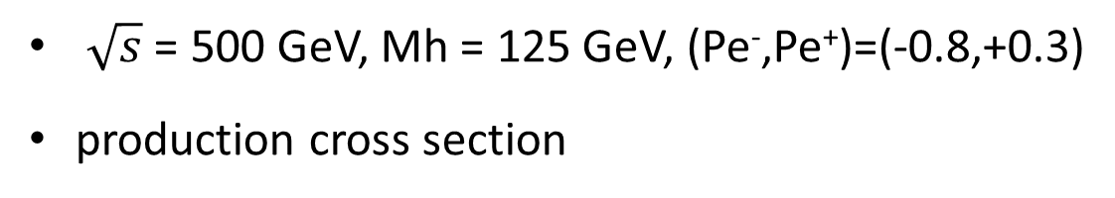
Expected # of events @ 500fb⁻¹
$\sqrt{s}$ = 500 GeV, Mh = 125 GeV, (Pe⁻,Pe⁺)=(-0.8,+0.3)
production cross section
Branching ratio
Process | σ (fb)
e⁻e⁺ → tth | 0.485
e⁻e⁺ → ttZ | 1.974
e⁻e⁺ → ttg(bb) | 1.058
e⁻e⁺ → tbW | 979.8
Decay mode | Branching ratio
h→bb | 0.577
tt→bqqbqq | 0.457
tt→blνbqq | 0.438
tt→blνblν | 0.105
expected # of signals and Backgrounds(@500fb⁻¹)
tth(tt6j, hbb) | 63.9 | tth(ttln4j,hbb) | 61.3
tth(ttall, hnobb) | 102.6 | ttZ | 987
tth(ttlνlν2b, hbb) | 14.6 | ttg(bb) | 529
 |  | tbW | 489902

Slide 19
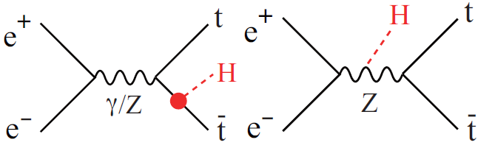
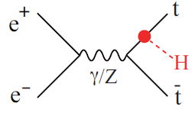
tth analysis
interference term is negligible
counting analysis with cut based event selection
Use Kt clustering only for removing low Pt background
lepton ID (cut base)
- muon selection
- electron selection
- tau (leptonic decay)
- tau (hadronic decay)
forced 8 jets clustering & 0 isolated lepton → 8jets channel
forced 6 jets clustering & 1 isolated lepton → lν6jets channel
forced 4 jets clustering & 2 isolated leptons → 2l2ν 4jets channel
In this analysis, higgs decays into two b jets
require at least 4 b jets (b tagging: LCFIPlus)

Slide 20
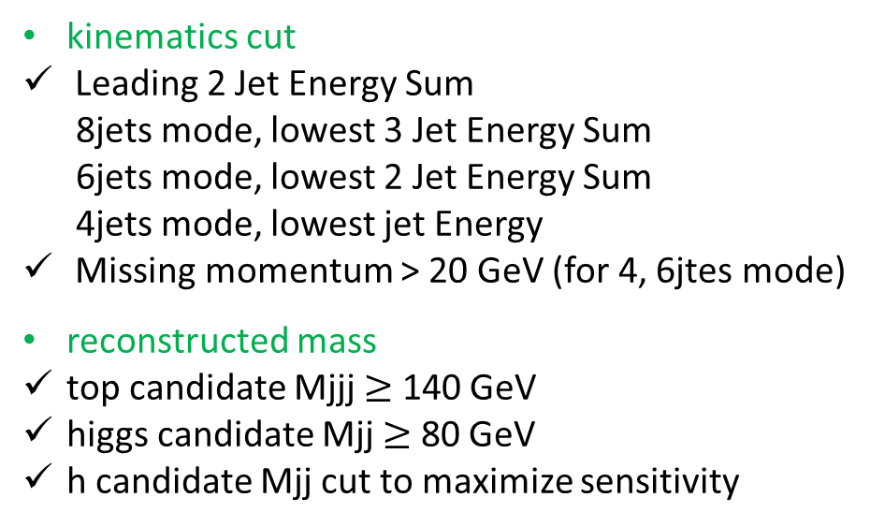
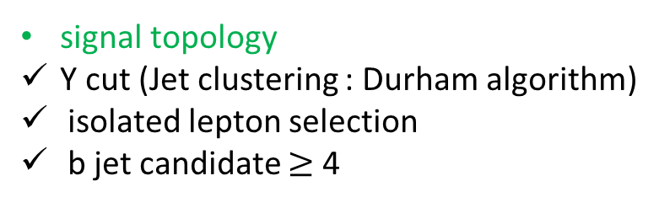
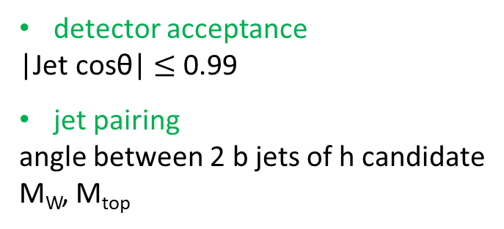
Event Selection
signal topology
Y cut (Jet clustering : Durham algorithm)
isolated lepton selection
b jet candidate $≥$ 4
detector acceptance
|Jet cosθ| $≤$ 0.99
jet pairing
angle between 2 b jets of h candidate
M_{W}, M_{top}
kinematics cut
Leading 2 Jet Energy Sum
8jets mode, lowest 3 Jet Energy Sum
6jets mode, lowest 2 Jet Energy Sum
4jets mode, lowest jet Energy
Missing momentum > 20 GeV (for 4, 6jtes mode)
reconstructed mass
top candidate Mjjj $≥$ 140 GeV
higgs candidate Mjj $≥$ 80 GeV
h candidate Mjj cut to maximize sensitivity
* tbW shape is used 2 b tagged category’s shape.

Slide 21
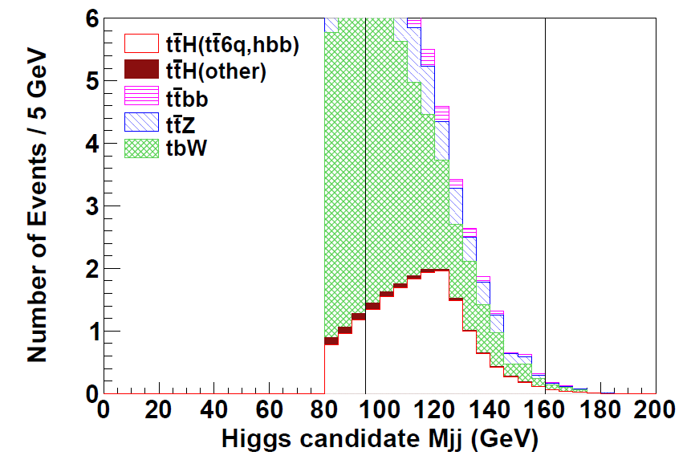

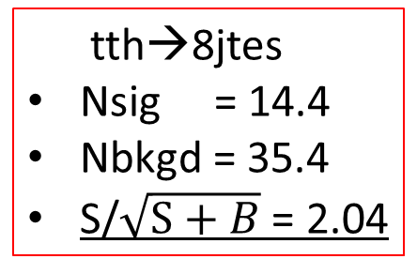
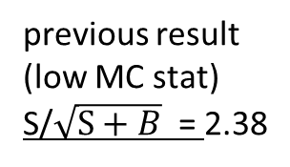
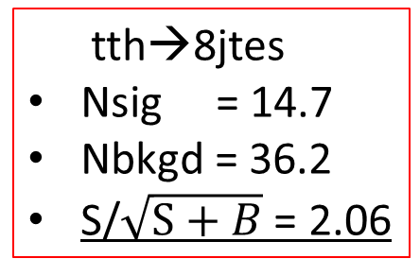
tth→8jets
number of events
passed all selection
cut base lepton ID
Process | # of evt
tth→4q+4b | 14.4
tth (other) | 0.46
ttZ | 7.29
ttbb | 2.59
tbW | 25.0
tth→8jtes
Nsig = 14.4
Nbkgd = 35.4
S/$\sqrt{S+B}$ = 2.04
previous result
(low MC stat)
S/$\sqrt{S+B}$ = 2.38
Iepton ID with BDT
Process | # of evt
tth→4q+4b | 14.7
tth (other) | 0.44
ttZ | 7.35
ttbb | 2.71
tbW | 25.7
tth→8jtes
Nsig = 14.7
Nbkgd = 36.2
S/$\sqrt{S+B}$ = 2.06

Slide 22
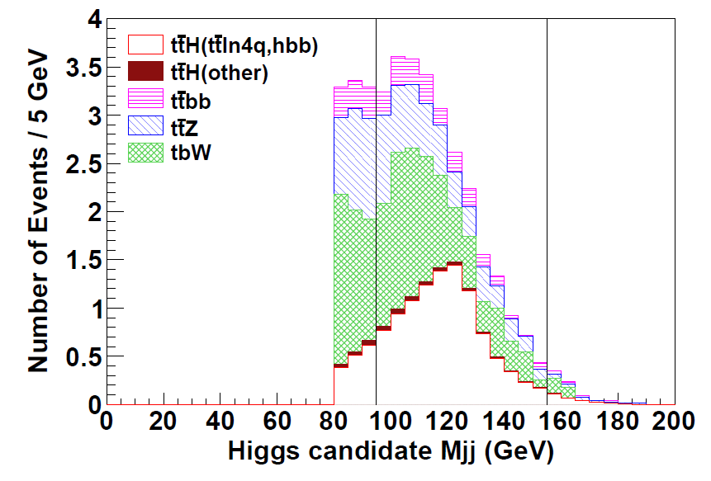
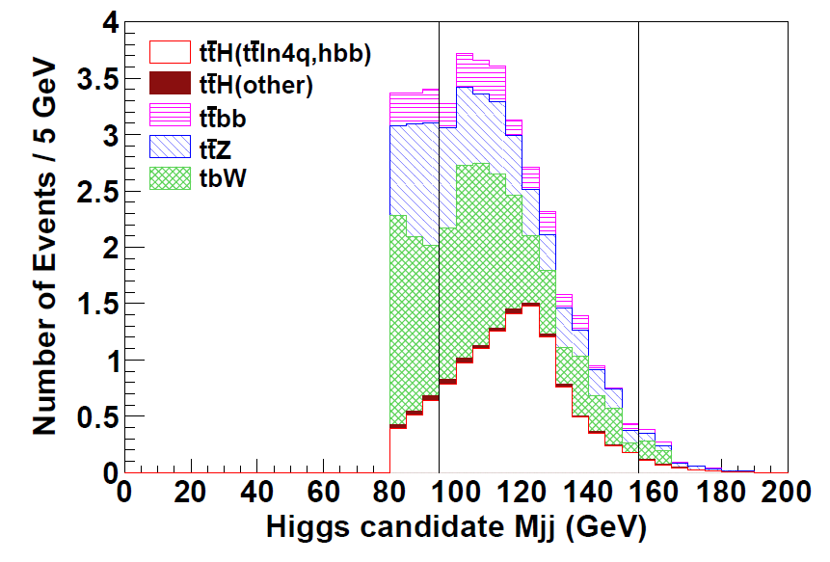
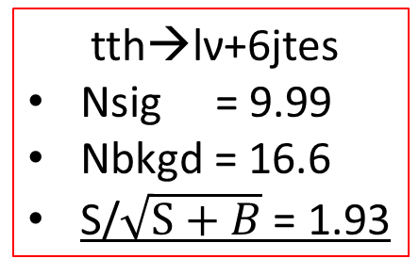
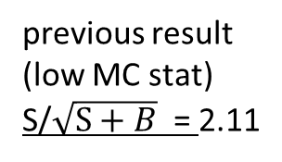
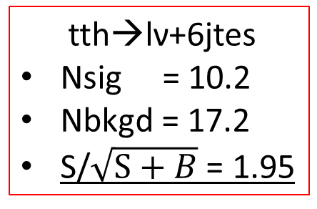
tth→ln+6jets
number of events
passed all selection
cut base lepton ID
tth→lν+6jtes
Nsig = 9.99
Nbkgd = 16.6
S/$\sqrt{S+B}$ = 1.93
Process | # of evt
tth→ ln+2q+4b | 9.99
tth (other) | 0.25
ttZ | 5.12
ttbb | 1.99
tbW | 9.30
previous result
(low MC stat)
S/$\sqrt{S+B}$ = 2.11
Iepton ID with BDT
Process | # of evt
tth→ ln+2q+4b | 10.2
tth (other) | 0.25
ttZ | 5.17
ttbb | 2.02
tbW | 9.80
tth→lν+6jtes
Nsig = 10.2
Nbkgd = 17.2
S/$\sqrt{S+B}$ = 1.95

Slide 23
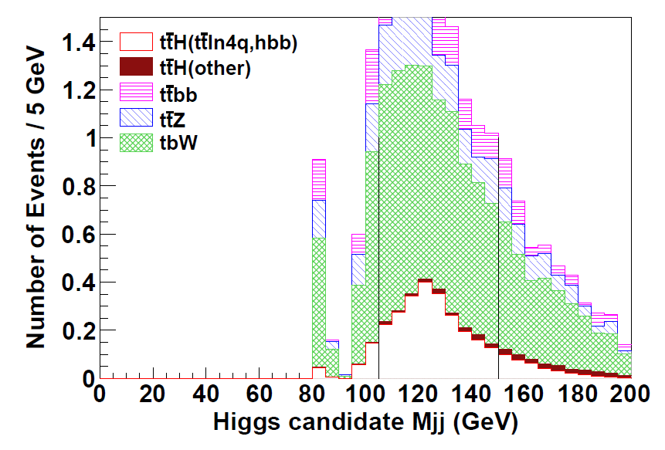
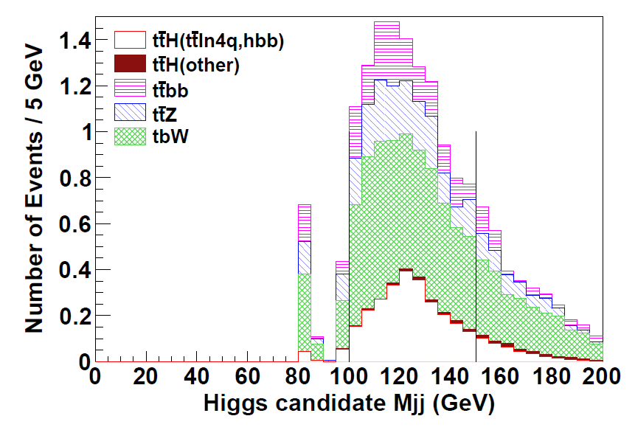
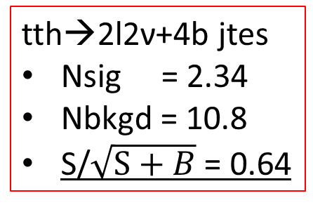
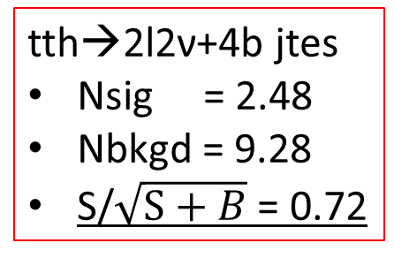
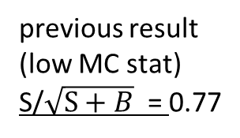
tth→2l2n+4b jets
number of events
passed all selection
cut base lepton ID
tth→2l2ν+4b jtes
Nsig = 2.34
Nbkgd = 10.8
S/$\sqrt{S+B}$ = 0.64
Process | # of evt
tth→ 2l2n+4b | 2.34
tth (other) | 0.12
ttZ | 1.78
ttbb | 1.61
tbW | 7.32
previous result
(low MC stat)
S/$\sqrt{S+B}$ = 0.77
Iepton ID with BDT
Process | # of evt
tth→ 2l2n+4b | 2.48
tth (other) | 0.08
ttZ | 1.98
ttbb | 1.72
tbW | 5.49
tth→2l2ν+4b jtes
Nsig = 2.48
Nbkgd = 9.28
S/$\sqrt{S+B}$ = 0.72

Slide 24
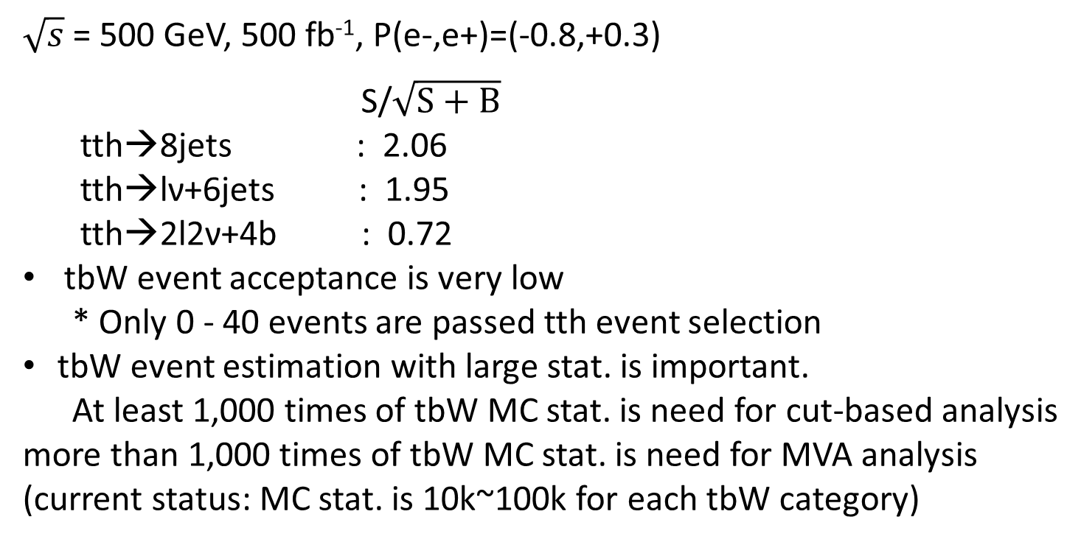
Summary2 & Conclusions
Signal Acceptance after all event selection | Cut-based lepton ID | BDT lepton ID
tth→8jets | 22.5 % | 23.0 %
tth→ln+6jets | 16.3 % | 16.6 %
tth→2l2n+4b | 16.0 % | 17.0 %
$\sqrt{s}$ = 500 GeV, 500 fb⁻¹, P(e-,e+)=(-0.8,+0.3)
S/$\sqrt{S+B}$
tth→8jets : 2.06
tth→lν+6jets : 1.95
tth→2l2ν+4b : 0.72
tbW event acceptance is very low
* Only 0 - 40 events are passed tth event selection
tbW event estimation with large stat. is important.
At least 1,000 times of tbW MC stat. is need for cut-based analysis
more than 1,000 times of tbW MC stat. is need for MVA analysis
(current status: MC stat. is 10k~100k for each tbW category)

Slide 25
Backup

Slide 26
Lepton ID
muon selection
electron selection
tau (e)
tau(muon)
tau (1-prong)
tau(3-prong)

Slide 27

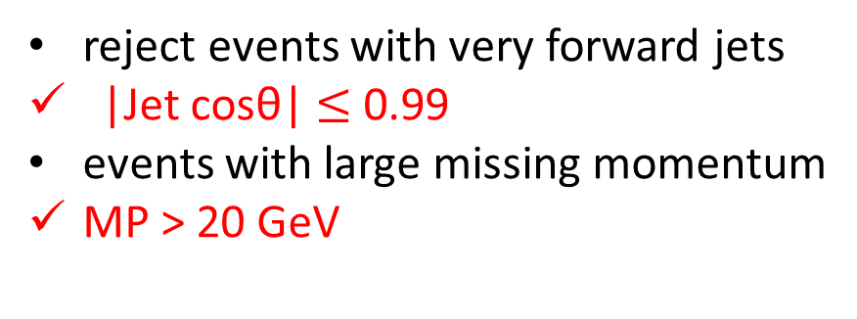
Event Selection
Jet clustering : Durham algorithm
forced 8 jet clustering for tth→8jets channel
“Y₈₇ > 0.00055” + “Y₈₇<=0.00055 && Y₇₆>0.0012”
forced 6 jet clustering for tth→lν+6jets channel
“Y₆₅ > 0.00165” + “Y₆₅<=0.00165 && Y₅₄>0.005”
Isolated Lepton
cosθ_{cone} = 0.98
E_{cone} < $\sqrt{6(Epfo−15)}$
Definition
(old definition)
require no(one) Isolated lepton to 8jet(lν+6jet) channel
b candidate jets $≥$ 4 (b likeness >=0.85 ,0.8, 0.6, 0.2)
reject events with very forward jets
|Jet cosθ| $≤$ 0.99
events with large missing momentum
MP > 20 GeV

Slide 28
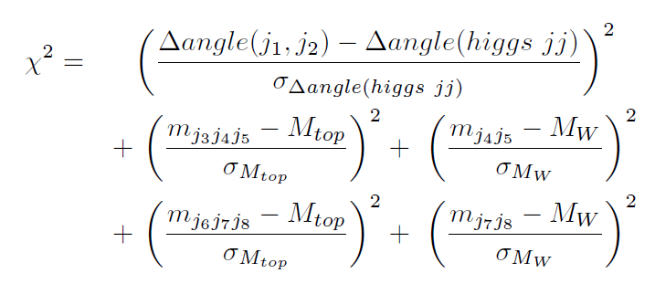
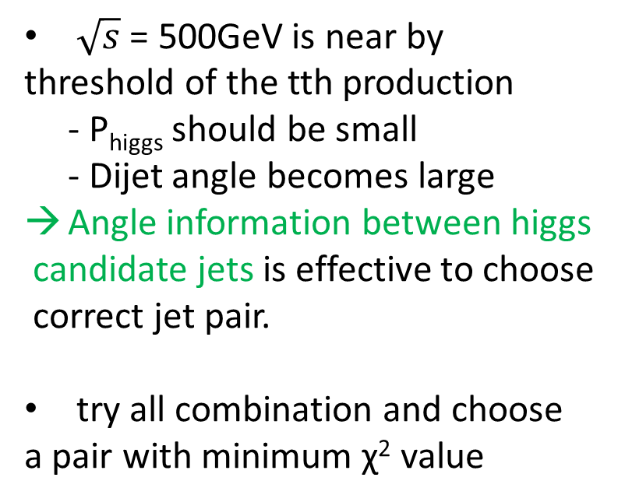

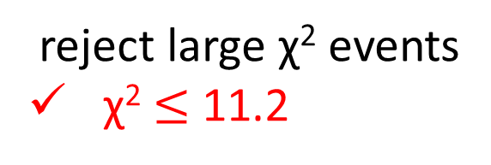
Jet pairing, χ2 Cut
$\sqrt{s}$ = 500GeV is near by
threshold of the tth production
- P_{higgs} should be small
- Dijet angle becomes large
Angle information between higgs
candidate jets is effective to choose
correct jet pair.
try all combination and choose
a pair with minimum χ² value
require b likeness$≥$ 0.2 to j₁, j₂, j₃, j₆
Reference values are made
from reconstructed jets which are
matched with MC information
- Mtop = 171.5GeV
- sigma Mtop = 16.8 GeV
- MW = 80. 5GeV
- sigma MW = 9.9 GeV
- angle(jj) = 2.448
- sigma angle(jj) = 0.277
reject large χ² events
χ² $≤$ 11.2

Slide 29
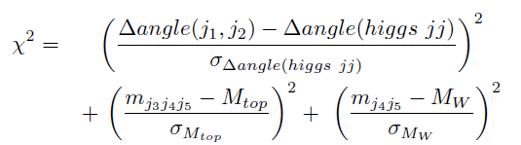



higgs and top pairing, χ2 Cut
Angle information between higgs
candidate jets is effective to choose
correct jet pair.
A W mass is reconstructed with
Isolated lepton and Missing P
try all combination and choose
a pair with minimum χ² value
require b likeness$≥$ 0.2 to j₁, j₂, j₃, j₆
Reference values are made
from reconstructed jets which are
matched with MC information
- Mtop = 171.5GeV
- sigma Mtop = 16.8 GeV
- MW = 80. 5GeV
- sigma MW = 9.9 GeV
- angle(jj) = 2.448
- sigma angle(jj) = 0.277
reject large χ² events
χ² $≤$ 16.5

Slide 30


Isolated Lepton Selection
Isolated Lepton
cosθ_{cone} = 0.98
E_{cone} < $\sqrt{6(Epfo−15)}$
Previous Definition
current lepton ID
muon selection
electron selection
tau (leptonic decay)
tau (hadronic decay)
muon selection
E_{PFO} with track > 9 GeV
Deposited energy in yoku >1.2 GeV
E_{HCAL}/E_{EMCAL} > 0.5
E_{CAL}/E_{PFO} < 0.5
E_{cone} < $\sqrt{6(EPFO−15)}$ (cosθ_{cone} = 0.98)
r0 < 0.02 mm

Slide 31

Isolated Lepton Selection
Isolated Lepton
cosθ_{cone} = 0.98
E_{cone} < $\sqrt{6(Epfo−15)}$
Previous Definition
current lepton ID
muon selection
electron selection
tau (leptonic decay)
tau (hadronic decay)
electron selection
E_{PFO} with track > 2 GeV
Deposited energy in yoku < 0.2
E_{HCAL}/E_{EMCAL} < 0.1
E_{cone} < $\sqrt{6(EPFO−15)}$ (cosθ_{cone} = 0.98)
r0 < 0.05 mm
or
r0 < 0.05 mm
E_{EMCAL} > 15 GeV
E_{HCAL}/E_{EMCAL} < 0.03
$\frac{\text{E}\text{cone}\text{(}\text{cos}\text{θ}\text{cone}\text{ = 0.9}\text{9}\text{) }}{\text{E}\text{cone}\text{(}\text{cos}\text{θ}\text{cone}\text{ = 0.98) }}>0.99$
E_{cone}(0.93 < $\text{cos}\text{θ}\text{cone}$< 0.98) < 2 GeV

Slide 32

Isolated Lepton Selection
Isolated Lepton
cosθ_{cone} = 0.98
E_{cone} < $\sqrt{6(Epfo−15)}$
Previous Definition
current lepton ID
muon selection
electron selection
tau (leptonic decay)
tau (hadronic decay)
tau (muon)
same as muon selection except r0 requirement → r0 > 0.02 mm
tau (electron)
E_{cone} < $\sqrt{6(EPFO−15)}$ (cosθ_{cone} = 0.98)
r0 >= 0.05 mm

Slide 33

Isolated Lepton Selection
Isolated Lepton
cosθ_{cone} = 0.98
E_{cone} < $\sqrt{6(Epfo−15)}$
Previous Definition
current lepton ID
muon selection
electron selection
tau (leptonic decay)
tau (hadronic decay)
hadronic tau selection
E_{PFO} with track >= 5 GeV
$\frac{\text{E}\text{cone}\text{(}\text{cos}\text{θ}\text{cone}\text{ = 0.99) }}{\text{E}\text{cone}\text{(}\text{cos}\text{θ}\text{cone}\text{ = 0.98) }}>0.8$
$\text{M}\text{cone}\text{(}\text{cos}\text{θ}\text{cone}\text{ = 0.99)}$ < 2 GeV
$\text{M}\text{cone}\text{(}\text{cos}\text{θ}\text{cone}\text{ = 0.9}\text{3)}$ < 2 GeV
no energetic(> 2 GeV) track in
0.93 < $\text{cos}\text{θ}\text{cone}$ < 0.99
1 or 3 tracks in $\text{cos}\text{θ}\text{cone}$ > 0.99
in hadronic tau category, purity of tau is ~80%.
There are ~10% contamination from electron and another ~10% comes from light flavor.

Slide 34

1.1 tth→ln+6jets number of signals after event selection
$\sqrt{s}$ = 500 GeV, Mh = 125 GeV, (Pe⁻,Pe⁺)=(-0.8,+0.3)
 | (Pe⁻,Pe⁺)=(-0.8,+0.3)
no cut | 61.3
only Iso Lep cut | 41.89
e | 16.2
mu | 17.6
tau | 7.2
after event selection | 10.6
e | 4.3
mu | 4.7
tau | 1.3

