Slide 1
Phase Monitor Electronics:
Output vs. Input Voltage in Both
Beam and Signal Generator Data
Jack Roberts

Slide 2
Overview
Revisiting tests of phase monitor electronics outputs vs. input power.
  (How) can we use the diodes?
  Is the response with beam the same as with the signal generator?
Comparison of the signal generator and beam method.
Mixer and diode vs. input voltage with both methods.

Slide 3
Signal Generator Tests
PhMon Electronics
SiS
Digitisers
LO
LO
IN
MIXER
OUT
Amplifier
Signal Generator
Amplifier
RF
IN
DIODE
OUT
Power Meter

Slide 4
Beam Tests
PhMon Electronics
SiS
Digitisers
LO
Amplifier
LO
IN
MIXER
OUT
Phase Monitor
Hybrid
Σ
Attenuator
RF
IN
DIODE
OUT

Slide 5
Comparison
BEAM
SIGNAL GENERATOR
Pulsed input (beam induced RF signal).
Vary input power by adding 0-20 dB additional attenuation on electronics input.
Beam input power with (with no additional attenuation) measured around 25 dBm in April.
  I have assumed this value is correct when calculating input voltages.
2nd monitor and set of electronics only.
Continuous output.
Create input with slight frequency offset wrt LO to give oscillating output.
  Also see cross-talk on diode.
Vary input power using signal generator (and measured on power meter) between 0 and 33 dBm.
All three monitors + electronics.
NB: Upstream monitors (1 and 2) have a 20 dB attenuator that could be removed to give up to 45 dBm input power.

Slide 6
Expected Dependence on Input Power
Mixer ~= A*sin(phi)
Diode ~= A^2
A = input voltage.
sin(phi) ~= Mixer/sqrt(Diode)

Slide 7
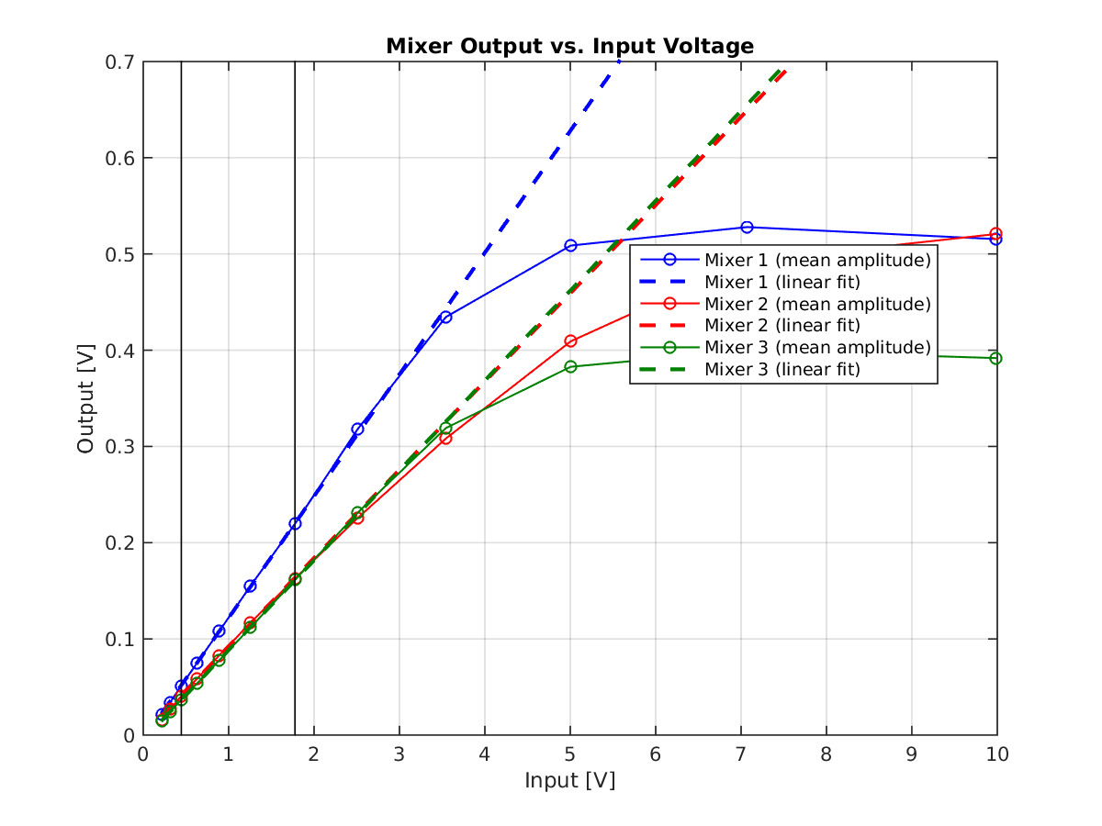
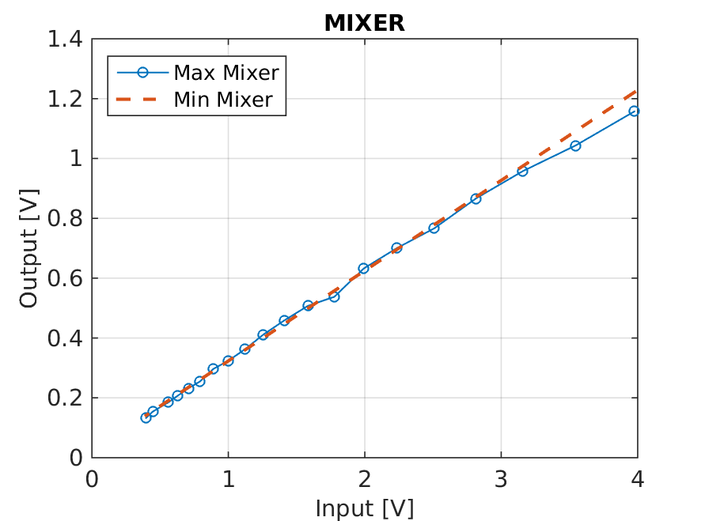
Max(Mixer) vs. Input Voltage
SIGNAL GENERATOR
BEAM (Mon2)

Slide 8
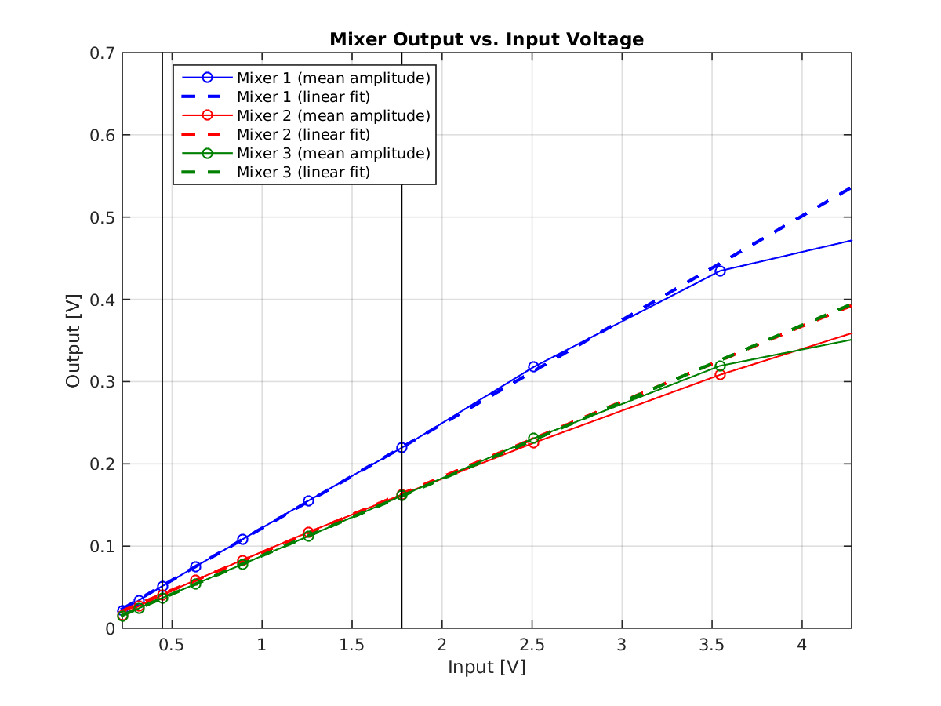
Max(Mixer) vs. Input Voltage (zoom)
SIGNAL GENERATOR
BEAM (Mon2)
Expected linear behaviour up until saturation starts to appear ~3.5 V. Response in two methods looks similar.

Slide 9
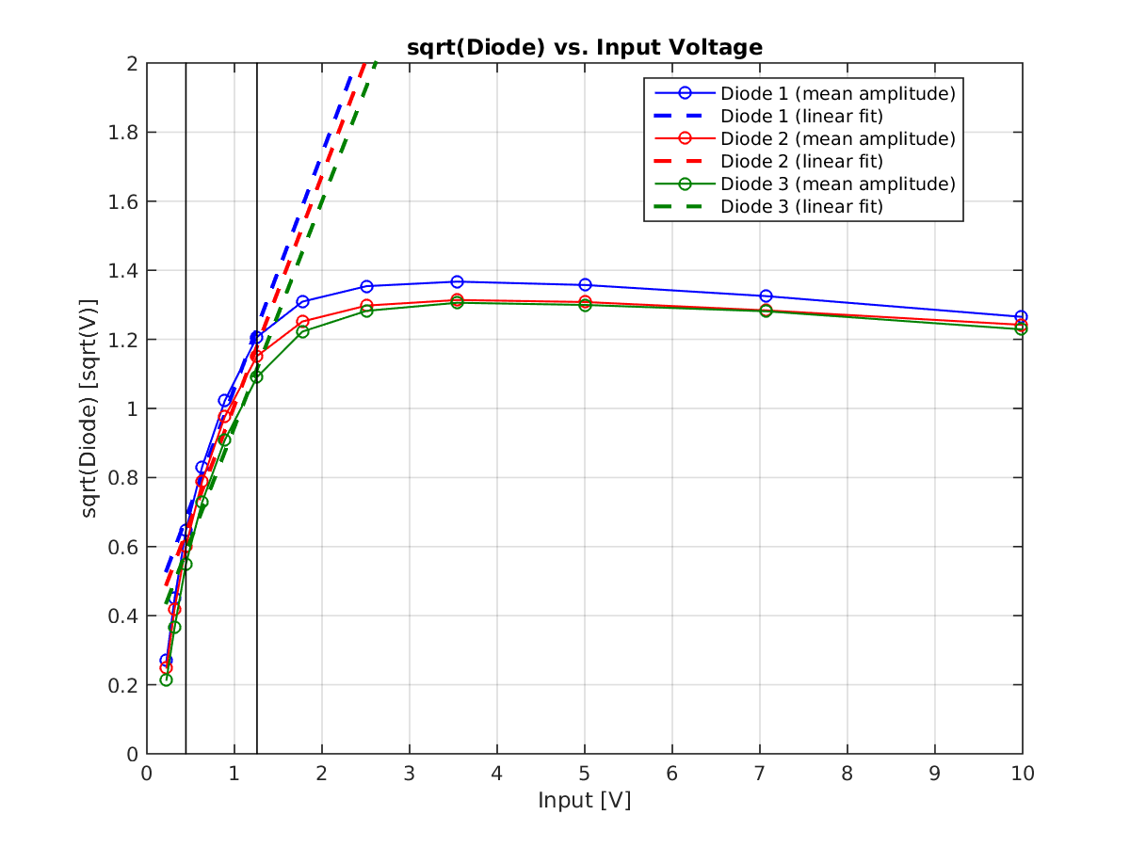
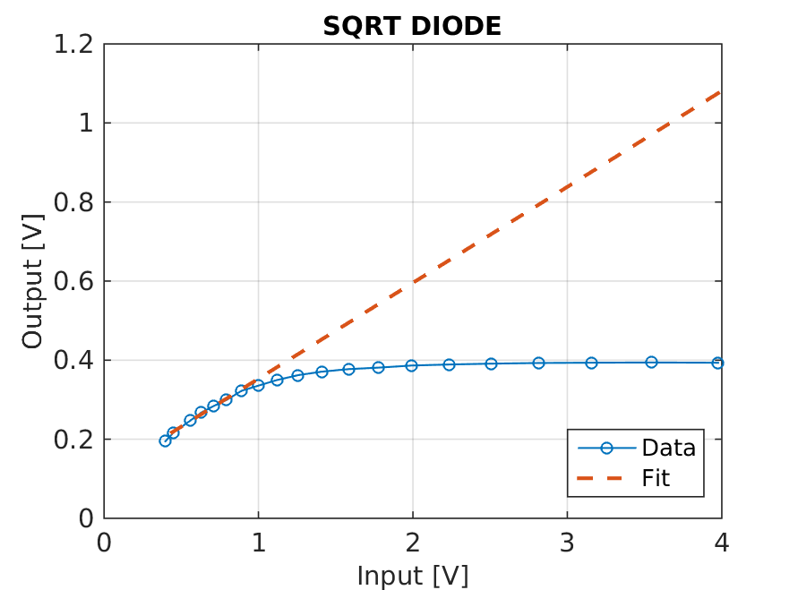
Sqrt(Diode) vs. Input Voltage
SIGNAL GENERATOR
BEAM (Mon2)
Saturation starts much earlier, around 1 V compared to 3.5 V on Mixer. If anything appears earlier in the beam tests.

Slide 10
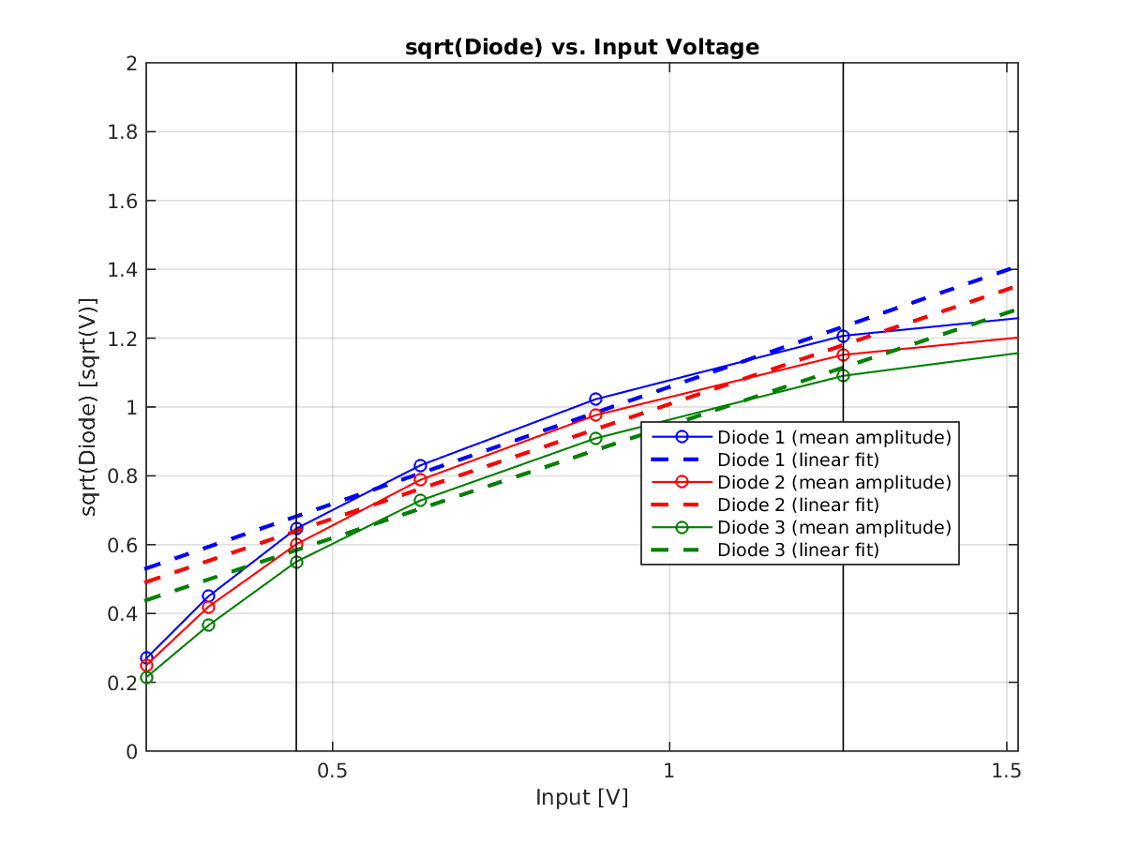
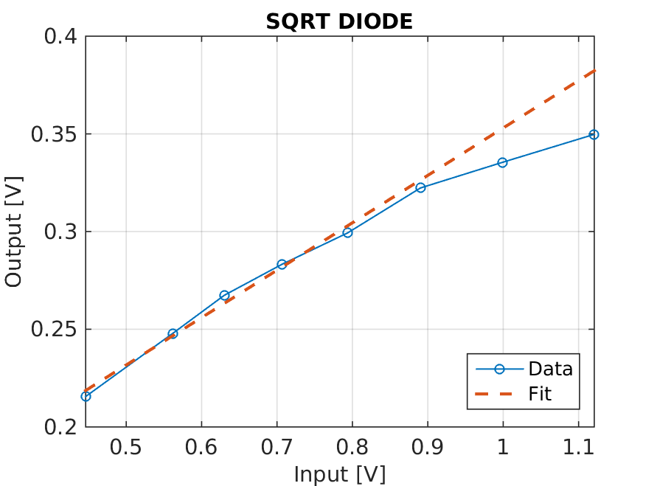
Sqrt(Diode) vs. Input Voltage (zoom)
SIGNAL GENERATOR
BEAM (Mon2)
Agreement with expected square law dependence not great (most visible in signal generator).

Slide 11
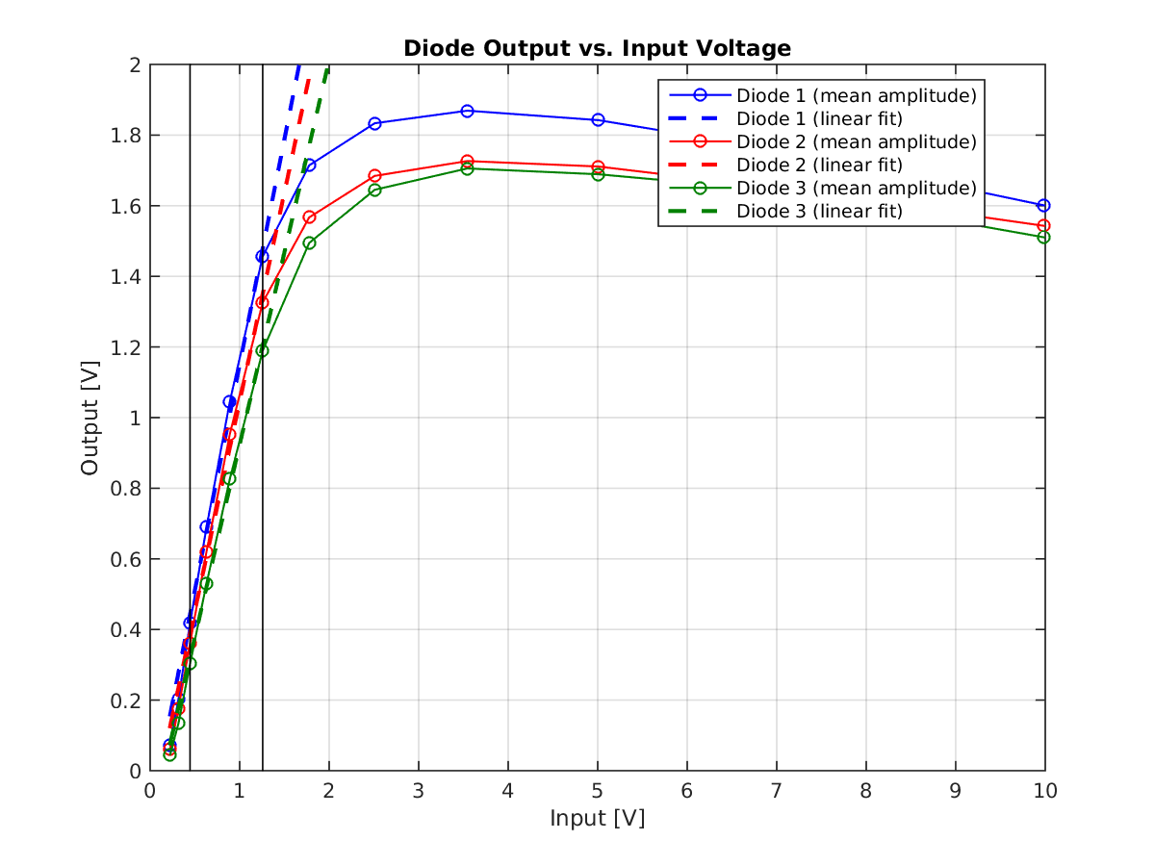
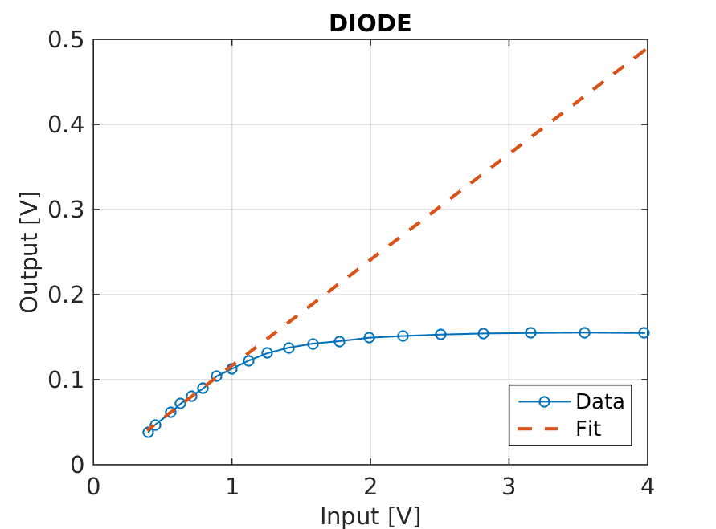
Diode vs. Input Voltage
SIGNAL GENERATOR
BEAM (Mon2)
Maybe response is linear wrt input voltage?

Slide 12
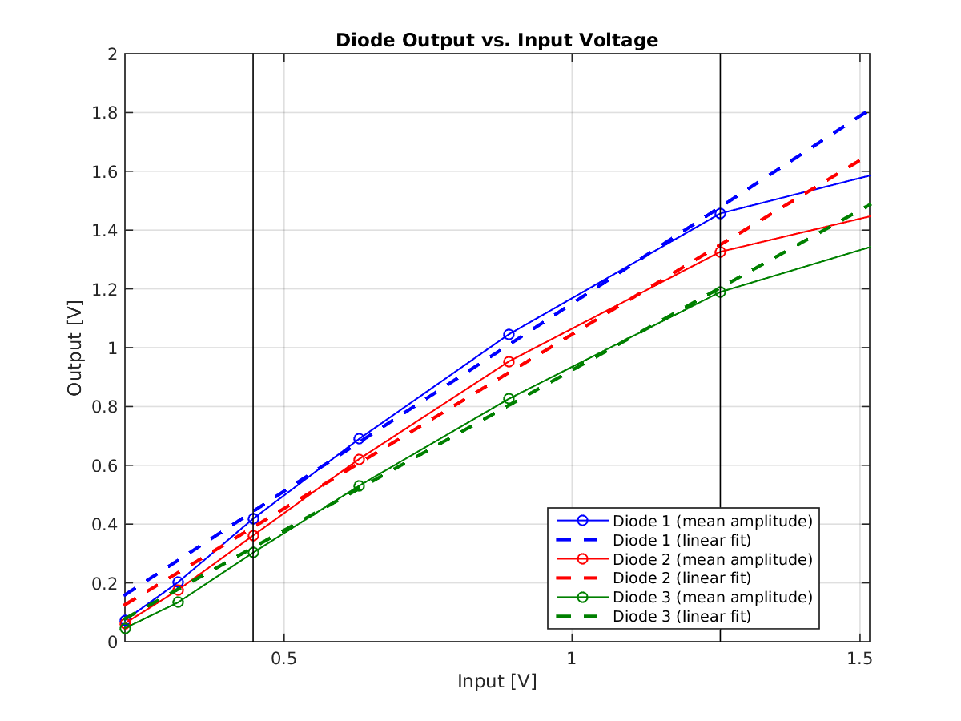
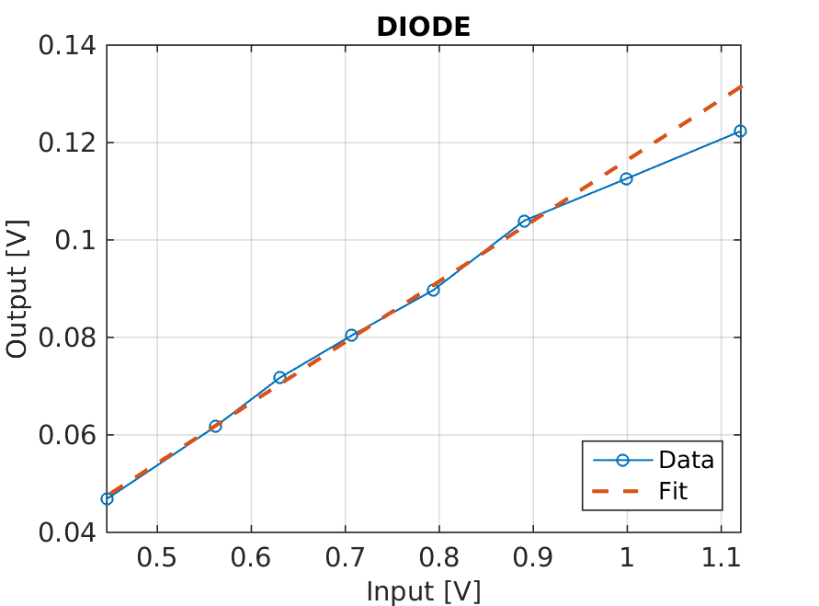
Diode vs. Input Voltage (zoom)
SIGNAL GENERATOR
BEAM (Mon2)
Fit is definitely better than for sqrt(Diode).

Slide 13
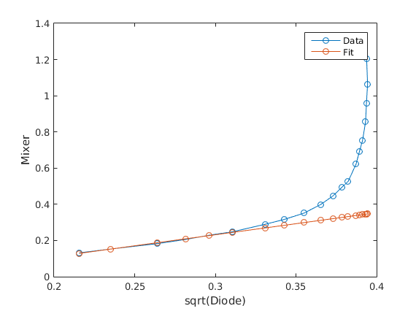
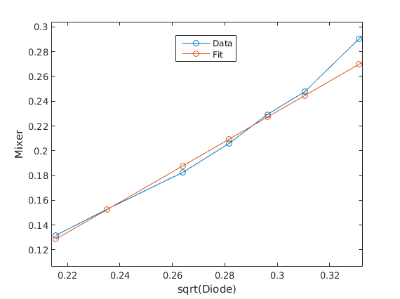
Mixer vs. sqrt(Diode)
Relationship that really matters for reconstructing the phase!
Using beam: Blue=data, Red=fit
Zoom
Better fit with Diode than sqrt(Diode) more apparent plotted in this way.

Slide 14
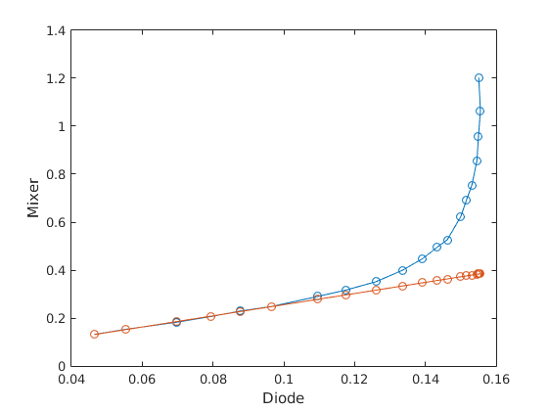
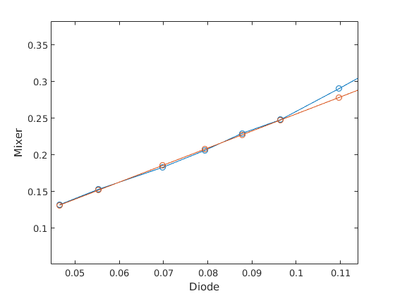
Mixer vs. Diode
Relationship that really matters for reconstructing the phase!
Using beam: Blue=data, Red=fit
Zoom
Better fit with Diode than sqrt(Diode) more apparent plotted in this way.

Slide 15
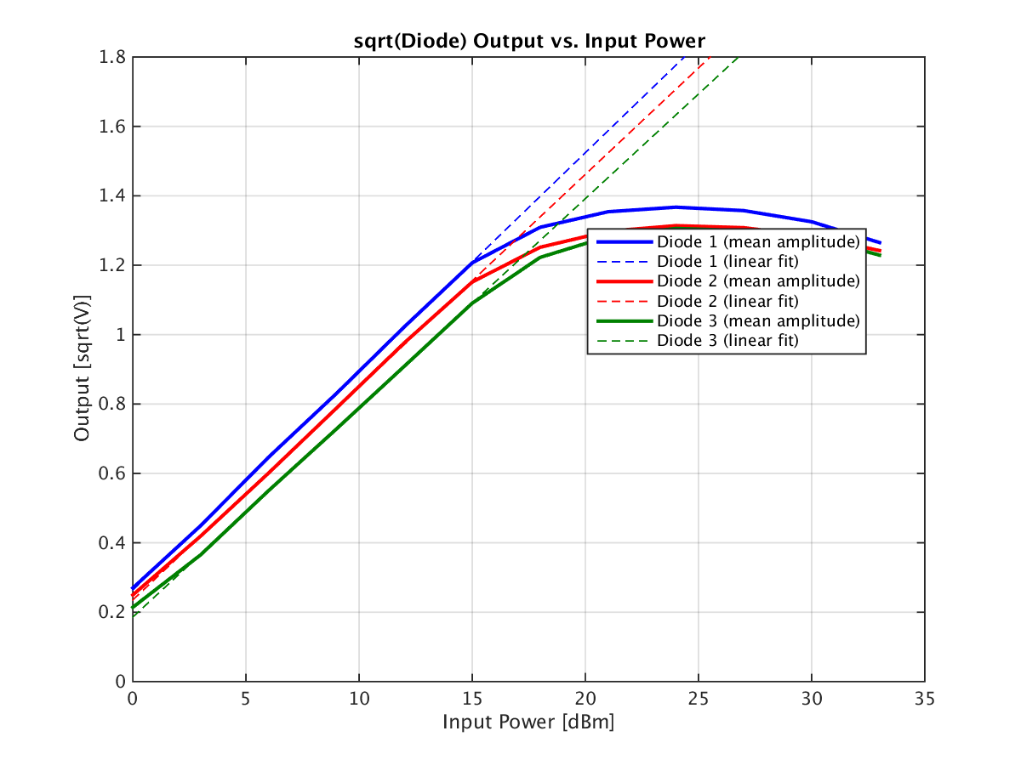
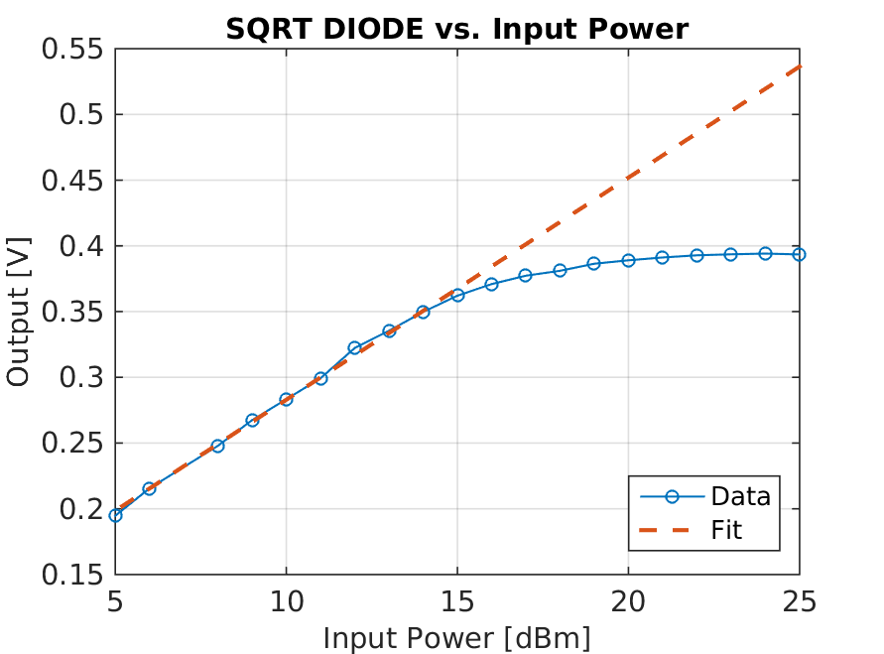
Sqrt(Diode) vs. Power in dBm
Relationship that I noticed whilst doing the original signal generator analysis.

Slide 16
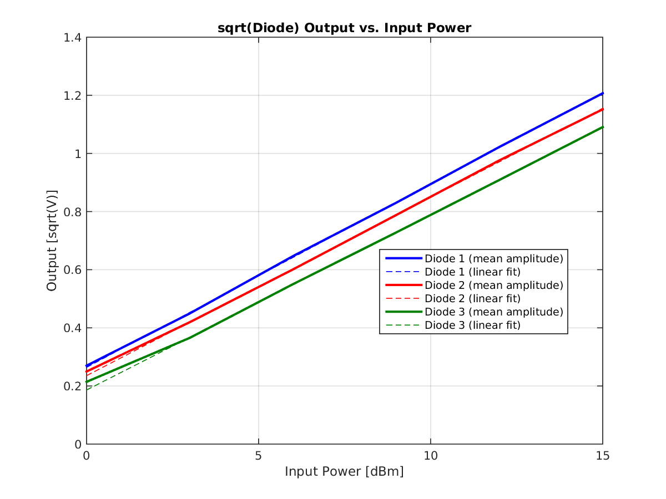
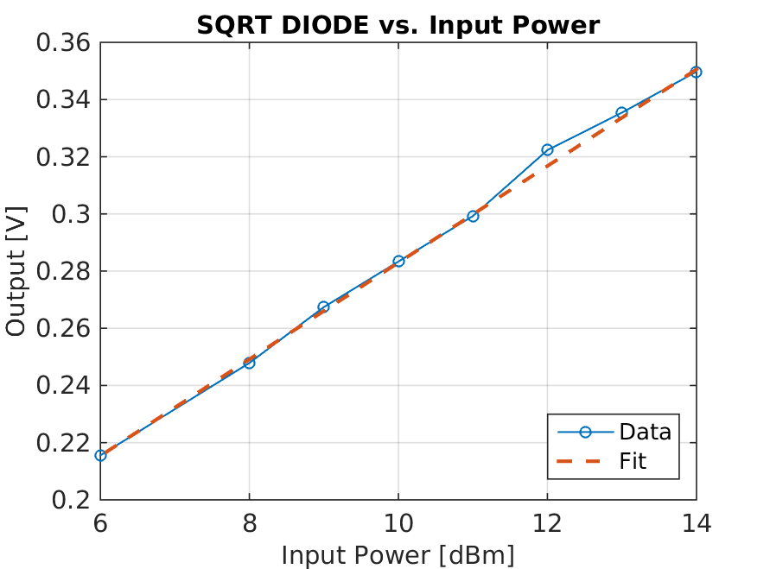
Sqrt(Diode) vs. Power in dBm (zoom)
Relationship that I noticed whilst doing the original signal generator analysis.

Slide 17
Summary
To me the results with the signal generator and the beam look more or less consistent with each other.
Mixer saturation starts around 3.5 V (24 dBm), diode around 1 V (13 dBm).
  After the beam tests (on the same day) I added 10 dB attenuation to the phase monitor electronics. Assuming measurement of input power in April is still valid, means input power (upstream) is now about 14 dBm.
  Note in my log book that resolution did not seem to be affected by doing this.
Diode output vs. input voltage is more linear than sqrt(Diode). sqrt(diode) vs. Power [dBm] also gives a linear response.

