Slide 1
  Staging Discussions and TCMB
  Benno List, DESY
  ILC at DESY General Project Meeting
  5.5.2017

Slide 2
Mini Workshop in Japan
3 Day Mini-Workshop at KEK (https://kds.kek.jp/indico/event/24127/)
2 Days discussions of WG1 (Positron Source) 2 (CFS), 3 (Cost)
Friday: Summary Session with Lyn Evans

Slide 3
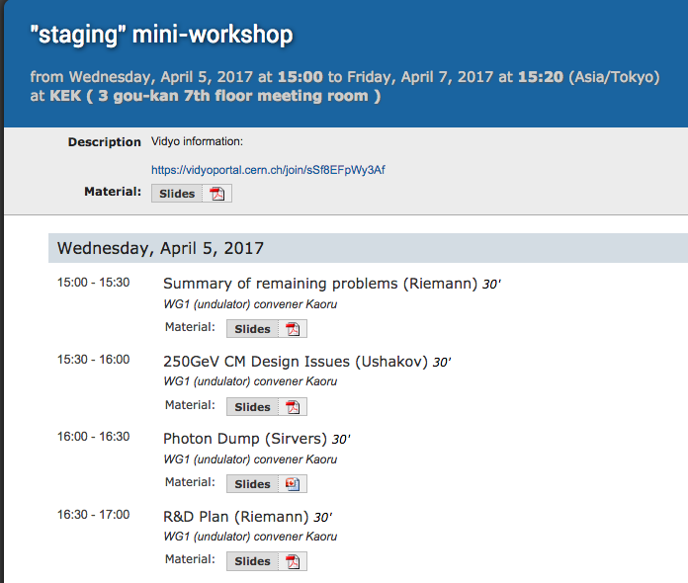
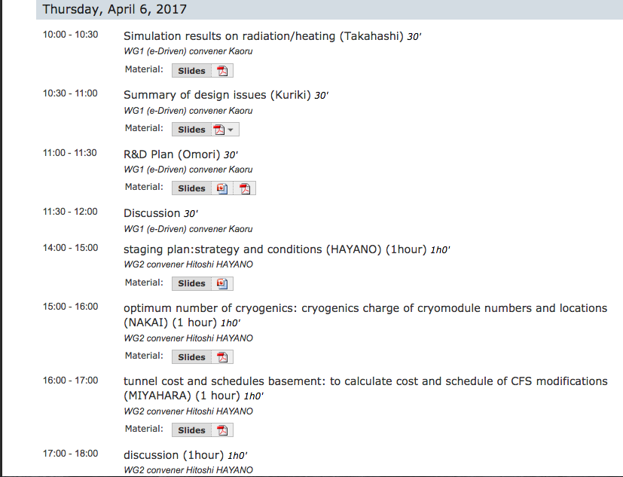
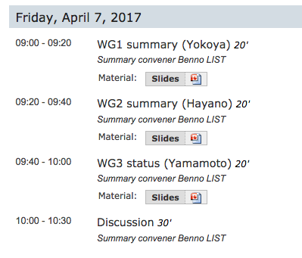

Slide 4

Some Impressions
”Staging is Coming” is our new Motto
Lyn reported from meeting with Diet Members: Staging is game-changer, MEXT is getting much more positive
The “FCC Shock” (incl. CEPC Shock) is wearing off:
an affordable ILC (at 250GeV) may be useful after all
Lyn says that we should not offer more cost reduction than necessary (~30%)
-> empty (500GeV) tunnel is not (yet) dead

Slide 5
The Plan (?)
Have a plan (with a cost) for ICFA meeting in August
Some agreement that
  ILC is still an international, i.e. LCC, enterprise
  LCC talks primarily to ICFA or maybe FALC, MEXT comes second
  We want to have one proposal
  We do not hand MEXT a menu of configurations to choose one (the cheapest) from
AWLC2017 is the time to discuss our options and unite behind one plan

Slide 6

Slides from Kaoru Yokoya (WG1, Positron Source)
Main message: KEK wants to complete e driven activities in JFY (Japanese Fiscal Year, April-March) 2017
From JFY2018 on, KEK wants to concentrate on undulator source
Are the source wars over?

Slide 7
Positron Summary
Undulator
e-Driven
K. Yokoya
2017.4.7 Staging Mini-WS, KEK

Slide 8
Draft plan for initial discussions about activities in JFY 2017 and 2018-19
2017: mainly simulations & specifications
  Undulator parameters (0.5MY)
  Realistic temperature and stress distribution (1Y – Eng + Phys)
    In particular: Contact target material to radiator
  Start wheel design
    Plan the Lab test of radiative cooling
    Initialize collaboration with external institutions (dynamic response , vibrations, bearings, …)
  Start revisiting FC
2018-19
  Continue wheel design
    Lab test of radiative cooling (in total 1Y, Eng+Tech, ≤100k$)
    Feasibility study for rotating wheel
      dynamic response, vibrations, …; prepare manufacturing (≤2.5MY, 100k$)
      Magnetic bearings (performance specification, vacuum, …) (<1MY, 50k$)
      Perform the feasibility study (<1MY, 50k$)
      Lab test, validation of wheel (1 MY+ Eng.+ Techn, 100k$)
  FC (in total 1-1.5 MY)
>2019: start prototyping of target wheel + FC (design, manufacturing and test) – most likely beyond 2019

Slide 9
Discussion/Question Issues
Beam loading flexibility for different bunch patterns (Benno, Okugi)
Transient beam loading compensation of SW multi-cell NC cavity (Okugi)
  Large difference from single-cell model for large beta
Need to know the tolerance of bunch-by-bunch population fluctuation

Slide 10
R&D Plan (1)
Target
  JPY 2017 (150k$)
    Full size prototype 128k$
      real size & weight, no tungsten, no water
    Ion pump, Ti pump etc 22k$
    The vacuum test of the central part is on going now at 225rpm (design speed). We already run 1.5 months.
    Need full size/weight and vacuum for mechanical stability study
  After green light
    W+Cu brazing test
    Full size Cu disk with water circuit (cavitation, water leak)
    Full size prototype with water circuit and W-rim
    Heating test
    These are O(1M$)
Omori

Slide 11
R&D Plan (2)
FC
  Design study with water cooling.
    Can the peak field be reduced?
  Prototyping can be done after the green light.
Capture Cavity
  Design study with water cooling.
  Prototyping can be done after the green light.
Radiation Issues
  Need to start evaluate radiation issues
Remote handling

Slide 12
Slides from Akira Yamamoto (WG3, Costs)

Slide 13
WG3: Resource Optimization
Working Status
Akira Yamamoto
To be reported at the KEK-ILC Mini-workshop, April 7, 2017

Slide 14
WG3 Charges
Justification of Cost Reduction with SRF R&D
  A1: Nb material
  A2: High-Q and High-G
  A3: Power input coupler
  A4: VEP with safer solution
Optimization of Resource
  Human resource study for further optimization
    Necessary partial trade b/w “Person-hours” and “Value”
  Staging Study from a resource optimization

Slide 15
Goals of Cost-Reduction w/ SRF R&D
A1 : Nb-material w/lower RRR and Ingot-slice
  Cost-down to be a half price, resulting - 2~3 % to total cost.
    RRR to be 250 (+/- 50), allowing more Ta (or some residual)
    Grain-size to be relaxed/larger
    Ingot-sliced disks for forming half-cell cavities
    Issue: mechanical property to satisfy high-pressure code
A2: High-Q and High-G,w / 10% higher G, twice Q
  Cost-down, resulting - 8~9% to total
    - 10 % Cryomodules, w/ <G> = 35 MV/m @ <Q> 1.6 E10 (+/- 20%)
    - 10 % tunnel length (or to be reserved for redundancy/)
    - 30 % Cryogenics load down to be further evaluated
    Issue: - ?% Surface process reduction (2nd EP etc)
    Issue: + ?% RF power system to keep beam-pulse duty, to be unchanged

Slide 16
WG3 Organization
Core members:
  S. Michizono, B. List, and A. Yamamoto
Individual task-force members
  Cost Reduction SRF R&D
    A1 (Nb material): Core + A1 task force members
    A2 (High-Q, -G) : Core + A2 task force member
  Resource optimization for Staging
    WG3 (Core) + WG1 + WG2, depending on themes

Slide 17
Short-Term Goals (by ALCW-2017)
Cost Reduction for SRF R&D
  Consensus for the strategy
  Overall cost reduction fraction to be agreed
Human resource optimization
  Reduction fraction for
    Cavity and CM qualification/performance Test
    ML Installation

Slide 18
Preliminary Cost Estimate for the ILC Staging with 250GeV
Rev. 170205
 | e-/e [GeV] | Tunnel [GeV] | Value Fraction CFS* [GILCU] | Value Fraction SRF [GILCU] | Value Fraction Others** [GILCU] | Value Total (GILCU] (Oku-JY) | Value Total [%] | Reduct. [%] | Cost- Red. R&D Effect [%] | Total Impact to Reduction [mid. %] | Human resources (M p-hr)&(%)
TDR | 250/250 | 500 |  |  |  |  |  |  | - 11.9 % - (13.5-1.6#)
TDR updated | 250/250 |  |  |  |  |  |  |  | - 11.9 % - (13.5-1.6)
Opt. F | 125/125 | 500
Opt. E | 125/125 | 500 |  |  |  |  |  |  | - 5.5 % - (6.25 -0.8)
Opt. D | 125/125 | 500 |  |  |  |  |  |  | - 5.5 % - (6.25 -0.8)
Opt. C | 125/125 | 250 |  |  |  |  |  |  | - 5.5 % - (6.25 -0.8)
*) CFS total cost (including the main campus land/surface and buildings) to be confirmed. ** )Both effects of additional undulator (80 m) for e+ yield and some fraction of common category to ML are included. Effect of HE beam transport addition (+α), and RTML transport-line reduction effect ( −β) to be further evaluated. # ) Tunnel length reduction because of the high-G not to be taken, in order to keep reasonable contingency (1.6 % for full 250 GeV and 0.8% for 125 GeV.
WG2
WG1
WG3
WG3
TDR:
250 GeV e-
250 GeV e+
Option F:
125GeV e-
125GeV e+
Option E:
125GeV e-
125GeV e+
Option D:
125GeV e-
125GeV e+
125GeV e-
125GeV e+
Simple tunnel
Option C:

Slide 19
Some Slides By Hitoshi Hayano for WG2 (CFS)
Slides are similar to Summary of KEK workshop, but updated for WG2 meeting on May 4

Slide 20
ILC-configuration and conditions to be considered for staging
Conditions & cryomodule distribution for staging; v6
H. Hayano, 05042017 LCC/ILC-WG2

Slide 21
staging option name （given ｂｙ S. Michizono, 02052017）
350GeV option were added
500GeV
TDR:
250 GeV e-
250 GeV e+
250 GeV
125GeV e-
125GeV e+
Option C:
Option D:
125GeV e-
125GeV e+
350GeV Option D’:
Simple tunnel
(no center wall, no facilities)
Simple tunnel (no center wall, no facilities)
Option E:
125GeV e-
125GeV e+
350GeV Option E’:
Option F:
125GeV e- sparse linac
125GeV e+ sparse linac
350GeV Option F’:

Slide 22
How to estimate the cost of each option
TDR cost
Subtract cost reduction of
2014-2016 TDR cost reduction and design change
Now we are working on
Decide working assumptions,
and cryomodule configuration,
tunnel configuration.
Subtract cost reduction of each staging option
Estimation of cost for each staging option
in case of 31.5MV/m
Subtract cost reduction by change of 31.5MV/m to 35MV/m, assuming success of 35MV/m Q₀=1.6x10¹⁰ SRF HG,HQ
Estimation of cost for each staging option
in case of 35MV/m

Slide 23
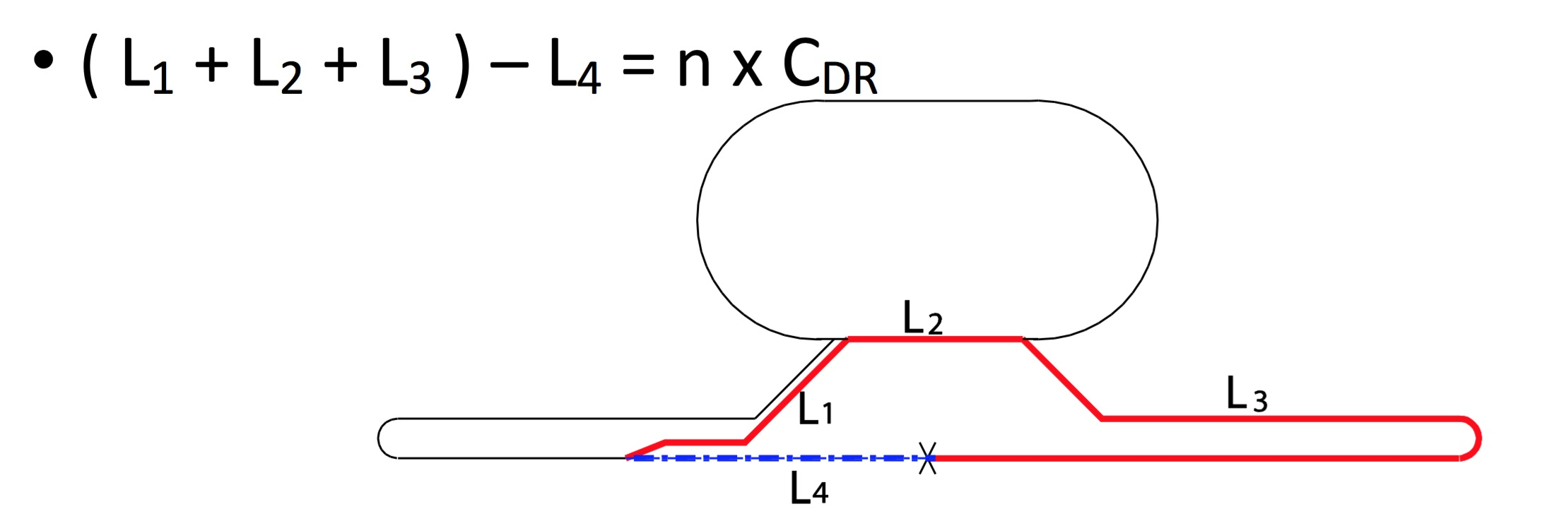
Working assumption (1)
(1) TDR-undulator-based positron is kept in this study.
The length of undulator is streched to 230m from 147m with 125GeV beam.
(2) Collision timing adjustment is put aside, for a while, even though accepted by CR.
(1.5km stretching in each linac is put aside.)
collision condition
C_{DR}=3238.68m
in TDR(Ecm=500GeV), this equation become as follows (not good);
CR is to adopt n=10;
(L₁ + L₂ + L₃’) - L₄ = 10 x C_{DR}
and putting 1473m space in both LINAC
(2) Considering collision timing adjustment,
option C = remove length between PM+10 and PM+12, and add 49.78m at around B.C.
option D = simple tunnel of length (6477m),
option D’ = simple tunnel of length (3238m),

Slide 24
collision condition
C_{DR}=3238.68m
In TDR(Ecm=500GeV), this equation is not satisfied as follows ( additional 294m);
Change Request is to adopt n=10;
(L₁ + L₂ + L₃’) - L₄ = 10 x C_{DR}
and putting 1473m space in both LINAC
In Option-C(Ecm=250GeV), required Linac length become half, we adopt n=6
put 49.78m at BC area.
remove 1473m,
294/2m
remove L _{(PM+10 – PM+12)} = 4907.8m
(-294/2m -1473m - 4907.8m + 49.78m) x 2 = -12956.04m = - 4 x C_{DR}
L₃ is shortened by 4 x C_{DR} , LINAC length is shortened by 6478.02m

Slide 25
For option-D(prepare Ecm=500GeV)
By filling RF unit in all space available in Option-C(Ecm=250GeV, n=6),
in case of 31.5MV/m energy reach will be 147.7GeV,
to reach 500GeV Ecm +2%margin(255GeV), 107.3GeV = 84 RFunit =4897.2m (required tunnel length)
Δn=4 (n=10), +6477m required
in case of 35MV/m energy reach will be 162.4GeV,
to reach 500GeV Ecm +2%margin(255GeV), 92.6GeV = 66 RFunit =3847.8m (required tunnel length)
Δn=3 (n=9) +4858m required
For option-D’(prepare Ecm=350GeV)
By filling RF unit in all space available in Option-C(Ecm=250GeV, n=6),
in case of 31.5MV/m energy reach will be 147.7GeV,
to reach 350GeV Ecm +6%margin(185.5GeV), 37.8GeV = 30 RFunit =1749m (required tunnel length)
Δn=2 (n=8), +3238m required
in case of 35MV/m energy reach will be 162.4GeV,
to reach 350GeV Ecm +6%margin(185.5GeV), 23.1GeV = 18 RFunit =1049.4m (required tunnel length)
Δn=1 (n=7), +1619m required

Slide 26
Working assumption (2)
(3) Linac central wall is 1.5m thick. Total width of Linac tunnel is 9.5m.
(4) Adopt CR0009 and CR0014 for cryogenics. The access hall is re-considered
with this design change. Angle cross with Linac tunnel and access tunnel
for cryomodule carry in, is considered.
(5) Two Vertical shaft access to detector hall is assumed.
(6) Number of beam dump and power of them proposed by Yokoya are adopted.
(7) Design change of positron side BDS tunnel and injector-linac position are adopted.
(8) Remove access tunnels at turn-around (PM-13 and PM+13) of TDR tunnel,
not for staging tunnel.
(9) One water-drain-tunnel is considered in the collision point, not at PM-13/PM+13.
(10) Only 5Hz Linac operation is considered (not 10Hz).

Slide 27
Working assumption (3)
(11) Maximum cryo-line length of one cryogenics is 2.5km+/-10%, the same as TDR.
(12) Stand-by module is around 2%, the same as TDR.
(12) Keep Energy Reach Margin enough safe to reach target.
(1) Module margin : margin to reach the target energy of the target experiment (0% in TDR)
2.5% module margin(3.1GeV each) for Ecm=250GeV
(2) Availability margin : margin to compensate cryomodule trip (1.5% in TDR, ~3 RF unit trip )
Ecm=250GeV; 3 RF unit correspond to 3%
(3) Space margin : cryomodule space to be installed more cryomodule in future.
*Anytime 0.5% is required in the operation with cavity phase offset.
margin total: 2% for Ecm=500GeV
6% for Ecm=250GeV

Slide 28
Working assumption (4)
(13) In case of HG,HQ R&D success;
HG HQ upgrade :from 31.5MV/m Q0=1E10 → 35MV/m Q0=1.6E10 by N-infusion.
Same RF unit configuration, but increase of klystron output to 11MW.
Consider decrease of number of RF unit for 35MV/m.
The length of tunnel is adjusted according to number of RF unit, but with a margin.
(14) Simple tunnel means: normal wall finish, but no central shield wall, no air-condition,
no AC power line, no cooling water line, but water drain installed.
(15) Digging tunnel during accelerator operation without serious interference.

Slide 29
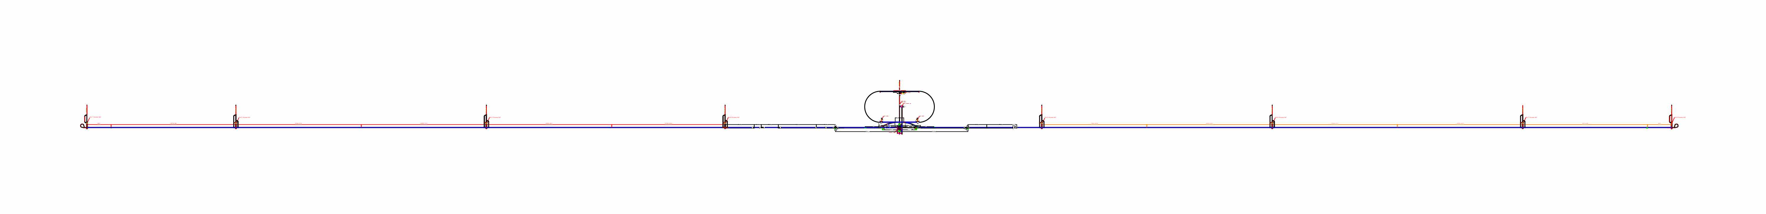
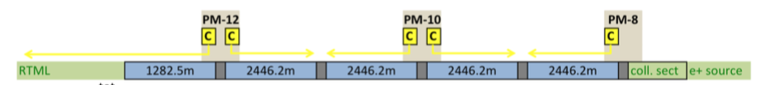
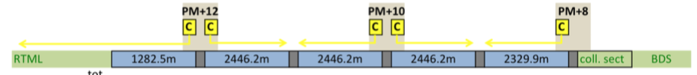
TDR
Ecm = 500GeV
SRF 31.5MV/m
1473m
1473m
129.3m
2509.7m
4907.8m
4911.6m
3413.8m
2334.9m
4795.2m
4907.8m
2509.7m
129.3m
PM-13
PM-12
PM-10
PM-8
PM+8
PM+10
PM+12
PM+13
IR
BC
Ecm=500GeV
BC
99
189
189
189
189
e+inj
cryomodules
e-inj
180
189
189
189
99
51
51
24
24
17
22
42
42
42
42
8
RF unit
8
40
42
42
42
22
17
10.0
28.1
53.6
53.6
53.6
53.6
5.0
E gain (GeV)
5.0
51.0
53.6
53.6
53.6
28.1
10.0
Total length of tunnel = 15872.2m+14676.9m+1473m+1473m=33495m
Cavity active length = 1.0385m
Energy gain by 1 cavity = 31.5*1.0385 = 32.7 MeV
Energy gain by 1 RF unit = 32.7 MeV * 39 =1.2753 GeV
length of 1 RF unit = 58.3m

Slide 30
Parameters for staging estimation
SRF 31.5MV/m
SRF 35MV/m
Cavity active length = 1.0385m
Energy gain by 1 cavity = 31.5*1.0385 = 32.7 MeV
Energy gain by 1 RF unit = 32.7 MeV * 39 =1.2753 GeV
length of 1 RF unit = 58.3m
Cavity active length = 1.0385m
Energy gain by 1 cavity = 35.0*1.0385 = 36.3 MeV
Energy gain by 1 RF unit = 36.3 MeV * 39 =1.418 GeV
length of 1 RF unit = 58.3m

Slide 31
LINAC configurations for each staging option
(number of RF unit, length of tunnel are considered for each option.)

Slide 32
Option C

Slide 33
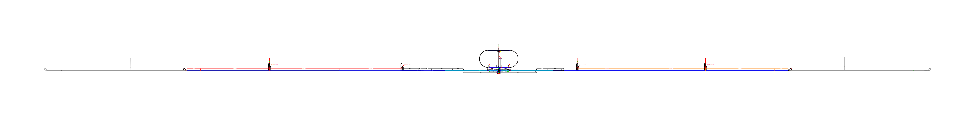
Option C
ECM=250GeV
SRF 31.5MV/m
2735.2m
4911.6m
3413.8m
2334.9m
4795.2m
2735.2m
PM-12
PM-10
PM-8
PM+8
PM+10
PM+12
49.78m space
(PM-0)drain tunnel
49.78m space
IR
BC
700m space
Ecm=250GeV
700m space
BC
e+inj
e-inj
51
99
189
189
24
module space
24
180
189
99
51
51
99
162
162
24
cryomodules
24
153
162
99
51
17
22
36
36
8
RF unit
8
34
36
22
17
e⁻ 134.9GeV =
10.0
28.1
45.9
45.9
5.0
E gain (GeV)
5.0
43.3
45.9
28.1
10.0
= e⁺ 132.3GeV
+5.8%margin
Total tunnel length = 20925.9m
(20.9km)
Required length for 250GeV Ecm collision at IP
for option C

Slide 34
Option C
ECM=250GeV
SRF 35MV/m
2735.2m
4911.6m
3413.8m
2334.9m
4795.2m
2735.2m
PM-12
PM-10
PM-8
PM+8
PM+10
PM+12
49.78m space
(PM-0)drain tunnel
49.78m space
IR
BC
1166m space
Ecm=250GeV
1166m space
BC
e+inj
e-inj
51
99
189
189
24
module space
24
180
189
99
51
51
99
144
144
24
cryomodules
24
135
144
99
51
17
22
32
32
8
RF unit
8
30
32
22
17
e⁻ 137.0GeV =
10.0
31.2
45.4
45.4
5.0
E gain (GeV)
5.0
42.5
45.4
31.2
10.0
= e⁺ 134.1GeV
+7.3%margin
Total tunnel length = 20925.9m
(20.9km)

Slide 35
Option D

Slide 37
Conclusions

Slide 40
Conclusions
Staging discussion is in going on
Japan studies a large set of options
Some questions about that:
  Minimal (250GeV) tunnel, or empty tunnel for 500 GeV?
  Intermediate 350GeV stage?
  Can one have a lumi upgrade with more cryogenics?
There is still a possibility to give input to these considerations
The basic problem:
Find the right balance between overall cost and physics potential
We fight a two front battle: funding agencies and competing projects
Japan favours the least expensive option, but they recognize the need to have viable upgrade paths

