Slide 1
CLIC Status and Outlook
October 2012
Covering:
The CLIC accelerator studies
  Feasibility studies and Performance studies
  Documented in volume 1 of the CDR
CLIC detector and physics studies
  Documented in volume 2 and 3 of the CDR
Project implementation studies
  Including timelines and programme for the coming years
  Mainly documented in volume 3
Summary

Slide 2


























Current CLIC&CTF3 Collaboration
CLIC multi-lateral collaboration - 44 Institutes from 22 countries
ACAS (Australia)
Aarhus University (Denmark)
Ankara University (Turkey)
Argonne National Laboratory (USA)
Athens University (Greece)
BINP (Russia)
CERN
CIEMAT (Spain)
Cockcroft Institute (UK)
ETH Zurich (Switzerland)
FNAL (USA)
Gazi Universities (Turkey)
Helsinki Institute of Physics (Finland)
IAP (Russia)
IAP NASU (Ukraine)
IHEP (China)
INFN / LNF (Italy)
Instituto de Fisica Corpuscular (Spain)
IRFU / Saclay (France)
Jefferson Lab (USA)
John Adams Institute/Oxford (UK)
Joint Institute for Power and Nuclear Research SOSNY /Minsk (Belarus)
John Adams Institute/RHUL (UK)
JINR (Russia)
Karlsruhe University (Germany)
KEK (Japan)
LAL / Orsay (France)
LAPP / ESIA (France)
NIKHEF/Amsterdam (Netherland)
NCP (Pakistan)
North-West. Univ. Illinois (USA)
Patras University (Greece)
Polytech. Univ. of Catalonia (Spain)
PSI (Switzerland)
RAL (UK)
RRCAT / Indore (India)
SLAC (USA)
Sincrotrone Trieste/ELETTRA (Italy)
Thrace University (Greece)
Tsinghua University (China)
University of Oslo (Norway)
University of Vigo (Spain)
Uppsala University (Sweden)
UCSC SCIPP (USA)

Slide 3
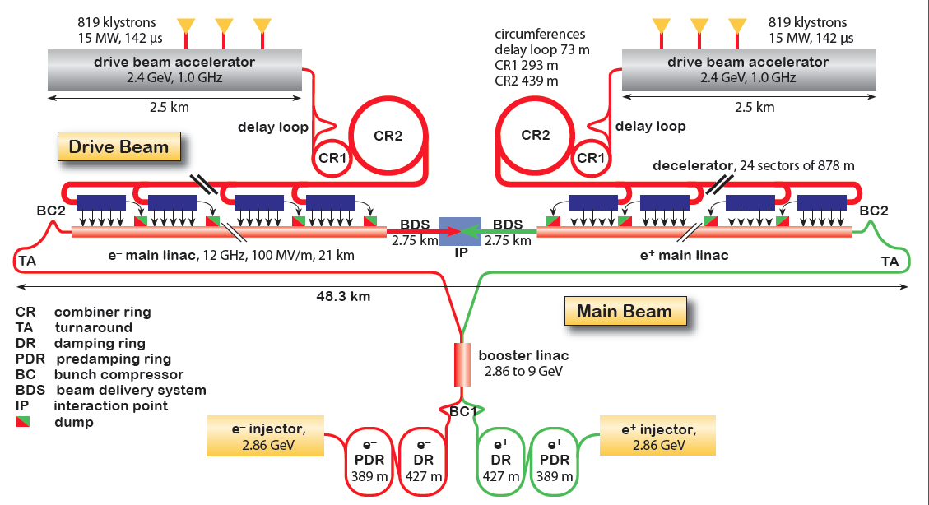
CLIC Layout at 3 TeV
Drive Beam Generation Complex
Drive beam time structure - initial
Drive beam time structure - final
240 ns
240 ns
5.8 μs
140 μs train length - 24 × 24 sub-pulses
4.2 A - 2.4 GeV – 60 cm between bunches
24 pulses – 101 A – 2.5 cm between bunches
Main Beam Generation Complex

Slide 4
CLIC Main Parameters

Slide 5
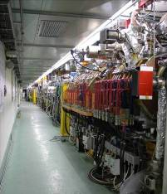
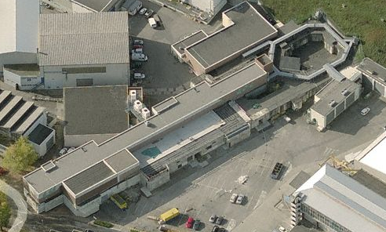
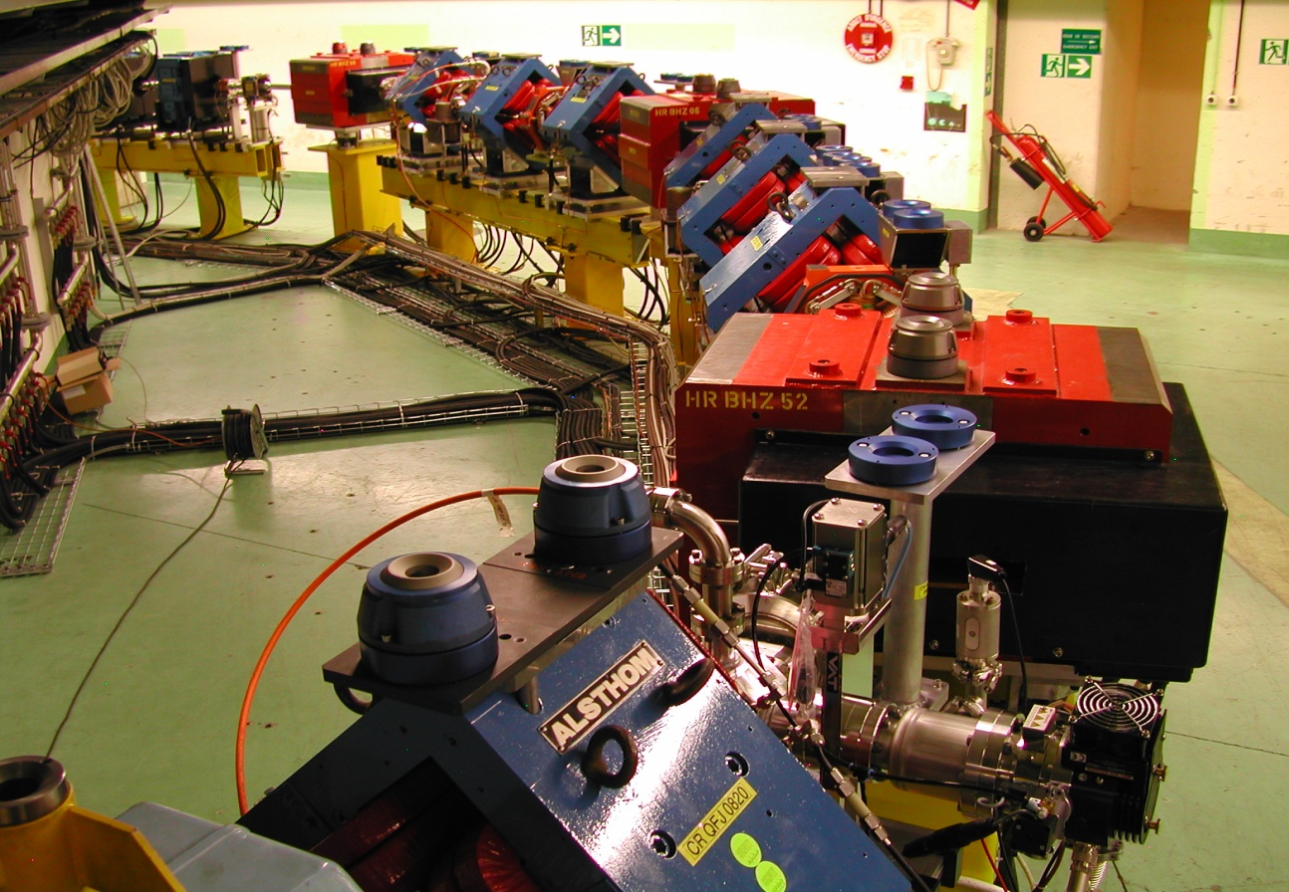
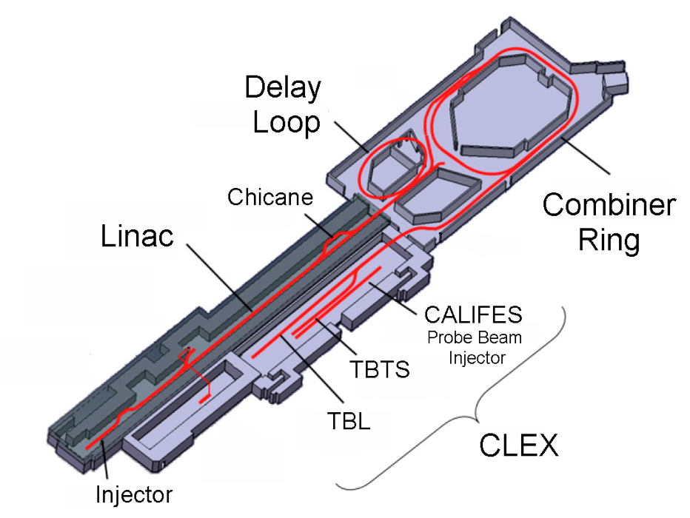
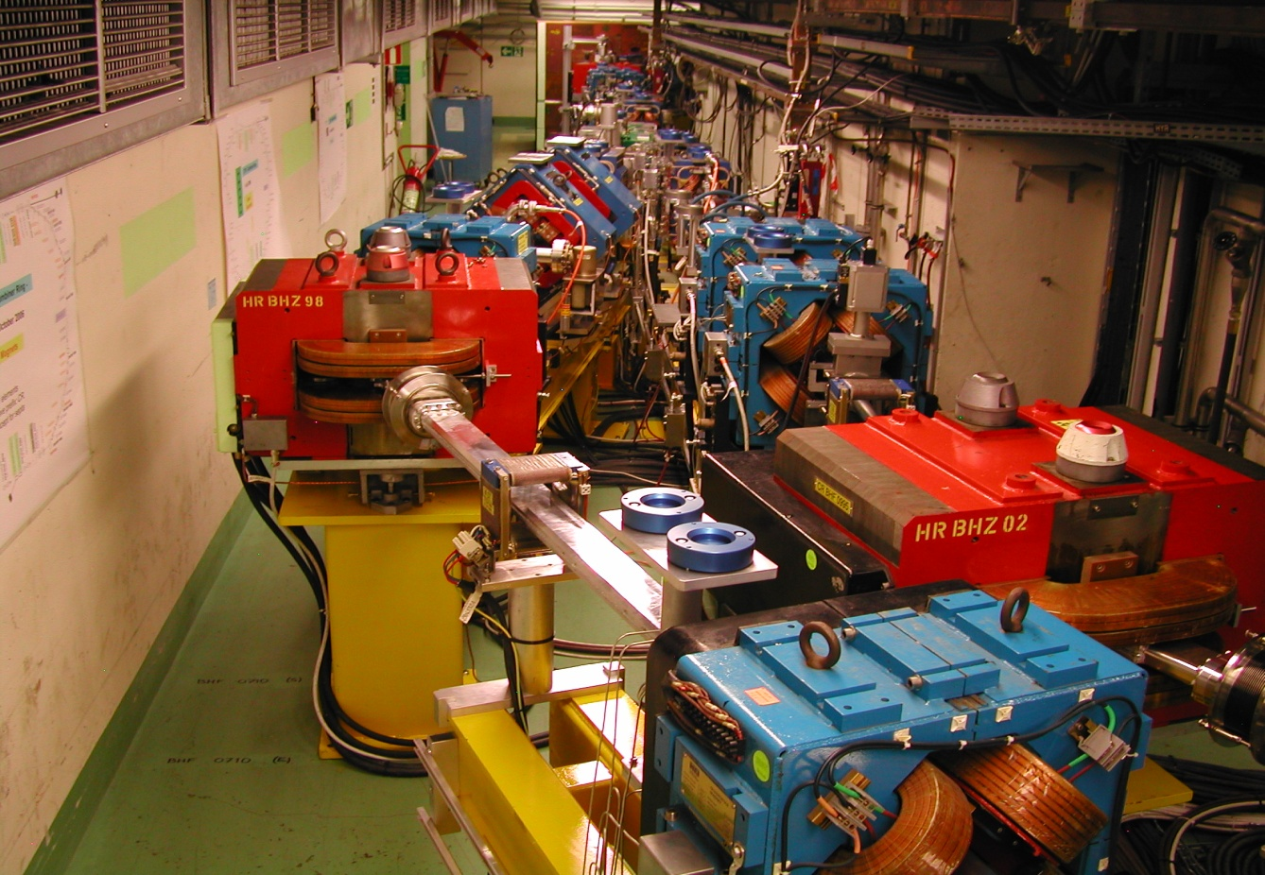
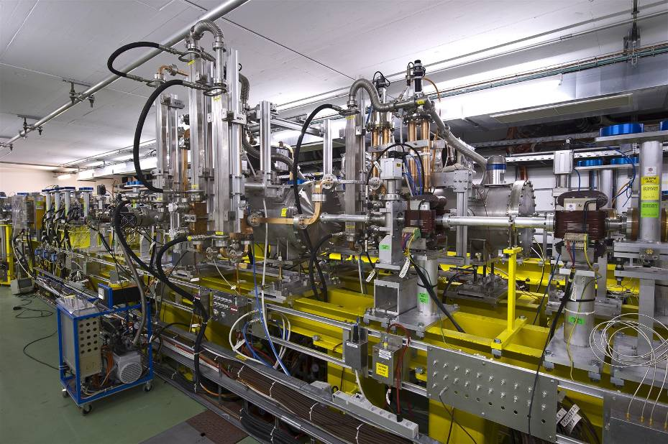
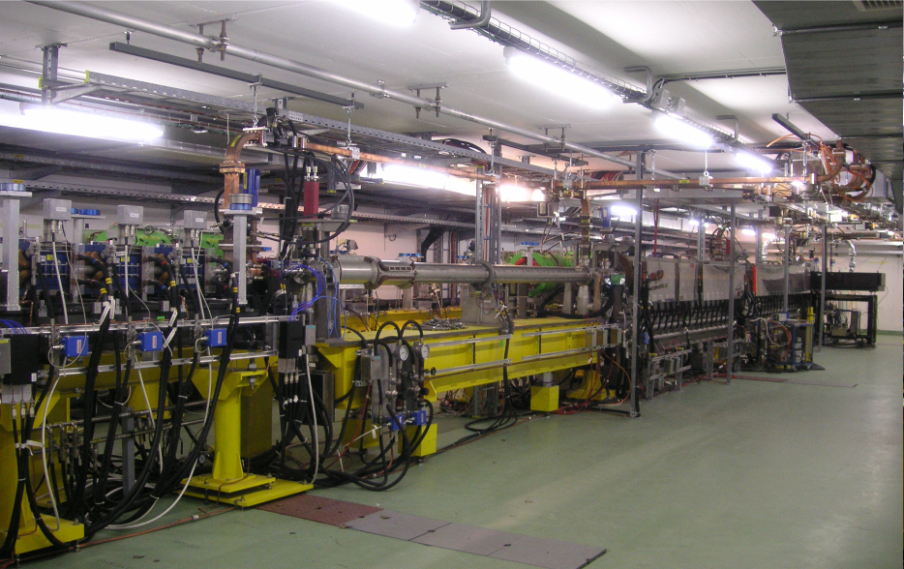
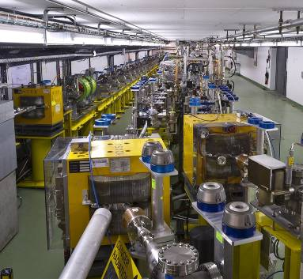
CLIC Test Facility (CTF3)
Operation of isochronous lines and rings
4 A, 1.4us
120 MeV
30 A, 140 ns
120 MeV
High current, full
beam-loading operation
Beam recombination and current multiplication by RF deflectors
12 GHz power generation by drive beam deceleration
High-gradient two-beam acceleration
30 A, 140 ns
60 MeV
Bunch phase coding
See talk of Roberto Corsini this afternoon

Slide 6
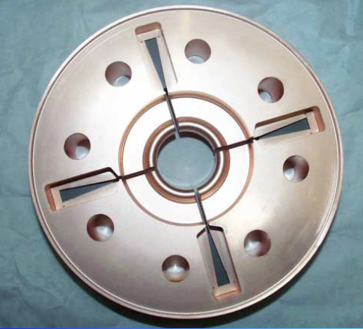
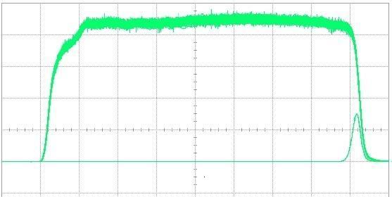
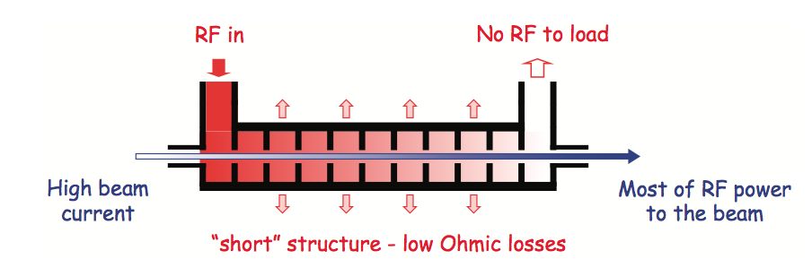
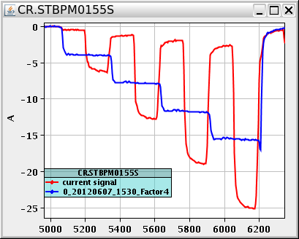
Drive Beam Generation
damping
slot
Full beam loading acceleration
95.3% RF to beam efficiency
Stable high current acceleration
Current stability
Isochronicity, phase coding
Factor 8 current & frequency multiplication
RF pulse at structure input
10 m
RF pulse at output
SiC load
RF in
No RF to load
High beam current
Most RF power
to beam
“short” structure – low Ohmic losses
Pulse charge measurement
Factor 8 combination

Slide 7
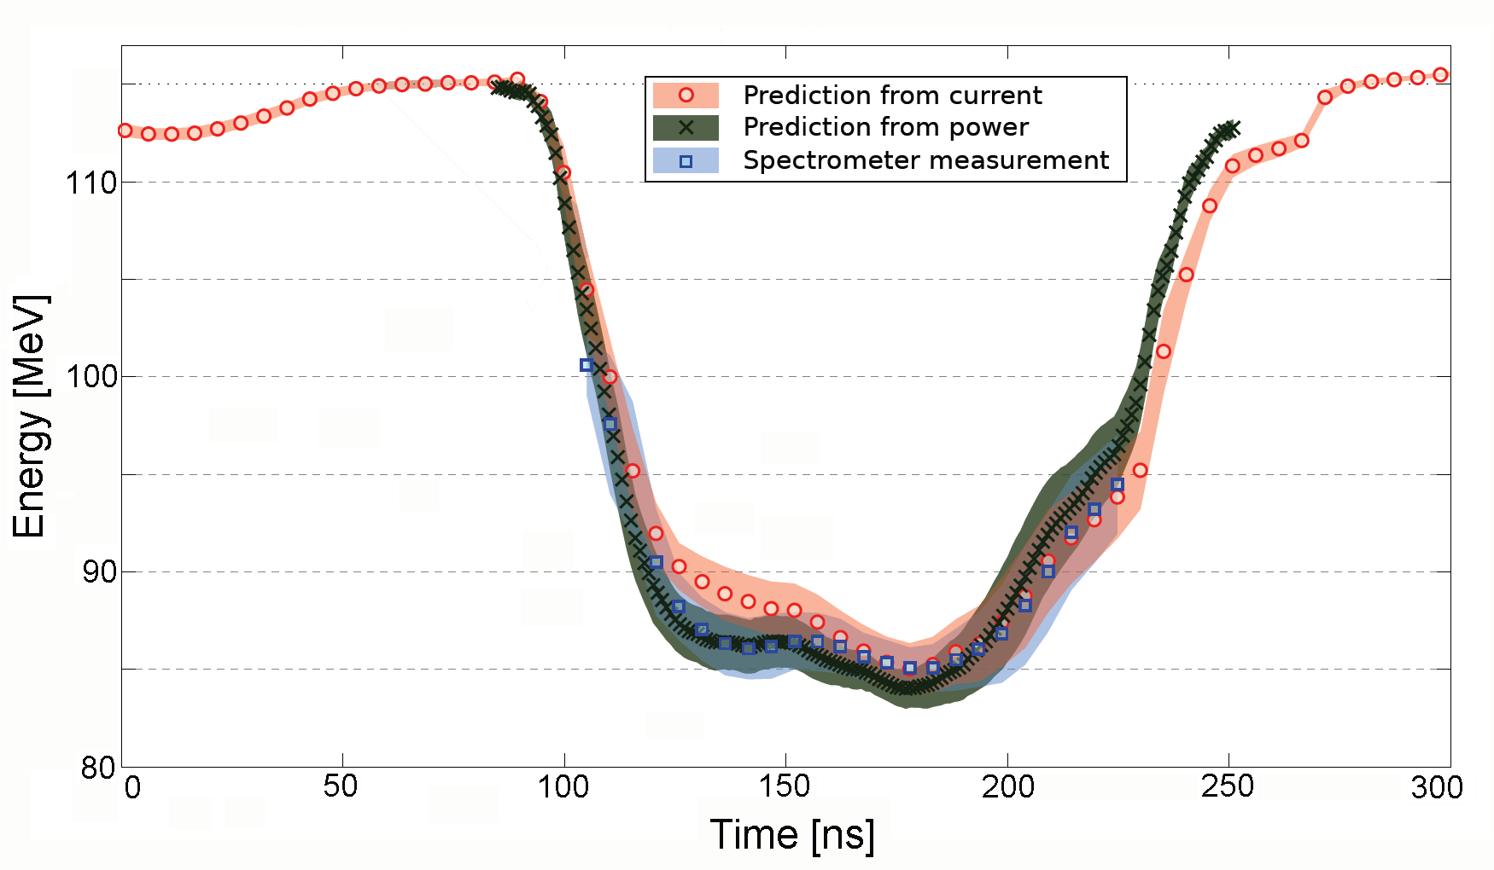
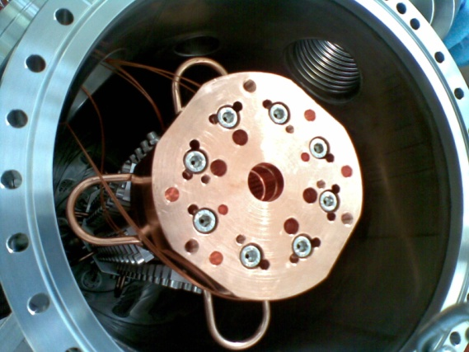
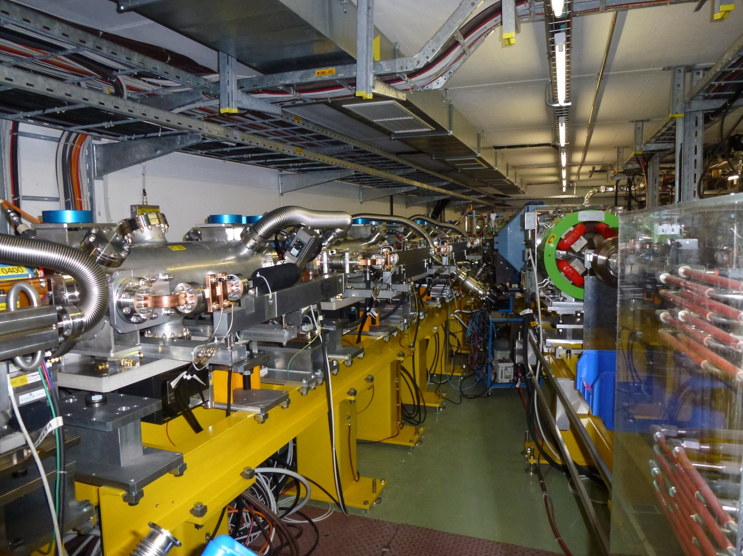
Power Production & Drive Beam Deceleration
TBTS:
Power production in PETS (P_{out}≈ 200MW)
Breakdown rates checked
On-off mechanism tested successfully
TBL:
13 PETS installed
Up to 21 A current transported
optics understood - no losses
Good agreement current/RF/deceleration
~ 26% deceleration
(Final goal is 50% deceleration)
Measurements at SLAC:
No breakdown last O(8 10⁶ pulses)
-> P consistent with p≤10⁻⁷/m/pulse
PETS – Power Extraction & Transfer Structure
TBL line in CLEX
~ 30 MeV
26%
More than half a GW of 12 GHz power!
7

Slide 8
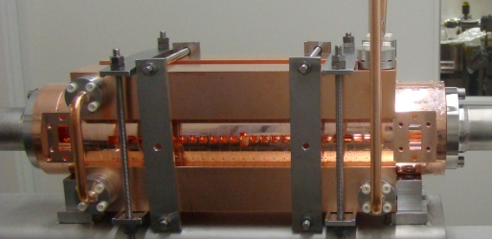
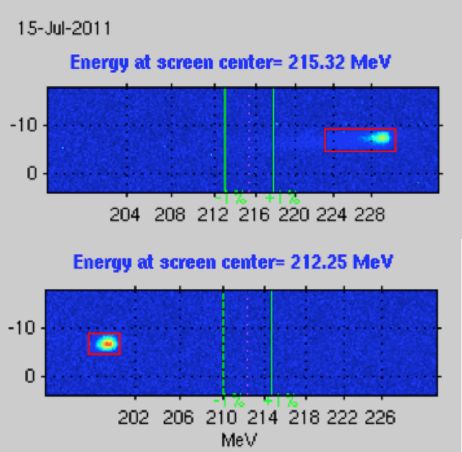
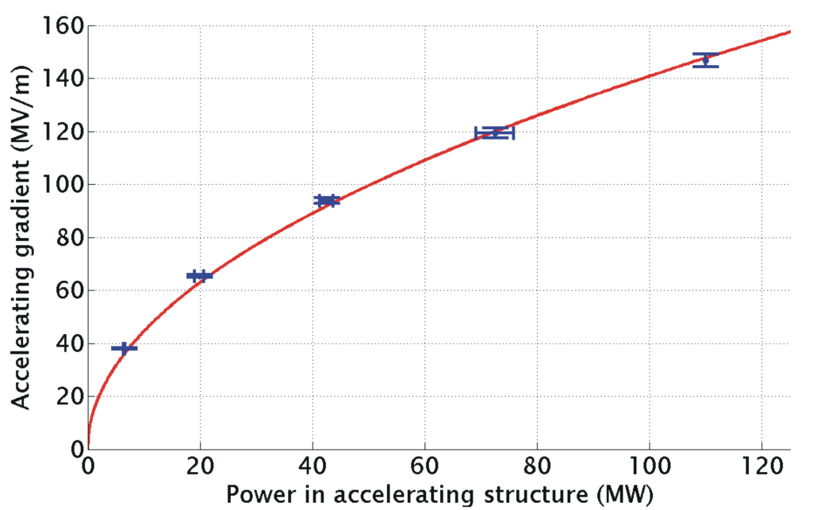
Two-Beam Acceleration
Two-Beam Acceleration demonstration in TBTS
Up to 145 MV/m measured gradient
Good agreement with expectations (power vs. gradient)
TD24
Maximum stable probe beam acceleration measured: 31 MeV
⇒ Corresponding to a gradient of 145 MV/m
Drive beam ON
CLIC Nominal, unloaded
CLIC Nominal, loaded
Drive beam OFF

Slide 9
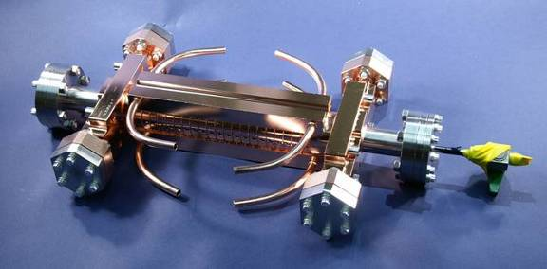
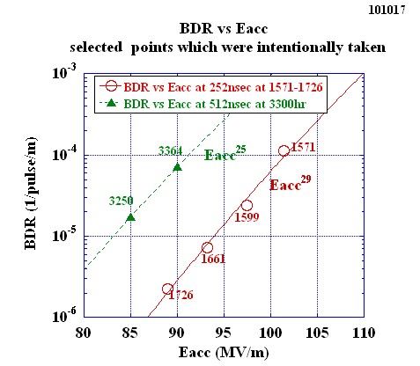
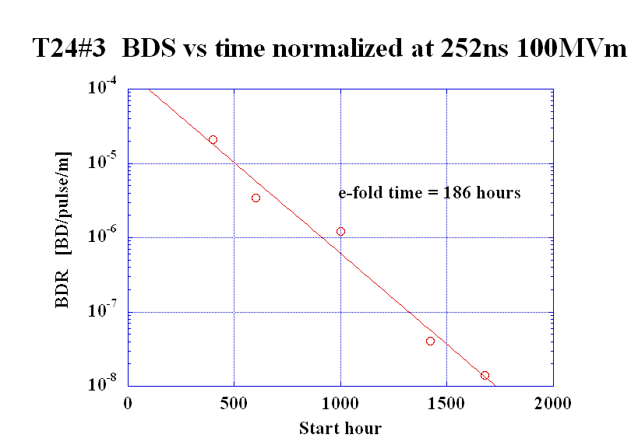
Accelerating Structures
Gradient limited by break-down, must include HOM damping
Require <1% probability of even a single break-down in any structure
  p ≤ 3x10⁻⁷m⁻¹pulse⁻¹
Design based on empirical constraints
Conditioning; break-down rate improves with time

Slide 10
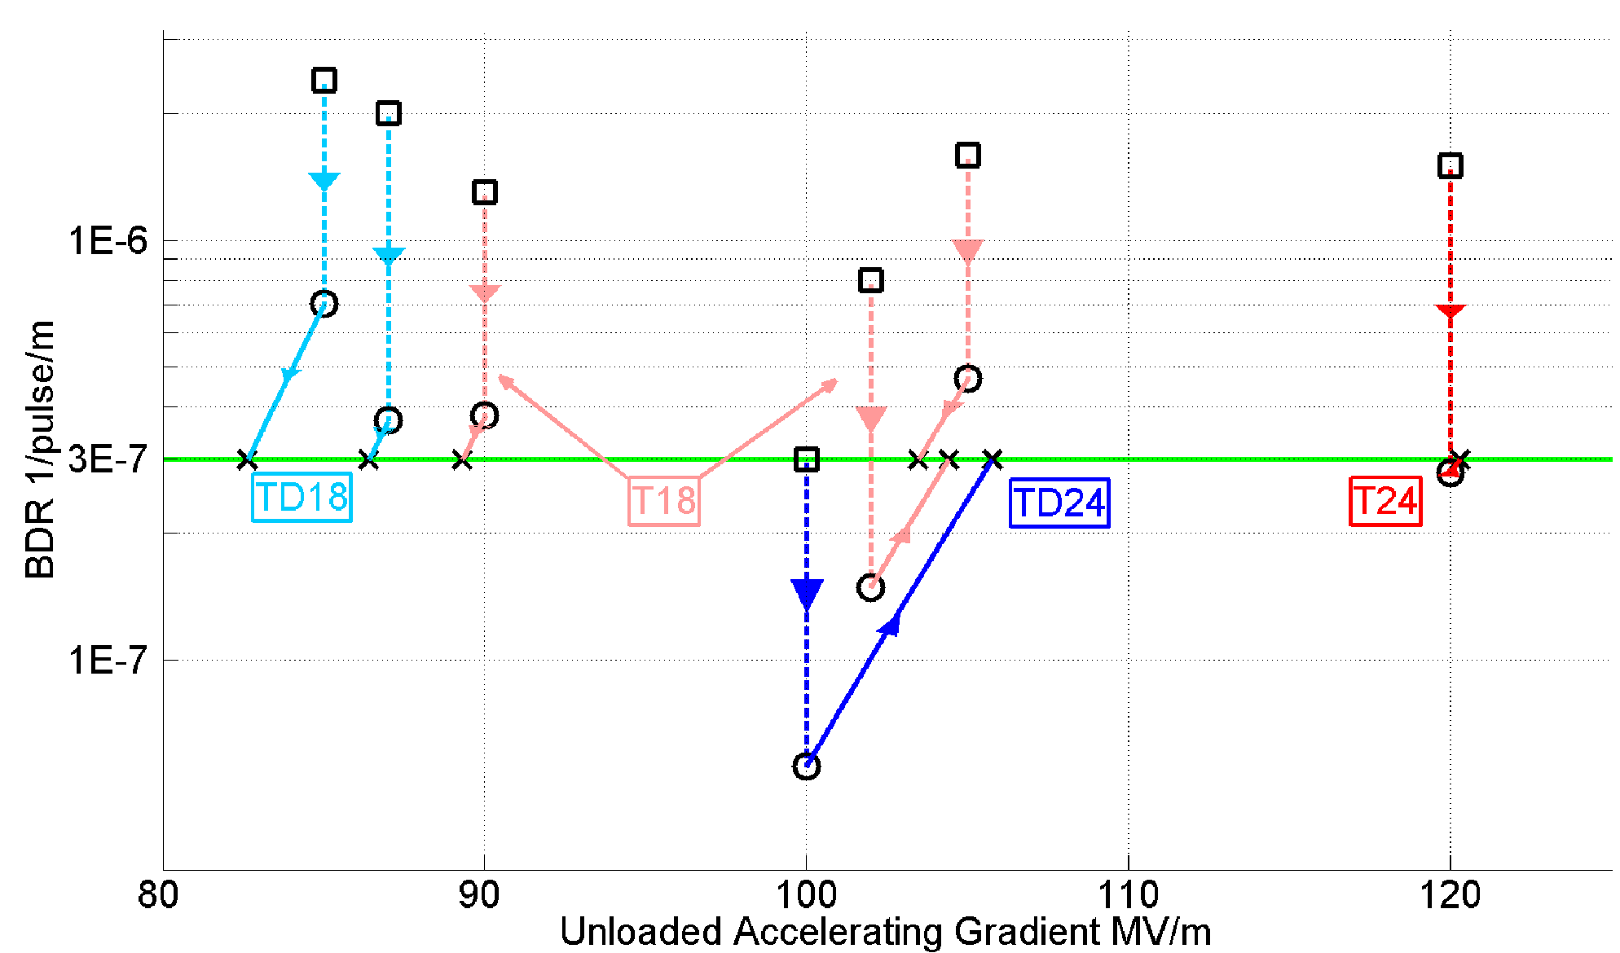
Achieved Gradient
Tests at KEK and SLAC
First cavity test ongoing at new CERN test station
Measurements scaled according to:
 | Simple early design to get started | More efficient fully optimized structure
No damping waveguides | T18 | T24
Damping waveguides | TD18 | TD24 = CLIC goal
Unloaded 106 MV/m
Expected with beam loading 0-16% less

Slide 11
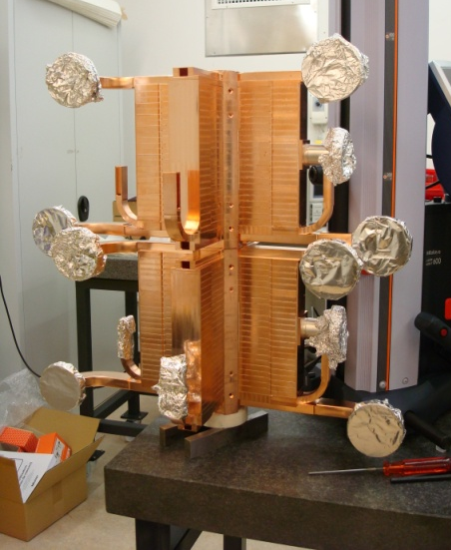
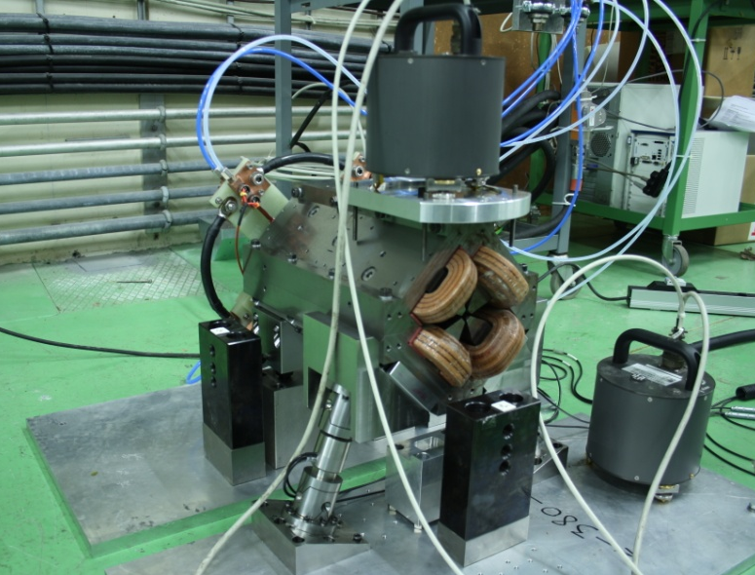
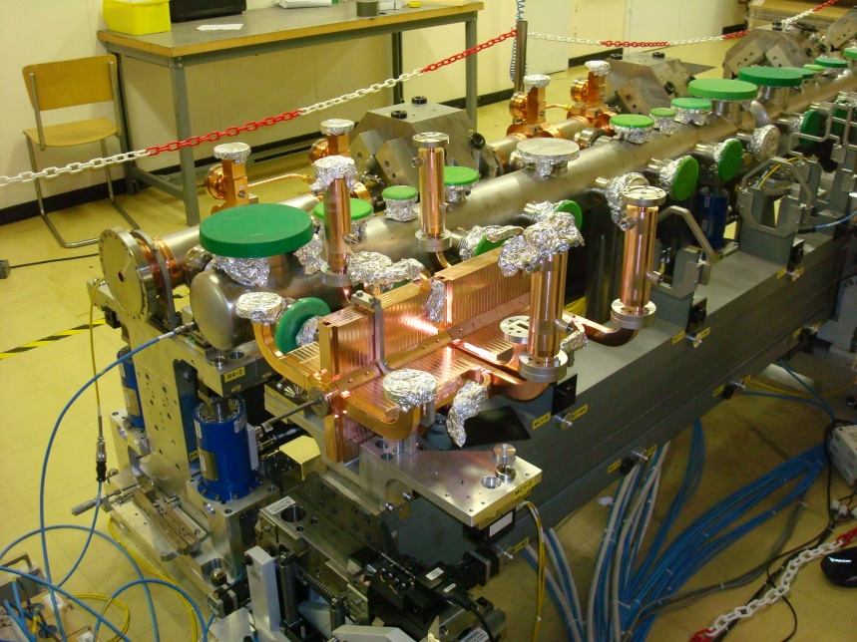
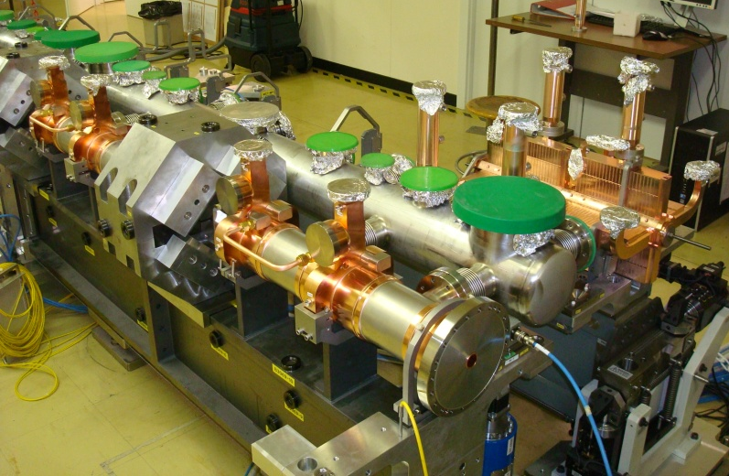
Two-Beam Modules
Next Steps:
Complete modules being assembled in lab and for beam-tests
Installation and test of full-fledged Two-Beam Modules in CLEX
First module in development, installation end 2013
Three modules in 2014-2016
Maximum stable probe beam acceleration measured: 31 MeV
⇒ Corresponding to a gradient of 145 MV/m
Drive beam ON
CLIC Nominal, unloaded
CLIC Nominal, loaded
Drive beam OFF

Slide 12
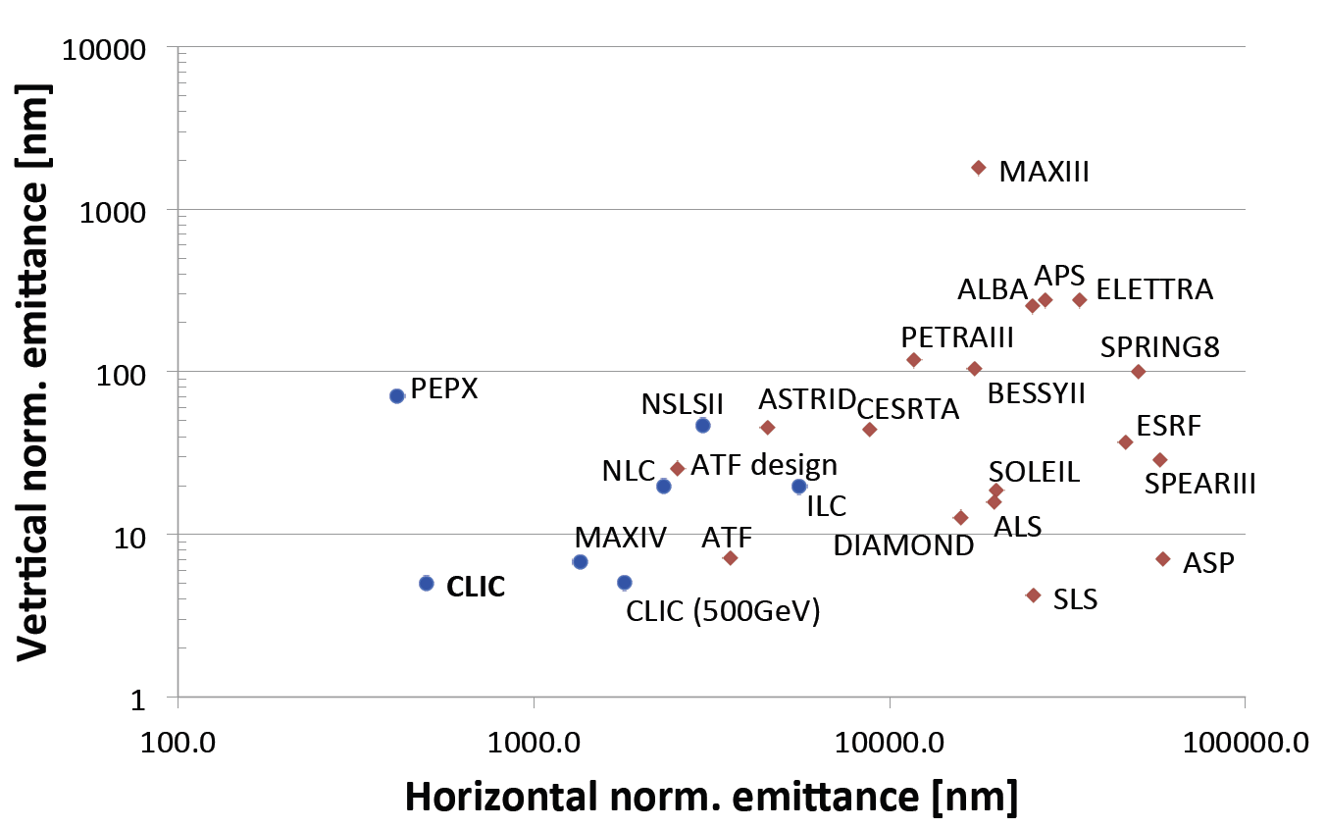
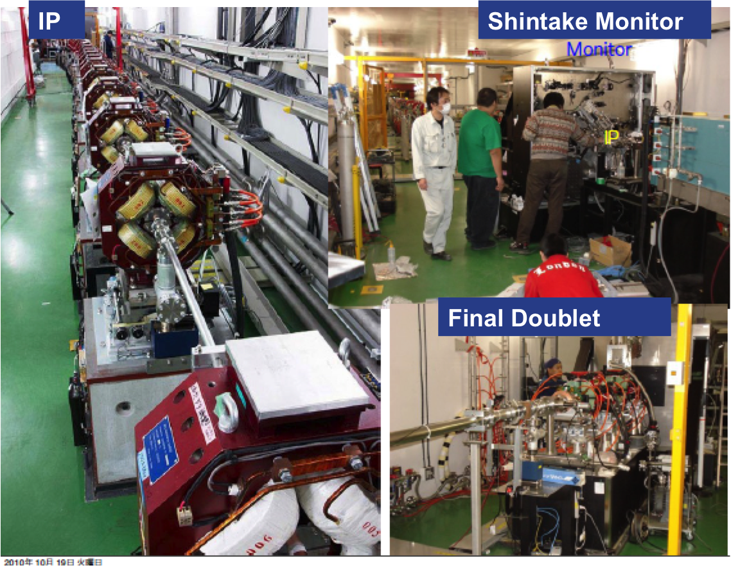
Emittance Generation
Many design issues addressed:
lattice design
dynamic aperture
tolerances
intra-beam scattering
space charge
wigglers
RF system
vacuum
electron cloud
kickers
In addition: wiggler and kicker developments
CLIC @3 TeV would achieve 1/3 of nominal luminosity with ATF performance
(3800nm/15nm@4e9)
Damping ring design is consistent with target performance

Slide 13
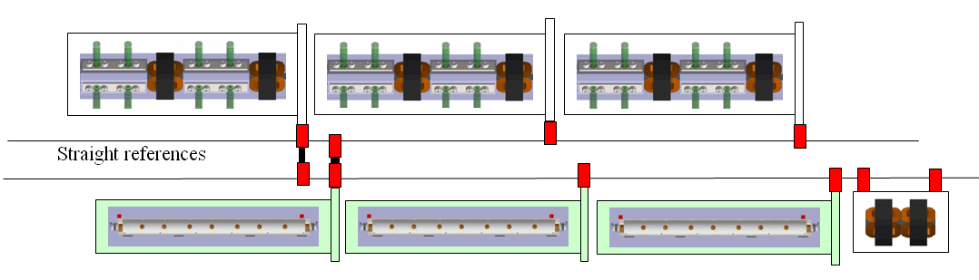
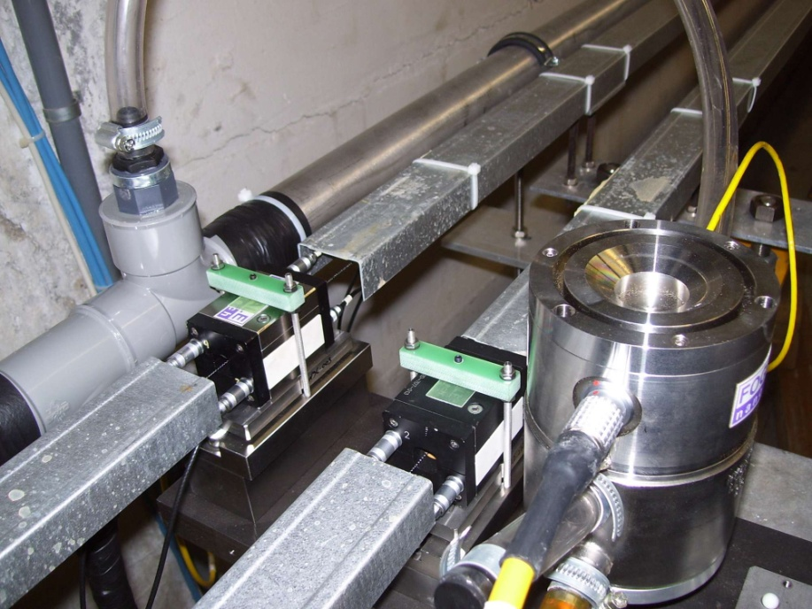
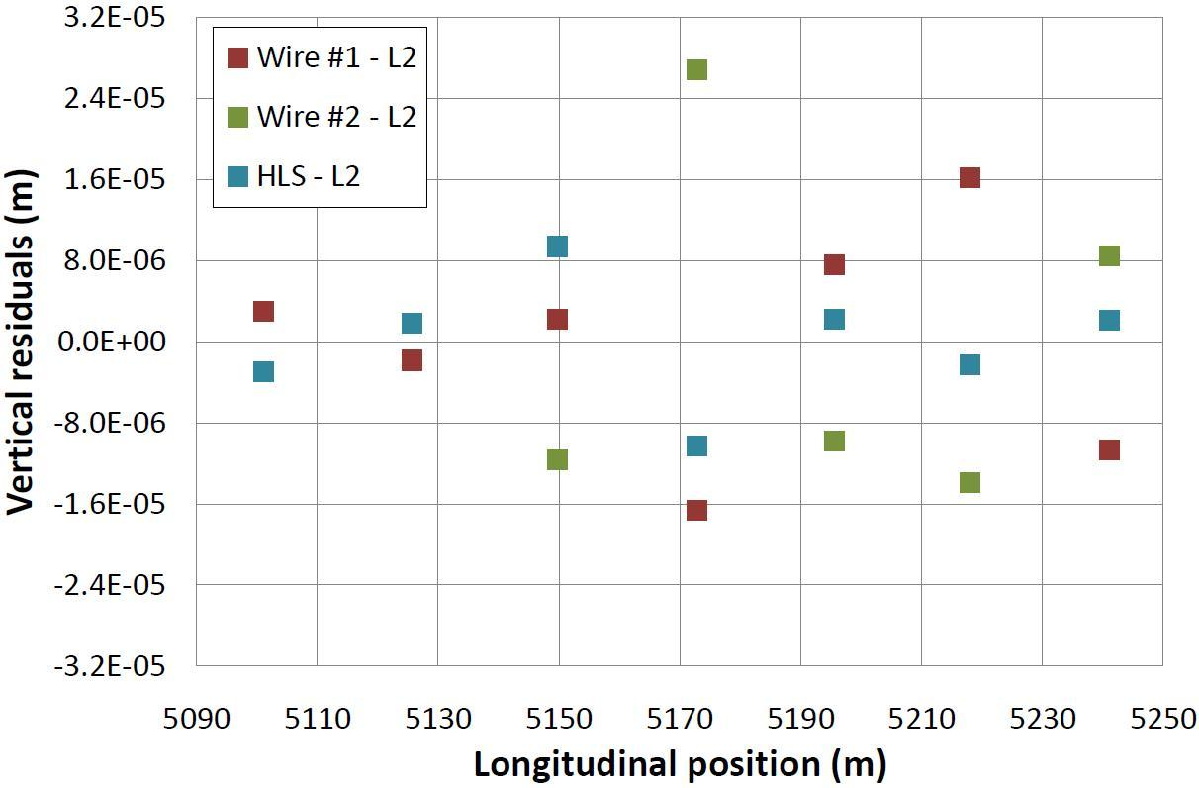
Main Linac Tolerances
Stabilise quadrupole
O(1nm) @ 1Hz
Pre-align BPMs+quads
accuracy O(10μm) over about 200m
3) Use wake-field monitors accuracy O(3.5μm)
2) Beam-based alignment
Test of prototype shows
  vertical RMS error of 11μm
  i.e. accuracy is approx. 13.5μm

Slide 14
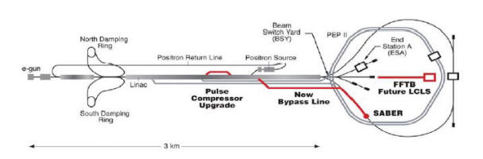
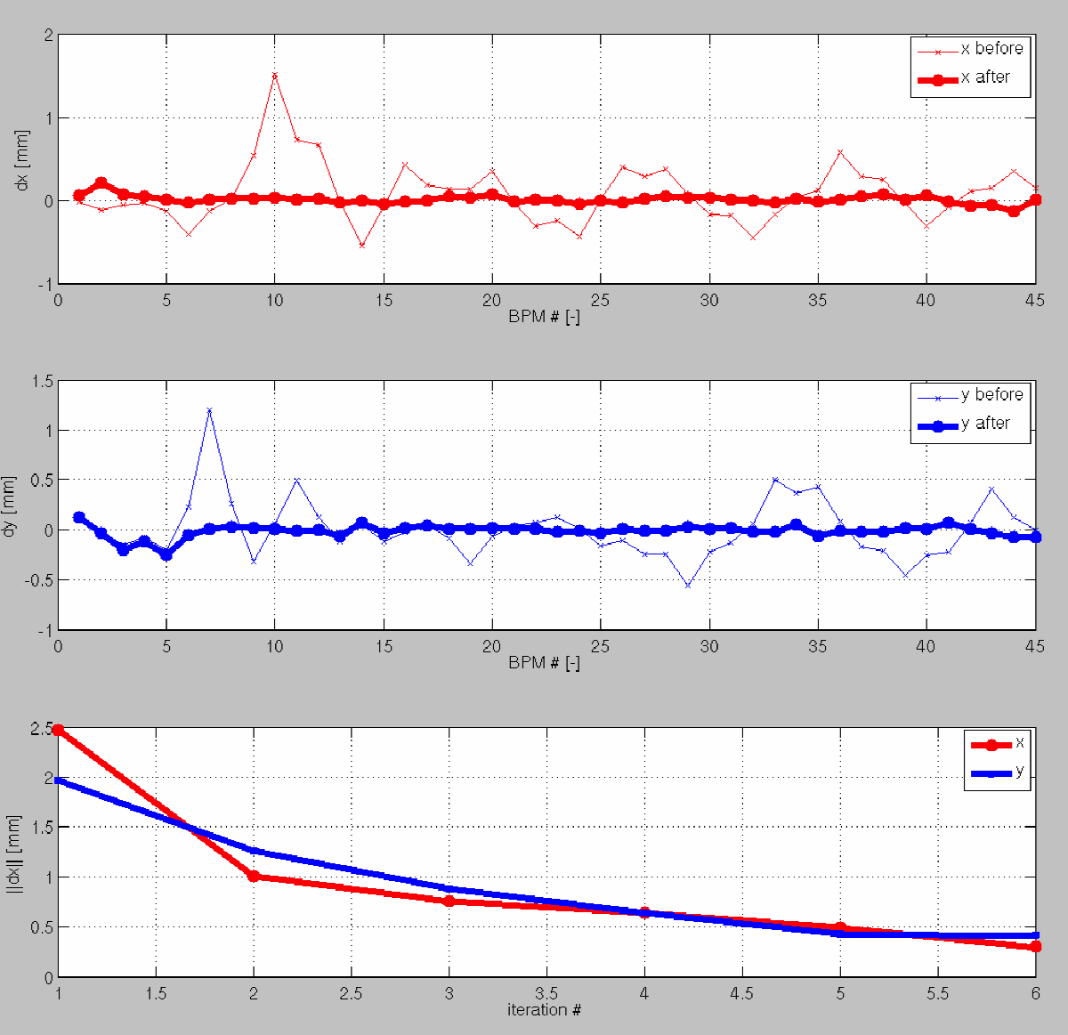
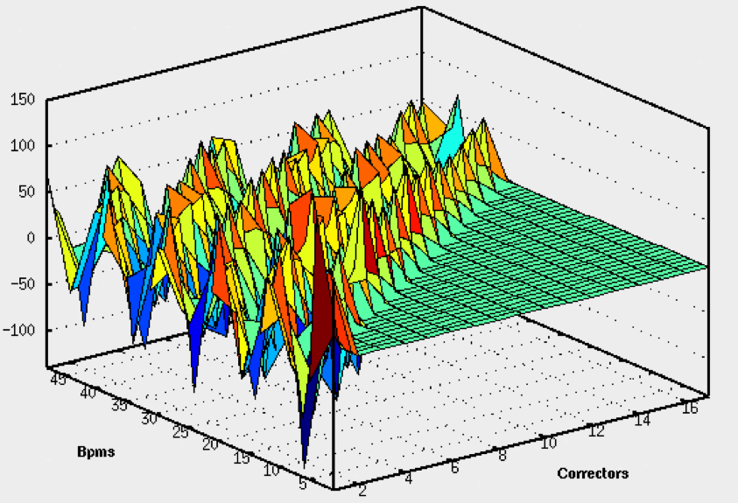
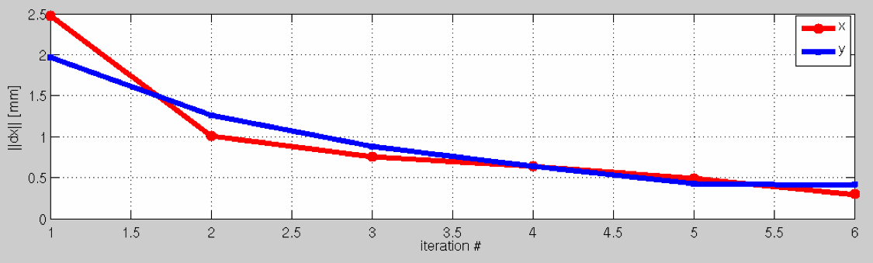
T501: BBA studies at SLAC
T501: FACET test-beam proposal to study advanced global correction schemes for future linear colliders.
CERN-SLAC collaboration where algorithms developed at CERN are tested on the SLAC linac.
The study includes linac system identification, global orbit correction and global dispersion correction.
Successful system identification and global orbit correction has been demonstrated on a test-section of 500 m of the linac.
The section of the SLAC beamlines we work on
RESULT: Example of global orbit correction of a test-section of the SLC linac:
(above) Horizontal and Vertical trajectories before and after orbit correction
(Above) Measured Rx response matrix for the test-section of the linac (17 correctors, 48 BPMs)
(above) Iterations of orbit correction: convergence of the algorithm

Slide 15
BDS Design and Alignment
Probability to achieve more than L/L₀ [%]
Main design issues
chromaticity
non-linear effects
synchrotron radiation
tuning
stability
Goal
Static imperfections:
Goal is L ≥ 110% L₀, with probability of 90%
Convergence is slow
faster method is being developed
Simulated full tuning performance
Need more complete imperfection modeling
independent sides
field errors
dynamic imperfections during tuning
realistic signals
Design is OK
Imperfection mitigation comes close to target
Test program at ATF2 at KEK

Slide 16
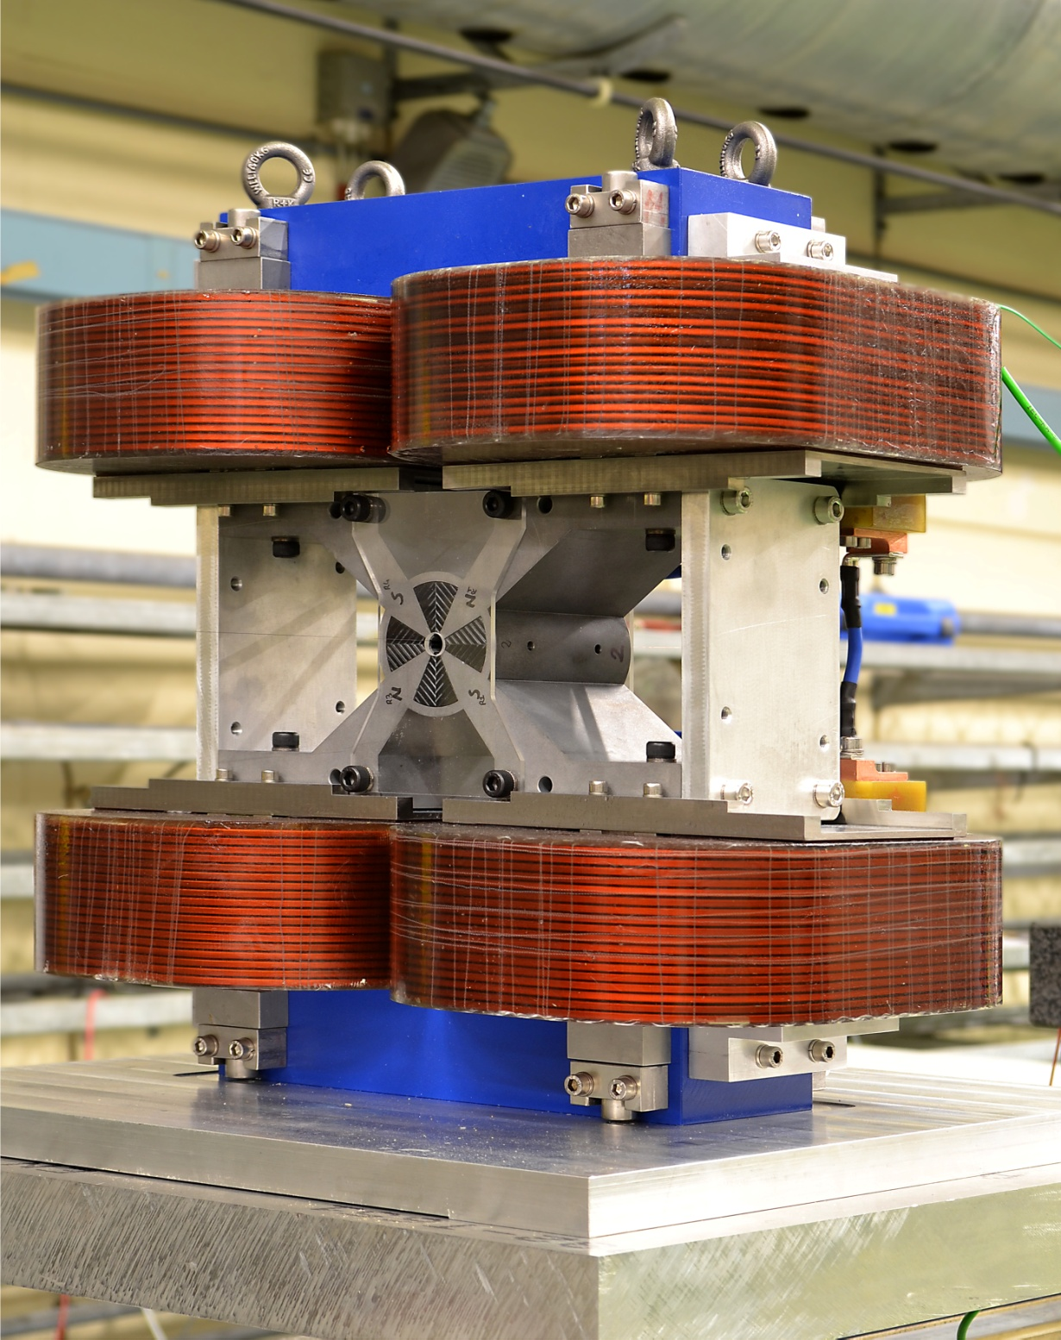
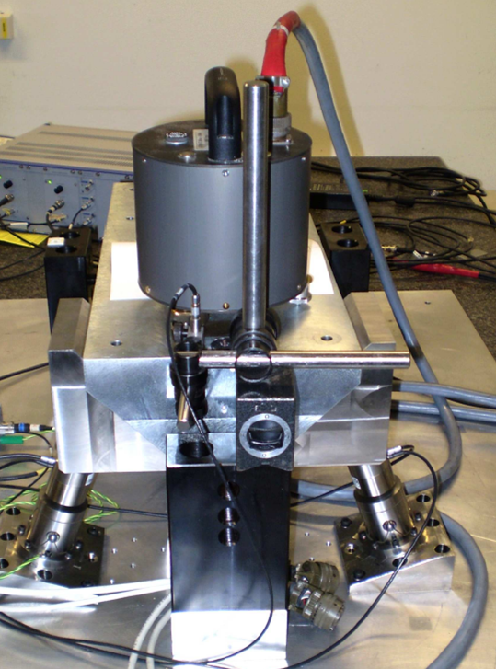
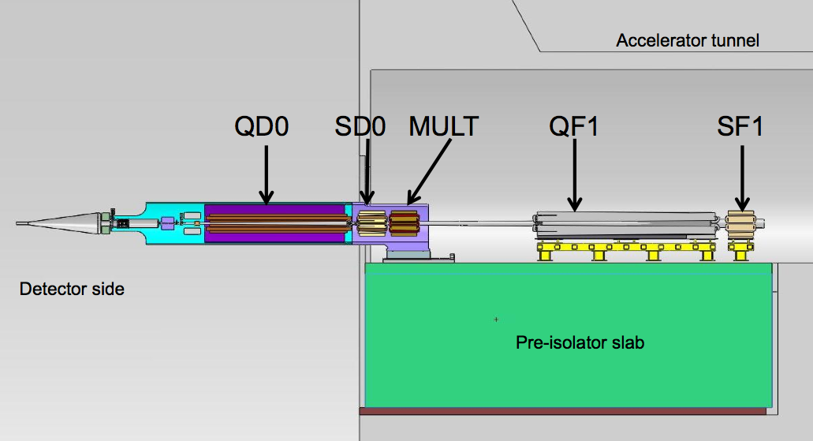
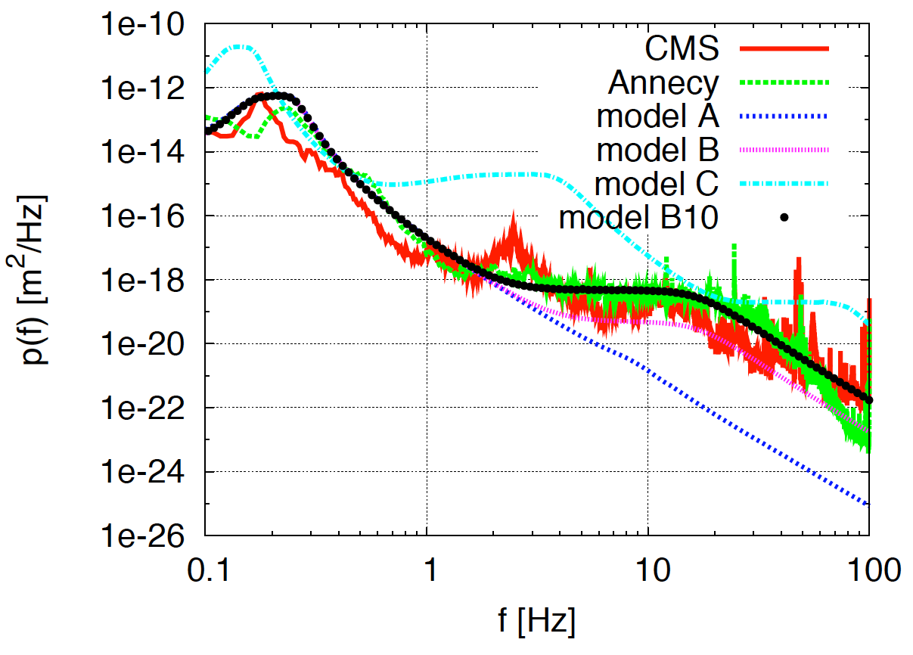
Active Stabilization
Typical quadrupole jitter tolerance O(1nm) in main linac and O(0.1nm) in final doublet
Final Focus QD0 Prototype
Luminosity achieved/lost [%]
 | B10
No stab. | 53%/68%
Current stab. | 108%/13%
Future stab. | 118%/3%
Code
Machine model
Beam-based feedback
Close to/better than target

Slide 17
Conclusion of the CDR studies
Main linac gradient
Ongoing test close to or on target
Uncertainty from beam loading
Drive beam scheme
Generation tested, used to accelerate test beam, deceleration as expected
Improvements on operation, reliability, losses, more deceleration (more PETS) to come
Luminosity
Damping ring like an ambitious light source, no show stopper
Alignment system principle demonstrated
Stabilisation system developed, benchmarked, better system in pipeline
Simulations seem on or close to the target
Operation
Machine Protection
Start-up sequence defined
Most critical failure studied
First reliability studies
Low energy operation developed

Slide 18
The CLIC CDR documents
Vol 1: The CLIC accelerator and site facilities (H.Schmickler)
- CLIC concept with exploration over multi-TeV energy range up to 3 TeV
- Feasibility study of CLIC parameters optimized at 3 TeV (most demanding)
- Consider also 500 GeV, and intermediate energy range
- Complete, presented in SPC in March 2011, in print: https://edms.cern.ch/document/1234244/
Vol 2: Physics and detectors at CLIC (L.Linssen)
- Physics at a multi-TeV CLIC machine can be measured with high precision, despite challenging background conditions
- External review procedure in October 2011
- Completed and printed, presented in SPC in December 2011 http://arxiv.org/pdf/1202.5940v1
Vol 3: “CLIC study summary” (S.Stapnes)
- Summary and available for the European Strategy process, including possible implementation stages for a CLIC machine as well as costing and cost-drives
- Proposing objectives and work plan of post CDR phase (2012-16)
- Completed and printed, submitted for the European Strategy Open Meeting
in September http://arxiv.org/pdf/1209.2543v1
In addition a shorter overview document was submitted as input to the European Strategy update, available at:
http://arxiv.org/pdf/1208.1402v1

Slide 19
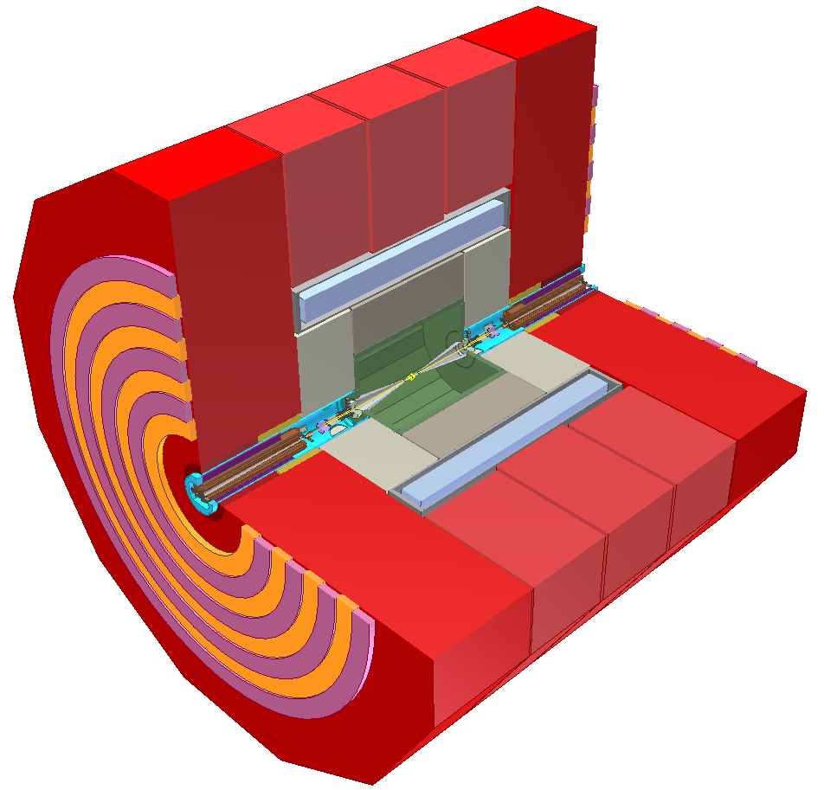
CLIC Detectors – in brief
Instrumented return yoke
for muon ID
Complex forward region with final beam focusing
Strong SC solenoid
4 T or 5 T
Fine grained calorimeters for PFA: 1 + 7.5 λ_{int}
6.5 m
Ultra low-mass
vertex detector
with 20 μm pixels
Tracking:
TPC+silicon (CLIC_ILD)
all-silicon (CLIC_SiD)
Detailed GEANT 4 simulation
Studied using full reconstruction with background

Slide 20
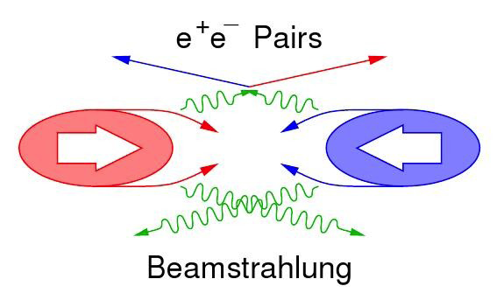
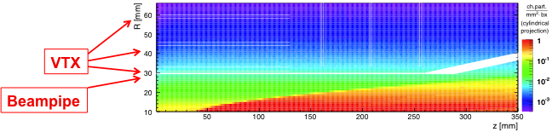
CLIC machine environment
 | CLIC at 500 GeV | CLIC at 3 TeV
L (cm⁻²s⁻¹) | 2.3×10³⁴ | 5.9×10³⁴
BX separation | 0.5 ns | 0.5 ns
#BX / train | 354 | 312
Train duration (ns) | 177 | 156
Rep. rate | 50 Hz | 50 Hz
σ_{x} / σ_{y} (nm) | ≈ 200 / 2.3 | ≈ 45 / 1
σ_{z} (μm) | 72 | 44
Drives timing
requirements
for CLIC detector
Simplified view:
Pair background
Design issue
gg → hadrons
Impacts on the physics
Needs suppression in data
Beam related background:
Small beam profile at IP leads to very
high E-field
  Beamsstrahlung
    Pair-background
    γγ to hadrons

Slide 21
background suppression at CLIC
Triggerless readout of full train
 t₀ physics event (offline)
Full event reconstruction + PFA analysis with background overlaid
  => physics objects with precise p_{T} and cluster time information
  Time corrected for shower development and TOF
Then apply cluster-based timing cuts
  Cuts depend on particle-type, p_{T} and detector region
  Allows to protect high-p_{T} physics objects
tCluster
tCluster
+
Use well-adapted jet clustering algorithms
  Making use of LHC experience (FastJet)

Slide 22
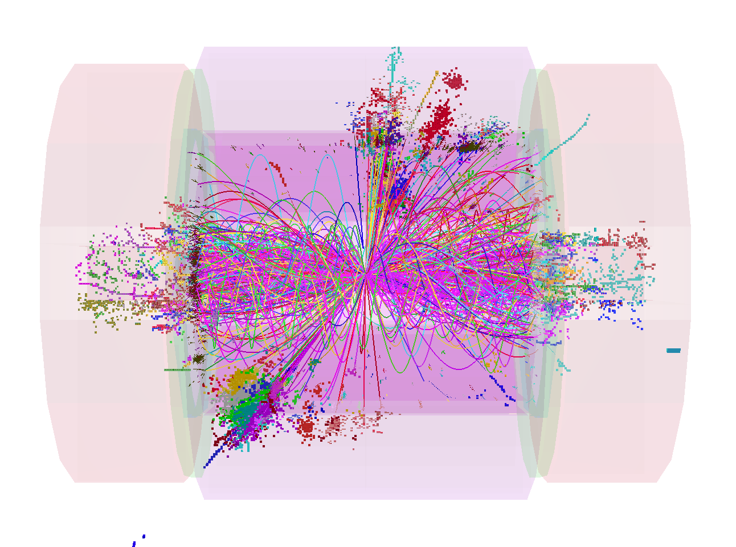
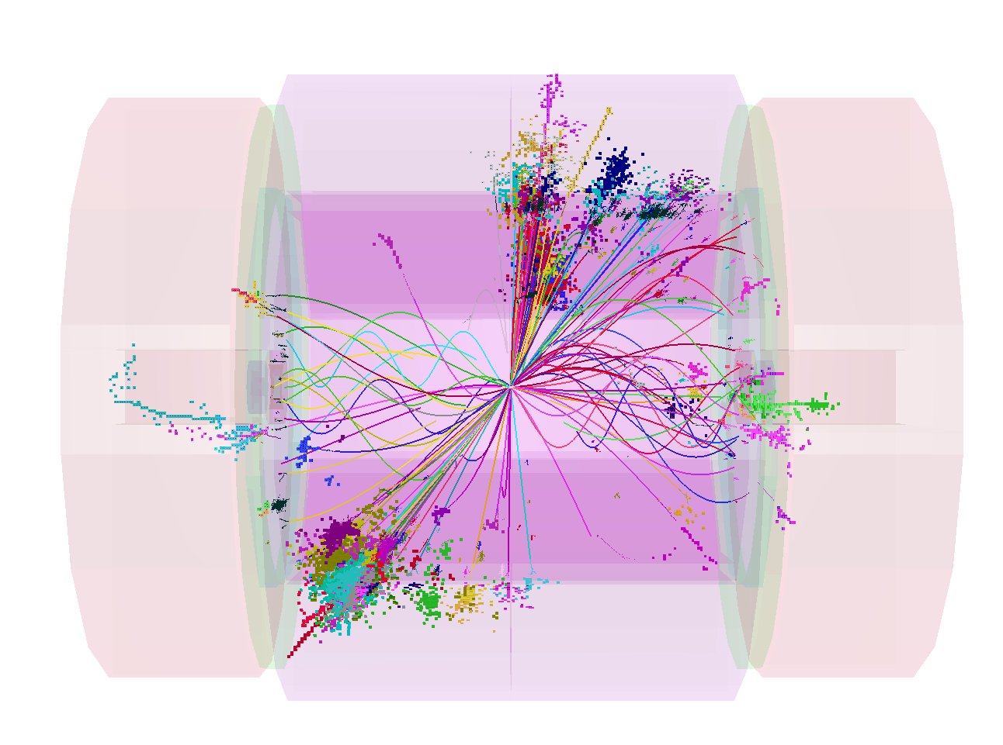
combined p_{T} and timing cuts
1.2 TeV
100 GeV
1.2 TeV background in reconstruction time window
100 GeV background after tight cuts

Slide 23
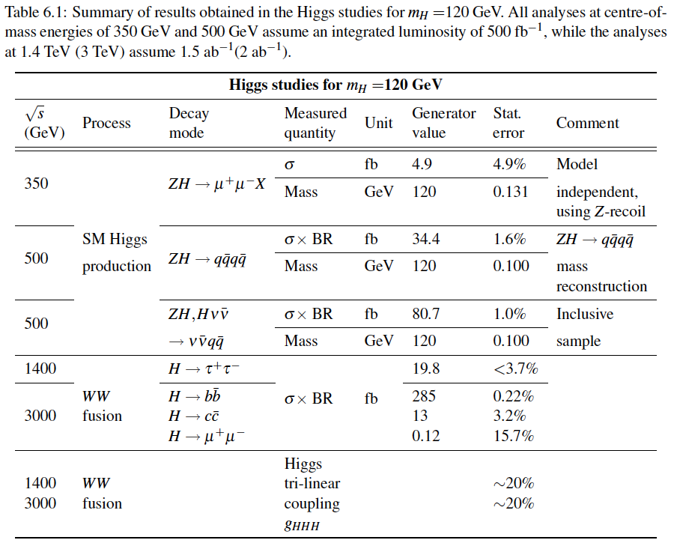
Results of Higgs benchmark studies
Details will be presented at LCWS12 for many of these studies
‘12
‘12
‘12
‘12
‘12
<= study still ongoing

Slide 24
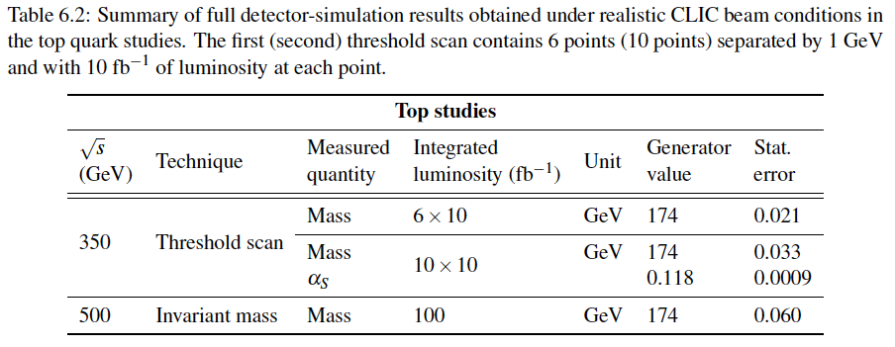
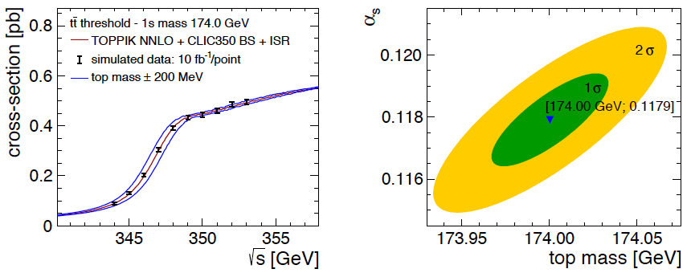
Results of top benchmark studies
left
right
plot
‘12

Slide 25
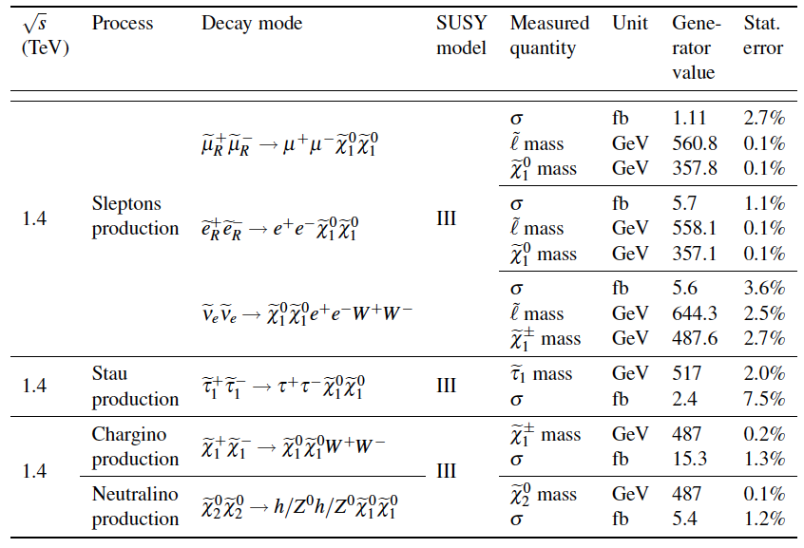
Results of SUSY benchmarks, 1.4 TeV
all results with
L => 1.5 ab⁻¹
CLIC CDR Vol. 3
‘12
‘12
‘12

Slide 26
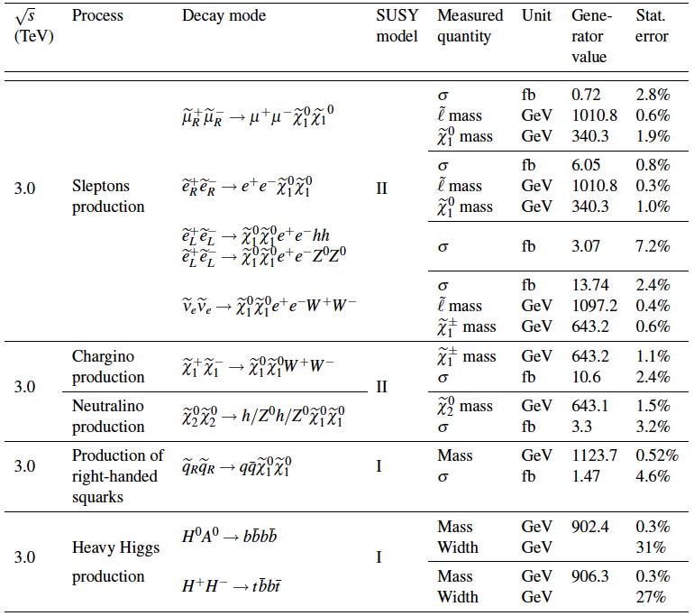
Results of SUSY benchmarks, 3 TeV
all results with
L => 2 ab⁻¹
CLIC CDR Vol. 2

Slide 27
The CLIC CDR documents
Vol 1: The CLIC accelerator and site facilities (H.Schmickler)
- CLIC concept with exploration over multi-TeV energy range up to 3 TeV
- Feasibility study of CLIC parameters optimized at 3 TeV (most demanding)
- Consider also 500 GeV, and intermediate energy range
- Complete, presented in SPC in March 2011, in print: https://edms.cern.ch/document/1234244/
Vol 2: Physics and detectors at CLIC (L.Linssen)
- Physics at a multi-TeV CLIC machine can be measured with high precision, despite challenging background conditions
- External review procedure in October 2011
- Completed and printed, presented in SPC in December 2011 http://arxiv.org/pdf/1202.5940v1
Vol 3: “CLIC study summary” (S.Stapnes)
- Summary and available for the European Strategy process, including possible implementation stages for a CLIC machine as well as costing and cost-drives
- Proposing objectives and work plan of post CDR phase (2012-16)
- Completed and printed, submitted for the European Strategy Open Meeting
in September http://arxiv.org/pdf/1209.2543v1
In addition a shorter overview document was submitted as input to the European Strategy update, available at:
http://arxiv.org/pdf/1208.1402v1

Slide 28

CLIC physics potential
LHC complementarity at the energy frontier:
How do we build the optimal machine given a physics scenario (partly seen at LHC ?)
Understand the benefits of running close to thresholds versus at highest energy, and distribution of luminosities as function of energy
Examples highlighted in the CDR
Higgs physics (SM and non-SM)
Top
SUSY
Higgs strong interactions
New Z’ sector
Contact interactions
Extra dimensions
….
^{σ(fb)}
Stage 1: ~500 (350) GeV => Higgs and top physics
Stage 2: ~1.5 TeV => ttH, ννHH + New Physics (lower mass scale)
Stage 3: ~3 TeV => New Physics (higher mass scale)

Slide 29
CLIC Implementation – in stages?
Need to operate at
lower than nominal energy
CLIC two-beam scheme compatible with energy staging to provide the optimal machine for a large energy range
Lower energy machine can run most of the time during the construction of the next stage.
Physics results will determine the energies of the stages
Linac 1
I.P.
Linac 2
0.5 TeV Stage
Injector
Complex
4 km
4 km
~14 km
Linac 1
I.P.
Linac 2
1-2 TeV Stage
Injector
Complex
7.0-14 km
7.0-14 km
~20-34 km
Linac 1
3 TeV Stage
I.P.
Linac 2
Injector
Complex
20.8 km
3 km
3 km
20.8 km
48.2 km
See talk of Daniel Schulte this afternoon

Slide 30


Possible CLIC stages studied

Slide 31


CLIC near CERN
Tunnel implementations (laser straight)
Central MDI & Interaction Region

Slide 32
Implementation issues
Physics - how do we build the optimal machine given a physics scenario (partly seen at LHC ?):
Understand the benefits of running close to thresholds versus at highest energy, and distribution of luminosities as function of energy
Construction scenario (and approval scenario):
Explore how we in practice will do the tunneling and productions/installation/movement of parts in a multistage approach ? Environmental impact study
Timescale/lifecycle for project re-defined: Buildup of drive beam (CLIC zero), stage one – physics, more stages/extensions
Parameters: energy steps and scans, inst. and int. luminosities, commissioning and lum. ramp up times.
Power and energy development.
Have started to work on energy estimates (not only max power at max luminosity and the highest energy) based on running scenarios and power on/off/standby estimates
Costs - Initial machine plus energy upgrade: External cost review 21-22.2.2012, costs discussed in volume 3 of the CDR

Slide 33

Schedule first two stages
coord. along collider
year

Slide 34



Possible luminosity examples
Based on 200 days/year at 50% efficiency (accelerator + data taking combined)
Target figures: >600 fb⁻¹ at first stage, 1.5 ab⁻¹ at second stage, 2 ab⁻¹ at third stage

Slide 35



Power/energy consumption
Considering 150 days per year of normal operation at nominal power and assuming reduced power for commissioning with beam in the early years at each stage of collision energy, the development of yearly energy consumption can be sketched.
Re-optimize parts
  Reduced current density in normal-conducting magnets
  Reduction of heat loads to HVAC
  Re-optimization of accelerating gradient with different objective function
Efficiency
  Grid-to-RF power conversion
  Permanent or super-ferric superconducting magnets
Energy management
  Low-power configurations in case of beam interruption
  Modulation of scheduled operation to match electricity demand: Seasonal and Daily
  Power quality specifications
Waste heat recovery
  Possibilities of heat rejection at higher temperature
  Waste heat valorization by concomitant needs, e.g. residential heating, absorption cooling
Beyond:
Scale with inst. luminosity – i.e. running at the very end of the project lifetime might be power limited and require more time.

Slide 36

Costs
First to second stage: 4 MCHF/GeV (i.e. initial costs are very significant)
Caveats:
  Uncertainties 20-25%
  Possible savings around 10%
  However – first stage not optimised (work for next phase), parameters largely defined for 3 TeV final stage

Slide 37

CLIC project time-line

Slide 38





Towards a Project Implementation Plan
Define the scope, strategy and cost of the project implementation
LHC data crucial – also at nominal energy
Costs, power, scheduling, site, etc
Define and keep an up-to-date optimized overall baseline design that can achieve the scope within a reasonable schedule, budget and risk.
Overall design and system optimisation, activities across all parts of the machine from sources to beam-dump, links to technical developments and system verification activities
Develop the technical design basis. i.e. move toward a technical design for crucial items of the machine – X-band as well as all other parts.
Priorities are the modulators/klystrons, module/structure development including significantly more testing facilities and alignment/stability
Identify and carry out system tests and programs to address the key performance and operation goals and mitigate risks associated to the project implementation.
Priorities are the measurements in: CTF3+, ATF, FACET and related to the CLIC Drive Beam Injector studies, addressing the issues of drive-beam stability, RF power generation and two beam acceleration, as well as beam delivery system studies.

Slide 39
Summary
Technical progress within the CLIC accelerator and detector studies very significant and results have now been documented in the CDR volumes:
  Substantial work on a staged implementation also documented
  CDR process finished and focus is now on next phase(s)
Plans for 2012-16 well defined for CLIC – with key challenges related to system specifications and performance, system tests to verify performances, technical developments of key elements, implementation studies including power and costs
  A rebaselining of the machine stages with particular emphasis on the lower energy stages in progress
  The programme combines the resources of collaborators inside the current collaboration, plus several new ones now joining – and involves around 20 CERN groups.
  The work needed also in the area of Physics and Detectors is also becoming clearer
  Workhop planned for last week of January: https://indico.cern.ch/conferenceDisplay.py?confId=204269
There will be many talks this weeks about specific studies on the accelerator and detector/physics side, showing much more details than I have managed here
Thanks to the CLIC collaboration for the slides and work presented – for and from the CDR and also recent presentations

Slide 41

Scheduling of installation/operation
coord. along linac
B
year

