Slide 1
The ILC BDC Final Focus:
250 GeV option(s).
Dr. Larisa Malysheva
Oxford University

Slide 2
ILC BDS lattice status and changes
Push-pull operation decks (A. Seryi)
3 version for different L*:
L*=3.51m, L*=4.5m, L*=4.0m
Optics was not tuned
Beta_x=15mm, bet_y=40mm (500GeV) option
Dipoles were not decimated.
New IP parameters (see table on next slide)
Operation for low energy ( possibility of swithing part of final doublet)

Slide 3
The ILC new set of IP parameters)
 | Centre-of-mass energy | E_{cm} | GeV | 200 | 230 | 250 | 350 | 500
 | Beam energy | E_{beam} | GeV | 100 | 115 | 125 | 175 | 250
 | Lorentz factor | γ |  | ####### | ####### | ####### | ####### | #######
 | Collision rate | f_{rep} | Hz | 5 | 5 | 5 | 5 | 5
 | Electron linac rate | f_{linac} | Hz | 10 | 10 | 10 | 5 | 5
 | Number of bunches | n_{b} |  | 1312 | 1312 | 1312 | 1312 | 1312
 | Positron bunch population | N₊ | ×10¹⁰ | 2.0 | 2.0 | 2.0 | 2.0 | 2.0
 | RMS bunch length | σ_{z} | mm | 0.3 | 0.3 | 0.3 | 0.3 | 0.3
 | Electron RMS energy spread | Δp/p | % | 0.206 | 0.194 | 0.190 | 0.158 | 0.125
 | Positron RMS energy spread | Δp/p | % | 0.187 | 0.163 | 0.150 | 0.100 | 0.070
 | Horizontal emittance | γε_{x} | μm | 10 | 10 | 10 | 10 | 10
 | Vertical emittance | γε_{y} | nm | 35 | 35 | 35 | 35 | 35
 | IP horizontal beta function | β_{x}* | mm | 16.0 | 14.0 | 13.0 | 16.0 | 11.0
 | IP vertical beta function (no TF) | β_{y}* | mm | 0.34 | 0.38 | 0.41 | 0.34 | 0.48
 | IP vertical beta function (TF) | β_{y}* | mm | 0.2 | 0.2 | 0.2 | 0.2 | 0.2
 | IP RMS horizontal beam size | σ_{x}* | nm | 904 | 789 | 729 | 684 | 474
 | IP RMS veritcal beam size (no TF) | σ_{y}* | nm | 7.8 | 7.7 | 7.7 | 5.9 | 5.9

Slide 4
Low energy (125 GeV) beam option.
MAPCLASS code based on MAD-X PTC was chosen ( R.Tomas )
Use 2 version of optics: L*=3.51m and L*=4.05m
Rematch the linear optics to the new IP parameters.
Second and higher order aberrations tuning
Decimate dipoles (keep space reserved)
Check the possibility of Half QD0/QF1 operation

Slide 5
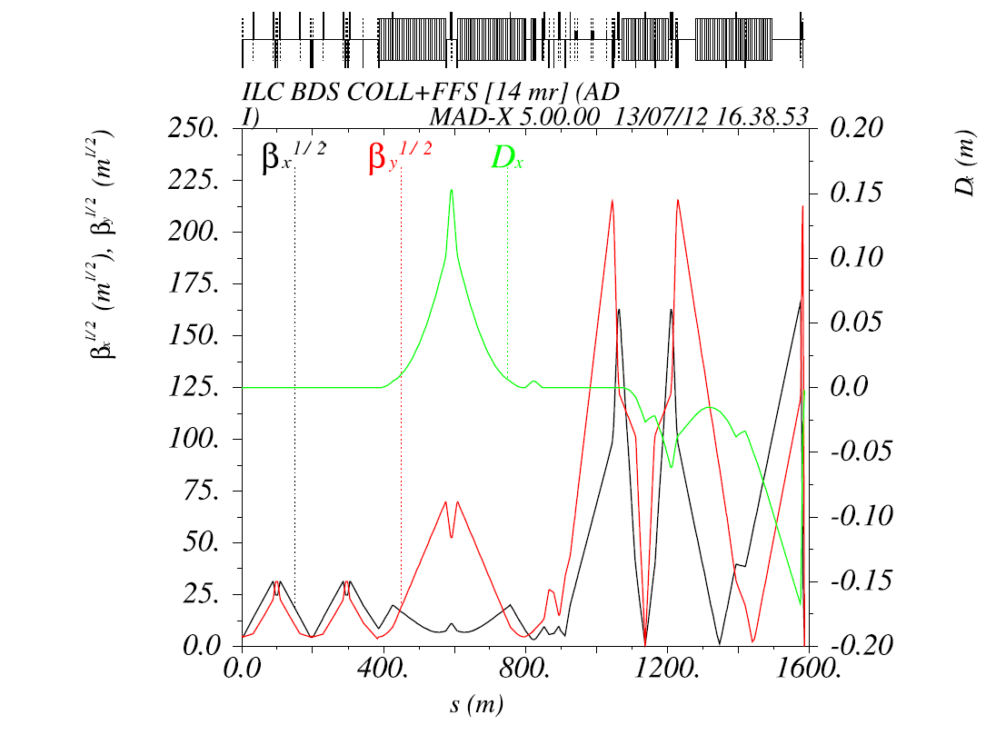
v.351LD0_135D1B (old version)
β_{x} = 0.015 ;
β_{y} =0.00040; Dx=-1.73528e-02
Original plot ( Dx=-1.735x10^{-3 !})
Corresponding beam sizes:
σ_{x}¹ _{=3.39e-06}
σ_{y}¹ _{=7.57e-09}

Slide 6
v.351LD0_135D1B ( new IP parameters)
Used QDO, Qf1, QD2A,Qf3, QD6,Qf5,QD4, QD2B + matching quads+ Sextupoles
β_{x} = 0013 ;
β_{y} =0.00041; Dx=-6.25e-05;
α_{x} =O(e-09);
α_{y} =O(e-09);
Corresponding beam sizes:
σ_{x}¹ _{=7.36e-07}
σ_{y}¹ _{=7.66e-09}
σ_{x}² _{=7.55e-07}
`σ_{y}² _{=7.75e-09}
σ_{x}³ _{=7.83e-07}
`σ_{y}³ _{=8.26e-09 .}
σ_{x}⁴ _{=7.92e-07}
`σ_{y}⁴ _{=8.41e-09}
.
σ_{x}⁵ _{=7.73e-07} σ_{x}⁶ _{=7.72e-07}
σ_{y}⁵ _{=8.63e-09} σ_{y}⁶ _{=8.58e-09}
σ_{x,y} / σ⁰_{x,y}
Beam size up to maximum order considered

Slide 7
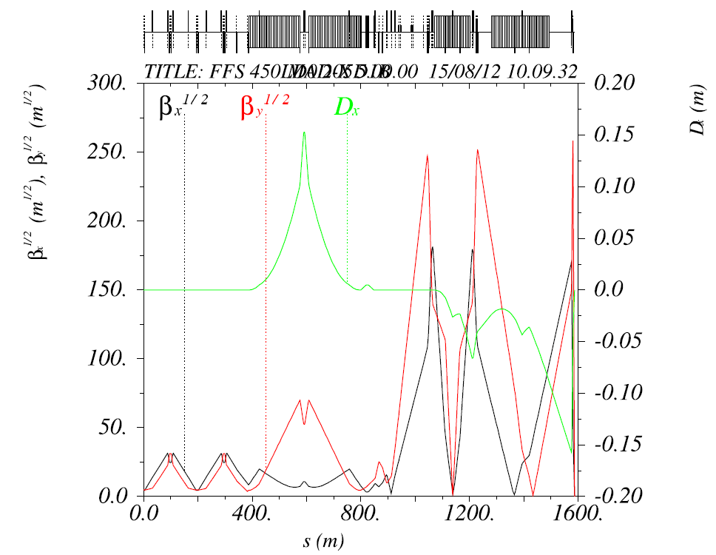
v.450LD0_205D1B –new optics
β_{x} = 0.01300000001 ;
β_{y} =0.000410000219;
α_{x} = O(e-010); α_{y} =O(e-9)
D_{x} =O(e-6);0
Used QDO, Qf1, QD2A,Qf3, QD6,Qf5,QD4, QD2B + matching quads to rematch to new Twiss
Used QDO, Qf1, QD2A,Qf3, QD6,Qf5,QD4, QD2B + sextupoles
Corresponding beam sizes:
σ_{x}¹ _{=7.29e-07}
σ_{y}¹ _{=7.66e-09}
σ_{x}² _{=7.41e-07}
`σ_{y}² _{=7.78e-09}
σ_{x}³ _{=7.521e-0}
`σ_{y}³ _{=8.01e-09 .}
σ_{x}⁴ _{=7.67e-07}
`σ_{y}⁴ _{=8.72e-09}
.
σ_{x}⁵ _{=7.54e-07}
`σ_{y}⁵ _{=8.52e-09}

Slide 8
v.450LD0_2055D1B-new optics
Corresponding beam sizes:
σ_{x}¹ _{=7.29e-07}
σ_{y}¹ _{=7.66e-09}
σ_{x}² _{=7.41e-07}
`σ_{y}² _{=7.78e-09}
σ_{x}³ _{=7.521e-0}
`σ_{y}³ _{=8.01e-09 .}
σ_{x}⁴ _{=7.67e-07}
`σ_{y}⁴ _{=8.72e-09}
.
σ_{x}⁵ _{=7.54e-07}
`σ_{y}⁵ _{=8.52e-09}

Slide 9
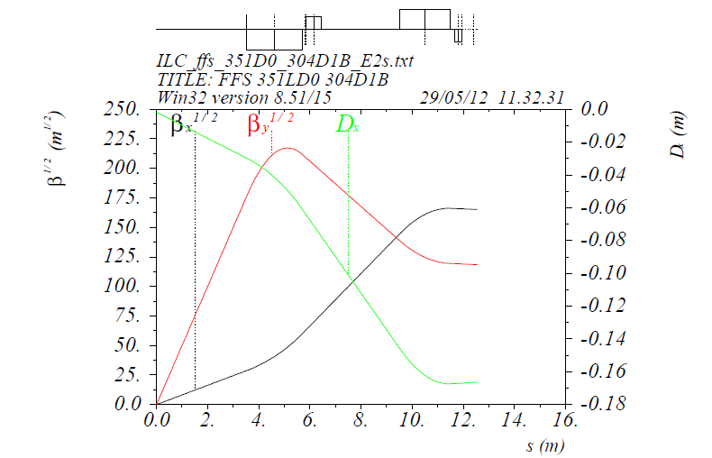
500 GeV CoM final doublet (orig.)

Slide 10
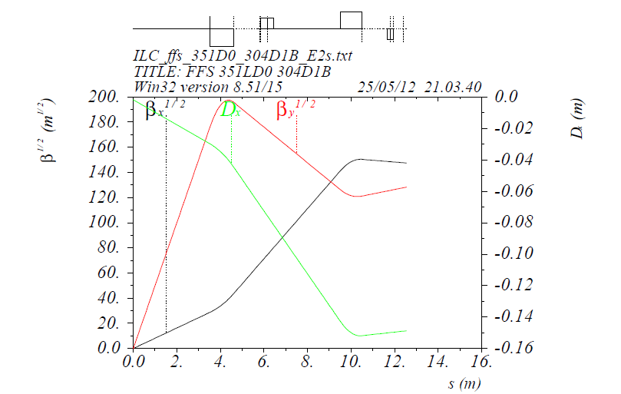
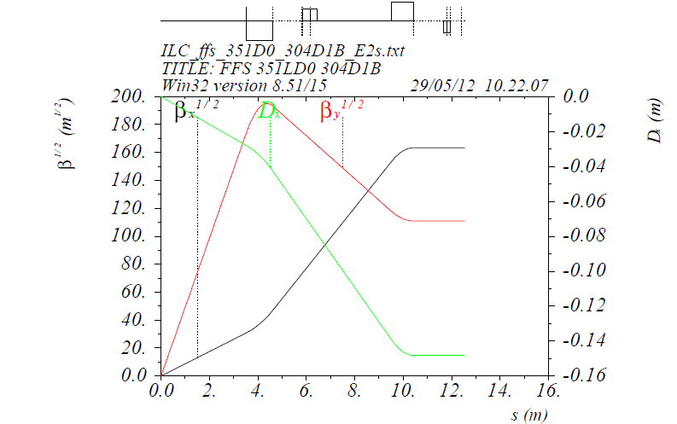
250 Gev CoM Half of FD is off
Replaced by drifts
Re-matched with
slight variation of QD0 and QF1
KQD0:=-0.30059( was -0.3046)
KQF1:= 0.11861 (was 0.14470)

Slide 11
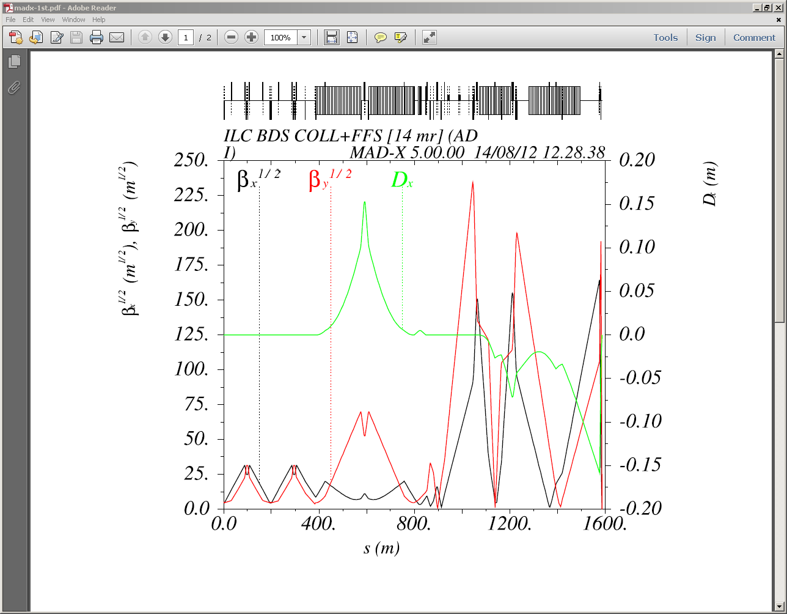
v.351LD0_135D1B (Half-quads)
Used QDO, Qf1, QD2A,Qf3, QD6,Qf5,QD4, QD2B + QF7,QD8,QD10, QF9+matching quads+ sextupoles
β_{x} = 0.013;
β_{y} =0.0004100; α_{x} = 4e-05;
α_{y} =-1.5e-09; D_{x} =O(e-5);
Corresponding beam sizes:
σ_{x}¹ _{=7.30e-07}
σ_{y}¹ _{=7.69e-09}
σ_{x}² _{=7.67e-07}
`σ_{y}² _{=7.78e-09}
σ_{x}³ _{=7.86e-0}
`σ_{y}³ _{=7.88e-09 .}
σ_{x}⁴ _{=8.74e-07}
`σ_{y}⁴ _{=9.19e-09}
.
σ_{x}⁵ _{=8.58e-07}
`σ_{y}⁵ _{=9.09.e-09}

Slide 12
v.351LD0_135D1B-new optics
( Half FD Quads)
Corresponding beam sizes:
σ_{x}¹ _{=7.30e-07}
σ_{y}¹ _{=7.69e-09}
σ_{x}² _{=7.67e-07}
`σ_{y}² _{=7.78e-09}
σ_{x}³ _{=7.86e-0}
`σ_{y}³ _{=7.88e-09 .}
σ_{x}⁴ _{=8.74e-07}
`σ_{y}⁴ _{=9.19e-09}
.
σ_{x}⁵ _{=8.58e-07}
`σ_{y}⁵ _{=9.09.e-09}
Used QDO, Qf1, QD2A,Qf3, QD6,Qf5,QD4, QD2B + QF7,QD8,QD10, QF9+matching quads+ Sextupoles

Slide 13
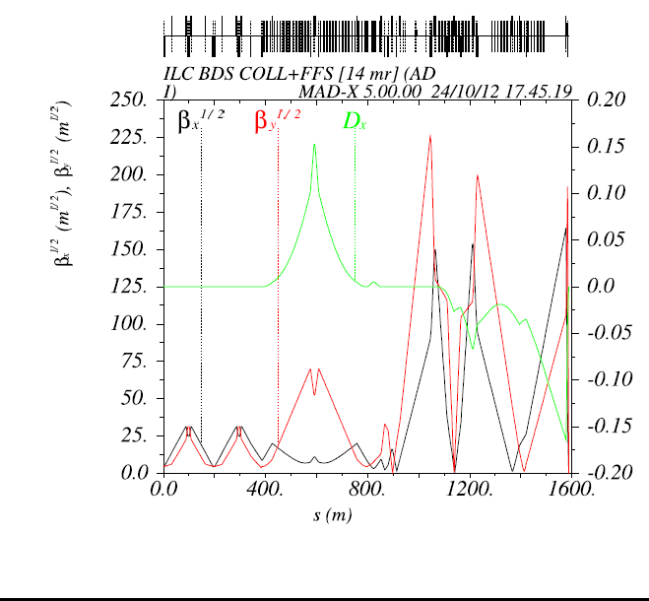
Decimation of dipoles
“So, for 250 GeV only two of these BS1 will be installed (i.e. one, 2.4 m long magnet) and other four 2.4 m long magnets will be installed in corresponding in ...SPACE at 500 GeV beam. The total angle at both 250 GeV and 500 GeV remains the same, so the footprint of the BDS does not change but dipoles are weaker at 500 GeV to keep the SR low.”
from D. Angal-Kalinin
Used the replacement “anzatz” from
B. List.
Replaced and checked that all the matching is still valid
New version of beamlines available.

Slide 14
v.351LD0_135D1B-new optics
( Half FD Quads )-1
Corresponding beam sizes:
σ_{x}¹ _{=7.30e-07}
σ_{y}¹ _{=7.66e-09}
σ_{x}² _{=7.39e-07}
`σ_{y}² _{=7.90e-09}
σ_{x}³ _{=7.48e-07}
`σ_{y}³ _{=7.93e-09 .}
σ_{x}⁴ _{=7.73e-07}
`σ_{y}⁴ _{=8.63e-09}
σ_{x,y} / σ⁰_{x,y}
Beam size up to maximum order considered

Slide 15
Conclusions/plans
R. Tomas’s code was tasted for Linear collider
250 Gev CoM lattice v.351LD0_304D1B with new IP parameters, new bending section and with half QD0/QF1 is ready
v. 450D0_205D1B with new IP parameters, new bending section is ready
v. 450D0_205D1B with half of QD0/QF1 requires more tuning
Tracking through lattices obtained (should be done

