Slide 1
Recent High-gradient test result at KEK
Linear Collider Workshop 2012
Arlington, Texas (WebEx)
25 October, 2012
Toshi Higo and X-band group of KEK

Slide 2
Contents
Performance comparison of prototype CLIC structures
  Processing speed
  Design parameters
  Breakdown rate
Proof with CLIC pulse operation
Some effort for understanding breakdown
Near-future studies in mind

Slide 3
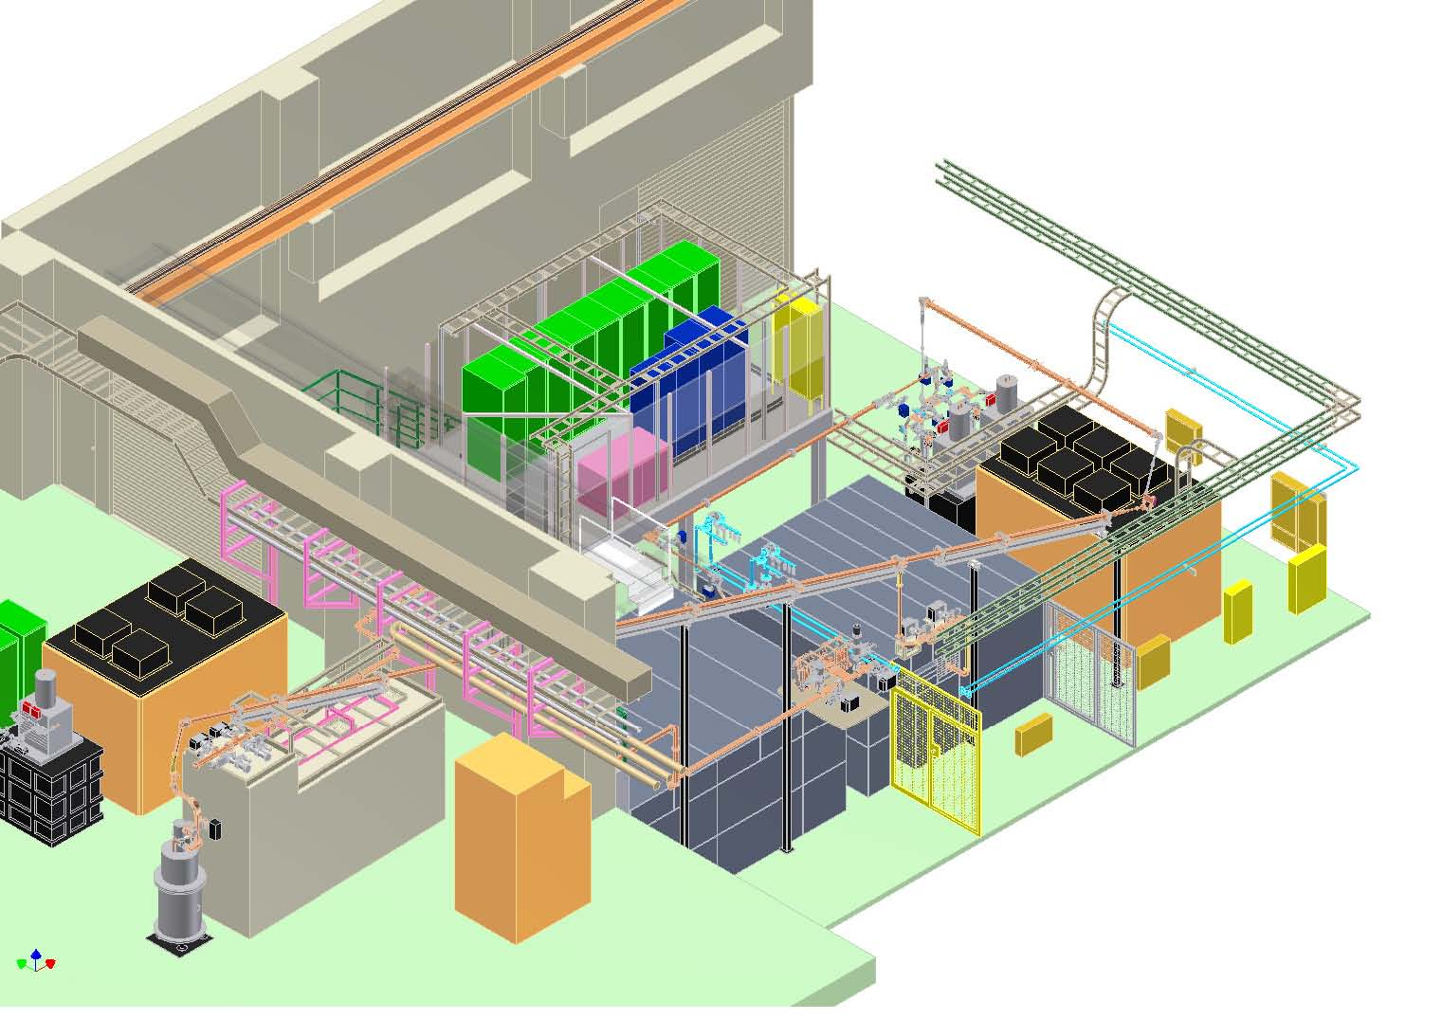
Nextef facilities at KEK
Nextef
X-band
KT-1
X-band
B
A
Basic tests at B
KT-2
C-band
Prototype tests at A

Slide 4
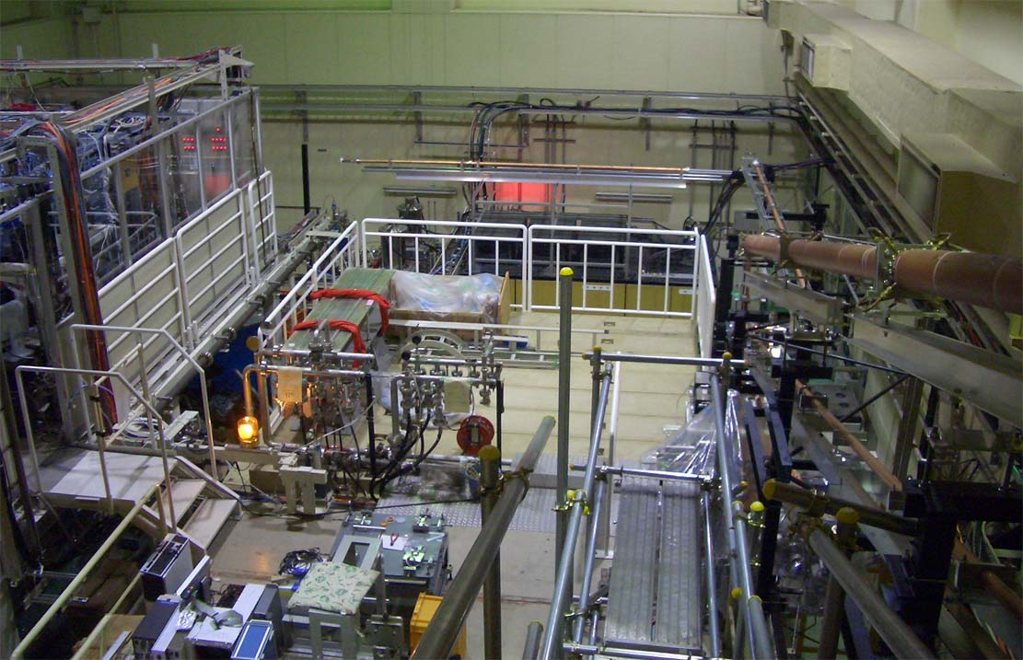
Nextef
RF source for A
Control
B
A
Power transfer to B

Slide 5
Comparison of
CLIC prototype structures in initial processing

Slide 6
Comparison of
CLIC prototype structures
Collaboration from 2007 ---
→ T18 2008 --- 2009
→ TD18 2009 --- 2010
→ T24 2010 --- 2011
→ TD24 2011 --- 2012
→TD24R05 2012 ----

Slide 7
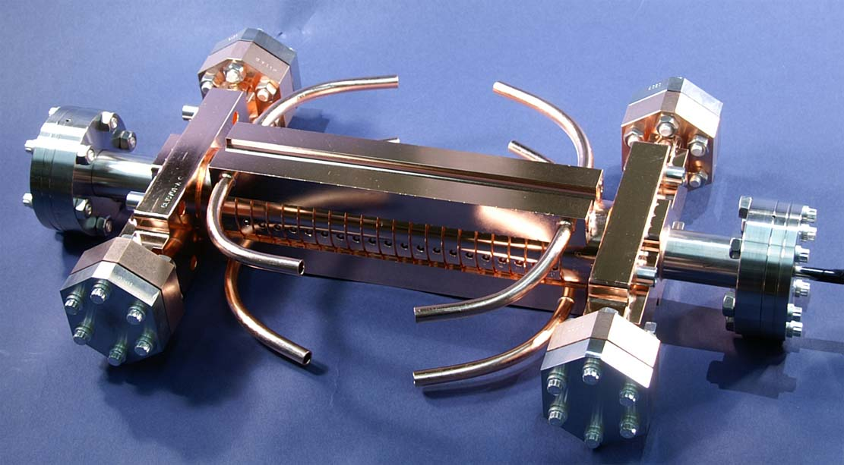
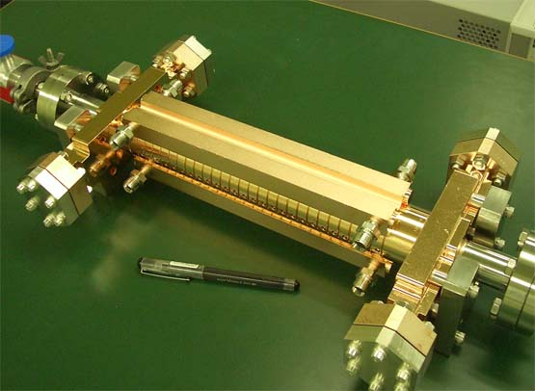


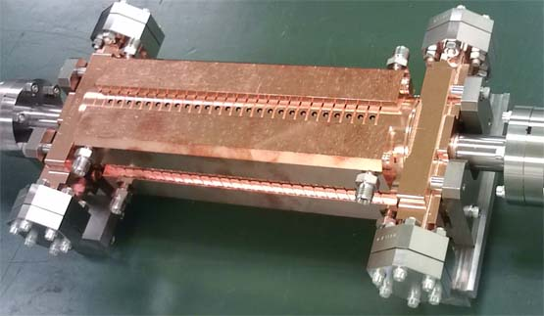
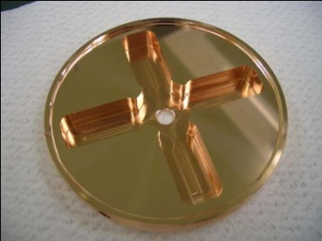
CLIC test structures; T18 →TD18→T24→TD24 a series of nominal fabrication by KEK+SLAC
undamped
T24_Disk_#3
T18_Disk_#2
2009
2011
2010
d
2011~12
d
damped
TD18_Disk_#2
TD24_Disk_#4

Slide 8
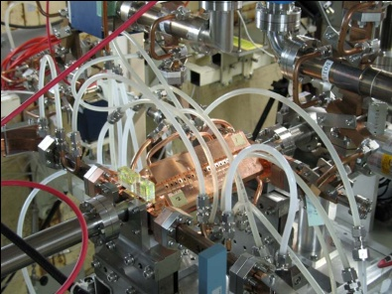
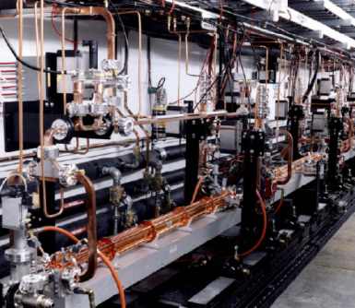

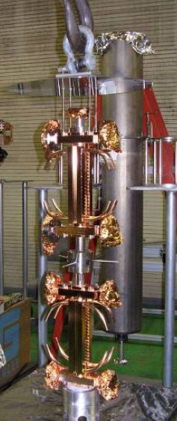
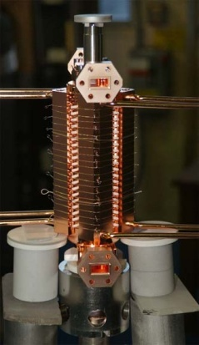
SLAC/KEK typical fab/test flow
Design for CLIC (CERN)
High power test (NLCTA-SLAC)
High power test (Nextef-KEK)
Fabrication of parts (KEK)
CP (SLAC)
VAC bake (SLAC)
Bonding (SLAC)
Notes:
プロトタイプの試験サイクル
ここでも 日米を基礎におく SLAC・KEK キープレーヤー

Slide 9
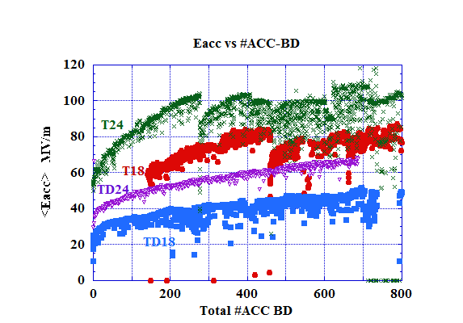
Comparison of initial processing starting at 51nsec

Slide 10
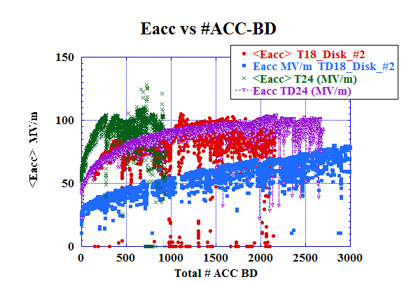
Difference in processing speed among four structures
More BD’s are required for damped!
BD’s are
needed for processing?
Can it be reduced?
T24
T18
TD24
TD18

Slide 11
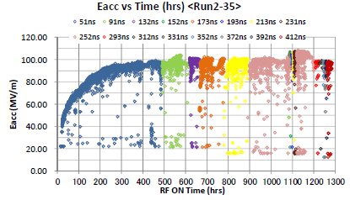
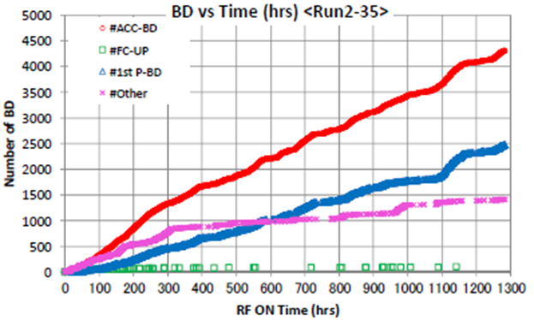
TD24#4 initial processing
132ns, 100MV/m
Through
ACC-BD = 2400
and
670 hours
ACC-BD

Slide 12
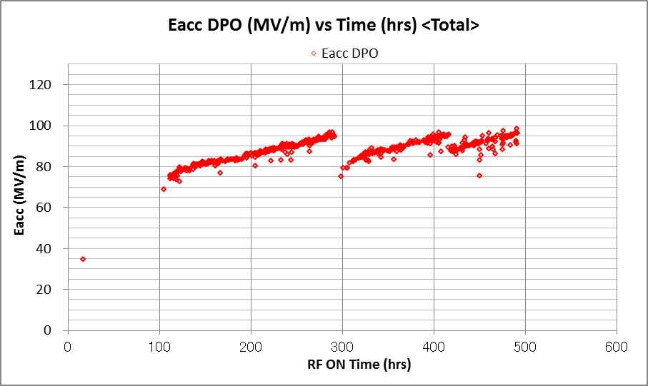
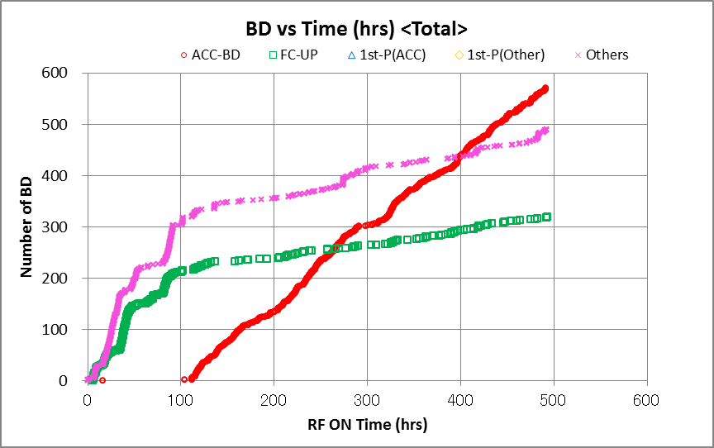
TD24R05 initial processing now
It has been processed to ~100MV/m at 132ns
in 500 hours at 50Hz
Accumulated ACC-BD events amounts only 800, much smaller than the early-tested structures.
Note: Most of ACC-BD were not taken. Those are included in FC-UP events shown in green dots.
51ns
91ns
132ns
132ns
91ns
51ns
51ns
91ns
132ns

Slide 13
Difference in processing speed among four+1 structures
Number if ACC-BD’s until reaching the same level in (Tp, Eacc)
Ranking
→T24
→TD24R05?
→T18
→TD24
→TD18
Magnetic field!?!?
TD24R05
T24
T18
91ns
132ns
51ns
TD24
TD18

Slide 14
Structure parameter choice

Slide 15
Reduced electric field 18 → 24
Alexej Grudiev
T18
Undamped
T24
Undamped
P (MW), Es (MV/m), Ea (MV/m), ΔT(C), Sc*50 (MW/mm2)
P (MW), Es (MV/m), Ea (MV/m), ΔT(C), Sc*50 (MW/mm2)
High Eacc
Reduce Eacc
Notes:
TW CLICプロトタイプ 試験 結果
Undamp 100MV/m
Damped → 80MV/m 実現

Slide 16
T24 TD24
Alexej Grudiev
Average unloaded of 100 MV/m
Increase of pulse heating ΔT ~ (Hp/Ea)^2
due to damping feature

Slide 17
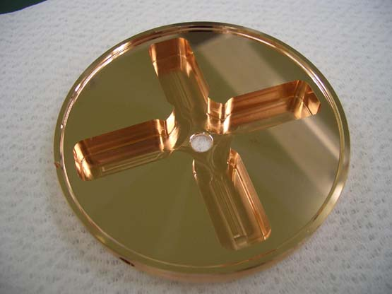
Reduced magnetic field 18 → 24
Alexej Grudiev
TD18
Damped
TD24
Damped
TD18 unloaded
100MV/m
TD24 unloaded
100MV/m
Sc
Es
P (MW), Es (MV/m), Ea (MV/m), ΔT(C), Sc*50 (MW/mm2)
P (MW), Es (MV/m), Ea (MV/m), ΔT(C), Sc*50 (MW/mm2)
Ea
Reduce Ep
P
ΔT
Iris number
Reduce ΔT (or Hp)
Notes:
TW CLICプロトタイプ 試験 結果
Undamp 100MV/m
Damped → 80MV/m 実現

Slide 18
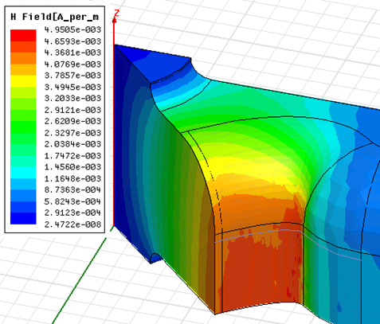
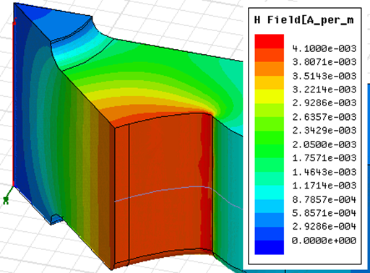
Reduce Hp/Ea and DT by reducing corner radius in the cell
Alexej Grudiev
TD24
TD24R05

Slide 19
Further reduce Hp/Ea
Alexej Grudiev
TD24
TD24R05
Average unloaded of 100 MV/m

Slide 20
Max field and temperature rise
 | Ep/Ea | Hp/Ea | Sc/Ea²
TD18 | 1.97 | 5.9 | 0.52
TD24 | 1.95 | 4.5 | 0.37
TD24R05 | 1.95 | 4.1 | 0.41
T18 | 1.95 | 3.2 | 0.47
T24 | 1.95 | 2.6 | 0.37

Slide 21
Breakdown rate and flat or CLIC pulse

Slide 22
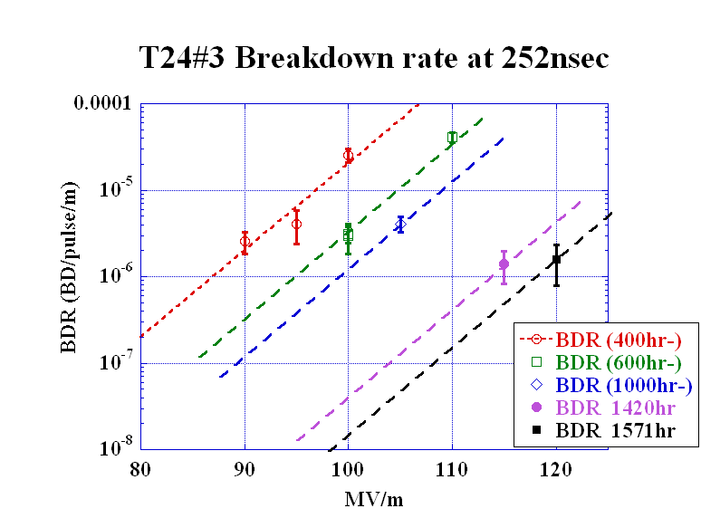
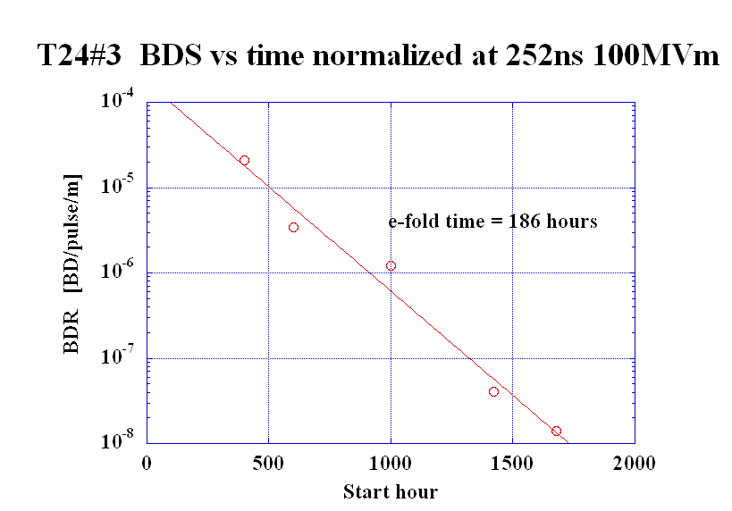
T24#4 BDR evolution at 252ns normalized 100MV/m
Assuming the same exponential slope as that at 400hr
BDR has kept decreasing.

Slide 23
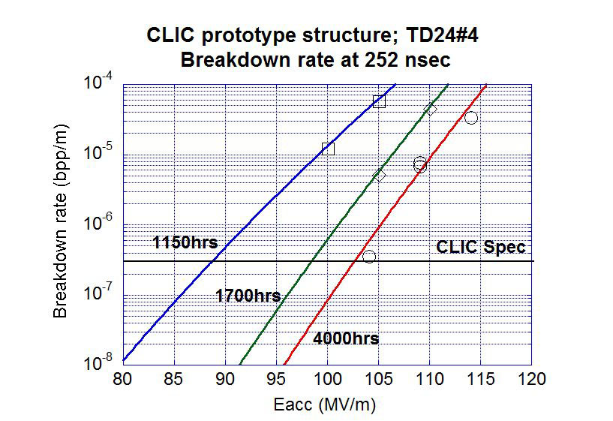

Slide 24
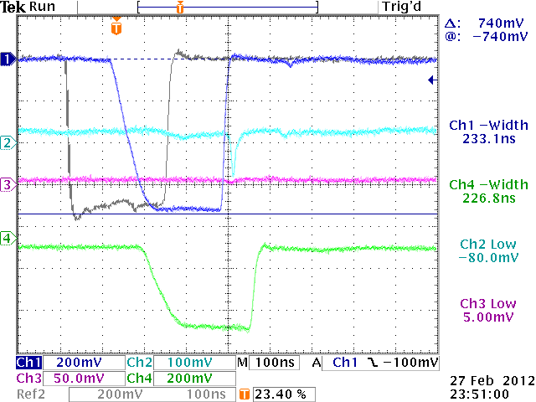
Nominal CLIC pulse
F(CLIC)
Rs
Tr

Slide 25
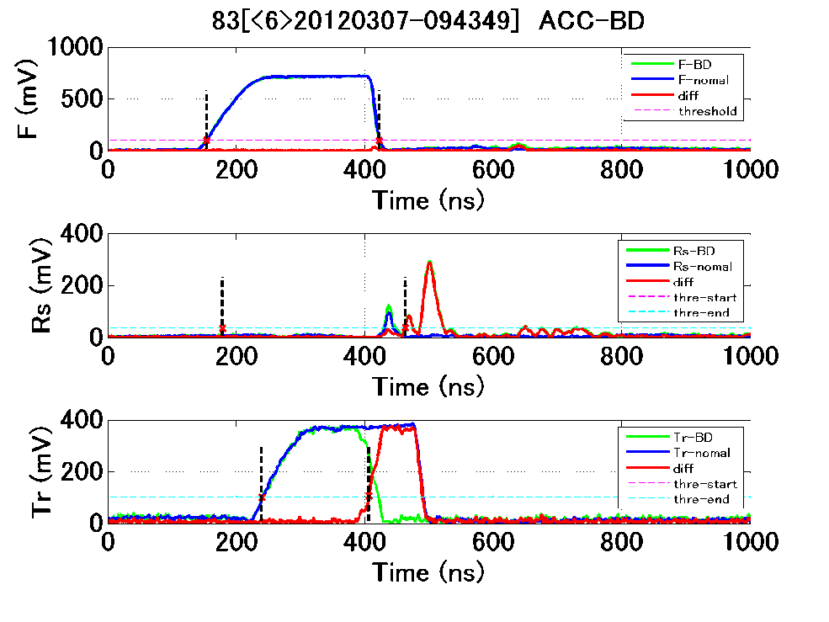
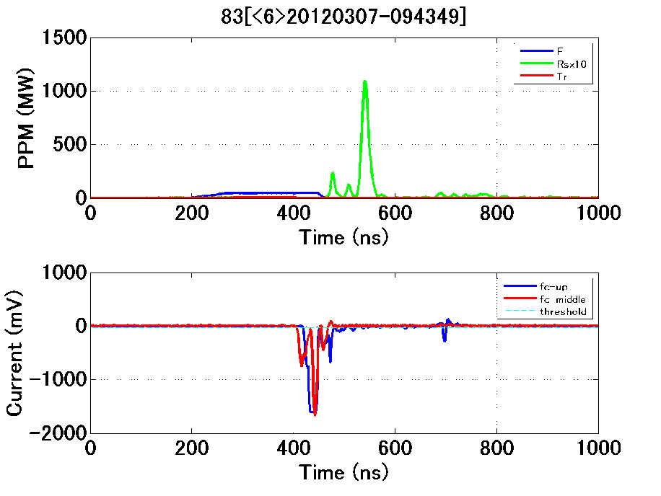
Only 3 breakdowns in 484 hour operation with CLIC pulse at FLT=100MV/m
1.6x10⁻⁷ bpp/m
ACC-IN
Rs
Tr
Rs
F
FC-UP
FC-Mid

Slide 26
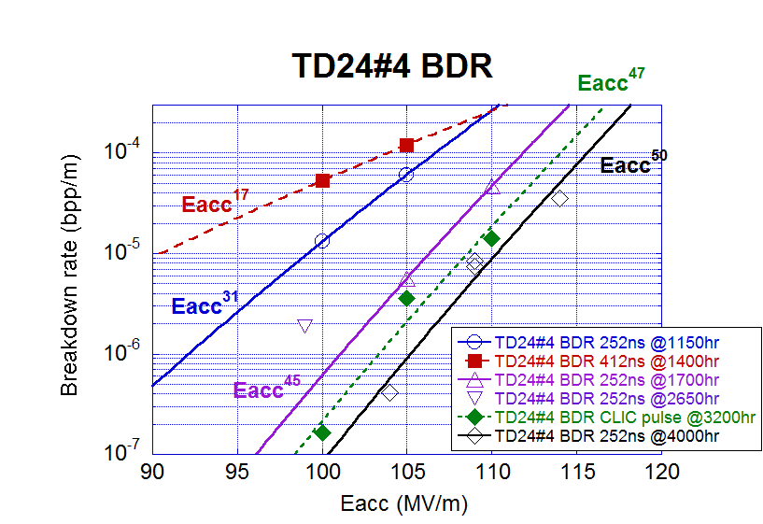
BDR summary on TD24
comparing to T24
T24#4(final)

Slide 27
BDR results of TD24#4
BDR decreases as processing, as usual
Larger BDR than T24 but much less than TD18
CLIC requirement is met through 2000 hours processing
BDR seems still keep decreasing
CLIC requirement (3X10⁻⁷ bpp/m) was actually confirmed in CLIC pulse

Slide 28
Various studies toward understanding of vacuum breakdowns

Slide 29
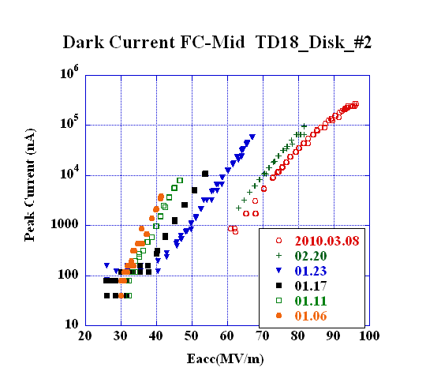
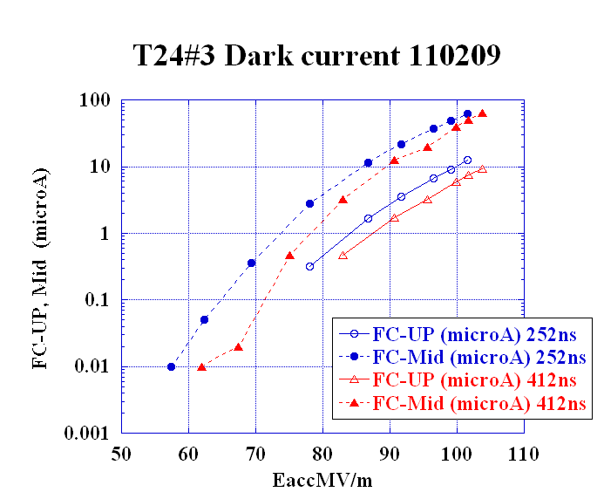
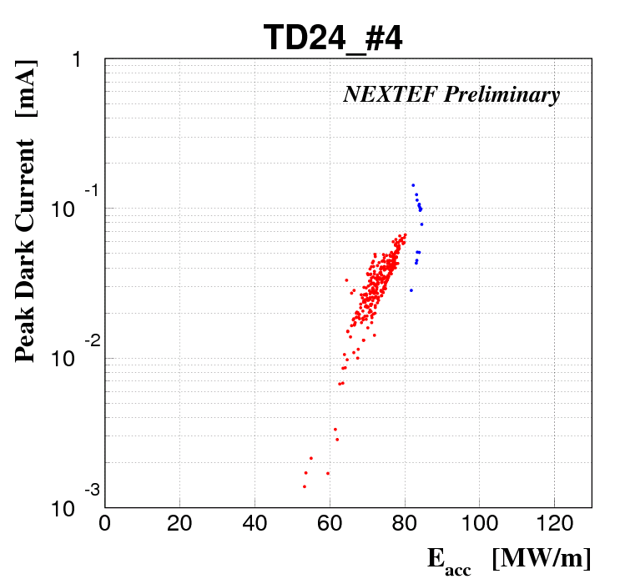
Comparison of dark current
Last year LCWS2011
T18_Disk
TD18_Disk
T24_Disk
TD24_Disk
(51ns processing)
Eacc for peak dark current of 10 μ
90MV/m 70MV/m 100MV/m (80MV/m)
Undamped 90~100 MV/m damped 70~80MV/m

Slide 30
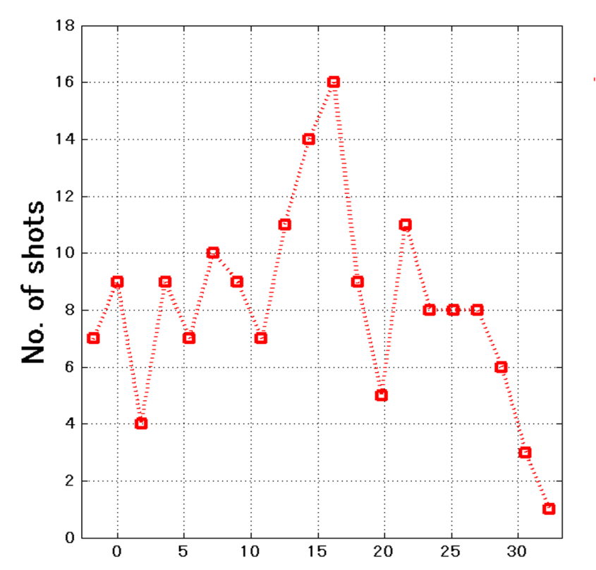
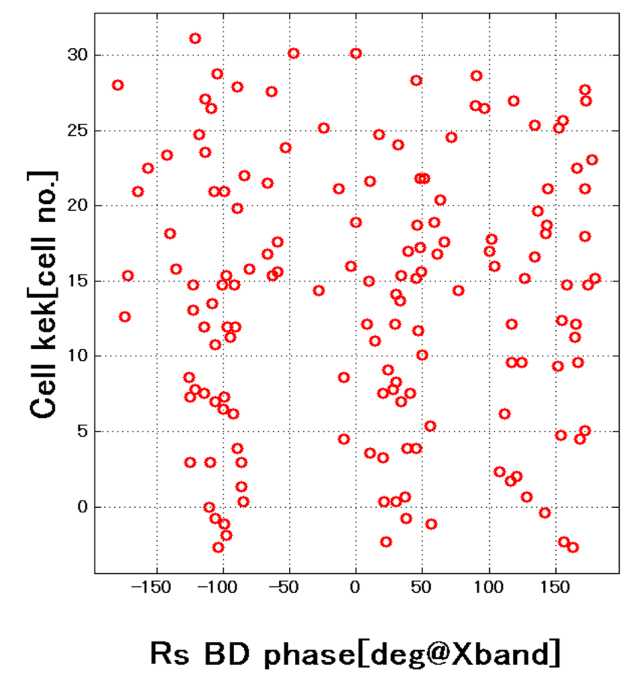
Identification of BD location from RF pulse shape and reflected phase
TD24R05#2
BD cell #
No special location nor steep variation along the structure.
→ Probably surface related mechanism is important to study.

Slide 31
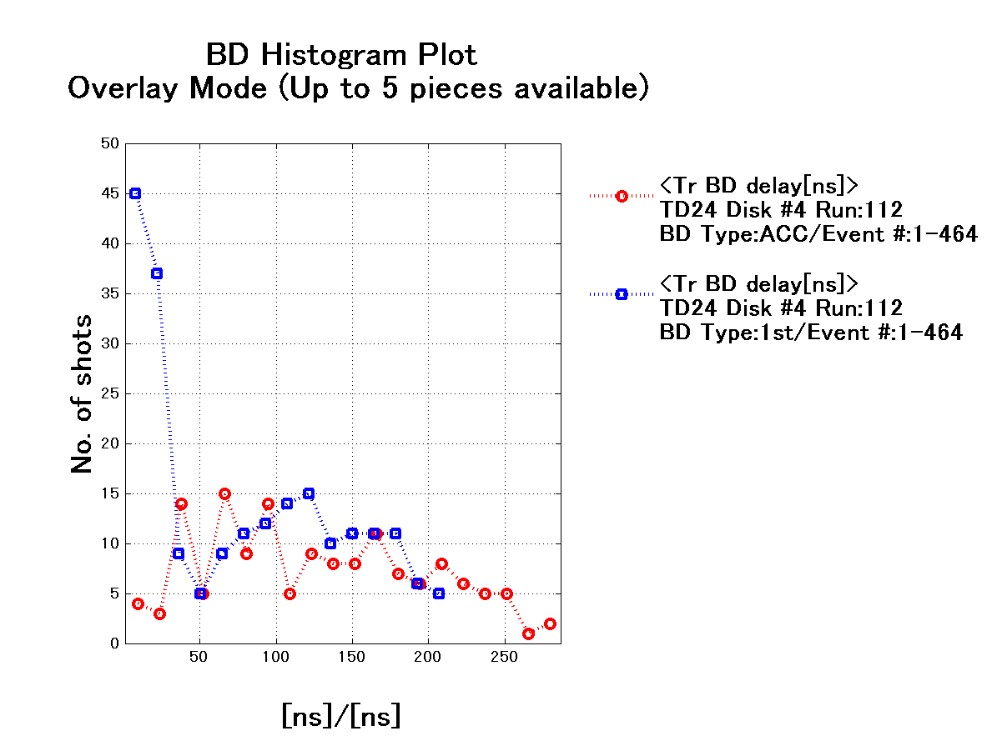
BD timing in pulse evaluated by decay timing of transmission
Uniformly distributed in the pulse for nominal ACC-BD.
High probability at the beginning of pulse for the 1st-pulse BD.
1st-pulse BD
Niminal BD
No BDR increase was observed in time in the pulse!!
Is it usual?
Is it naturally understood?
We see in many cases in structure test, but contradictory to the result we observed in the waveguide experiment!?

Slide 32
Switching mode operation in power and width
Power
Width
2sec
Time
As one of the trials to study memory on following pulses.

Slide 33
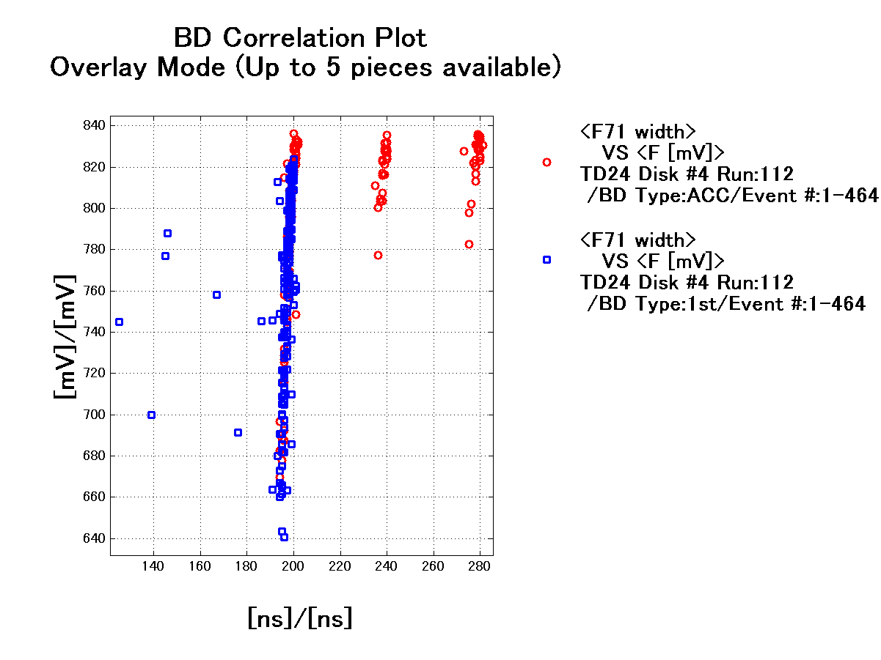
Width and Power → Failed!
Ned more sophisticated experimental programming!
More BD’s in higher Eacc.
→ Obvious!
Power dependence was not well resolved.
→need more spacing in power level.
→ need more time to study in this mode.
Lower power BD’s in 1st-pulse BD
→Because startup with less power setting
for recovery routine.
BDR characteristics on width is not evident.
→ Need more statistics.

Slide 34
Setups being prepared to study basic characteristics and mechanism of vacuum breakdowns in RF

Slide 35
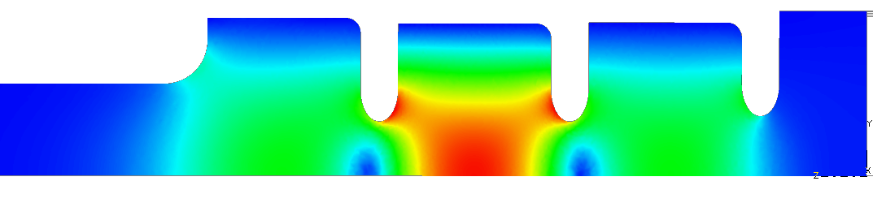
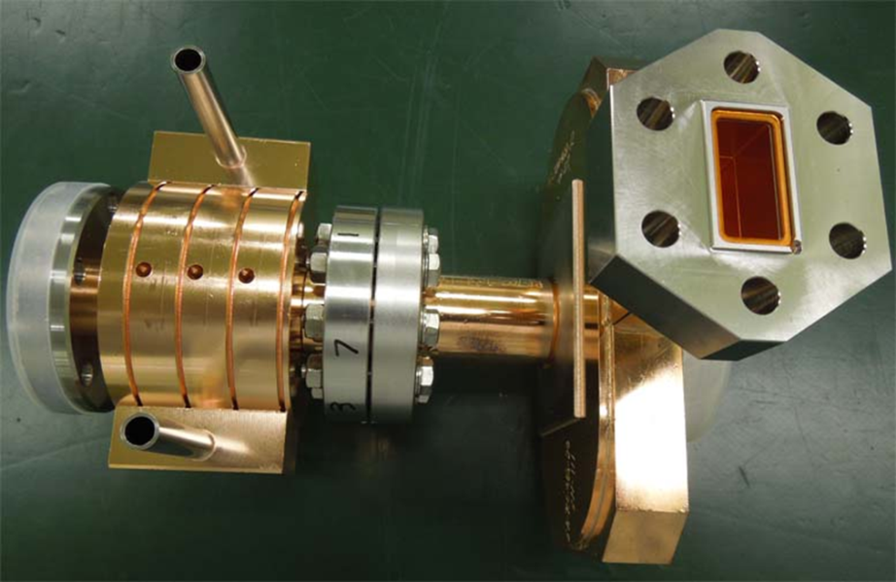
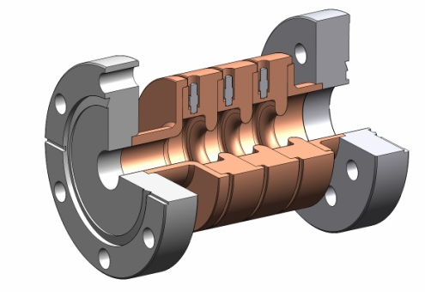
Single-cell setup just as that established by SLAC
We will study breakdown characteristics taking much focus on the initial processing stage appearing at medium field, 60-100 MV/m
Notes:
基礎試験用
モードロンチャー SLAC製 → KEKで使用
単セル空洞 を 今後の日米資金と協力関係を元に 製作 ＋ 試験 できる

Slide 36
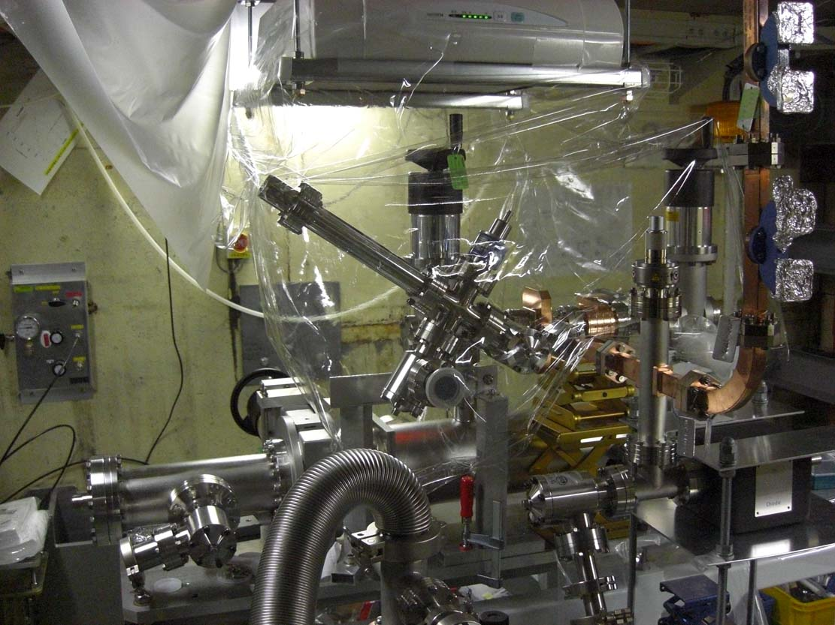
Preparation of setup in shield-B
HEPA
GV
Cavity
NEG
Waveguide

Slide 37
Studies in mind
Explore basic research in a simple geometry
Center cell is such as the following
  Standard: KEK made – SLAC test
  Nominal: Heavily-damped
  Made of large-grain material
  Undamped but all-milled
  All milled quadrant type
  Choke-mode type (take Tsinghua design?)
These are under preparation
Notes:
継続申請の3年間の目標 概略
基礎試験の立ち上げ
複合材料を含めた試験
TWでの可能性 見極め
放電頻度を決める放電のトリガーの理解
100MV/m超の加速ユニットの提案

Slide 38
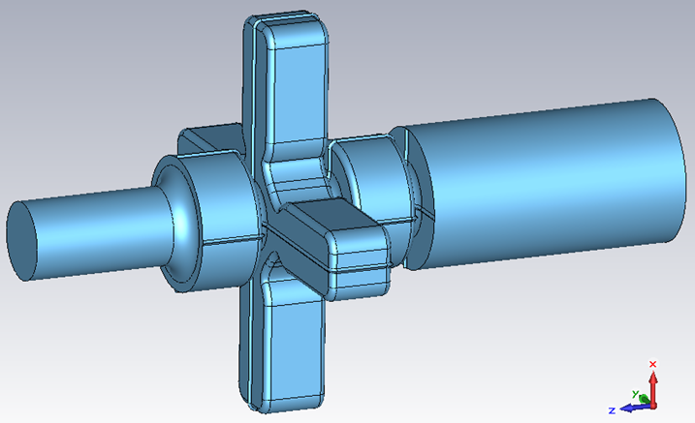
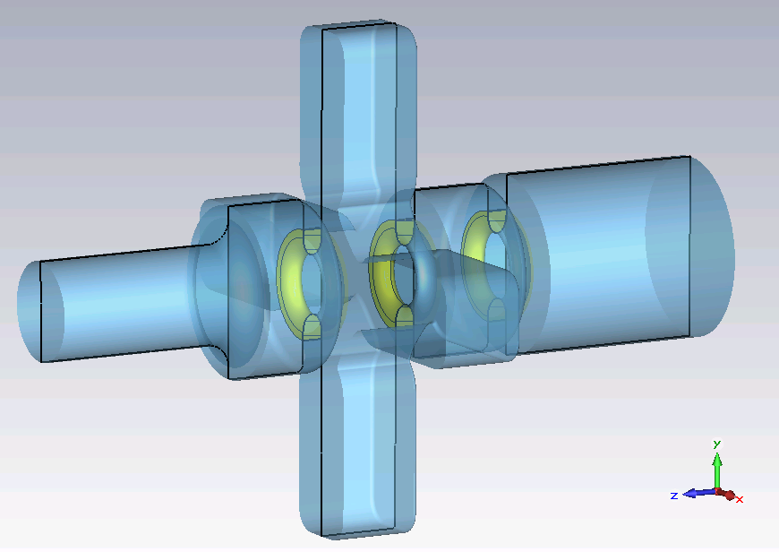
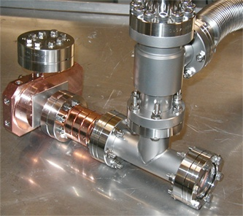
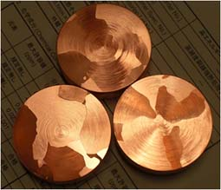
Some studies in mind
Quad with large chamfer radius
Damped cell
Crystal characteristics
Clean surface

Slide 39
Conclusion
Finished high gradient test of four CLIC prototype structures.
TD24 closest to actual CLIC3000 has estimated to meet CLIC BDR requirement in full-flat pulse. CLIC pulse operation was actually confirmed to meet CLIC BDR requirement.
Processing of TD24R05 recently started. Initial processing speed as function of # of ACC-BD showed better than TD24, and even better than T18, up to 132nsec . (preliminary)
Basic study test stand is ready to start. The klystron for it is being evaluated whether to be recovered from water leakage into waveguide.

