Slide 1
Structure testing and RF tests stands
Jan Kovermann
CERN
On behalf of the CLIC structure test team

Slide 2
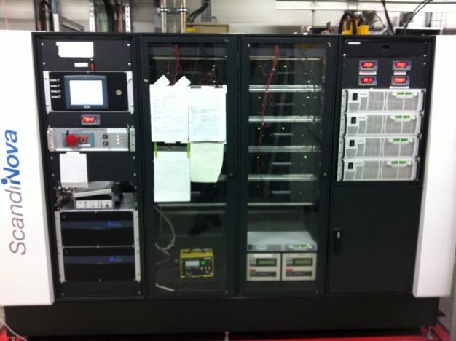
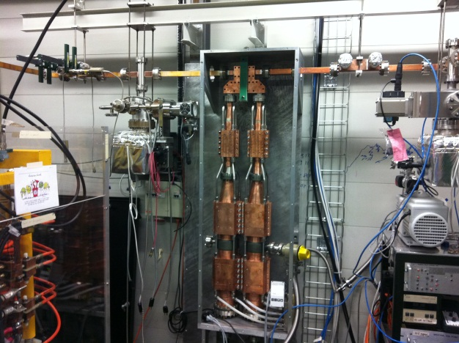
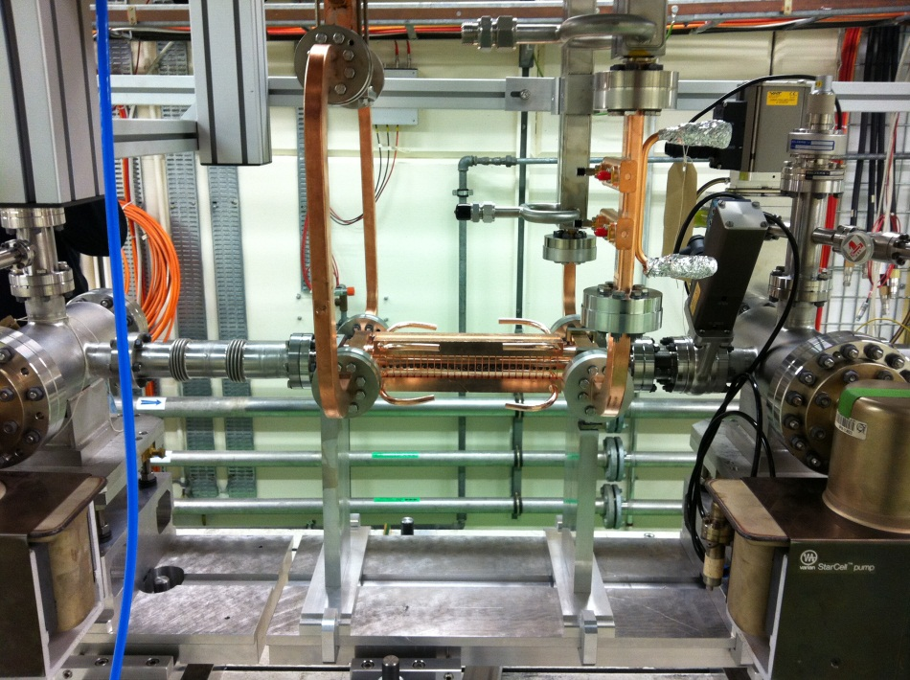
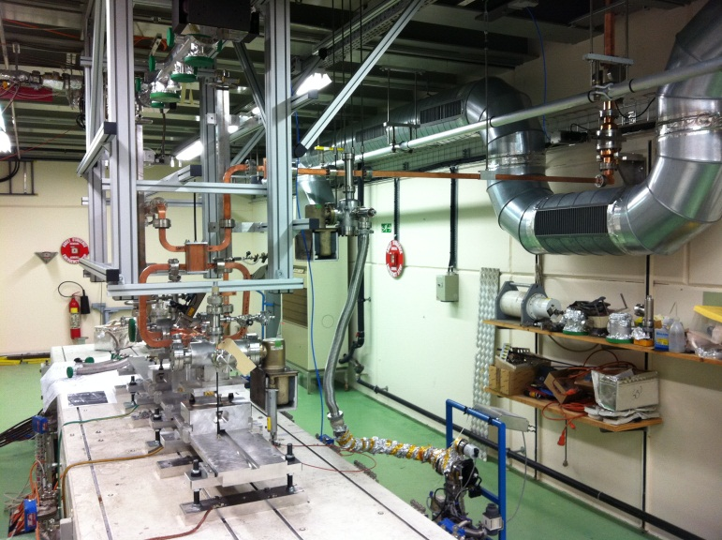
Layout of the CERN x-band test stand
(X-box 1)
Clockwise from top-left:
Modulator
Pulse compressor
DUT + connections
Accelerating structure
Gallery
Bunker

Slide 3
Components of X-box 1
Klystron (SLAC XL5, #1 prototype)
  50 MW, 1.5us pulse width, 50Hz rep. rate
Modulator (ScandiNova K2-3X solid state, #1 prototype)
  Max. 450kV, 350A, 3.5us pulse width, 50Hz rep. rate
Pulse compressor (GYCOM Russia, #1 prototype)
  50MW, 1.5us rf → 140MW, 250ns rf
DUT (CLIC T24 accelerating structure)
  11.99424GHz, 24 regular cells, 2 coupling cells,
  2 symmetric in/out couplers,
  100MV/m acc. Gradient @ 42MW rf input power
  And several other new high-power rf components like valves, directional couplers, mode converters etc.

Slide 4
Status of X-box 1
Hardware installation finished this summer
Development of control and DAQ software on-going
Waveguide network including pulse compressor conditioned up to 20MW av., 1.5us, 50Hz into compressor, 170ns, 30MW, 50Hz out of compressor into structure. Pulse compressor needed about 200h of rf cleaning to reduce outgassing (chem. cleaning/baking not possible)
SC solid state modulator is running without major problems, pulse-to-pulse stability is excellent (10^-4)
Klystron output window showed activity when arriving in the 20MW, 1.5us regime, but calmed down after ~25h of conditioning
T24 structure reached 80MV/m@10^-6/pulse and 170ns PW
24/7 operation still limited due to pulse compressor instability at increased breakdown rate, working on new operating schemes to overcome that limitation

Slide 5
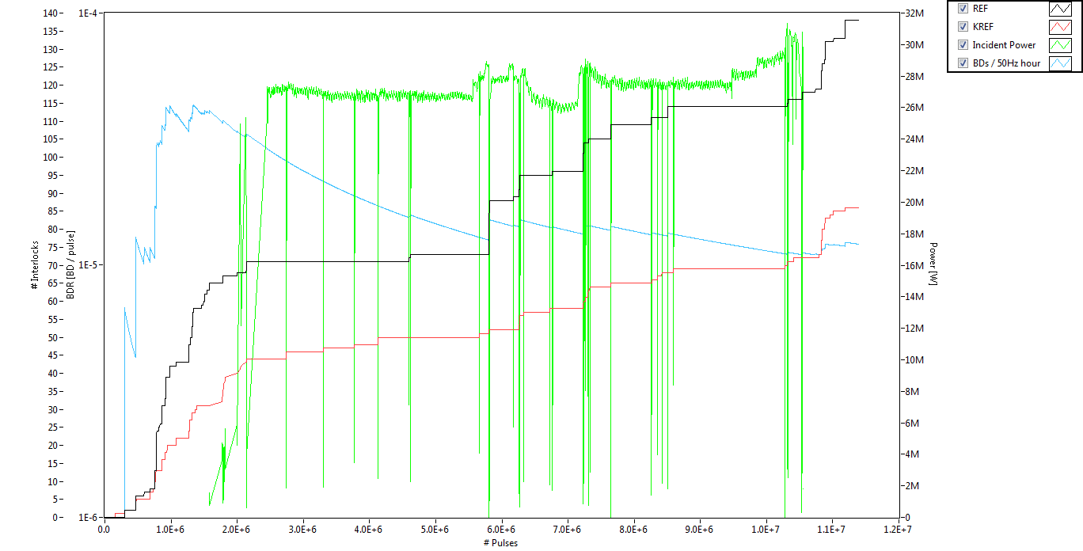
Current results with new X-box 1 DAQ system
All data @ 170ns PW
Structure BDs
Network BDs
11385142 pulses (63h@50Hz), 138 structure BDs, 86 system BDs
DAQ system logging deployed first time mid of October, but software development not yet completely finished! Just starting to take data!

Slide 6
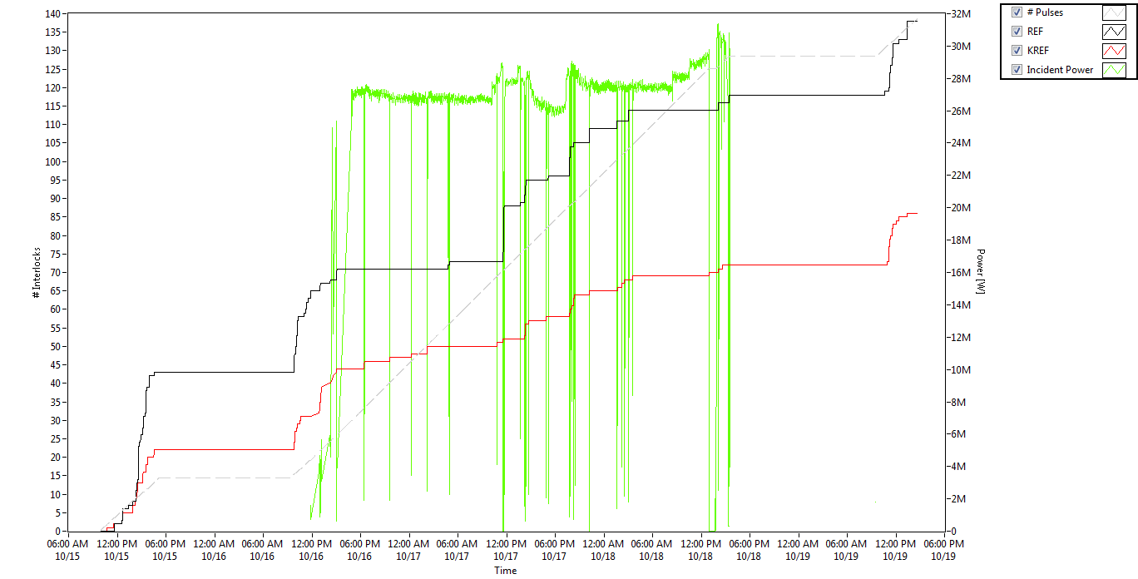
Current results with new X-box 1 DAQ system
In real time, several hours of running missing due to instable pulse compressor:
BDs stop rf, pulse compressor cools down and detunes, compensation using frequency tuning seems to increase structure BDR

Slide 7
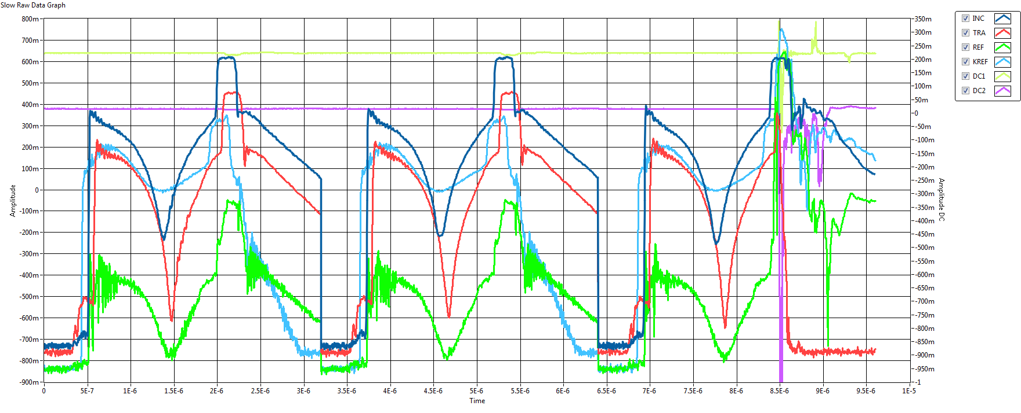
Current results with new X-box 1 DAQ system
Phase modulation for pulse compression works well, rf flat top can be easily controlled using the dark current emission waveform. Logarithmic power detectors ease operation at all power levels and help to obtain good power resolution without saturation effects during breakdown.

Slide 8
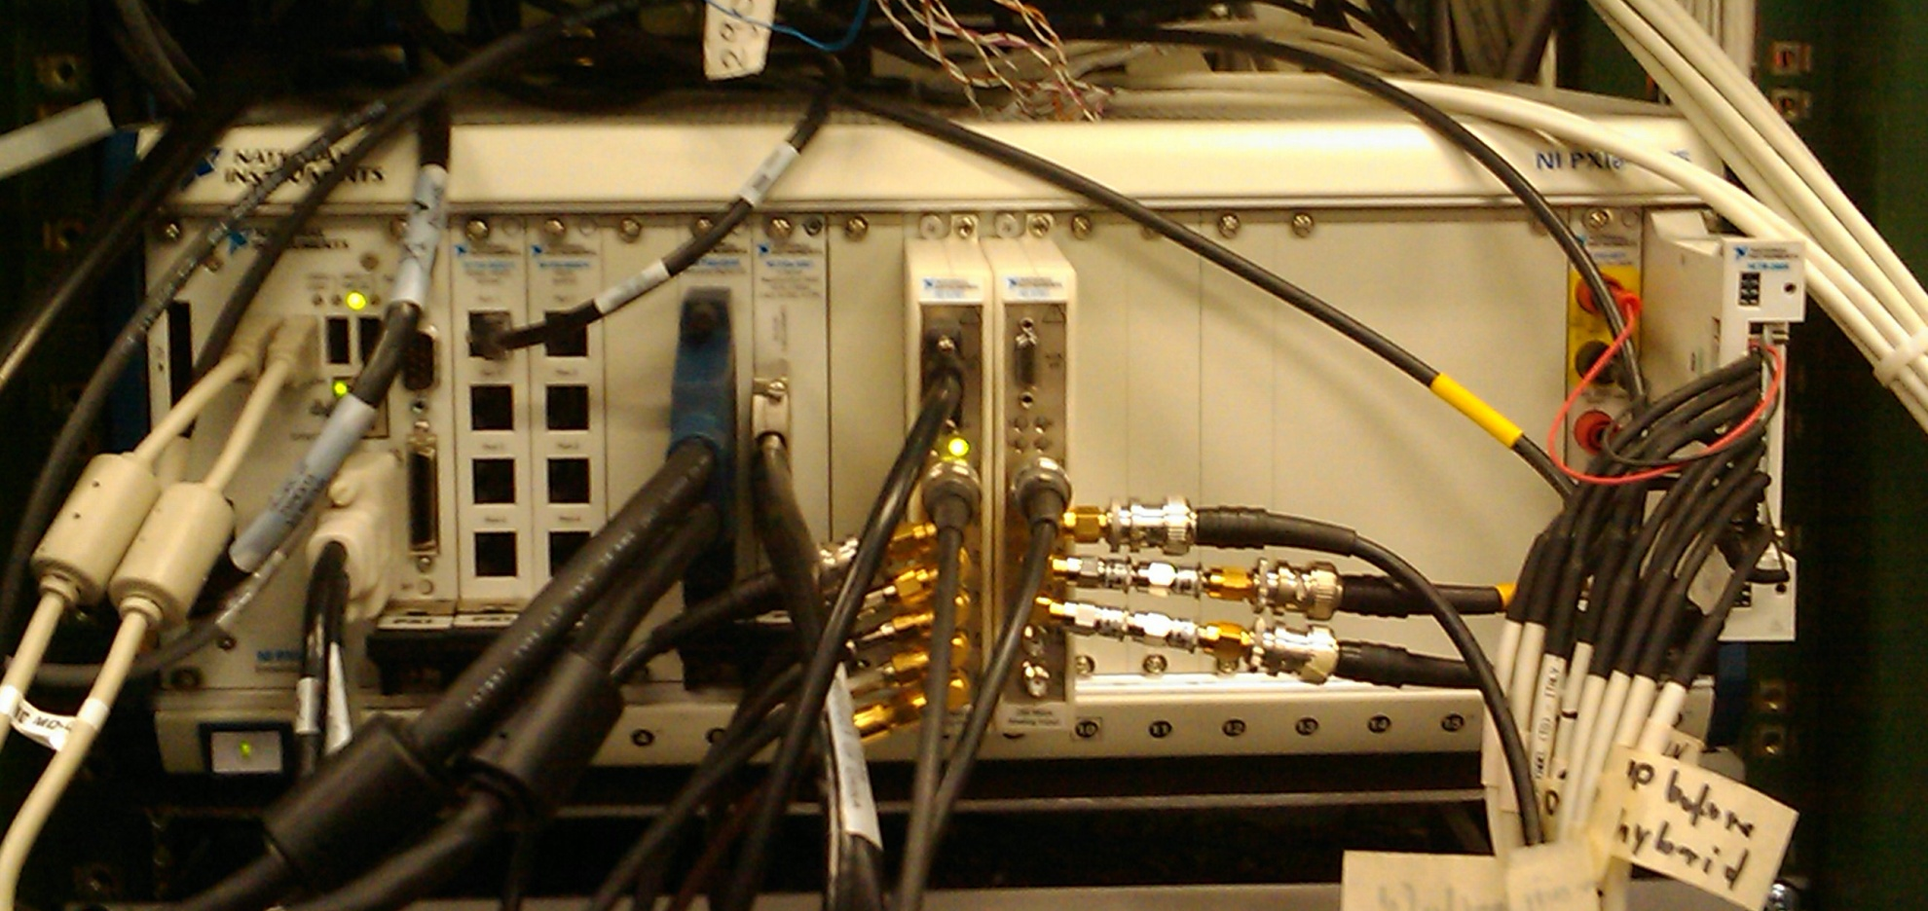
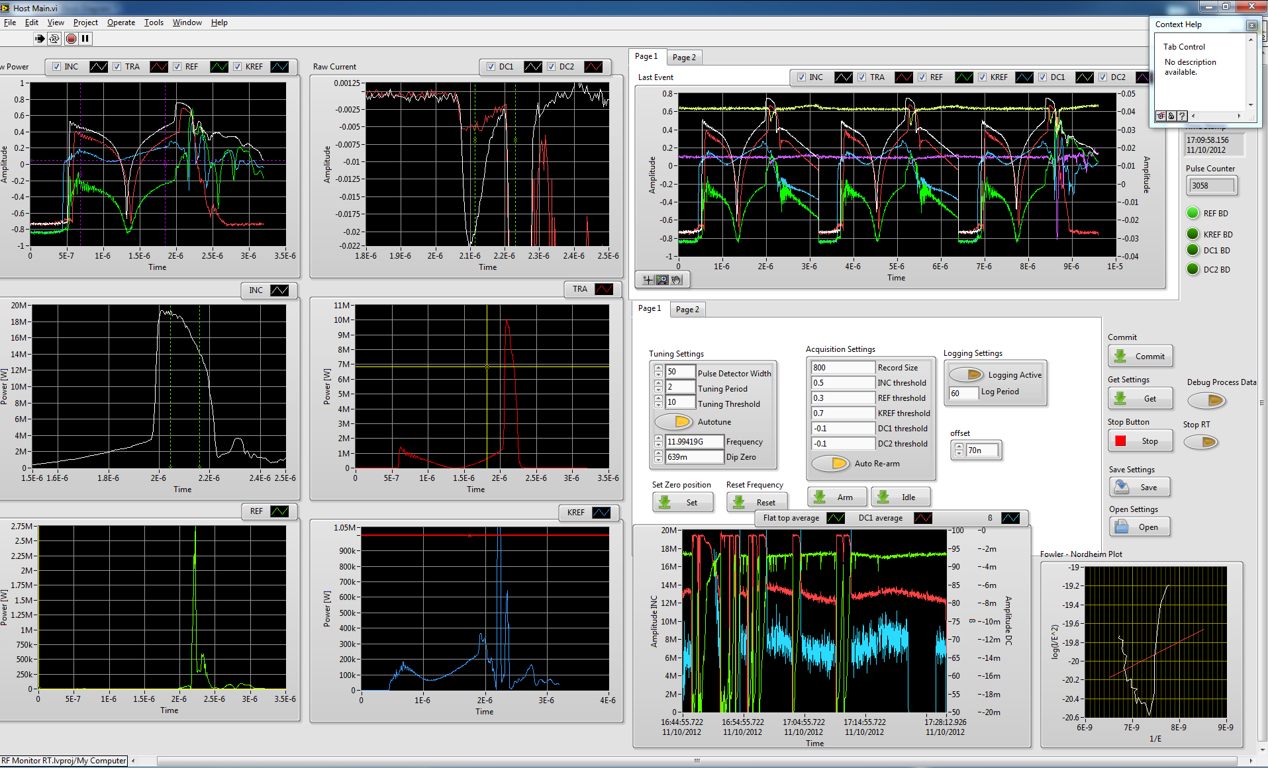
New X-box 1 DAQ system
Based on NI LabView and NI PXI hardware
50dB log detector into 14bit 250MSps/s ADC for controls
Last interlock event display (plus two previous pulses)
Log det raw data
Interlock levels, calibration etc.
Dark current
Inc. power
Tra. power
Power, DC, beta history
Ref. power
Ref. power to klystron
Single shot FN-plot
All at 50Hz rep. rate! 400Hz possible!

Slide 9
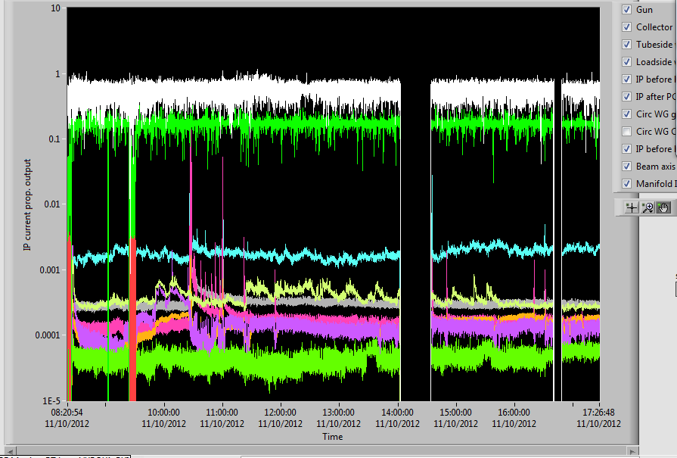
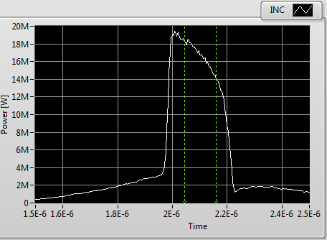
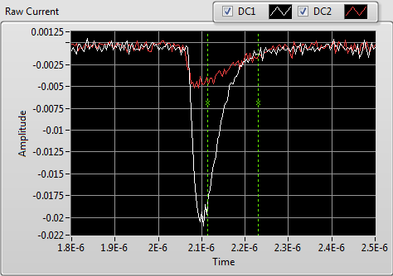
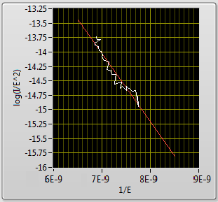
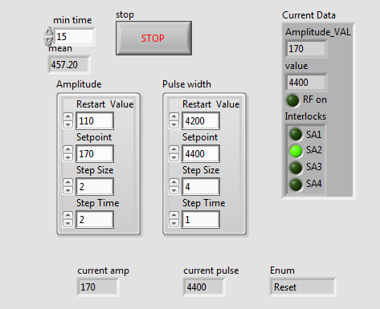
New X-box 1 DAQ system
Based on NI LabView and NI PXI hardware
Vac history plot
Automatic conditioning
Beta = 70 +/- 5

Slide 10
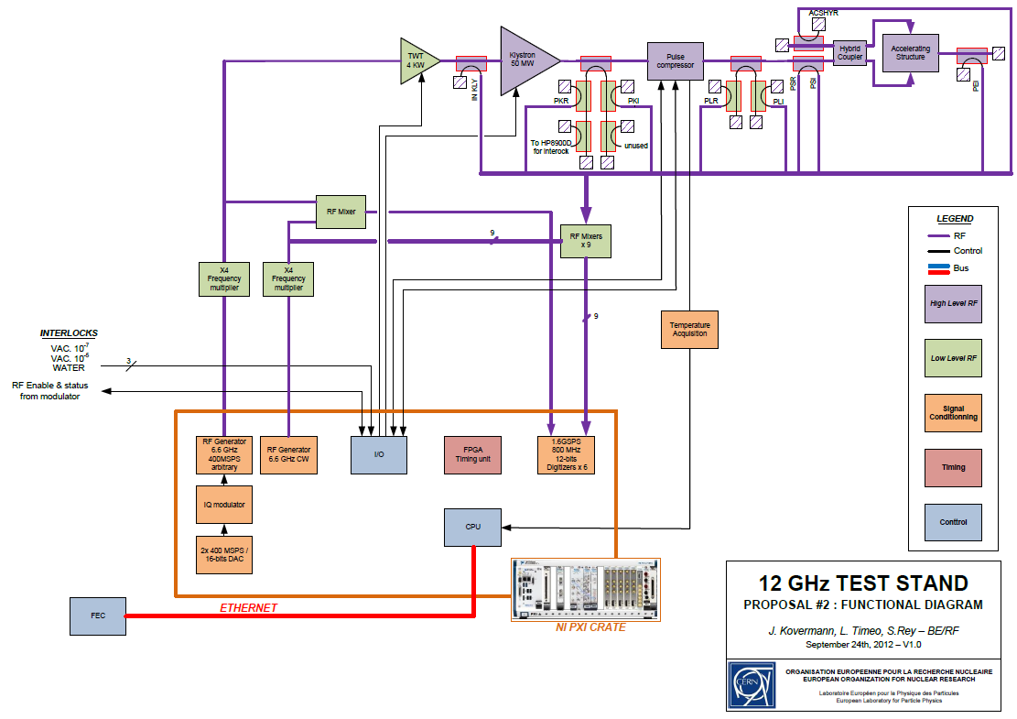
Development of improved DAQ system for Xbox 2
Improve rf DAQ by using faster ADCs with higher dynamic range (1.6Gsps/s, 800MHz analogue BW)
Decrease system complexity and calibration issues by using a down mixing and direct IF sampling scheme
Low-level synthesis of driving rf signal with I/Q modulator and two 400Msps/s DACs allows very flexible pulse shaping
Only one PXI crate for timing, interlocks, low level rf synthesis and rf data acquisition
All interlocks as FPGA logic with watchdog and multiple instances gives high reliability
Independent of CERN control system
Operation at 400Hz repetition rate seems feasible
Proof of concept until beginning of 2013

Slide 11
Future CERN RF test-stands progress

Slide 12
50 MW klystron station #2 (X-Box 2).
50 MW CPI klystron. Some brazing problems in production of the first tube. Hopefully final brazing will be done towards end of October 2012. If successful, the testing will start in December 2012. The delivery to CERN is expected in March 2012.
“ScandiNova” HV modulator has been ordered from the company. Following the schedule, it will be delivered to CERN in March 2013.
New SLED type RF pulse compressor. All the pieces are fabricated at CERN. Going trough the final brazing steps. Ready for the low RF power tests in November 2012.
The various RF components of are ordered from the industry. First prototypes will arrive to CERN in November 2012 for the acceptance RF check. The rest will be delivered to CERN before March 2012.
The detailed 3D layout and integration of the test stand are ready.

Slide 13
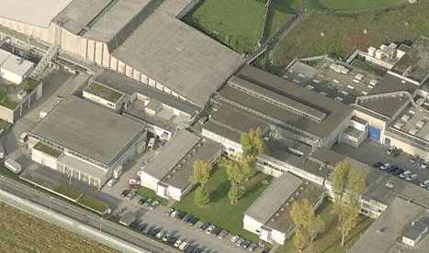
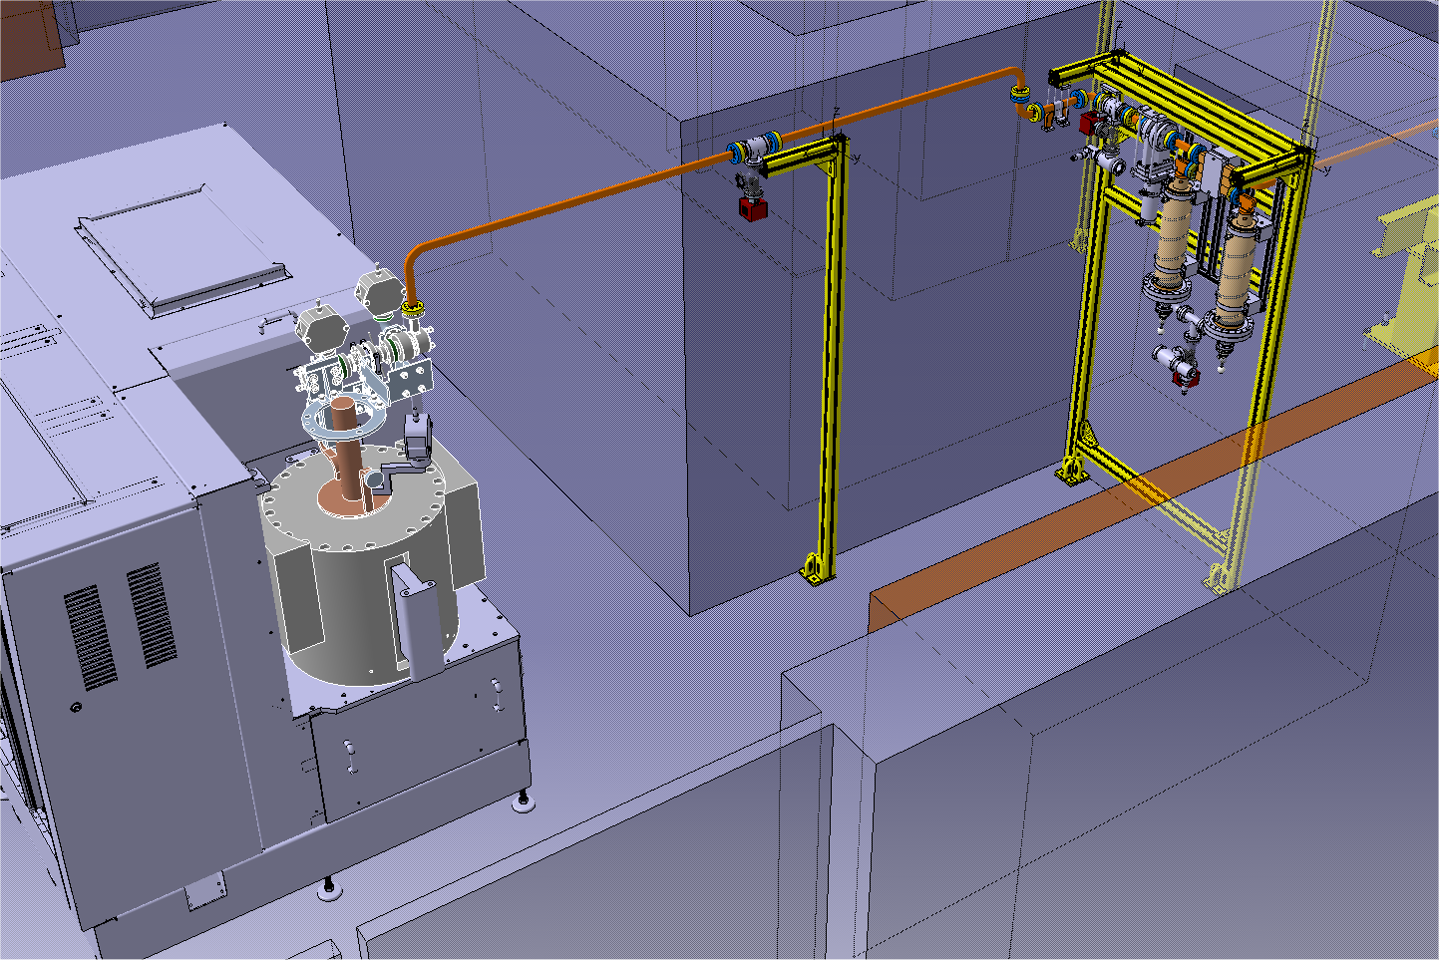
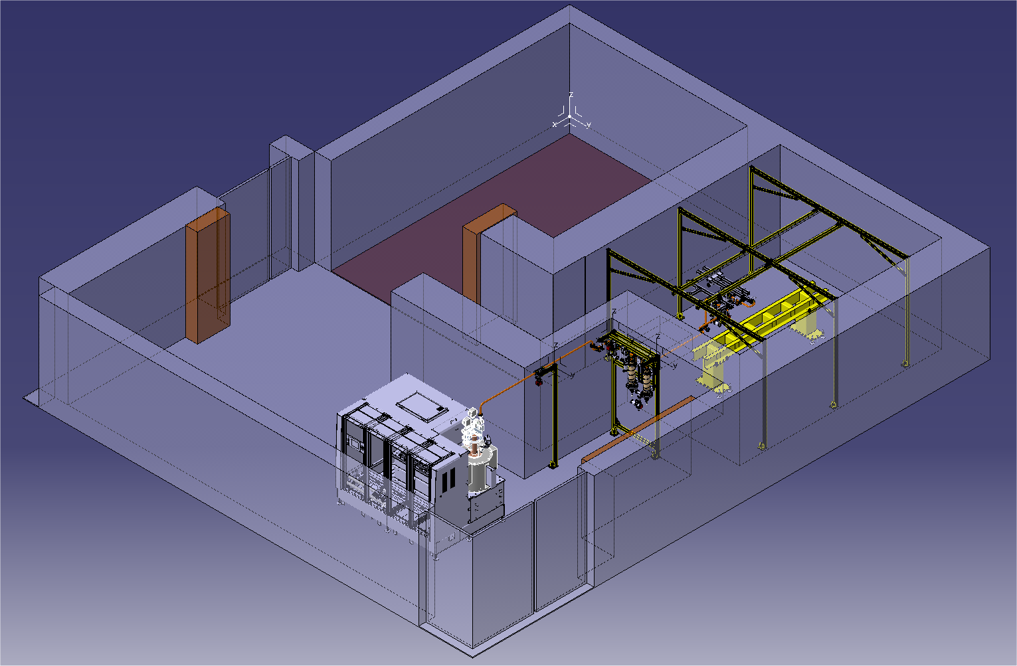
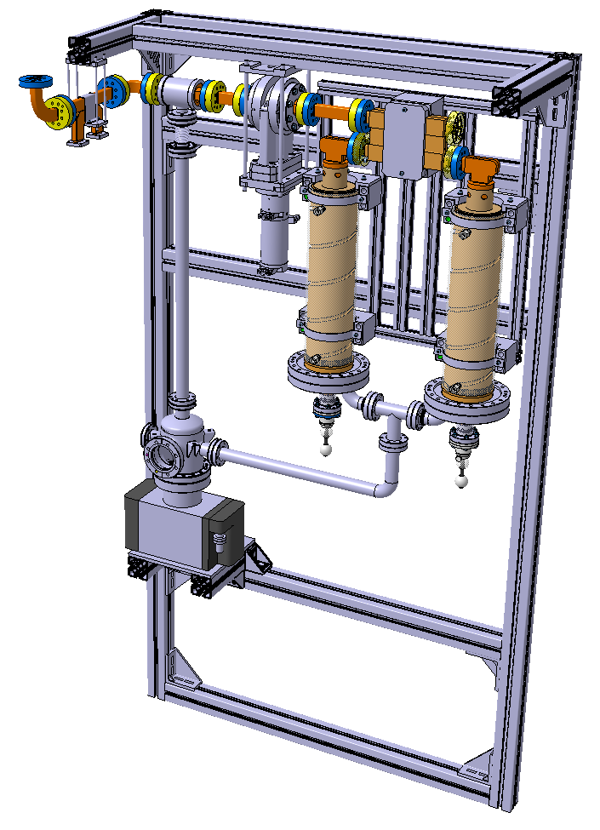
X-Box#2 at one of its possible location.
Bld. 150
D. Gudkov, CERN

Slide 14
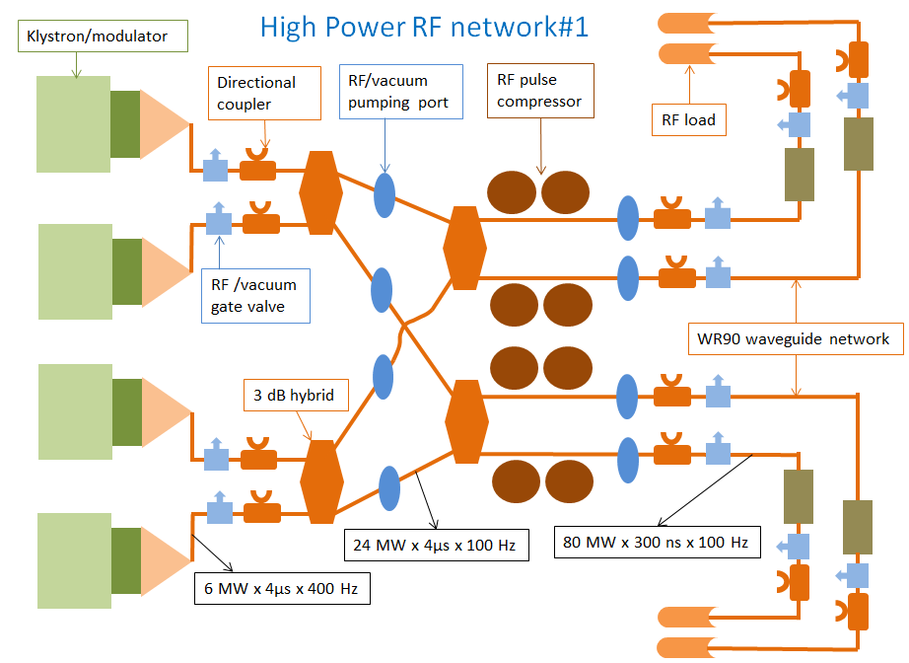
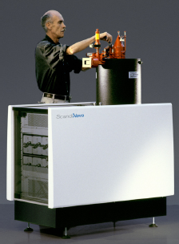
4x (6 MW + SLED) cluster station (X-Box#3).
Market survey completed. Three klystron manufacturing companies are qualified. Invitation for tender is now prepared. We expect to go to finance committee in March 2013 for approval with delivery of 4 turnkey 6 MW klystron / modulators for Q2/Q3 2015.
The RF components are similar to the ones used in X-Box-2. Some of them are already in the production pipeline.
The detailed 3D layout and integration of the cluster test stand is under way.

Slide 15
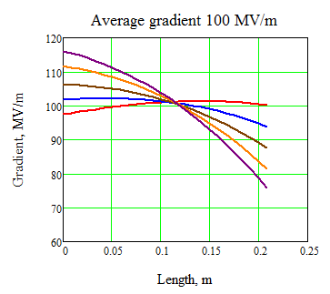
Dog-leg test area for the experiments with beam loading
Unloaded
Testing of accelerating structure with nominal beam loading is a missing block in our testing program.
Such a test will be done using CTF3 drive beam and RF power delivered from X-box#1 via modified 30 GHz low loss transfer line.
Increasing current
Loaded (CLIC)
All overmoded RF components (designed and fabricated in CEA) are in stock.
The accelerating structure (T24) is prepared and placed on its final girder.
The other RF components (pumping ports, gate valves) are ordered from the industry and will arrive to CERN in November 2012.
The installation of the T24 on the beam line will be done during 2013 winter shutdown.
The RF low loss transfer line network from CTF2 to CTF3 will be modified in May 2013.

Slide 16
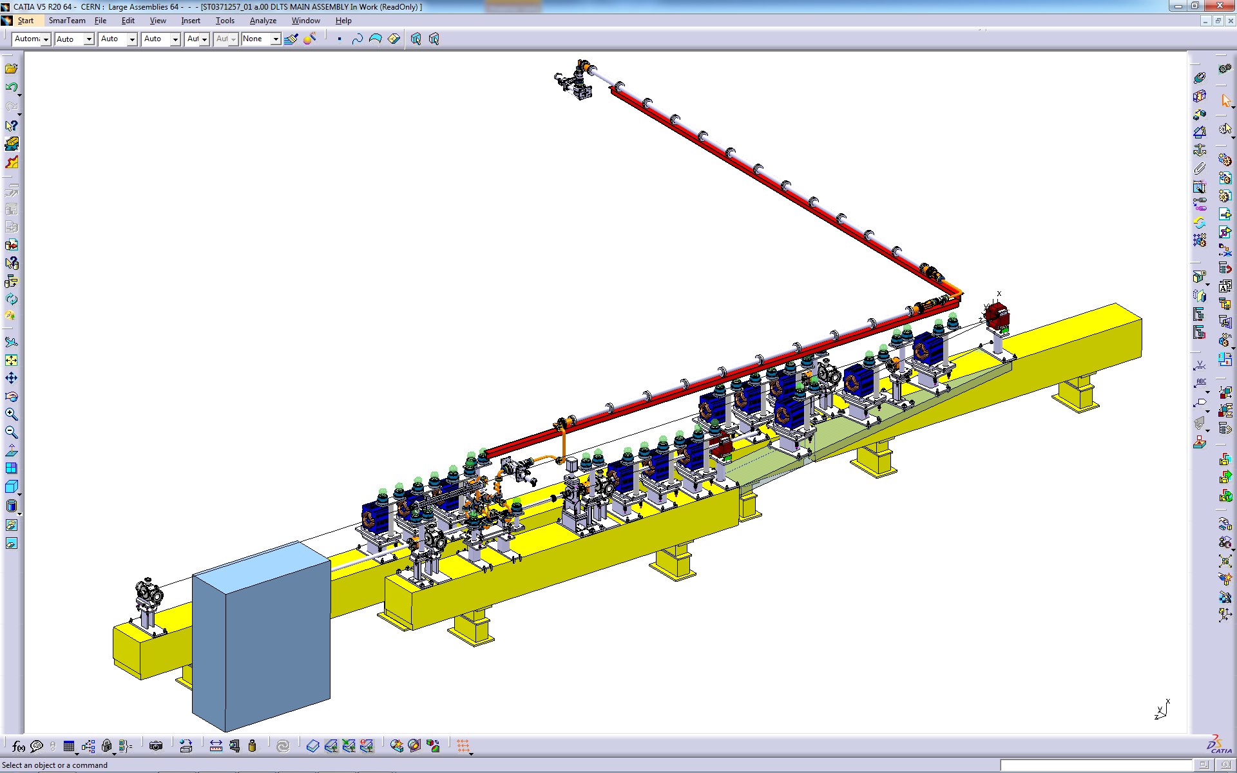
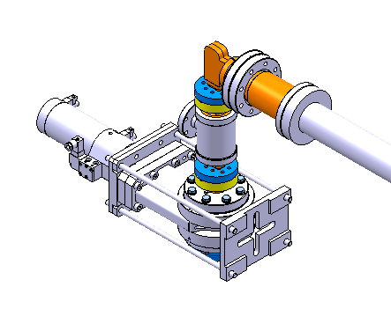
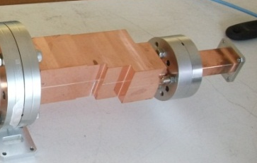
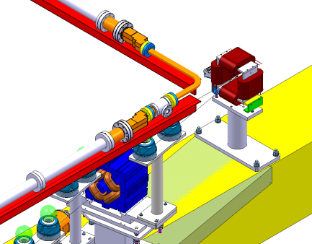
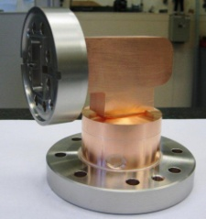
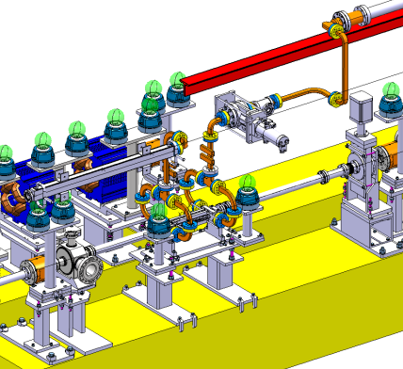
Dog-leg test layout
RF
Beam
A. Solodko, CERN

