Slide 1
FPCCD option of ILD vertex detector
Yasuhiro Sugimoto
KEK
for FPCCD VTX group
@LCWS2012

Slide 2
Outline
FPCCD VTX design parameter
FPCCD sensors
Support structure

Slide 3
FPCCD VTX design parameter
Layer | R (mm) | |Z| (mm) | |cosθ| | Pixel size (μm)
1 | 16 | 62.5 | 0.97 | 5
2 | 18 | 62.5 | 0.96 | 5
3 | 37 | 125 | 0.96 | 10
4 | 39 | 125 | 0.95 | 10
5 | 58 | 125 | 0.91 | 10
6 | 60 | 125 | 0.9 | 10
Pixel size of outer layers
  It was 5μm, but changed to 10μm
  ➔ Reduction of number of readout channels and power consumption

Slide 4
Power consumption
Assumptions
Results
Readout frequency | 10 Mpix/s
Readout time | 200 ms
Clock timing | Same for inner and outer layers
Vertical shift time | 40 us/line
Power consumption | 15 mW/ch
Chip size (in/out) | 11x62.5mm² / 22x125mm²
Number of chips (in/out) | 40 (=10x2x2) / 112 (=(11+17)x2x2)
Pixel size (in) | Pixel size (out) | # of ch/chip (in) | # of ch/chip (out) | # of ch (total) | Power consumption
5 um | 5 um | 28 | 56 | 7392 | 111 W
5 um | 10 um | 15 | 15 | 2280 | 34 W

Slide 5
Expected IP resolution
Increase of pixel size of outer layers does not affect the IP resolution

Slide 6
Pixel occupancy
Simulation results for pixel occupancy at 1TeV (statictics:10BX)
Increase of occupancy due to decrease of # of pixels (1/4) is less than x4
Layer | Occupancy for 5um (%) |  |  | Occupancy for 10um (%)
 | Direct | B.S. | Total | Direct | B.S. | Total
1 | 5.1 | 14.5 | 19.6
2 | 3.1 | 7.3 | 10.4
3 | 0.18 | 0.06 | 0.24 | 0.41 | 0.14 | 0.55
4 | 0.15 | 0.06 | 0.20 | 0.33 | 0.13 | 0.46
5 | 0.033 | 0.014 | 0.047 | 0.075 | 0.032 | 0.107
6 | 0.029 | 0.017 | 0.046 | 0.064 | 0.039 | 0.104

Slide 7
FPCCD sensors
Small prototype in FY2012
  6mm square image area
  6um pixel size
  4ch/chip with different horizontal shift register size: 6x6, 6x12, 6x18, 6x24 um²
  It works except for the channel with 6x6um² horizontal shift register

Slide 8
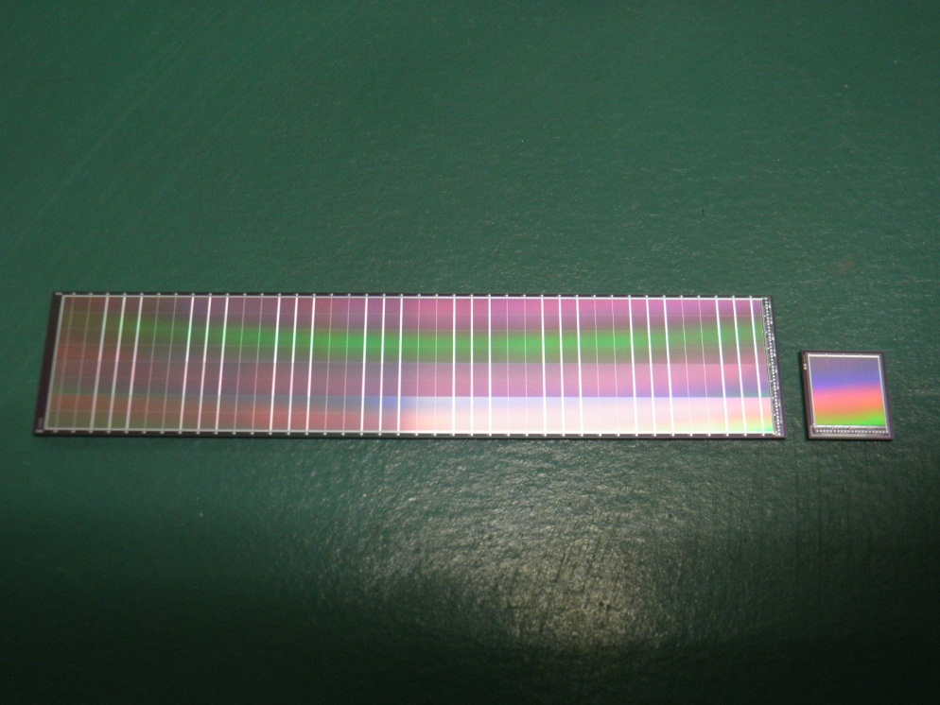
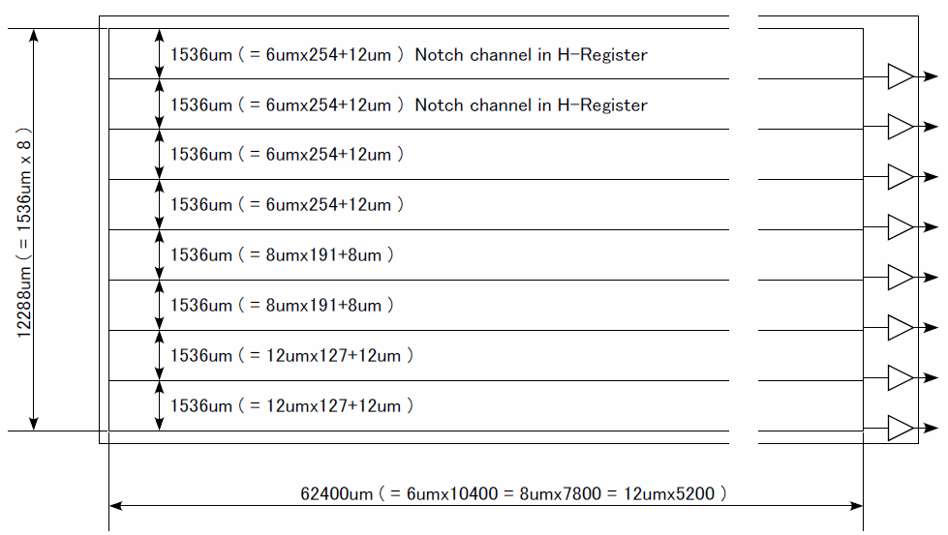
FPCCD sensors
Large prototype
  62.4x12.3mm² image area ~ Real size prototype for inner layers
  8ch/chip with several pixel sizes: 4chx6um, 2chx8um, 2chx12um
  Si wafer has been made, but waiting for packaging

Slide 9
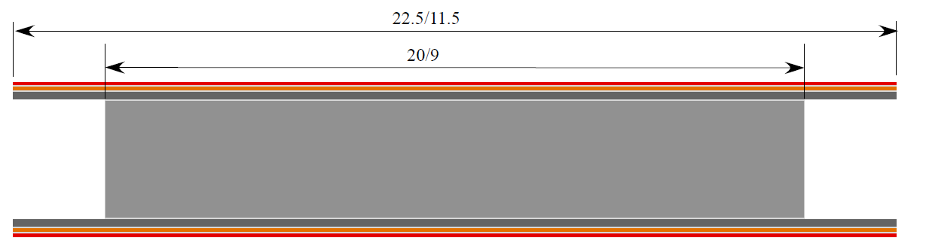
Support structure
 |  | t (μm) | Total t (μm) | X0 (%)
Si |  | 50 | 50 | 0.0534
Epoxi |  | 10 | 2000 | 0.0028
FPC | Cu | 9 |  | 0.0125
 | Kapton | 51 |  | 0.0179
Epoxi |  | 10 |  | 0.0028
CFRP |  | 100 |  | 0.0383
Epoxi |  | 20 |  | 0.0056
RVC |  | 1600 |  | 0.0300
Epoxi |  | 20 |  | 0.0056
CFRP |  | 100 |  | 0.0383
Epoxi |  | 10 |  | 0.0028
FPC | Cu | 9 |  | 0.0125
 | Kapton | 51 |  | 0.0179
Epoxi |  | 10 |  | 0.0028
Si |  | 50 | 50 | 0.0534
Total |  |  | 2100 | 0.2966
Ladder design
  Ladder has a tricky shape to allow overlapping of sensors with adjacent ladder
  Material budget ~0.3%X₀/ladder = 0.15%X₀/sensor layer

Slide 10
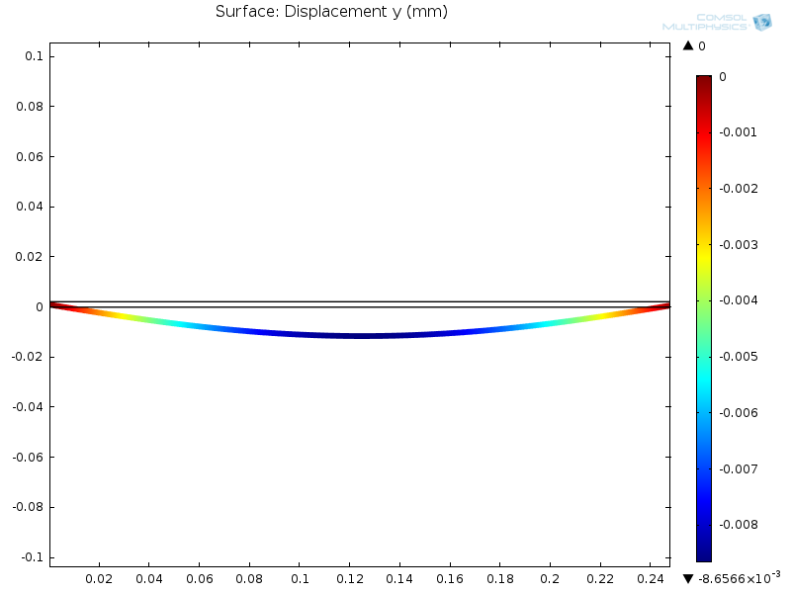
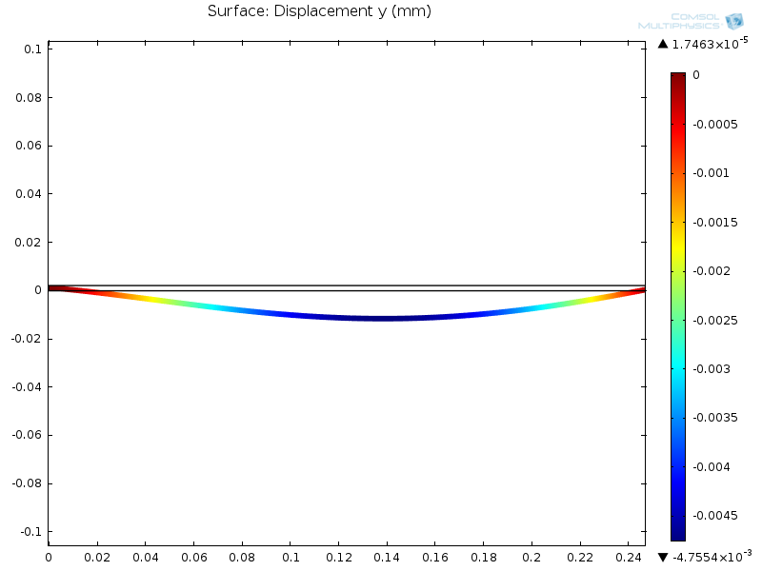
Support structure
Ladder deformation by self weight
  Simplified geometry of 50um Si sensors (200um gap between two sensors) + CFRP sheets and RVC core
Two edges support:
Maximum deformation ~ 8.66 um
One edge fix, one edge support:
Maximum deformation ~ 4.76 um

Slide 11
Support structure
Design in ILD simulation model
  Similar to SLD vertex detector
  2 mm thick Be end plate, 0.5 mm thick Be support shell
  Kapton+Cu flexible cables
  Ladders
  1 cm thick foam of the cryostat

Slide 12
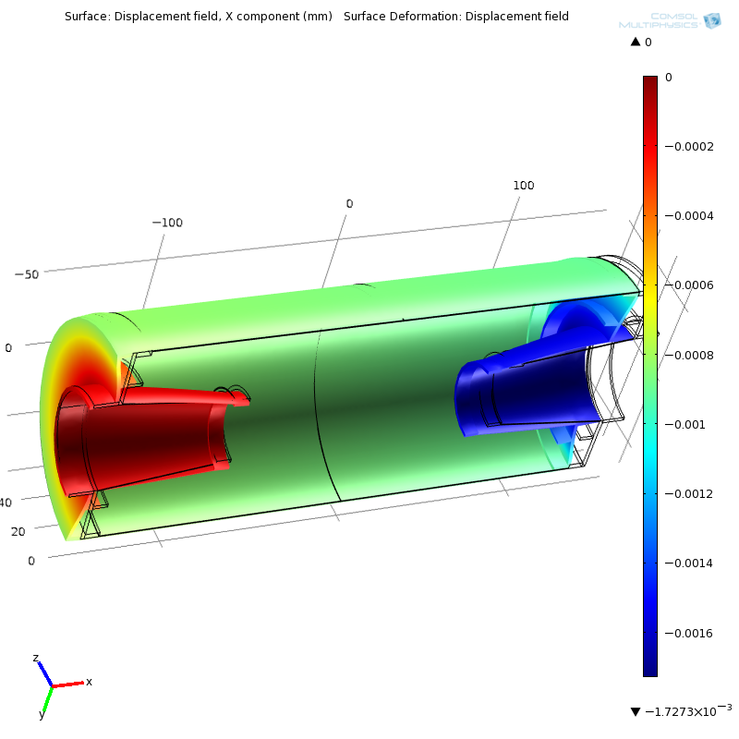
Beryllium support shell
FEA calculation of deformation
  1kgf (9.8N) is applied in z-direction
  Maximum deformation is less than 2μm
  Total weight is less than 500g → max force caused by the friction at the kinematic mount would be less than 500gf
(mm)

Slide 13
Summary
FPCCD vertex detector design for DBD
  3 sets of double-layer ladders: total 6 layers
  Rin=16mm, Rout=60mm
  Pixels size is 5um for inner two layers and 10um for outer 4 layers: Impact parameter resolution is almost same as the all 5um pixel case
  Material budget ~ 0.3%X0/ladder = 0.15%X0/layer
  Ladders are supported by a Beryllium support structure: 2mm-thick end-plate and 0.5mm-thick cylindrical support shell
  The support structure is enclosed in a rigid foam cryostat and operated at −40℃
Sensor R&D status
  A small size prototype with 6um pixel size has been made and it works
  Almost real size large prototype with 6 – 12um pixel size has been made: to be tested soon
  Detailed characterization is expected in coming 1~2 years

