Slide 1
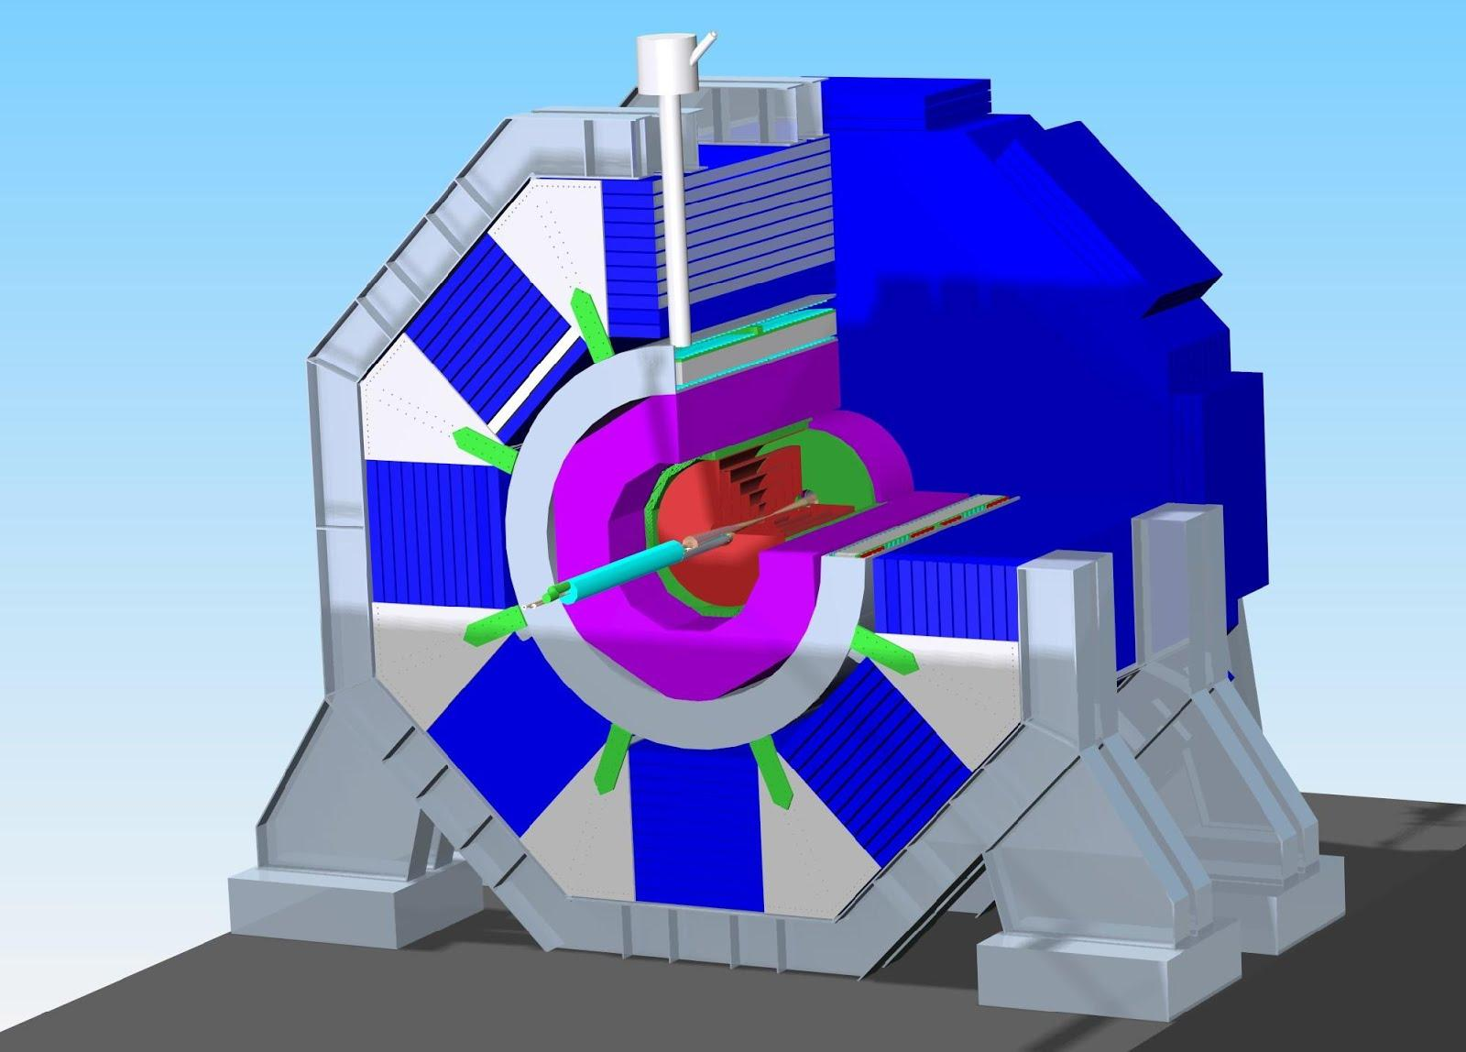
SiD performance for the DBD
Jan Strube
CERN

Slide 2
Content
Overview over the DBD simulation and reconstruction setup
Introduction to Machine-induced background
Performance of the detector as relevant for the Analyses

Slide 3
Workflow
Whizard / Pythia / GuineaPig
stdhep
lcsim (DST maker)
SLIC
lcio
Marlin (LCFIPlus)
lcsim
Background Overlay
Tracking
slicPandora
new since LOI

Slide 4
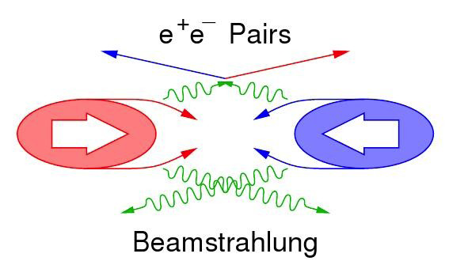



Beam-Induced Background
Merged with every “physics” event
MCParticles that don’t make hits will be dropped
Pair background
1 event per BX
450k particles
Generated by GuineaPig
ascii → hepevt → stdhep
γγ interactions
4.1 events per BX @ 1 TeV
1.7 events per BX at 500 GeV
Generated by Whizard

Slide 5
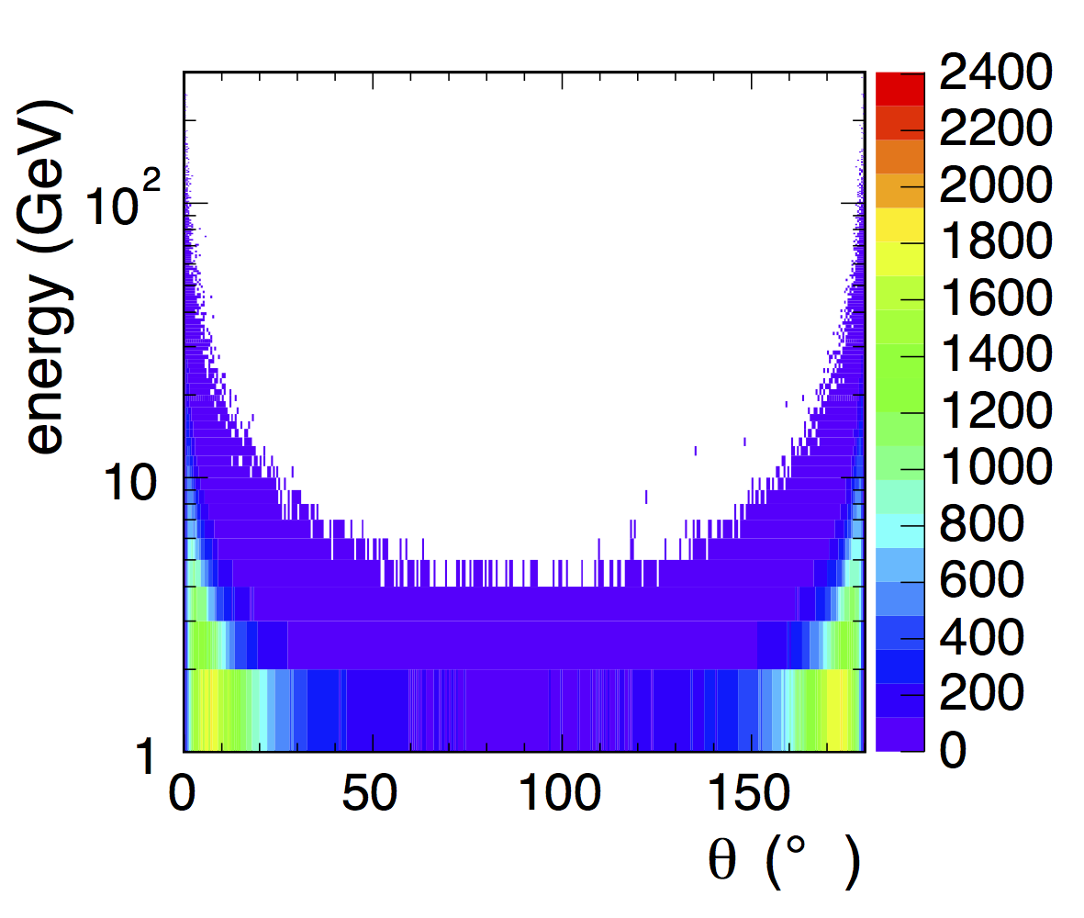
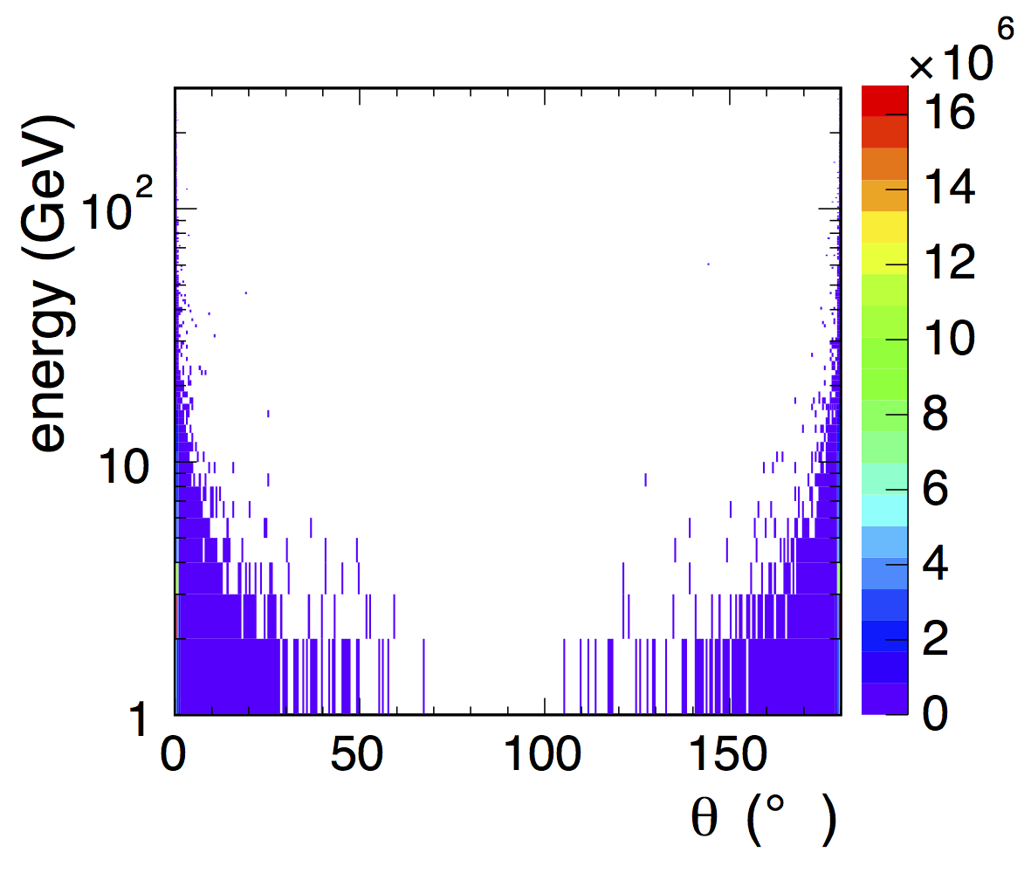
Angular distribution of background
hadrons
incoheren pairs
Incoherent pairs affect mostly occupancies and tracking efficiencies
Hadrons have enough energy to reach the calorimeter

Slide 6
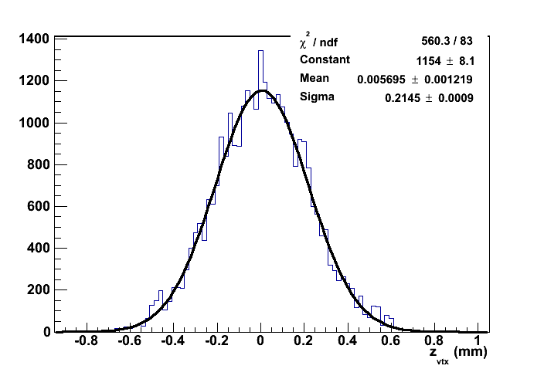
Luminous Region
Finite extension: σ_{z} = 225 μm
  conservative compromise
Events from beam-beam interactions (γγ→ hadrons, incoherent pairs) are distributed randomly over the luminous region
Physics events always at z = 0
Reconstructed primary vertex position for γγ→ hadrons, pairs
Fitted width: 214 μm
6

Slide 7
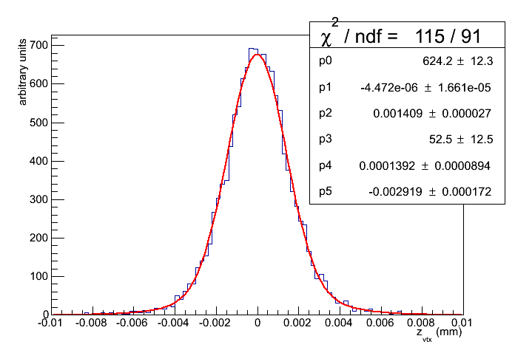
Primary Vertex Resolution
Note the different scales
e⁺e⁻ → hadrons
and pair background
Resolution 214 μm
ttH semi-leptonic channel
resolution < 3 μm

Slide 8
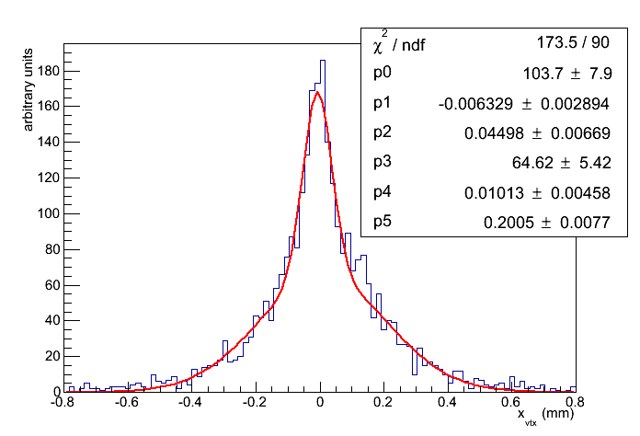
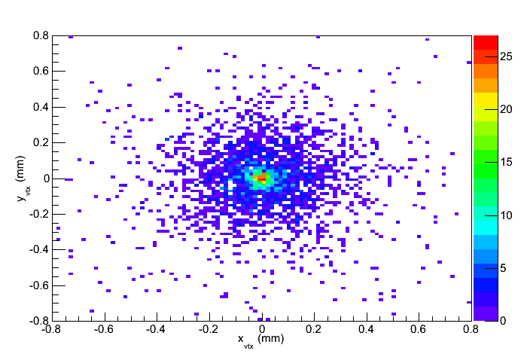
Primary Vertex Resolution II
e⁺e⁻ → invisible
+ pair background
+ hadrons
Full detector simulation and reconstruction
Fit with two 2D Gaussians:
Width of the narrow Part: 33 μm

Slide 9
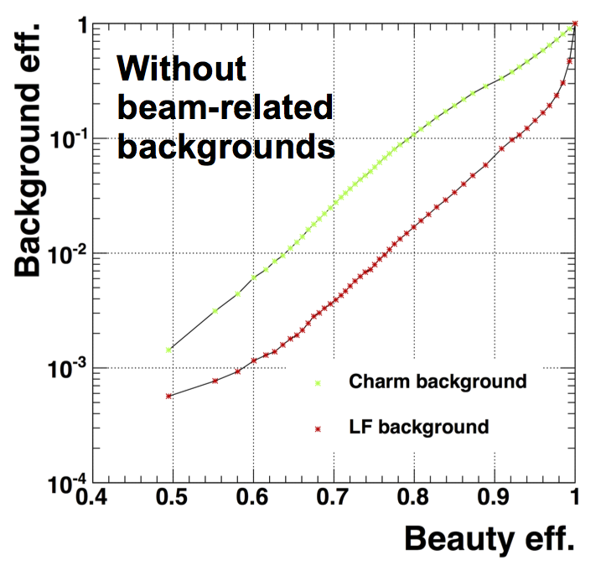
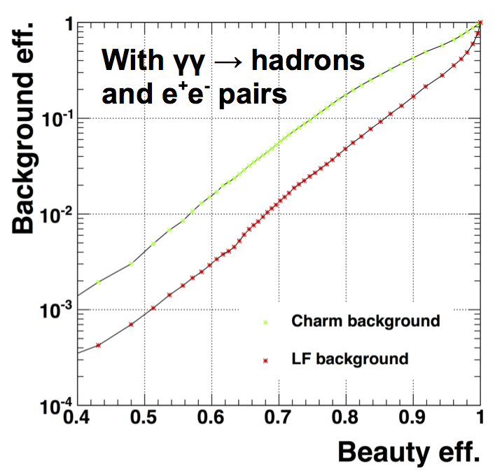
Flavor Tagging
Using LCFIPlus, tuned for SiD detector
Classifier trained on dijet events
from top Yukawa coupling analysis (see P. Roloff talk)

Slide 10
Single Particle ID
Why?
How?
Several analyses depend on excellent PID
  WW, tth (semi-)leptonic, hmumu
Currently, PID comes from PandoraPFA
  Performance must not be perfect, but must be well-known and understood
Digital HCAL: remove muons before clustering
Generate single particle of given type
Full detector simulation
org.lcsim tracking
PandoraPFA reconstruction
Plot ratio of reconstructed / generated particles of given type
10
Notes:
Make ID matrix:

Slide 11
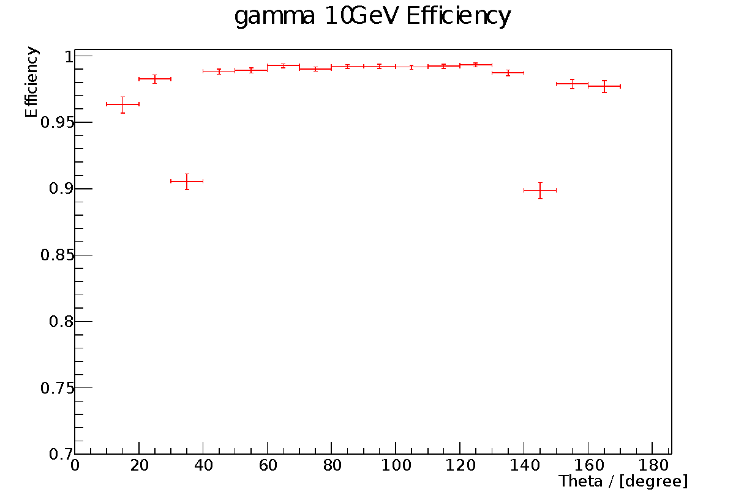
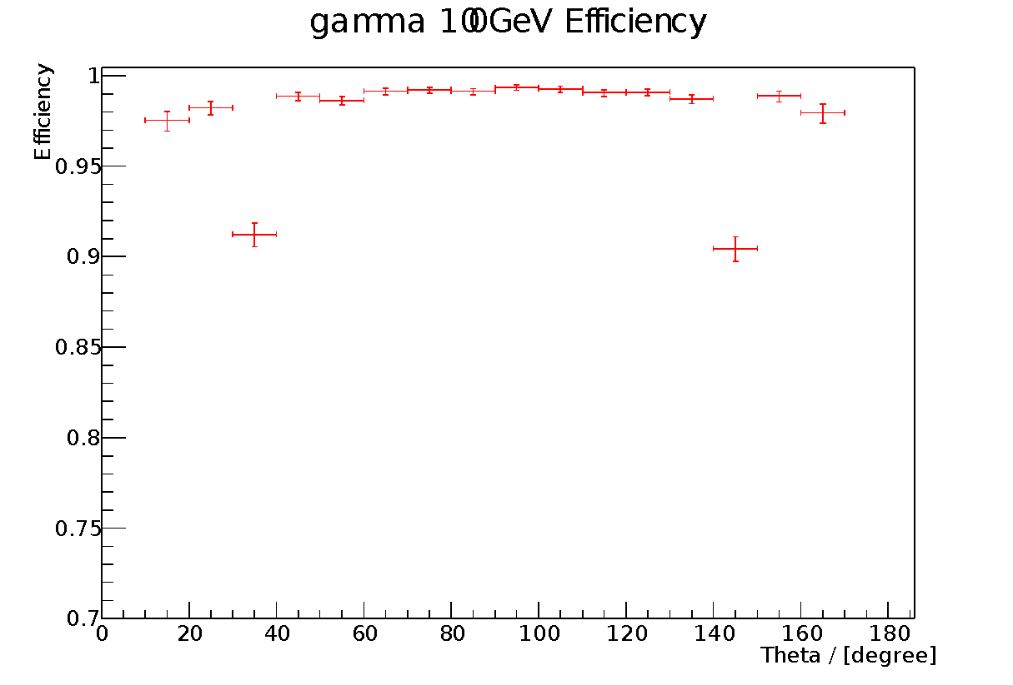
Single Photons
Photon Identification > 97% in barrel and endcap
Transition region needs optimization
11

Slide 12
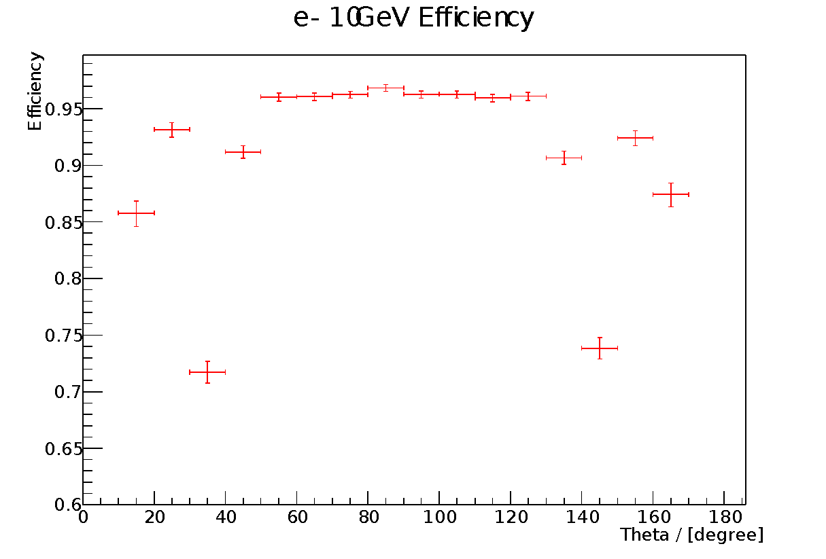
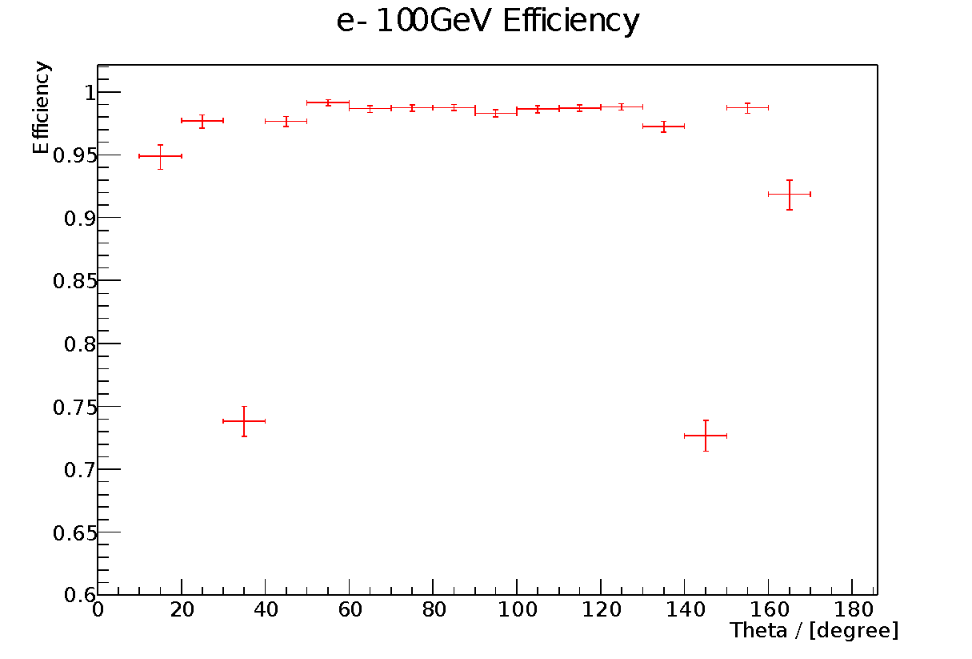
Single Electrons
Electron Identification at higher energy slightly worse than tracking efficiency
Transition region needs optimization

Slide 13
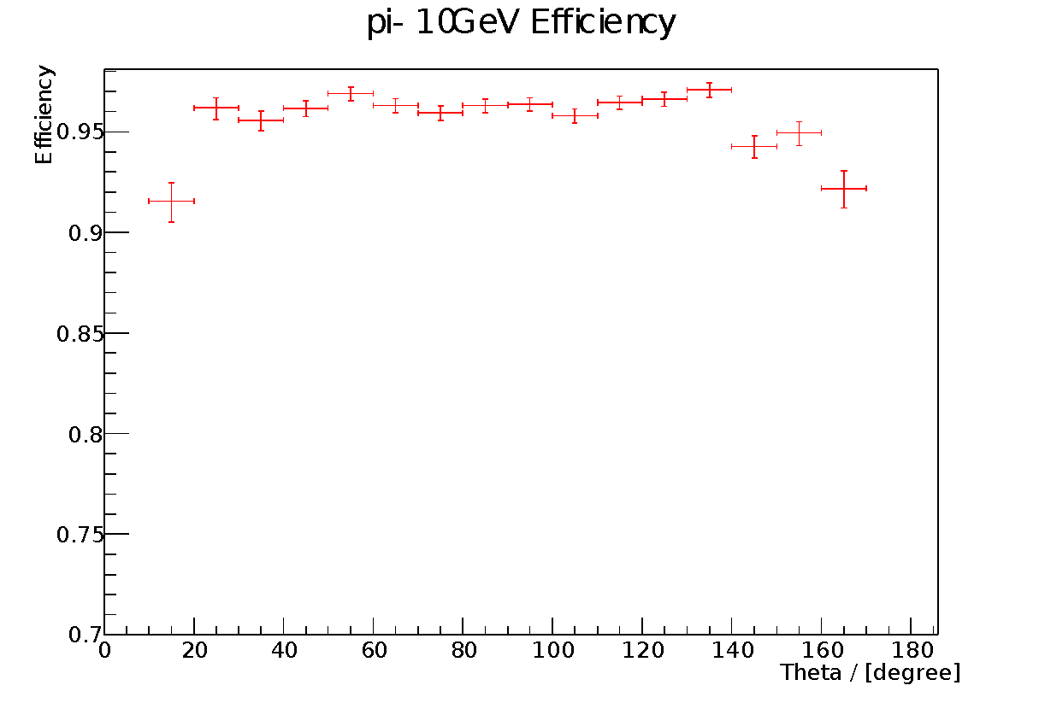
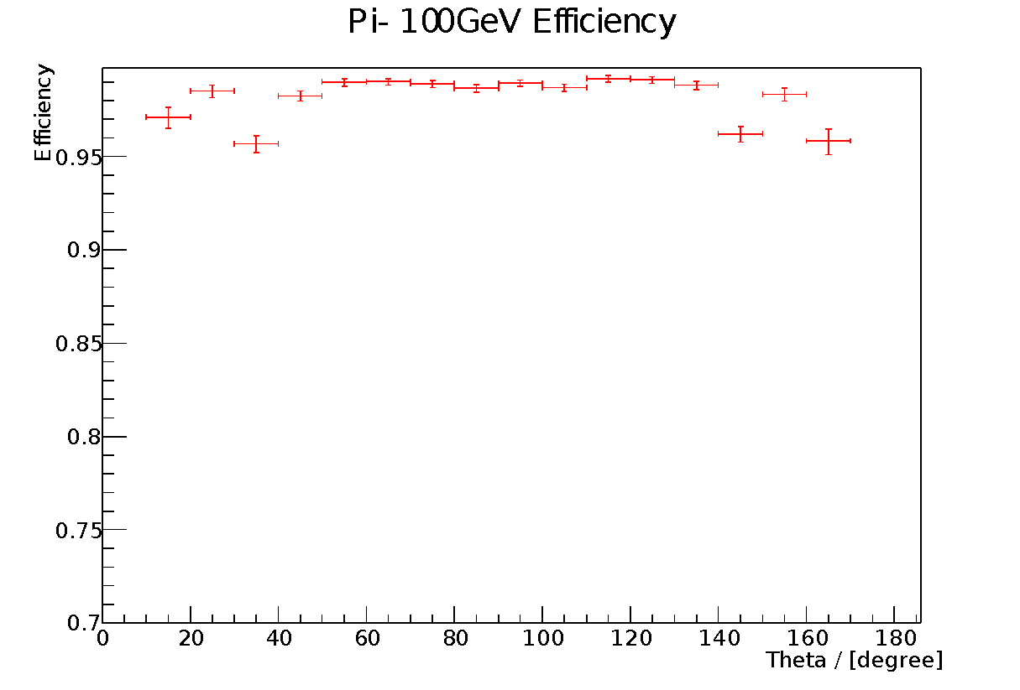
Single Pions
Pion Identification efficiency commensurate with tracking efficiency
At higher energies slight deterioration in the transition region

Slide 14
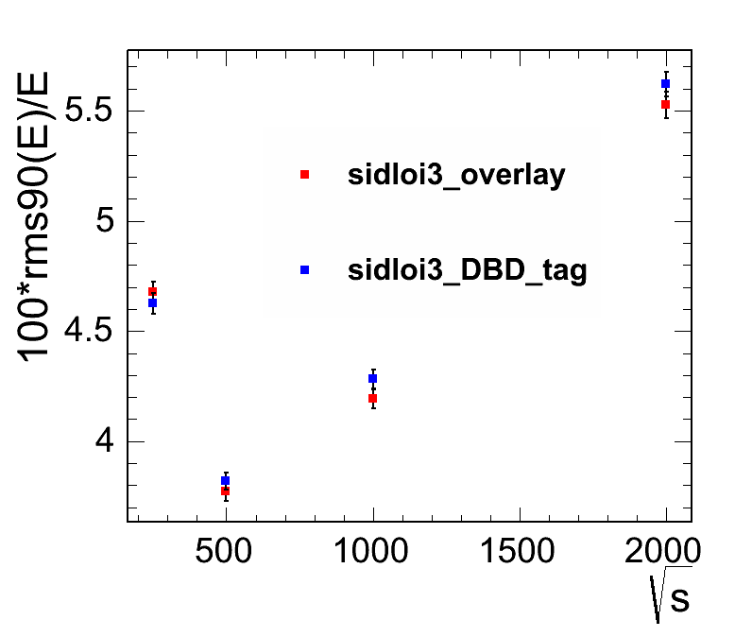
RMS₉₀ versus energy
Performance of the detector in physics events
ZZ → 2 jets + invisible
Full simulation and reconstruction with and without background
Includes effects of jet finding
Studies indicate that performance at 1 TeV can be improved. Performance of PandoraPFA in DHCAL not yet optimal
14

Slide 15
Summary
We have evaluated the performance of those aspects of the SiD Detector that are relevant for physics analyses
The performance is more than adequate for DBD analyses in a realistic environment with machine-induced background
Areas for improvement are clearly identified
The DBD is not the end of SiD optimization studies

Slide 16
Backup

