Slide 1

Open discussion for physics motivation, future designs, and possible paths for γγ colliders
Mayda M. Velasco
LCWS 2012
Oct. 25, 2012

Slide 2
Physics motivation
Complementarity of γγ colliders to e⁺e⁻ Higgs factories due to:
  large cross section of γγ to h, H, A and hh etc.
  strength of having both:
    circular (J=0 or 2) polarization
    linear polarization -- separation of odd and even states
is all well documented.
Production of more exotic states also well developed
➔ Question: Why γγ-colliders are not more advanced and better known?

Slide 3
So what is the problem?… in my opinion
So far, mostly consider as an extra option of a much bigger project, like ILC
Technical issues associated with the Laser Compton Back-Scattering needed to produce high energy photon beams makes the more conservative members of our community concern about the design
➔ If we want a γγ collider, we need to address these two issues!

Slide 4
My suggestions
Request ICFA (& Snowmass) support to look at the physics case and possible designs of γγ colliders on their own
Do not necessarily start with the Higgs factory, but a simpler design that can do both:
  Interesting and relevant physics, and
  Advance the technical aspects

Slide 5
Some examples of physics topics
Lower energy γγ or medium energy eγ machines that can give good physics and serve as stepping stone for higher energy γγ/eγ/e⁻e⁻ colliders
Examples,
  γγ → τ⁺ τ⁻, γγ → τ⁺ τ⁻ γ with E_{cm} (e⁻e⁻) ~ 10 GeV
    Tau properties, including Magnetic-Moment of τ
    Significant number of inconsistencies among LEP and B-factory based measurements
      Since taus are the heaviest lepton, it is very important to understand them well!
  γ e⁻ → W⁻ ν → τ⁻ ν_{τ} ν_{e} (only one e⁻ converted to γ)
    Well control environment for τ production via W⁻
    Precise measurements of the Γ_{W} and M_{W} starting from an E_{cm} (e⁻e⁻) = 120 GeV

Slide 6
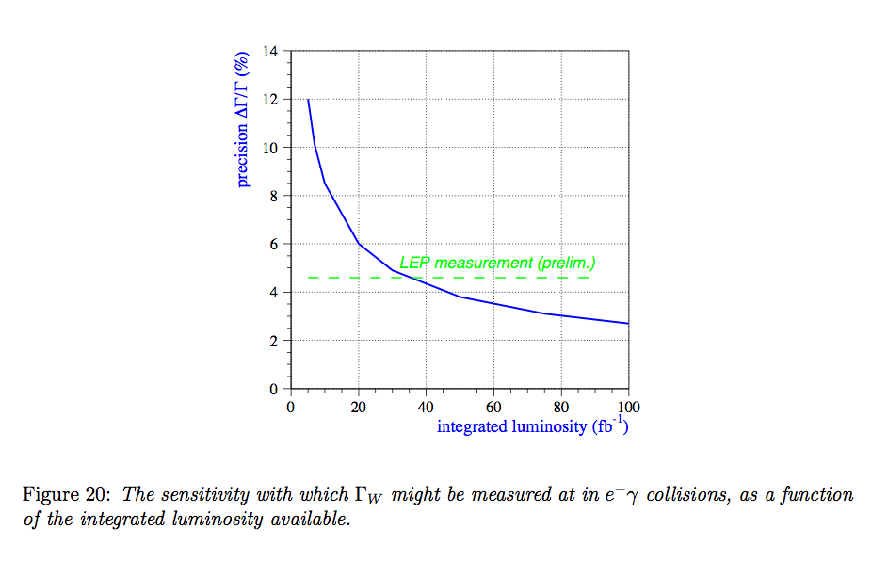
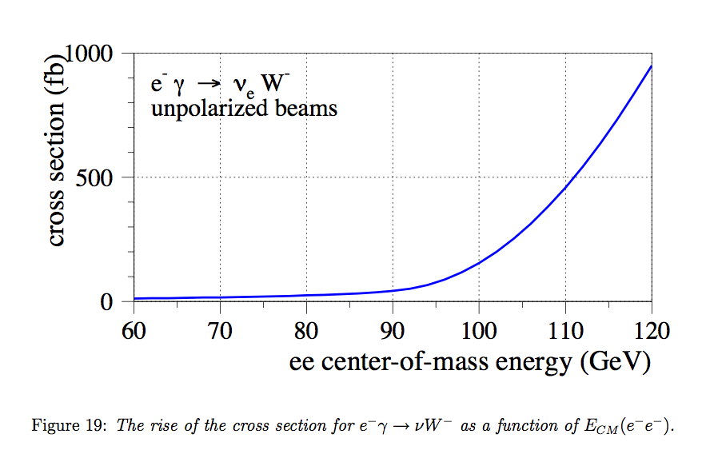
γ e → W ν: Already discussed by us in the past in a CLIC based design

Slide 7
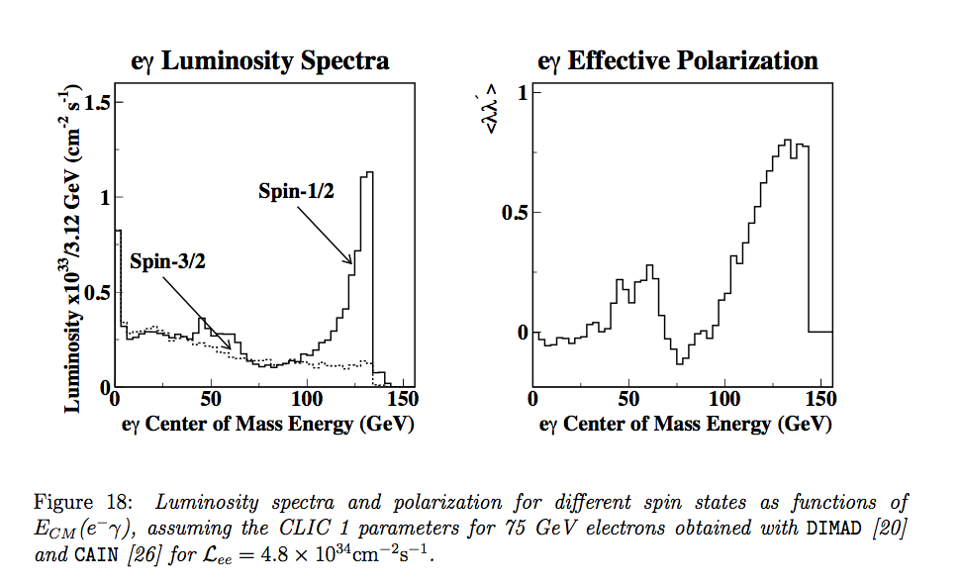
γ e → W ν: CLIC based CLICHÉ Design
~70% Conversion efficiency for both e- beams and polarized
For a pure eγ designed only one photon beam used and the
Luminosity will be ~2 times large than this

Slide 8
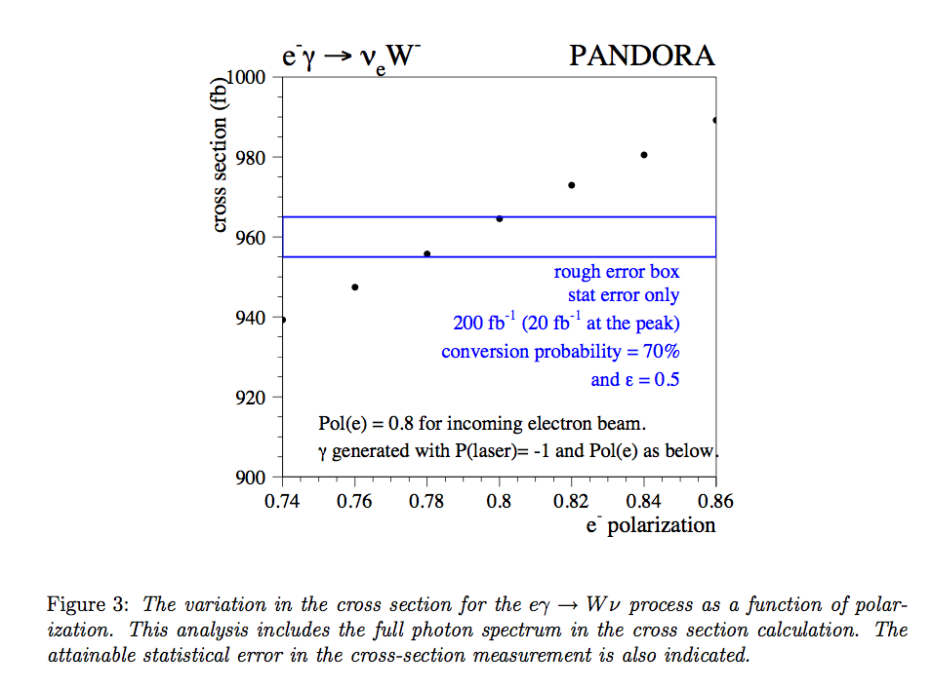
In this operation mode we are capable of making measurements to keep beam systematic under control: Ex. Polarization

Slide 9
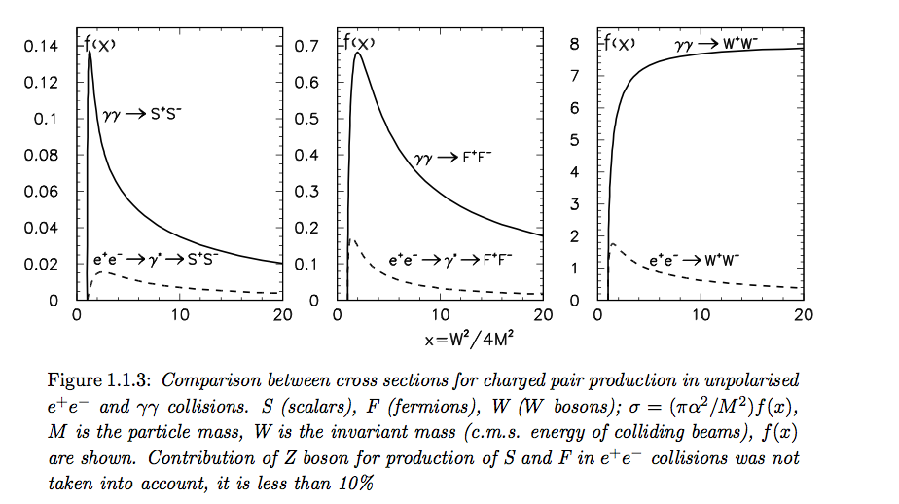
Some comments in γγ→ff and γff
The σ(γγ→ ττ) >> 100 pb at low energy

Slide 10
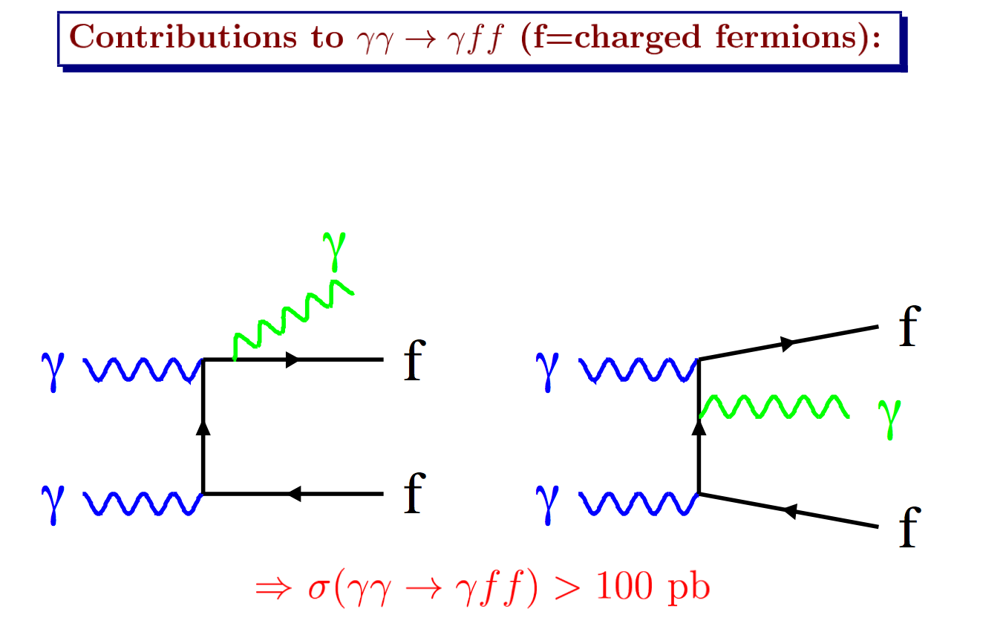
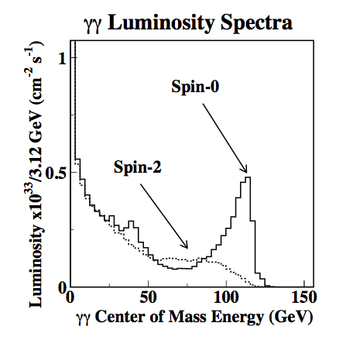


In case of polarization…
Example, at 120 GeV
About 10% of events
Survive with basic cuts

Slide 11
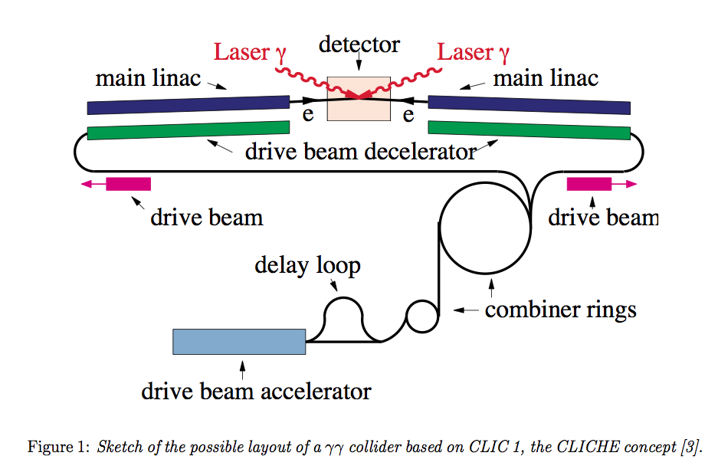
Examples of machines #1

Slide 12
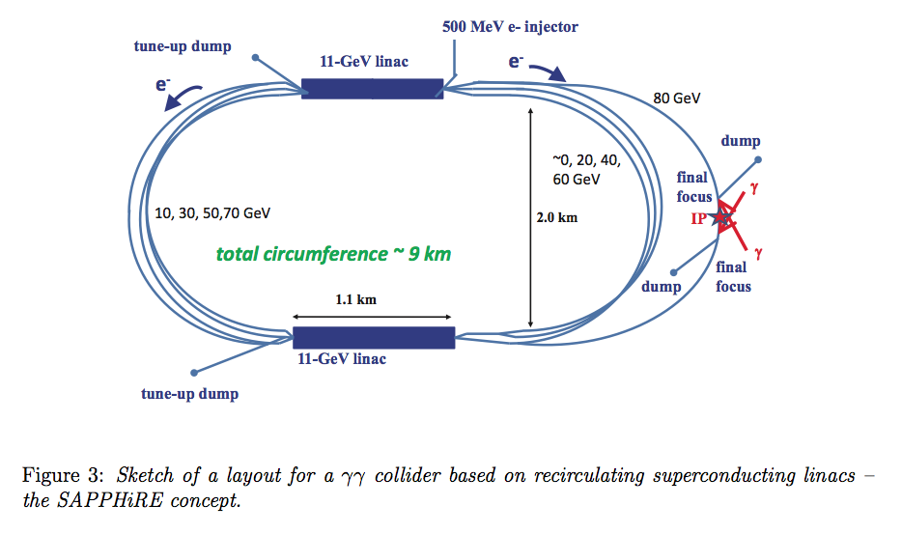
Examples of machines #2

Slide 13
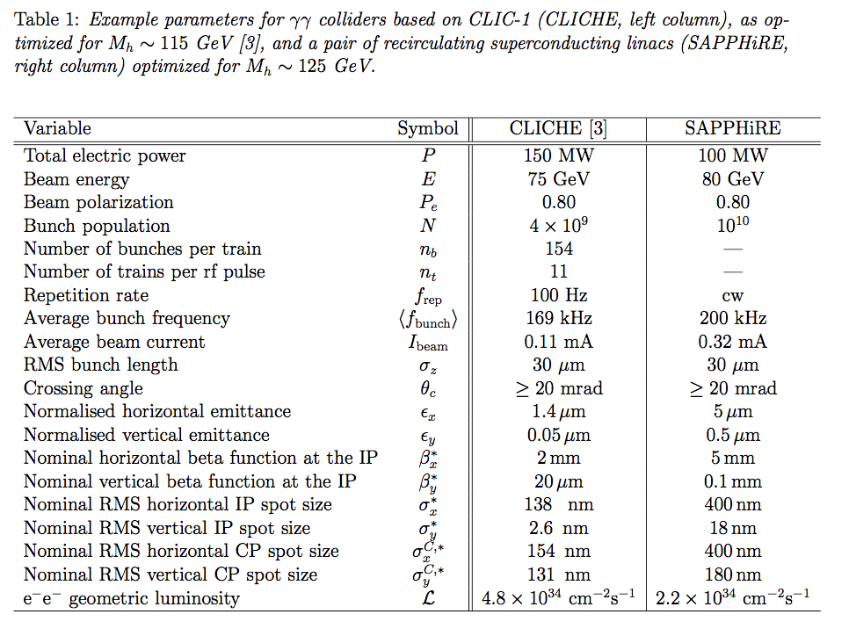
Comparison of Parameter with Higgs-factory inn mind… need to be revise

Slide 14
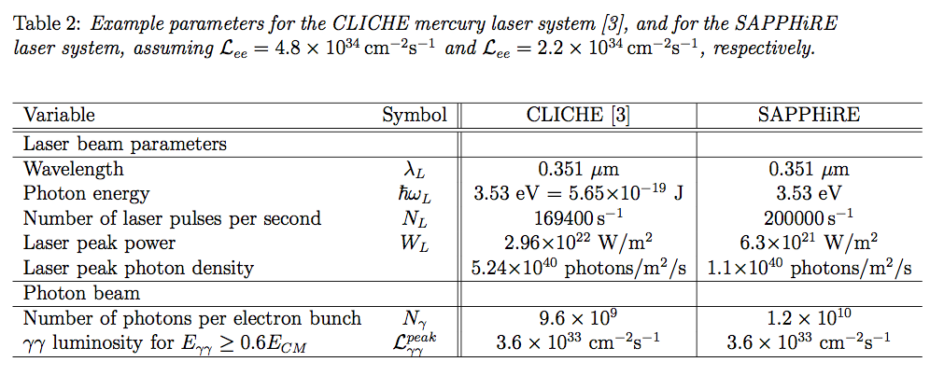
Laser needs

Slide 15
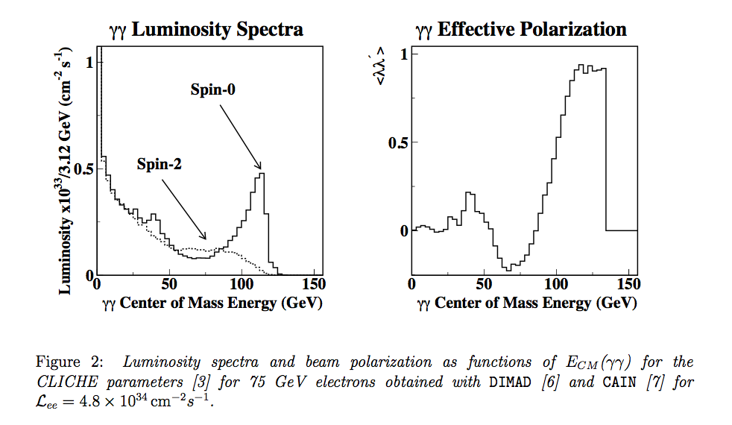

Slide 16
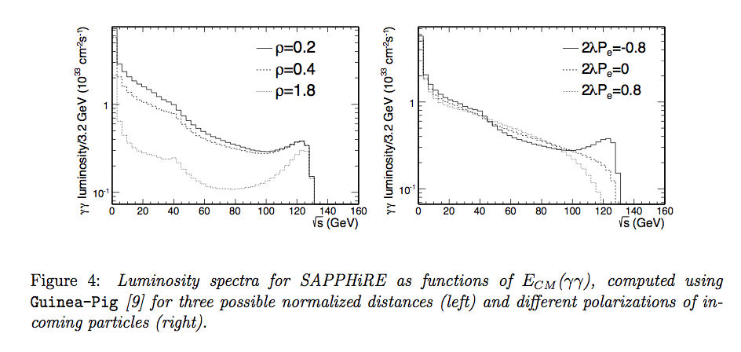

Slide 17
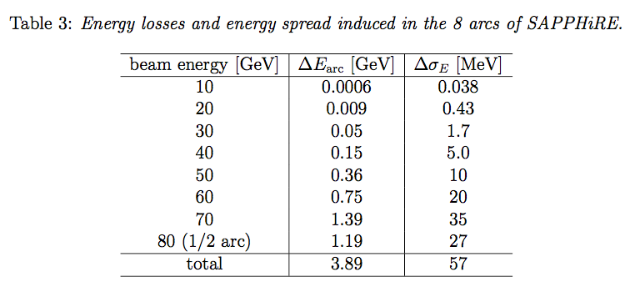
Energy loss not the only issue to be looked at more carefully

Slide 18
Conclusions
We should request to ICFA & Snowmass study for support to look at the physics case and possible designs of γγ colliders
  Independently of the e+e- collider program
We need to keep it:
  Simple and cost effective
  With very interesting and relevant physics
  While Advancing the technical aspects for future high energy γγ colliders

