Slide 1
CLIC CDR
Power & Energy
Philippe Lebrun & Bernard Jeanneret
LCWS 12
University of Texas at Arlington, USA
22 – 26 October 2012

Slide 2
Contents
Scope of the CLIC CDR study
Power, energy and efficiency estimates
Electrical power distribution
Cooling and HVAC
Paths to power and energy savings
Conclusion

Slide 3
Contents
Scope of the CLIC CDR study
Power, energy and efficiency estimates
Electrical power distribution
Cooling and HVAC
Paths to power and energy savings
Conclusion

Slide 4
Scope of the CLIC CDR study
CDR Volume 1
The basic parameters for the CLIC CDR study are optimized for a collision energy of 3 TeV and a peak luminosity of 2 E34 cm⁻² s⁻¹
The study includes a first stage at 500 GeV and a second stage at ~1.5 TeV, for which a single drive-beam production complex is sufficient to power both main linacs
The bunch charge must be almost doubled to preserve luminosity at 500 GeV. This results in
  Main linac accelerating structures with larger iris and lower gradient (80 MV/m)
  Longer main linacs (2 x 5 sectors)
  Increased RF power in the drive-beam and main-beam production complexes
Accelerator and technical systems are built as far as possible in a modular way, so as to follow the staged construction. Part of the infrastructure is however defined by the 3 TeV horizon
A possible operation schedule based on physics requirements and expected machine performance enables to estimate energy consumption
  Integrated luminosity of 500 fb⁻¹ at 500 GeV, 1.5 ab⁻¹ at ~1.5 TeV, and 2 ab⁻¹ at 3 TeV
  Operational efficiency (collider & detectors) taken at 0.5 for 200 days/year, with ramp-up in initial years

Slide 5
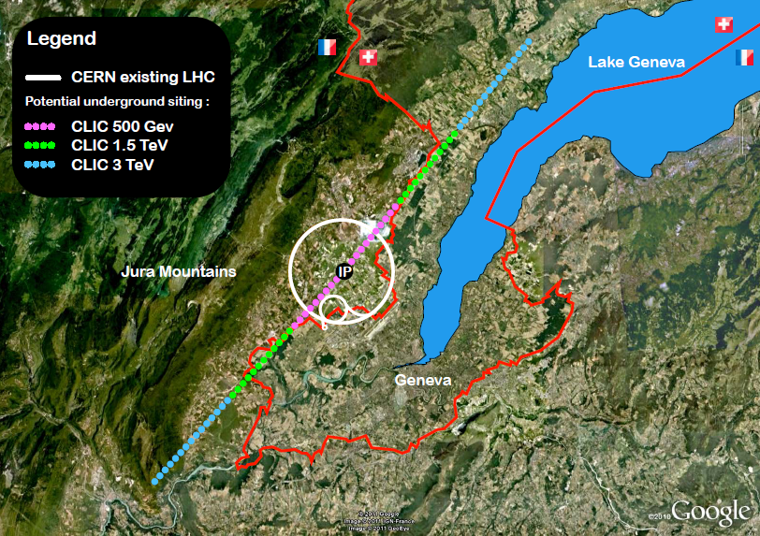
CLIC footprints near CERN

Slide 6
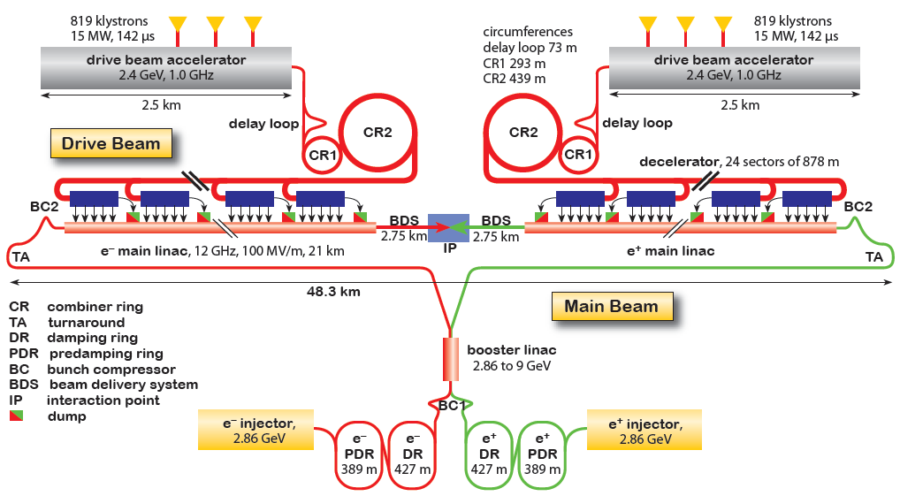
CLIC layout at 3 TeV

Slide 7
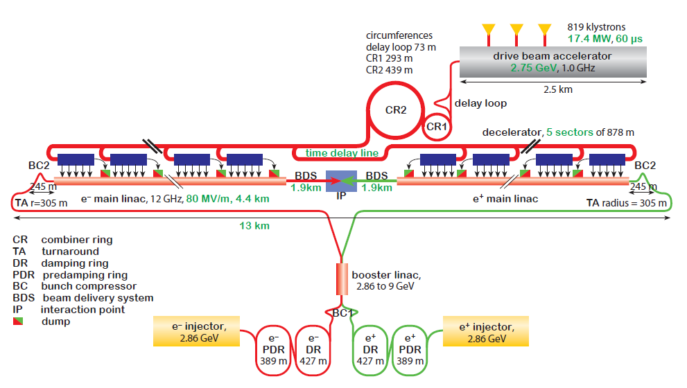
CLIC layout at 500 GeV

Slide 8
Scope of the CLIC CDR study
Changes in CDR Volume 3
Two alternative staging scenarios
  Each with three stages: 500 GeV, ~1.5 TeV and 3 TeV
  Scenario A: « optimized for luminosity in the first stage »
  Scenario B: « optimized for lower entry cost »
  First and last stages of scenario A are identical to CDR Volume 1
  Reuse of 80 MV/m structures in scenario A limits the energy of the second stage to 1.4 TeV
  Scenario B has nominal bunch charge at all stages, resulting in
    Use of final (100 MV/m) gradient structures already at 500 GeV
    Shorter main linacs (2 x 4 sectors)
    Lower installed RF power in the main-beam and drive-beam production complexes

Slide 9
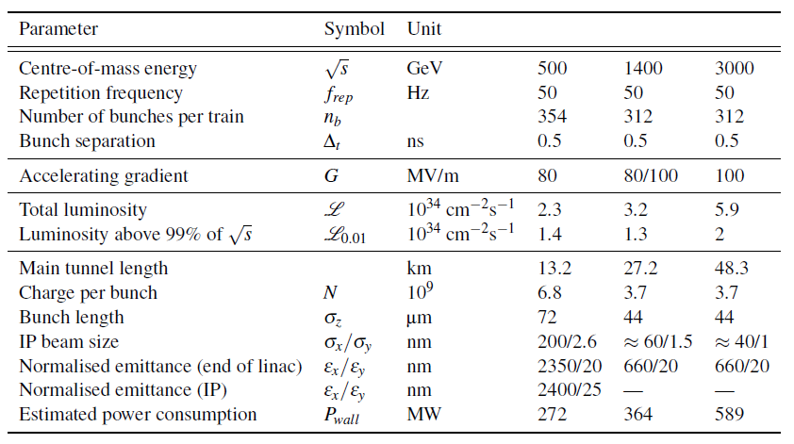
Parameters for Scenario A
« optimized for luminosity at 500 GeV »

Slide 10
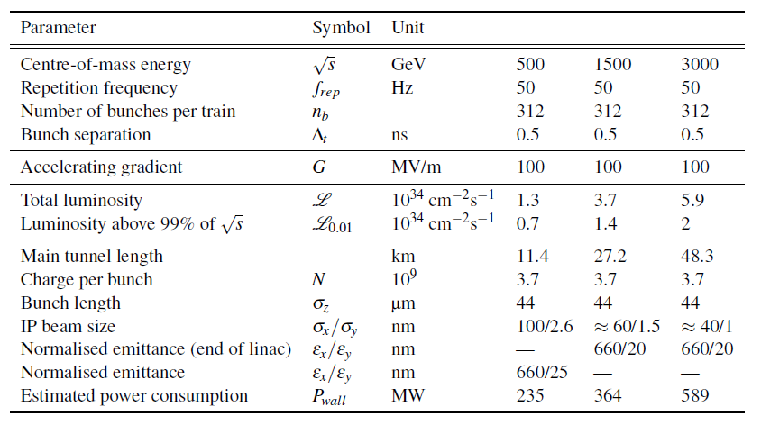
Parameters for Scenario B
« lower entry cost »

Slide 11
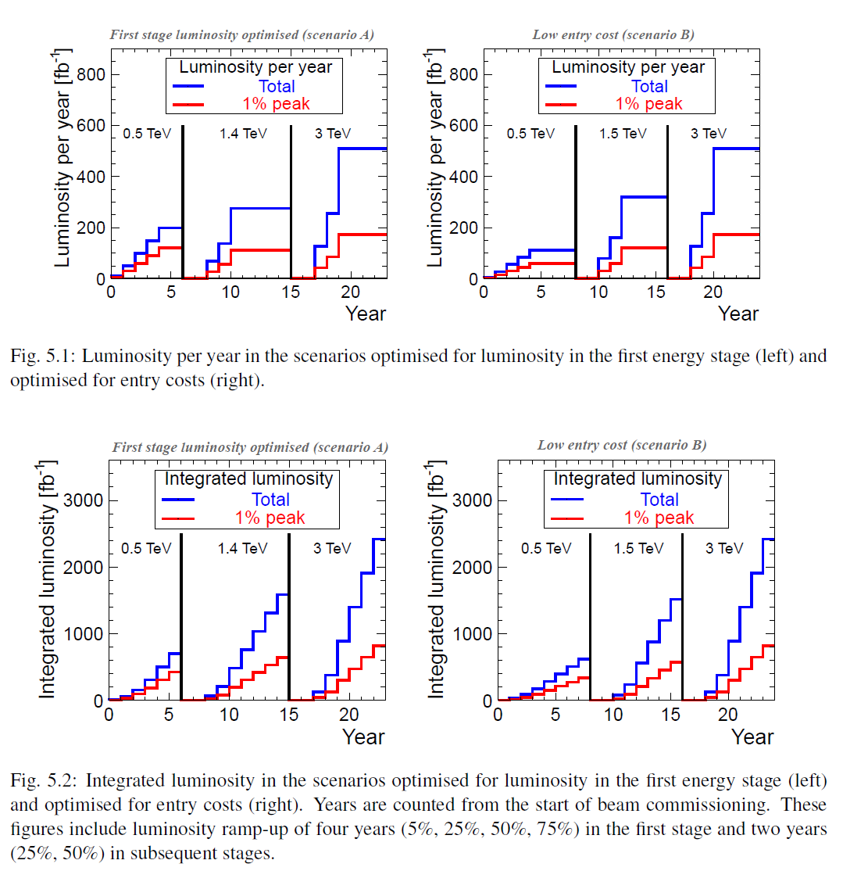

Slide 12
Contents
Scope of the CLIC CDR study
Power, energy and efficiency estimates
Electrical power distribution
Cooling and HVAC
Paths to power and energy savings
Conclusion

Slide 13
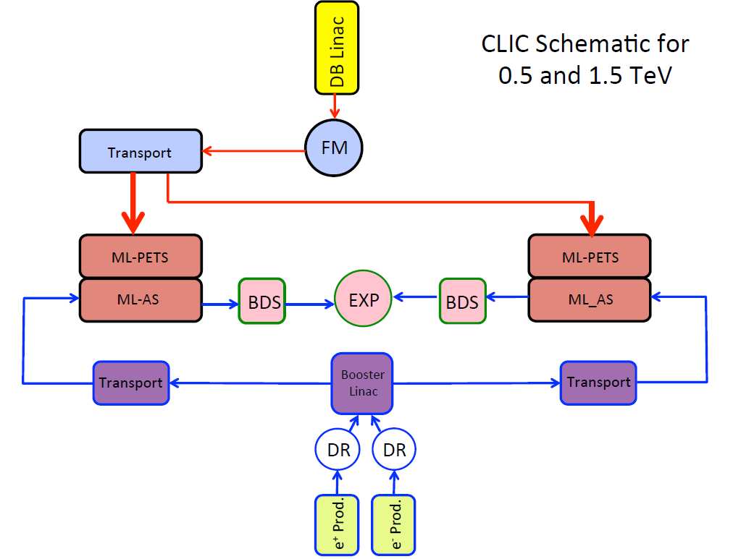
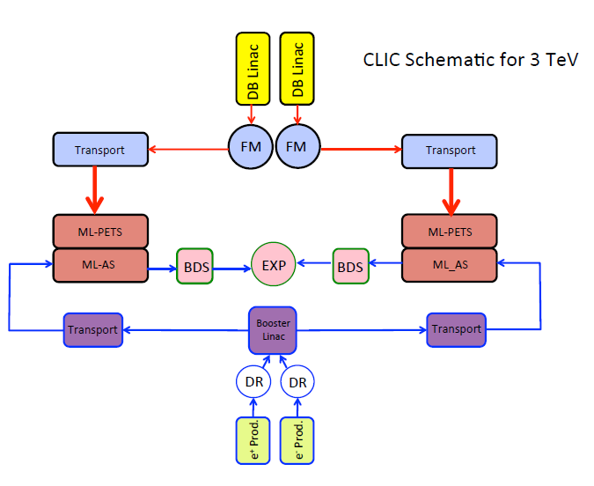
CLIC functional schematics

Slide 14
Assumptions & boundary conditions for power estimates
Power & energy consumption are consistent with the technical definition of the CLIC accelerator project as per the CDR
  Minor adjustments have been made to the numbers between CDR Volume 1 and Volume 3
  In addition, Volume 3 includes numbers for scenario 500 GeV B
Assumptions for RF-to-beam efficiencies
  Modulators 0.89 (0.95 flat-top, 3 μs rise time, 5 μs setting time)
  Klystrons 0.7 (R&D goal, best achieved today 0.68)
  Drive beam acceleration 0.89 (low-gradient structures)
  PETS (fully loaded) 0.98
  Residual drive beam power after deceleration 17 % ⇒ effective power extraction from drive beam 0.81
  Main beam acceleration 0.25 (compromise between gradient, efficiency and minimization of wake fields)
A number of technical alternatives aiming at mitigation of power and energy consumption have been identified, and will be studied in the post-CDR phase

Slide 15
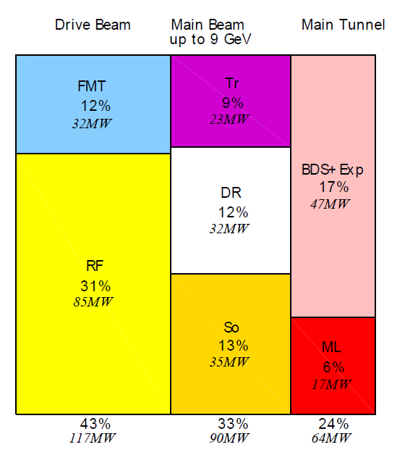
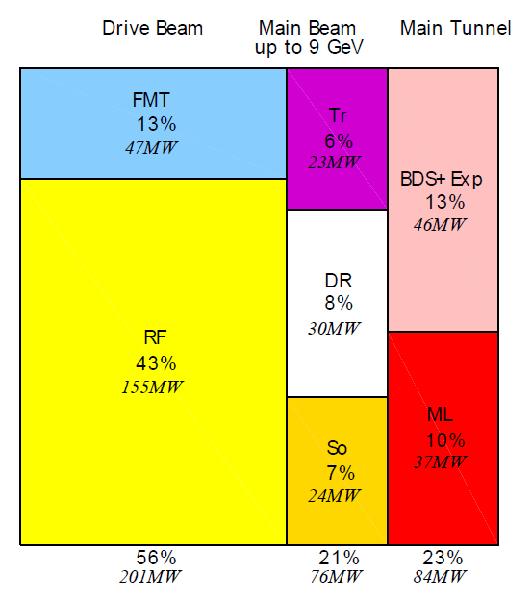
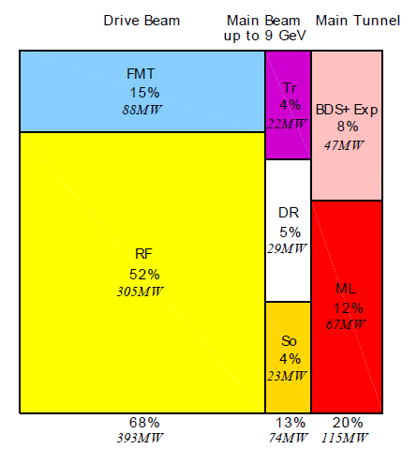
Power consumption by WBS domain
Minor changes between CDR Volume 1 and Volume 3
Numbers in parentheses refer to CDR Volume 1
Power consumption of ancillary systems ventilated pro rata and included in numbers by WBS domain
500 GeV A
Total 272 (271) MW
1.5 TeV
Total 364 (361) MW
3 TeV
Total 589 (582) MW
RF: drive beam linac, FMT: frequency multiplication & transport, So: sources & acceleration up to 2.5 GeV, DR: damping rings, Tr: booster linac up to 9 GeV & transport, ML: main linacs, BDS: beam delivery system, main dump & experimental area

Slide 16
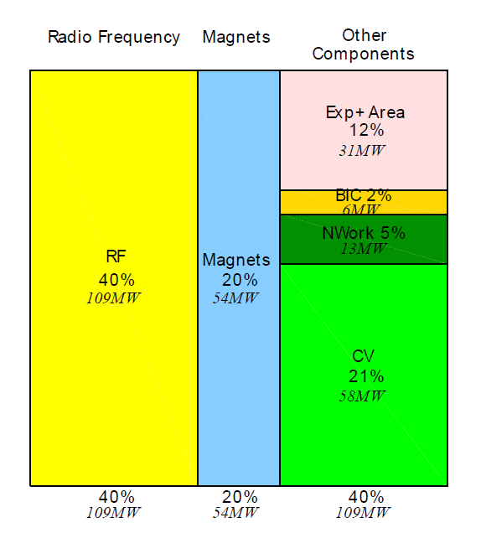
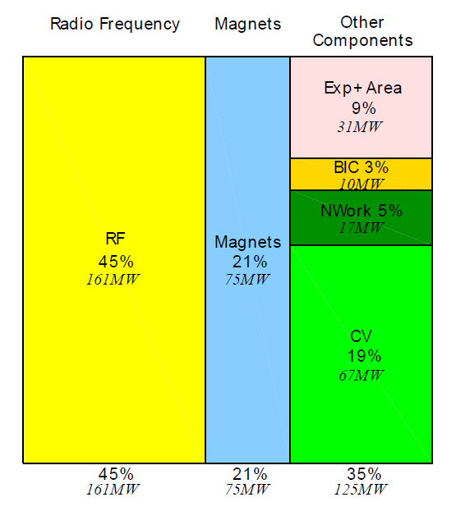
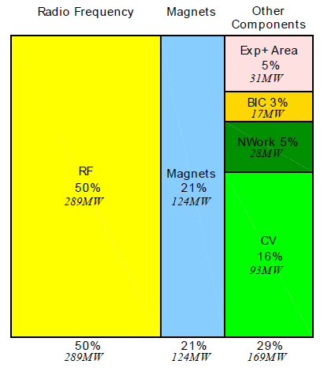
Power consumption by technical system
Minor changes between CDR Volume 1 and Volume 3
Numbers in parentheses refer to CDR Volume 1
500 GeV A
Total 272 (271) MW
1.5 TeV
Total 364 (361) MW
3 TeV
Total 589 (582) MW
CV: cooling & ventilation, NW: electrical network losses, BIC: beam instrumentation & control

Slide 17
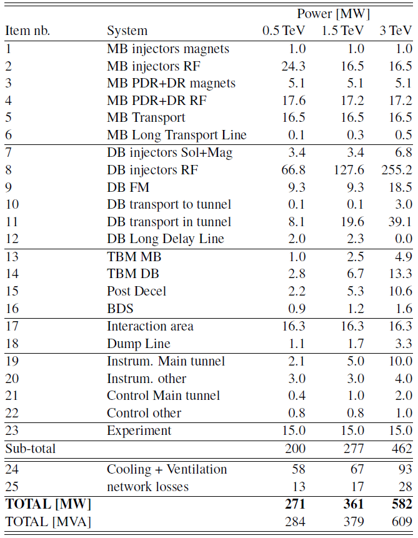
Scenario A

Slide 18
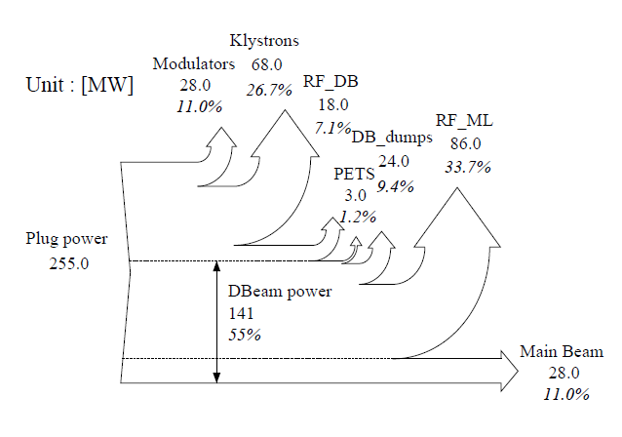
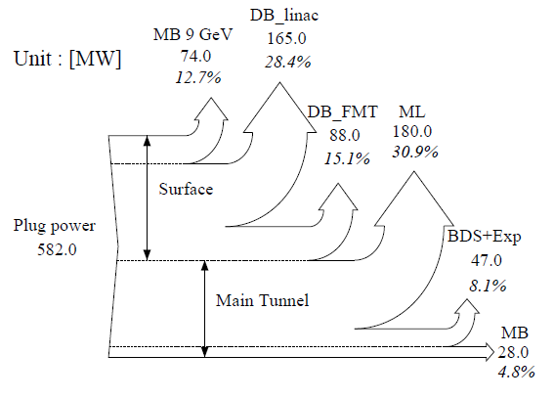
Power flow at 3 TeV
RF chain only
All systems

Slide 19
 | A | A |  | B | B
 | LUM_opt |  |  | Low_entry
E_CM [TeV] | 0.5 | 1.4 |  | 0.5 | 1.5
POWER [MW]
MB injectors magnets | 1 | 1 |  | 1 | 1
MB injectors RF | 24.3 | 16.5 |  | 16.5 | 16.5
MB PDR+DR magnets | 5.1 | 5.1 |  | 5.1 | 5.1
MB PDR+DR RF | 17.6 | 17.2 |  | 17.2 | 17.2
MB Transport | 16.5 | 16.5 |  | 16.5 | 16.5
MB Long Transport Line | 0.1 | 0.3 |  | 0.1 | 0.3
DB injectors Sol+Mag | 3.4 | 3.4 |  | 3.4 | 3.4
DB injectors RF | 66.8 | 127.6 |  | 49.0 | 127.6
DB FM | 9.3 | 9.3 |  | 9.3 | 9.3
DB transport to tunnel | 0.1 | 0.1 |  | 0.1 | 0.1
DB transport in tunnel | 8.1 | 19.6 |  | 6.5 | 19.6
DB Long Delay Line | 2.0 | 2.3 |  | 2.0 | 2.3
TBM MB | 2.0 | 4.9 |  | 1.6 | 4.9
TBM DB | 2.8 | 6.7 |  | 2.2 | 6.7
Post Decel | 2.2 | 5.3 |  | 2.0 | 5.3
BDS | 0.9 | 1.2 |  | 0.9 | 1.2
Interaction area | 16.3 | 16.3 |  | 16.3 | 16.3
Dump Line | 1.1 | 1.7 |  | 1.1 | 1.7
Experiment | 15.0 | 15.0 |  | 15.0 | 15.0
Instrum. Main tunnel | 2.1 | 5.0 |  | 2.0 | 5.0
Instrum. other | 3.0 | 3.0 |  | 3.0 | 3.0
Control Main tunnel | 0.4 | 1.0 |  | 0.4 | 1.0
Control other | 0.8 | 0.8 |  | 0.8 | 0.8
Cooling & Ventilation | 58.0 | 67.0 |  | 52.2 | 67.0
Network Losses | 13.0 | 17.0 |  | 11.3 | 17.0
TOTAL POWER [MW] | 272 | 364 |  | 235 | 364
Twice fewer e⁺
26% gain
16% on beam
10% on klystrons at optimum yield
Proportional reduction
with the above

Slide 20
From power to energy
For each value of CM energy
177 days/year of beam time
188 days/year of scheduled and fault stops
First year
  59 days of injector and one-by-one sector commissioning
  59 days of main linac commissioning, one linac at a time
  59 days of luminosity operation
  All along : 50% of downtime
Second year
  88 days with one linac at a time and 30 % of downtime
  88 days without downtime
Third year
  Still only one e+ target at 0.5 TeV, like for years 1 & 2
  Nominal at 1.5 and 3 TeV
Power during stops: scheduled, fault, downtime

Slide 21
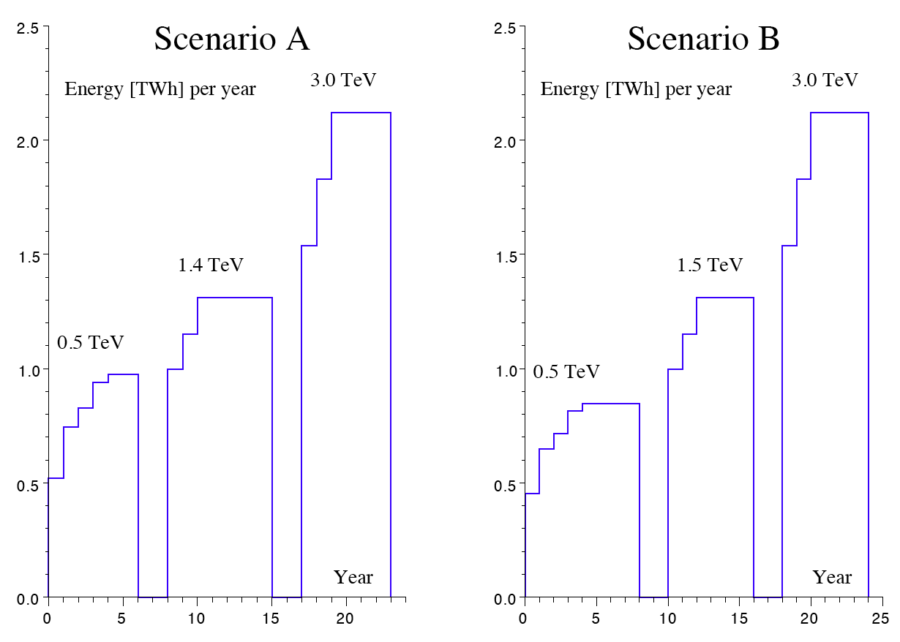
Yearly energy consumption
Integral over the whole programme
  Scenario A : 25.6 TWh
  Scenario B : 25.3 TWh

Slide 22
Contents
Scope of the CLIC CDR study
Power, energy and efficiency estimates
Electrical power distribution
Cooling and HVAC
Paths to power and energy savings
Conclusion

Slide 23
Electrical power distribution, main substation
C. Jach

Slide 24
C. Jach

Slide 25
Contents
Scope of the CLIC CDR study
Power, energy and efficiency estimates
Electrical power distribution
Cooling and HVAC
Paths to power and energy savings
Conclusion

Slide 26
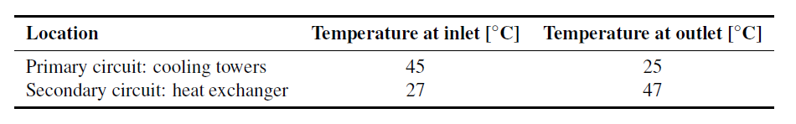
Cooling
Primary circuits
  Raw industrial water, make-up of drinking water
  Treatment against scaling and algae
  Evaporative cooling towers on main campus
Secondary circuits
  Demineralized water σ < 0.1 μS/cm
  Make-up from independent central station
Chilled water
  For cooling of ventilation plants
M. Nonis

Slide 27
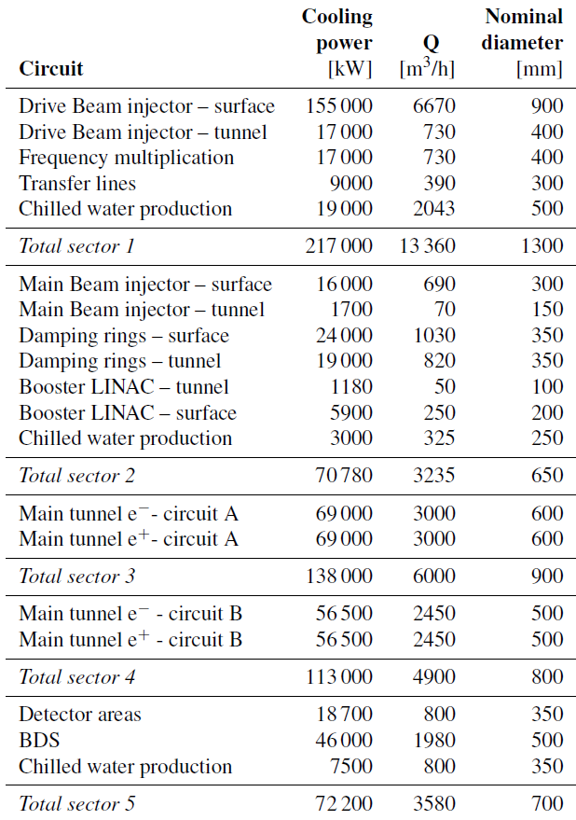
Sizing of cooling water circuits
3 TeV
Total capacity 611 MW
M. Nonis

Slide 28
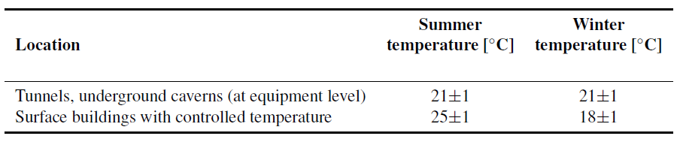
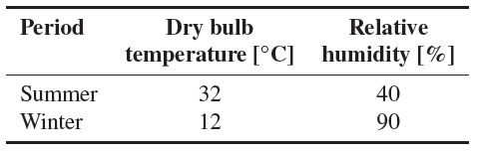
Ventilation
Functions
  Supply fresh air for people
  Provide heating & ventilation
  Maintain suitable temperature at surface of equipment
  Dehumidify to prevent condensation (dewpoint kept below 12 °C)
  Perform smoke extraction
Indoor conditions
Outdoor conditions Geneva
M. Nonis

Slide 29
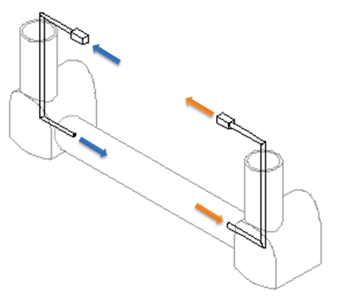
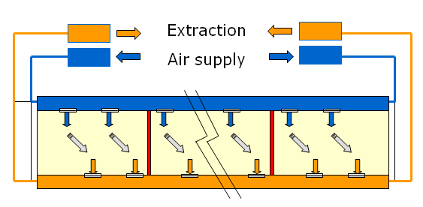
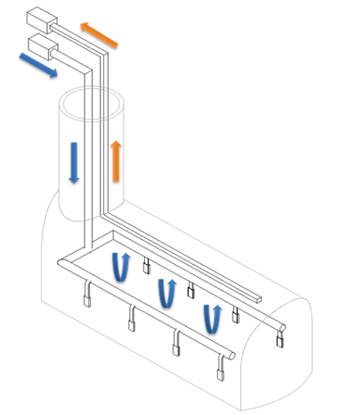
Ventilation schemes
Longitudinal
  Access or equipment tunnels
Semi-transverse
  Main tunnel
Standard
  Caverns
M. Nonis

Slide 30
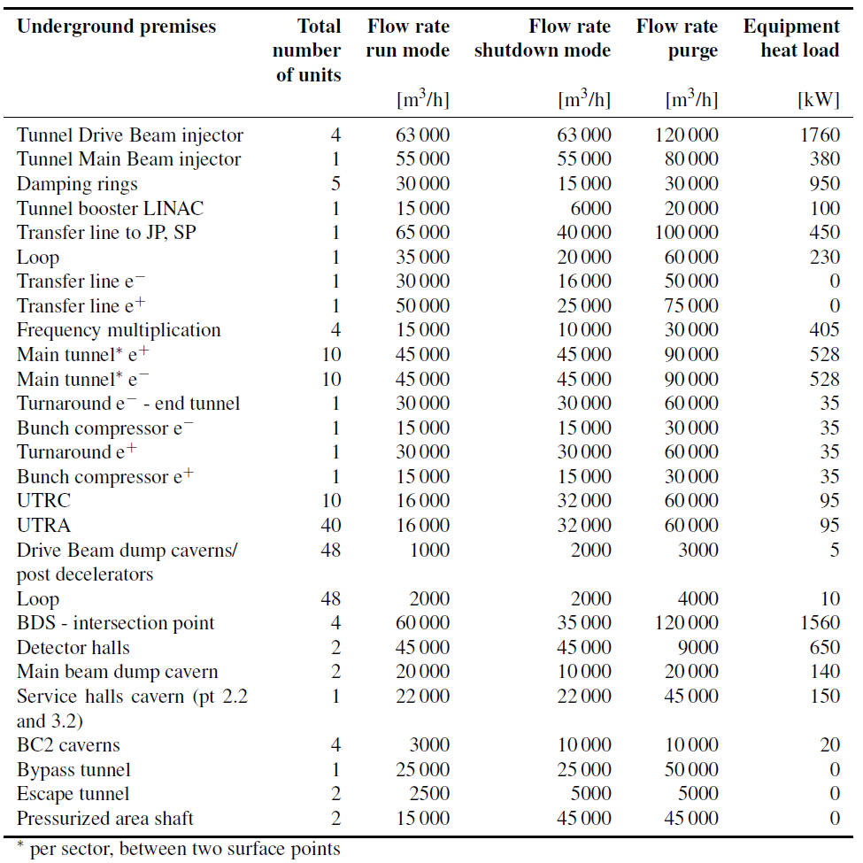
Ventilation, underground premises
3 TeV
Total capacity 39 MW
M. Nonis

Slide 31
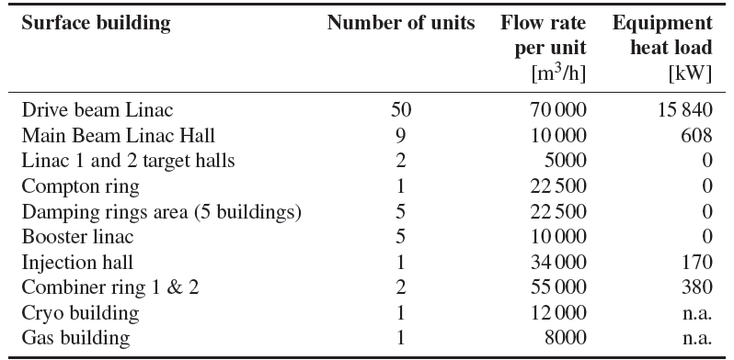
Ventilation, surface buildings
3 TeV
Total capacity 17 MW
M. Nonis

Slide 32
Contents
Scope of the CLIC CDR study
Power, energy and efficiency estimates
Electrical power distribution
Cooling and HVAC
Paths to power and energy savings

Slide 33

power & energy economy
waste heat recovery
sobriety
energy management
efficiency

Slide 34
Paths to power & energy savings
Sobriety
Reduced current density in normal-conducting magnets
  Magnets & overheads (electrical network losses, cooling & ventilation) represent 27 % of overall power at 3 TeV
  For given magnet size and field, power scales with current density
  Compromise between capital & real estate costs on one hand, and operation costs on the other hand
Reduction of HVAC duty
  Most heat loads already taken by water cooling
  Possible further reduction in main tunnel by thermal shielding of cables
  Possible reduction in surface buildings by improved thermal insulation, natural ventilation, relaxation of temperature limits

Slide 35
Paths to power & energy savings
Efficiency
Grid-to-RF power conversion
  R&D on klystrons
  R&D on modulators, powering from the grid at HV
RF-to-beam power conversion
  Re-optimization of accelerating structures and gradient with different objective function (present value 0.25)
Permanent or super-ferric superconducting magnets
  Permanent magnets
    distributed uses, e.g. main linac DB quads
    fixed-field/gradient or mechanical tuning
  Super-ferric superconducting magnets
    « grouped » and DC uses, e.g. combiner rings, DB return loops in main linacs
⇒ Potential for power savings at 3 TeV
- magnets ~ 86 MW
- cooling & ventilation ~24 MW

Slide 36
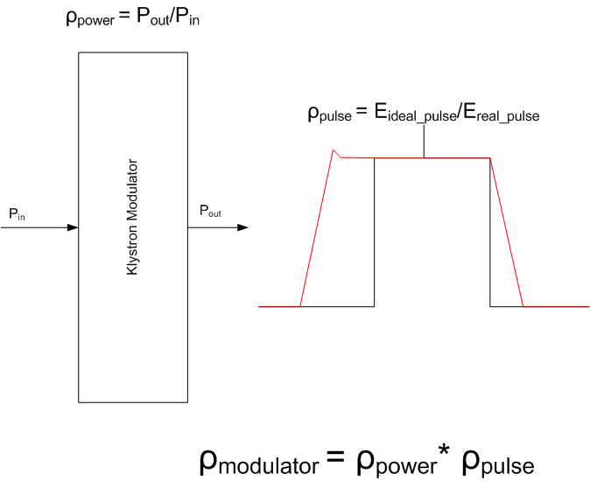
Development of high-efficiency modulators
Useful flat-top Energy | 22MW*140μs = 3.08kJ
Rise/fall time energy | 22MW*5μs*2/3= 0.07kJ
Set-up time energy | 22MW*5μs = 0.09kJ
Pulse efficiency | 0.95
Pulse forming system efficiency | 0.98
Charger efficiency | 0.96
Power efficiency | 0.94
Overall Modulator efficiency | 89%
D. Nisbet & D. Aguglia

Slide 37
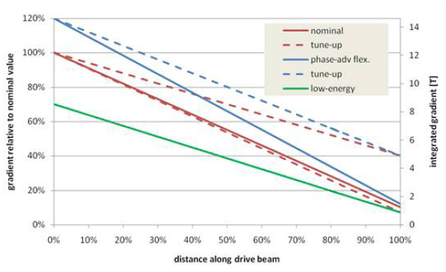
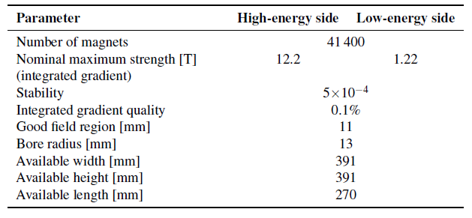
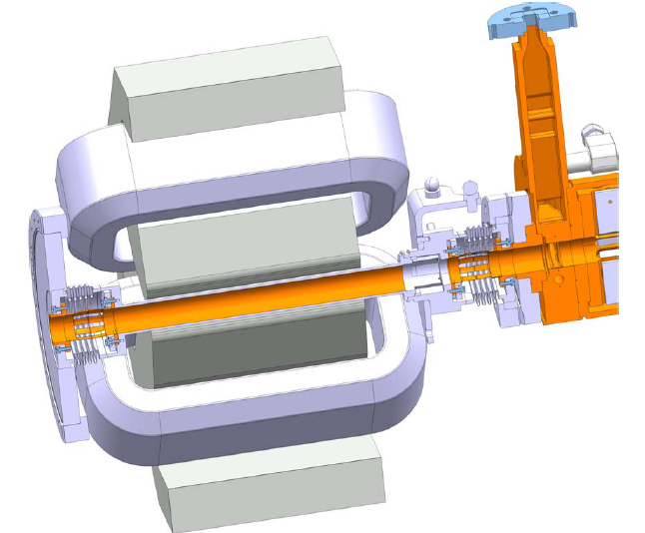
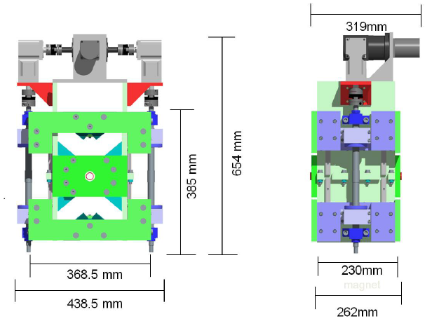
Main linac DB quadrupoles
Conventional electromagnet
Tunable permanent magnet
M. Modena

Slide 38
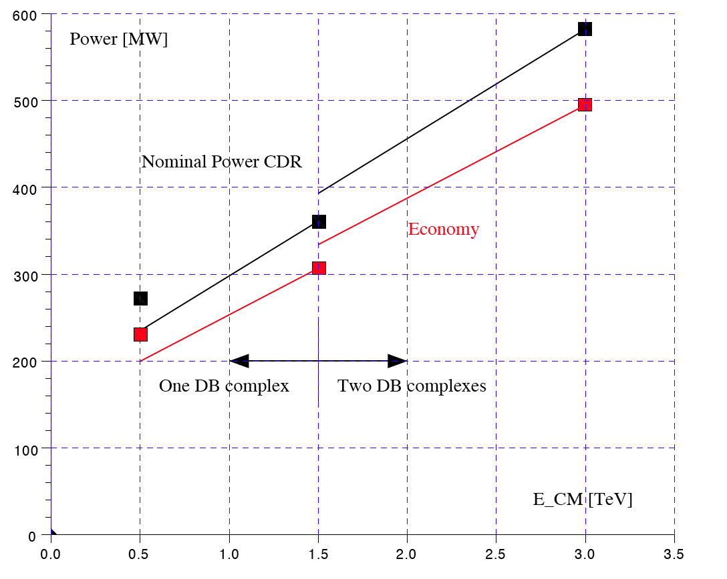
Power consumption versus cm energy
Option A
Option B

Slide 39
Paths to power & energy savings
Energy management
Low-power configurations in case of beam interruption
Modulation of scheduled operation to match electricity demand
  Seasonal load shedding
  Diurnal peak shaving

Slide 40
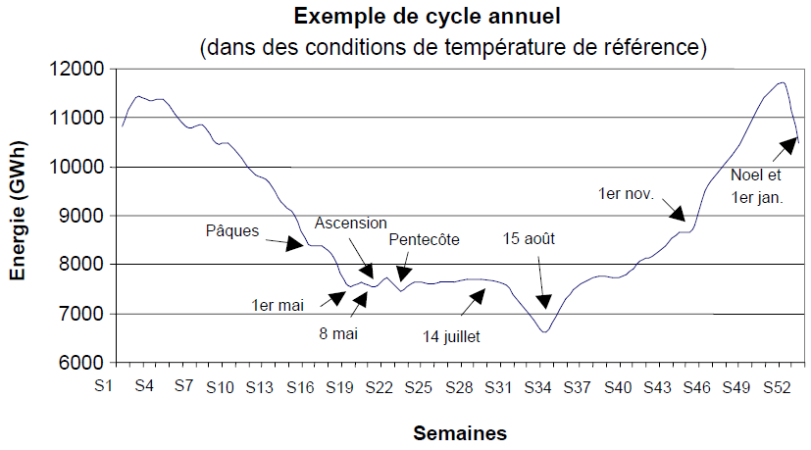
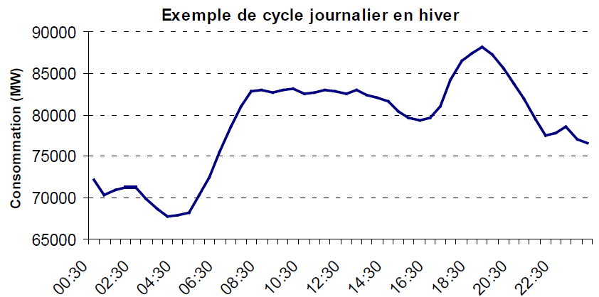
Variations of electricity demand in France
(source: RTE)
Annual variations of power consumption (integrated weekly)
Diurnal variations of power consumption (winter day)

Slide 41
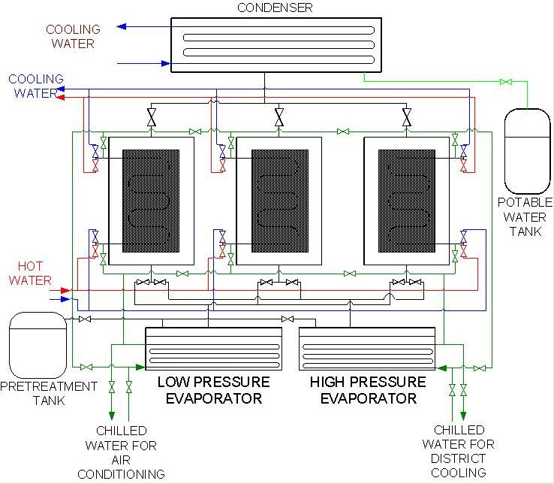
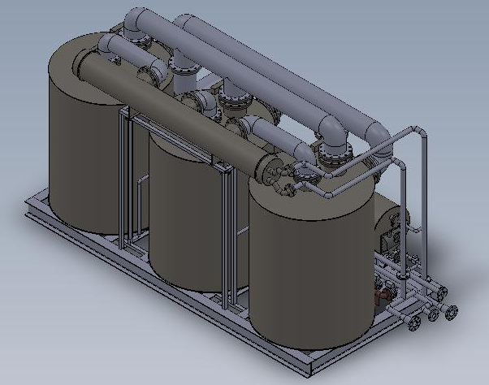
Paths to power & energy savings
Waste heat recovery
Possibilities of heat rejection at higher temperature, e.g. beam dumps
Valorization of low-grade waste heat for concomitant needs, e.g. residential heating or absorption cooling
Three-bed, two evaporator adsorption chiller
(Wroclaw Technology Park)

Slide 42
Conclusions
Linear colliders are single-pass machines and thus unavoidably show low energy efficiency
Optimization of the RF chain is therefore an essential issue, from power grid to RF and from RF to beam. Well identified by CLIC (and ILC), this has driven design choices and triggered specific R&D. The RF system however uses only about half of the total power consumed
CLIC is a large complex of accelerators and beam lines, resulting in significant power being used in magnet systems (21 % of total). Several approaches to mitigating this demand are being explored
In view of the large size and installed power of the CLIC complex, conventional services such as electrical distribution and cooling & HVAC are also large power consumers (21 % of total)
Re-optimizing machine parameters for 500 GeV collision energy (or below) with comprehensive accounting of power consumption constitutes the main path of power savings
Significant and swift decrease of power consumption in standby modes opens the way for running CLIC as peak-shaving facility
Recovery and valorization of low-grade waste heat appears feasible in specific cases and requires further study

