Slide 1
CTF3 Results
R. Corsini for the CTF3 Team & the CLIC Collaboration
OUTLINE:
Short introduction to CTF3
Feasibility studies
  Drive beam generation
  Deceleration and RF power production
  Two-Beam acceleration
    (Conceptual Design Report)
Timelines and program for the coming years
Conclusions

Slide 2
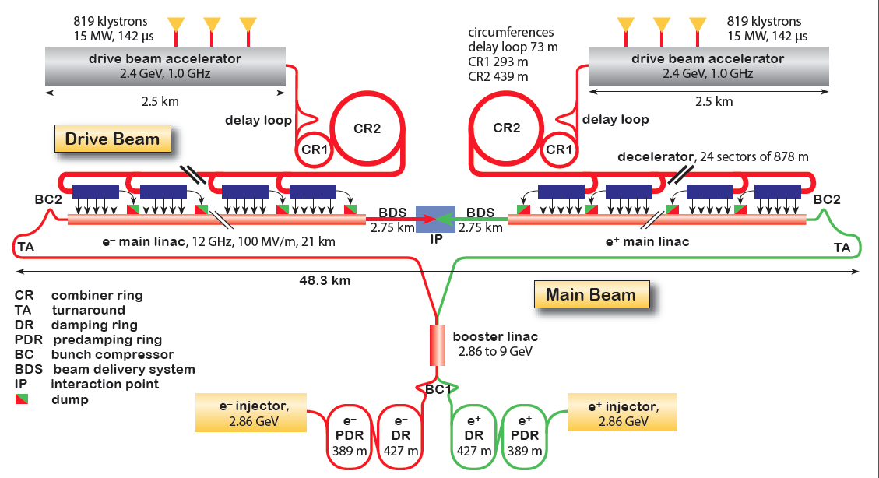
CLIC Layout at 3 TeV
Drive beam time structure - initial
Drive Beam Generation Complex
Drive beam time structure - final
240 ns
240 ns
5.8 ms
140 ms train length - 24 × 24 sub-pulses
4.2 A - 2.4 GeV – 60 cm between bunches
24 pulses – 101 A – 2.5 cm between bunches
Main Beam Generation Complex

Slide 3
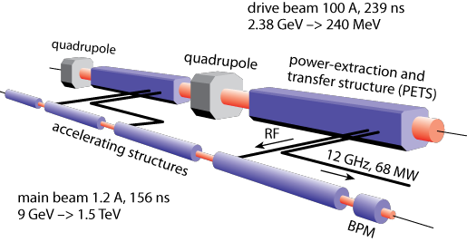
CLIC Feasibility Benchmarks
Main linac gradient
Accelerating structure
(CTF3)
Drive beam scheme
Drive beam generation
PETS (power extraction and transfer structures)
Two beam acceleration
Drive beam deceleration
CTF3
Luminosity
Main beam emittance generation, preservation and focusing
Alignment and stabilisation
(CTF3)
Operation and Machine Protection System (robustness)
(CTF3)
Detector (experimental conditions)

Slide 4
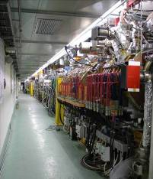
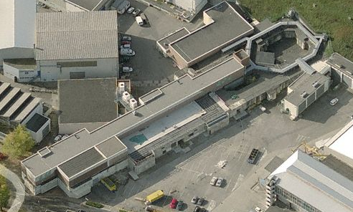
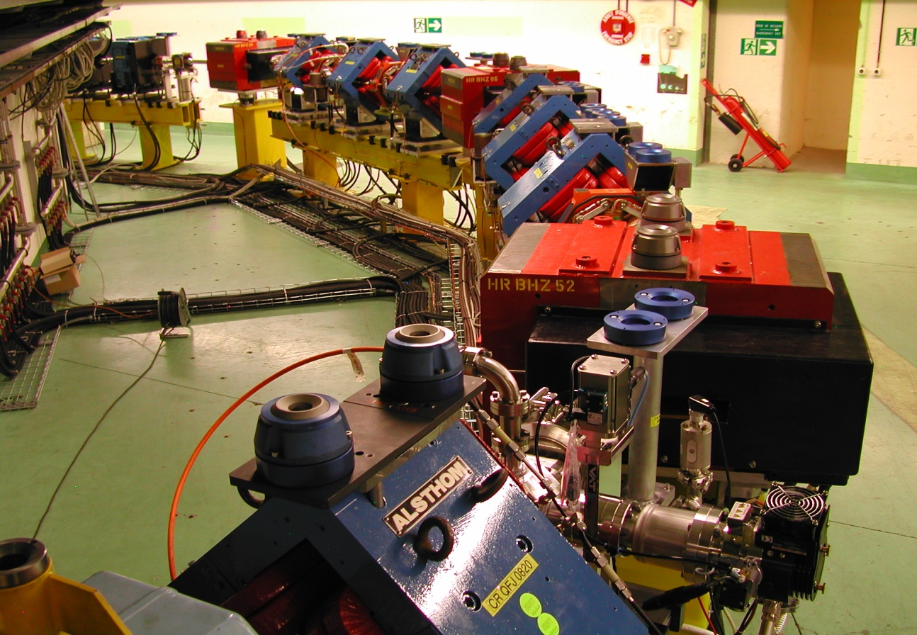
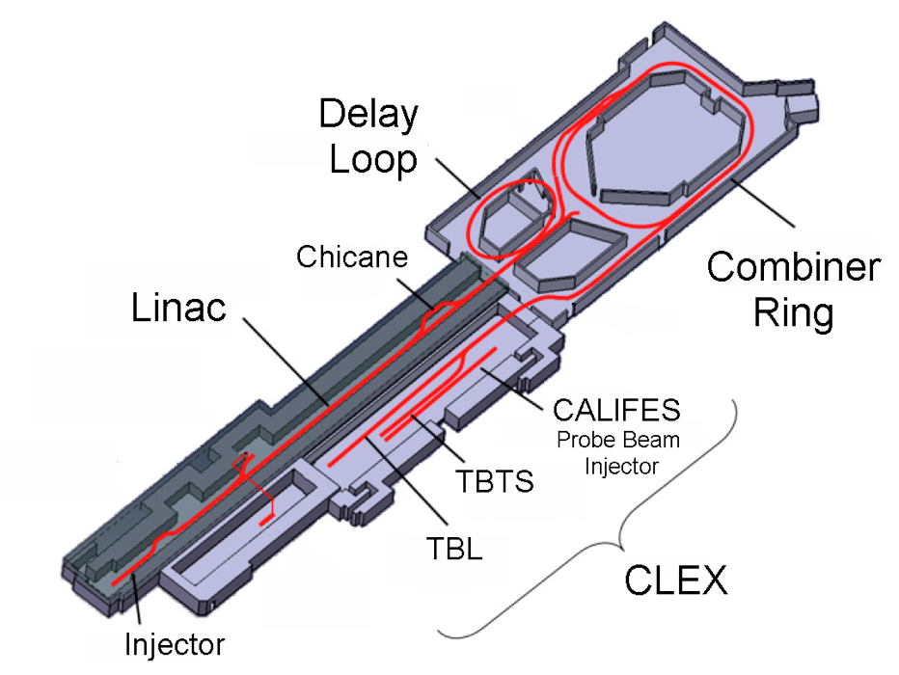
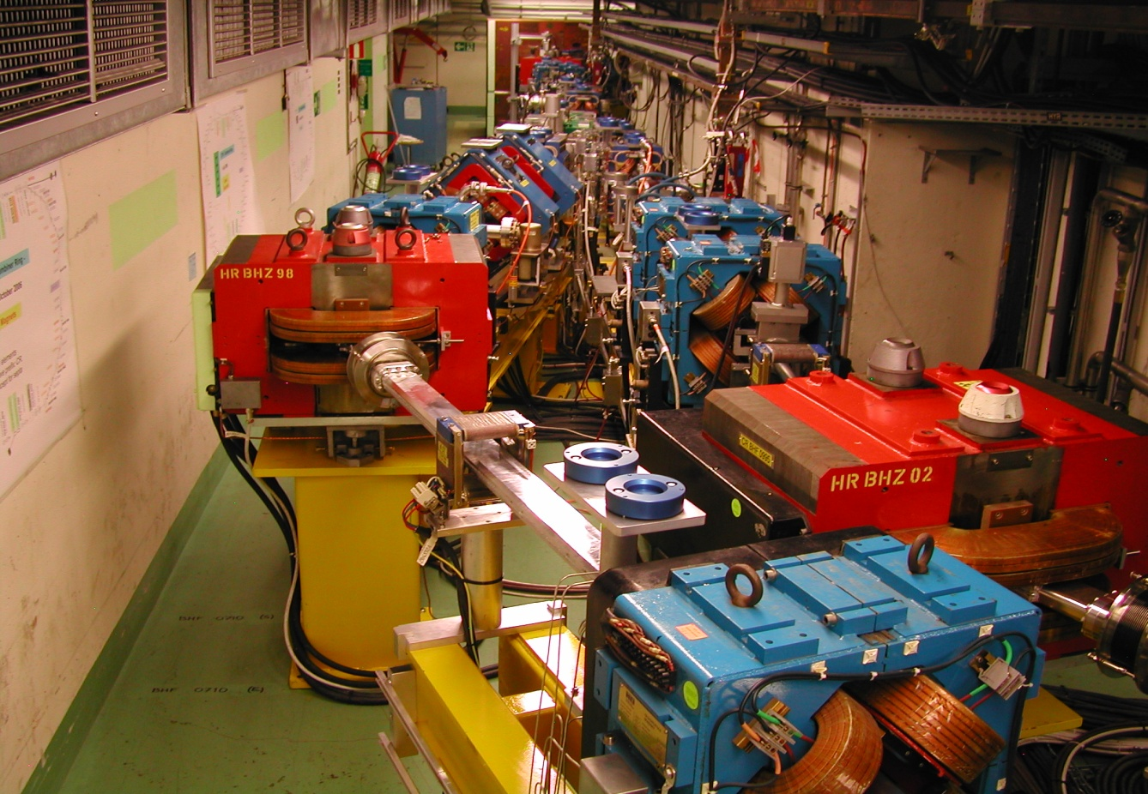
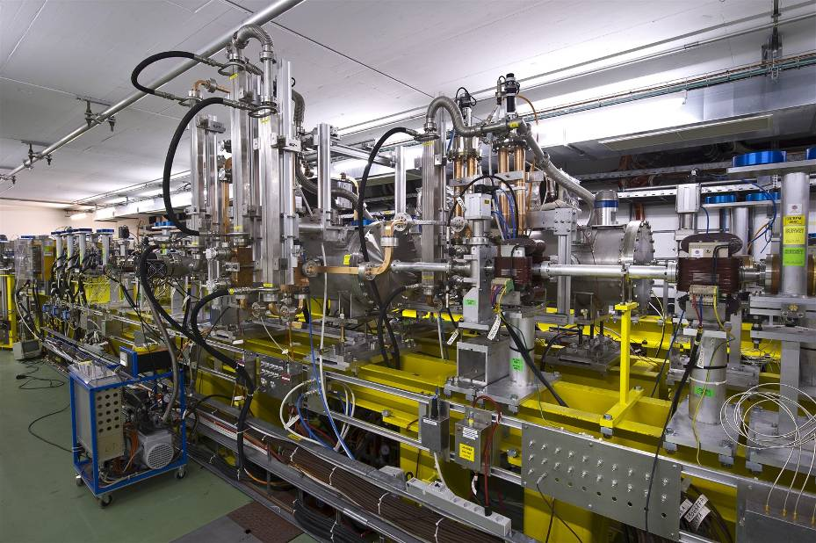
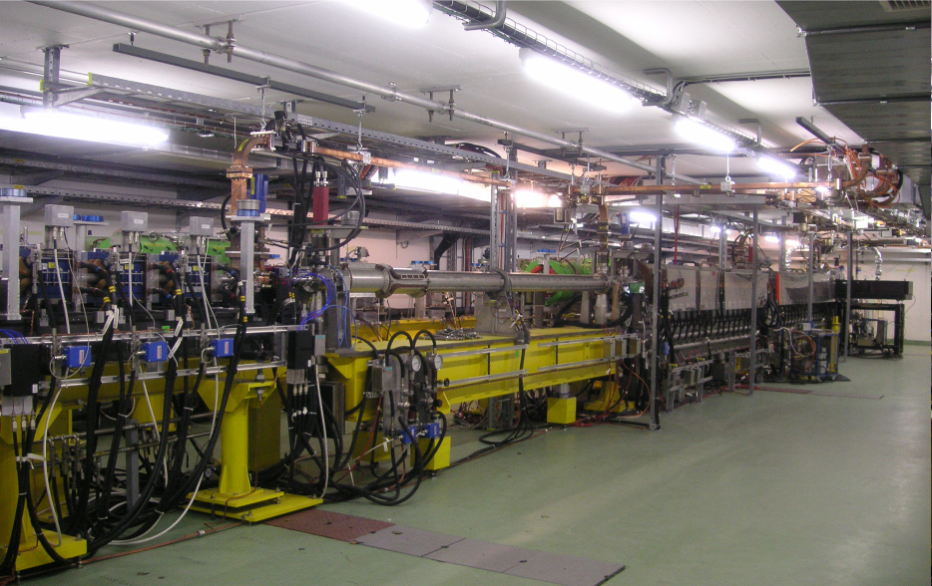
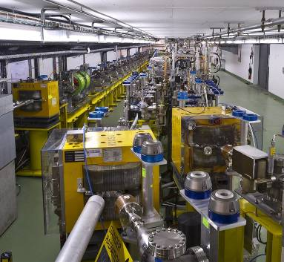
CLIC Test Facility (CTF3)
Operation of isochronous lines and rings
4 A, 1.4us
120 MeV
30 A, 140 ns
120 MeV
High current, full
beam-loading operation
Beam recombination and current multiplication by RF deflectors
12 GHz power generation by drive beam deceleration
High-gradient two-beam acceleration
30 A, 140 ns
60 MeV
Bunch phase coding

Slide 5
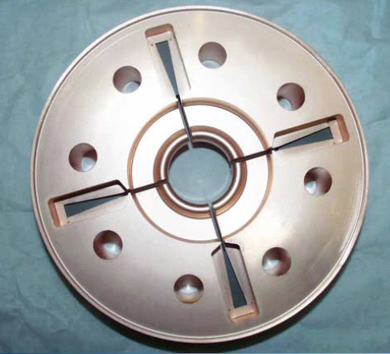
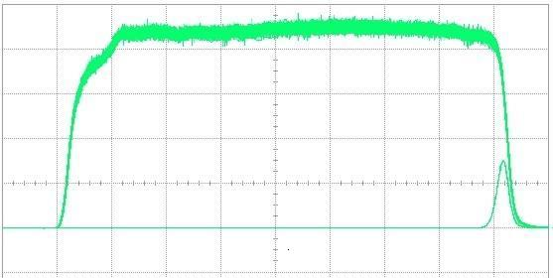
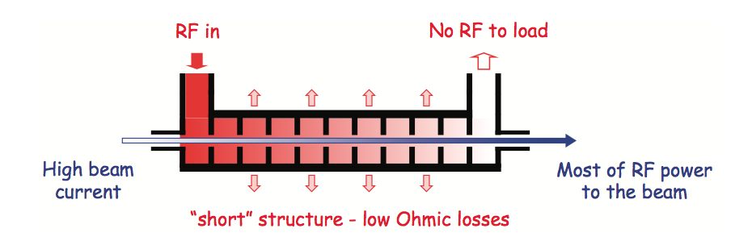
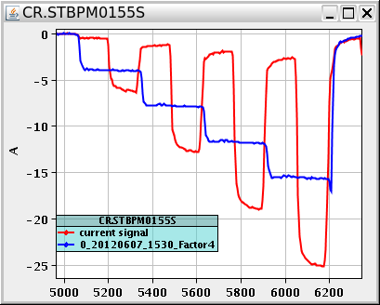
Drive Beam Generation
damping
slot
Full beam loading acceleration
95.3% RF to beam efficiency
Stable high current acceleration
Current stability
Isochronicity, phase coding
Factor 8 current & frequency multiplication
RF pulse at structure input
10 m
RF pulse at output
SiC load
RF in
No RF to load
High beam current
Most RF power
to beam
“short” structure – low Ohmic losses
Pulse charge measurement
Factor 8 combination

Slide 6
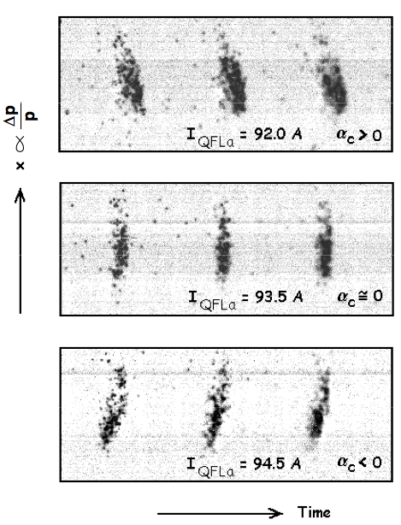
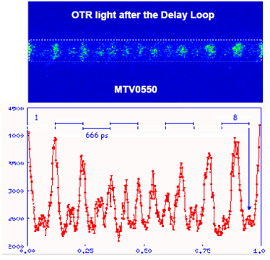
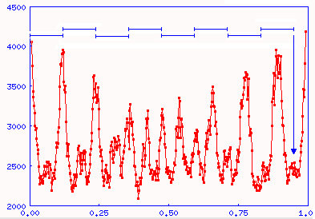
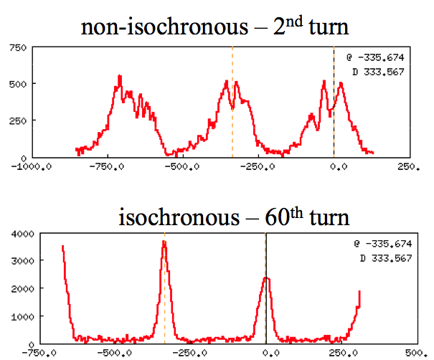
Drive Beam Generation
Beam recombination
Fast bunch phase switch in SHB system
Operation of isochronous rings and beam lines
6 ns

Slide 7
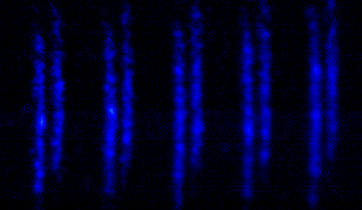
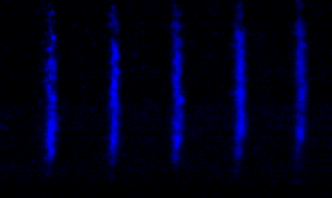
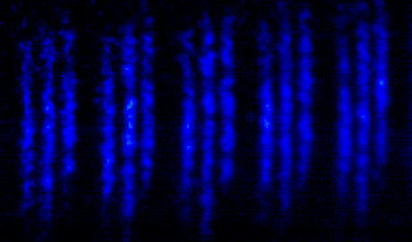
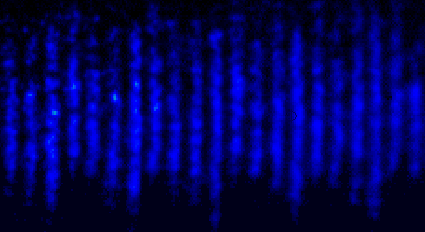
Drive Beam Generation
x
333 ps
83 ps
Streak camera images of the beam, illustrating the bunch combination process in the ring
t

Slide 8
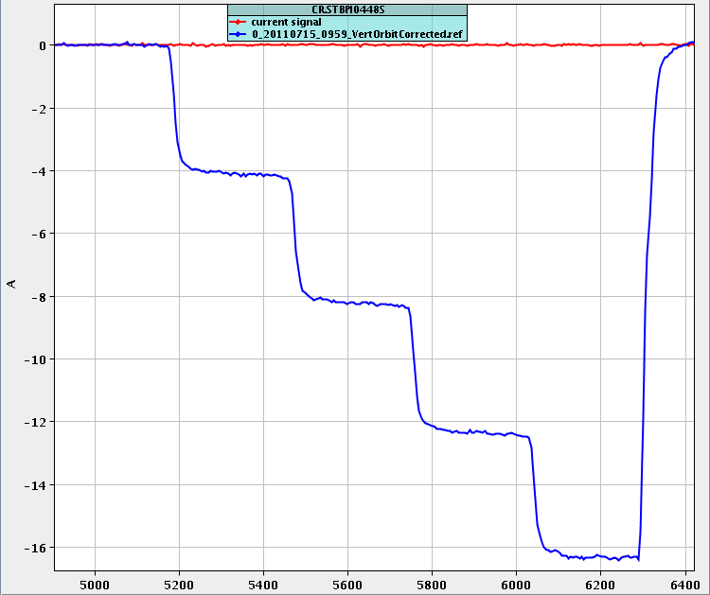
Drive Beam Generation
Beam recombination
Factor 4 - OK
Factor 8
  basic principle demonstrated
  Still need some improvement
  (stability, emittance)
Beam recombination - Emittance
Best results in CLEX
for factor 4: ε_{H}= 250 um ε_{V}= 140 um
for factor 8: ε_{H}= 550 um ε_{V}= 170 um
Different turns are ~ ok, no unknown effects
Emittance increase due to non perfect orbit

Slide 9
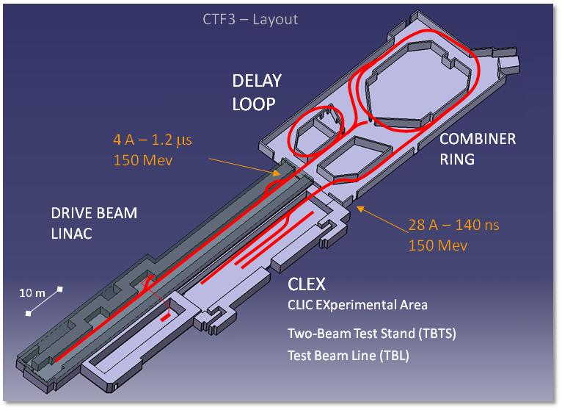
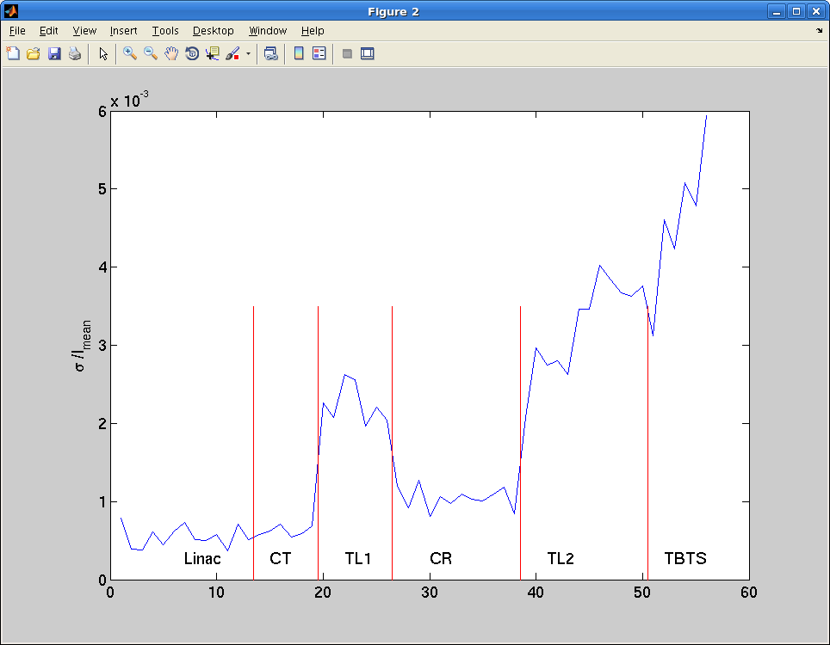
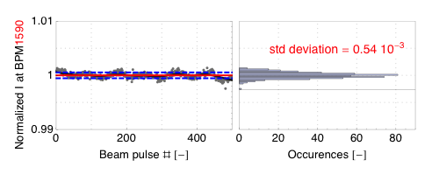
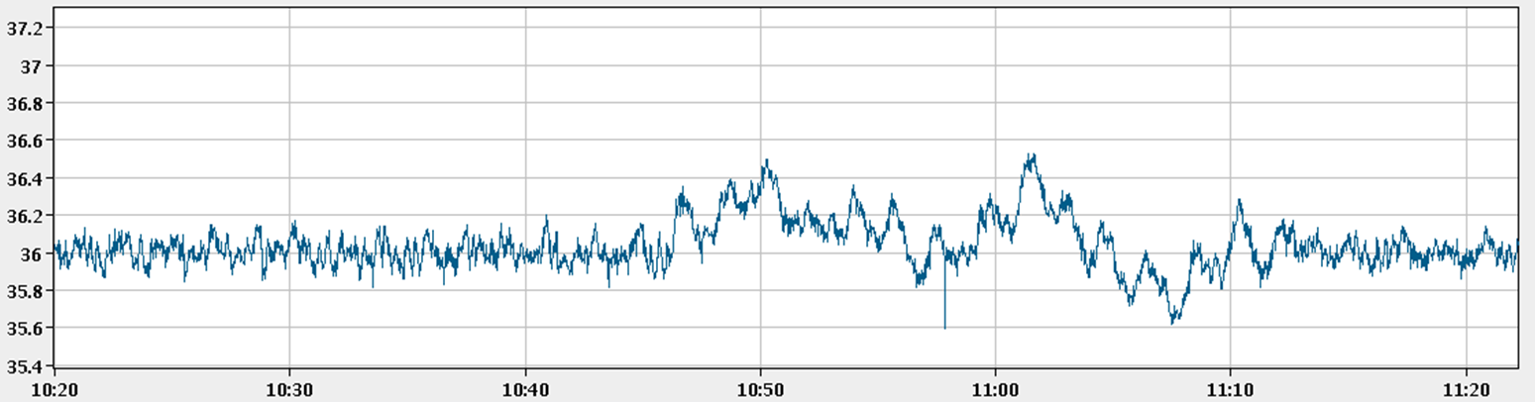
Drive Beam Stability
Repeatibility and long term current stability improved
Pulse charge stability at end of the linac better than CLIC requirements
Charge stability – Factor 4
18th November 2011
3 to 4 10⁻³
1 10⁻³
5 10⁻⁴
CLIC requirement
S [m]
Several feed-back loops operational, for temperature, RF phase and power and gun current.
RF power feedback, MKS 13
Feedback off
P [MW]
Feedback on
Feedback on
Time [h:m]

Slide 10

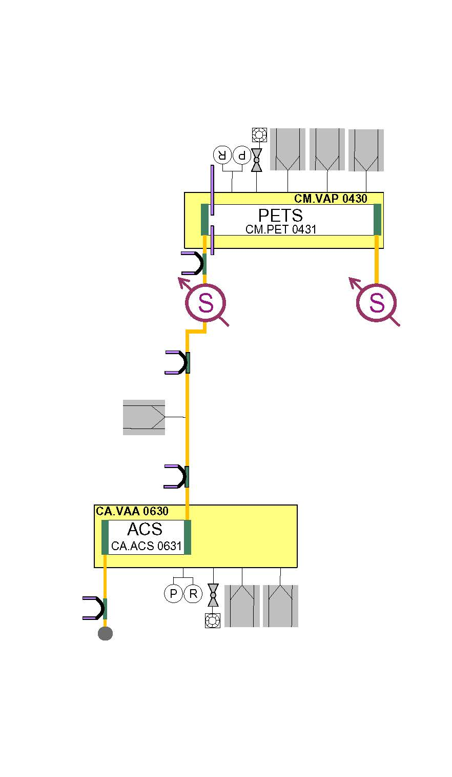
The Two-Beam Test Stand (TBTS)
PETS – Power Extraction & Transfer Structure
Two-Beam Test Stand in CLEX
PETS tank
Two-Beam Test Stand
(TBTS) Layout
Structure tank

Slide 11
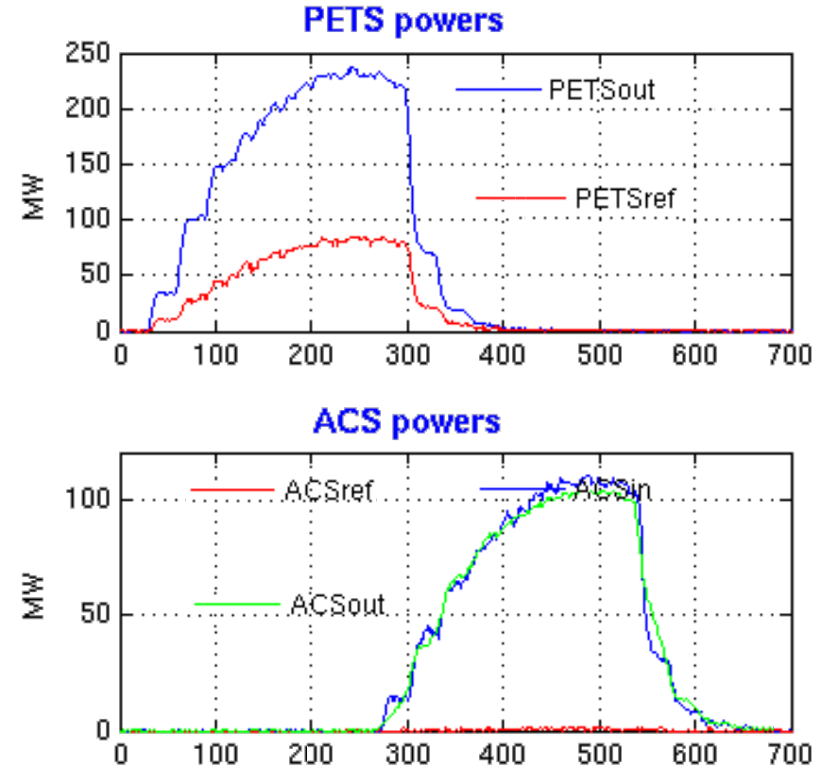
Power production in TBTS
PETS operated routinely above 200 MW peak RF power
providing reliably pulses ~ 100 MW peak to accelerating structure.
About twice the power needed to demonstrate 100 MV/m acceleration in a two-beam experiment with TD24 structure.
CLIC target
Two-Beam Test Stand
(TBTS) Layout
135 MW
t [ns]

Slide 12
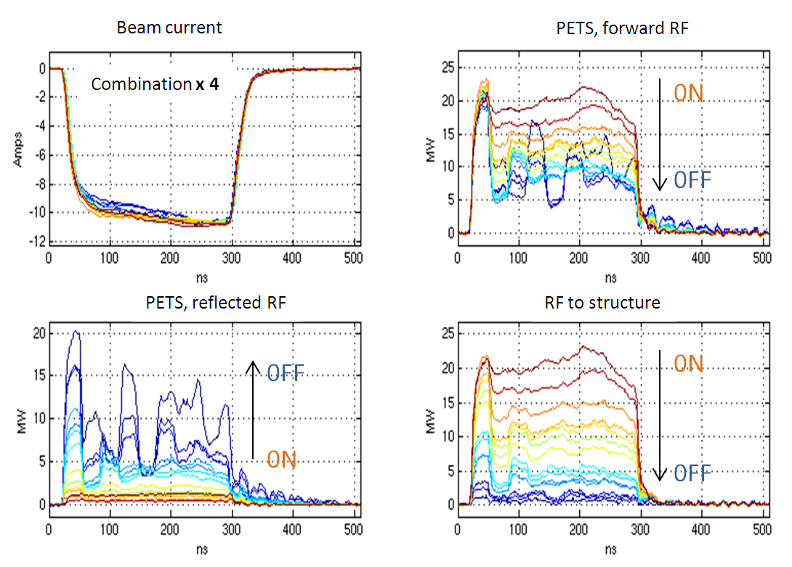
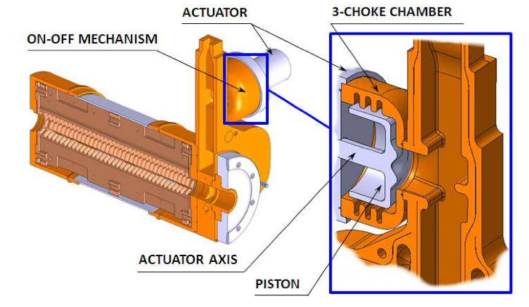
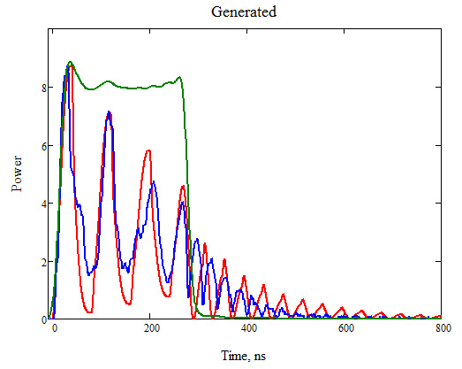
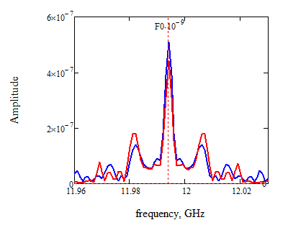
TBTS – PETS On-off mechanism
Demonstration of PETS of-off mechanism
Considered a feasibility issue
Ability to:
  Switch off power from individual PETS to accelerating structure in case of breakdown
  Reduce substantially power in PETS, to cope with PETS breakdowns
PETS on-off principle fully tested
Conditioned at high power
(135 MW - nominal) by recirculation
Simulation vs. experiment
PETS , forward RF
Spectra
comparison
ON
OFF

Slide 13
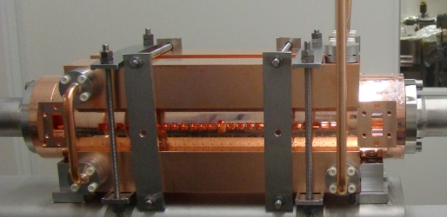
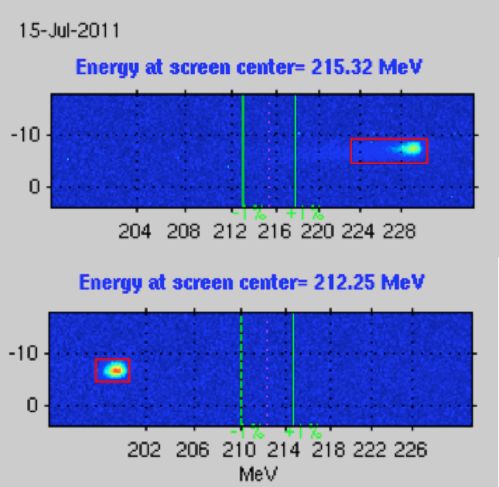
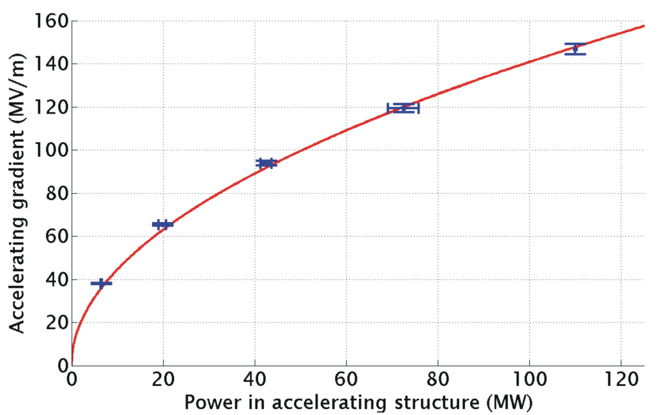
Two-Beam Acceleration
TD24
Two-Beam Acceleration demonstration in TBTS
Up to 145 MV/m measured gradient
Good agreement with expectations (power vs. gradient)
Maximum stable probe beam acceleration measured: 31 MeV
⇒ Corresponding to a gradient of 145 MV/m
Drive beam ON
CLIC Nominal, unloaded
CLIC Nominal, loaded
Drive beam OFF

Slide 14
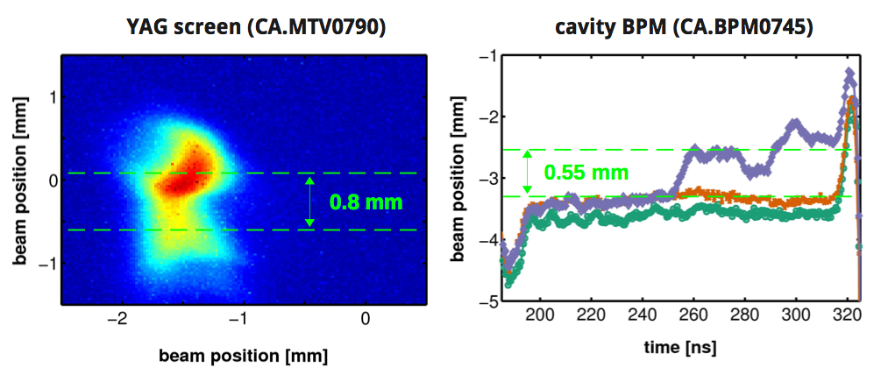
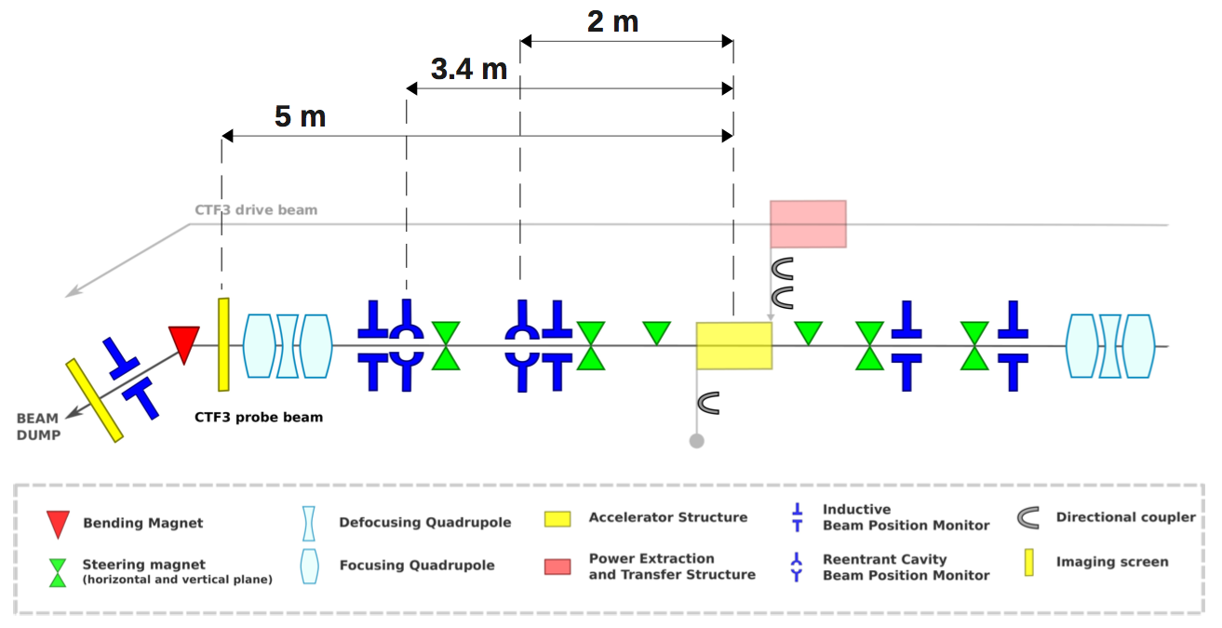
Breakdown kick studies
TBTS layout
  Uppsala
  University

Slide 15
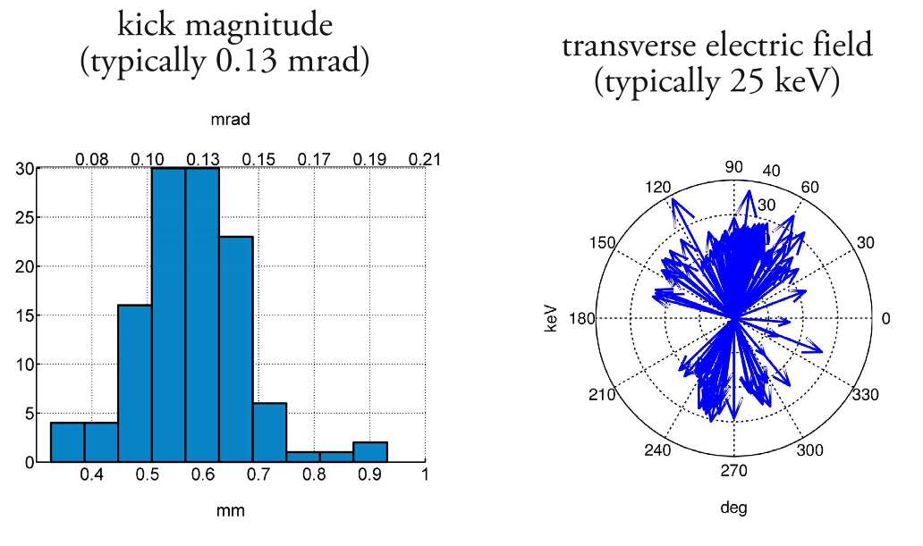
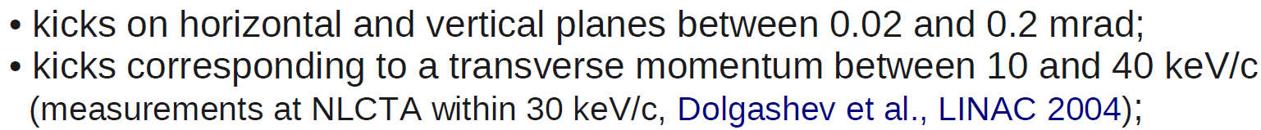
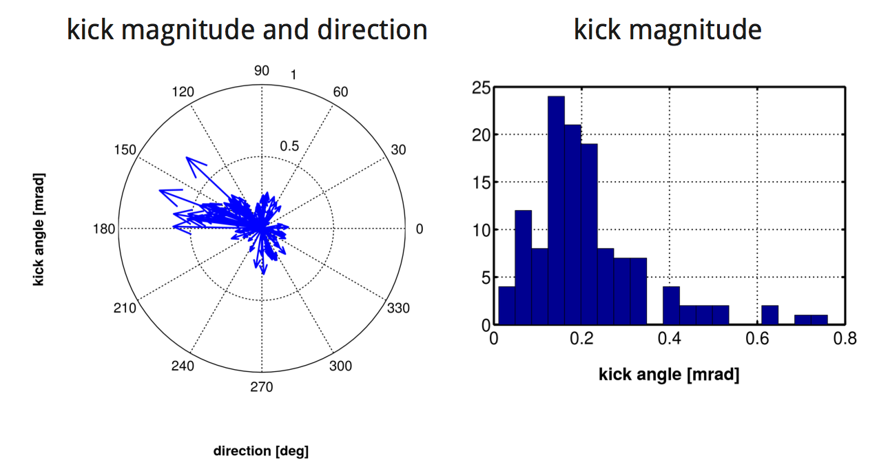
Breakdown kick studies
2011 run
Limited amount of events
Using only screen
2012 run
Many events, larger statistics
Using BPMs and screen
Time resolution
Subtraction of systematic effects
Analysis ongoing, but basically confirming 2011 results
  Uppsala
  University

Slide 16
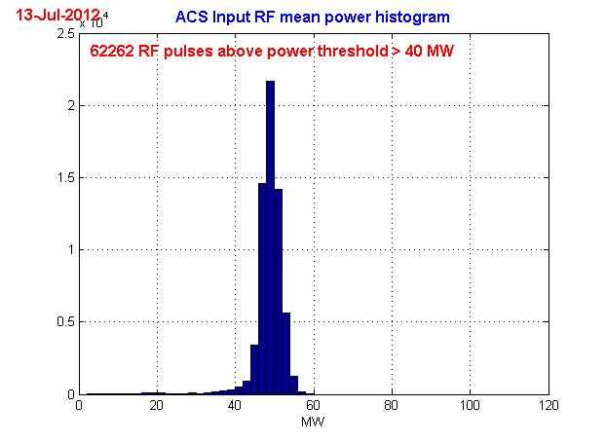
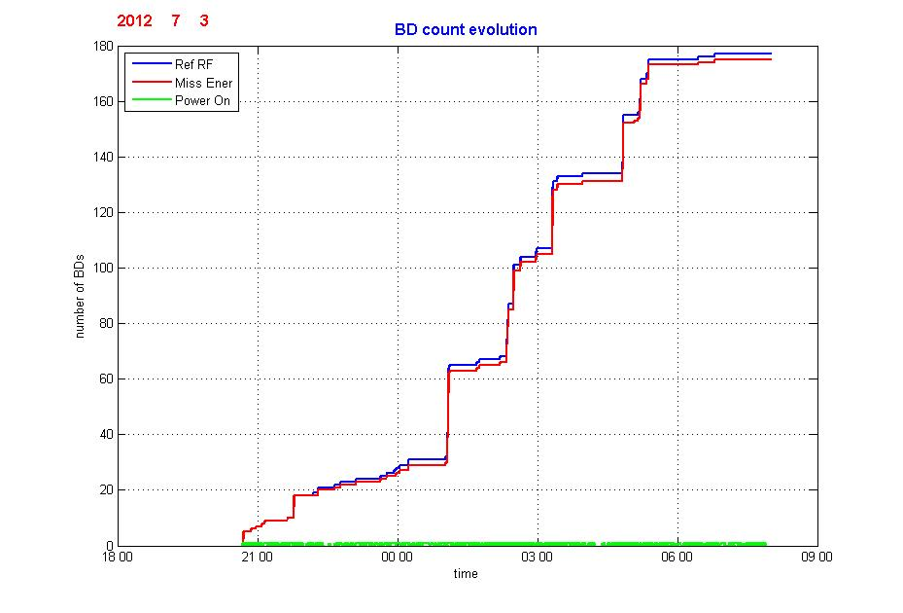
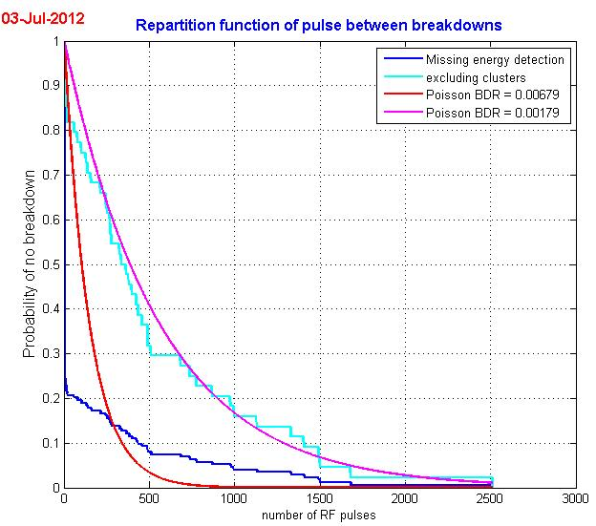
Breakdown physics & statistics
BD count evolution shows several period of intense BDs activity: clusters
Histogram of number of pulses between breakdowns, showing the presence of clusters.
Inside clusters the BD probability becomes very high.
Discarding clusters, good fit by a Poisson law as in low BD rate regime
  CEA-Dapnia & Uppsala University

Slide 17
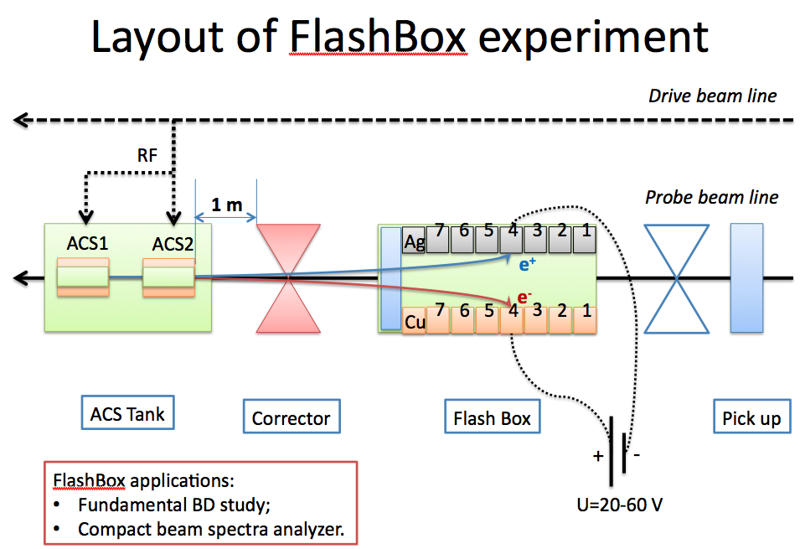
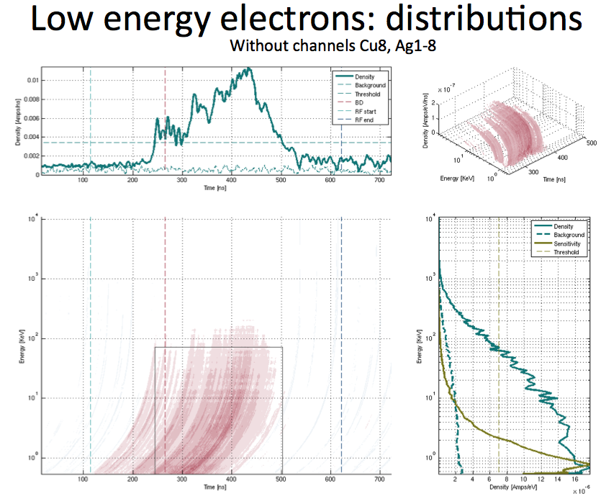
Breakdown physics & statistics
Measurement of intensity and energy distribution of electrons/ions produced during a break-down event
  Uppsala
  University

Slide 18
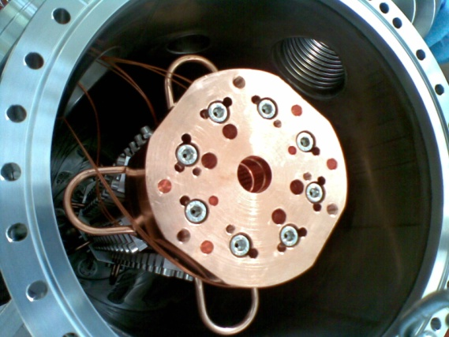
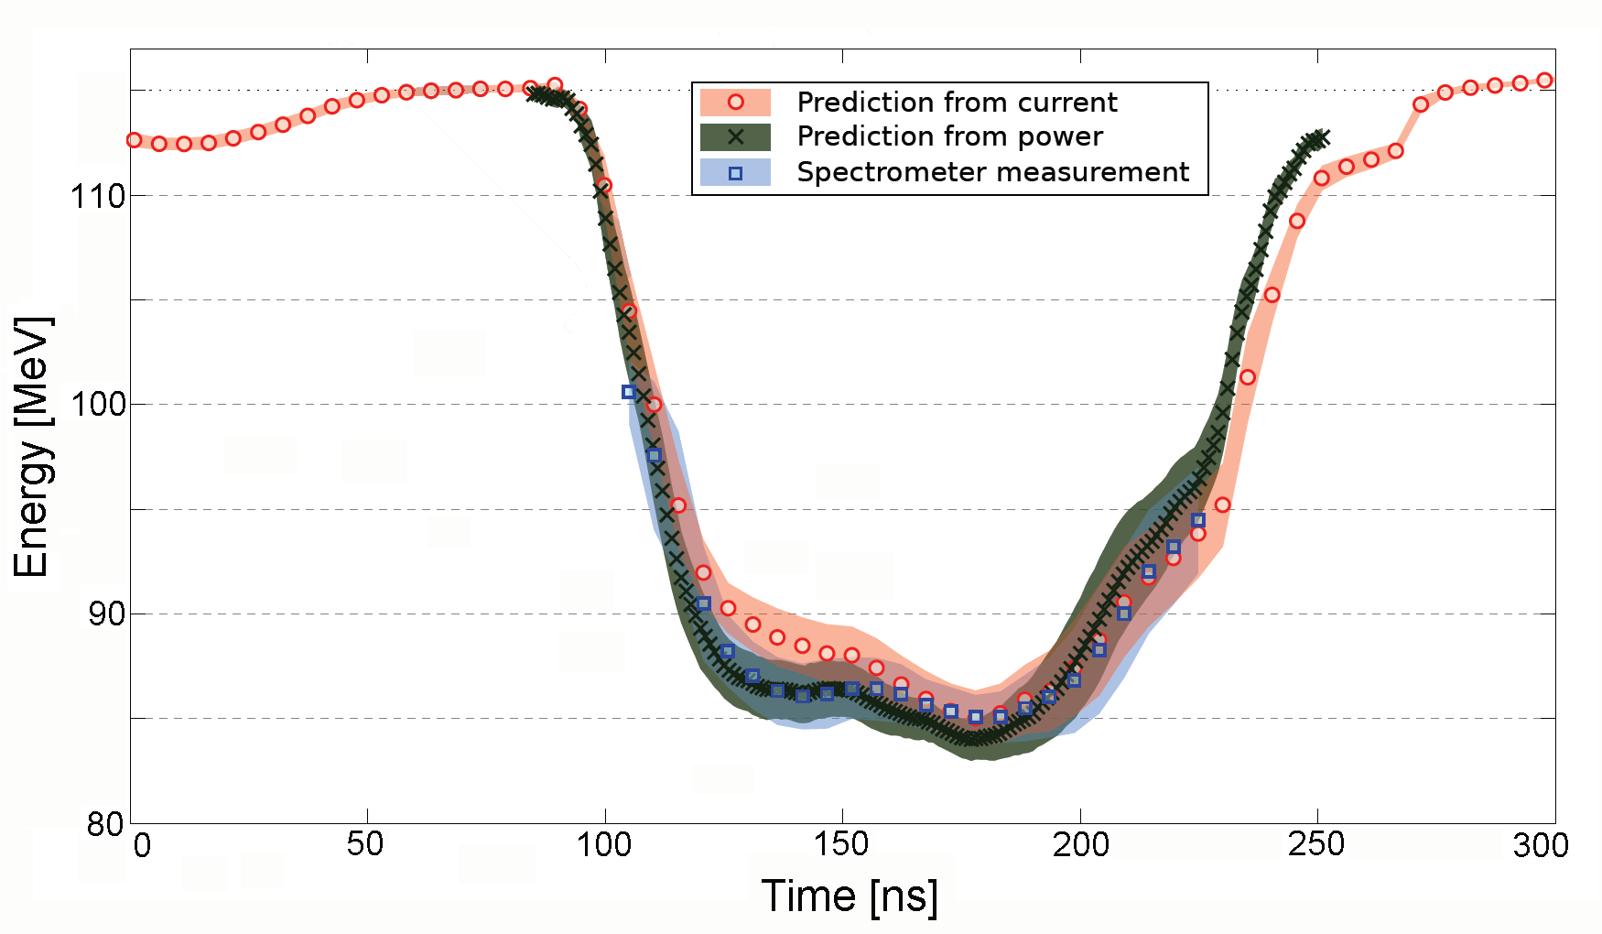
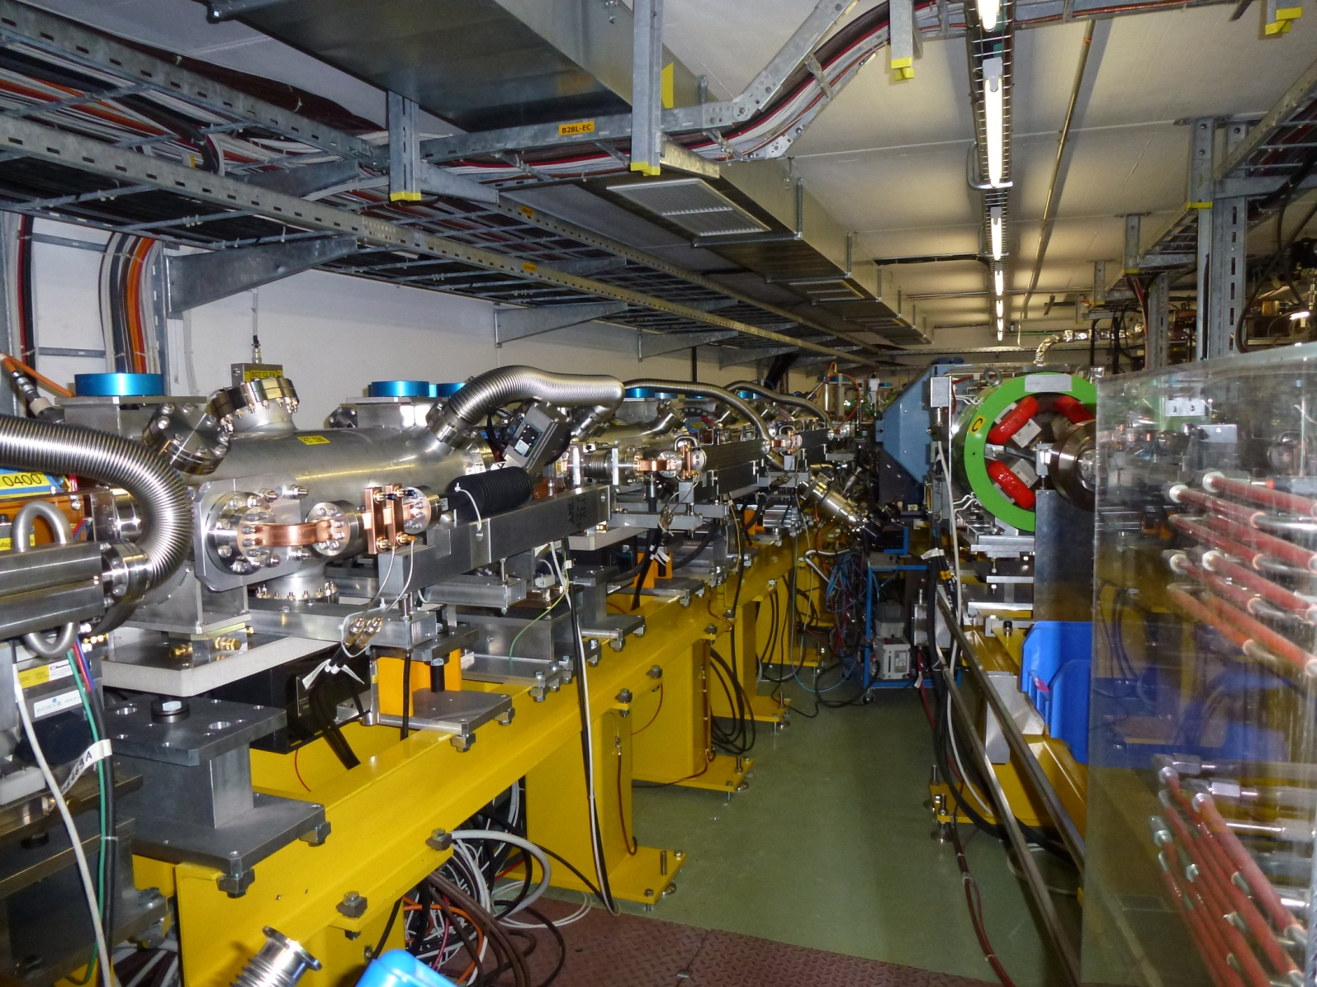
Test Beam Line
13 Power Extraction & Transfer Structures (PETS)
installed and running in 2012
(9 PETS in 2011)
Full beam transport to end-of-line spectrometer, stable beam
Power produced (70 MW/PETS) fully consistent with drive beam current (21 A) and measured deceleration.
PETS tank during installation
More than half a GW of 12 GHz power!
Beam deceleration, measured in spectrometer and compared with expectations
TBL line in CLEX
~ 30 MeV
26%
end 2011

Slide 19
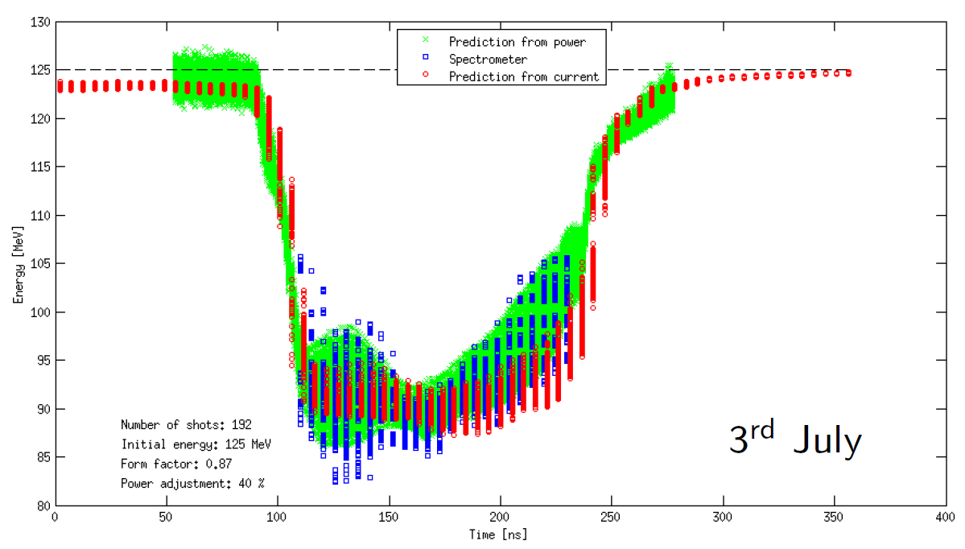


Test Beam Line
2012: Reached 30% deceleration
Potential to exceed 40%

Slide 20
Conclusion of our CDR studies
Two-beam scheme
Drive Beam generation fully tested
Nominal parameters for RF production reached and exceeded
Deceleration as expected
Used to accelerate test beam - 150 MV/m gradient measured with beam
Improvements on operation, reliability, losses
More deceleration and improvements on drive beam quality expected this year
Feasibility of the CLIC Two-Beam scheme has been established in the CLIC Test Facility CTF3

Slide 21

CLIC project time-line

Slide 22


Drive Beam phase feed-forward tests
Phase stability 0.2° @ 12GHz
CTF3 - Phase feed-forward
Fast kickers
Phase monitor
CLIC drive beam phase feed-forward concept
Phase stability 2.5° @ 12GHz
0.2° @ 1GHz
FONT5 board
(Oxford)
  Not just a single experiment – series of related studies:
  Measure phase and energy jitter, identify sources, devise & implement cures, extrapolate to CLIC
  Show principle of CLIC fast feed-forward
Stripline kicker (INFN-LNF)
  Close link to collaborating partners:
  INFN-LNF: Phase monitors, stripline kickers
  Oxford University/JAI: feedback electronics, amplifiers

Slide 23





Feed-forward tests in CTF3
  Phase monitor tests – 2 monitors installed in summer 2012
  First system tests planned in summer 2013
Test starting in 1-2 weeks
Cable hole
Beam direction
Phase monitor
(INF-LNF, EuCARD)

Slide 24


Experiment on the effect of Beam-Loading on BD rate
Beam loading reduces field locally in the structure
⇨ is it the break-down rate lower (or higher)?
CLEX probe beam has only limited current/pulse length, CLEX Drive beam has limited rep rate
⇨ use CTF3 drive beam and klystron driven X-band structure
Reactivate the old ‘30 GHz PETS’ line, 1 A DB current, can reach 50 Hz
Measure BDR with/without beam to get a direct comparison
Present schedule: Install in winter shutdown 2012-2013
Run experiment in 2013
DELAY LOOP
BL - BDR experiment
COMBINER RING
LINAC
CLEX
From X-band klystron
1 A, 240 ns pulse from CTF3 linac
X-band components
G. Riddone, A. Solodko
X-band structure TD24

Slide 25



Evolution of TBL
Upgrade TBL to a test facility relevant for future CLIC program
12 GHz power production for structure conditioning
  Working experience with a real decelerator
  Beam dynamics studies, pulse shaping, feedbacks, etc
Timeline:
Last batch of PETS will be adapted to high-power testing (using internal recirculation)
One (or two slots) tested at beginning of 2013
Gradual increase of slots to 4-8 slots and rep rate to 25-50 Hz
Accelerating structure under test
Beam
RF
PETS tank
Improved PETS design, mini-tank + input coupler
S. Doebert

Slide 26


Two-Beam Modules
Ongoing: Fabrication of 4 modules to be mechanically tested
in laboratory
Next Step: Installation and test of full-fledged Two-Beam Modules in CLEX
First module in development, installation end 2013
Three modules in 2014-2016

Slide 27




Two-Beam Modules
3D model of integration of
the first CLIC Module in CLEX (2013)
Module T0
TBTS PETS tank
CLEX - Three two-beam modules
(2014)
Main Beam line
Drive Beam line
Present schedule:
First module installation end 2013
(At least one year of testing)
Module string installation end 2014

Slide 28
CTF3 program in 2012-2017
Consolidation, energy upgrade,
Increased rep-rate
CLIC Diagnostics tests
Phase feed-forward,
DB quality,
DB stability studies
Beam loading/BDR
experiment
Two-Beam Modules, Wake-field monitors, Two-beam studies
RF pulse shaping
Power production,
high-power testing,
RF conditioning with DB & further decelerator tests

Slide 29

CONCLUSIONS
Feasibility of the CLIC Two-Beam scheme has been established in the CLIC Test Facility CTF3
Original experimental program basically completed
Drive Beam generation demonstrated – emittance and stability shall be further improved this year
Nominal parameters for RF production & two-beam acceleration reached and exceeded – 150 MV/m gradient measured with beam
Deceleration by 30% of a 20 A beam of the drive beam with no losses, expect > 40% this year
CTF3 experimental program for the next five years established and under way
Drive beam phase feed-forward experiment
Beam loading / breakdown experiment
High-power testing of structures in TBL
Full fledged two-beam modules tested with beam in CLEX

Slide 30


























Current CLIC & CTF3 Collaboration
CLIC multi-lateral collaboration - 44 Institutes from 22 countries
MANY THANKS TO ALL COLLABORATION MEMBERS!
ACAS (Australia)
Aarhus University (Denmark)
Ankara University (Turkey)
Argonne National Laboratory (USA)
Athens University (Greece)
BINP (Russia)
CERN
CIEMAT (Spain)
Cockcroft Institute (UK)
ETH Zurich (Switzerland)
FNAL (USA)
Gazi Universities (Turkey)
Helsinki Institute of Physics (Finland)
IAP (Russia)
IAP NASU (Ukraine)
IHEP (China)
INFN / LNF (Italy)
Instituto de Fisica Corpuscular (Spain)
IRFU / Saclay (France)
Jefferson Lab (USA)
John Adams Institute/Oxford (UK)
Joint Institute for Power and Nuclear Research SOSNY /Minsk (Belarus)
John Adams Institute/RHUL (UK)
JINR (Russia)
Karlsruhe University (Germany)
KEK (Japan)
LAL / Orsay (France)
LAPP / ESIA (France)
NIKHEF/Amsterdam (Netherland)
NCP (Pakistan)
North-West. Univ. Illinois (USA)
Patras University (Greece)
Polytech. Univ. of Catalonia (Spain)
PSI (Switzerland)
RAL (UK)
RRCAT / Indore (India)
SLAC (USA)
Sincrotrone Trieste/ELETTRA (Italy)
Thrace University (Greece)
Tsinghua University (China)
University of Oslo (Norway)
University of Vigo (Spain)
Uppsala University (Sweden)
UCSC SCIPP (USA)

