Slide 1
Developing Common Metrics and Models for RF Overhead Calculations
Brian Chase FNAL
Presenter for ILC LLRF Team

Slide 2
Overview
Issues surrounding power overhead
  Value engineering (performance vs. capital expense)
  Optimize design
Power budget
  Understanding losses and disturbances
Models
  Global and local RF station
  Simulations
Metrics – how to make meaningful measurements
  9mA tests and other system tests
  Extrapolate to ILC
Plans going forward

Slide 3
Power Requirements Based on Maximum Gradient and Maximum Beam Current
Current Limited
Power limited
Region
Beam Current
(mA)
Design
Goal
Operation Region
Constant Power
Quench
Gradient limited
Current test
Gradient (MV/m)
•Peak power is only required at peak gradient and beam current
•Goal: Meet design requirements with minimal power overhead (cost)
•Could operation ever go outside of the design operation region?

Slide 4
Accelerator Section Cost/Gradient vs.
Klystron max Power
Cost/Unit Gradient
~8:1 ratio in linear cost of Linac
to RF power
Power limited
Region
Quench Gradient limited
Available RF Power
Best power match while meeting regulation
Example: If the last half of cryomodule production increased gradient to 33MV/m
and we increased available power to match – save $## in capital expense

Slide 5
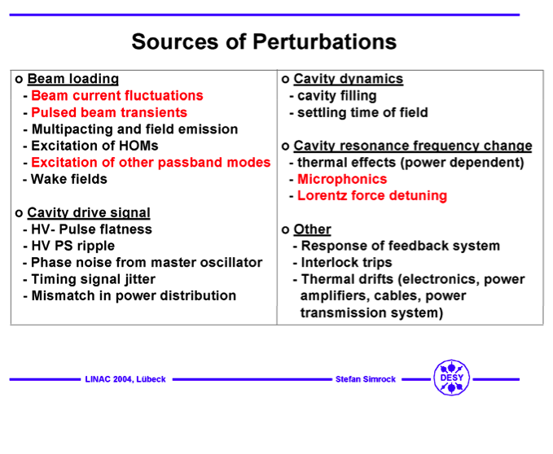

Slide 6
Static Losses
Distribution Loss | Mostly the same for all Stations
Cavity Gradient Variation | Dependent on Cavity quench limit
Parameter Variation | Dependent on Ql match
Peak Power Headroom | Same for all klystrons
Slow Thermal Drifts | Generate Vector Sum errors
There are few statistics available on these losses

Slide 7
Disturbance Categories
Narrowband or static errors | Broadband (noise)
Lorentz Force and microphonic detuning | System, Receiver and ADC noise * gain
Parameter variation | Transmitter and Drive amplifier
Waveguide loss | Klystron modulator ripple
Beam current fluctuations | Spurious noise sources
Static or phase modulating disturbances subtract in linear power
Amplitude modulating noise sources subtract in linear voltage
Non linear system responses cause AM - PM conversion and coupling in feedback loops

Slide 8
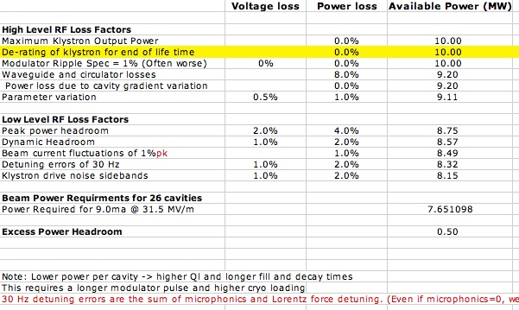
RF Station Power Budget
(Straw-man Proposal)

Slide 9
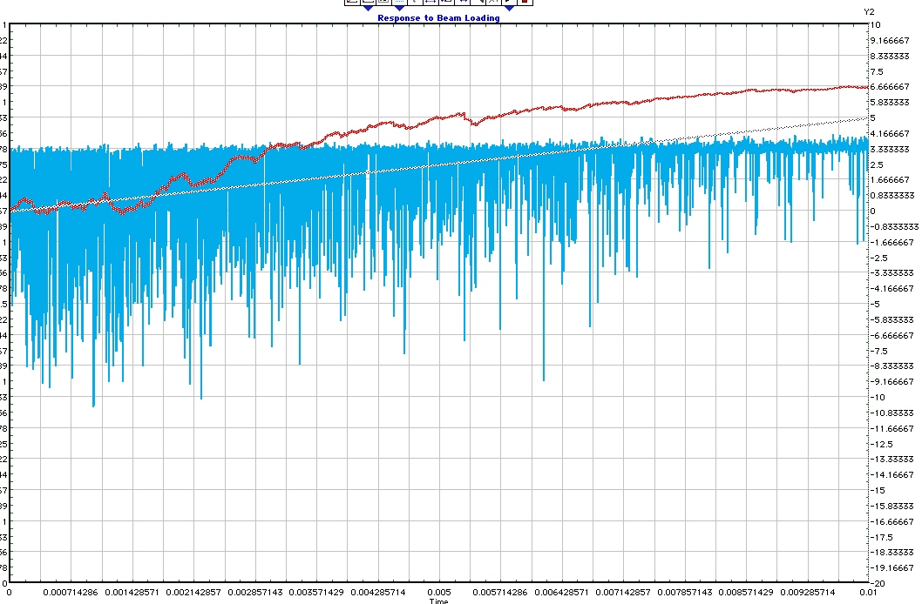
Model for Overhead Power
We develop a model that we use to estimate the required RF overhead given:
  Performance requirements
    Regulation of beam energy and jitter
    Reliability and exception rate
  Measured or calculated losses
  Measured noise spectrum (rms, spectrum, peak, etc)
  …
We use measurements at FLASH etc to help develop and validate the model and power budget
Output would be a series of graphs, eg
  Overhead requirements vs. noise power
  Overhead vs. percentage of time within spec
  …
System response to noise + ramp into a compression stage

Slide 10
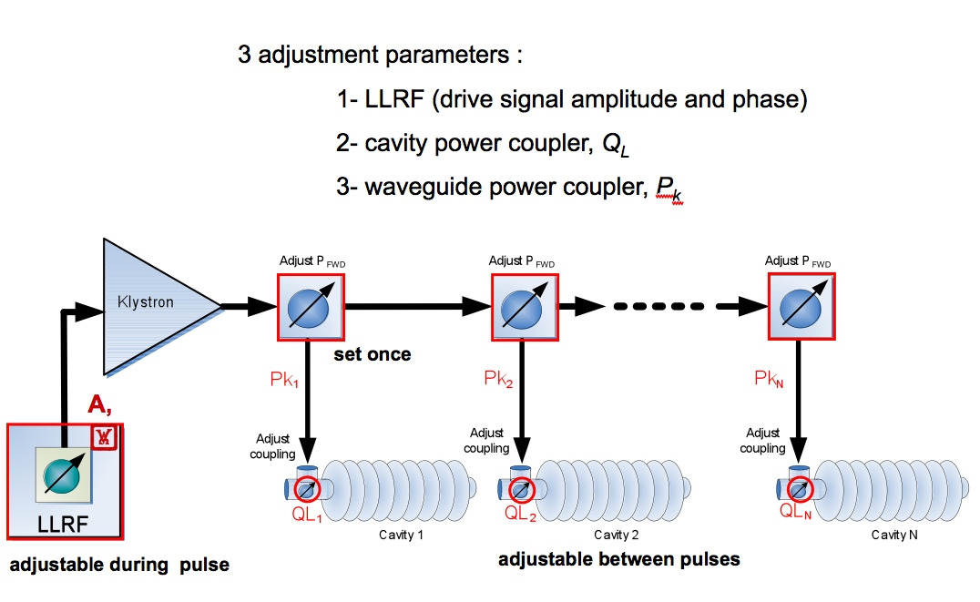
Models and Simulators
Accepted model for the cavities (Tesla)
  Dependent on dressed cavity design
Model for HLRF is dependent on:
  Drive amplifier
  Modulator type and specification
  klystron (3 types)
  Distribution scheme
Model for LLRF is dependent on
  Design variations
  Distribution scheme
Present simulator features:
  Cavity, klystron response, Ql, Pk
  Drive amp response, receiver noise
Goal: A common Matlab simulator for general use
  We are fairly close

Slide 11
Supervisory Control of Energy Regulation
Supervisory controller is
needed to respond to exceptions and accumulated errors to meet the 0.1% energy requirement
Must be part of system model and simulations
Supervisory
Controller
Bunch by bunch gradient request
Bunch by bunch beam energy
Status and regulation
Station
Controller
(n)
Station
Controller
(n+1)
Beam Energy Server
Beam Energy = Gradient sum
Gradient error passed forward
To down stream stations (real-time)

Slide 12
Measurements at FLASH
Maximum Klystron Output Power
  We have no way to measure absolute value to better than 5% but we can make relative calibrations of forward power pickups
Modulator Ripple
  Will probably only measure modulator voltage and current, not RF AM and PM ripple
Waveguide and circulator losses
  Must rely on measurements made at installation
Cavity gradient variation
  While we can ignore for ILC calculations, how do we separate them out from FLASH measurements?
Parameter variation
  We could measure but how does this relate to the ILC? FLASH is hand tuned, ILC power ratios will be set with wrenches
Peak power headroom
  This is maybe our biggest concern. Will we be able to operate the klystron for cryo-modules 4,5,6 near saturation with 9mA?
Dynamic Headroom
  This is very dependent on feedback gain and measurement bandwidth
Beam current fluctuations
  Torroid data, extrapolate to ILC specification is direct
Cavity detuning
  LFD, microphonics, mistuning – can only be measured accurately at RF turnoff
Klystron drive noise sidebands
  Will need vector demodulation of power signals to measure complex spectrum

Slide 13
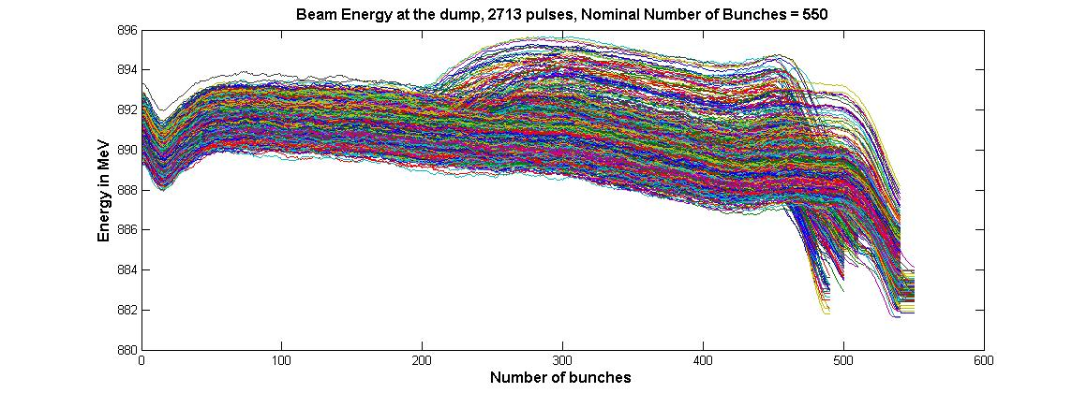
De-convolving the Measurements
• 3mA test – beam energy data
• 9 minutes of operation
- 1.5% Pk to Pk spread,
not 0.1% RMS
Data sets are complex sums of many effects
Many aspects of the cavity and RF systems are non-linear so disturbances inter-modulate
Operating point is at only a fraction of 10MW
• Will take some work to fully analyze

Slide 14
What are the weaknesses to this approach?
Models be themselves are often too simplistic
  Need to study the real machines
The 9mA tests are and will be very informative - but limited
  Only one RF station close to ILC design
  Operation at a fraction of design gradient
  Power limited by circulators
  Different distribution scheme
  Studies are very time limited
What do we need from 9mA tests to help?
  Calibrated vector signals for forward and reflected power
  Ql and Pk setup as per ILC design
  Operation off crest with ACC1 (phase jitter)
• Studies at KEK and Fnal may fill in the gaps

Slide 15
Summary
Work continues to validate the RDR RF power design
Modeling, power budget, simulations, system tests, design improvements in a spiral design cycle
  Simulations will be used to explore statistical beam energy and jitter regulation as a function of power overhead
  High level simulations will include a supervisory controller
  Machine studies will continue to provide insight

