Slide 1
Current LLRF Activities at FNAL
B. Chase
Gustavo Cancelo, Yuriy Picshainikov, Warren Schappent, Ruban CarcagnoJulien Branlard, Ed Cullerton, Paul Joireman, Uros Mavric, Vitali Tupokov, Philip Varghese
FNAL, AD/RF - LLRF

Slide 2
Projects
Low Energy Linac LLRF Upgrade
  Based on MFC Module
    Commissioning in progress
Main Injector Comb Filter
  Based on MFC Module
    Operational tests on one station
    Production in progress (35 cards)
HINS 325 MHz copper cavities
SRF at A0, HTS, CC2, NML,
  MFC and ESECON
ILC design efforts
  Piezo control
  9mA tests at FLASH

Slide 3
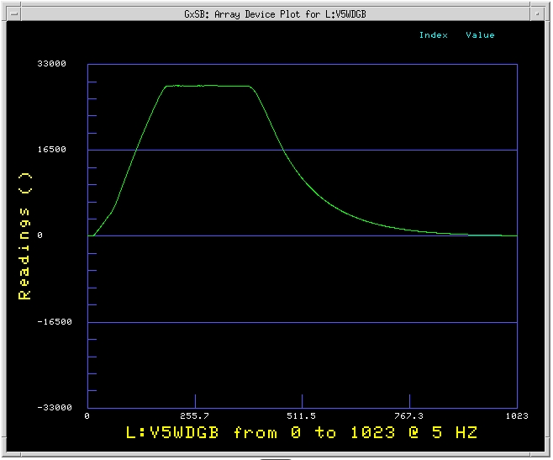
Linac LLRF Upgrade (MFC)
Amp and phase loop
Adaptive Feedforward
0.5 % 0.5 degree
Acnet control

Slide 4
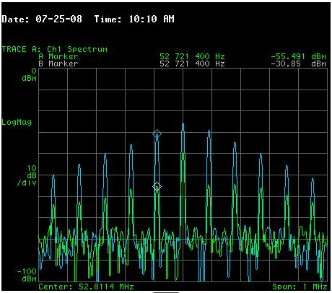
Main Injector Comb Filter
MFC based
FF + Comb at injection
20 dB suppression of revolution lines

Slide 5
HINS Low-Energy Linac Layout
{
Five 2.5 MW 325 MHz Toshiba JPARC-type klystrons
{
{
{
{
I.S.
RFQ
MEBT
RT
single-spoke SC β=0.2
single-spoke SC β=0.4
triple-spoke SC β=0.6
 | Ion Source | RFQ | MEBT | Room Temp | SSR1 | SSR2 | TSR
Eout | 50 keV | 2.5 MeV | 2.5 MeV | 10 MeV | 30 MeV | 120 MeV | ~600 MeV
Zout | 0.7 m | 3.7 m | 5.7 m | 15.8 m | 31 m | 61 m | 188m
Cavities |  |  | 2 buncher cavities and fast beam chopper | 16 copper CH-spoke cavities | 18 single-spoke SC β=0.2 cavities | 33 single-spoke SC β=0.4 cavities | 66 triple-spoke SC β=0.6 cavities
Gradient |  |  |  |  | 10 MV/m | 10 MV/m | 10 MV/m
Focusing |  |  | 3 SC solenoids | 16 SC solenoids | 18 SC solenoids | 18 SC solenoids | 66 SC quads
Cryomodules |  |  |  |  | 2 | 3 | 11

Slide 6
Cavities operating at different synchronous phase angles
HINS/PROJECT X
What’s unique
  normal and super conducting cavities with 1 klystron ?
  each cavity has its own: Q₀, V₀, Φ_{s}, ψ, Q_{L}
Use of high power Ferrite Vector Modulator (FVM)
Can HINS work without FVM ?

Slide 7
HINS with FVM: individual Cavity Feedback Control

Slide 8
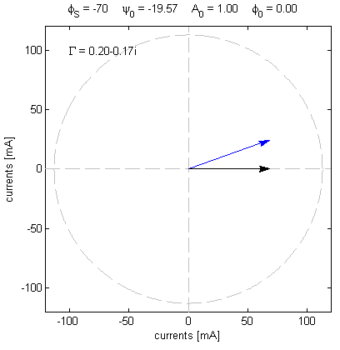
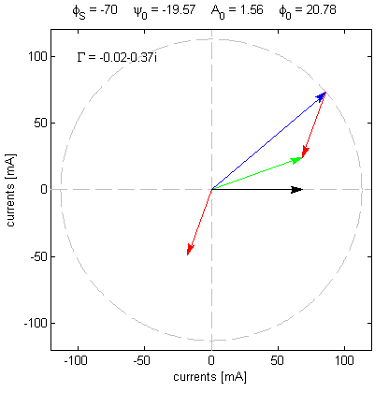
Using the klystron FF to compensate for beam loading
➔ No dynamic use of FVM
I_{gen}
I_{beam}
Φ_{s}
I_{gen}
Φ
I_{tot}
ψ
I_{tot}
I_{cav}
Φ_{s}
I_{cav}
I_{beam}
ψ = cavity detuning angle
I_{gen}(beam) = I_{gen}(no beam) x Ae^{iΦ}
Beam OFF
Beam ON
Assuming nominal beam loading, there is no need to modulate the klystron forward power using the ferrite vector modulator if I_{tot}(beam OFF) = I_{tot}(beam ON)

Slide 9
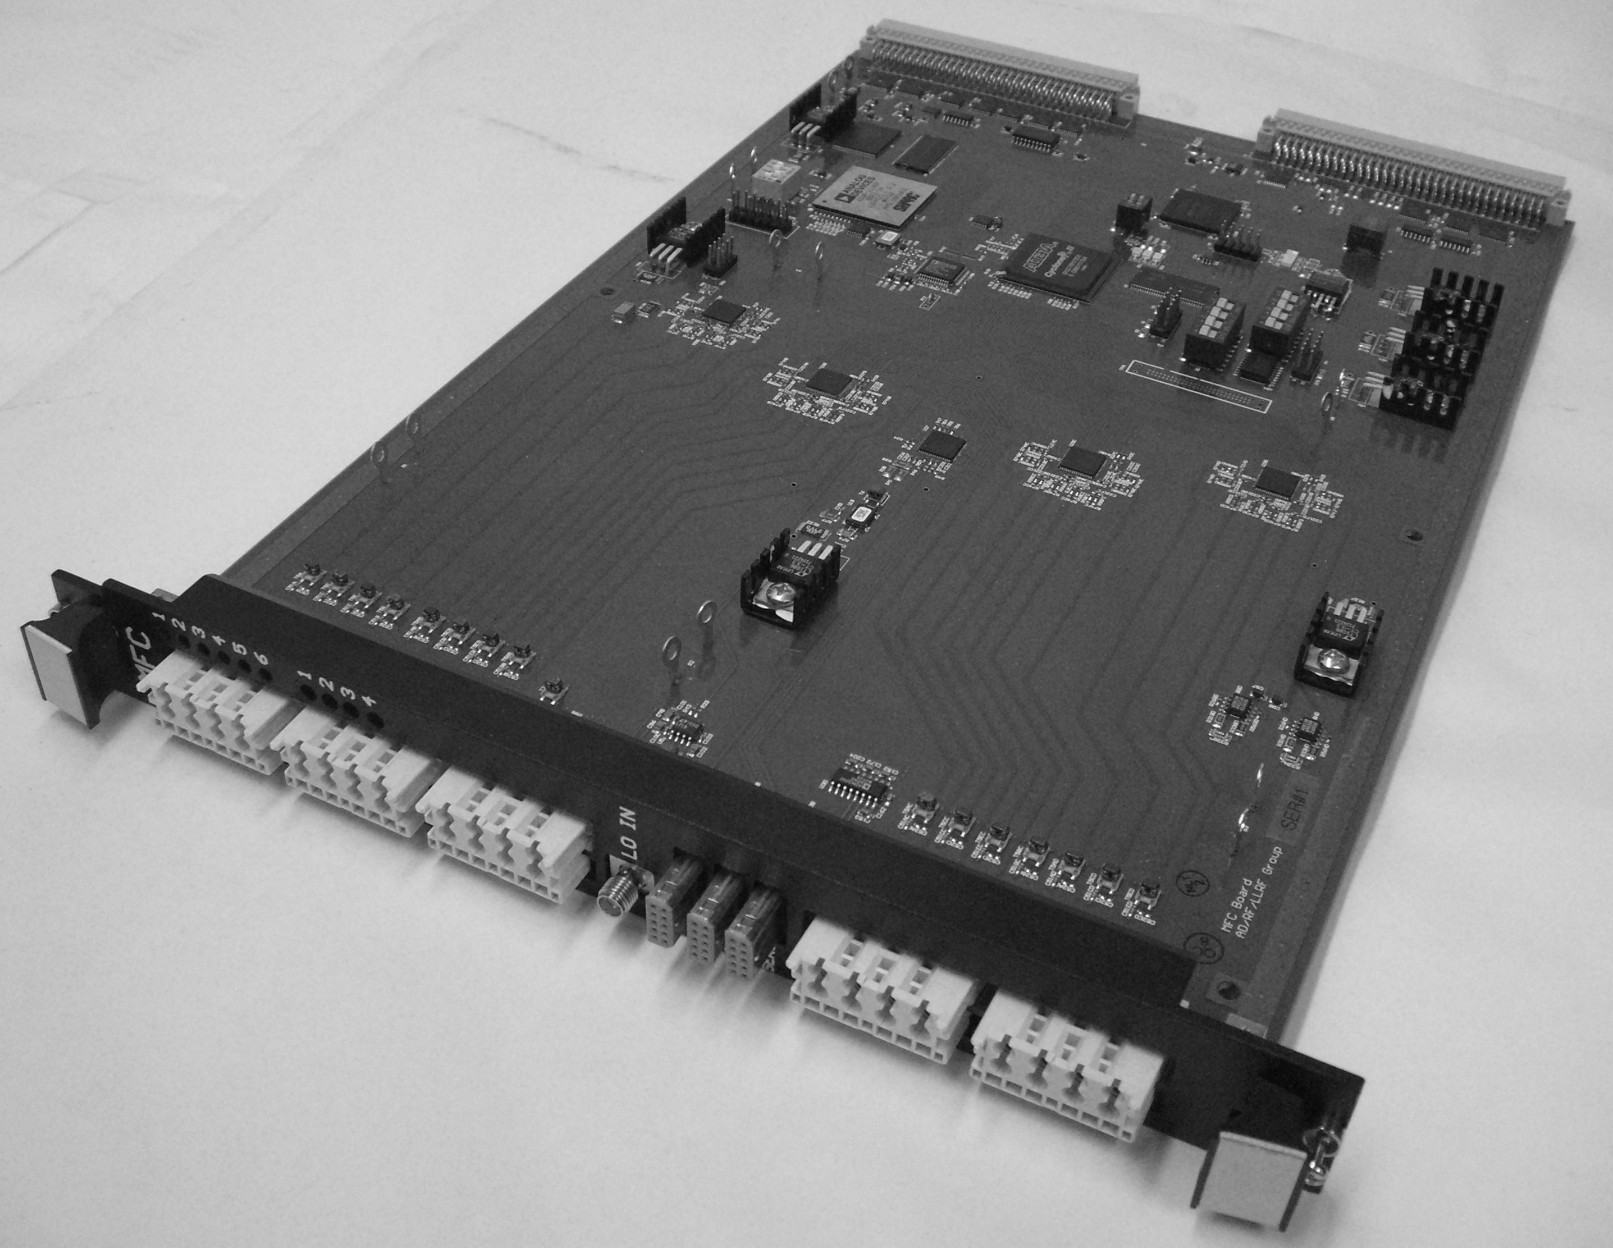
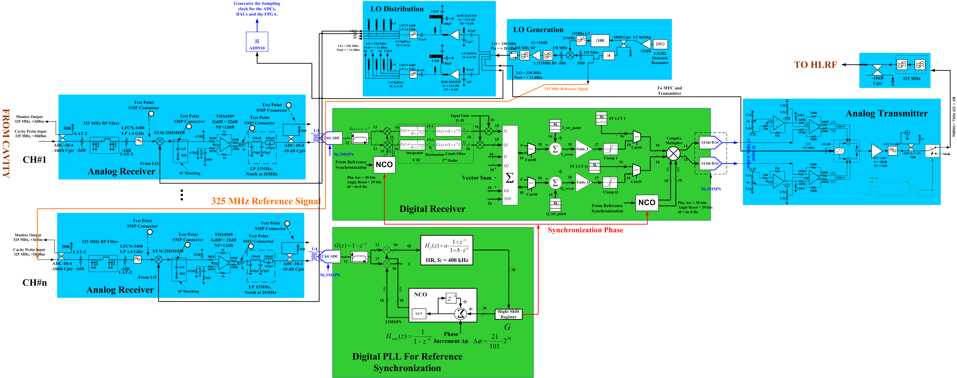
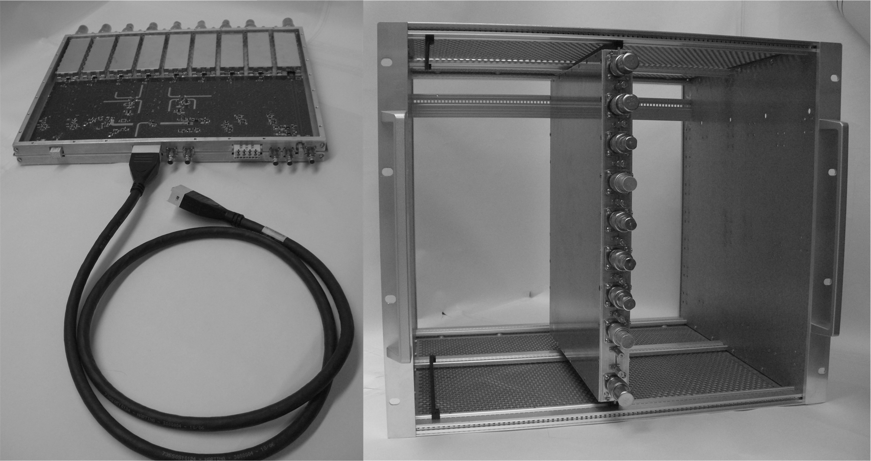
325 MHz LLRF System With MO and LO Generation

Slide 10
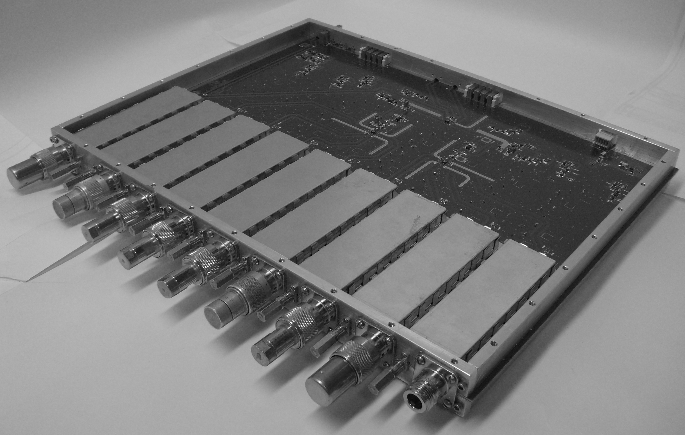
Modified 1.3 GHz Board for
3.9 GHz System

Slide 11
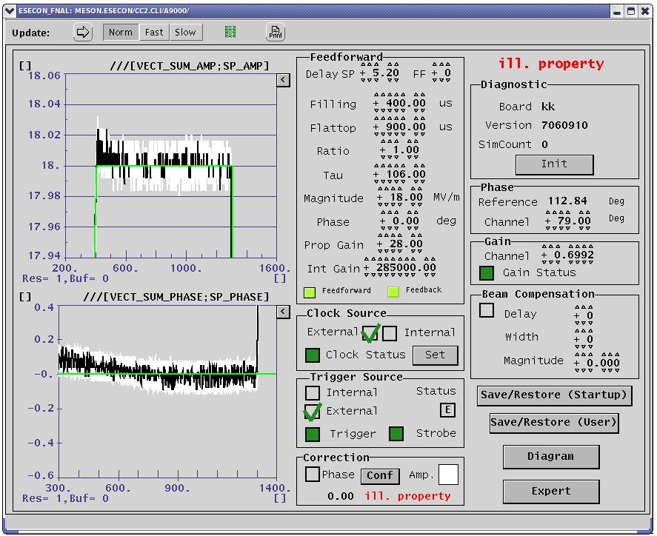
3.9GHz Regulation - ESECON
HTS cavity 3 QL = 1.2e6
w12 = 9.42 Krad/s Pgain = 28
Igain 285000.

Slide 12
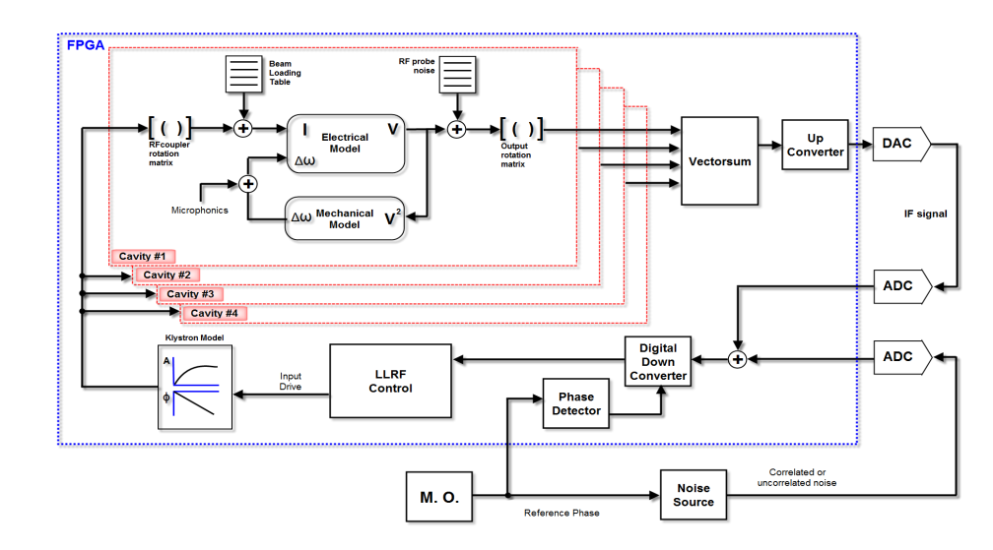
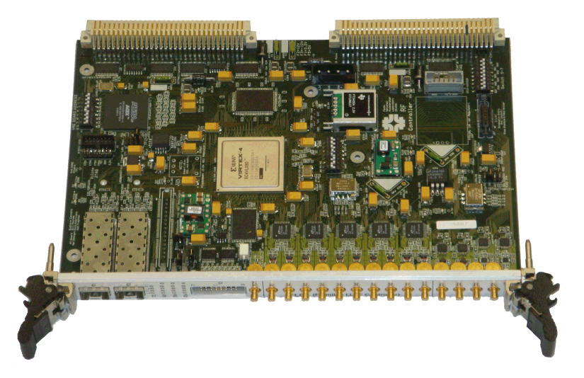
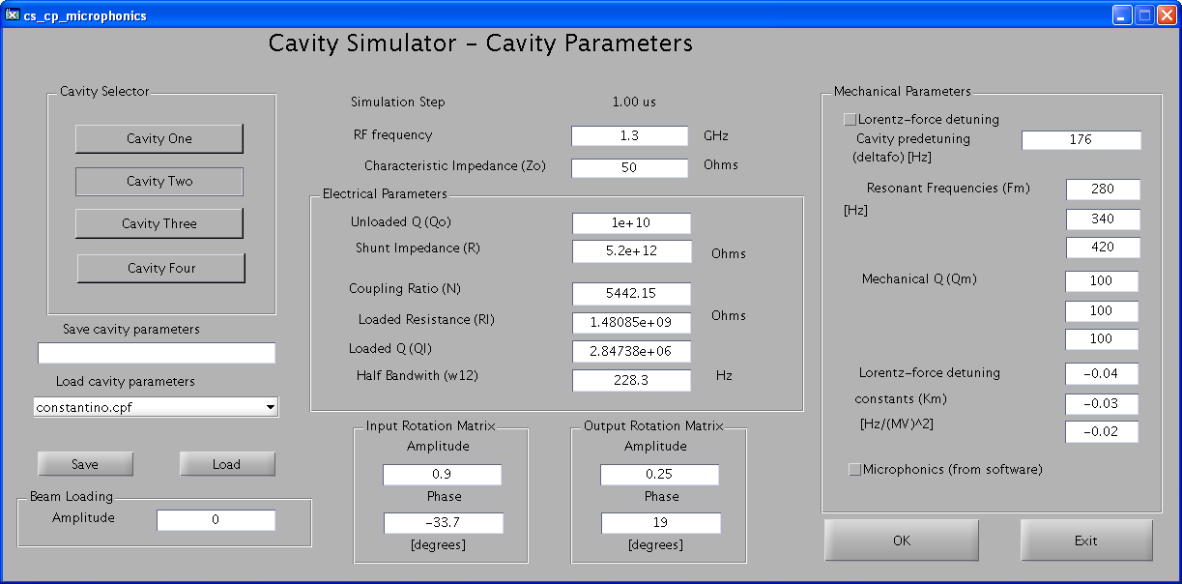
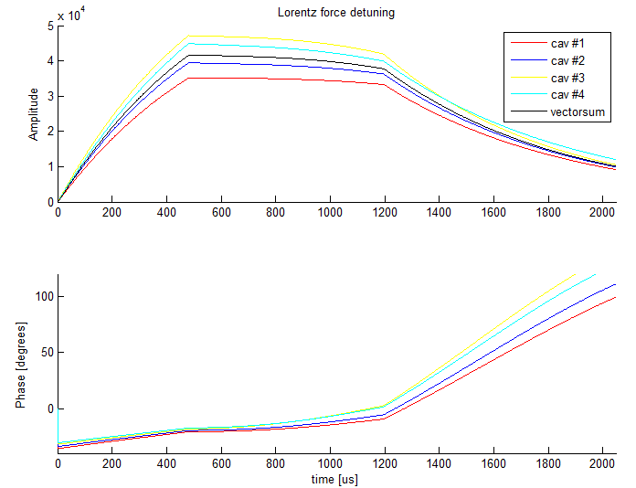
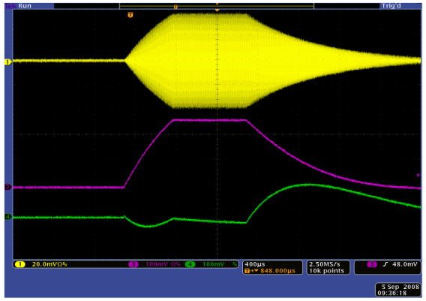
Real Time RF Simulator (RTS) and control
The RTS simulates the amplitude and phase dynamics of multiple RF cavities. The RTS implements the TTF electrical and mechanical dynamic models. It also includes several noise and disturbance sources. Al simulation parameters can be uploaded or saved to a file, or entered through the RTS control panel. The simulator outputs can be displayed on an oscilloscope and they are also logged on file through the DAQ for off line analysis.
RTS hardware platform (ESECON)
RTS block diagram
RTS cavity outputs into
DAQ log file
RTS outputs on the
oscilloscope
RTS control panel

Slide 13
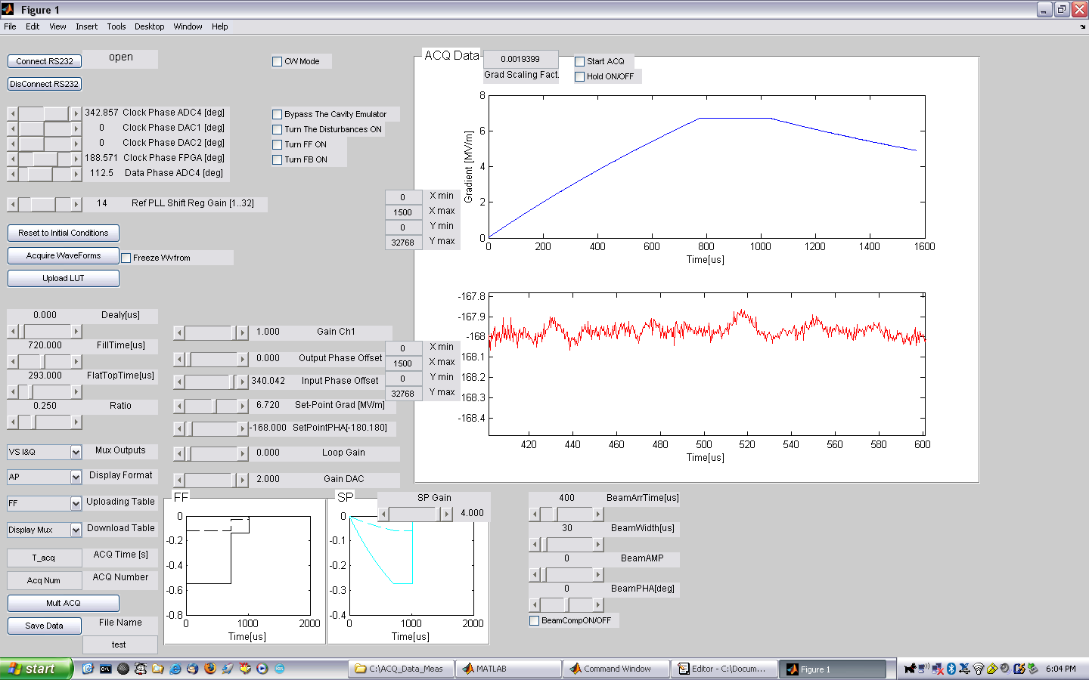
Regulation of CC1 at A0
loop gain up to 1200
0.016% of amplitude stability and 0.007deg phase stability

Slide 14
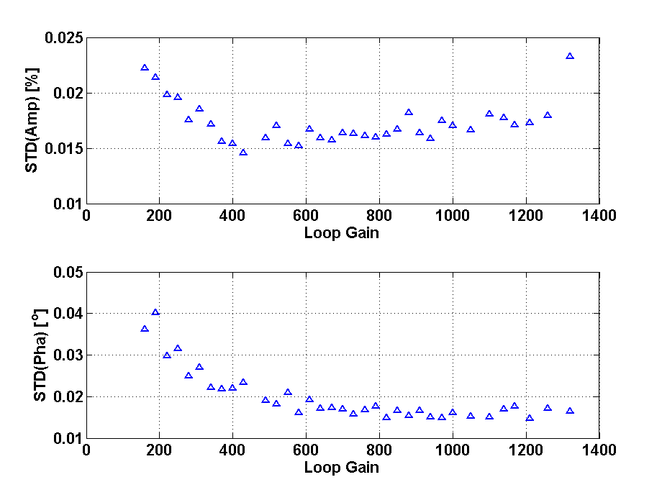
CC1- Error as a Function of Gain

Slide 15
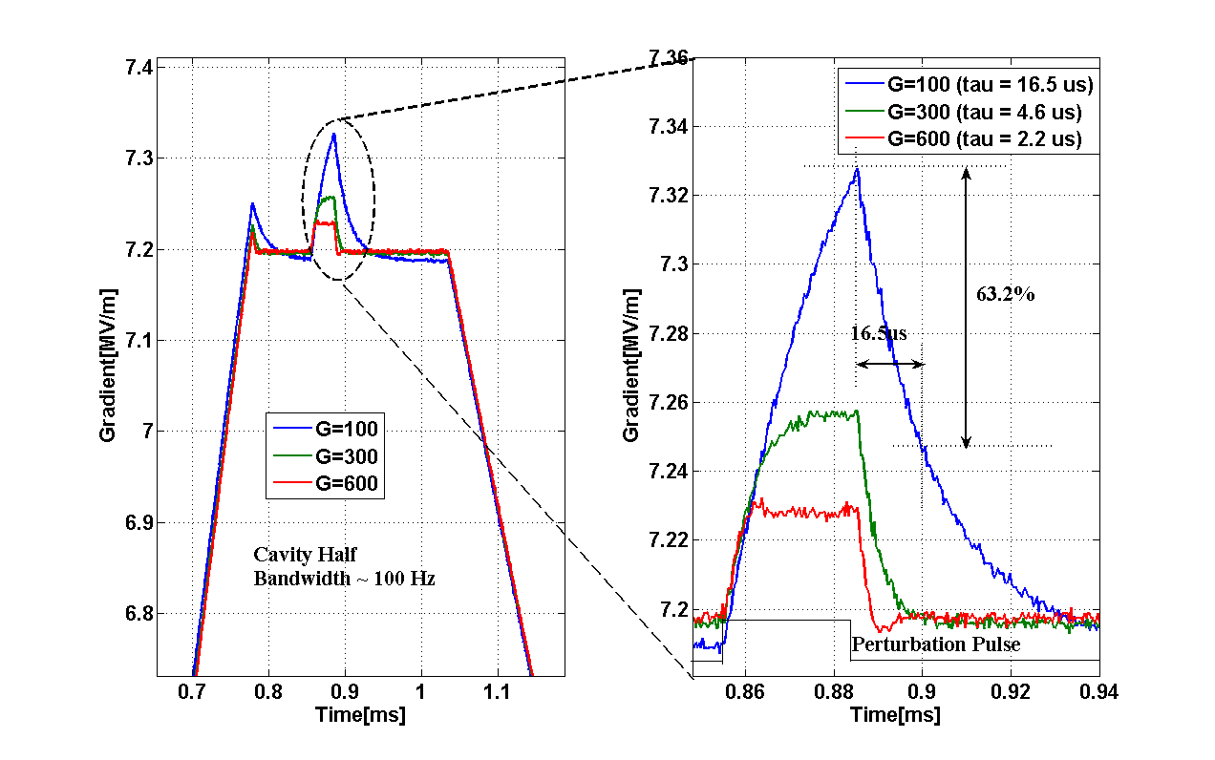
Response to Disturbance

Slide 16
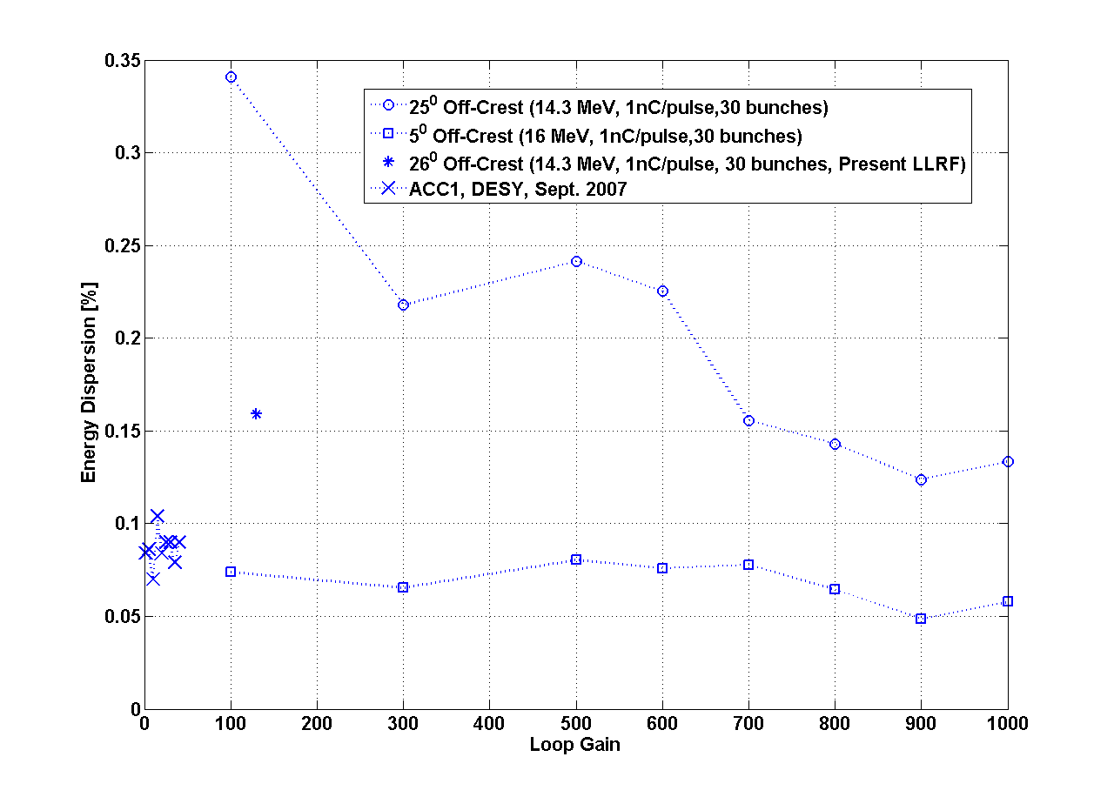
Beam Jitter Measurements

Slide 17
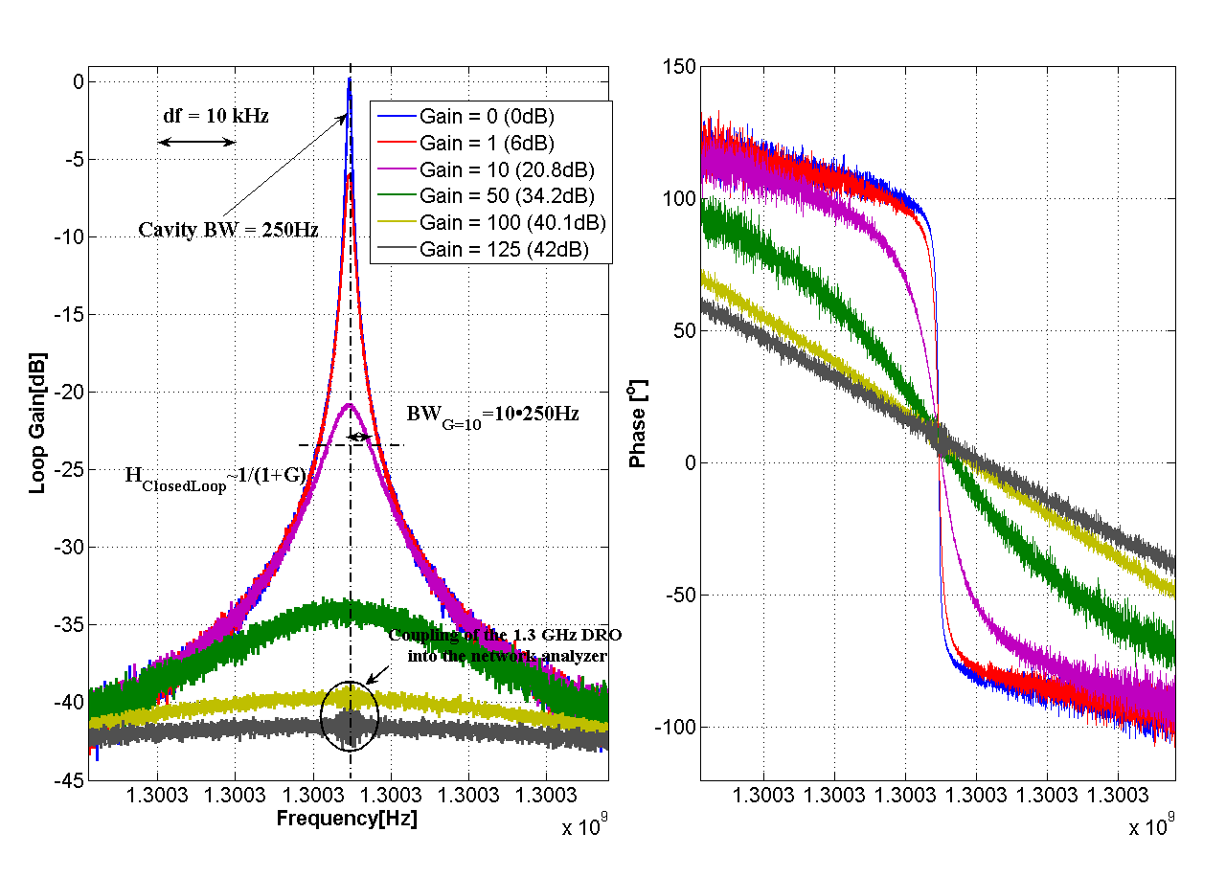
Closed Loop Response of
Cavity Model and Controller

Slide 18
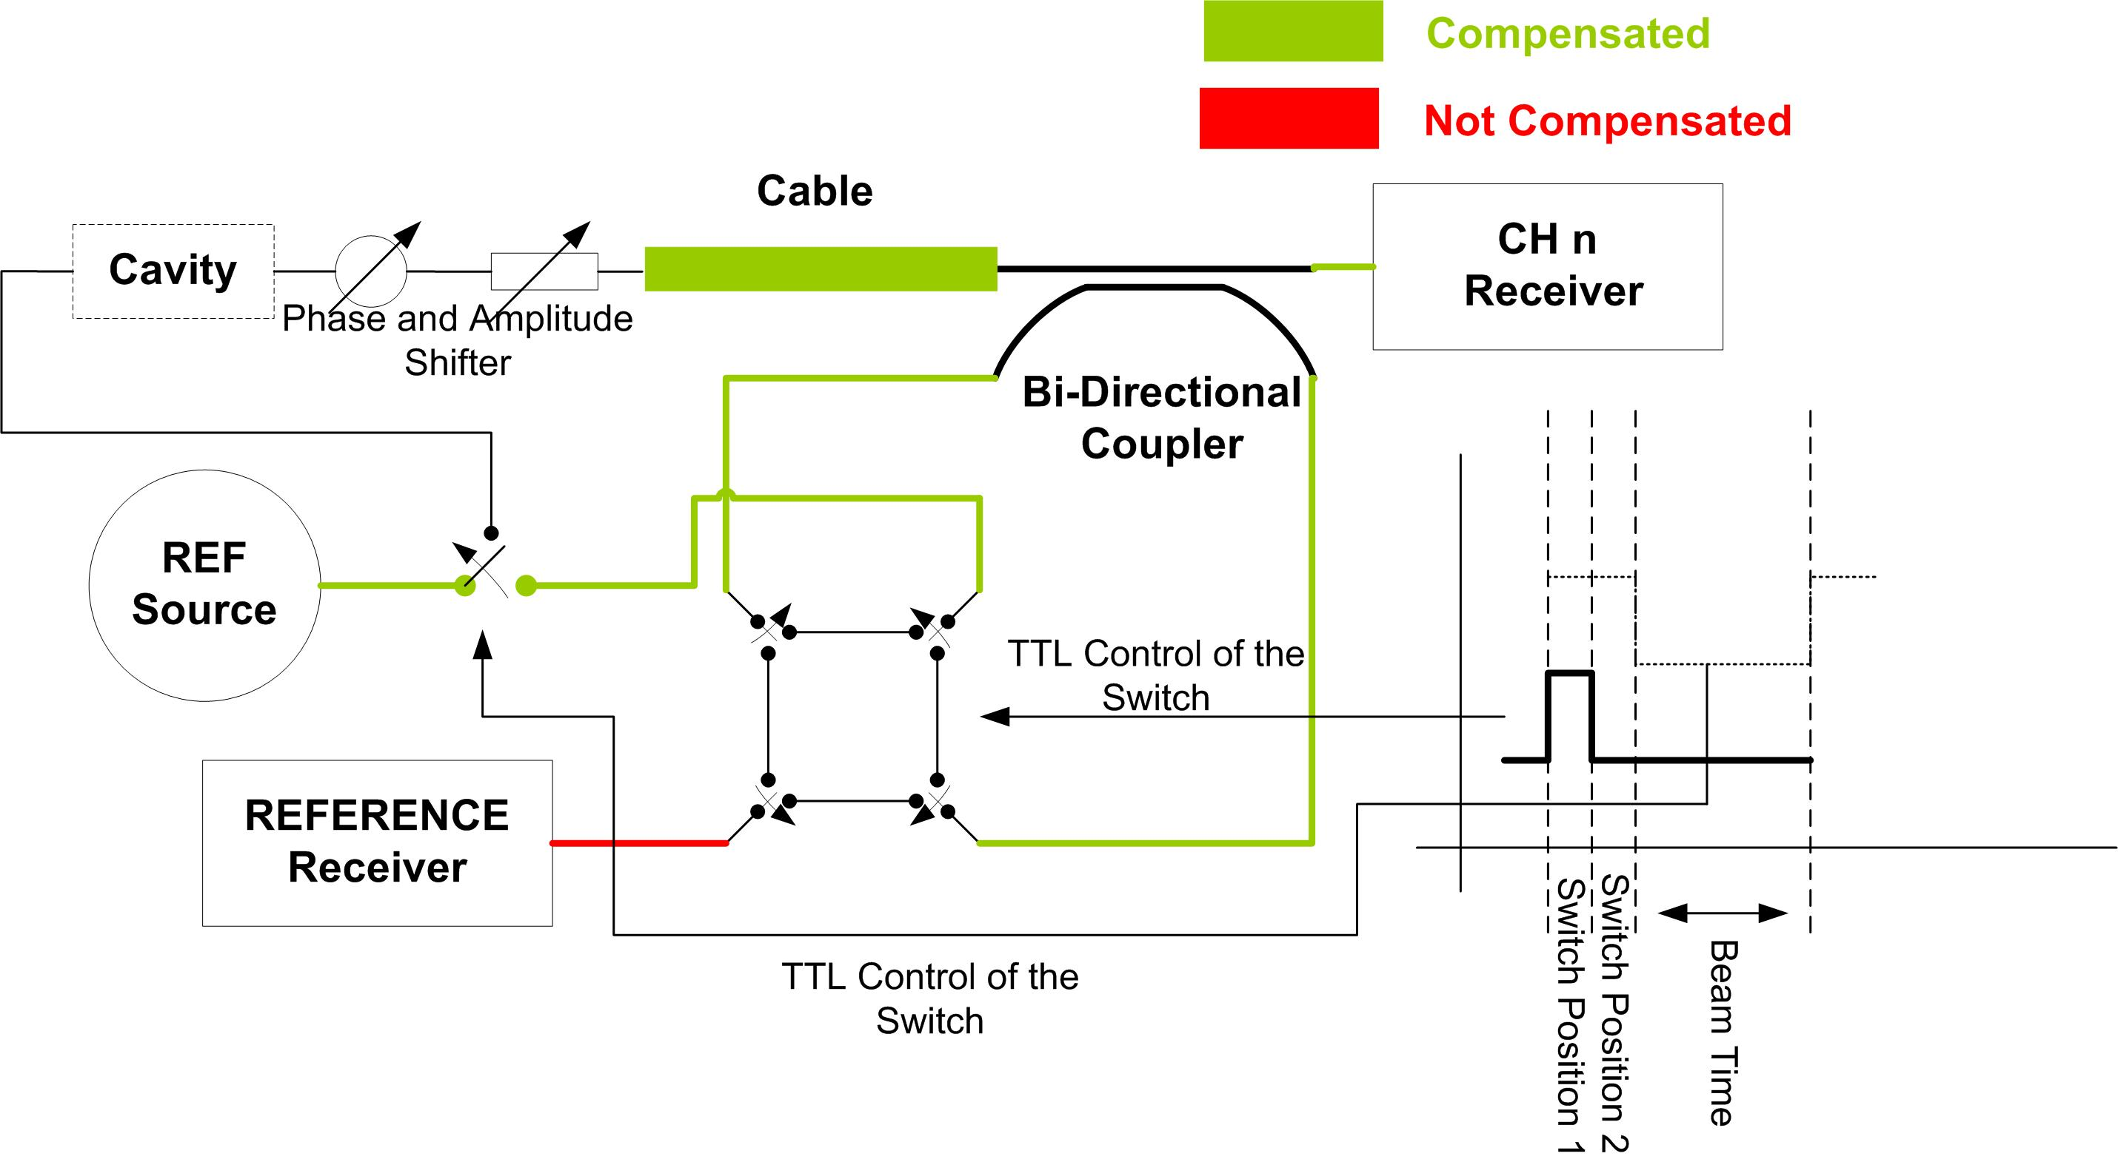
Drift Calibration

Slide 19
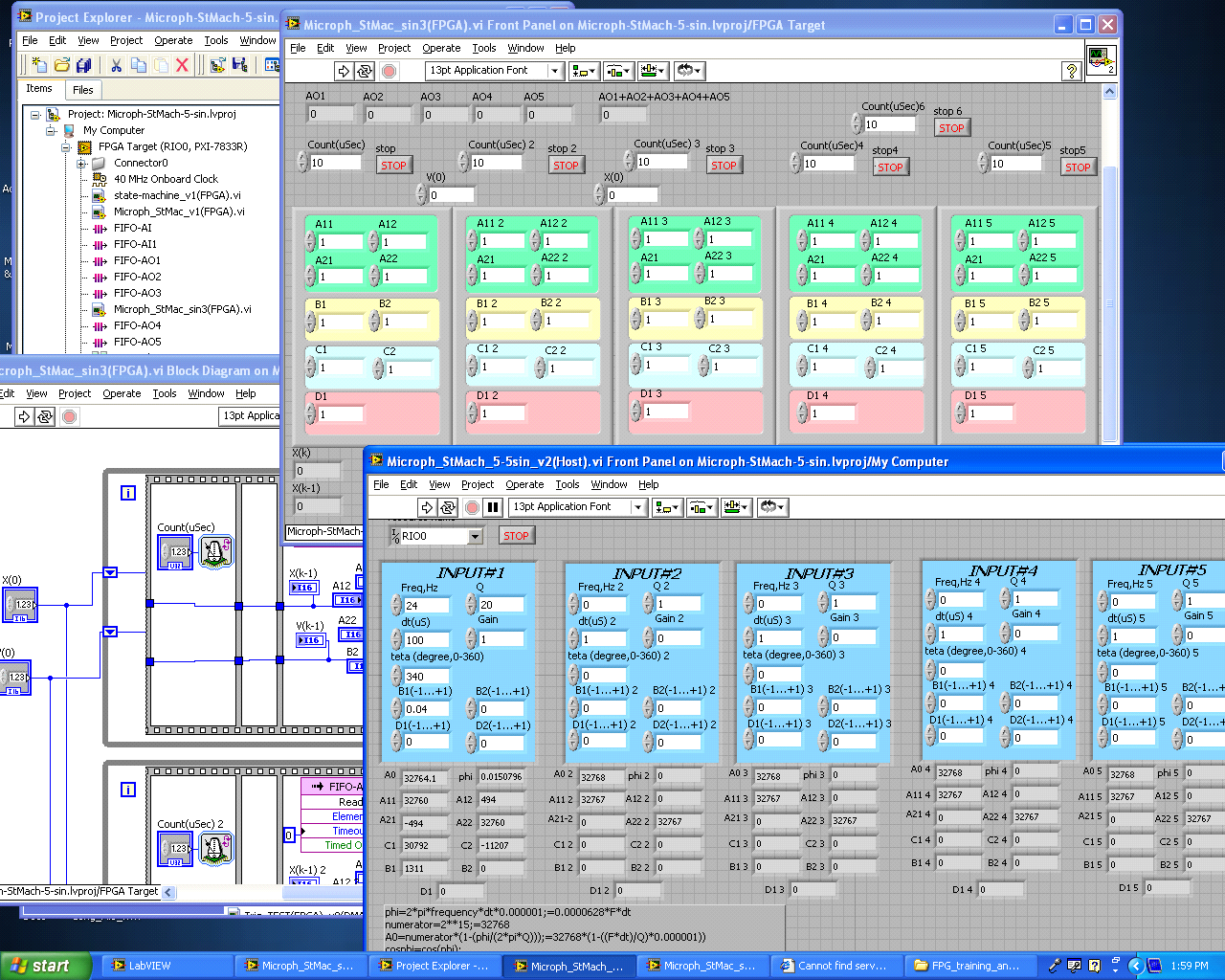
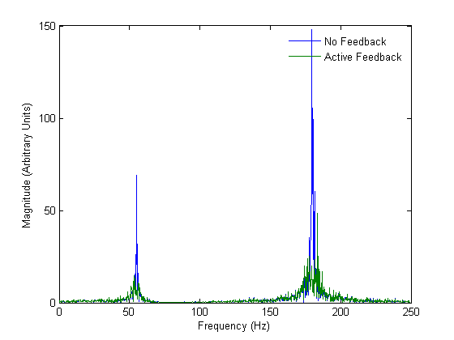
Active Compensation of Microphonics in CCII
Reviewed 3 different algorithms used with SCRF cavities to actively dump random vibrations.
  High Order Transfer Function (DESY)
  LMS Adaptive Filter (FNAL)
  Narrow Band Filter Bank (Michigan State)
Developed code and implemented on NI FPGA PXI-7833R “ Narrow Band Filter Bank ” algorithm (with up to 5 resonances/poles).
Matlab simulation of NBFB in CW cavity. Two mode system (55 Hz and 180 Hz) driven by white noise. Predicts 15 dB of suppression possible.
Matlab simulation of NBFB in CW cavity

Slide 20
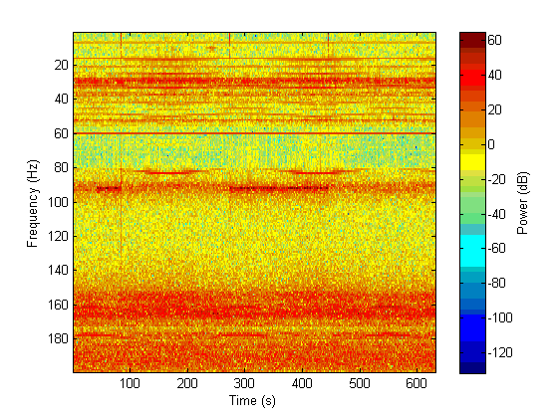
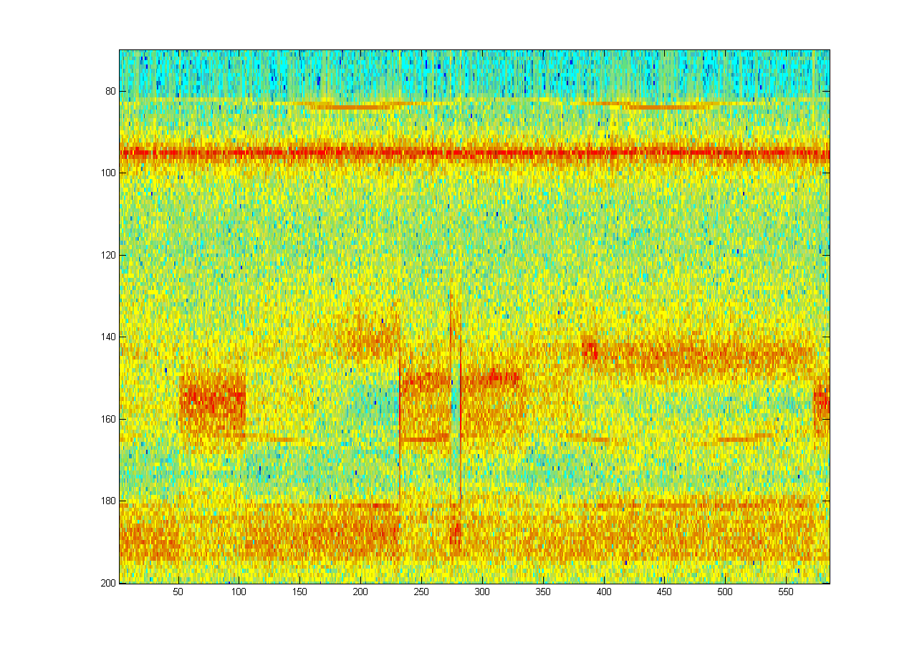
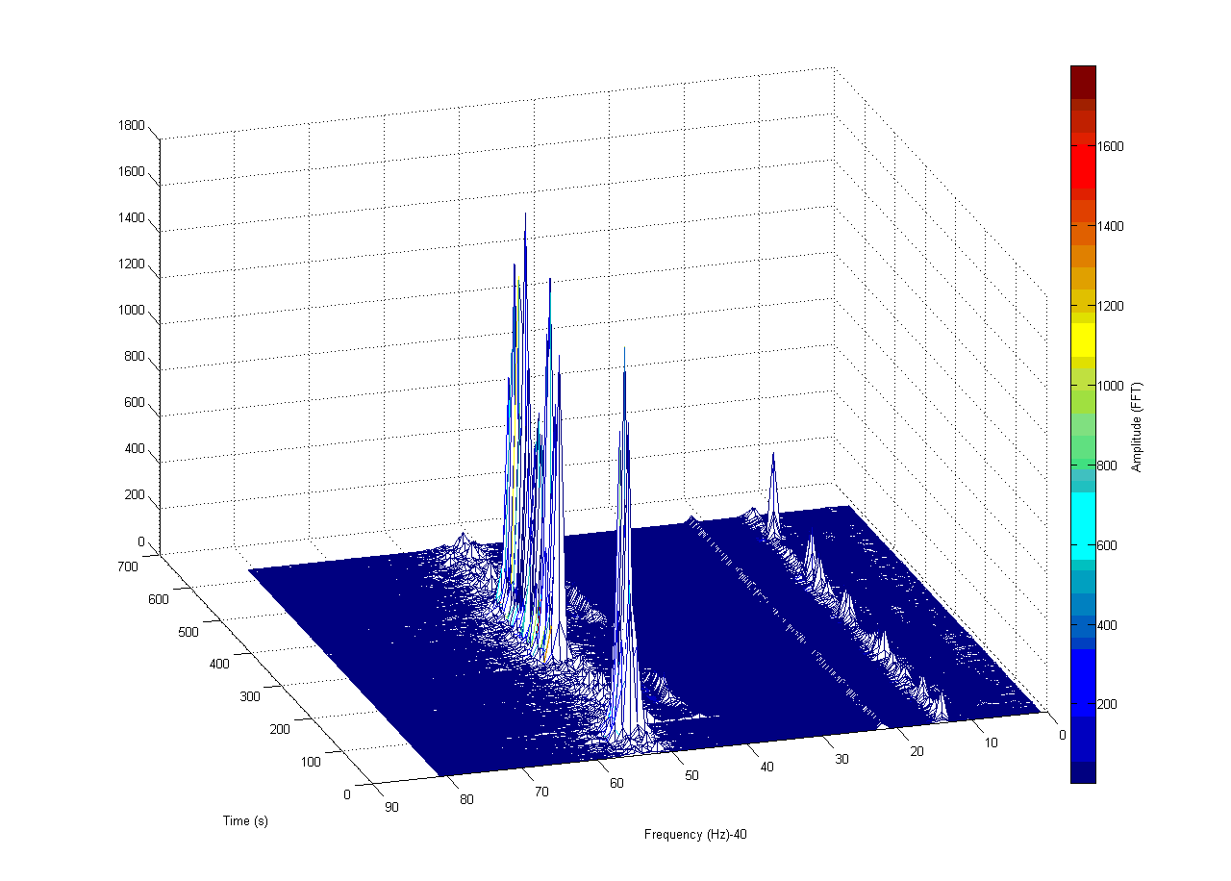
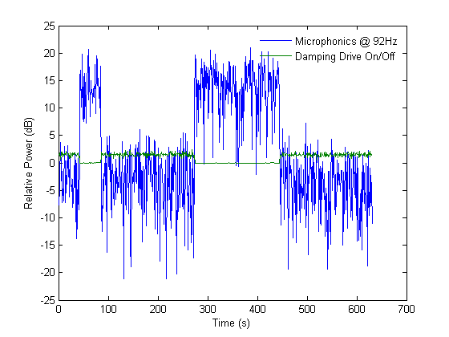
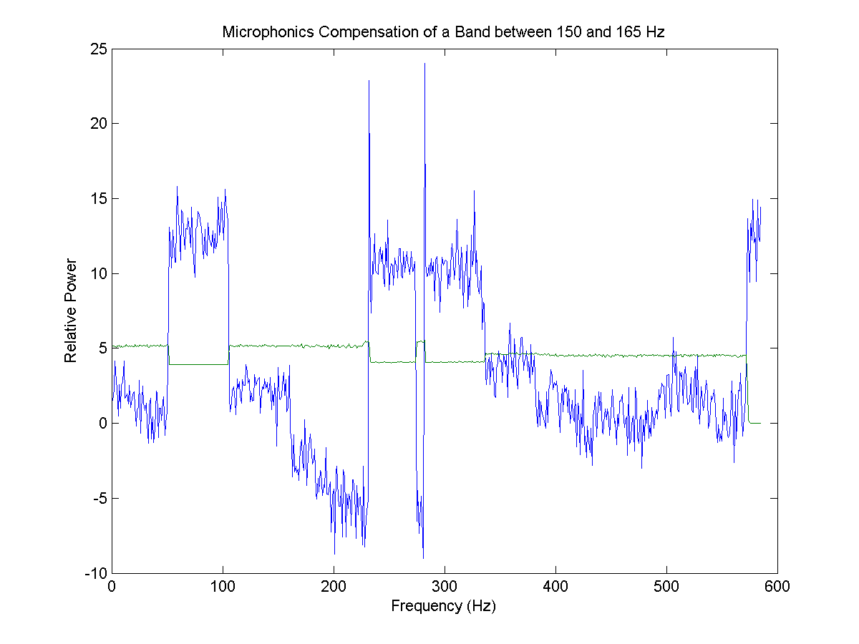
Active Compensation of Microphonics in CCII (cont.)
Run CCII in CW mode (low power). Forward Power and Probe signals feed to AD8302EB (RF/IF Gain and Phase Detector board from Analog Devices). Analog Phase detector signal used as input signal for “Narrow Band Filter”.
Illustrated dumping vibration of CCII (at 52Hz, 92Hz, 155Hz, etc.) up to 15db.
Single Resonance (III)
T=2K, 92Hz
Resonance compensation
Single Resonance (III)
T=2K, 155Hz (wide) Resonance compensation
Piezo Tuner
OFF /ON

Slide 21
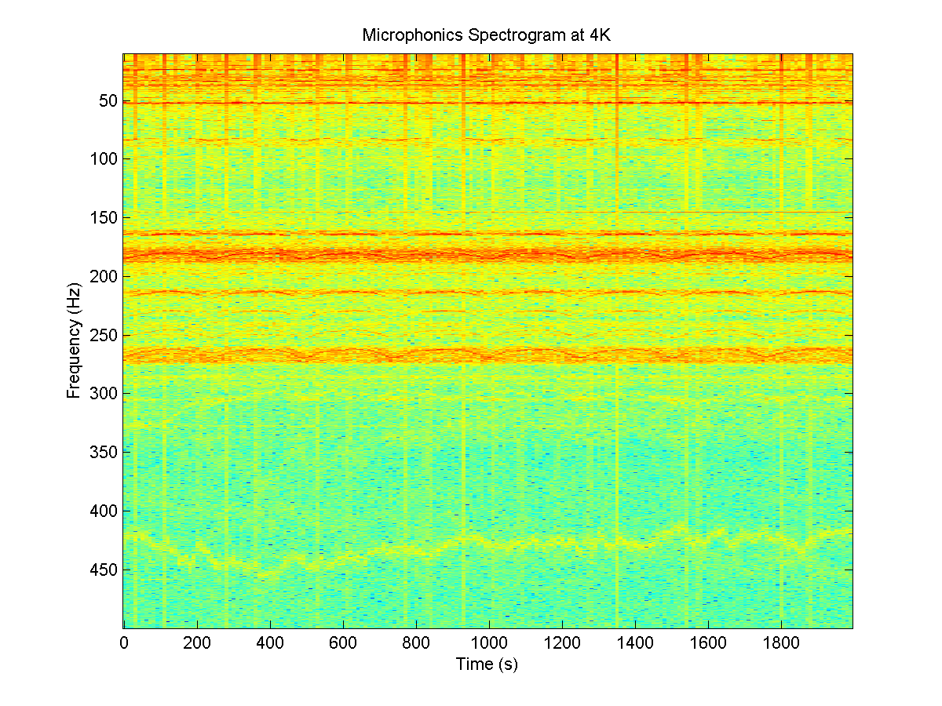
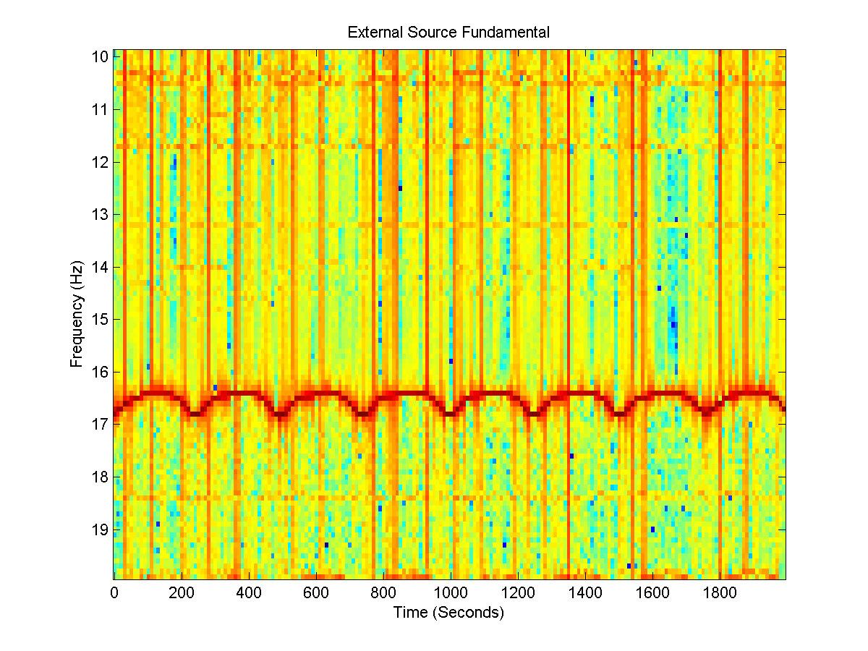
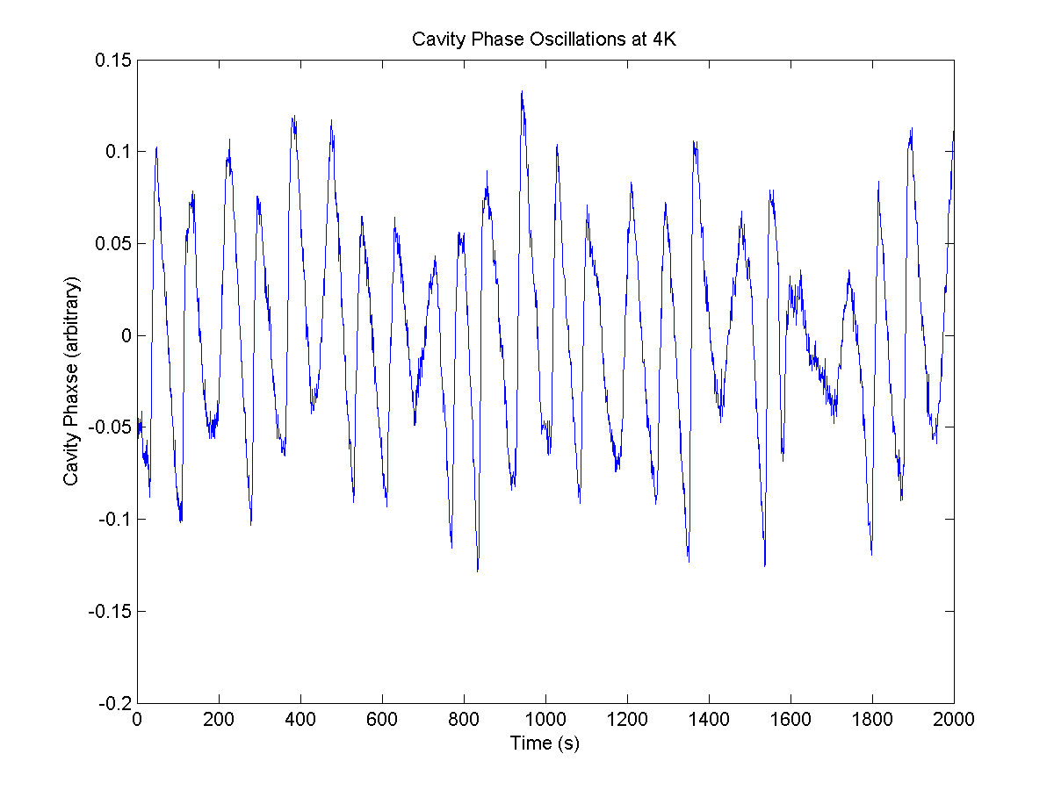
Active Compensation of Microphonics in CCII (cont.)
Measured CCII vibration at 4K, 2K during many hours of operation (long term stability of microphonics vibrations).
~80Hz

Slide 22
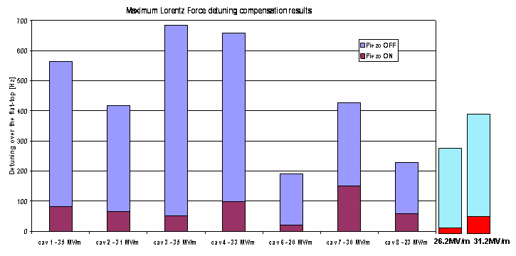
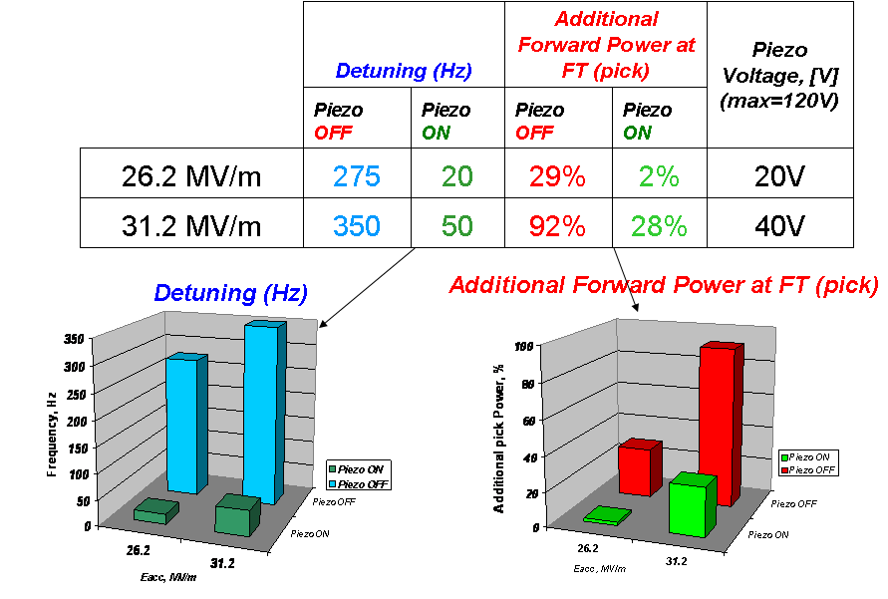
Experimental results with LFDC system proposed for NML/CM1/CC2
FNAL’s Resonance Control Group used this system for LFD compensation at CC2.
DESY
Experimental results from FLASH, Module#6 (L. Lilje)
Maximum Compensation per Cavity
CC2 results

Slide 23
Plans for 2009
Complete Linac and Comb Filter projects
Control 8 cavity cryomodule at NML
  MFC and ESECON drive and monitor
Control 6 copper cavities for HINS
Build new Recycler LLRF for NOVA
Continue with 9mA tests at FLASH

