Slide 1
Data on Carbon Intensity of Electric Power
Benno List, DESY

Slide 2
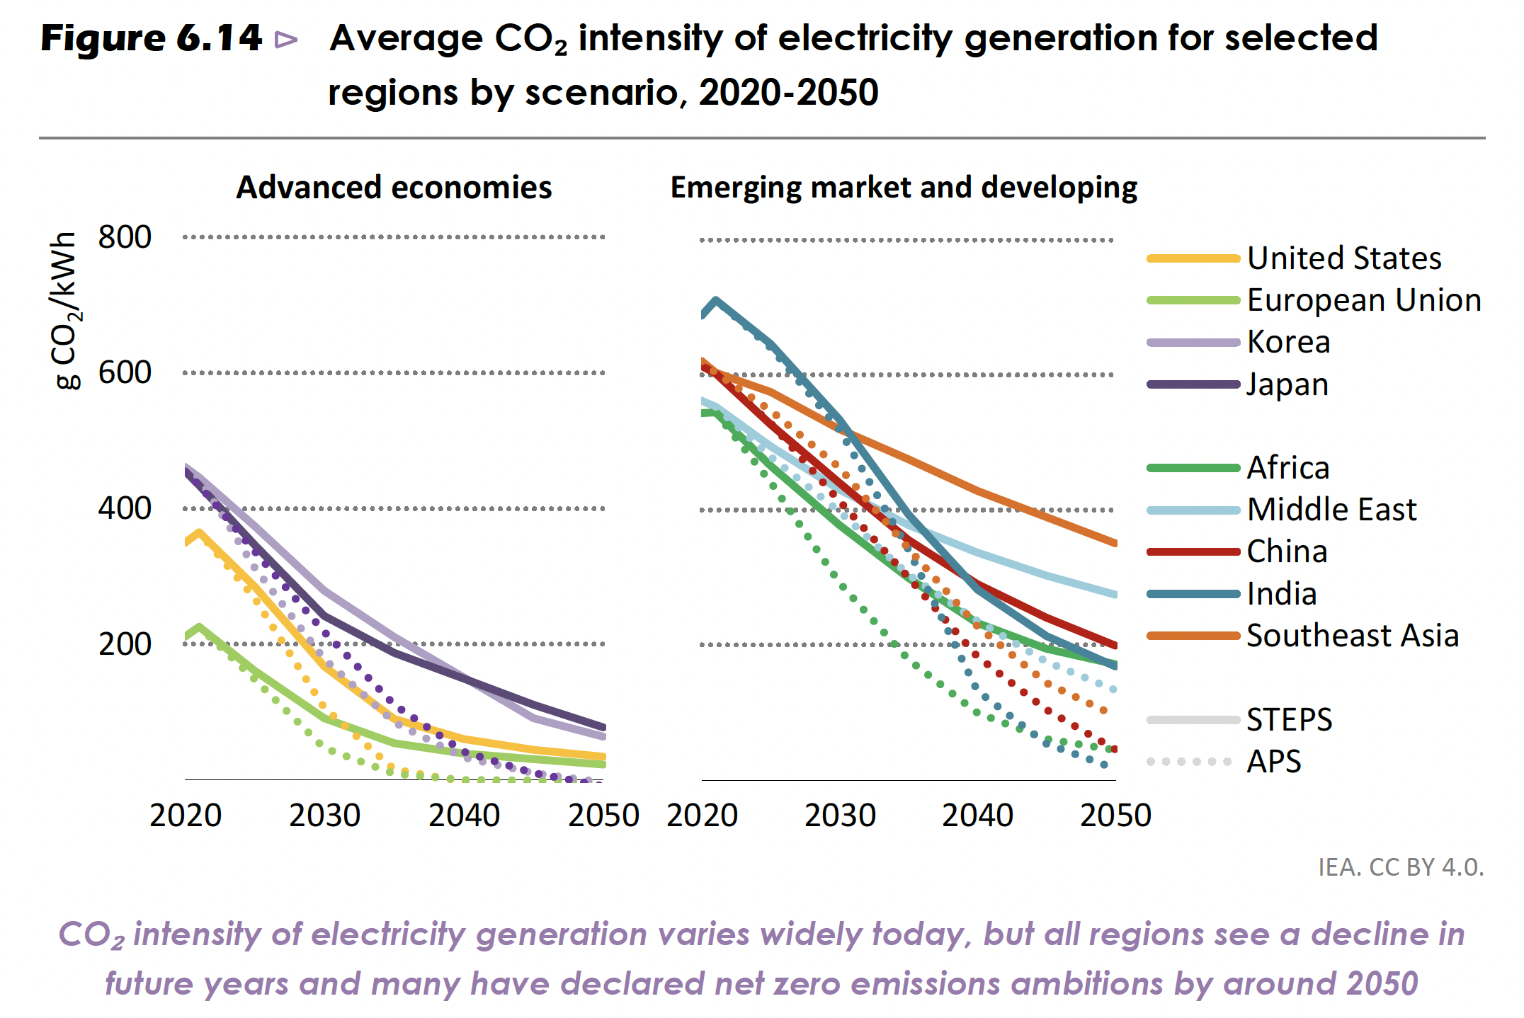
IEA (2022), World Energy Outlook 2022, IEA, Paris https://www.iea.org/reports/world-energy-outlook-2022,
License: CC BY 4.0 (report); CC BY NC SA 4.0 (Annex A)

Slide 3
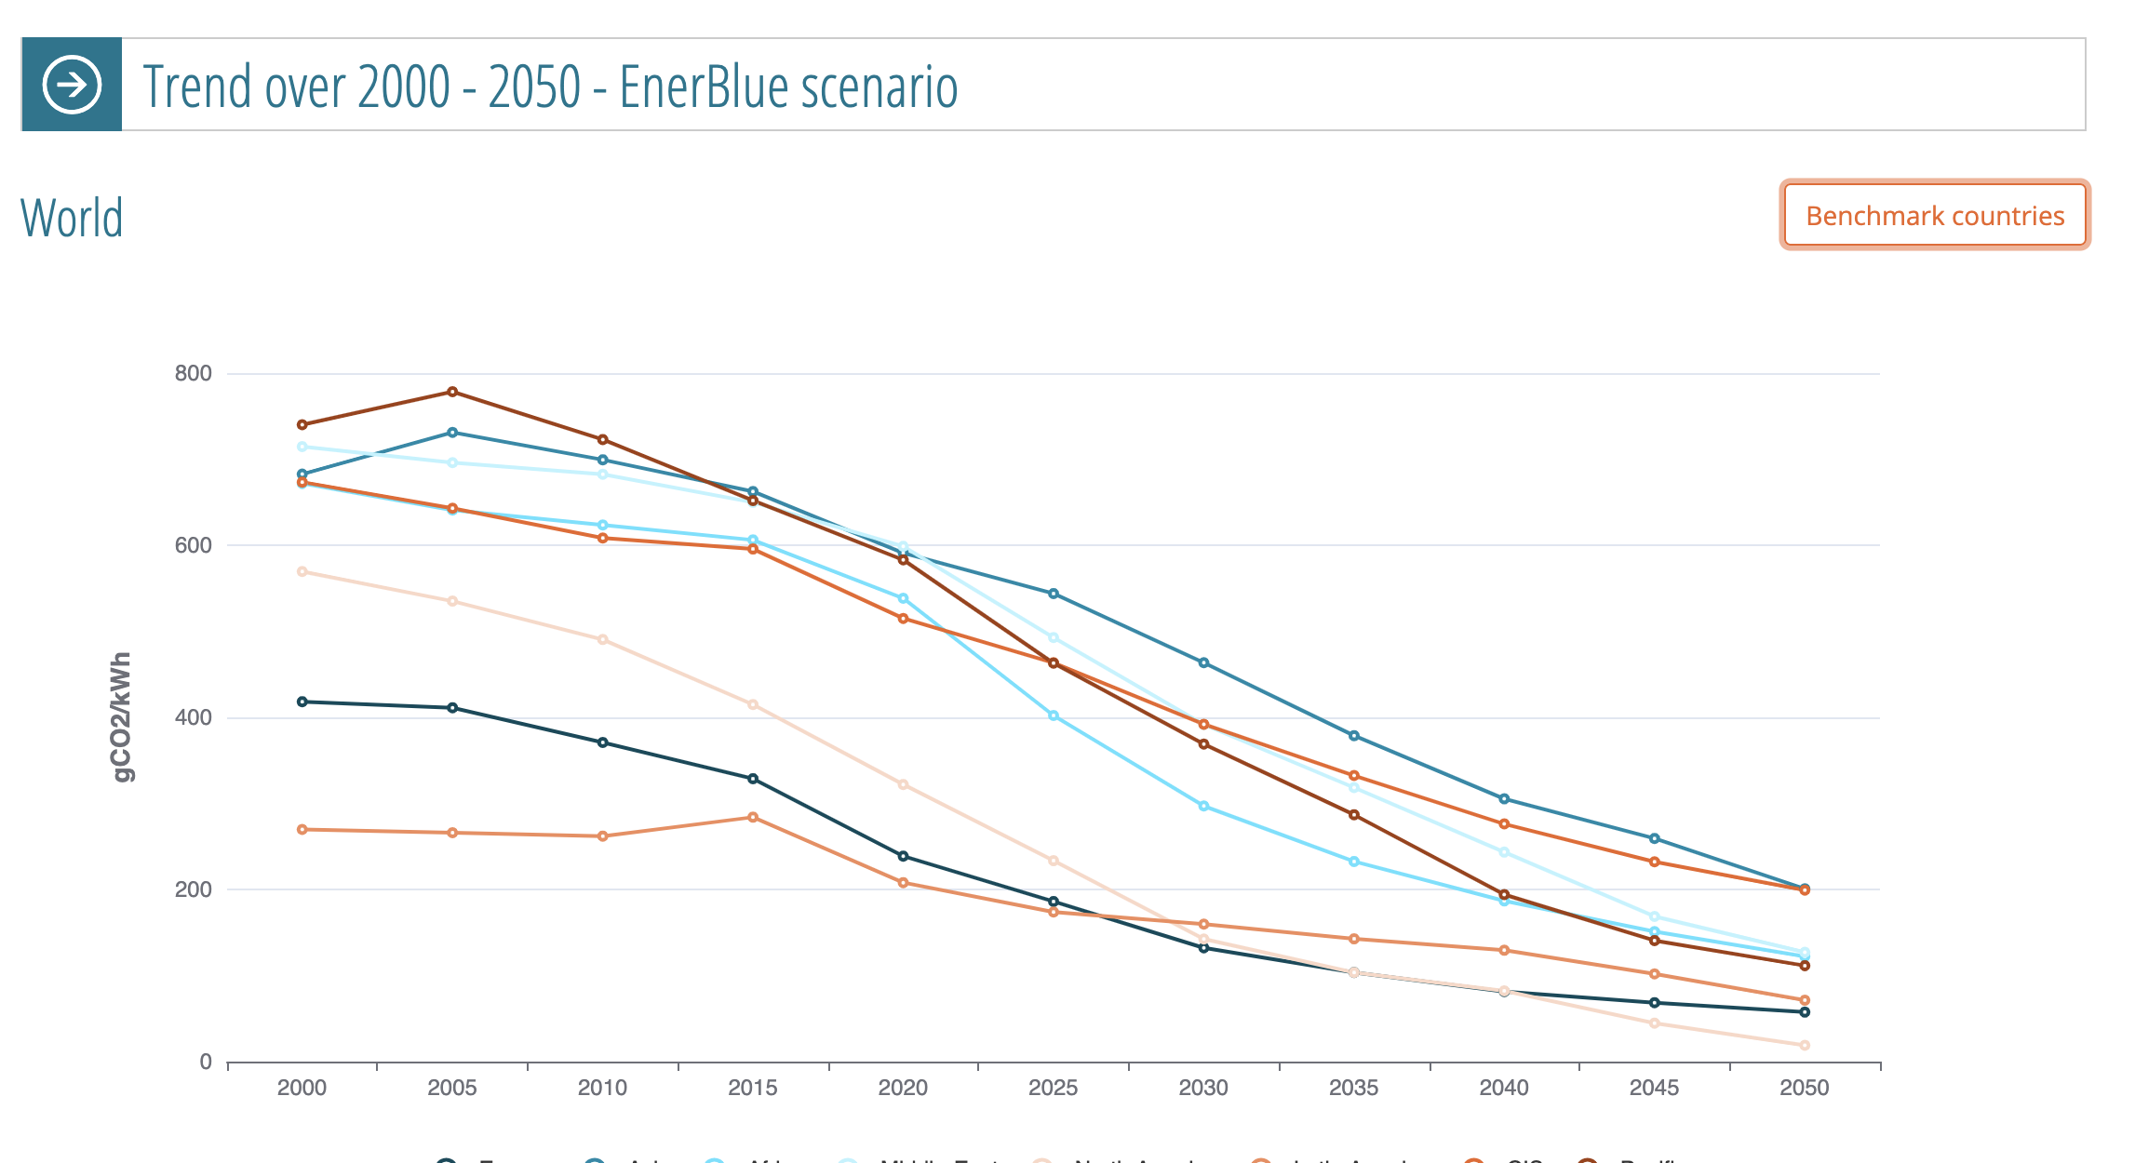
https://eneroutlook.enerdata.net/forecast-world-co2-intensity-of-electricity-generation.html
Europe 2040: 81g/kWh

Slide 4

Forecasted CO2 intensity of electricity generation worldwide from 2000 to 2050, by region (in grams of carbon dioxide per kilowatt hour)*
CO2 intensity of electricity generation worldwide 2000-2050, by region
Note(s): Worldwide; 2022
Further information regarding this statistic can be found on page 8.
Source(s): Enerdata; ID 1257765
2

Slide 5
Forecasted CO2 intensity of electricity generation worldwide from 2000 to 2050, by region (in grams of carbon dioxide per kilowatt hour)*
CO2 intensity of electricity generation worldwide 2000-2050, by region
Source and methodology information
Source(s) | Enerdata
Conducted by | Enerdata
Survey period | 2022
Region(s) | Worldwide
Number of respondents | n.a.
Age group | n.a.
Special characteristics | n.a.
Published by | Enerdata
Publication date | June 2022
Original source | EnerOutlook 2050, 2022 Edition
Website URL | visit the website
Notes: | CO2 intensity of electricity generation represents the amount of anthropogenic CO2 emissions associated to the generation of one kilowatt-hour of electricity. Forecast is based on the successful achievement of NDCs (Nationally Determined Contributions) announced in the 2015 Paris agreement (not incl [...] For more information visit our Website
Description
The carbon intensity of electricity generation has fallen in all regions since the turn of the century, and this trend is expected to continue in the coming decades. As of 2020, the Asia-Pacific region had the highest CO2 intensity from electricity generation of any region, at 599 grams of CO2 per kilowatt-hour. Projections show that by 2050, should all NDCs be successfully achieved, the CO2 intensity in the Asia-Pacific region will have decreased to 199 grams of CO2 per kilowatt-hour. North America is forecast to have the lowest emissions intensity by 2050, at 19 grams of CO2 per kilowatt-hour. The United States accounts for the majority of electric power emissions in North America.
8

Slide 6
Carbon intensity of the power sector in the European Union in 2021, by country (in grams of CO₂ per kilowatt-hour)
Power sector carbon intensity in the European Union 2021, by country
Note(s): EU; 2021
Further information regarding this statistic can be found on page 8.
Source(s): Ember; ID 1291750
4

Slide 7
Carbon intensity of the power sector in the European Union in 2021, by country (in grams of CO₂ per kilowatt-hour)
Power sector carbon intensity in the European Union 2021, by country
Source and methodology information
Source(s) | Ember
Conducted by | Ember
Survey period | 2021
Region(s) | EU
Number of respondents | n.a.
Age group | n.a.
Special characteristics | n.a.
Published by | Ember
Publication date | February 2022
Original source | ember-climate.org
Website URL | visit the website
Notes: | Figures are estimates.
Description
In 2021, Poland recorded the largest power sector carbon intensity in the European Union, estimated at 736 grams of CO₂ per kilowatt-hour of electricity generated. Estonia followed in close second, with almost 700 gCO₂/kWh. Meanwhile, Sweden's power sector was the least carbon-intensive in the EU, with 10 gCO₂/kWh.
8

Slide 8
Carbon intensity outlook of the power sector in France from 2020 to 2050 (in grams of CO2 per kilowatt-hour)
Power sector carbon intensity outlook in France 2020-2050
Note(s): France; 2020
Further information regarding this statistic can be found on page 8.
Source(s): Aurora Energy Research; ID 1190067
2

Slide 9
Carbon intensity outlook of the power sector in France from 2020 to 2050 (in grams of CO2 per kilowatt-hour)
Power sector carbon intensity outlook in France 2020-2050
Source and methodology information
Source(s) | Aurora Energy Research
Conducted by | Aurora Energy Research
Survey period | 2020
Region(s) | France
Number of respondents | n.a.
Age group | n.a.
Special characteristics | n.a.
Published by | Aurora Energy Research
Publication date | October 2020
Original source | auroraer.com
Website URL | visit the website
Notes: | n.a.
Description
The power sector in France emitted 57.3 grams of carbon dioxide per kilowatt-hour (gCO2/KWh) of electricity generated in 2020. Projections show that in 2050, France's power sector will emit roughly 70 gCO2/KWh. One reason for France's relatively low carbon intensity is its use of nuclear power. Unlike fossil fuels such as coal, nuclear power does not produce direct CO2 emissions. Nuclear power in France accounts for more than 70 percent of the country's total power generation.
8

Slide 10
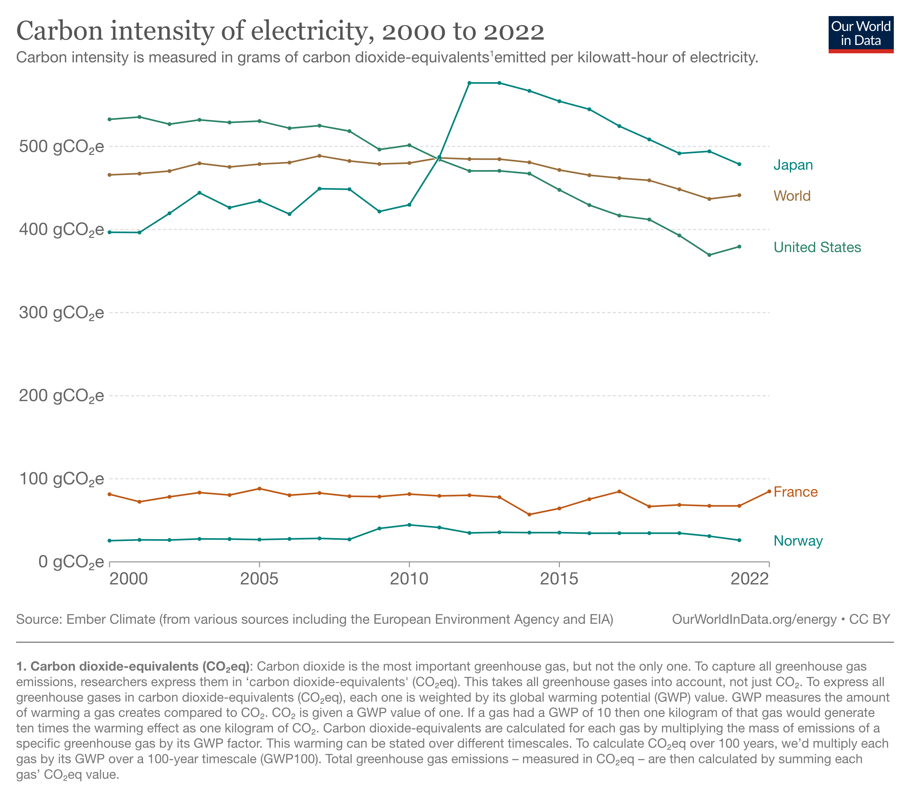
https://ourworldindata.org/grapher/carbon-intensity-electricity?tab=chart&country=FRA~EU-27~OWID_WRL~NOR~JPN~USA

Slide 11
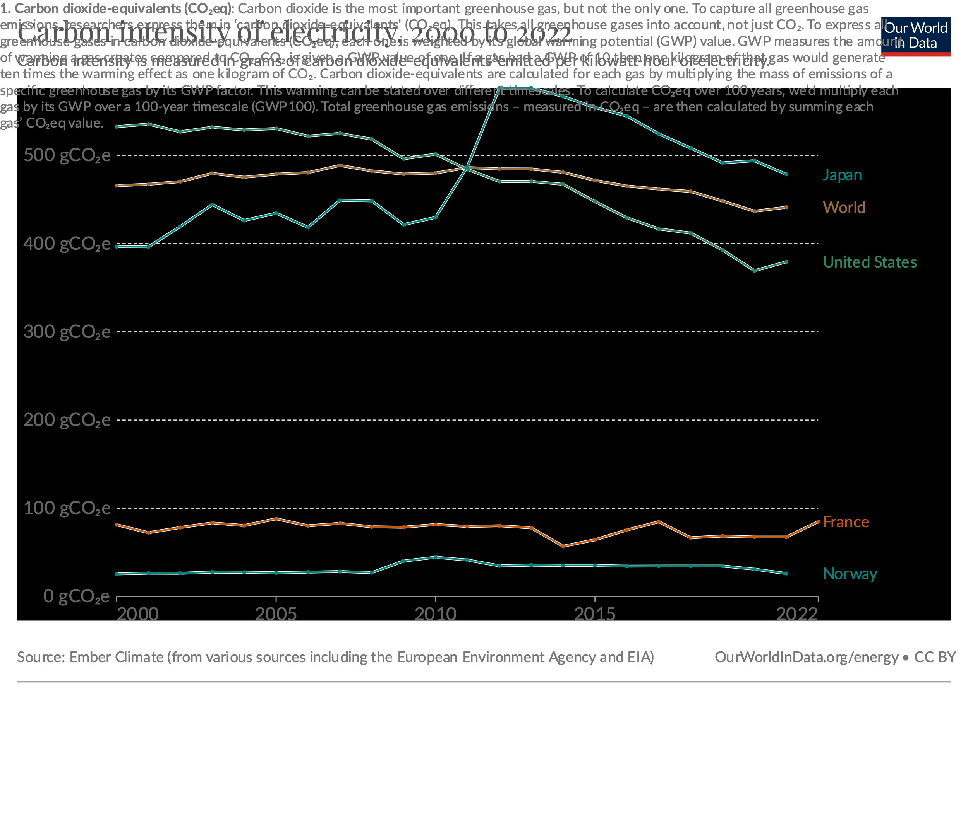

Slide 12
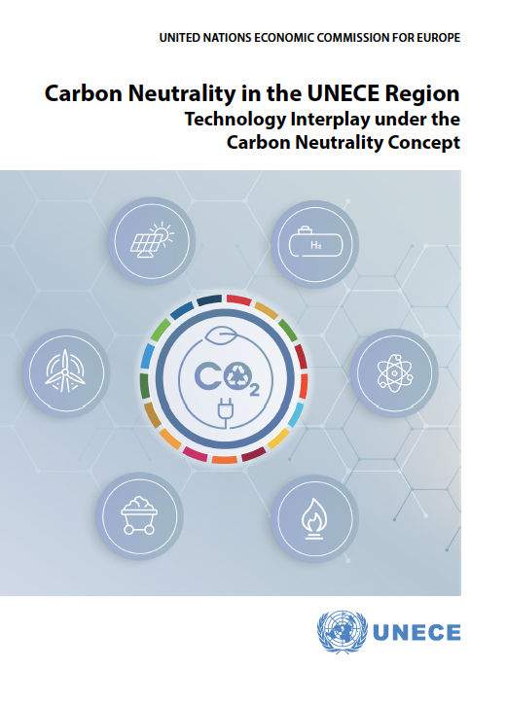
This UNECE (UN Economic Commission for Europe)
gives full life cycle analyses for various energy types
https://unece.org/sites/default/files/2022-04/LCA_3_FINAL%20March%202022.pdf

Slide 13
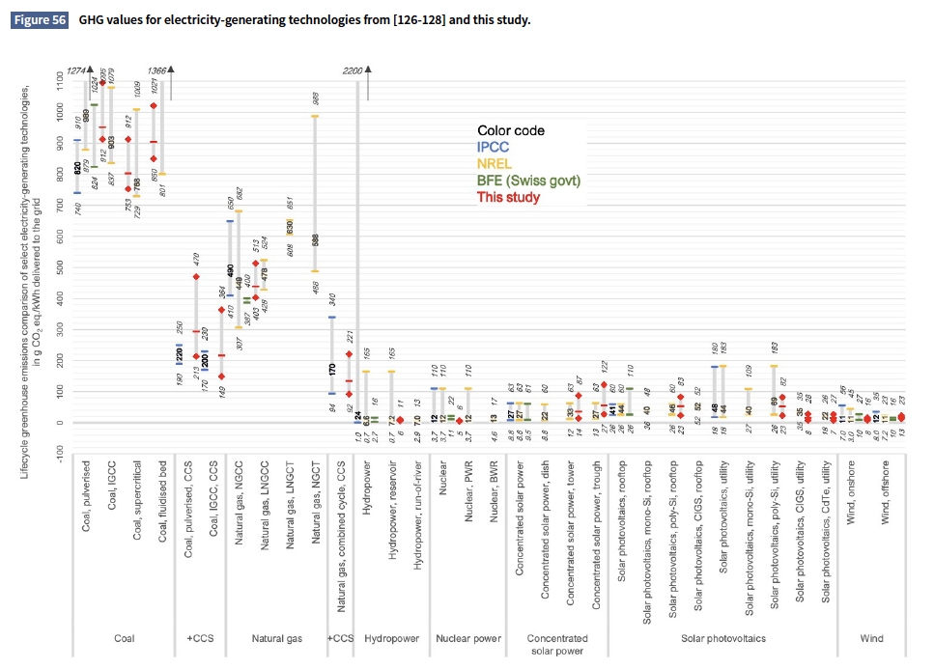
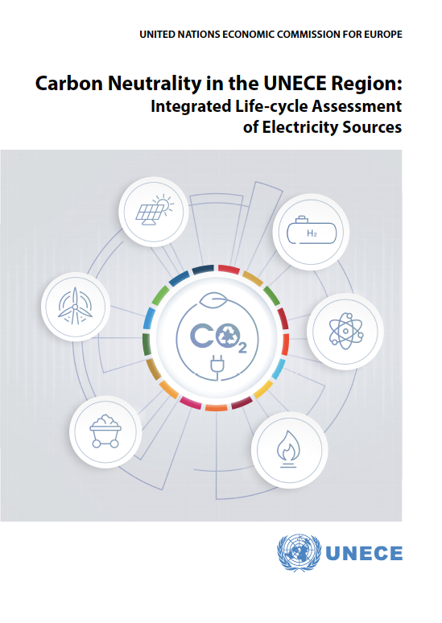
Carbon Intensity of Electricity Technologies
https://unece.org/sites/default/files/2022-04/LCA_3_FINAL%20March%202022.pdf

Slide 14
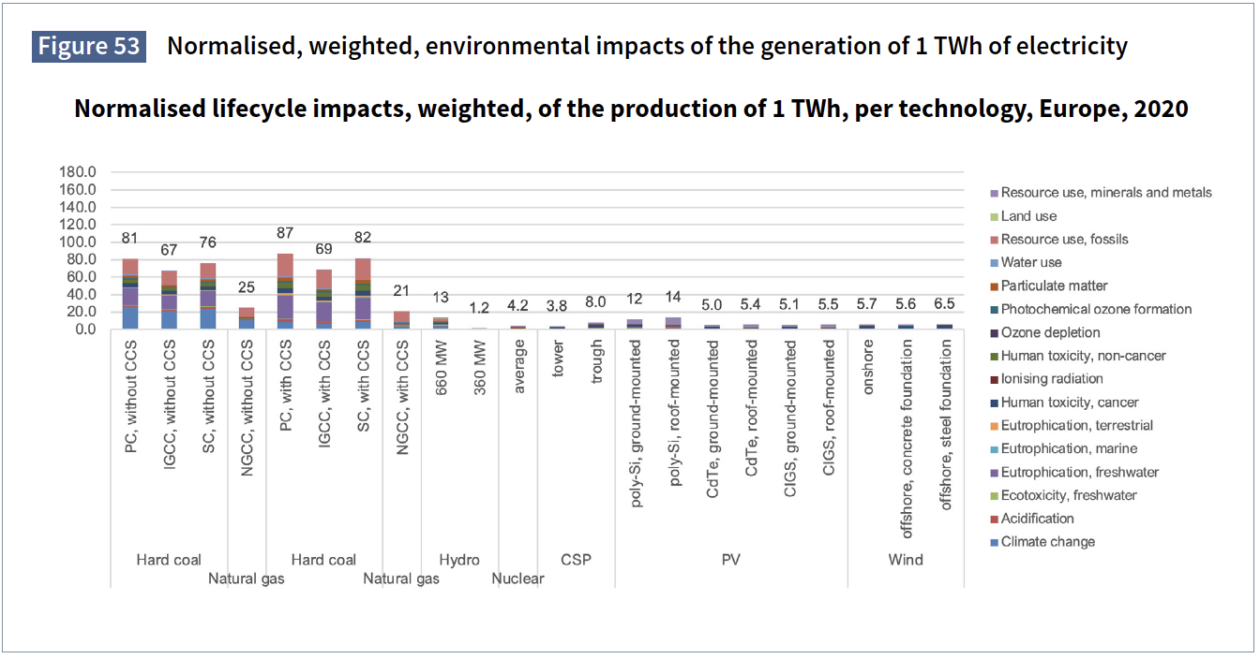
https://unece.org/sites/default/files/2022-04/LCA_3_FINAL%20March%202022.pdf

Slide 15
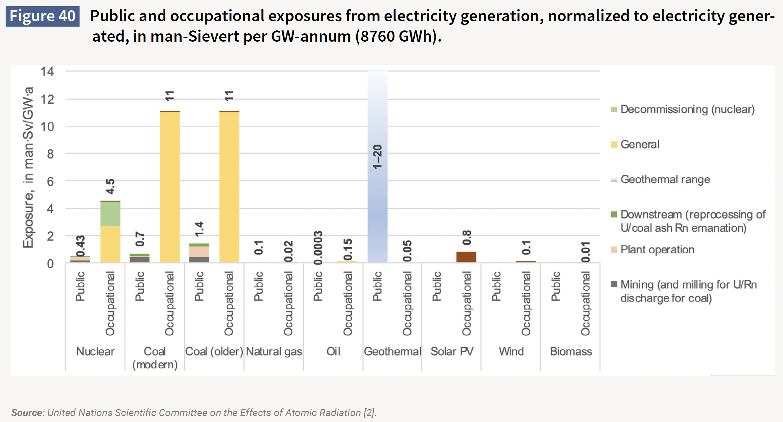
https://unece.org/sites/default/files/2022-04/LCA_3_FINAL%20March%202022.pdf

Slide 16
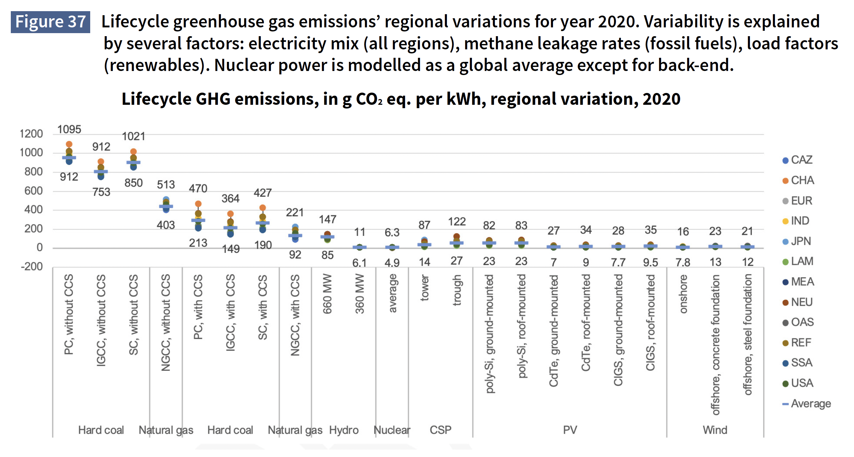
https://unece.org/sites/default/files/2022-04/LCA_3_FINAL%20March%202022.pdf
PC: Pulverized Coal
CCS: Carbon (dioxide) Capture and Storage
CSP: Concentrated Solar Power
PV: Photovoltaics

Slide 17
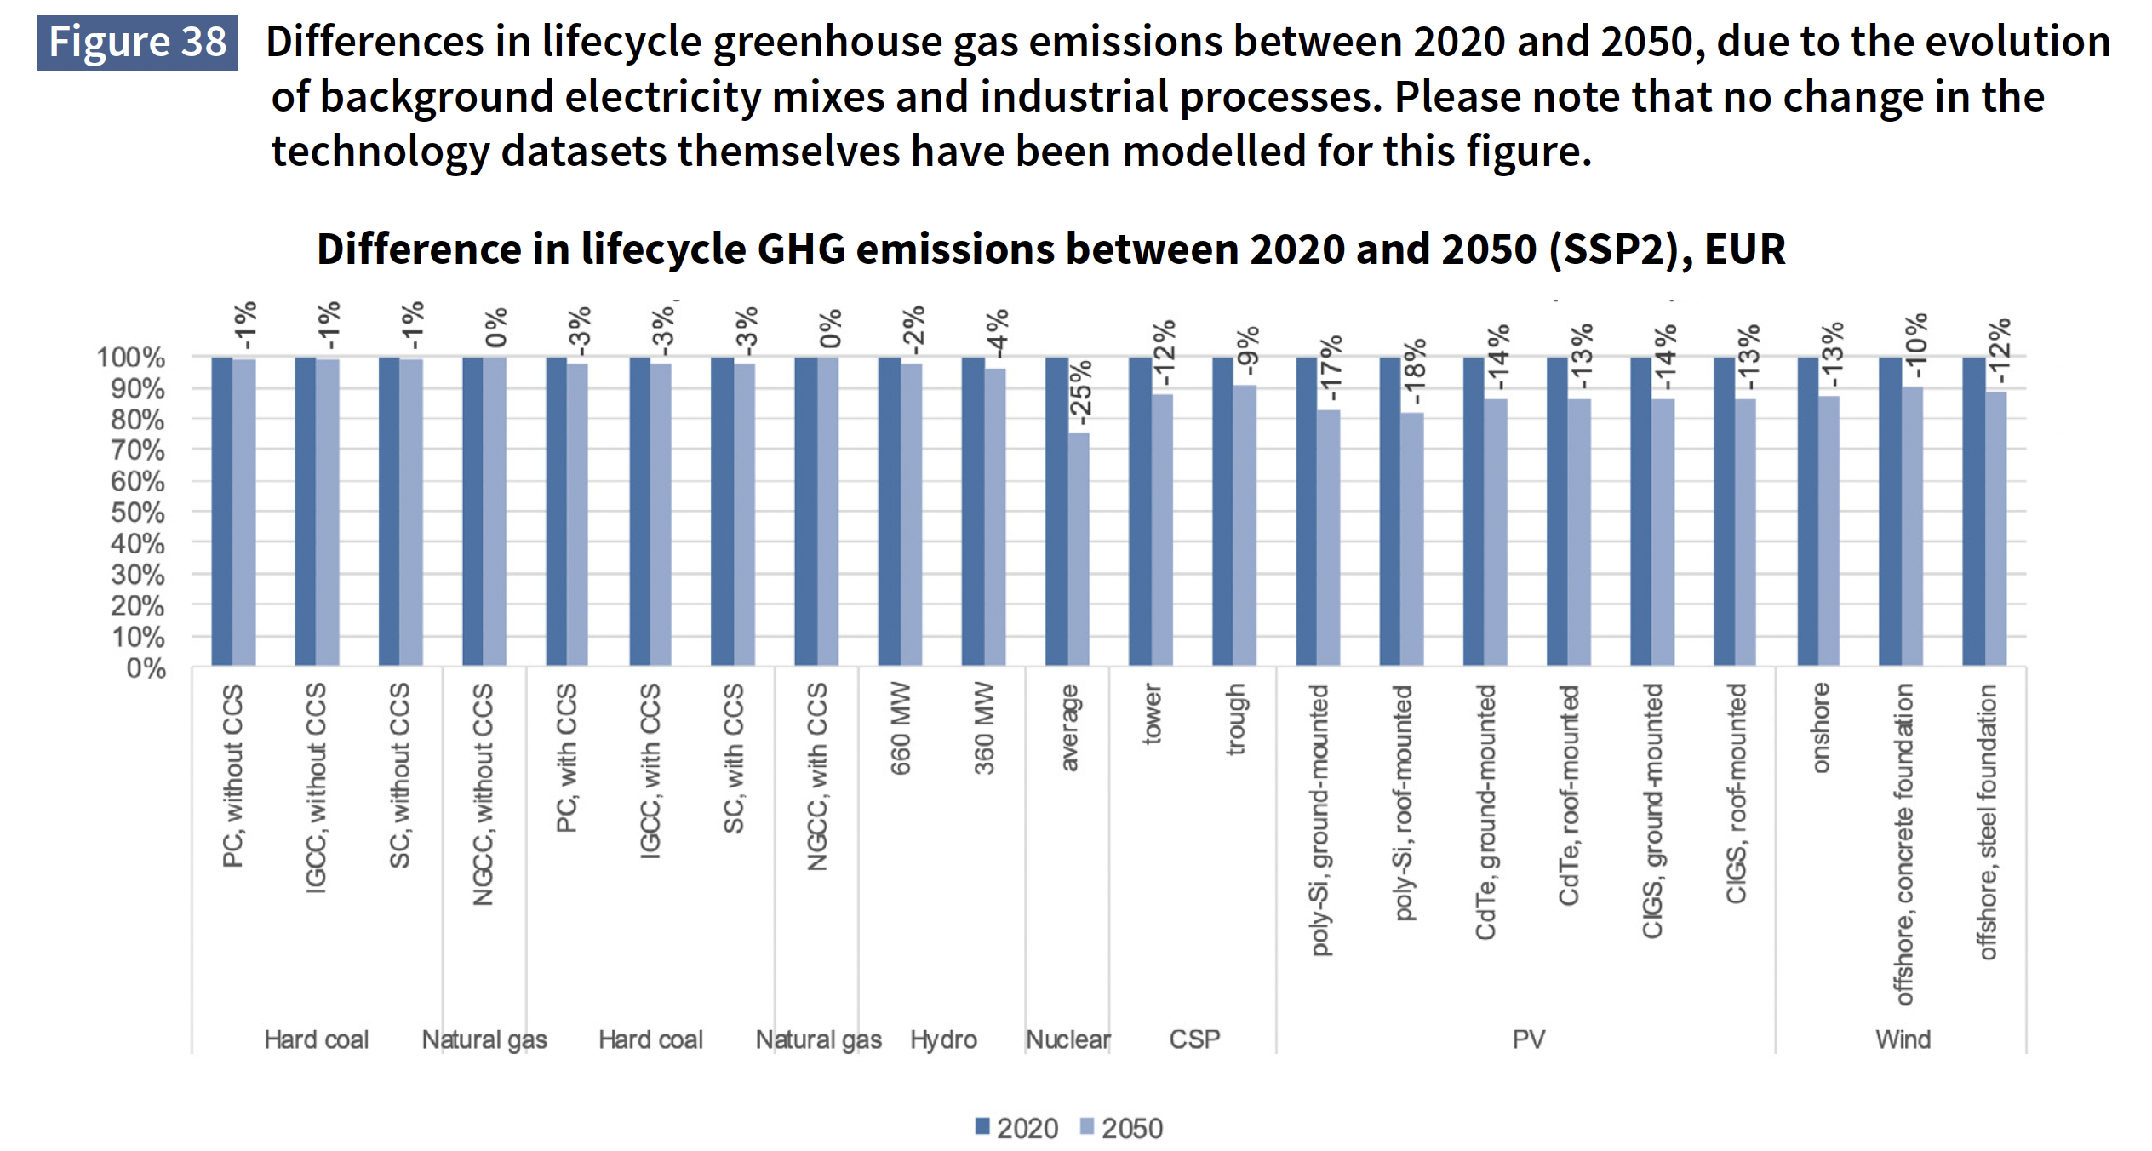
https://unece.org/sites/default/files/2022-04/LCA_3_FINAL%20March%202022.pdf

