Slide 1
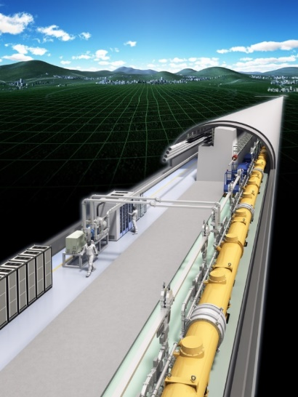
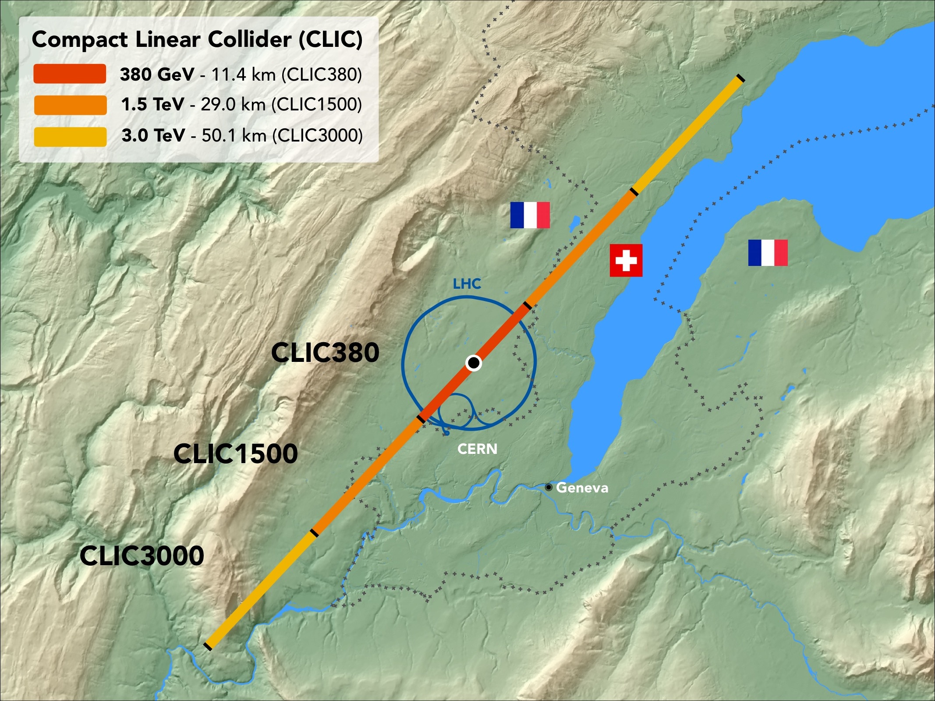


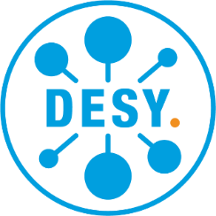

Sustainability Studies for Future Linear Colliders
Benno List, Shinichiro Michizono, Takayuki Saeki, Steinar Stapnes, Maxim Titov*
CEA, CERN, DESY, KEK
14th Particle Accelerator Conference
(IPAC23),Venice, Italy, May 7-12, 2023

Slide 2
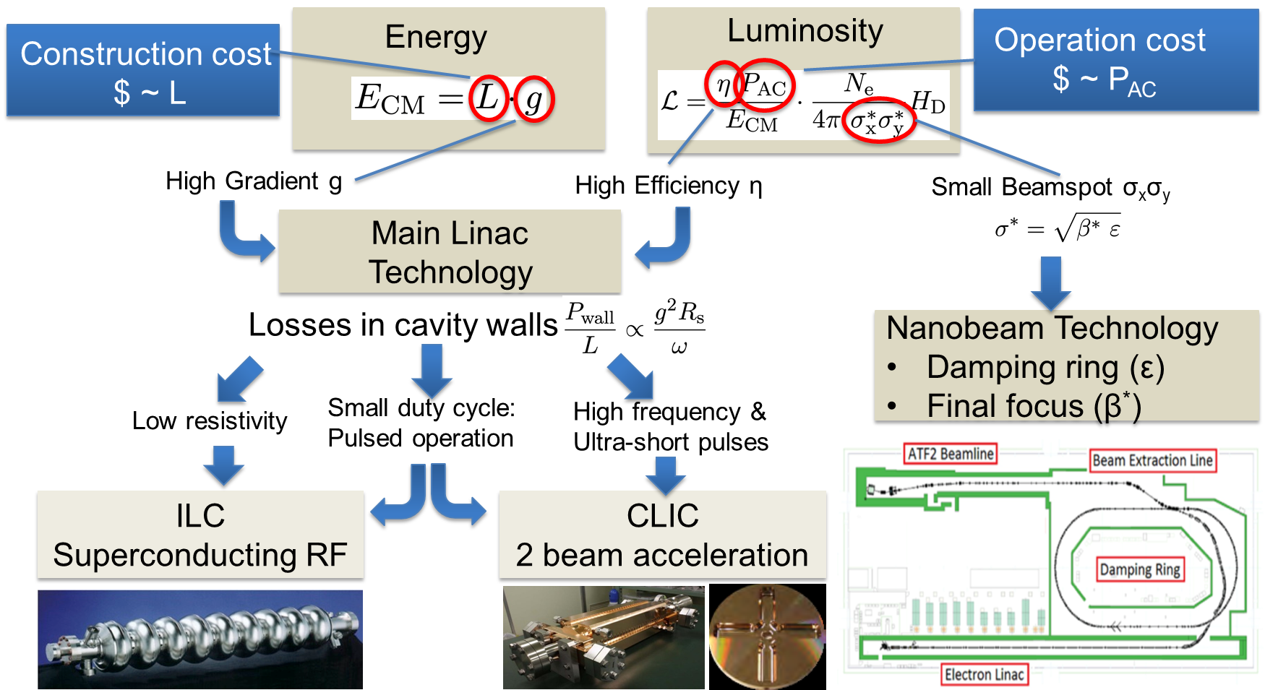
Linear Collider Challenges
Critical aspects: Physics, Gradient and Power Efficiency, Cost
Tunnel length →
construction cost
Power consumption→
operating costs
Increasing focus on Power, Energy Consumption, Carbon Emission and other Sustainability issues → This talk covers examples of past, ongoing and future studies.

Slide 3
ILC / CLIC: Approaches to Increase Sustainability
Resource optimization traditionally done for accelerators:
Overall system design
  Compact accelerator
  → high gradient; high field magnets
  Energy efficient
  → low losses (wall-plug to beam)
  Effective
  → nm-beam sizes to maximize luminosity
  Energy recovery concepts
  Civil engineering including landscaping and « community » integration
Subsystem and component design, e.g.
  High-efficiency cavities and klystrons
  Permanent magnets, HTS magnets
  Heat-recovery. e.g. in tunnel linings
  Responsible sourcing and material choices
Sustainable operation concepts
  Renewables
  Adapt to regenerative power availability
  Exploit energy buffering potential
  Recover energy (heat recovery)
  Length/complexity -> construction cost
  Power/energy consumption -> operating costs
  Traditionally we optimize for energy reach and luminosity wrt to cost and power
Sustainability in a wider sense adds new construction and operation optimization criteria:
  Energy use not only costs but also embedded CO₂ in construction materials and components, rare earth usage → responsible sourcing in general for all parts, landscaping, integration in local communities, life cycle assessments including decommission and many more issues
Good progress on the green points (was also part of the our radiational approach), initial progress/focus on the yellow / black ones

Slide 4
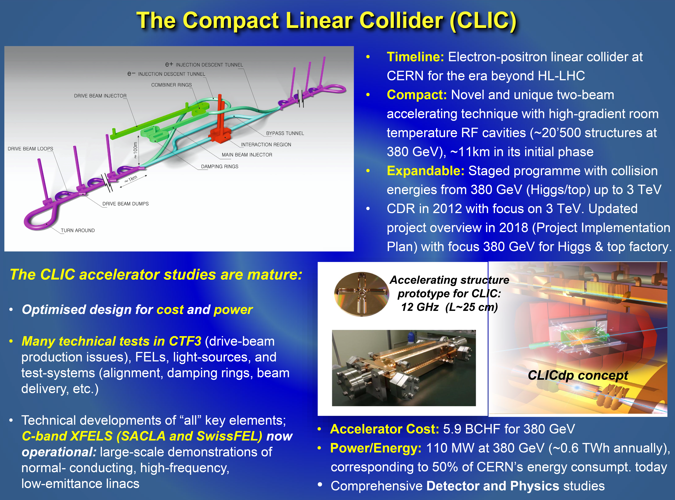
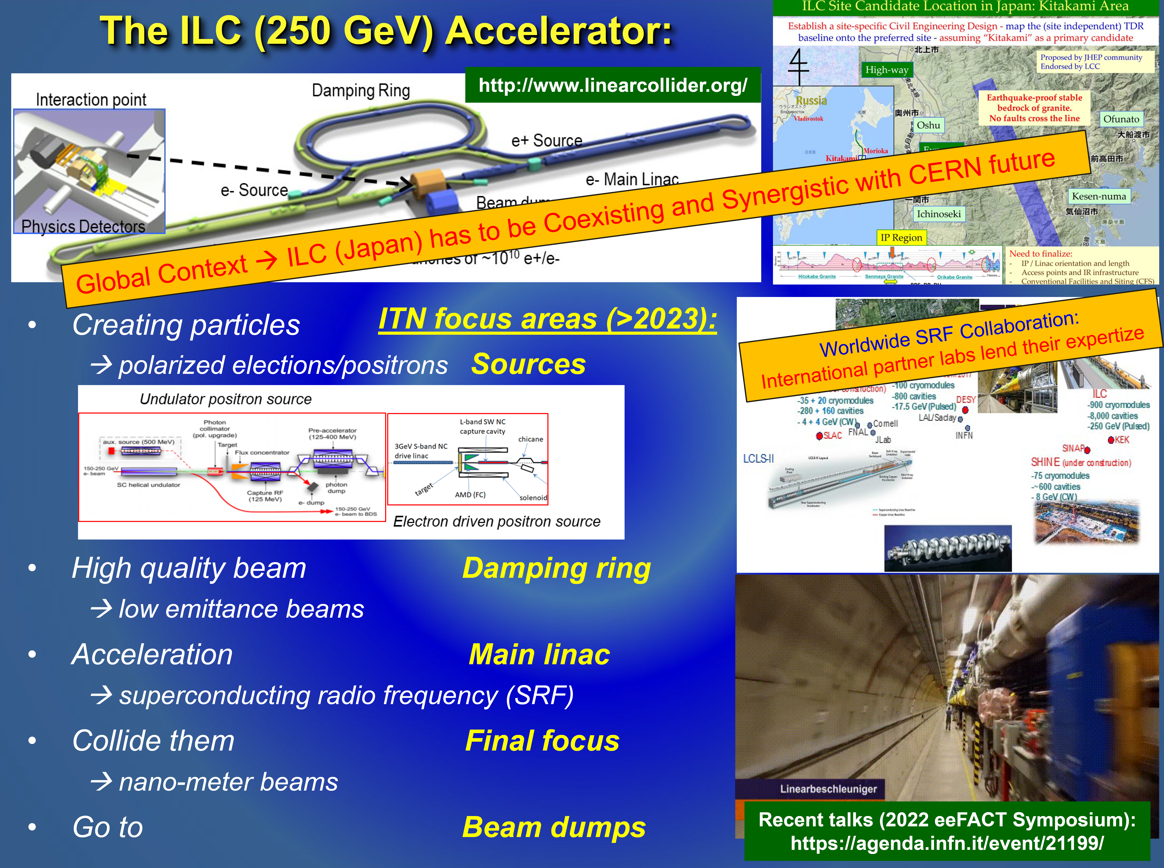
ILC / CLIC: Overall Resource Efficiency Considerations
Challenge: Achieve target energy and luminosity
with least possible amount of resources
Optimize resources for construction/operation:
  Compact: high acceleration gradient
  Energy-efficiency: RF efficiency becomes increasingly important for higher energies
  - ILC: superconducting RF
  - CLIC: high frequency & ultra-short pulses
  Effectiveness: maximize luminosity / beam power → nanobeams technology
ILC (250 GeV) and CLIC (380 GeV):
  Different solutions to the efficiency problem
  → final power consumption similar (~100 MW)
Embodied CO₂: proportional to facility length
  Efficient RF systems, luminosities optimization vs. beam power for stability, alignment, instrumentation for nano-beams, etc …
  Embodied carbon addressed by reducing length of installation and tunnel diameter

Slide 5
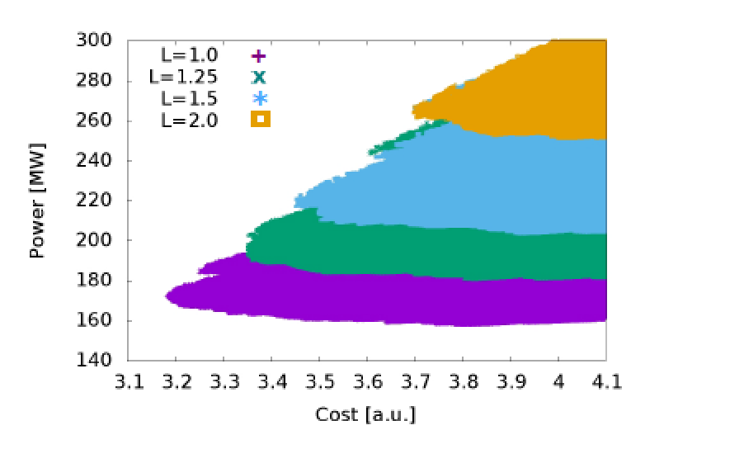
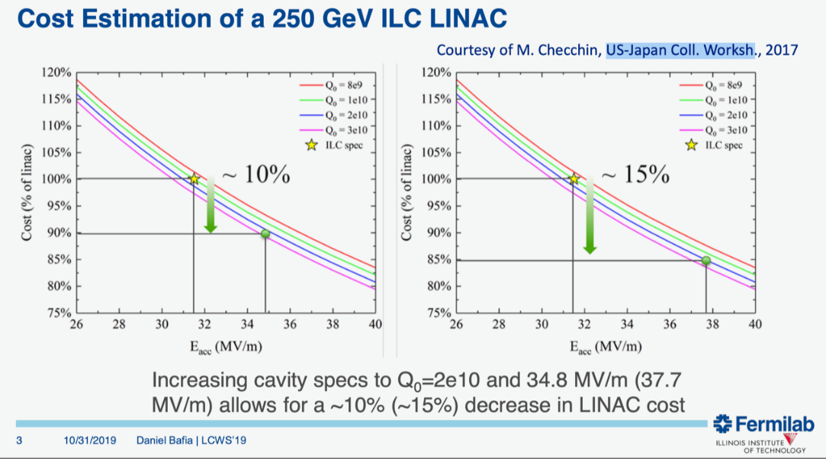
ILC / CLIC: Overall System Design & Optimization
Usually, projects optimize – energy reach, luminosity and cost. Power becomes increasingly important; solutions exist compromising ultimate performance for power consumption & savings
Design Optimization for CLIC:
CLIC designs (drive-beam), including key performance parameters as accelerating gradients, pulse lengths, bunch-charges and luminosities, have been optimised for cost, but also focusing on power consumption (in parallel: re-design and optimisation of RF systems, e.g. damping rings and drive-beam)
E.g. Parameter scans to find optimal parameter set, change acc. structure designs and gradients to find an optimum (2015)
Design Optimization for ILC:
ILC design optimization have been, focusing on parameters choices, for example repetition rates, pulse-lengths, cryo and RF systems for various luminosity choices
E.g. higher E_{acc} means lower invest in cavities/cryomodules, but larger invest in RF/cryogenics (losses per length scale as E_{acc}²)
Updated Baseline for a Staged
CLIC: CERN-2016-004
ILC linac cost vs. gradient (E_{acc}) and Q₀
D. Baifa @ LCWS2019
For both ILC / CLIC, it would be interesting to repeat studies, focusing more strongly on power consumption, and including exercise with CO₂ (e.g. weigh the savings in embodied CO₂ vs the expense of CO₂ through operation…)

Slide 6
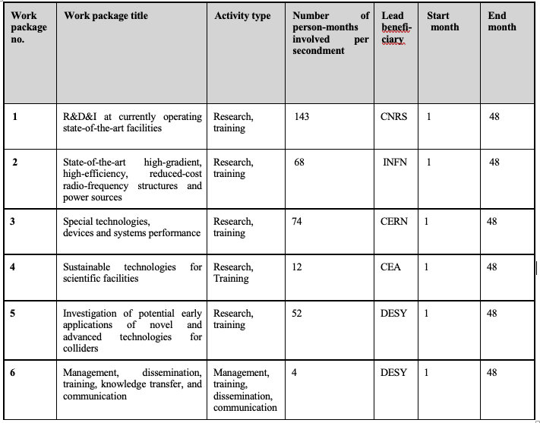
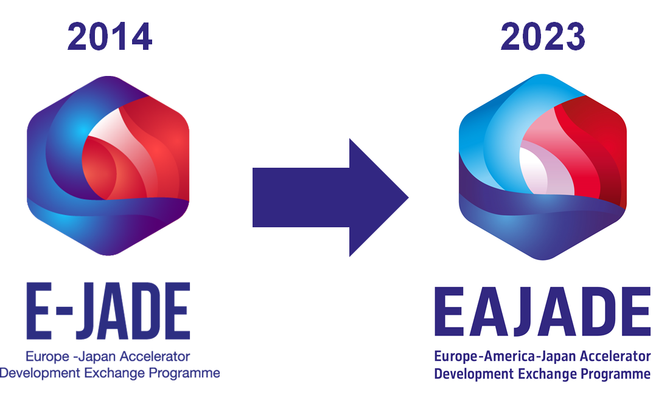
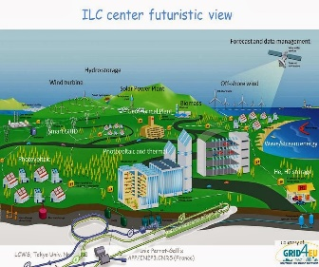
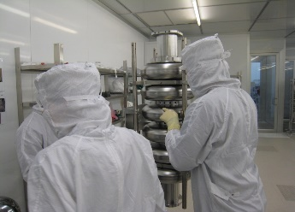
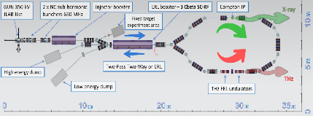
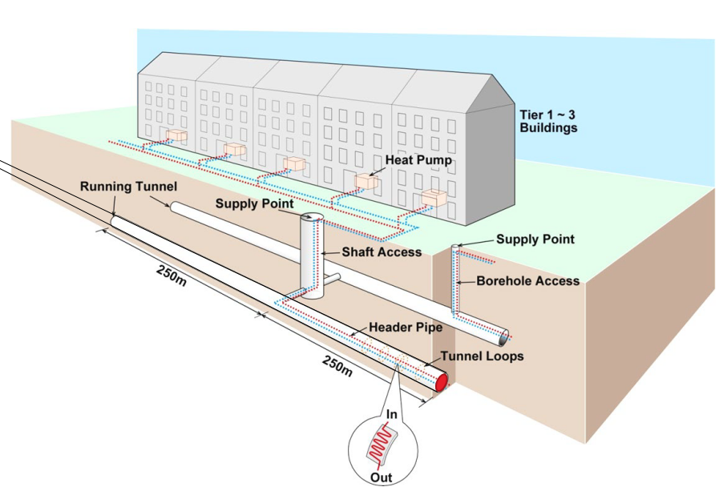
Europe – America – Japan (EAJADE) Program (2023-2027)
European Union’s Horizon Europe Marie Sklodowska-Curie Staff Exchanges programme under grant agreement no. 101086276
http://www.eajade.eu/
WP4: Sustainable Technologies
for Scientific Facilities
Task 4.6: “Green ILC”
Task 4.1: High Efficiency & Sustainable SC cavities
WP4
Task 4.5: Smart Tunneling
Task 4.2: High efficiency RF power amplifiers
Task 4.3: Energy Recovery Linacs
Task 4.4: Power Modulation

Slide 7
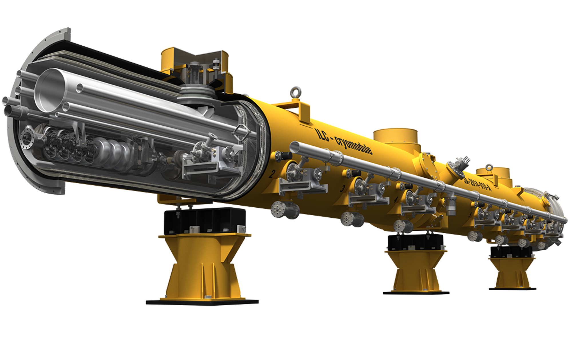
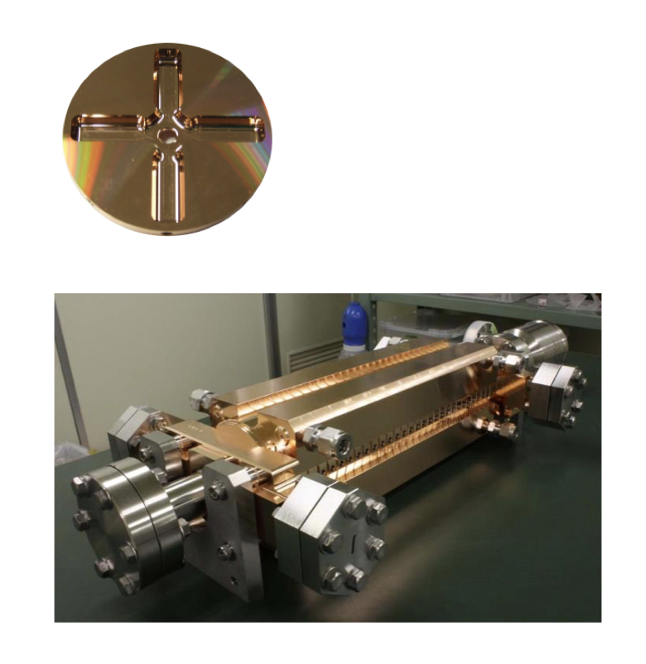
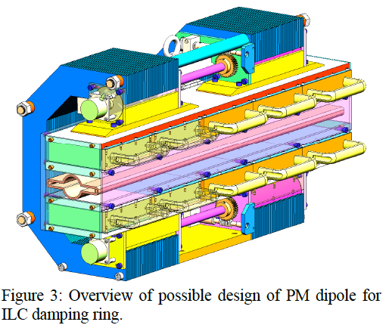
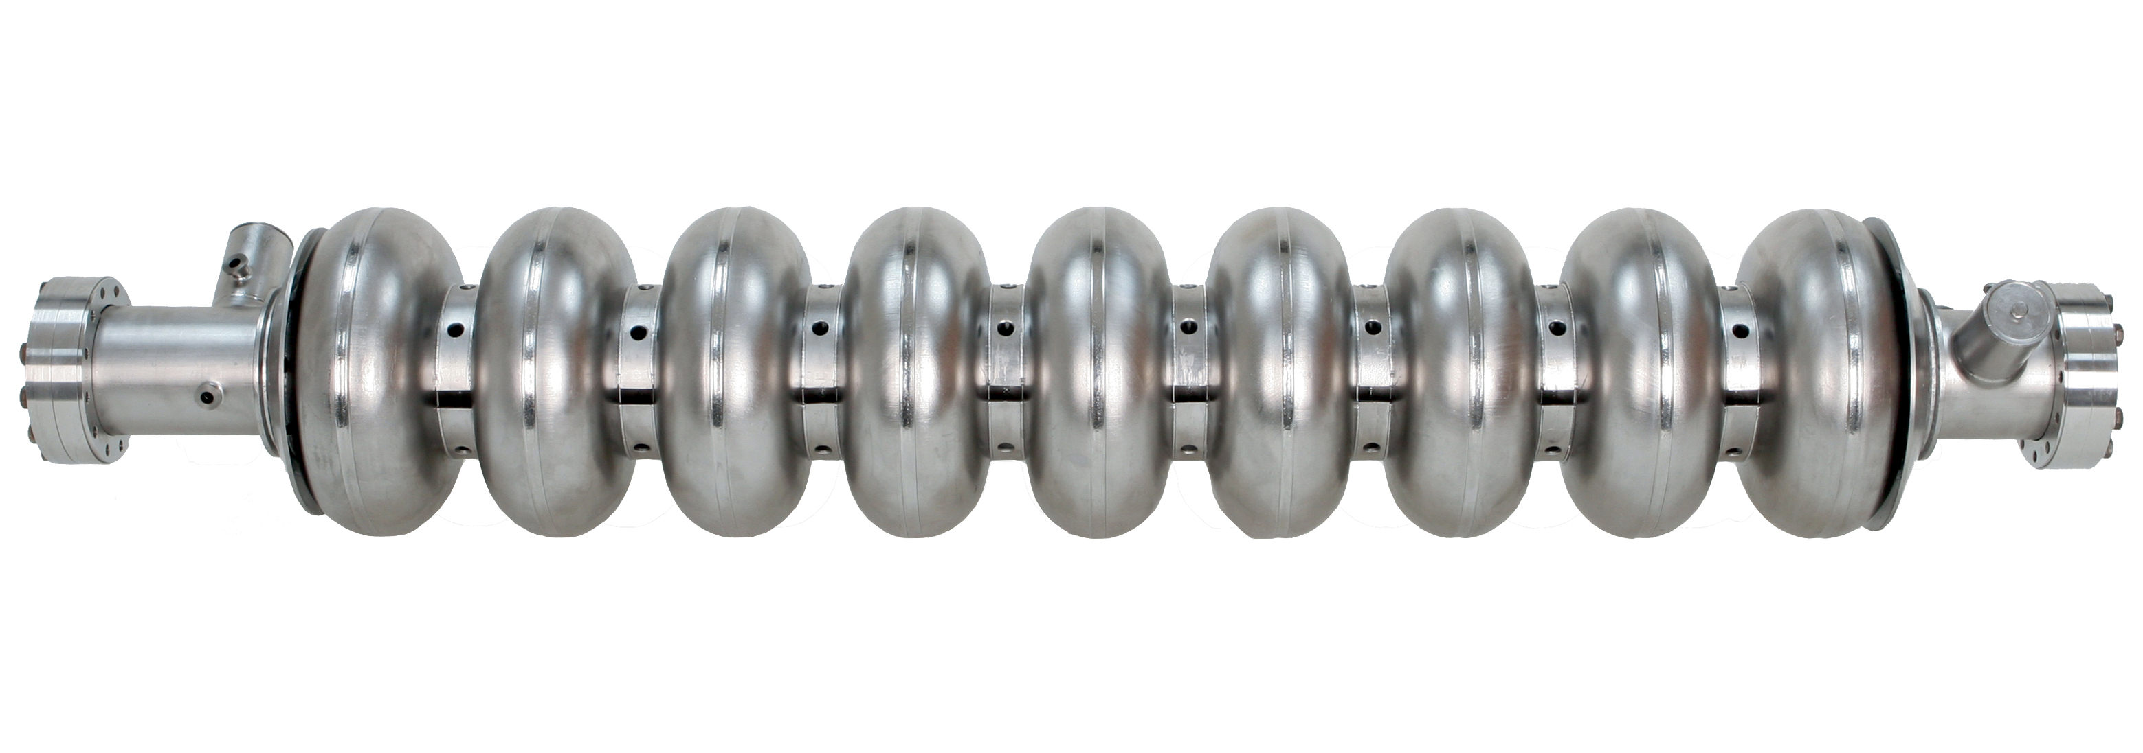
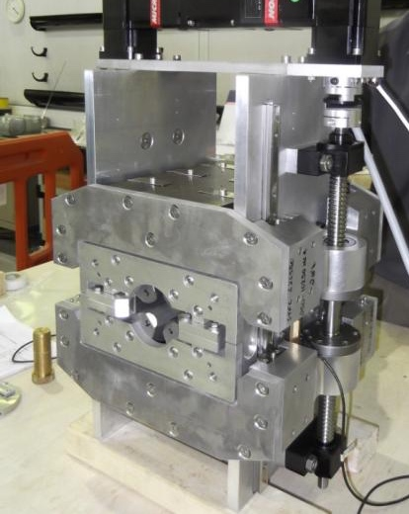
Approaches to Increase Sustainability:
Optimization of Subsystems and Components

Slide 8

R&D for Improved ILC SRF Performance & Sustainability
Major progress during past 10 years:
bulk niobium (1.3 GHz as ILC & FEL linacs), improvements in gradient, processing steps; surface treatment, cavity shapes; power efficiency (Q₀) always an integrated part of studies
- Raise Gradient:
Short term goal: 31.5MV/m -> 35MV/m
Medium term goal: 45MV/m
Lab record: 59MV/m
- Improve Q₀: reduce cryogenic losses
(1W @ 2K requires ~750W AC power!)
Short term goal: 1E10 -> 2E10
State-of-the-art surface treatment of bulk Nb: baking/annealing/doping, plasma processing (possibly reducing aggressive chemicals, required for electropolishing)
R&D into replacement of bulk niobium cavities with Nb or Nb3Sn coated copper (beyond bulk Nb – thin-film SRF): reduce Nb consumption, increase performance
C. Antoine talk @IPAC2023
arXiv: 2203.09718

Slide 9
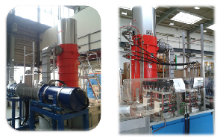
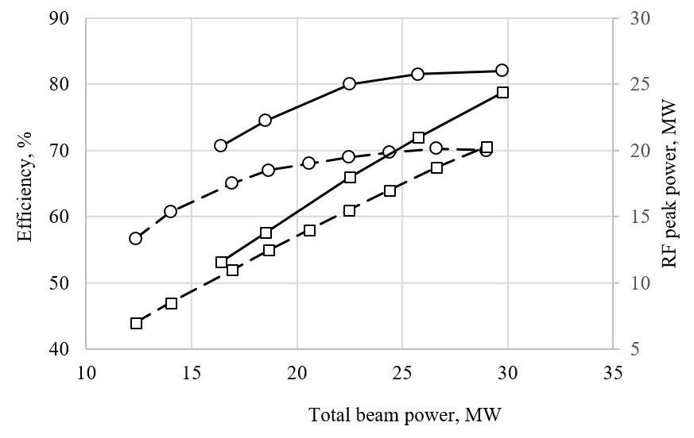
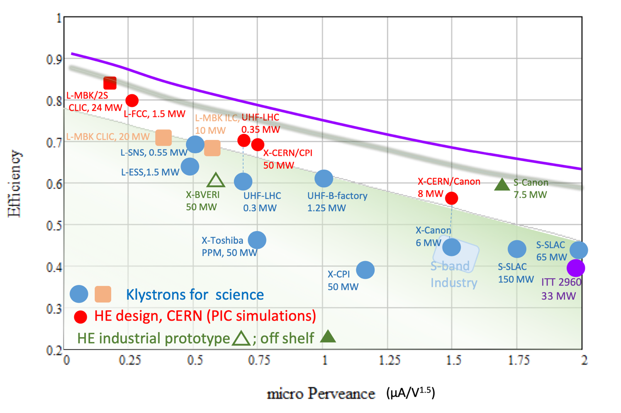
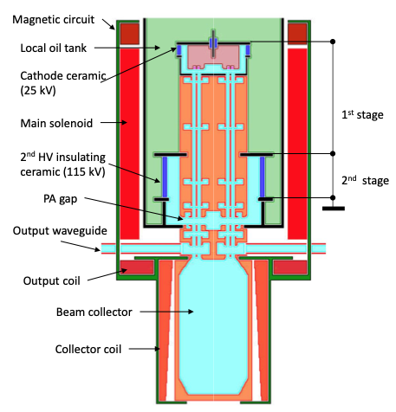
High Efficiency (L-Band, X-Band) Klystron Project at CERN
Accelerators technology could require RF signals in a wide range of the frequencies (few 100 MHz – 12 GHz), peak power levels (few 100 kW – 100 MW) and pulse lengths (CW -100ns). The klystron amplifiers technology is the one that covers almost all RF frequency/power demands of the modern accelerators.
High Efficiency implementations:
New small X-band klystron – recent successful prototype
Large X-band with CPI
L-band two stage, design done, prototype desirable
Efficiency performance of the selected
commercial klystrons and the new HE klystrons.
https://ieeexplore.ieee.org/document/9115885
Drivebeam klystron: The klystron efficiency (circles) and the peak RF power (squares) simulated for the CLIC TS MBK (solid lines) and measured for the Canon MBK E37503 (dashed lines) vs beam power.
CLIC
goal
https://indico.cern.ch/event/1138197/contributions/4821294/attachments/2474897/4246880/HE_WS_2022_Syratchev.pdf
High efficiency: 24MW,
CLIC
TS MBK
achieved
L-band klystron
CLIC (1 GHz),
ILC (1.3 GHz)
CW-FCC (600 MHz)
https://indico.cern.ch/event/1101548/contributions/4635959

Slide 10
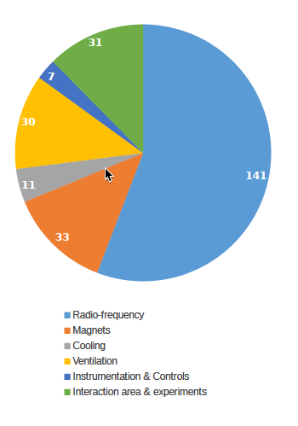
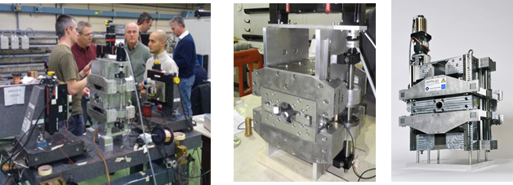
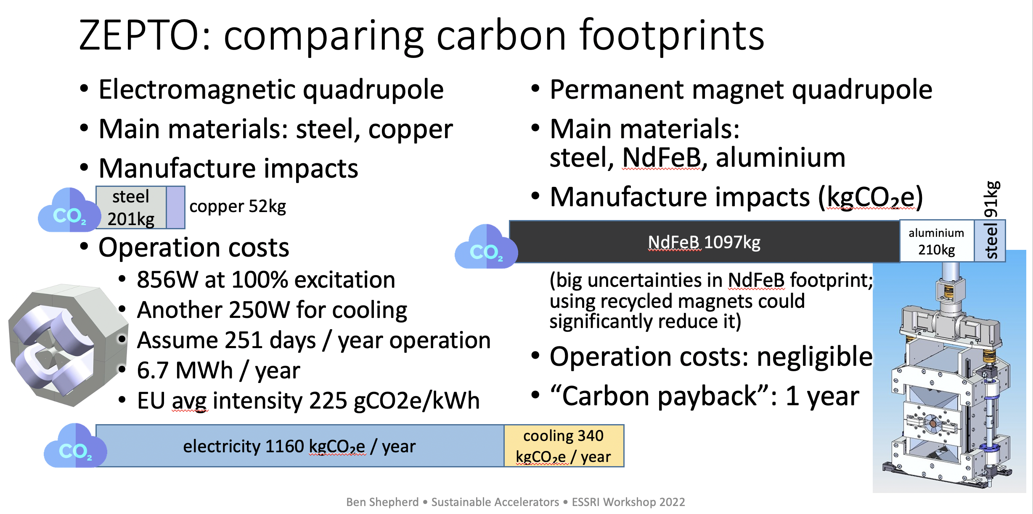
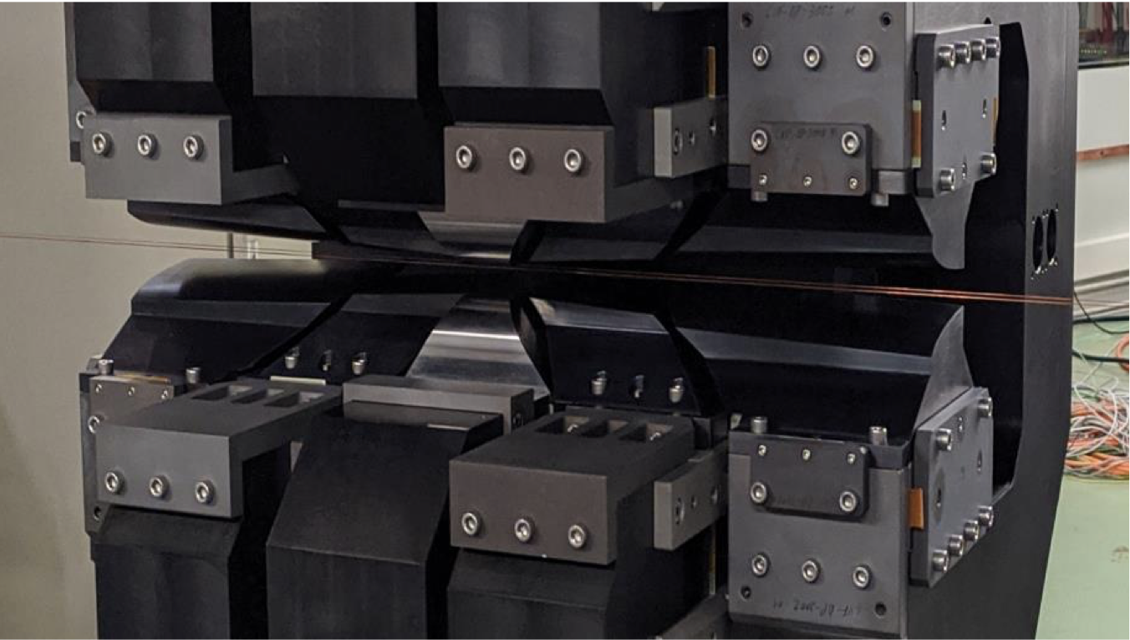
R&D for Permanent Magnets (also important for Higgs Factories)
1.5 TeV CLIC power
Magnets second largest
ZEPTO (Zero Power Tuneable Optics) project is a collaboration between CERN and STFC Daresbury Laboratory to save power and costs by switching from resistive electromagnets to permanent magnets
For CLIC the dominant power is in the drive-beam quadrupoles, successfully prototyped & tested as permanent (two different strengths) magnets, and also dipoles (in drivebeam turn arounds)
Longitudinal gradient dipole magnet for the
CLIC DR (CIEMAT)
HTS magnets might be of interest in Higgs factories to reduce power consumption
(CIEAMT/ILC: HTS; N3Ti magnets for ULC main quadrupoles for)
Ben Shepherd, ESSRI Workshop 2022, https://indico.esrf.fr/event/2/contributions/108/

Slide 11
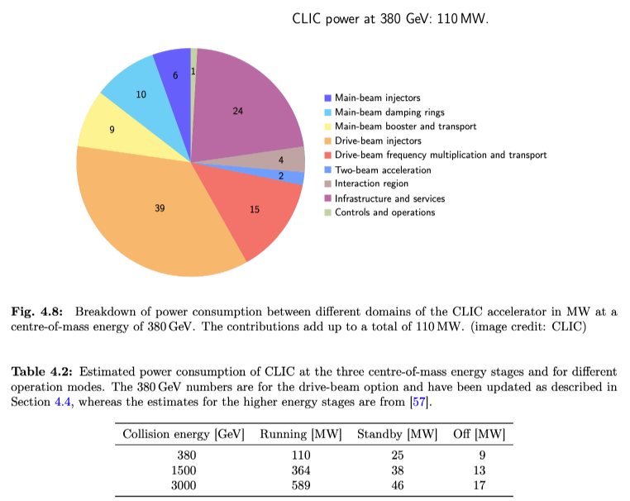
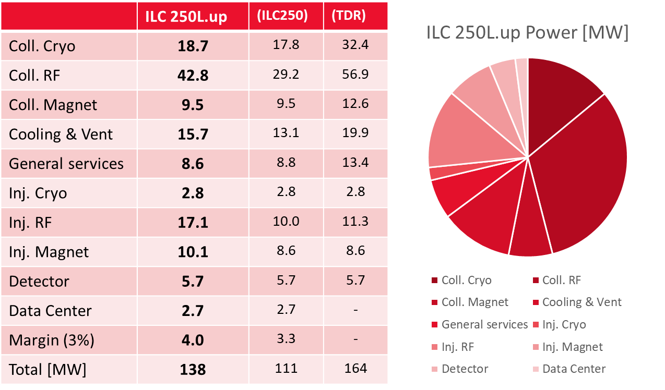
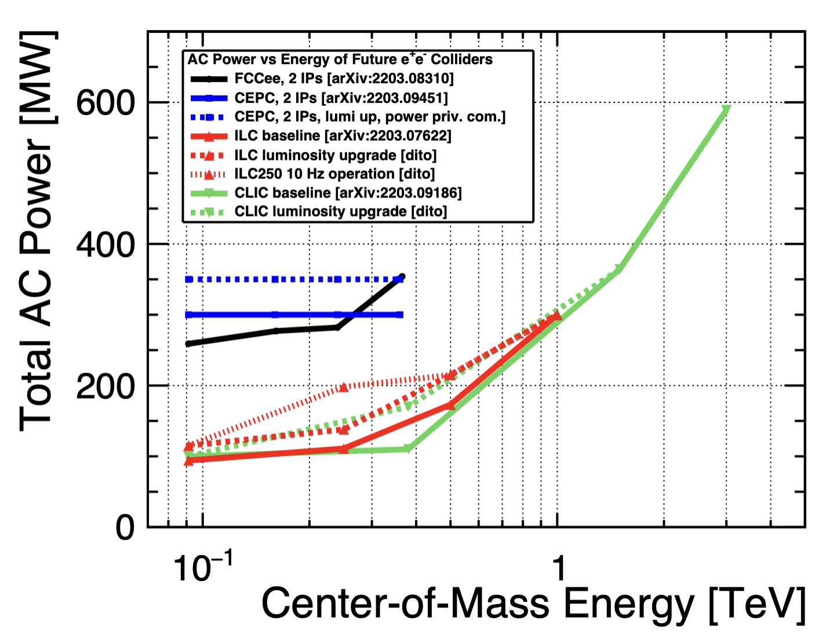
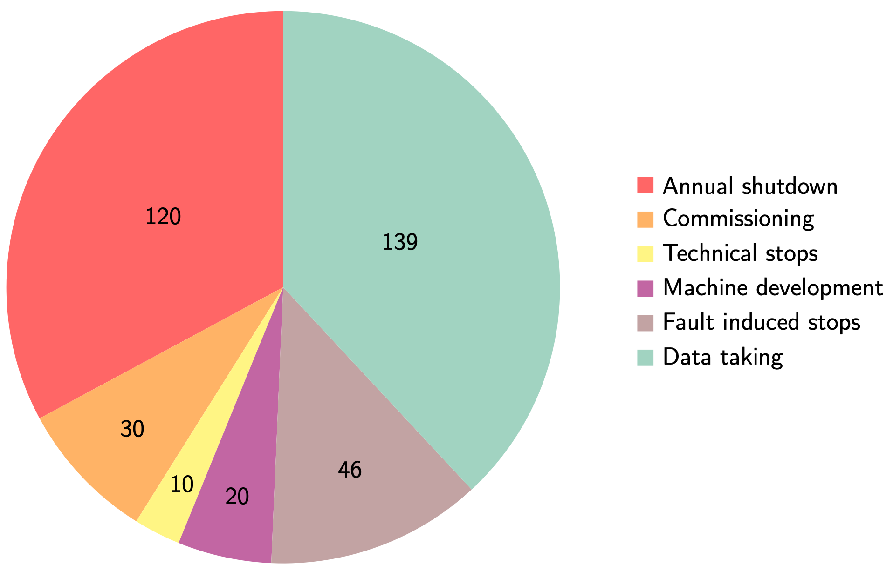
Power and Energy
Focus on CLIC (380 GeV) ← Power Estimate → ILC (250 GeV) & Lumi Upgrade
Very large reductions in power estimate (380 GeV) since the CDR: better estimates of nominal settings, much more optimised drivebeam complex and more efficient klystrons, injectors more optimized, main target damping ring RF significantly reduced, recent L-band klystron studies
1.5 TeV and 3 TeV numbers still from the CDR (but included in the reports), to be re-done the next ~2 years
Savings of high efficiency klystrons, DR RF redesign or permanent magnets not included at this stage
«Standard» LHC running scenario
With standard running scenario every 100MW corresponds to ~ 0.6 TWh (~85 MCHF) annually → CERN MTP assumes 140 MCHF/TWh beyond 2026

Slide 12


From Power and Energy Towards Addressing Sustainability
«Power, Energy & Sustainability»
Workshop in Tohoku → Fall 2023
(organized by Tohoku ILC Project Promotion Center, KEK, AAA/Japan)
ILC Energy Center (Arthistic View)

Slide 13
Green ILC and Carbon Neutrality - Regional Revitalization
CO2-neutrality by 2050 is a goal for Tohoku region → next generation town development when ILC is operational (Green ILC Concept):
  Exhaust heat recovery from the ILC and the creation of business derived from it
  Connecting the ILC with agriculture, forestry, fisheries industries to reduce CO₂ emissions and offset by increasing CO₂ absorption
  Building an energy recycling society based on the Global Village Vision
  23% regenerative electricity today – sufficient for ILC operation (ILC is < 1%)
M. Yoshioka; PASJ2020 & PASJ2022 Proceedings
Next generation town development for ILC operation
ILC Central Collision Point → Eco-Campus Concept
ILC Link with Region → Wood first, Zero emissions, …
AAA talk
@ ILCX2021
“Green ILC”: https://green-ilc.in2p3.fr/documents/

Slide 14
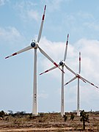
Power Modulation - Running on Renewables
Different approaches to reduce impact of large electric power consumption (single pass colliders are wel suited):
  - Reduce power (by higher efficiency)
  - Re-use waste energy (heat)
  - Modulate power according to availability (price)
  - Use regenerative power
A real implementation of renewable energy supply:
A physical power purchase agreement (PPA) is a long-term contract for the supply of electricity at a defined, fixed price at the start and then indexed every year, and a consumer for a defined period (generally 20 years). Being considered for CERN, initially at limited scale. Advantages: price, price stability, green, renewable.
Must be a goal to run future accelerator at CERN primarily on green and more renewable energy with very low carbon footprint. However, energy costs will remain a concern.
https://edms.cern.ch/document/2065162/1
FRAUNHOFER STUDY:
Supply the annual electricity demand of CLIC (380Gev) by installing local wind and PV generators (this could be e.g. achieved by 330 MW-peak PV and 220 MW-peak wind generators) at a cost of slightly more than 10% of the CLIC
Study done for 200 MW, in reality only ~110 MW are needed
Self-sufficiency during all times can not be reached but 54% of the time CLIC could run independently from public electricity supply with the portfolio simulated.
Flexibility to adjust the power demand is expected to become increasingly important and in demand by energy companies

Slide 15
Sustainable Construction: Proactivity
Operation costs dominated by energy (and personnel)
  Reducing power use, and costs of power, will be crucial → huge uncertainty in how the energy market, prices and price variations will be in ~2040 (ILC), ~2050 (CERN projects)
  Carbon footprint related to energy source, relatively low already for CERN (helped by nuclear power), expected to become significantly lower towards 2050 when future accelerators are foreseen to become operational (in Europe, US and Japan).
  Align to future energy markets, green and more renewables, make sure we can be flexible customer and deal with grid stability/quality
  Other consumables (gas, liquids, travels, computing … ) during operation need to be justified (and estimated)
For carbon the construction impact might be (more) significant (also rare earths etc) than operational footprint
  Construction: CE, materials, processing and assembly – not easy to calculate, very likely a/the dominating carbon source
  Markets will push for reduced carbon, “responsible purchasing” crucial – construction costs likely to increase
  Many other factors than a carbon life cycle assessment, rare earths, toxicity, acidity ..
  Environmental studies, integration in local environment/power grids, very important (CERN generally, Green ILC)
Decommissioning – how do we estimate impacts ?

Slide 16
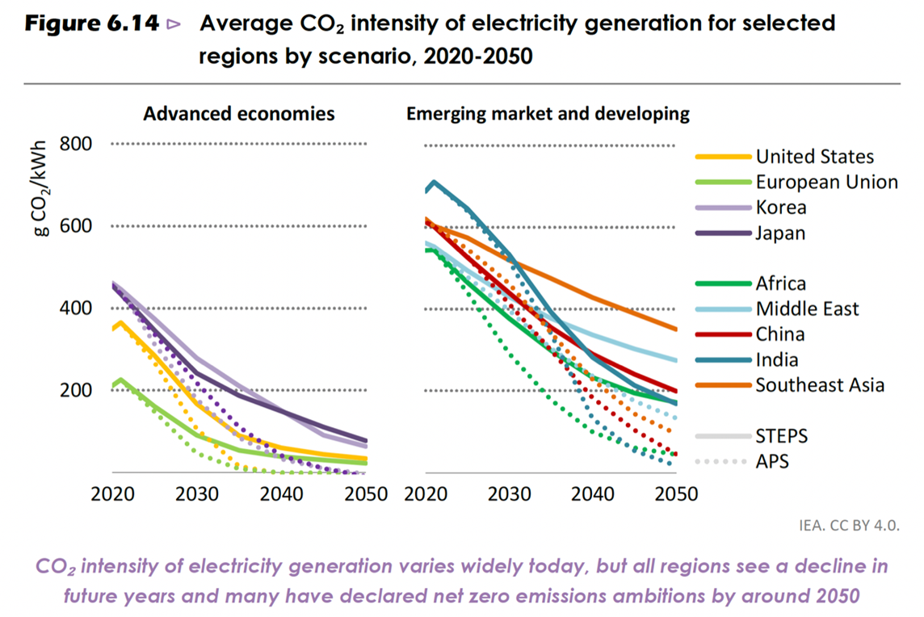
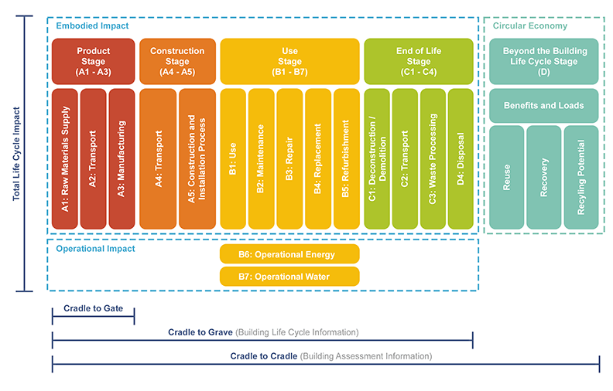
Sustainable Linear Collider Operation
Data of carbon intensity of electric power
(Nuclear energy remains very important, on the timescale of a future CERN facility):
Power Projections Europe (2040):
- 50% nuclear at 5g CO₂/kWh;
- 50% renewables at 20g CO₂/kWh
(mix sun, wind, hydro,…)
IEA (2022), World Energy Outlook 2022, IEA, Paris https://www.iea.org/reports/world-energy-outlook-2022,
License: CC BY 4.0 (report); CC BY NC SA 4.0 (Annex A)
Whole Lifecycle is Important –
Lifecyle Assessment (LCA):
Ultimate Goal:
- Quantify the environmental
impact of a whole accelerator
project, i.e., CLIC
Accepted method:
- LCA = Life Cycle Assessment
Define Scope:
- System Boundaries
- Lifecycle Stages
Lifecycle stages according to EN 15978

Slide 17
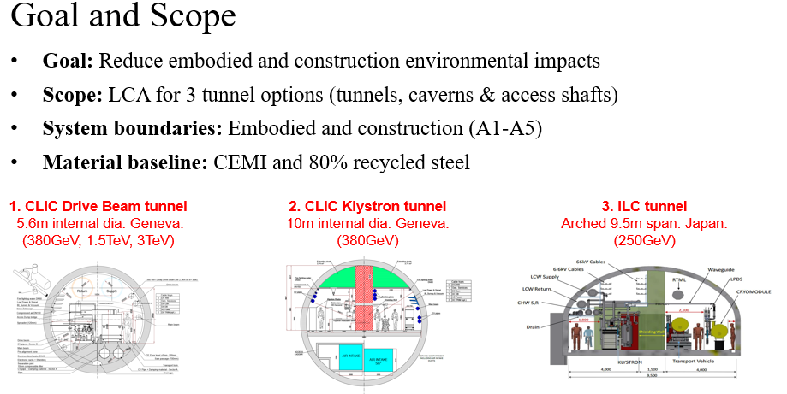
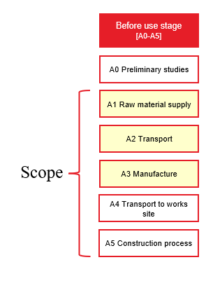
Sustainable Construction: Life-Cycle Assessment
ARUP STUDY (2023): Suzanne Evans, Ben Castle, Yung Loo, Heleni Pantelidou
CERN: John Osborne, Liam Bromiley
LCA starting point: Determine the embodied and construction environmental impact of tunnel, caverns and shafts
→ perform a LCA (Lifecycle Assessment) for the construction stage (A1-A5)
→ generate solid data as basis for optimisation
Ref: ISO 14040:2006
A1-A3
study
completed
Concrete and steel production is very carbon intensive
Typical concrete grade in construction is CEM1
Typical EU steel is 80% recycled
Current progress on the study assesses the A1 – A3 phases of construction
A4 - A5
to be done

Slide 18
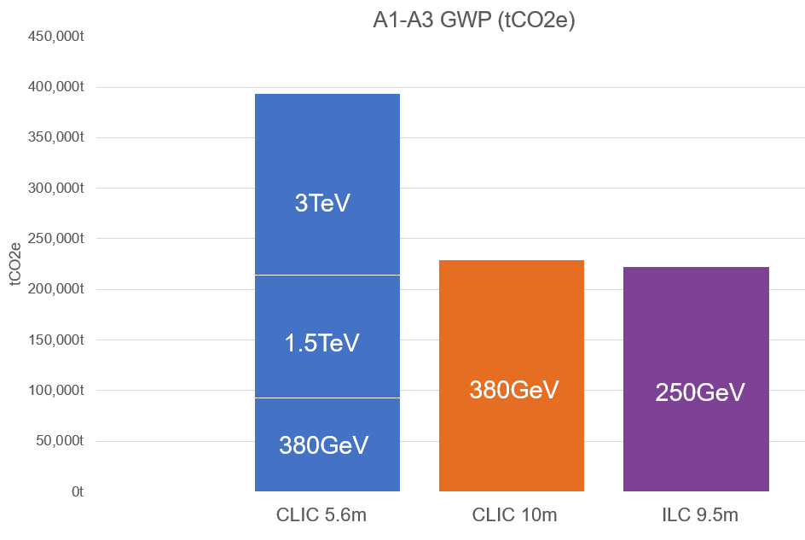
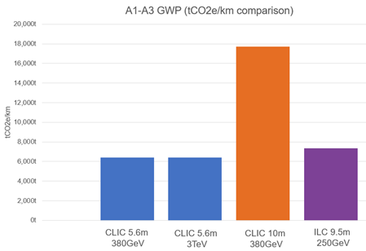
Sustainable Construction: Life-Cycle Assessment
ARUP STUDY (2023): Suzanne Evans, Ben Castle, Yung Loo, Heleni Pantelidou
CERN: John Osborne, Liam Bromiley
Comparative environmental footprint for future linear colliders CLIC & ILC
CLIC (3TeV) - highest total CO₂ due to 50 km length
Assuming a small CLIC tunnel (~5.6m diameter) and that the equipment has the same carbon footprint as the tunnel itself,
20 km accelerator (tunnel plus components) correspond to 240 kton CO₂ equivalent
CLIC (10m dia. Klystron) - highest CO₂ footprint due
to largest cross section and concrete shielding wall
The embedded carbon due to civil engineering work and material (concrete for example) is a very important contribution, on a level comparable to many years of carbon emission due to energy use during the operational phase

Slide 19
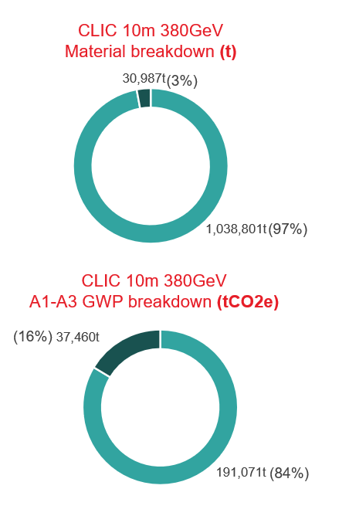
Sustainable Construction: Life-Cycle Assessment
ARUP STUDY (2023): Suzanne Evans, Ben Castle, Yung Loo, Heleni Pantelidou
CERN: John Osborne, Liam Bromiley
Steel only 3% of total mass, but 16% of total embodied CO₂
CO₂ reduction opportunities
Lower CO₂ concrete mixes
Optimising concrete volume by reducing structural thicknesses
Partial replacement of concrete shielding wall with compacted excavated material
If we have energy available at 12.5 g CO₂ /kWh = 12.5 kton CO₂/TWh (not unlikely in 2050) this corresponds to:
20km accelerator construction ~ 20 years of operation.
1 km accelerator construction ~ 1 TWh annual electricity
(annual LC operation 0.6 TWh)
Many caveats, first of all this is a very first indication of the scale:
many more components in tunnel (also infrastructure), injectors, shafts, detectors, construction, spoils, etc …
upgrades and decommissioning, this is not only an initial important contribution
improvement and optimisations (e.g. less and/or better concrete mixes, support structures, steel in tunnels)
responsible purchasing (understanding the impact of supply chain, costs and potential for changes – will be essential for future projects – CERN implementation information from E. Cennini)

Slide 20


LCWS2023 @SLAC: International Workshop on
Future Linear Colliders (May 15-19, 2023)
INDUSTRY PLENARY SESSION:
SUSTAINABILITY PLENARY SESSION:
https://indico.slac.stanford.edu/event/7467/sessions/441/#20230516
https://indico.slac.stanford.edu/event/7467/sessions/443/#20230516
Introduction to Industry/Sustainability Session
Japan - AAA activity - Takahashi Tohru (Hiroshima Univ./AAA, Japan)
US Office of accelerator R&D and Production (ARDAP) – Ginsburg Camille (Deputy Director of ARDAP, USA)
Advances in Spanish Science Industry – Fernandez Erik (INEUSTAR, Spain)
Development of C-band RF infrastructure and initial experiments at RadiaBeam – Alex Murokh (Radiabeam, USA)
Experience in participating in the development of an electron-driven positron source as a company in the Tohoku region - KONDO, Masahiko (Kondo Equipment Corporation, Japan)
Development of Nb3Sn SRF cavity using electroplating method - TAKAHASHI, Ryo (Akita Chemical Industry Co., Ltd, Japan)
Sustainability Studies for Future Linear Collider – Benno List (DESY, Germany)
LC related high efficiency RF systems, status and prospects – Syratchev Igor (CERN)
LC Carbon Assessments: A Life Cycle Assessment of the CLIC and ILC Linear Collider Feasibility Studies – Suzanne Evans (ARUP)
Green ILC Concept – Yoshioka Masakazu (Iwate University/KEK, Japan)
Permanent magnet technology for sustainable accelerators – Shepherd Ben (STFC, UK)
IHEP high efficiency, high power klystron development - Zusheng Zhou (IHEP, China)
Basic research using synchrotron radiation and commercialization of waste heat recovery technology from ILC - Mitoya Goh (Higashi Nihon Kidenkaihatsu Co., Ltd., Japan)
Town planning in the vicinity of ILC candidate site as a regional company - Kondo Masahiko (Kondo Equipment Corporation, Japan)

Slide 21
Summary and Outlook
Power efficiency, energy consumption and also carbon emission and other sustainability targets are today important drivers of accelerator development and R&D:
- Related to designs, new concepts and many technical developments
- Very large synergy across the entire field of accelerator science (small and large installations)
- Funding in many cases “encourages” this R&D
Optimisation of subsystems and components for energy efficiency, e.g.:
- Better accelerator cavities (optimize design for more gradient, reduced losses, etc …)
- Efficient klystrons
- Permanent magnets
Important to be pro-active, anticipating the changes happening in the energy markets and society with respect to sustainability driven changes:
- Power, energy efficiency at all levels
- Adapting to and using more renewables (increased availability of it, can be increased by
contracts)
- Reducing carbon in construction from civil engineering to technical components
- Making use of materials, technologies and working with suppliers that are invested in these
changes
- Integration in/with local areas, their infrastructure and development plans (e.g. Green ILC)

