Slide 1
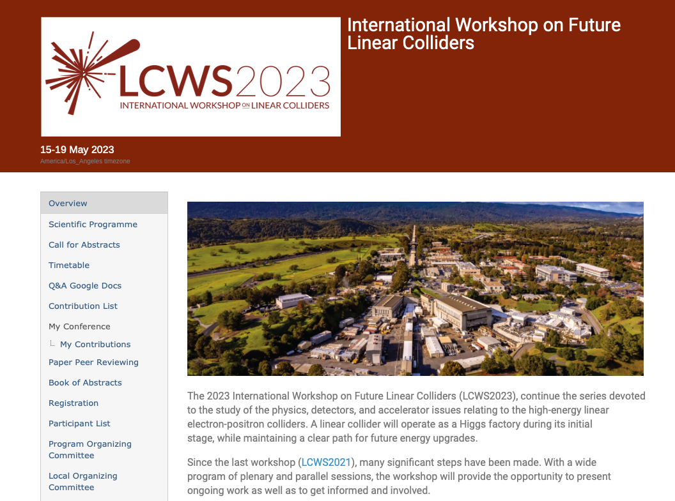
Nice to meet again in person
California has sorted out its weather and increased prices
Good attendance, many new faces, in particular due to Snowmass and C3. HALFV has also given plasma community a boost.
ILC:
First meeting in person (mostly) of IDT, WG2 and WG3?
Plenary ITN, ILC and IDT presentations, many topical presentations related to ITN, see next slide
WG3 activity comments?
Sustainability a key focus of discussion
Carbon estimates for construction becoming much more solid
Statement provided a good focusing point for discussions – result ~ok (personal opinion), ILC mature and a priority, other technologies encouraged including for possible upgrades, mentioning hosting outside Japan

Slide 2
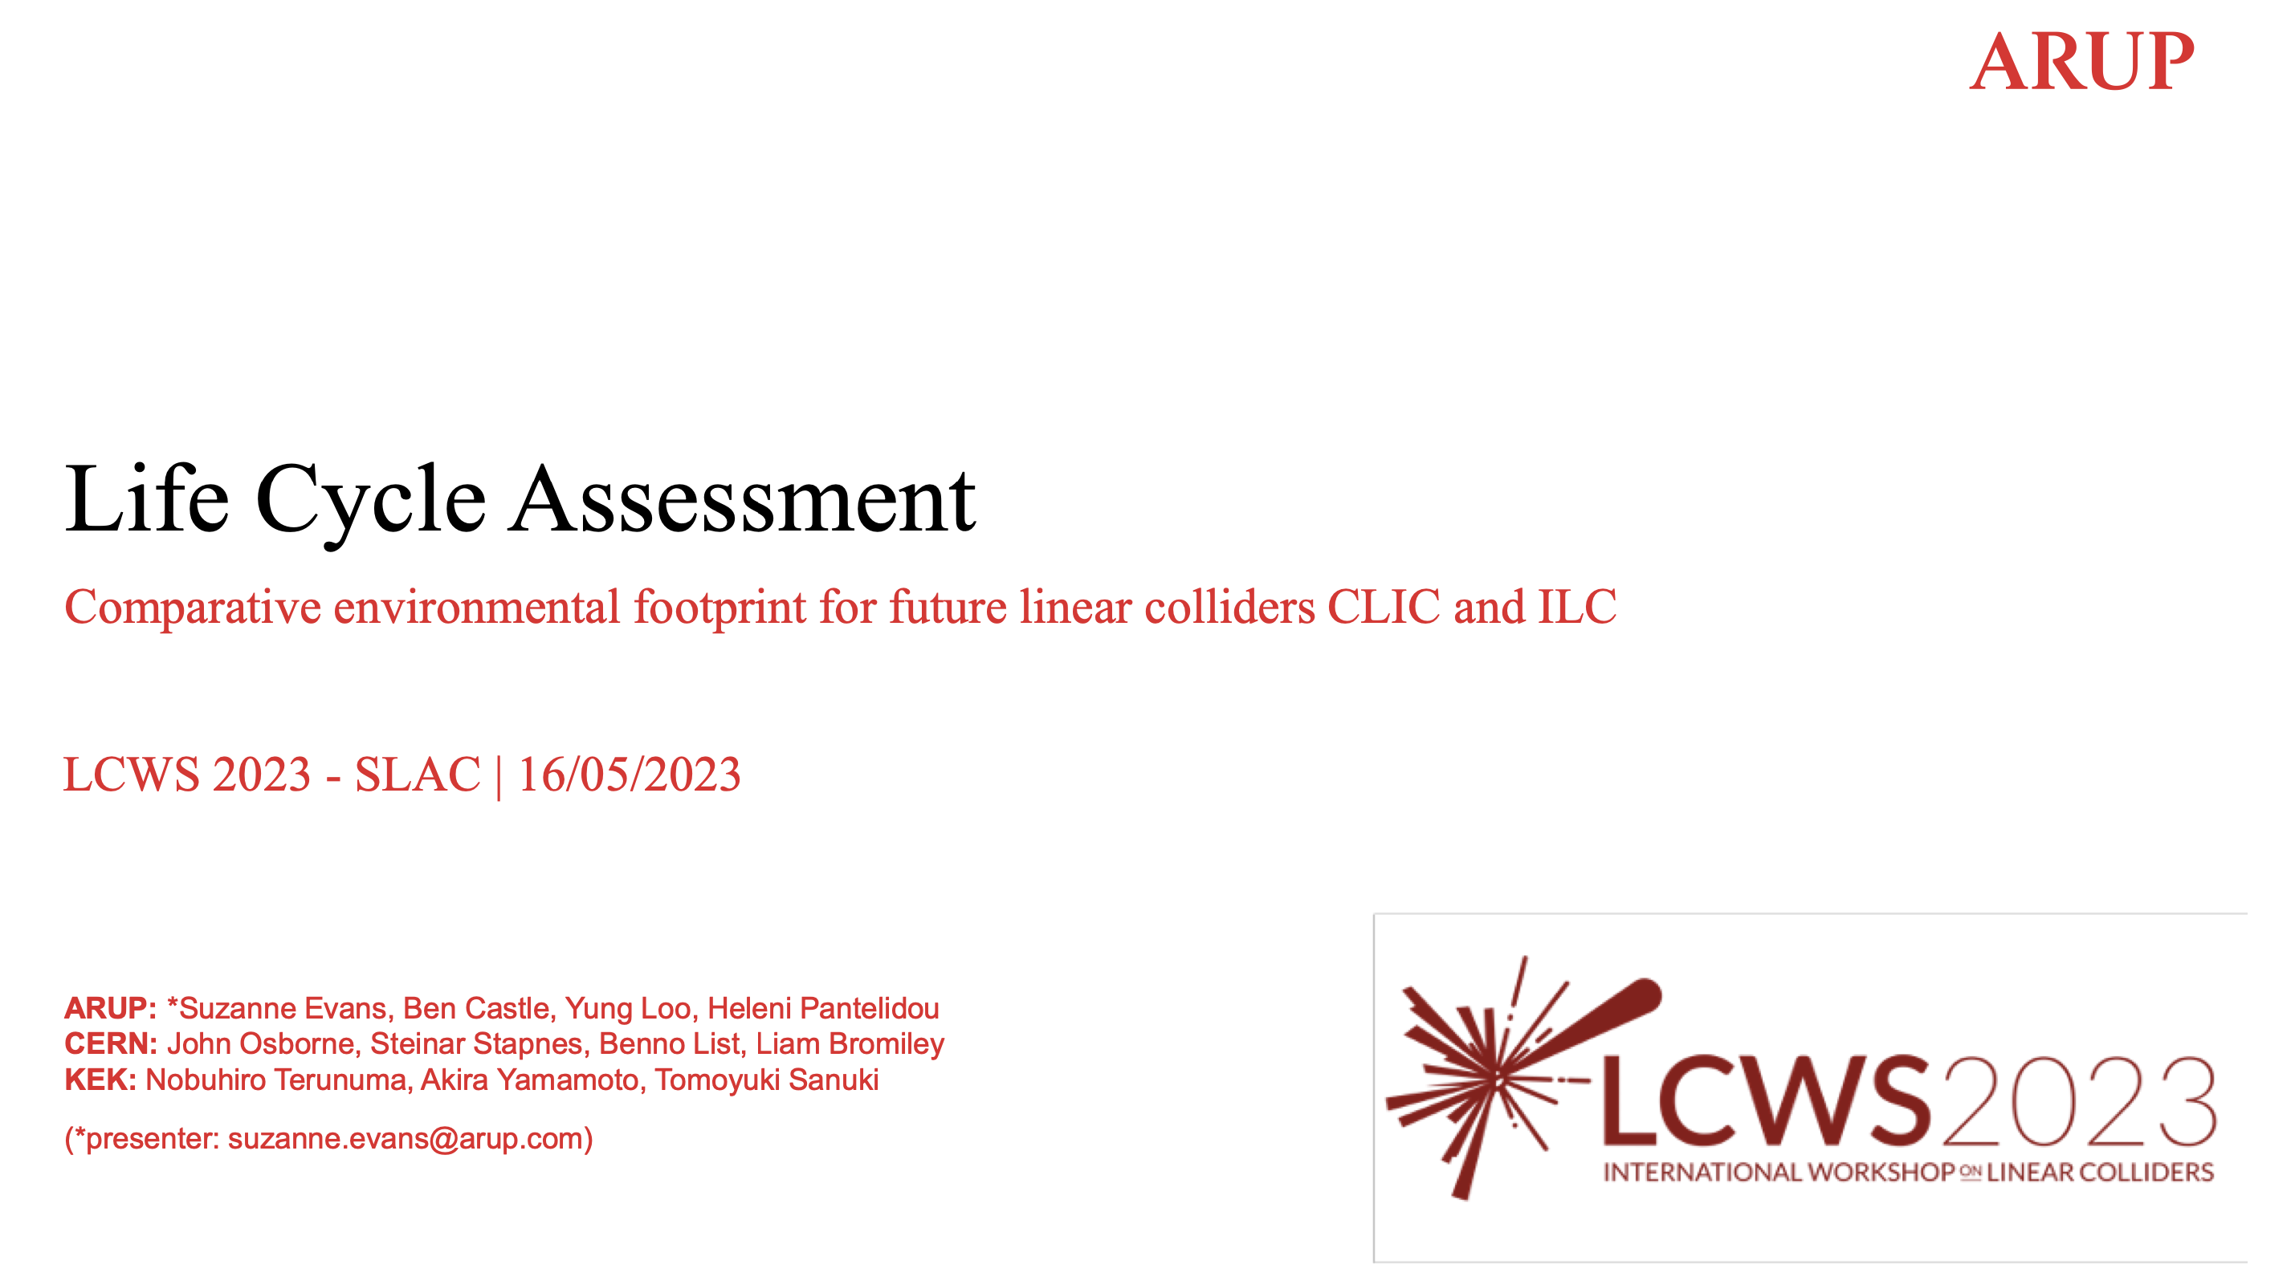
Tunnel construction (ILC and CLIC DB dimensions) is around 6kton/km
Add shafts, caverns , access tunnels, DR, etc – vary from 30 to 80%
Add transports, power used in construction, etc – 25%
= > ILC (20km) around 270 kton, CLIC (11 km) around 125 kton
Possible savings (but at a cost to be defined) of ~40%
Adding accelerator components (another 50%?)
Operation (in 2040-50)
Nuclear 5g/kWh
Renewables (sun/wind/hydro) 20g/kWh
Can be higher with poor energy mix, can be lower with good contracting (good mix)
Assume 50/50 mix => 1 TWh is 12.5 kton
Energy use estimated for LCs 0.6-0.8 TWh annually
Construction in the 2030’ies the most (time)critical carbon emission to address
Provides us with handles for optimisation
https://indico.slac.stanford.edu/event/7467/contributions/5902/attachments/2851/7968/ARUP_CERN_LCA_LCWS_-_2023.pdf

Slide 3
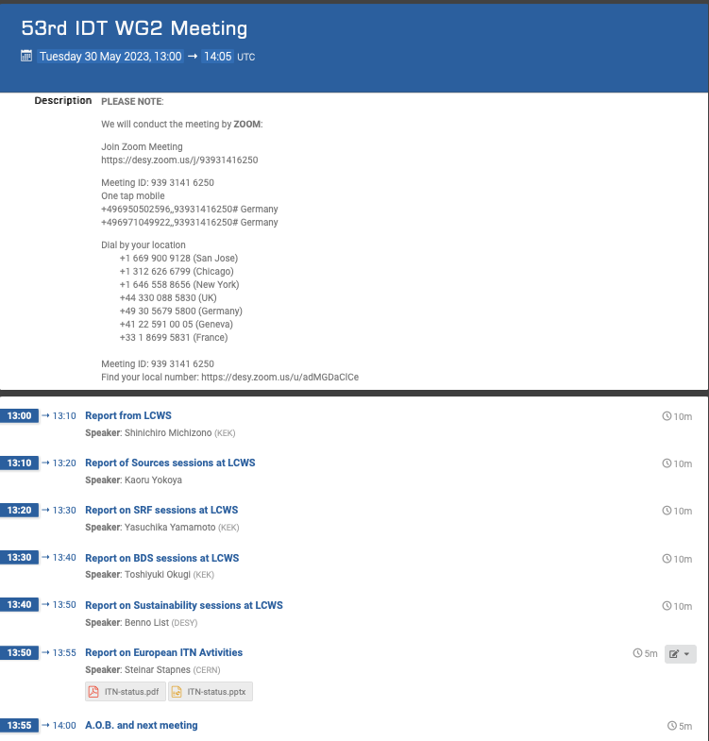
Please see much comprehensive summaries of the LCWS from the ILC WG2 point of view:
https://agenda.linearcollider.org/event/10043/

Slide 4
The European ITN activities – end May 2023
Personnel with interest and skills in European labs/Univ., local infrastructure.
See text left
Material funds as estimated (major/core part from KEK), in some cases complemented by local funding.
Agreement in final draft, KEK board discussion Friday
EAJADE, MC exchange project supporting Higgs factory personnel exchange to Japan and the US.
Started 1.3.2023
CERN LC, project office (within existing LC resources at CERN).
LC budget line in MTP until end 2028
European ITN studies are distributed on five main activity areas:
A1 with three SC RF related tasks
SRF: Cavities, Module – CEA/INFN/KEK: materials and single cell cavities
Crab-cavities – UK/CERN: programme after down-select to be discussed
A2 Sources
Pulsed magnet to production drawing level - Univ. Hamburg, DESY
Wheel/target: need to discuss more widely scope and plans (Europe and US)
A3 Damping Ring including kickers
Low Emittance Ring community – not yet addressed
A4 ATF activities for final focus and nanobeams
Many European groups very active in ATF – UK, France, Spain, DESY, CERN, Friday operation meetings restarted.
A5 Implementation including Project Office
Dump, CE, Cryo, Sustainability, MDI, others (many of these are continuations of on-going collaborative activities) – e.g. Spain/KEK: ML quads and cold BPMs (own funding), EAJADE started (EU funding), sustainability studies also (e.g. ARUP report) (CERN LC funding), etc
EAJADE: Information at LINK

Slide 5
Successful LCWS 2023, next year in Asia (Japan?)
ITN moving, also in Europe, need to continue and come back to searching external resources in Europe. Many practical hurdles ahead .. contracts, orders
Carbon studies maturing (LC studies leading this effort)
US efforts under discussion (P5 on-going)
Need to build stronger case for ILC serving a wide community
(LCs/diversity programme/R&D on acc.&detectors)

