Slide 1
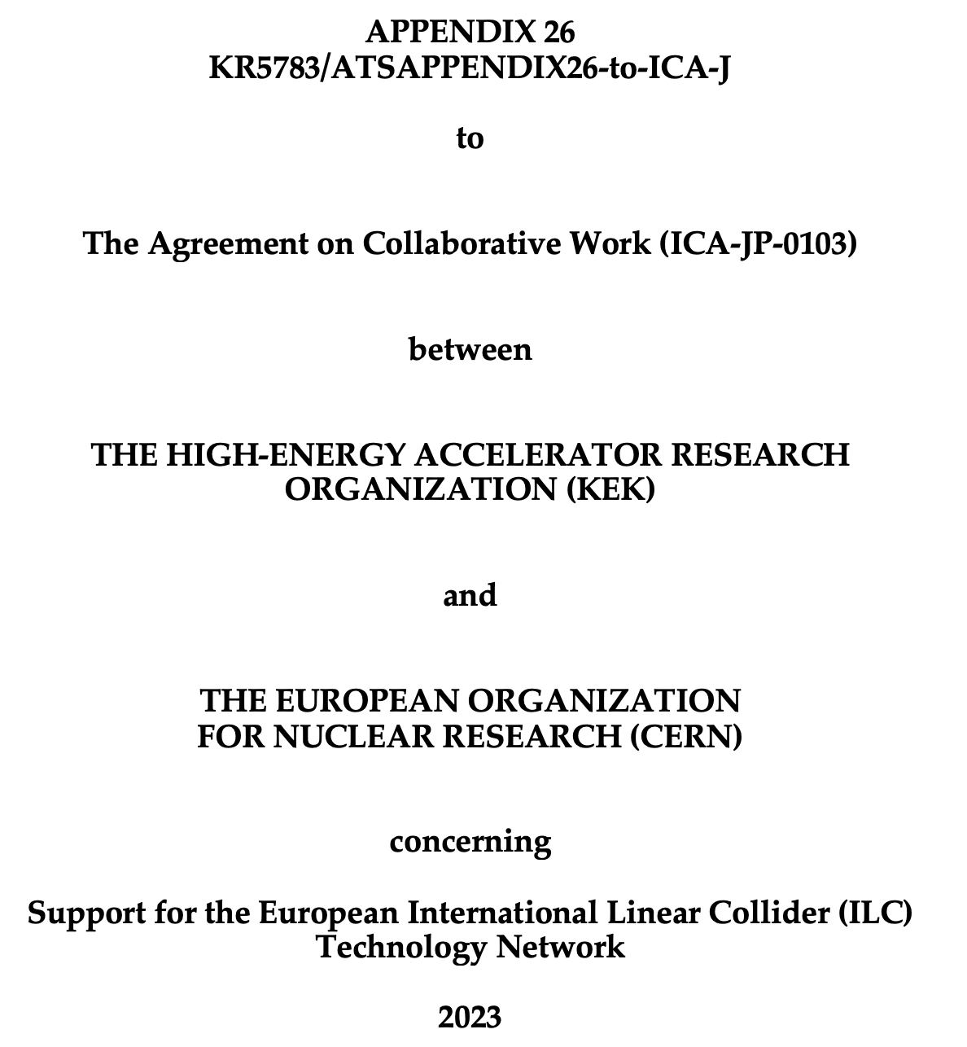
Being signed this week

Slide 2
The European ITN activities – July 2023
Personnel with interest and skills in European labs/Univ., local infrastructure.
See text left
Material funds as estimated (major/core part from KEK), in some cases complemented by local funding.
Agreement in final draft, KEK board discussion Friday
EAJADE, MC exchange project supporting Higgs factory personnel exchange to Japan and the US.
Started 1.3.2023
CERN LC, project office (within existing LC resources at CERN).
LC budget line in MTP until end 2028
European ITN studies are distributed on five main activity areas:
A1 with three SC RF related tasks
SRF: Cavities, and CM
Crab-cavities
In addition ML elements: ML quads and cold BPMs
A2 Sources
Pulsed magnet
Wheel/target
A3 Damping Ring including kickers
Low Emittance Ring lab
A4 ATF activities for final focus and nanobeams
A5 Implementation including Project Office
Dump, CE, Cryo – earlier efforts at CERN, possible visitor from KEK to CERN
Sustainability
EAJADE started (EU funding)
EAJADE: Information at LINK

