Slide 1

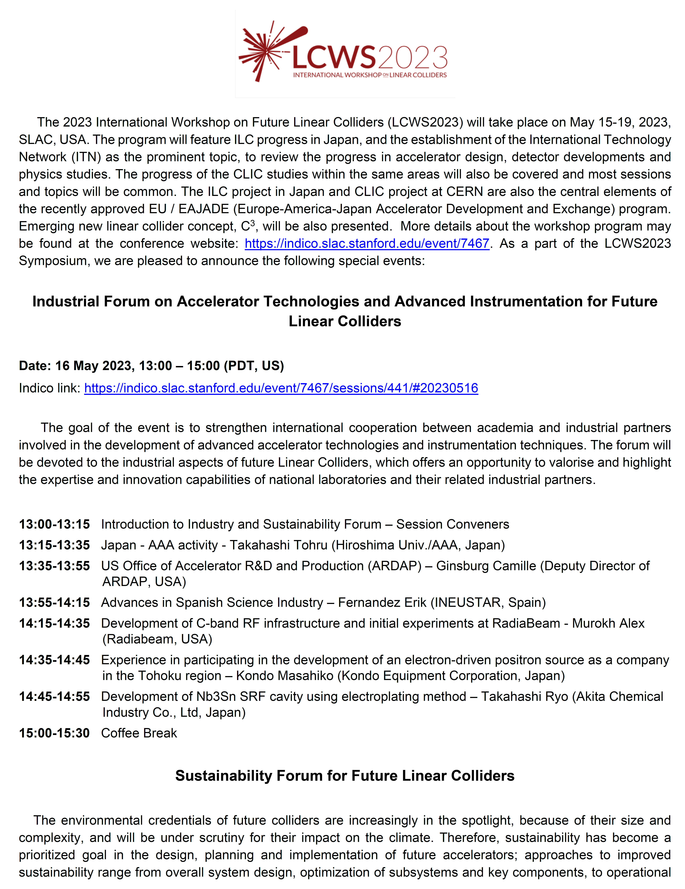
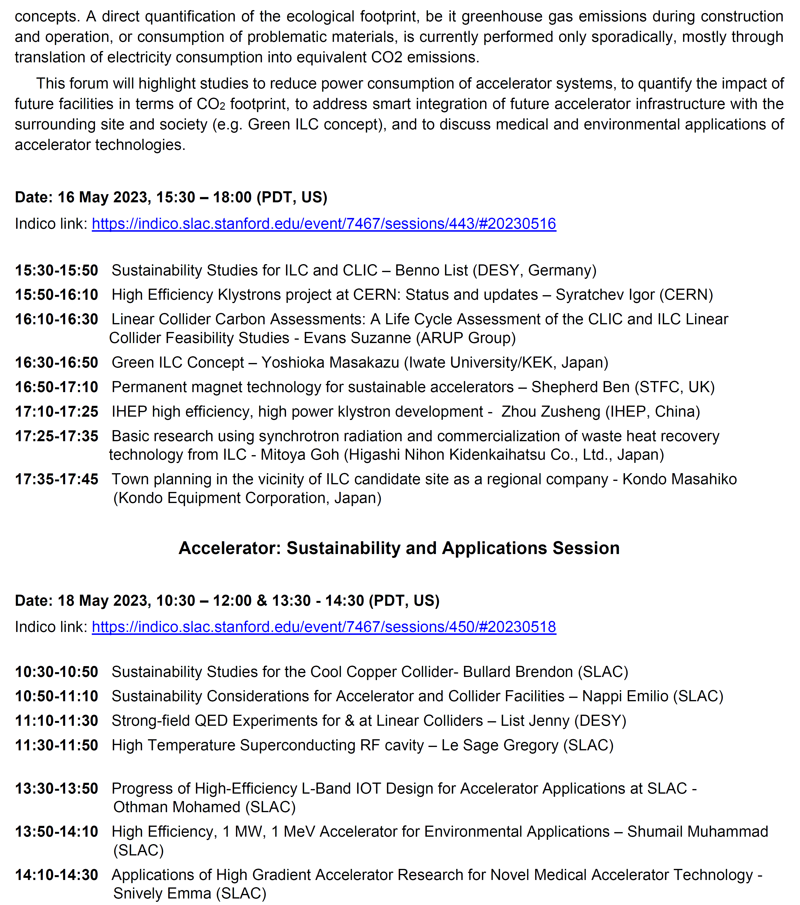
LCWS2023 @SLAC: International Workshop on
Future Linear Colliders (May 15-19, 2023)

Slide 2
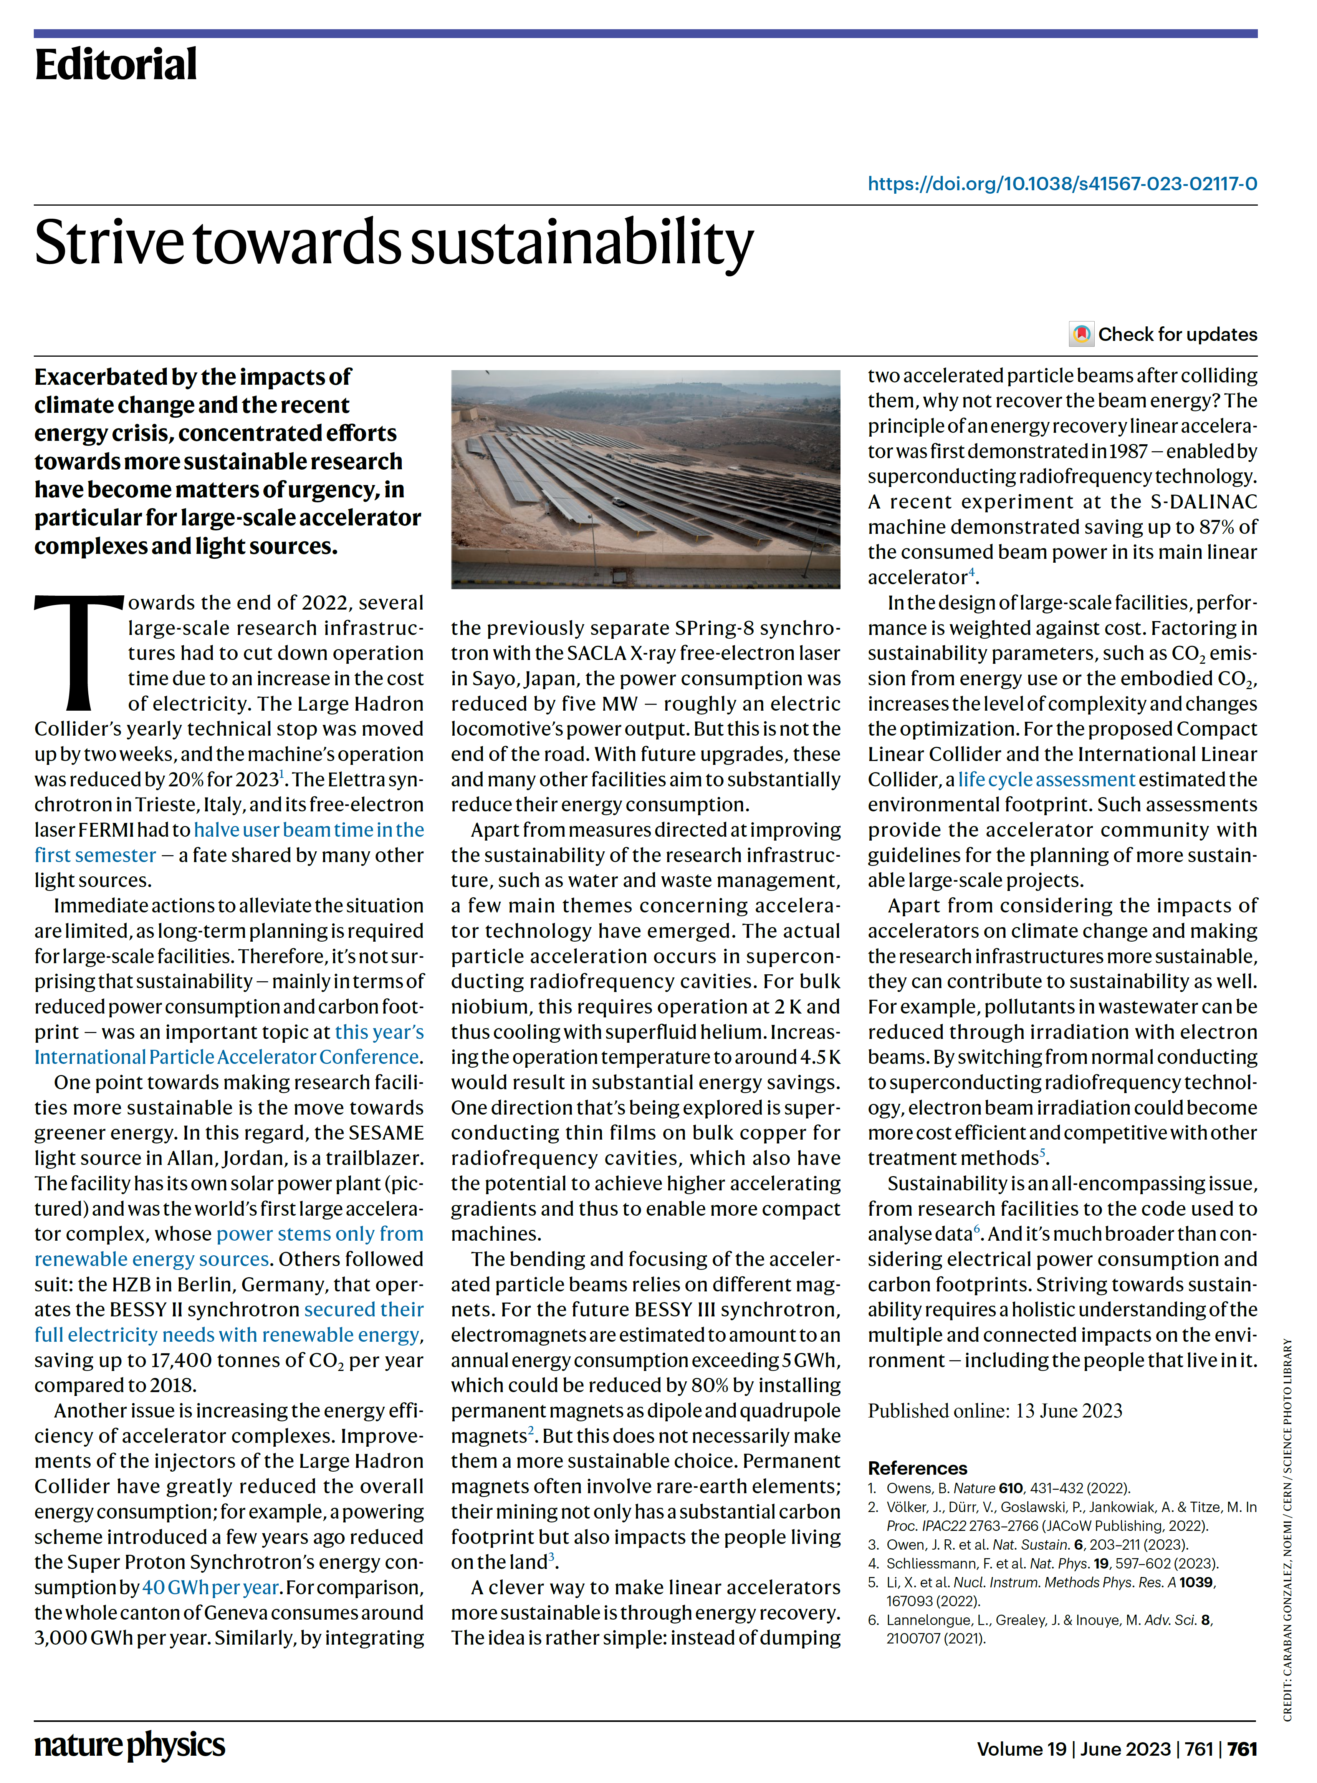
LCWS2023 @SLAC: International Workshop on
Future Linear Colliders (May 15-19, 2023)
Nat. Phys. 19, 761 (2023).
https://doi.org/10.1038/s41567-023-02117-0
In the design of large-scale facilities, performance is weighted against cost. Factoring in sustainability parameters, such as CO2 emission from energy use or the embodied CO2, increases the level of complexity and changes the optimization. For the proposed Compact Linear Collider and the International Linear Collider, a life cycle assessment estimated the environmental footprint. Such assessments provide the accelerator community with guidelines for the planning of more sustainable large-scale projects.

Slide 3
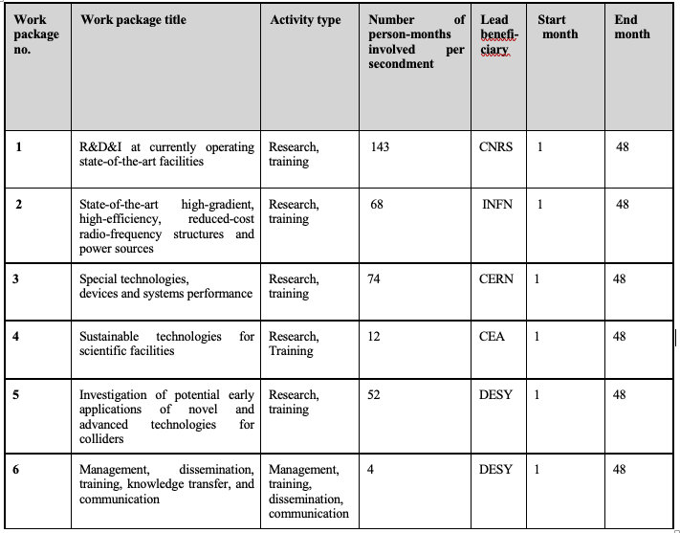

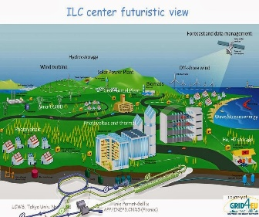
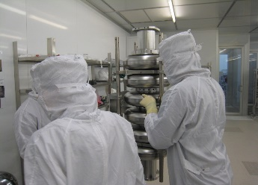
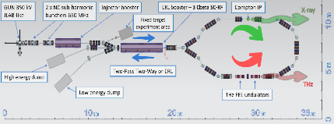
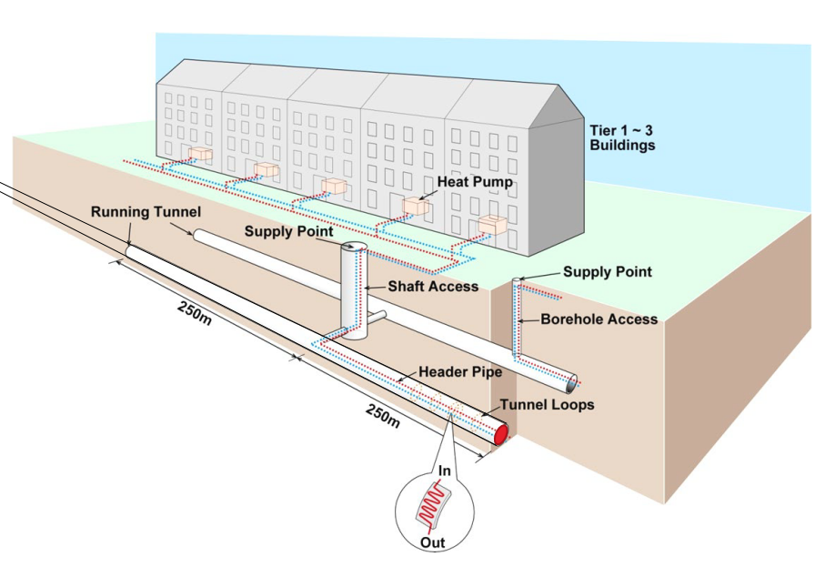
Europe – America – Japan (EAJADE) Program (2023-2027)
European Union’s Horizon Europe Marie Sklodowska-Curie Staff Exchanges programme under grant agreement no. 101086276
http://www.eajade.eu/
WP4: Sustainable Technologies
for Scientific Facilities
Task 4.6: “Green ILC”
Task 4.1: High Efficiency & Sustainable SC cavities
WP4
Task 4.5: Smart Tunneling
Task 4.2: High efficiency RF power amplifiers
Task 4.3: Energy Recovery Linacs
Task 4.4: Power Modulation

Slide 4


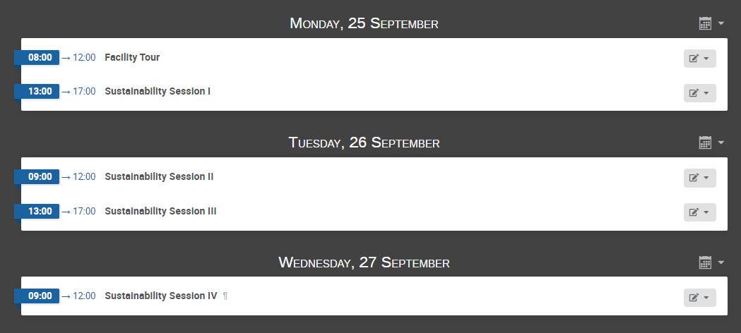
EAJADE Workshop on Sustainability in Future Accelerators (WSFA2023)
MORIOKA, JAPAN, SEPTEMBER 25-27, 2023
Alina Center, the same venue as LCWS2016, hosted by Iwate University
All sustainability aspects:
Power, Energy & Green ILC / ESS
International Program Committee:
Phil Burrows (University of Oxford, UK)
Benno List (DESY Hamburg, Germany)
Shin Michizono (KEK, Japan)
Takayuki Saeki (KEK, Japan)
Tomoyuki Sanuki (Tohoku University, Japan)
Steinar Stapnes (CERN, Switzerland)
Thomas Schoerner-Sadenius (DESY Hamburg, Germany)
Nobuhiro Terunuma (KEK, Japan)
Maxim Titov (CEA Saclay / IRFU, France)
Marc Winter (IJCLab, France)
Masakazu Yoshioka (Iwate University, Japan)
ILC Energy Center (Arthistic View)
https://indico.desy.de/event/39980/
Local Organizing Committee:
Satomi Fujisaki (Iwate University, Japan)
Kiyotomo Kawagoe (Kyushu University, Japan)
Masao Kuriki (Hiroshima University, Japan)
Shinya Narita (Iwate University, Japan) – Chair
Aiko Shoji (Iwate University, Japan)
Tohru Takahashi (Hiroshima University, Japan)
Tohru Takeshita (Shinshu University, Japan)
Satoru Yamashita (Iwate Pref.l University, Japan)

