Slide 1

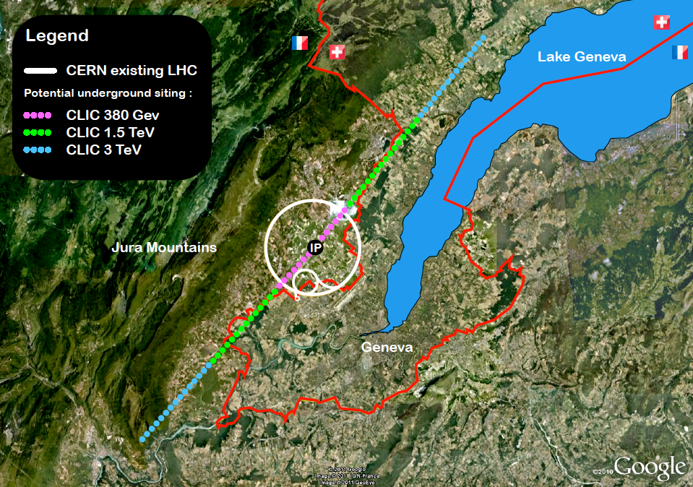


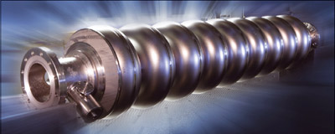
Status and Future programme for LC studies at ATF2-3
3
A. Faus-Golfe on behalf ATF collaboration
Notes:
On behalf of the ATF collaboration

Slide 2
ATF3 objectives and collaboration:
Based on the achievements of the ATF2 no showstopper for ILC has been found, ATF3 plan is to pursue the necessary R&D to maximize the luminosity potential of ILC. In particular the assessment of the ILC FFS system design from the point of view of the beam dynamics aspects and the technological/hardware choices and the long-term stability operation issues.
3
Long Term stability
Instrumentation R&D
High-order aberrations
Collimator
Incoherent Diffraction Cherenkov Radiation Monitor
Ultra-low β* studies
Intensity dependence studies
Energy bandwidth
Waveguide BPM
Notes:
Based on this achievements and with the support of the KEK DG we have started to plan the next operation years of ATF2 and the future ATF3.
The main objective of the ATF3 is to deep in the understanding of the luminosity optimization of the ILC.
In particular the system design and hardware and the long term stability operation issues.

Slide 3
ILC – IDT WP15 System Design of ILC FFS
Time critical WPs relevant for ATF
WP15 Tasks : Maximize Luminosity potential of ILC
T1: ILC-FFS system design | T1.1: Hardware optimization
 | T1.2: Realistic beam line driven / IP design
T2: ILC-FFS beam tests | T2.1: Long-Term stability
 | T2.2: High-order aberrations
 | T2.3: R&D complementary studies
Long Term stability
High-order aberrations
Instrumentation R&D
Collimator
Incoherent Diffraction Cherenkov Radiation Monitor
Ultra-low β* studies
Intensity dependence studies
Energy bandwidth
Waveguide BPM
Notes:
More in detail for WP15:
The main objective of the ATF3 is to maximize the luminosity potential of ILC.
Two task has been identified:
- The system design of beam optics and hardware for the ILC FFS based on established technologies
- The necessary beam experiments to solve the long term stability operation issues, the deep understanding of the high-order aberration's and the R&D on complementary studies as beam instrumentation or other as collimation, kicker technologies....

Slide 4
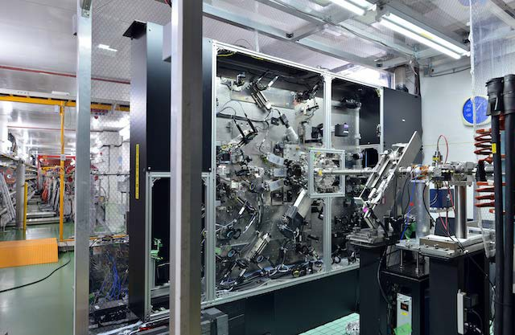
T1.1: ATF2-3 Hardware upgrades
CBPMs:
Re-installation of all CBPMs (current #24, all #32)
Add separate fast small movers for centering and position calibration, including mechanical study, specs (~10kg load and um resolution, prioritize high-β regions)
Electronics: analogue electronics reliable but spares needed
Digitizers: 20-year old model, higher resolution ADCs would increase the dynamic range.
Vacuum Chambers (ID beam 24 mm):
Bellows shielding
Clamp Flanges (ATF-DR type)
Cavity BPM tapering (ID 20 mm)
Stripline BPMs
Dipole chamber (box type replaced by simple pipe)
Septum chambers (A, B, C)
FONT stripline kicker
Pumping port chamber (ID 24 mm)
New Magnets
FD: QD0, QF1, SD0, SD1
Skew sextupoles including movers
Septum C (standard dipole)
ZVOX vertical corrector (between septum B and C)
IP-BSM Laser:
Nd:YAG laser replacement choice, new laser parameters
Start LTL, FF-IP simulation study
Start laser stability study (energy, pointing, mode, and fringe pattern)
e-beam arrival and timing jitter
IP-BPMs
Re-design towards sub-10 nm, wide dynamic range and linearity (new electronics/digitizers)
Multi-OTR system
Focusing motor, Filter actuator, CDD cameras
XPS with oriented motor
FD vibration girder
Girder for all the final elements coupled with a global positioning system
IPBSM (nanometer beam size monitor)
FONT IP feedback
Font kicker to improve wakefields
Notes:
Given this facts we have identified the most important changes to be made are:
..
- Upgrade of IP-BSM
Standardization of the vacuum chamber
New magnets
CBPMs:
Re-installation of all CBPMs (current #24, all #32)
Add separate fast small movers for centering and position calibration
- this action requires a mechanical study given the fact that BPMs are brazed to the beam pipe inside quads.
- movers relatively low spec (~10kg load and um resolution, prioritise high beta regions)
Centering would reduce the wakefield contribution.
Need better mover cost/FTE/duration estimates.
Electronics: analogue electronics reliable, but may need more spares if CBPMs are re-installed – AL to contact SLAC
Digitizers: 20-year old model, higher resolution ADCs would increase the dynamic range.
Need cost and duration estimates.

Slide 5
T1.1: ATF2-3 Hardware upgrades
CBPMs:
Re-installation of all CBPMs (current #24, all #32)
Add separate fast small movers for centering and position calibration, including mechanical study, specs (~10kg load and um resolution, prioritize high-β regions)
Electronics: analogue electronics reliable but spares needed
Digitizers: 20-year old model, higher resolution ADCs would increase the dynamic range.
Vacuum Chambers (ID beam 24 mm):
Bellows shielding
Clamp Flanges (ATF-DR type)
Cavity BPM tapering (ID 20 mm)
Stripline BPMs
Dipole chamber (box type replaced by simple pipe)
Septum chambers (A, B, C)
FONT stripline kicker
Pumping port chamber (ID 24 mm)
Major hardware ATF issues were identified in the ATF2 review. ATF2 beam line upgrade will be done in the framework of the new R&D MEXT grant starting in April 2023 and continue for 5 years.
Priority has been established, starting with IP-BSM, magnets and beam pipes.
New Magnets
FD: QD0, QF1, SD0, SD1
Skew sextupoles including movers
Septum C (standard dipole)
ZVOX vertical corrector (between septum B and C)
IP-BSM Laser:
Nd:YAG laser replacement choice, new laser parameters
Start LTL, FF-IP simulation study
Start laser stability study (energy, pointing, mode, and fringe pattern)
e-beam arrival and timing jitter
IP-BPMs
Re-design towards sub-10 nm, wide dynamic range and linearity (new electronics/digitizers)
Multi-OTR system
Focusing motor, Filter actuator, CDD cameras
XPS with oriented motor
FD vibration girder
Girder for all the final elements coupled with a global positioning system
IPBSM (nanometer beam size monitor)
FONT IP feedback
Font kicker to improve wakefields
Notes:
Given this facts we have identified the most important changes to be made are:
..
Standardization of the vacuum chamber
New magnets
CBPMs:
Re-installation of all CBPMs (current #24, all #32)
Add separate fast small movers for centering and position calibration
- this action requires a mechanical study given the fact that BPMs are brazed to the beam pipe inside quads.
- movers relatively low spec (~10kg load and um resolution, prioritise high beta regions)
Centering would reduce the wakefield contribution.
Need better mover cost/FTE/duration estimates.
Electronics: analogue electronics reliable, but may need more spares if CBPMs are re-installed – AL to contact SLAC
Digitizers: 20-year old model, higher resolution ADCs would increase the dynamic range.
Need cost and duration estimates.

Slide 6
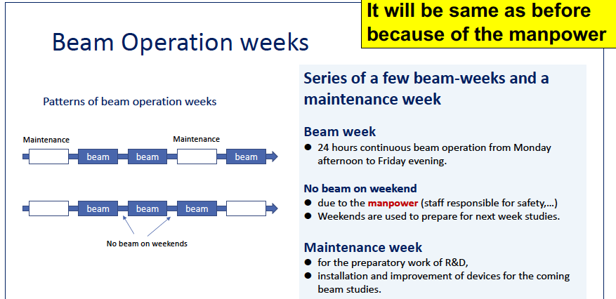
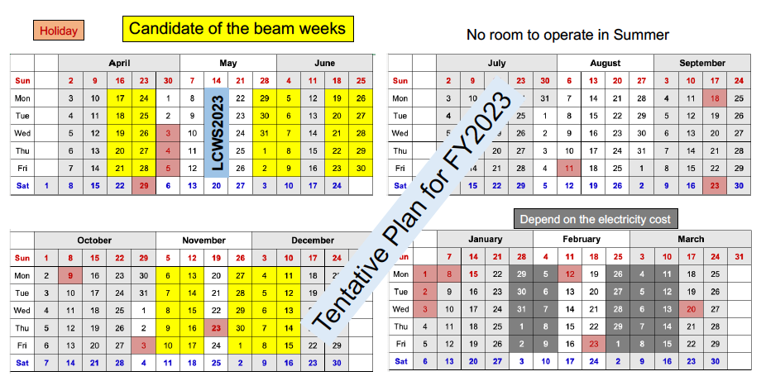
T2: ATF3 operational plan FY2023
The grant for ILC related R&D will begin early FY2023 and will continue for 5-years. For ATF, this grant will support the equipment for ATF2 upgrade and workers contracting. However, it should not pay for the electricity operation of ATF.
Based on the current electricity budget estimation, the operation of ATF will be about 10 weeks in FY2023.
The electricity cost is high and more than double that of previous years. We expect it will continue for a first half of FY2023.
Plan for a 10-week beam operation by the end of December 2023, depending on the supplementary budget ( as in FY2022) or cost of electricity is eased in some extent we will plan for January 2024
Notes:
Proposal: Apr-Jun (5~6weeks), Oct-Dec (5weeks), and Jan-Mar (?weeks) if available

Slide 7
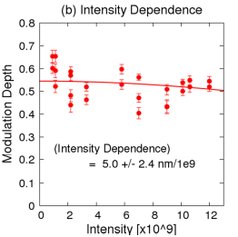
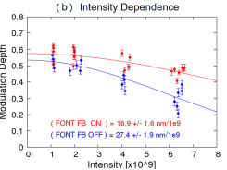
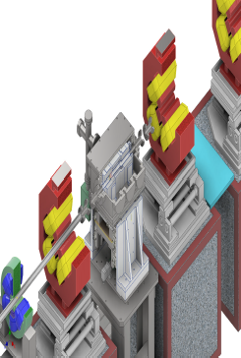
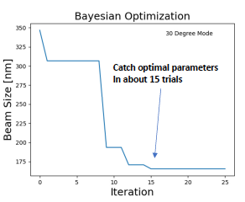
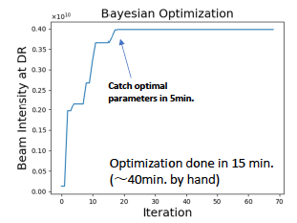
T2: ATF2 recent experimental studies
without the participation of the overseas collaborators
Wakefield mitigation (new wakefield test station)
  Static: mitigation by relocating the sources in lower β-positions
  Dynamic: FONT feedback
High-order aberration correction and mitigation
  Measurement of FF quads mutipoles
  Impact of tilt scan
  Ultra low-β studies
ILC beam tuning (ML)
  Automatic beam tuning
    Minimize the tuning parameters
    Simultaneous optimization
  Beam optimization
    “Black-box”
    Bayesian optimization
Static and dynamic wakefield sources compensation
FF nano-beam tuning
Linac transport to DR
Notes:
Since the pandemics and without the participation of the overseas collaborators ATF2 has continued some of the studies with the help of KEK doctoral students an postdoc.

Slide 8


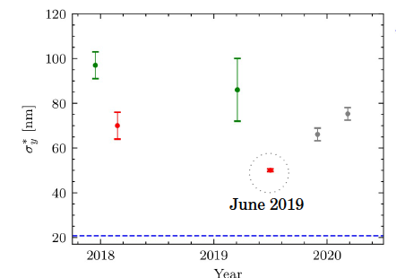
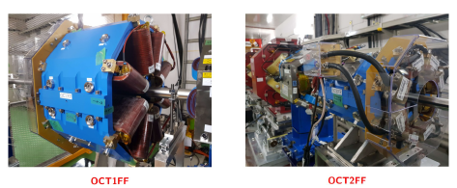

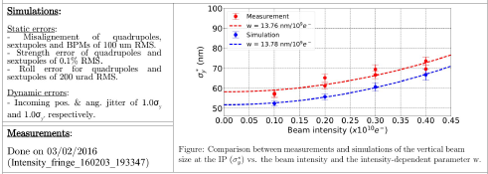

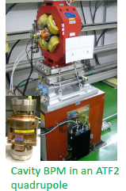
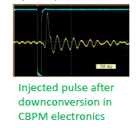
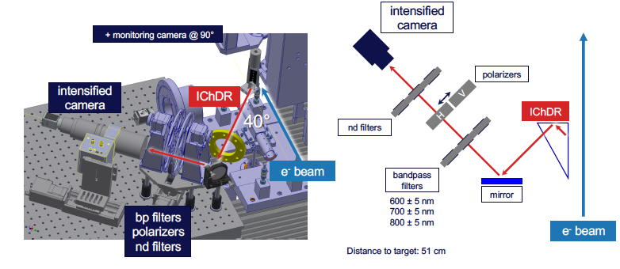

T2 : ATF3 overseas collaborations contributions
Most of collaborators are willing to participate starting in June 2023. The ideal will be to arrive the week before in to check/familiarize with the ATF2 current situation (Database lattices with all the ATF2-3 upgrades)
Beam Instrumentation: CERN team has participated in ChDR studies in June 2023.
Beam dynamics: CERN, JAI CNRS team will participate in Fall 2023.
Task force in “magnet movers”
Task force for “software new Flight simulator
Task force in “cavity BPMs”
Ultra low-β beam tuning
Octupoles studies
WFS studies
CBPMs electronic upgrade
Incoherent ChDR
Cold CBPMs for ILC main linac

Slide 9

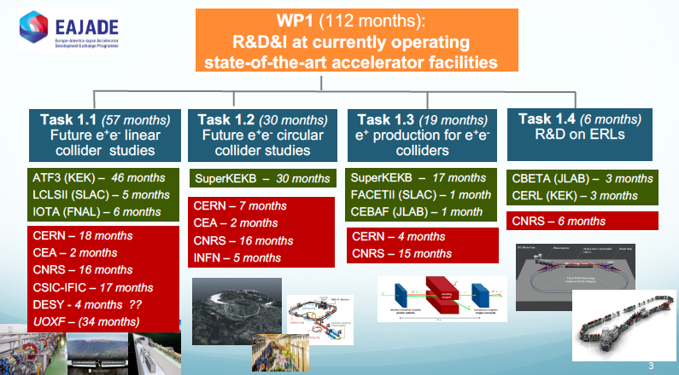
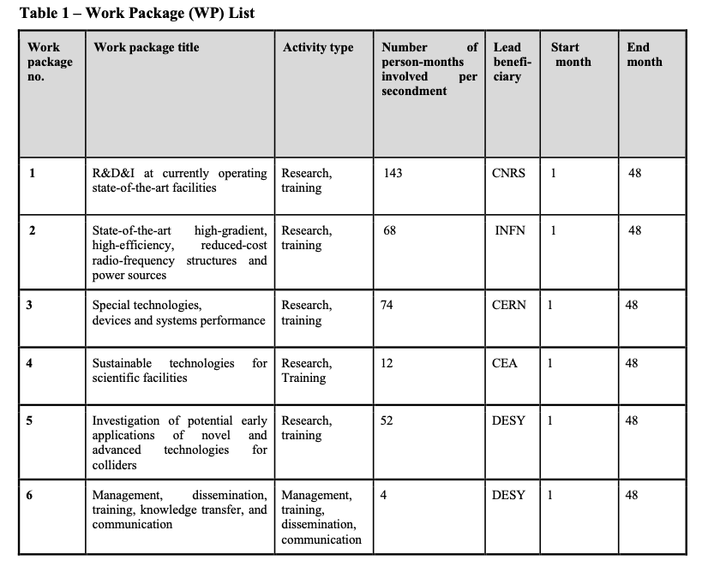
ATF3 in EAJADE project
EAJADE (Europe–America–Japan Accelerator Development and Exchange programme) focused in Higgs Factories, with participation of major EU (CERN, INFN, CEA, DESY, CNRS, CSIC, UOXF), Japan (KEK, Tokyo Univ., Tohoku Univ.) USA (BNL, FNAL, SLAC, JLAB, LBNL, Cornell Univ.) and Canada (VISPA) labs. (2023-2027)
Notes:
EAJADE (Europe–America–Japan Accelerator Development and Exchange programme) is a training, education and staff exchange network in the field of accelerator research for high-energy elementary particle physics (HEP).
The key technical challenges for the future Higgs factories are many but the most important addressed in EAJADE are, all with important training, skill development and knowledge exchange elements:
● Luminosity performance, hardware and method developments related to this, being addressed in smaller beam facilities, prototypes and laboratory tests (addressed in work packages 1,2 and 3 covering method studies and hardware evaluations in beam tests, development and tests of radio-frequency (RF) systems and special devices that are critical for nanobeam creation, conservation and diagnostics).
● Upgrading to higher energies and accelerating gradients (addressed in work packages 2 and 5 covering RF developments and plasma acceleration studies).
● Power efficiency and sustainability, importantly connected to RF (addressed in work packages 2 and 4 covering RF efficiency improvements and power/energy reductions and recovery, and sustainable facilities in a wider perspective).
● Best practices, international collaboration, exchange of ideas and collaborative studies across Higgs factory proposals, training related to prototyping and tests in facilities and laboratory setup (all work packages).
For all the on-going R&D activities, and for the Higgs factory studies and potential later implementation, training of future accelerator experts will be crucial. These projects are very long term and today it is important to train the future scientists and engineers who will implement them. The training, networking and interdisciplinary focus of EAJADE create an ideal and very international career development environment for these future experts and leaders in the field. Providing such an environment is therefore the overarching goal of EAJADE.

Slide 10
17th ICB ATF/ATF2 in LCWS2023, SLAC
Last ICB meeting: 16th MEETING OF THE ATF/ATF2 INTERNATIONAL COLLABORATION BOARD: October 30th 2019, LCWS19, Sendai.
The ICB thanked KEK for supporting ATF3 and agreed to extend the Collaboration scope so as to include ATF3.
The ICB agreed to extend the period of validity of the Collaboration MoU until either: the day that it declares officially the dissolution of the ATF/ATF2/ATF3 Collaboration, or: a future MoU that replaces the current one is signed.
The ICB agreed to consider applications from new member institutes that wish to participate in ATF3 activities.

Slide 11
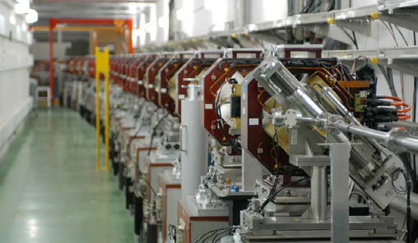
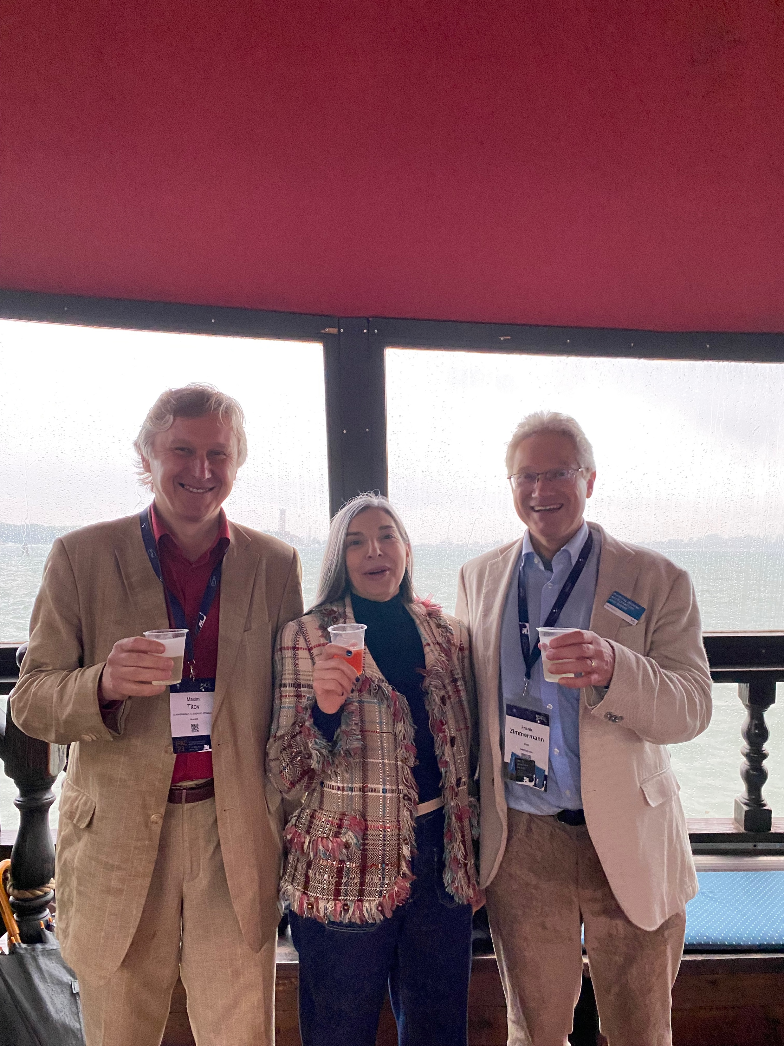
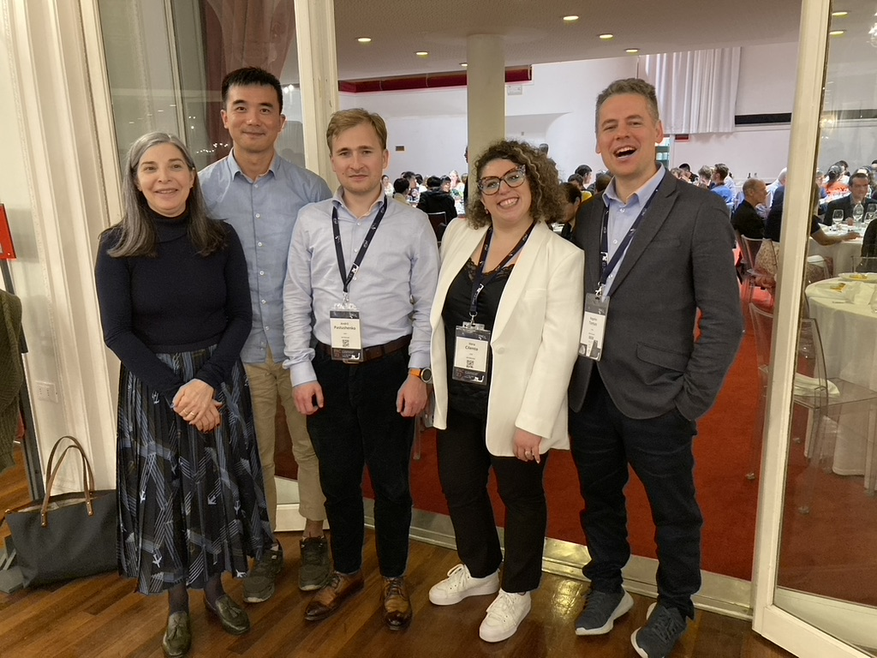

3
ATF2 final focus test beamline
ITN-EU contribution to WP15 is starting...
Very well known collaborators
New possible collaborators...
synergies to be founded
IlC- CLIC- FCCee

Slide 12
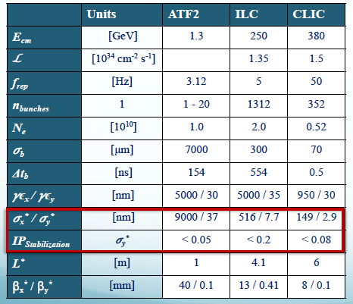
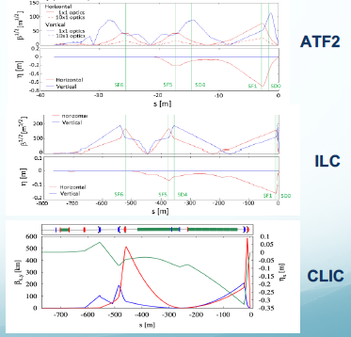
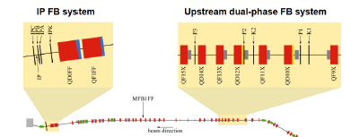
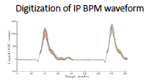

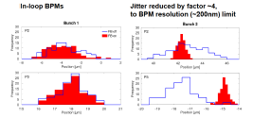
ATF2 goals and achievements
ATF2 is a unique test facility to develop nanobeam technologies for LCs
Goal 1: Establish the ILC FFS methodology with similar optics and compatible beamline tolerances
Goal 2: Develop a few nm position stabilization for ILC collisions
FONT5 system
Small beam sizes were obtained with beam intensities of 0.5-1.5 10⁹ e⁻/bunch (10¹⁰ design value) and reduced aberration optics (10β_{x}* x β_{y}*)
IP beam position has been stabilized up to the BPM resolution for both upstream and IP. FB latency 133 ns (366 ns target value) and IP position jitter from 106 to 41 nm (2018)
smallest beam size ~41 nm (2016)
Notes:
The Final Focus System is one of the most challenging sytems of the LCs. The FFS main characteristics of the FFS systems for ILC and CLIC and ATF2 are rather similar. ATF2 is a scale down version of the Final Focus to test local chromaticity correction and to demonstrate the nano-beam technologies for LCs: ILC and CLIC.
There has been a continuous work from many labs, in ATF first and ATF2 after to get nanobeam size and its stabilization, last times centered in ultra-low beams for CLIC and intensity dependence studies.
We could observe In the right figures the similarities between them.
In the red box, the targets values for the beam sizes and stabilization values at the IP.
IP stabilization: 5, 20 and 8 % of vertical beam size.
in the case of ATF2 for the control of beam position at nm level requires a vertical beam jitter <5% of sigma_y, translates to a vertical jitter at the input of ATF2 FF of < 1 um.
In a similar way the 37 nm sigma_y at the IP requires <30 % of sigma_y that translate to a vertical jitter < few um.

Slide 13
ATF3 overseas collaborations contributions
Ultra low-β beam tuning
Octupoles studies
Most of collaborators are willing to participate starting in June 2023. The ideal will be to arrive the week before in to check/familiarize with the ATF2 current situation.
Beam dynamics: CERN team will be interested not in specific beam time in June 2023 but just familiarize with the current ATF3.
  Ultra-low studies (long L*...)
  Optics optimization and simulation (wakefield mitigation)
  Beam time in Nov-December 2023
Beam Instrumentation: ChDR checks and will be interested in some beam time starting in June 2023
WFS studies
Incoherent ChDR

Slide 14

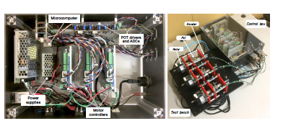
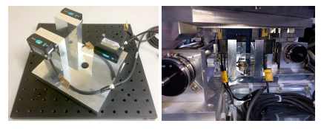
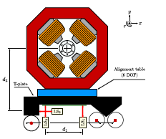
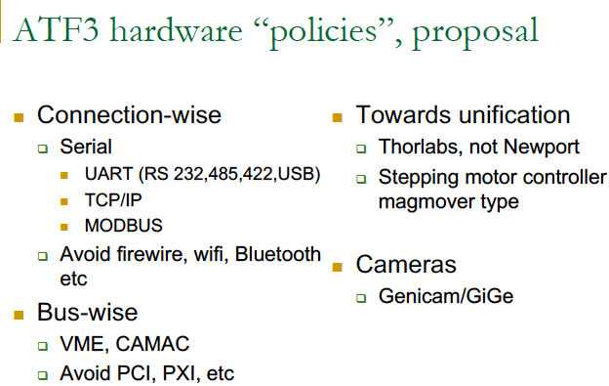
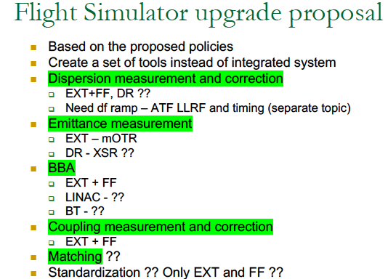
ATF3 overseas collaborations contributions
Database lattices with all the ATF2-3 upgrades
Task force in “magnet movers”: dedicated meetings will be organized to discuss the proposed upgrades (A. Aryshev, K. Kruchinin, S. Mazzoni, A. Schloegelhofer, L. Brunetti, P. Karataev, A. Lyapin)
Task force for “software new Flight simulator”: dedicated meetings will be organized to discuss the proposed upgrades. Agreed in one first tool and first implementation. (A. Aryshev, K. Kruchinin, A. Latina, P. Korysko, A. Aksoy, A. Pastushenko, R. Tomas, E. Manosperti, ).
Task force in “cavity BPMs”: dedicated meetings will be organized to discuss the proposed upgrades (A. Aryshev, K. Kruchinin, K. Popov, A. Lyapin, N. Fuster)
New control hardware design
New calibration bracket
CBPMs electronic upgrade
Cold CBPMs for ILC main linac
Notes:
Task forces ha been initiated.

