Slide 1
Life Cycle Assessment of CLIC and ILC civil construction
A study with ARUP
Benno List
ILC Europe Meeting 5.7.23

Slide 2
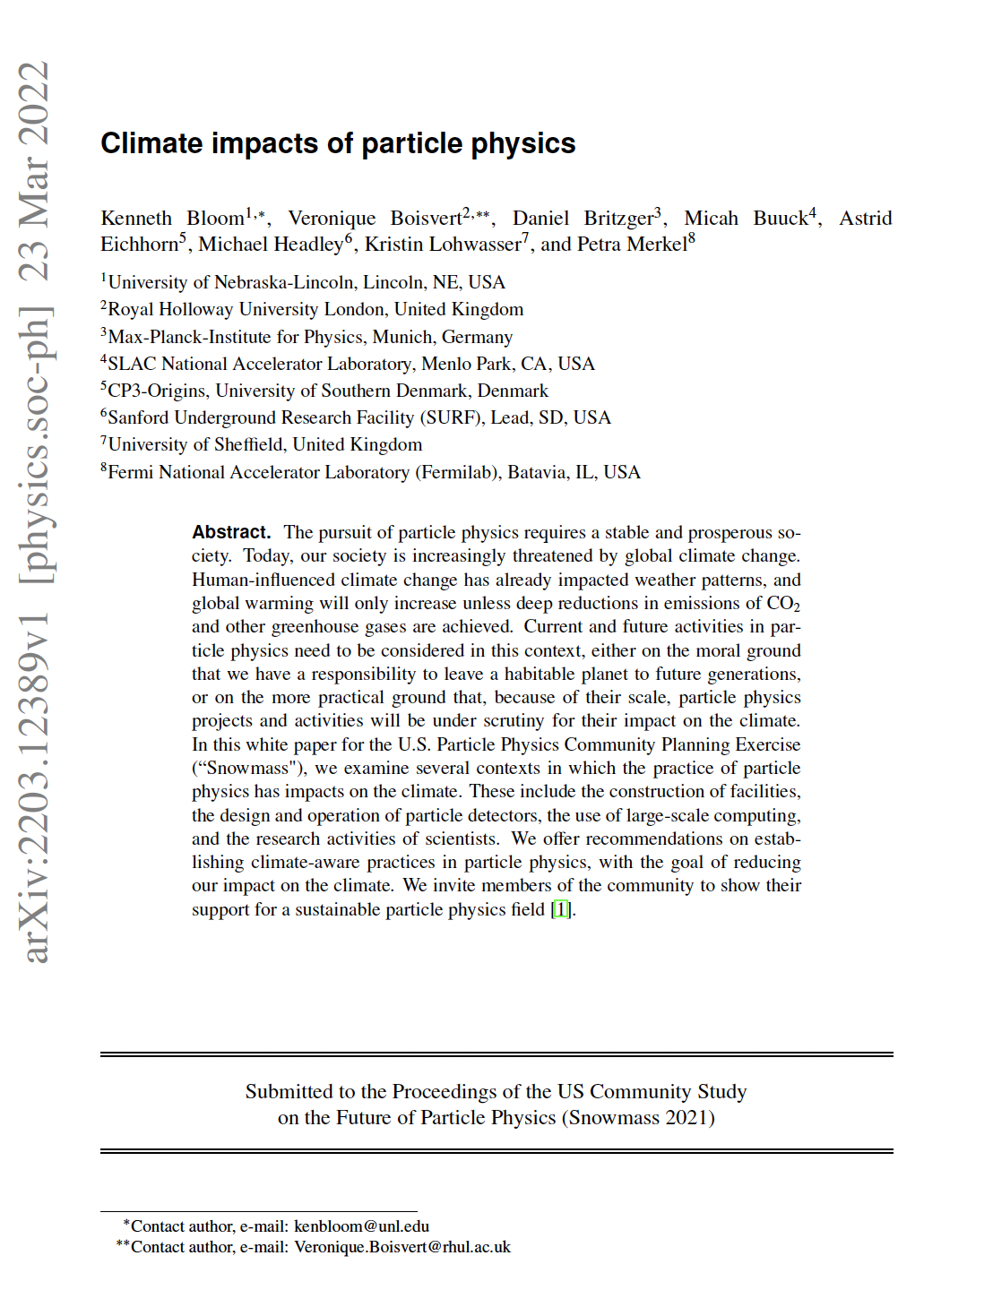

Introduction
Environmental impact of large HEP projects increasingly under consideration, also in Snowmass process
Civil construction has a large impact -
but how large exactly?

Slide 3
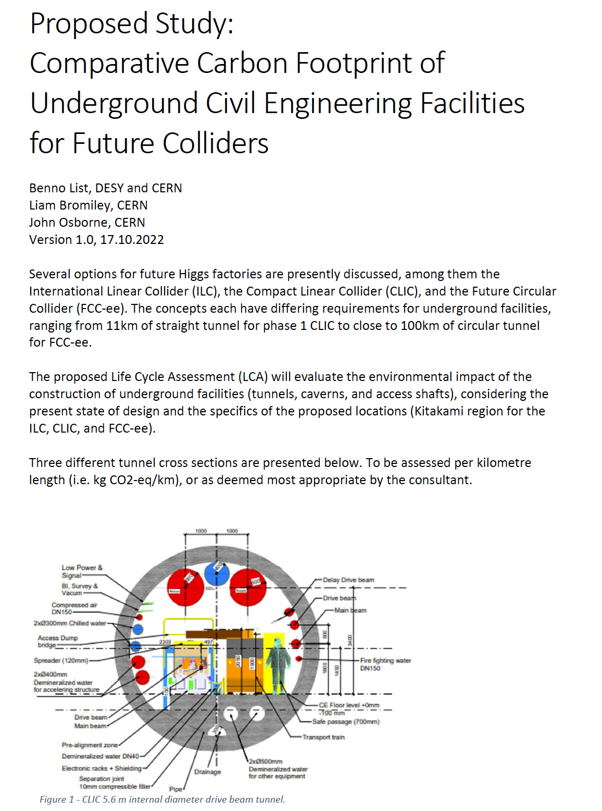
ARUP Study
CERN commissioned a study by ARUP (international civil construction consultancy) to study carbon footprint (and other environmental impacts) of underground civil construction
Comprehensive study
  Covering tunnels, caverns and shafts
  Assesses material, transport, construction
  Covers CO2, but also other impact categories
  According to international standards

Slide 4
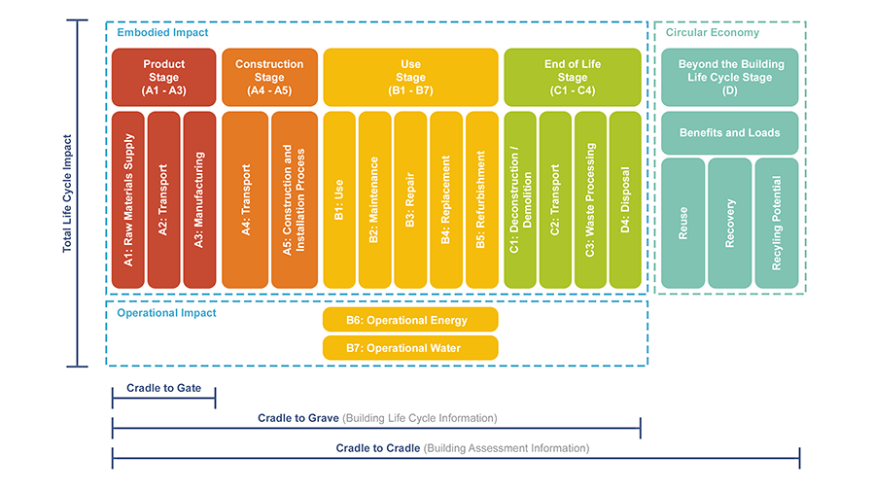
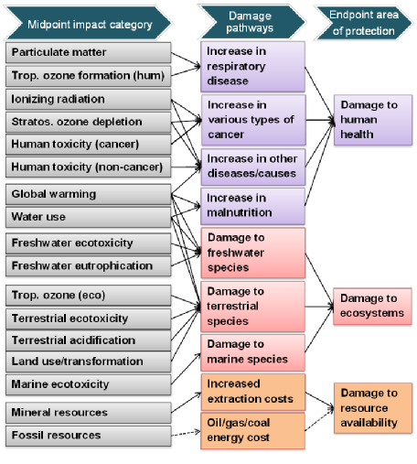
Quantitative Approach: Lifecycle Assessment LCA
Whole Lifecycle
Raw materials, fabrication & construction
Usage: operation, maintenance, refurbishment
End of life: demolition, disposal
Defined in International Standards
Whole Environmental Impact
Quantifying total damage by endpoint indicators (e.g. damage to human health) possible but difficult
”Midpoint indicators” asses impact on environment in a quantitative way:
  Greenhouse Warming Potential (GWP) – kg CO2 eqiv
  Ozone Depletion Potential (ODP) – kg CFC-11 equiv
  Ecotoxicity – kg 1,4-DCB equiv
M.A.J. Huijbregts et al., Int. J. Life Cycle Ass. 22 (2017) 138,
DOI:10.1007/s11367-016-1246-y
https://browningday.com/news/lca-stages-matter-when-tracking-embodied-carbon/
https://www.buildingenclosureonline.com/blogs/14-the-be-blog/post/
89547-lca-stages-matter-when-tracking-embodied-carbon
Lifecycle stages according to EN 15978

Slide 5
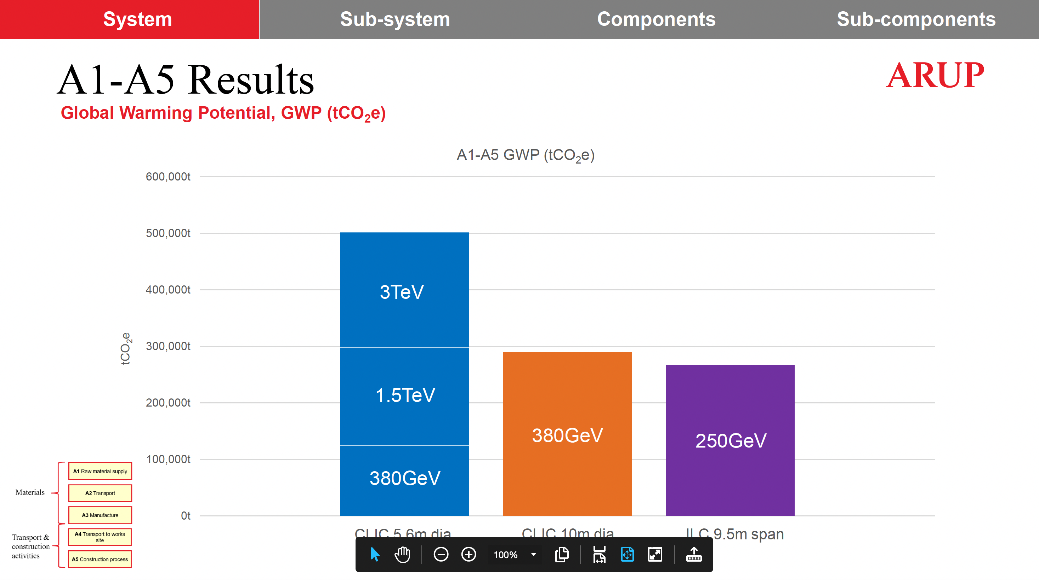
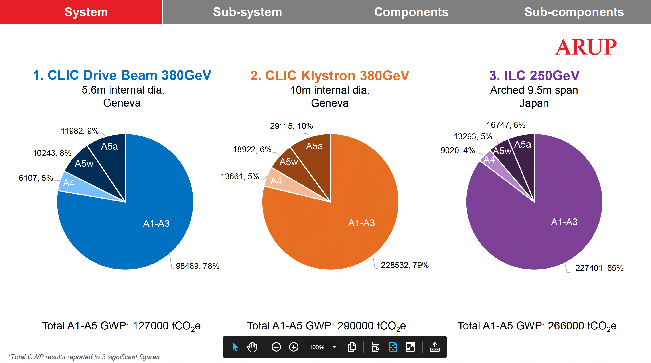
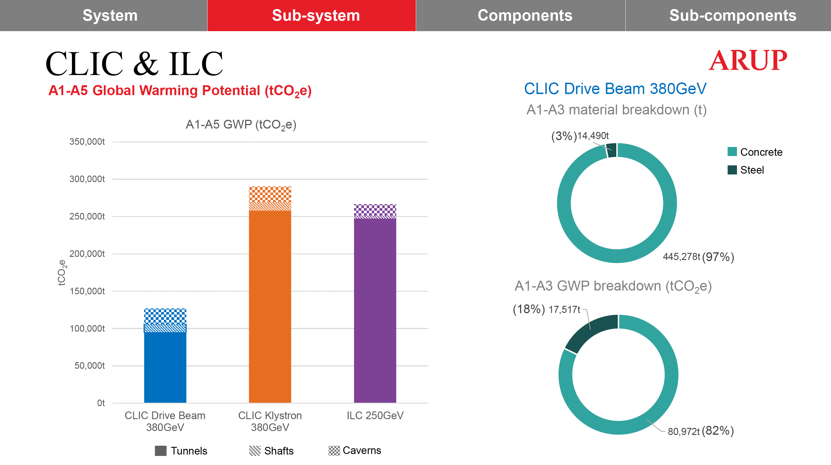
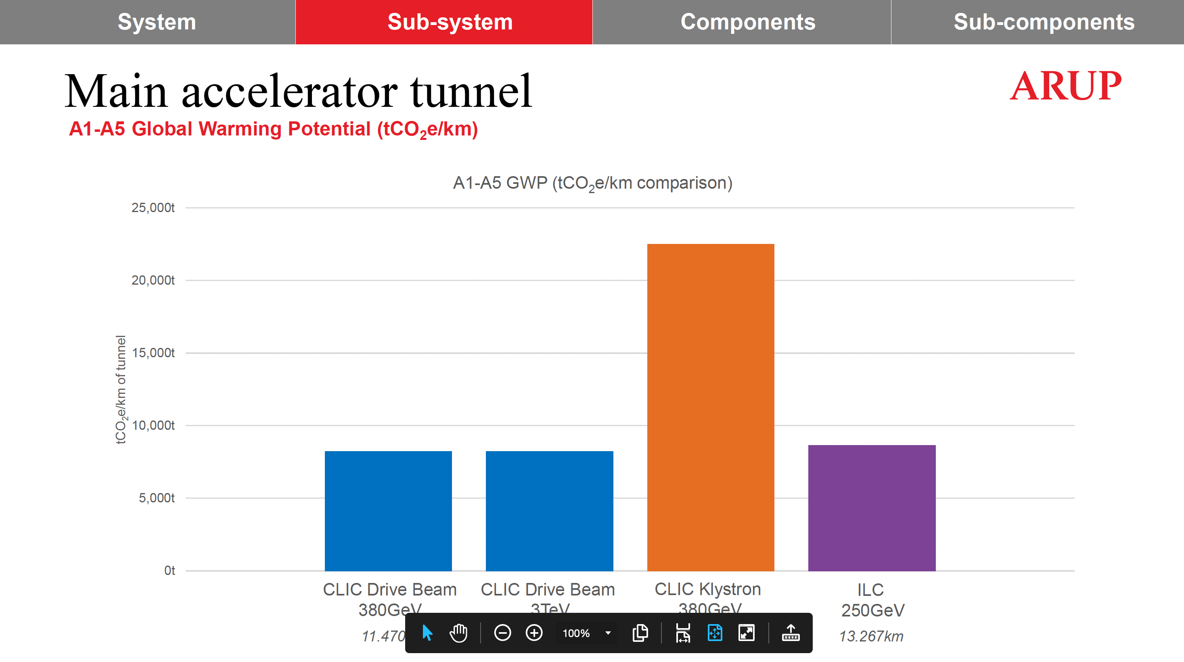
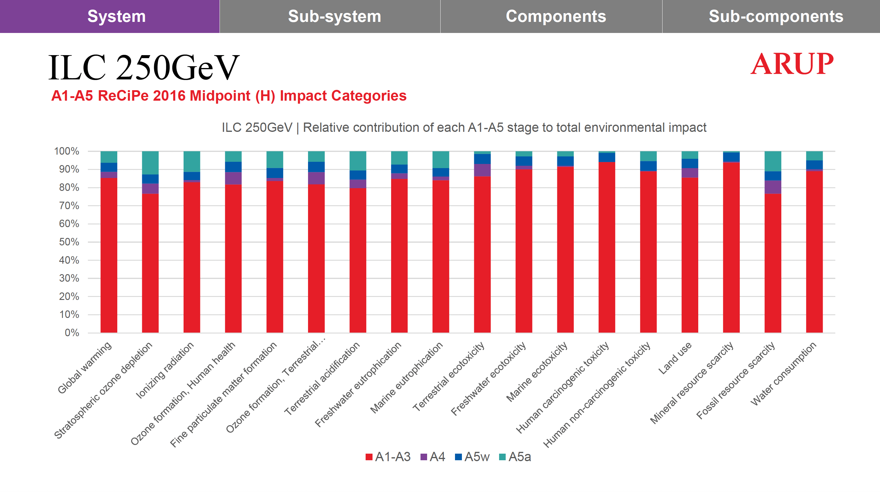
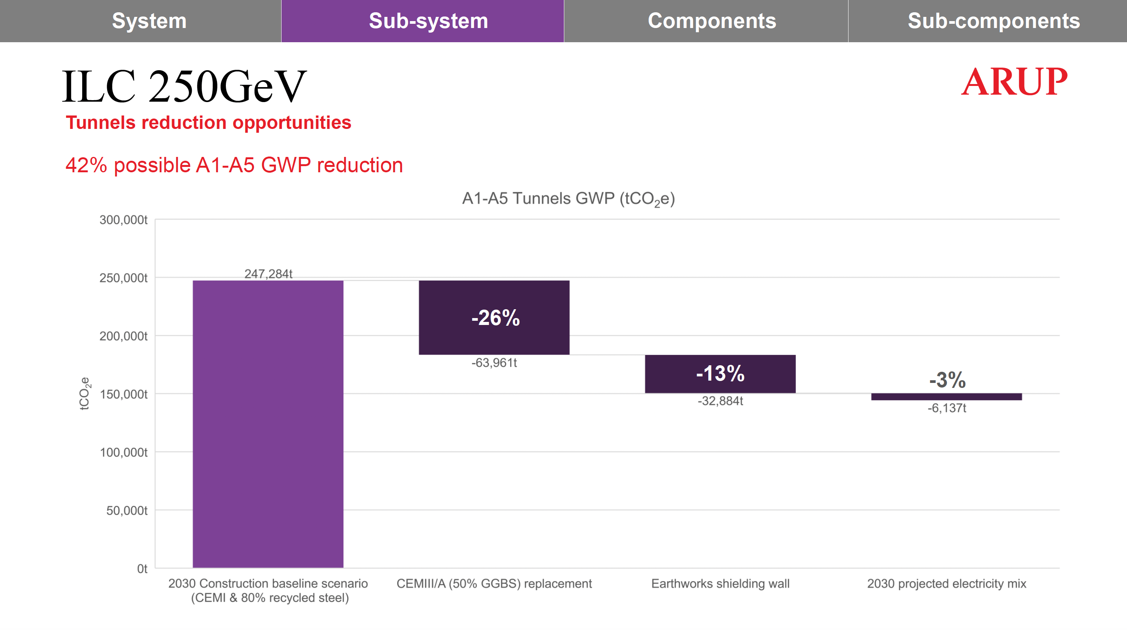
ARUP Study: Results
Total CO2
Per phase
Concrete and steel
CO2 per meter (ML tunnel)
Other impacts
Reduction potential

Slide 6
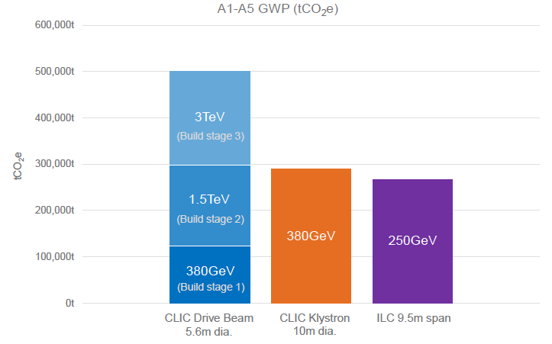
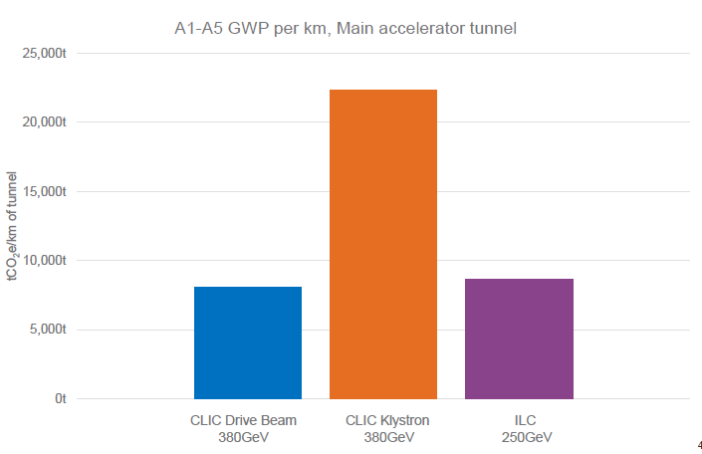
Main Results
Total CO2
Global Warming Potential of underground civil construction:
CLIC 380GeV:
  127kton CO2-eq (two-beam option)
  290kton CO2-eq (klystron option)
ILC 250 GeV:
  266kton CO2-eq
300kton
100kton
CO2/km,
Main Linac
20 ton/m
10 ton/m

Slide 7
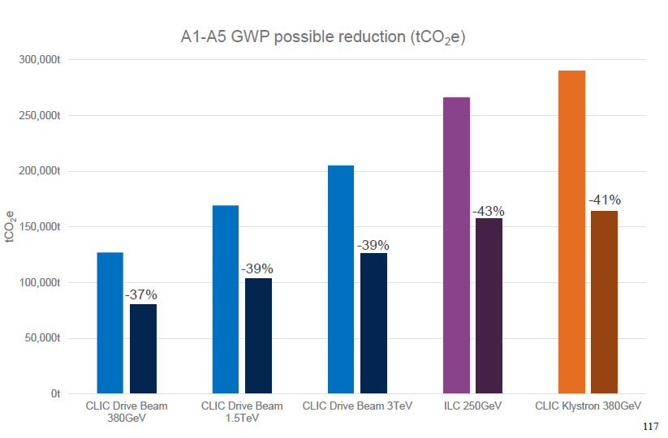
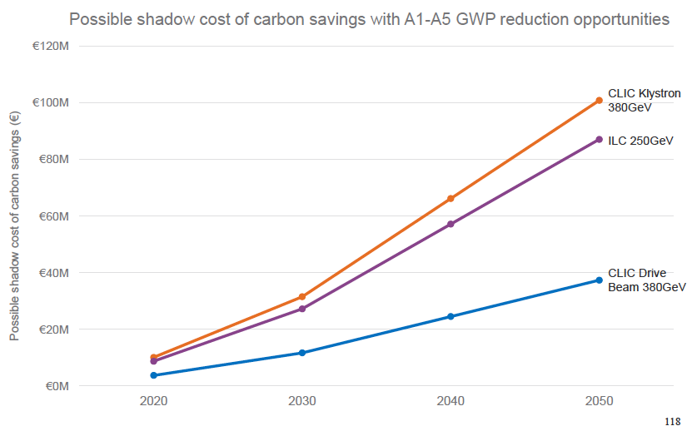
Conclusion
Full report will be made public
Evaluation of impact is the first step towards optimisation:
  Report includes section on ways to reduce CO2 impact
  “Shadow cost” of CO2 gives a monetary value to these reductions – “is it worth it”
This study sets a new standard for lifecycle assessment studies of future accelerator facilities
100 M€

