Slide 1
The ILD concept from linear to circular colliders
I.Laktineh, UCBL-IP2I

Slide 2
Prelude
International Large Collider (ILD) was born within the ILC project
ILD was optimized for ILC duty cycle mode and for the different expected CM energies of ILC (250, 500 and 1000 GeV)
ILD was used as the starting point for the first CEPC baseline detector
Last year ILD collaboration decided to study the possibility to propose ILD for other colliders, namely the FCCee with the main challenges coming form the Tera-Z run scenario.

Slide 3
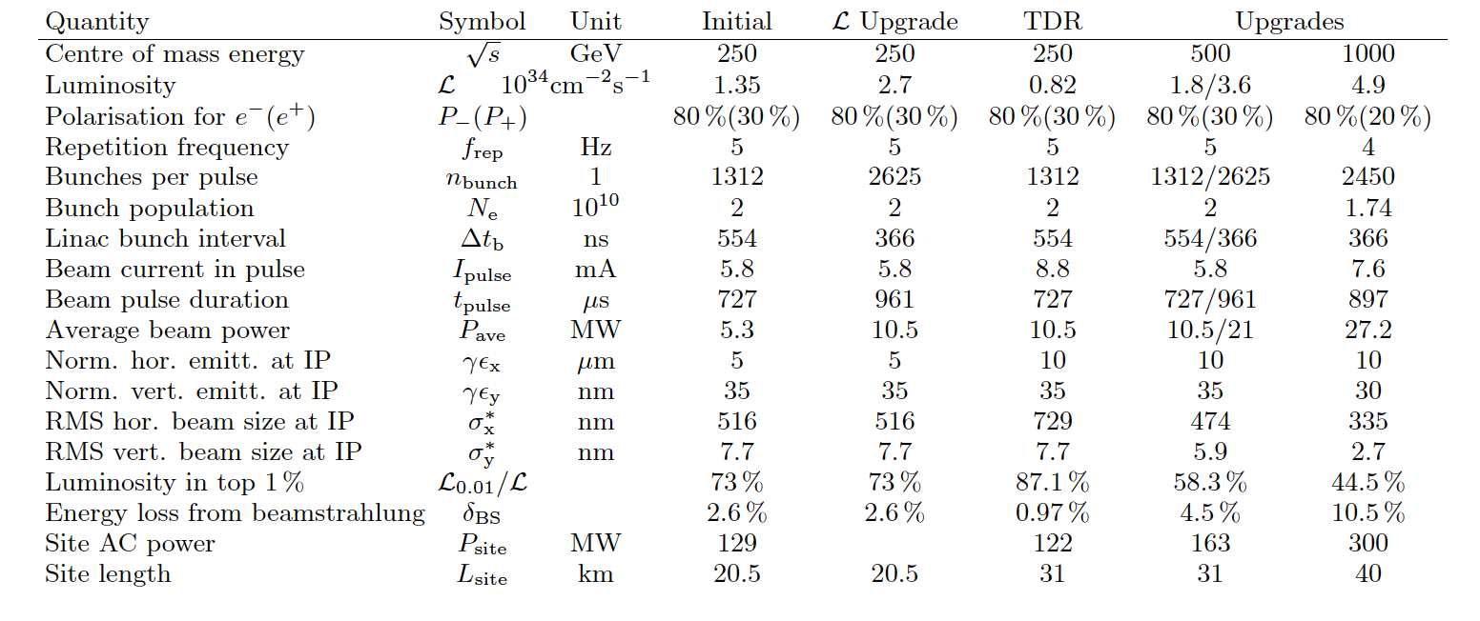

Slide 4
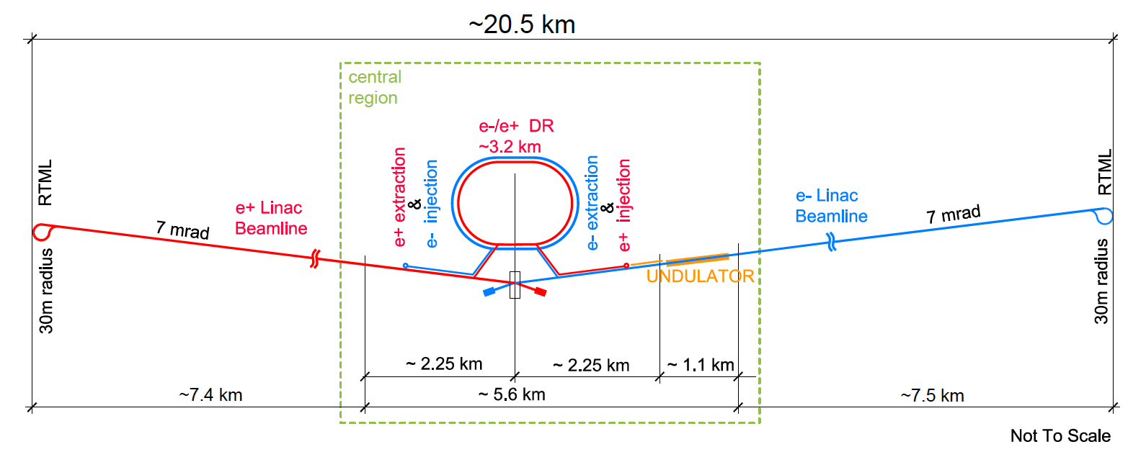
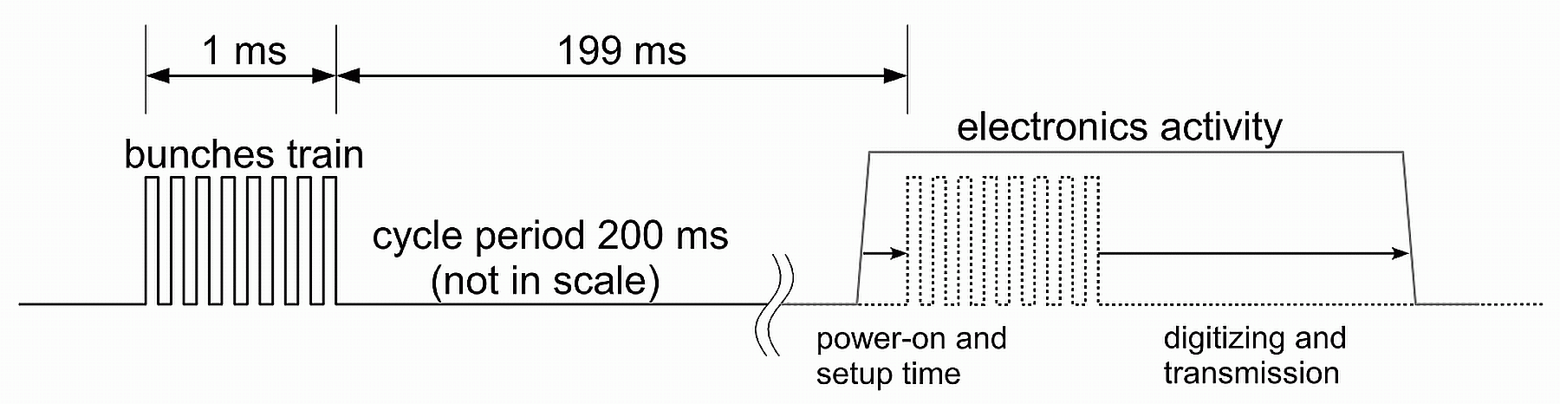
Train of 1ms duration every 200 ms (5 Hz), 1312 BC/train
Readout electronics is conceived to read out all the events (triggerless mode) during the bunch crossings, store them and then transfer them just after.
Electronics is switched off after data transfer until a new train
(a factor 100 of power reduction)
→ almost no cooling →low material budget

Slide 5
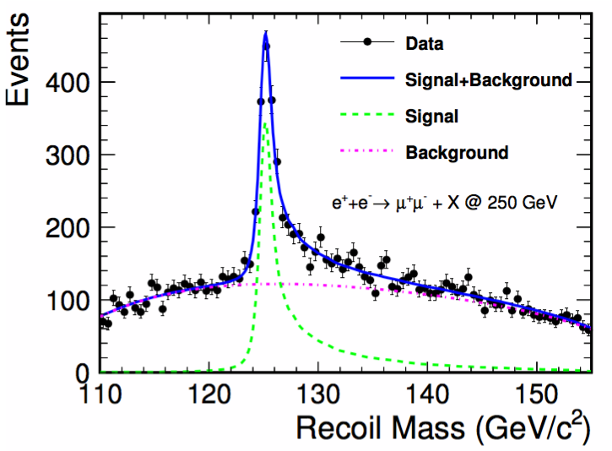
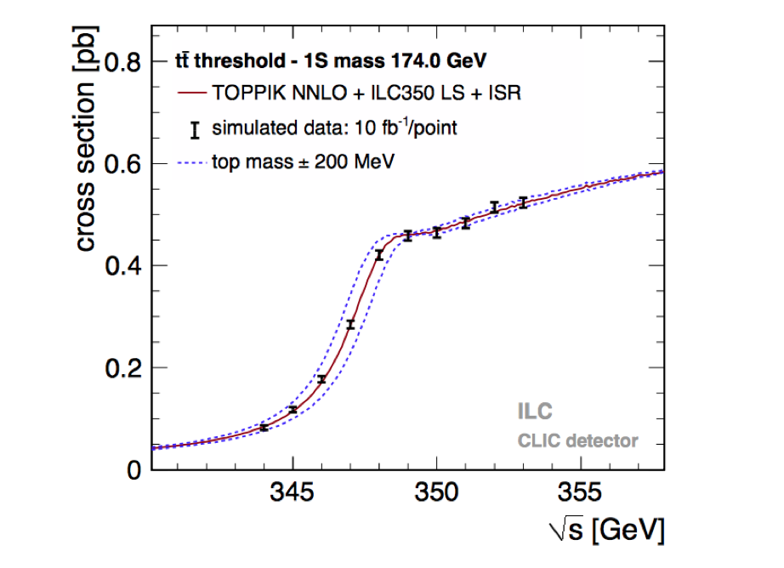
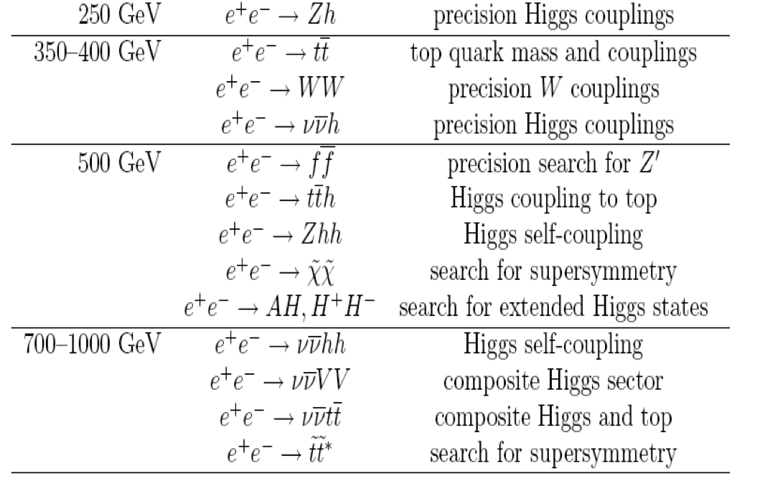
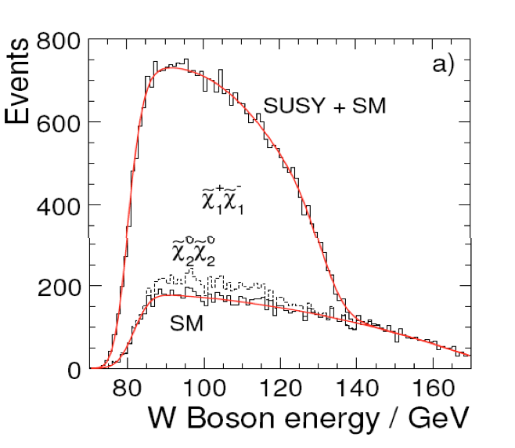
Philosophy of ILD
Detectors should be a precision and discovery
tool beyond the LHC scope.
Relevant Physics phenomena in the TeV energy range
are associated to multi jet final states
→ Jet energy measurement is the most important item.

Slide 6
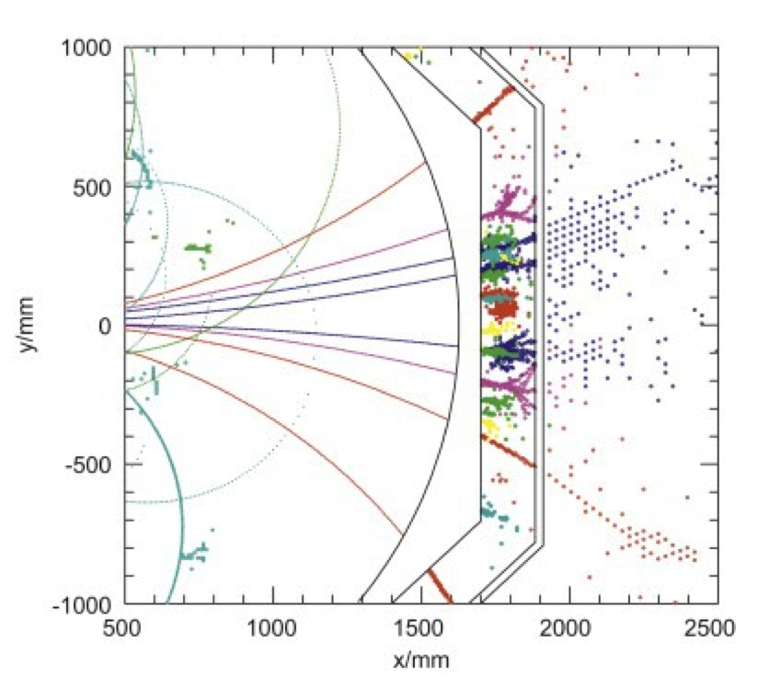
Philosophy of the ILD detectors
Detectors should be precision and discovery
tools beyond the LHC scope.
Relevant Physics phenomena in the TeV
energy range are associated to multi jet
final states → Jet energy measurement
is the most important item.
Particle Flow Algorithm is adopted in both
SiD and ILD concepts. PFA: Construction of individual
particles and estimation of their energy/momentum
in the most appropriate sub-detector.
PFA requires the different sub-detectors including calorimeters to be highly granular.
PFA uses their granularity to separate neutral from charged contributions and exploits
the tracking system to measure with precision the energy/momentum of charged particles.

Slide 7
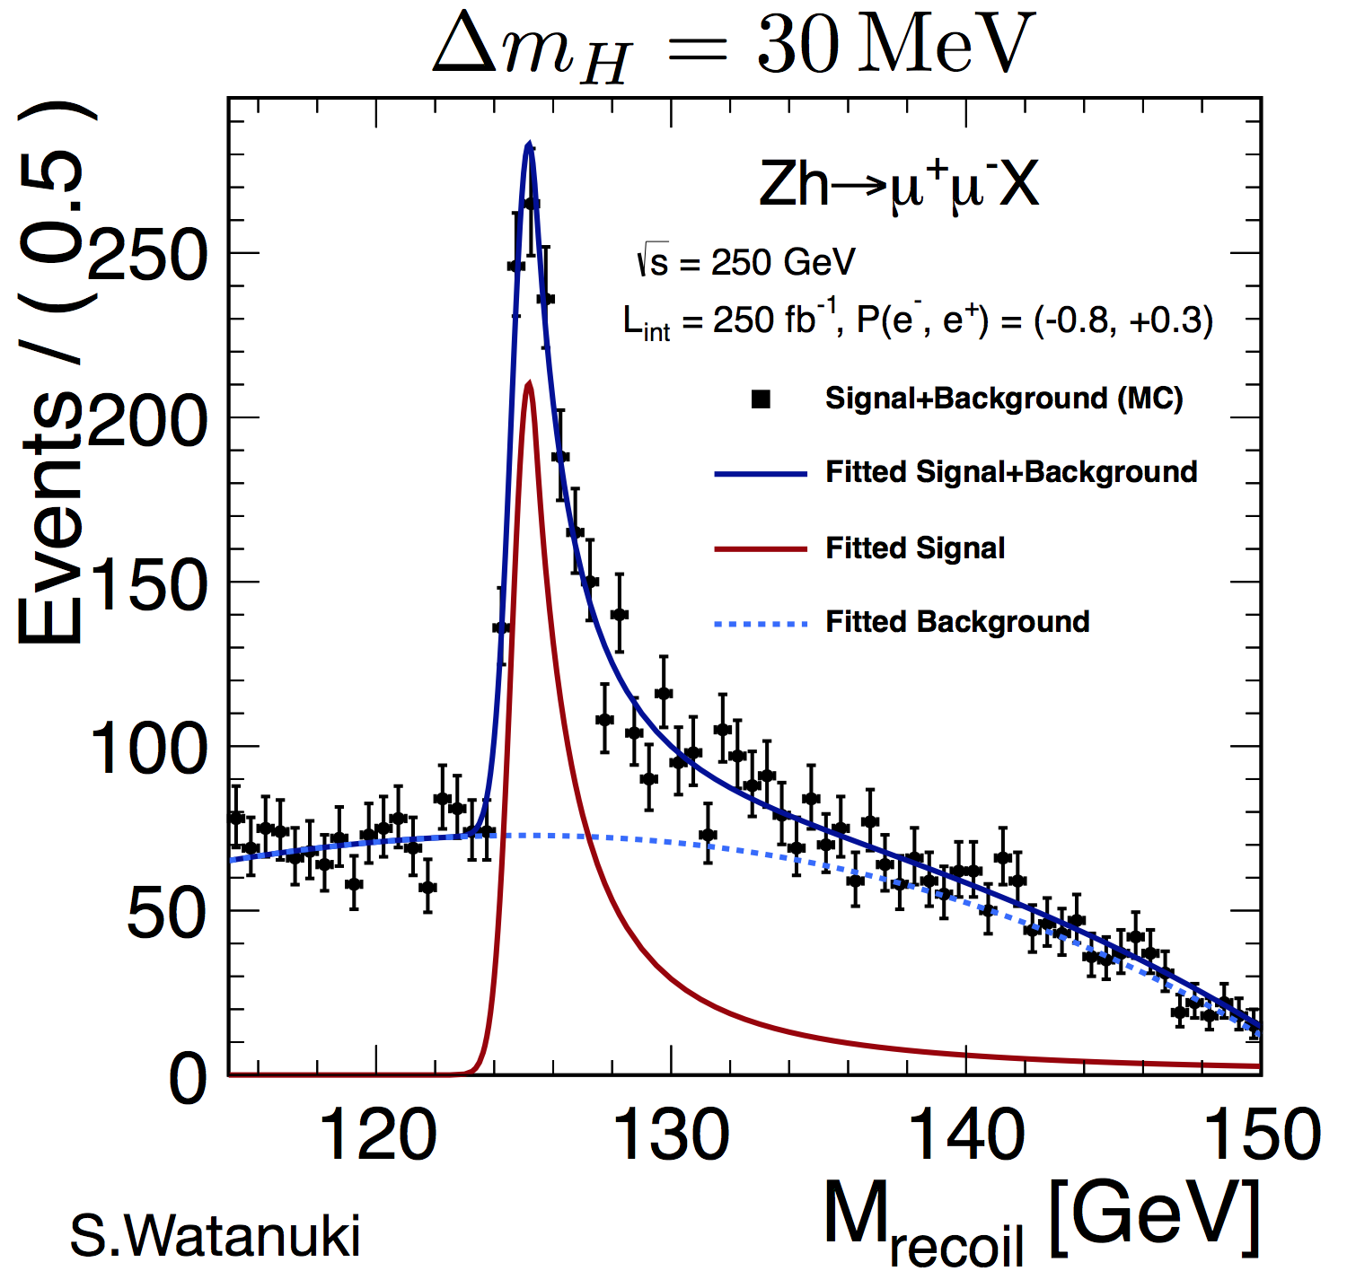
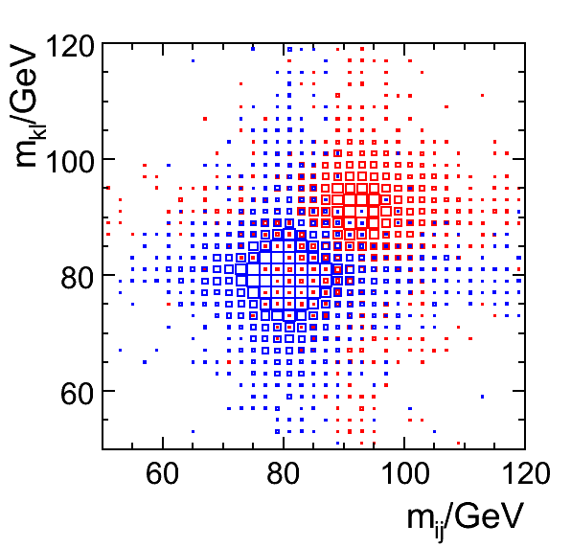
Philosophy of ILD : Requirements
Vertex detector : excellent resolution
σ_{IP}(rφ) = 5+10/(p sin^{2/3}(θ)) μm
b-tag, c-tag,… for H → bb, cc, ττ studies
Τracker : excellent precision measurement of p_{t}
σ(1/p_{t}) =10⁻⁵ GeV⁻¹
H mass recoil, e⁺ e⁻ → H Z→ μ⁺ μ⁻ + anything
Calorimeters : highly granular but still providing
good measurement of neutrals
σ_{E}/E = 30%/√E
The whole detector should be hermitic, compact
with moderate power consumption
30%/√E

Slide 8
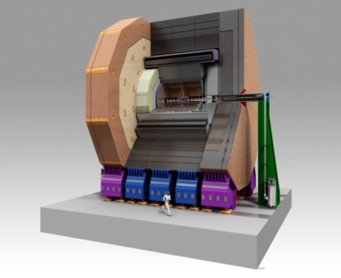
ILD

Slide 9
ILD
Precision vertex detectors
CMOS MAPs, FPCCD, DEPFET
Tracker
TPC (GEM,MMEGAS,MAPs)
many measurement points
Calorimeters
Forward Calorimeter: Si-W, GaAs-W..
ECAL: Si-W, Sc-W
AHCAL: Sc-Steel, SDHCAL-GRPC,..
Size&Magnet
Large/Small size options, 3.5 Tesla

Slide 10
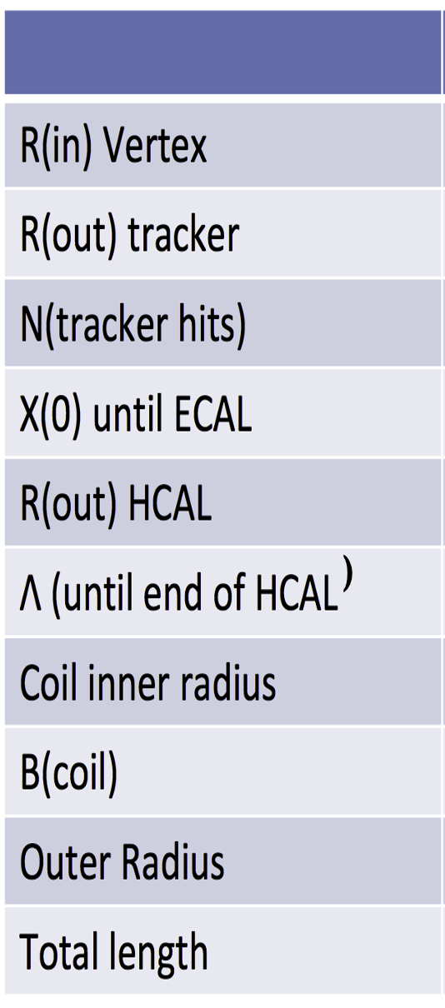
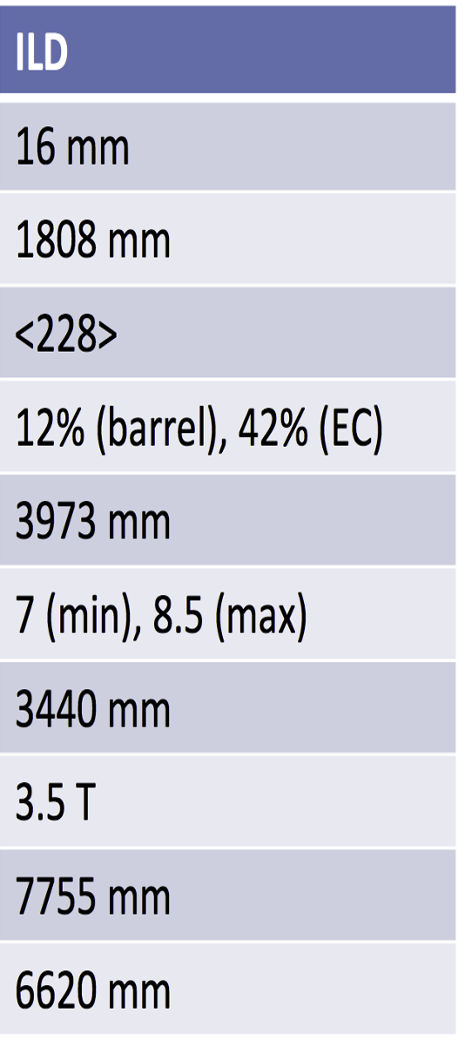
)

Slide 11
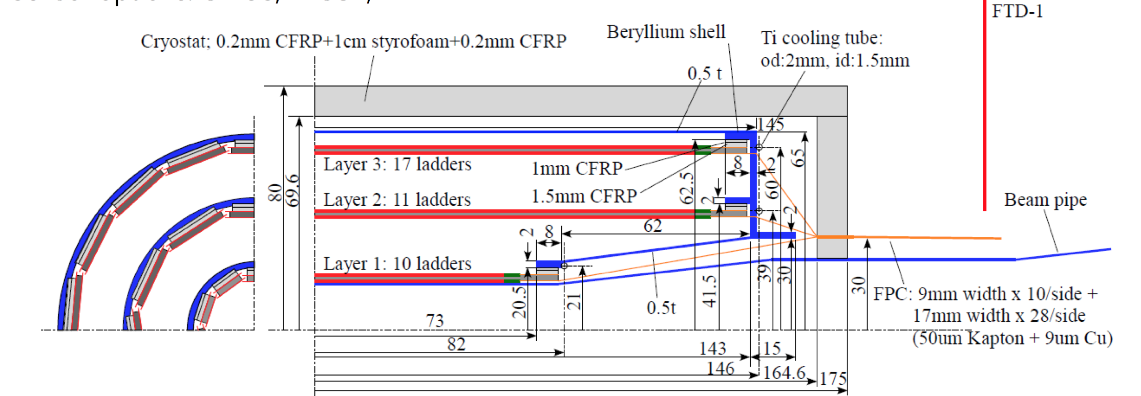
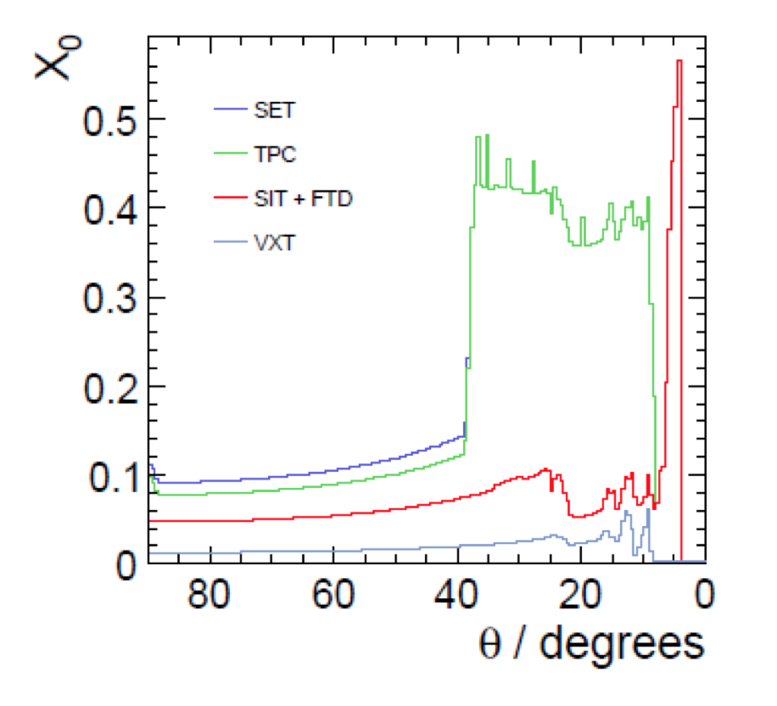
Tracker Silicon detectors : ILD
Central Si Tracker System (vertex detector)
3 ladders of double layers (6 pixel layers)
|cos(θ)| <.97 for inner layer, |cos(θ)| <.9 for outer layer
Inner radius ~1.6 cm, outer radius ~ 6 cm
3μm resolution in the inner layer
Material budget ~ 0.3 X₀/ladder layer : light support and air-based cooling system.
A pixel occupancy not exceeding a few %

Slide 12
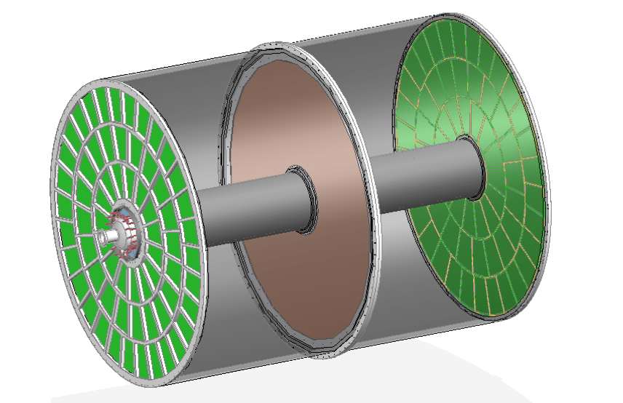
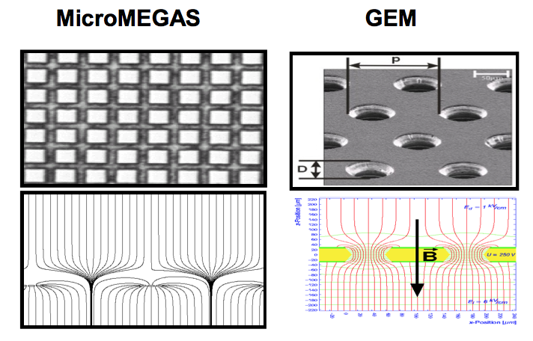
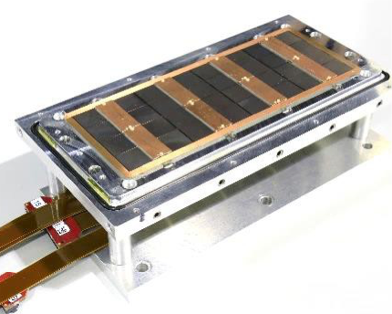
ILD TPC tracker
Time Projection Chamber (TPC) is chosen as the
central tracker of ILD
3D tracks (rφz) can be built thanks to many
hits (∼200/Track)
σ(rφ) of 100 μm (60 μm at z=0) is expected
σ(z) of 1400 μm (400 μm at z=0) is expected
σ(1/p_{t}) ∼10⁻⁴ GeV⁻¹
dE/dx information is provided (particle identification)
Readout pad size ∼ 1x6 mm² → 10⁶ pads/side
Material budget : 5%X₀ in central region and less
than 0.25 X₀ in the endplate region
Cooling is needed: two-phase CO₂ is a possibility.
Two main options for gas amplification are considered :
GEM, Micromegas and more granular one (GridPix)
0.4m <R< 1.8m
|z|< 2.15 m

Slide 13
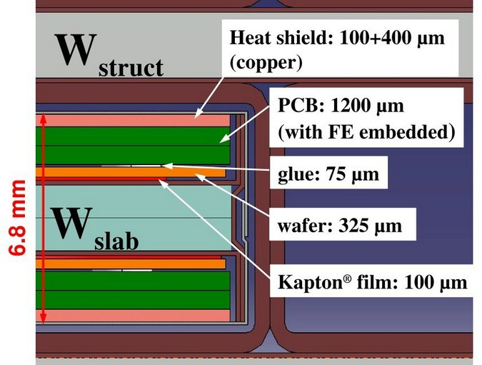
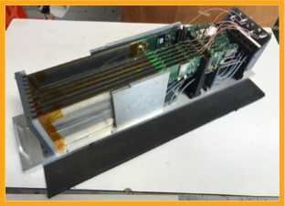
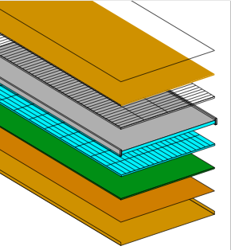
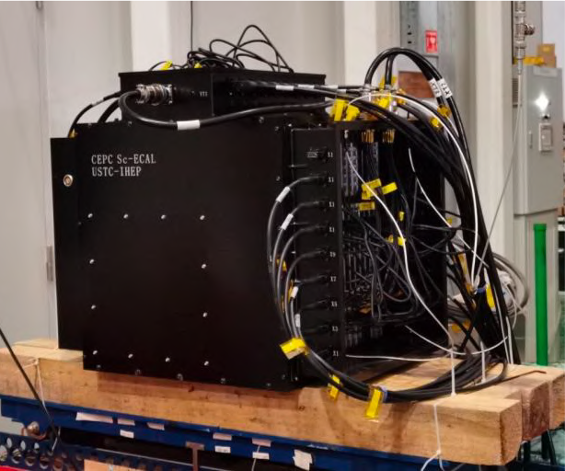
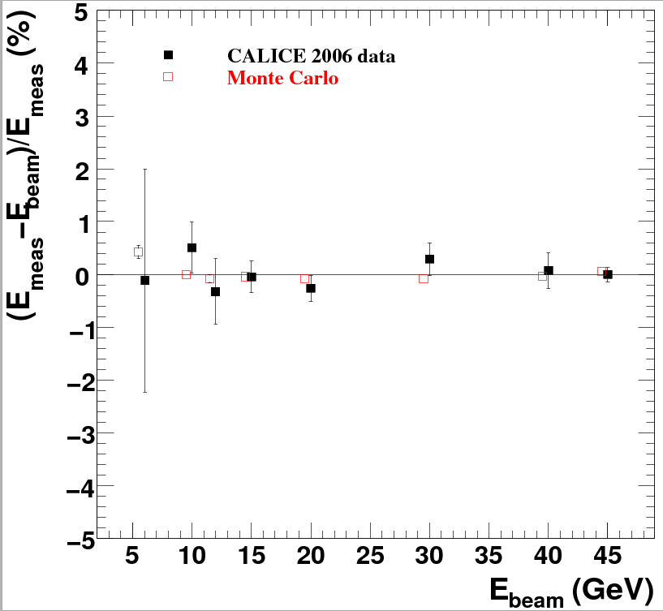
Technologies proposed for ILD
ECAL for ILD
30 layers of tungsten wih three different thickness representing (24X₀) interleaved with
-Pixellated Silicon of 5x5 mm² with silicon wafer thickness (300-500 µm)
-Doublets each made of two layers of scintillator bars of 45x5x2 mm³ with in horizontal position for one and vertical position for the other
electron data (2006)
MOKKA (geant4) simulation
electron data (2006)
MOKKA (geant4) simulation
non-linearity<1%
non-linearity<1%
Ebeam
Ebeam

Slide 14
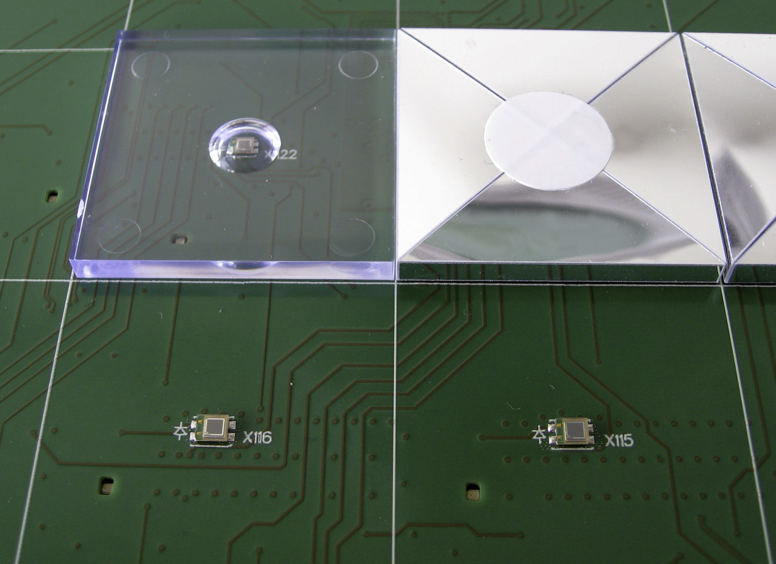
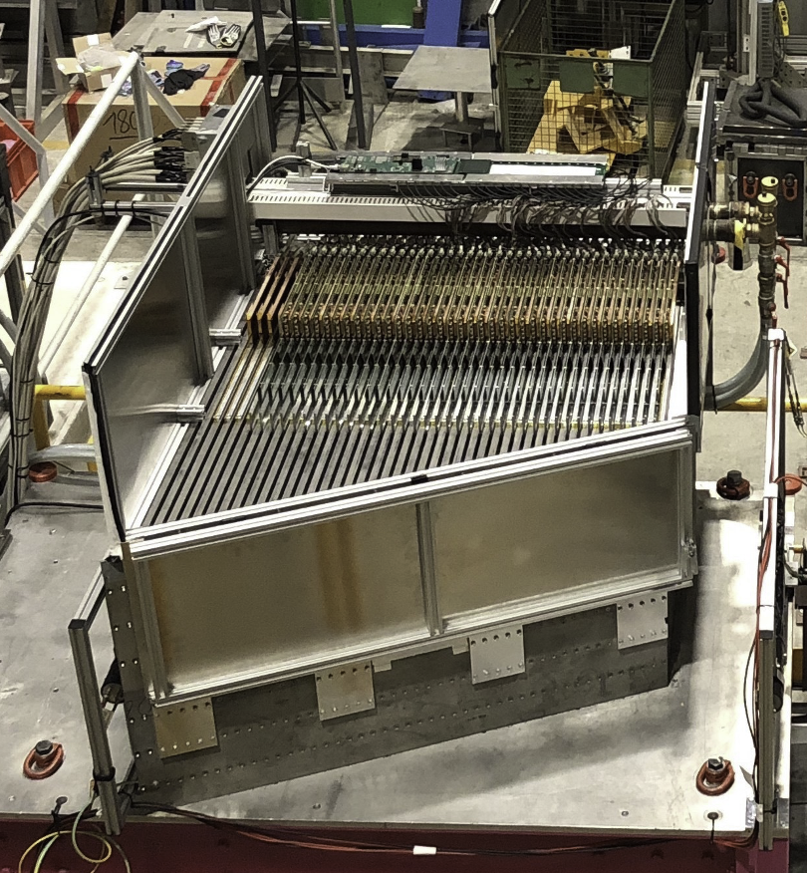
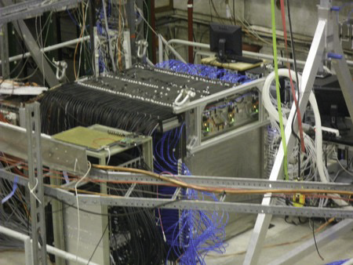
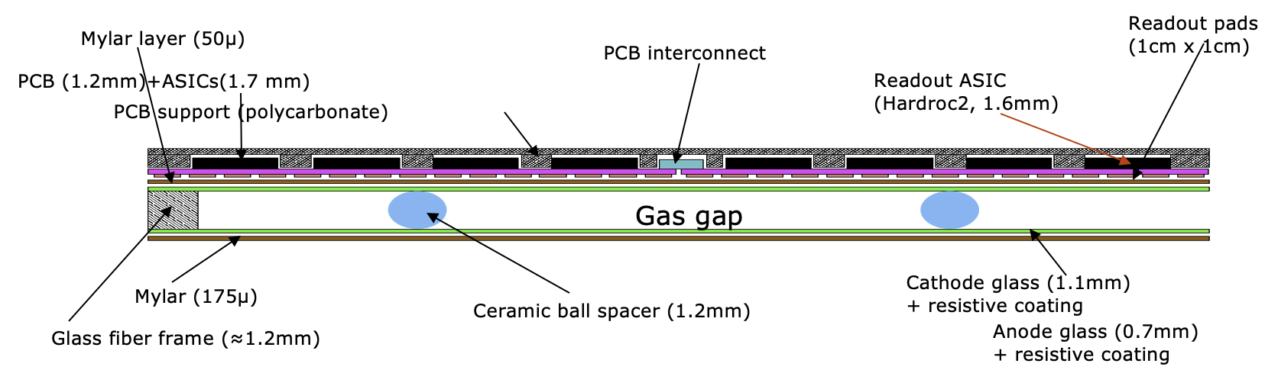
Technologies proposed for ILD&SiD calorimeters
HCAL for ILD
48 layers of 2 cm stainless steel (6 λ) interleaved with
planes made of 3 x 3 x .3 cm³ tiles read out with SiPM
of Glass RPC and their embedded readout 2-bit electronics allowing a lateral segmentation of 1 cm²
electron data (2006)
MOKKA (geant4) simulation
electron data (2006)
MOKKA (geant4) simulation
non-linearity<1%
non-linearity<1%
Ebeam
Ebeam

Slide 15
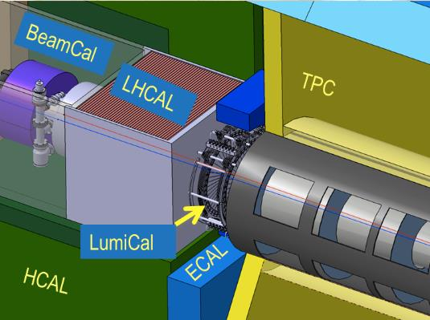
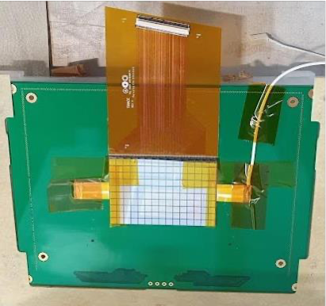
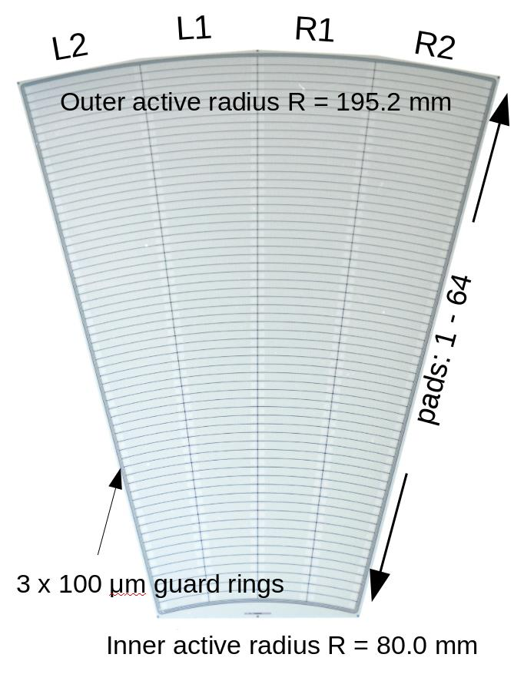
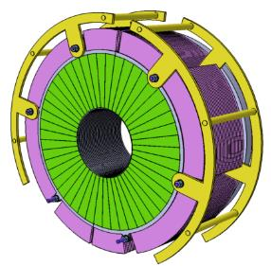
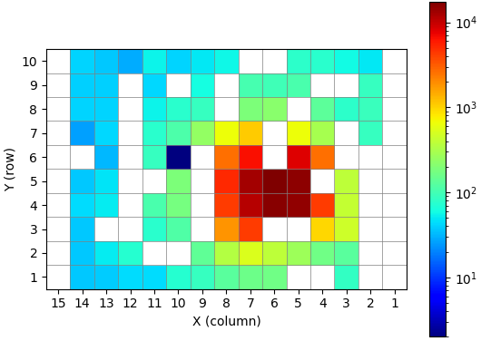
Forward calorimeters
Lumical
– Precise integrated luminosity measurements (Bhabha events)
– Extend calorimetric coverage to small polar angles.
Important for physics analysis
Si-W
Beamcal
Measure instant Luminosity. Feedback for beam
tuning
– Tagging of high energy electrons to suppress
backgrounds to potential BSM process
GaAS, CVD Dimond, Sapphire
LHCAL
- Extends the coverage of HCAL
Si-W or Fe

Slide 16
What one should do to adapt ILD detectors to circular colliders
Vertex Detector
Tracker: Inner and outer
Calorimeters

Slide 17
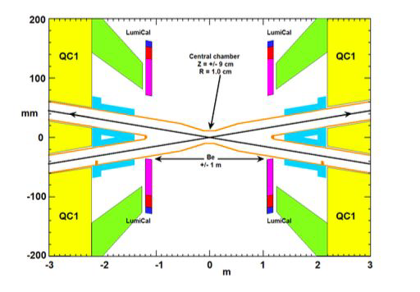
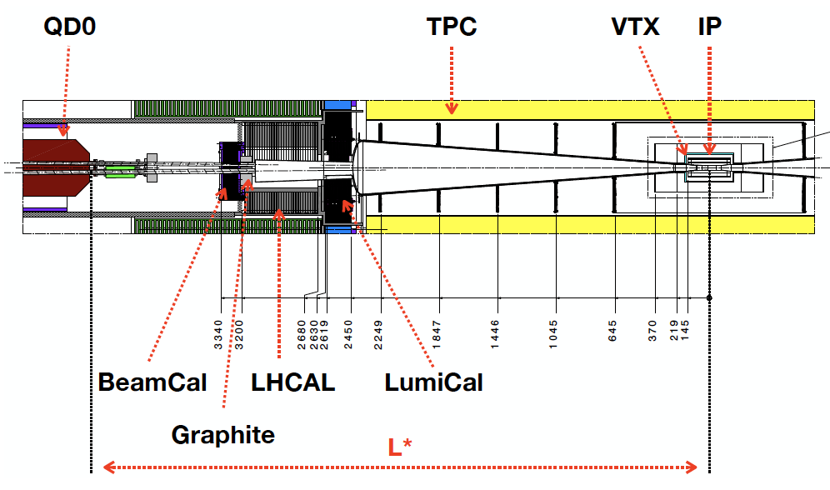


FCCee vs ILC MDI
Crossing angle 30mrad
L* 2m: Final Quadrupole inside the detector
Solenoid magnetic field restricted to 2T maximum
Lumical at ~1m from IP
➔ Tracker acceptance: cosθ ~ 0.984
Inner beam pipe radius 10mm
Crossing angle 14 mrad
L* 4.1 m: Final Quadrupole outside the detector
Solenoid magnetic field 3.5 – 4 T
Lumical at ~2.5m from IP
Conical ➔ Tracker acceptance: cosθ ~ 0.996
Inner beam pipe radius 16 mm

Slide 18
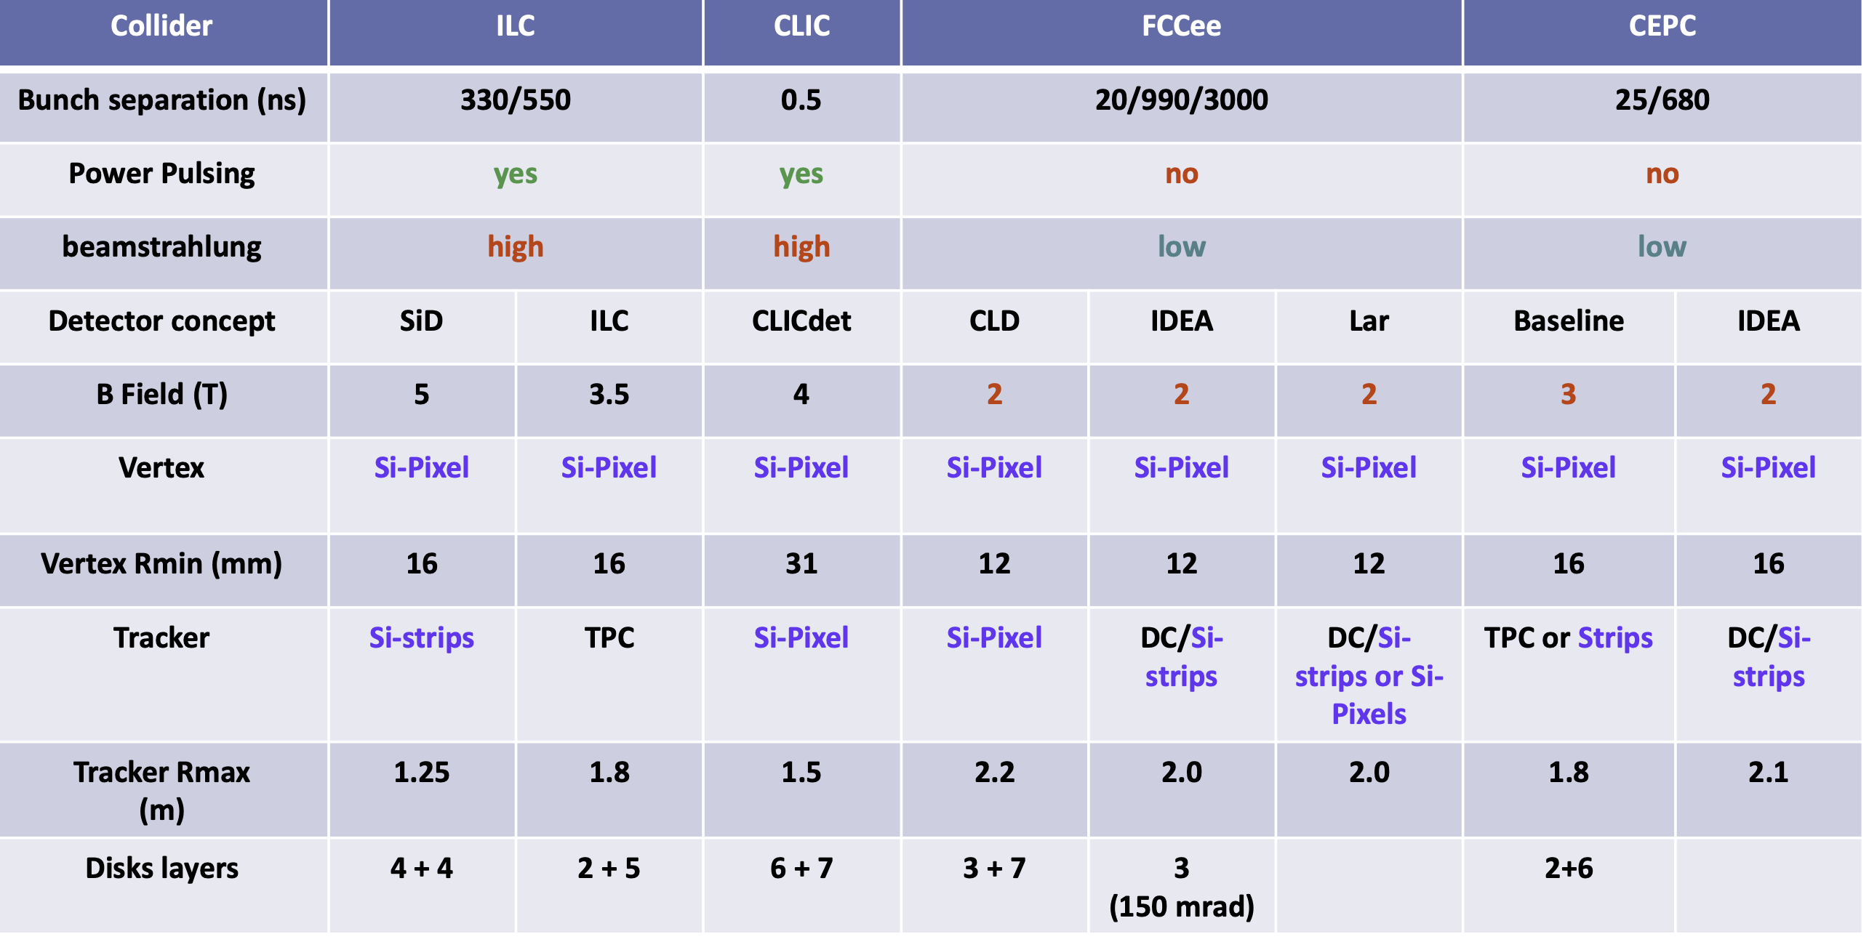
Vertex detectors &Tracker

Slide 19
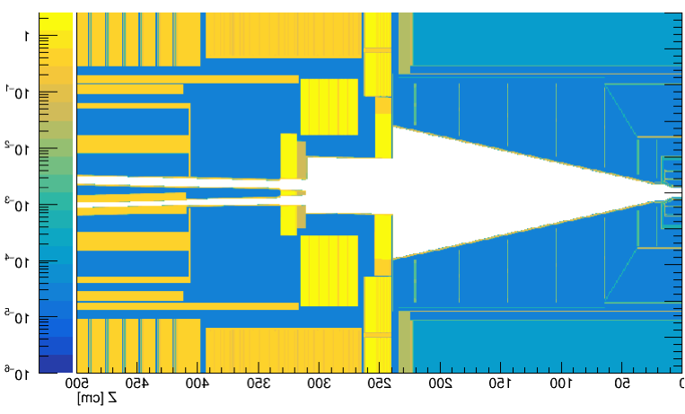
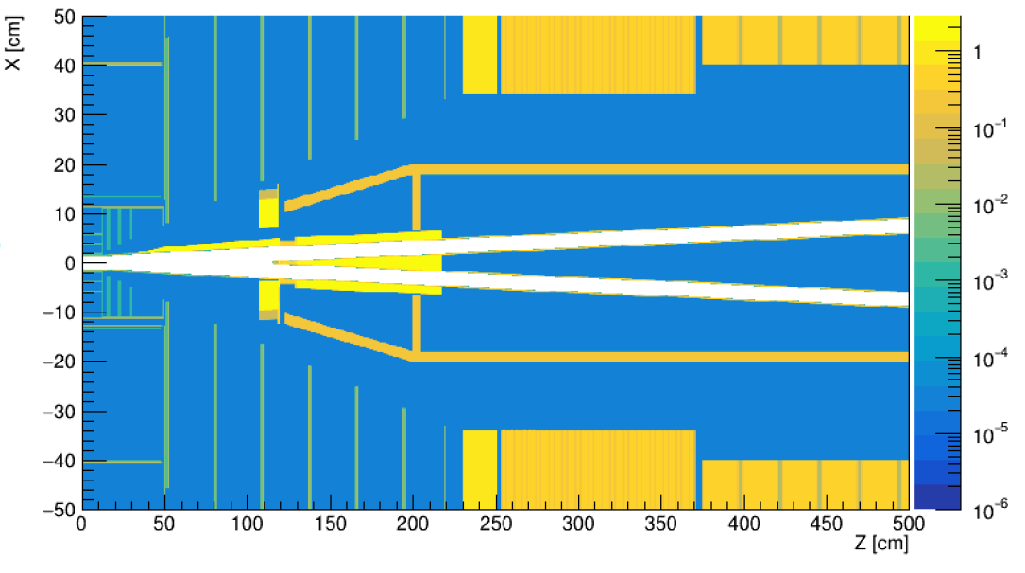
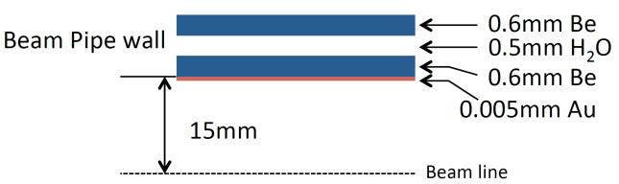
Why ILD Vertex detector and inner trackers need to be adapted?
Structure:
The space available to vertex and inner trackers are not the same due to different L*
Beam pipe in FCCee is thicker than that of ILC with additional Au coating
ILC: 500 µm → 0.15 X₀
FCCee: 2x400 µm (2 pipes) + 400 µm (water) + 5 µm Au → 0.4 X₀
The increase in material budget will result in a degradation of the spatial
resolution. Reducing the inner radius of the vertex detector could reduce the deterioration.

Slide 20
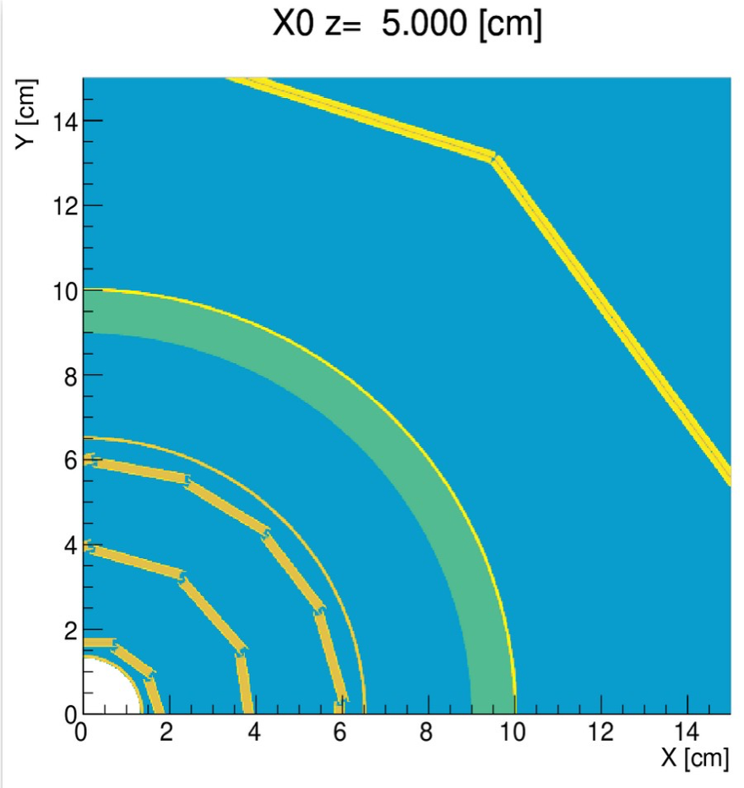
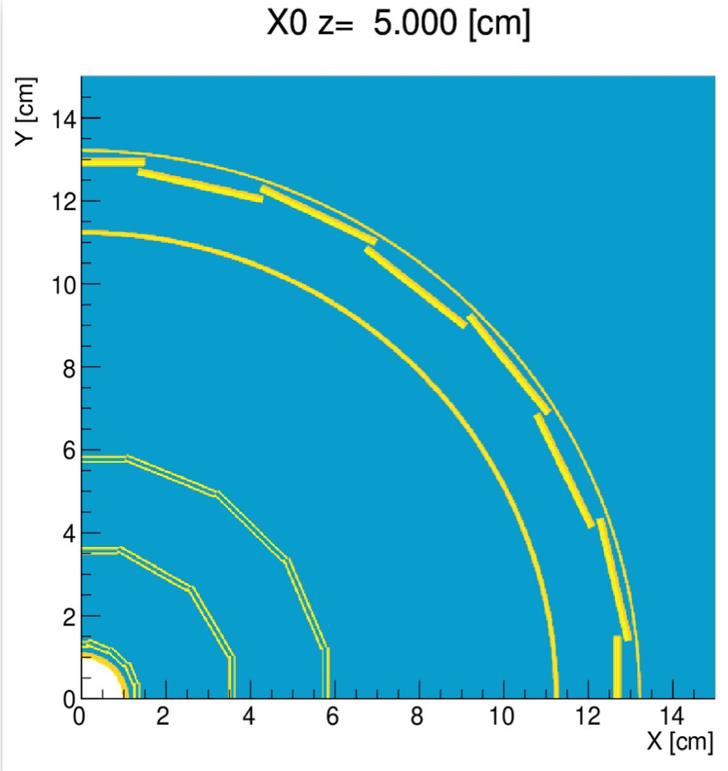
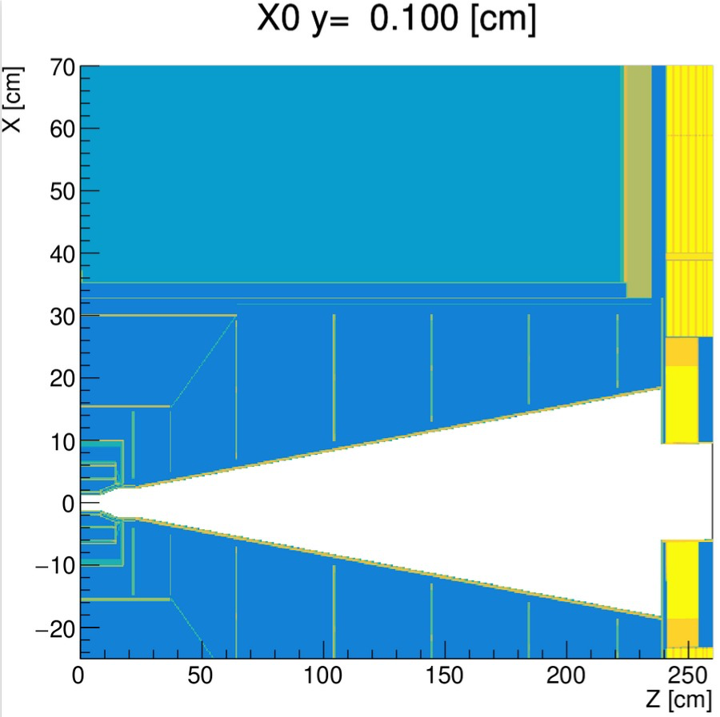
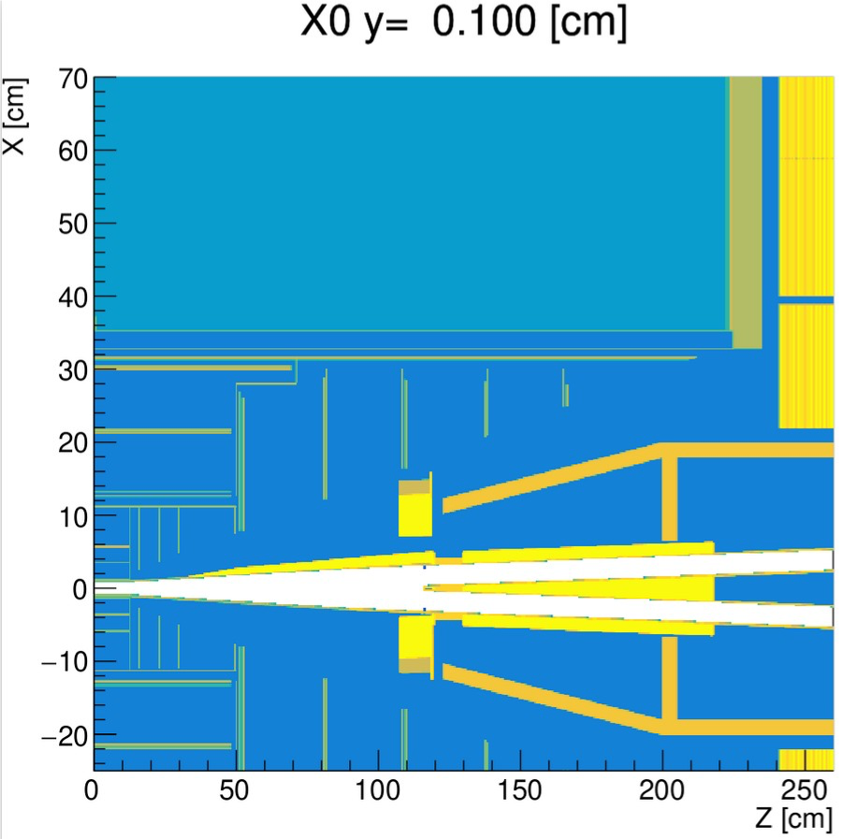
Why ILD Vertex detector and inner trackers need to be adapted?
The silicon inner tracker should be compressed if one decides to keep the same dimension of the TPC-→ smaller pitch is probably needed

Slide 21
Why ILD Vertex detector and inner trackers need to be adapted?
Backgrounds:
-Less beamstralung in circular than in linear (reduced beampipe radius)
-More synchrotron background in circular than in linear (increased beampipe thickness)
-Backscattered background is different due to difference in L*
Time resolution (< 10 ns) could reject much of the background but the
price should be paid in terms of power consumption
Power:
The duty cycle of FCCee results in continuous data taking
-Power depends on # channels, data flux and time information
-Air cooling is ok up to 20mW/cm² but more complex structure renders such
solution more difficult.
-For power consumption > 20 mW/cm² active cooling may be needed
resulting in more material budget and less precision
A compromise should be found

Slide 22
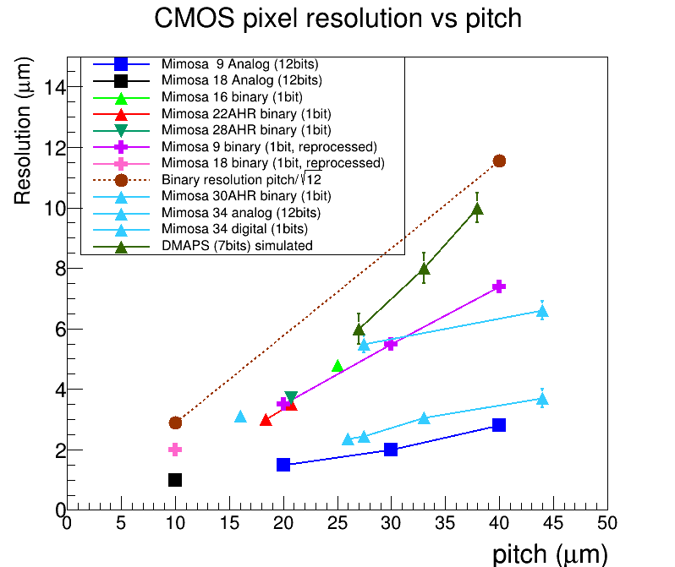
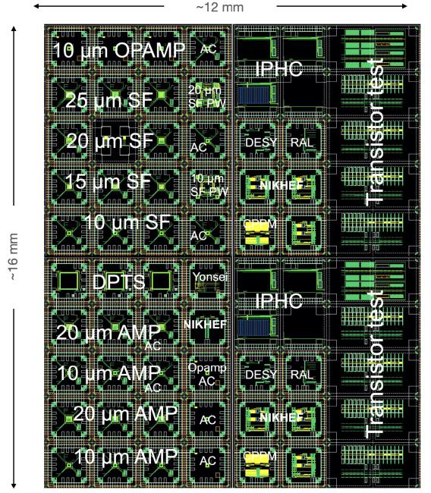
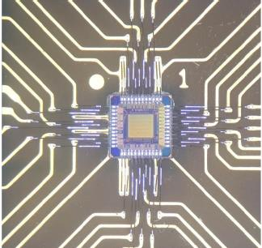
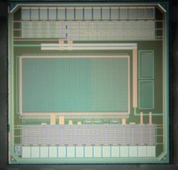
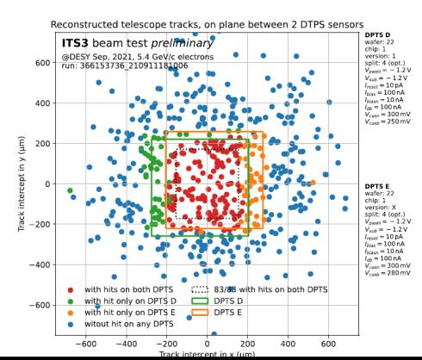
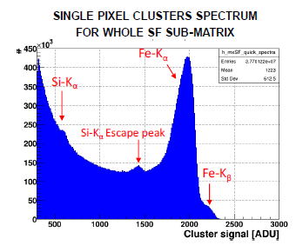
The silicon-based technologies proposed for ILC can be adapted for CC
-Reduced pitch to improve on spatial resolution:
possible with finer technologies which also gives
better charge collection efficiency).
and/or
use analog readout and shared charge
-Reduced power consumption: about 50% less when going from 180 to 65 nm
65 nm MLR1
Pitch: 15-25 mm, different EPI
Very encouraging results

Slide 23
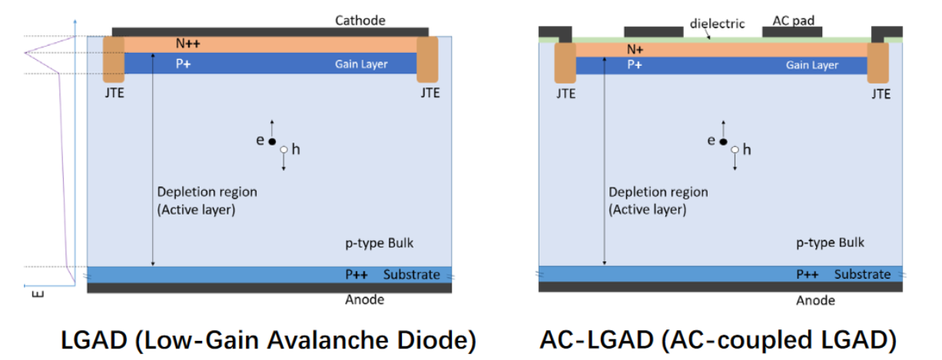
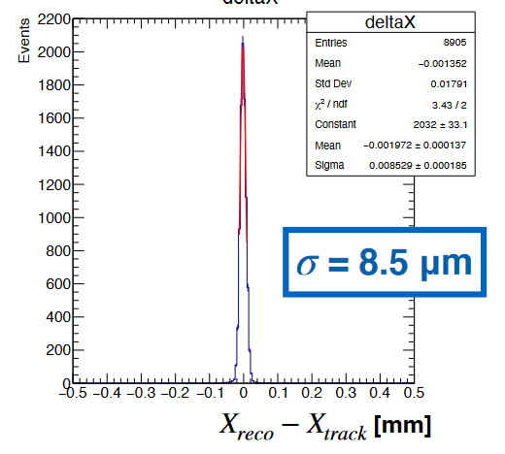
Other technologies with precise time information (4D) are also being investigated
One can have excellent spatial resolution O(1 µm )
One can have excellent timing O(10 ps)
But this may
Timing requires complex circuitry and thus large pitch
Timing increases power consumption necessitating more complex cooling system and thus high material budget
Both lead to spatial resolution degradation.
Timing layers (1-2) could be used but more in the external part
One of the most attractive technology that is under study is the 2D AC-LGAD
where a better spatial resolution an be obtained by charge sharing. M. Mandurrino et al., IEEE Electron Device Lett. 40(11) (2019) pp.1780-1783
30-40 ps

Slide 24

TPC
TPC is an important sub-detector of ILD:
200 hits → remarkable P measurement
dE/dX → PID
Low material budget
TPC is impacted by two sorts of ions
-Primary ions
-Flow Back ions
he ions produced in the TPC gas amplification drift through the gas volume for ~0.44 s
In case of ILC this results in 3 localized disks of ions drifting through the TPC each made from a ions produced by a train of 1.3k BC. This has almost no consequence on the momentum resolution
In the case of FCCee-pole (~33 MHz) it is 14 M BC producing a cloud of ions that introduces a big distortion of the electric field of the TPC

Slide 25



TPC
By placing ILD TPC within FCCee MDI structure
and a 2T magnetic field the impact of ions
produced by the tracks of the 22 kHz
hadronic Z decays that take place during
the TPC clearing time (0.44 s) was studied
and their impact on the field distortion
Is found to be quite important (up to 1 mm).
had. Z @ 50 kHz, IBF=1
~1.3 M primary ions / event
maximum distortion~ (100 + 230*IBF) μm
IBF=1-5

Slide 26




TPC
Reducing IBF is rather mandatory to be able to
reduce the distortion and then to correct for.
Several methods are proposed to reduce the IBF:
-Active gating proposed for ILC seems not possible
in CC but passive gating (E field configurations)
could help.
-Using a combination of different MPGD (MM+GEM)
can reduce the IBF.
-Most promising solution is to use Graphene to stop
IBF since graphene allows the passing of
electrons with but not ion.
J. Kang et al
NIMA 1031 (2022) 166521

Slide 27



Graphene deposition on GEM foil is being developed by CERN group using a wet transfer procedure
Coverage estimation with bilayer: ~90% after the first cleaning in ACE
Coverage estimation: ~30% after the second cleaning w/ Remover

Slide 28




Calorimeters
The most important issue to face when proposing PFA calorimeters for future CC is the power consumption in the absence of LC power-pulsing scheme. This represents 100 more power consumption that needs to be addressed. Several solutions are under scrutiny:
-Active cooling:
Similar in spirit to the one proposed for HGCAL for SiW ECAL
By adding a Cu plate containing hollow tubes in which 2-phase CO2 circulates
Or by adding a thin copper plate in thermal contact with the electronics and a
water cooling circuit that could be cast in the absorber layer
water circulation in copper pipes
SDHCAL
0.5 m
108 chips
Rectangular section tubes : 2x1 mm
1.5 m
Copper plate over: 1.5 mm
Flow out
symmetry
Flow in
PCB plate under: 1.4 mm

Slide 29
Calorimeters
The most important issue to face when proposing PFA calorimeters for future CC is the power consumption in the absence of LC power-pulsing scheme. This represents 100 more power consumption that needs to be addressed. Several solutions are under scrutiny:
-Electronics with less power consumption and/or less granularity:
First option
-Use finer technologies → less power consumption (factor of 2 or more)
350 nm → 130nm → 65 nm →
-Work out the ASIC design and optimize the power consumption of each component
Second option
Reduce the granularity
Going from pads of 5 mm x 5 mm to 1 cm x 1 cm reduced the ASIC related power consumption by a factor of 4.
here the consequence on performances needs to be carefully studied
Probably combing both and compare with realistic performance obtained with acyive cooling to decide for the future

Slide 30



Calorimeters
The most important issue to face when proposing PFA calorimeters for future CC is the power consumption in the absence of LC power-pulsing scheme. This represents 100 more power consumption that needs to be addressed. Several solutions are under scrutiny:
-New ideas:
Reduction of number of channels by interconnecting pads/pixels as far as the occupancy/ambiguity is under control
NxN→ 3N reduction
For large area detectors like calorimeters this may as efficient as PP reduction

Slide 31
Calorimeters
High rate capability of some technologies is questioned in particular at FCCee@Zpole
-
For instance GRPC-based SDHCAL in its present status could not be efficiently used
Hopefully, development of new low resistive materials such as the low-resistivity glass (Tsinghua) and low-resistivity thermoplastic (Lyon) will allow to increase the rate capability from O(10²) Hz/cm to a O(10⁴) Hz/cm
Results from Tsinghua

Slide 32
Timing@ILD
Adding time information to ILD detectors will provide them with additional tools to
to reject background and also to improve on PID and jet reconstruction
A few points that need to be considered before to switch for T-detectors:
-Time information comes however with a price, namely increasing power
consumption that we are trying to reduce
-Trackers equipped with time information could not compete with
detectors like TPC as PID detectors unless they reach a few ps of time
resolution which is not yet affordable
Calorimeters with time information could be very useful for PID and PFA but
this should be in balance with the degradation of energy resolution due to
active cooling

Slide 33
Conclusion
ILD collaboration intends to play a major role in any future e⁺ e⁻ colliders
ILD@ILC has reached the required maturity even though improvements could always been brought in
ILD@CC studies has started
  Adaptation of ILD detector within the constraints of CC
  Adequacy of some sub-detectors with CC conditions and solutions
  Physics performance study (not shown in this talk)
ILD collaboration is eager to build bridges with other collaborations to face the challenges the CC environment pose

