Slide 1

Application of Particle Transformer in Quark Flavor Tagging
Presenter: Lai Gui
Date: 2023-08-01

Slide 2
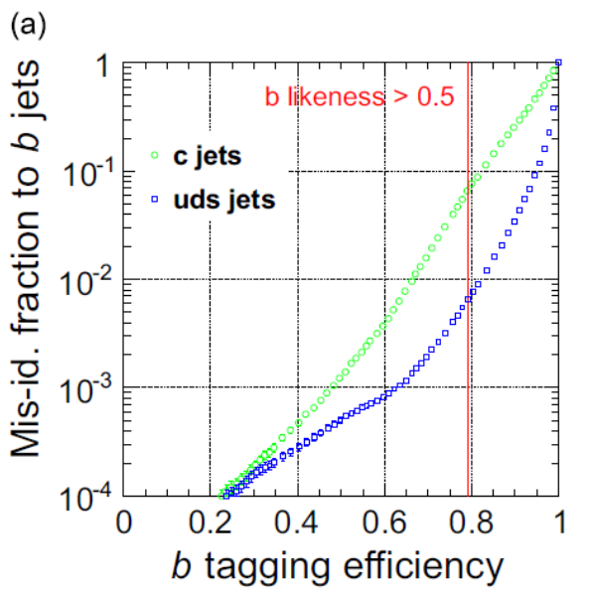
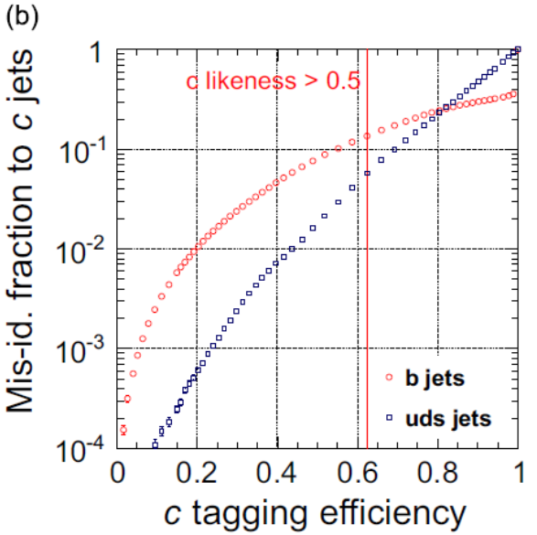
Background
Precise measurements instrumentation and reconstruction software are essential for the ILC programme.
Various frameworks have been developed for jet flavour identification.
LCFIPlus (published 2013)^{[1]} was successful in vertex finding, jet clustering and flavour tagging.
Reached a reasonable performance of:
  b-tag: 80% eff., 10% c / 1% uds acceptance;
  c-tag: 50% eff., 10% b / 2% uds acceptance.

Slide 3
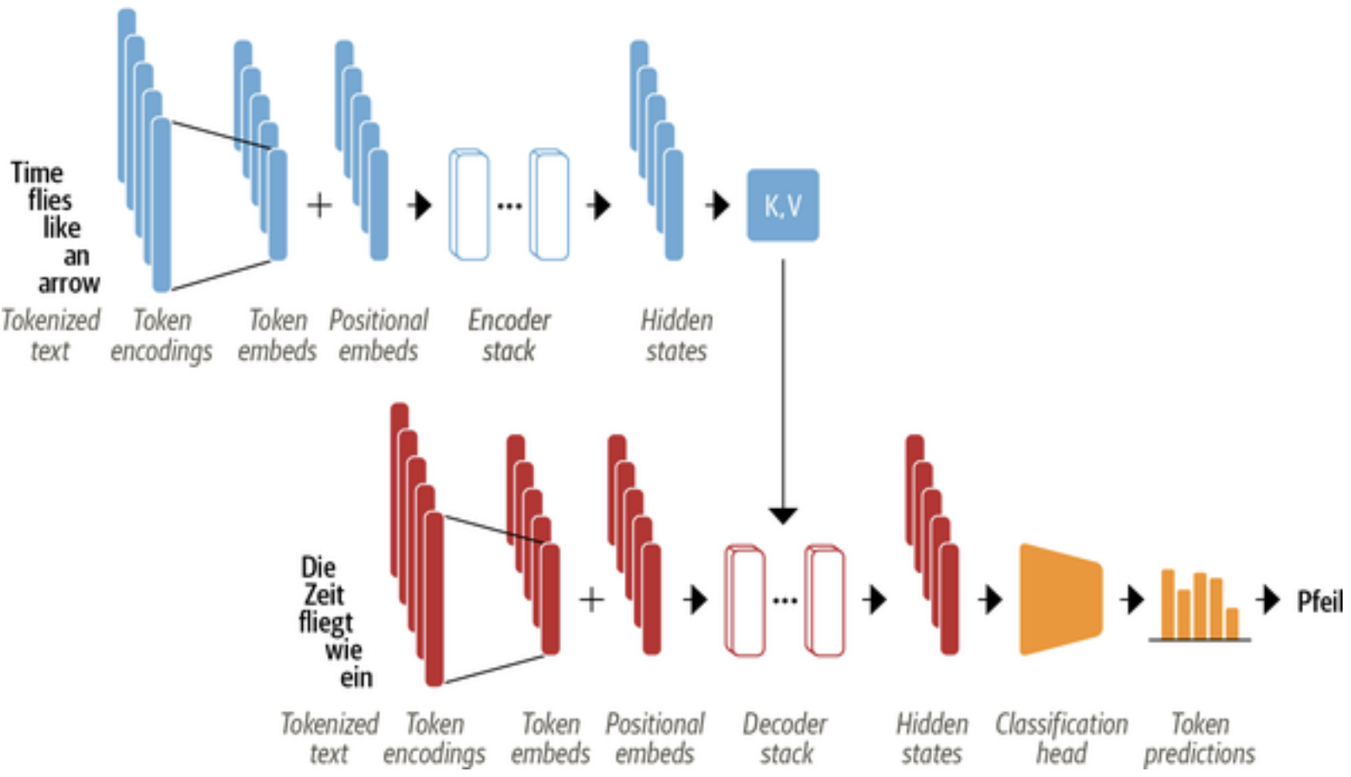
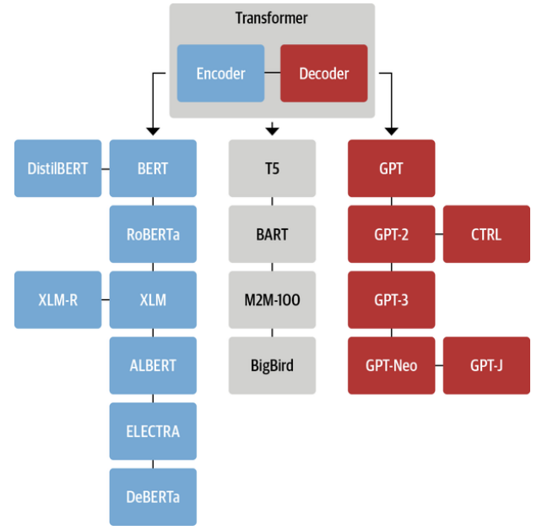
Transformer
Input is converted by the Encoder into a sequence of hidden states that is consisted of Token Embeds and Positional Embeds.
This hidden state is then processed through layers of Self-Attention and Feed-Forward neural networks.
The Self-Attention mechanism calculates the relative importance of each token relative to all the other tokens in the input sequence (Outperforms traditional RNN and CNN).
The Decoder then outputs one token at a time, and this token is then added to the input to generate the next context iteratively.

Slide 4
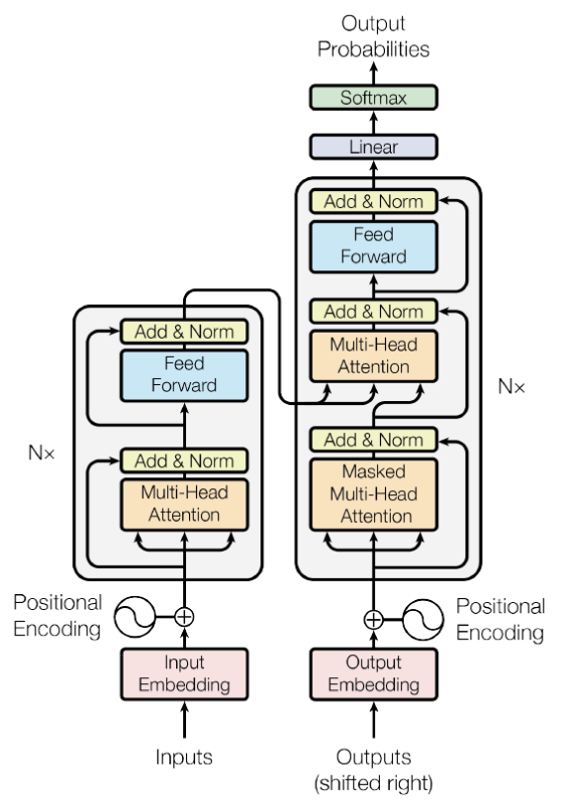
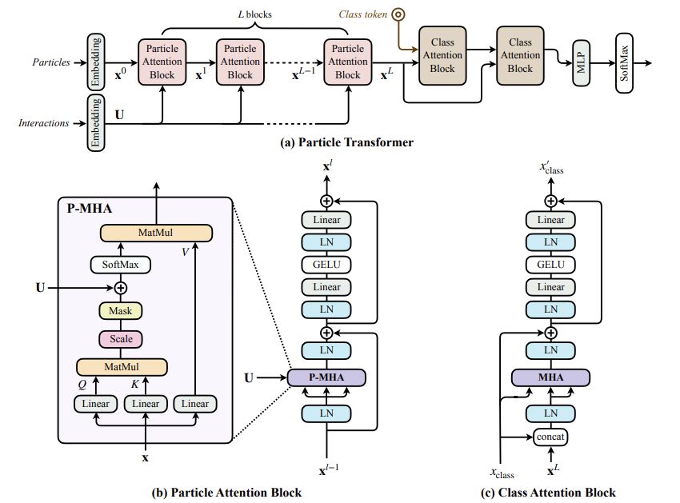
Comparison between regular Transformer and Particle Transformer
Note: MHA – MultiHeadAttention
P-MHA – Augmented version of MHA by Particle Transformer that
involves Interactions Embeddings instead of Positional Embeddings

Slide 5
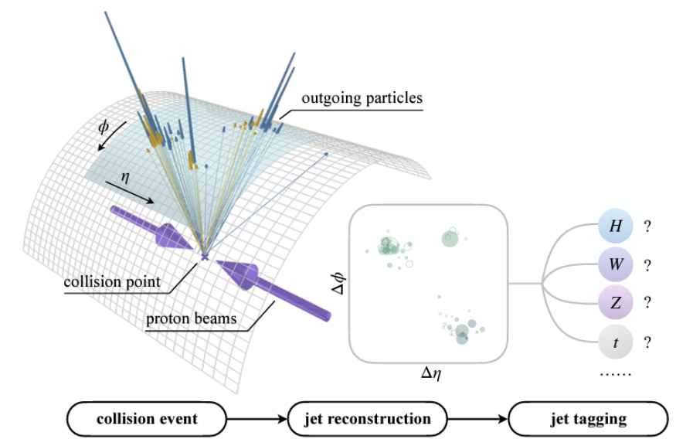
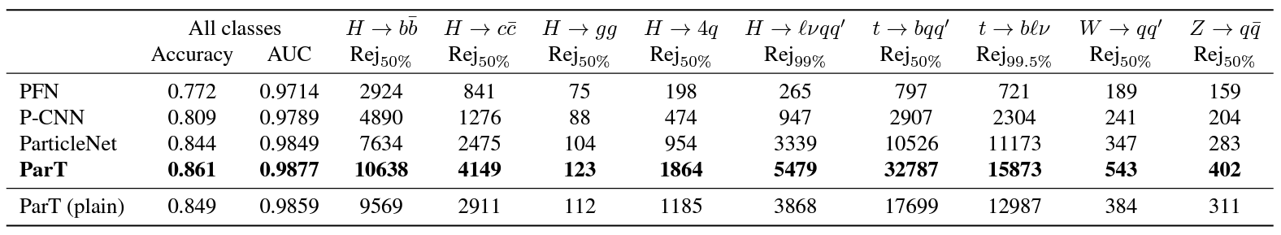
Particle Transformer (ParT)
A new Transformer-based architecture for Jet tagging, published in 2022^{[2]}.
It analyses the readings collected after collision events to reconstruct jets. (Illustration of CERN LHC p-p collisions)
Surpasses the performance of previous architectures by a large margin. Values below are rejection ratio (inverse of acceptance ratio).

Slide 6
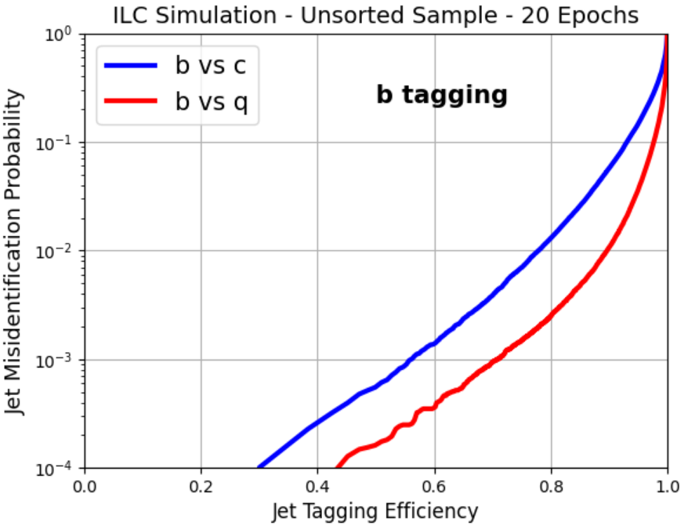
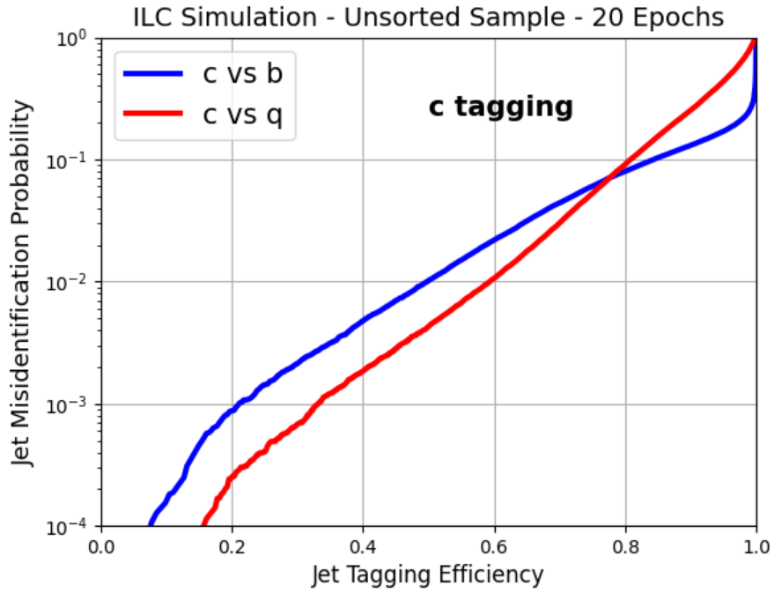
Application of ParT to ILC data
Jet tagging performance is greatly improved by ParT immediately:
  b-tag: 80% eff., 1.29% c / 0.247% uds acceptance;
  c-tag: 50% eff., 1.02% b / 0.428% uds acceptance.
  The performance is improved by 4.05 – 9.80 times compared to LCFIPlus with the same set of data.
  Can this performance to be further improved?

Slide 7
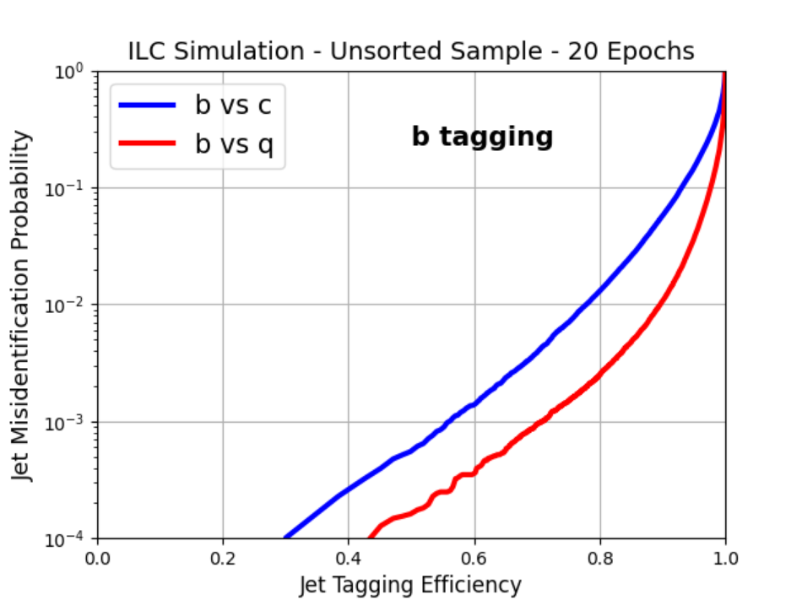
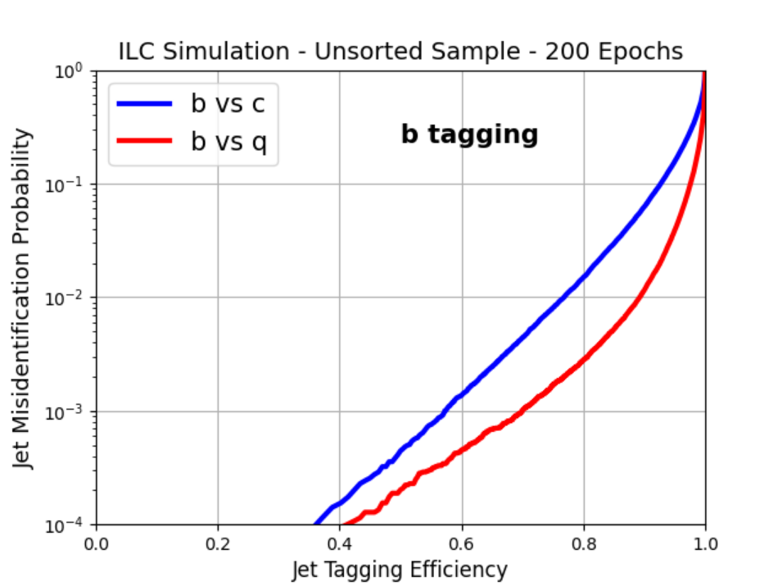
Training parameters - epochs
20-epoch training takes 3 hours
200-epoch training takes 30 hours
No significant improvement in tagging efficiency at 0.6 or 0.8 efficiency
Difference towards 0.4 efficiency might due to random fluctuation

Slide 8
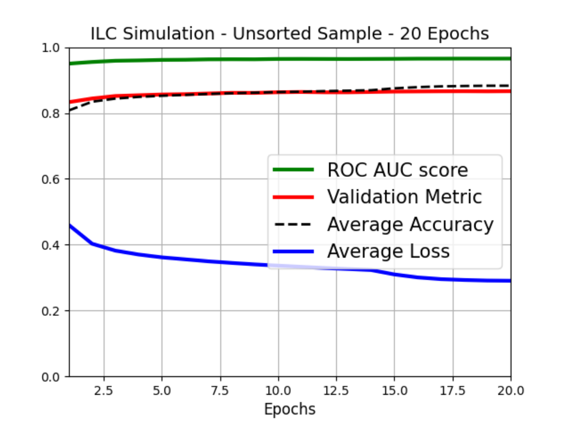
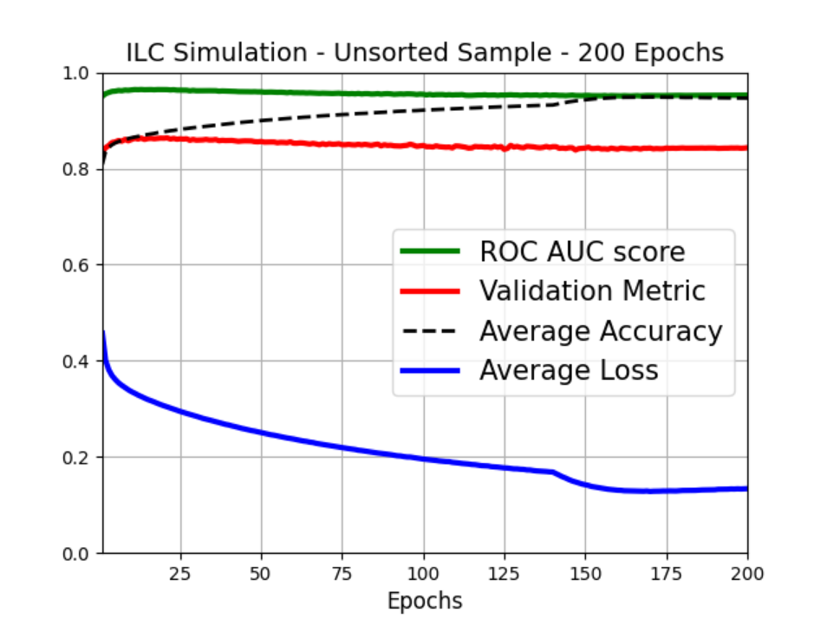
Training parameters - epochs
Both ROC AUC score and Validation Metric reaches a maximum around 20 epochs
The Average Accuracy and Average Loss still witness an improvement, but not significant in the analysis result – overtraining after 20 epochs
Hence 20 epochs of training is selected to be the standard for future training

Slide 9
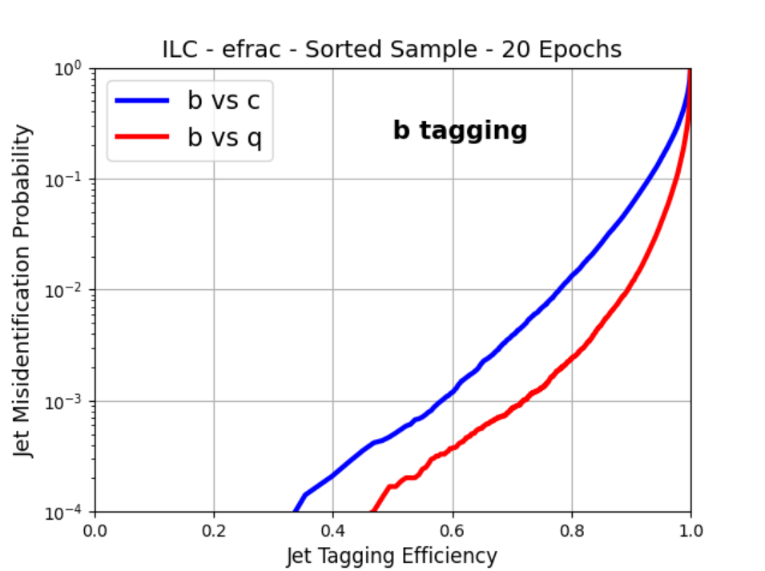
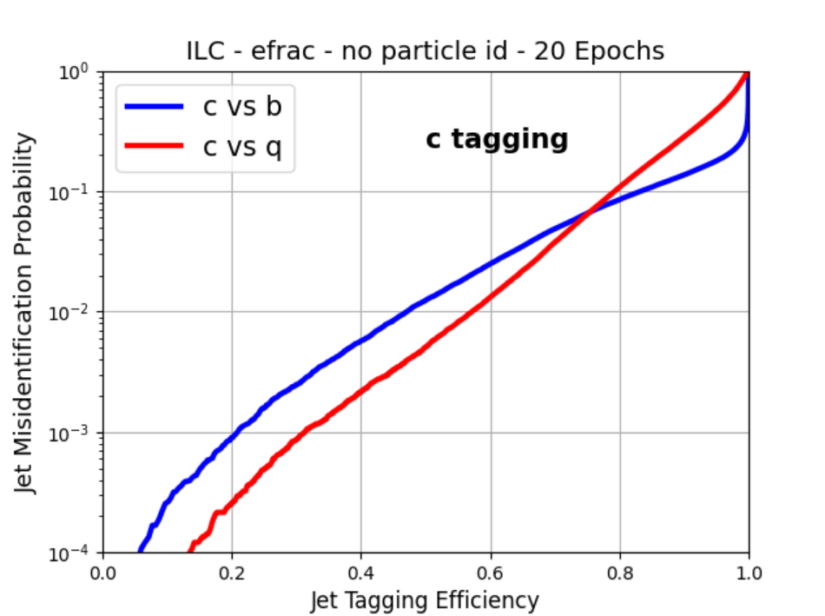
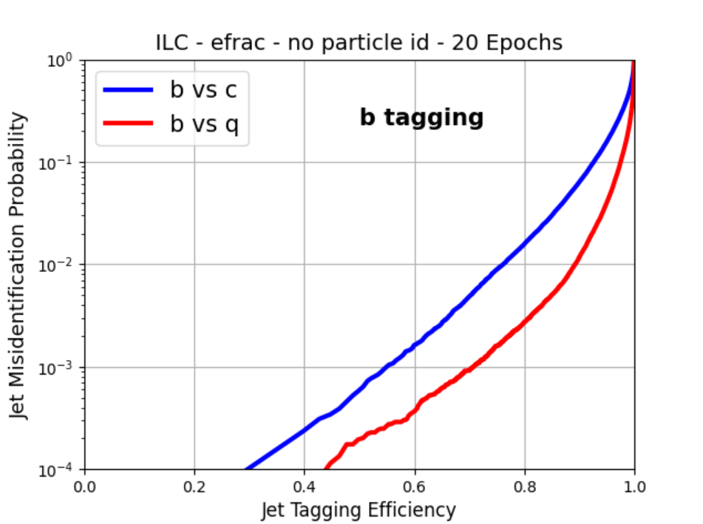
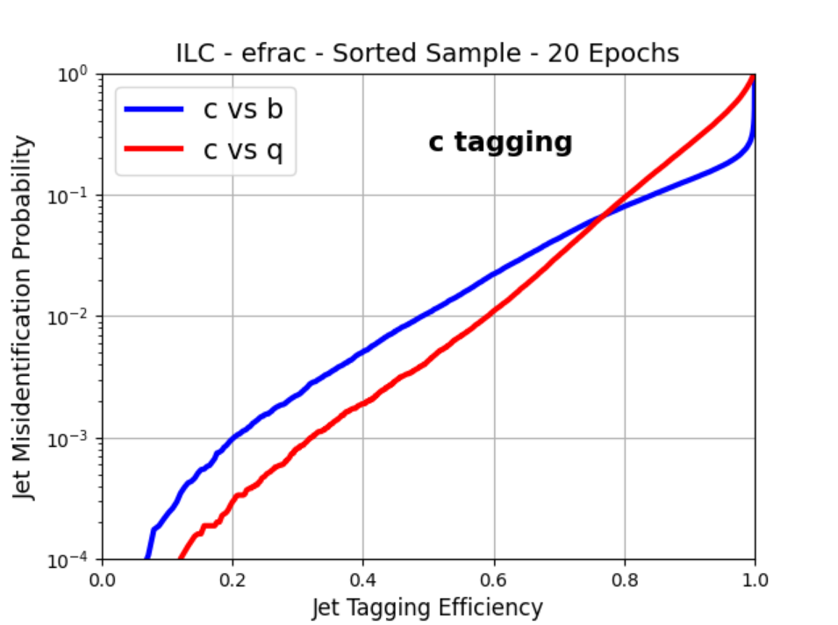
Training parameters – Particle ID
With Particle ID:
  b-tag: 80% eff., 1.32% c / 0.237% uds acceptance;
  c-tag: 50% eff., 1.06% b / 0.429% uds acceptance.
Without Particle ID:
  b-tag: 80% eff., 1.57% c / 0.272% uds acceptance;
  c-tag: 50% eff., 1.24% b / 0.507% uds acceptance.
Particle ID improves tagging performance

Slide 10
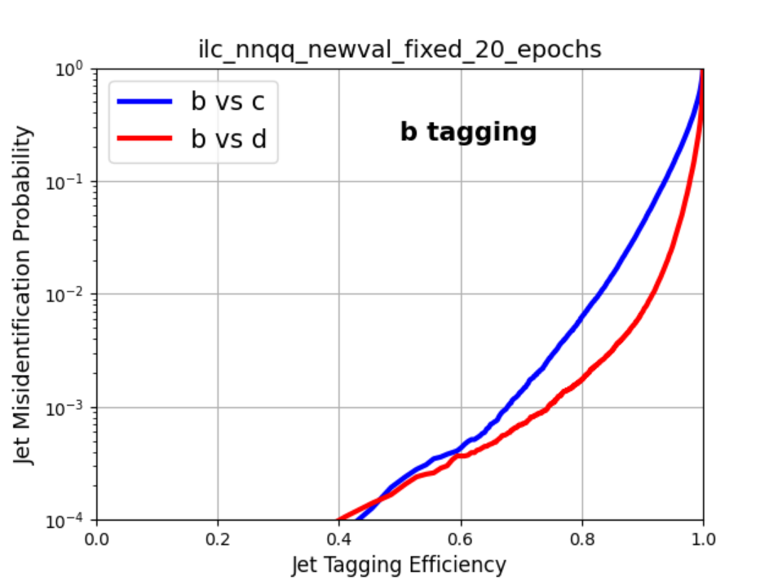
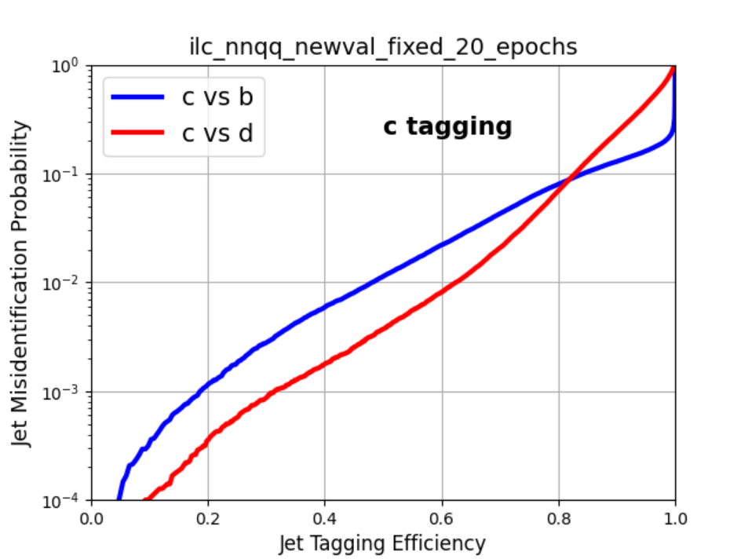
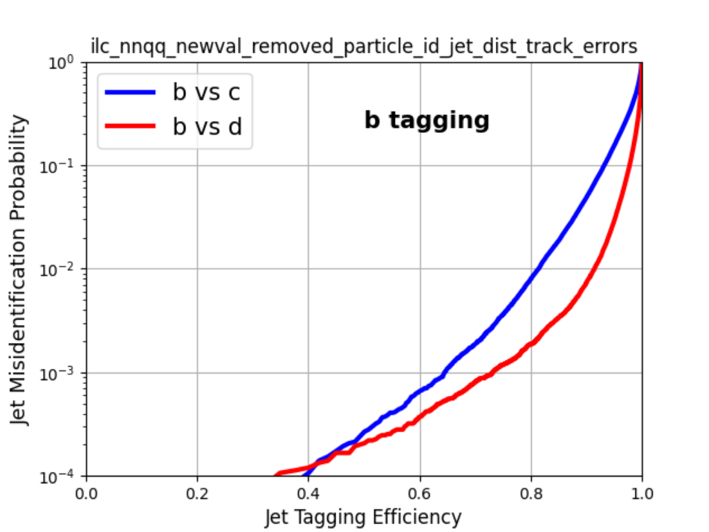
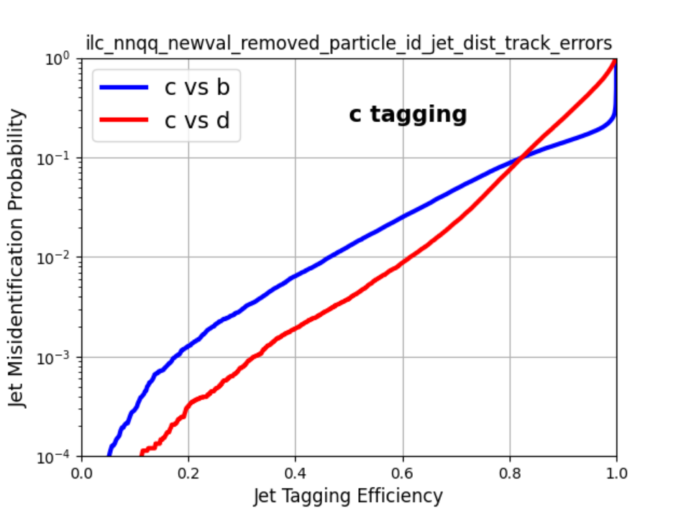
Training parameters – Jet Distance Values and Track Errors
With Jet Distance Values and Track Errors :
  b-tag: 80% eff., 0.623% c / 0.174% uds acceptance;
  c-tag: 50% eff., 1.14% b / 0.372% uds acceptance.
Without Jet Distance Values and Track Errors :
  b-tag: 80% eff., 0.794% c / 0.187% uds acceptance;
  c-tag: 50% eff., 1.28% b / 0.380% uds acceptance.
Jet Distance Values and Track Errors improves tagging performance

Slide 11
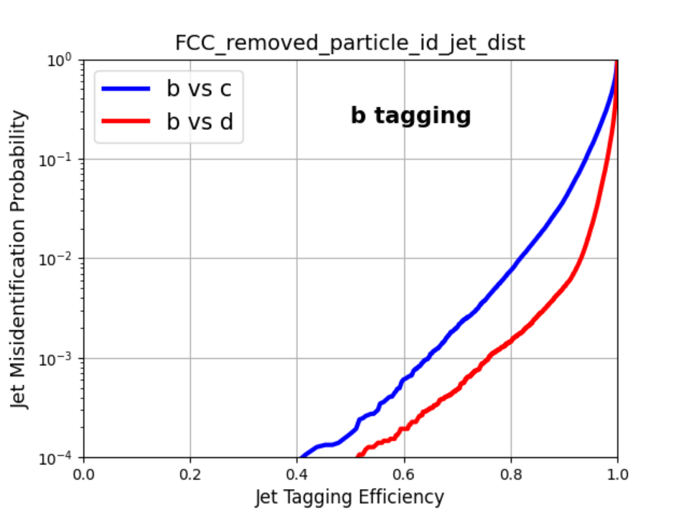
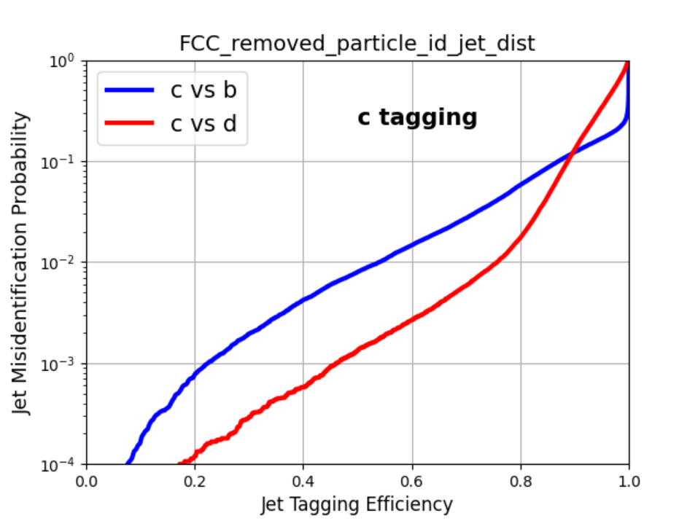
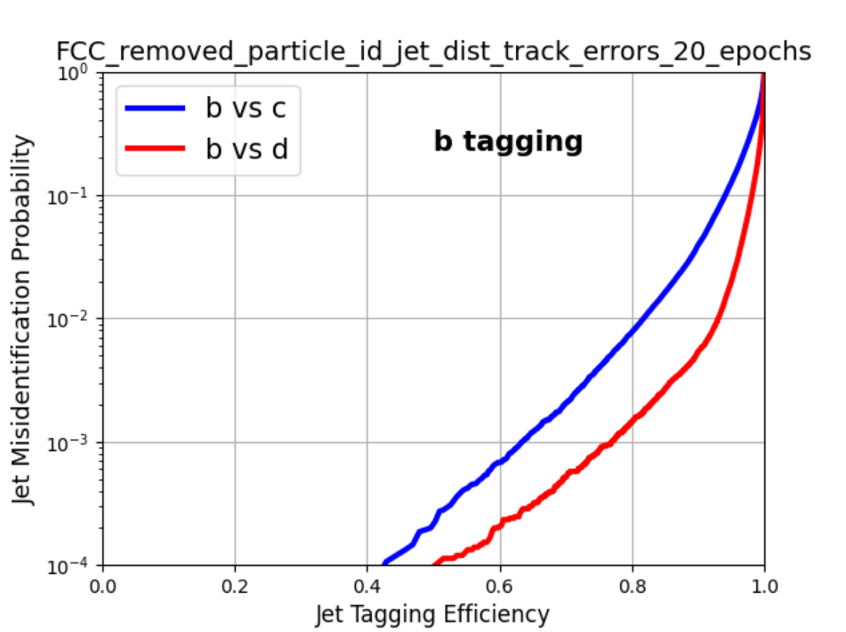
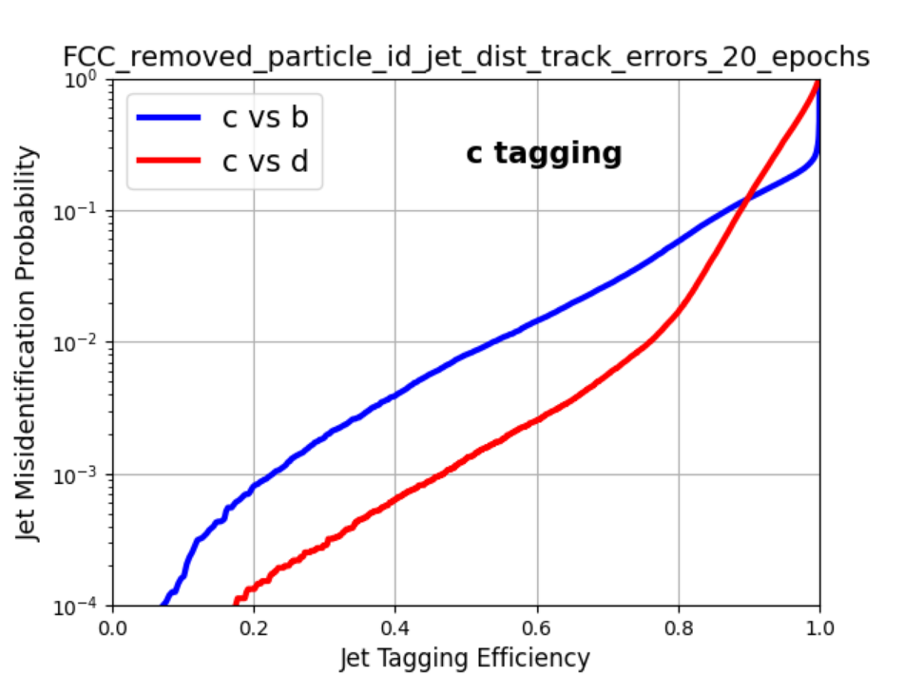
Training parameters – Track Errors
With Track Errors:
  b-tag: 80% eff., 0.747% c / 0.145% uds acceptance;
  c-tag: 50% eff., 0.797% b / 0.131% uds acceptance.
Without Track Errors:
  b-tag: 80% eff., 0.773% c / 0.146% uds acceptance;
  c-tag: 50% eff., 0.799% b / 0.130% uds acceptance.
Track Errors does not affect tagging performance significantly.

Slide 12
Training parameters – More to be confirmed

Slide 13
Reference List
[1] https://doi.org/10.1016/j.nima.2015.11.054
[2] https://arxiv.org/abs/2202.03772

