Slide 1

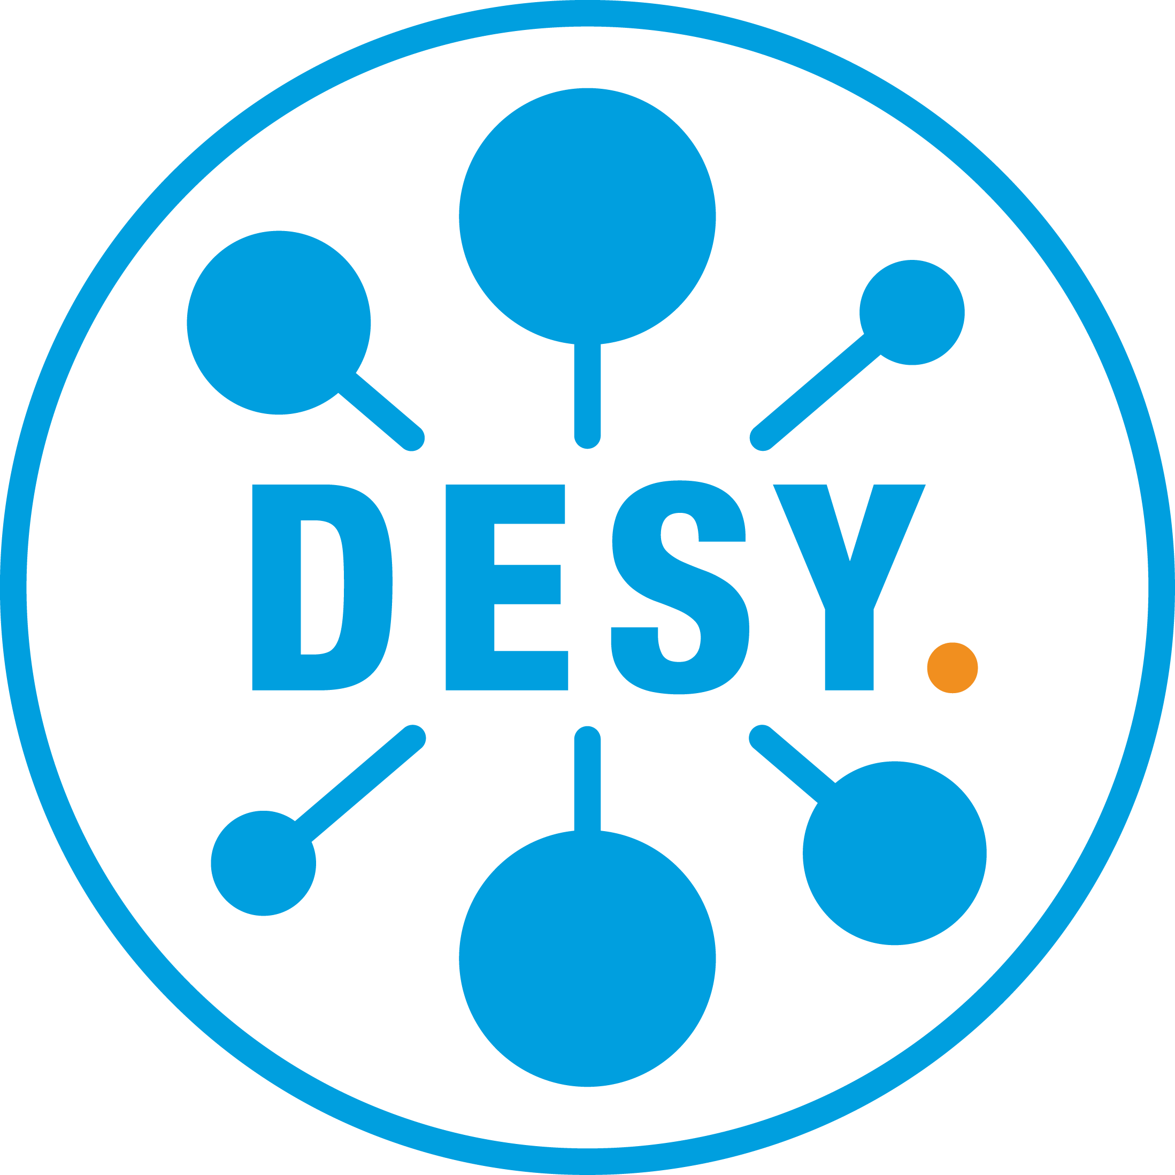
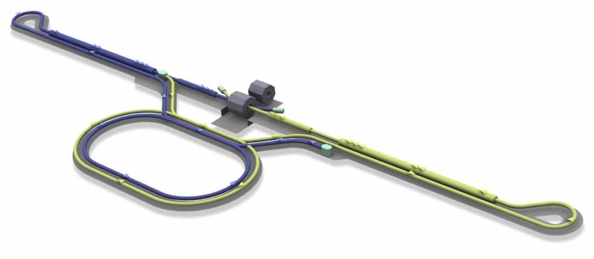
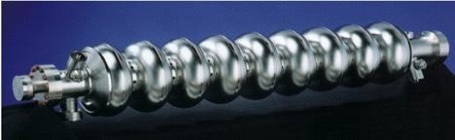
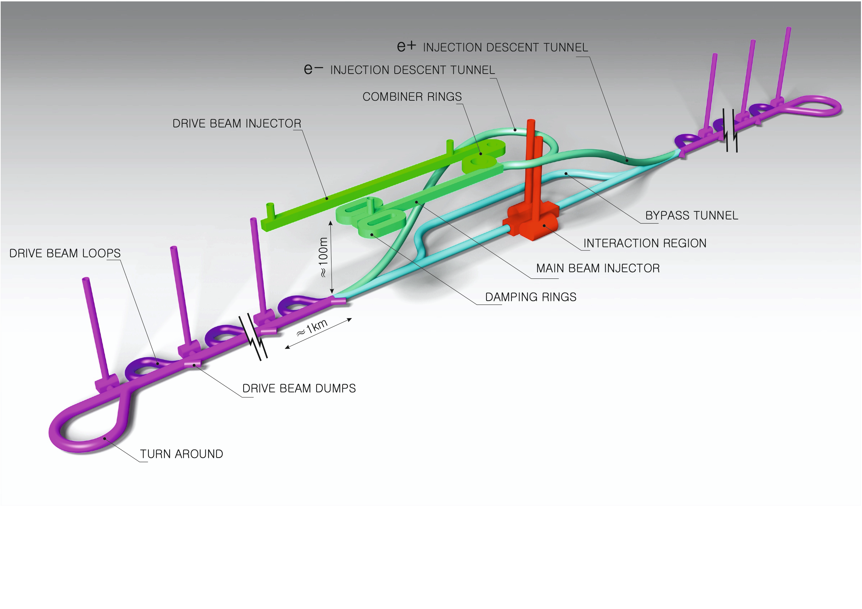
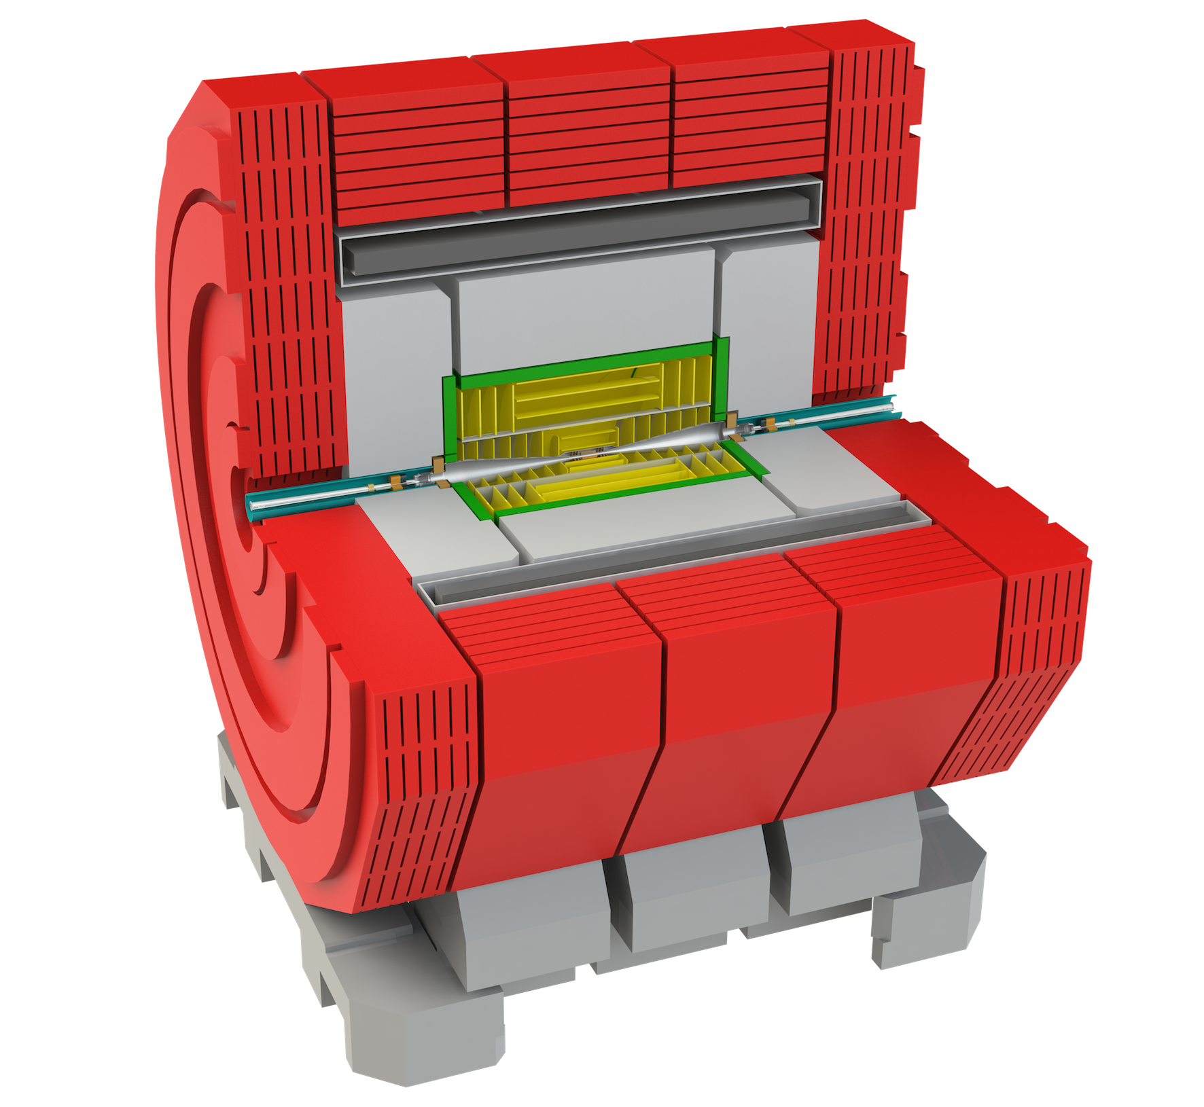
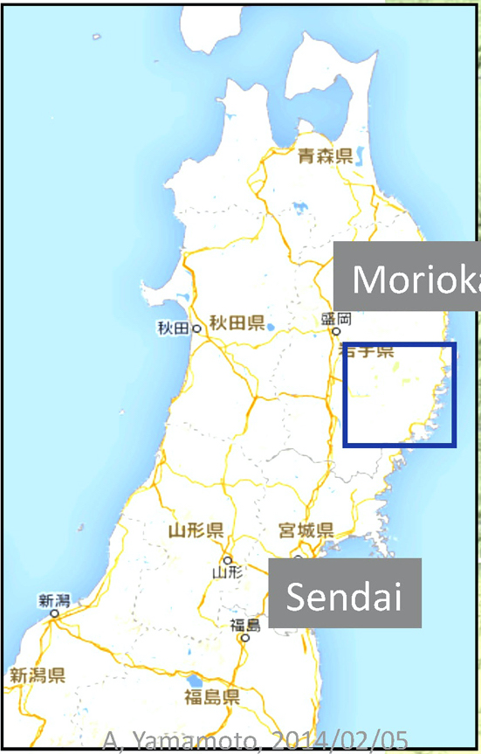
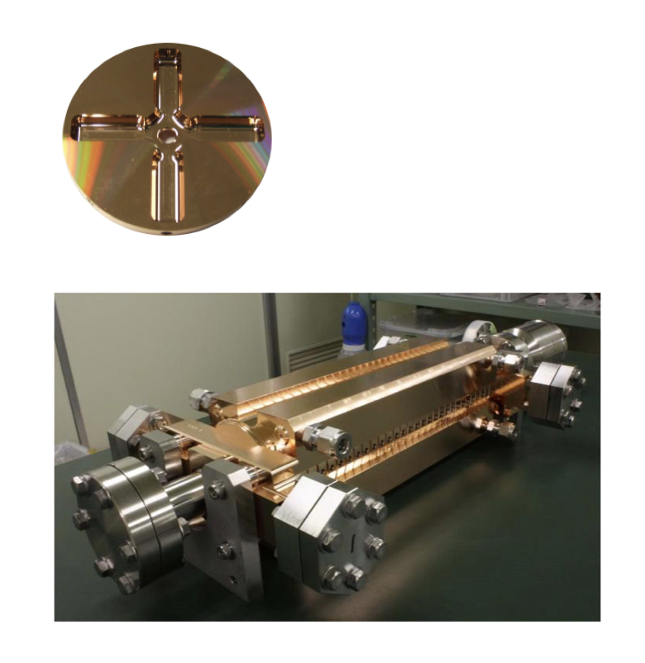

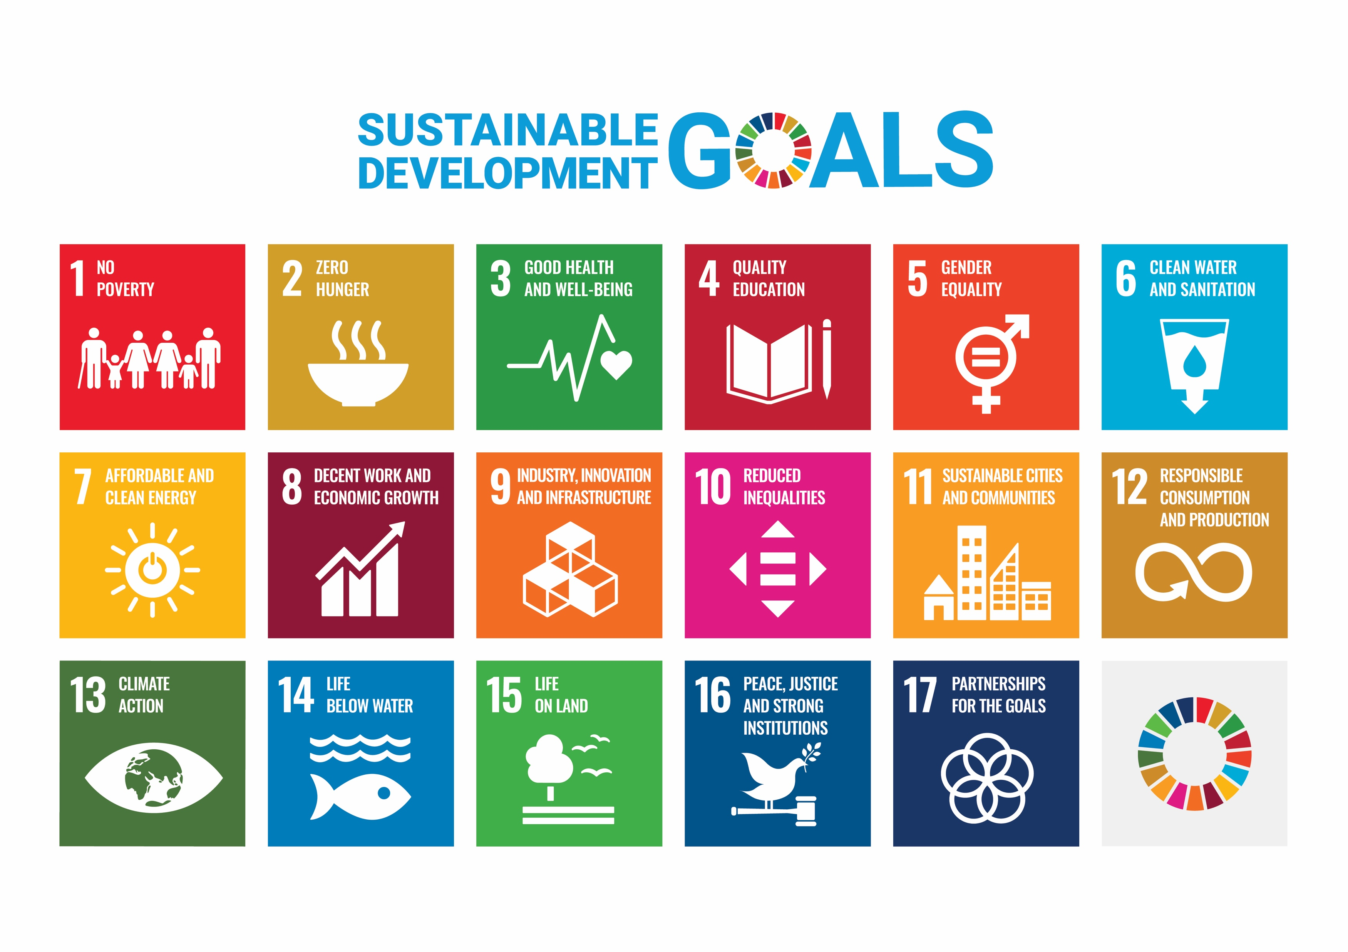
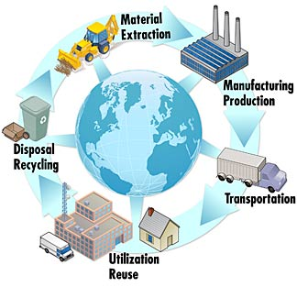

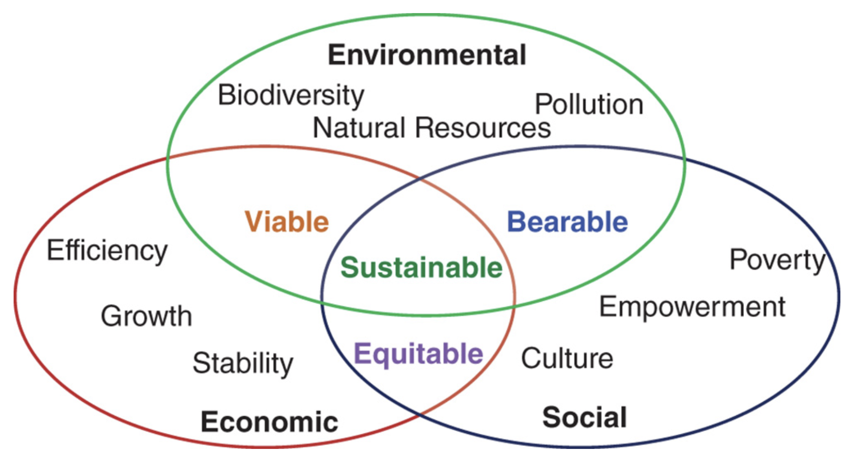
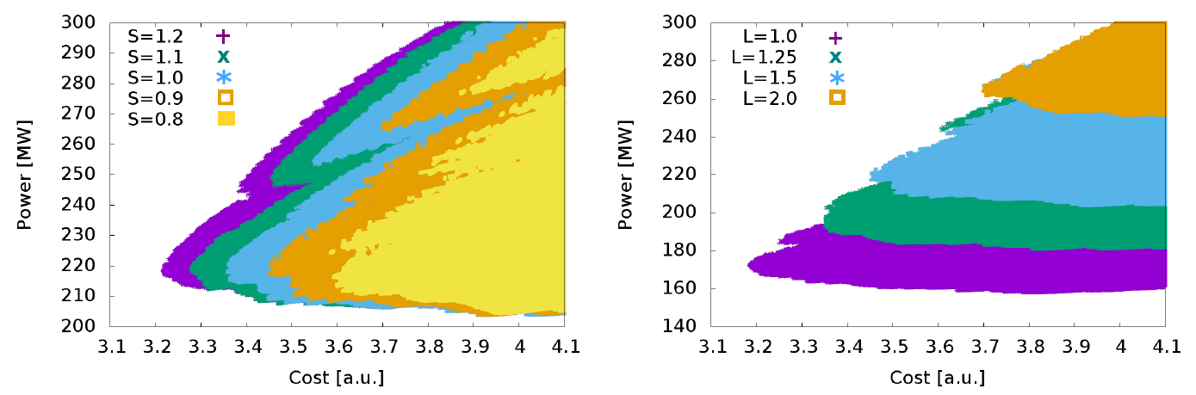
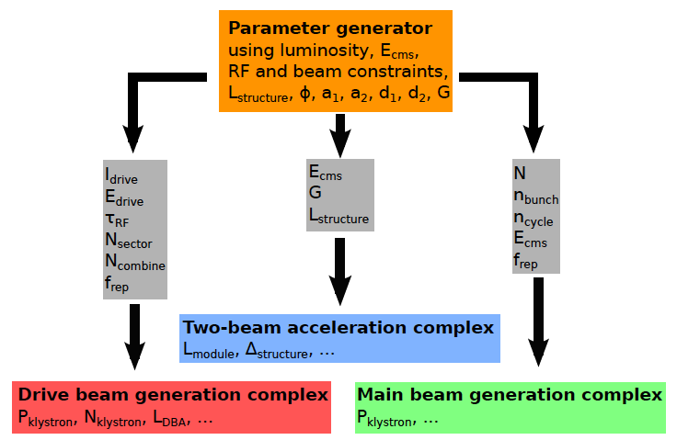
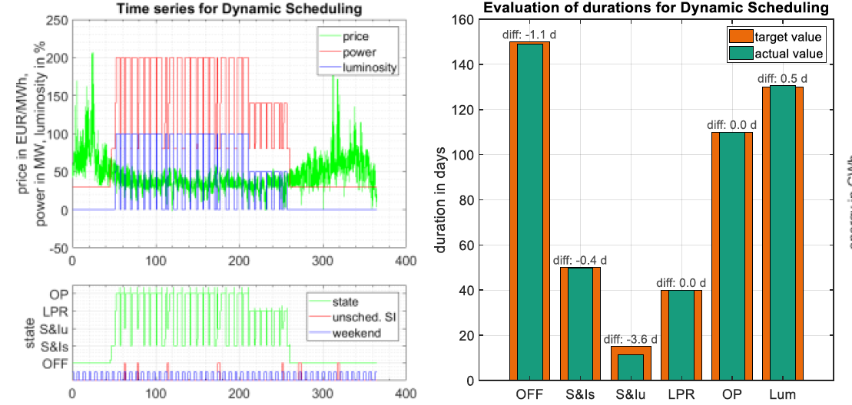
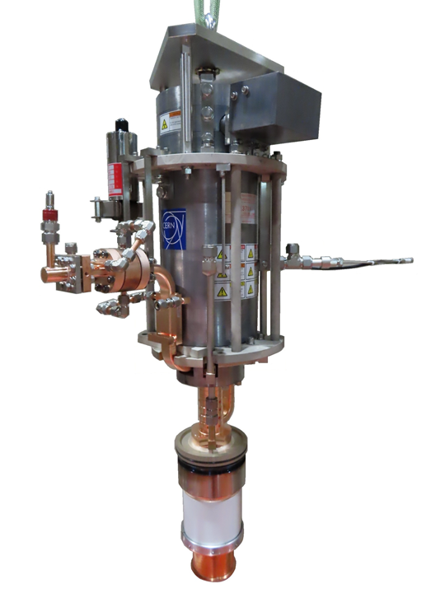
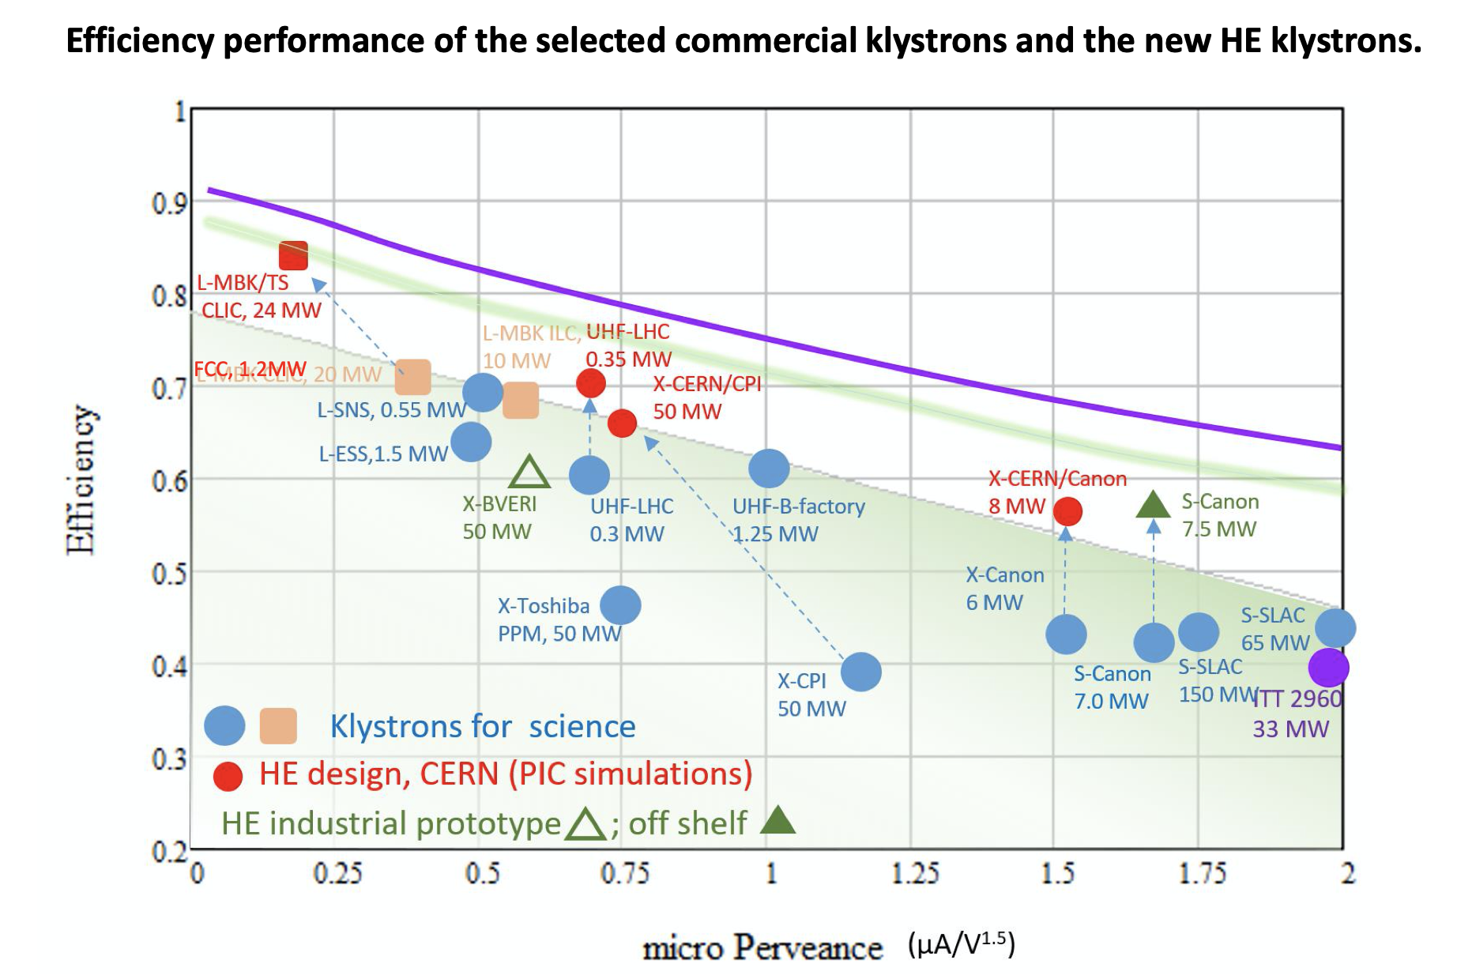
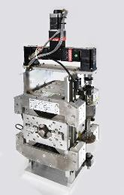
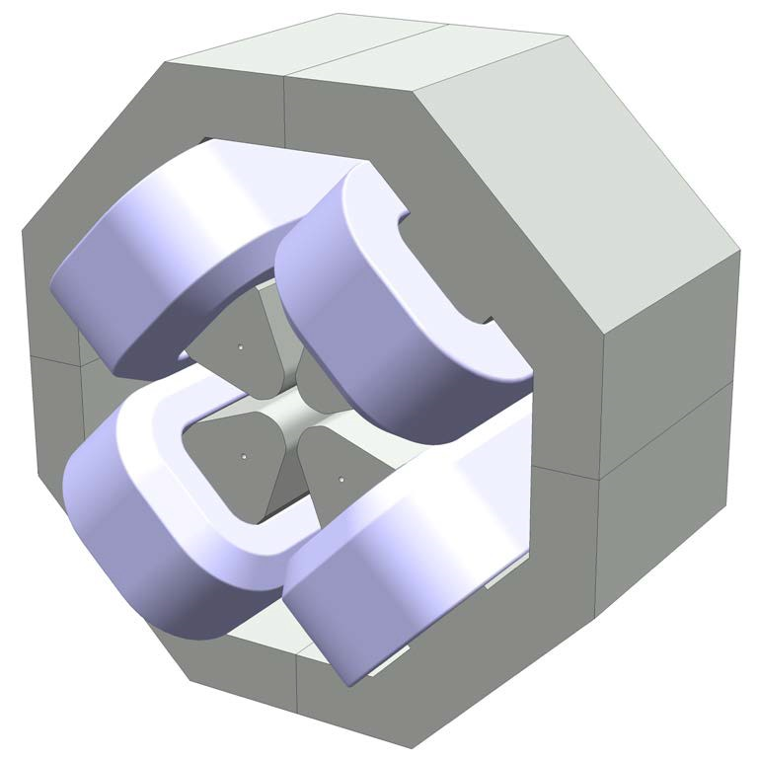
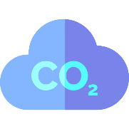
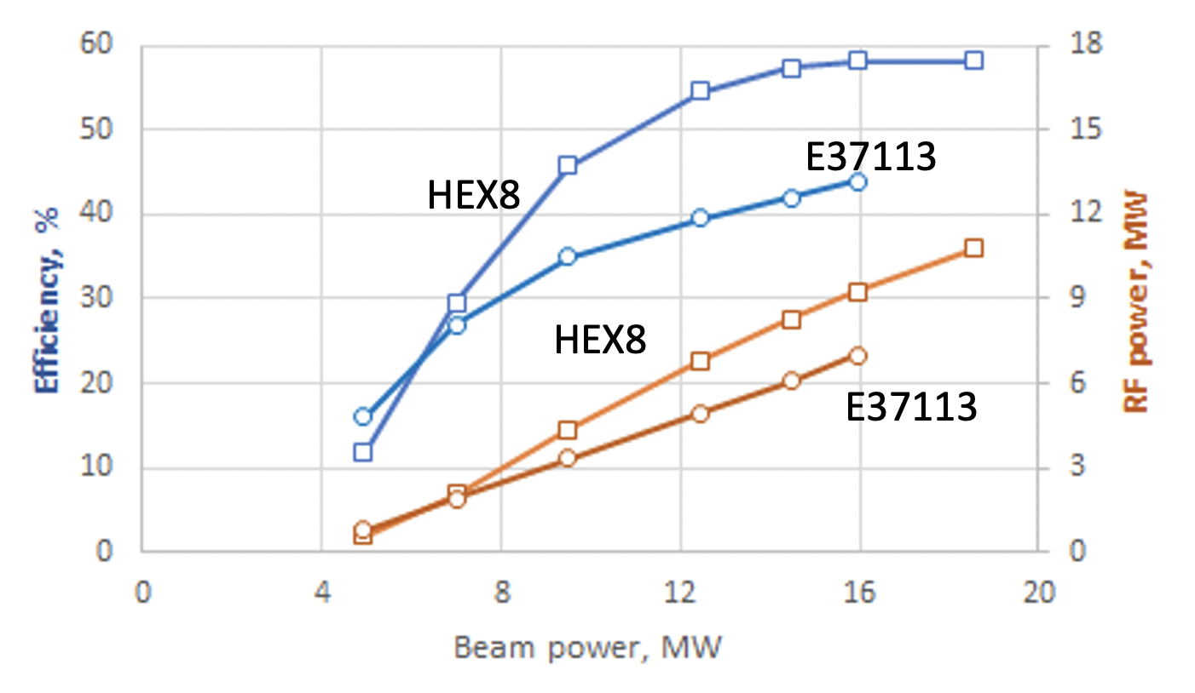


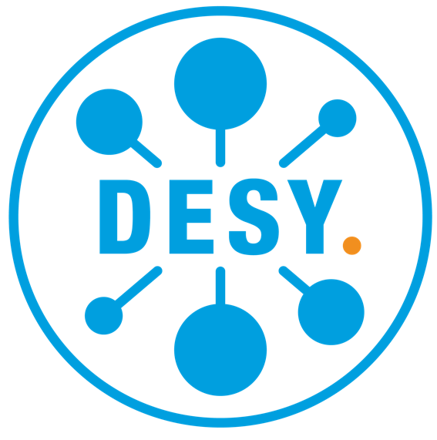
Sustainability Studies for
Future Linear Colliders.
Making the next generation of accelerators more sustainable
Benno List¹, S. Michizono², T. Saeki², S. Stapnes³, M. Titov^{4. 1}DESY, ²KEK, ³CERN, ⁴CEA Saclay/Irfu
International Linear Collider ILC
Item | Parameters
C.M. Energy | 250 GeV
Length | 20km
Luminosity | 1.35 x10³⁴ cm⁻²s⁻¹
Repetition | 5 Hz
Beam Pulse Period | 0.73 ms
Beam Current | 5.8 mA (in pulse)
Beam size (y) at FF | 7.7 nm＠250GeV
SRF Cavity G. Q₀ | 31.5 MV/m (35 MV/m) Q₀ = 1x10 ¹⁰
Compact Linear Collider CLIC
e- Main Linac
  Timeline: Electron-positron linear collider at CERN for the era beyond HL-LHC
  Compact: Novel and unique two-beam accelerating technique with high-gradient room temperature RF cavities (~20’500 structures at 380 GeV), ~11km in its initial phase
  Expandable: Staged programme with collision energies from 380 GeV (Higgs/top) up to 3 TeV (Energy Frontier)
  CDR in 2012 with focus on 3 TeV. Updated project overview documents in 2018 (Project Implementation Plan) with focus 380 GeV for Higgs and top.
  Cost: 5.9 BCHF for 380 GeV
  Power: 110 MW at 380 GeV corresponding to ~50% of CERN’s energy consumption today
  Comprehensive Detector and Physics studies
RTML(e-)
(Ring To ML)
e+ Source
Beam delivery system (BDS)
8,000 SRF cavities at 1.3GHz, 2K
Damping Ring (DR)
Dump
e- Source
e+ Main Linac
Total 20.5 km
RTML(e+)
(Ring To ML)
Accelerating structure prototype for CLIC:
12 GHz (L~25 cm)
Proposed Higgs factory in Tohoku (Japan), 250GeV initial energy
Superconducting Main Linac for energy efficiency
Timeline: 4 year preparation + 10 years construction -> operation 2037
Expandable to 1TeV
Cost: 6.3 – 7.0 B$, including human ressources
Power: 111 MW at 250GeV
Morioka
1
Considering the full lifecycle of a product, facility or system is crucial for the evaluation and overall optimisation of its impact to the environment, society and economy.
Impact categories according to the RCiPe Midpoint(H) 2016 method.
Considering more impact categories in addition to Global Warming Potential (GWP) is crucial for trade-off studies, e.g. in the case of permanent magnets which require problematic materials such as rare earths.
Goals
https://www.nist.gov/
Lifecycle Stages according to BS EN 17472: Sustainability of construction works – Sustainability assessment of civil engineering works – Calculation methods.
In 2015, the UN adopted “2030 Agenda for Sustainable Development” with 17 goals, addressing economy, society and environment. Global accelerator projects contribute to many of these goals, including fostering peace and understanding and education.
Full Lifecycle
Follow
Standards
Impact
Categories
CLIC 380
Klystron
ILC 250
Development that meets the needs of current generations without compromising the ability of future generations to meet their needs and aspirations. (WCED, 1987)
WCED (World Commission for Environment and Development) (1987) Our Common Future, Oxford University Press, Oxford.
Tons CO₂-eq
CLIC 380
Drive Beam
Cover of the “Brundtland Report” 1987
Lifecycle
Assessment
Result of a comparative Lifecycle Assessment (LCA) for the construction stages (A1-A5) of the CLIC and ILC underground civil engineering structures (tunnels, caverns, and shafts) according to BS EN 17472.
ARUP 2023
Sustainability comprises environmental, economic and social dimension. For a project to be sustainable, all dimensions need to be considered and balanced.
Definition
Lifecycle
Thinking
Global Warming
Potential
R.Y. Surampalli et al. (eds), Sustainabilit.y Wiley 2020.
SUSTAINABILITY
Professional Lifecycle Assessment (LCA) studies consider the full lifecycle of a project in corformance to international standards. One such study on the underground civil facilities was performed by the ARUP company on behalf of CLIC and ILC.
ARUP 2023
Reduce
Impacts
The lifecycle assessment of CLIC and ILC tunnels identified reduction potentials around 40%, e.g. through
Use of less CO2 intensive materials
Reduction of tunnel lining thickness
System
Design
Improve
A study by Fraunhofer Institute investigated in howfar CLIC could be running exclusively on renewable energy resources.
Linear accelerators are capable of modulating power consumption according to the availability of regenerative energy sources, a key feature for integration into future energy networks.
Optimize the overall systems design with respect to costs (monetary or environmental cost) while keeping the key performance indicators as required.
Operation
https://edms.cern.ch/document/2065162/1
Components
Optimisation of key components for better performance, efficiency and waste during production reduces the overall environmental impact of the project.
Lifecycle assessments help in balancing overall costs, CO2 and other impacts such as ecotoxicity or resource scarcity.
A scan of the CLIC parameter space was performed to find the optimal combination of parameters such as cavity gradient, iris, cells per structure, etc.
Ref: arXiv:1608.07537, Sec. 3.3, and CLIC-Note-1031
Klystrons
steel 201kg
copper 52kg
Magnets
2-step low-temperature baking (single-cell cavities)
Cavities
electricity 1160 kgCO₂e / year
cooling 340 kgCO₂e / year
R&D pushes performance of superconducting cavities
New materials (Nb3Sn) and new surface treatments (shown here: mid-RT bake [Grasselino et al arXiv:1806.09824]) make it possible to obtain higher gradients with lower cryogenic losses at lower cost and/or (for Nb3Sn) at higher temperature.
This leads to
Reduced raw material use,
Reduced use of chemicals for electro polishing
Reduced cryogenic power
LCA of a conventional resistive electromagnet
Prototype of 8MW high-efficiency X-band klystron
CERN – Canon,
CLIC-Note-1176
NdFeB 1097kg
aluminium 210kg
steel 91kg
LCA of a coreresponding permanent magnet
Development of high-efficiency klystrons based on novel beam optics (Core Stabilisation Method, Core Oscillation Method, Two Stage) greatly improves output power and efficiency of klystrons, reducing the energy demand of accelerators.
I. Syratchev, https://indico.cern.ch/event/1138197/contributions/4821294/
and https://indico.slac.stanford.edu/event/7467/contributions/6129/
Replacing resistive electromagnets by permanent magnets has a large potential to reduce power consumption. The ZEPTO project has successfully produced ands tested tuneable permanent magnet quadrupoles. It is important to consider the full lifecycle to assess whether the savings are beneficial overall.
Ref: B. Shepherd, ESSRI workshop 2022.

