Slide 1

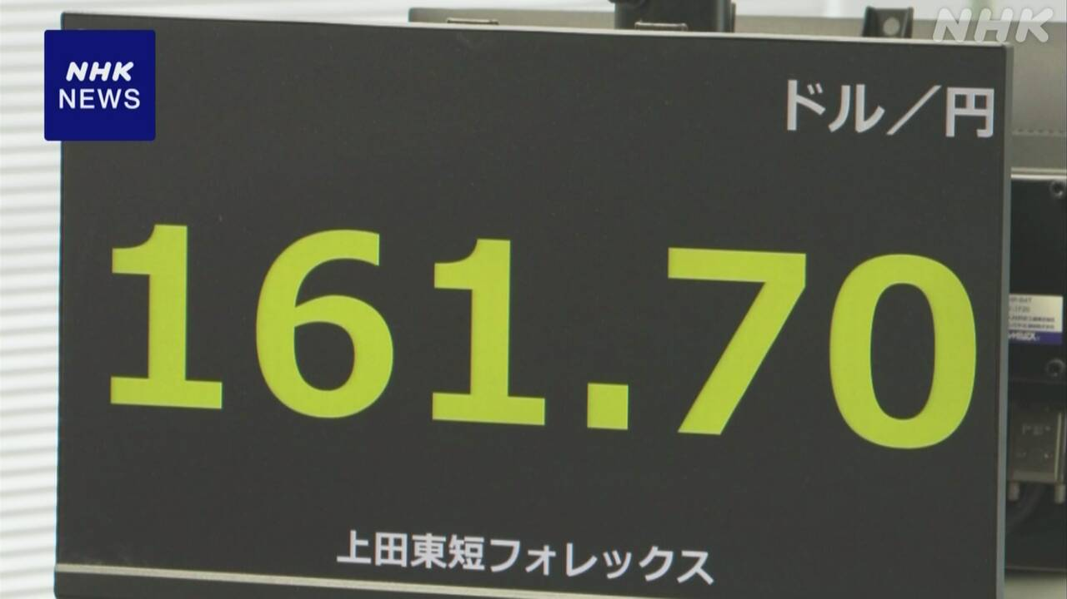
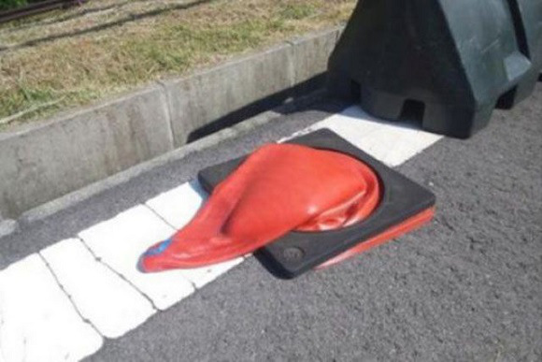
Welcome to Japan
LCWS2024
１USD=
Exciting Night
Crazy Hot
Shoji ASAI (KEK)

Slide 2

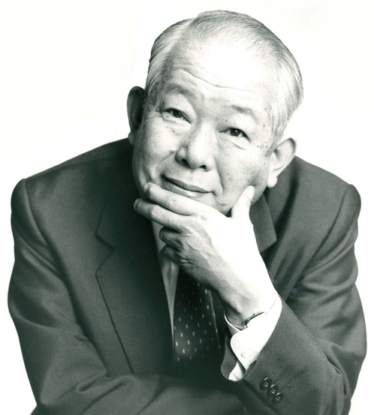
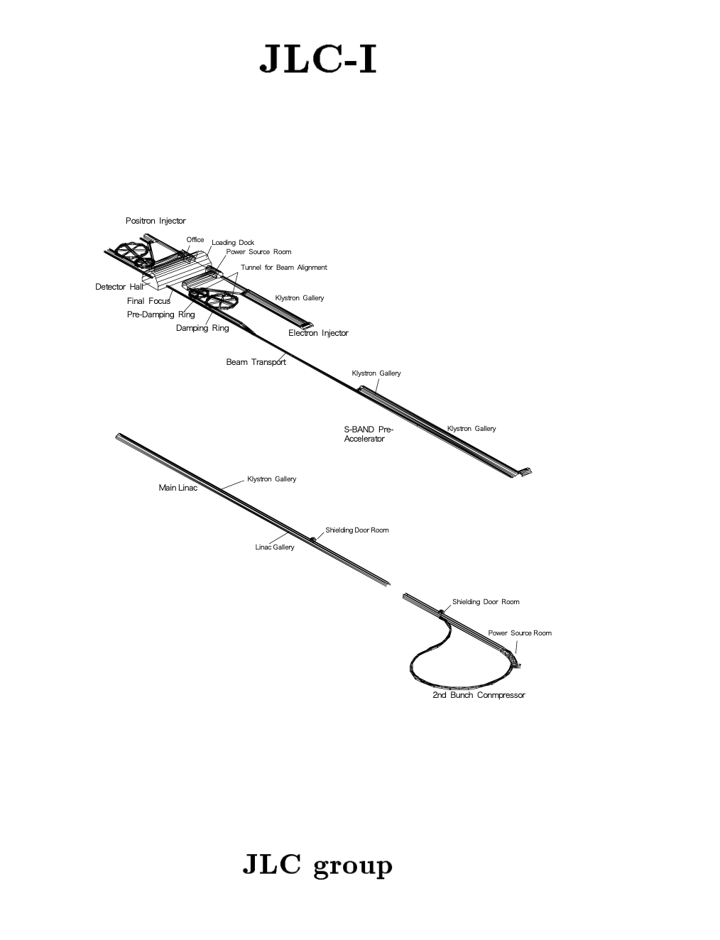
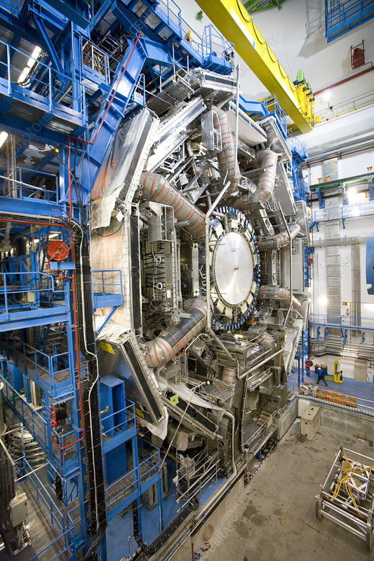
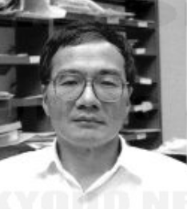
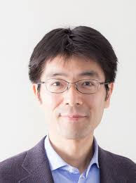
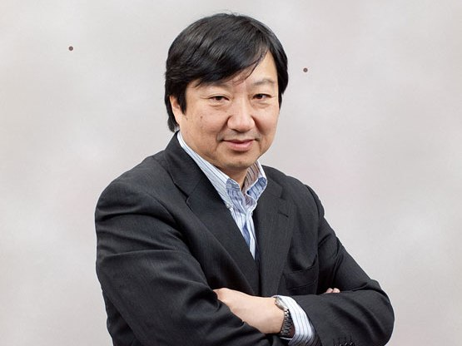
Host of this conf.
DG of ICEPP
ICEPP makes leading
contribution to ILC
ICEPP: Center for
overseas projects
Koshiba-san
@ DESY,PSI, CERN
30years ago
Orito-san
ILC-Japan
(hep community)
Ishino-san
Komamiya-san
ASAI

Slide 3
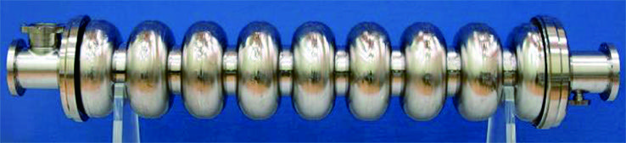
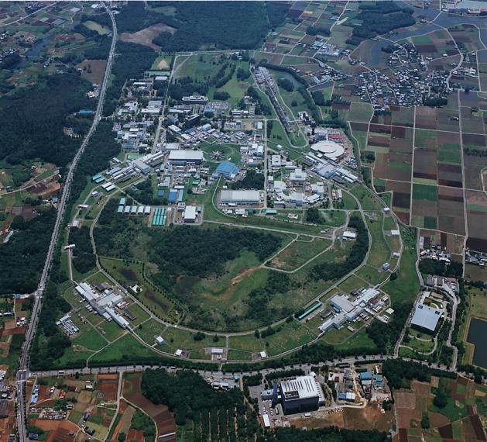
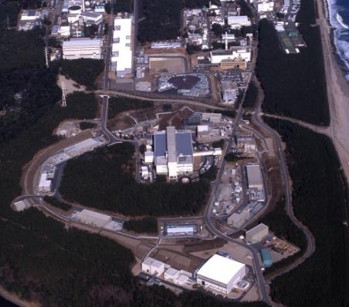
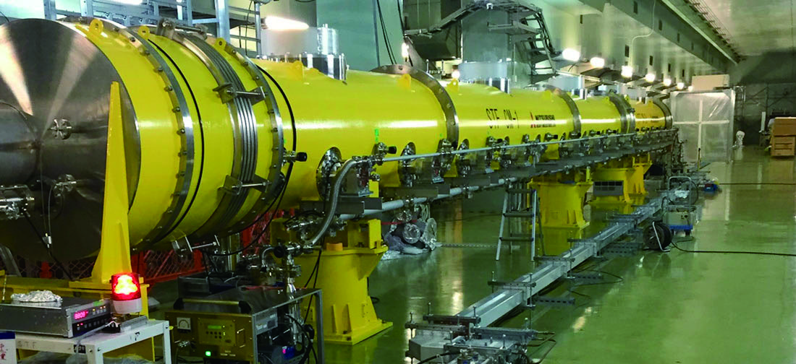
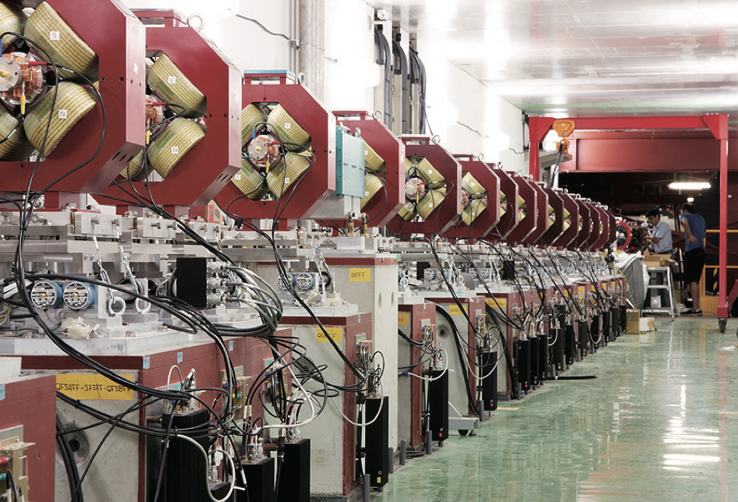
KEK is co-host
Key Lab for ITN (Michizono-san’s talk)
KEK: National Accelerator Lab
SuperKEKB @ Tsukuba
J-PARC @ Tokai
World Highest Luminosity
Collider SuperKEKB
MW proton Machine
is used for T2K

Slide 4
Promotion scheme of ILC / relation of Stakeholder
Foreign
Governments
1. KEK&
Community
& IDT
Japanese Government
Diet Federation
For ILC
Cabinet office
M. Finance
M. Foreign
2. Five
Party Meeting
M. Eco/Ind.
Intergovern. discussion
Five Party meeting
DOE, etc
MEXT
3. liaison
office between
MEXT
and Cabinet
office
starts
Diet members
MEXT (Government)
Physicists
Industrial sector (AAA)
Candidate site (Thohoku ILC Prom.)
Expert panel
2) International
Expert panel
International
community
ILC-Japan
(M.Ishino)
community
KEK
(S.Asai)
IDT(T.
Nakata)
Industrial sector
National
Lab.s
CERN
Japanese
Community
Candidate site
1) ILC-Tech. Network
for Work-package
Strong supports are obtained
International
Domestic

Slide 5
ILC is planed as the Global Project:
Global vs International approaches
causes “chicken and egg problem”.
Japanese Government considers ILC/the next collider is constructed with “Global” approach.
1) Cost is not affordable
2) Human resource
A) sustainable developments
on industrial invest and HR
B) Diversity of Science
Let’s discuss “Global Approach” for not only “ILC”
but also LC(with Various ECM & technologies)
Let’s have fruitful discussion !!!

