Slide 1
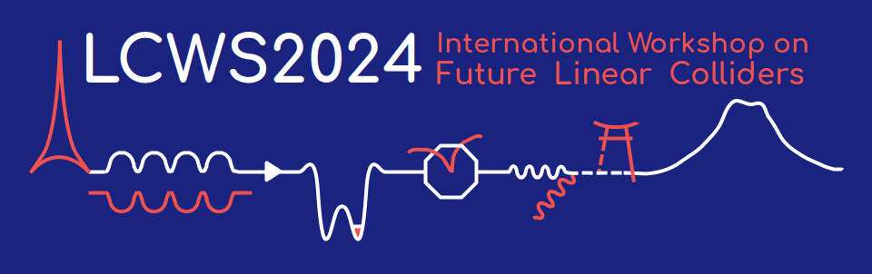
A Wakefield Resilient,
High Shunt Impedance Accelerating Structure for Cold Copper Collider (C³)
Muhammad Shumail, Zenghai Li, Emilio A. Nanni
July 10, 2024

Slide 2
What is New in the Cavity Design
The Initial Proposed Design
Based on a distributed coupling accelerating (DCA) rf structure where the phase advance between the accelerating standing wave cavities is π.
Aperture radius of 2.624 mm for a shunt impedance of 300 MΩ/m with 77K copper walls.
Proposed Design
A novel DCA rf structure with 3π/4 phase advance between the individually fed cavities.
Aperture radius of 3.55 mm for the same shunt impedance and the peak field constraints.
Because of this 35% larger aperture, this rf structure is much more resilient to both short-range and long-range wakefield effects.

Slide 3
What is New in the RF Manifold
Current Implementation of 3π/4 DCA
The researchers at SLAC have already proposed and designed a 3π/4 DCA with four feeding waveguide manifolds.
The implementation of four waveguide manifolds is, however, mechanically challenging.
Proposed Implementation of 3π/4 DCA
We present a novel 3π/4 DCA for C³ which is based on only two waveguide manifolds.
This rf structure comprises of 56 cavities where cavities are fed in pairs through a standard π phase advance rf manifold. This is achieved by pairing the cavities as, first and third, second and forth, and so on. With such pairing, the phase advance between the two cavities in a pair is π/2 and the phase advance between successive pairs is π.

Slide 4
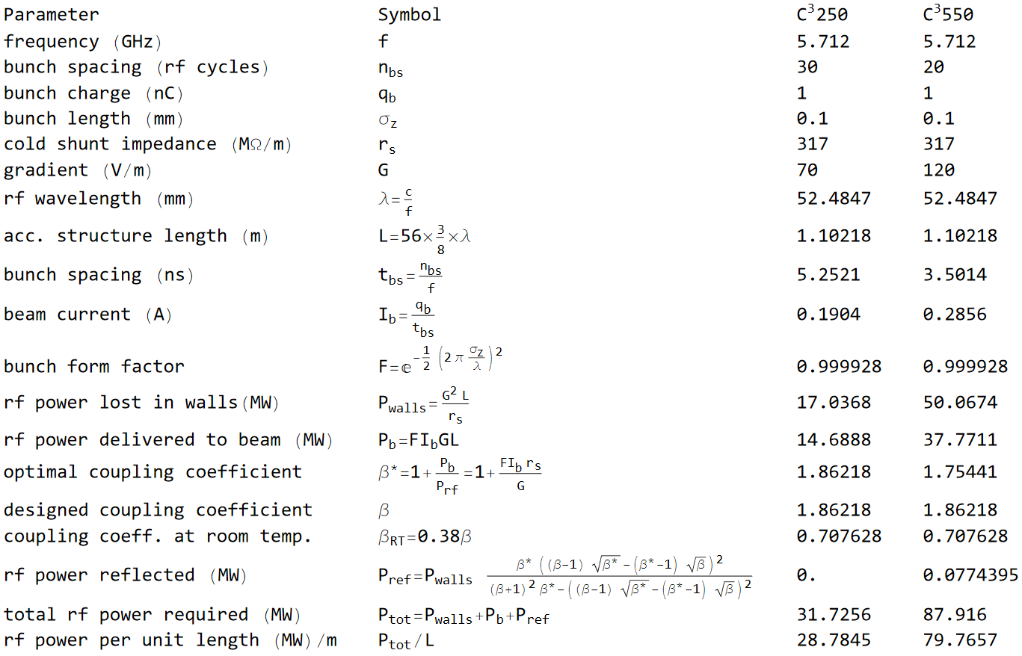
C³ Parameters

Slide 5
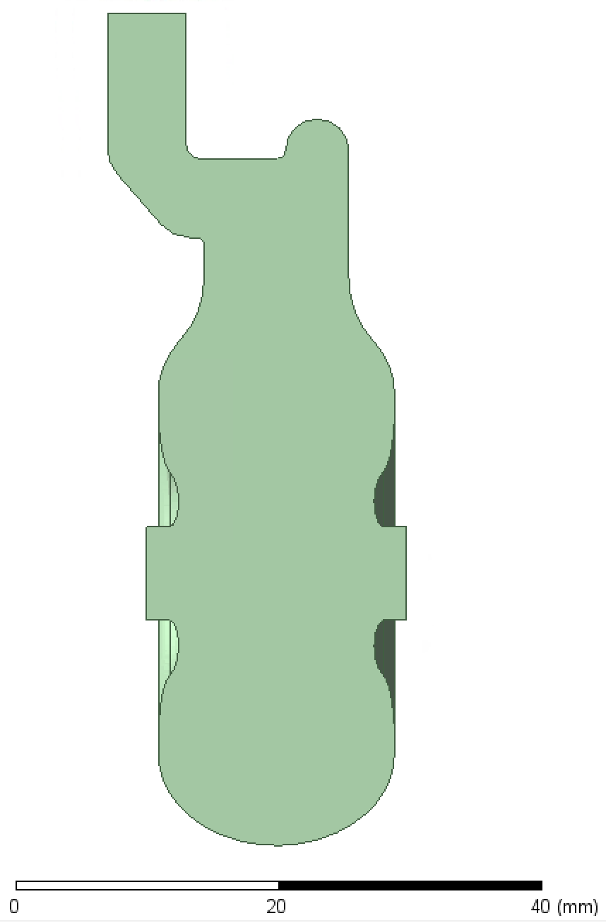
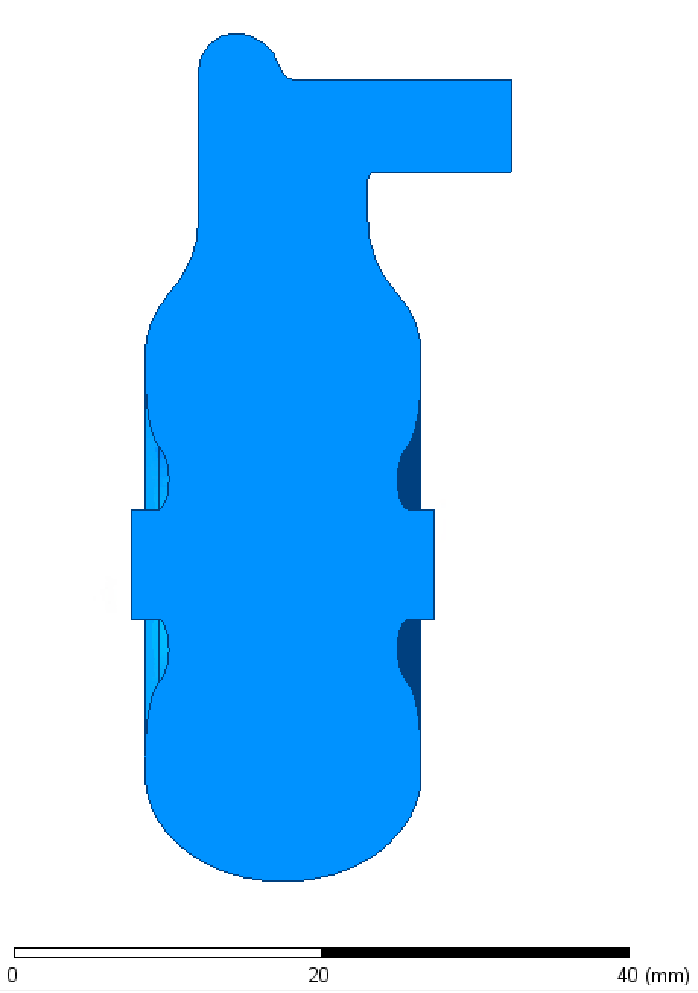

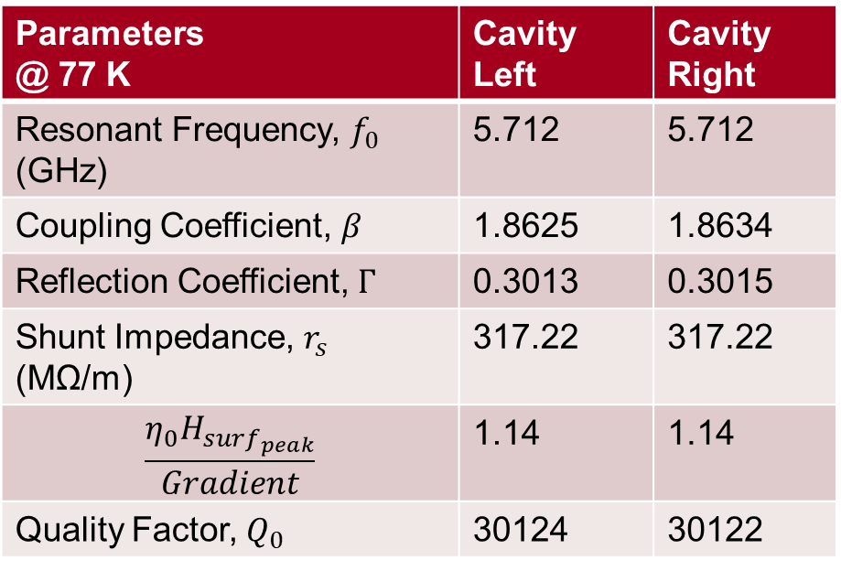
Cavity (with two different coupler implementations) Parameters Determined Through HFSS® Simulations
Parameters @ 77 K | Cavity Left | Cavity Right
Resonant Frequency, $f_{0}$ (GHz) | 5.712 | 5.712
Coupling Coefficient, $β$ | 1.8625 | 1.8634
Reflection Coefficient, $Γ$ | 0.3013 | 0.3015
Shunt Impedance, $r_{s}$ (MΩ/m) | 317.22 | 317.22
$$\frac{η_{0}H_{surf_{peak}}}{Gradient}$$ | 1.14 | 1.14
Quality Factor, $Q_{0}$ | 30124 | 30122
$φ$ 7.1 mm

Slide 6
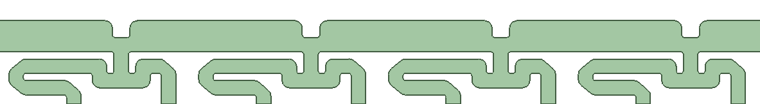
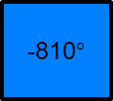
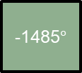
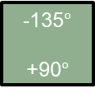
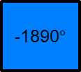
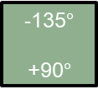
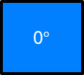
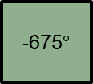
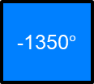
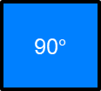
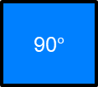
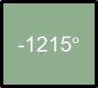
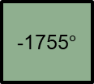
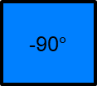
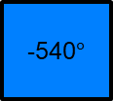
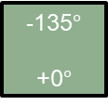
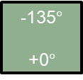
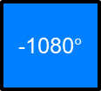
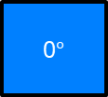
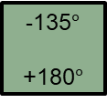
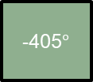
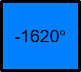
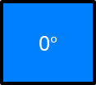
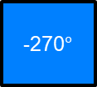
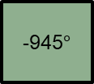
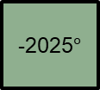
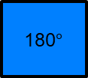
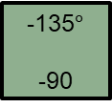
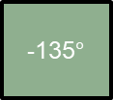
Cavity Phases in an Accelerator Made of 135$°$ Phase Advance Cavities
($e^{iωt}$ convention)
Beam Direction
0$°$
-135$°$
-270$°$
-405$°$
-540$°$
-675$°$
-810$°$
-945$°$
-1080$°$
-1215$°$
-1350$°$
-1485$°$
-1620$°$
-1755$°$
-1890$°$
-2025$°$
Equivalent phases and Feeding Scheme:
0° 180$°$ 0° 180$°$
0$°$
-135$°$
+0$°$
90$°$
-135$°$
+90$°$
180$°$
-135$°$
+180$°$
-90$°$
-135$°$
-90
0$°$
-135$°$
+0$°$
90$°$
-135$°$
+90$°$
180$°$
-135$°$
+180$°$
-90$°$
-135$°$
-90
0° 180$°$ 0° 180$°$
There has to be a phase difference of 135$°$ between the upper and lower rf feeding manifold.

Slide 7
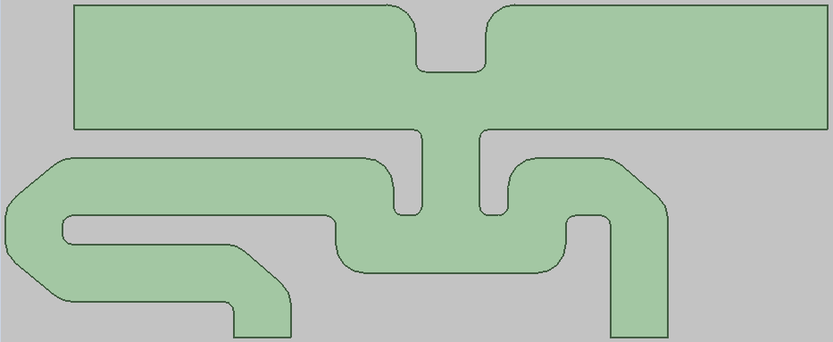
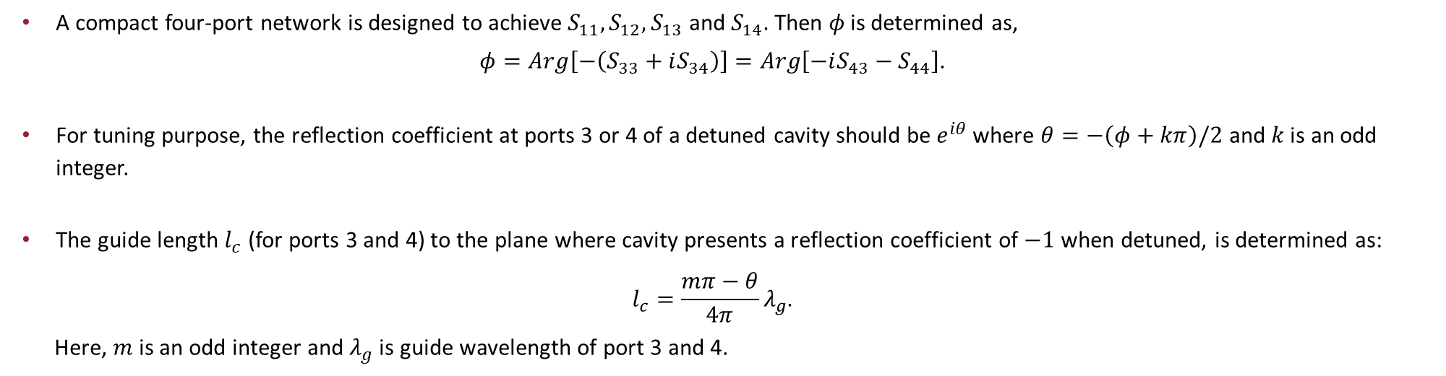
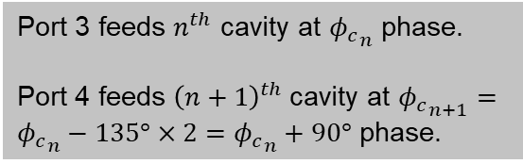
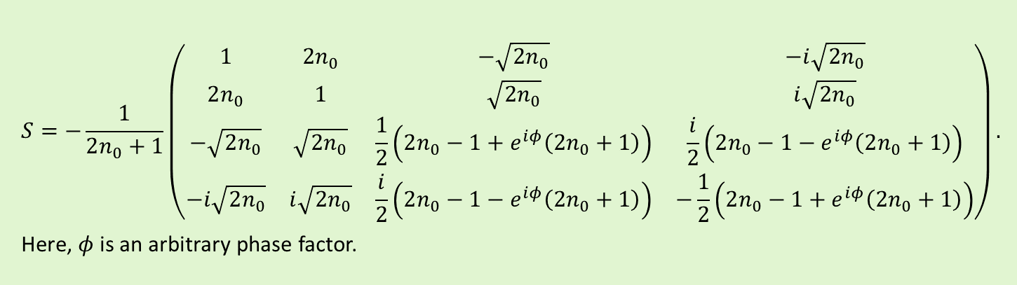
The General S-Parameter for Four-Port Network That Makes a Unit of This Distributed Feed ($n_{0}$: Number of Networks to be Cascaded in Each Manifold)
Port 1
Port 2
$$S=−\frac{1}{2n_{0}+1}\left(\text{⁠}\begin{matrix}1 & 2n_{0} & −\sqrt{2n_{0}} & −ⅈ\sqrt{2n_{0}} \\ 2n_{0} & 1 & \sqrt{2n_{0}} & ⅈ\sqrt{2n_{0}} \\ −\sqrt{2n_{0}} & \sqrt{2n_{0}} & \frac{1}{2}\left(2n_{0}−1+ⅇ^{ⅈφ}\left(2n_{0}+1\right)\right) & \frac{i}{2}\left(2n_{0}−1−ⅇ^{ⅈφ}\left(2n_{0}+1\right)\right) \\ −ⅈ\sqrt{2n_{0}} & ⅈ\sqrt{2n_{0}} & \frac{i}{2}\left(2n_{0}−1−ⅇ^{ⅈφ}\left(2n_{0}+1\right)\right) & −\frac{1}{2}\left(2n_{0}−1+ⅇ^{ⅈφ}\left(2n_{0}+1\right)\right)\end{matrix}\right).$$
Here, $φ$is an arbitrary phase factor.
Port 3
Port 4
Port 3 feeds $n^{th}$ cavity at ${φ_{c}}_{n}$ phase.
Port 4 feeds ${\left(n+1\right)}^{th}$cavity at ${φ_{c}}_{n+1}={φ_{c}}_{n}−135°×2={φ_{c}}_{n}+90°$ phase.
A compact four-port network is designed to achieve $S_{11},S_{12},S_{13}$ and $S_{14}.$ Then $φ$ is determined as,
$$φ=Arg\left[−\left(S_{33}+iS_{34}\right)\right]=Arg\left[−iS_{43}−S_{44}\right].$$
For tuning purpose, the reflection coefficient at ports 3 or 4 of a detuned cavity should be $e^{iθ }$where $θ=−\left(φ+kπ\right)/2$ and $k$ is an odd integer.
The guide length $l_{c}$ (for ports 3 and 4) to the plane where cavity presents a reflection coefficient of $−1$ when detuned, is determined as:
$$l_{c}=\frac{mπ−θ}{4π}λ_{g}.$$
Here, $m$ is an odd integer and $λ_{g}$ is guide wavelength of port 3 and 4.

Slide 8
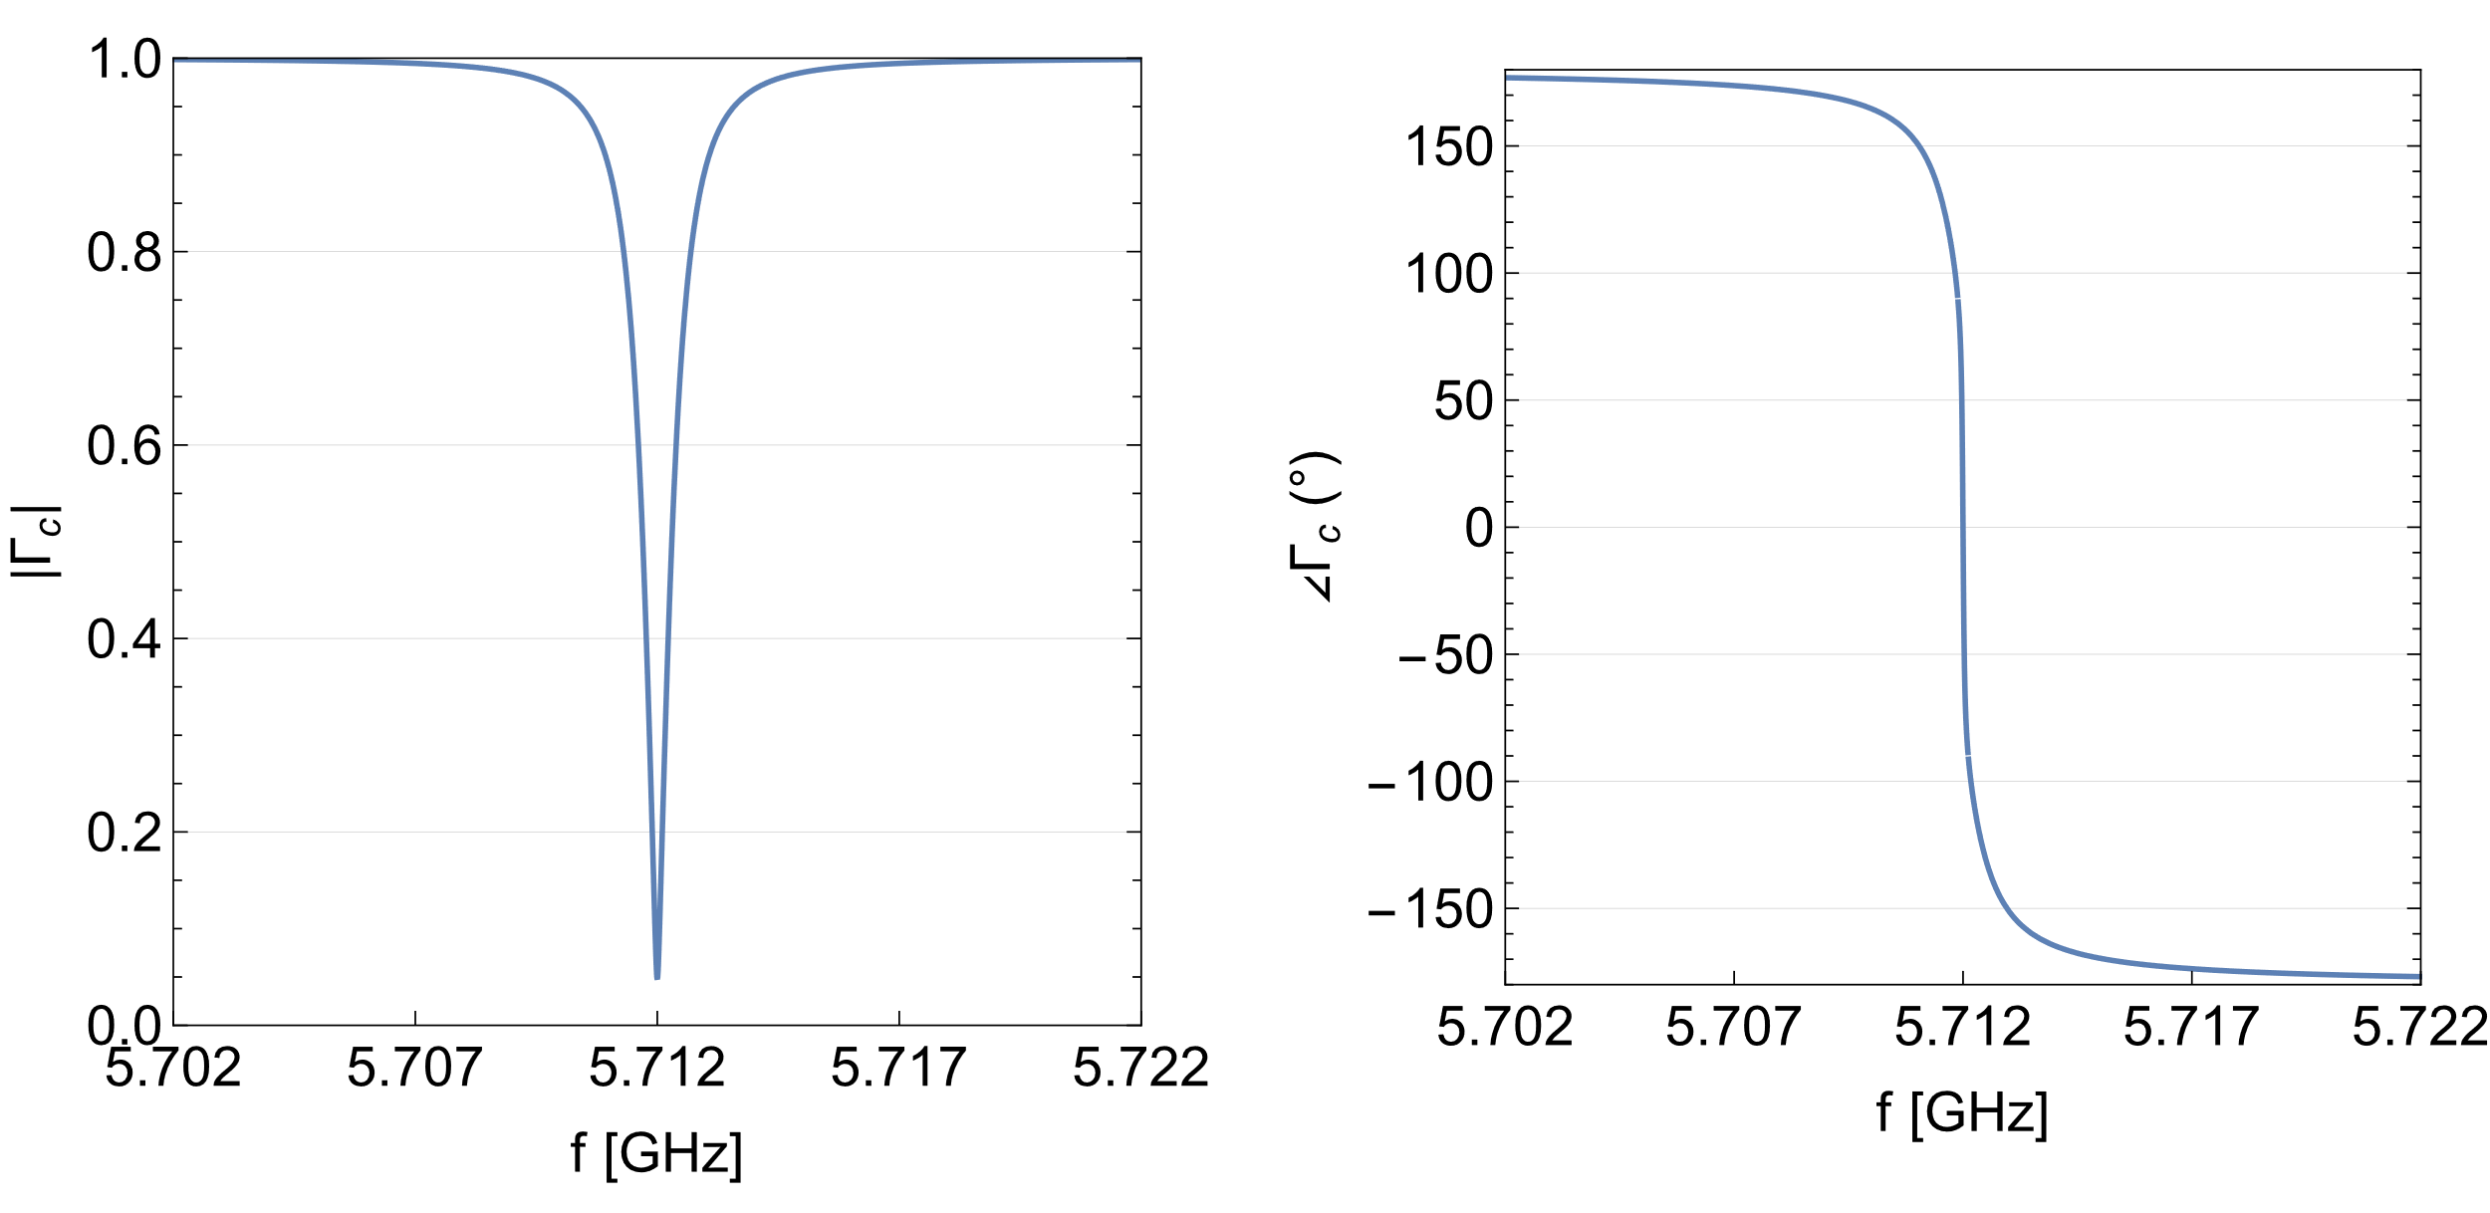
A Potential CCC Cavity Response
Here is the reflection coefficient from a cavity resonant at 5.712 GHz with intrinsic quality factor of 11,500 and coupling coefficient of 1.1.

Slide 9
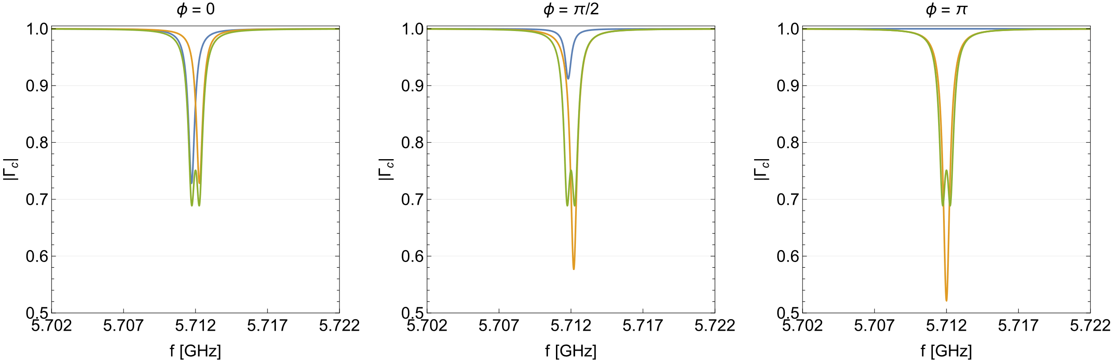
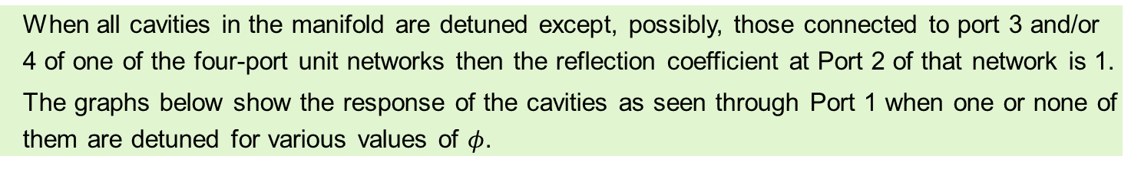
Response of Cavities Through the Manifold (for Tuning Purpose)
Port 1
Port 2
When all cavities in the manifold are detuned except, possibly, those connected to port 3 and/or 4 of one of the four-port unit networks then the reflection coefficient at Port 2 of that network is 1.
The graphs below show the response of the cavities as seen through Port 1 when one or none of them are detuned for various values of $φ$.
Port 3
Port 4
-- Blue: Response of cavity at port 3 when cavity at port 4 is detuned
-- Orange: Response of cavity at port 4 when cavity at port 3 is detuned
-- Green: Response of both cavities at port 3 and port 4

Slide 10
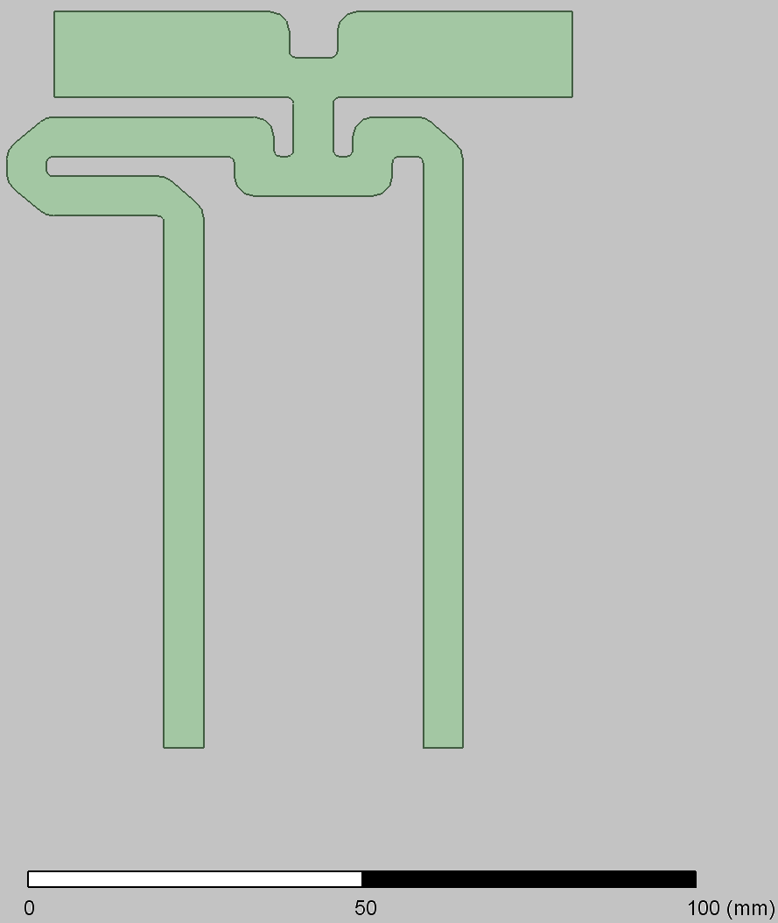
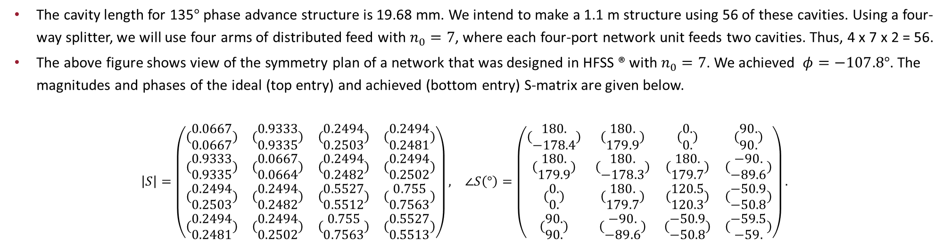
Design of Four-Port Network
Port 1
Port 2
$$S=−\frac{1}{2n_{0}+1}\left(\text{⁠}\begin{matrix}1 & 2n_{0} & −\sqrt{2n_{0}} & −ⅈ\sqrt{2n_{0}} \\ 2n_{0} & 1 & \sqrt{2n_{0}} & ⅈ\sqrt{2n_{0}} \\ −\sqrt{2n_{0}} & \sqrt{2n_{0}} & \frac{1}{2}\left(2n_{0}−1+ⅇ^{ⅈφ}\left(2n_{0}+1\right)\right) & \frac{i}{2}\left(2n_{0}−1−ⅇ^{ⅈφ}\left(2n_{0}+1\right)\right) \\ −ⅈ\sqrt{2n_{0}} & ⅈ\sqrt{2n_{0}} & \frac{i}{2}\left(2n_{0}−1−ⅇ^{ⅈφ}\left(2n_{0}+1\right)\right) & −\frac{1}{2}\left(2n_{0}−1+ⅇ^{ⅈφ}\left(2n_{0}+1\right)\right)\end{matrix}\right).$$
Here, $φ$is an arbitrary phase factor.
Port 3
Port 4
The cavity length for 135$°$ phase advance structure is 19.68 mm. We intend to make a 1.1 m structure using 56 of these cavities. Using a four-way splitter, we will use four arms of distributed feed with $n_{0}=7$, where each four-port network unit feeds two cavities. Thus, 4 x 7 x 2 = 56.
The above figure shows view of the symmetry plan of a network that was designed in HFSS ® with $n_{0}=7$. We achieved $φ=−107.8°$. The magnitudes and phases of the ideal (top entry) and achieved (bottom entry) S-matrix are given below.
$$\begin{matrix}\left|S\right|=\left(\begin{matrix}(\text{⁠}\begin{aligned}0.0667 \\ 0.0667\end{aligned}\text{⁠}) & (\text{⁠}\begin{aligned}0.9333 \\ 0.9335\end{aligned}\text{⁠}) & (\text{⁠}\begin{aligned}0.2494 \\ 0.2503\end{aligned}\text{⁠}) & (\text{⁠}\begin{aligned}0.2494 \\ 0.2481\end{aligned}\text{⁠}) \\ (\text{⁠}\begin{aligned}0.9333 \\ 0.9335\end{aligned}\text{⁠}) & (\text{⁠}\begin{aligned}0.0667 \\ 0.0664\end{aligned}\text{⁠}) & (\text{⁠}\begin{aligned}0.2494 \\ 0.2482\end{aligned}\text{⁠}) & (\text{⁠}\begin{aligned}0.2494 \\ 0.2502\end{aligned}\text{⁠}) \\ (\text{⁠}\begin{aligned}0.2494 \\ 0.2503\end{aligned}\text{⁠}) & (\text{⁠}\begin{aligned}0.2494 \\ 0.2482\end{aligned}\text{⁠}) & (\text{⁠}\begin{aligned}0.5527 \\ 0.5512\end{aligned}\text{⁠}) & (\text{⁠}\begin{aligned}0.755 \\ 0.7563\end{aligned}\text{⁠}) \\ (\text{⁠}\begin{aligned}0.2494 \\ 0.2481\end{aligned}\text{⁠}) & (\text{⁠}\begin{aligned}0.2494 \\ 0.2502\end{aligned}\text{⁠}) & (\text{⁠}\begin{aligned}0.755 \\ 0.7563\end{aligned}\text{⁠}) & (\text{⁠}\begin{aligned}0.5527 \\ 0.5513\end{aligned}\text{⁠})\end{matrix}\right), & ∠S\left(°\right)=\left(\begin{matrix}(\text{⁠}\begin{aligned}180. \\ −178.4\end{aligned}\text{⁠}) & (\text{⁠}\begin{aligned}180. \\ 179.9\end{aligned}\text{⁠}) & (\text{⁠}\begin{aligned}0. \\ 0.\end{aligned}\text{⁠}) & (\text{⁠}\begin{aligned}90. \\ 90.\end{aligned}\text{⁠}) \\ (\text{⁠}\begin{aligned}180. \\ 179.9\end{aligned}\text{⁠}) & (\text{⁠}\begin{aligned}180. \\ −178.3\end{aligned}\text{⁠}) & (\text{⁠}\begin{aligned}180. \\ 179.7\end{aligned}\text{⁠}) & (\text{⁠}\begin{aligned}−90. \\ −89.6\end{aligned}\text{⁠}) \\ (\text{⁠}\begin{aligned}0. \\ 0.\end{aligned}\text{⁠}) & (\text{⁠}\begin{aligned}180. \\ 179.7\end{aligned}\text{⁠}) & (\text{⁠}\begin{aligned}120.5 \\ 120.3\end{aligned}\text{⁠}) & (\text{⁠}\begin{aligned}−50.9 \\ −50.8\end{aligned}\text{⁠}) \\ (\text{⁠}\begin{aligned}90. \\ 90.\end{aligned}\text{⁠}) & (\text{⁠}\begin{aligned}−90. \\ −89.6\end{aligned}\text{⁠}) & (\text{⁠}\begin{aligned}−50.9 \\ −50.8\end{aligned}\text{⁠}) & (\text{⁠}\begin{aligned}−59.5 \\ −59.\end{aligned}\text{⁠})\end{matrix}\right).\end{matrix}$$

Slide 11
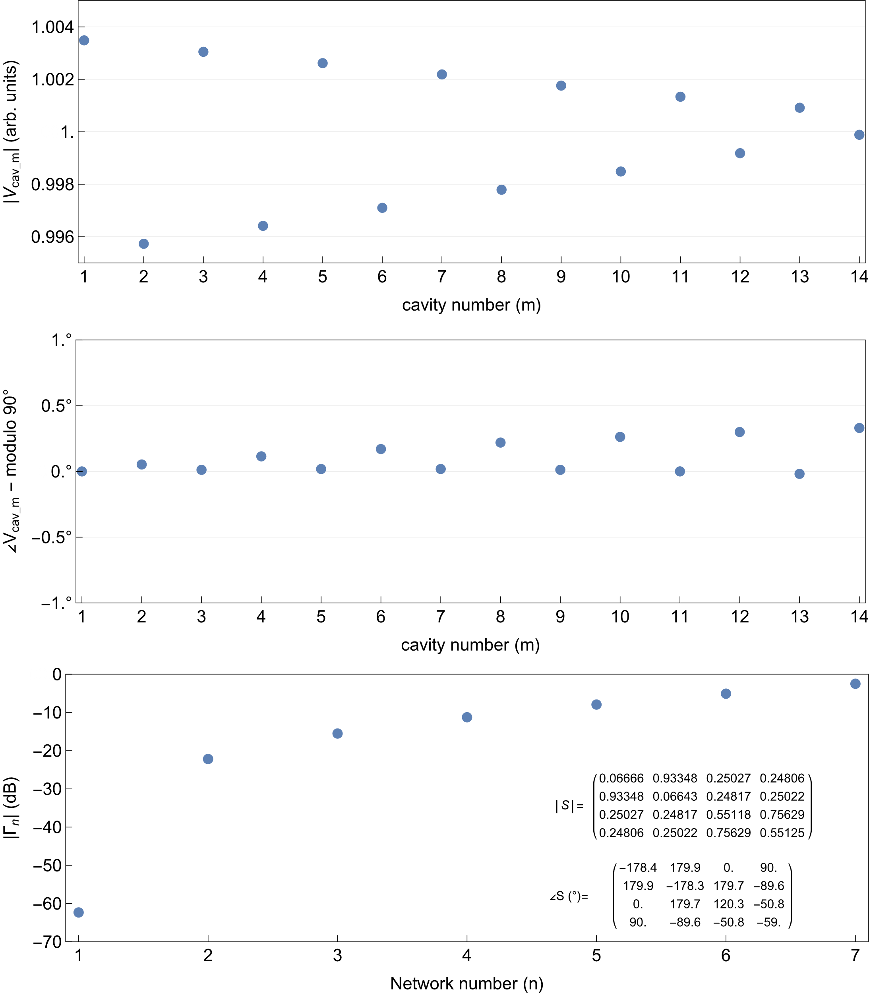





The Results of Analytical Cascading of 7 of These Designed Four-Port Networks
$$Γ_{1}$$
$$Γ_{6}$$
$$Γ_{7}$$
$$e^{iτ}$$
$V_{cav_1}$ $V_{cav_2}$ $V_{cav_13}$ $V_{cav_14}$
The above figure is a depiction of analytical cascading where the last one is truncated with a reflection coefficient of $e^{iτ}$, where $τ=\text{6.3355}$ $\text{for} \text{minimum} \text{overall} \text{reflection}$ $Γ_{1}$. Here we assume no reflection from cavity ports.
The top two figures on the right show the stability of the relative cavity voltages and phases.
The bottom figure on the right shows the reflection coefficient at the entrance of each network. Note that this 7 x 2 distributed feed is well matched with overall reflection coefficient of less than -60 dB.

Slide 12
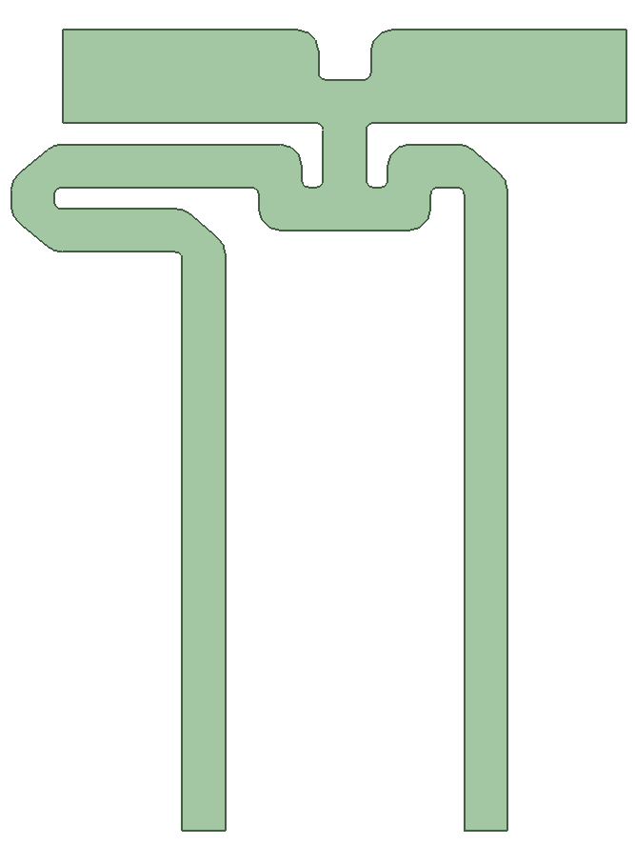
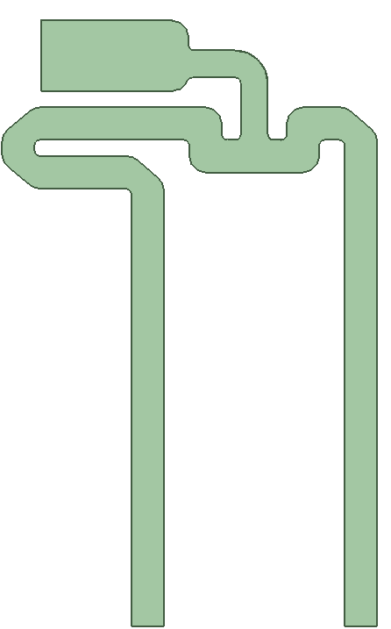
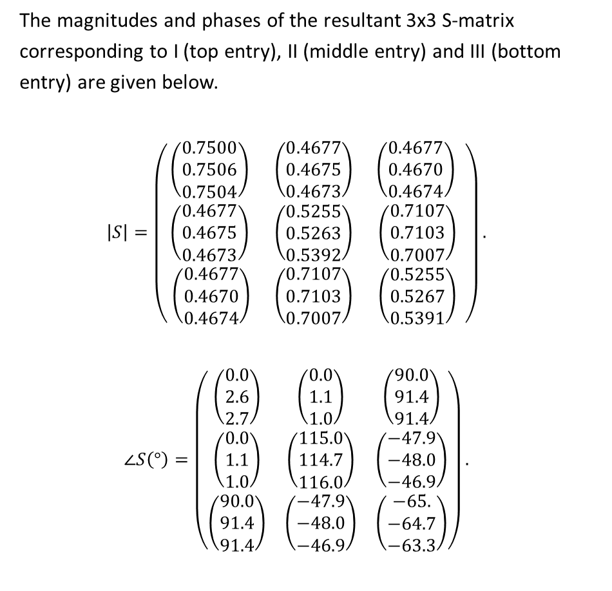


Implementation of a Compact Termination for the Last Network in a Right Going 7x2 Manifold
$e^{iτ}$, $τ=\text{2}π$
The magnitudes and phases of the resultant 3x3 S-matrix corresponding to I (top entry), II (middle entry) and III (bottom entry) are given below.
$$\left|S\right|=\left(\begin{matrix}\text{⁠}\left(\begin{aligned}0.7500 \\ 0.7506 \\ 0.7504\end{aligned}\right)\text{⁠} & \text{⁠}\left(\begin{aligned}0.4677 \\ 0.4675 \\ 0.4673\end{aligned}\right)\text{⁠} & \left(\begin{aligned}0.4677 \\ 0.4670 \\ 0.4674\end{aligned}\right)\text{⁠} \\ \text{⁠}\left(\begin{aligned}0.4677 \\ 0.4675 \\ 0.4673\end{aligned}\right)\text{⁠} & \text{⁠}\left(\begin{aligned}0.5255 \\ 0.5263 \\ 0.5392\end{aligned}\right)\text{⁠} & \text{⁠}\left(\begin{aligned}0.7107 \\ 0.7103 \\ 0.7007\end{aligned}\right)\text{⁠} \\ \text{⁠}\left(\begin{aligned}0.4677 \\ 0.4670 \\ 0.4674\end{aligned}\right) & \text{⁠}\left(\begin{aligned}0.7107 \\ 0.7103 \\ 0.7007\end{aligned}\right)\text{⁠} & \text{⁠}\left(\begin{aligned}0.5255 \\ 0.5267 \\ 0.5391\end{aligned}\right)\text{⁠}\end{matrix} \right).$$
$$∠S\left(°\right)=\left(\begin{matrix}\left(\begin{aligned}0.0 \\ 2.6 \\ 2.7\end{aligned}\right) & \left(\begin{aligned}0.0 \\ 1.1 \\ 1.0\end{aligned}\right) & \left(\begin{aligned}90.0 \\ 91.4 \\ 91.4\end{aligned}\right) \\ \left(\begin{aligned}0.0 \\ 1.1 \\ 1.0\end{aligned}\right) & \left(\begin{aligned}115.0 \\ 114.7 \\ 116.0\end{aligned}\right) & \left(\begin{aligned}−47.9 \\ −48.0 \\ −46.9\end{aligned}\right) \\ \left(\begin{aligned}90.0 \\ 91.4 \\ 91.4\end{aligned}\right) & \left(\begin{aligned}−47.9 \\ −48.0 \\ −46.9\end{aligned}\right) & \left(\begin{aligned}−65. \\ −64.7 \\ −63.3\end{aligned}\right)\end{matrix}\right).$$
I: Ideal network with termination of reflection coefficient 1.
II: Implemented network with termination for minimum overall reflection.
III: Compact Implementation
$e^{iτ}$, $τ=\text{6.3355}$

Slide 13
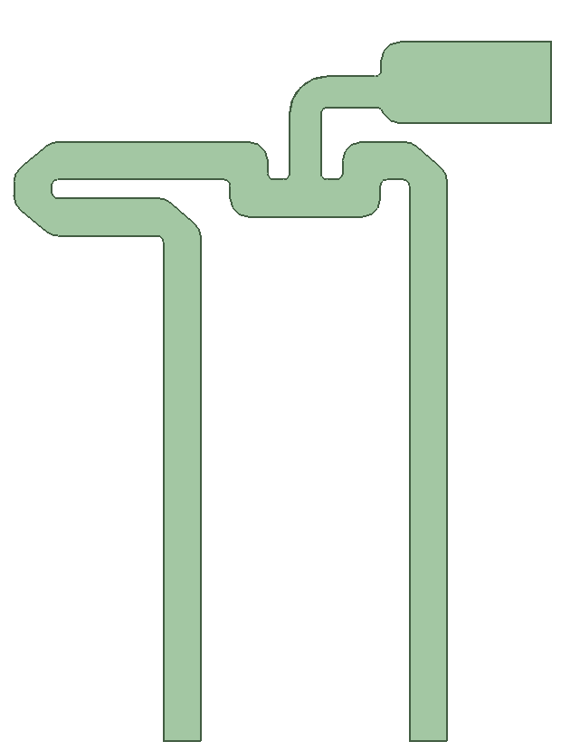

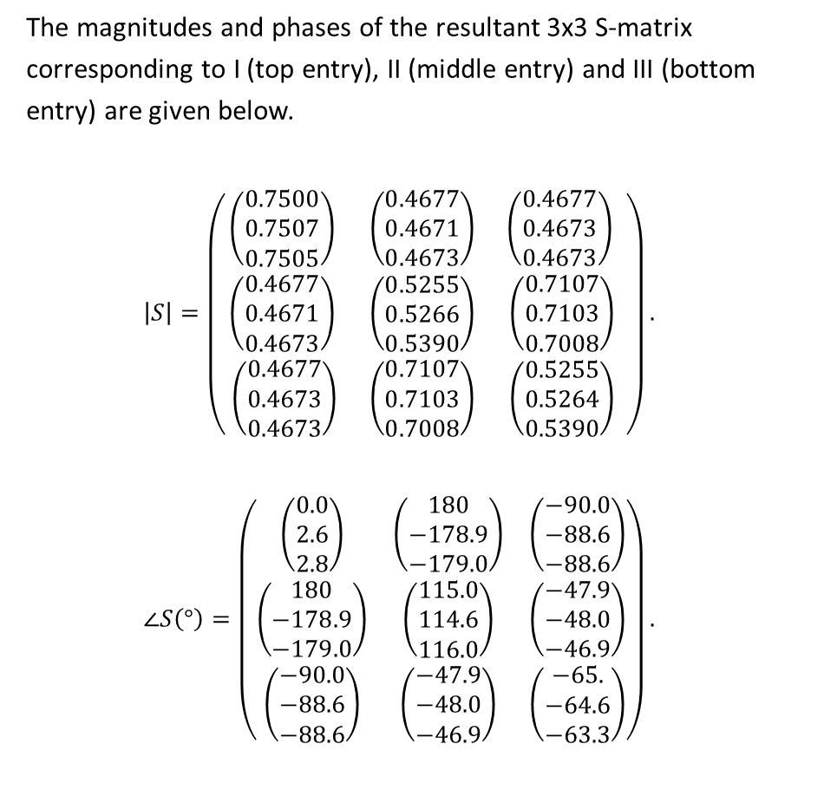

Implementation of a Compact Termination for the Last Network in a Left Going 7x2 Manifold
$$e^{iτ}$$
$τ=\text{2}π$
The magnitudes and phases of the resultant 3x3 S-matrix corresponding to I (top entry), II (middle entry) and III (bottom entry) are given below.
$$\left|S\right|=\left(\begin{matrix}\text{⁠}\left(\begin{aligned}0.7500 \\ 0.7507 \\ 0.7505\end{aligned}\right)\text{⁠} & \text{⁠}\left(\begin{aligned}0.4677 \\ 0.4671 \\ 0.4673\end{aligned}\right)\text{⁠} & \left(\begin{aligned}0.4677 \\ 0.4673 \\ 0.4673\end{aligned}\right)\text{⁠} \\ \text{⁠}\left(\begin{aligned}0.4677 \\ 0.4671 \\ 0.4673\end{aligned}\right)\text{⁠} & \text{⁠}\left(\begin{aligned}0.5255 \\ 0.5266 \\ 0.5390\end{aligned}\right)\text{⁠} & \text{⁠}\left(\begin{aligned}0.7107 \\ 0.7103 \\ 0.7008\end{aligned}\right)\text{⁠} \\ \text{⁠}\left(\begin{aligned}0.4677 \\ 0.4673 \\ 0.4673\end{aligned}\right) & \text{⁠}\left(\begin{aligned}0.7107 \\ 0.7103 \\ 0.7008\end{aligned}\right)\text{⁠} & \text{⁠}\left(\begin{aligned}0.5255 \\ 0.5264 \\ 0.5390\end{aligned}\right)\text{⁠}\end{matrix} \right).$$
$$∠S\left(°\right)=\left(\begin{matrix}\left(\begin{aligned}0.0 \\ 2.6 \\ 2.8\end{aligned}\right) & \left(\begin{aligned}180 \\ −178.9 \\ −179.0\end{aligned}\right) & \left(\begin{aligned}−90.0 \\ −88.6 \\ −88.6\end{aligned}\right) \\ \left(\begin{aligned}180 \\ −178.9 \\ −179.0\end{aligned}\right) & \left(\begin{aligned}115.0 \\ 114.6 \\ 116.0\end{aligned}\right) & \left(\begin{aligned}−47.9 \\ −48.0 \\ −46.9\end{aligned}\right) \\ \left(\begin{aligned}−90.0 \\ −88.6 \\ −88.6\end{aligned}\right) & \left(\begin{aligned}−47.9 \\ −48.0 \\ −46.9\end{aligned}\right) & \left(\begin{aligned}−65. \\ −64.6 \\ −63.3\end{aligned}\right)\end{matrix}\right).$$
I: Ideal network with termination of reflection coefficient 1.
II: Implemented network with termination for minimum overall reflection.
III: Compact Implementation
$$e^{iτ}$$
$τ=\text{6.3355}$

Slide 14


Fixing the lengths of Port 3 and Port 4
For tuning purpose, the guide length $l_{c}$ (for ports 3 and 4) to the plane where cavity presents a reflection coefficient of $−1$ when detuned, is determined to be -77.05 mm. As seen here, we have reduced the length of ports 3 and 4 accordingly. The cavities with response equivalent to the one shown in slide # 3 will be attached to ports 3 and 4 as shown here.
Four-Port Network
Three-Port Network at the
End of Right Going Manifold
Three-Port Network at the
End of Left Going Manifold
Port 1
Port 2
Port 1
Port 2
Port 3
Port 4
Port 3
Port 4
Port 3
Port 4

Slide 15


Right Going 7x2 Manifold
-41 dB
0
1 2 3 4 5 6 7 8 9 10 11 12 13 14

Slide 16


Left Going 7x2 Manifold
0
-43 dB
1 2 3 4 5 6 7 8 9 10 11 12 13 14

Slide 17





2x2 S-Matrix of Right Going 7x2 Manifold When All, Except an Odd Cavity Port # $n$, are Shorted (Detuned Cavities)
0
1
3
5
7
9
11
13
1 2 3 4 5 6 7 8 9 10 11 12 13 14
The magnitudes of the resultant 2x2 S-matrix are calculated to be as follows when $n$ is odd.
$$\left|S\right|=\left(\begin{matrix}0.9576 & 0.2880 \\ 0.2880 & 0.9576\end{matrix}\right).$$
The phases of the resultant 2x2 S-matrix are calculated to be as follows when $n$ is odd. Here, the upper values correspond to $n=1,5,9,13$ while the lower values correspond to $n=3,7,1$1.
$$∠S\left(°\right)=\left(\begin{matrix}1.6 & \left(\begin{matrix}122.2 \\ −57.8\end{matrix}\right) \\ \left(\begin{matrix}122.2 \\ −57.8\end{matrix}\right) & 62.8\end{matrix}\right).$$
The HFSS simulation of a particular such scenario yielded following magnitudes of the 2x2 S-matrix. Here the upper to lower values correspond to $n=1,3,5,7,9,11,13$, respectively.
$$\left|S\right|=\left(\begin{matrix}⁠\left(\begin{aligned}0.9579 \\ 0.9578 \\ 0.9578 \\ 0.9577 \\ 0.9576 \\ 0.9577 \\ 0.9555\end{aligned}\right)⁠ & ⁠\left(\begin{aligned}0.2870 \\ 0.2873 \\ 0.2875 \\ 0.2877 \\ 0.2880 \\ 0.2878 \\ 0.2949\end{aligned}\right)⁠ \\ \left(\begin{aligned}0.2870 \\ 0.2873 \\ 0.2875 \\ 0.2877 \\ 0.2880 \\ 0.2878 \\ 0.2949\end{aligned}\right)⁠ & ⁠\left(\begin{aligned}0.9579 \\ 0.9578 \\ 0.9578 \\ 0.9577 \\ 0.9576 \\ 0.9577 \\ 0.9555\end{aligned}\right)\end{matrix}\right).$$
The HFSS simulation of a particular such scenario yielded following phases of the 2x2 S-matrix. Here the upper to lower values correspond to $n=1,3,5,7,9,11,13$, respectively.
$$∠S\left(°\right)=\left(\begin{matrix}\left(\begin{aligned}4.1 \\ 4.2 \\ 4.1 \\ 4.2 \\ 4.2 \\ 4.1 \\ 4.0\end{aligned}\right) & \left(\begin{aligned}123.4 \\ −56.5 \\ 123.5 \\ −56.5 \\ 123.5 \\ −56.6 \\ 124.7\end{aligned}\right) \\ \left(\begin{aligned}123.4 \\ −56.5 \\ 123.5 \\ −56.5 \\ 123.5 \\ −56.6 \\ 124.7\end{aligned}\right) & \left(\begin{aligned}62.8 \\ 62.8 \\ 62.8 \\ 62.8 \\ 62.8 \\ 62.8 \\ 65.4\end{aligned}\right)\end{matrix}\right).$$

Slide 18




2x2 S-Matrix of Right Going 7x2 Manifold When All, Except an Even Cavity Port # $n$, are Shorted (Detuned Cavities)
0
2
4
6
8
10
12
14
1 2 3 4 5 6 7 8 9 10 11 12 13 14
The magnitudes of the resultant 2x2 S-matrix are calculated to be as follows when $n$ is even.
$$\left|S\right|=\left(\begin{matrix}0.6807 & 0.7326 \\ 0.7326 & 0.6807\end{matrix}\right).$$
The phases of the resultant 2x2 S-matrix are calculated to be as follows when $n$ is odd. Here, the upper values correspond to $n=2,6,10,14$ while the lower values correspond to $n=4,8,1$2.
$$∠S\left(°\right)=\left(\begin{matrix}16.0 & \left(\begin{matrix}−112.8 \\ 67.2\end{matrix}\right) \\ \left(\begin{matrix}−112.8 \\ 67.2\end{matrix}\right) & −61.7\end{matrix}\right).$$
$$.$$
The HFSS simulation of a particular such scenario yielded following magnitudes of the 2x2 S-matrix. Here the upper to lower values correspond to $n=1,3,5,7,9,11,13$, respectively.
$$\left|S\right|=\left(\begin{matrix}⁠\left(\begin{aligned}0.6834 \\ 0.6830 \\ 0.6826 \\ 0.6819 \\ 0.6814 \\ 0.6807 \\ 0.6869\end{aligned}\right)⁠ & ⁠\left(\begin{aligned}0.7300 \\ 0.7305 \\ 0.7308 \\ 0.7314 \\ 0.7319 \\ 0.7326 \\ 0.7267\end{aligned}\right)⁠ \\ \left(\begin{aligned}0.7300 \\ 0.7305 \\ 0.7308 \\ 0.7314 \\ 0.7319 \\ 0.7326 \\ 0.7267\end{aligned}\right)⁠ & ⁠\left(\text{⁠}\begin{aligned}0.6834 \\ 0.6830 \\ 0.6826 \\ 0.6819 \\ 0.6814 \\ 0.6807 \\ 0.6869\end{aligned}\right)\end{matrix}\right).$$
The HFSS simulation of a particular such scenario yielded following phases of the 2x2 S-matrix. Here the upper to lower values correspond to $n=2,4,6,8,10,12,14$, respectively.
$$∠S\left(°\right)=\left(\begin{matrix}\left(\begin{aligned}18.4 \\ 18.4 \\ 18.5 \\ 18.6 \\ 18.5 \\ 18.6 \\ 18.\end{aligned}\right) & \left(\begin{aligned}−111.7 \\ 68.3 \\ −111.6 \\ 68.4 \\ −111.6 \\ 68.5 \\ −111.4\end{aligned}\right) \\ \left(\begin{aligned}−111.7 \\ 68.3 \\ −111.6 \\ 68.4 \\ −111.6 \\ 68.5 \\ −111.4\end{aligned}\right) & \left(\begin{aligned}−61.9 \\ −61.8 \\ −61.8 \\ −61.7 \\ −61.7 \\ −61.6 \\ −60.8\end{aligned}\right)\end{matrix}\right).$$

Slide 19


3x3 S-Matrix of Right Going 7x2 Manifold When All, Except Two Consecutive Cavity Ports # $n$ & $n+1$, are Shorted (Detuned Cavities) 1/2
0
1
2
3
4
5
6
7
8
9
10
11
12
13
14
1 2 3 4 5 6 7 8 9 10 11 12 13 14
The magnitudes of the resultant 3x3 S-matrix are calculated to be as follows.
$$\left|S\right|=\left(\begin{matrix}0.7506 & 0.4675 & 0.4670 \\ 0.4675 & 0.5263 & 0.7103 \\ 0.4670 & 0.7103 & 0.5267\end{matrix} \right).$$
The HFSS simulation of a particular such scenario yielded following magnitudes of the 3x3 S-matrix. Here the upper to lower values correspond to $n=1,3,5,7,9,11,1$3, respectively.
$$\left|S\right|=\left(\begin{matrix}\left(\begin{aligned}0.7525 \\ 0.7522 \\ 0.7520 \\ 0.7513 \\ 0.7510 \\ 0.7508 \\ 0.7530\end{aligned}\right) & \left(\begin{aligned}0.4660 \\ 0.4662 \\ 0.4664 \\ 0.4669 \\ 0.4672 \\ 0.4674 \\ 0.4659\end{aligned}\right) & \left(\begin{aligned}0.4654 \\ 0.4657 \\ 0.4658 \\ 0.4664 \\ 0.4667 \\ 0.4668 \\ 0.4648\end{aligned}\right) \\ \left(\begin{aligned}0.4660 \\ 0.4662 \\ 0.4664 \\ 0.4669 \\ 0.4672 \\ 0.4674 \\ 0.4659\end{aligned}\right) & \left(\begin{aligned}0.5278 \\ 0.5273 \\ 0.5272 \\ 0.527 \\ 0.5266 \\ 0.5263 \\ 0.5385\end{aligned}\right) & \left(\begin{aligned}0.7101 \\ 0.7103 \\ 0.7103 \\ 0.7101 \\ 0.7102 \\ 0.7104 \\ 0.7021\end{aligned}\right) \\ \left(\begin{aligned}0.4654 \\ 0.4657 \\ 0.4658 \\ 0.4664 \\ 0.4667 \\ 0.4668 \\ 0.4648\end{aligned}\right) & \left(\begin{aligned}0.7101 \\ 0.7103 \\ 0.7103 \\ 0.7101 \\ 0.7102 \\ 0.7104 \\ 0.7021\end{aligned}\right) & \left(\begin{aligned}0.5283 \\ 0.5278 \\ 0.5277 \\ 0.5275 \\ 0.5271 \\ 0.5267 \\ 0.5395\end{aligned}\right)\end{matrix}\right).$$
$$.$$

Slide 20


3x3 S-Matrix of Right Going 7x2 Manifold When All, Except Two Consecutive Cavity Ports # $n$ & $n+1$, are Shorted (Detuned Cavities) 2/2
0
1 2 3 4 5 6 7 8 9 10 11 12 13 14
The phases of the resultant 3x3 S-matrix are calculated to be as follows. Here, the upper values correspond to $n=1,5,9,1$3 while the lower values correspond to $n=3,7,1$1.
$$∠S\left(°\right)=\left(\begin{matrix}2.6 & \left(\begin{matrix}163.7 \\ −16.3\end{matrix}\right) & \left(\begin{matrix}−106.0 \\ 74.0\end{matrix}\right) \\ \left(\begin{matrix}163.7 \\ −16.3\end{matrix}\right) & 79.9 & −82.8 \\ \left(\begin{matrix}−106.0 \\ 74.0\end{matrix}\right) & −82.8 & −99.5\end{matrix} \right).$$
The HFSS simulation of a particular such scenario yielded following phases of the 3x3 S-matrix. Here the upper to lower values correspond to $n=1,3,5,7,9,11,1$3, respectively.
$$∠S\left(°\right)=\left(\begin{matrix}\left(\begin{aligned}5.1 \\ 5.2 \\ 5.2 \\ 5.2 \\ 5.2 \\ 5.2 \\ 4.2\end{aligned}\right) & \left(\begin{aligned}164.8 \\ −15.1 \\ 164.9 \\ −15.1 \\ 164.9 \\ −15.1 \\ 164.2\end{aligned}\right) & \left(\begin{aligned}−104.8 \\ 75.2 \\ −104.7 \\ 75.2 \\ −104.7 \\ 75.3 \\ −105.5\end{aligned}\right) \\ \left(\begin{aligned}164.8 \\ −15.1 \\ 164.9 \\ −15.1 \\ 164.9 \\ −15.1 \\ 164.2\end{aligned}\right) & \left(\begin{aligned}80. \\ 80. \\ 80. \\ 79.9 \\ 79.9 \\ 79.9 \\ 81.1\end{aligned}\right) & \left(\begin{aligned}−82.9 \\ −82.9 \\ −82.9 \\ −82.9 \\ −82.8 \\ −82.8 \\ −82.1\end{aligned}\right) \\ \left(\begin{aligned}−104.8 \\ 75.2 \\ −104.7 \\ 75.2 \\ −104.7 \\ 75.3 \\ −105.5\end{aligned}\right) & \left(\begin{aligned}−82.9 \\ −82.9 \\ −82.9 \\ −82.9 \\ −82.8 \\ −82.8 \\ −82.1\end{aligned}\right) & \left(\begin{aligned}−99.5 \\ −99.4 \\ −99.5 \\ −99.5 \\ −99.5 \\ −99.5 \\ −98.7\end{aligned}\right)\end{matrix}\right).$$
$$.$$

Slide 21


Reflection ($Γ$) Through the Right Going Manifold (for Tuning Purpose)
$$Γ$$
0
1 2 3 4 5 6 7 8 9 10 11 12 13 14

Slide 22





Power Divider Between the Right Going and the Left Going Manifold
Power Divider
Left Going Manifold
Right Going Manifold
Requirements for the Power Divider:
It has to be implemented as an E-bend divider to naturally give 180$°$ phase difference between the right going and left going manifold.
The input waveguide must have WR187 cross-section
For tuning purpose, the S-matrix of the power divider should be of the form shown here on the right (up to an arbitrary phase factor for port 1).
$$S=\left(\begin{matrix}0 & \frac{1}{\sqrt{2}} & \frac{1}{\sqrt{2}} \\ \frac{1}{\sqrt{2}} & \frac{1}{2} & −\frac{1}{2} \\ \frac{1}{\sqrt{2}}0 & −\frac{1}{2} & \frac{1}{2}\end{matrix} \right)$$
Port 1
Port 2
Port 3
$$λ_{g}/2$$

Slide 23


Design of the Power Divider
The magnitudes and phases of the ideal (top entry) and achieved (bottom entry) S-matrix are given below.
$$\left|S\right|=\left(\begin{matrix}\left(\begin{aligned}0.00000 \\ 0.00082\end{aligned}\right) & \left(\begin{aligned}0.70711 \\ 0.70710\end{aligned}\right) & \left(\begin{aligned}0.70711 \\ 0.70711\end{aligned}\right) \\ \left(\begin{aligned}0.70711 \\ 0.70710\end{aligned}\right) & \left(\begin{aligned}0.50000 \\ 0.49972\end{aligned}\right) & \left(\begin{aligned}0.50000 \\ 0.50029\end{aligned}\right) \\ \left(\begin{aligned}0.70711 \\ 0.70711\end{aligned}\right) & \left(\begin{aligned}0.50000 \\ 0.50029\end{aligned}\right) & \left(\begin{aligned}0.50000 \\ 0.49971\end{aligned}\right)\end{matrix}\right).$$
$$∠S \left(°\right)=\left(\begin{matrix}\left(\begin{aligned}0 \\ −135\end{aligned}\right) & \left(\begin{aligned}0 \\ 0\end{aligned}\right) & \left(\begin{aligned}0 \\ 0\end{aligned}\right) \\ \left(\begin{aligned}0 \\ 0\end{aligned}\right) & \left(\begin{aligned}180.0 \\ 179.9\end{aligned}\right) & \left(\begin{aligned}0.0 \\ −0.2\end{aligned}\right) \\ \left(\begin{aligned}0 \\ 0\end{aligned}\right) & \left(\begin{aligned}0.0 \\ −0.2\end{aligned}\right) & \left(\begin{aligned}180.0 \\ 179.9\end{aligned}\right)\end{matrix}\right).$$
$$.$$
Port 1
Port 2
Port 3
$$λ_{g}/2$$

Slide 24


The 2x7x2 Manifold
0
-39 dB
1 2 3 4 5 6 7 8 9 10 11 12 13 14 15 16 17 18 19 20 21 22 23 24 25 26 27 28

Slide 25

2x2 S-Matrix of 2x7x2 Manifold
When All, Except Cavity Port # 5, are Shorted (Detuned Cavities)
0
5
$$\left|S\right|=\left(\begin{matrix}\left(\begin{aligned}0.9786 \\ 0.9790\end{aligned}\right) & \left(\begin{aligned}0.2057 \\ 0.2037\end{aligned}\right) \\ \left(\begin{aligned}0.2057 \\ 0.2037\end{aligned}\right) & \left(\begin{aligned}0.9786 \\ 0.9790\end{aligned}\right)\end{matrix} \right).$$
$$∠S \left(°\right)=\left(\begin{matrix}\left(\begin{aligned}42.4 \\ 45.5\end{aligned}\right) & \left(\begin{aligned}−37.4 \\ −35.8\end{aligned}\right) \\ \left(\begin{aligned}−37.4 \\ −35.8\end{aligned}\right) & \left(\begin{aligned}62.7 \\ 62.8\end{aligned}\right)\end{matrix} \right).$$
The magnitudes and phases of the calculated (top entry) and simulated (bottom entry) S-matrix are given as follows.

Slide 26

2x2 S-Matrix of 2x7x2 Manifold
When All, Except Cavity Port # 6, are Shorted (Detuned Cavities)
0
6
$$\left|S\right|=\left(\begin{matrix}\left(\begin{aligned}0.8244 \\ 0.8271\end{aligned}\right) & \left(\begin{aligned}0.5660 \\ 0.5621\end{aligned}\right) \\ \left(\begin{aligned}0.5660 \\ 0.5621\end{aligned}\right) & \left(\begin{aligned}0.8244 \\ 0.8271\end{aligned}\right)\end{matrix} \right).$$
$$∠S \left(°\right)=\left(\begin{matrix}\left(\begin{aligned}49.5 \\ 52.4\end{aligned}\right) & \left(\begin{aligned}85.0 \\ 86.6\end{aligned}\right) \\ \left(\begin{aligned}85 \\ 86.6\end{aligned}\right) & \left(\begin{aligned}−59.5 \\ −59.1\end{aligned}\right)\end{matrix} \right)$$
The magnitudes and phases of the calculated (top entry) and simulated (bottom entry) S-matrix are given as follows.

Slide 27

2x2 S-Matrix of 2x7x2 Manifold
When All, Except Cavity Port # 5 and 6, are Shorted (Detuned Cavities)
0
5 6
$$\left|S\right|=\left(\begin{matrix}\left(\begin{aligned}0.8669 \\ 0.8694\end{aligned}\right) & \left(\begin{aligned}0.3524 \\ 0.3493\end{aligned}\right) & \left(\begin{aligned}0.3525 \\ 0.3495\end{aligned}\right) \\ \left(\begin{aligned}0.3524 \\ 0.3493\end{aligned}\right) & \left(\begin{aligned}0.5526 \\ 0.552\end{aligned}\right) & \left(\begin{aligned}0.7553 \\ 0.7571\end{aligned}\right) \\ \left(\begin{aligned}0.3525 \\ 0.3495\end{aligned}\right) & \left(\begin{aligned}0.7553 \\ 0.7571\end{aligned}\right) & \left(\begin{aligned}0.5525 \\ 0.5519\end{aligned}\right)\end{matrix}\right).$$
$$∠S \left(°\right)=\left(\begin{matrix}\left(\begin{aligned}42.9 \\ 46.0\end{aligned}\right) & \left(\begin{aligned}3.9 \\ 5.5\end{aligned}\right) & \left(\begin{aligned}94.3 \\ 95.9\end{aligned}\right) \\ \left(\begin{aligned}3.9 \\ 5.5\end{aligned}\right) & \left(\begin{aligned}85.3 \\ 85.5\end{aligned}\right) & \left(\begin{aligned}−85.7 \\ −85.6\end{aligned}\right) \\ \left(\begin{aligned}94.3 \\ 95.9\end{aligned}\right) & \left(\begin{aligned}−85.7 \\ −85.6\end{aligned}\right) & \left(\begin{aligned}−93.9 \\ −93.6\end{aligned}\right)\end{matrix}\right).$$
The magnitudes and phases of the calculated (top entry) and simulated (bottom entry) S-matrix are given as follows.

Slide 28

The 2x7x2 Manifold (Cold Copper $σ={2.5}^{2}×5.8×10^{7} S/m$)
0
-42 dB
1 2 3 4 5 6 7 8 9 10 11 12 13 14 15 16 17 18 19 20 21 22 23 24 25 26 27 28

Slide 29



Reflection ($Γ$) Through the 2x7x2 Manifold
(Room Temperature Copper, $σ=5.8×10^{7} S/m$, for Tuning Purpose)
0
$$Γ$$
1 2 3 4 5 6 7 8 9 10 11 12 13 14 15 16 17 18 19 20 21 22 23 24 25 26 27 28

Slide 30




















Next Work: Theory of Periodic Coupled Microwave Cavities
Each cavity is fed with rf signals of equal amplitude but phased advanced by $−φ$ with respect to the previous.
We have derived the inter-cavity coupling coefficients from the measurements of the reflected signal from only a single cavity corresponding to only three values of $φ$: $0$, $π/2$, and $π$. We are working on this theory to guide the design of the end cavities for a uniform amplitude and periodic phase excitation even in the case of strong inter-cavity coupling.
$$e^{ikφ}$$
$$e^{i2φ}$$
$$e^{iφ}$$
$$1$$
$$e^{−iφ}$$
$$e^{−i2φ}$$
$$e^{−ikφ}$$
…
$$−k$$
…
$$−4$$
$$−3$$
$$−2$$
$$−1$$
$$0$$
$$1$$
$$2$$
$$3$$
$$4$$
…
$$k$$
…

Slide 31
Thanks
Questions are welcome!

