Slide 1
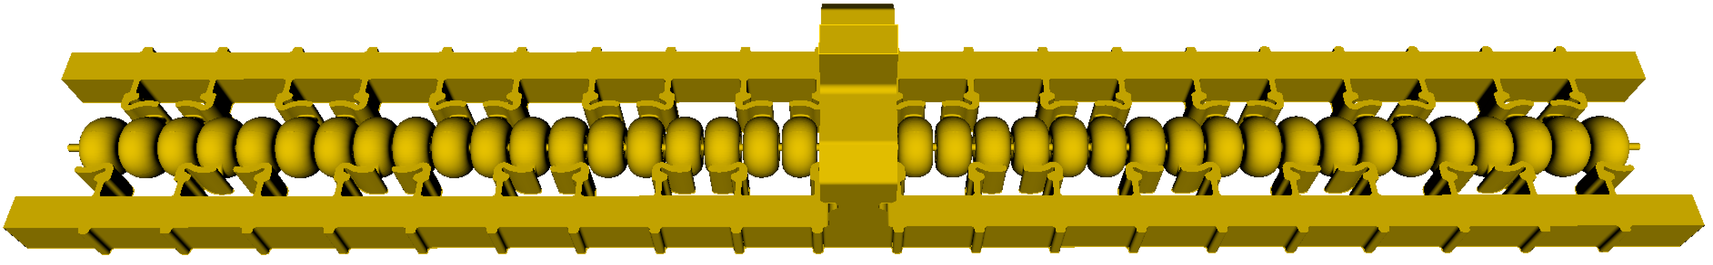
High Gradient Testing of a Meter-Scale Distributed-Coupling C³ Accelerating Structures
2024 International Workshop on Future Linear Colliders
Emilio Nanni
7/10/2024

Slide 2
Acknowledgements
SLAC
Radiabeam
Muhammad Shumail
Mitchell Schneider
Emma Snively
Sami Tantawi
Valery Dolgashev
Zenghai Li
Dennis Palmer
Garrett Mathesen
Charlotte Wehner
Julian Merrick
Mamdouh Nasr
Ankur Dhar
Ronald Agustsson
Robert Berry
Amirari Diego
Alex Murokh

Slide 3
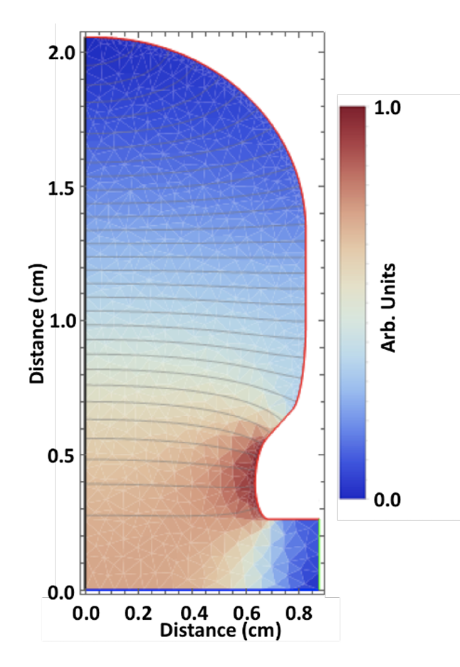
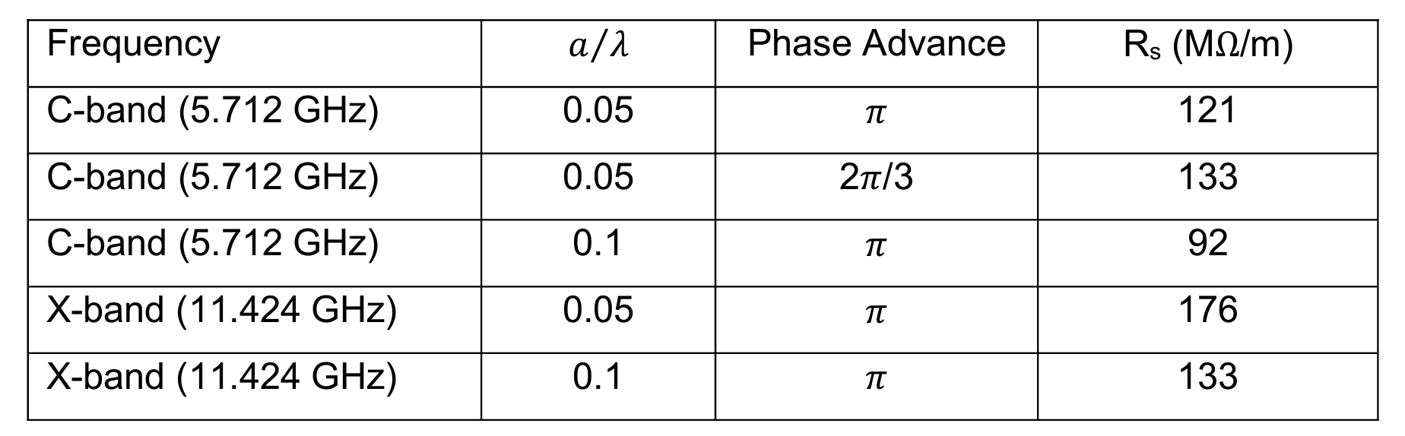
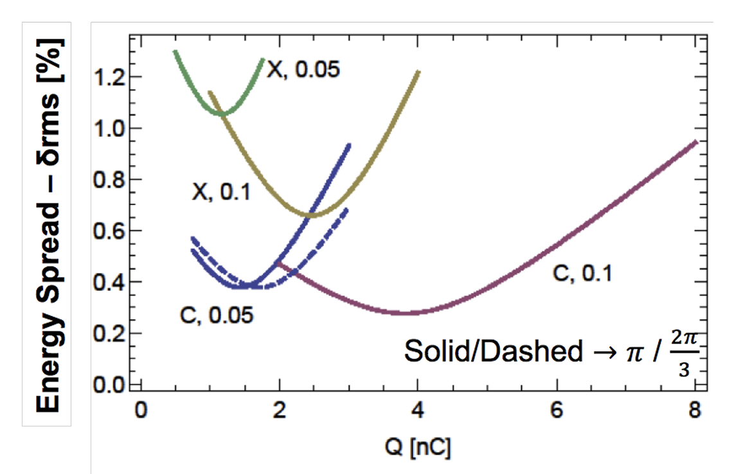
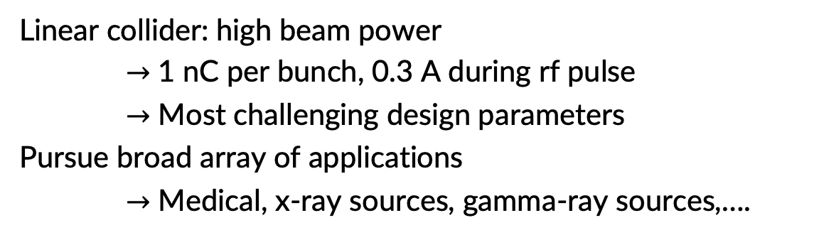
What’s the Optimal Frequency for High Charge Beams?
Linear collider: high beam power
$→$ 1 nC per bunch, 0.3 A during rf pulse
$→$ Most challenging design parameters
Pursue broad array of applications
$→$ Medical, x-ray sources, gamma-ray sources,….
1 nC, 150 micron, 25 deg.
arXiv:1807.10195 (2018)

Slide 4
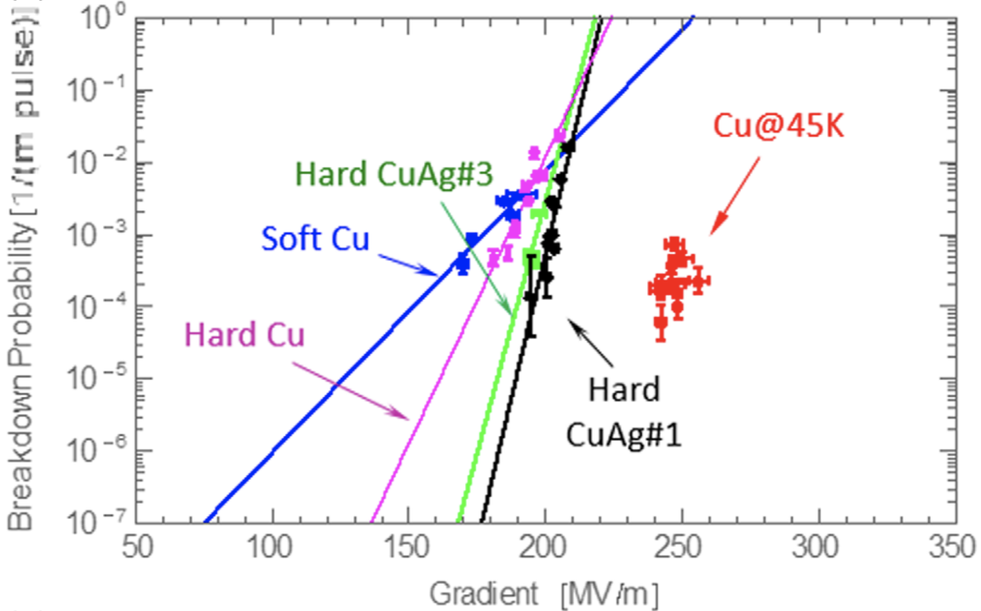
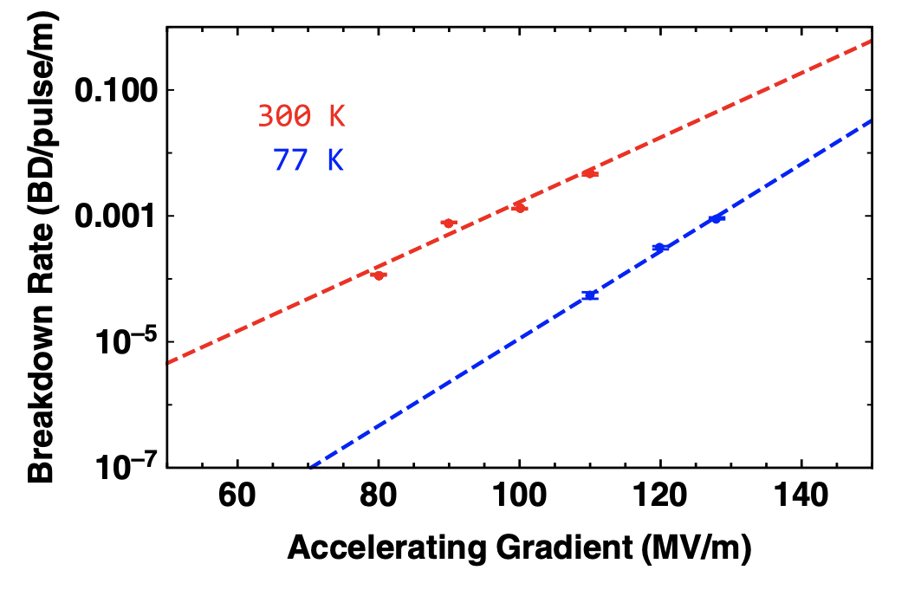
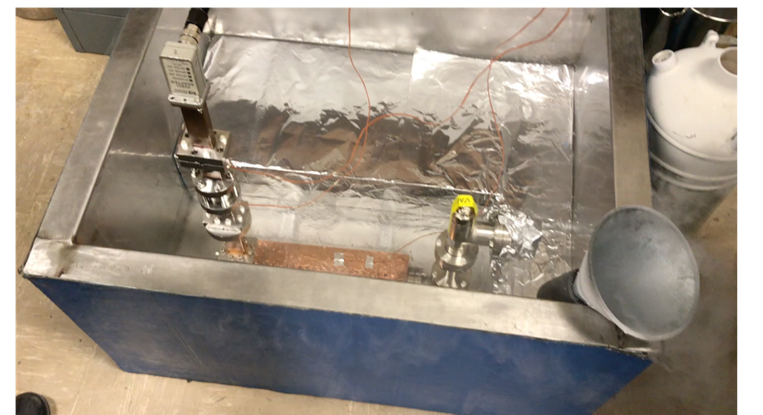
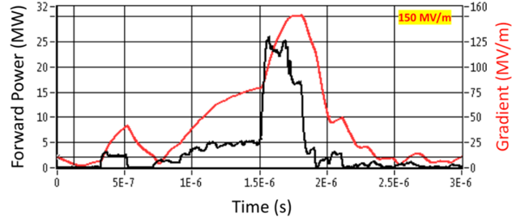
Cryo-Copper: Enabling Efficient High-Gradient Operation
Cryogenic temperature elevates performance in gradient
Material strength is key factor
Impact of high fields for a high brightnessdampig ring
Operation at 77 K with liquid nitrogen
Large heat capacity, simple handling
Small impact on electrical efficiency
Cryogenic temperature elevates gradient
Increased material strength is key factor
Increase electrical conductivity reduces pulsed heating in the material
High Gradient Operation at 150 MV/m
Nasr, et al. PRAB 24.9 (2021): 093201

Slide 5
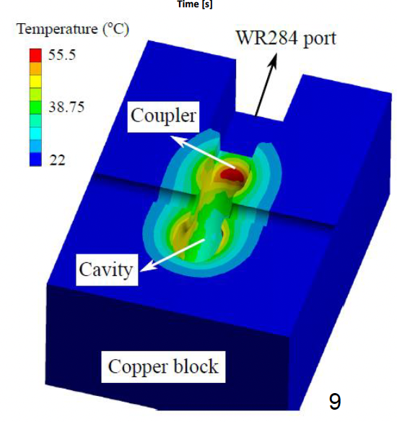
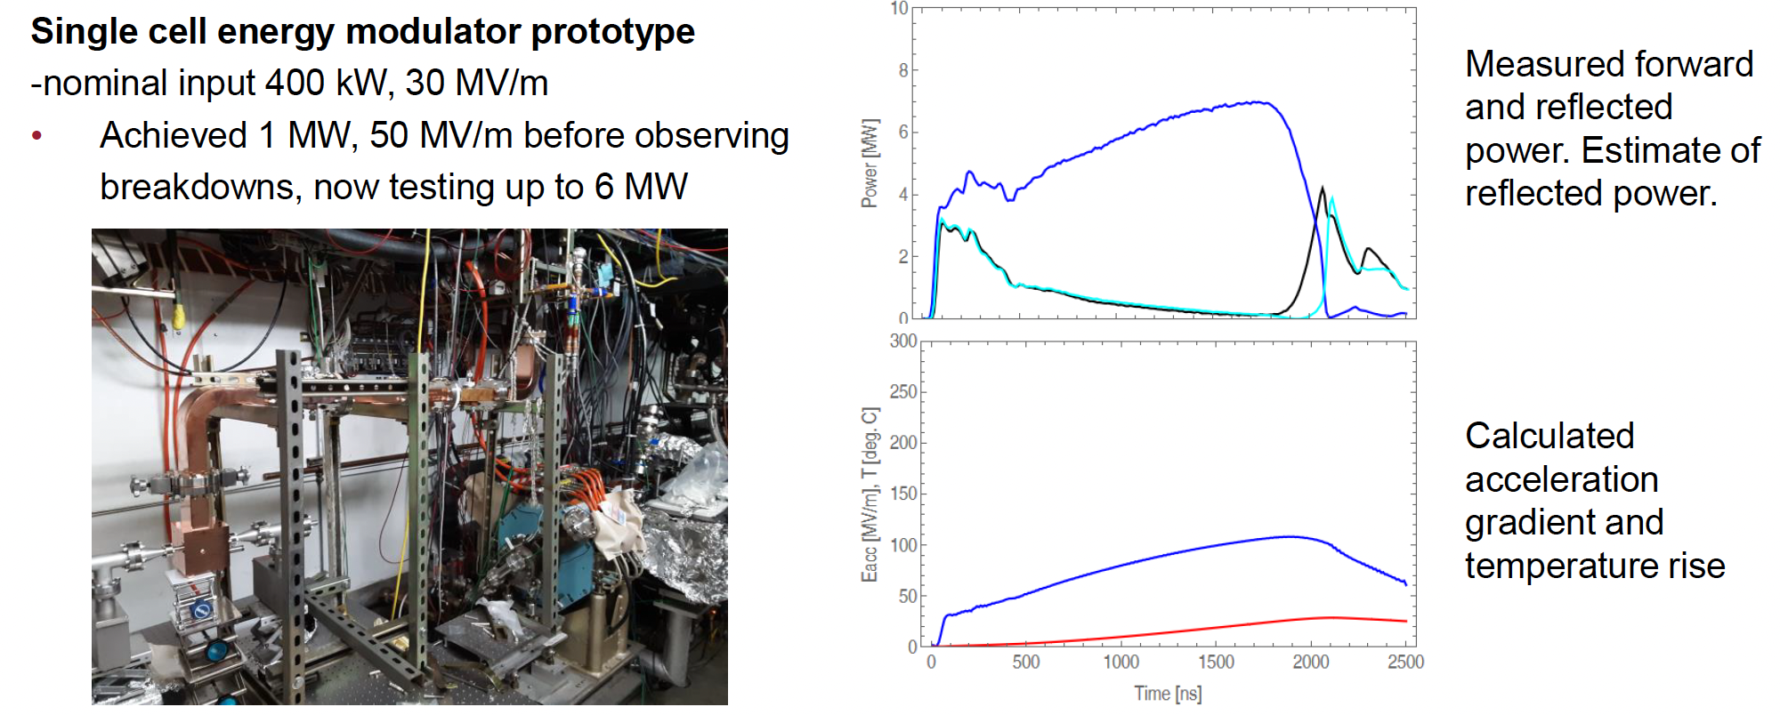
Optimized RF Feed for Distributed Coupling Structure
Energy modulator (and deflector) for rastering proton beams
RF power coupled to each cell can lead to a local hot spot in H-field
Tailoring coupler profile limits enhancement to 15-20% (vs. 230%)
Built and tested on an S-band structure
Lu, et al., Review of Scientific Instruments 92.2 (2021).

Slide 6
Meter-Scale Distributed-Coupling Structure

Slide 7
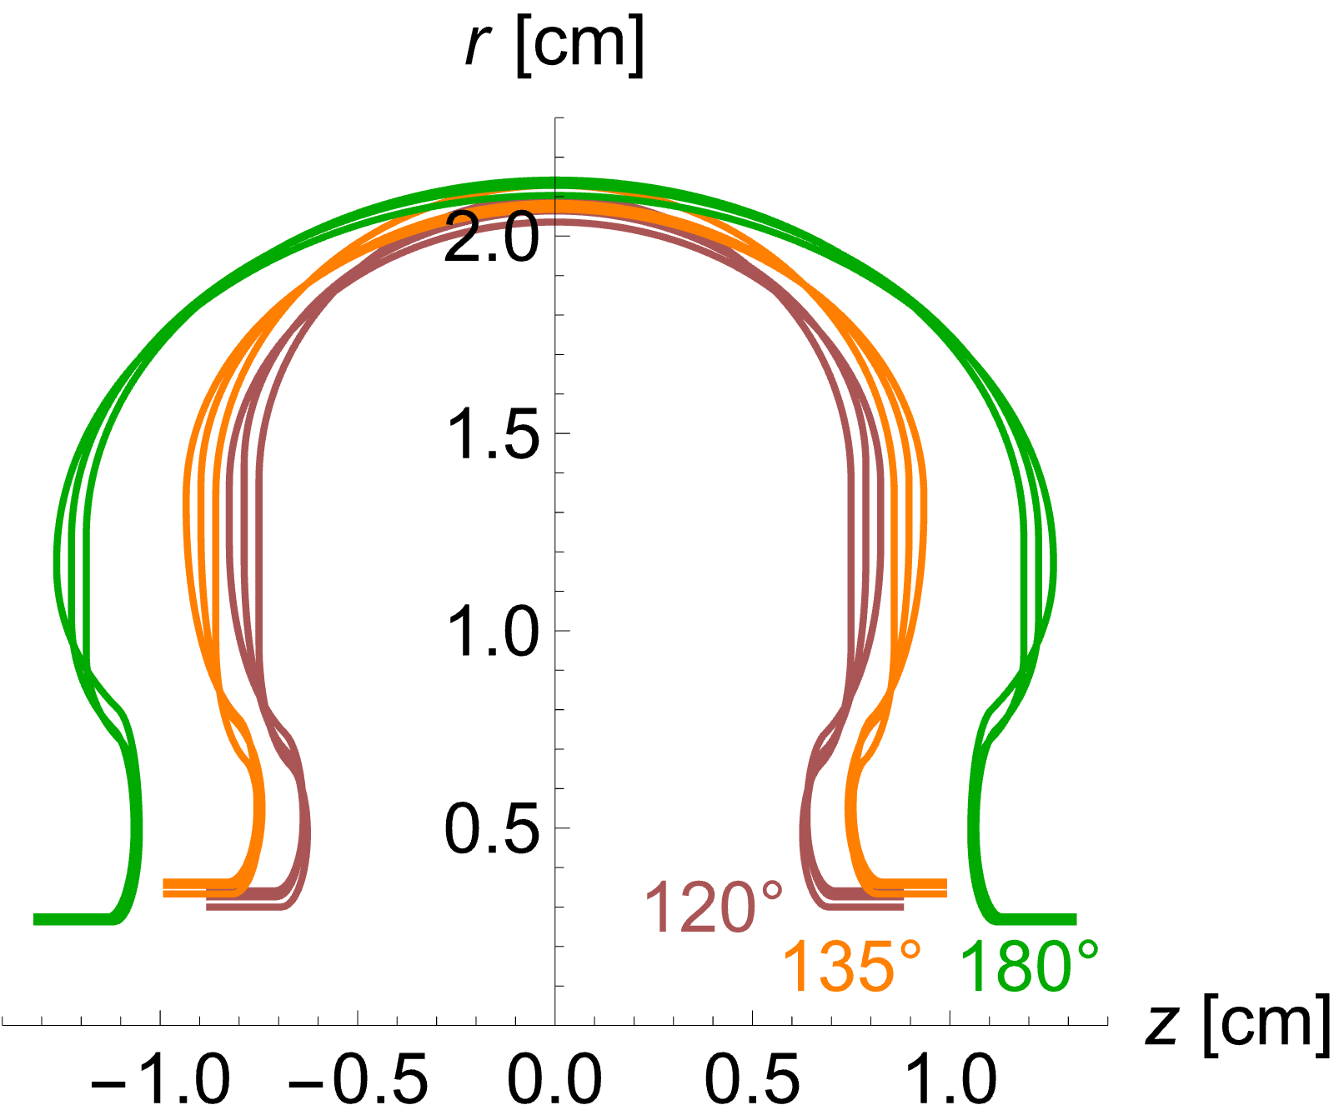

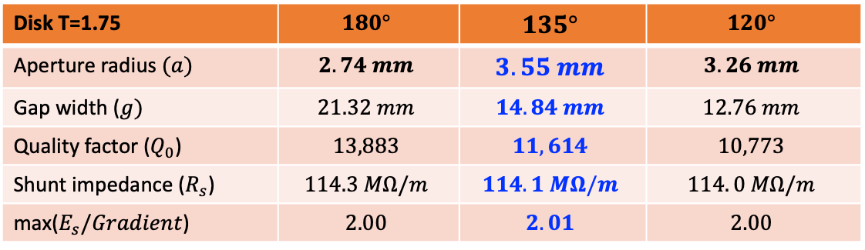

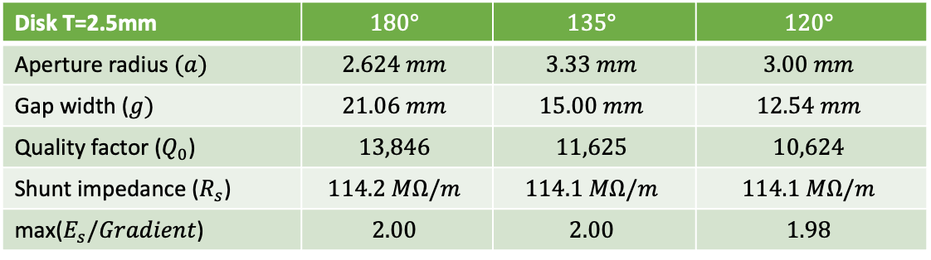

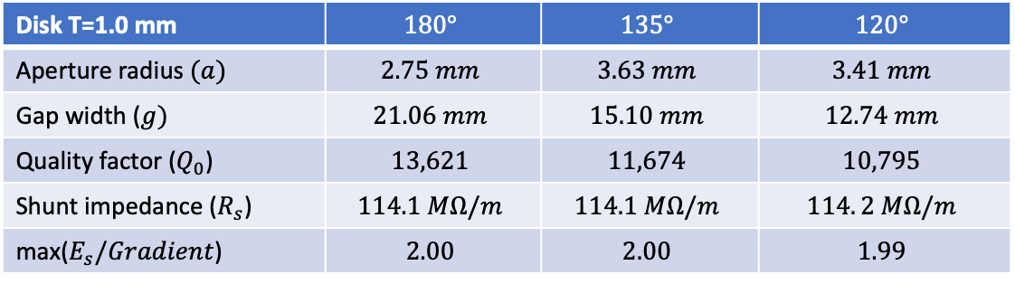
Cavity Geometry Optimized for Constant Aperture
Structure optimization at 5.712 GHz for
phase advance of interest:
180°, 135°, and 120°.
Disk T=2.5mm | $$180°$$ | $$135°$$ | $$120°$$
Aperture radius $(a)$ | $$2.624 mm$$ | $$3.33 mm$$ | $$3.00 mm$$
Gap width ($g)$ | $$21.06 mm$$ | $$15.00 mm$$ | $$12.54 mm$$
Quality factor ($Q_{0}$) | $$13,846$$ | $$11,625$$ | $$10,624$$
Shunt impedance ($R_{s}$) | $$114.2 MΩ/m$$ | $$114.1 MΩ/m$$ | $$114.1 MΩ/m$$
max($E_{s}/Gradient$) | $$2.00$$ | $$2.00$$ | $$1.98$$
$$t = 2.50 mm$$
Disk T=1.75 | $$180°$$ | $$135°$$ | $$120°$$
Aperture radius $(a)$ | $$2.74 mm$$ | $$3.55 mm$$ | $$3.26 mm$$
Gap width ($g)$ | $$21.32 mm$$ | $$14.84 mm$$ | $$12.76 mm$$
Quality factor ($Q_{0}$) | $$13,883$$ | $$11,614$$ | $$10,773$$
Shunt impedance ($R_{s}$) | $$114.3 MΩ/m$$ | $$114.1 MΩ/m$$ | $$114. 0 MΩ/m$$
max($E_{s}/Gradient$) | $$2.00$$ | $$2.01$$ | $$2.00$$
$$t =1.75 mm$$
$$t =1.00 mm$$
[Shumail]
Disk T=1.0 mm | $$180°$$ | $$135°$$ | $$120°$$
Aperture radius $(a)$ | $$2.75 mm$$ | $$3.63 mm$$ | $$3.41 mm$$
Gap width ($g)$ | $$21.06 mm$$ | $$15.10 mm$$ | $$12.74 mm$$
Quality factor ($Q_{0}$) | $$13,621$$ | $$11,674$$ | $$10,795$$
Shunt impedance ($R_{s}$) | $$114.1 MΩ/m$$ | $$114.1 MΩ/m$$ | $$114. 2 MΩ/m$$
max($E_{s}/Gradient$) | $$2.00$$ | $$2.00$$ | $$1.99$$
This work at 180°, in future 135°

Slide 8
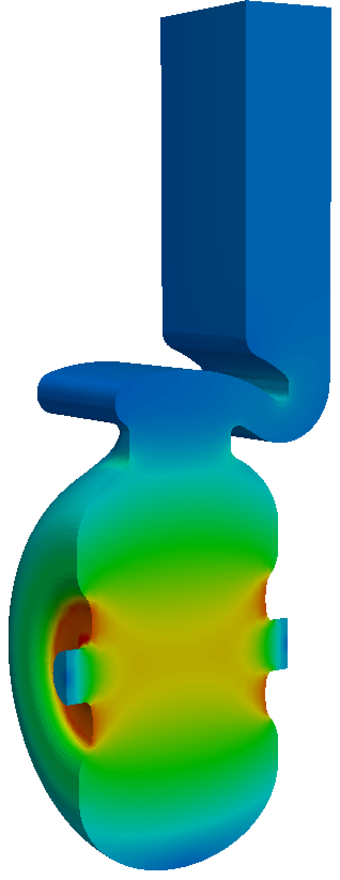
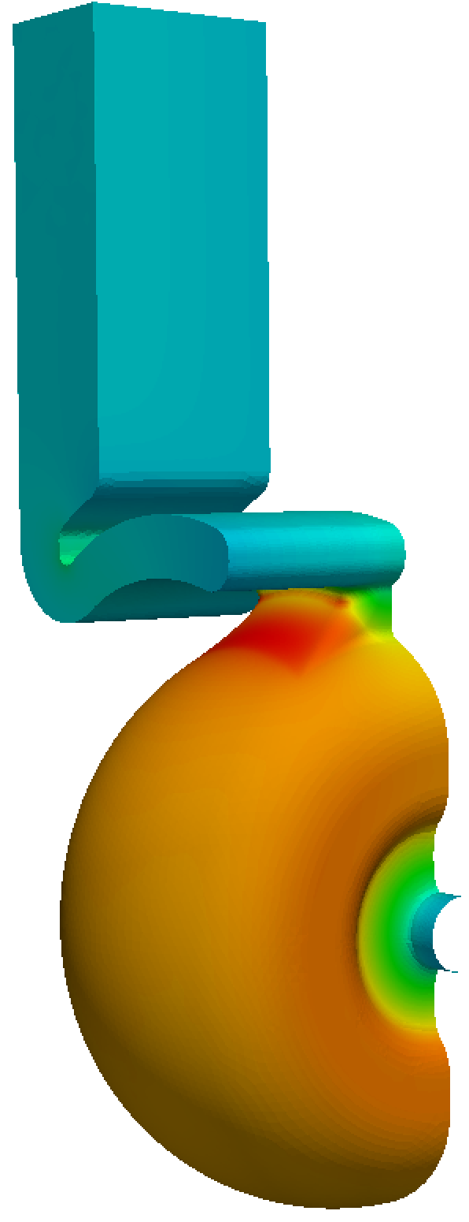
RF Coupler Design
Structures are critically coupled at room temperature
Overcoupled at cryogenic temperatures
  Reduces fill time
  Critically coupled with beam injection
Coupler Impact – H-field enhancement 18.6%
Peak surface E-field / Accelerating Gradient = 2.22
E-Field
H-Field

Slide 9
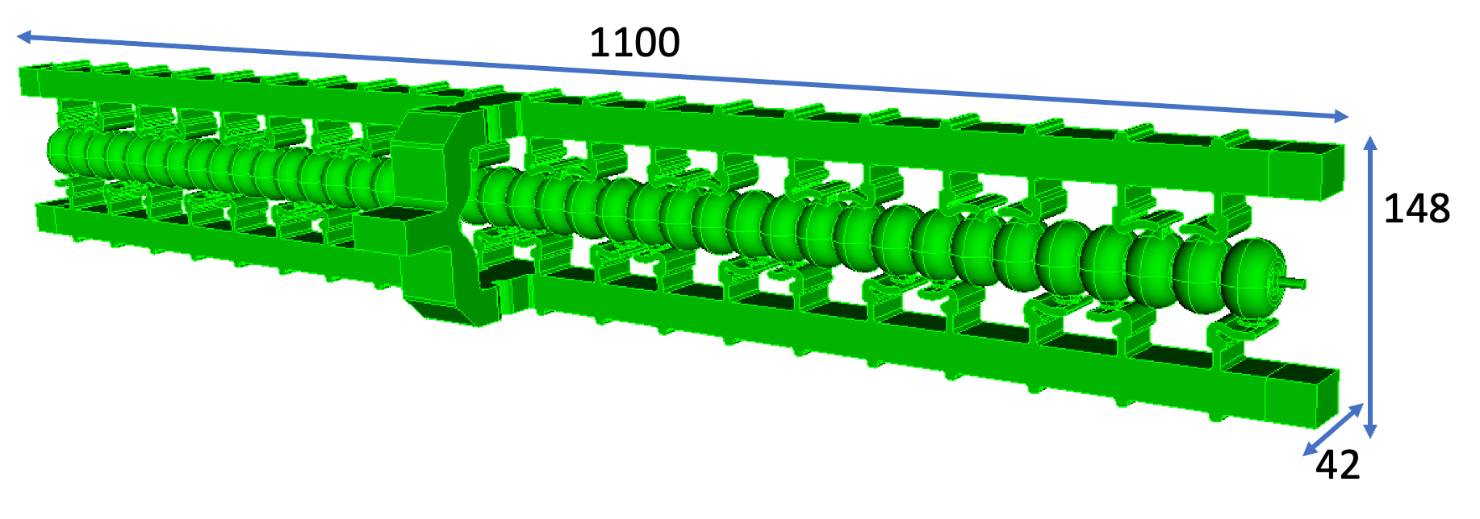
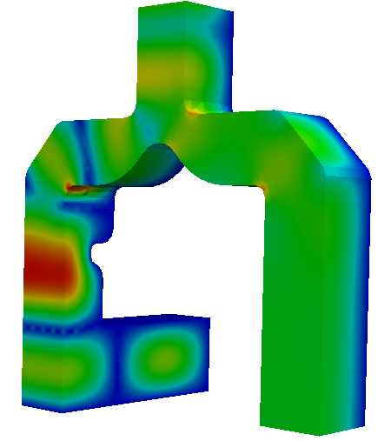
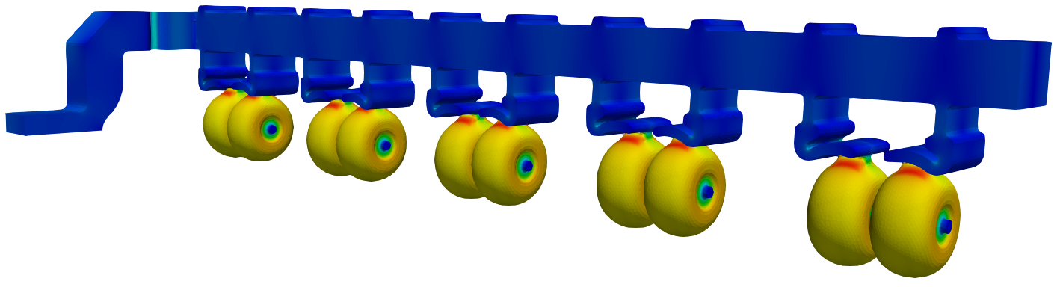
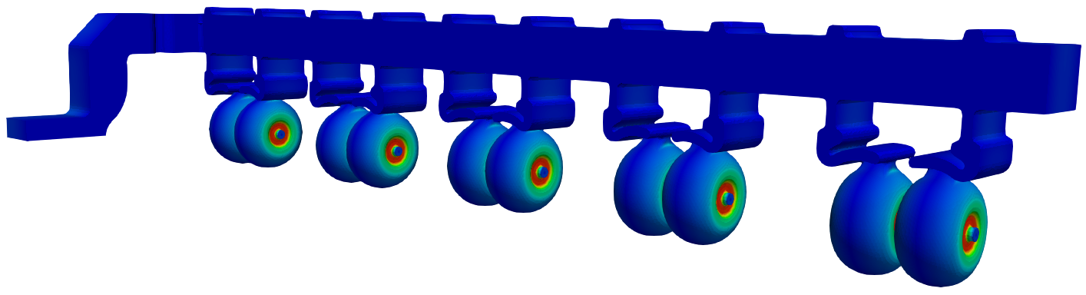
Manifold Design
Each structure powered by a single feed split into two manifolds
H-Field
Note: Pairs of structures fed by a hybrid to avoid reflections to klystron
Power Splitter
E-Field

Slide 10
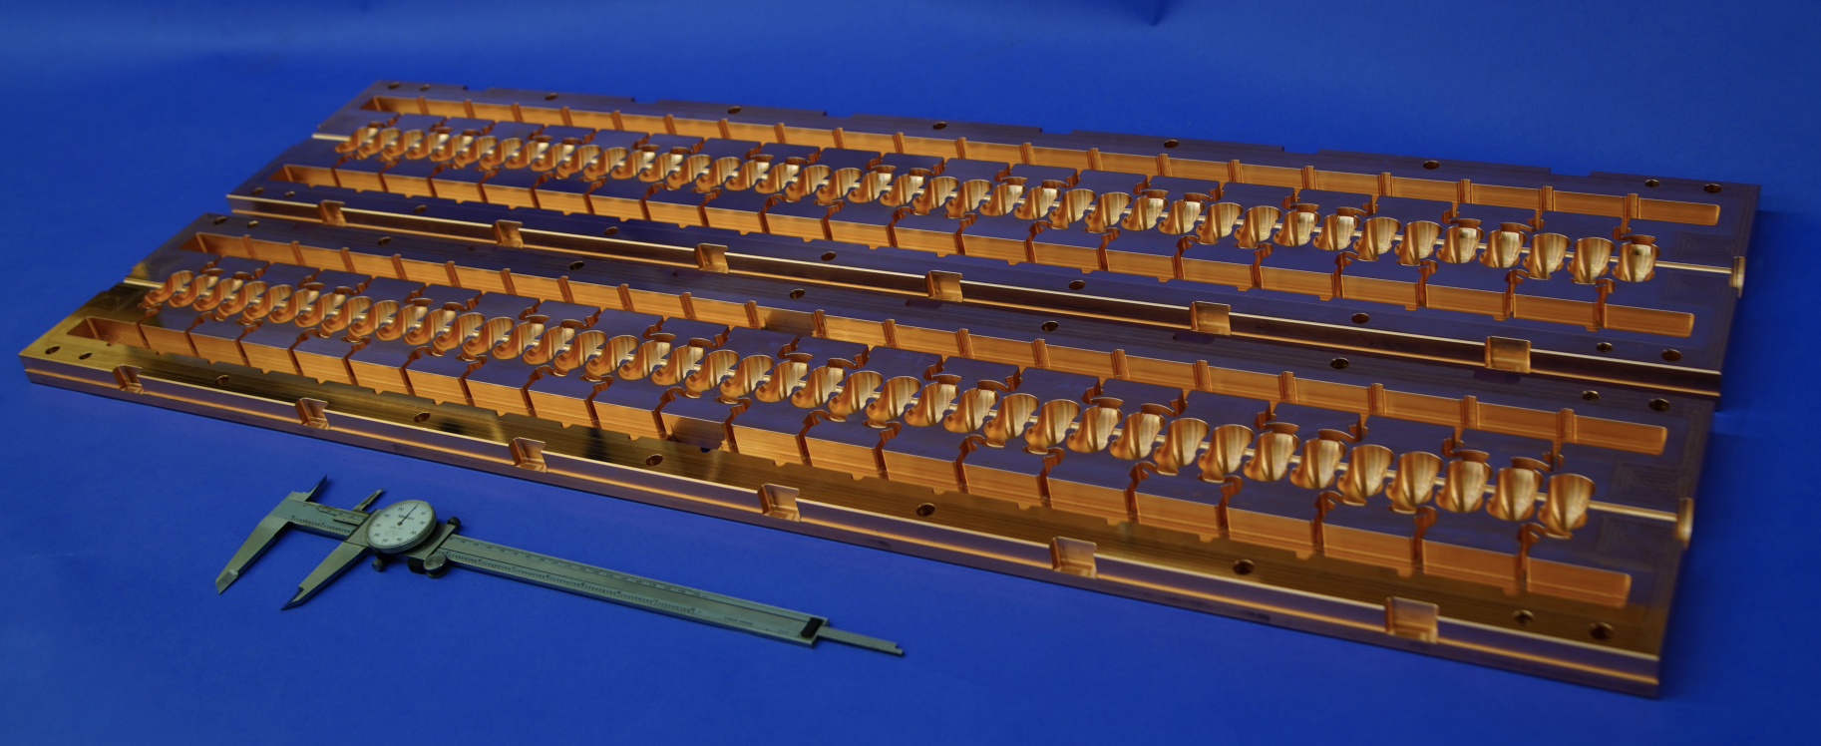
Split Cell Manufacturing
One of the core innovations for C3 is distributed coupling, allowing RF power to be individually fed to each cavity with precise phasing
The engineering innovation that makes this possible is split cell manufacturing, where the cavities are machined in two halves and then joined via brazing or diffusion bonding

Slide 11
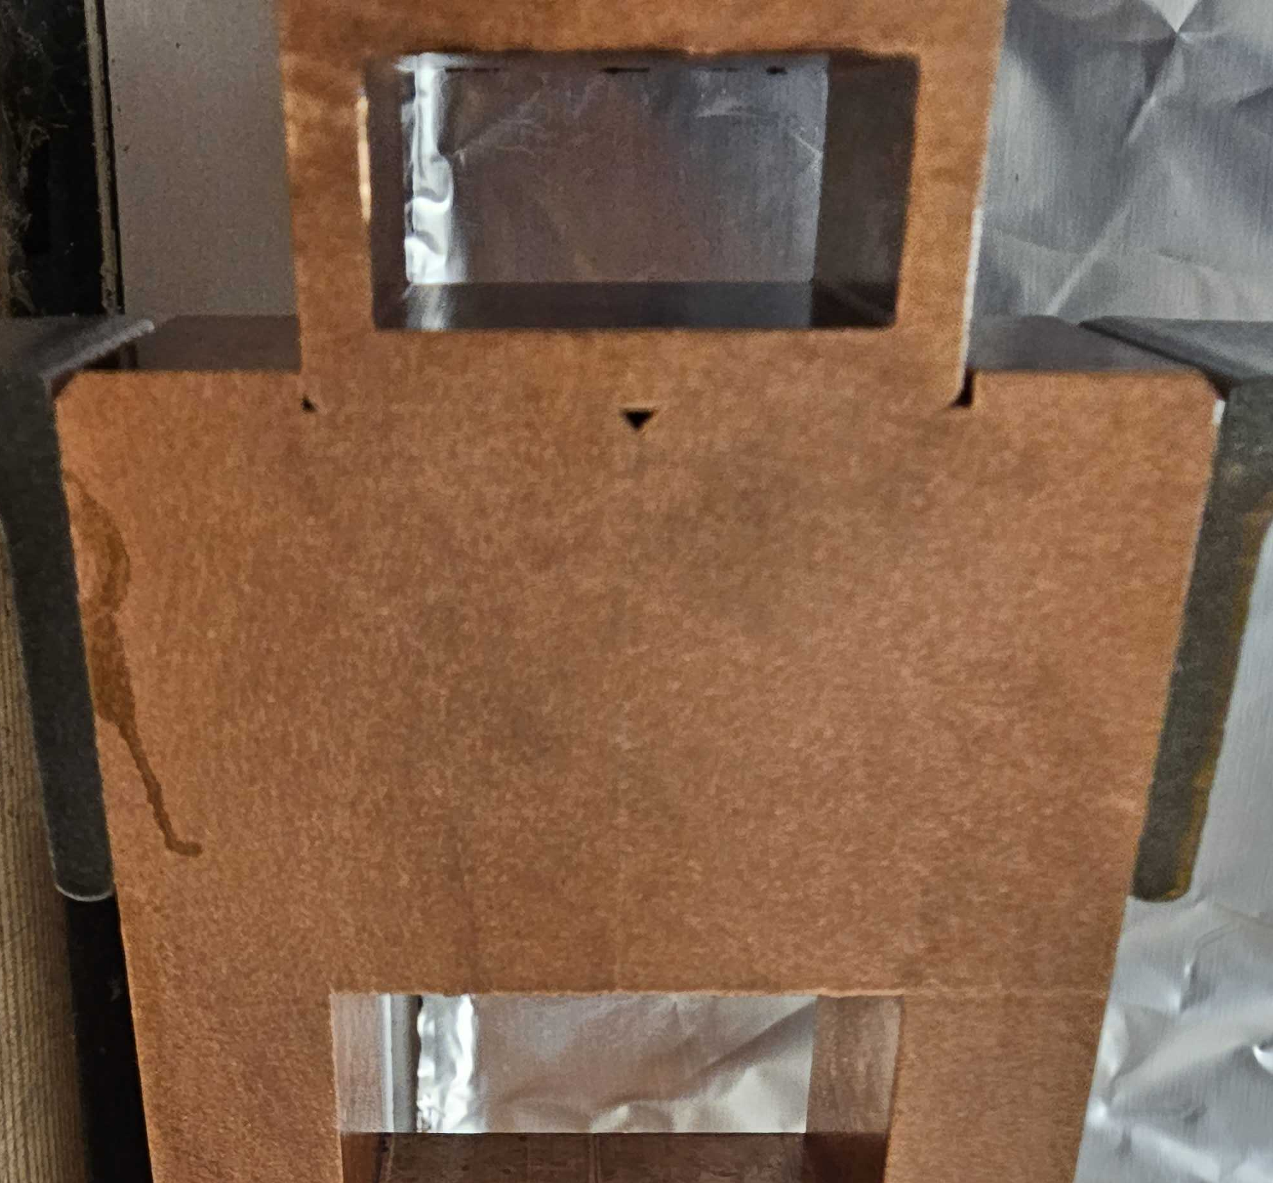
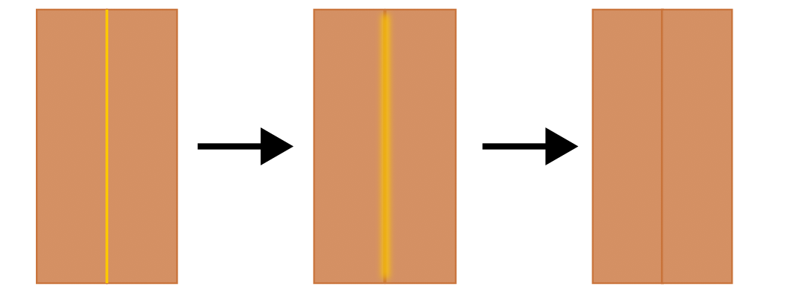
Brazing
Brazing is a process by which metals can be bonded by almost melting the interface between them and joining them with a filler metal with a lower melting point
In the case of RF structures, this is used for joining copper pieces together
The filler metal in this case is typically an alloy of copper and gold, the exact proportion of each determining the melting point of the alloy
Using split cell manufacturing greatly reduces the number of braze steps

Slide 12
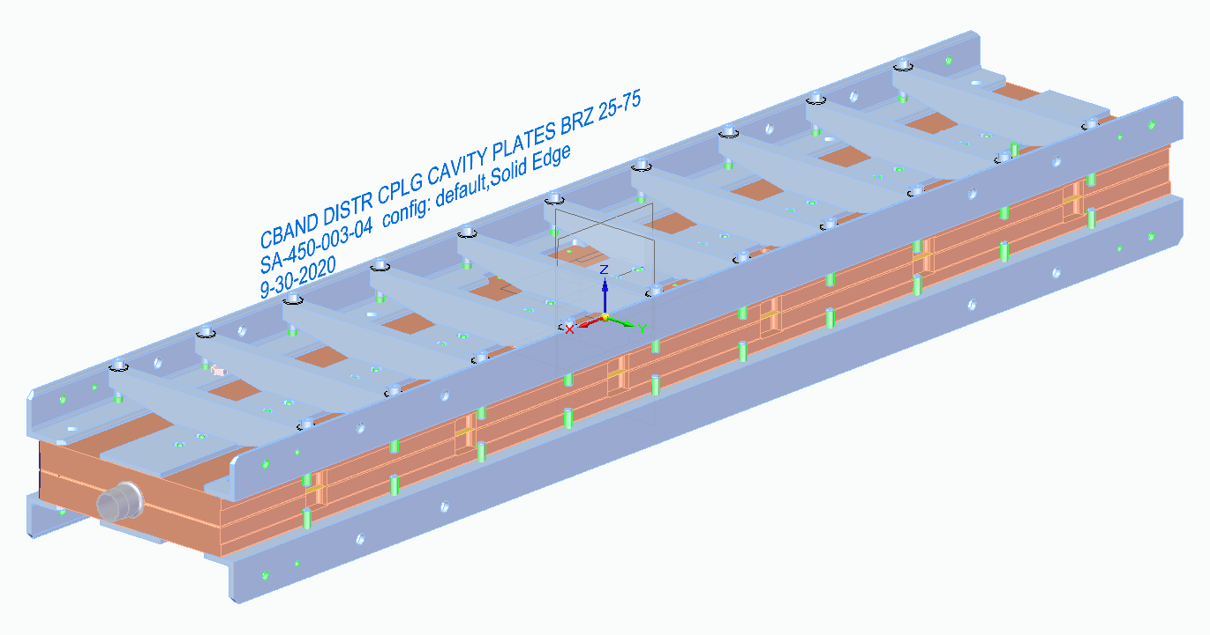
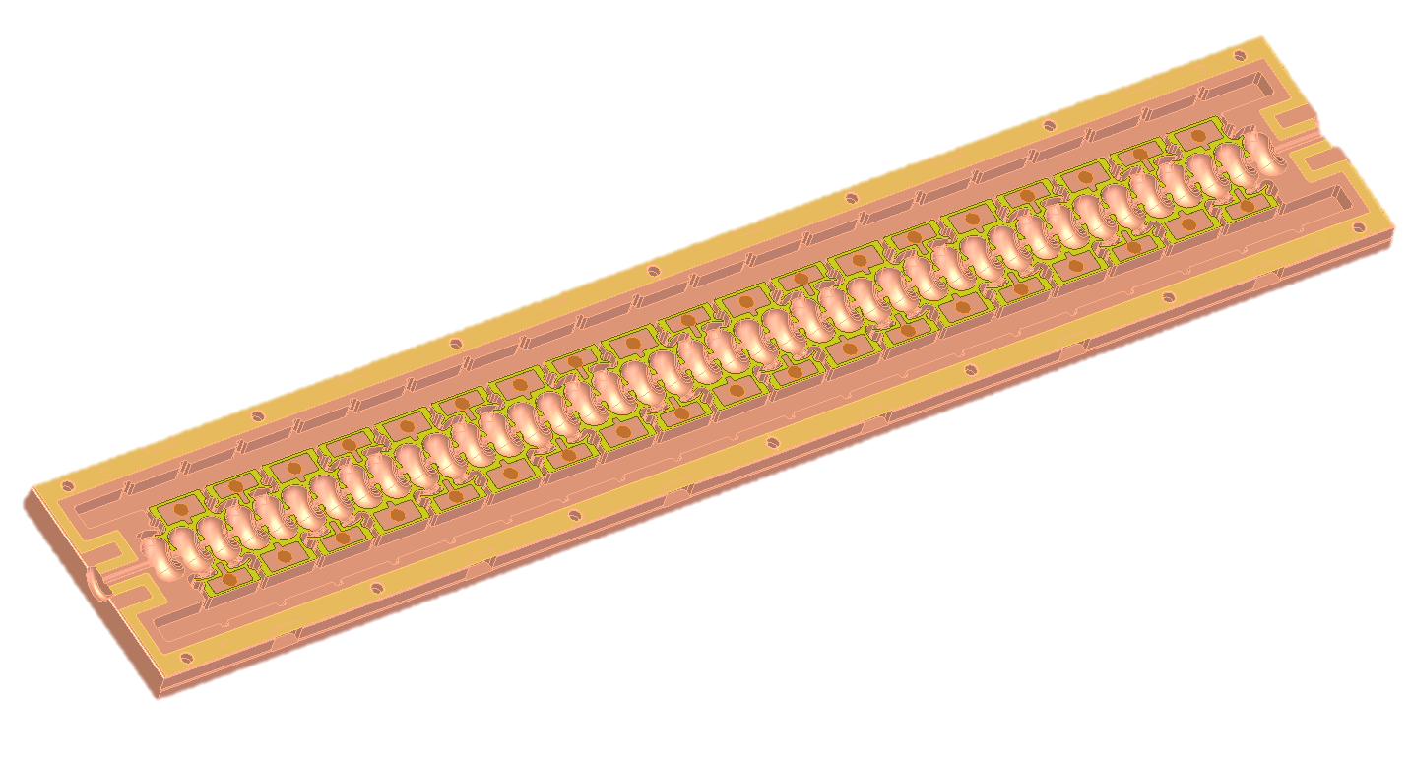
Brazing Assembly
Typical tolerances for bonding require surface flatness to within 0.001”
Braze filler metal is typically cut from sheet stock that is 0.001” to 0.002” thick
To ensure contact between bonding surfaces, strongback braces can be used
Slab
Braze shim
Strongback

Slide 13
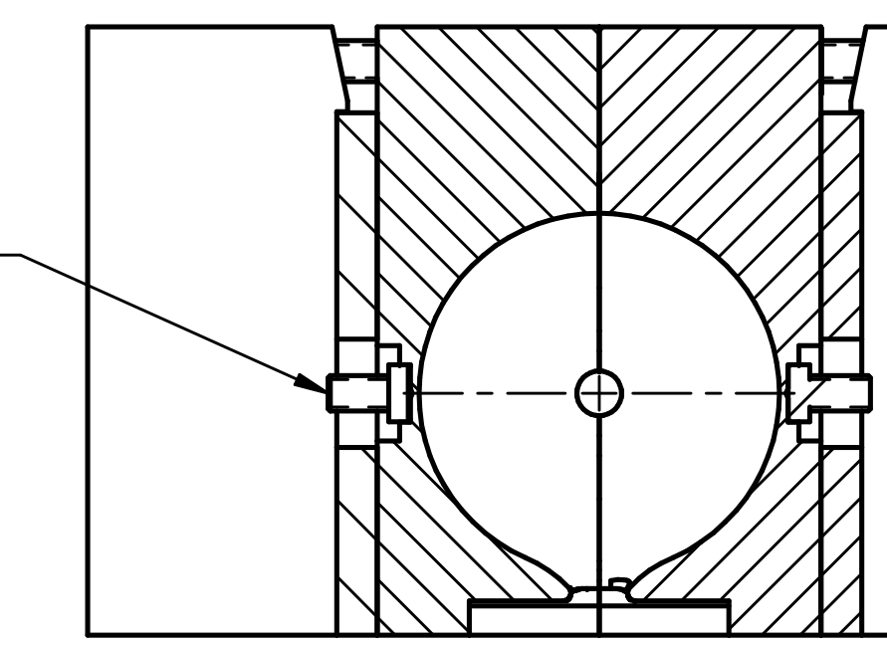
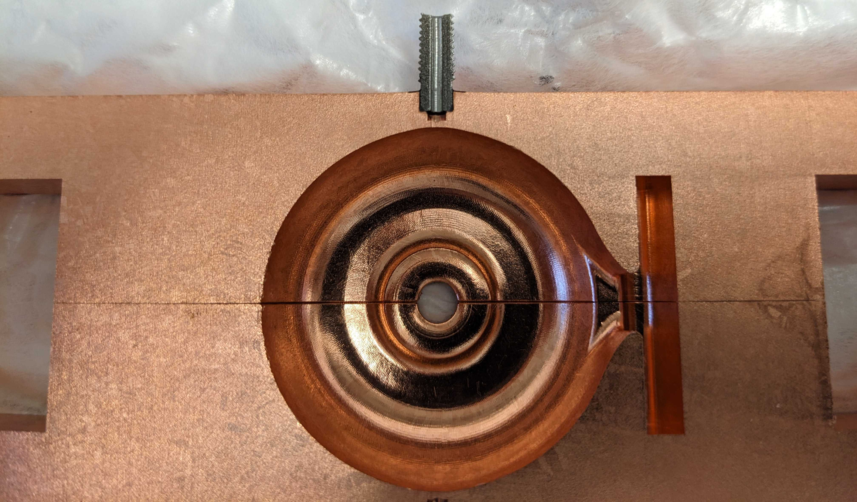
Frequency Tuner for Cavities
After the two slabs are bonded, extra features e.g. power splitter / tuning pins are brazed in

Slide 14
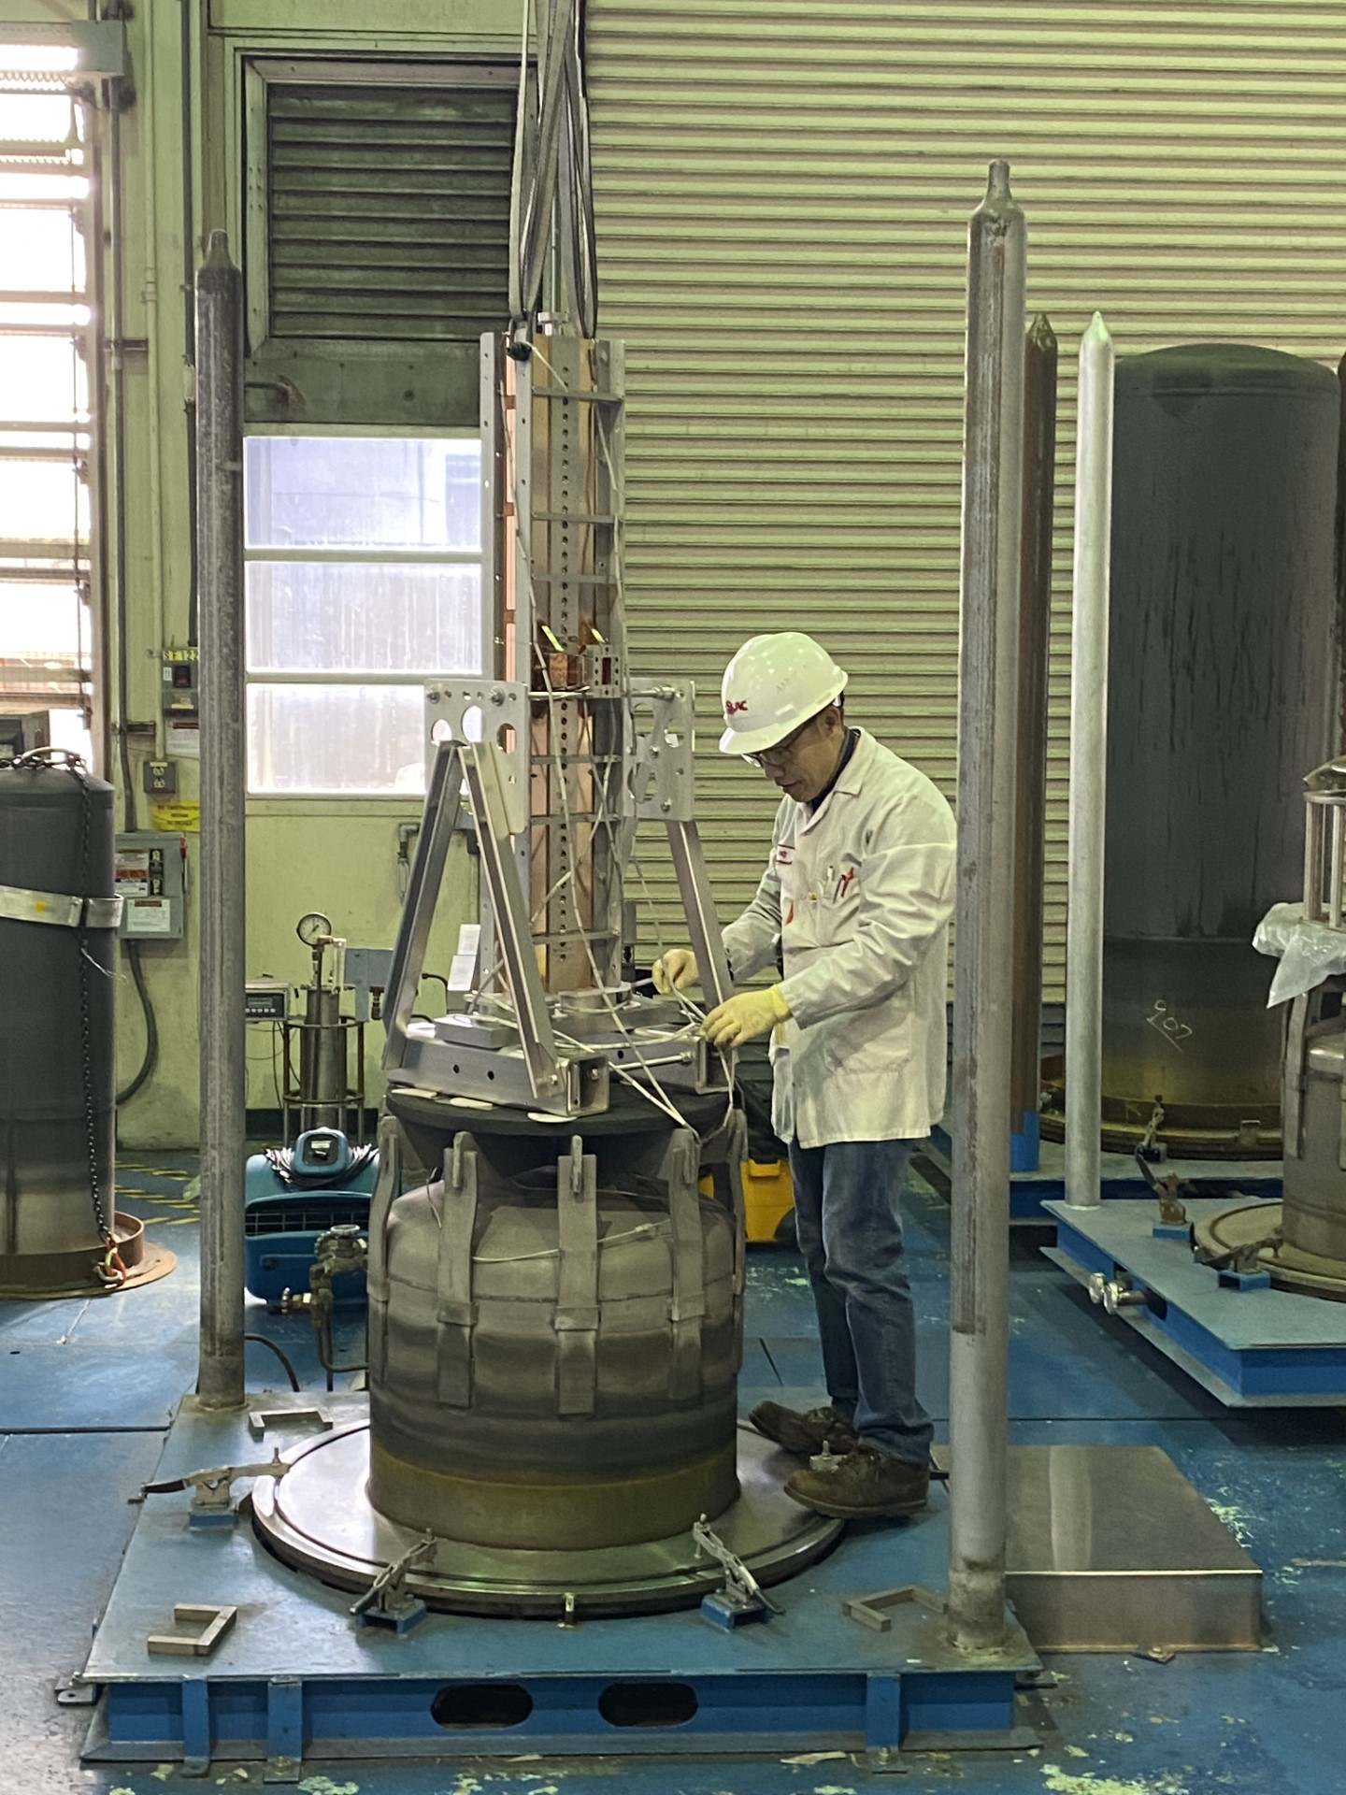
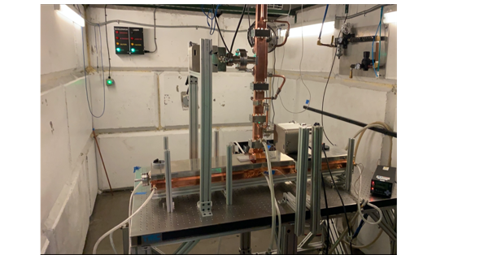
3rd C³ Meter-Scale Prototype Completed Spring ‘24
Previous structures tested warm at high power
Max power 15 MW into structure – klystron limited
Braze process and fixturing was improved iteratively
Third structure for cold operation

Slide 15
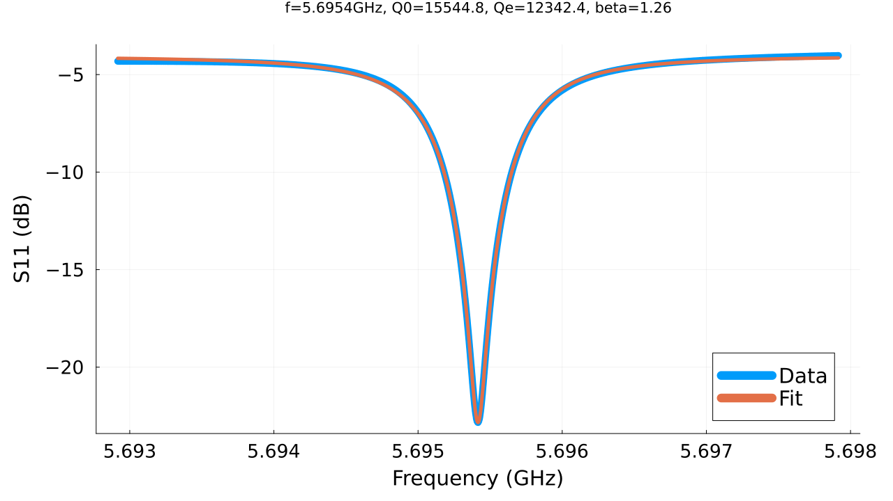
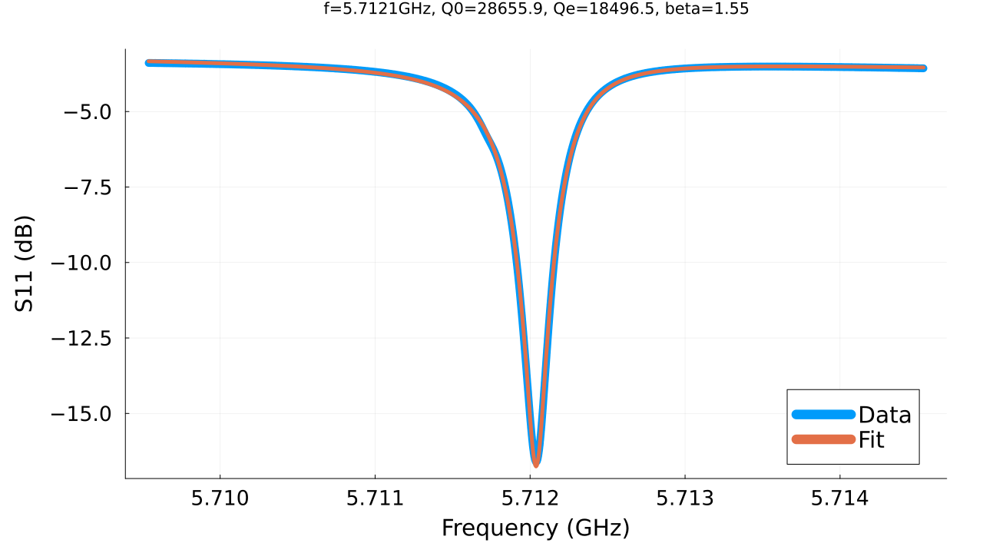
Low Power Structure Performance
Parameter | Unit
Qo Design Warm - 300 K | 13,800
Qo Warm - 300 K | 12,300
Qo Cold - 77 K | 28,700
Enhancement | 2.34
Structure Tuned at 300 K with N2 Purge
Frequency shift during cooldown predictable and repeatable
Each cell tuned while others are detuned by a rod
300 K
77 K

Slide 16
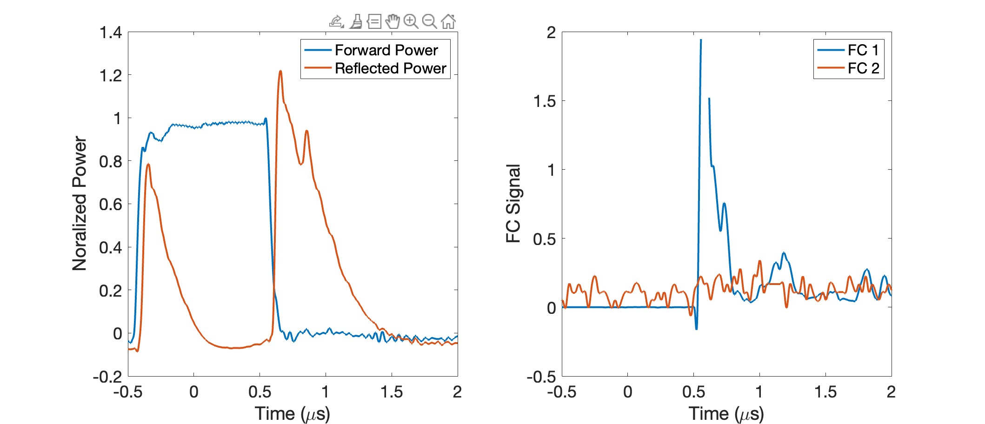
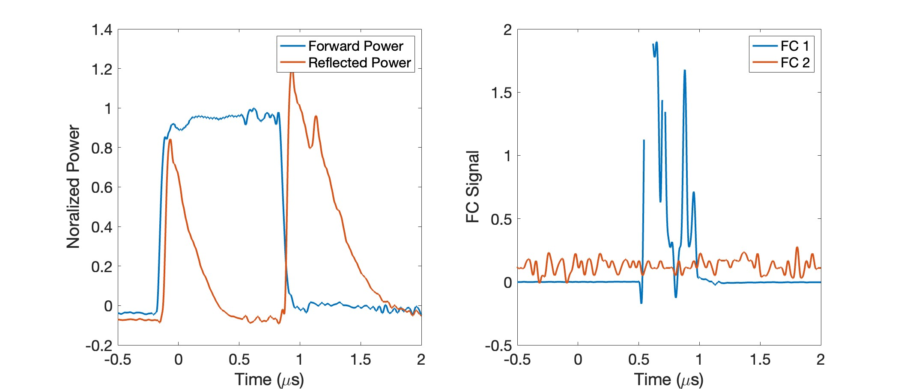
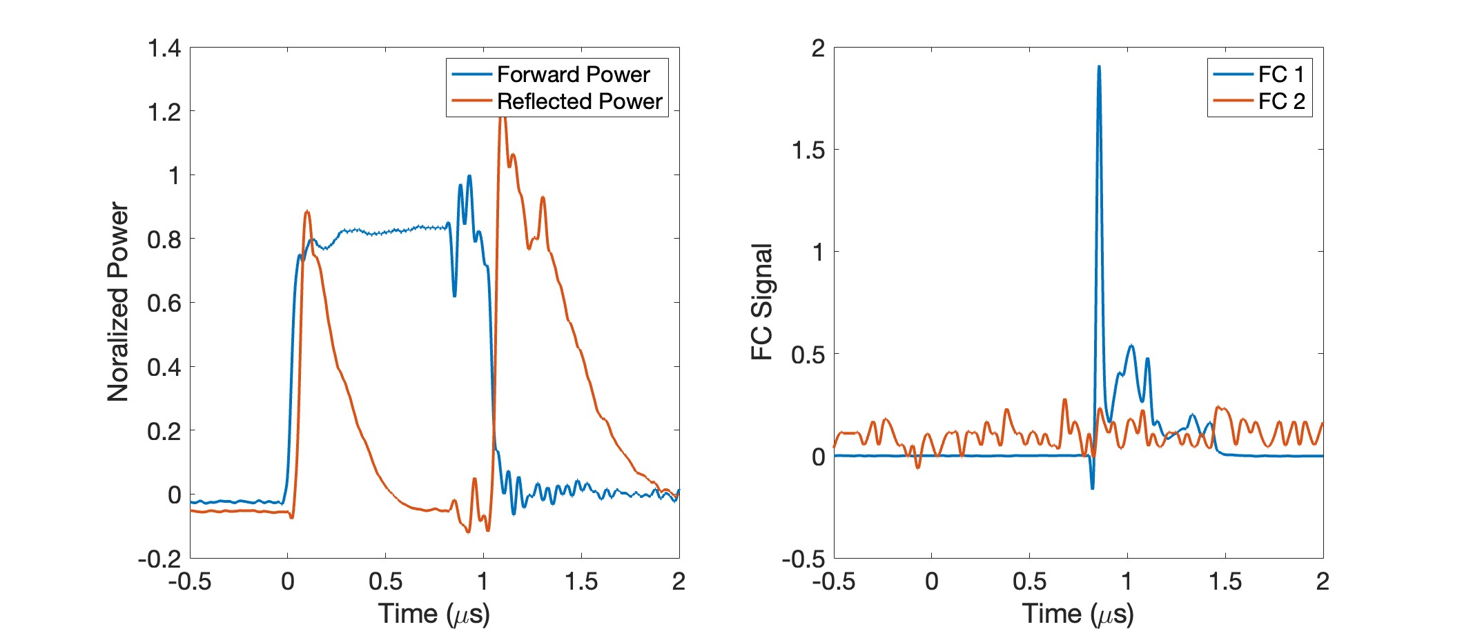
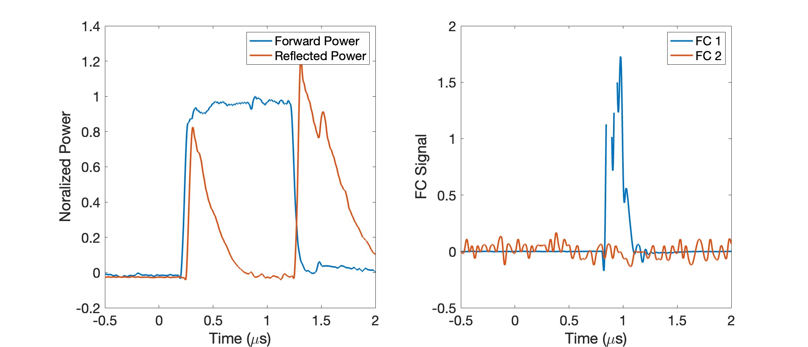
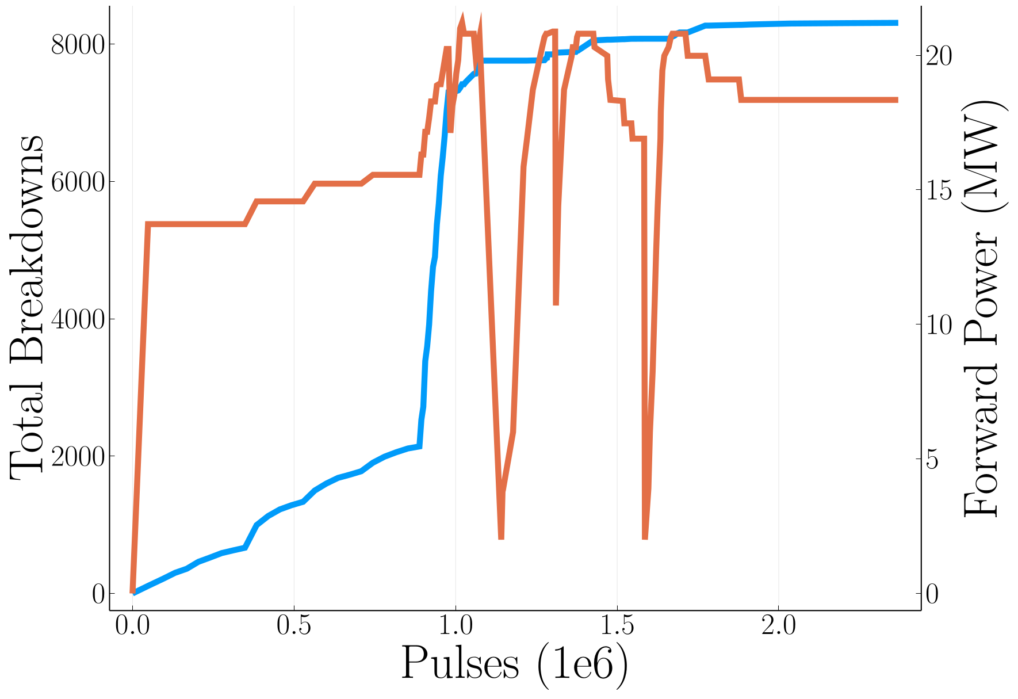
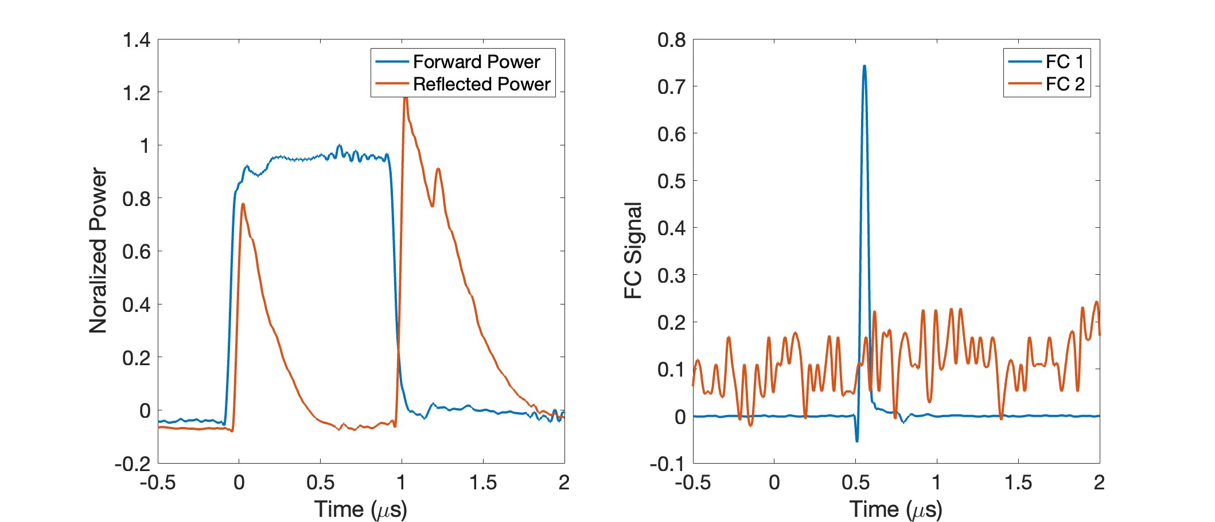
Measurement of RF Signals and Breakdowns
Structure was processed over 10 days – power limit to structure from klystron 21 MW
Example Breakdowns
Processed at 400 ns, 700 ns and 1000 ns
First operation of RF network >5 MW
Rep rate was varied 10-80 Hz
50 MW Klystron into variable power splitter
Total Number of Pulses/Breakdowns

Slide 17
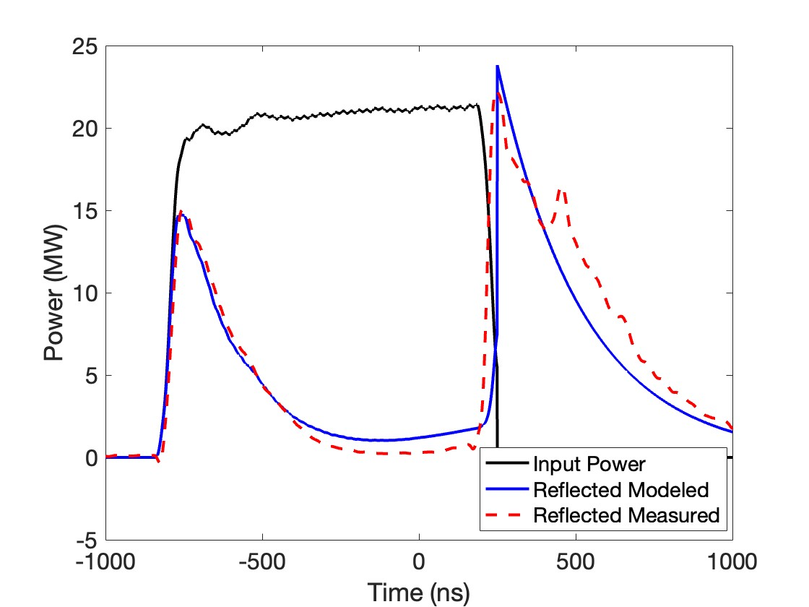
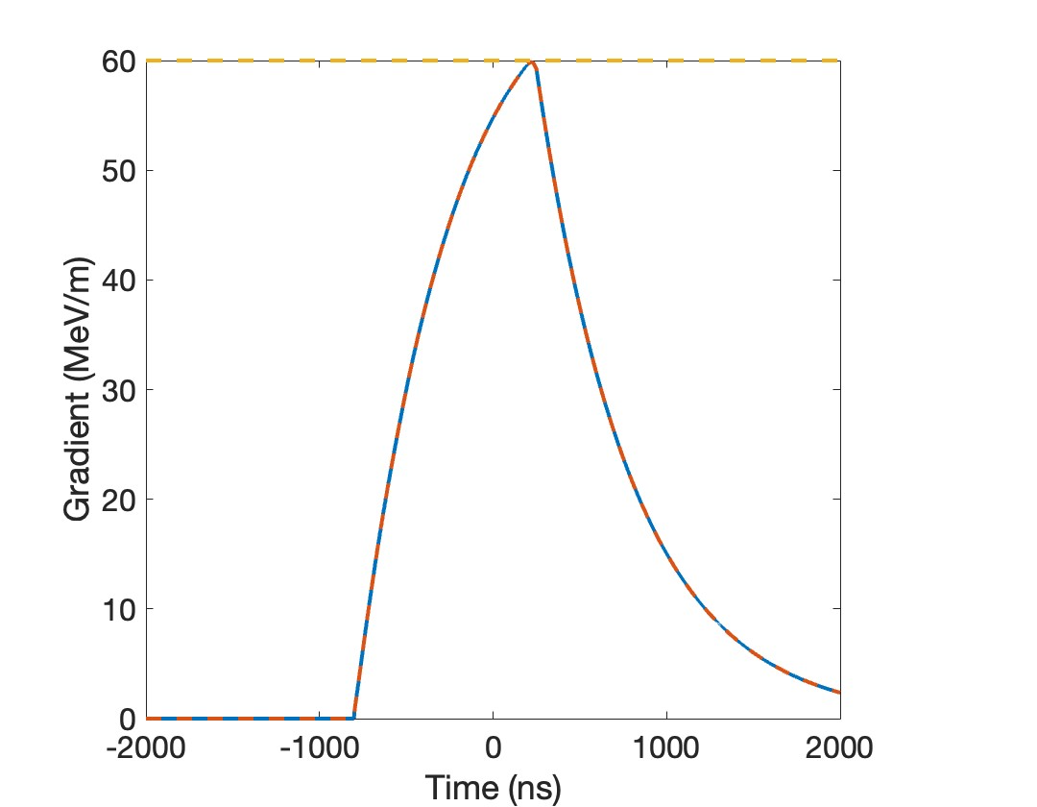
Achieved Accelerating Gradient
60 MeV/m for 21 MW (klystron/rf network limit) and 1 microsecond in just ~2M rf pulses!
At 50 MeV/m BDR was O(10⁻⁶) /pulse/m
Measured and Modeled Reflected Power
Modeled Gradient
Moving Forward: Need longer pulse ~1.5$μs$, higher power ~35 MW, longer run time (over night, ~2 months)

Slide 18
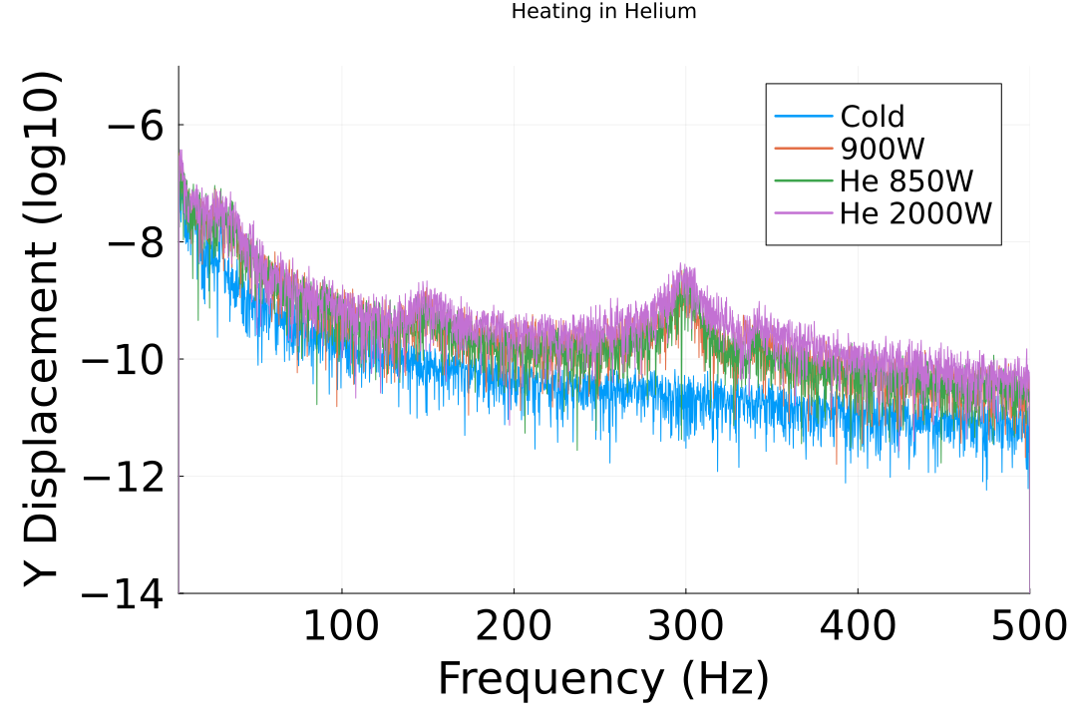
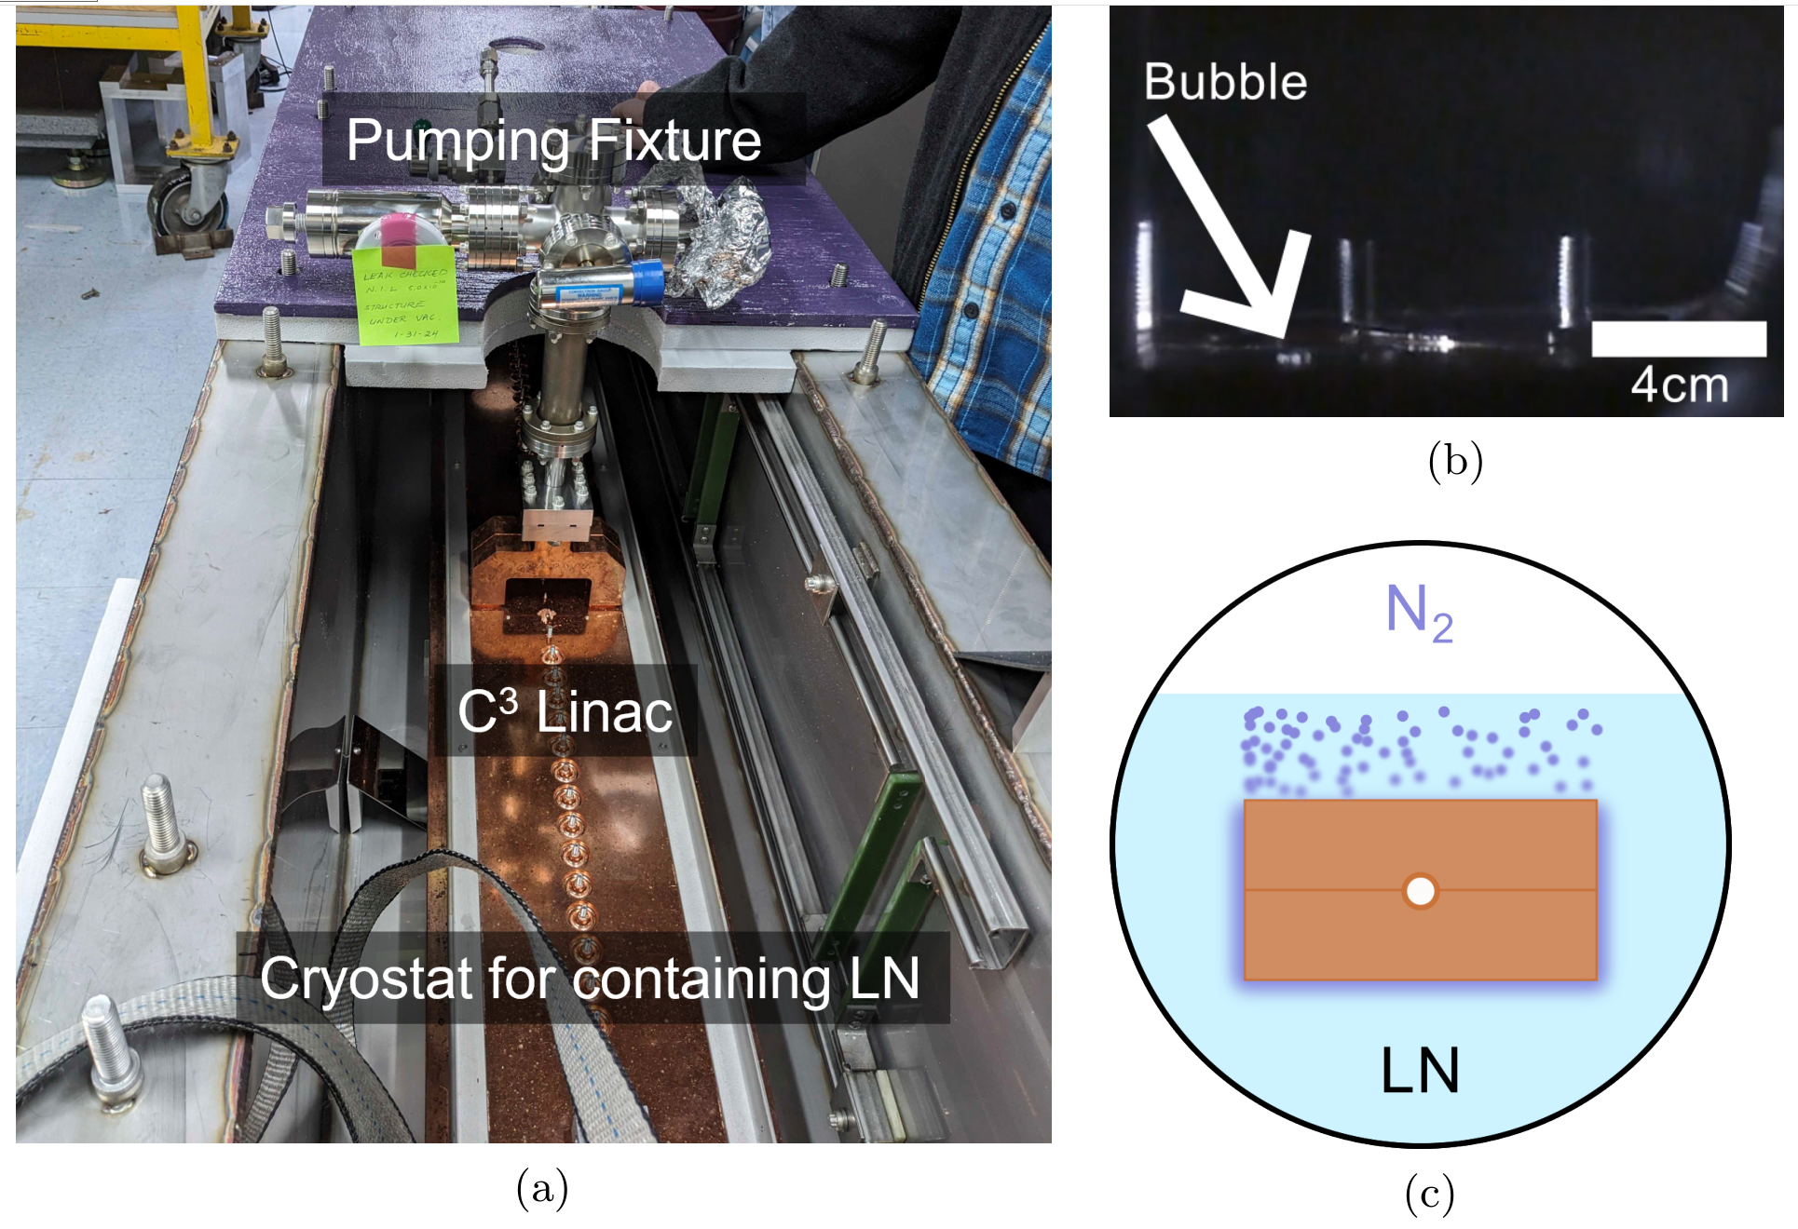
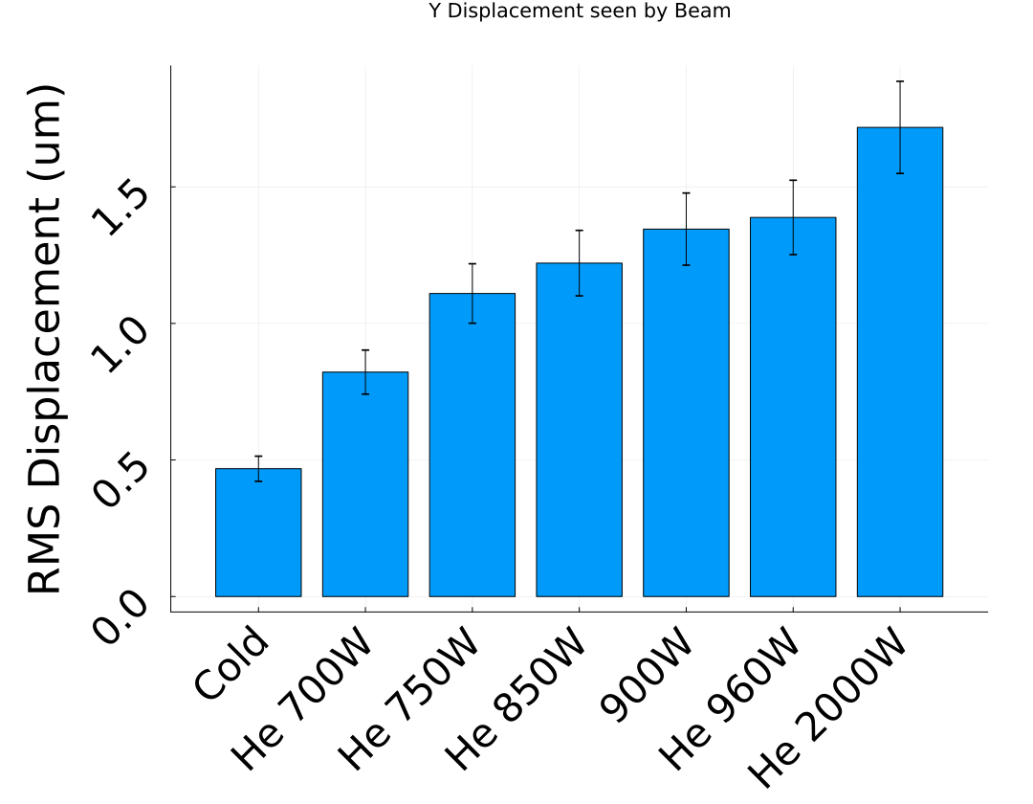
Vibration Measurements Resistive Heater in Beam Tunnel
For main linac structures vibration tolerance is ~10 $μm$
Prototype C3 Linac with a resistive heater was used to test vibration within LN up to 2 kW (thermal load of main linac)
https://www.osti.gov/biblio/2371576

Slide 19
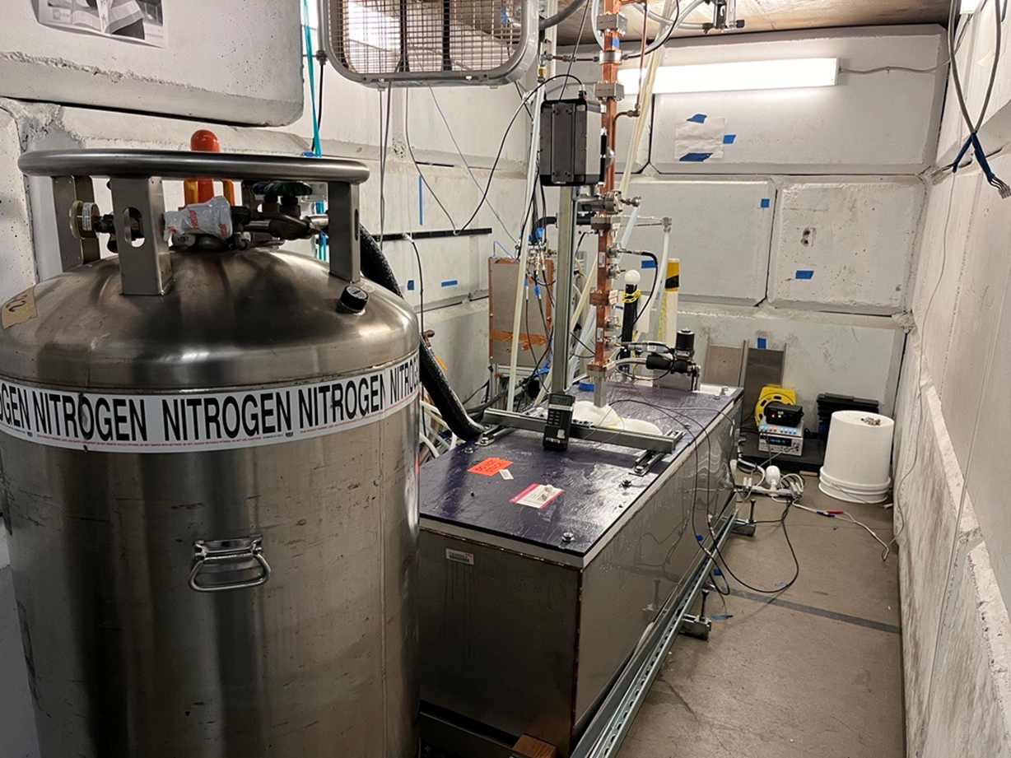
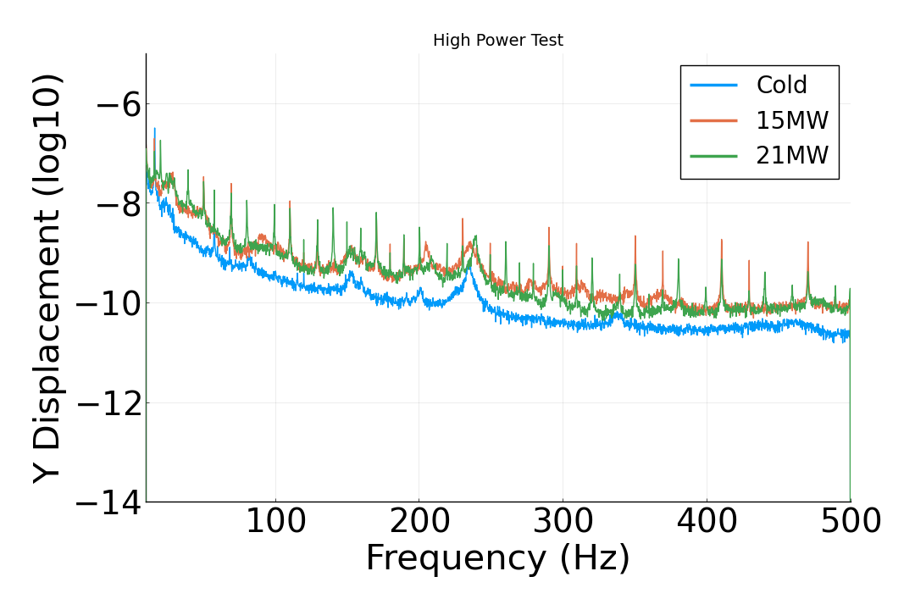
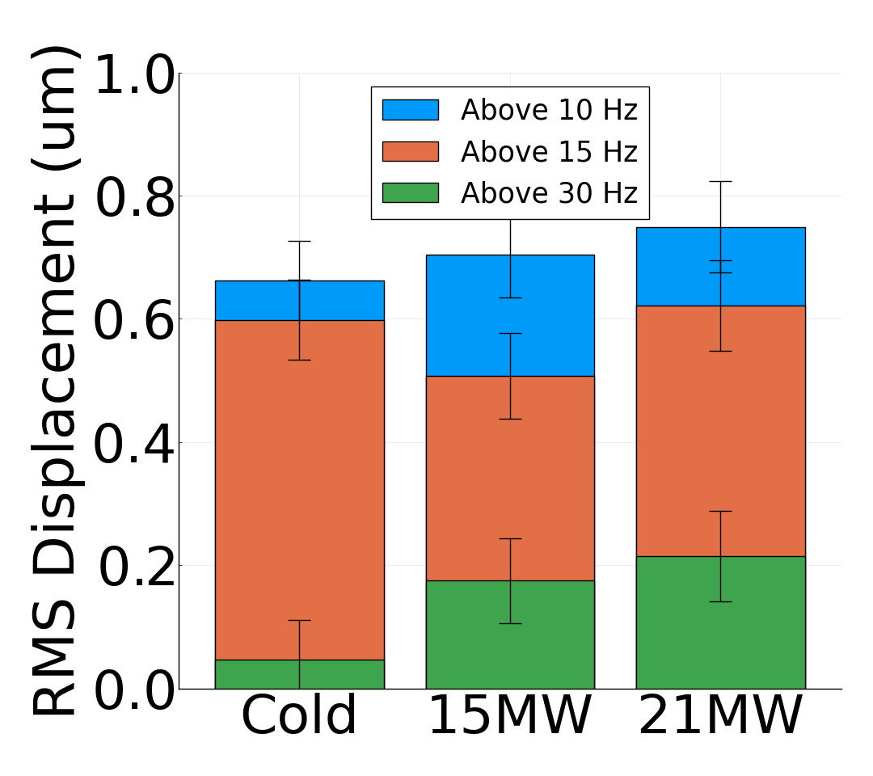
Vibration Measurements with RF Heating
Vibration Data Collected at 10 Hz and 1 μs
Accelerometer measurements at max power showed sub-micron displacements, even with mechanical propagation from outside the bunker
More Environmental Background – RF Heating RMS Displacement Consistent with Resistive Heating

Slide 20
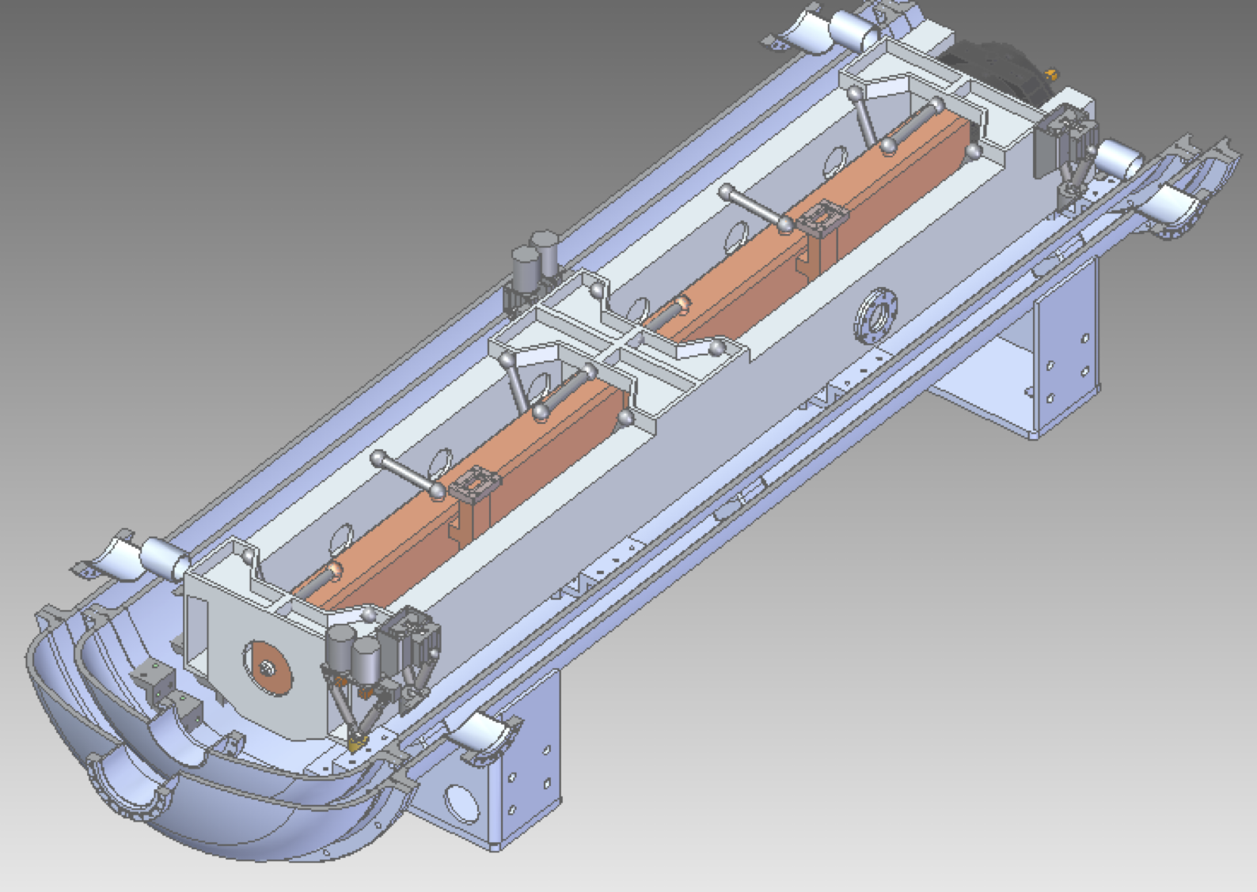
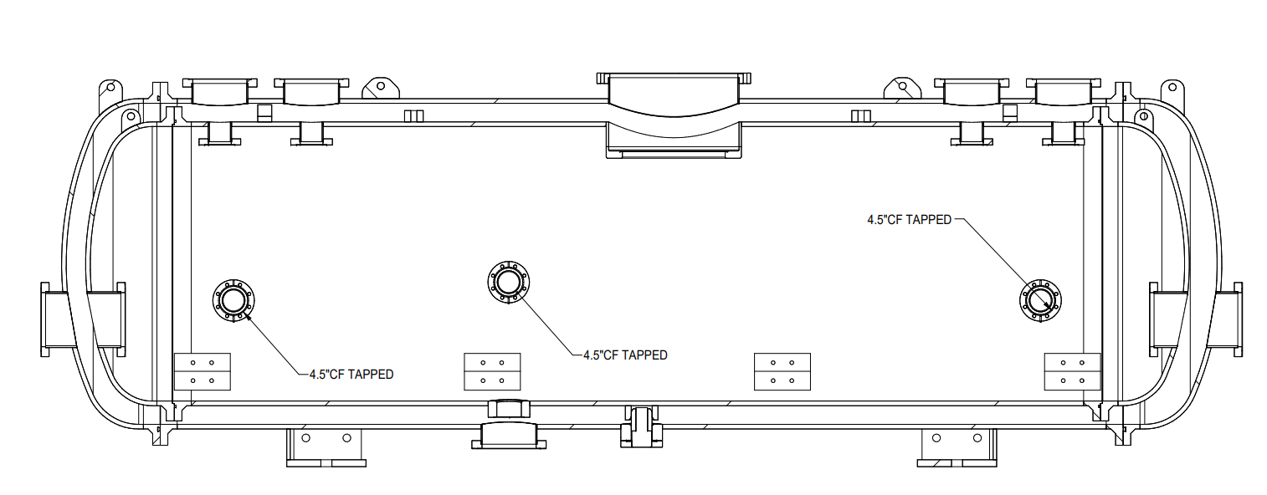
Conclusions
RF tests for cold copper meter scale structures are underway
Structure tests should proceed with:
Beam: Direct measurement of gradient, wakefield studies
RF: Need longer pulse ~1.5 𝝁𝒔, higher power ~35 MW, longer run time (over night, ~2 months)
Future efforts to increase aperture, reduce phase advance and incorporate damping
Quarter CryoModule (QCM)

