Slide 1
Cryomodule Test Bunker for ILC Technology Network
(Cryogenic systems)
K.Nakanishi, K.Hara, T.Honma, S.Kessoku, H.Nakai, H.Shimizu
(refrigerator group)

Slide 2
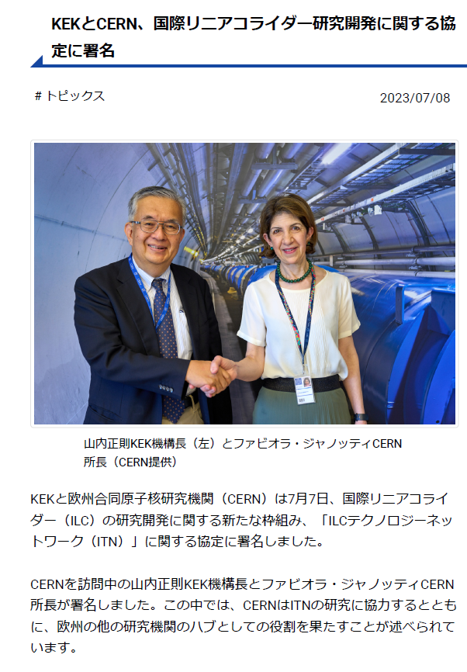
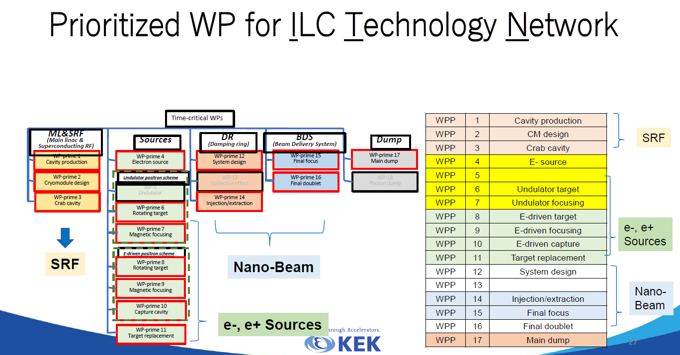
What is ITN.
ITN:ILC technology network
The ILC project has not started yet.
Technological development should be continued.
ITN is an international initiative comprised of many bilateral collaborations.
For WP1 and 2, one cryomodule will be built and that performance will be measured.
From AFAD2023

Slide 3
Step of ILC development
The ILC project will be done in the following steps.
ITN 8cavities 1 cryomodule 5 years → New!!
Prelab 120cavities 4~6cryomodules 5 years
ILC construction 8000cavities 900cryomodules 10years
⇨ILC operation
ITN
1 cryomodule including 8cavities will be made.
A low-temperature experimental facilities will be established to measure the cryomodule.
Prelab
40 cavities and 1~2cryomodules will be made in Japan.
4~6cryomodules including foreign cryomodules will be tested.
1cavity/week, 1~2cryomodules/year → easy!
ILC construction
The first 5% of cryomodules will be inspected in Japan.
1/3 of cryomodules made in Japan are inspected at random. → totaly140cryomodules
2500cavities will be made in Japan. More than 2500 times of VT should be done.
5~cavities/week , 1~2cryomodules/month(In case of 100% inspection 8cryomodules/month)
Not very difficult. But efficient operation should be realized.

Slide 4
Schedule of ITN
CM test
 | 2023 | 2024 | 2025 | 2026 | 2027
CE(LN₂ tank) replace | Done
Helium purifier |  | 〇
Control system update |  | 〇 | 〇 | 〇
Change HPGS category. (He Liquefier) |  |  |  | 〇
Liquid helium transfer line |  | design | 〇 | 〇
2K refrigerator |  | design | 〇 | 〇
Pump (warm compressor) | Done |  |  |  | Add?

Slide 5
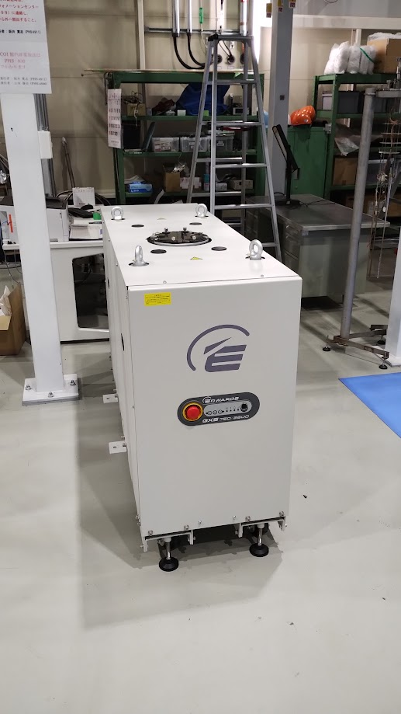
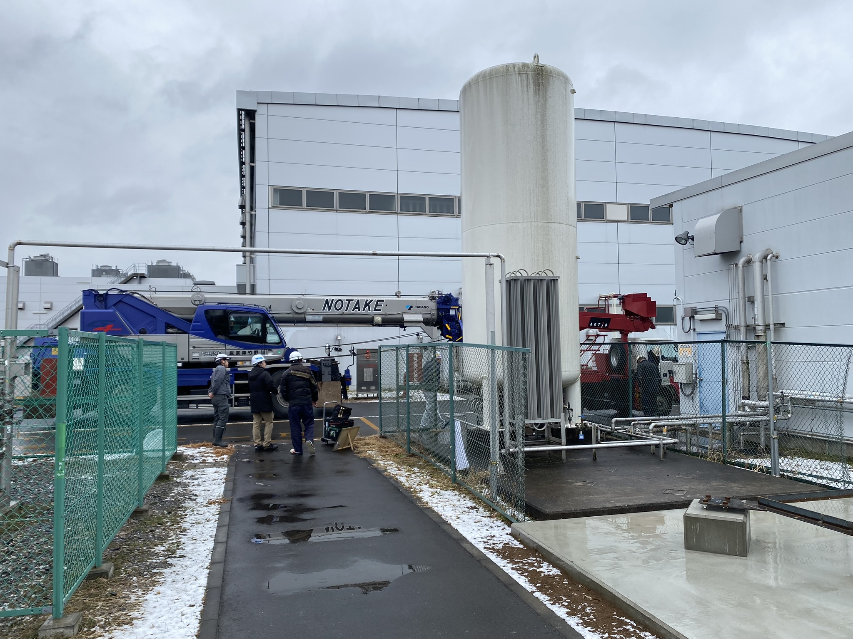
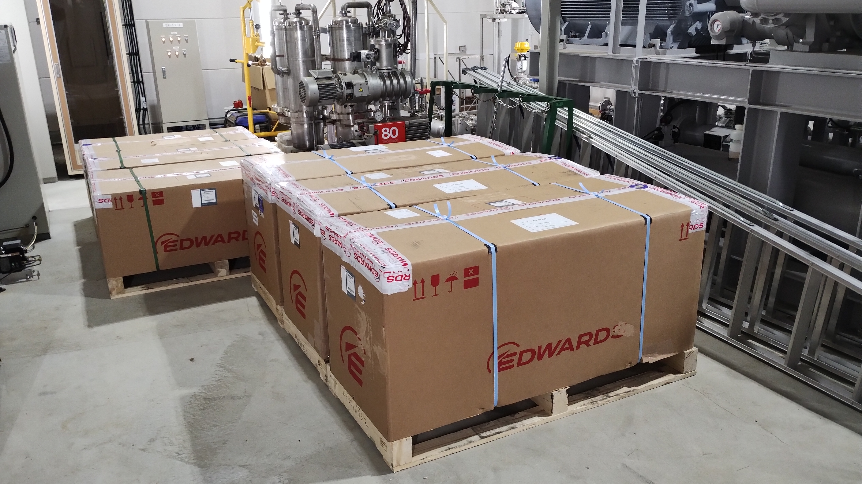
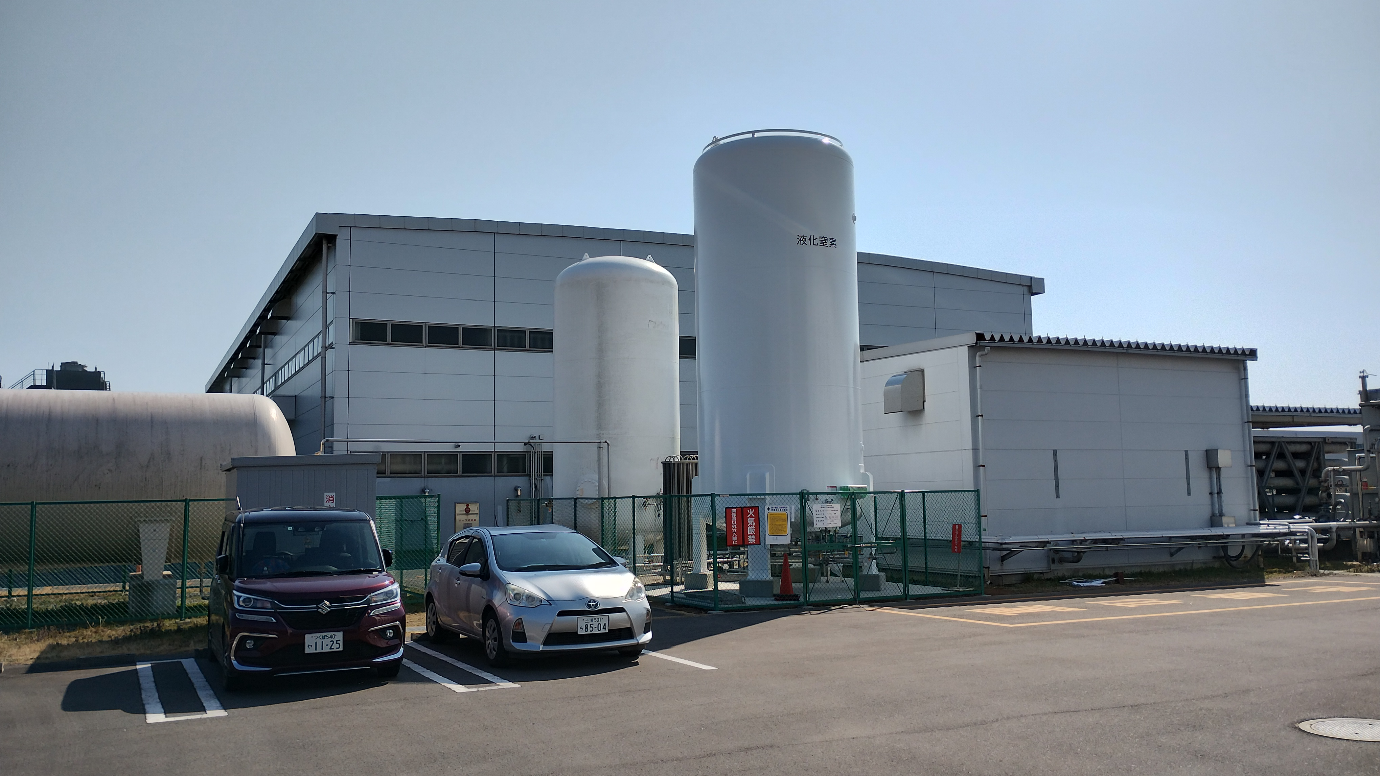
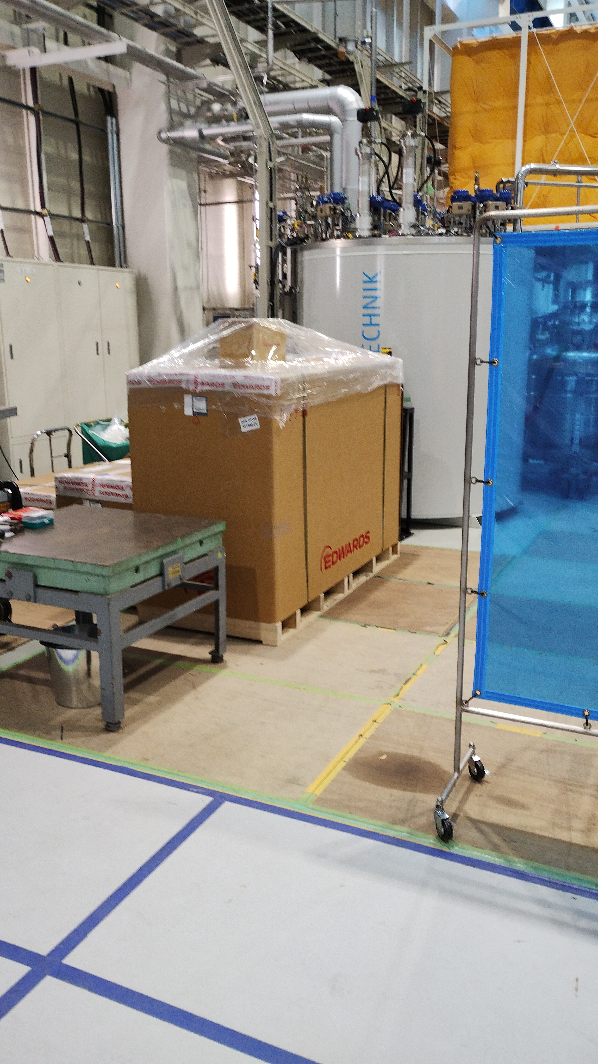
Vacuum pump for 2K refrigerator:
Tests will be conducted.
(noise, vibration, mass flow …)
Old CE
(liquid nitrogen tank)
New bigger CE
Pumps arrived
CE was upgraded
Installed He buffer tank (used)

Slide 6
Items to be done
CE (liquid Nitrogen storage tank) upgrade
Add a helium tank
Control system update for liquefier and 2K refrigerator
Prepare helium purifier
Change the category of HPGS of Helium refrigerator
(General → Refrigerator)
Build liquid helium transfer line (TRT)
Build 2K refrigerator
Prepare vacuum pump for 2K refrigerator
(Regulation on Safety of General High Pressure Gas)

Slide 7
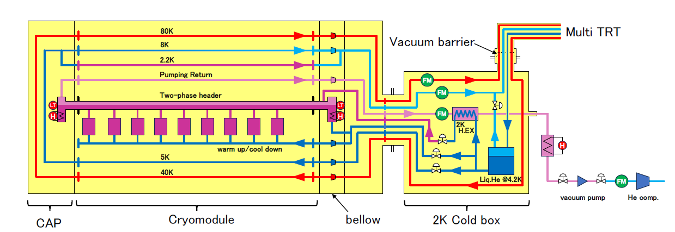
Schematic view of the 2K refrigerator
Transfer Line
FM : Flow Meter

Slide 8
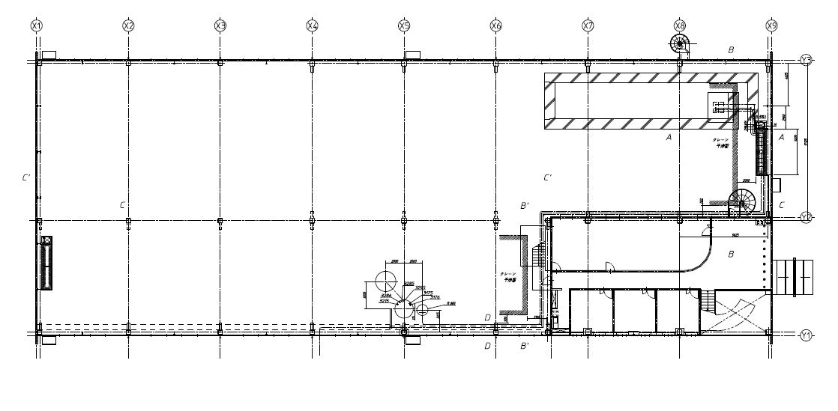
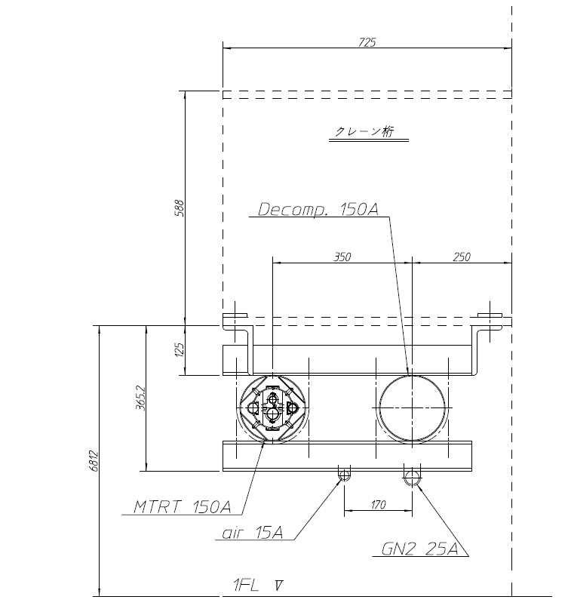
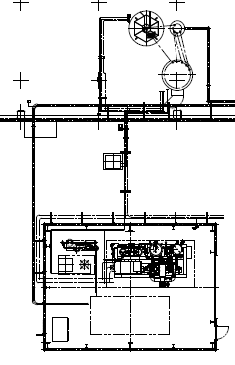
Layout of COI building
CTB should be established here due to the floor strength.
3
Helium purifier
(if possible)
Candidates of pump site
1
Transfer line and return line.
The length is about 100m
The root of transfer line was decided.
The pump site for 2K refrigerator is not decided.
2

Slide 9
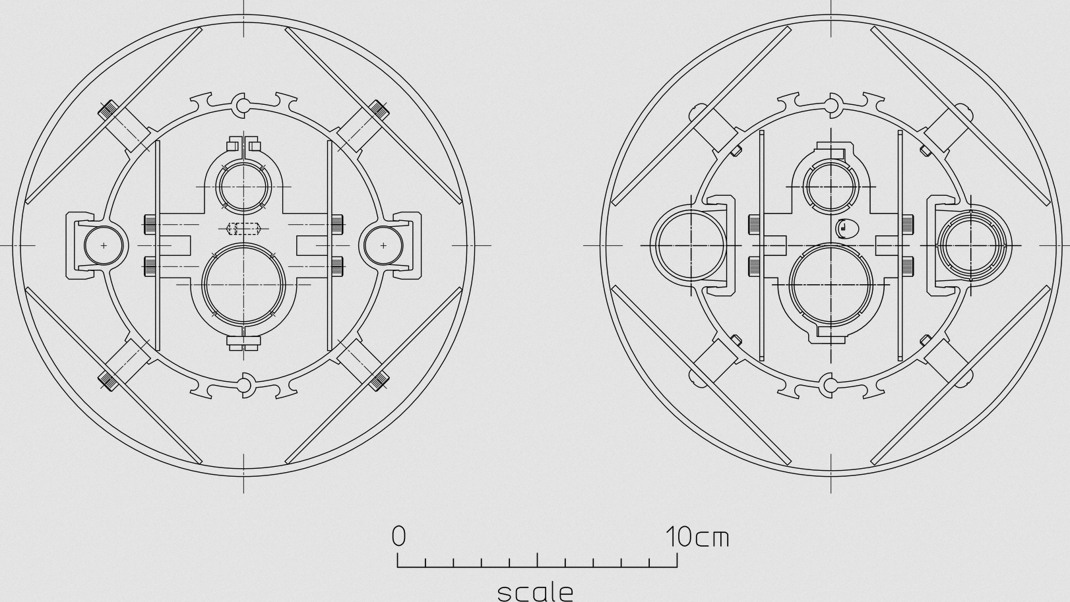
He transfer line design
4 pipes are contained in the transfer line.
One pair(outside) is for cooling the radiation shield.
Another pair(inside) is for handling the liquid helium.
This is based on the KEKB’s TRT design.
Since liquefied nitrogen is not used, the pipes for shielding are larger. And the supply pipe is not in contact with the shield.
Flow rate = 3g/s
Temperature distribution at the start of cooling
80K
300K
Calculated its characteristics.
Gas velocity and pressure are acceptable.
TRT: The design is almost complete.

Slide 10
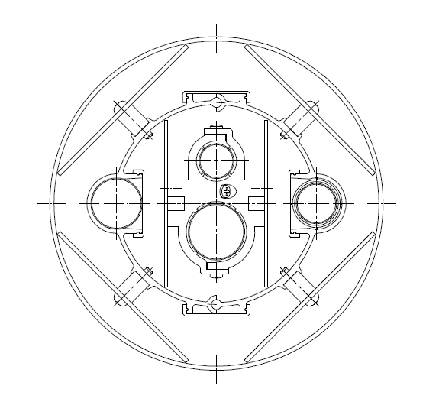
Transfer line
80K:the surface area is about 30m².
If more than 10 layers of SI are installed, the heat load is about 70W
150A(O.D.=165.2mm)
O.D.≒100mm
LHe(5K) Supply
Crane girder
40K Supply
80K Return
8K Return
5K:heat load is about 10W.(less than 0.1W/m)

Slide 11
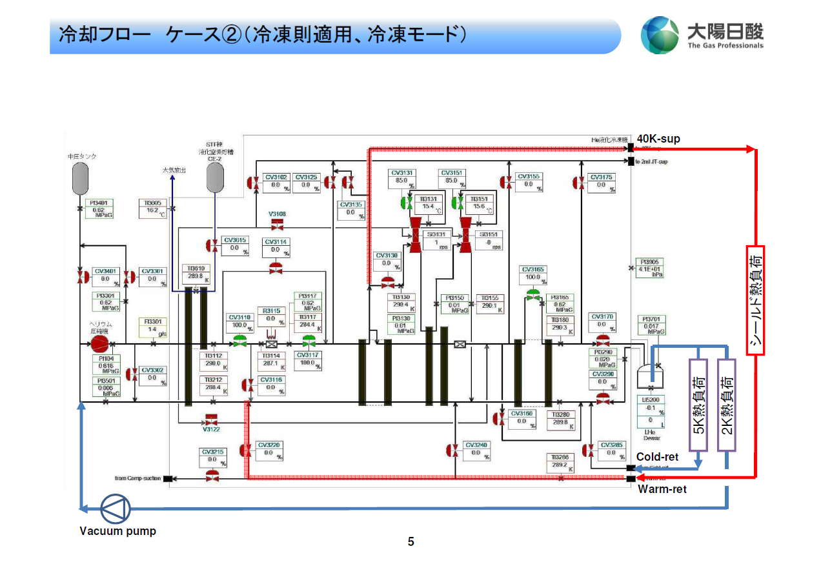
Control system update
We negotiated with the manufacturer of the He refrigerator.
The logic that controls the turbine has not been exposed.
The manufacturer want to keep the control of three valves.
Valves used for turbine control
For precooling
40~80K shield
5K shield
Cavity (2K)

Slide 12
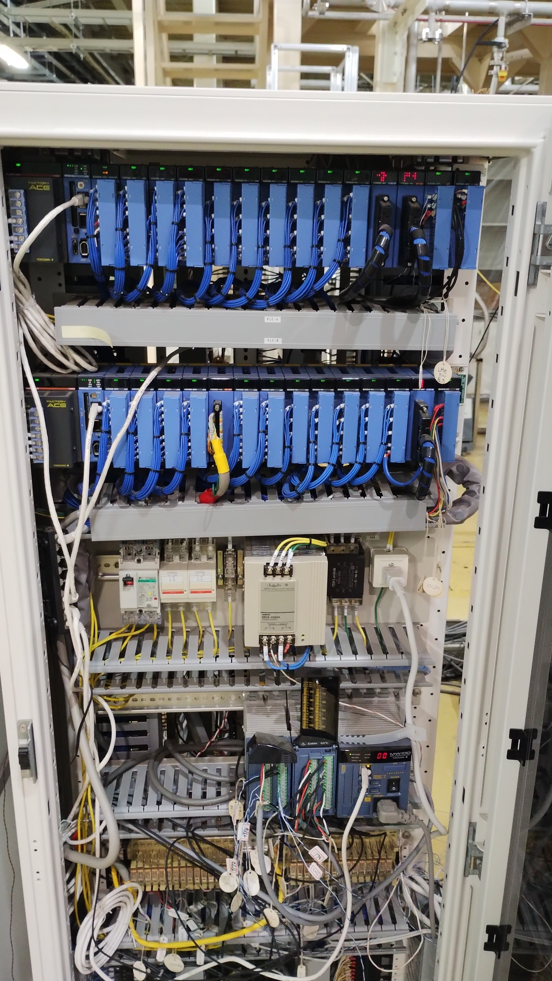
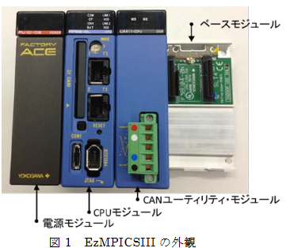
Control system update
FY2024:Programming test ☺
FY2025:Construction
FY2026:Operation test
EPICS base control system
(KEK’s (OS:Linux))
Accelerators are controlled by EPICS.
These control system use same platform.
They can be merged.
Refrigerator control system
(manufacturer’s (OS:VxWorks))
Our refrigerator control system at cERL

Slide 13
HPGS category will be changed
The HPGS category of the refrigerator dewar and buffer tank must be changed.
Our local government(Ibaraki-ken) only requires pressure test and Airtightness test.
Devices which managed by different categories of HPGS can not be connected. STF and ITN-CTB system must be separated.

Slide 14
Separation of ITN cryogenic system from STF
The HPGS categories of STF accelerators and ILCs are different.
Under Japan law, devices of different categories cannot be connected, so ITN should be separated from STF.
The red frame shows equipment that uses liquid nitrogen.
To purchase in FY2024
Cryomodule for ILC
ITN
Purifier
STF
Pump
Buffer tank
(100m³)
190kg
Cryostat for vertical test
Dewar
Refrigerator
LR280
(300L/h
or
600W)
Dewar
(3000L)
(=380kg)
Cut here in FY2026
Gas bag
The red frame indicates equipment that uses liquefied nitrogen.
Pure He
Max:190kg
Purifier
Buffer tank
(46m³)
50kg
Gas bag
Installed
Dirty He
Recovery Compressor
Max:190kg
Refrigerator TCF200
STF Accelerator

Slide 15
Helium purifier
HPGS for refrigerator does not allow to use gas bag and recovery compressor.
Middle pressure purifier should be installed.
100g/s
95g/s
This device will be purchase in FY2024
Refrigerator
5g/s
Purifier
Buffer tank
Pure He
Dirty He
It should be used before operating the helium refrigerator.
The buffer tank has a capacity of 100 m³ and is filled with about 1.0 MPa.
The impurity concentration decreases by e^(-t/τ).
If the flow rate is 5 g/s, the time constant(τ) is about 12 hours.

Slide 16
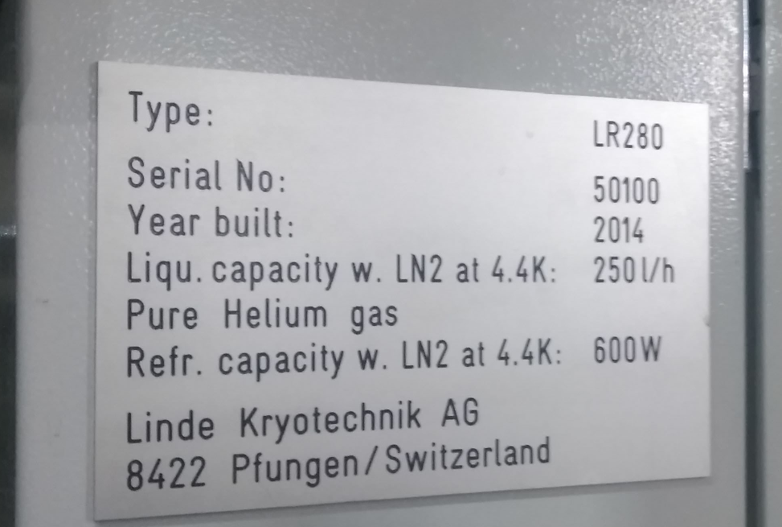
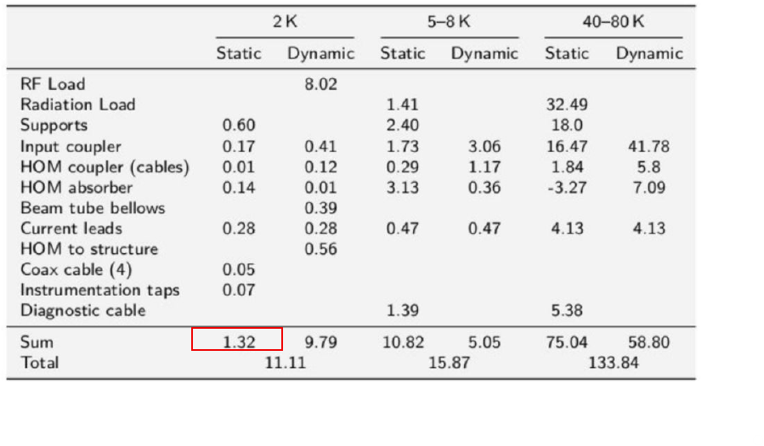
Cooling capacity
When 40K gas is used 20g/s, the cooling capacity becomes half. Thus, the capacity of this cooling mode is 40g/s. We called that cooling mode parasitic mode.
Assuming a temperature rise of 40 K, the cooling capacity per 1 g/s is 200 W.
Capacity of refrigerator:
Parasitic mode : 40g/s
→40×200=8kW
Refrigerator mode:
600W
→Maximum 4K heat load is 600W
Liquefier mode:
250L/s 0.7J/L : latent heat 0.9 : wetness at just after JT valve
→ Maximum 2K heat load is 150W
250×0.7×0.9≒150W

Slide 17
Summary
Cryomodule test station is being prepared.
CE (liquid nitrogen tank) and He buffer tank were extended.
Liquid Helium transfer line and 2K refrigerator is being designed and will be prepared from 2025.
The test station will be operated in 2027

Slide 18
Cooling capacity
Heat load:
12W@2K →12/150=8%
16(CM)+10(TRT)W@5K →26/600=5%
134+70W@40K →204/8000=3%
Total 16％
If the estimation of heat load is correct, the refrigerator is powerful enough.

Slide 19
Cold mass and heat load
The heat loads of TRT are smaller than the static heat loads of a cryomodule at 40K and 5K, respectively.
40~80K region
Aluminum 320kg, Stainless 2500kg
In TDR, Static:75W, Dynamic:59W, cooling capacity : 8kW(Parasitic mode)
5K
Stainless 200kg
Static:11W, Dynamic 5W, cooling capacity : 600W(refrigerator mode)
2K
Stainless 750kg, Niobium250kg, Titanium 150kg, Cupper 420kg
Static:1.3W, Dynamic 10W, cooling capacity : 200W(liquefier mode)

