Slide 1
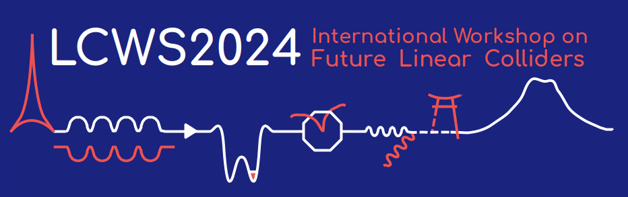

Traveling Wave Demonstration in SRF Cavity With a Feedback Waveguide
The 2024 International Workshop on Future Linear Colliders (LCWS2024)
Session - Accelerator: Superconducting RF
Presenter : Roman Kostin, Euclid Techlabs
July 10, 2024 - The University of Tokyo, Japan
Notes:
Dr. Roman Kostin. Roman Kostin graduated from Moscow Engineering Physics Institute, Russia in 2012 with a M.S. in Physics, and received his Ph.D. in 2017. The subject of his thesis was “Superconducting Traveling-Wave Cavity Development.” In 2011, he was granted a President Scholarship to study abroad, which covered his internship at Fermilab (Batavia, IL, USA), where he worked on a normal conducting bunching cavity for Project-X. Roman Kostin became a Euclid Beamlabs employee in 2013. From 2016 to 2018, he was the PI of a project on conduction cooling and RF structures development under a CRADA with Fermilab/IARC. Dr. Kostin’s research interests include normal conducting and superconducting RF devices development, engineering design, optimization, and testing. He is currently a project lead for a compact X-ray source and an SRF gun based on conduction cooling for ultrafast microscopy. Dr. Kostin currently serves as the Principal Engineering Physicist and Director of Engineering Department of Euclid Beamlabs LLC.
Conventional SRF cavities are used in standing wave regime and are limited by surface fields to ~50 MV/m. In order to overcome this limit, Superconducting Traveling Wave (SCTW) cavity was proposed as it allows to achieve ~1.5 times higher accelerating gradient operating at lower phase advance per cell, thus improving transit time factor. However, power recirculation through a feedback waveguide is required to maintain cavity efficiency. Funded by the U.S. Department of Energy's SBIR program, Euclid Techalbs, in collaboration with Fermilab, demonstrated in the past the surface processing capability of a single-cell prototype with a feedback waveguide. Subsequently, a 3-cell prototype was designed and fabricated to demonstrate a traveling wave regime in SRF cavity with a feedback waveguide at cryogenic temperatures and the highest gradients. Here we present our recent results of traveling wave demonstration in the 3-cell prototype, tested in 2K liquid helium at Fermilab.

Slide 2
Contents
About Euclid
SC TW Introduction
Cavity test preparation
TW at 300K
TW at 2K, QL=1E6
SW at 2K, QL~1E10
Next steps
Summary

Slide 3
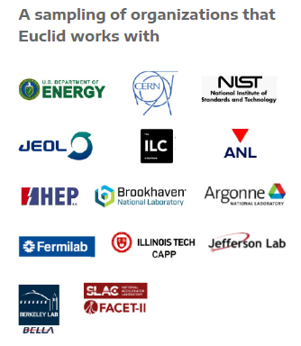
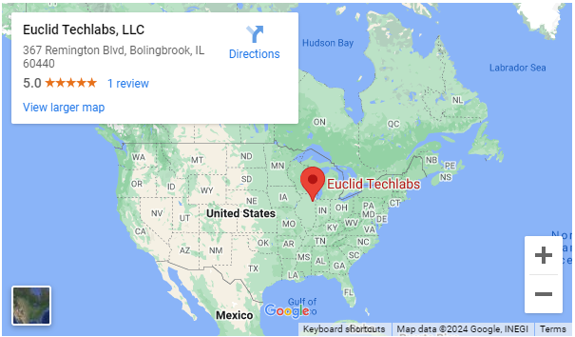
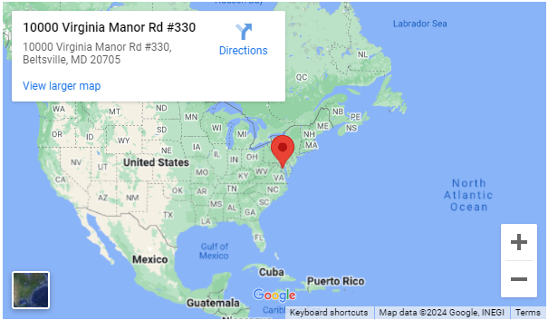
Euclid Techlabs/Euclid Beamlabs
Euclid is an accelerator R&D company with broad area of expertise:
Advanced materials manufacturing – conductive ceramics, ferroelectric materials, diamonds
Accelerator components design and manufacturing – NC RF, SRF and dielectric structures
Beam manipulations – beamline designs, time resolved TEM
And much more
accelerator R&D lab in IL
material science lab in MD
https://euclidtechlabs.com/
Notes:
Euclid Techlabs, LLC is a research and development company specializing in linear particle accelerators, ultrafast electron microscopy, and advanced material technologies. The company was formed in 2003. Euclid Beamlabs LLC, formed in the winter of 2014, is a sister (spin-off) company of Euclid Techlabs LLC, particularly to commercialize industrial accelerator and related advanced material technologies developed at Euclid Techlabs. Euclid has developed expertise and products in several innovative technologies: time-resolved ultra-fast electron microscopy; ultra-compact linear accelerators; electron guns with thermionic, field emission or photo-emission cathodes; fast tuners for SRF cavities; advanced dielectric materials; HPHT and CVD diamond growth and applications; thin-film for accelerator technologies; Present: 27 people research staff (researchers, engineers, technicians) and 5 administrative. 16 PhDs in accelerator physics and material science, 32 staff. 2 labs: Bolingbrook, IL (accelerator R&D lab) and Beltsville, MD (material science lab). Long term collaborations with National Labs and Institutes: ANL, Fermilab, BNL, Jlab, LBL, SLAC, LANL, NIST, NIU, IIT, etc.

Slide 4
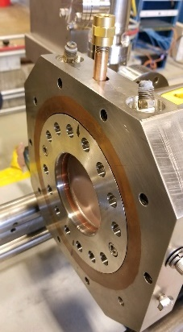
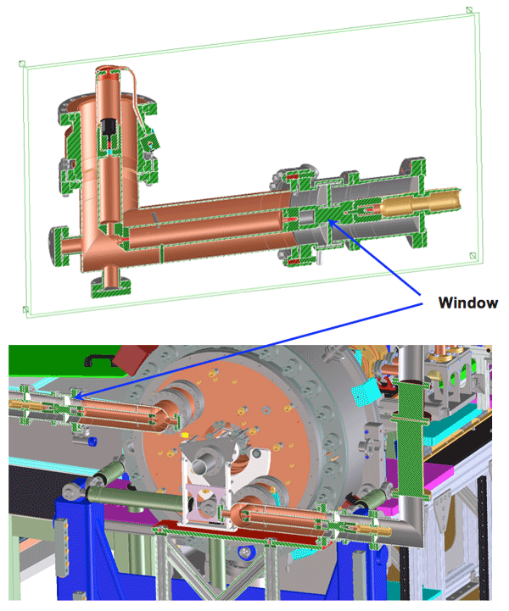
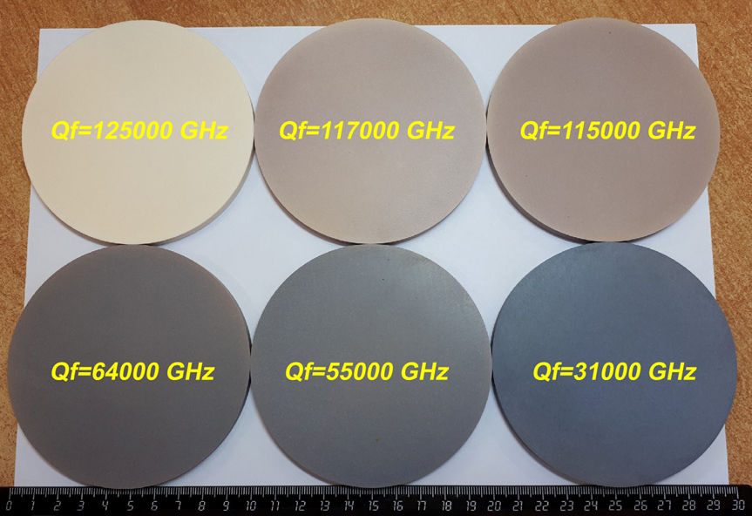
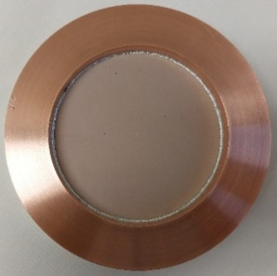
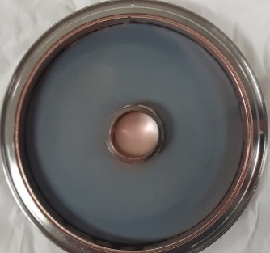
Low RF Loss DC Conductive Ceramic Windows
Major reasons for window failure include charging from the "triple junction“, multipacting and electron halo.
A new low-loss microwave ceramic material with increased DC electrical conductivity and low loss tangent for use in high power coupler windows.
  Increased conductivity from 10⁻¹² to 10⁻⁸ S/m
  Relative dielectric constants ε_{r}=15
  Loss tan ~ 1x10⁻⁵ @ 650 MHz
https://euclidtechlabs.com/

Slide 5
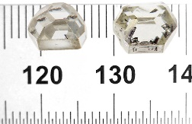
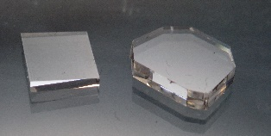
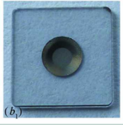
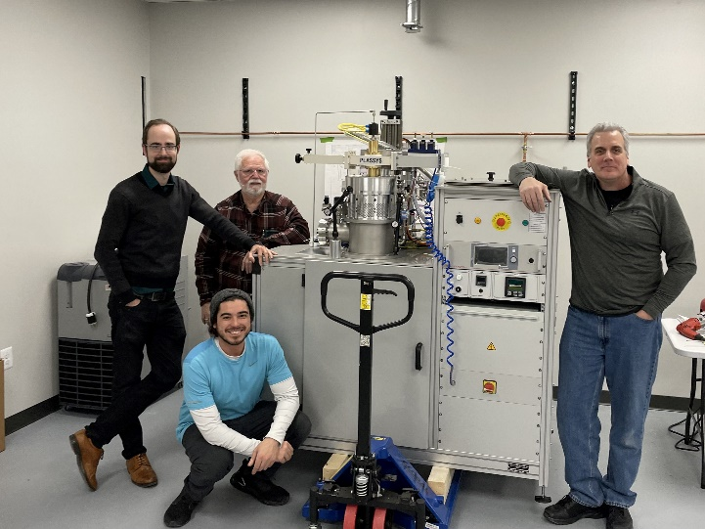
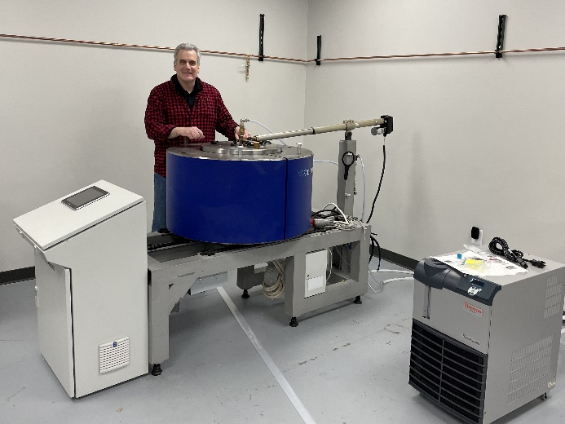
X-ray Optics for Light Sources. Domestically Produced Synthetic Diamonds for SLAC and ANL.
Presently, there are no suppliers in the US to provide scalability and manufacturability of high-quality HPHT diamonds for the rapidly developing field of X-ray optics for the next generation X-ray sources.
With Euclid's 2021 DOE SBIR Ph2 projects, we have commissioned the first HPHT and CVD diamond growth reactor. Euclid had previously developed techniques for growing near dislocation free diffraction-grade diamonds that were characterized and highly praised by APS/ANL and SLAC
Commissioning the CVD reactor in Beltsville, MD
In collaboration with ANL and SLAC
HPHT diamond growth reactor at Beltsville, MD lab
https://euclidtechlabs.com/

Slide 6
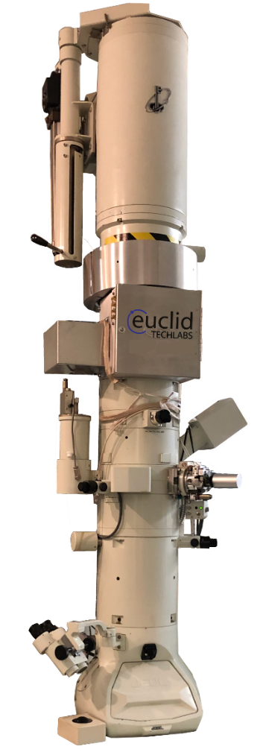
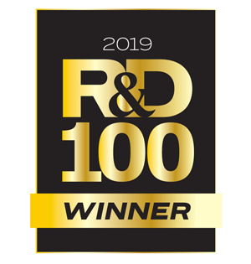
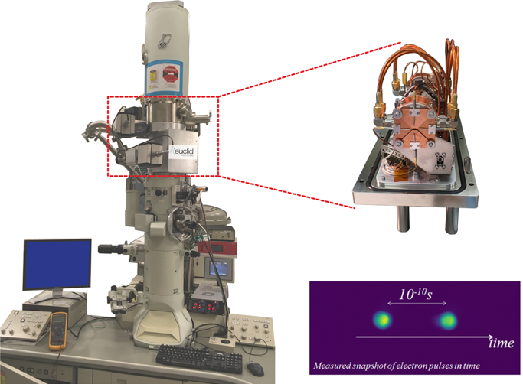
Ultrafast Pulser for Transmission Electron Microscopy (in collaboration with BNL, NIST)
As a successful result of the DoE SBIR “Stroboscopic TEM Pulser” project, Euclid was awarded a Phase III contract ($680k) for Transmission Electron Microscope (TEM) modification at NIST in 2016-2018. The NIH $1.4M and Chan-Zuckerberg $180k awards started in 2021. Currently Euclid is installing the UltraFast Pulser at California Institute of Technology (Caltech) as part of the NIH project, and another at ER-C, Europe’s largest electron microscopy center, in Jülich, Germany.
In February 2023, we confirmed full compatibility on a state-of-the-art aberration corrected instrument at JEOL Ltd (Japan)
(G1)
https://euclidtechlabs.com/

Slide 7
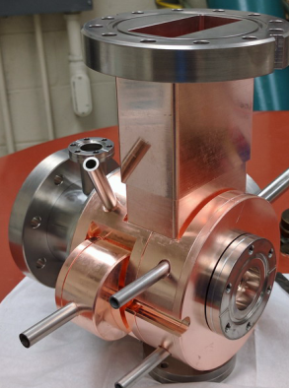
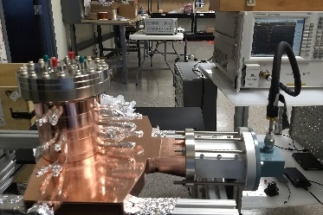
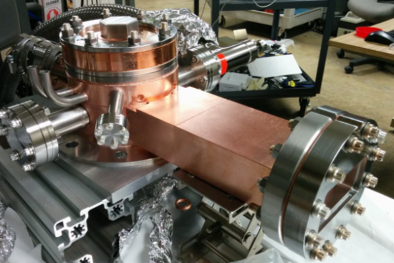
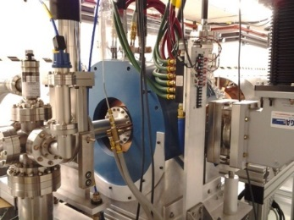
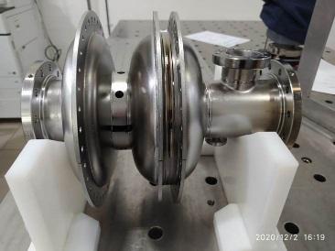
Commercial products: Electron Sources for Accelerators
S-band 1000 pps Photogun
S-band 100MV/m Photogun
S-band Thermionic RF gun
L-band 100nC Photogun
1.3GHz SRF Photogun
https://euclidtechlabs.com/

Slide 8
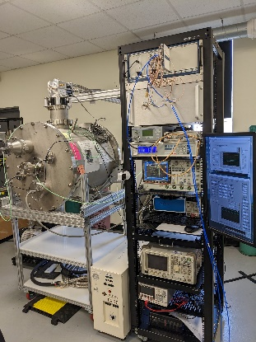

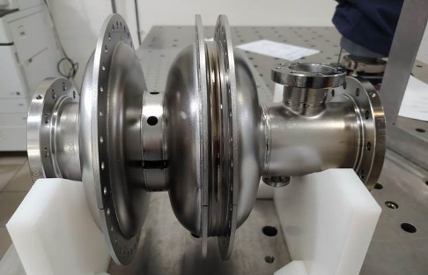
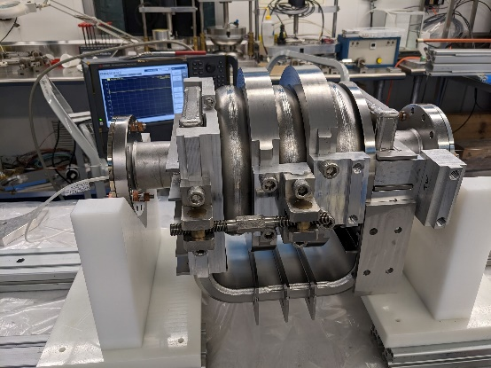
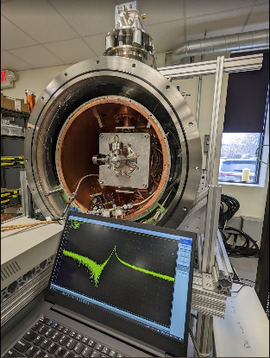
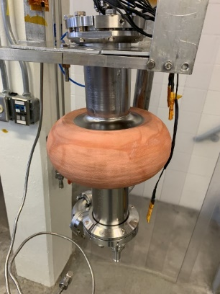
Superconducting RF Cavities and SRF Technologies for Industrial Accelerators
Development of MeV-range ultrafast electron diffraction/microscopy (UED and UEM) is a priority for the DOE. Euclid is developing the SRF photocathode gun that is a promising candidate to produce highly stable electrons for UEM/UED applications
Design optimization of TW structures was done. It is shown that a TW structure can have an accelerating gradient that is about 1.5 times higher than contemporary standing wave structures with the same critical magnetic field.
1.3 GHz SRF Photogun
Euclid is developing SRF technology for conduction cooled industrial accelerator
3-Cell Traveling Wave Cavity
Euclid’s Conduction Cooled Cryomodule
(in collaboration with FNAL, BNL and Jlab)
https://euclidtechlabs.com/

Slide 9
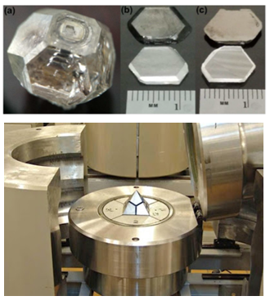
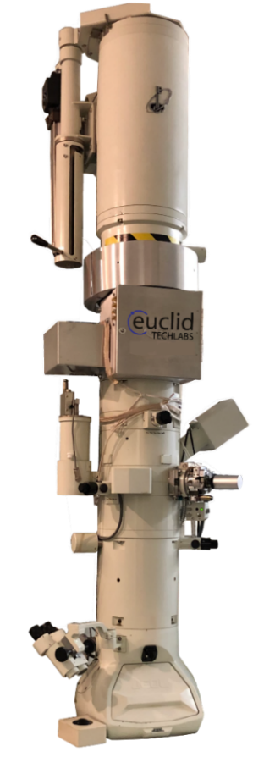
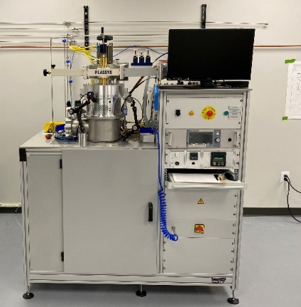

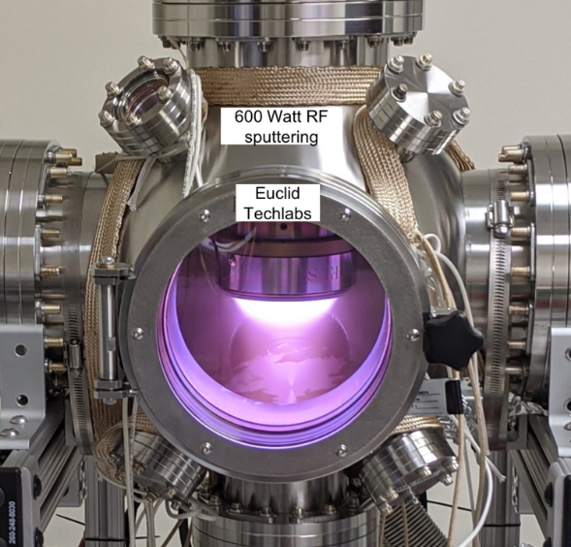
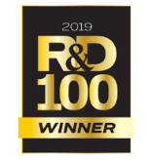
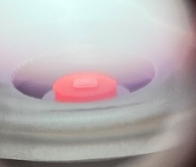
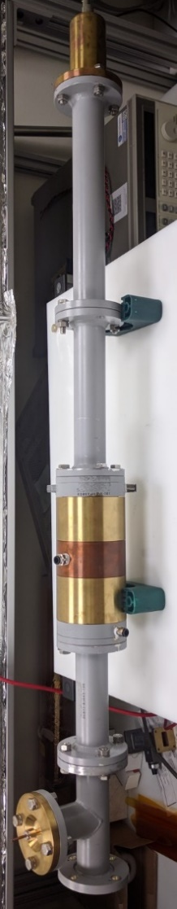
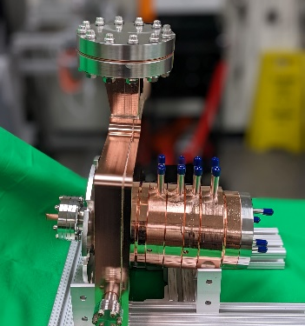
Products & Capabilities Snapshot
Products
UltraFast Pulser (UFPTM) for TEM
Dislocation free (HPHT&CVD) diamond for Xray optics
Compact X-Ray Source
NCRF and SRF electron sources
Low loss ceramics (linear and non-linear)
LINAC
RF window
In flange BPM
Capabilities
Femtosecond Laser Ablation System
Thin Film Deposition Lab
EM/RF Testing Lab
Radiation Shielding/Testing Lab
Cryogenic 4K measurements
Custom designs and consulting
https://euclidtechlabs.com/

Slide 10
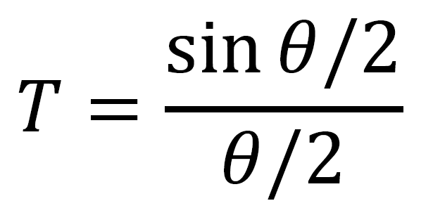
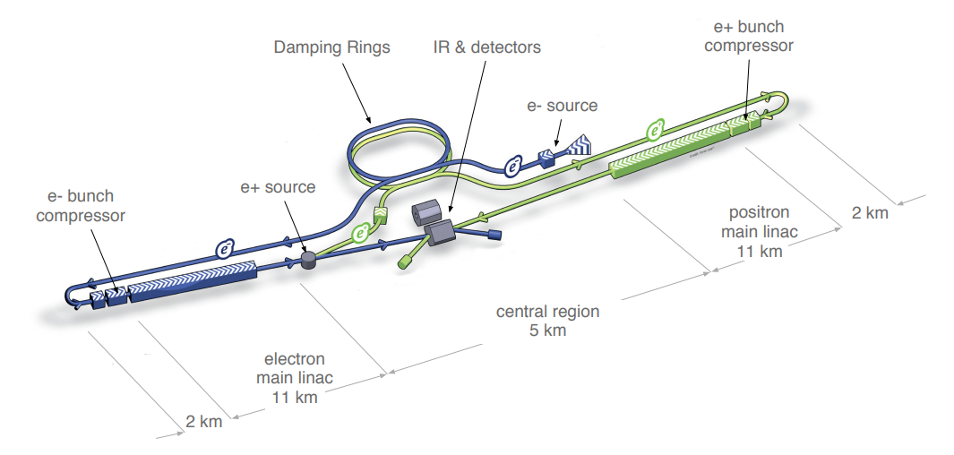
Motivations
TW enables:
  >20% increase in Eacc b.o. higher transit time factor T at lower phase advances (SW ~0.64, TW ~0.87 ^{[1]}).
  >20% increase in Eacc b.o. longer cavities (more real estate gradient)
Overall 50% higher accelerating efficiency than SW structures is feasible: Eacc>70MV/m
TW SRF makes linear collider a bit closer to reality.
Initially was intended for ILC, now considered for HELEN
The proposed TW-based linear collider HELEN ^{[2]} can achieve a 250 GeV center-of-mass energy in only 7.5 km, in contrast to the 30-km scale of the SW ILC structure.
Eacc gain at 70mm aperture
[1] P. Avrakhov et al., "Traveling Wave Accelerating Structure for A Superconducting Accelerator", Proceedings of the PAC2005, pp. 4296-4298
[2] S. Belomestnykh et al., “Superconducting radio frequency linear collider HELEN,” JINST 18, P09039 (2023)

Slide 11
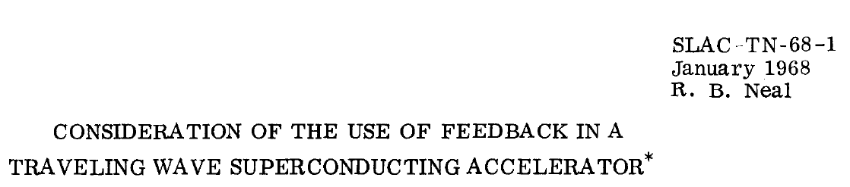
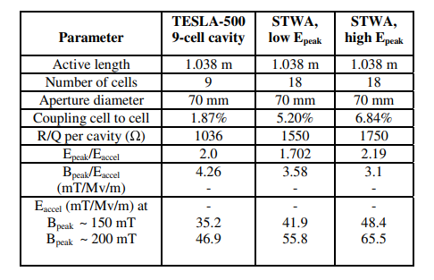
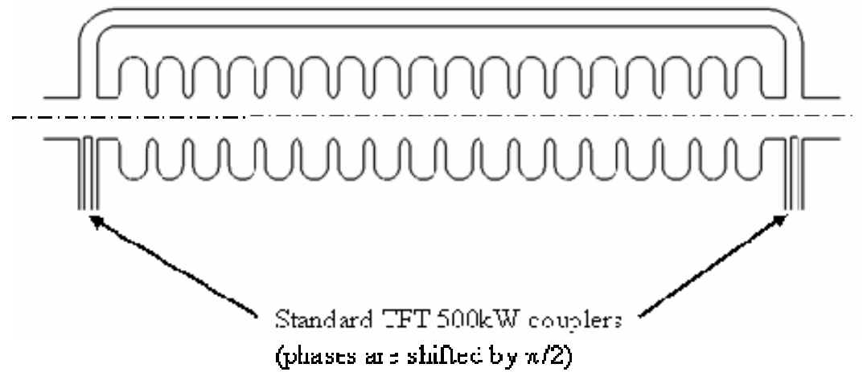
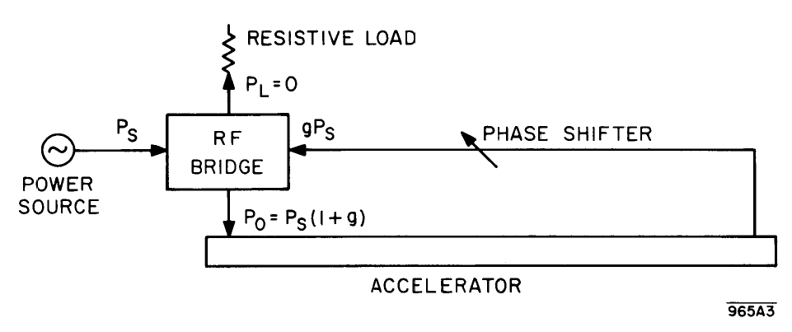
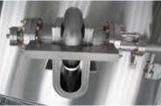
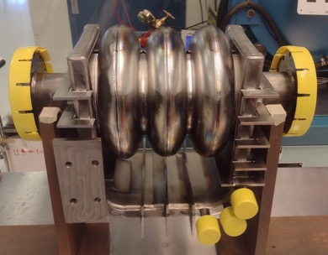
TW SRF cavity development milestones
TW SRF proposed by R.B. Neal at SLAC 1968!
First materialization of the concept 2005
[1] P. Avrakhov, A. Kanareykin, N.Solyak: "Traveling Wave Accelerating Structure for A Superconducting Accelerator", Proceedings of the PAC2005, pp. 4296-4298
Very limited funding – extremely slow progress!
Special thanks to
  V.Yakovlev,
  H.Padamsee
  S.Belomestnyh
  for pushing interest to this technology!
See the next talk by Fumio Furuta on 0.5m long structure
[2] Roman Kostin et al 2015 Supercond. Sci. Technol. 28 095007
Euclid Techlabs funded by
DOE SBIR DE-FG02-06ER84462
1-cell SW cavity developed by Euclid
Processed and tested at Fermilab 2010
Euclid Techlabs funded by DOE SBIR DE-SC0006300
3-cell TW cavity developed by Euclid - 2013
Processed and tested at Fermilab – 2022
First TW SRF demonstrated 2023!

Slide 12
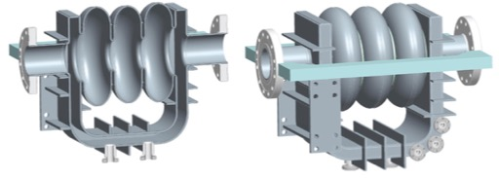
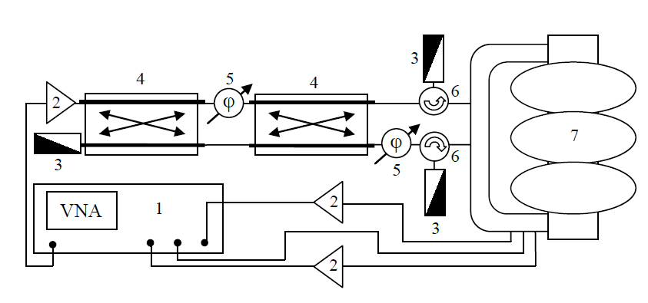
RF feed and measurement scheme for the 3-Cell TW cavity
Three monitoring couplers
Forward wave signal
Calibration signal
Backward wave signal
Two Input coupler
RF feed and measurement scheme for the 3-Cell TW^{[3]}
1 –Vector Network Analyzer (VNA);
2 – power amplifier;
3 – matched load;
4 – 3dB hybrid;
5 – phase shifter;
6 – circulator;
7 – resonator
[3] R. Kostin et al. “Progress towards 3-cell super-conducting traveling wave cavity cryogenic test,” Journal of Physics: Conf. Series 941 (2017) 012100

Slide 13
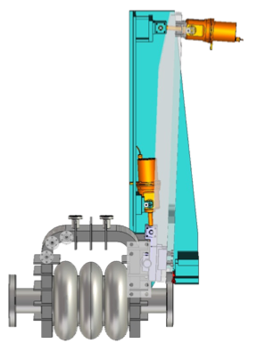
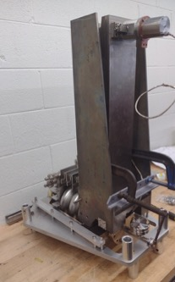
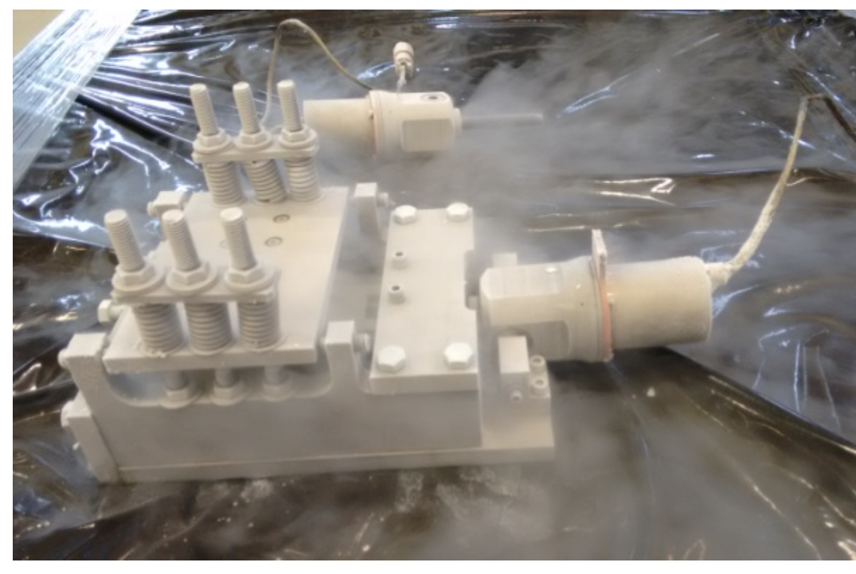
Special tuner (Matcher) for the 3-cell TW cavity
2D tuner/matcher – deform WG and move along the WG to compensate phase and amplitude of reflection
designed and fabricated to compensate Lorentz force and maintain the TW resonance at 2 K VTS conditions.
The preliminary LN2 test of the matcher confirmed the design feasibility
Matcher was designed to fit the VTS pit.
Matcher for the 3-cell tested in liq. N2 temp ^{[4]}
Model of the 3-cell with one Matcher.
Assembly test
Model of the cavity w VTS HW
[4] R. Kostin et al., "A tuner for a superconducting traveling wave cavity prototype,” Journal of Instrumentation 10.10 (2015): P10038

Slide 14
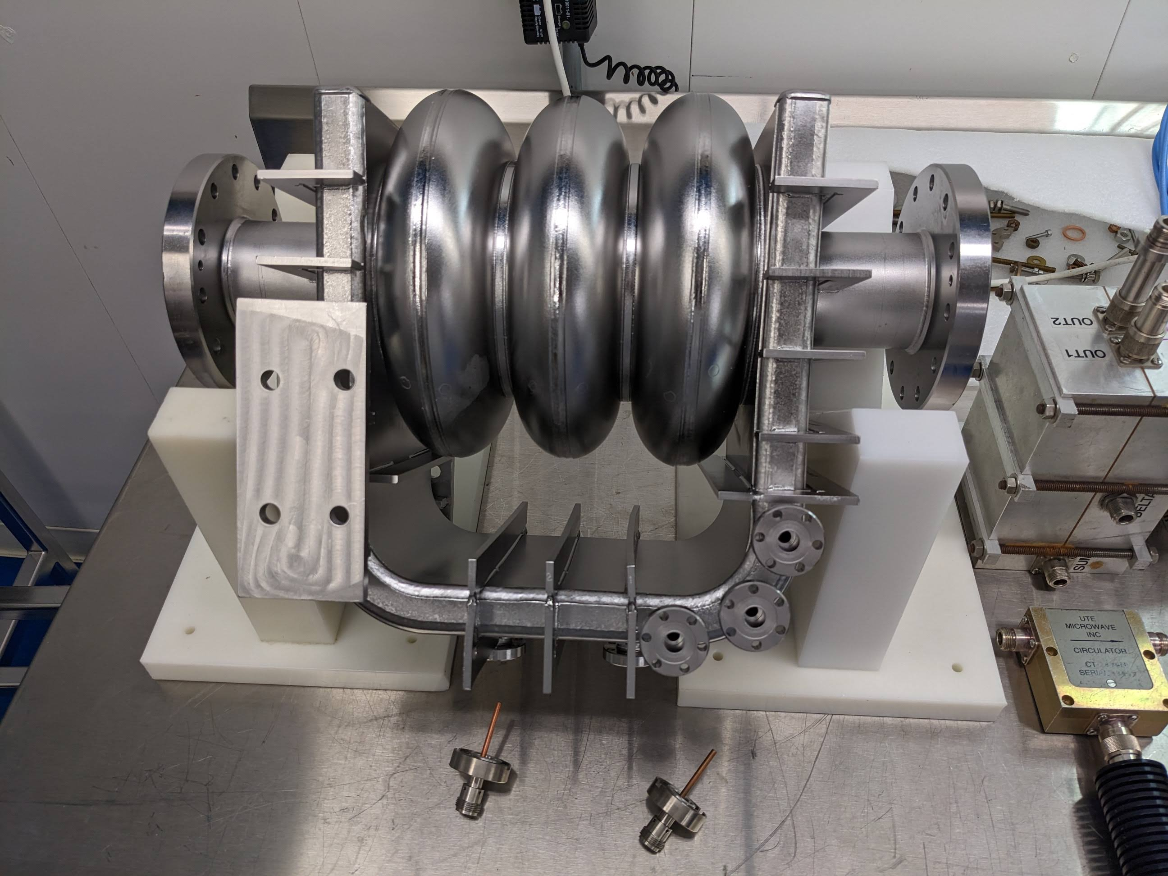
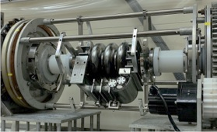






TW 3-cell VTS preparations
BCP at ANL
HPR at IB4, FNAL
Cavity after 120um rotational BCP
800C bake, external BCP to remove oxides
CUSTOM Tuning hardware on the 3-cell and the field profiles (SW mode) post tuning.
VTS instrumentations

Slide 15


TW demonstration: Cavity with air, room temp. at RF test bench
Forward wave
~200k BW
The 3-cell on RF test bench
Backward wave
An example of TW at 1300.53MHz (700k away from resonance 1301.06 MHz) excited at room temperature after cell tuning
Magenta; a forward wave signal
Blue; a suppressed backward wave signal (~30dB less than forward)
Yellow; a signal from the calibration pick up.

Slide 16


TW demonstration; Cavity under vacuum, at room temp. in VTS
Forward wave
~200k BW
Backward wave
An example of TW at 1301.100 MHz excited at room temperature
Yellow; a forward wave signal
Blue; a suppressed backward wave signal (~30dB less than forward)
Purple; a signal from the calibration pick up.
The 3-cell installation into VTS pit

Slide 17


TW demonstration; Cavity under vacuum, in 2K liquid helium, VTS
Forward wave
~1k BW
Backward wave
An example of TW at 1303.155 MHz being tuned at 2K
Yellow; a forward wave signal
Blue; a suppressed backward wave signal (>30dB less than forward)
Purple; a signal from the calibration pick up.
QL~1E6 – easier to tune, matcher was not installed
TW demonstrated at 2K for the first time!

Slide 18





VTS test 1/23/24: SW regime, high Q
Eacc=19 MV/m
Eacc=20 MV/m
Q0 1277MHz
Post quench Q0 1277MHz
Qext 1305MHz
Eacc= 25 MV/m
Qext 1277MHz
Qext 1303MHz
Corrected 20 MV/m
Eacc= 28 MV/m
Notes:
Comment on Performance Limitation: 1.277GHz:
FE onset - 47MV/m (~0.47mR), then quenched at 48MV/m, reached 55MV/m (quenched) with max rad ~800mR/h
1.303GHz:
FE onset - 47MV/m (~150mR/h), at 49MV/m - 980mR/h (stopped there)
1.305GHz:
FE onset - 28MV/m (90mR/h), at 29.3 - 900mR/h (stopped there)
Comment on Multipacting, if Applicable: 1.165GHz:
FE onset - 15MV/m, quenched at 20MV/m, then processed, final quench 22.7MV/m, with much lower radiation after
processing.

Slide 19

VTS test 1/23/24: SW regime, high Q continued
3 modes field emission
Field emission was observed for all modes
WG limits the Eacc, but in TW regime WG field is 3 times less.
LFD is K_{L}=-1.9 Hz/(MV/m)² – lower than estimated in TW regime.
Cavity was designed/reinforced to withstand 0.1mbar of VTS helium pressure fluctuations and LFD
It was found that VTS pressure fluctuation is actually 0.1ubar level (TW operation was stable) – good chance for TW at high Q high Eacc!

Slide 20
Next steps
Final goal for this cavity is TW at as high as possible gradient: Eacc=30MV/m with QL~1E8 and 300W SSA at VTS
What is needed:
  VTS reconfiguration for TW excitation and detection
  Enhanced processing – EP
We start with QL~1E7 - coming this month, matcher will be installed with VTS reconfigured for TW excitation
Next step QL~1E8 - harder to tune but higher gradient achievable, thus limiting factor can be processing
EP processing and high Q high gradient test.

Slide 21
Summary
SRF TW cavity development through the 3-cell has been progressing at Fermilab
Cavity was processed: 120um rotational BCP
800C bake, external BCP to remove oxides
Tuning has been done: custom HW was designed, successfully used
TW excitation at room temperature demonstrated
TW excitation at cryogenic temperature and QL~1E6
SW regime high gradient tested: Eacc=20-25MV/m reached.
What’s next: TW @ high Q, high Eacc with VTS reconfiguration

Slide 22


Acknowledgment
Thank to all colleagues supported the 3-cell TW works!!
Fumio Furuta
Kellen McGee
Vyacheslav Yakovlev
Sergey Belomestnyh
RF support
Timergali Khabiboulline
Gennady Romanov
Cavity support
Damon Bice
Chad Thompson
Thomas Reid
Ben Guilfoyle
VTS support
Alexandr Netepenko
Abraham Diaz
David Burk
Paul Dubiel
Man Kwan (Trista) Ng
Cryo support
Dan Marks
Roman Kostin
Pavel Avrakhov
Engineering Consultant
John Rathke (AES)
and more….

Slide 23







3-cell SCTW cavity TW mode RF parameters
TW excitation is possible by two FPC couplers excitation with power and phase redistribution
RF parameters are in the Table below
VTS measurement requires $ᴂ$ parameter to get Eacc from reactive power (wW or Q2Pt)
$ᴂ$ is taken from R/Q but it is nothing else as a proportion coefficient between Eacc and wW
R/Q make sense for TW mode but not so much for SW in the 3-cell structure as shunt impedance (or voltage gain) can be zero, see the next slide
${\text{ᴂ}}^{2}\text{=}\frac{r}{Q}/L=\frac{{E_{acc}}^{2}}{ω∙W}$= $\frac{{E_{acc}}^{2}}{Q_{2}{∙P}_{t}}$
$$E_{acc}\text{=}\text{ᴂ}∙\sqrt{Q_{2}{∙P}_{t}}$$
Parameter | Value
Phase advance, deg | 105
Cell length, mm | 67.26
Aperture R, mm | 60
rsh/Q, Ω/m | 1808
G, Ω | 194
βgr, % | 2.9
K_E | 1.94
K_H | 3.05
$ᴂ$, Ω/m2 | 94.65

Slide 24












3-cell SCTW cavity Standing Wave modes parameters
$${\text{ᴂ}}^{2}\text{=}\frac{{E_{acc}}^{2}}{Q_{2}{∙P}_{t}}$$
${\text{ζ}}^{2}\text{=}\frac{{E_{pk}}^{2}}{ω∙W}$= $\frac{{E_{pk}}^{2}}{Q_{2}{∙P}_{t}}$
$$K_{E}=Epk/Eacc\text{\sim 1.94}$$
$\text{ᴂ}$=94.65
$\text{ζ}\text{=}\text{ᴂ}∗Ke=186$ (from known Ke and $\text{ᴂ}$)
Also: $\text{ζ}$=$\sqrt{\frac{{E_{pk}}^{2}}{ω∙W}}=181$ for acc part only!
$$E_{pk}\text{=}\text{ζ}∙\sqrt{Q_{2}{∙P}_{t}}$$
Frequency (GHz) | Epk (V/m) | Wst*2 (J) | $\text{ζ}$=$\sqrt{\frac{{E_{pk}}^{2}}{ω∙W} }$, Ω/m2
0.960848 | 1806.45 | 5.95E-09 | 301
1.03717 | 1946.295 | 5.63E-09 | 321
1.164893 | 2180.612 | 5.44E-09 | 346
1.273506 | 998.8066 | 6.09E-09 | 143
1.3012 | 1393.405 | 5.84E-09 | 202
1.301318 | 1801.715 | 5.60E-09 | 266
1.30082 (TW)* | 3700 | 5.13E-08 | 181*/186

