Slide 1
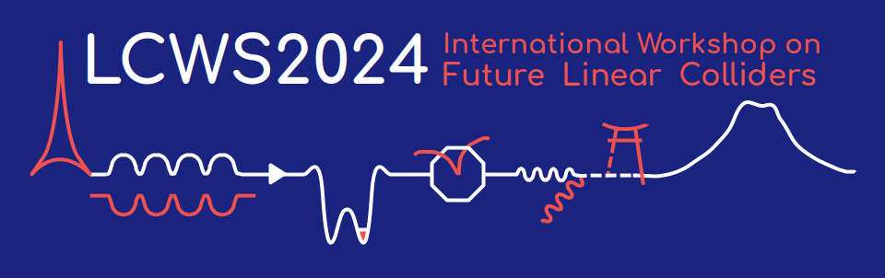



Application of laser-plasma accelerators to future linear colliders
Carl Schroeder, C. Benedetti, J. Osterhoff, K. Nakamura, E. Esarey
Lawrence Berkeley National Laboratory
Wednesday July 10, 2024
University of Tokyo, Japan
Work supported by the U.S. DOE, Office of Science, Office of High Energy Physics, under Contract No. DE-AC02-05CH11231

Slide 2
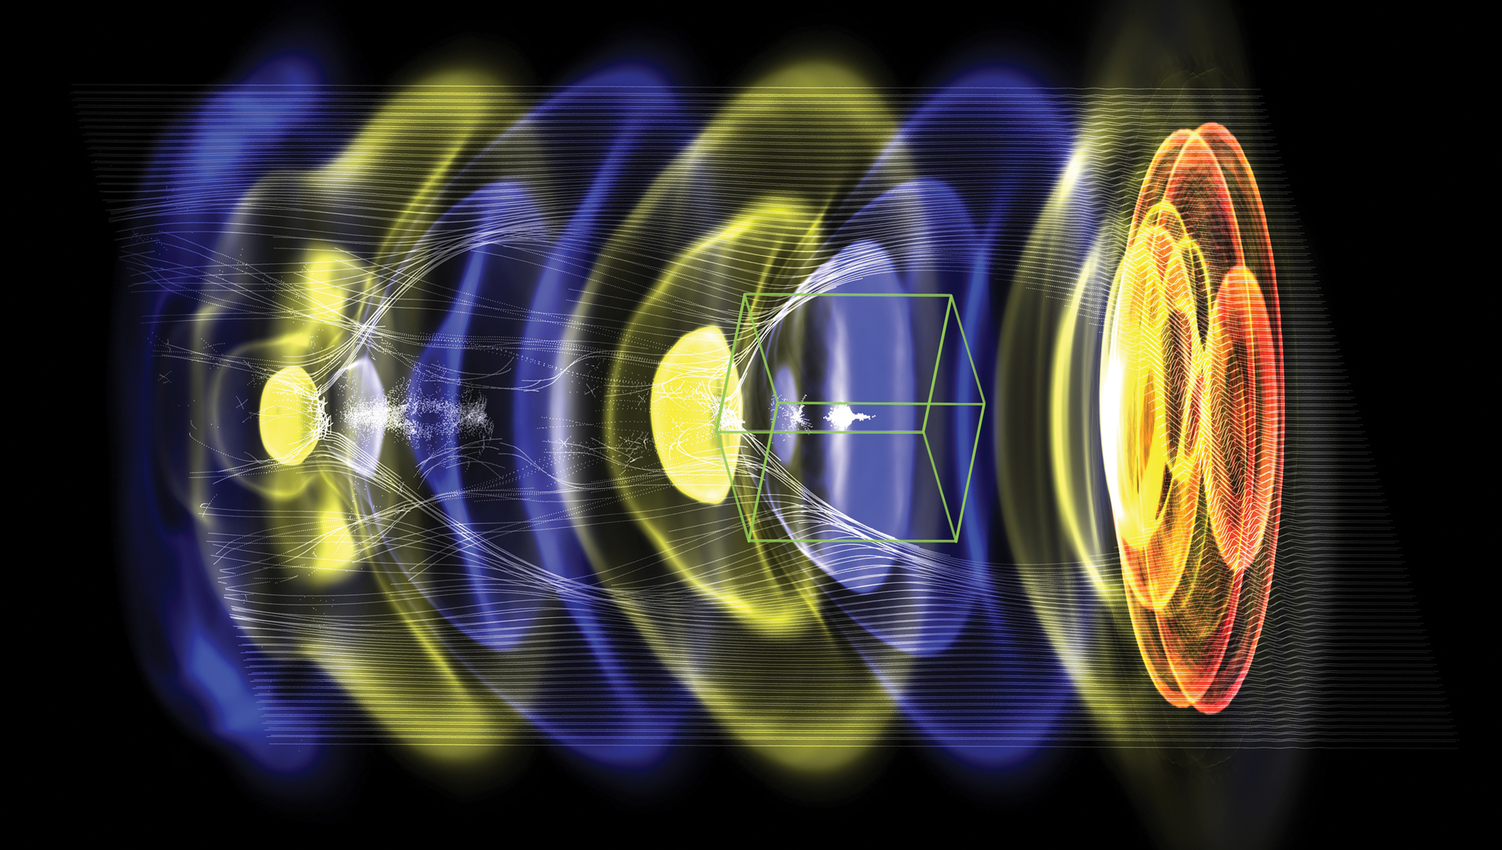
Outline
Laser-plasma accelerators (LPAs) produce ultra-high field gradients (~1-100 GV/m), accelerating ultra-short bunches (~1-10 micron)
LPA-based collider design (10 TeV CM):
  High gradient collider linacs (geo. gradient ~1TeV/km)
  High charge/bunch, maximize L/P
Example of LPA stage for plasma-based linac
  High efficiency with beam quality preservation
Laser driver characteristics for collider application
  R&D toward high average power laser drivers based on coherent combination of fiber lasers
WarpX
Intense laser (red) drives a density wave (blue to yellow) in plasma, electrons (white) are trapped and accelerated with fields of order 10 GeV/m

Slide 3
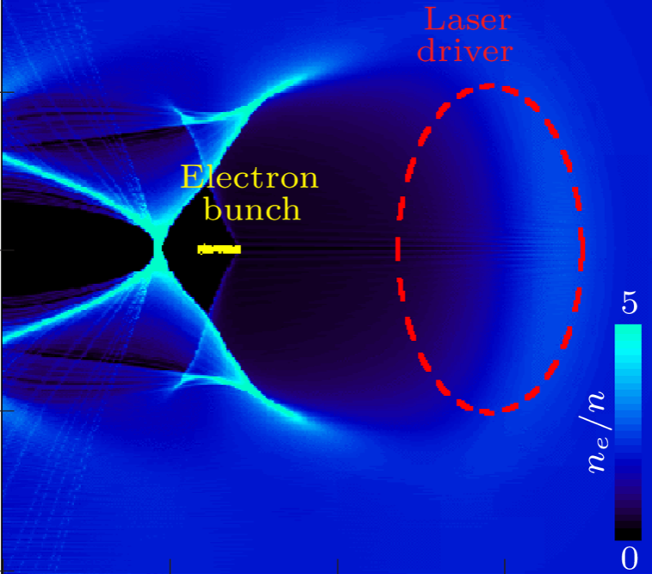
Plasma accelerator, laser driver, and accelerated beam characteristics set by plasma density
C. Benedetti
Schroeder et al. PRL (2011); Benedetti et al PRE (2015)
laser propagation direction
Accelerator length limited by laser energy depletion:
Accelerating gradient:
Energy gain:
~ plasma wavelength, λ_{p}
Laser energy:
Charge/bunch:
Pulse duration:
Lower plasma density yields higher energy beams; requires more laser energy.
Laser depletion (and high gradient) necessitates LPA staging to reach high energy.
Plasma density choice determines required laser parameters; in practice, available laser (with laser energy/pulse and wavelength) determines plasma density

Slide 4
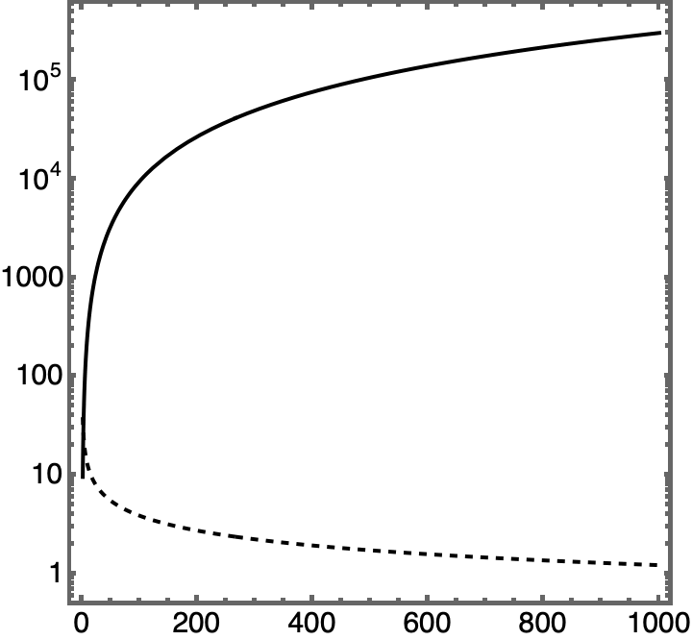
Higher energy beams requires staging plasma accelerators
Once driver energy is depleted, new driver must be coupled into plasma
In laser-driven plasma accelerator: (energy gain) ~1/(plasma density)
For resonant plasma wake excitation: (laser energy) ~ λ_{p}³ ~(plasma density)^{3/2}
Laser energy [J]
Gradient [GV/m]
Beam Energy gain [GeV]

Slide 5
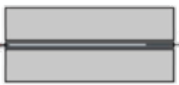
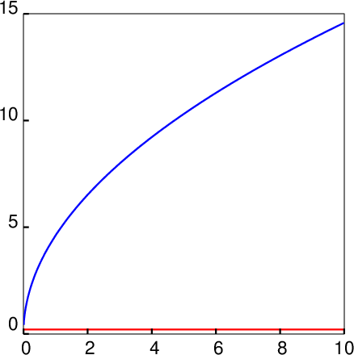
Interstage coupling determined by e-beam not laser driver
e-beam
focusing
laser
Space required for laser coupling L_{c, laser} determined by laser intensity @ plasma mirror (I_{pm}~10¹⁶ W/cm²); for example L_{c, laser} = 0.2 m @ n=10¹⁷ cm⁻³
LPA stage
LPA stage
e-beam
plasma
mirror
L_{c, e-beam}
L_{c, laser}
L_{c, e-beam} (assuming ideal active plasma lens w/ gradient 2000 T/m)
Determined by focusing gradient and beam energy
→ L_{c, e-beam} ~ (energy)^{1/2} , for fixed gradient
Coupling distance [m]
Inter-stage distance grows as energy increases
L_{c, laser} = 0.2 m
@ n=10¹⁷ cm⁻³
Beam energy [TeV]

Slide 6
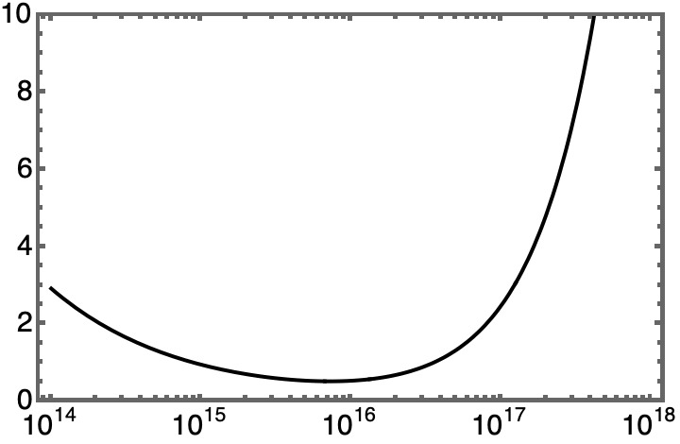
Minimizing linac length (“construction cost”)
Staged LPAs:
<Lc> = 5 m
LINAC length [km] (to 5 TeV)
Lc, interstage coupling distance
Advantage of laser-drivers: compact driver coupling with plasma mirrors
Operational plasma density [cm⁻³]

Slide 7
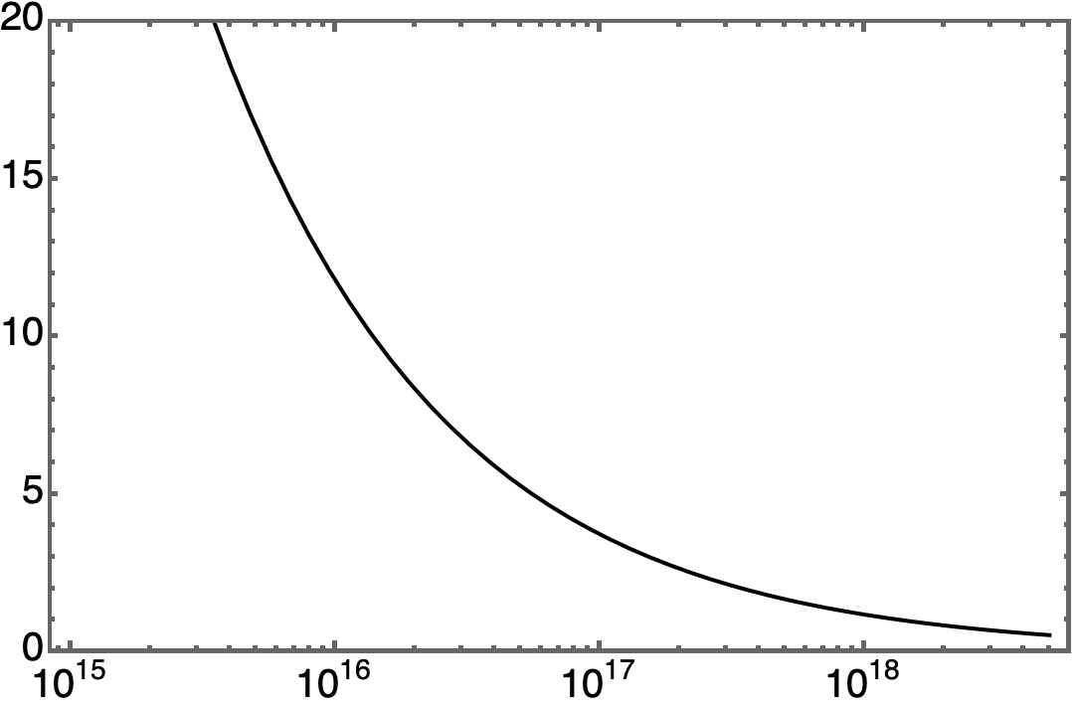
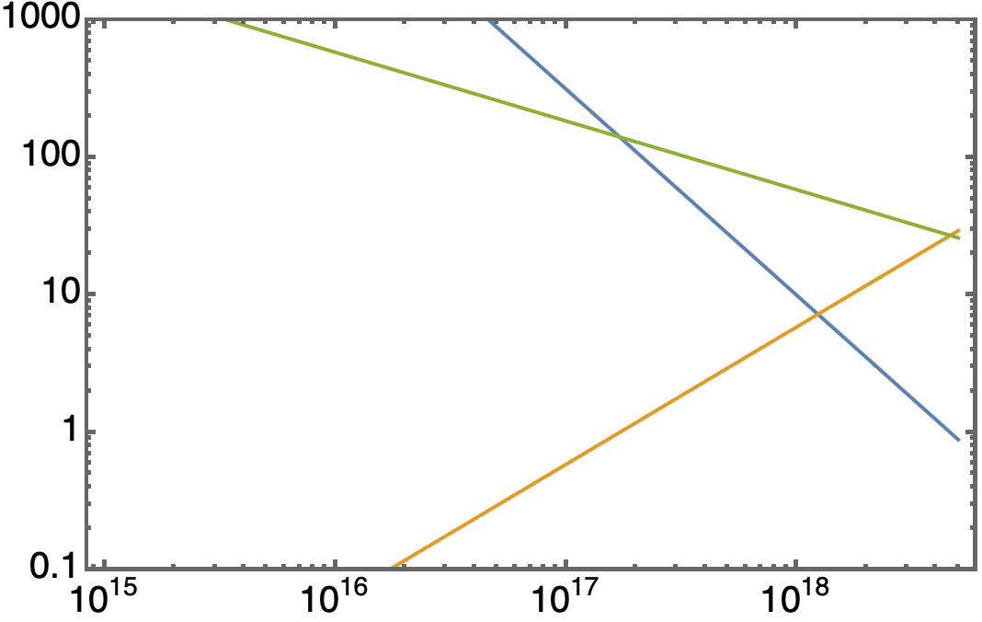
Operating density determines required laser driver
@ 10 TeV CoM
assuming ε² =10⁴ nm²
High density: higher gradient (reduced linac length, reduced construction costs) and low charge/bunch (reduced L/P, increased operation costs)
Low density: Lower gradient (increased linac length, increased construction costs) and high charge/bunch (increased L/P, reduced operation costs)
Beamstrahlung may limit charge/bunch for e+/e- collider
          Operating density range: ~ 10¹⁷ cm⁻³
          Laser technology requirements:
          Laser energy/pulse ~ 1-100 J
          Rep rate ~ 1-10s kHz
          Average laser power ~100kW
Luminosity / Power
[10³⁴cm⁻²s⁻¹ / 100MW]
P_{avg}[kW]
U_{L}[J]
Laser bandwidth:
Laser wavelength λ=1µm
f[kHz]
Operational plasma density [cm⁻³]

Slide 8
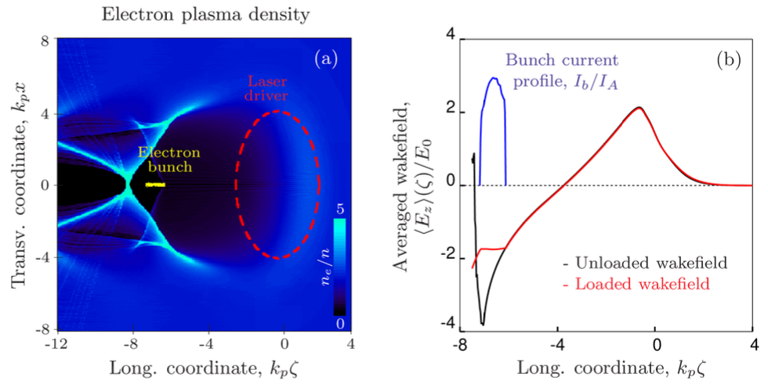
Example LPA stage for laser-plasma-based linac
Schroeder et al. J. Inst. (2022)
Laser: U=50 J, λ₀=1.0 um, a₀=4.5, T₀=80 fs, w₀=36 mm
Plasma: n₀= 3.4x10¹⁷ cm⁻³, stage length = 3.1 cm, linear taper (+74%)
ΔW_{bunch}= 3.1 GeV (~100 GV/m)
Q_{bunch}= 1.2 nC, L_{bunch} =9.3 um,
Energy spread = 0.1%
Wake-to-bunch energy transfer = 43%
Laser driver depletion = 20%
325 stages/TeV

Slide 9
Emittance growth by Coulomb scattering in plasma
Scattering of beam on background ions leads to emittance growth
Schroeder et al. Phys. Plasmas (2013)
E_{z}/E₀ =0.5
Strong focusing suppress emittance growth
Normalized emittance growth [nm]
Emittance growth (very) weakly dependent on plasma density (reduction in density or targets compensated by increase length to achieve target energy, reduction in focusing force)
Final beam energy [TeV]
Sub-nm normalized emittance growth from scattering with plasma for TeV-scale collider

Slide 10
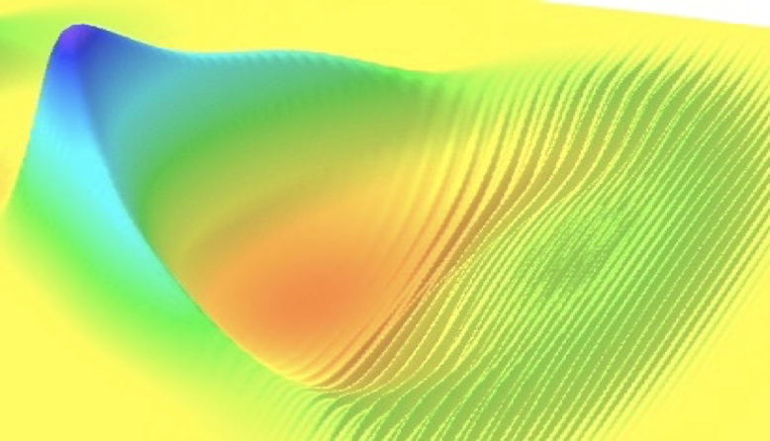
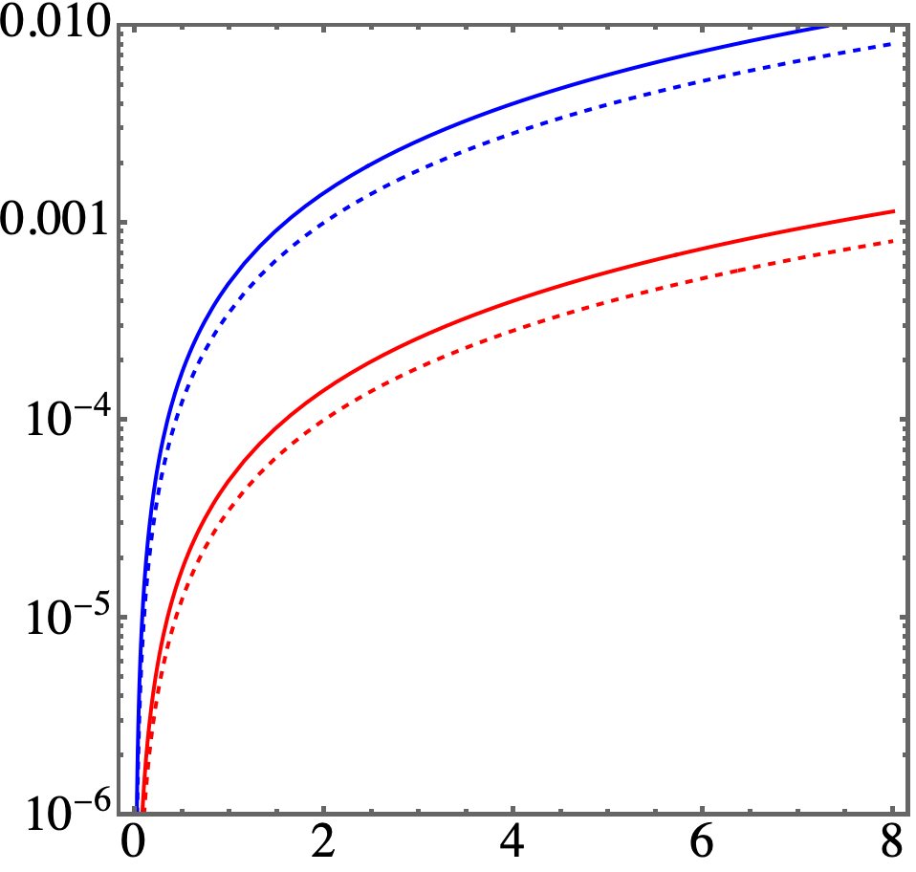
Synchrotron radiation in plasma linacs
Wiggler/betatron period:
n=10¹⁷ cm⁻³
100nm
Wiggler strength parameter:
10nm
Energy spread growth linearly proportional to emittance (betatron amplitude):
Rel. energy spread
Schroeder et al. JINST (2022)
Fraction of beam power rad.
Energy spread induced by synchrotron radiation from plasma betatron motion (assuming low-emittance matched beam) sub-%
Final beam energy [TeV]

Slide 11
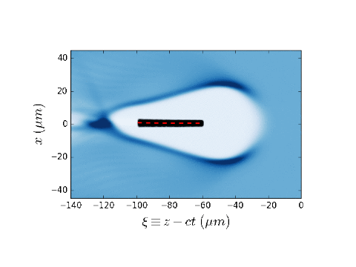
Hosing instability must be suppressed
Hosing (aka BBU): exponential growth of beam centroid displacement (misalignment) owing to coupling transverse beam-driven wake (beamloading) of beam head to beam tail
  results in emittance growth and beam loss.
  transverse (focusing) wakefield ~ longitudinal (accelerating) wakefield in plasma accelerators
  since wakefields are large (>GV/m), hosing can be severe in plasma accelerators
  High beam loading (efficiency) = large long. wakefield = large trans. wakefield = loss of stability
Whittum et al., PRL (1991)
Schroeder et al., PRL (1999)
Huang, et al., PRL (2007)
Lehe et al., PRL (2017)
Mehrling Phys. Plasmas (2018)
Lindstrom et al., PRL (2018)
Lebedev et al., PRAB (2017)
centroid displacement:
number of betatron periods
beam length
R. Lehe

Slide 12
Ion motion mitigates hosing instability growth
Stability to hosing/BBU achieved via BNS damping:
  Requires large (~10%) energy chirp, owing to strong beam loading
  large chirps have transport challenges
Stability also achieved with head-to-tail density variation
  Naturally created by ion motion
Mehrling, Benedetti, Schroeder et al., PRL (2018)
Centroid displacement
Hosing suppressed
Normalized emittance
emittance preserved
Stable beams may be efficiently accelerated in plasma accelerators with emittance preservation with proper matching
Propagation distance

Slide 13
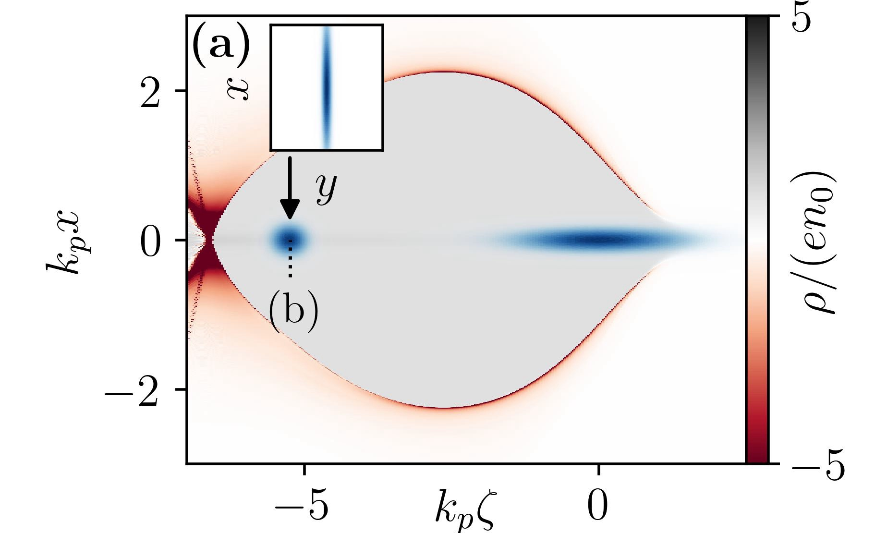
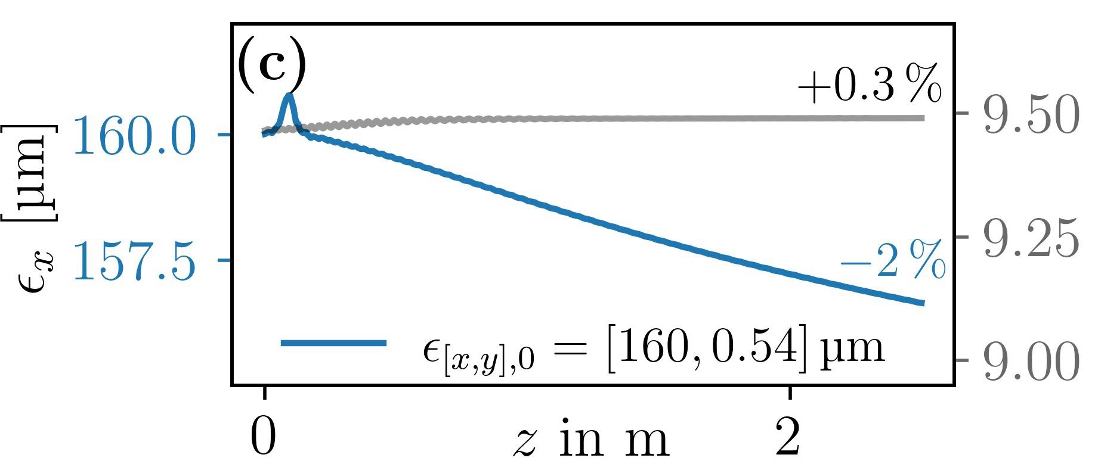
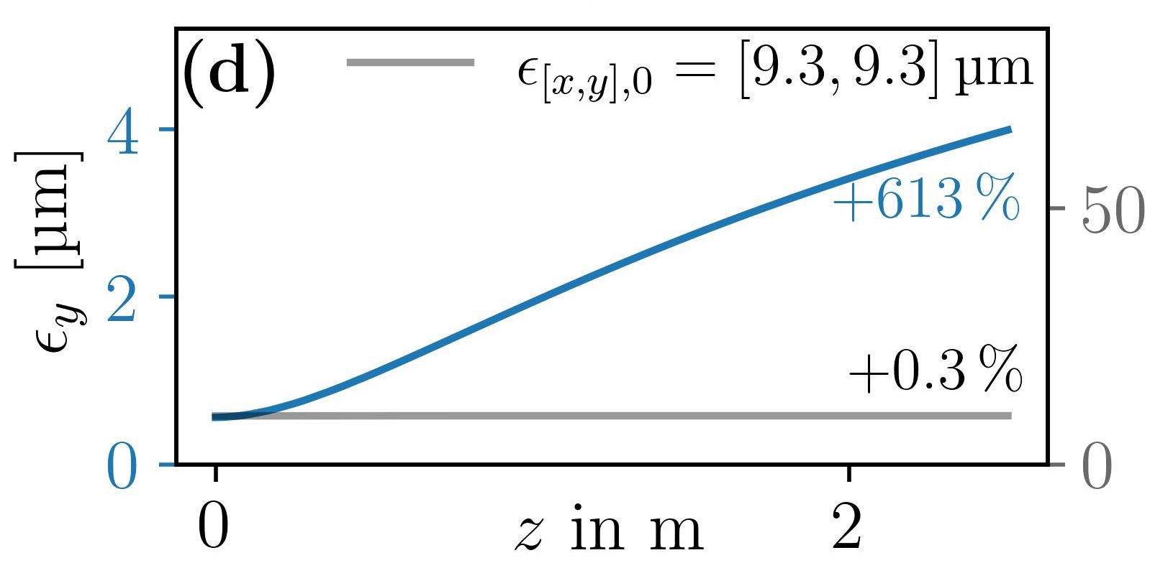

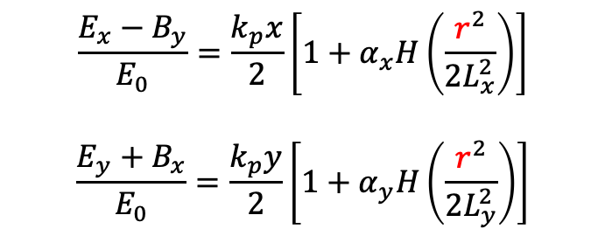
Ion motion couples horizontal/vertical:
Emittance growth for flat beams
Diederichs,…Schroeder, Thevenet, arXiv 2023; submitted to PRL
Benedetti, Schroeder et al. PRAB 2017
Transverse wakefields with ion motion
$$\frac{{E_{x}−B}_{y}}{E_{0}}=\frac{k_{p}x}{2}\left[1+α_{x}H\left(\frac{r^{2}}{2L_{x}^{2}}\right)\right]$$
$$\frac{{E_{y}+B}_{x}}{E_{0}}=\frac{k_{p}y}{2}\left[1+α_{y}H\left(\frac{r^{2}}{2L_{y}^{2}}\right)\right]$$
Coupled nonlinearity: $r=\sqrt{x^{2}+y^{2}}$
enables x-y coupling and emittance growth

Slide 14
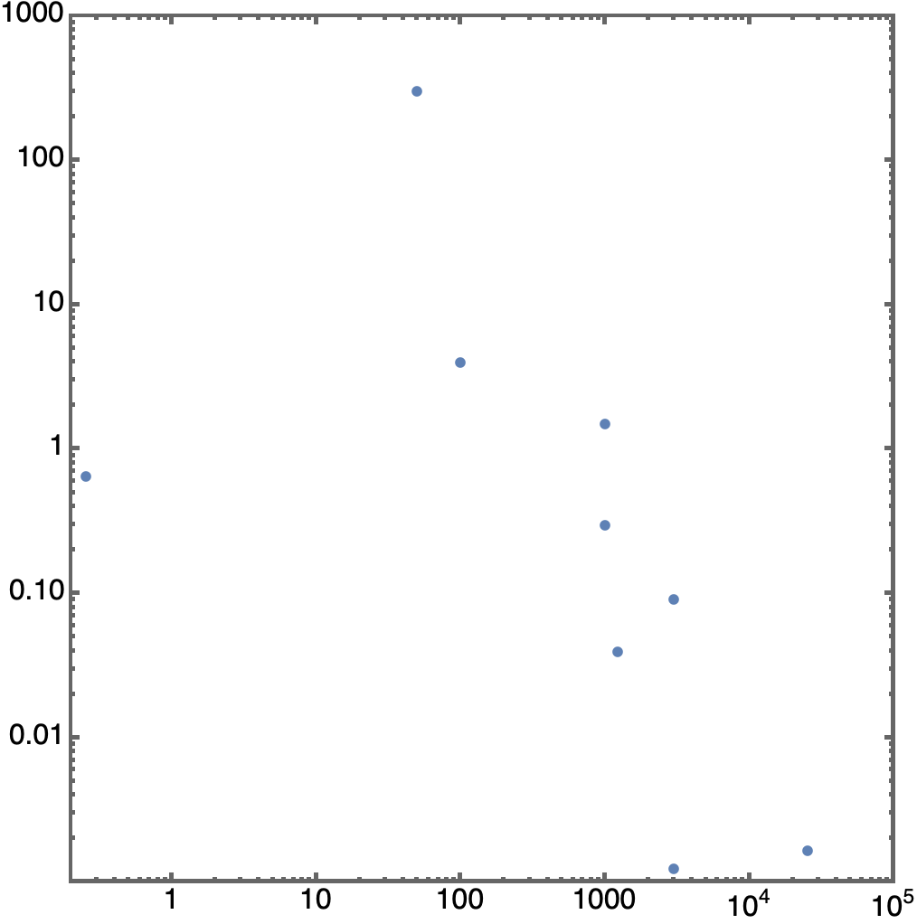
Laser technology R&D required for collider
Present ~10sJ-class Ti:Sa laser systems operate at 1-10Hz (~10-100W average power), with low efficiency (quantum defect fundamentally limits efficiency for Ti:Sa laser systems: 532 nm pumping / 800 nm lasing; ~33% thermal loss)
Collider application will require ~100kW average power with >30% efficiency
  Promising emerging laser architectures
  Tm:YLF (λ=1.9µm), R&D at LLNL
  Coherent combination of fiber lasers (λ=1µm),
  R&D at LBNL, Michigan, Jena
    potential for highest efficiency (~50%)
    1µm (minimize # of accelerator stages)
    monolithic design for robustness, serviceability, etc.
collider requirements
~100kW
~100TW
> 30% effic.
fibers scalable,
efficient
J-class kHz systems
kBELLA (LBNL) – fiber, planned
technically
feasible
(available
near-term)
average laser power [kW]
KALDERA (DESY) – Ti:Sa, planned
coherent combination
MEC-U (SLAC, planned; glass)
~30 mJ
fiber lasers
Ti:Sa perf. ceiling
(quantum defect, cooling)
L3-HAPLS (ELI-BL)
existing
laser
systems
CoReLS (Korea)
BELLA (LBNL)
NSF OPAL (Rochester, planned; OPCPA)
ZEUS (Michigan)
peak laser power [TW]
Laser tech path for collider
Can not address collider needs

Slide 15

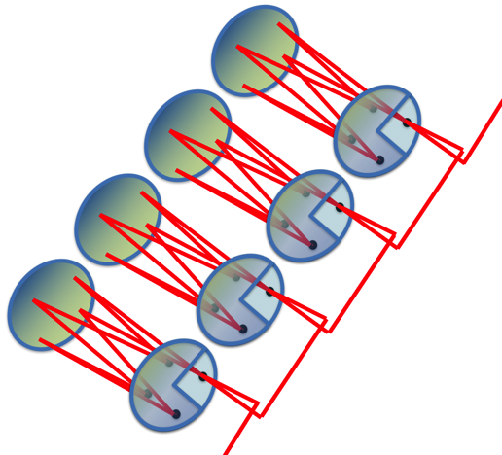
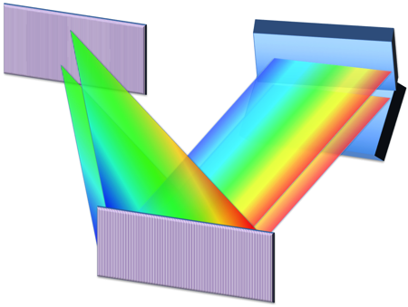
Coherent combing of fiber lasers path to high average power
spectral
splitter
stretchers and
pre-amplifiers
Concept: Use high efficiency, high average power fiber lasers, and add them coherently for high pulse energy
Combine 100’s fibers spatially x 100 pulses temporally for collider energy needs
  Stack 100 pulses in 1 fiber to get >10mJ, sub-kW
  Combine 100’s fibers to get Joules, 100’s kW
  Relies on control of laser phase of each pulse
oscillator
power
amplifiers
λ₁
spatial
combiners
λ₂
λ₃
spectral
combiners
…
Yb-doped fibers:
diode pump at 976 nm , lase at 1030 nm
Large surface/vol. ratio = excellent thermal energy handling
total efficiency wall-to-laser of ~40-50%:
- electrical-to-optical of diode pumped lasers = 60%
- optical-to-optical of fibers = 90%
- combining fibers = 85%
pulse compressor
Achieved to-date:
81 pulses stacked temporally (>10 mJ)
Spatially combined 8, 100fs beams (90% efficiency)
3 channels spectrally combine to 42 fs
Next step: 27 spatial beams, 81 temporal pulses, 3 spectral bands (200mJ, 1kW)
temporal
stackers
output

Slide 16
Conclusions
Linacs based on staging plasma accelerators: ~1 TeV/km geo. gradient
  Proper beamloading and tapering: low energy spread (0.1%), high efficiency (>40%), high gradient
  Minimal emittance growth (<nm) owing to scattering in plasma (due to strong focusing)
  Synchrotron emission low (dE/E~10⁻³ ) for collider-relevant emittances (<100nm)
  Hosing suppressed via coherent ion motion
  Ion motion results in horizontal-vertical coupling and round beams
Laser-plasma-based collider:
  Positron acceleration is a challenge, requires R&D and demonstrations of new concepts
  Gamma-gamma (or e-e-) colliders are promising option with demonstrated wakefield technology
    Scattering using 0.33um (~10J laser) with 5TeV beam, yields x~300>>4.82
  Collider sub-systems (BDS, damping, injector, etc.) require development
High average power laser system R&D required
  coherent combination of fiber lasers promising path to high average, high peak power, and high efficiency short-pulse lasers

