Slide 1
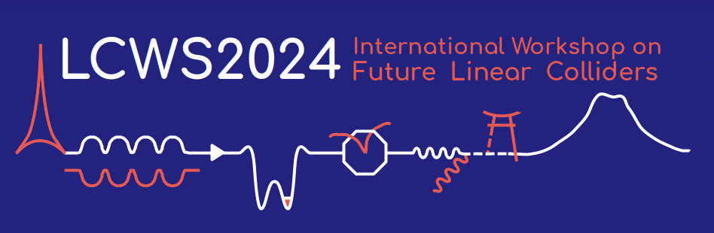
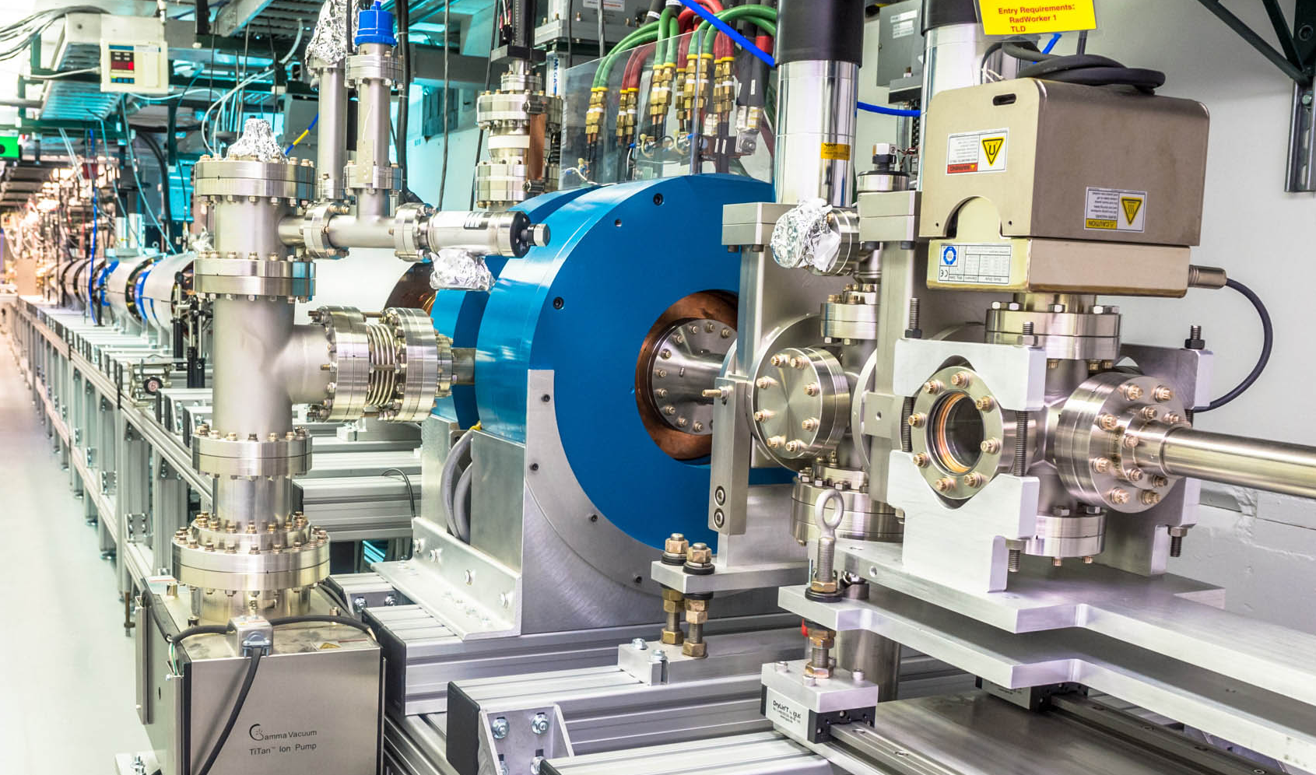
Advanced Structures R&D For Structure Wakefield Acceleration at Argonne Wakefield Accelerator
Xueying Lu
Northern Illinois University (NIU)
& Argonne National Laboratory (ANL)
July 10, 2024
The University of Tokyo, Japan

Slide 2

Outline
Structure wakefield acceleration (SWFA)
SWFA research at the Argonne Wakefield Accelerator (AWA)
Advanced structure R&D
  X-band structures for two-beam acceleration
  Sub-THz structures for collinear acceleration
  RF breakdown studies
    see my talk later this afternoon in the normal conducting RF working group
Work supported by US DOE HEP
NIU: DE-SC0021928, DE-SC0022010
AWA: DE-AC02-06CH11357
CAST Traineeship: DE-SC0020379

Slide 3
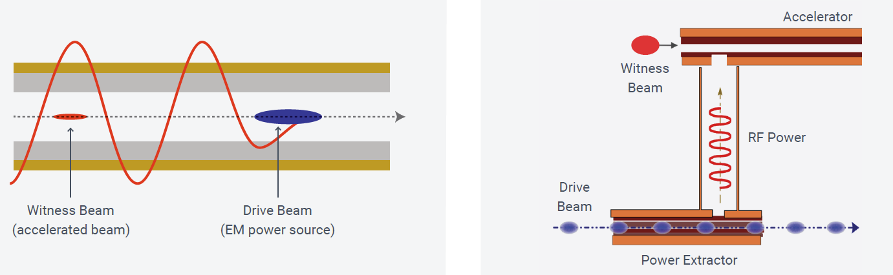
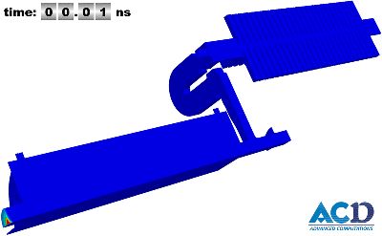
Structure Wakefield Acceleration (SWFA):
Beam-driven wakefield acceleration in RF structures in vacuum
  Collinear wakefield acceleration
  (CWA)
  Two-beam acceleration
  (TBA)
  TBA in action

Slide 4
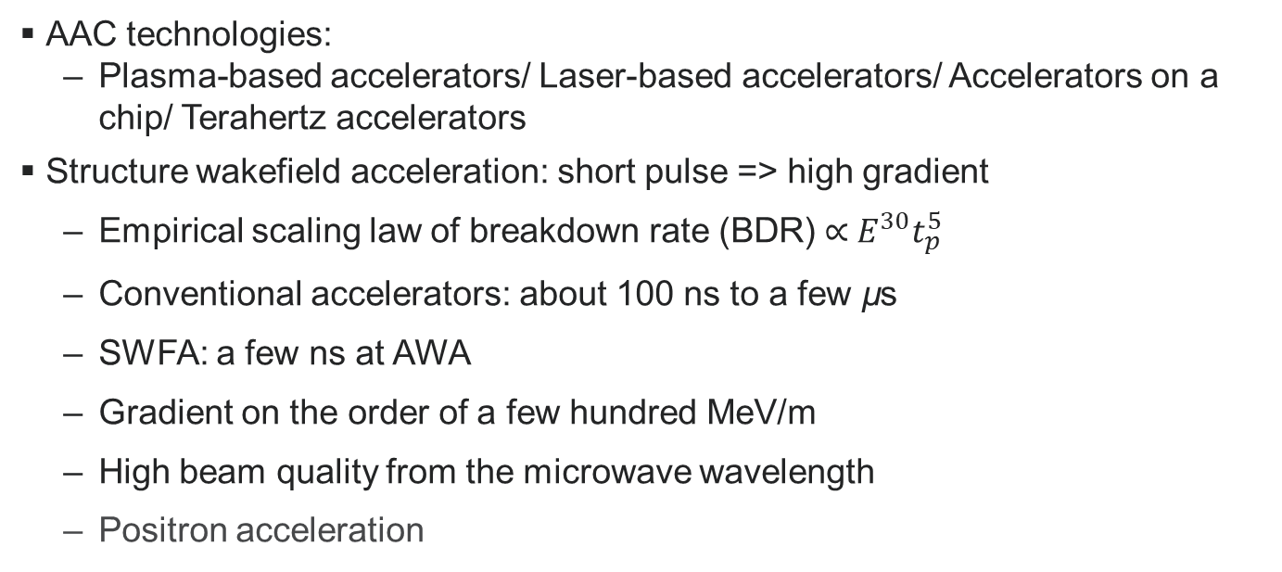
SWFA in the context of AAC
AAC technologies:
  Plasma-based accelerators/ Laser-based accelerators/ Accelerators on a chip/ Terahertz accelerators
Structure wakefield acceleration: short pulse => high gradient
  Empirical scaling law of breakdown rate (BDR) ∝${ E}^{30}t_{p}^{5}$
  Conventional accelerators: about 100 ns to a few µs
  SWFA: a few ns at AWA
  Gradient on the order of a few hundred MeV/m
  High beam quality from the microwave wavelength
  Positron acceleration

Slide 5

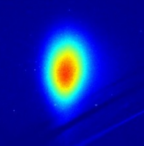
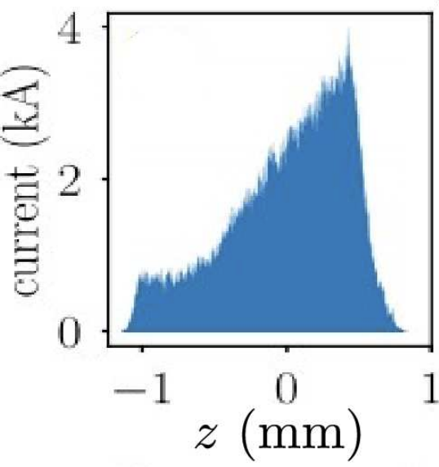

Topics of Interest in SWFA
Overall goals:
  Achieve desirable luminosity (scalable energy, beam power, low emittance, short bunch length, etc.), & achieve higher efficiency to reduce site power
CWA
TBA
SWFA
R&D
Intense, shaped
Microwave
THz
Beam
Structure
Figure credit: C. Jing

Slide 6
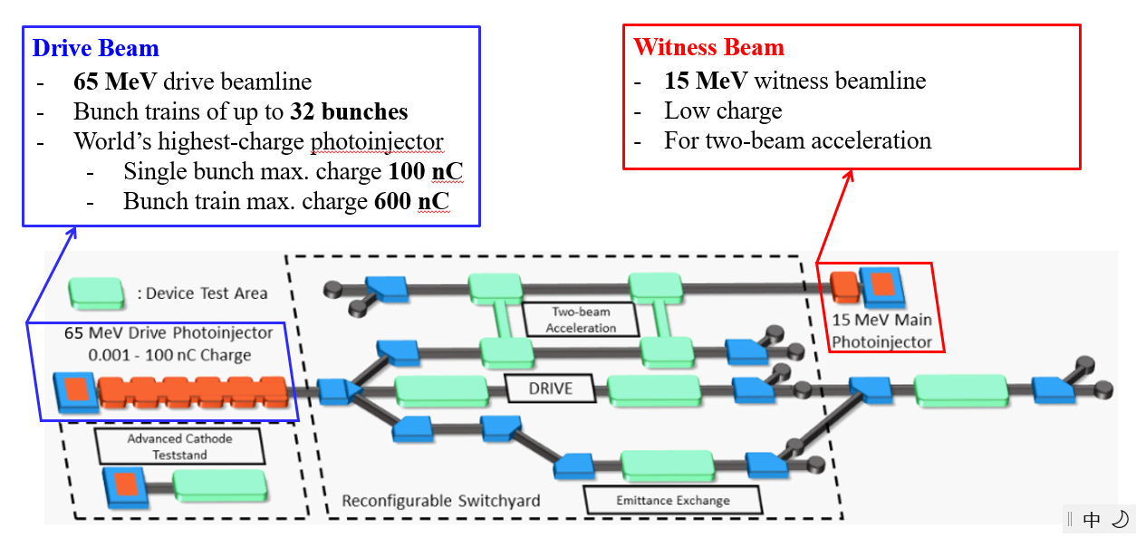
Argonne Wakefield Accelerator (AWA)

Slide 7
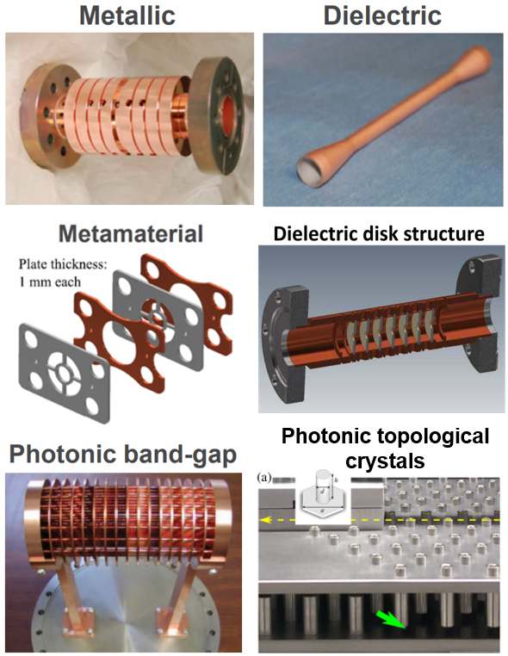
Advanced wakefield structures
SWFA with short RF pulses requires advanced structures for high gradient and high efficiency
  Desired features:
    Low RF loss
    High group velocity
    High shunt impedance
  Goals:
    1 GW power extraction
    500 MeV/m acceleration

Slide 8
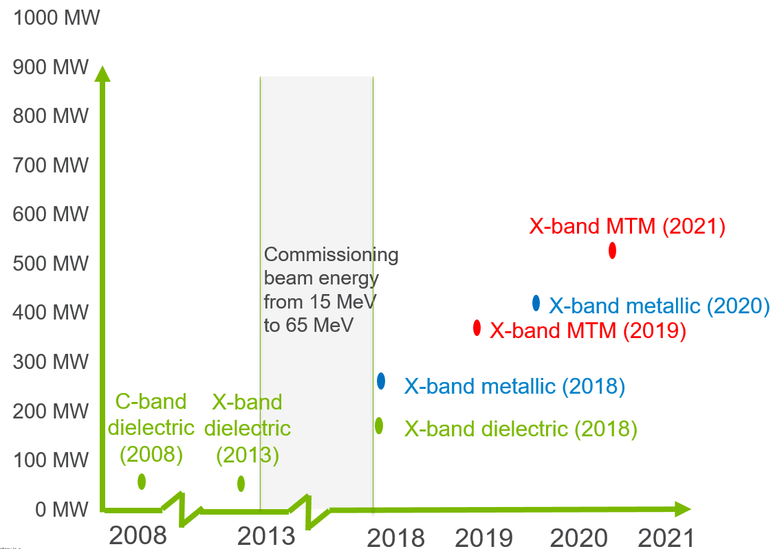
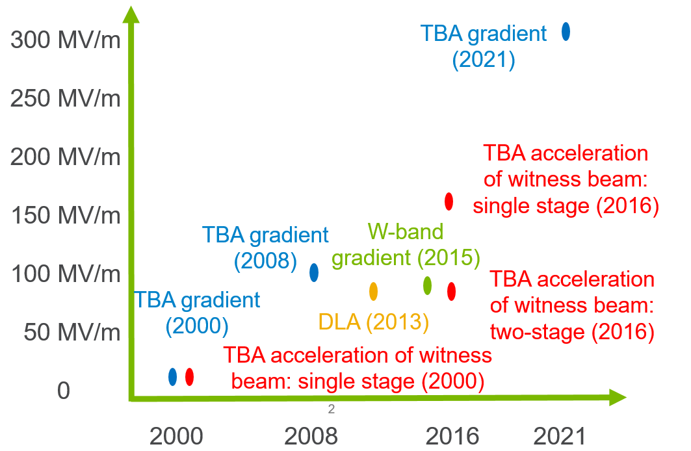
Recent Progress in X-band structures for TBA
Power Extraction
Acceleration Gradient

Slide 9
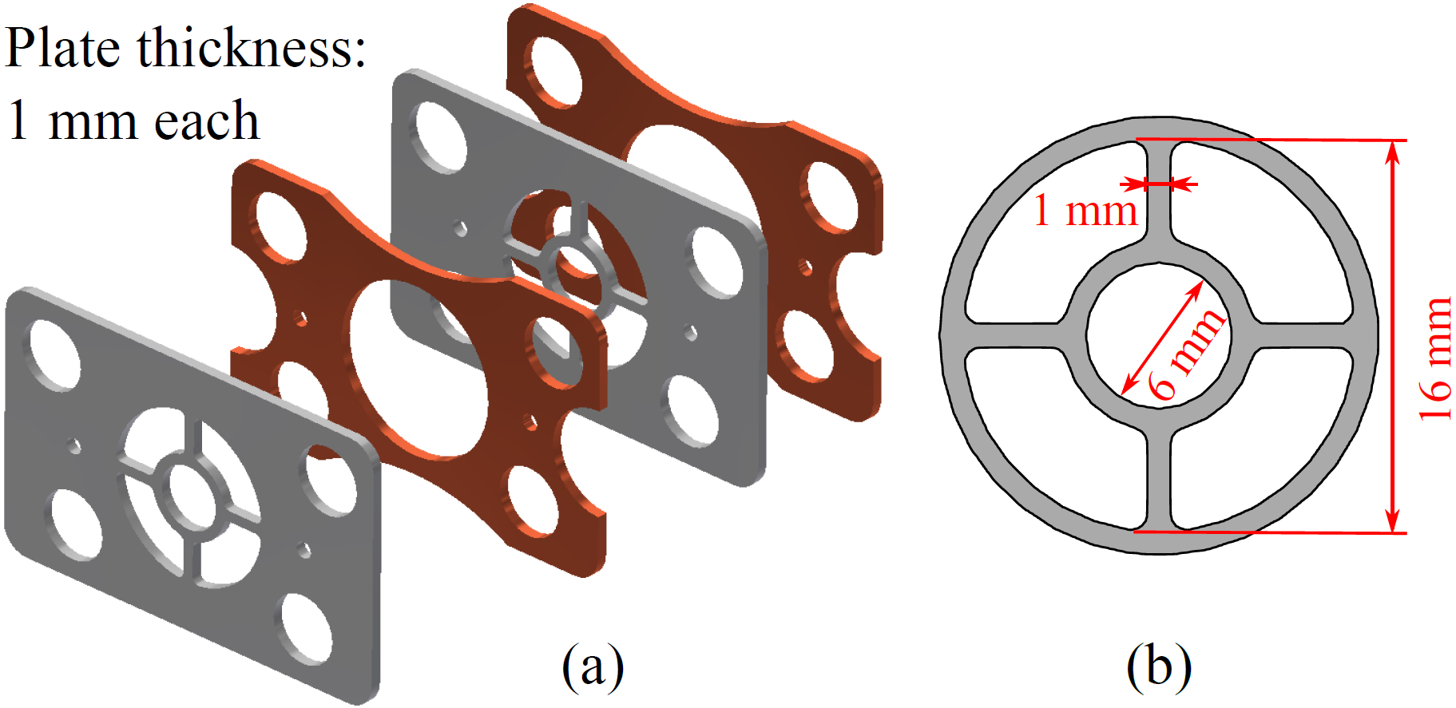
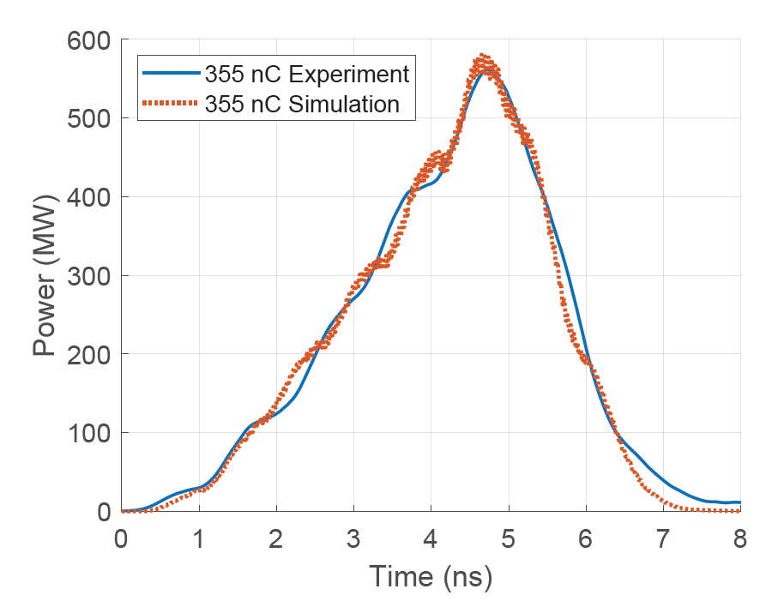
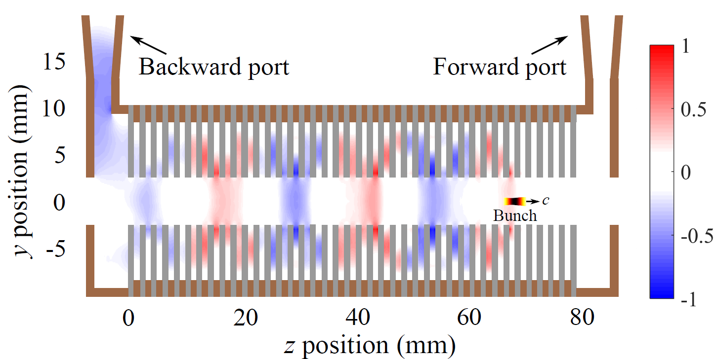
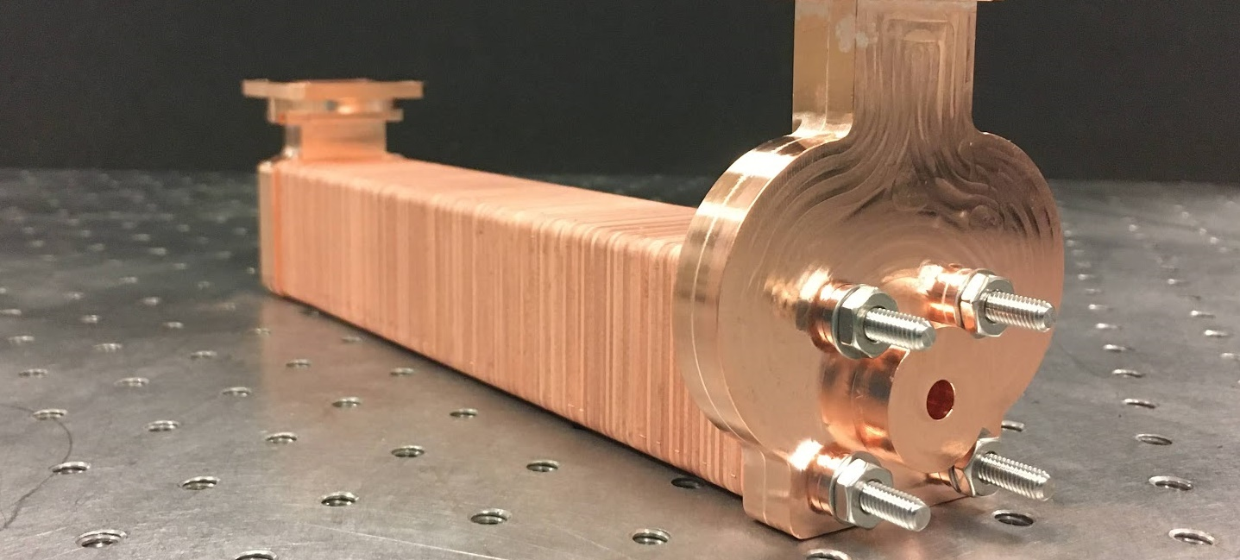
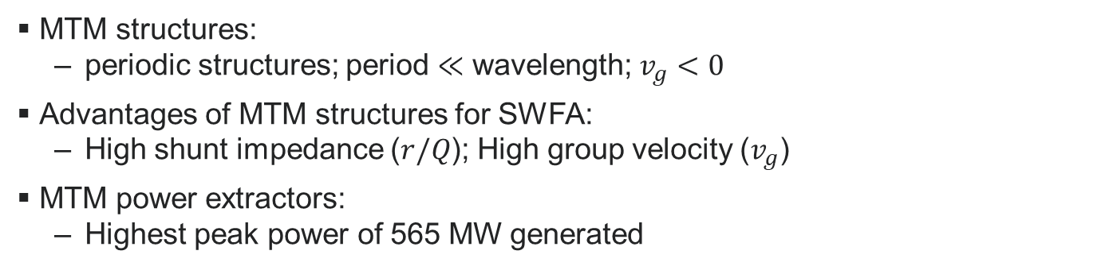
Example- metamaterial (MTM) structures
MTM structures:
  periodic structures; period $≪$ wavelength; $v_{g}<0$
Advantages of MTM structures for SWFA:
  High shunt impedance ($r/Q$); High group velocity ($v_{g}$)
MTM power extractors:
  Highest peak power of 565 MW generated
J. Picard et al, PRAB 25, 051301 (2022)

Slide 10
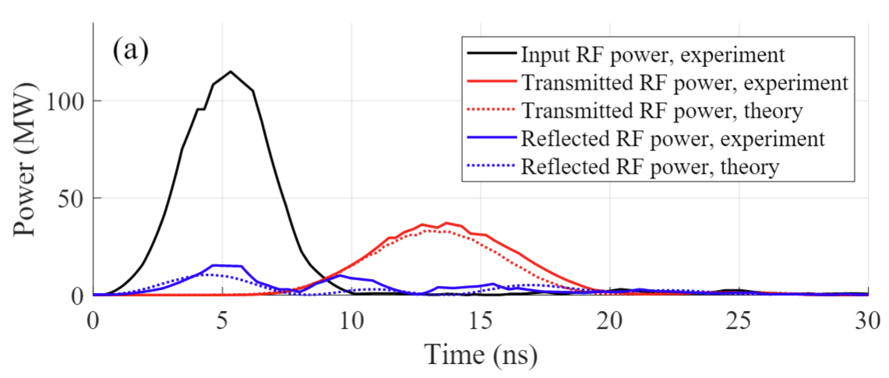
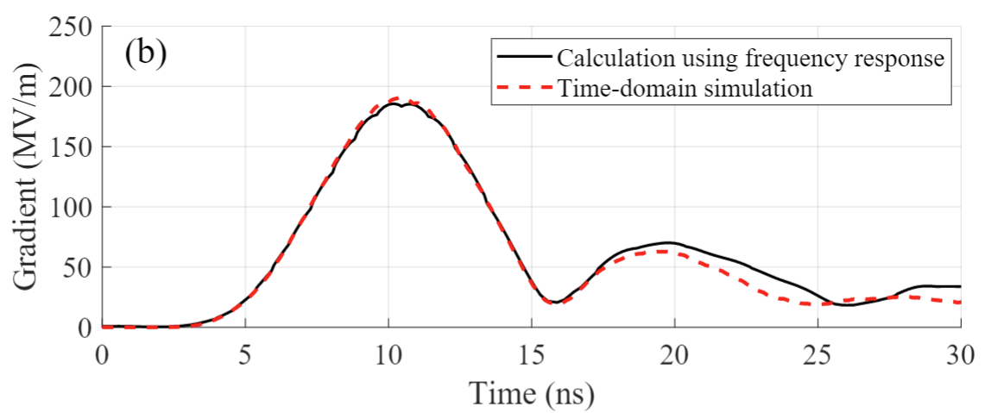
Metamaterial accelerators for TBA
Thesis project of NIU student Dillon Merenich
Efficient structure design to explore gradient limitation
  Optimized for high gradient with a 6 ns FWHM input RF pulse
Measured RF traces in good agreement w/ theory
Gradient
D. Merenich et al, PRAB 27, 041301 (2024)

Slide 11
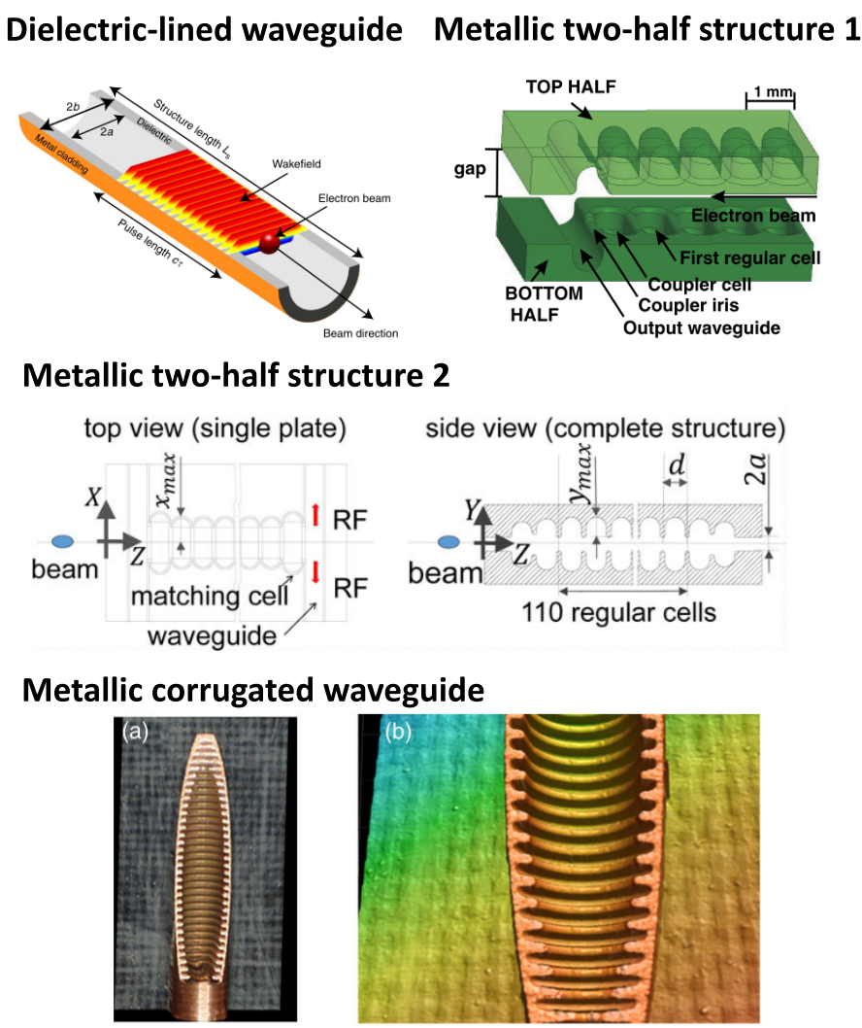
Sub-THz structures
Advantages of sub-THz wakefield structures
  Strong beam-structure interaction
  Small transverse size
  High efficiency when combined with longitudinal bunch shaping
Two recent exp. in this talk
  A W-band metallic structure w/ shaped bunch for high-gradient high-transformer-ratio
  A dielectric structure for energy recovery
See next talk by H. Kong for an ongoing collaboration with PAL

Slide 12
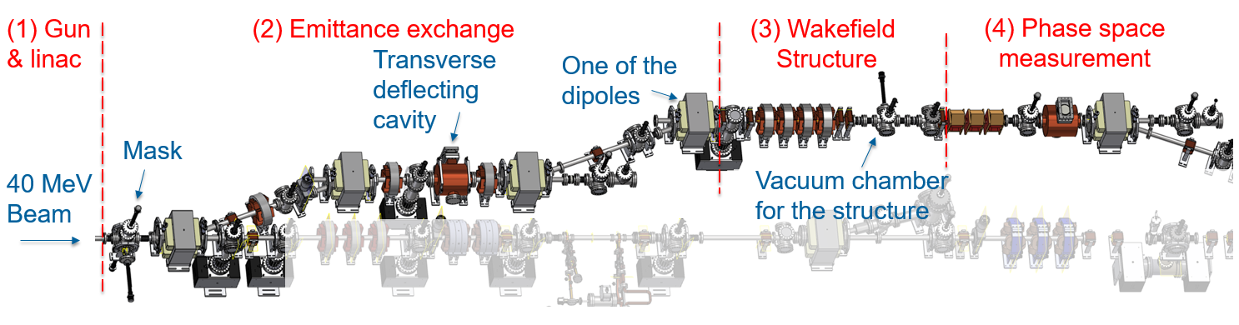
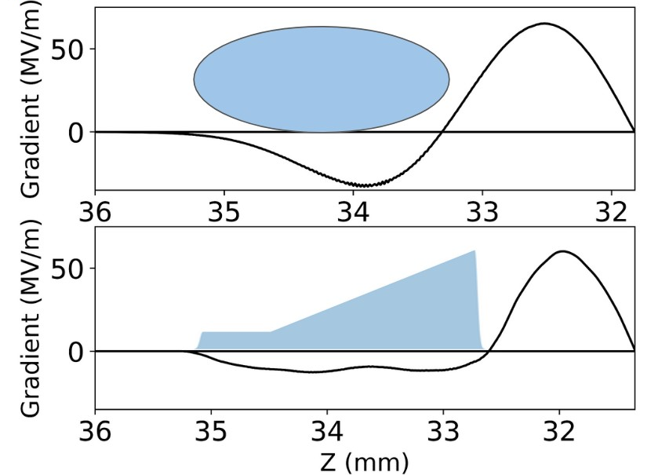
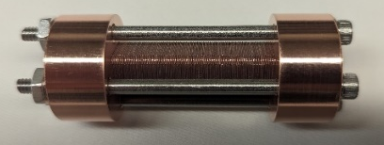
Sub-THz structure experiment w/ shaped bunches
Thesis project of NIU student Brendan Leung
Integration of wakefield structures + shaped beams
  Longitudinally shaped bunches w/ emittance exchange (EEX) beamline at AWA
W-band structure fabricated by laser micromachining
High transformer ratio with a shaped bunch

Slide 13
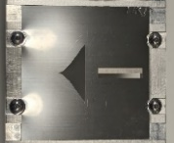
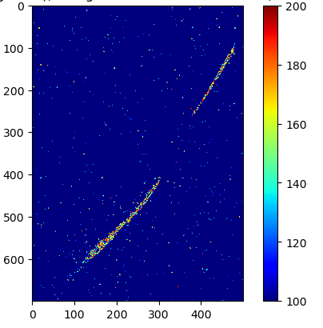
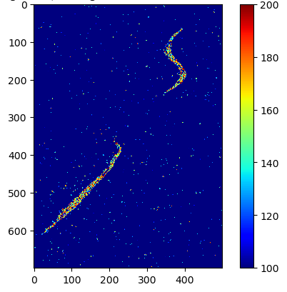
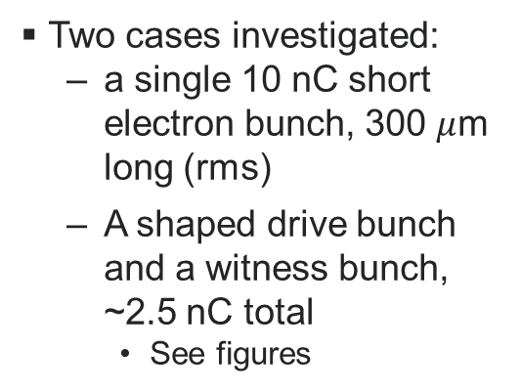
High gradient & high transformer ratio
Preliminary
Mask
Two cases investigated:
  a single 10 nC short electron bunch, 300 $μ$m long (rms)
  A shaped drive bunch and a witness bunch, ~2.5 nC total
    See figures
No structure
With structure
Witness
Witness
Drive
Time
Time
Drive
Energy
Energy
Experiment just completed! Stay tuned for more results!

Slide 14
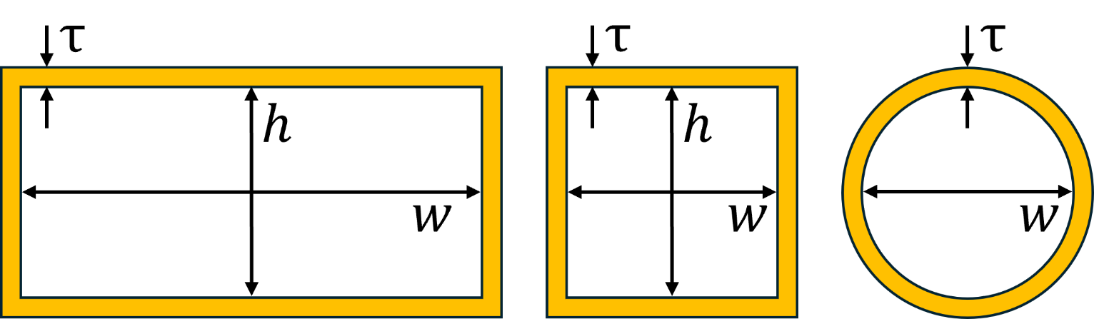



Sub-THz dielectric-lined waveguides
Thesis project of NIU student Calcifer Philipps (co-supervised by Philippe Piot)
Various transverse cross-sectional shapes have been investigated
  Aluminum coating outside of commercially available dielectric tubes
Plan for energy recovery with structure wakefield acceleration
  Cut end of square structure at an angle, so bunch travels straight out and radiation travels at an angle to be captured and recycled back into the structure
$$τ_{ε}$$
$$τ_{σ}$$
$$h$$

Slide 15
Short-pulse RF breakdown studies
More at my talk later this afternoon in Working Group: Normal conducting RF
To
load
RF power extracted, to DUT
Drive beam
direction
Power extractor
High peak power (~500 MW)
Short pulse length (a few nanoseconds)
Flexibility in the choice of output frequency
Harmonic of the bunch train frequency 1.3 GHz (e.g. 7.8 GHz, 11.7 GHz, 26 GHz, sub-THz)

Slide 16







Conclusions & Acknowledgements
Advanced structures R&D is at the core of SWFA research
Recent progress in two-beam acceleration & sub-THz collinear acceleration
Great training opportunities towards building the workforce for future colliders
NIU graduate students & postdoc
AWA group: Scott Doran, Gongxiaohui Chen, Wanming Liu, Rachel Margraf-O'Neal, Chunguang Jing, Alexander Ody, Philippe Piot, John Power, Charles Whiteford, Eric Wisniewski
Brendan
Leung
Calcifer
Philipps
Dillon
Merenich
Gaurab
Rijal
Salih
Colmekci
Zara
Sheemanto
Omkar
Ramachandran

