Slide 1
Design and Optimization of the CLIC FFS at 7 TeV
Enrico manosperti
Rogelio Tomas Garcia
Andrii Pastushenko

Slide 2
Table of contents
Description of the new FFS design
Optimization of the bending magnets
Scan of the vertical beta function
Length optimization
Final doublet optimization
Conclusions

Slide 3
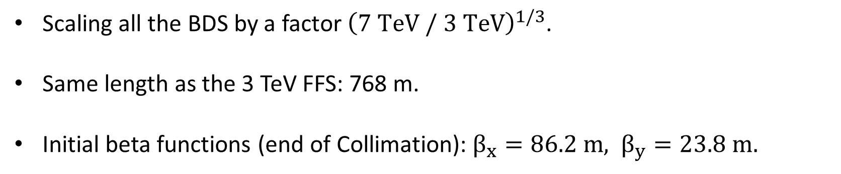
FFS Design
Scaling all the BDS by a factor ${\left(7 TeV / 3 TeV\right)}^{1/3}$.
Same length as the 3 TeV FFS: 768 m.
Initial beta functions (end of Collimation): $β_{x}=86.2 m, β_{y}=23.8 m.$

Slide 4
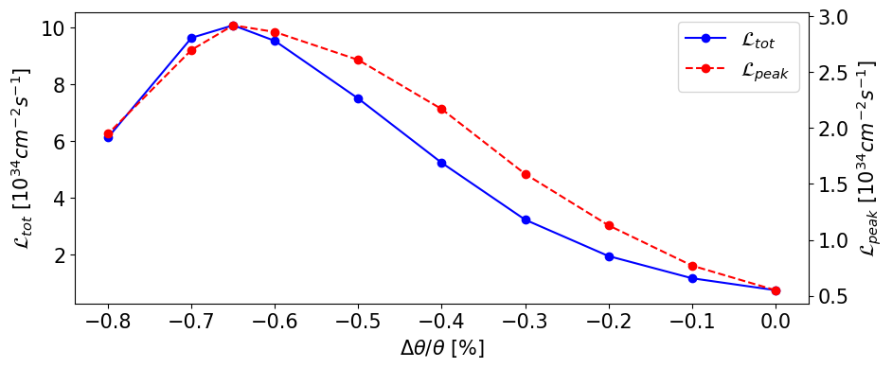
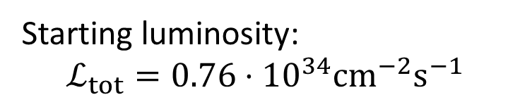
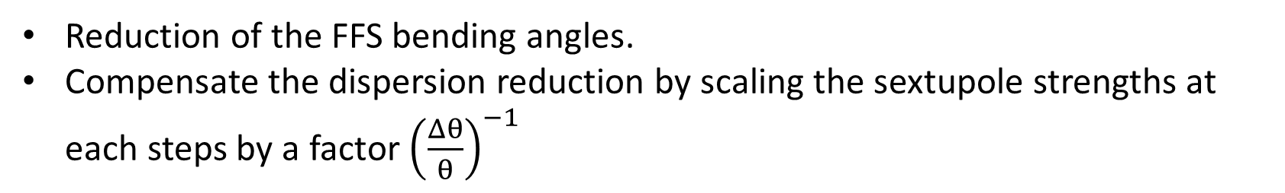
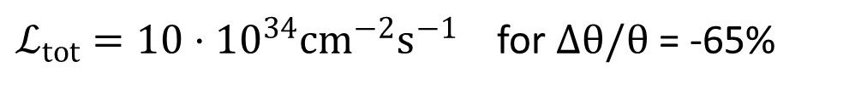
Scaling of the Bending angles
Starting luminosity:
$$ℒ_{tot}=0.76⋅{10}^{34}cm^{−2}s^{−1}$$
Reduction of the FFS bending angles.
Compensate the dispersion reduction by scaling the sextupole strengths at each steps by a factor ${\left(\frac{Δθ}{θ}\right)}^{−1}$
$ℒ_{tot}=10⋅{10}^{34}cm^{−2}s^{−1}$ for $Δθ/θ$ = -65%

Slide 5
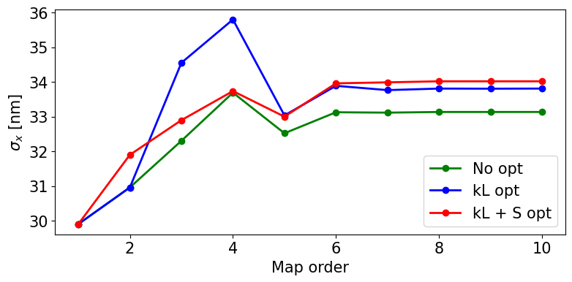
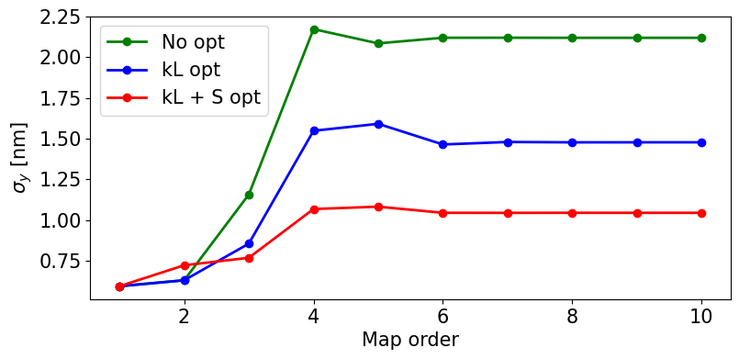
Beam size optimization
Optimization of the beam size at the IP by varying:
only the magnet strengths (blue).
the magnet strengths and the octupoles and decapoles positions (red).

Slide 6
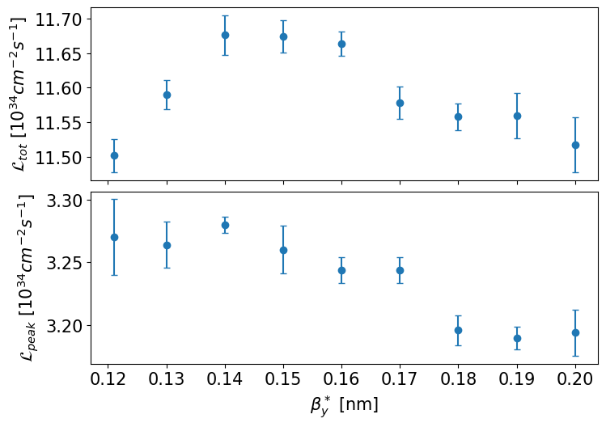
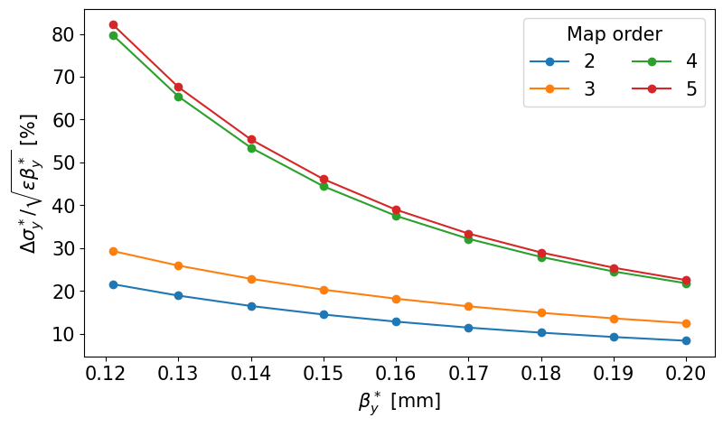

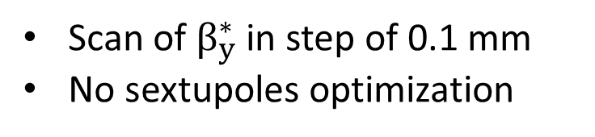

$β_{y}^{∗}$ Scan
Scan of $β_{y}^{∗}$ in step of 0.1 mm
No sextupoles optimization
Best $β_{y}^{∗}=0.14 mm$

Slide 7
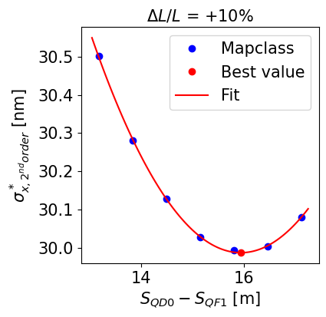
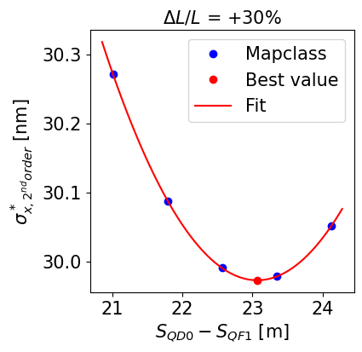
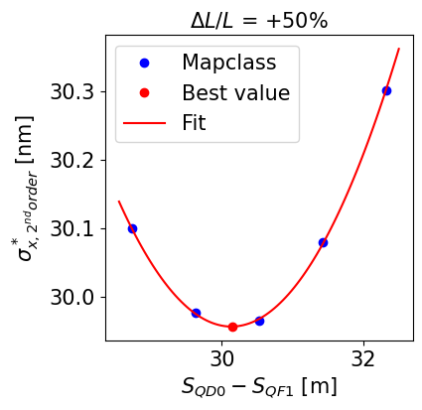
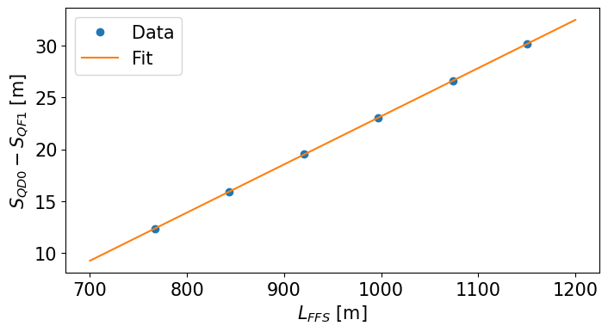
Length scaling – best QF1-QD0 distance
Increase the length of the FFS to reduce the magnetic field into the dipoles that leads to a decrease in an energy loss by synchrotron radiation.
FFS length increased in steps of 10%.
Optimization of the distance between QD0 and QF1 to minimize the horizontal chromaticity.

Slide 8
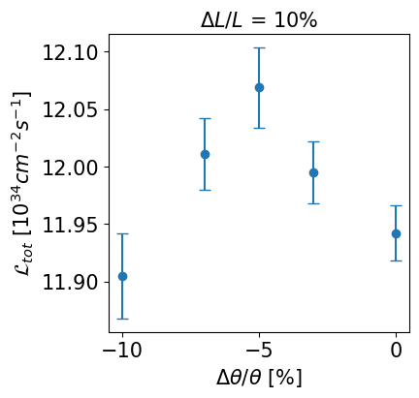
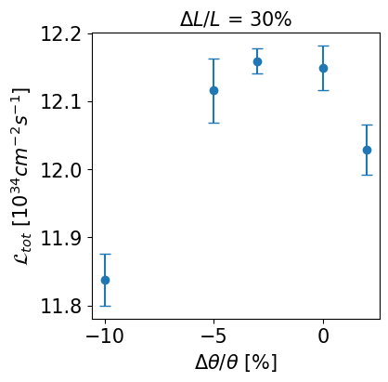
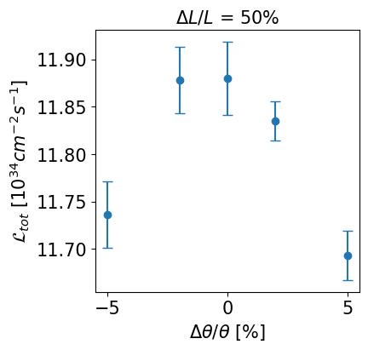
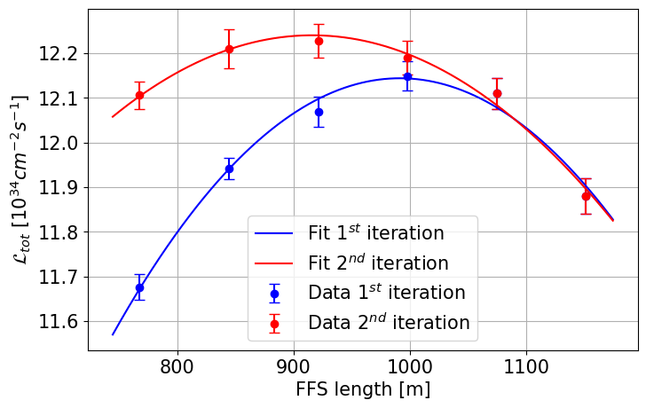
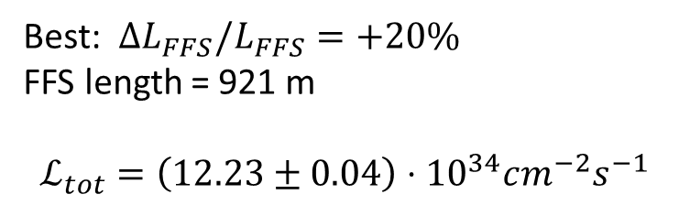
Length scaling – dispersion optimization
Optimization of the beam size with Mapclass (1st iteration)
Dispersion reduction to reduce the Synchrotron Radiation effects
Optimization of the beam size with Mapclass (2nd iteration)
Best: $ΔL_{FFS}/L_{FFS}=+20\%$
FFS length = 921 m
$$ℒ_{tot}=\left(12.23±0.04\right)⋅{10}^{34}cm^{−2}s^{−1}$$

Slide 9
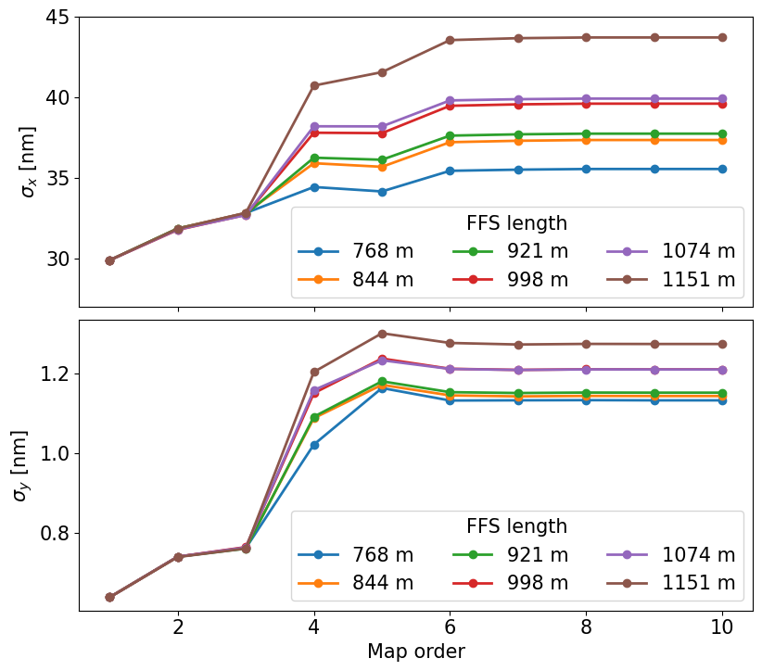
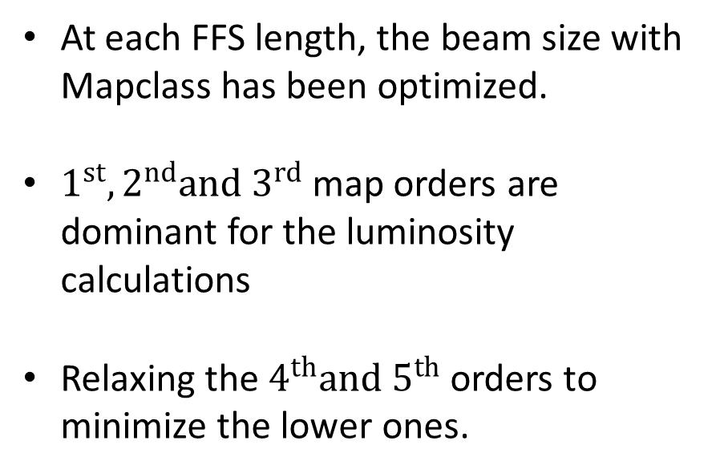
Length scaling – beam size
At each FFS length, the beam size with Mapclass has been optimized.
$1^{st}, 2^{nd}and 3^{rd}$ map orders are dominant for the luminosity calculations
Relaxing the $4^{th}and 5^{th}$ orders to minimize the lower ones.

Slide 10
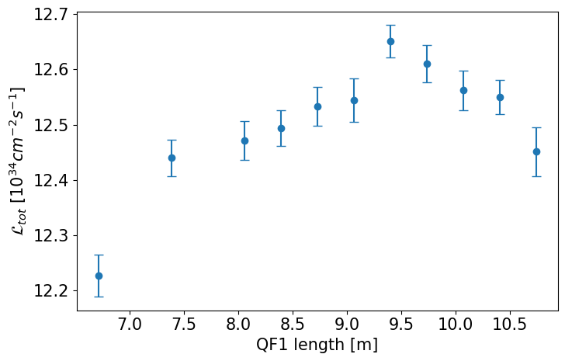
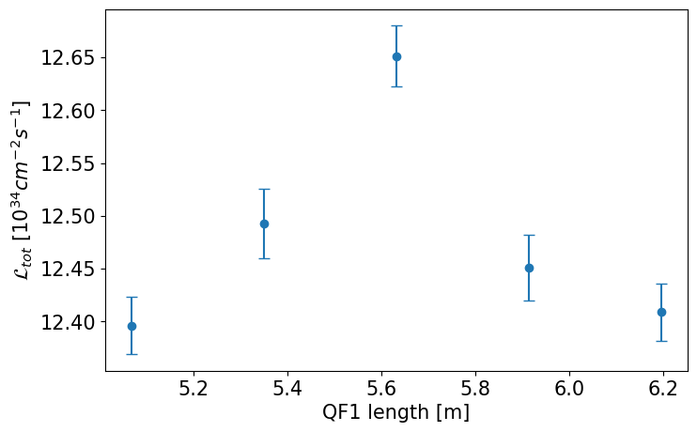
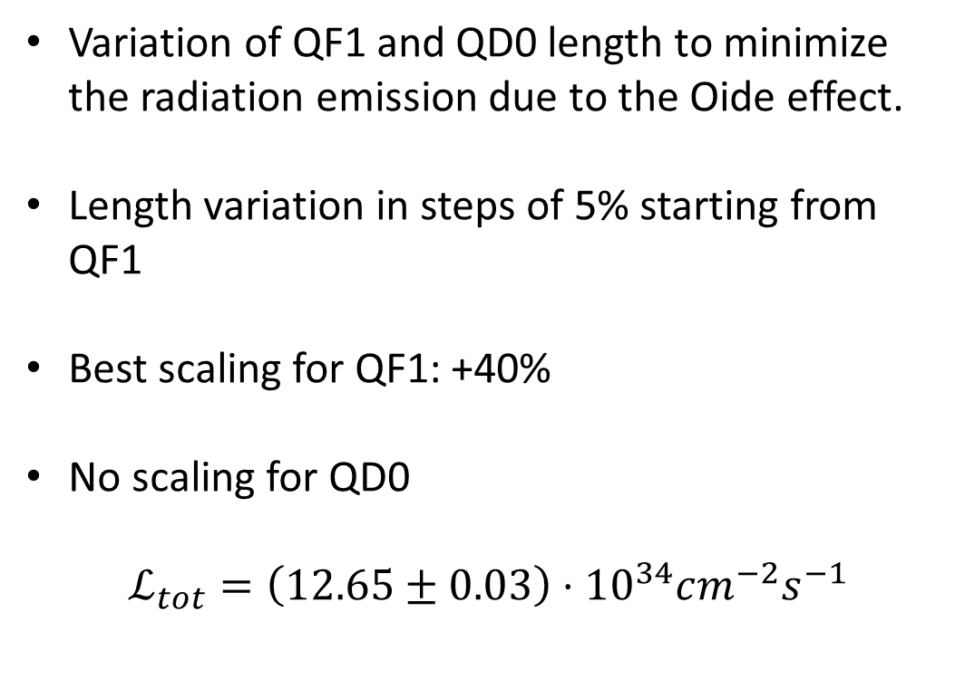
Final doublet optimization
Variation of QF1 and QD0 length to minimize the radiation emission due to the Oide effect.
Length variation in steps of 5% starting from QF1
Best scaling for QF1: +40%
No scaling for QD0
$$ℒ_{tot}=\left(12.65±0.03\right)⋅{10}^{34}cm^{−2}s^{−1}$$
QD0 length [m]

Slide 11
Conclusions
A first design for the FFS at 7 TeV has been proposed.
FFS optimized and scaled differently from all the other sections of the BDS.
Strong radiation effects have been minimized.
An optimization of all the elements into the line has been performed to maximize the luminosity.

