Slide 1
Test-beam measurements of instrumented sensor planes for a highly compact and granular electromagnetic calorimeter
Yan Benhammou,
On behalf of the LUXE ECAL-P group,
LCWS2024

Slide 2
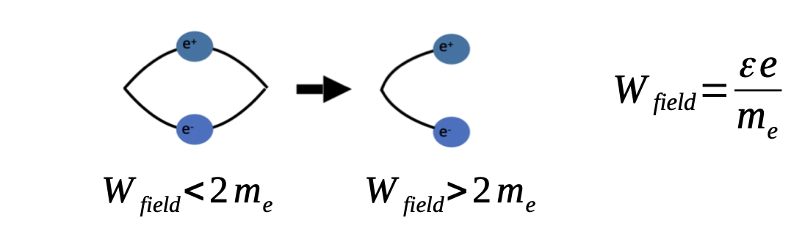
QED and strong fields
Although perturbative QED with small background fields is well-understood and well-tested, there is much less understanding of QED in the regime of strong fields.
For stronger fields, QED perturbation theory breaks down and becomes non perturbative
At the Schwinger critical field, ε_{crit} = m_{e}²c³/eh ∼ 10¹⁸ V/m, the vacuum becomes unstable to pair production
Notes:
QED is well understood and well tested theory in the perturbative region, meaning without strong fields.
In presence of stong fields, the theory becomes non perturbative and after a limit, called the Schwinger limit, the vacuum becomes unstable and we have
creation of physical electron-positron pairs from virtual electron-positron vacuum fluctuations. The schwinge rlimit for the electric field is 10^18 v/m

Slide 3
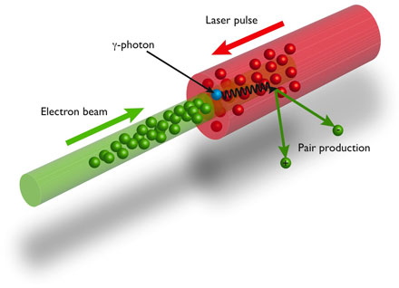
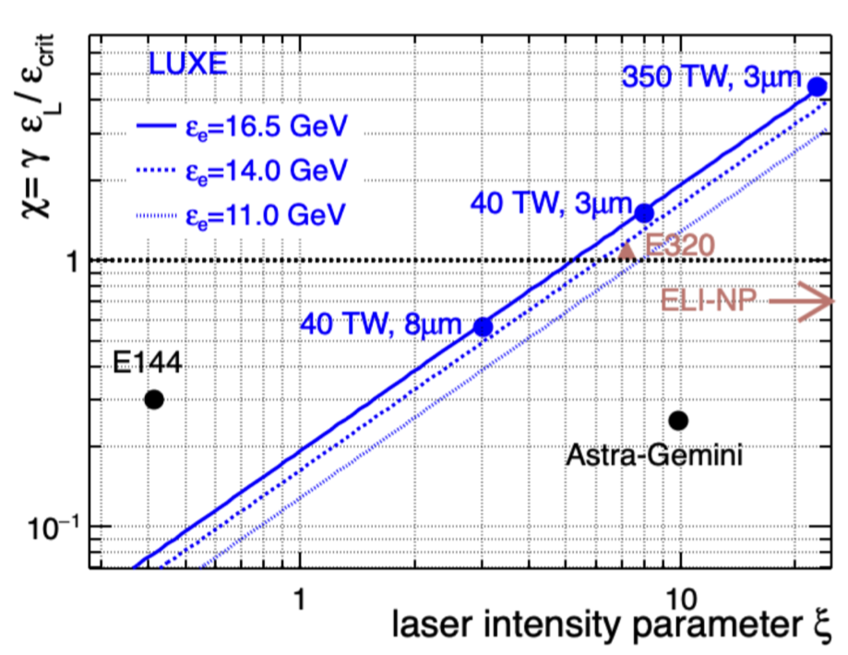
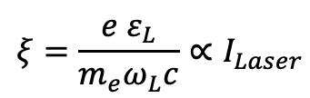

LUXE (Laser Und XFEL Experiment)
Such fields have not been reached experimentally in laboratories although they are expected to exist:
  On the surface of neutron stars.
  In bunches of future linear e+e− colliders.
Can be reached by colliding photons with a high-energy electron beam
  First experiment to try this E144 @ SLAC in 1990s.
  Nowadays experiments : SLAC-E320 (US), Astra Gemini (UK), ELI-NP (RO)
  Propose to provide this field using the TeraWatt laser-pulse and the European XFEL electron beam in the only long term dedicated experiment : LUXE .
$$χ=γ \frac{ε_{L}}{ε_{crit}}∝\sqrt{I_{Laser}}Ebeam$$
LOI: 2019
CDR: 2021, published Eur. Phys. J. Spec. Top. 230, 2445–2560
TDR: 2023, accepted Eur. Phys. J. Spec. Top. arXiv:2308.00515
$$ξ=\frac{e ε_{L}}{m_{e}ω_{L}c}∝I_{Laser}$$
Notes:
Extreme Light Infrastructure - Nuclear Physics (ELI-NP)
The Figure represents the region in the parameter spaoe that is accessible to the LUXE experiment, in comparison to other experiments. The x axis is ksi, the classical non linear parameter of the laser field. If ksi <<1, QED is perturbative, and above 1, the perturbative expansion breaks down and QED becomes non perturbative. In y, chi is the quantum parameter (ratio of the effective field strength in the electron rest frame and the critical field). It is proportional to the electron beam.
Chi and ksi depends on the laser power and laser spot size
========================================
Two parameters are commonly used when describing processes of non-linear QED: the so- called classical non-linearity parameter of the laser field, ξ = eEL/meωL, where ωL is the laser frequency, quantifies the coupling of the laser field to the probe charge. In the regime where ξ ≪ 1, QED is fully perturbative, while, as ξ approaches 1, an increasing number of higher- order processes contribute, until for ξ > 1, the perturbative expansion breaks down and QED becomes non-perturbative in the coupling to the laser field. The second parameter is the quan- tum parameter χe = E⋆/Ecrit which, in case of electron-laser interaction, quantifies the ratio of the effective field strength in the electron rest frame and the critical field.
Figure shows the region in parameter space that is accessible by the LUXE experiment, in comparison to a selection of past and future strong-field QED experiments. The χ and ξ values accessible with LUXE depend on the power of the laser system as well as on the laser spot size. With the foreseen upgrade to a 350 TW laser power in connection with a small spot size (3μm), LUXE is expected to reach well into the non-perturbative regime of χ > 1 and ξ > 1. Compared to the previous E144 experiment [13, 14], the LUXE phase-1 setup will attain a factor of 20 higher χ and a factor of 60 higher ξ. This improvement is mainly due to the higher laser intensity of the LUXE laser. Another novelty of the LUXE experiment compared to previous strong-field QED experiments are the foreseen collisions between real, externally produced GeV photons with the laser.

Slide 4
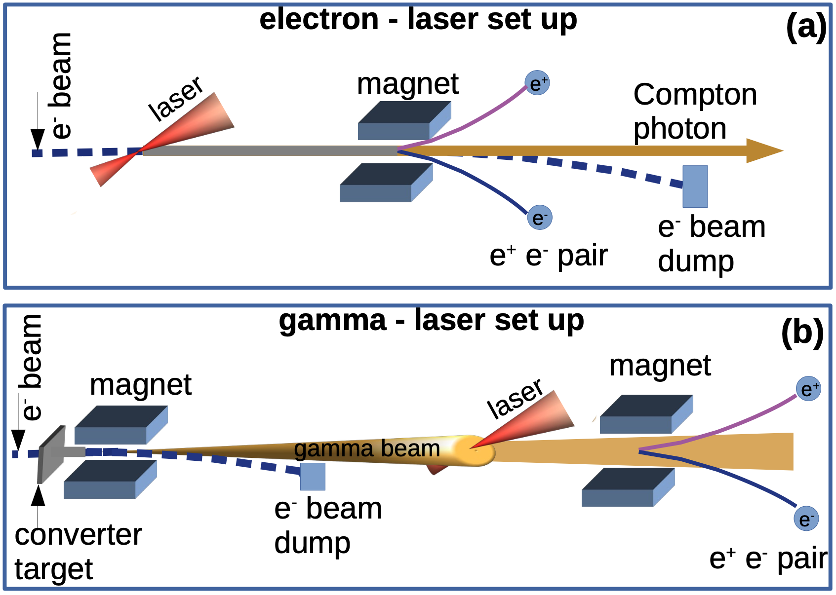
LUXE production : two set ups and two phases
Electron beam:
16.5 GeV (possibility 10 and 14 GeV)
10 Hz
LUXE uses one out of 7200 bunches per train
10⁹ e-/bunch
Laser:
Wavelength is 800nm
Rate: 1 Hz
Focal spot size : 3 or 8 μm
Two phases :
Phase 0: laser power 40 TW (ξ=7.9)
Phase 1: laser power 350TW (ξ=23.6)

Slide 5
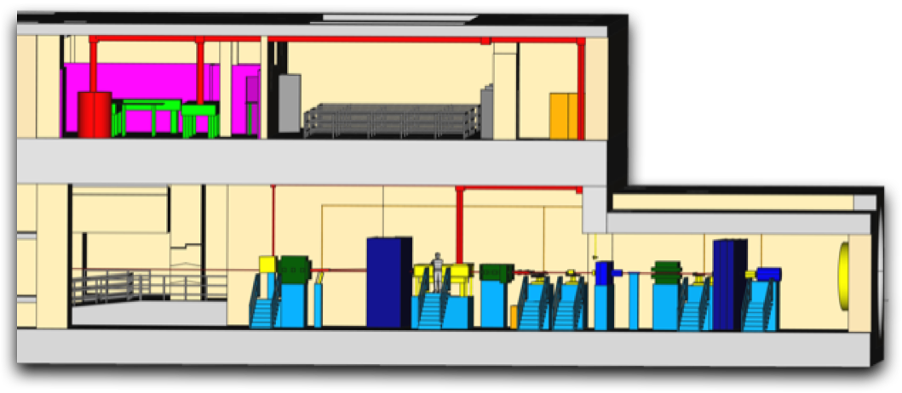
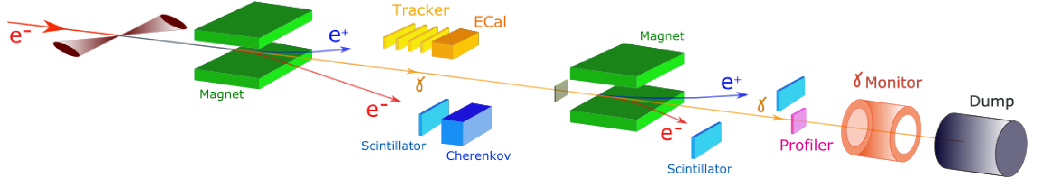
LUXE detection setup
mirror
Laser
mirror
mirror
electrons
IP
10⁻³-10⁴ positrons
10⁵ positrons
10⁹ photons
1.5 10⁹
10⁶-10⁹ electrons
10⁵ electrons
IP detectors: electron positron spectrometers
Forward detectors : photon detection system
Notes:
The ecal p group is in charge of the ECAL

Slide 6






The ECAL-P group

Slide 7
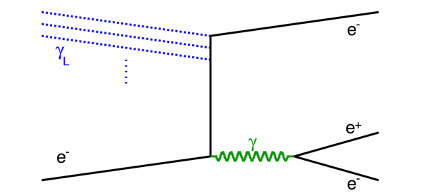
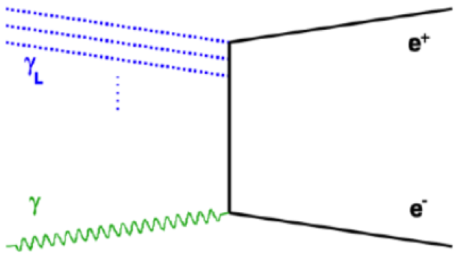
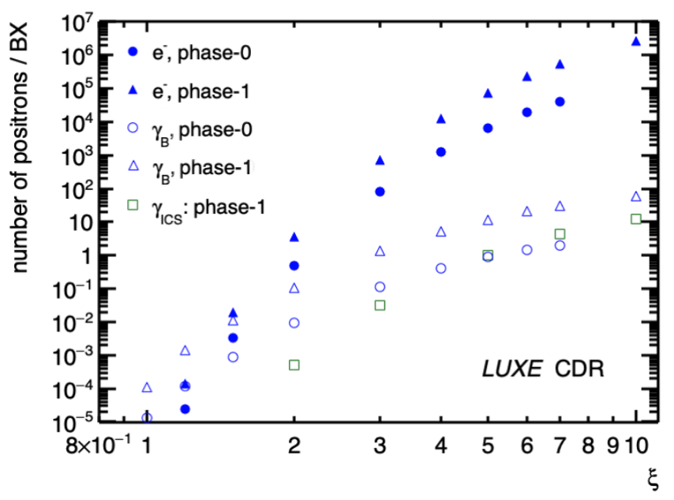
Challenges of the ECAL-P
Study e⁺e⁻ pair
Positron rate depends on the laser intensity and production type : from 10⁻⁴ to 10⁷

Slide 8
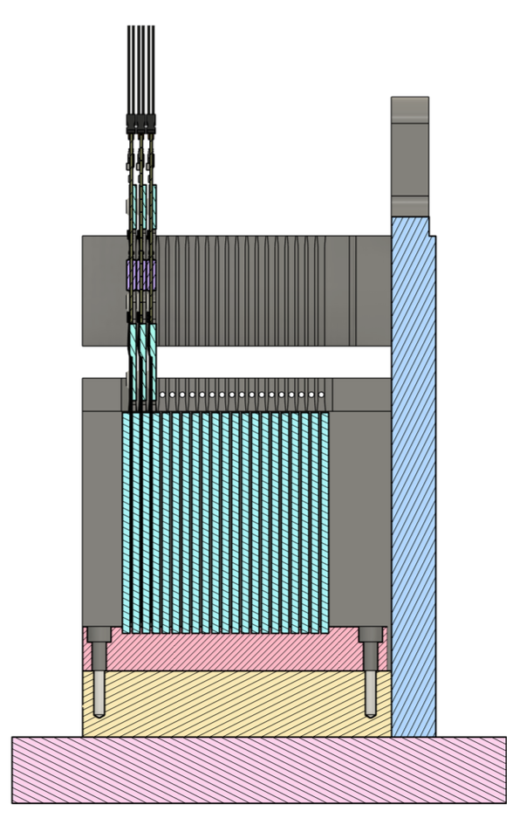
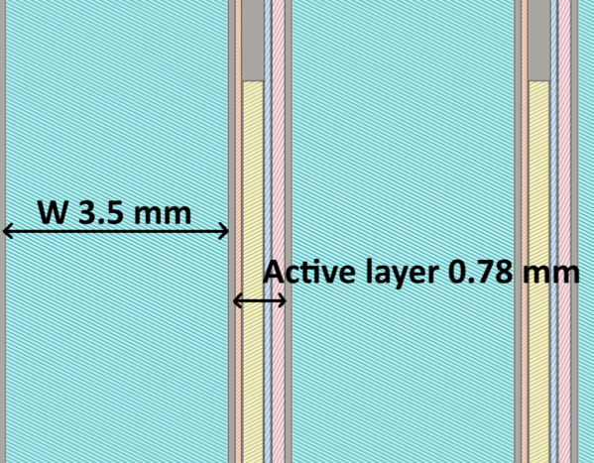
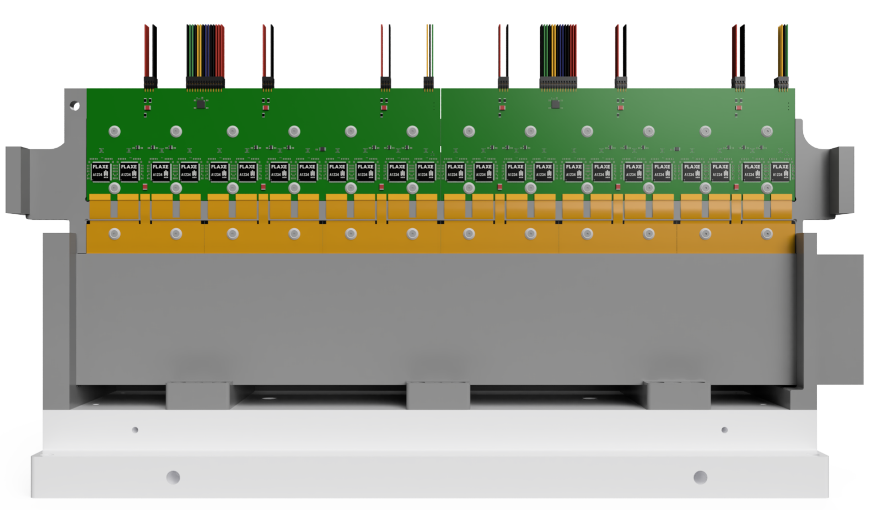
The ECAL-P detector
15 (phase 1) -20 (phase 2) layers
3.5 mm tungsten absorber
320 μm silicon sensor (5.5 x 5.5 mm² pads)
1mm between two tungsten planes (Moliere radius ~9.3mm)

Slide 9
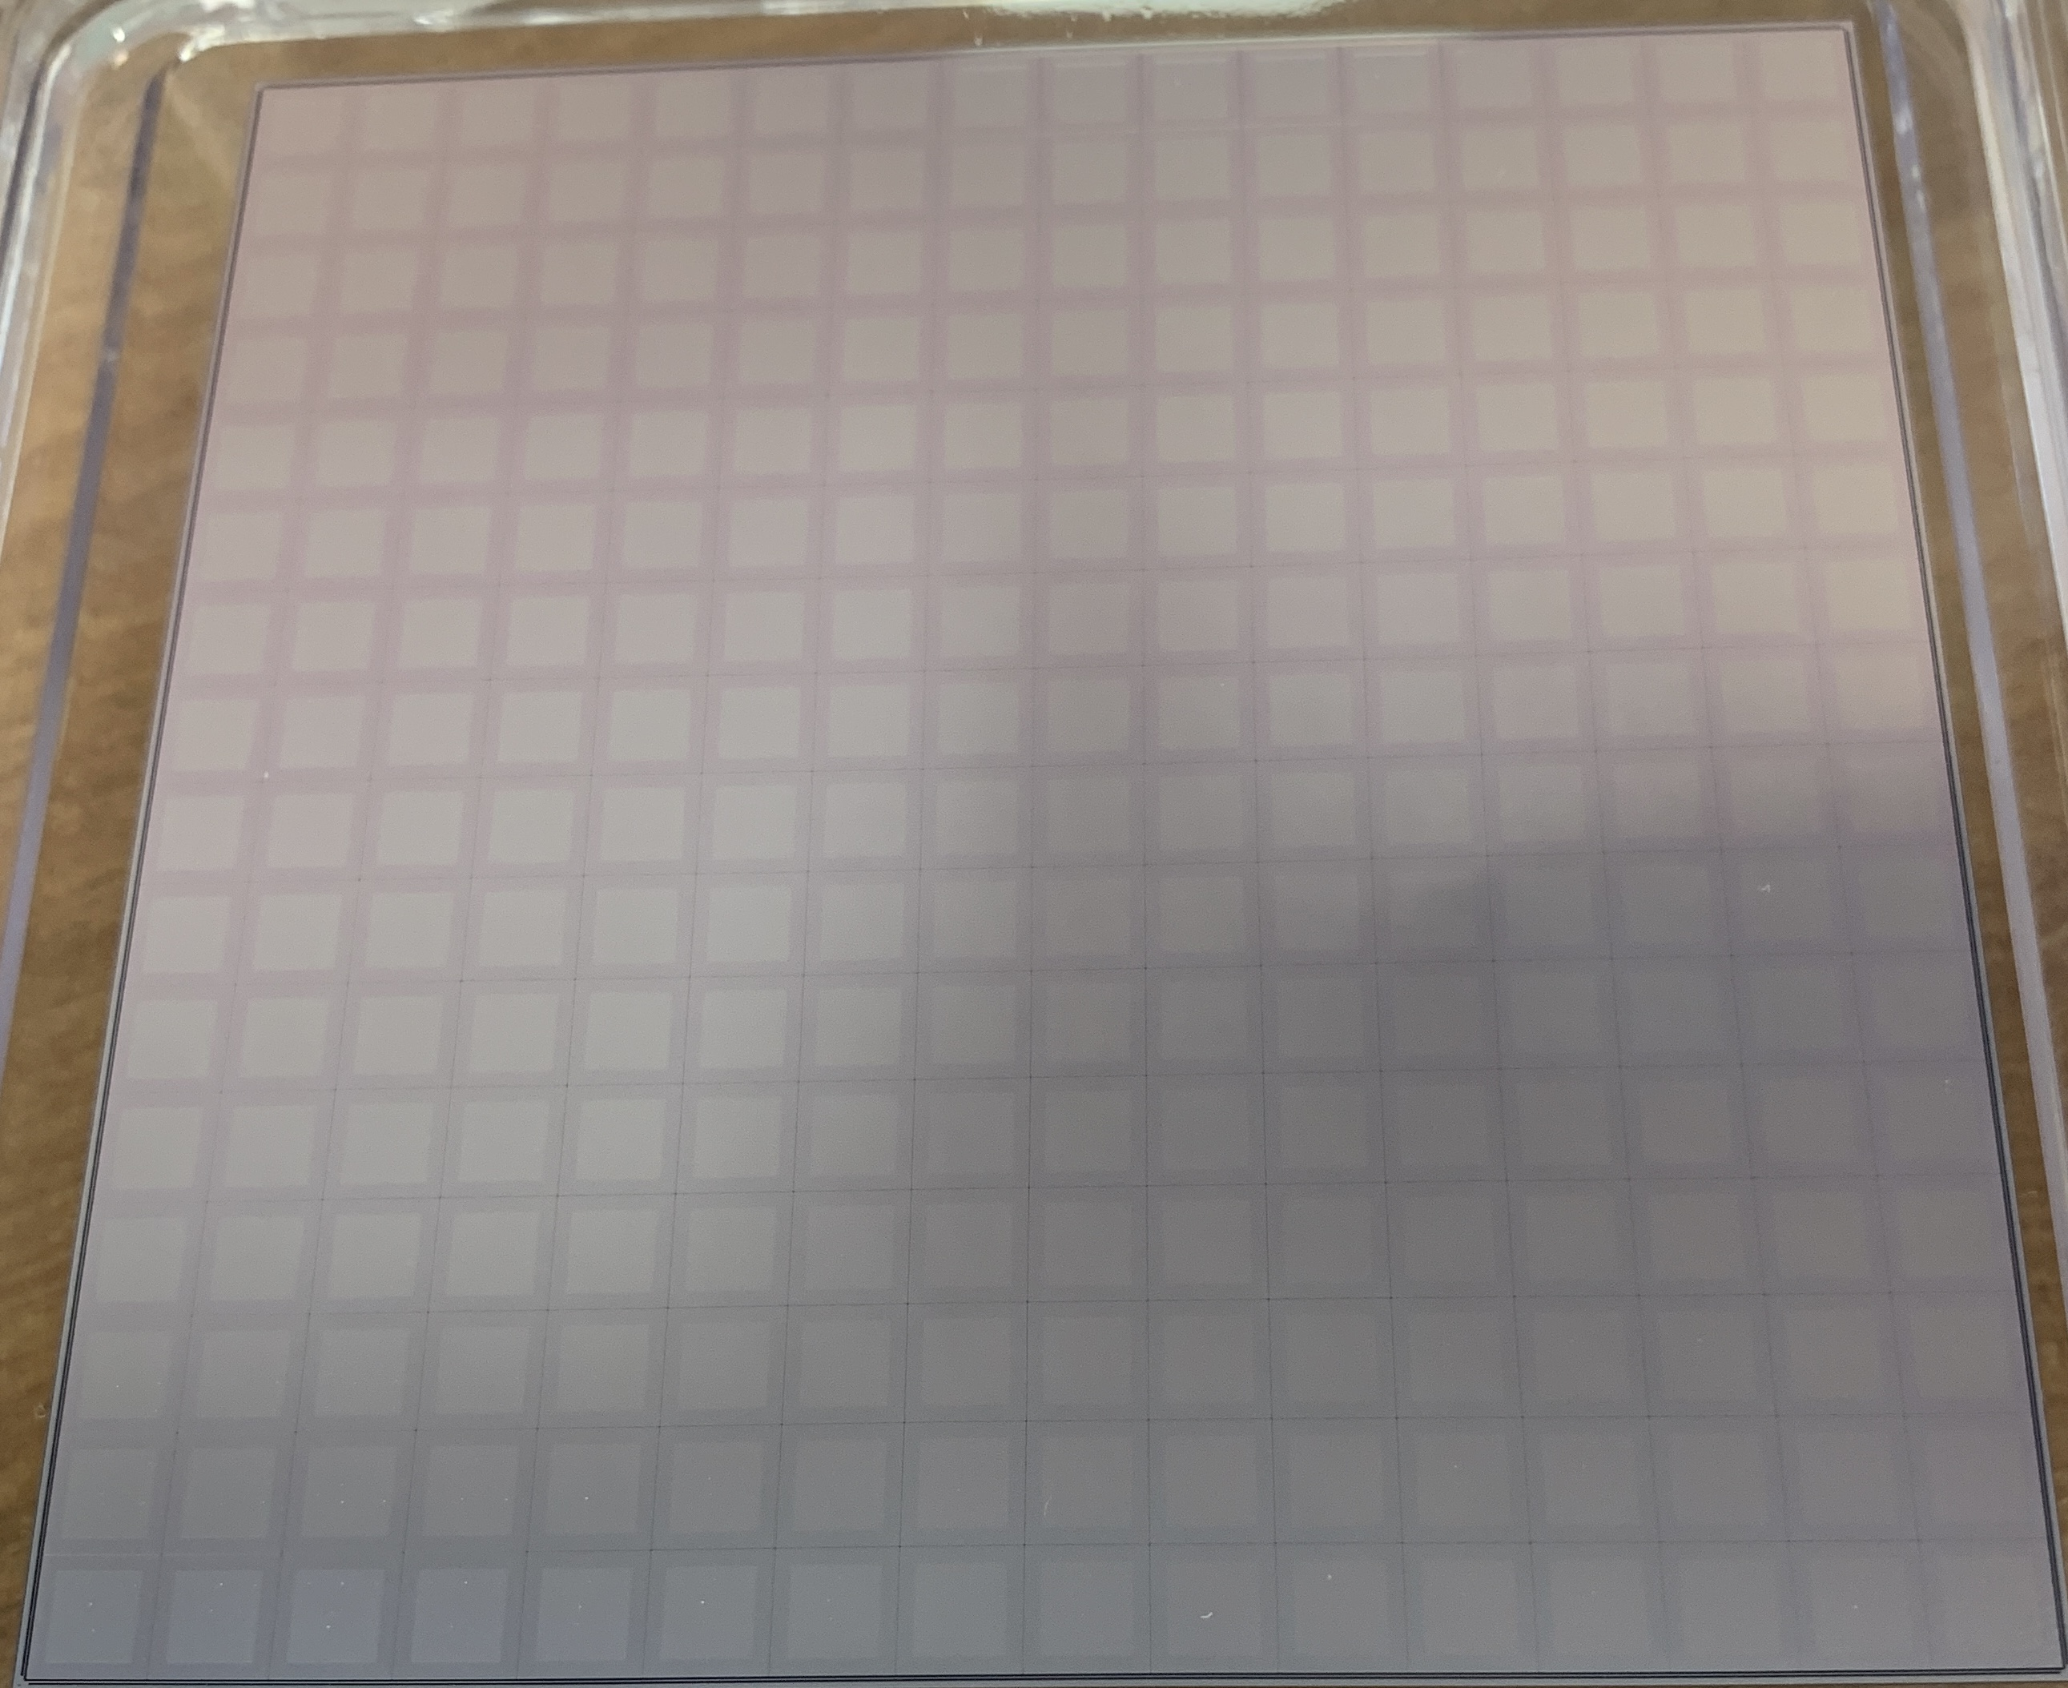
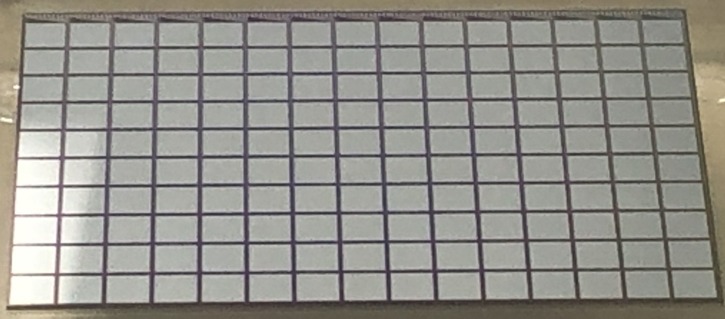
2022 test beam @ DESY : detectors
Silicon (CALICE)
Gallium Arsenide
Array of 5.5x5.5 mm2
Thickness 500μm
10μm between pads
p+ on n substrate
Produced by Hamamatsu
Array of 4.7x4.7 mm2
Thickness 500μm
300μm between pads
Produced by Tomsk State University

Slide 10
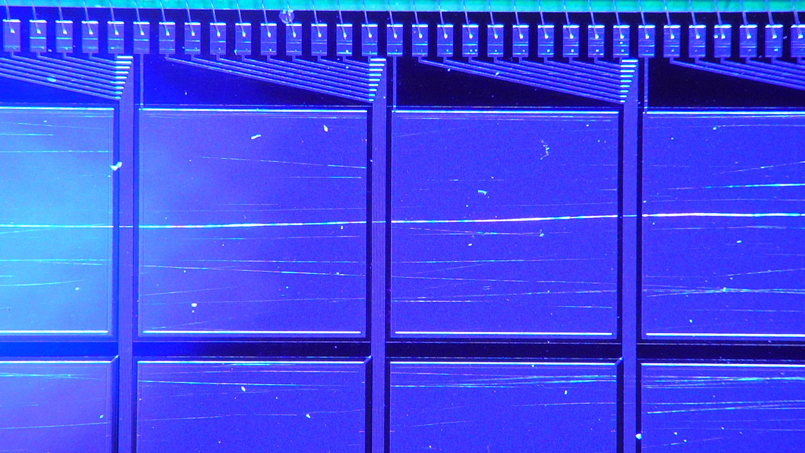
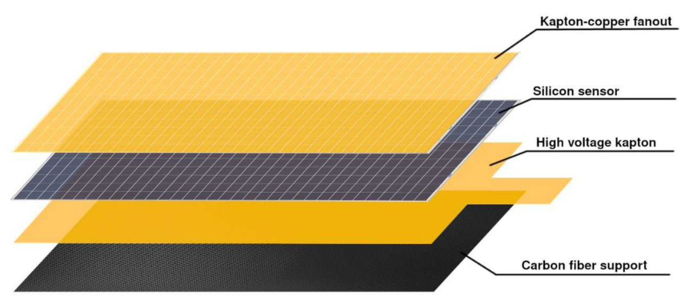
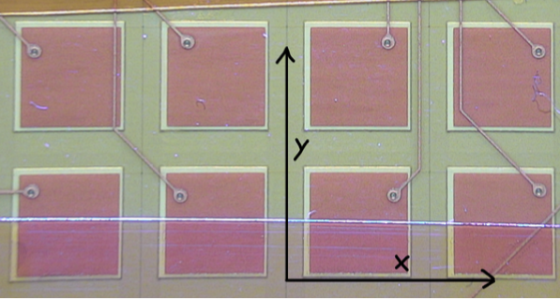
2022 test beam @ DESY : connection
Silicon (CALICE)
Gallium Arsenide
Kapton fan out with copper traces (to the connector) glued (conductive glue) to the sensor
Aluminum traces in between the pads
Bonding to PCB

Slide 11
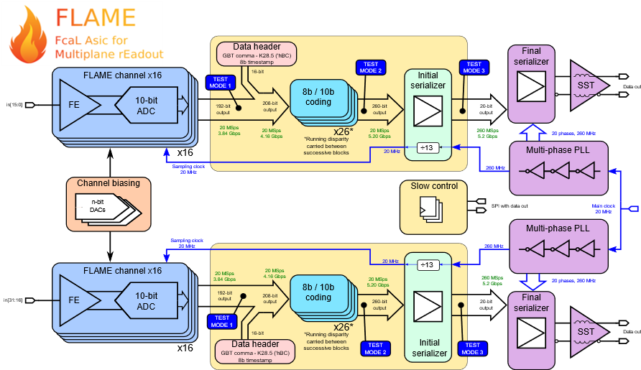
2022 test beam @ DESY : front end ASIC
FLAME (FCal ASIC for Multiplane rEadout)
32-channel ASIC CMOS 130 nm
Analog front end:
  CR-RC shaping (50ns)
  High and low gain
  Cin 20-40 pF
10-bit ADC
  20 MHz
  ENOB>9.5
Fast serializers (5.2 Gbps) and data transmitters (not needed for the LUXE ASIC: FLAXE)

Slide 12
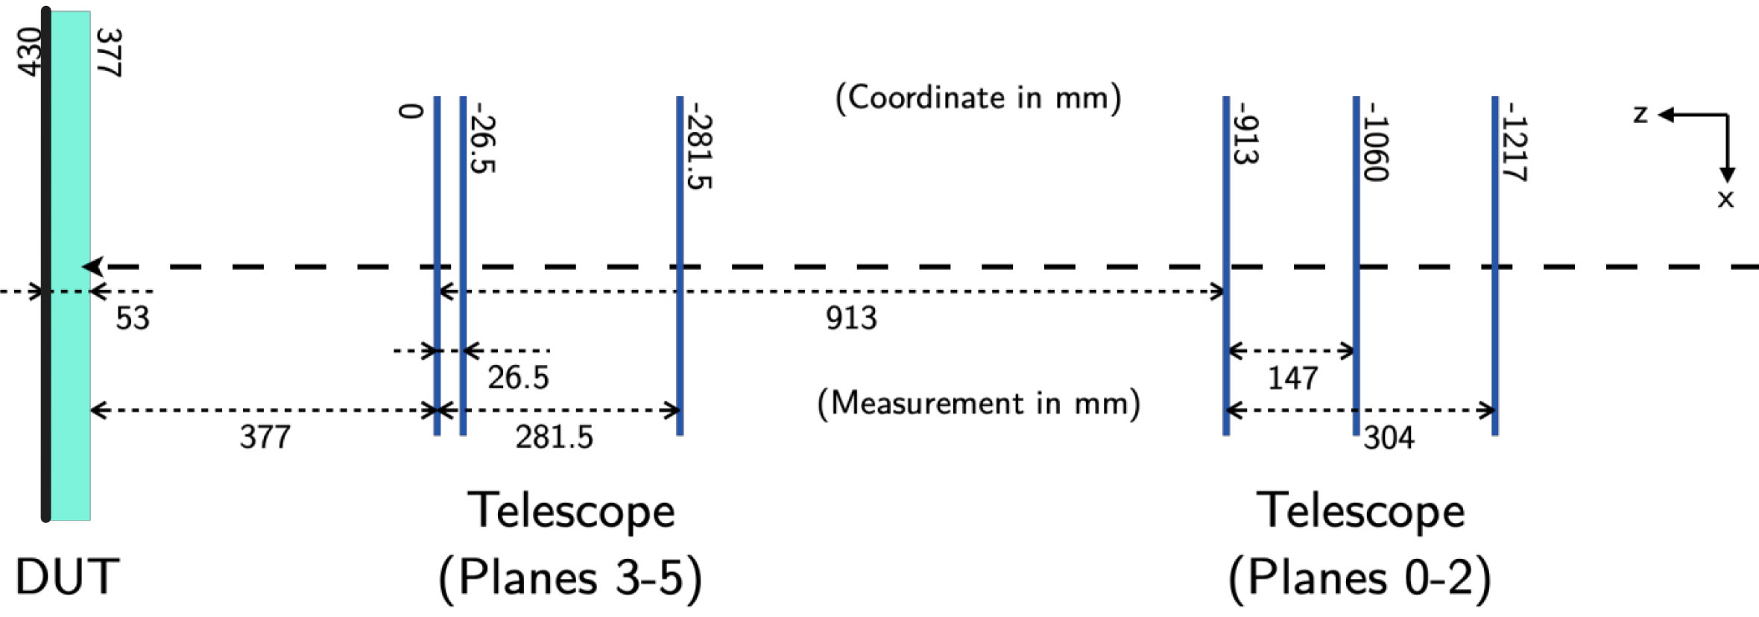
2022 test beam @ DESY : setup
5 GeV electron beam
Telescope based on the Alpide sensor (6 planes)
Two silicon sensors
Two GaAs sensors
Trigger with TLU
Electron beam

Slide 13
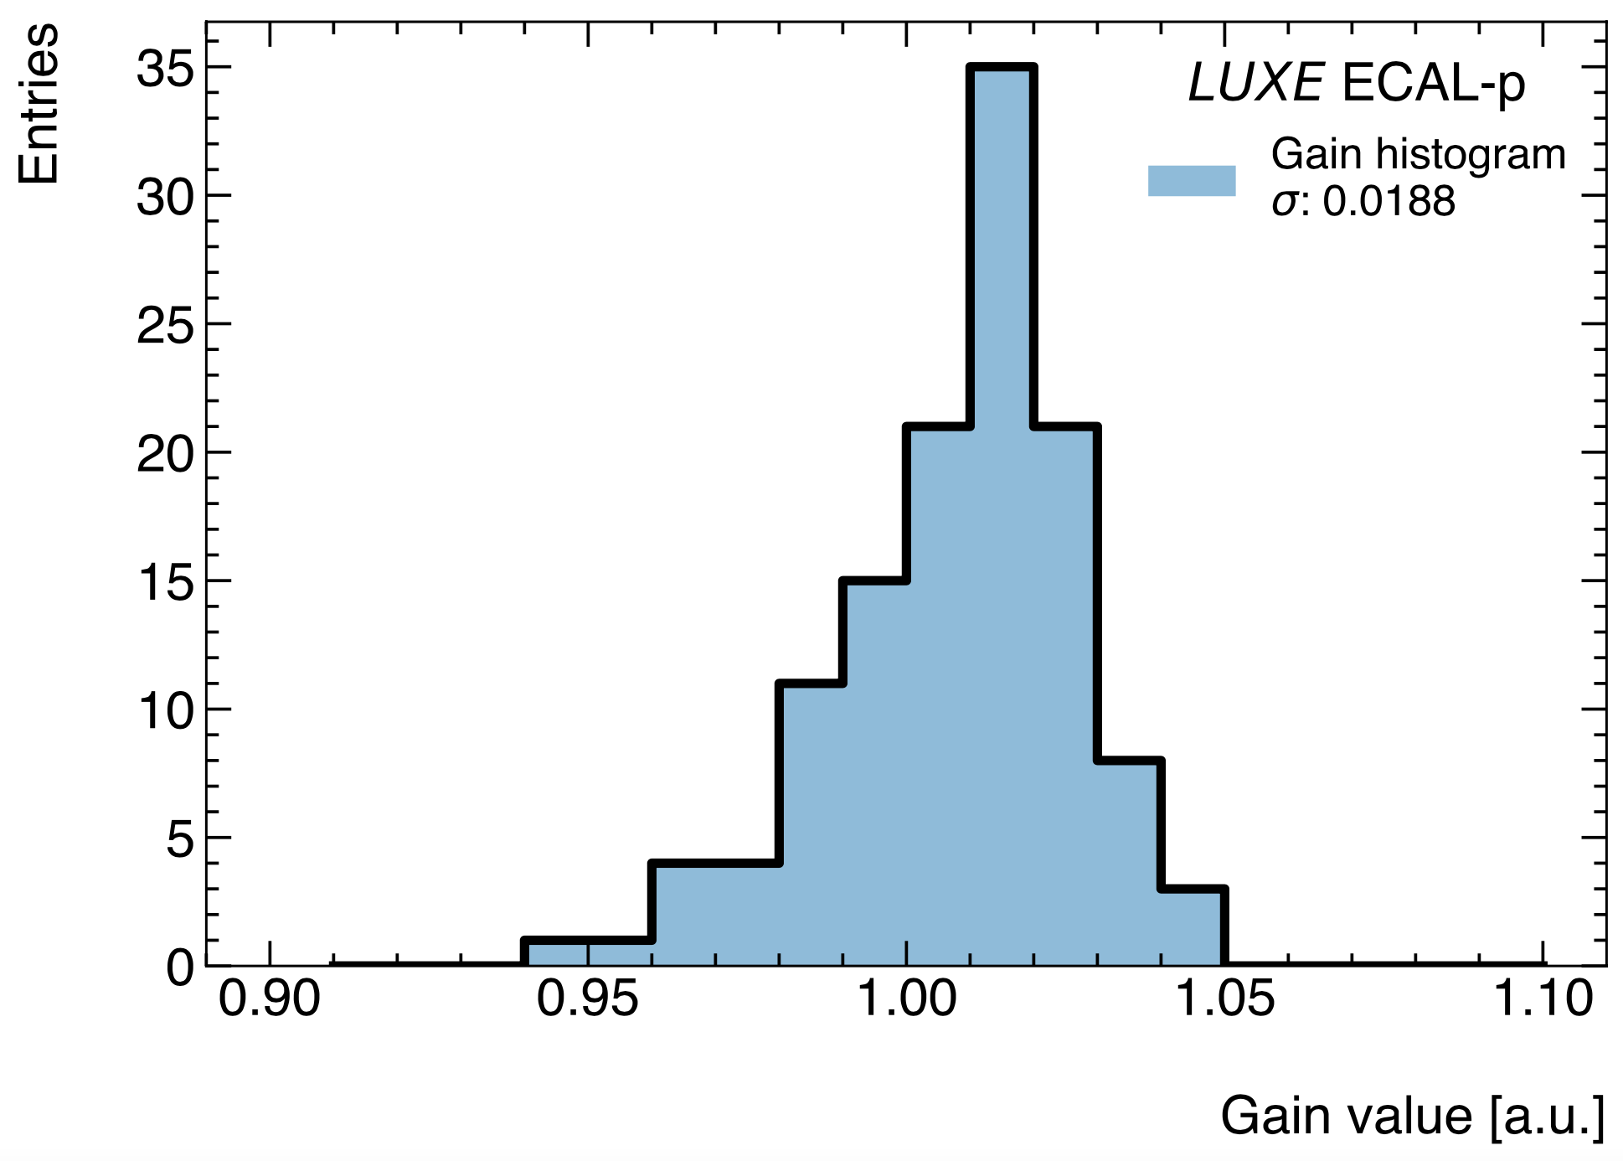
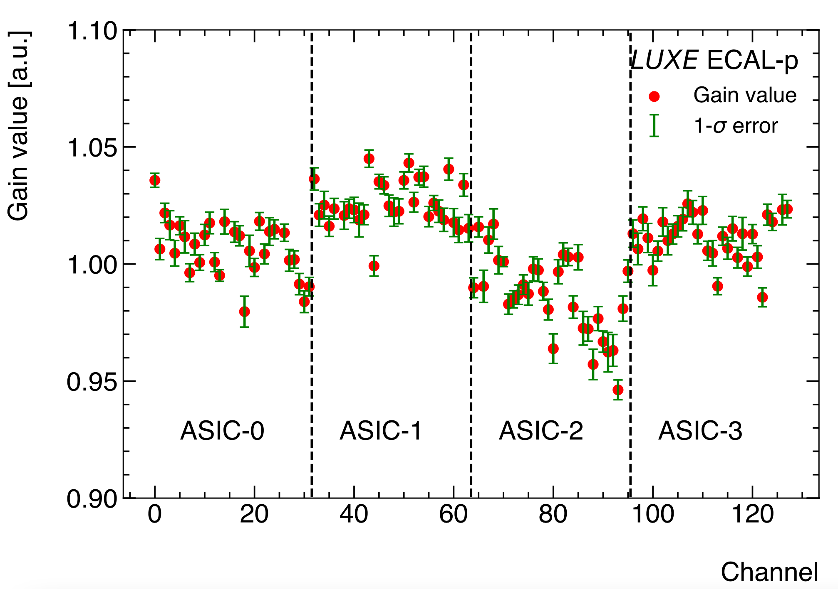
Front end calibration
Injection of a known charge to calibrate the ASIC amplifier → gain correction per channel

Slide 14

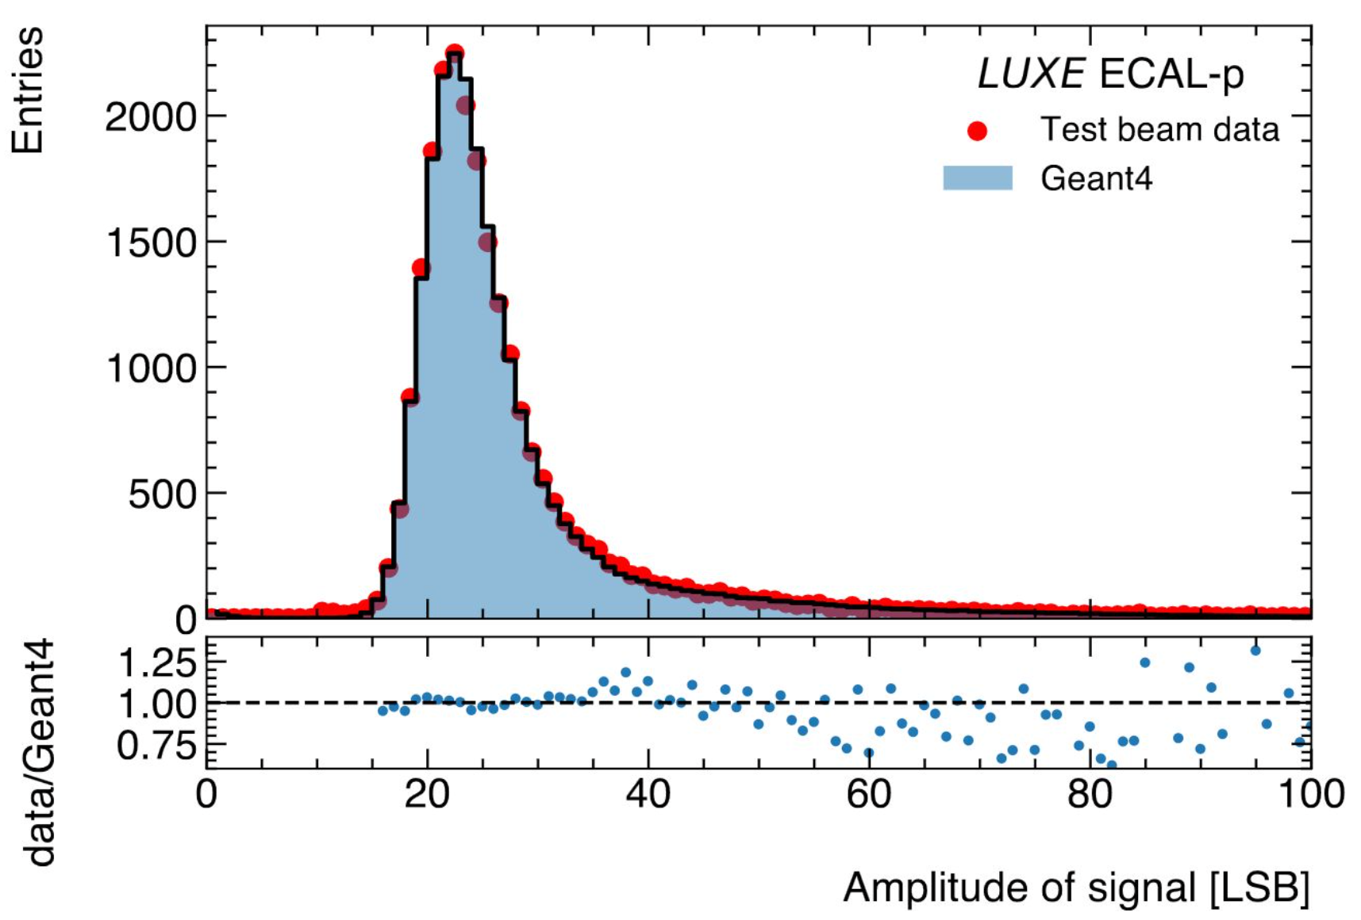
2022 test beam @ DESY : simulation
Simulation of the setup with Geant4
Comparison data/simulation signal of a 5 GeV electron beam in a silicon sensor

Slide 15

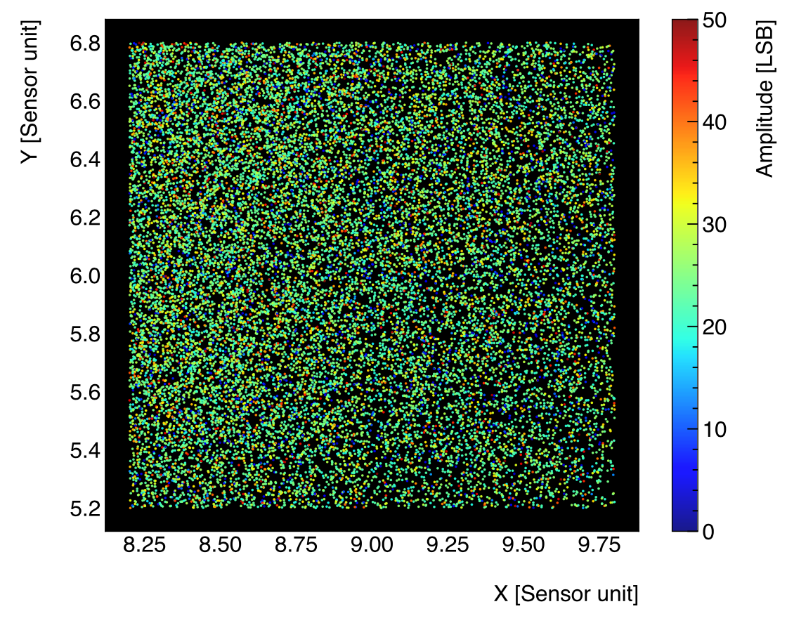
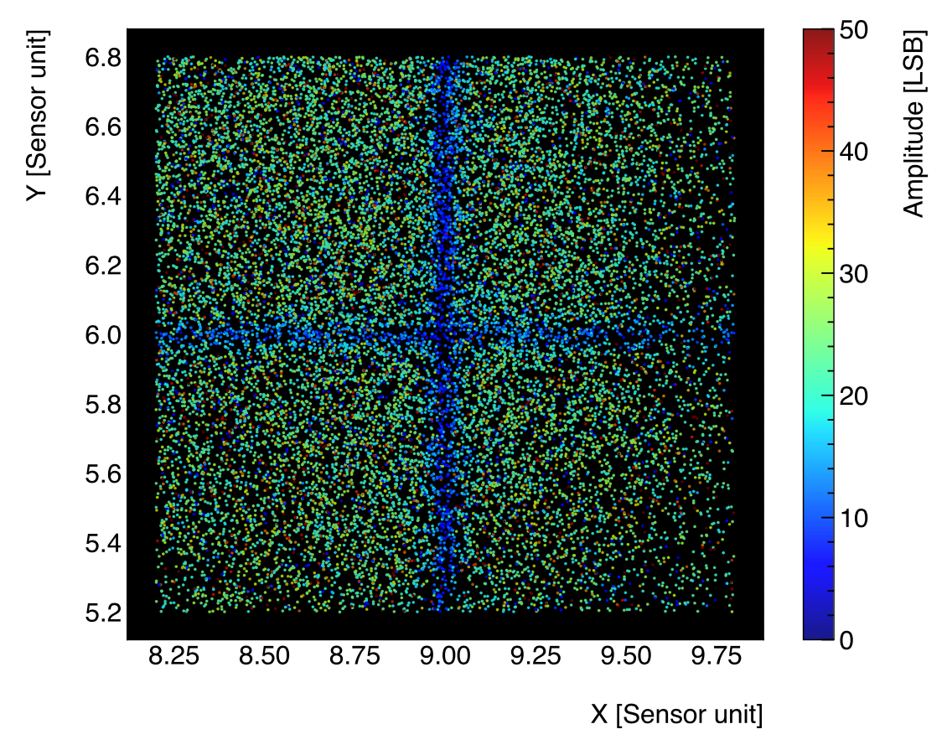
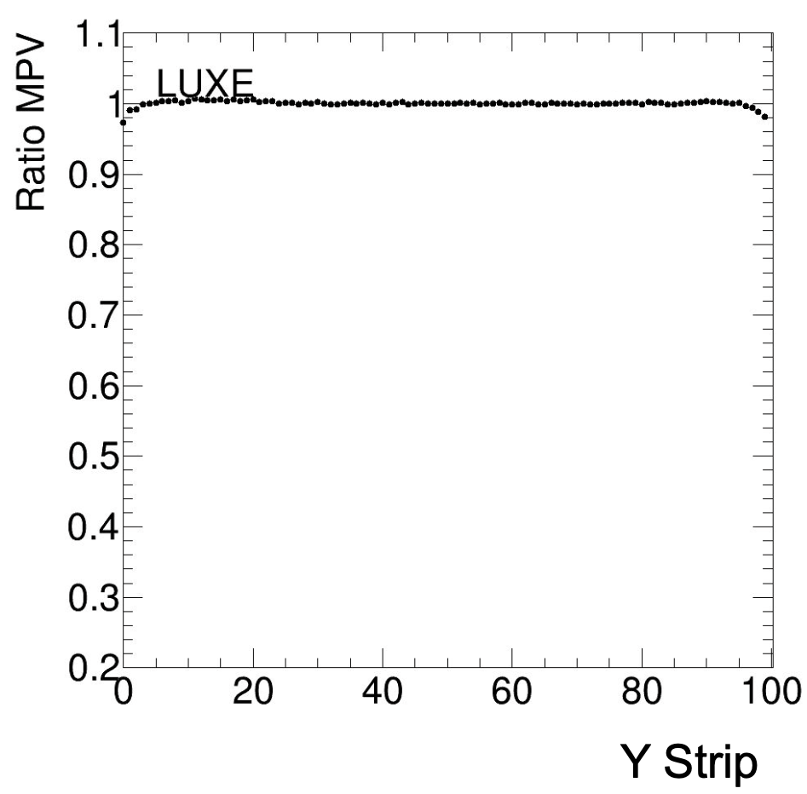
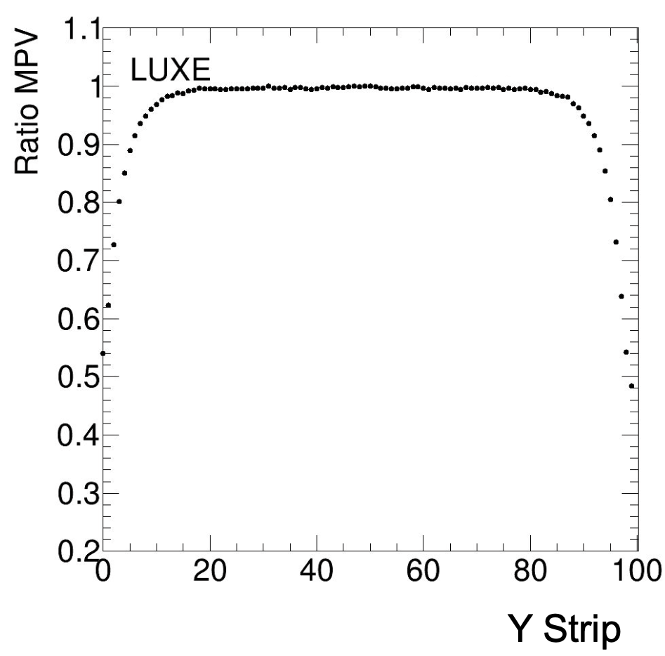
Edge effects: signal
Silicon
GaAs
10μm between pads
300μm between pads
2x2 pads
2x2 pads
Pad is subdivided into 100 strips
2% drop
50% drop

Slide 16
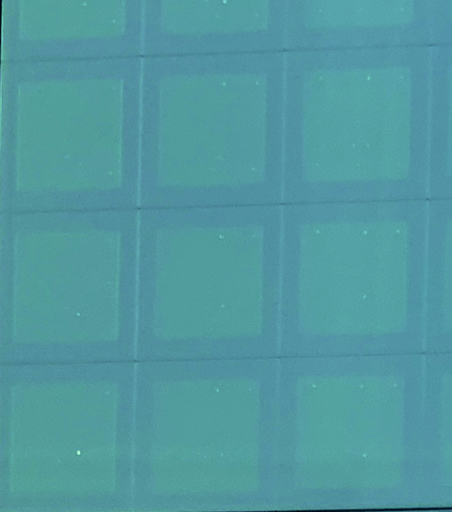
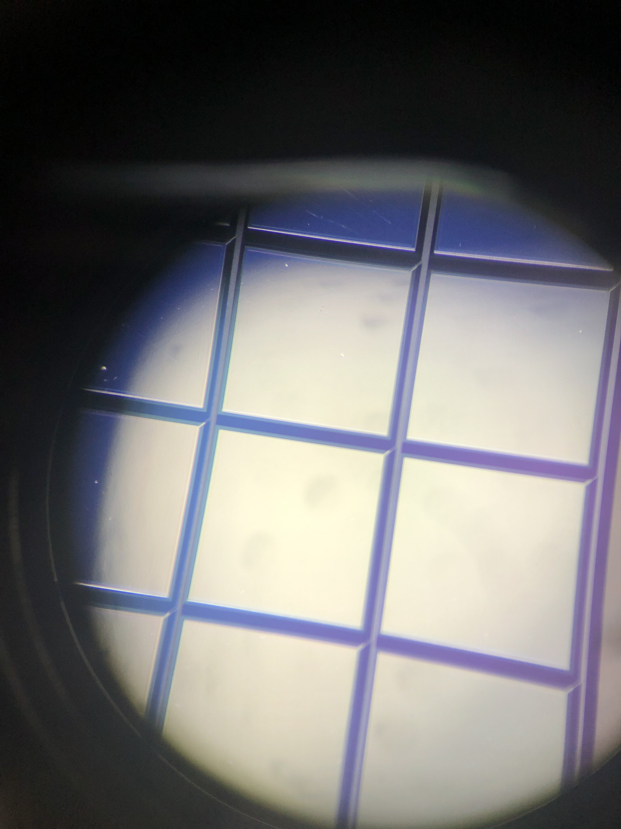
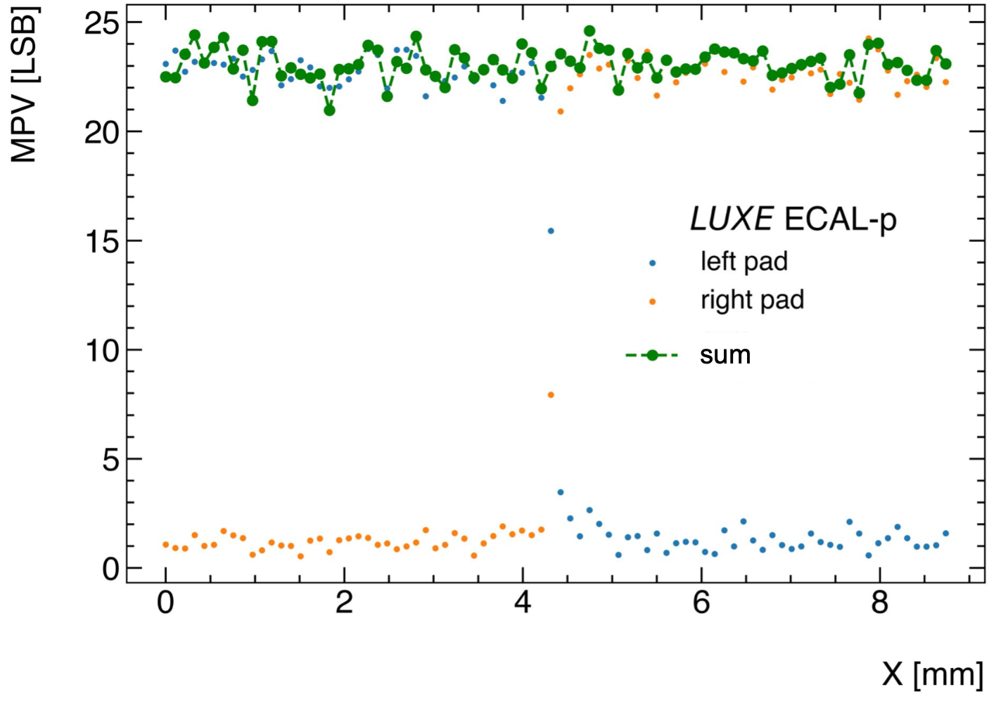
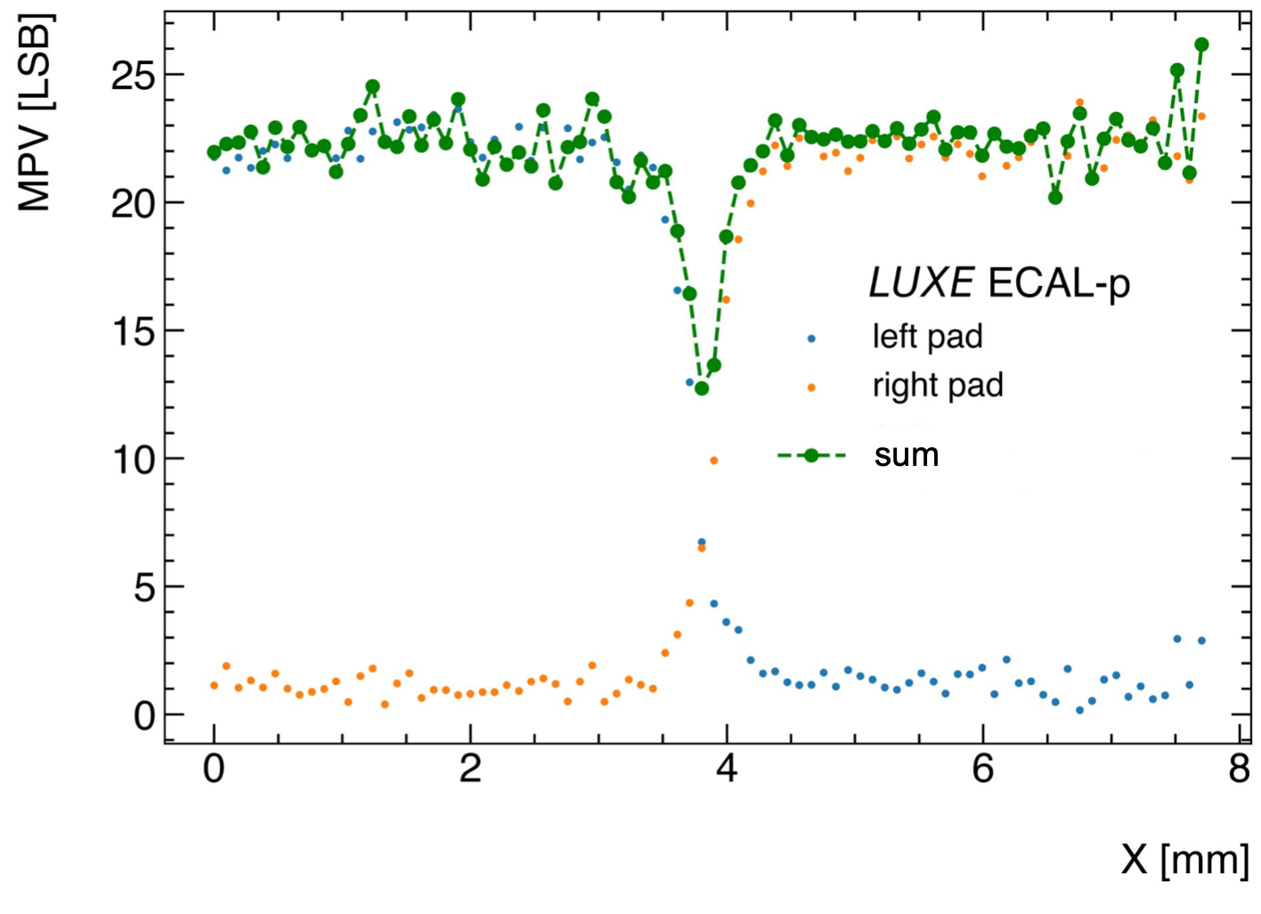
Edge effects: sum of adjacent pad signal in X
Silicon
GaAs
10μm between pads
300μm between pads
No drop
Drop of 40% (traces)

Slide 17
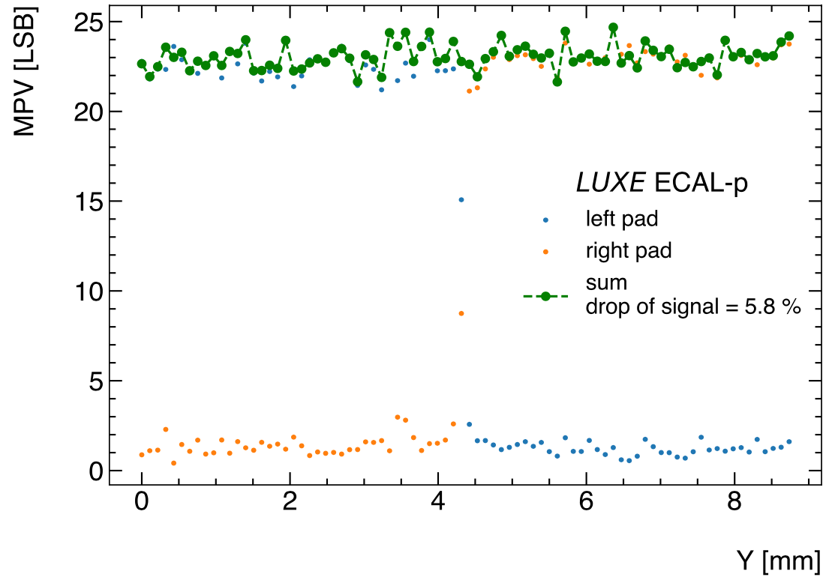
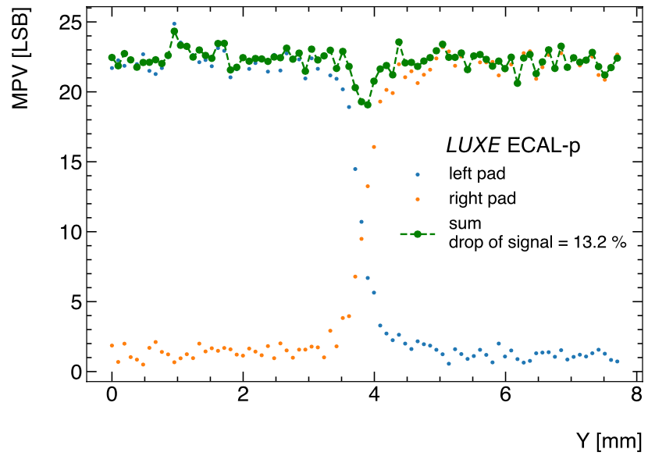
Edge effects: sum of adjacent pad signal in Y
Silicon
GaAs
10μm between pads
300μm between pads
No drop
Drop of 13%

Slide 18
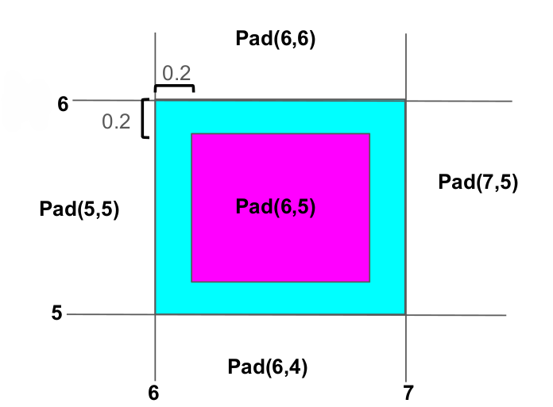
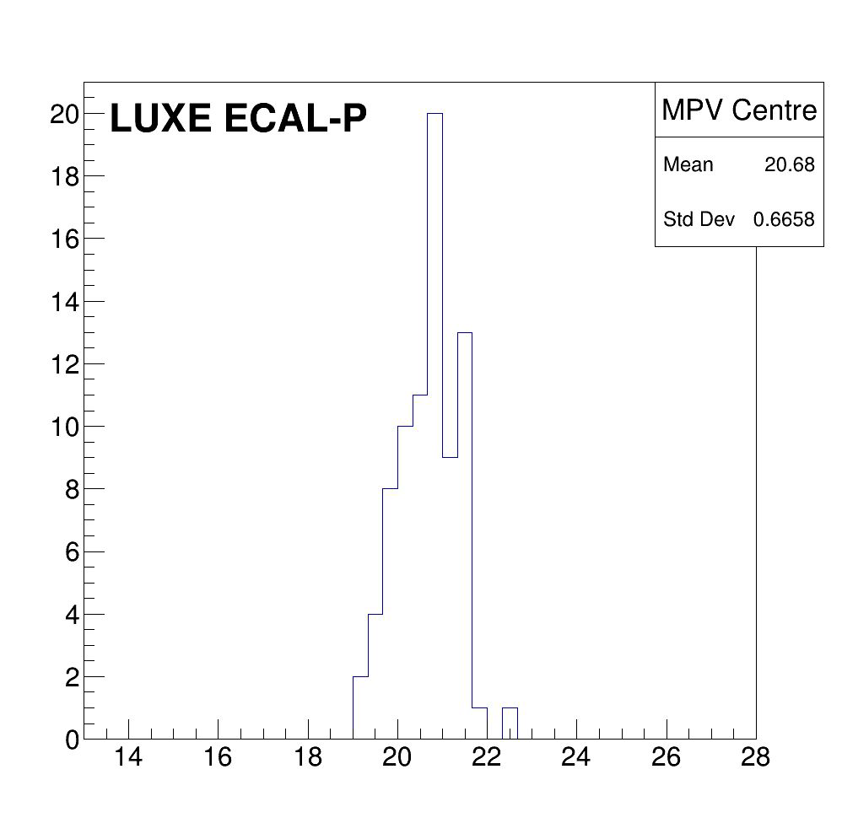
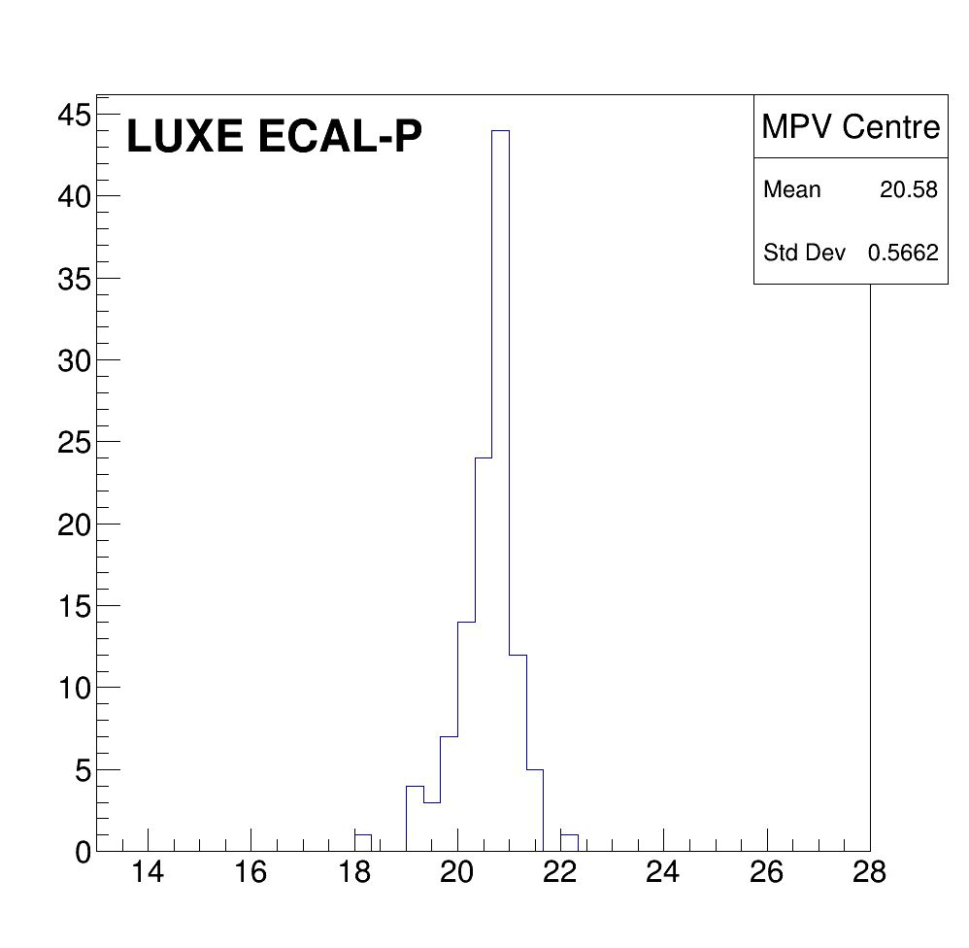
Homogeneity of the sensor response
MPV calculation for all pads, in the pad center region
Silicon
GaAs
Number of pads
Number of pads
MPV
MPV
Pad response within less than 3%

Slide 19
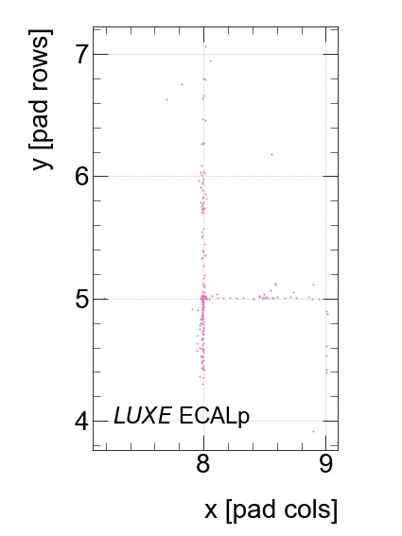
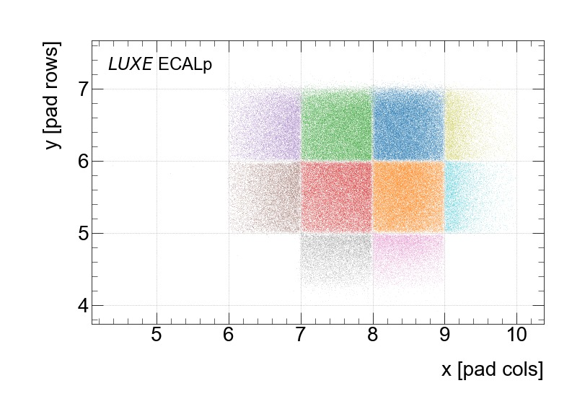
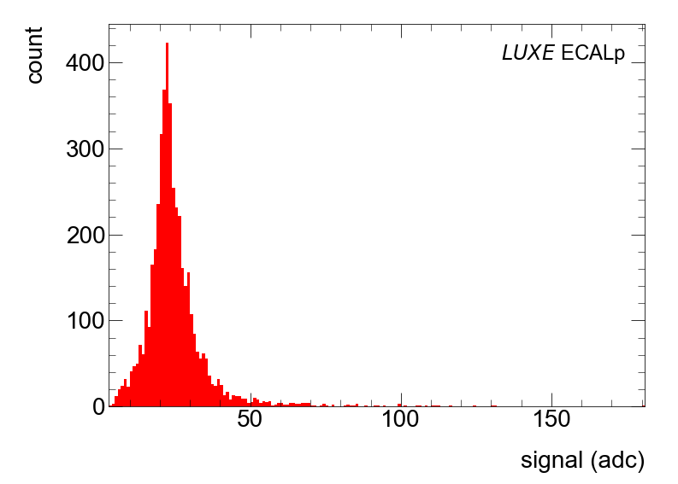
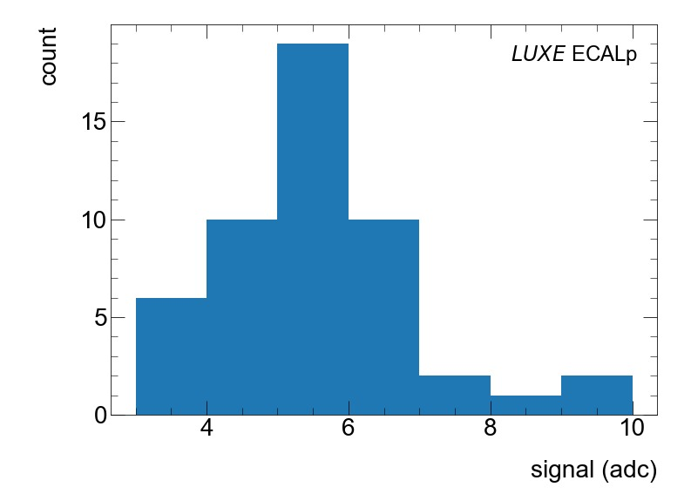
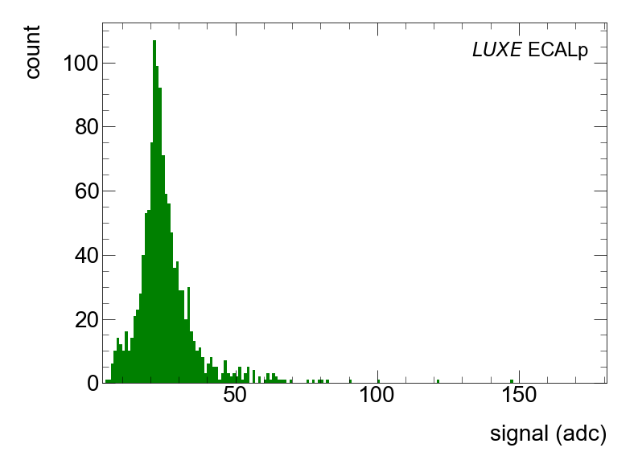
Trace signal (preliminary results)
traces
plotting all the hits which belong to the pink pad (and only this one) and located outside the pad

Slide 20
Conclusion
The LUXE experiment will explore strong-field QED predictions using European XFEL and high power laser
All the detectors have been designed and tuned to cope with rate measurements, from 10⁻² to 10⁹ per bunch crossing
Important test beam in 2022 @ DESY
  Good modeling of the test beam data
  GaAs sensors with embedded aluminum traces present a drop of signal amplitude on the pad edges,
  Silicon sensors doesn’t present any drop between the pads
  Homogeneity of the sensor response within less than 3%: good comprehension of the full system
  First evidences of trace signal

Slide 21
Thanks for your attention !

Slide 22
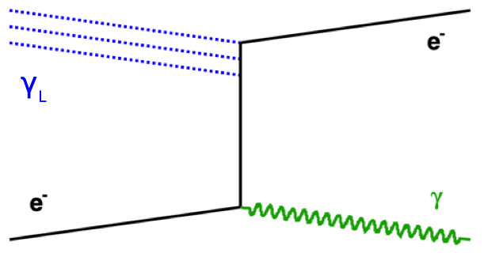
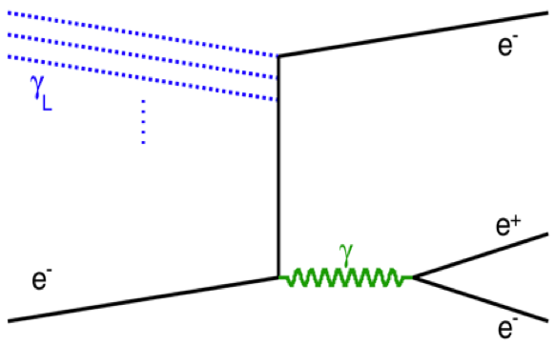
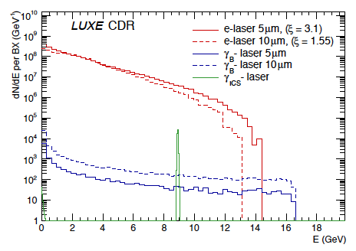
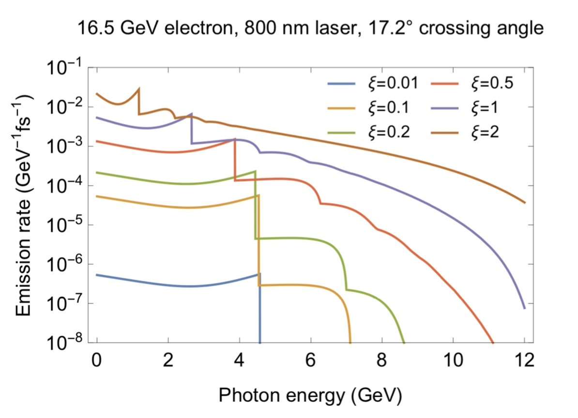
LUXE: physics processes
Non linear Compton scattering
Pair production
e⁻ +nγ_{L}→e⁻+γ
Non linear Breit-Wheeler
trident
Observables :
Compton edges
Intensity of nγ scattering
Non-linear Compton
Inverse Compton scattering
bremsstrahlung
Notes:
n case of non linear Compton scattering the edges in the photon spectra correspond to the interaction of the electron with several photons of the laser field. The first edge (with lowest energy) is when
electron interacted with one laser photon, the next one is when electron interacted with two laser photons then with three and so on. As the laser intensity increases (higher xi) the probability of
multiphoton interactions grows. For low intensity there is only (linear) one photon interaction. For higher xi also the effective mass of the electron in the field increases, this cause the shifts of the
kinematic edges towards lower energies. In simple words, as xi increases there are more steps in the spectra, and the values which corresponds to the steps moves to the left.
In strong fields, electron obtains larger effective mass m* = me (1 + ξ2) →
Compton edge shifts as function of laser intensity parameter ξ
Three methods for generating incident photon:
• Comptonphotonsinsidesamelaserpulse=>largestrate
• Bremsstrahlung photons produced upstream => highest E • Inverse Compton scattering upstream (E=9 GeV)

